Slide 1
Constrained optimization (part 1)
MAE598/494 Design Optimization
Yi Ren
ASU Fall 2026

Slide 2
Overview
Constrained optimization and KKT conditions
A geometric interpretation of KKT conditions
Derivation of KKT
A sensitivity interpretation of Lagrange multipliers
Examples

Slide 3
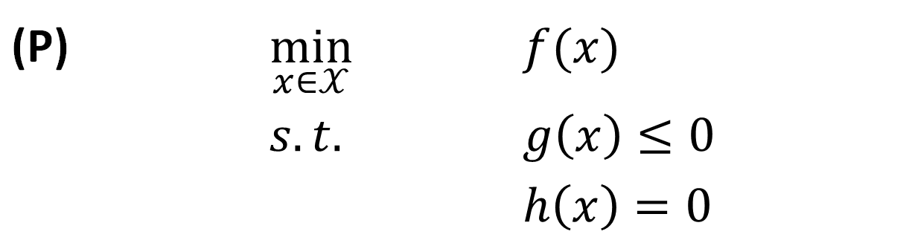
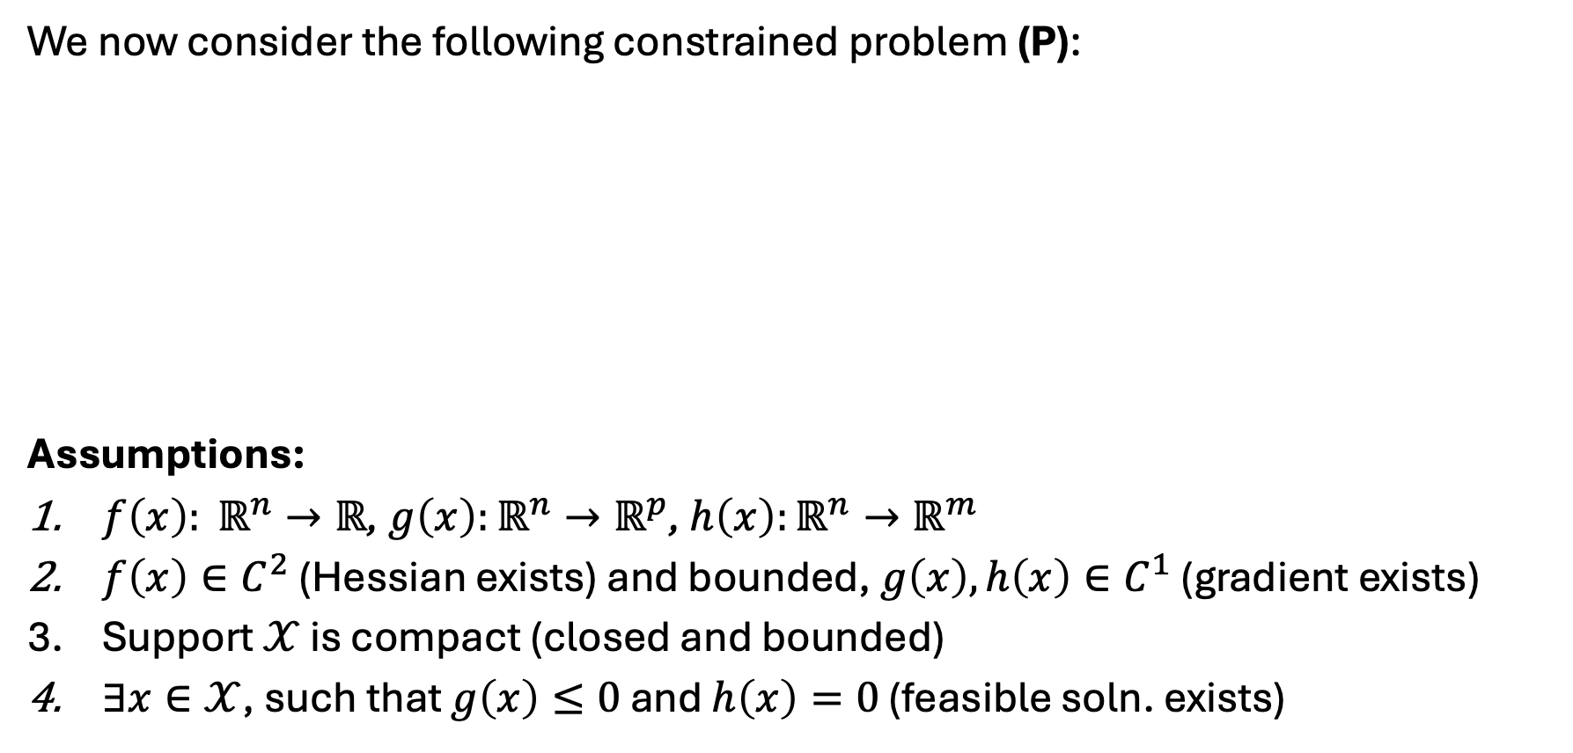
Constrained optimization
We now consider the following constrained problem (P):
Assumptions:
$f\left(x\right): ℝ^{n}→ℝ$, $g\left(x\right):ℝ^{n}→ℝ^{p}$, $h\left(x\right):ℝ^{n}→ℝ^{m}$
$f\left(x\right)∈C^{2}$ (Hessian exists) and bounded, $g\left(x\right), h\left(x\right)∈C^{1}$ (gradient exists)
Support $𝒳$ is compact (closed and bounded)
$∃x∈𝒳$, such that $g\left(x\right)≤0$ and $h\left(x\right)=0$ (feasible soln. exists)
(P) | $$\min_{x∈𝒳}$$ | $$f(x)$$
 | $$s.t.$$ | $$g\left(x\right)≤0$$
 |  | $$h\left(x\right)=0$$

Slide 4
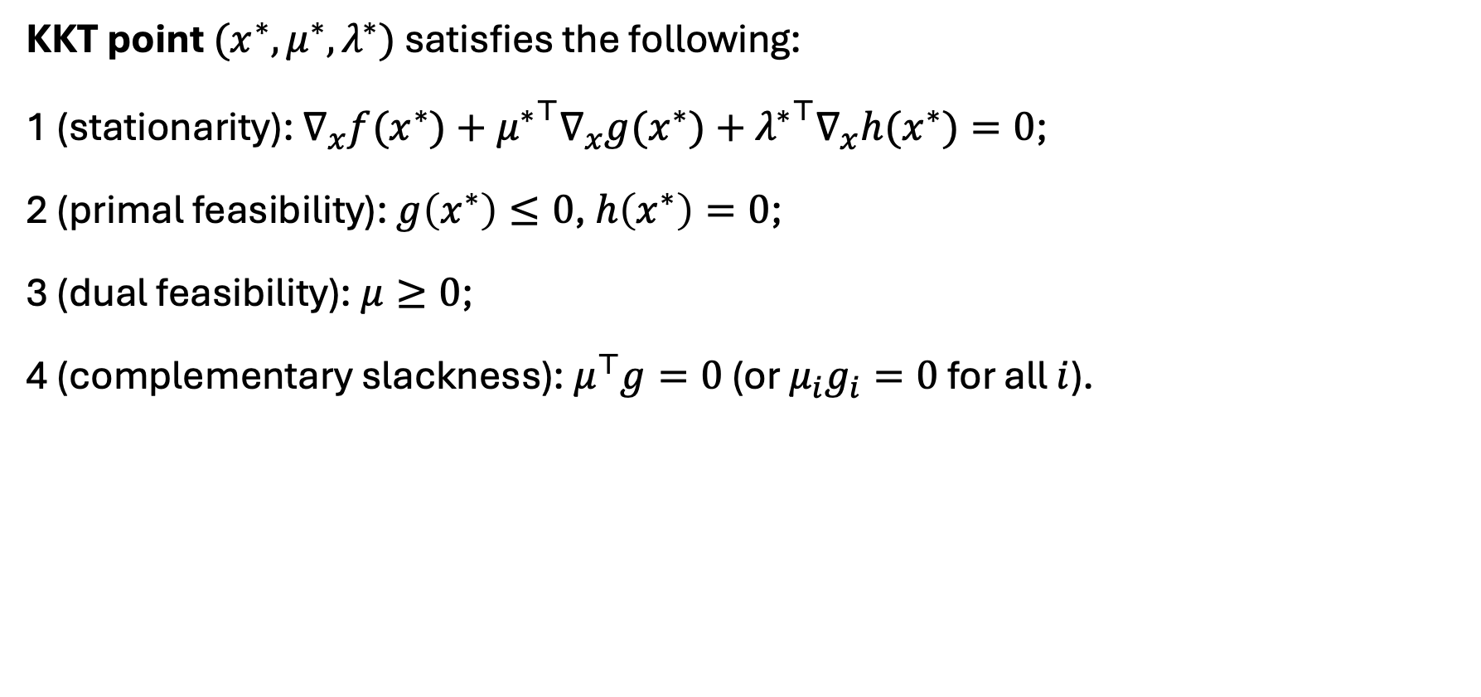
Karush-Kuhn-Tucker (KKT) point
KKT point $(x^{∗},μ^{∗},λ^{∗})$ satisfies the following:
1 (stationarity): $∇_{x}f(x^{∗})+{μ^{∗}}^{⊤}∇_{x}g(x^{∗})+{λ^{∗}}^{⊤}∇_{x}h(x^{∗})=0$;
2 (primal feasibility): $g\left(x^{∗}\right)≤0$, $h\left(x^{∗}\right)=0$;
3 (dual feasibility): $μ≥0$;
4 (complementary slackness): $μ^{⊤}g=0$ (or $μ_{i}g_{i}=0$ for all $i$).

Slide 5
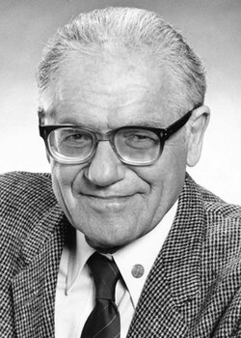
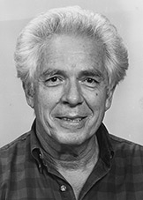
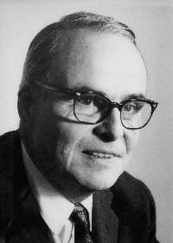
Karush-Kuhn-Tucker (KKT) point
William Karush: First developed KKT conditions in 1939 in his Master’s thesis at U. Chicago.
Harold Kuhn: Re-discovered KKT conditions w/ Tucker in 1951. Colleague and main advocate of John Nash.
Albert Tucker: PhD adviser of John Nash on non-cooperative games, coined “prisoner’s dilemma”.

Slide 6
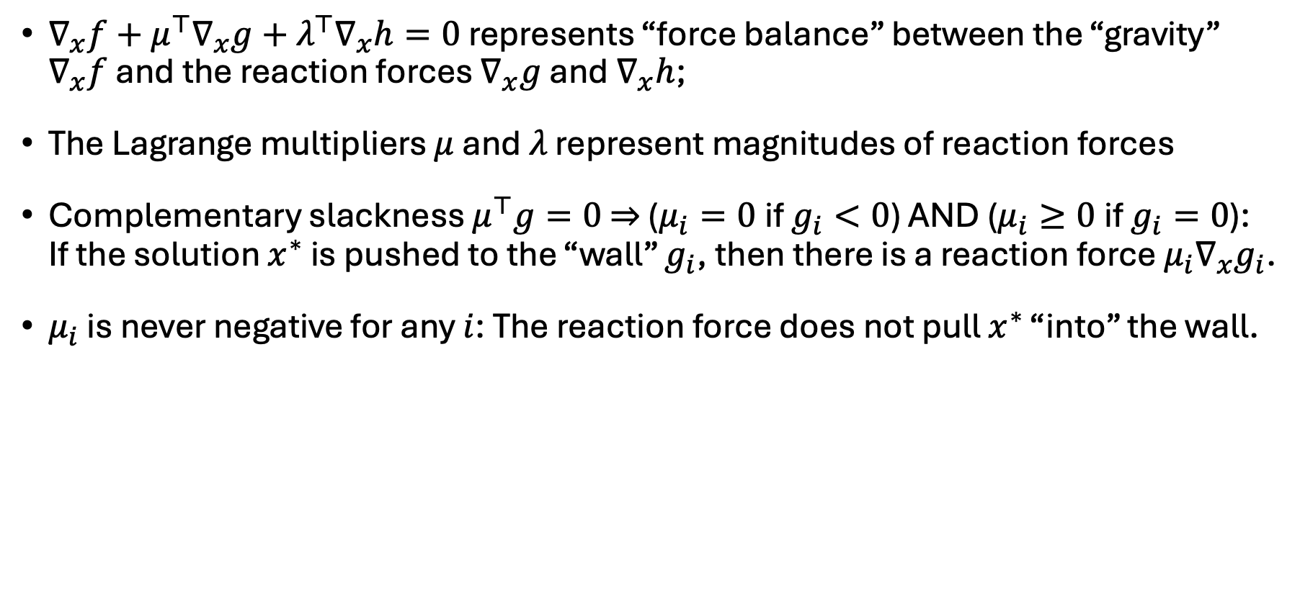
Geometric interpretation
$∇_{x}f+μ^{⊤}∇_{x}g+λ^{⊤}∇_{x}h=0$ represents “force balance” between the “gravity” $∇_{x}f$ and the reaction forces $∇_{x}g$ and $∇_{x}h$;
The Lagrange multipliers $μ$ and $λ$ represent magnitudes of reaction forces
Complementary slackness $μ^{⊤}g=0$ $⇒$ ($μ_{i}=0$if $g_{i}<0$) AND ($μ_{i}≥0$if $g_{i}=0$): If the solution $x^{∗}$ is pushed to the “wall” $g_{i}$, then there is a reaction force $μ_{i}∇_{x}g_{i}$.
$μ_{i}$ is never negative for any $i$: The reaction force does not pull $x^{∗}$ “into” the wall.

Slide 7
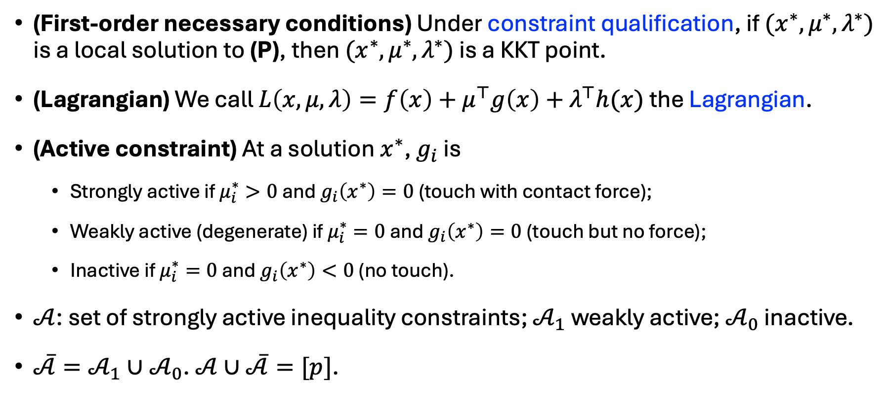
Optimality conditions
(First-order necessary conditions) Under constraint qualification, if $x^{∗}$ is a local solution to (P), then there exist $μ^{∗},λ^{∗}$ such that $(x^{∗},μ^{∗},λ^{∗})$ is a KKT point.
(Lagrangian) We call $L\left(x,μ,λ\right)=f\left(x\right)+μ^{⊤}g\left(x\right)+λ^{⊤}h(x)$ the Lagrangian.
(Active constraint) At a solution $x^{∗}$, $g_{i}$ is
  Strongly active if $μ_{i}^{∗}>0$ and $g_{i}\left(x^{∗}\right)=0$ (touch with contact force);
  Weakly active (degenerate) if $μ_{i}^{∗}=0$ and $g_{i}\left(x^{∗}\right)=0$ (touch but no force);
  Inactive if $μ_{i}^{∗}=0$ and $g_{i}\left(x^{∗}\right)<0$ (no touch).
$𝒜$: set of strongly active inequality constraints; $𝒜_{1}$ weakly active; $𝒜_{0}$ inactive.
$\overline{𝒜}=𝒜_{1}∪𝒜_{0}$. $𝒜∪\overline{𝒜}=[p]$.

Slide 8
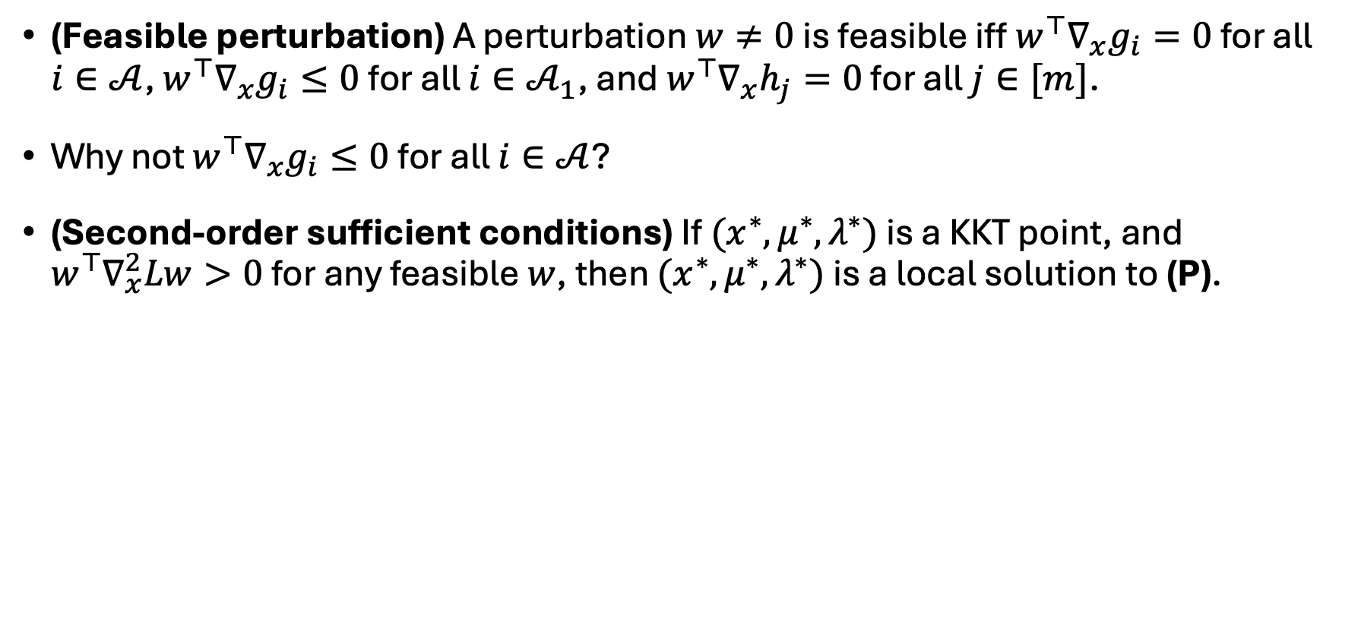
Optimality conditions
(Critical direction) A perturbation $w≠0$ is a critical direction iff $w^{⊤}∇_{x}g_{i}=0$ for all $i∈𝒜$, $w^{⊤}∇_{x}g_{i}≤0$ for all $i∈𝒜_{1}$, and $w^{⊤}∇_{x}h_{j}=0$ for all $j∈[m]$.
Why not $w^{⊤}∇_{x}g_{i}≤0$ for all $i∈𝒜$?
(Second-order sufficient conditions) If $(x^{∗},μ^{∗},λ^{∗})$ is a KKT point, and $w^{⊤}∇_{x}^{2}Lw>0$ for any critical direction $w$, then $x^{∗}$ is a strict local solution to (P).

Slide 9
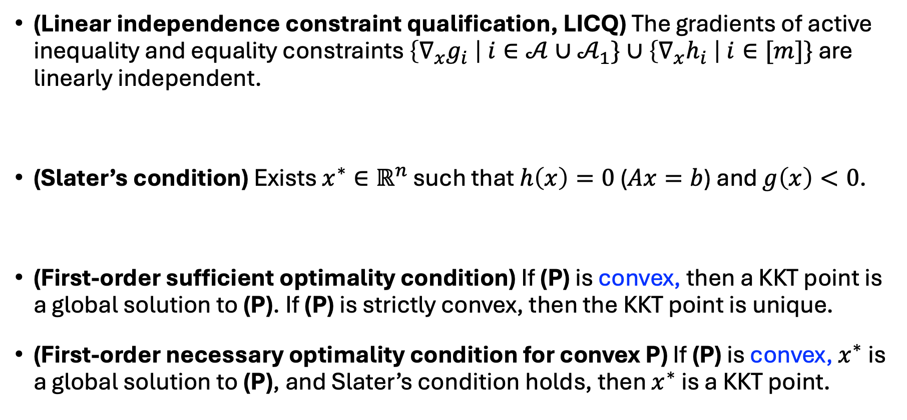
Constraint qualification
(Linear independence constraint qualification, LICQ) The gradients of active inequality and equality constraints $\left\{∇_{x}g_{i} \right| i∈𝒜∪𝒜_{1}\}∪\left\{∇_{x}h_{i} \right| i∈[m]\}$ are linearly independent.
(Slater’s condition) Exists $x∈ℝ^{n}$ such that $h\left(x\right)=0$ ($Ax=b$) and $g\left(x\right)<0$.
(First-order sufficient optimality condition) If (P) is convex, then a KKT point is a global solution to (P). If (P) is strictly convex, then the solution is unique.
(First-order necessary optimality condition for convex P) If (P) is convex, $x^{∗}$is a global solution to (P), and Slater’s condition holds, then there exist multipliers such that $(x^{∗},μ^{∗},λ^{∗})$ is a KKT point.

Slide 10
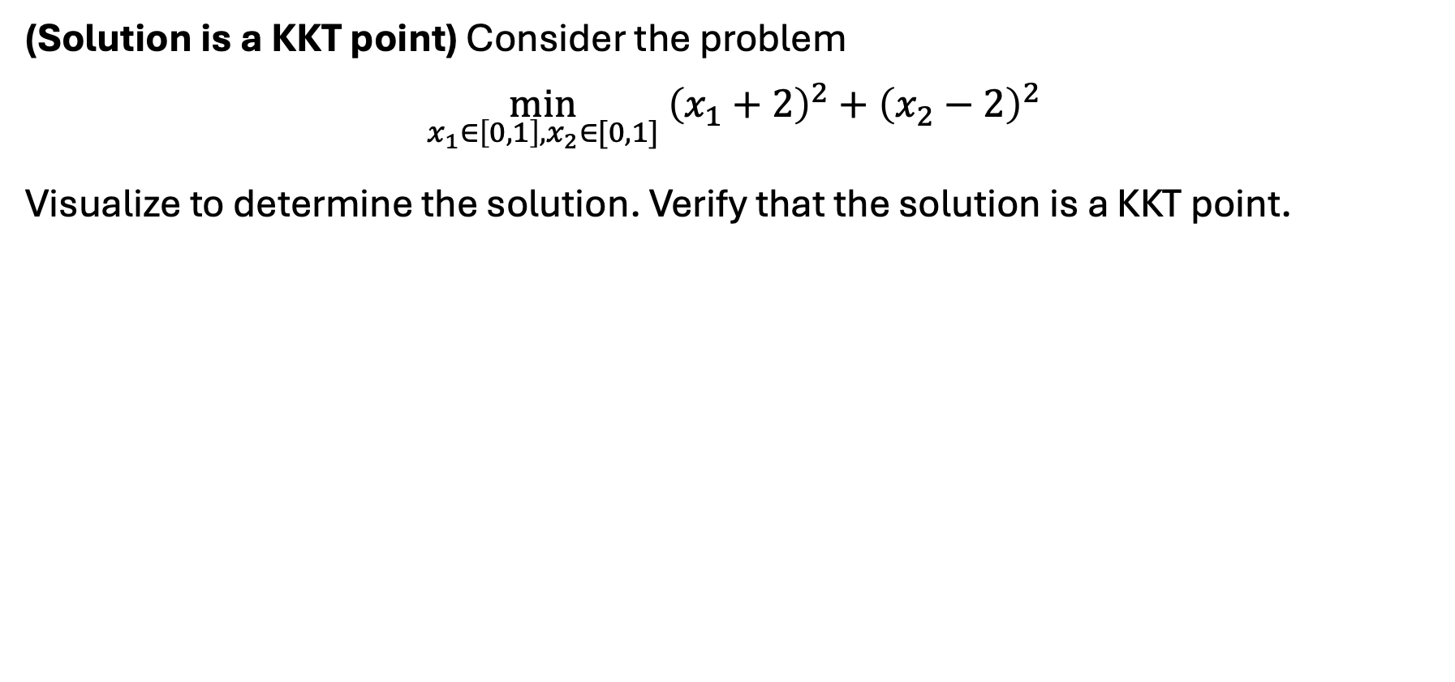
Exercise
(Solution is a KKT point) Consider the problem
$$\min_{x_{1}∈\left[0,1\right],x_{2}∈[0,1]} {\left(x_{1}+2\right)}^{2}+{\left(x_{2}−2\right)}^{2}$$
Visualize to determine the solution. Verify that the solution is a KKT point.

Slide 11
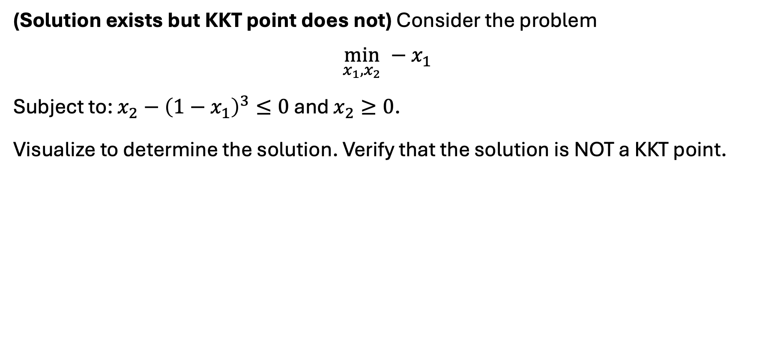
Exercise
(Solution exists but KKT point does not) Consider the problem
$$\min_{x_{1},x_{2}} −x_{1}$$
Subject to: $x_{2}−{\left(1−x_{1}\right)}^{3}≤0$ and $x_{2}≥0$.
Visualize to determine the solution. Verify that the solution is NOT a KKT point.

Slide 12
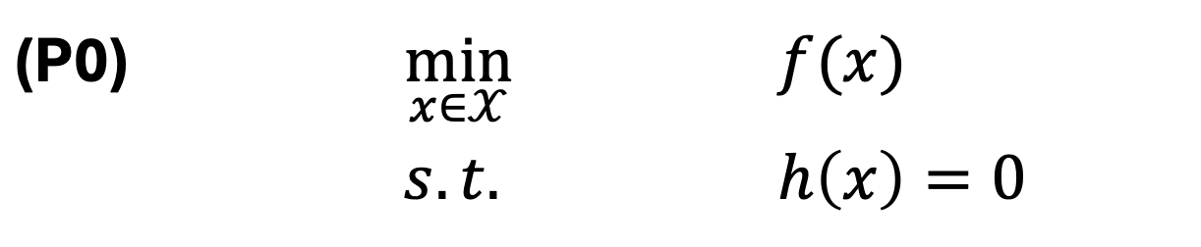
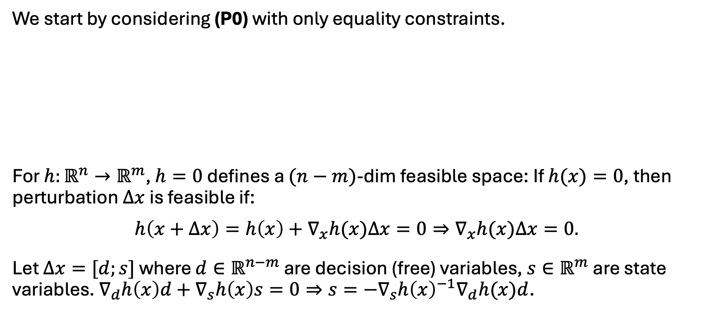
Derivation – equality constraints only
We start by considering (P0) with only equality constraints.
For $h:ℝ^{n}→ℝ^{m}$, $h=0$ defines a $(n−m)$-dim feasible space: If $h(x)=0$, then perturbation $Δx$ is feasible if:
$$h\left(x+Δx\right)=h\left(x\right)+∇_{x}h(x)Δx=0⇒∇_{x}h(x)Δx=0.$$
Let $Δx=[d;s]$ where $d∈ℝ^{n−m}$ are decision (free) variables, $s∈ℝ^{m}$ are state variables. $∇_{d}h\left(x\right)d+∇_{s}h\left(x\right)s=0⇒s=−∇_{s}h{\left(x\right)}^{−1}∇_{d}h(x)d$.
(P0) | $$\min_{x∈𝒳}$$ | $$f(x)$$
 | $$s.t.$$ | $$h\left(x\right)=0$$

Slide 13
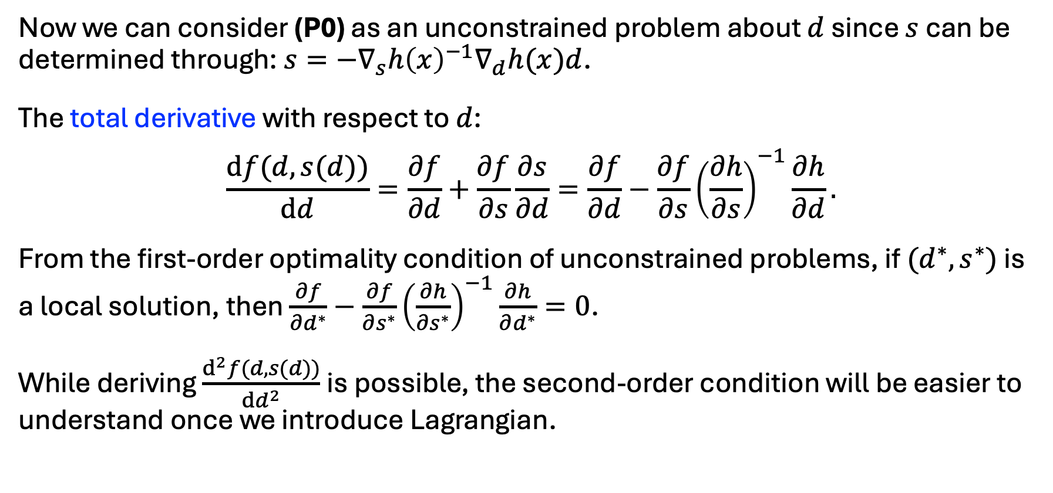
Derivation – equality constraints only
Now we can consider (P0) as an unconstrained problem about $d$ since $s$ can be determined through: $s=−∇_{s}h{\left(x\right)}^{−1}∇_{d}h(x)d$.
The total derivative with respect to $d$:
$$\frac{df(d,s(d))}{dd}=\frac{∂f}{∂d}+\frac{∂f}{∂s}\frac{∂s}{∂d}=\frac{∂f}{∂d}−\frac{∂f}{∂s}{\left(\frac{∂h}{∂s}\right)}^{−1}\frac{∂h}{∂d}.$$
From the first-order optimality condition of unconstrained problems, if $(d^{∗},s^{∗})$ is a local solution, then $\frac{∂f}{∂d^{∗}}−\frac{∂f}{∂s^{∗}}{\left(\frac{∂h}{∂s^{∗}}\right)}^{−1}\frac{∂h}{∂d^{∗}}=0$.
While deriving $\frac{d^{2}f(d,s(d))}{dd^{2}}$is possible, the second-order condition will be easier to understand once we introduce Lagrangian.

Slide 14
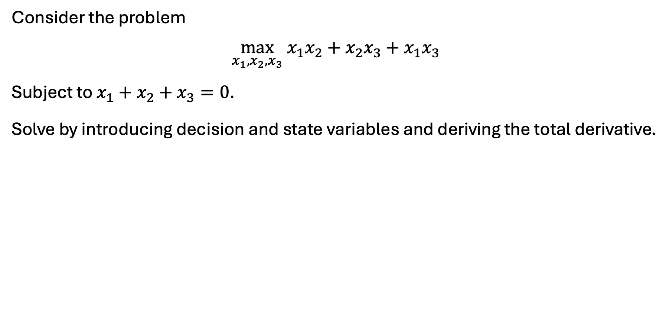
Exercise
Consider the problem
$$\max_{x_{1},x_{2},x_{3}} x_{1}x_{2}+x_{2}x_{3}+x_{1}x_{3}$$
Subject to $x_{1}+x_{2}+x_{3}=0$.
Solve by introducing decision and state variables and deriving the total derivative.

Slide 15
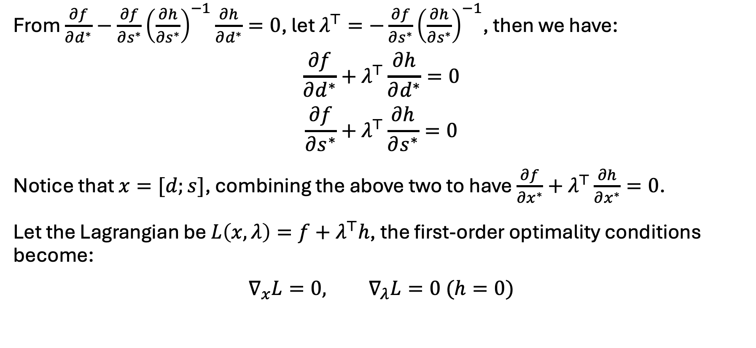
Derivation – equality constraints only
From $\frac{∂f}{∂d^{∗}}−\frac{∂f}{∂s^{∗}}{\left(\frac{∂h}{∂s^{∗}}\right)}^{−1}\frac{∂h}{∂d^{∗}}=0$, let $λ^{⊤}=−\frac{∂f}{∂s^{∗}}{\left(\frac{∂h}{∂s^{∗}}\right)}^{−1}$, then we have:
$$\frac{∂f}{∂d^{∗}}+λ^{⊤}\frac{∂h}{∂d^{∗}}=0$$
$$\frac{∂f}{∂s^{∗}}+λ^{⊤}\frac{∂h}{∂s^{∗}}=0$$
Notice that $x=[d;s]$, combining the above two to have $\frac{∂f}{∂x^{∗}}+λ^{⊤}\frac{∂h}{∂x^{∗}}=0$.
Let the Lagrangian be $L\left(x,λ\right)=f+λ^{⊤}h$, the first-order optimality conditions become:
$$∇_{x}L=0, ∇_{λ}L=0 (h=0)$$

Slide 16
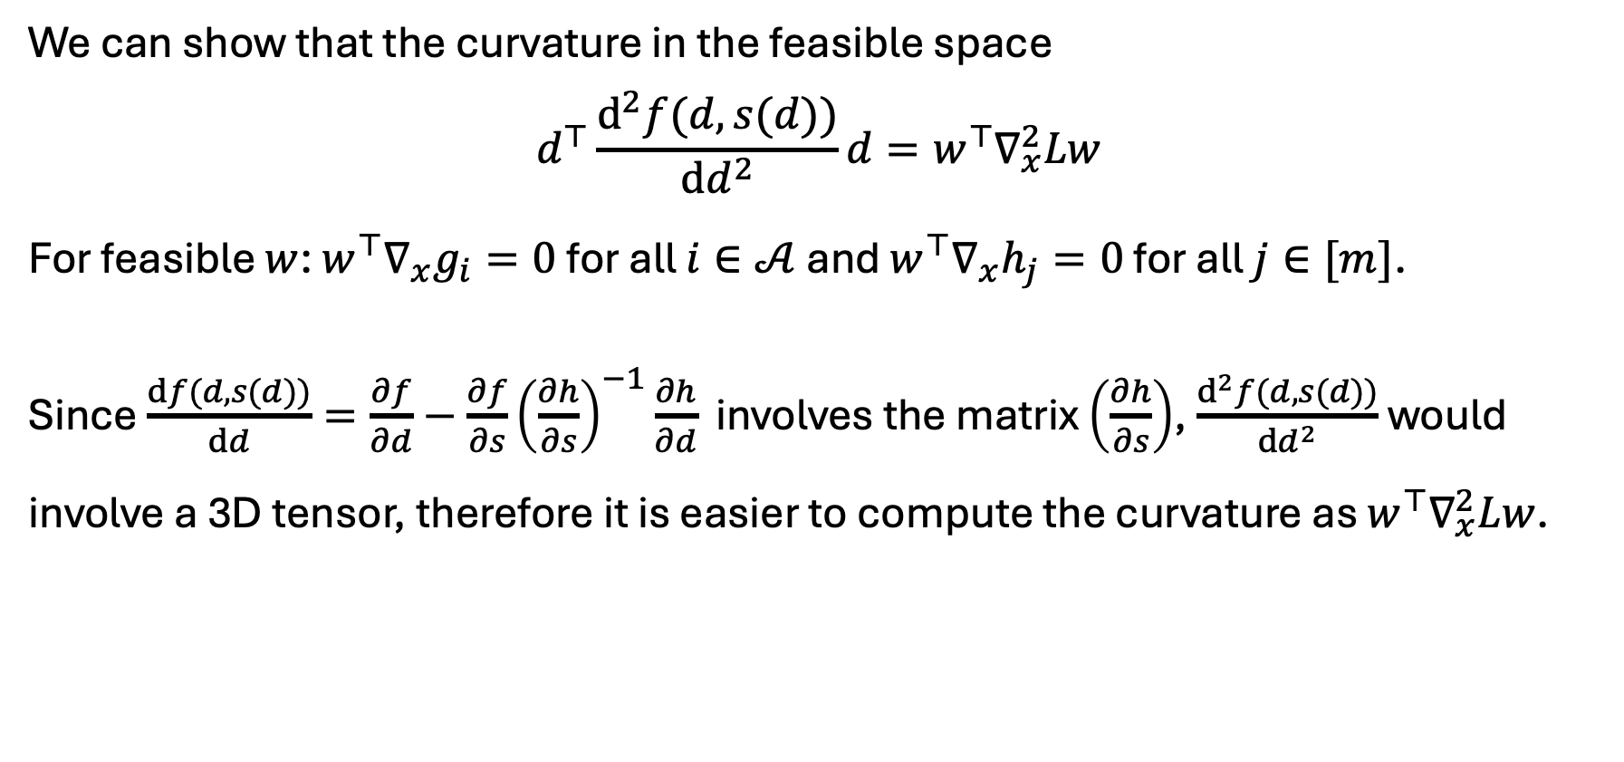
Derivation – second-order conditions
We can show that the curvature in the feasible space
$$d^{⊤}\frac{d^{2}f(d,s(d))}{dd^{2}}d=w^{⊤}∇_{x}^{2}Lw$$
For feasible $w$: $w^{⊤}∇_{x}h_{j}=0$ for all $j∈[m]$.
Since $\frac{df(d,s(d))}{dd}=\frac{∂f}{∂d}−\frac{∂f}{∂s}{\left(\frac{∂h}{∂s}\right)}^{−1}\frac{∂h}{∂d}$ involves the matrix $\left(\frac{∂h}{∂s}\right)$, $\frac{d^{2}f(d,s(d))}{dd^{2}}$ would involve a 3D tensor, therefore it is easier to compute the curvature as $w^{⊤}∇_{x}^{2}Lw$.

Slide 17
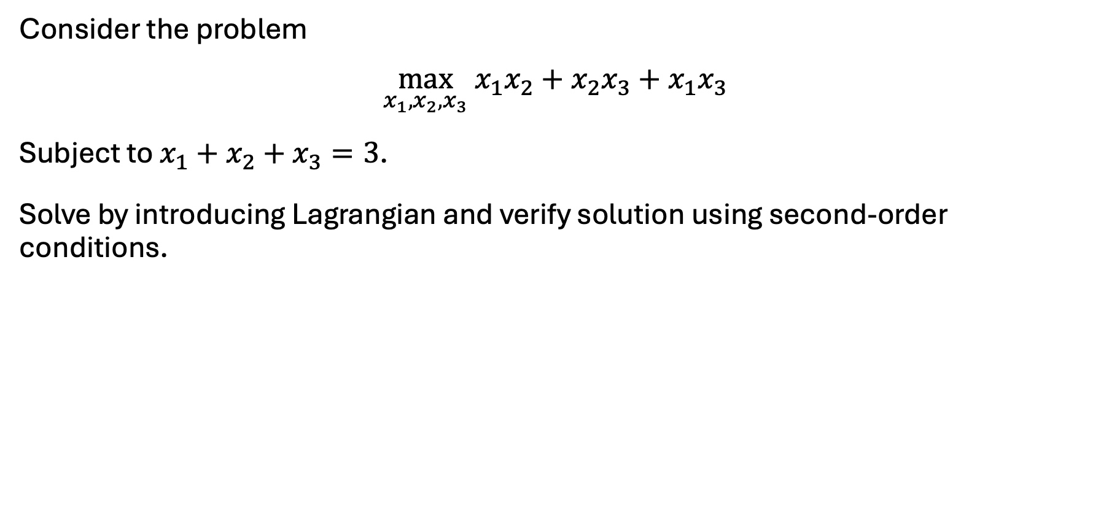
Exercise
Consider the problem
$$\max_{x_{1},x_{2},x_{3}} x_{1}x_{2}+x_{2}x_{3}+x_{1}x_{3}$$
Subject to $x_{1}+x_{2}+x_{3}=3$.
Solve by introducing Lagrangian and verify solution using second-order conditions.

Slide 18
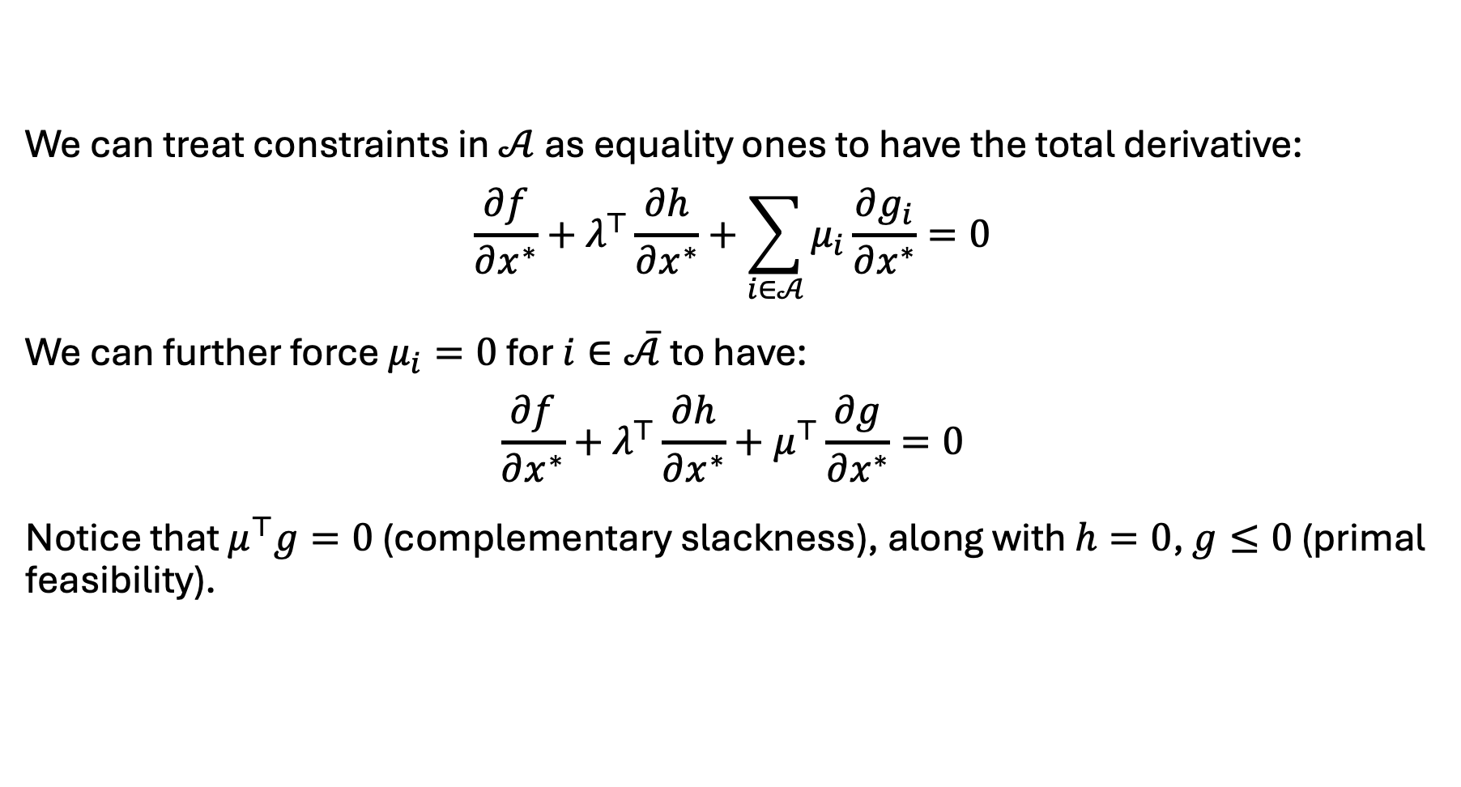
Derivation – incorporate inequality constraints
We can treat constraints in $𝒜$ as equality ones to have the total derivative:
$$\frac{∂f}{∂x^{∗}}+λ^{⊤}\frac{∂h}{∂x^{∗}}+\sum_{i∈𝒜}{μ_{i}\frac{∂g_{i}}{∂x^{∗}}}=0$$
We can further force $μ_{i}=0$ for $i∈\overline{𝒜}$ to have:
$$\frac{∂f}{∂x^{∗}}+λ^{⊤}\frac{∂h}{∂x^{∗}}+μ^{⊤}\frac{∂g}{∂x^{∗}}=0$$
Notice that $μ^{⊤}g=0$ (complementary slackness), along with $h=0$, $g≤0$ (primal feasibility).

Slide 19
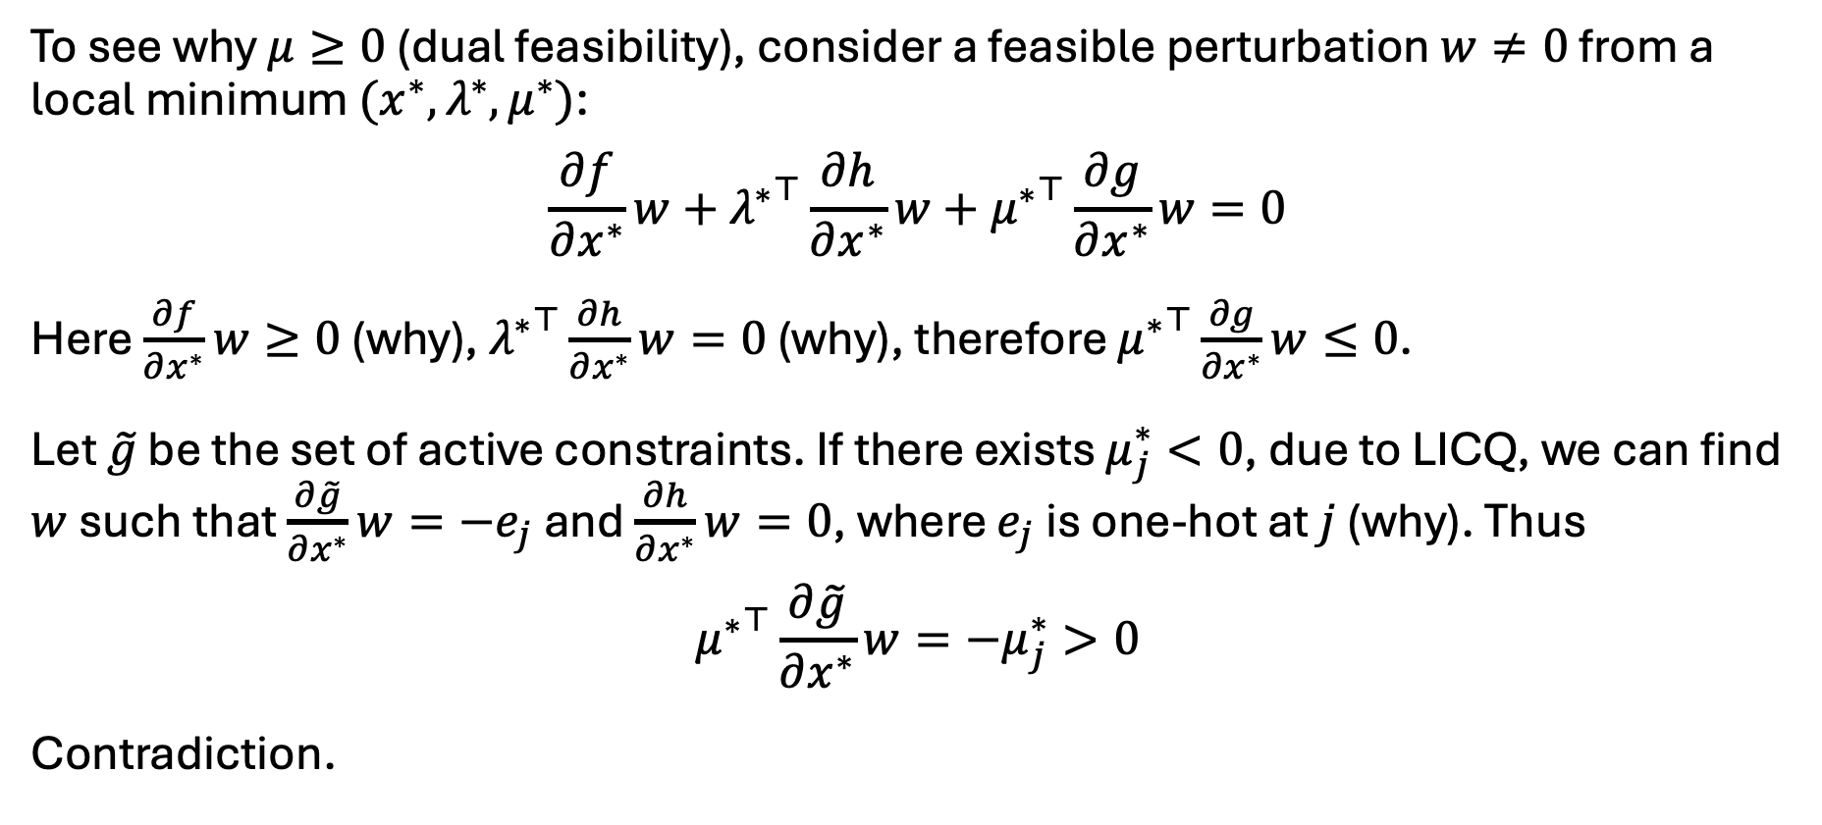
Derivation – incorporate inequality constraints
To see why $μ≥0$ (dual feasibility), consider a feasible perturbation $w≠0$ from a local minimum $(x^{∗},λ^{∗},μ^{∗})$:
$$\frac{∂f}{∂x^{∗}}w+{λ^{∗}}^{⊤}\frac{∂h}{∂x^{∗}}w+{μ^{∗}}^{⊤}\frac{∂g}{∂x^{∗}}w=0$$
Here $\frac{∂f}{∂x^{∗}}w≥0$ (why), ${λ^{∗}}^{⊤}\frac{∂h}{∂x^{∗}}w=0$ (why), therefore ${μ^{∗}}^{⊤}\frac{∂g}{∂x^{∗}}w≤0$.
Let $\tilde{g}$ denote only the active inequality constraints. If there exists $μ_{j}^{∗}<0$, due to LICQ, we can find $w$ such that $\frac{∂\tilde{g}}{∂x^{∗}}w={−e}_{j}$ and $\frac{∂h}{∂x^{∗}}w=0$, where $e_{j}$ is one-hot at $j$ (why). Thus
$${μ^{∗}}^{⊤}\frac{∂\tilde{g}}{∂x^{∗}}w=−μ_{j}^{∗}>0$$
Contradiction.

Slide 20
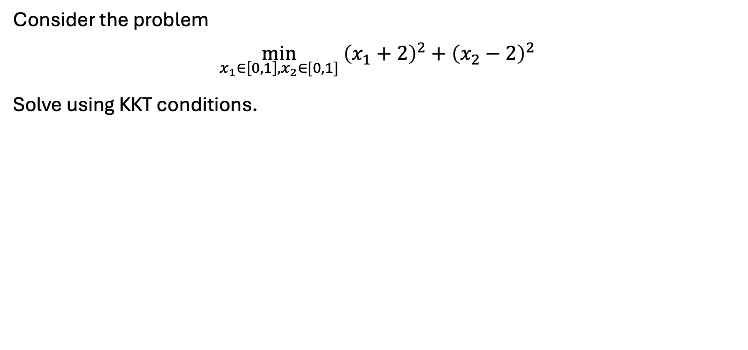
Exercise
Consider the problem
$$\min_{x_{1}∈\left[0,1\right],x_{2}∈[0,1]} {\left(x_{1}+2\right)}^{2}+{\left(x_{2}−2\right)}^{2}$$
Solve using KKT conditions.

Slide 21
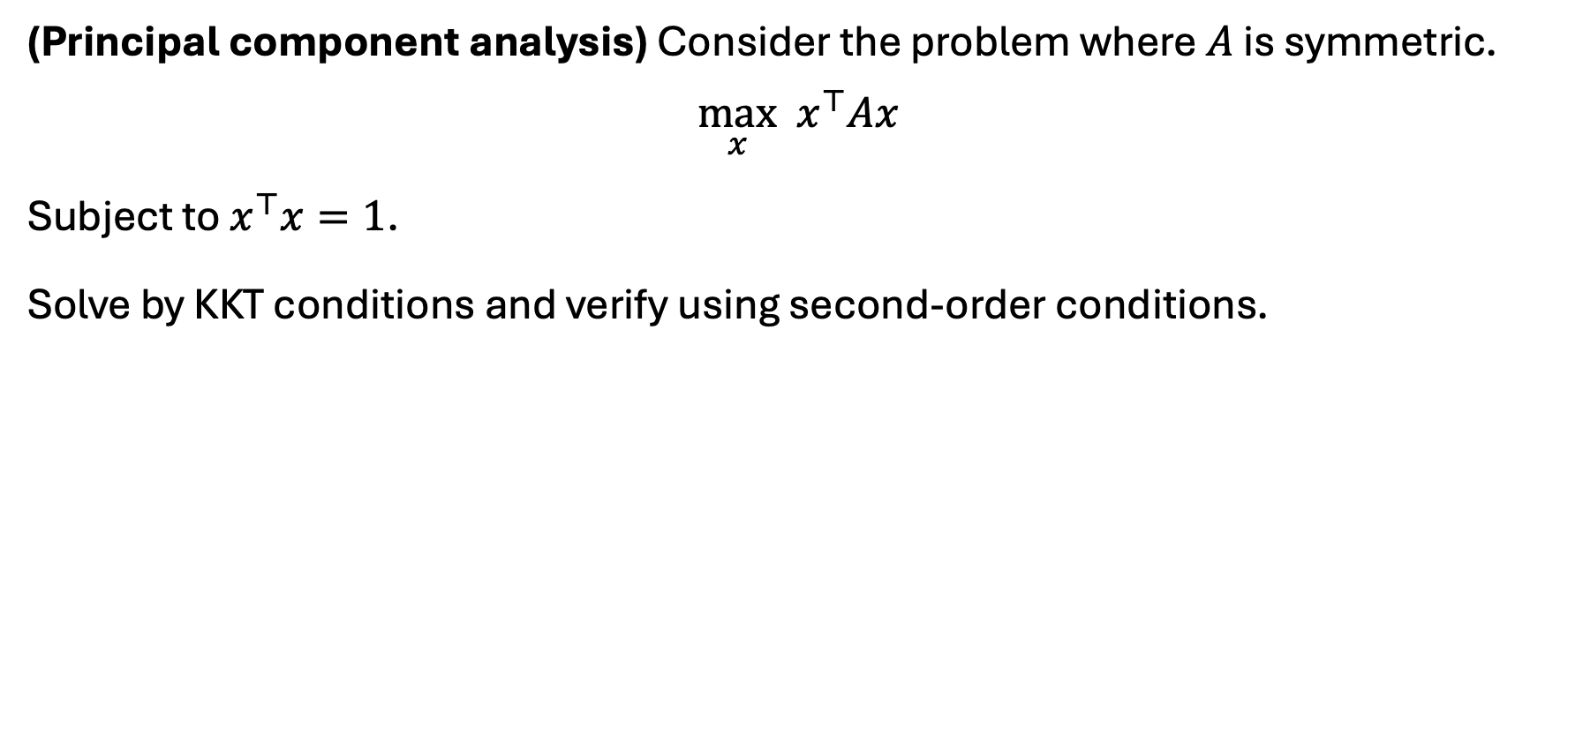
Exercise
(Principal component analysis) Consider the problem where $A$ is symmetric.
$$\max_{x} x^{⊤}Ax$$
Subject to $x^{⊤}x=1$.
Solve by KKT conditions and verify using second-order conditions.

Slide 22
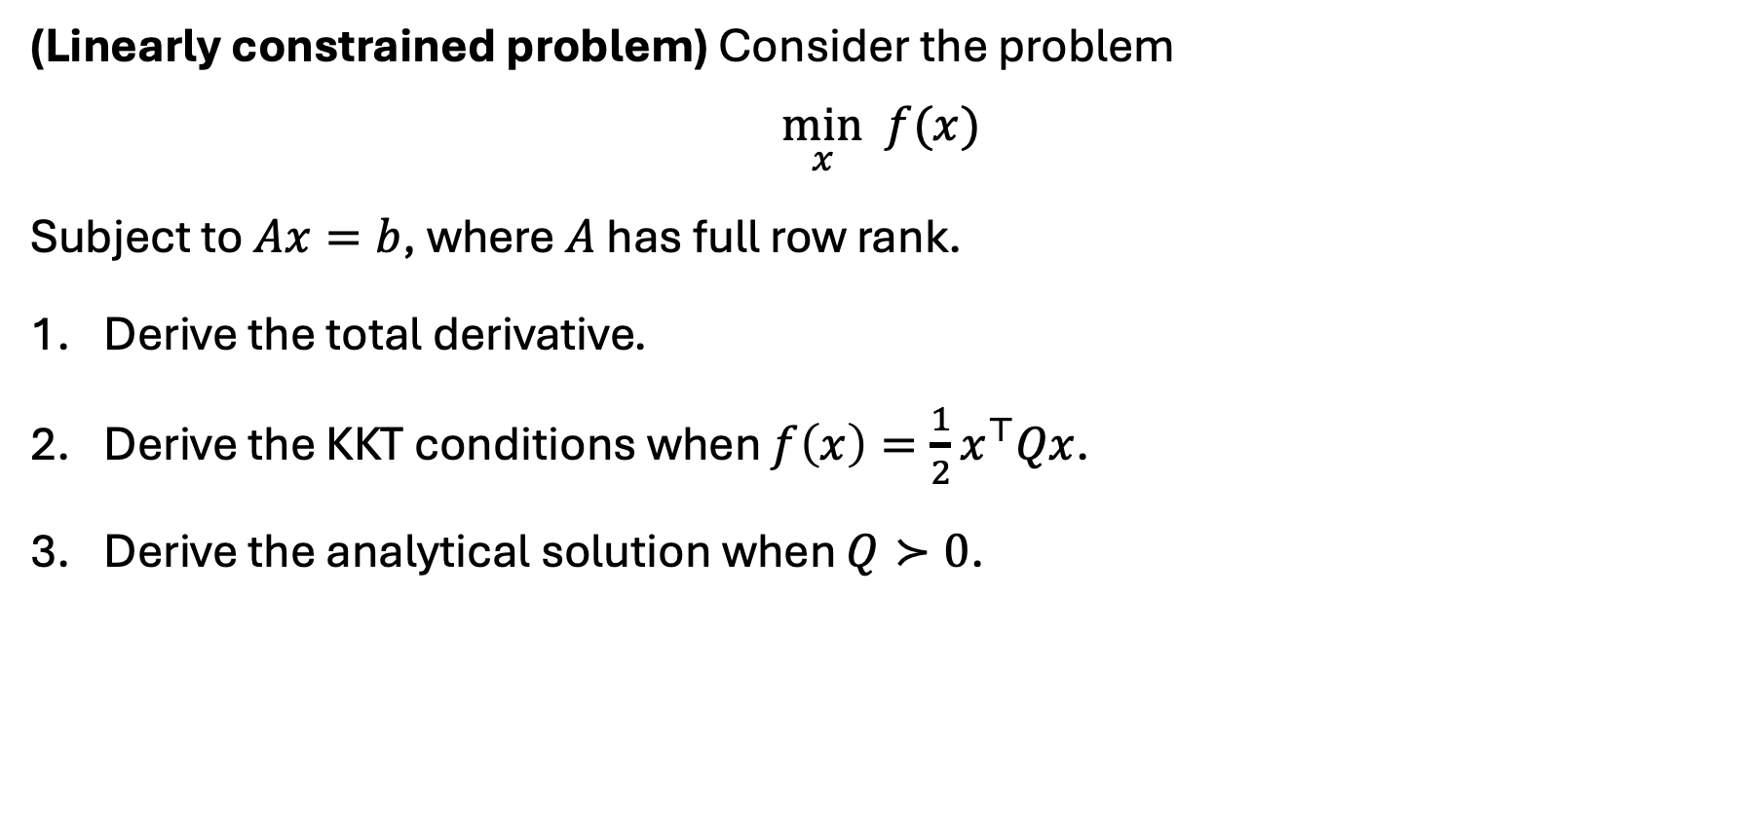
Exercise
(Linearly constrained problem) Consider the problem
$$\min_{x} f(x)$$
Subject to $Ax=b$, where $A$ has full row rank.
Derive the total derivative.
Derive the KKT conditions when $f\left(x\right)=\frac{1}{2}x^{⊤}Qx$.
Derive the analytical solution when $Q≻0$.

Slide 23
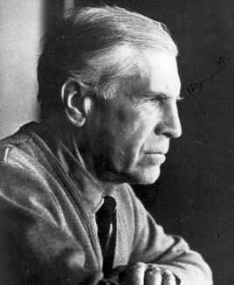
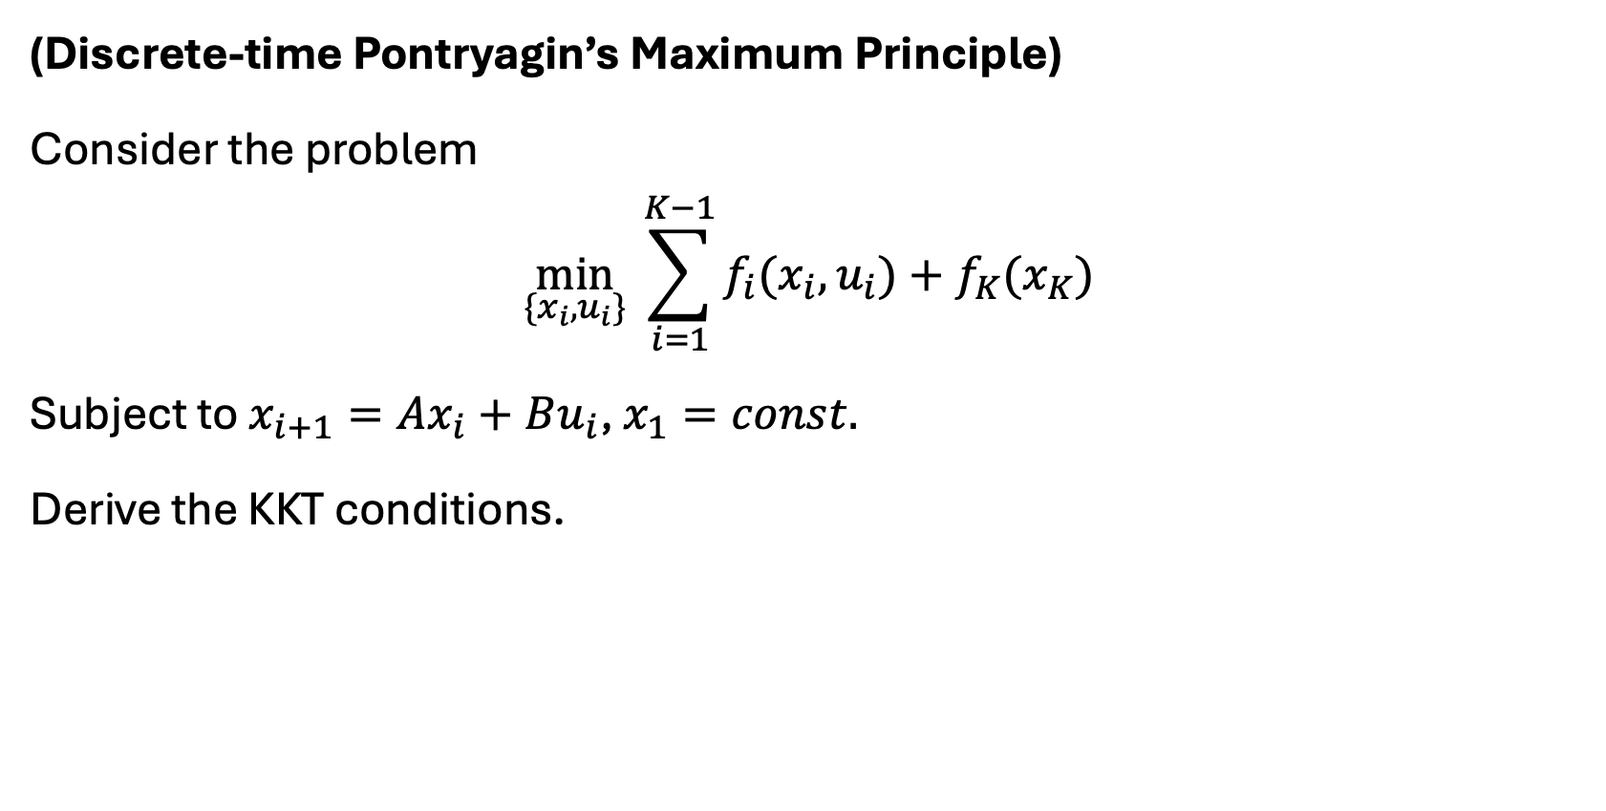
Exercise
(Discrete-time Pontryagin’s Maximum Principle)
Consider the problem
$$\min_{\{x_{i},u_{i}\}} \sum_{i=1}^{K−1}{f_{i}(x_{i}, u_{i})}+f_{K}(x_{K})$$
Subject to $x_{i+1}=Ax_{i}+Bu_{i}$, $x_{1}=const.$
Derive the KKT conditions.
Lev Pontryagin: USSR Mathematician. Completely blind since 14. Optimal control theory (1956).

Slide 24
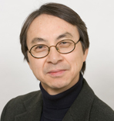
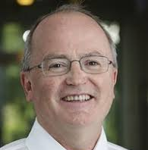
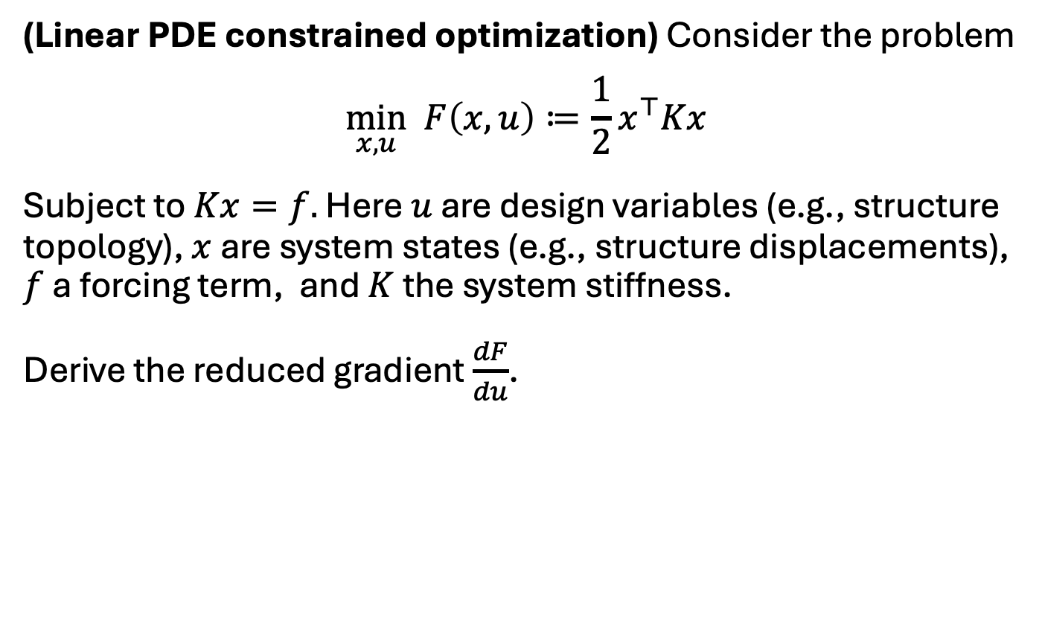
Exercise
(Linear PDE constrained optimization) Consider the problem
$$\min_{x,u} F\left(x,u\right)≔\frac{1}{2}x^{⊤}K(u)x$$
Subject to $K(u)x=f.$ Here $u$ are design variables (e.g., structure topology), $x$ are system states (e.g., structure displacements), $f$ a forcing term, and $K(u)$ the system stiffness.
Derive the reduced gradient $\frac{dF}{du}$.
Noboru Kikuchi:
President, Toyota R&D
Martin Bendsoe:
Mathematician, DTU
Bendsoe & Kikuchi (1988 paper) – HyperWorks – Altair – Siemens acquisition (11bn, 2024)

Slide 25
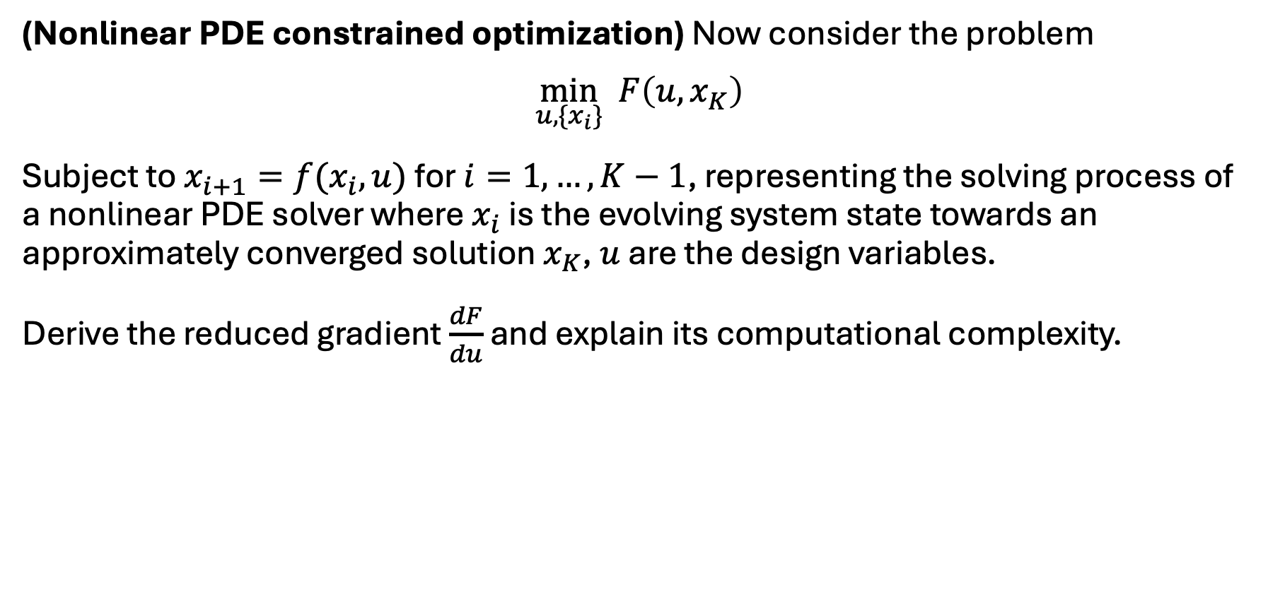
Exercise
(Nonlinear PDE constrained optimization) Now consider the problem
$$\min_{u,\{x_{i}\}} F\left(u,x_{K}\right)$$
Subject to $x_{i+1}=f(x_{i},u)$ for $i=1,…,K−1$ with $x_{1}$ given, representing the solving process of a nonlinear PDE solver where $x_{i}$ is the evolving system state towards an approximately converged solution $x_{K}$, $u$ are the design variables.
Derive the reduced gradient $\frac{dF}{du}$ and explain its computational complexity.

Slide 26
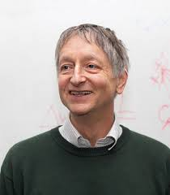
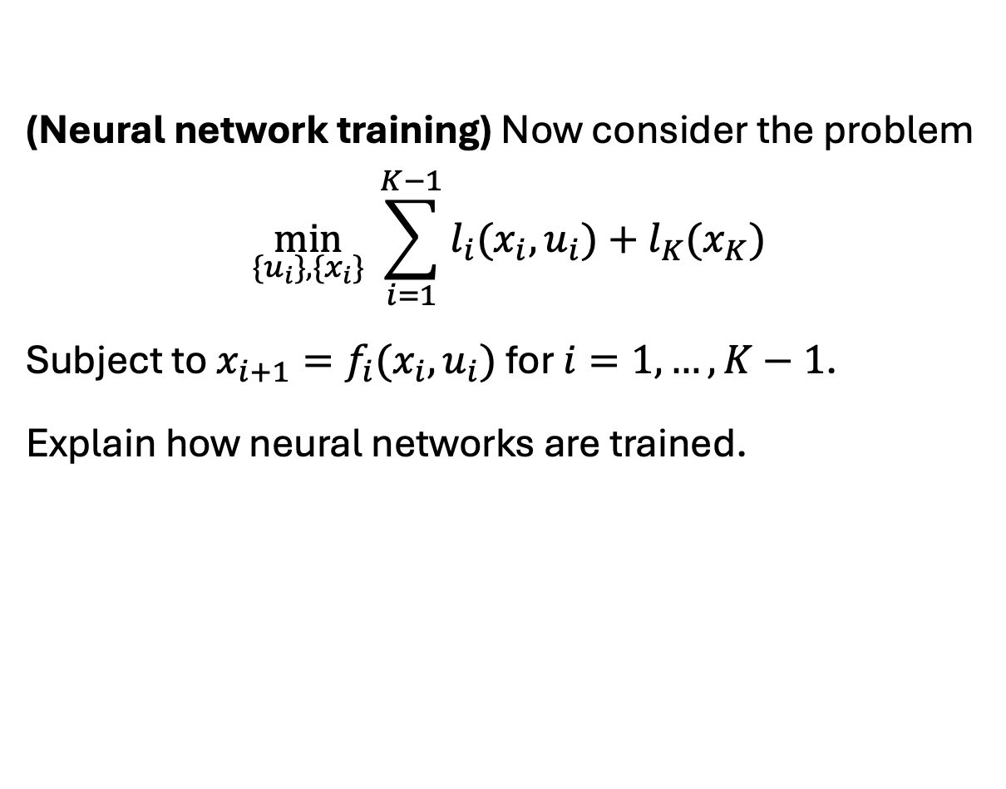
Exercise
(Neural network training) Now consider the problem
$$\min_{\{u_{i}\},\{x_{i}\}} \sum_{i=1}^{K−1}{l_{i}(x_{i}, u_{i})}+l_{K}(x_{K})$$
Subject to $x_{i+1}=f_{i}(x_{i},u_{i})$ for $i=1,…,K−1$ with $x_{1}$ given.
Explain how neural networks are trained.
Geoffrey Hinton: Turing award (2018) for successful application of Backpropagation to neural net training.
Nobel Prize in Physics (2024, for Boltzmann machine)

Slide 27
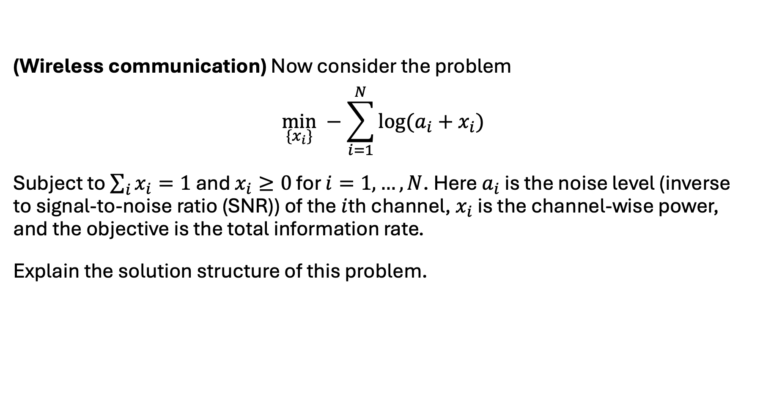
Exercise
(Wireless communication) Now consider the problem
$$\min_{\{x_{i}\}} −\sum_{i=1}^{N}{\log{(a_{i}+x_{i})}}$$
Subject to $\sum_{i}{x_{i}}=1$ and $x_{i}≥0$ for $i=1,…,N$. Here $a_{i}$ is the noise level (inverse to signal-to-noise ratio (SNR)) of the $i$th channel, $x_{i}$ is the channel-wise power, and the objective is the negative total information rate.
Explain the solution structure of this problem.

Slide 28
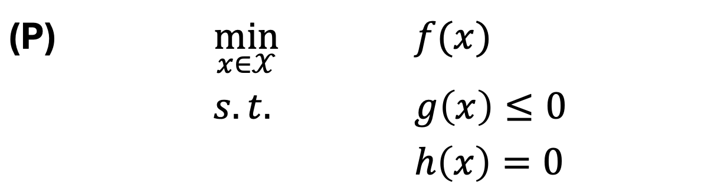
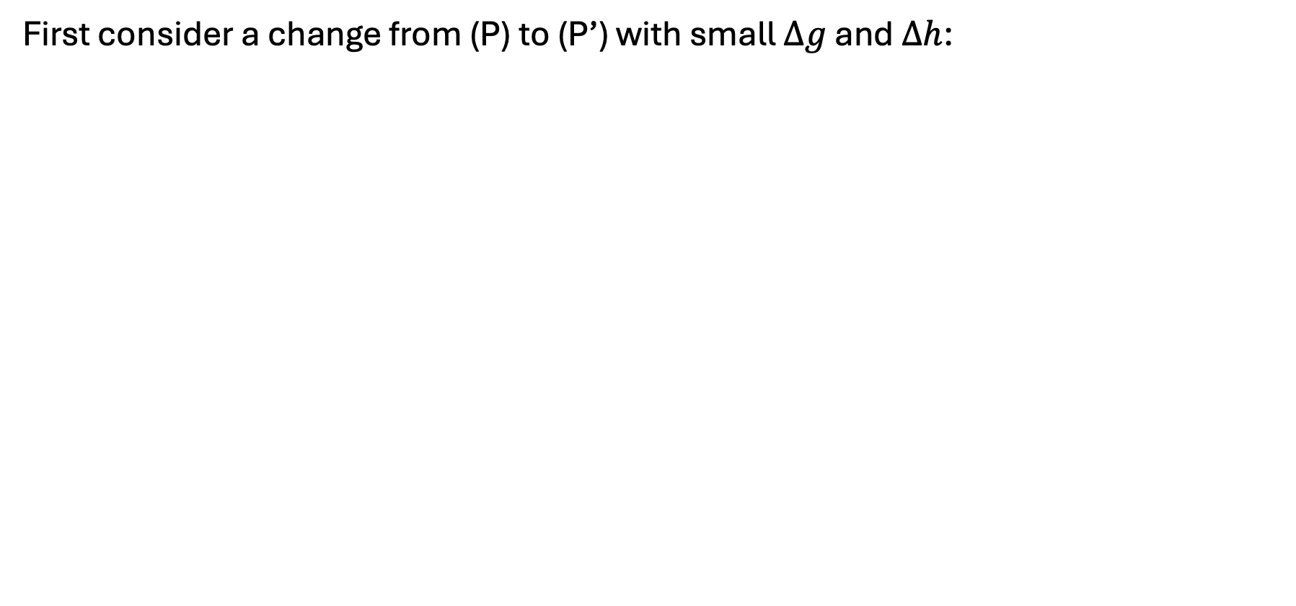
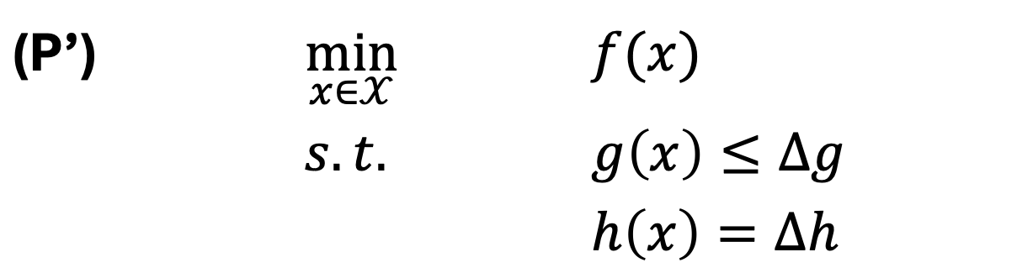
Sensitivity analysis
First consider a change from (P) to (P’) with small $Δg$ and $Δh$:
(P) | $$\min_{x∈𝒳}$$ | $$f(x)$$
 | $$s.t.$$ | $$g\left(x\right)≤0$$
 |  | $$h\left(x\right)=0$$
(P’) | $$\min_{x∈𝒳}$$ | $$f(x)$$
 | $$s.t.$$ | $$g\left(x\right)≤Δg$$
 |  | $$h\left(x\right)=Δh$$

Slide 29
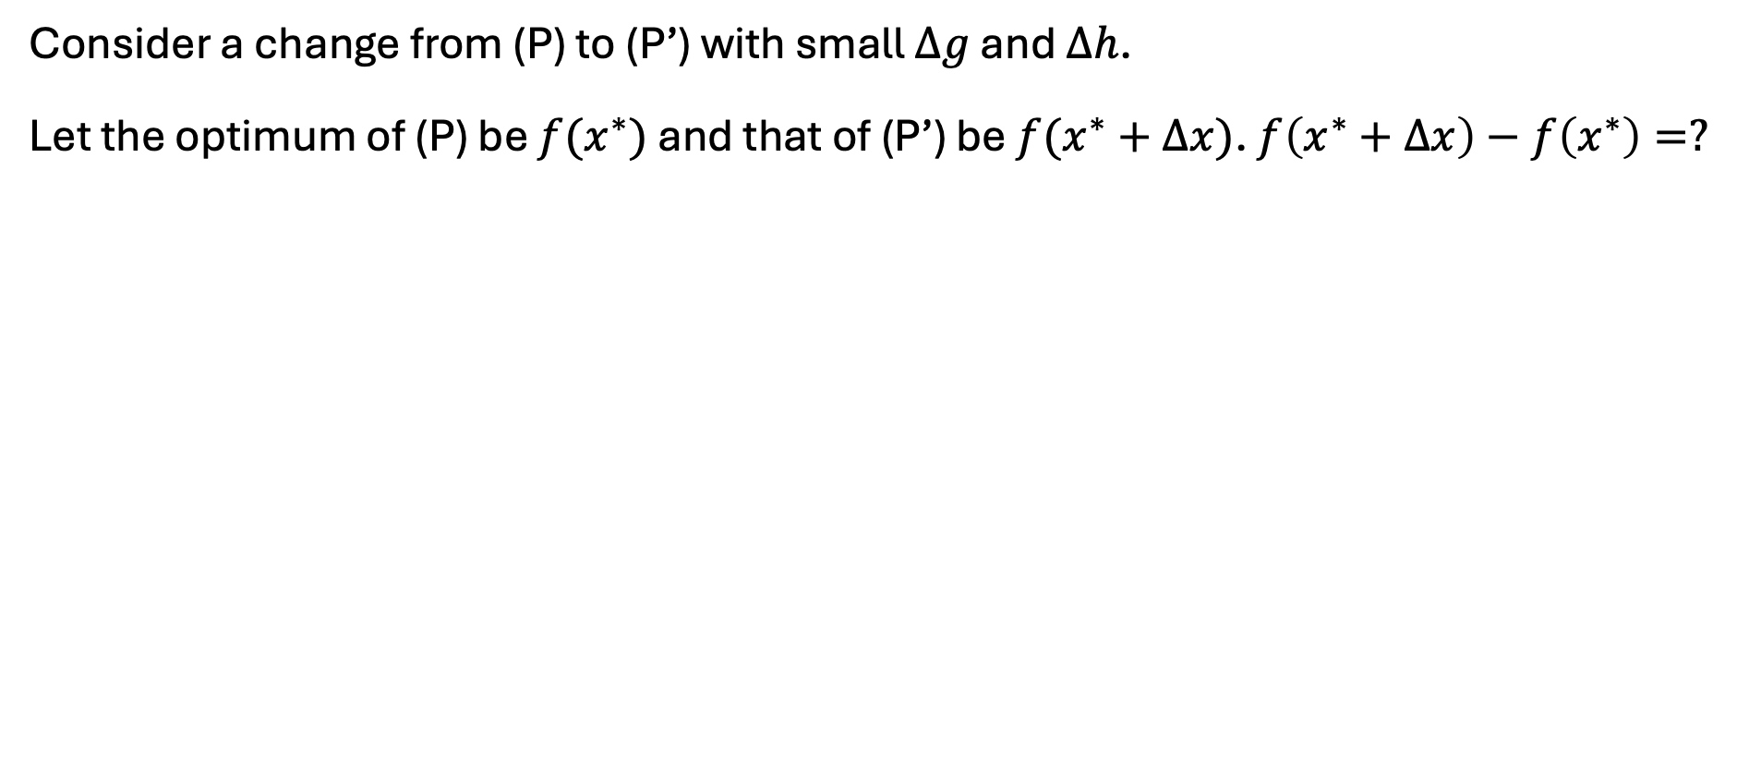
Sensitivity analysis
Consider a change from (P) to (P’) with small $Δg$ and $Δh$.
Let the optimum of (P) be $f(x^{∗})$ and that of (P’) be $f(x^{∗}+Δx)$. $f\left(x^{∗}+Δx\right)−f\left(x^{∗}\right)=?$
(P’) | $$\min_{x∈𝒳}$$ | $$f(x)$$
 | $$s.t.$$ | $$g\left(x\right)≤Δg$$
 |  | $$h\left(x\right)=Δh$$

Slide 30
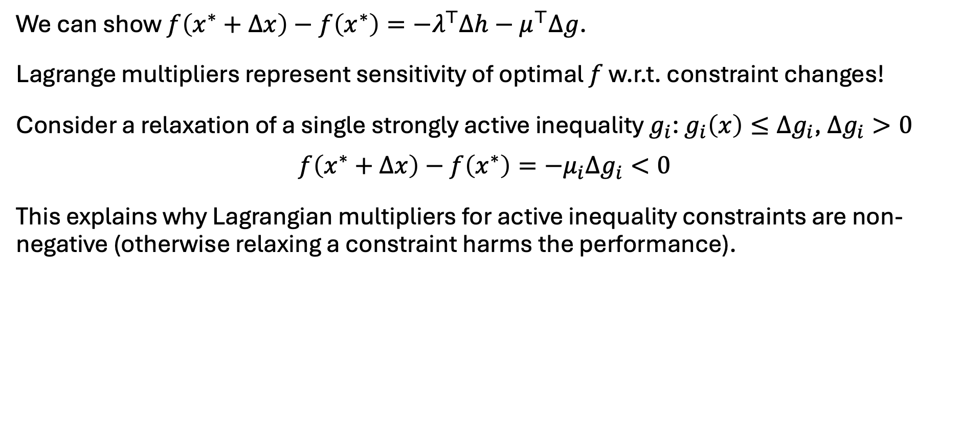
Sensitivity analysis
We can show $f\left(x^{∗}+Δx\right)−f\left(x^{∗}\right)=−λ^{⊤}Δh−μ^{⊤}Δg$.
Lagrange multipliers represent sensitivity of optimal $f$ w.r.t. constraint changes!
Consider a relaxation of a single strongly active inequality $g_{i}$: $g_{i}\left(x\right)≤Δg_{i}$, $Δg_{i}>0$
$$f\left(x^{∗}+Δx\right)−f\left(x^{∗}\right)=−μ_{i}Δg_{i}<0$$
This explains why Lagrangian multipliers for active inequality constraints are non-negative (otherwise relaxing a constraint harms the performance).

Slide 31
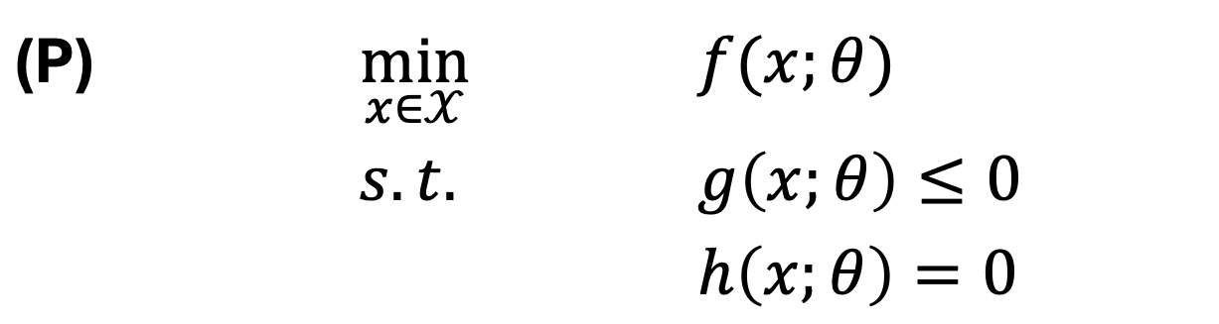
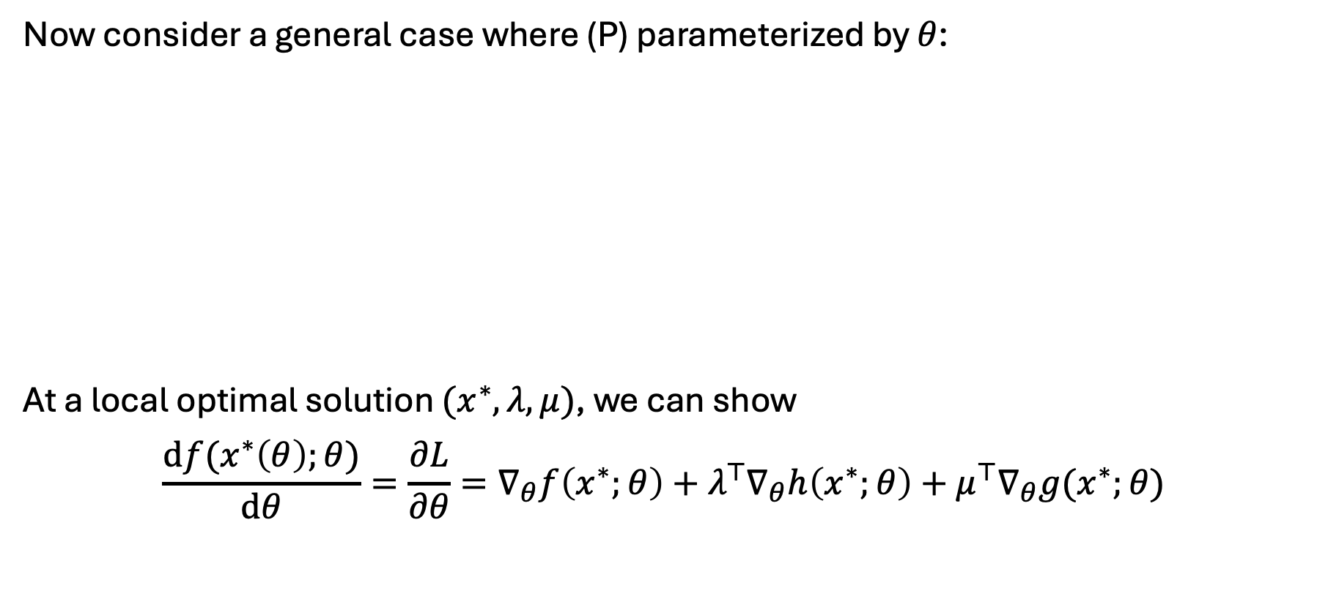
Sensitivity analysis
Now consider a general case where (P) parameterized by $θ$:
At a local optimal solution $(x^{∗},λ, μ)$, we can show
$$\frac{df(x^{∗}\left(θ\right);θ)}{dθ}=\frac{∂L}{∂θ}=∇_{θ}f\left(x^{∗};θ\right)+λ^{⊤}∇_{θ}h\left(x^{∗};θ\right)+μ^{⊤}∇_{θ}g(x^{∗};θ)$$
(P) | $$\min_{x∈𝒳}$$ | $$f(x;θ)$$
 | $$s.t.$$ | $$g\left(x;θ\right)≤0$$
 |  | $$h\left(x;θ\right)=0$$

Slide 32

Exercise
(Manufacturing) A company manufactures two types of products: A and B. Price: $x_{i}$, sale quantity: $q_{i}$: $q_{A}=400−2x_{A}+x_{B}$, $q_{B}=200+x_{A}−x_{B}$.
Manufacturing one unit of A requires 2 hours of labor and 1 unit of raw material.
For B, 3 hours of labor and 2 units of raw material.
We have 1000 hours of labor and 200 units of raw material available.
What are the revenue-maximizing prices?
How much would the company be willing to pay for another hour of labor? Or another unit of raw material?

Slide 33
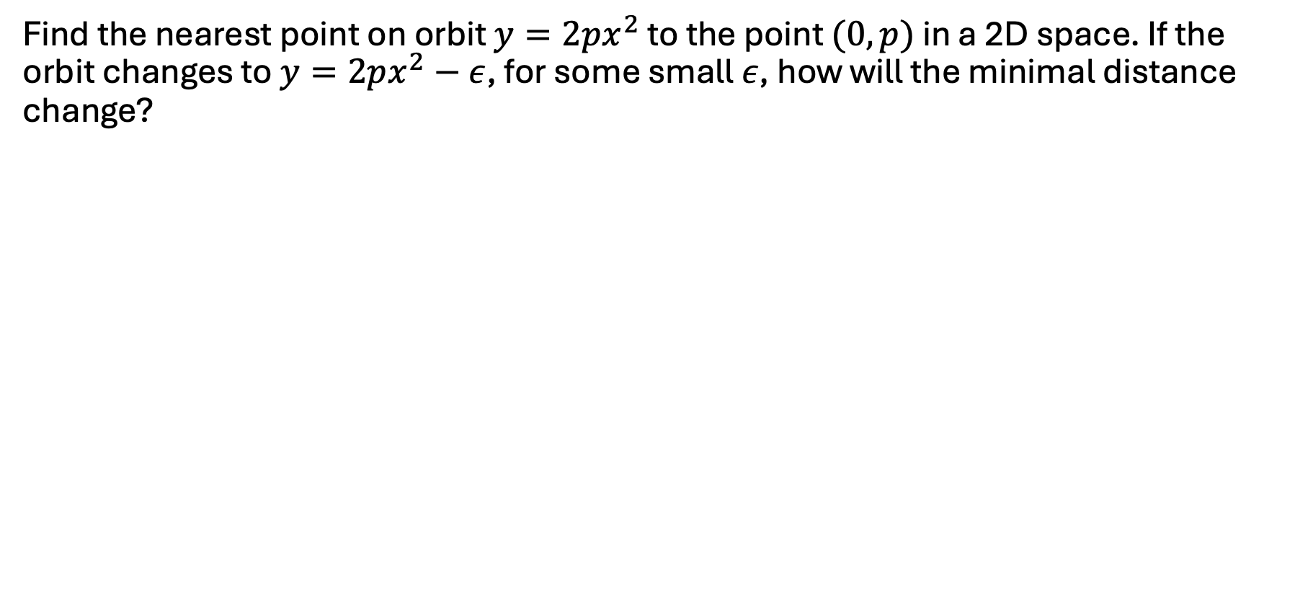
Exercise
Find the nearest point on the curve $y=2px^{2}$ to the point $(0,p)$ in a 2D space, assuming $p≥1/2$. If the curve changes to $y=2px^{2}−ε$, for some small $ε$, how will the minimal distance change?

