Slide 1

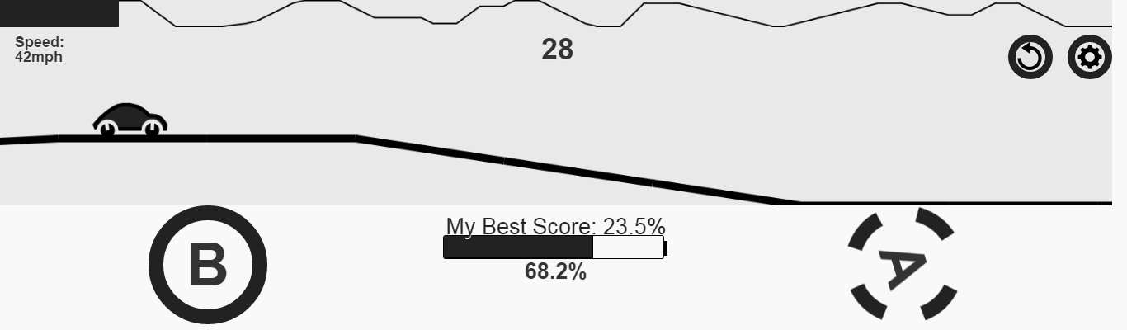
ecoracer.herokuapp.com
Design and race to minimize energy consumption
Winner updated on login screen
Best strategy will be announced in class
Don’t spend too much time on gaming
No personal information will be collected.
Conclusions of the game will be published in research conferences and journals.

