Slide 1
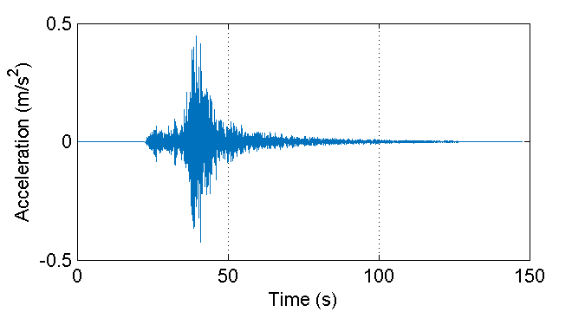
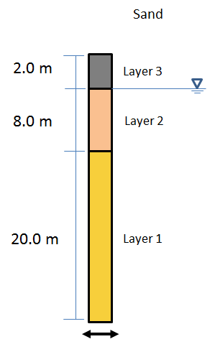
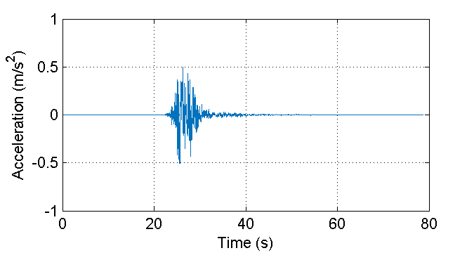

Effective Site Response Analysis
Demonstrate the benefits of Jupyter notebooks to run simulations using DesignSafe infrastructure and tools.
Problem description:
Site response analysis
Workflow:
Run OpenSees
Postprocess results
Create report
Explore use of interactive plots

