Slide 1

VAccination tracker
DBMS Mini project

Slide 2
Problem Statement
The onset of a pandemic or any communal disease requires quick and coordinated action, manifested frequently as the administration of vaccinations.
It is difficult and inefficient to keep track of the vaccinated within a large population and maintain other information like personal data and infection status, which are all relevant to the fight against disease.
We think, that automating the collection, updation and query of this data will be a great step forward towards mobilizing efficient and swift responses to pandemics today and going forward.

Slide 3
introduction
Our solution consists of a database that maintains personal information of citizens, information about their vaccination (eg. Number of shots taken), authentication data for the application, scheduled vaccinations, center locations, etc.
The database technology used is SQLite, with Flutter (Dart) used for the user interface and Rust for interfacing with the database.

Slide 4
TABLE DEFINITIONS
ID | Password | Name
Integer PK | string | string
OFFICIAL
ID | Password | Name | age | Vaccination level
Integer PK | string | string | Integer | Integer
CITIZEN
ID | Location | Name
Integer PK | string | string
CENTER
CenterID | CitizenID
Integer | Integer
APPOINMENT

Slide 5
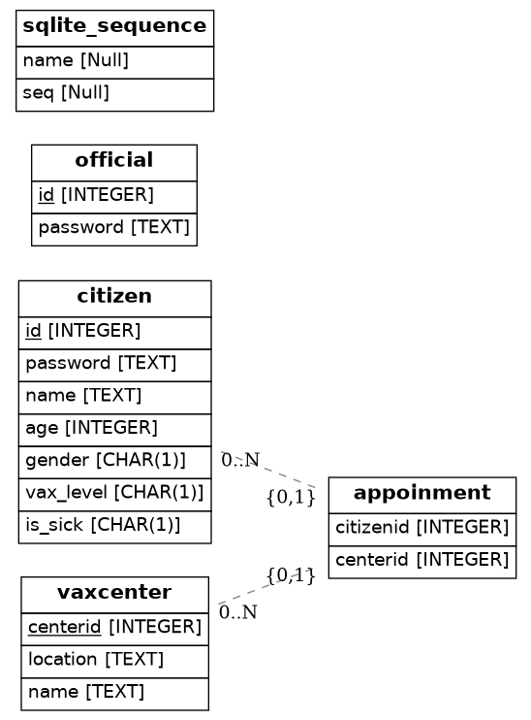
ER DIAGRAM

