Slide 1


X
DEASIGNED BY HUMMING GROUP MIKAEL LEHTONEN, LU ZENG, LI HUANG, ANDERS BROTHERUS

Slide 2


Slide 3
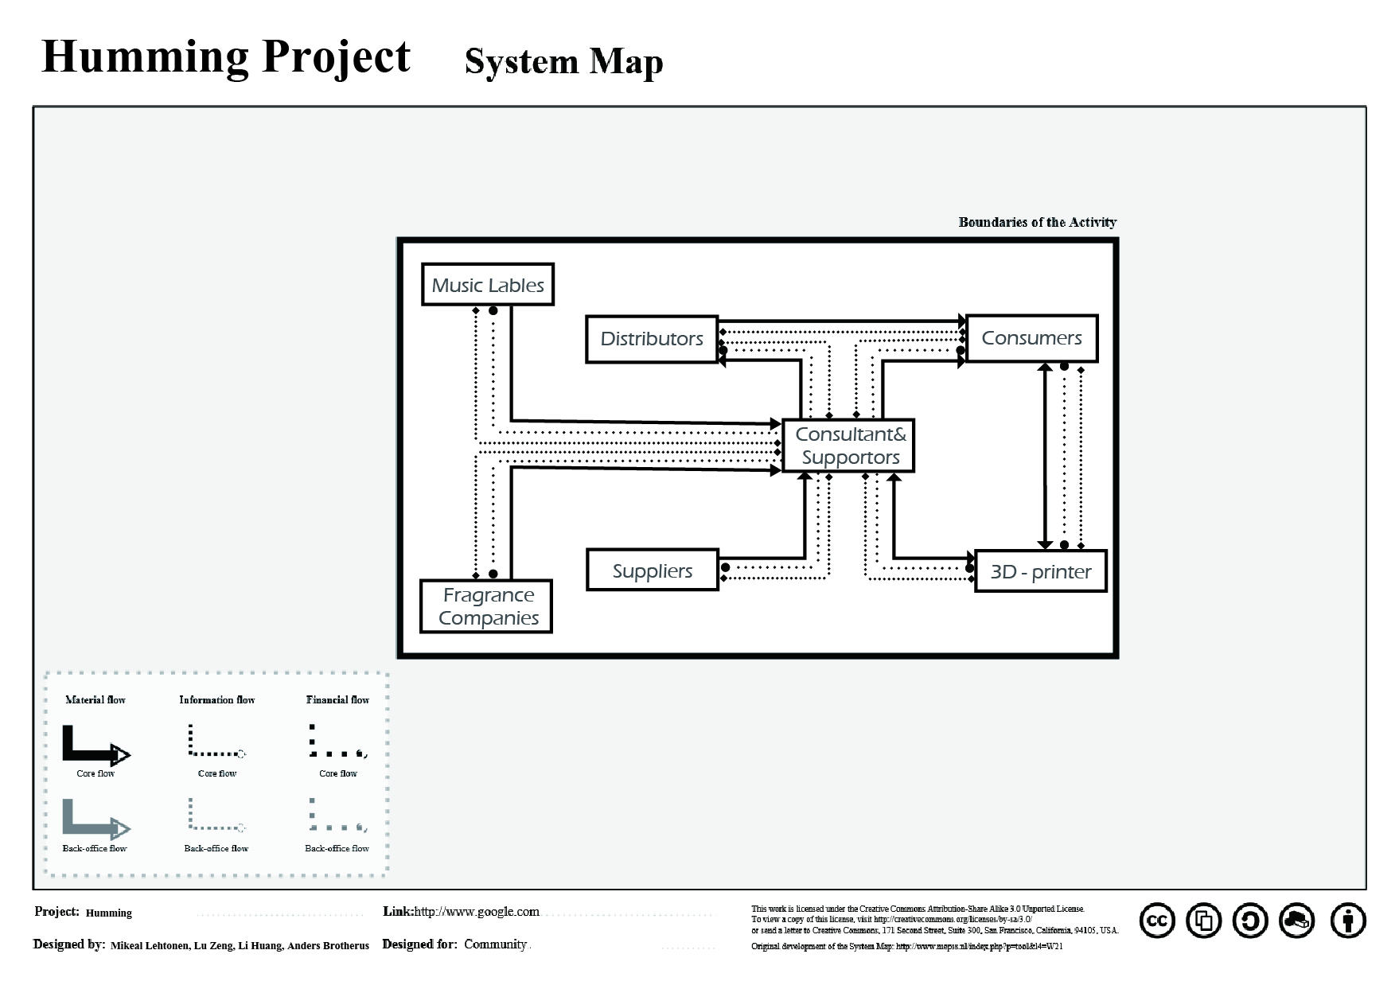

Slide 4



Slide 5


