Slide 1

DesigningOpenInnovation.01
Version Control Systems – SVN, Git and GitHub
Massimo Menichinelli massimo.menichinelli@aalto.fi
@openp2pdesign http://www.slideshare.net/openp2pdesign
11.03.2013

Slide 2
01.
Subversion – the central version control system

Slide 3
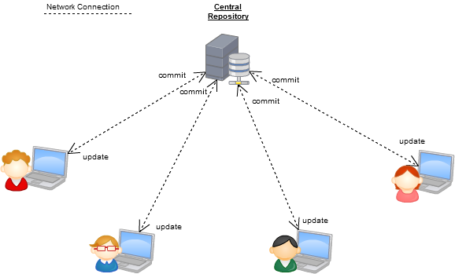
Server/client-based Version Control System
Server
Client
Client
Client
Client
The first architecture that emerged for versioning files and projects.
Source: http://www.kalekold.net/index.php?post=13

Slide 4
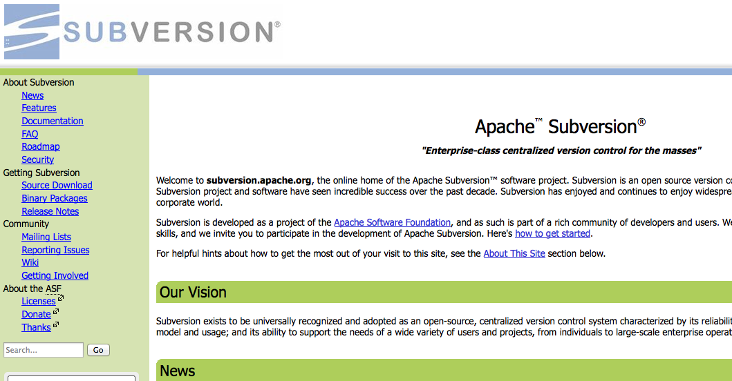
Subversion: an open Version Control System
Subversion manages files and directories, and the changes made to them, over time, like a time machine.
Source: http://subversion.apache.org/

Slide 5
Version Control System: the vocabulary (01)
* Change
A change (or diff) represents a specific modification to a document under version control.
* Checkout
A check-out (or co) is the act of creating a local working copy from the repository. A user may specify a specific revision or obtain the latest. Also refers to the same files.
* Commit
A commit (checkin, ci) is the action of writing or merging the changes made in the working copy back to the repository. Also refers to the same files.
* Head
The most recent commit.
Source: http://en.wikipedia.org/wiki/Revision_control

Slide 6
Version Control System: the vocabulary (02)
* Conflict
A conflict occurs when different parties make changes to the same document. A user must resolve the conflict by combining the changes, or by selecting one change.
* Merge
A merge or integration is an operation in which two sets of changes are applied to a file or set of files.
* Update
An update (or sync) merges changes made in the repository (by other people, for example) into the local working copy.
* Working copy
The working copy is the local copy of files from a repository, at a specific time or revision. Conceptually, it is a sandbox.
Source: http://www.time.com/time/magazine/article/0,9171,1570810,00.html

Slide 7
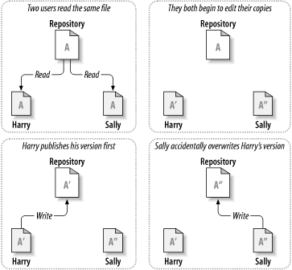
Versioning model: the problem
How will the system allow users to share information, but prevent them from accidentally overwriting?
Source: http://svnbook.red-bean.com/en/1.6/svn.basic.version-control-basics.html

Slide 8
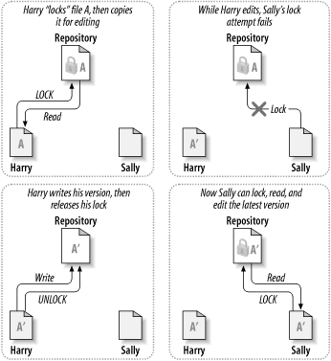
Versioning model: the lock-modify-unlock solution
In this model, the repository allows only one person to change a file at a time, by locking it.
Source: http://svnbook.red-bean.com/en/1.6/svn.basic.version-control-basics.html

Slide 9
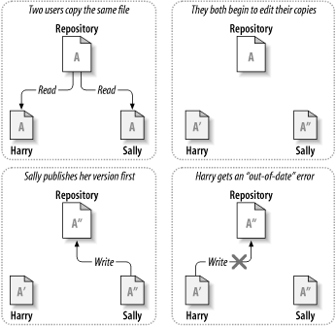
Versioning model: the copy-modify-merge solution (01)
In this model, each user's client contacts the project repository and creates a personal working copy. The private copies are merged together into a new version.
Source: http://svnbook.red-bean.com/en/1.6/svn.basic.version-control-basics.html

Slide 10
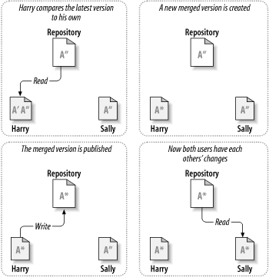
Versioning model: the copy-modify-merge solution (01)
In this model, each user's client contacts the project repository and creates a personal working copy. The private copies are merged together into a new version.
Source: http://svnbook.red-bean.com/en/1.6/svn.basic.version-control-basics.html

Slide 11
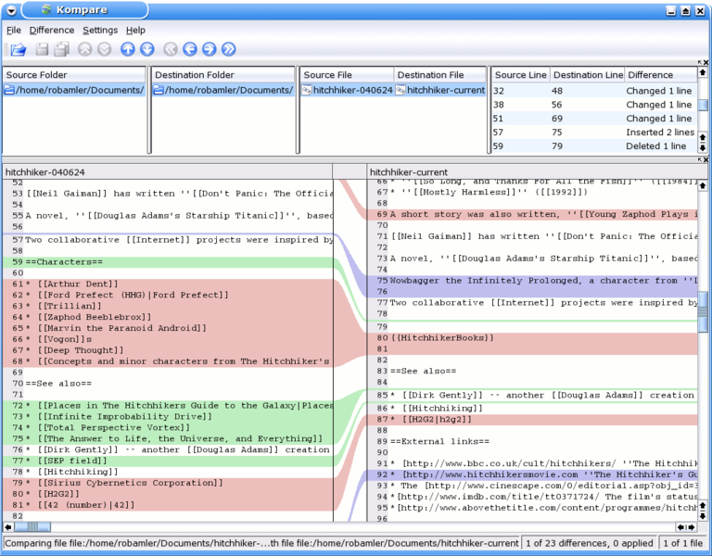
Diff: how to understand the changes
A specific software that highlight the differences and let you choose how to retain or discard them.
Source: http://en.wikipedia.org/wiki/Diff http://en.wikipedia.org/wiki/Kompare

Slide 12
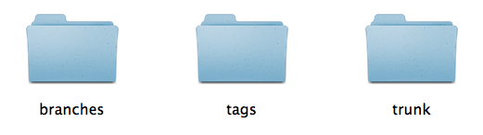
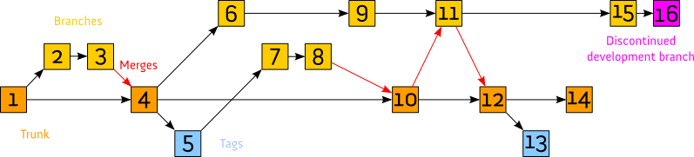
The structure of a typical Subversion project
The typical structure of the folder, and the typical workflow in Subversion.
Source: http://en.wikipedia.org/wiki/Apache_Subversion

Slide 13

A real example: a spool for the RepRap Mendel
An open source 3D printer, that has generated many more open source projects.
Source: http://reprap.org/wiki/Mendel

Slide 14
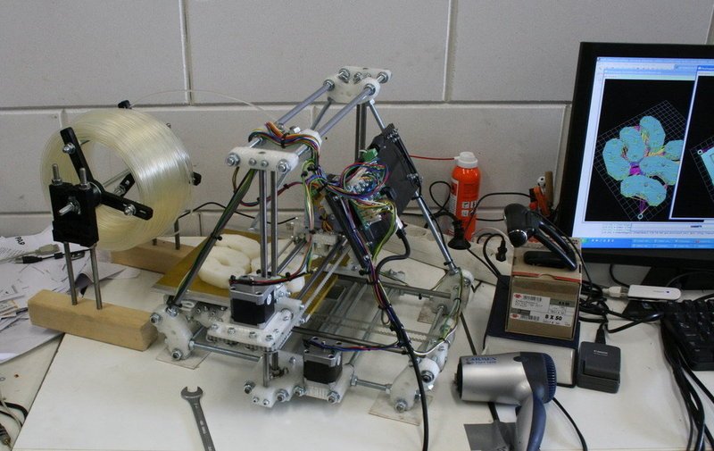
A spool for the RepRap Mendel: an improvement
A real example: a component for holding the cable for the RepRap
Source: http://www.thingiverse.com/thing:3866

Slide 15
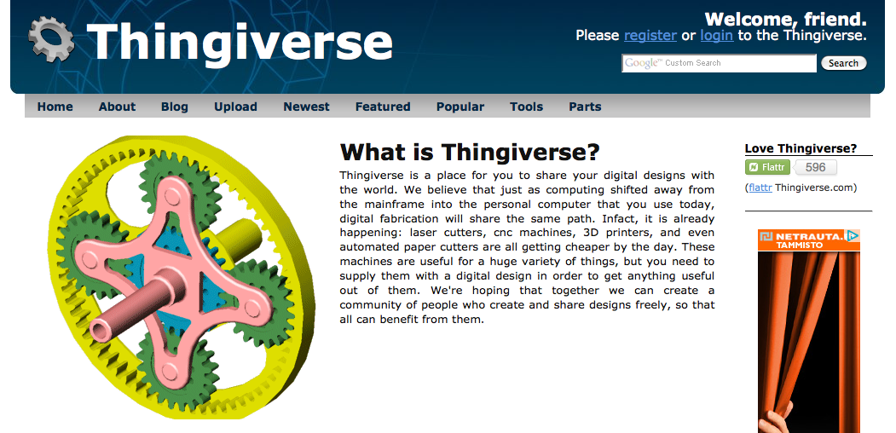
A real example, from Thingiverse
An online platform for sharing projects of physical things as Open Source.
Source: http://www.thingiverse.com/about

Slide 16
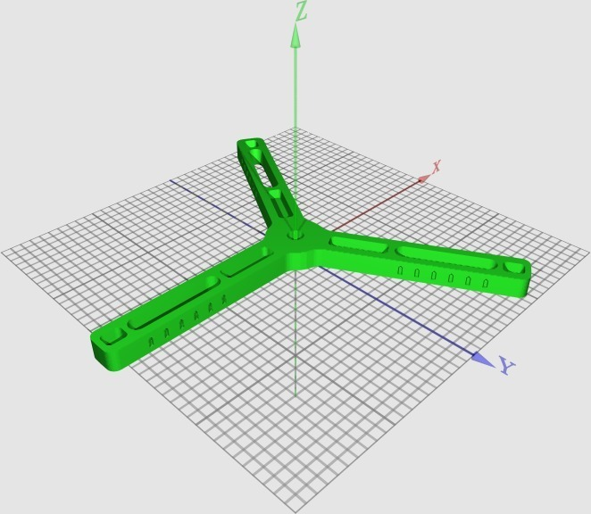
A spool for the RepRap Mendel: improvement 01
“Well i wanted to have a very simple, but bearing based spool system.” Camiel
Source: http://www.thingiverse.com/thing:3866

Slide 17
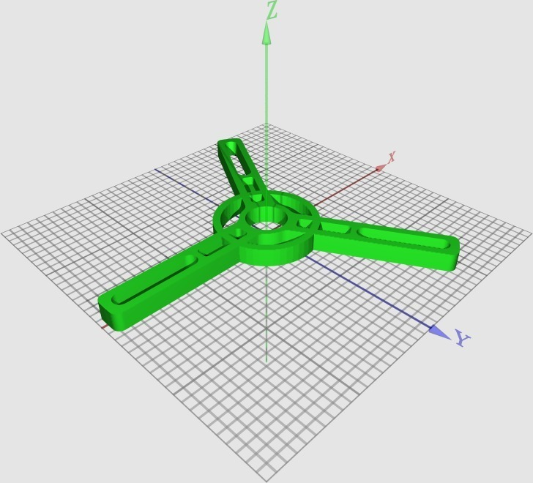
A spool for the RepRap Mendel: improvement 02
“I have changed the design to put the bearings in the spool itself. This way you can be more flexible in what you use to support the axle. ” Brokentoaster
Source: http://www.thingiverse.com/thing:3962

Slide 18
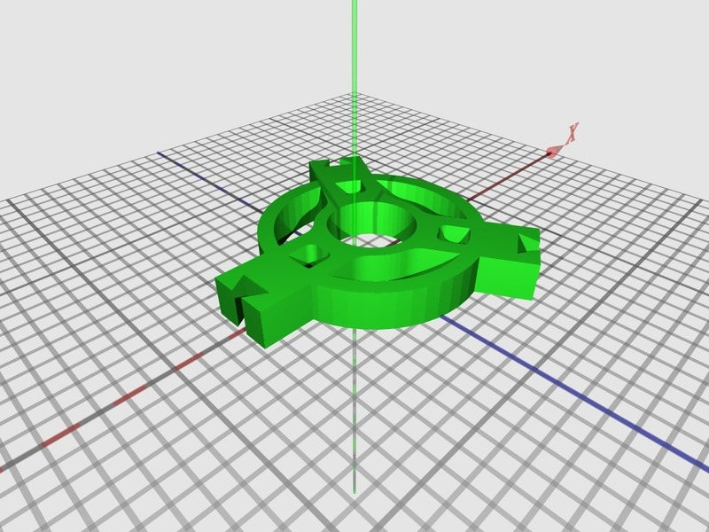
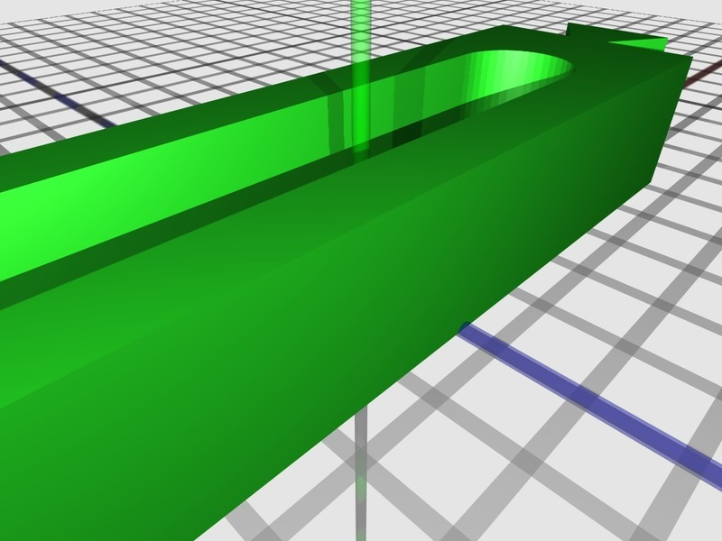
A spool for the RepRap Mendel: improvement 03
“I liked BrokenToaster's idea of a bearing-driven filament spool holder, but that version was too big to fit on a Makerbot [...] It now fits on a Makerbot print bed!!!” Randyy
Source: http://www.thingiverse.com/thing:4337

Slide 19
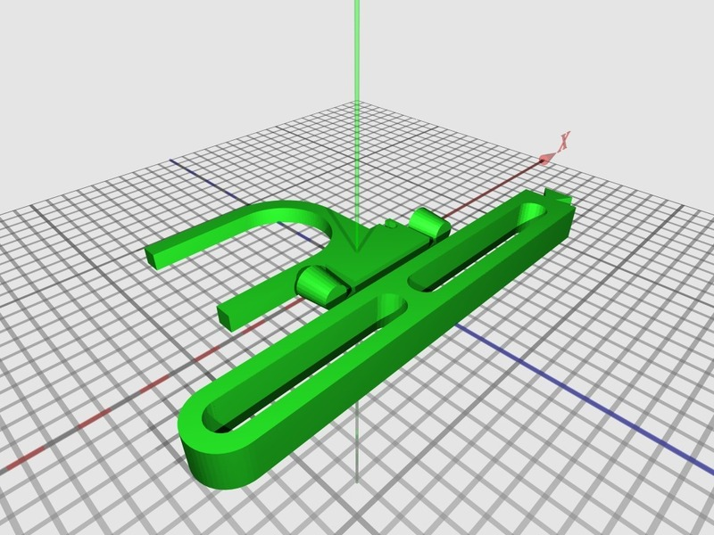
A spool for the RepRap Mendel: improvement 04
“This takes advantage of the larger print area on RepRaps by printing the arm as one piece, avoiding the need for a dovetail joint in the middle of the arm.” Fil
Source: http://www.thingiverse.com/thing:11250

Slide 20
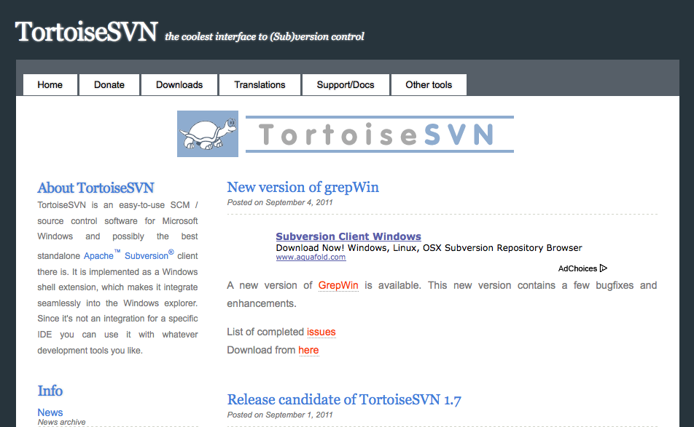
SVN Client + File comparison: TortoiseSVN (Win)
The most common Subversion client for Windows.
Source: http://tortoisesvn.net/

Slide 21
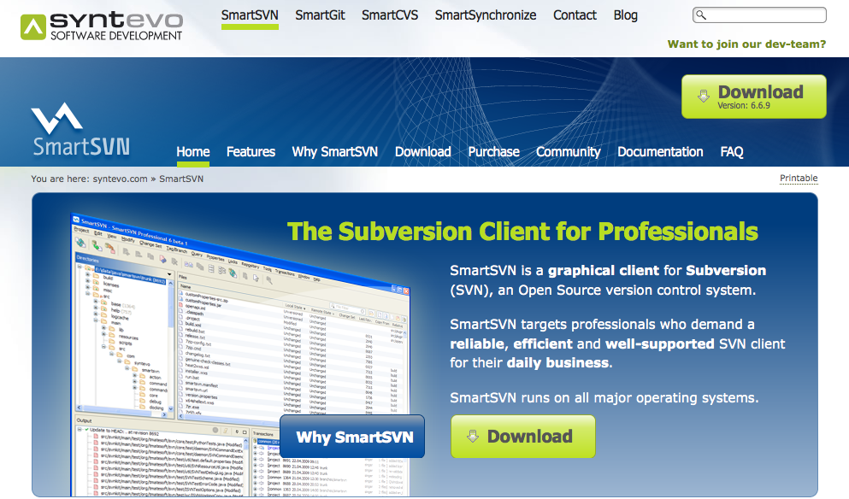
SVN Client: SmartSVN (Win, Mac, Linux)
A multiplatform and freeware Subversion client.
Source: http://www.syntevo.com/smartsvn/index.html

Slide 22
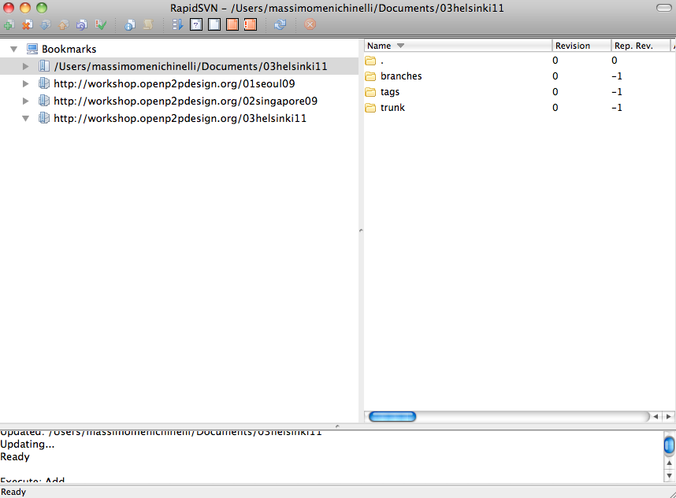
SVN Client: RapidSVN (Win, Mac, Linux)
An open source and multiplatform Subversion client.
Source: http://www.rapidsvn.org/

Slide 23
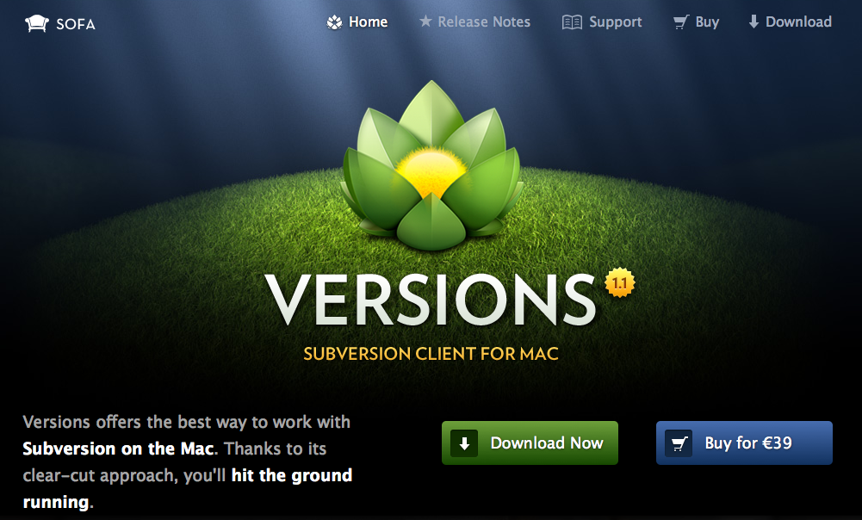
SVN Client: Versions (Mac)
A paid Subversion client with a great interface, but only for Mac.
Source: http://www.versionsapp.com/

Slide 24
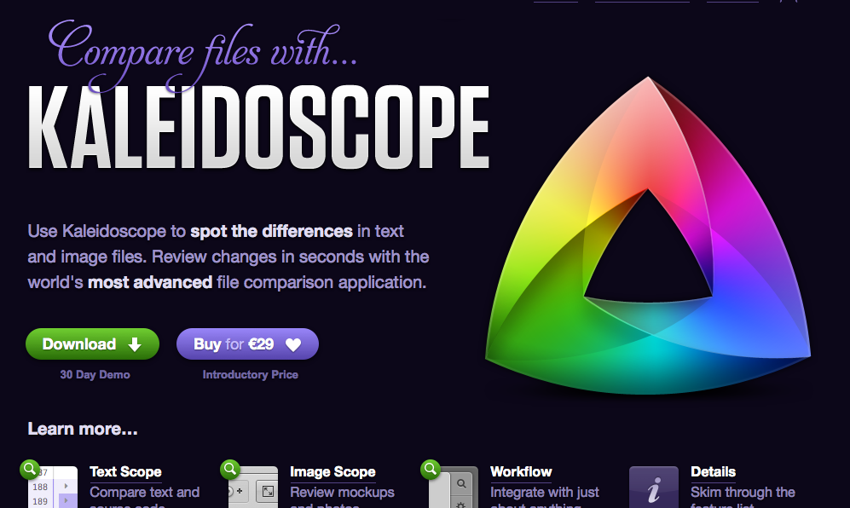
File comparison: Kaleidoscope (Mac)
From the same developers of Versions, a file and image comparison app for Mac.
Source: http://www.kaleidoscopeapp.com/

Slide 25
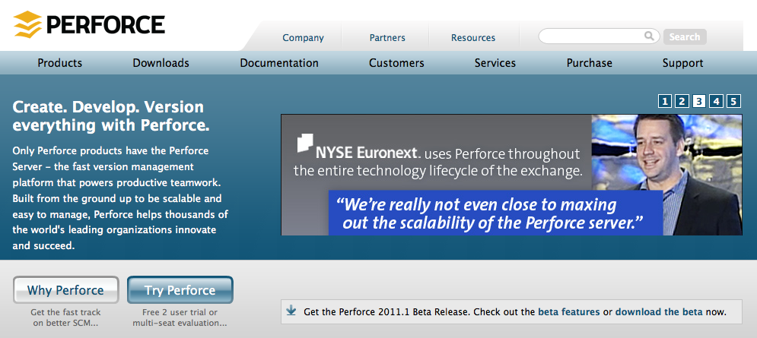
File comparison: Perforce P4Merge (Win, Mac, Linux)
A freeware and multiplatform file and image comparison app.
Source: http://www.perforce.com/product/components/perforce_visual_merge_and_diff_tools http://www.andymcintosh.com/?p=33
http://blog.richardadleta.com/2009/02/free-diff-merge-tool-p4merge.html

Slide 26
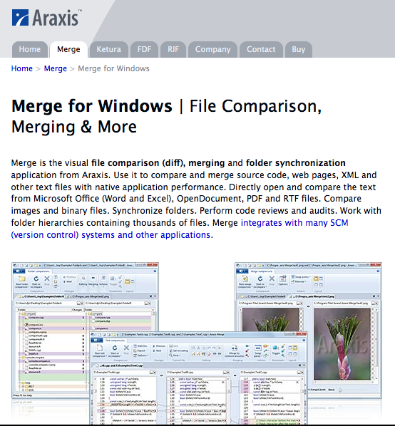
File comparison: Araxis Merge (Win)
A paid file and image comparison app for Windows.
Source: http://www.araxis.com/merge/

Slide 27
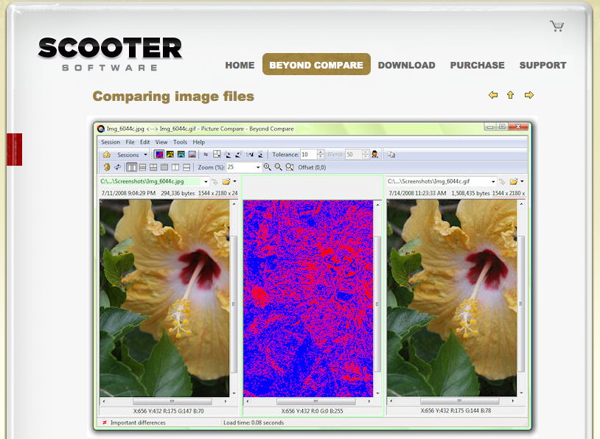
File comparison: BeyondCompare (Win, Linux)
A paid app for Linux and Windows that can compare images.
Source: http://www.scootersoftware.com/moreinfo.php?zz=screenshot&shot=PixCompare

Slide 28
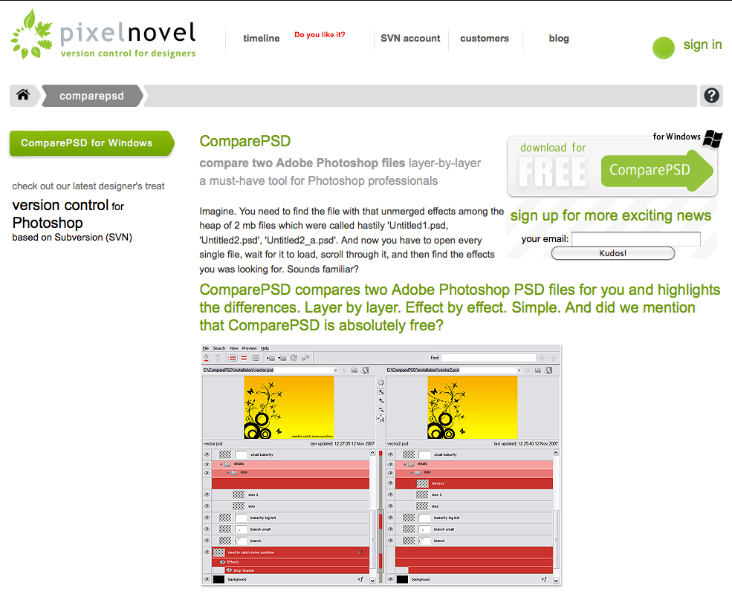
File comparison: ComparePSD (Win)
A freeware app that lets you compare Photoshop PSD files.
Source: http://pixelnovel.com/comparepsd/

Slide 29
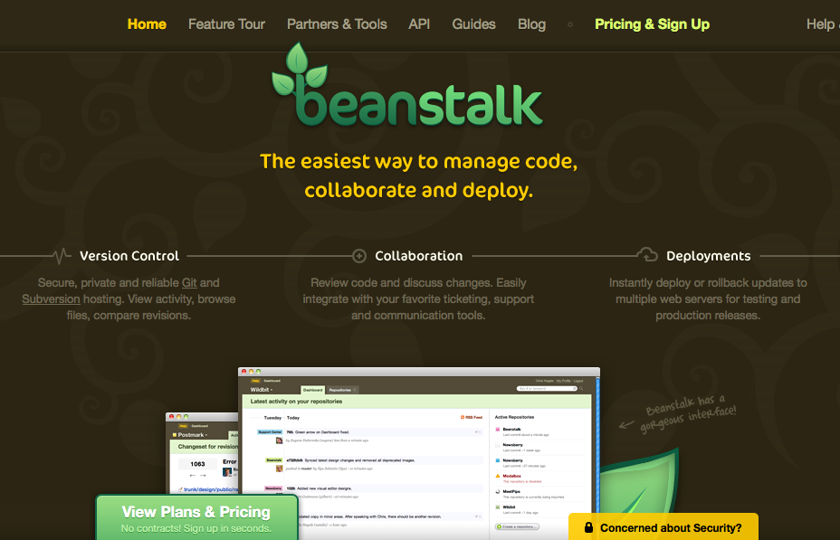
Subversion Hosting Service: Beastalk
Source: http://beanstalkapp.com/
A paid hosting service for Subversion, but also for Mercurial and Git
Source: http://beanstalkapp.com/

Slide 30
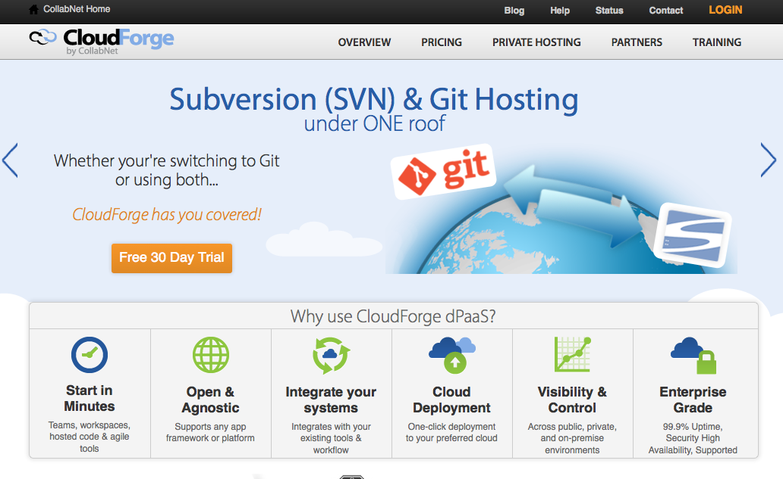
Subversion hosting service: CloudForge
Subversion and Git hosting plans.
Source: http://cloudforge.com/

Slide 31
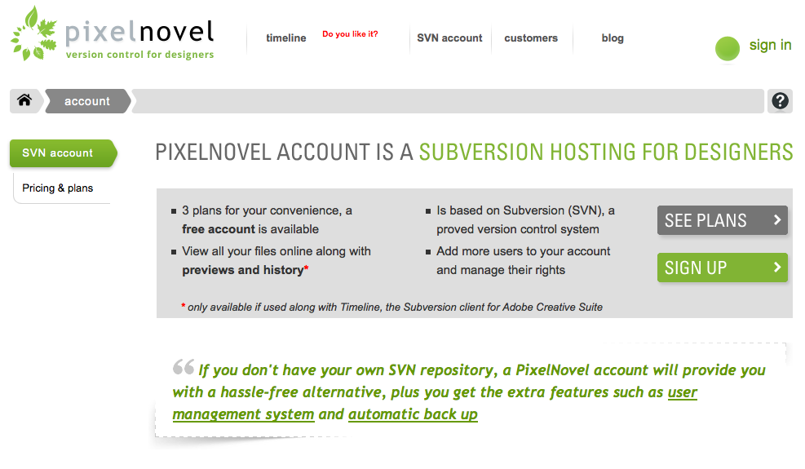
Subversion hosting service: Pixelnovel
A Subversion hosting service for designers using Adobe Photoshop
Source: http://pixelnovel.com/svn-account/

Slide 32
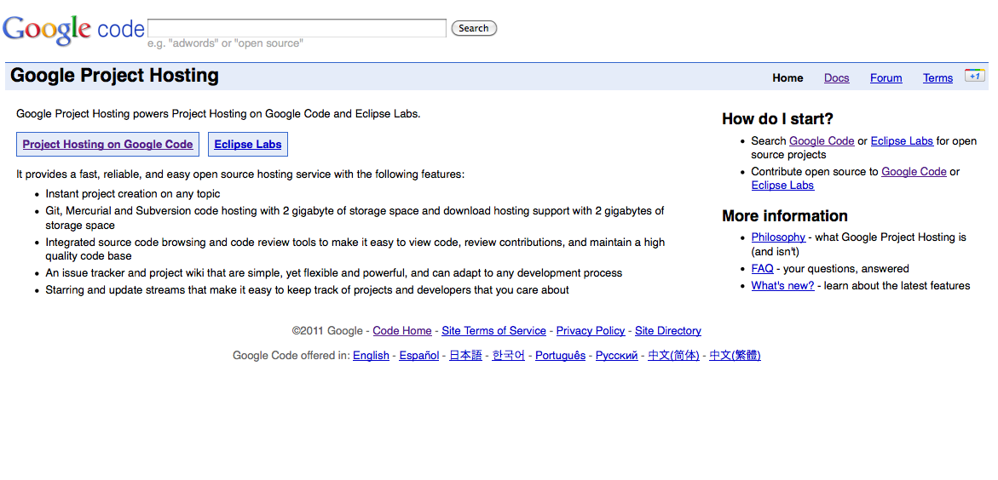
Subversion hosting service: Google Code
A free hosting with Subversion and Git for Open Source projects.
Source: http://code.google.com/projecthosting/

Slide 33
02.
Git – the distributed architectural engine

Slide 34
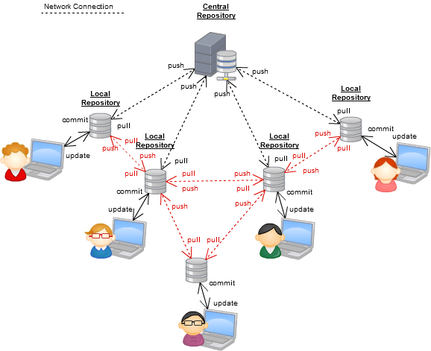
Distributed version control system
A distributed version control system: it may have a central repository but it is fully distributed.
Source: http://www.kalekold.net/index.php?post=13

Slide 35
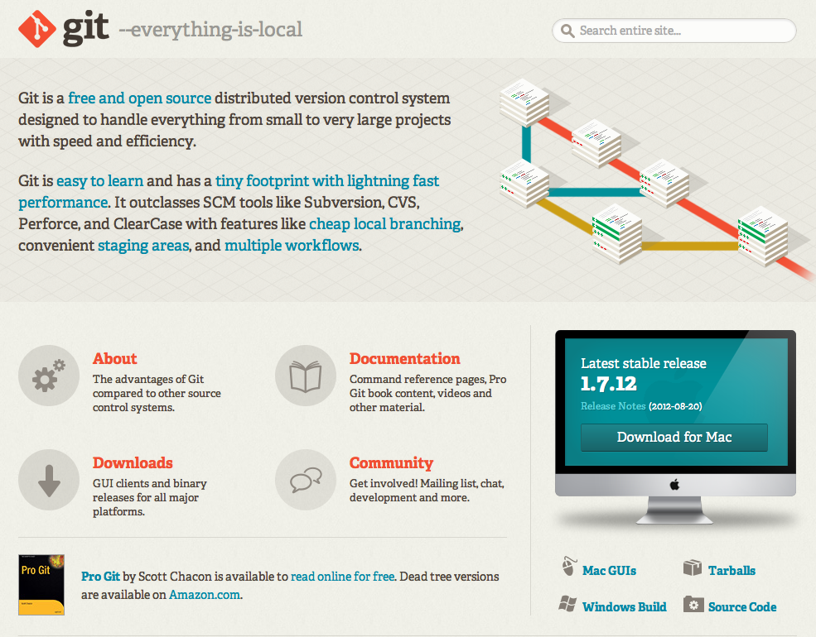
Git: a distributed version control system
Source: http://git-scm.com/

Slide 36
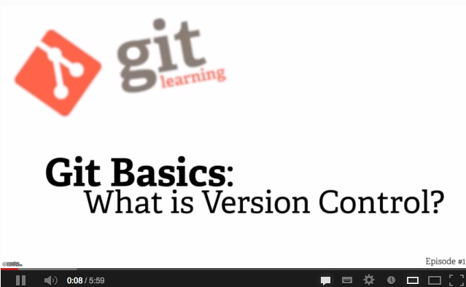
Git: a distributed version control system
Source: http://youtu.be/hKfo0OXc1BI

Slide 37
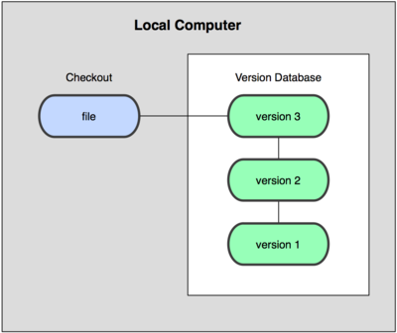
A local version control system
Source: http://git-scm.com/book/en/Getting-Started-About-Version-Control

Slide 38
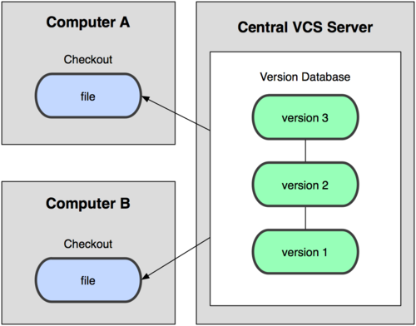
A centralized version control system
Source: http://git-scm.com/book/en/Getting-Started-About-Version-Control

Slide 39
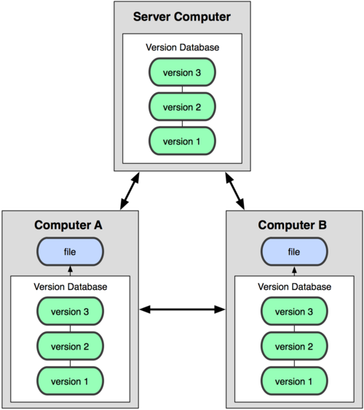
Git: a distributed version control system
Source: http://git-scm.com/book/en/Getting-Started-About-Version-Control

Slide 40
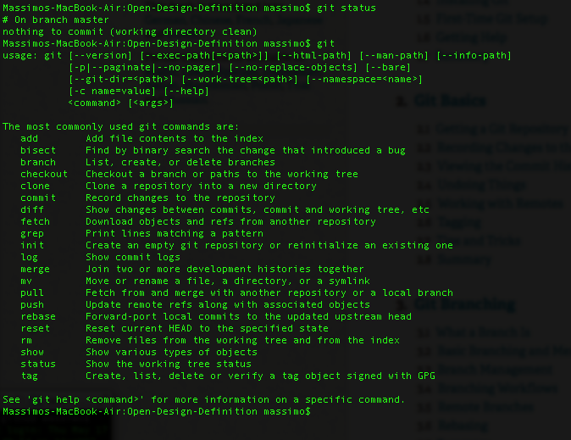
Git: a command line tool

Slide 41
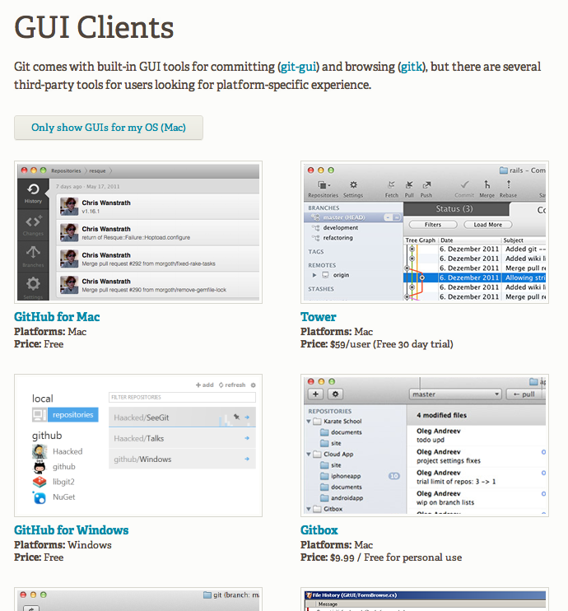
Git: GUIs also available
Source: http://git-scm.com/downloads/guis

Slide 42
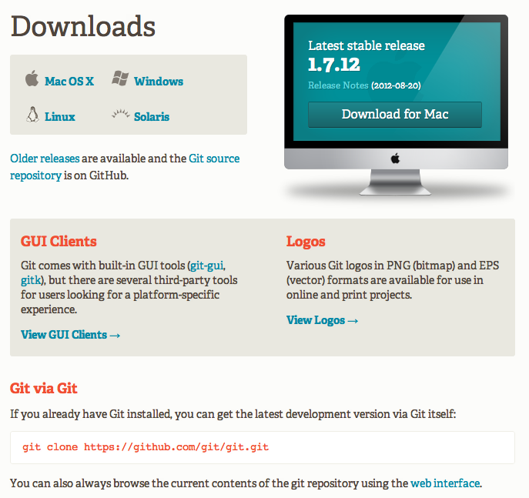
01: Download and install Git
Source: http://git-scm.com/download/

Slide 43
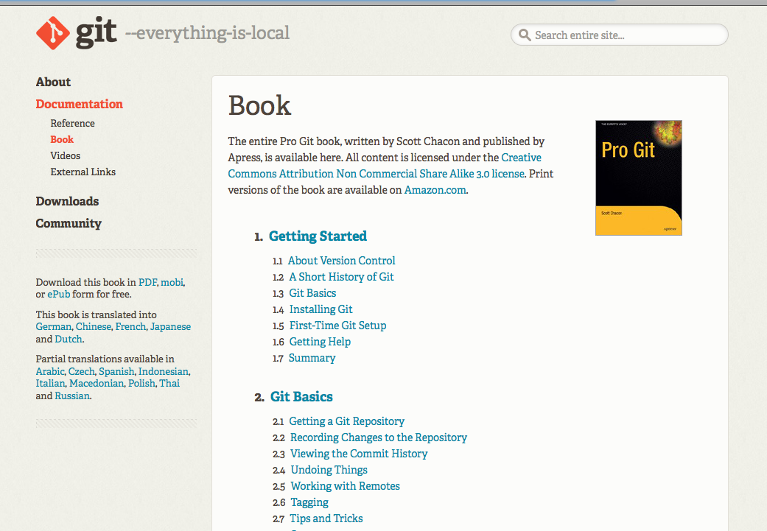
Git: a good free book
Source: http://git-scm.com/book

Slide 44
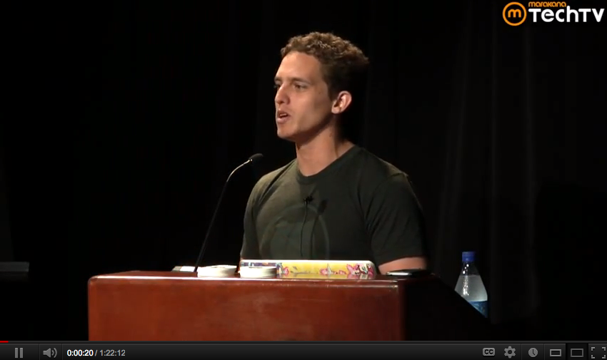
Git: a good free lecture, from the same author
Source: http://www.youtube.com/watch?v=ZDR433b0HJY

Slide 45
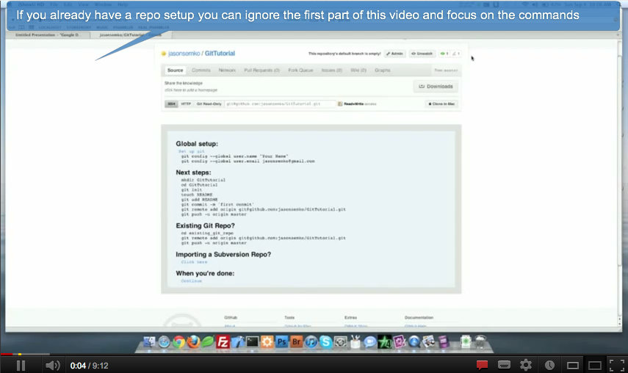
Git: good videotutorials
Source: http://youtu.be/DQUcmNO4diQ

Slide 46
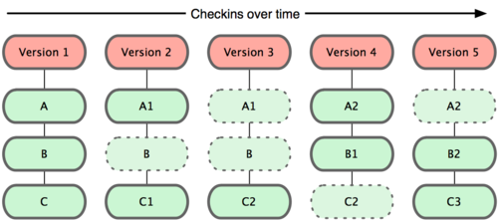
Git: history of a file system
Source: http://git-scm.com/book/en/Getting-Started-Git-Basics

Slide 47
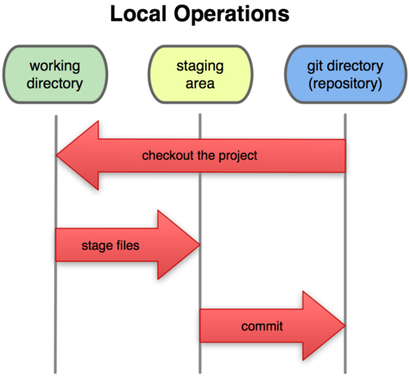
Git: architecture
Source: http://git-scm.com/book/en/Getting-Started-Git-Basics

Slide 48
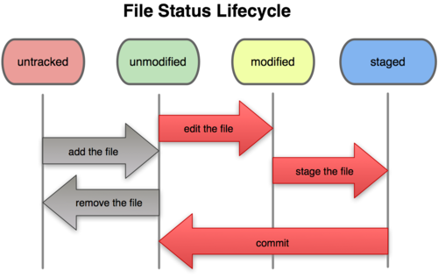
Git: history of a file
Source: http://git-scm.com/book/en/Git-Basics-Recording-Changes-to-the-Repository

Slide 49
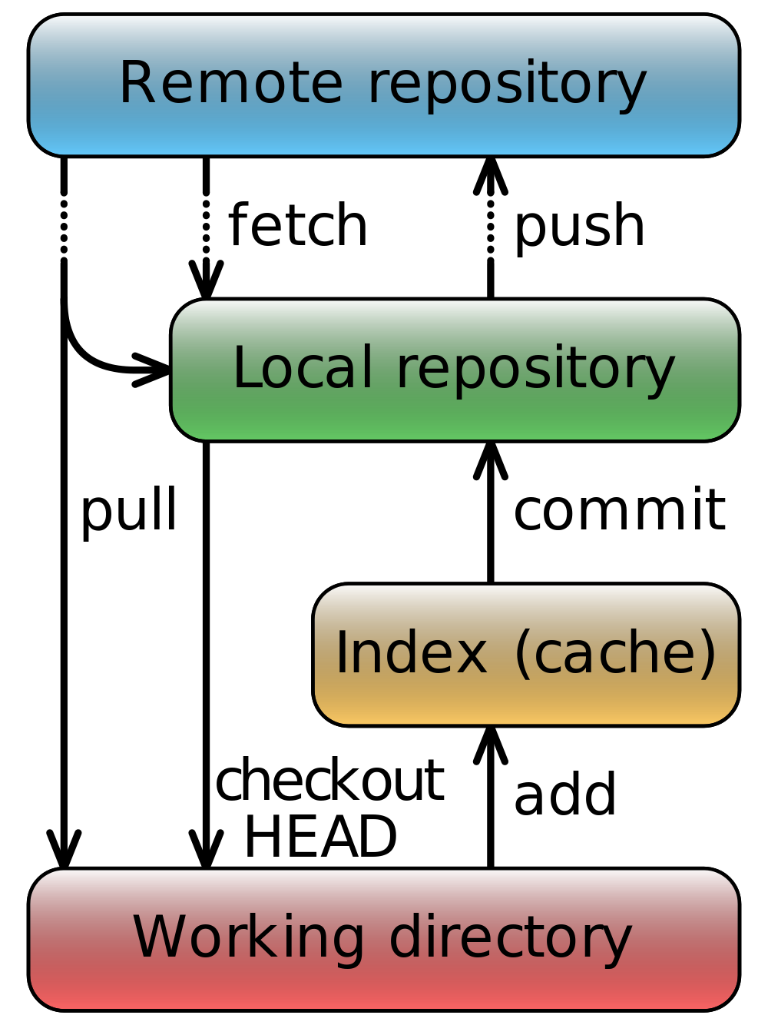
Git: commands and architecture
Source: http://en.wikipedia.org/wiki/Git_%28software%29

Slide 50
02.
GitHub – the easy online interface to a repository

Slide 51
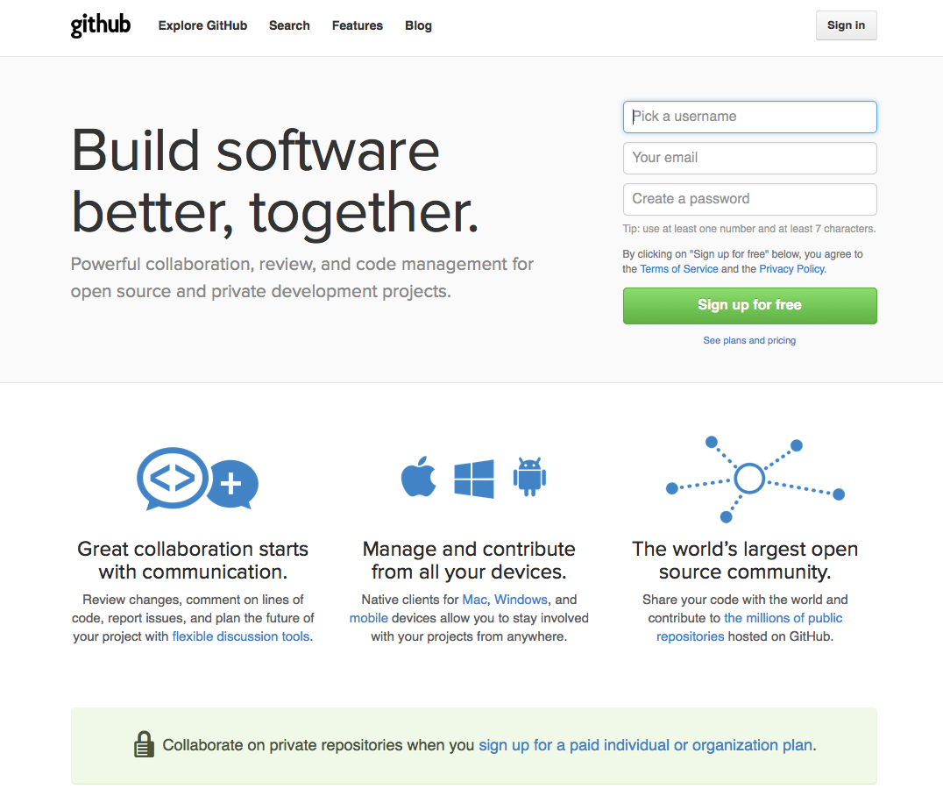
GitHub: a platform for open source
Source: https://github.com/

Slide 52
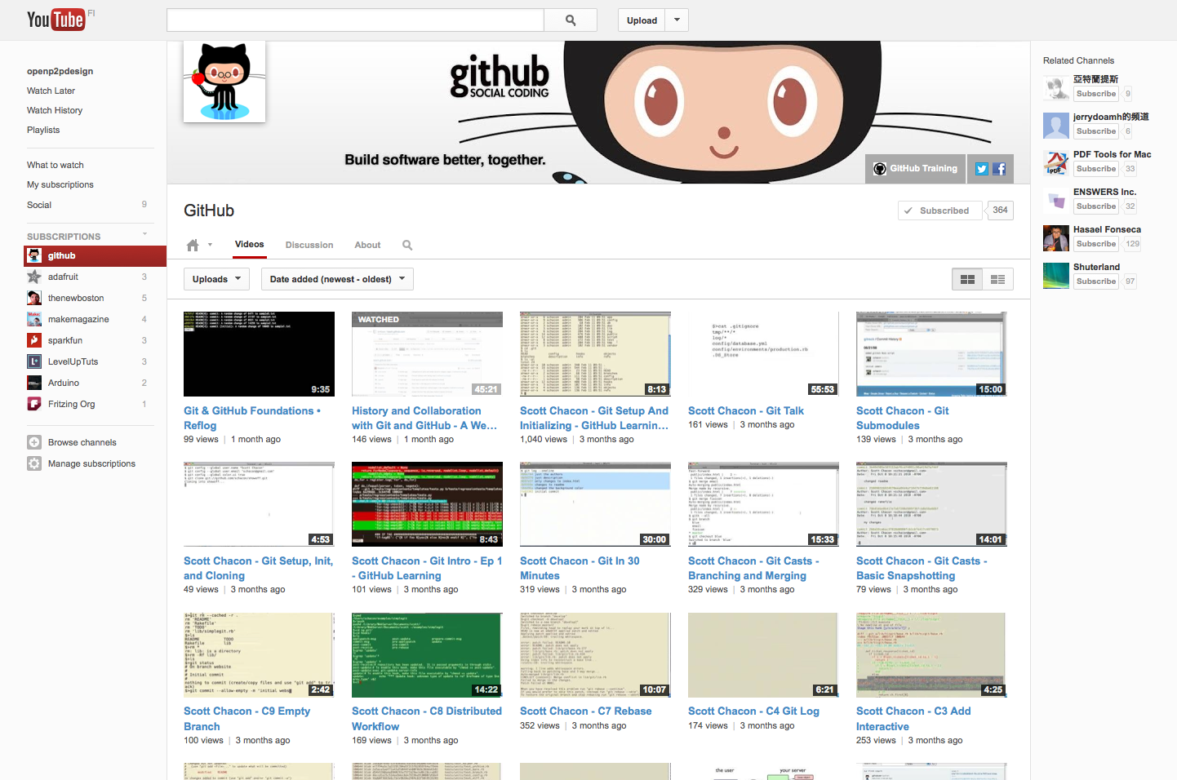
GitHub: good videotutorials
Source: http://www.youtube.com/user/github/videos?sort=dd&tag_id=&view=0

Slide 53
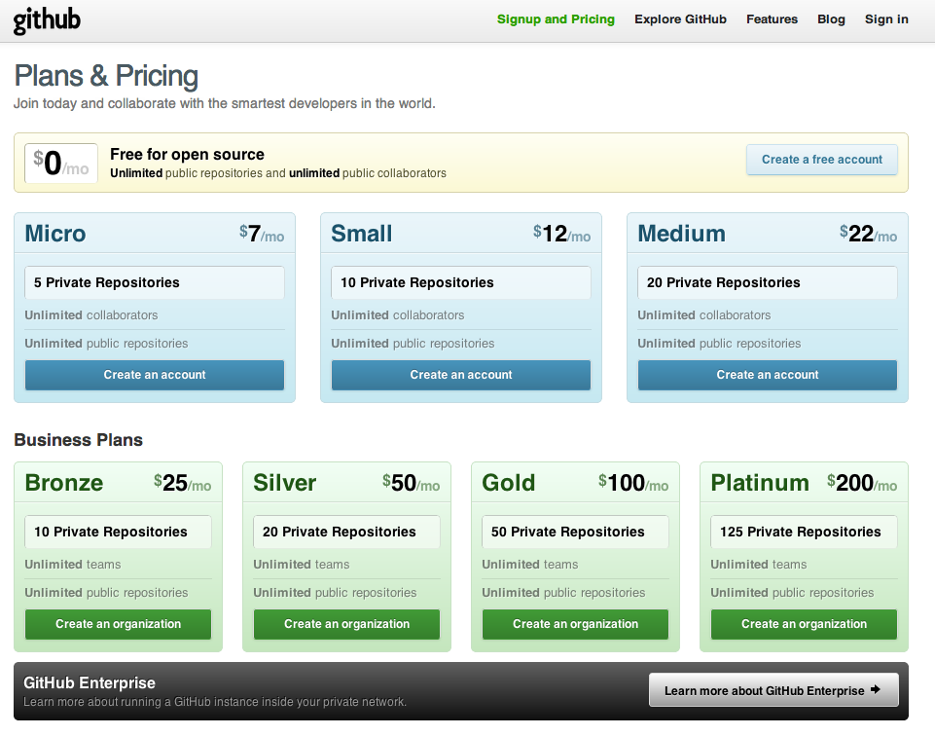
02: Create a user (free plan)
'
Source: https://github.com/plans

Slide 54
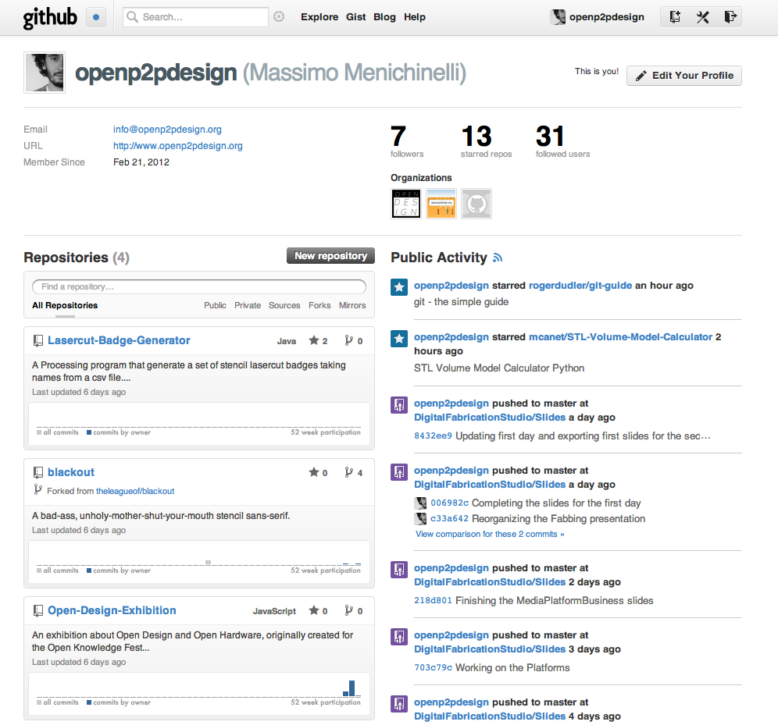
03: Send your username to massimo.menichinelli@aalto.fi
'
Source: https://github.com/plans

Slide 55
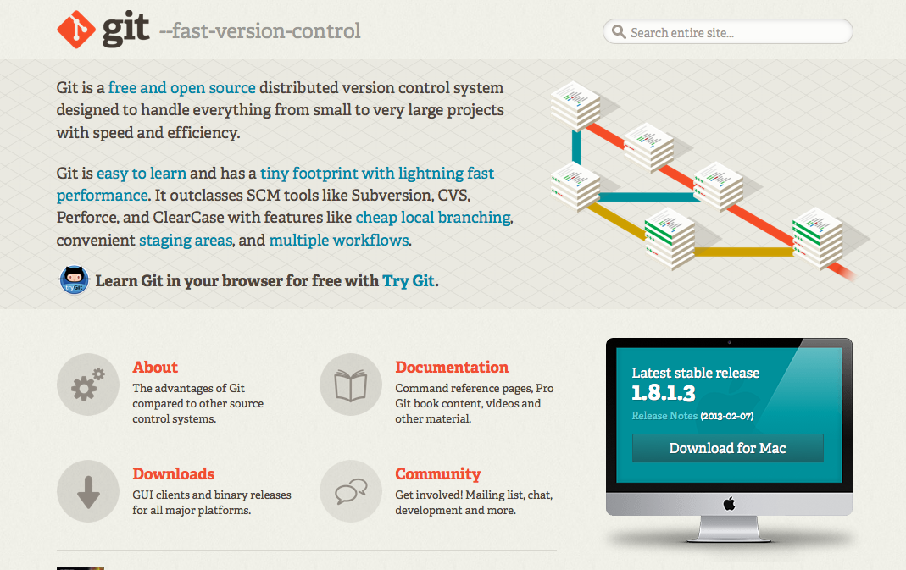
04. Download Git
Source: http://git-scm.com/

Slide 56

05. Setup Git

Slide 57

06. Download a client: an easy client for Mac
Source: http://mac.github.com/

Slide 58

06. Download a client: an easy client for Windows
Source: http://windows.github.com/

Slide 59

06. Download a client: an easy client for Eclipse
Source: http://eclipse.github.com/

Slide 60

Aptana: my suggestion for Eclipse
Source: http://www.aptana.com/

Slide 61

06. Download a client: SourceTree
Source: http://www.sourcetreeapp.com/

Slide 62

06. Download a client: GitX(L)
Source: http://gitx.laullon.com/

Slide 63

Git, a simple guide...
Source: http://rogerdudler.github.com/git-guide/

Slide 64

On GitHub itself ;)
Source: https://github.com/rogerdudler/git-guide

Slide 65

07. Learn Markdown
Source: http://daringfireball.net/projects/markdown/syntax
http://en.wikipedia.org/wiki/Markdown

Slide 66

07. Learn GitHub Markdown
Source: http://github.github.com/github-flavored-markdown/

Slide 67

07. Learn GitHub Markdown
Source: http://github.github.com/github-flavored-markdown/

Slide 68

07a. Convert text to Markdown
Source: http://johnmacfarlane.net/pandoc/try

Slide 69

07a. Convert text to Markdown
Source: http://milianw.de/projects/markdownify/demo.php

Slide 70
03.
Exercise:
Create a repository, create your bio with your picture inside it. Try it with Git and with the GitHub client.

Slide 71
04.
Exercise:
Create a branch, add a picture to your bio. Merge the branch with the master.

Slide 72
Thank you!!
Massimo Menichinelli massimo.menichinelli@aalto.fi
@openp2pdesign http://www.slideshare.net/openp2pdesign
11.03.2013

