Slide 1

DesigningOpenInnovation.00
Course organization
Massimo Menichinelli massimo.menichinelli@aalto.fi
@openp2pdesign http://www.slideshare.net/openp2pdesign
11.03.2013

Slide 2
00.
Course Organization

Slide 3
Course structure
11/3 – 15/3: Massimo Menichinelli:
Designing Open Source initiatives: Open Design
18/3 – 22/3 + 25/3 – 28/3: Elina Hiltunen
Designing Business Initiatives and Scenarios

Slide 4
Course Structure: First week
11/3/2013 9:00 - 12:00: Open Source and Open Innovation
11/3/2013 13:00 - 15:00: From Web 2.0 to Open Design
11/3/2013 15:00 - 17:00: Version Control Systems
12/3/2013 9:00 - 12:00: Metadesign
12/3/2013 13:00 - 17:00: Project development: Process design and Community Analysis
13/3/2013 9:00 - 12:00: Intellectual Property
13/3/2013 13:00 - 17:00: Project development: Activity design, System Map, Storyboard
14/3/2013 9:00 - 12:00: Business for Open Projects
14/3/2013 13:00 - 17:00: Project development: Business model
15/3/2013 9:00 - 12:00: Project development: Open Design proposal
15/3/2013 13:00 - 17:00: Final presentation

Slide 5
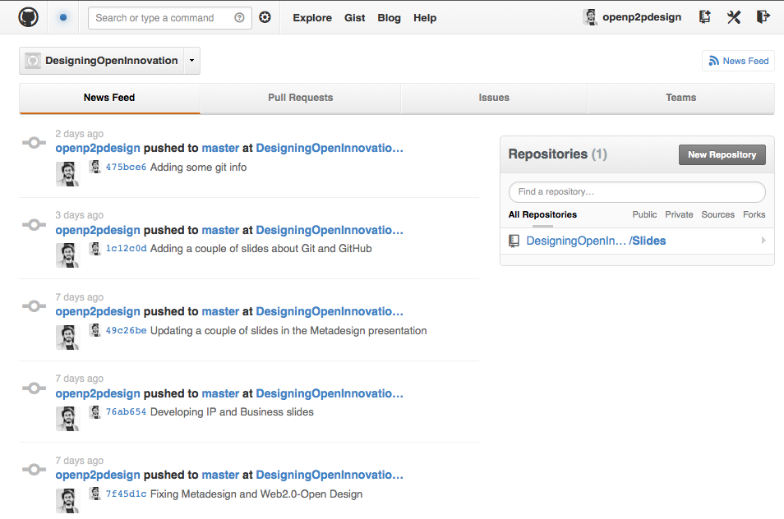
Online platform: GitHub
A platform for developing Open Source projects.
Source: https://github.com/organizations/DesigningOpenInnovation

Slide 6
Evaluation
11 groups with 4 students each:
* I will evaluate your activity in your project (repository)
* I will evaluate your activity in helping other projects
Every change and modification has to be documented on GitHub

Slide 7
Thank you!!
Massimo Menichinelli massimo.menichinelli@aalto.fi
@openp2pdesign http://www.slideshare.net/openp2pdesign
11.03.2013

