Slide 1

DesigningOpenInnovation.02
From Web 2.0 to Open Design
Massimo Menichinelli massimo.menichinelli@aalto.fi
@openp2pdesign http://www.slideshare.net/openp2pdesign
11.03.2013

Slide 2
01.
From Web 2.0 to Open Everything: mass collaboration enabled by the Internet and other tools

Slide 3
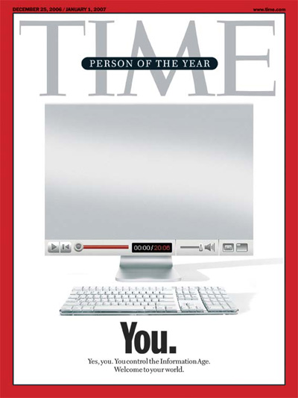
Web 2.0
A new model of mass collaboration, based on user-generated content and commenting.
Source: http://www.time.com/time/magazine/article/0,9171,1570810,00.html

Slide 4
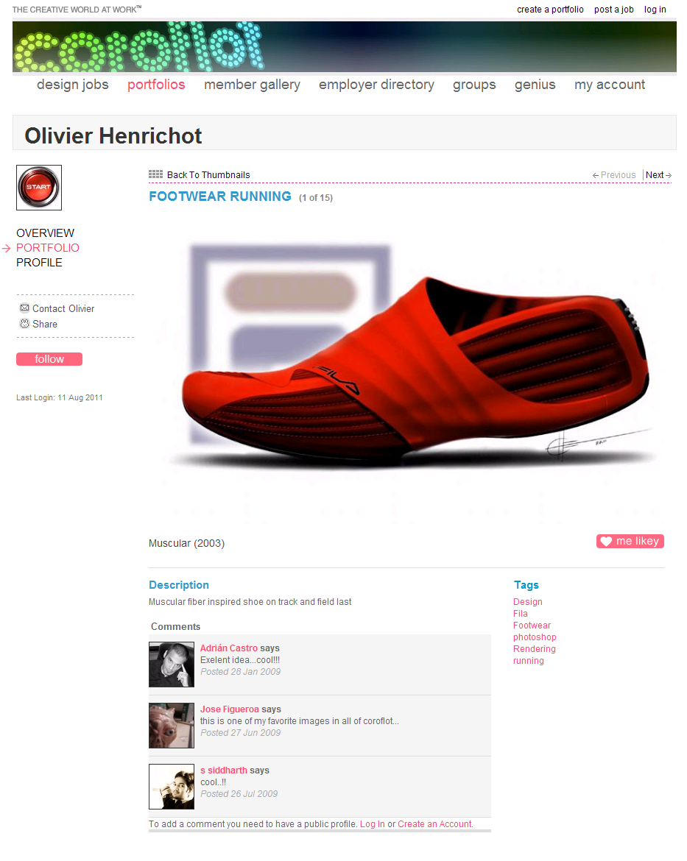
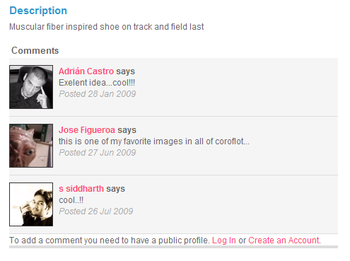
Web 2.0
And the same model can be applied to Design.
Source: http://www.coroflot.com/heo/FOOTWEAR-RUNNING/1

Slide 5
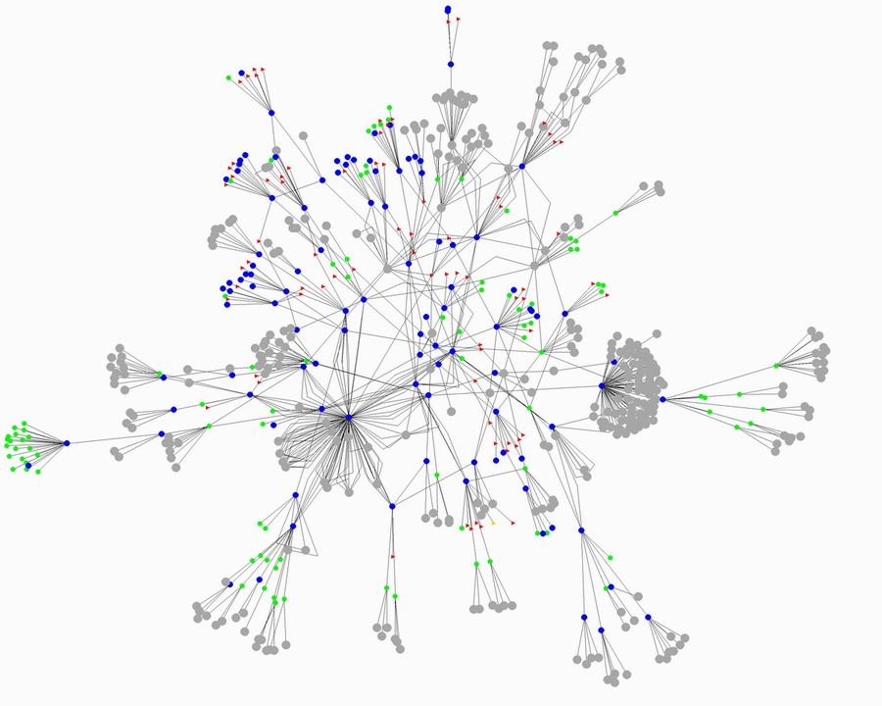
Peer-to-Peer
More than about file sharing, peer-to-peer defines new dynamics between people.
Source: http://home.comcast.net/~gregory.bray/

Slide 6
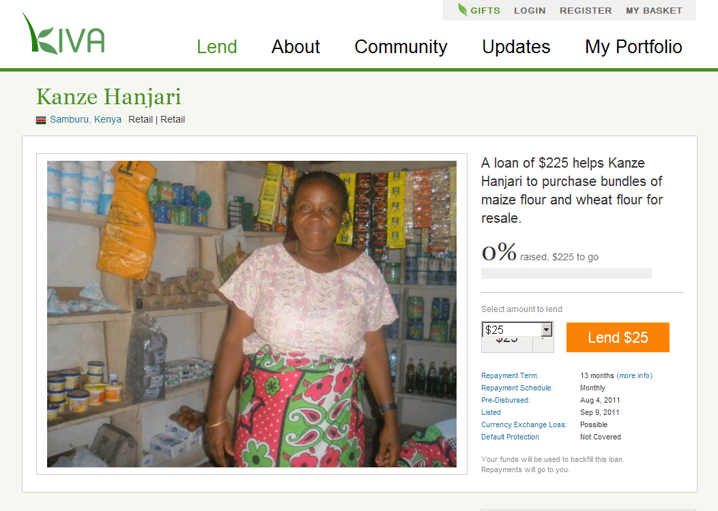
Peer-to-Peer
And the same model can be applied to Design.
Source: http://www.kiva.org/lend/333427

Slide 7
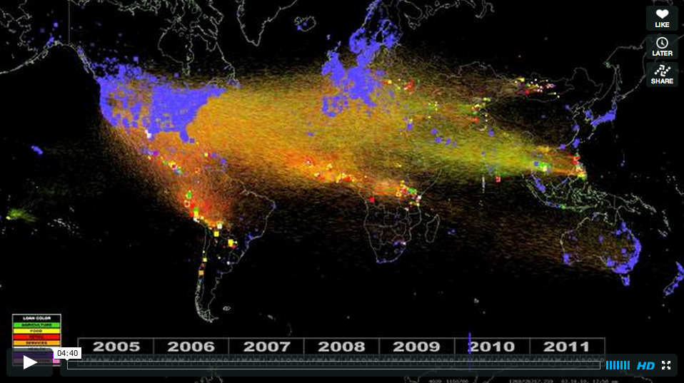
Peer-to-Peer
And the same model can be applied to Design, with important results!
Source: http://vimeo.com/28413747

Slide 8
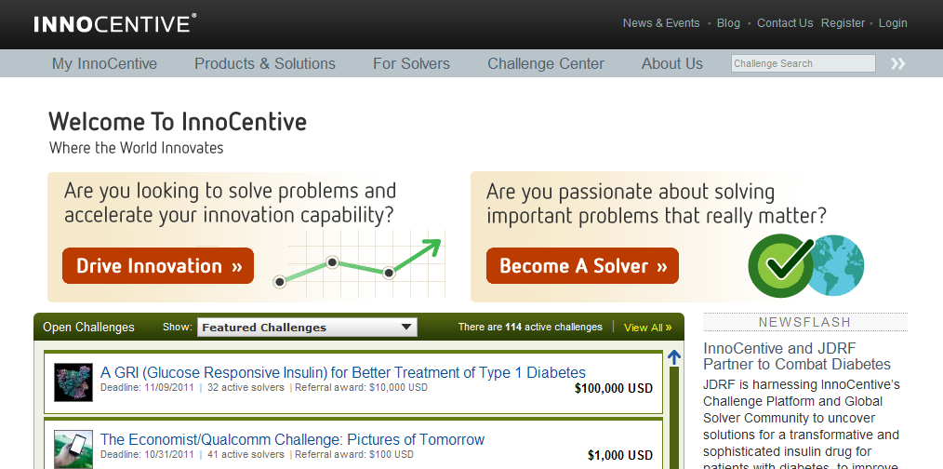
Crowdsourcing
Outsourcing a project or a task to an online crowd, more about competition than collaboration.
Source: http://www.innocentive.com/

Slide 9
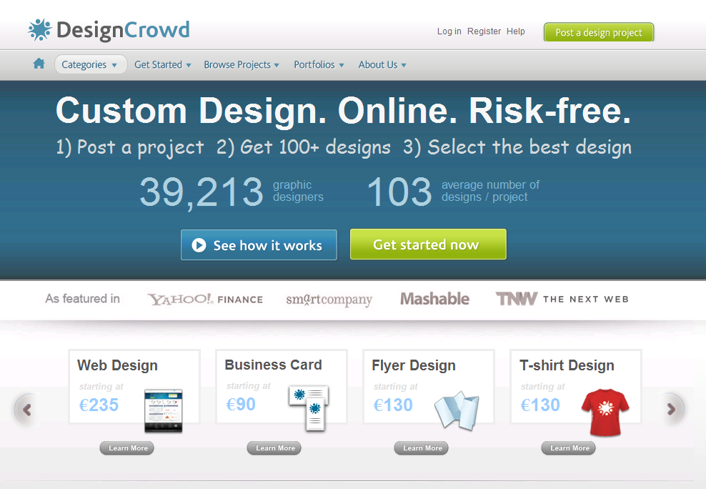
Crowdsourcing
And the same model can be applied to Design, with critica results!!
Source: http://www.designcrowd.com/

Slide 10
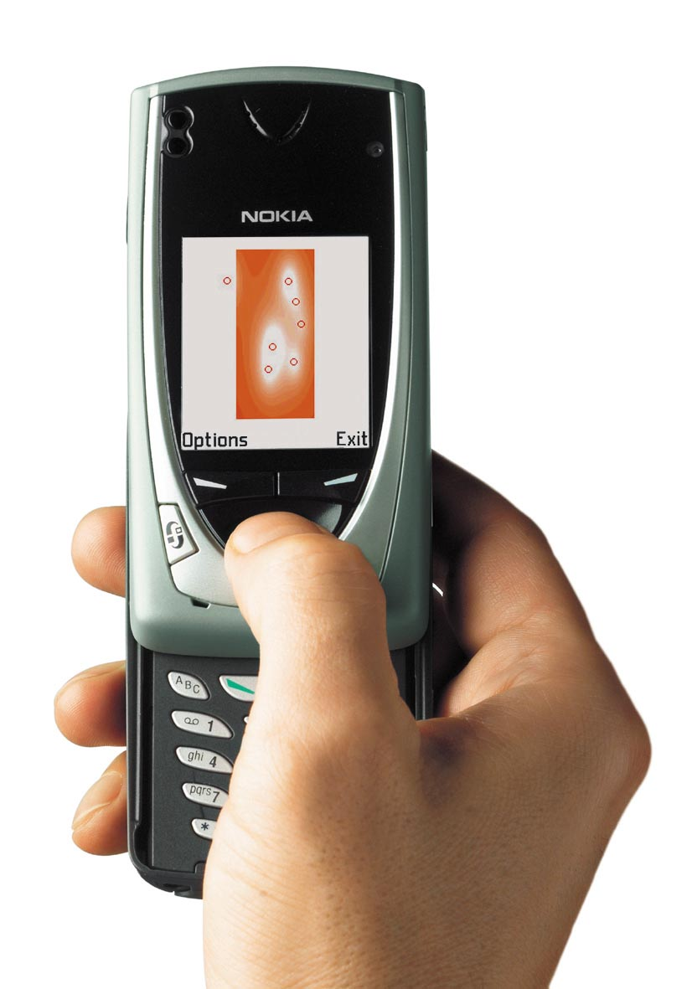
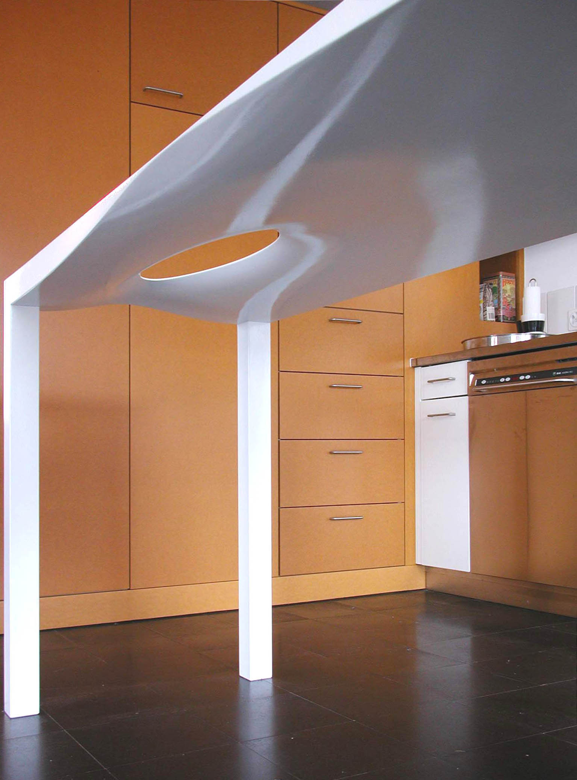
Mobile: Single user designing, no collaboration
Collaboration is not only based on a single tool: not only on a PC!
Source: http://www.mshape.com/

Slide 11
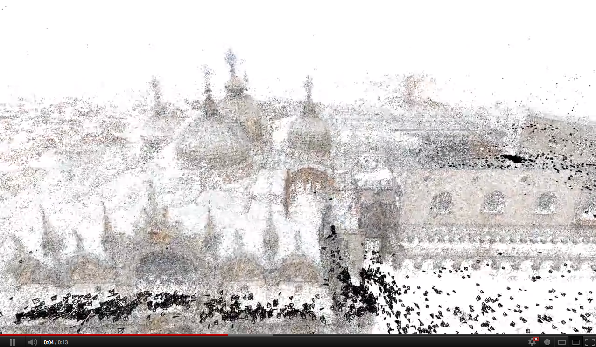
Mobile: Smart Mobs, Ubiquitous Computing
We could even (re)build a design from noncoordinated users.
Source: http://grail.cs.washington.edu/rome/ http://youtu.be/HrgHFDPJHXo

Slide 12
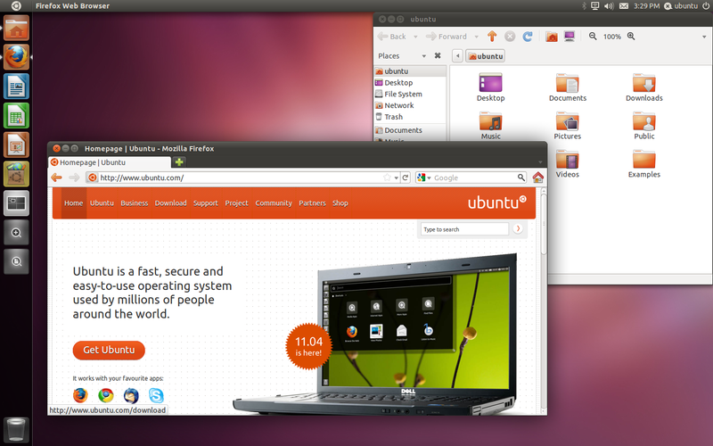
Open Source: open collaborative development
Source: http://en.wikipedia.org/wiki/Ubuntu_%28operating_system%29
The most complete and promising model for mass-collaboration on the Internet.
Source: http://www.buglabs.net/ford-buglabs

Slide 13
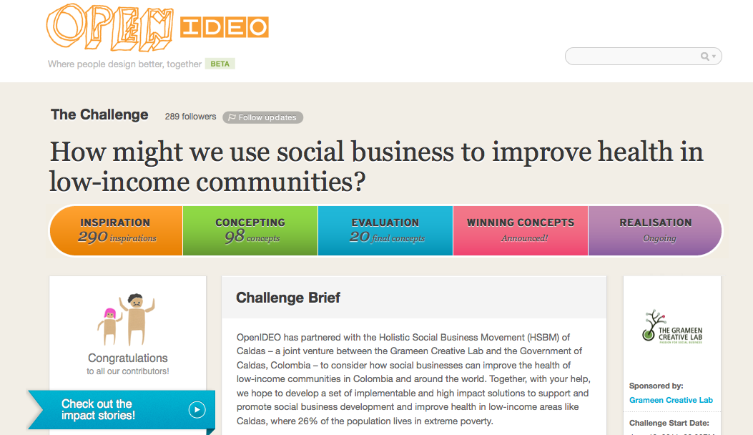
And hybrid models... like OpenIDEO
Crowdsourcing 50% + Web 2.0 30% + Open Source 20%.
Source: http://www.openideo.com/

Slide 14
Open Source Everywhere...
“Software is just the beginning … open source is doing for mass innovation what the assembly line did for mass production. Get ready for the era when collaboration replaces the corporation.”
Thomas Goetz, Wired November 2003
Source: http://www.wired.com/wired/archive/11.11/opensource.html
Open Source as promising way to organise communities.
Source: http://www.buglabs.net/ford-buglabs

Slide 15
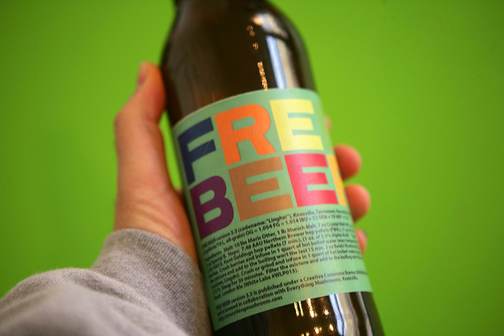
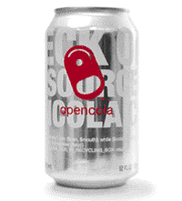
Open Drinks
Started as an example or for marketing, now an important field of experimentation!
Source: http://en.wikipedia.org/wiki/OpenCola_(drink) http://en.wikipedia.org/wiki/Free_Beer
http://www.flickr.com/photos/16038409@N02/2327138220/in/photostream

Slide 16
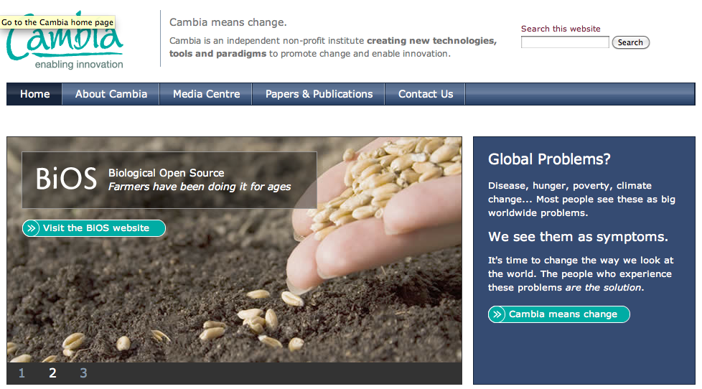
Open Biotechnology
Applied in many different scientific researches.
Source: http://www.cambia.org/

Slide 17



Open Movies + Videogames
Done with and for Blender (Open Source 3D modeling software).
Source: http://www.elephantsdream.org/ http://www.bigbuckbunny.org/ http://www.sintel.org/

Slide 18
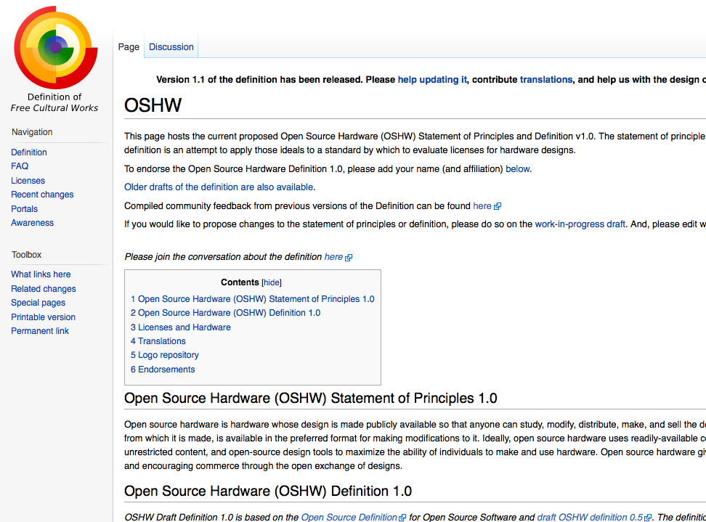
Open Hardware: the definition
Even hardware and especially electronics can be open source, and there is already an official definition.
Source: http://freedomdefined.org/OSHW

Slide 19

Open Hardware: the logo
… and an official logo, reminding the Open Source one.
Source: http://oshwlogo.com/

Slide 20

Open Hardware: Arduino
The most popular open hardware board for developing interaction design projects in an easy way.
Source: http://arduino.cc/

Slide 21
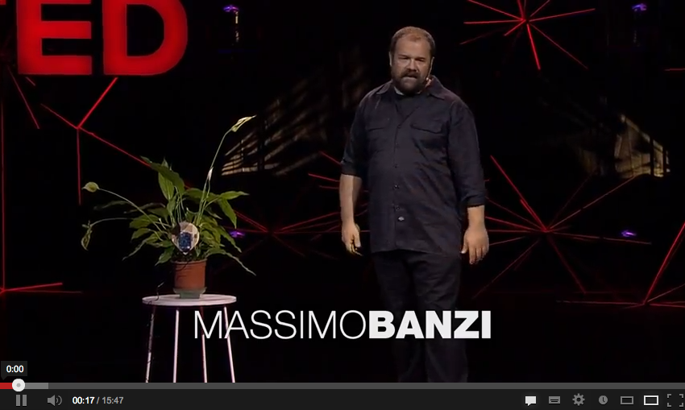
Open Hardware: Arduino
The most popular open hardware board for developing interaction design projects in an easy way.
Source: http://youtu.be/UoBUXOOdLXY

Slide 22
02.
Open Design: mass collaboration in the design field

Slide 23
What is Open Design? A generic definition
a project published with a license that facilitates its sharing and that can be “compiled” or “manufactured” locally.
* sharing
* collaboration
* open licenses
* code --> artifact
Open Design refers to every kind of design projects that can be shared in a digital format over a network.

Slide 24
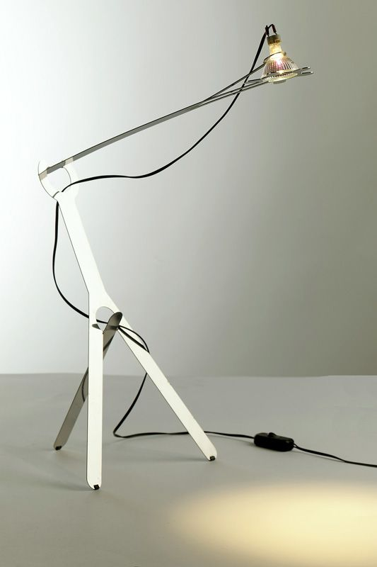
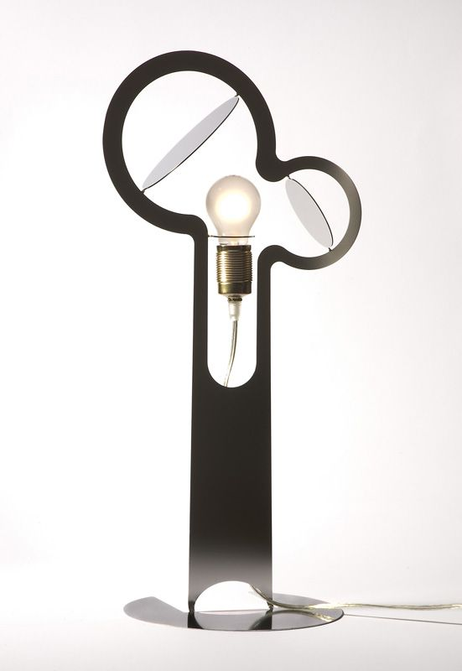
Open Product Design
Ronen Kadushin: the first author designer to embrace Open Design.
Source: http://www.ronen-kadushin.com/index.php/open-design/

Slide 25
Open Typography
ABCDEFGHIJKLMNOPQRSTUVWXYZ
abcdefghijklmnopqrstuvwxyz
ÈÉÊËĒĔĖĘĚȄȨȆḔḖḘḚḜẸẺẼỀẾỂỄỆ
èéêěèéêëēĕėęěȅȩȇḕḕḗḗḙḛḝẹẻẽềếểễềếểễ
o̊őo̍o̖o̗o̘o̙o̜o̹o̝o̞o̟o̠ọoooo̧ǫo̩o̪o̫o̬oo̯oo̱o̼o̒o
“‹«.:?!©*¶§&/(‖)[¦]{|}€†‡@®™¿¡;,»›”
¤¢$£€¥₡₢₣₤#01234567891⁄41⁄23⁄4%₦₧
The first open source font (2001) by Victor Gaultney, with a specific license: SIL Open Font License (OFL).
Source: http://scripts.sil.org/cms/scripts/page.php?site_id=nrsi&item_id=Gentium

Slide 26
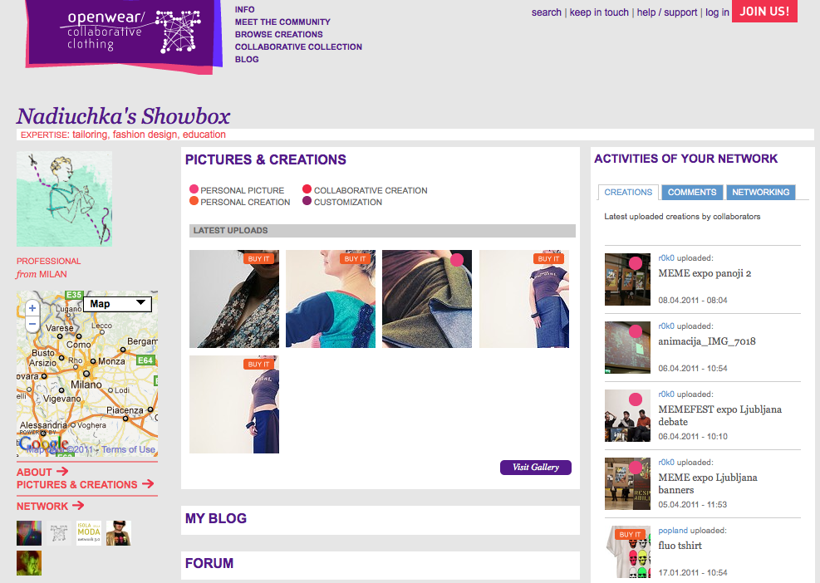
Open Fashion Design
Open Fashion Design projects and brands.
Source: http://www.openwear.org/

Slide 27
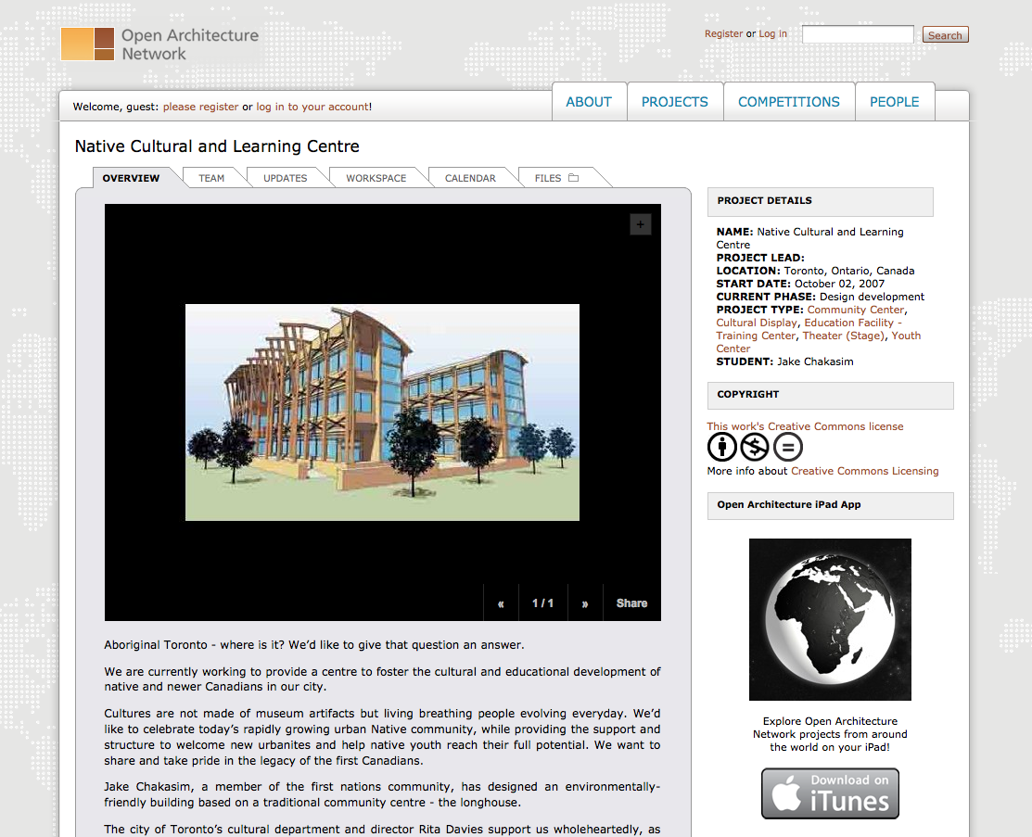
Open Architecture
Not as advanced as Open product design, but still part of an ongoing experimentation.
Source: http://openarchitecturenetwork.org/

Slide 28
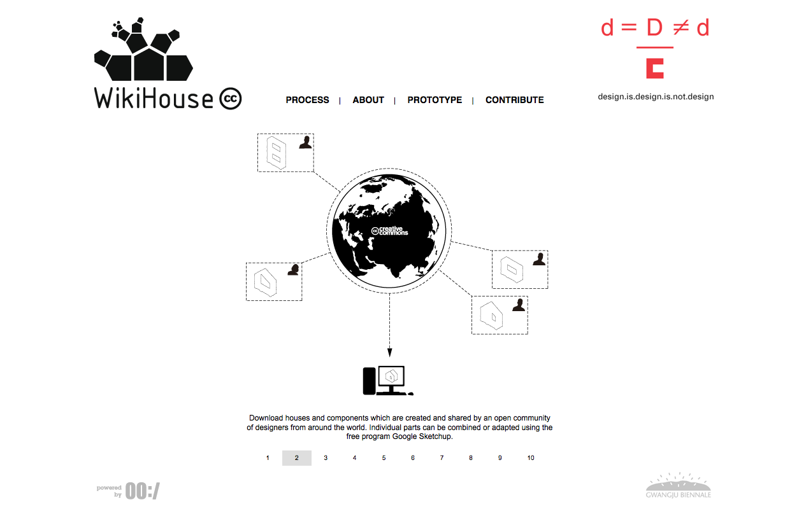
Open Architecture
Not as advanced as Open product design, but still part of an ongoing experimentation.
Source: http://www.wikihouse.cc/

Slide 29
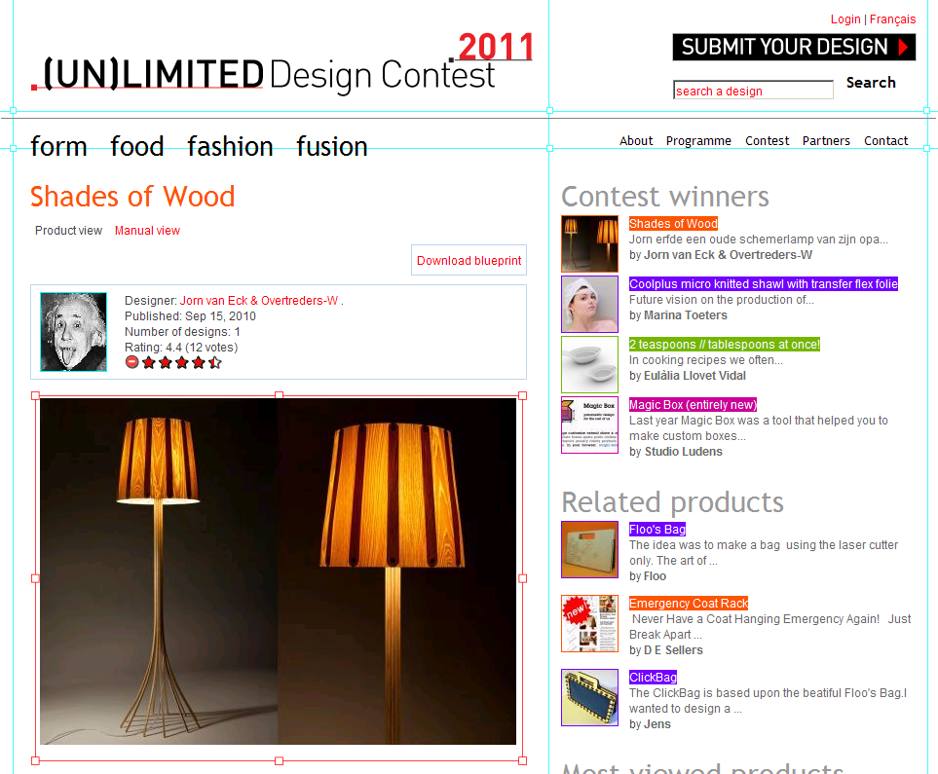
(Open) Design competitions
Digital fabrication and FabLabs open new possibilities for Design competitions and Open Design.
Source: http://unlimiteddesigncontest.org/

Slide 30
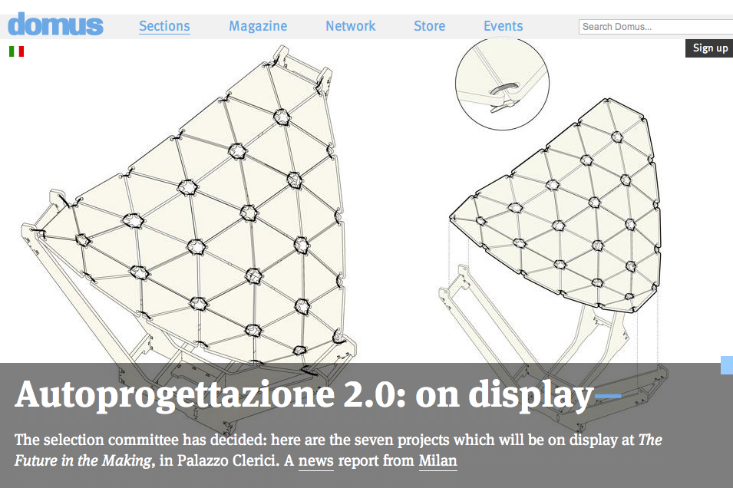
(Open) Design competitions
Digital fabrication and FabLabs open new possibilities for Design competitions and Open Design.
Source: http://www.domusweb.it/en/upcoming-event/call-for-ideas-autoprogettazione-20--/
http://www.domusweb.it/en/news/autoprogettazione-20-on-display/

Slide 31
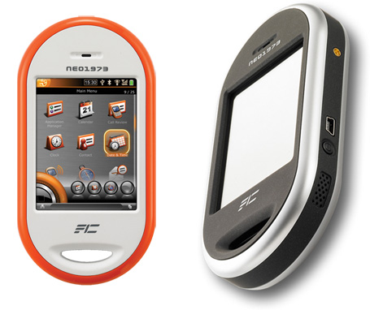
Completely Open: Hardware, Software, Design
OpenMoko was the first product to be completely open: open hardware, open source software, open design.
Source: http://wiki.openmoko.org/wiki/Main_Page

Slide 32
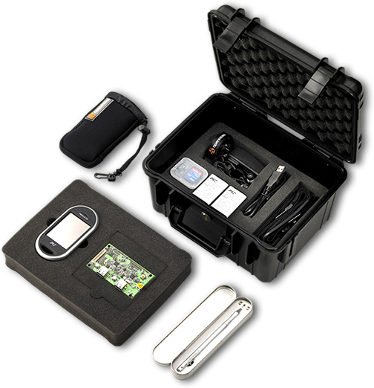
Completely Open: Hardware, Software, Design
OpenMoko was the first product to be completely open: open hardware, open source software, open design.
Source: http://wiki.openmoko.org/wiki/Main_Page

Slide 33
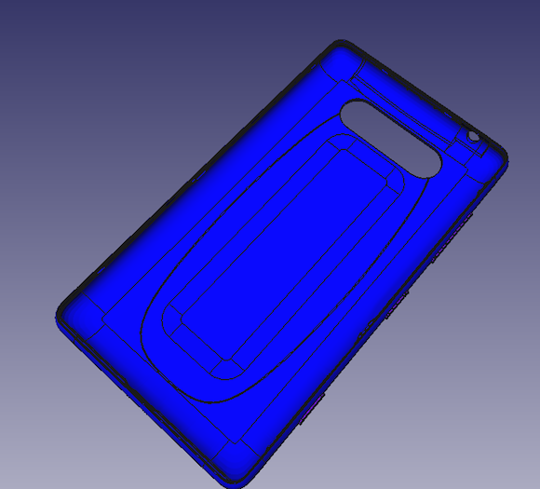
Open Design and mobile phones?
Nokia has released a part from its Lumia 820 (and then partnered with Makerbot).
Source: http://www.openp2pdesign.org/2013/open-design/first-global-company-to-embrace-open-design/

Slide 34
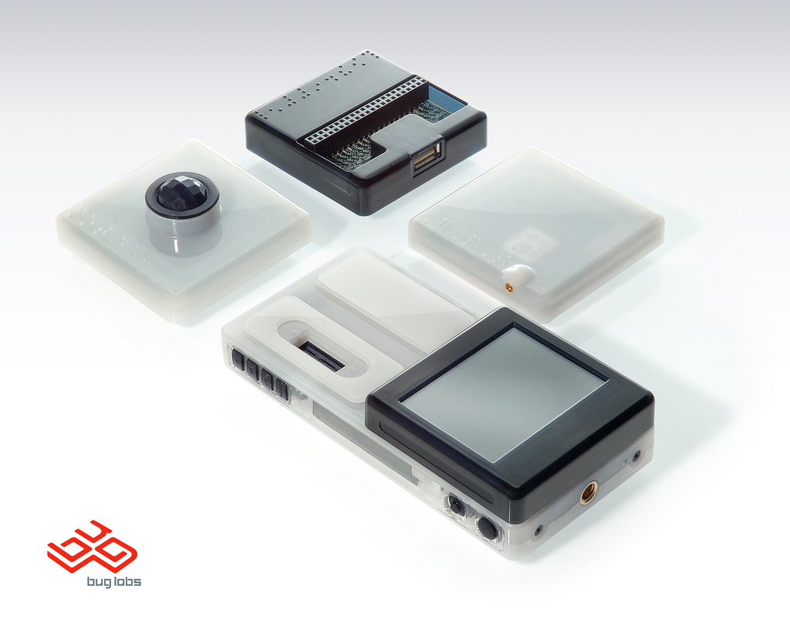
Completely Open: Hardware, Software, Design
BugLabs has been much more successful in offering completely open products.
Source: http://www.buglabs.net/

Slide 35
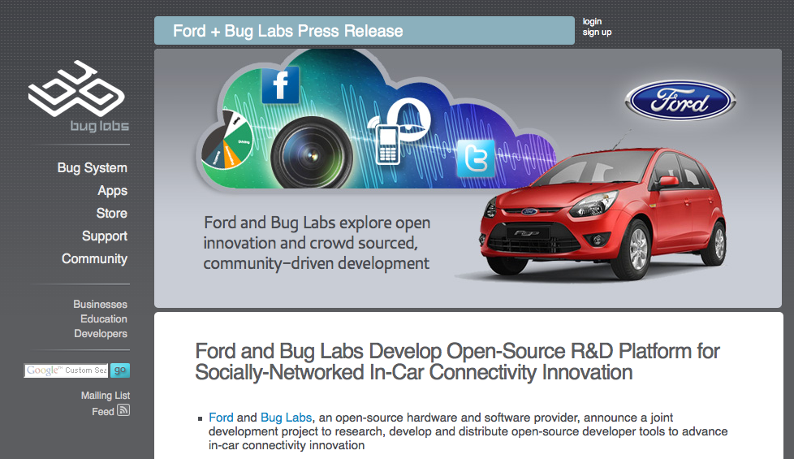
BugLabs + Ford
So successful that they just announced a partnership with Ford Car.
Source: http://www.buglabs.net/ford-buglabs

Slide 36
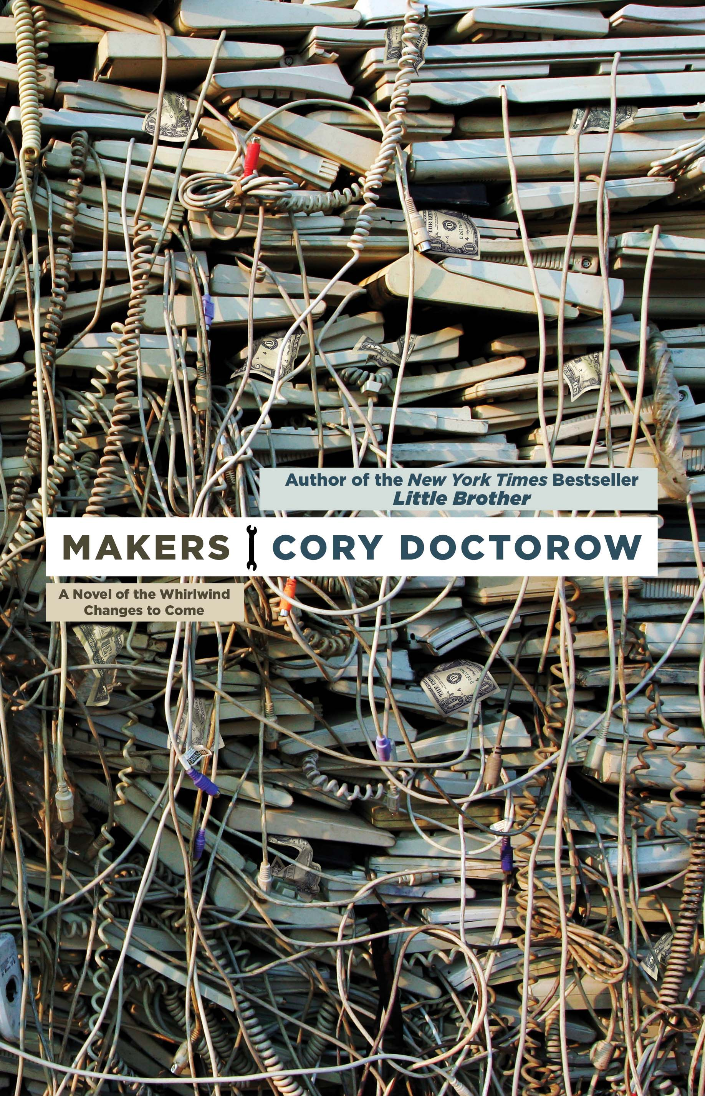
Open Design: (almost) already successful
When you have a sci-fi novel from a popular autor about open design and makers, they are not underground any longer.
Source: http://craphound.com/makers/download/

Slide 37
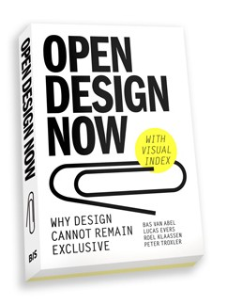

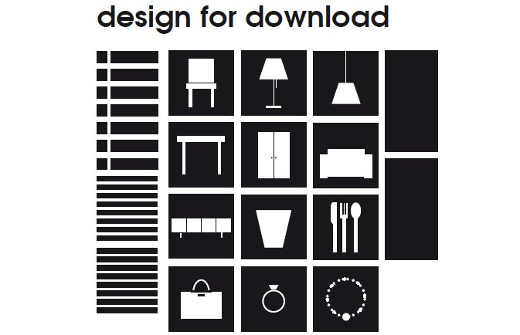
Open Design: (almost) already successful
Source:
http://opendesignnow.org/
http://www.droog.com/projects/events/design-for-download/
http://www.droog.com/blog/category/design-for-download-2/
When a famous design company and the national organization of design embrace Open Design ...
Source: http://www.buglabs.net/ford-buglabs

Slide 38
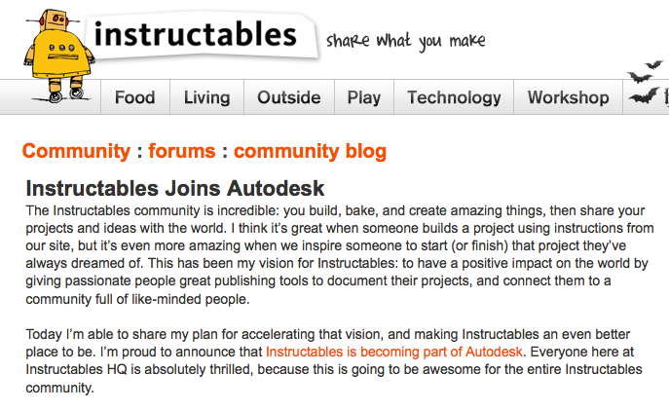
Open Design: (almost) already successful
And when probably the biggest CAD design software house buys an open design community, there must be money ahead!
Source: http://www.instructables.com/community/Instructables-Joins-Autodesk/
http://techcrunch.com/2011/08/01/autodesk-acquires-diy-community-instructables/

Slide 39
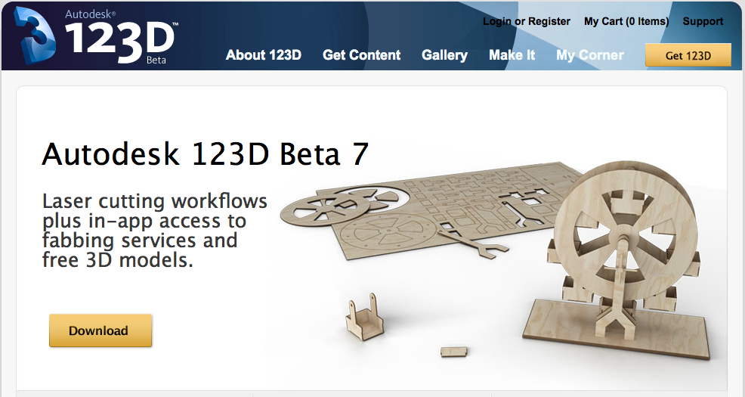
Open Design: (almost) already successful
Source: http://www.123dapp.com/
And when probably the biggest CAD design software house offers freeware software for makers, there must be money ahead!
Source: http://www.123dapp.com/

Slide 40
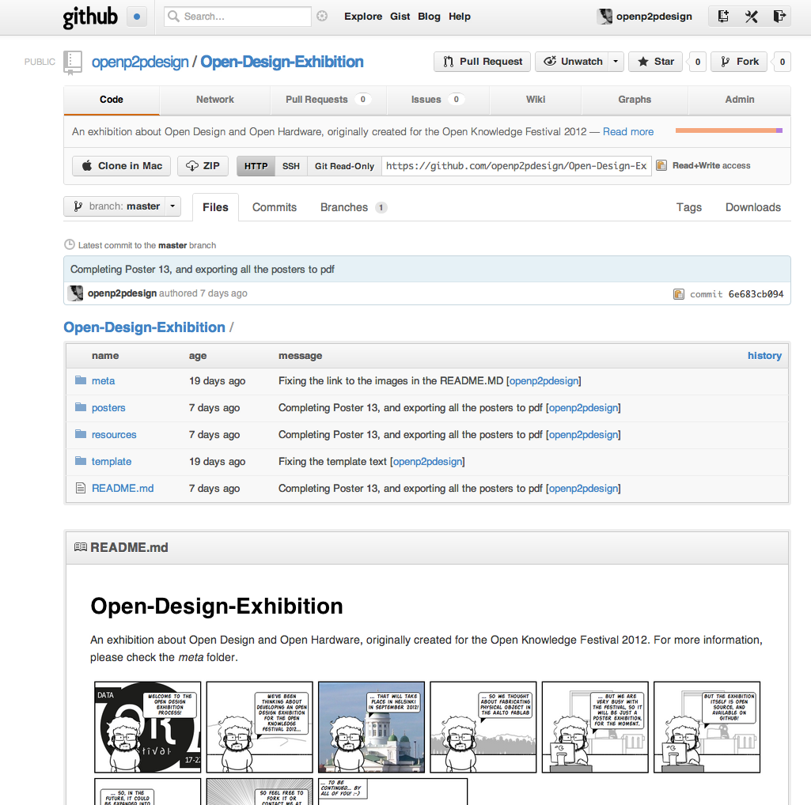
More on the Open Design Exhibition!
Source: http://www.123dapp.com/
An open exhibition about the most important Open Design projects: on Media Factory's walls and on GitHub!
Source: https://github.com/openp2pdesign/Open-Design-Exhibition

Slide 41
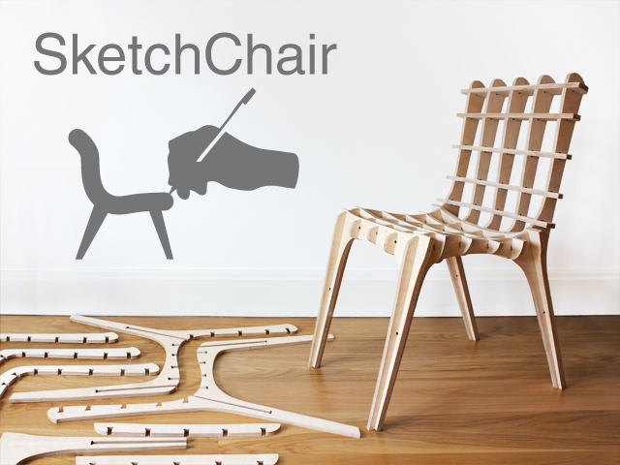
Sketch Chair: Open Design as code
What is Open Design, if the chair is designed by a software?
Source: http://www.sketchchair.cc/

Slide 42
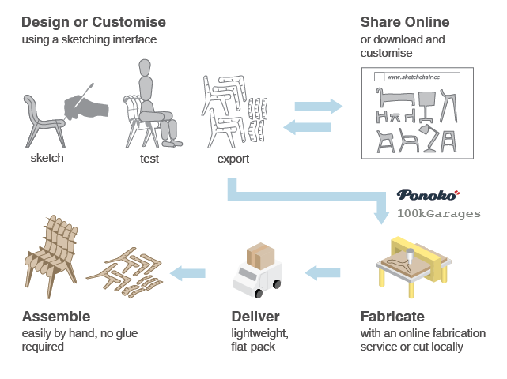
Sketch Chair: Open Design as code
What is Open Design, is manufacturing and supply chain process?
Source: http://www.sketchchair.cc/

Slide 43
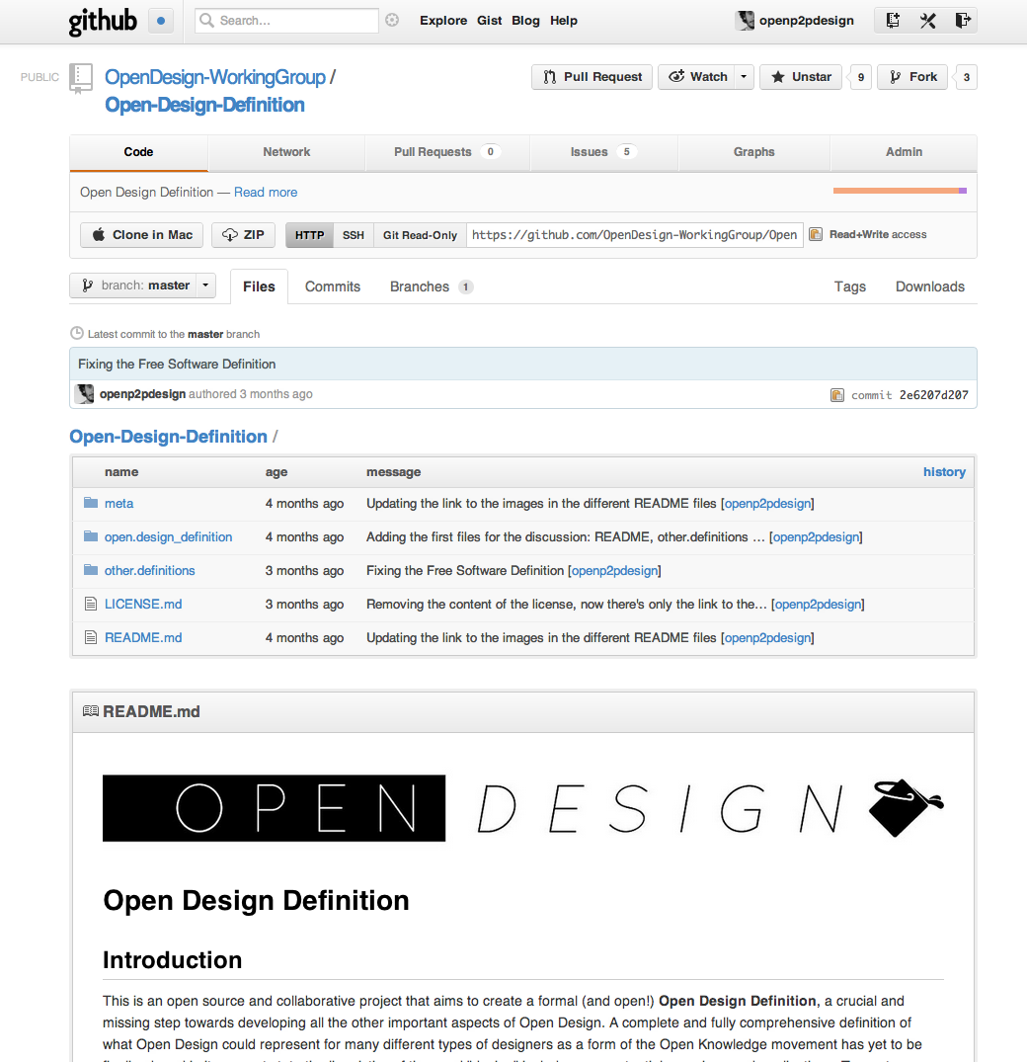
… and participate in the Open Design Definition!
Source: http://www.123dapp.com/
And when probably the biggest CAD design software house offers freeware software for makers, there must be money ahead!
Source: https://github.com/OpenDesign-WorkingGroup/Open-Design-Definition

Slide 44
The current status of Open Design
* single persons or small groups design a project and then just publish it online
* lack of new tools, processes, systems that enable designers and users in developing open design projects
--> where is the collaboration?
--> where are the open processes?
--> where are the communities?

Slide 45
The current status of Open Design
From: torvalds@klaava.Helsinki.FI (Linus Benedict Torvalds)
Newsgroups: comp.os.minix
Subject: What would you like to see most in minix?
Summary: small poll for my new operating system
Message-ID:
Date: 25 Aug 91 20:57:08 GMT
Organization: University of Helsinki
Hello everybody out there using minix -
I'm doing a (free) operating system (just a hobby, won't be big and
professional like gnu) for 386(486) AT clones. This has been brewing
since april, and is starting to get ready. I'd like any feedback on
things people like/dislike in minix, as my OS resembles it somewhat
(same physical layout of the file-system (due to practical reasons)
among other things).
I've currently ported bash(1.08) and gcc(1.40), and things seem to work.
This implies that I'll get something practical within a few months, and
I'd like to know what features most people would want. Any suggestions
are welcome, but I won't promise I'll implement them :-)
Linus (torvalds@kruuna.helsinki.fi)
So successful that they just announced a partnership with Ford Car.
Source: http://www.cs.cmu.edu/~awb/linux.history.html

Slide 46
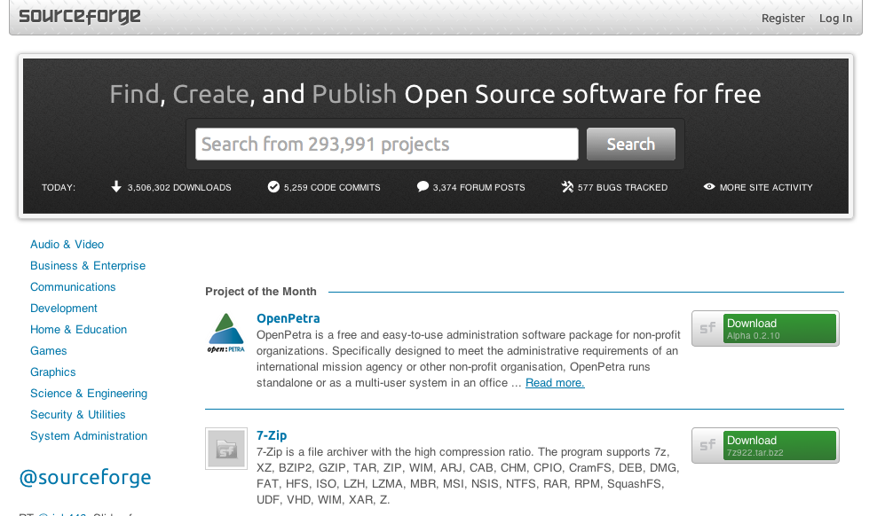
The experience of a user of Open Source software
The surface experience with open source software: not only finished products that can be downloaded and used!
Source: http://sourceforge.net/

Slide 47
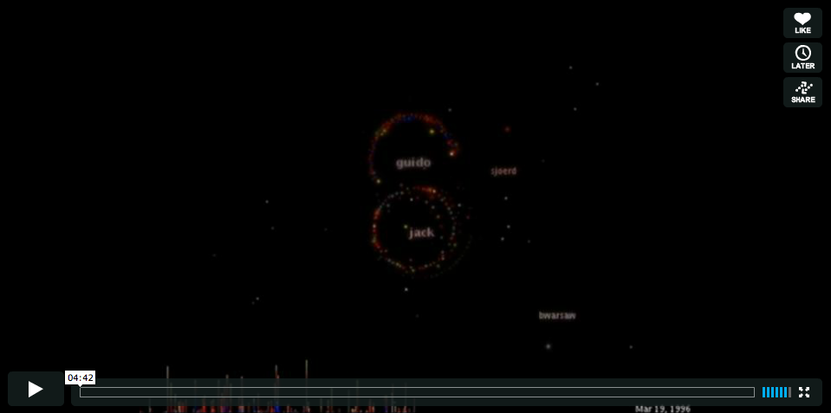
… the big picture of Open Source: the process
But there's a big process of collaboration behind the final product!
Source: http://code.google.com/p/codeswarm/
http://vimeo.com/1093745

Slide 48
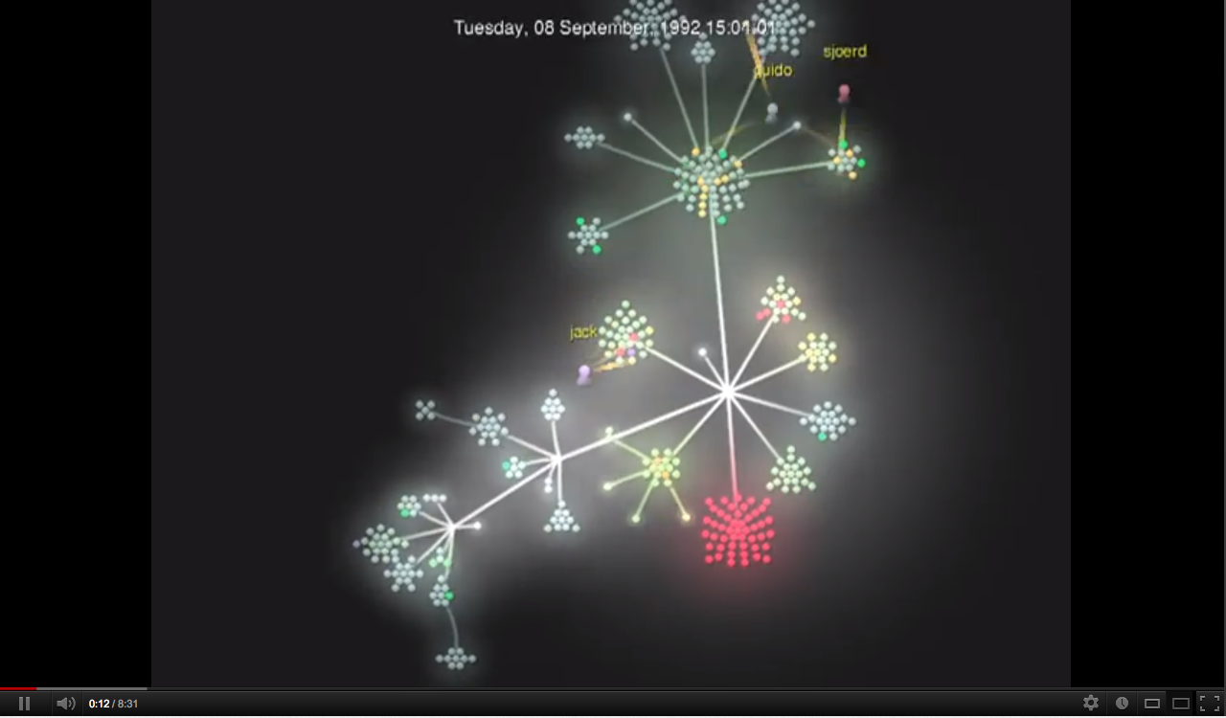
… the big picture of Open Source: the process
But there's a big process of collaboration behind the final product!
Source: http://code.google.com/p/gource/
http://youtu.be/aPk1BqK8zzI

Slide 49
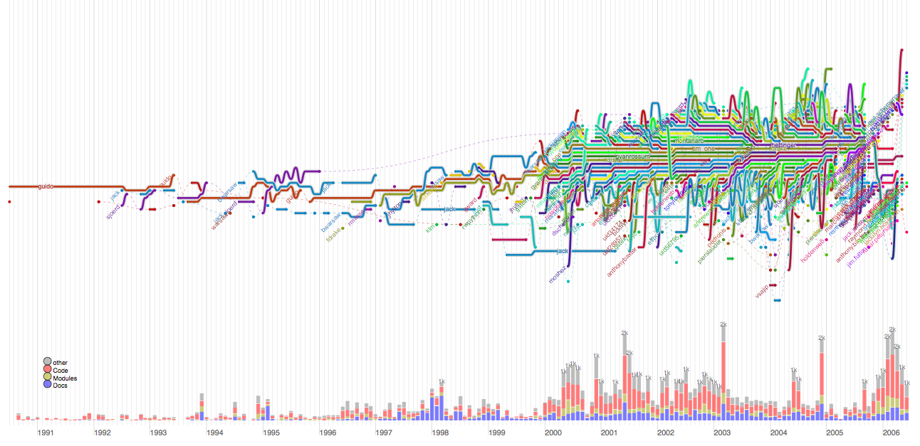
… the big picture of Open Source: the process
But there's a big process of collaboration behind the final product!
Source: http://www.michaelogawa.com/research/storylines/

Slide 50
A more systemic definition of Open Design
A collaborative distributed system of design & manufacturing
* sharing
* collaboration
* open licenses
* open and distributed manufacturing technologies
A system of agents that:
* use
* design
* manufacture
* market
* distribute
* manage the end-of-life

Slide 51
03.
Open Data and Big Data: open innovation at the data level

Slide 52
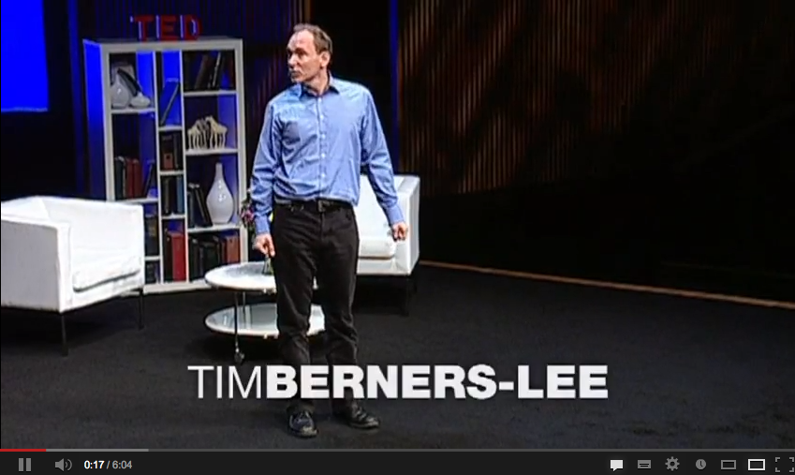
Open Data
Open data is the idea that certain data should be freely available to everyone to use and republish as they wish, without restrictions.
Source: http://youtu.be/3YcZ3Zqk0a8

Slide 53
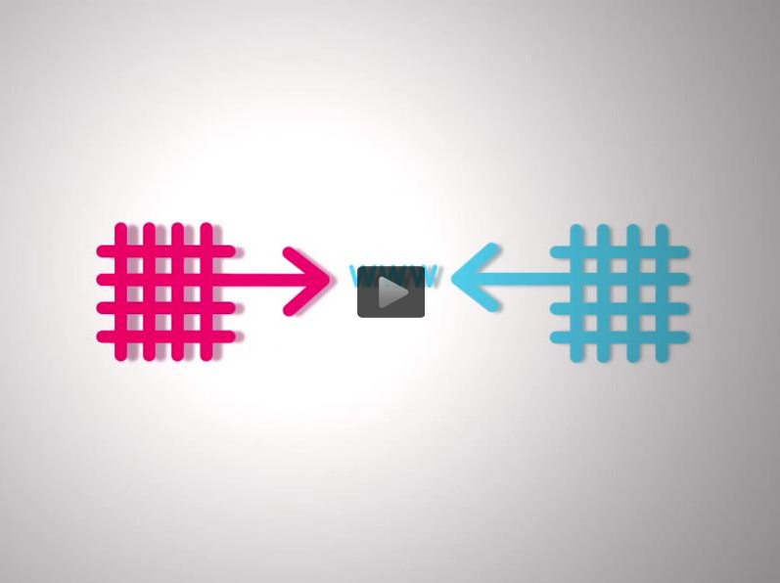
Linked Open Data
Open data is the idea that certain data should be freely available to everyone to use and republish as they wish, without restrictions.
Source: http://en.wikipedia.org/wiki/File:Linked-open-data-Europeana-video.ogv

Slide 54
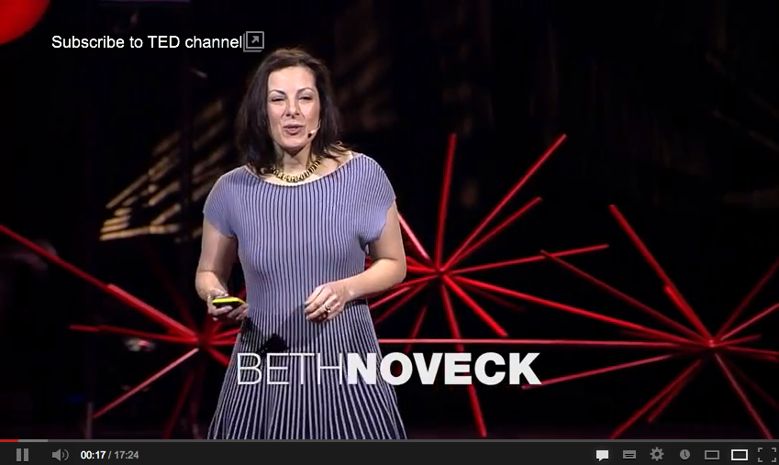
Open Data for Open Government
Open government is the doctrine which holds that citizens have the right to access
the documents and proceedings of the government to allow effective public oversight
Source: http://youtu.be/bLGTrz1Zolk

Slide 55
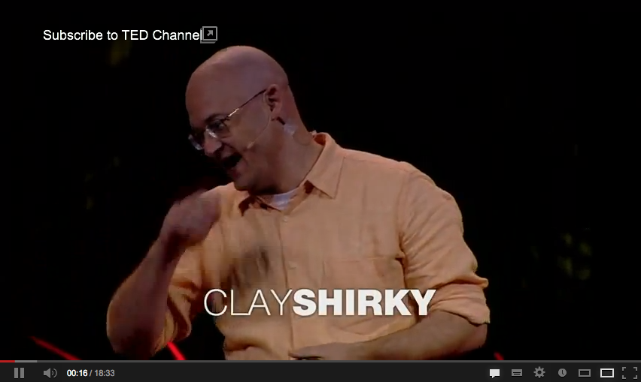
Opening Government... with Git
Another reason why you need to study Git and GitHub...
Source: http://youtu.be/CEN4XNth61o

Slide 56
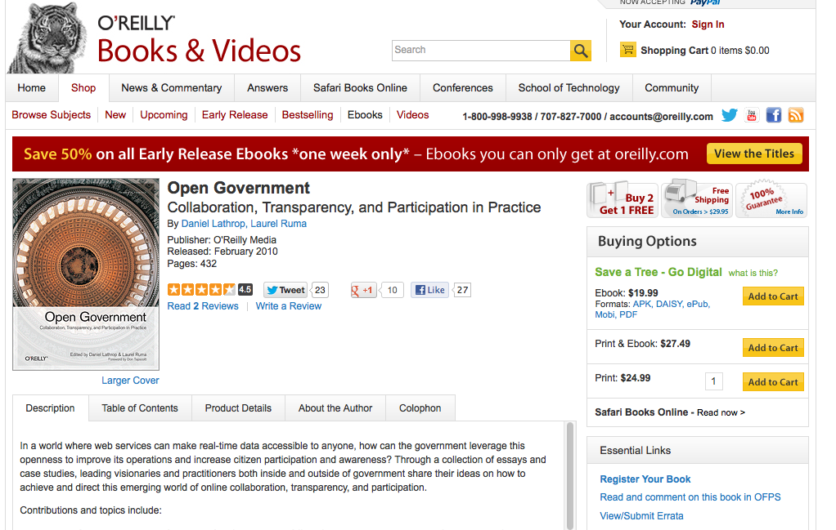
Opening Open Government... with books
Open Government: an ecosystem of professions, tools, books...
Source: http://shop.oreilly.com/product/9780596804367.do

Slide 57
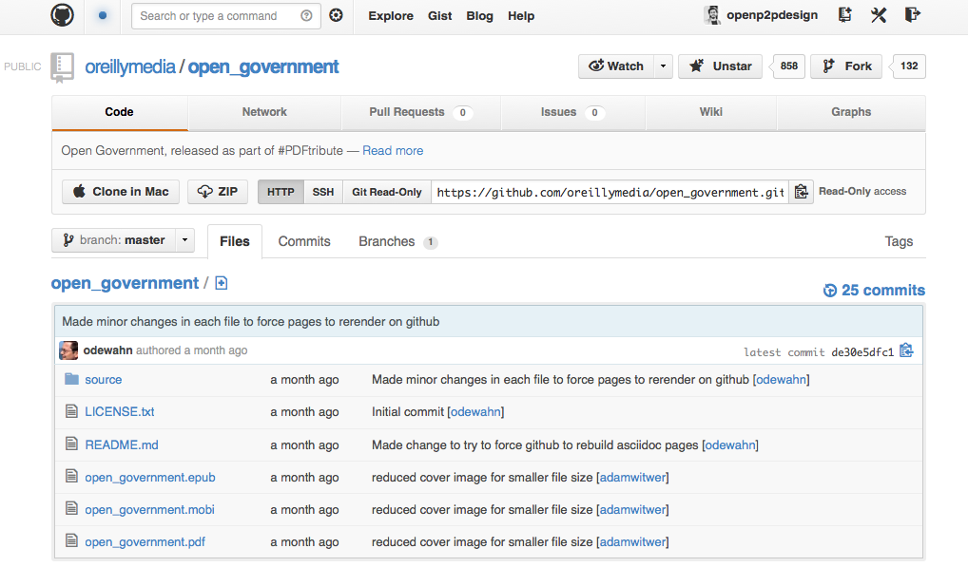
Opening Open Government... with books
… which may be open themselves!
Source: https://github.com/oreillymedia/open_government

Slide 58
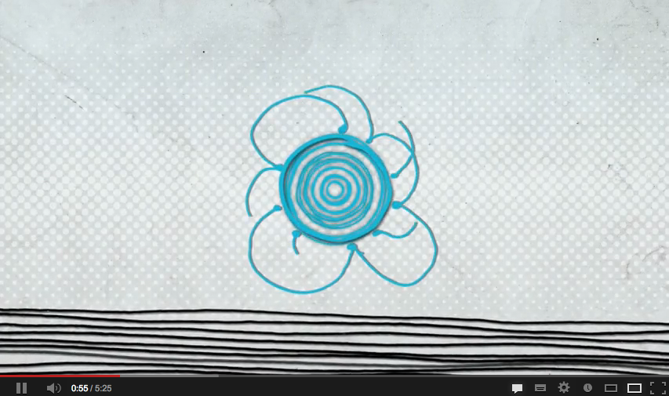
The Internet of Things
What about the data that we get by connecting all the machines?
Source: http://youtu.be/sfEbMV295Kk

Slide 59

Open Data and the Internet of Things
What about releasing machine data as Open Data?
Source: http://youtu.be/oO3m7r_p2sc

Slide 60

Open Data and the Internet of Things
What about releasing machine data as Open Data?
Source: https://cosm.com/

Slide 61

Big Data: the numbers
And data becomes big, so we need different tools, concepts and perspectives.
Source: http://youtu.be/qqfeUUjAIyQ

Slide 62

Big Data: the types
And data becomes big, so we need different tools, concepts and perspectives.
Source: http://youtu.be/eEpxN0htRKI

Slide 63

Big Data: the effects
Intrigued by the sheer scales involved, photojournalist Rick Smolan wanted to see how data was transforming the world.
Source: http://www.bbc.co.uk/news/technology-21535739

Slide 64
Thank you!!
Massimo Menichinelli
Aalto Media Factory massimo.menichinelli@aalto.fi
@openp2pdesign http://www.slideshare.net/openp2pdesign
11.03.2013

