Slide 1

DesigningOpenInnovation.04
Metadesign
Massimo Menichinelli massimo.menichinelli@aalto.fi
@openp2pdesign http://www.slideshare.net/openp2pdesign
12.03.2013

Slide 2
01.
Metadesign: designing the design processes and tools

Slide 3
What can we do for Open Design projects?
Metadesign is the design of the design tools, processes and systems
* research and share design knowledge
* research and share business models
* research and share financial and environmental sustainability
* design and share design tools
* design and share design processes
* facilitate design & manufacturing & end-of-life systems
* facilitate the distributed creativity

Slide 4
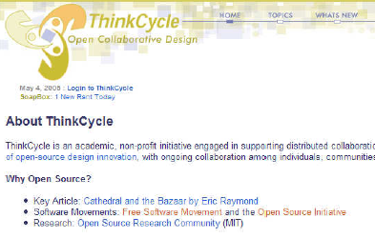
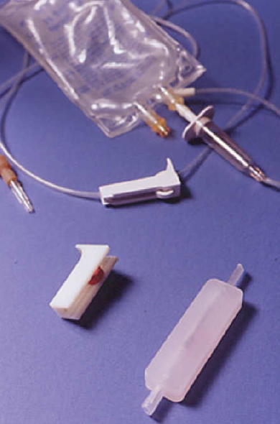
Designing Open Collaborative projects: Thinkcycle
First open and collaborative design process (2000-2007)
First example: a platform and supply chain and social system for Open Design projects.
Source: http://www.thinkcycle.org (now closed) http://web.media.mit.edu/~nitin/thesis/

Slide 5

P2P Service Design: Open Health (Design Council)
Second example: first peer-to-peer public services by design (2004-2006).
Source: http://www.designcouncil.info/mt/RED/ (now inactive) http://www.participle.net/

Slide 6
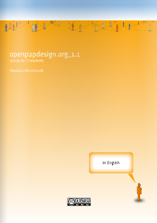
Open P2P Design: Metadesign for Open projects
A short summary of a research about developing metadesign initiatives for Open projects.
Source: http://www.issuu.com/openp2pdesign http://www.scribd.com/openp2pdesign

Slide 7
Where should we use Open P2P Design?
* for community-centered projects
* for community-based services / businesses
* for projects that are distributed in a territory / locality
* for complex projects
* for participatory processes
* for open processes and projects
In Open Design, Open Innovation, Open Business, Open Government...

Slide 8
Why Open P2P Design?
* mass-collaboration/crowdsourcing --> change in the role of designers
* being subjected to mass collaboration --> designing it
* communities generate innovations --> more opportunities for designers
--> designers can be enablers / facilitators of distributed creativity
--> designers still have more knowledge and expertise, just now they are part of collaborative networks
--> designers could even adopt open strategies

Slide 9
And the Design research and practice is changing
Design by author -->
Design by marketing -->
User-centred Design →
User-experience Design →
Activity-centred Design →
Co-Design --> …

Slide 10
What does Open P2P Design design?
Activity Theory +
Service Design (+ Activity Theory) +
Action Planning (Urbanism) +
Social Network Analysis +
...
}
Activity

Slide 11
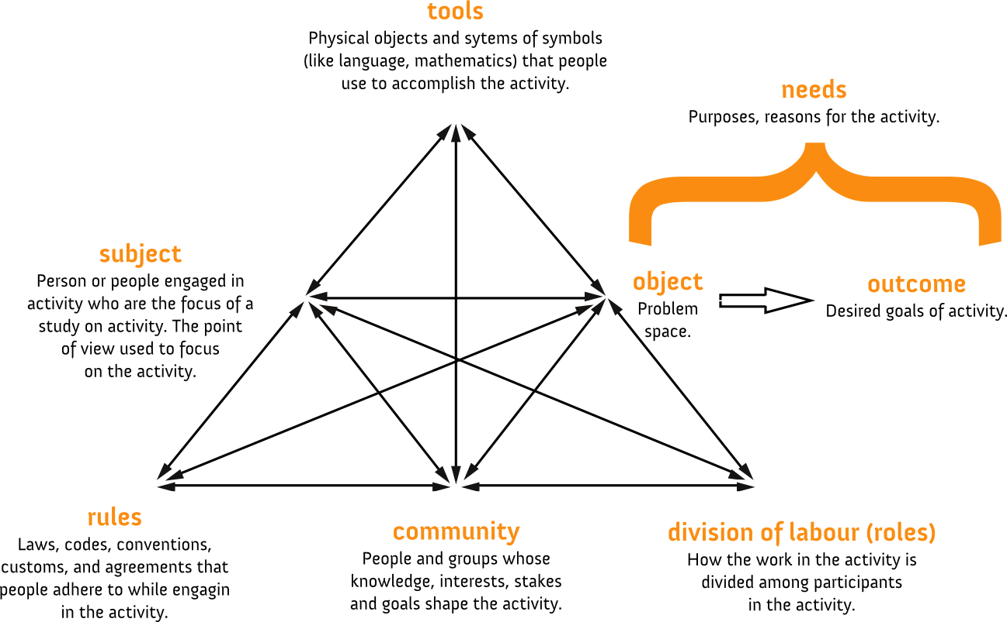
Activity Theory
Activity theory is an approach in psychology that aims to understand individual / social entities, with an analysis of the genesis, structure, processes of their activities.
Source: http://www.helsinki.fi/cradle/chat.htm http://www.helsinki.fi/cradle/activitysystem.htm

Slide 12
Metadesign with Open P2P Design ?
}
Analysis +
Concept design +
Prototyping +
Manufacturing +
Distribution +
Support +
End of life +
...
Design process:
A systemic activity comprising set of actions (sub-activities), with their own tools, roles, rules

Slide 13
What about the source code for Open P2P Design?
}
Process Design
Participation matrix +
Activity analysis +
Social Network Analysis +
Storyboard +
System map +
Service blueprint +
Motivation matrix +
Activity description +
…
Design project
}
}
Community analysis
Activity Design
}
Open Design

Slide 14
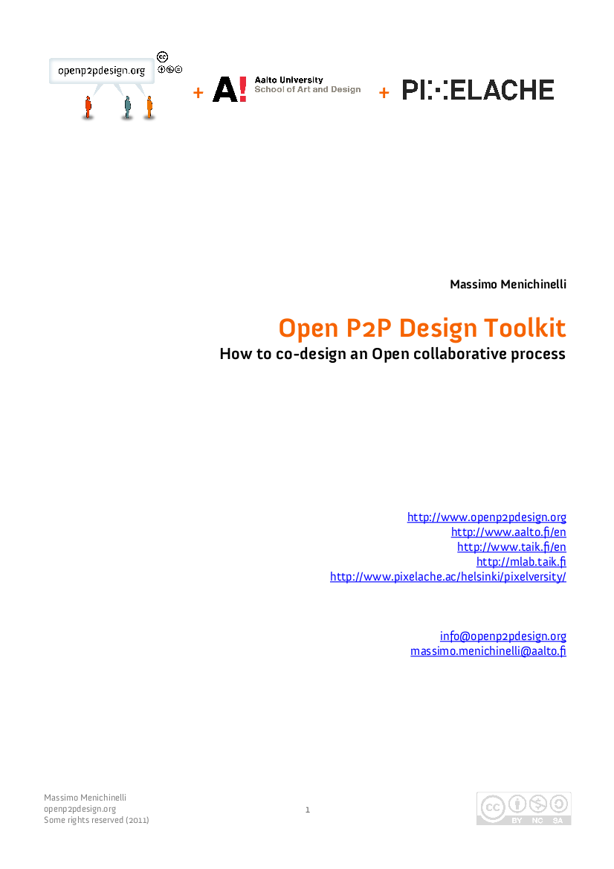
A toolkit for the Open P2P Design methodology
A simple, free and open paper toolkit for brainstorming metadesign projects for Open initiatives.
Source: http://www.issuu.com/openp2pdesign http://www.scribd.com/openp2pdesign

Slide 15
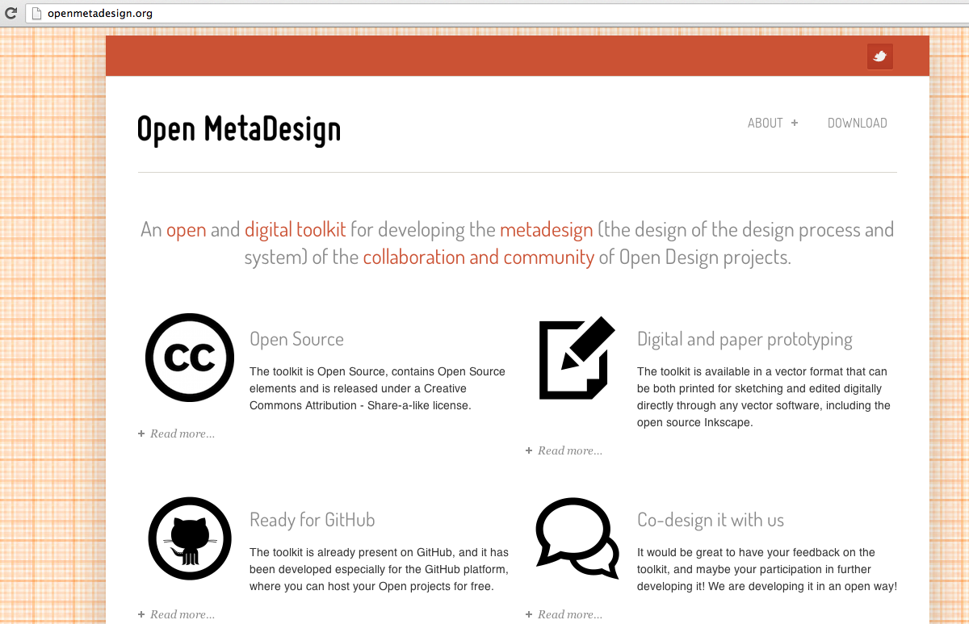
A toolkit for the Open P2P Design methodology
A simple, free and open paper toolkit for brainstorming metadesign projects for Open initiatives.
Source: http://openmetadesign.org

Slide 16
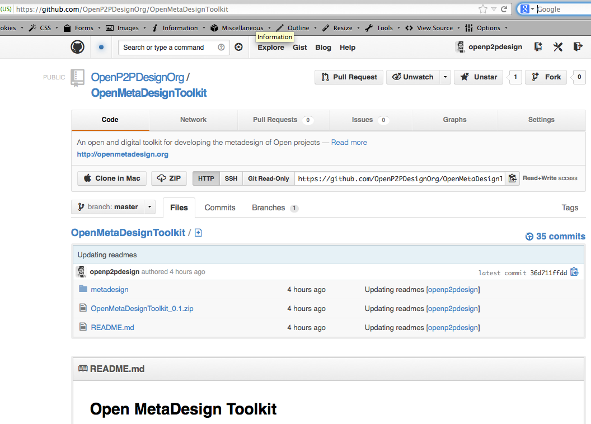
A toolkit for the Open P2P Design methodology
A simple, free and open paper toolkit for brainstorming metadesign projects for Open initiatives.
Source: https://github.com/OpenP2PDesignOrg/OpenMetaDesignToolkit

Slide 17
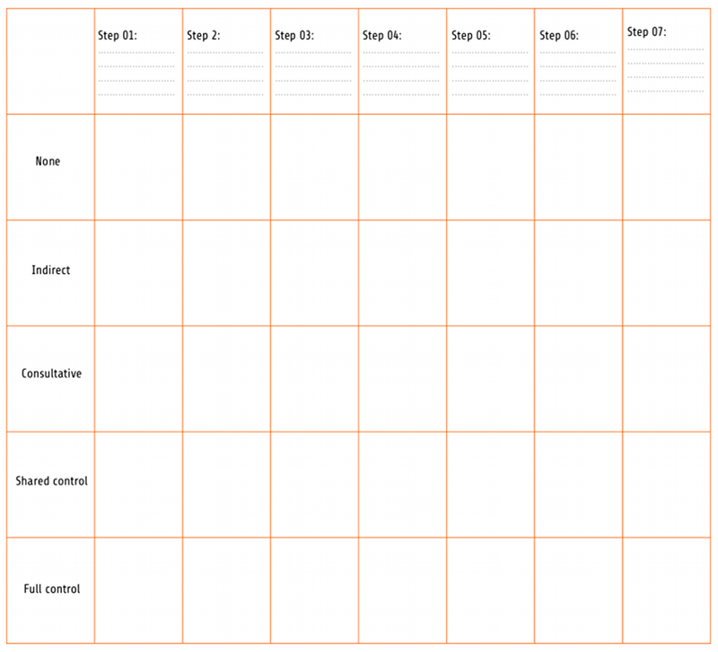
Process: Activities and participation
A simple way for designing the level of participation in the different steps of the design process.
Source: Hamdi, N., & Goethert, R. (1997). Action Planning for Cities: A Guide to Community Practice. Academy Press

Slide 18
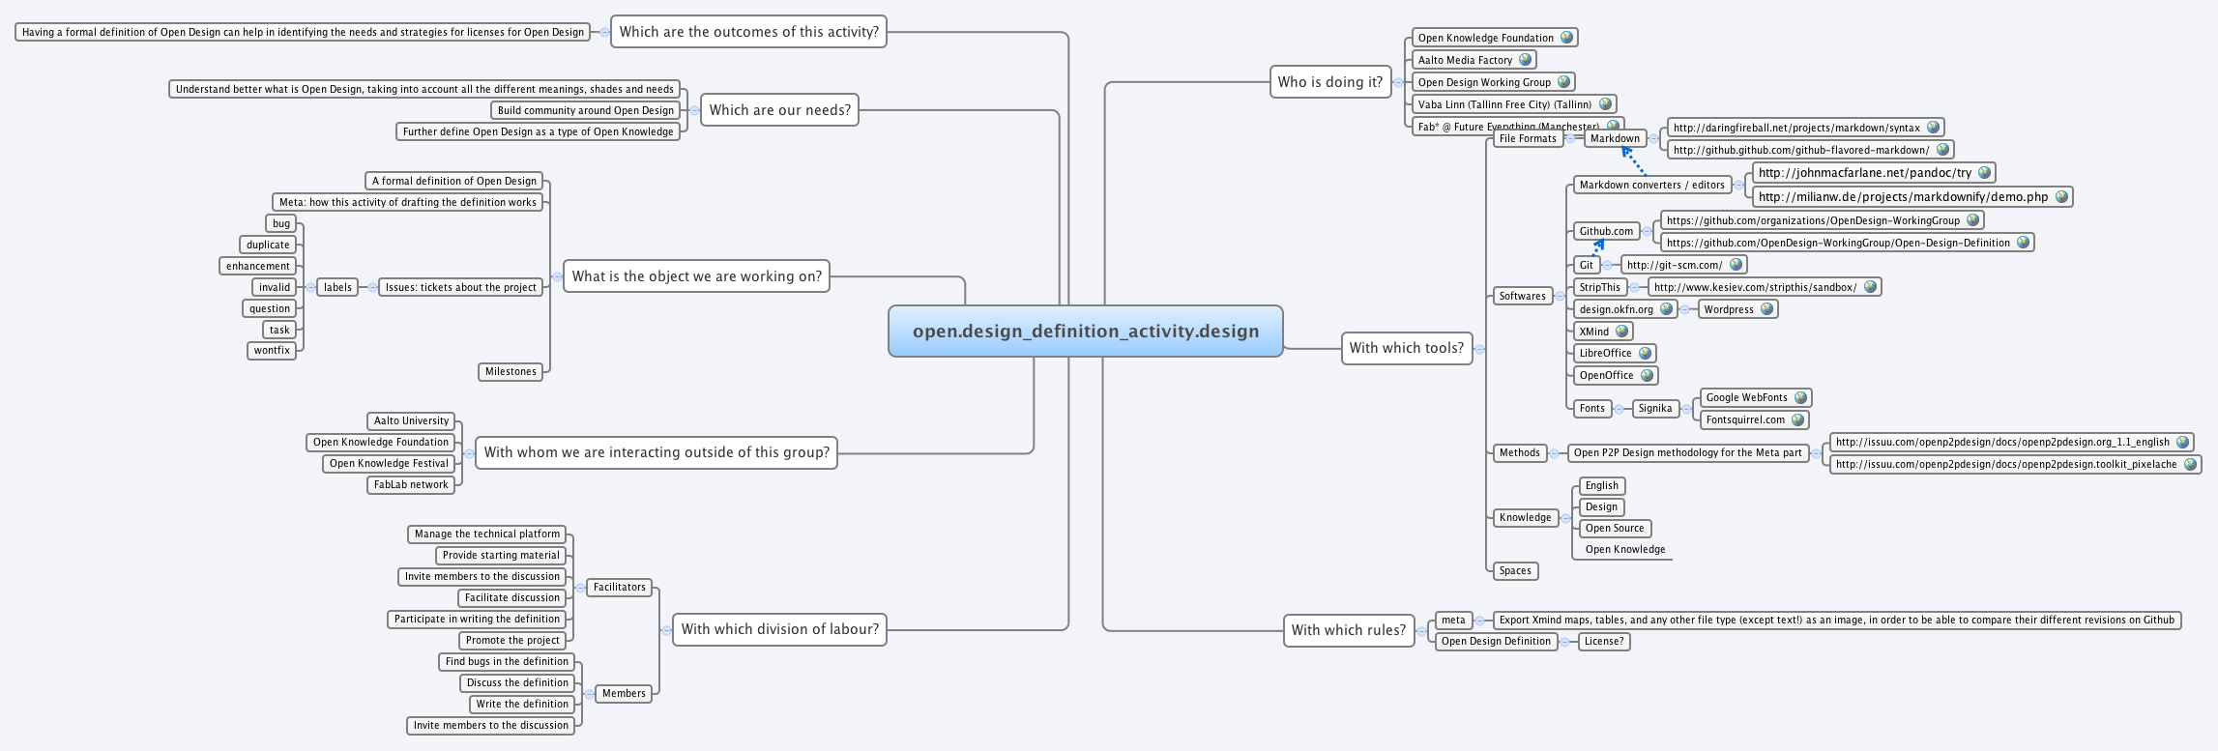
Activity Design
A simple way of designing the Open Design Activity is by using a MindMap instead of an Activity System.
Source: https://github.com/OpenDesign-WorkingGroup/Open-Design-Definition/tree/master/meta

Slide 19
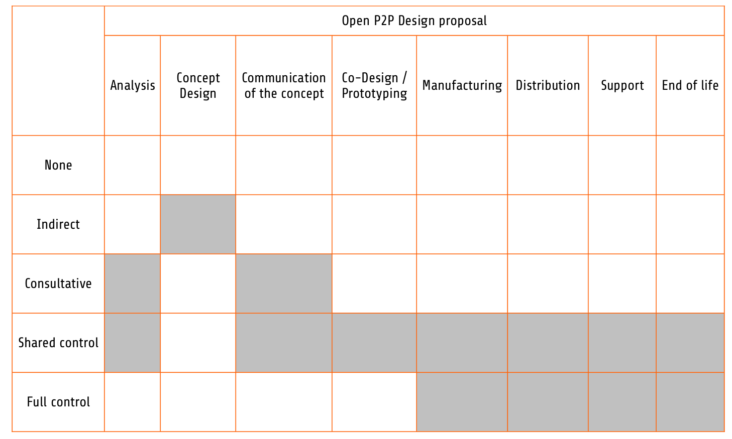
Open P2P Design Process

Slide 20



Flows: System Map
The System Map is very useful to visualize and design interactions as flows between people. Its elements are:
* material flows
* information flows
* financial flows
+ roles
+ border of the system
Source:http://www.mepss.nl/index.php?p=tool&l4=W21

Slide 21
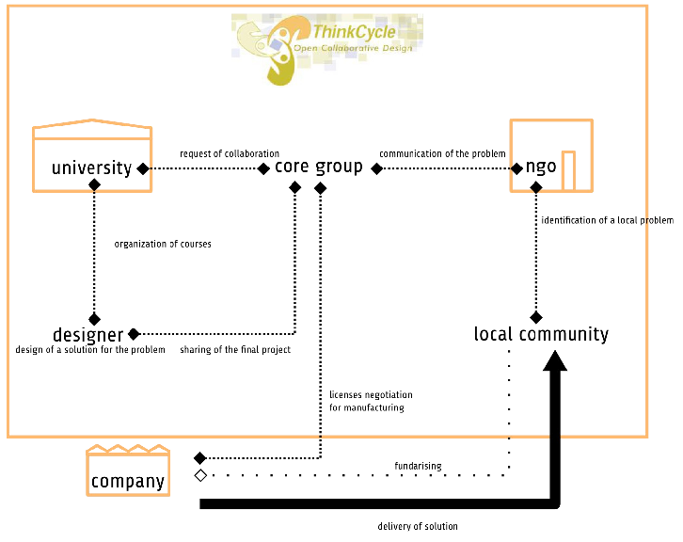
System Map
The flows of money, information and material resources in the Thinkcycle project.

Slide 22
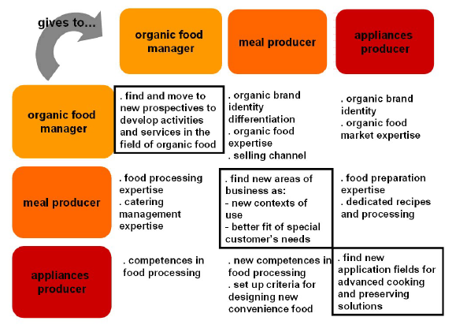
Interactions: Motivation Matrix
The Motivation Matrix is useful for analysing, designing, visualizing interactions as motivations between the roles of the Open Design activity.
Source: http://www.servicedesigntools.org/tools/20 http://servicedesign.wikispaces.com/Motivation+Matrix

Slide 23
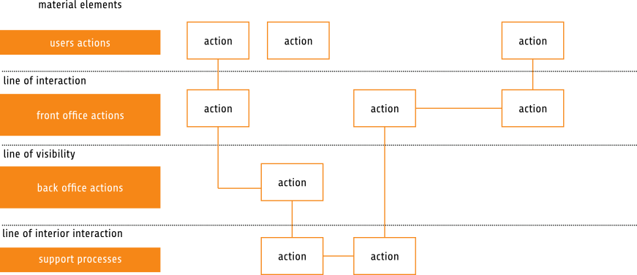
Blueprint
Service Blueprints are used in torder to design and visualize processes and specifications of the Activity when it happens inside an organization or place.
Source: http://www.face.ubiobio.cl/webfile/media/42/version%20-8-1/mariaperez.pdf
http://www.servicedesigntools.org/tools/35

Slide 24
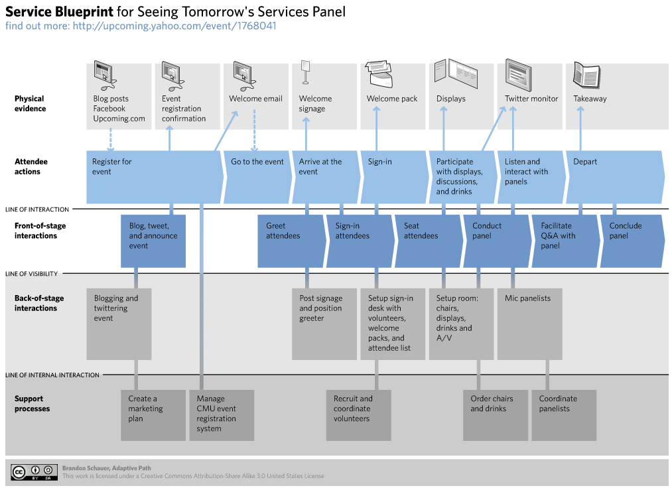
Blueprint
Source: http://www.flickr.com/photos/brandonschauer/3363169836/
Service Blueprints are used in torder to design and visualize processes and specifications of the Activity when it happens inside an organization or place.
Source: http://www.face.ubiobio.cl/webfile/media/42/version%20-8-1/mariaperez.pdf
http://www.servicedesigntools.org/tools/35

Slide 25
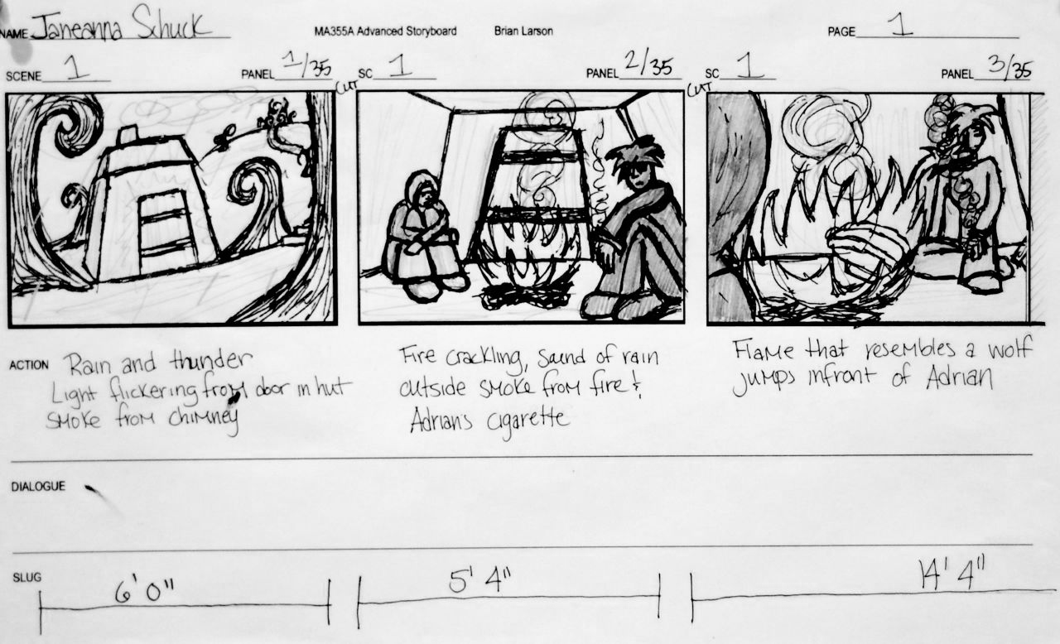
Storyboard
Storyboards are a series of illustrations or images displayed in sequence. They enable analysing, designing, visualizing interactions through time as a story.
Source: http://www.servicedesigntools.org/tools/13 http://en.wikipedia.org/wiki/Storyboard
http://www.flickr.com/photos/ninga/473316247/

Slide 26
02.
Example 01:
A workshop in Singapore

Slide 27
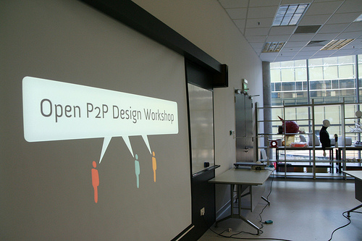
Open P2P Design Workshop, Singapore, NTU
With Roger Pitiot. 25-27 November 2009, NTU University
Singapore Design Festival
Source: http://www.openp2pdesign.org/projects/past-projects/open-p2p-design-workshop-seoul-singapore-2009/

Slide 28
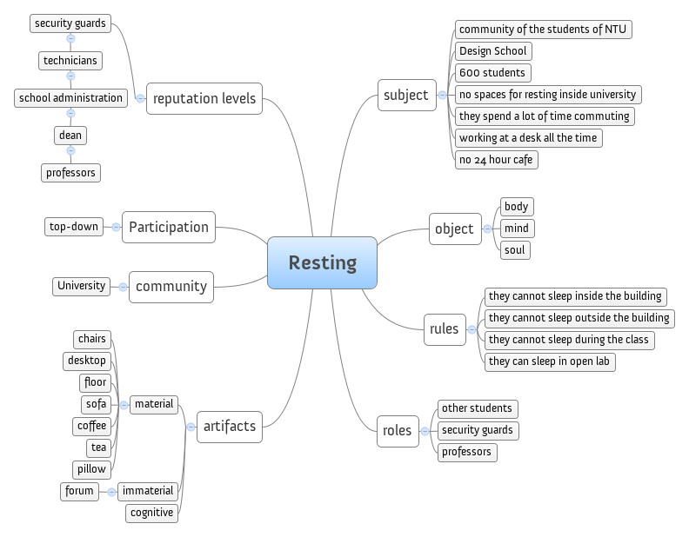
01. Community Analysis
Analysis of the community of students at NTU and of their activity we want to solve.

Slide 29
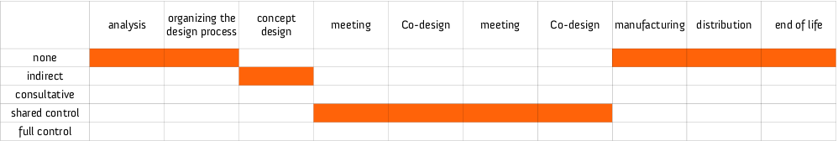
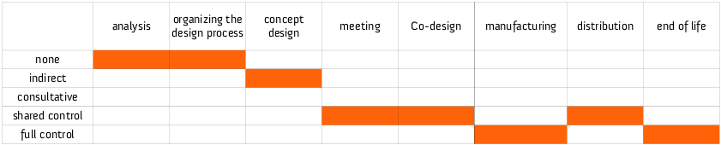
02. Participation Matrix
“First version of the Participation Matrix, we do everything by ourselves”
“Second version, now the students manufacture and manage the product, we just help them distributing it”
Process design (with a participation matrix): two revisions.

Slide 30
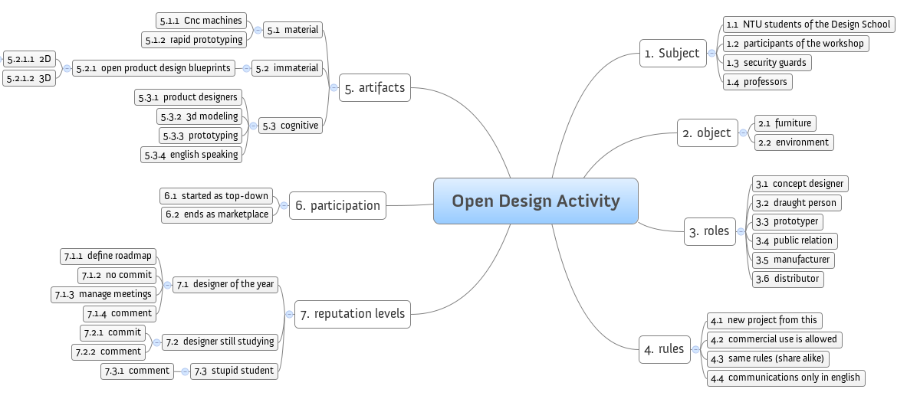
03. Open Design Activity
Design of the Open Design Activity, based on the Activity Theory System.

Slide 31
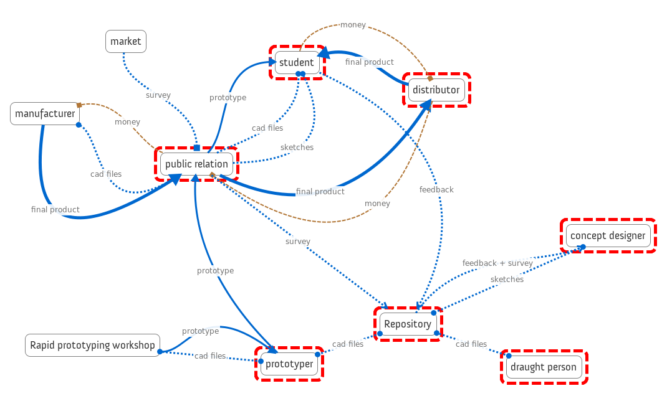
04. System Map rev. 20
“Feedback from students and survey results from customers, now available to read by concept designers.”

Slide 32
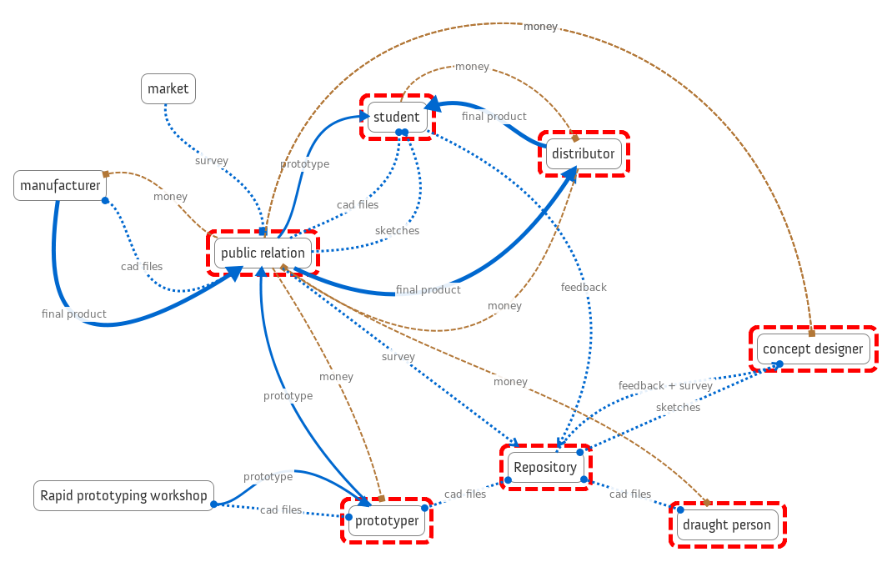
04. System Map rev.21
“Everyone gets paid now”

Slide 33
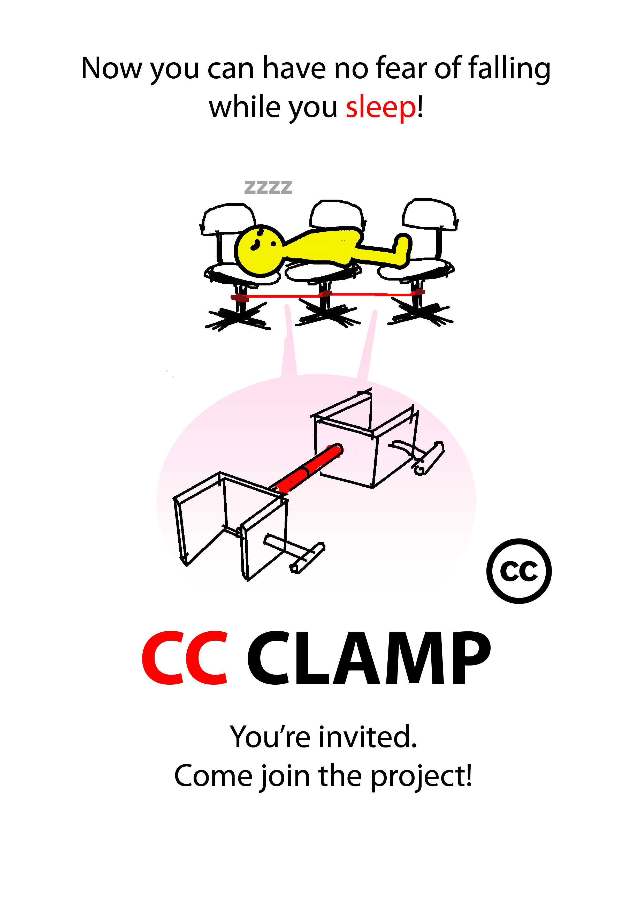
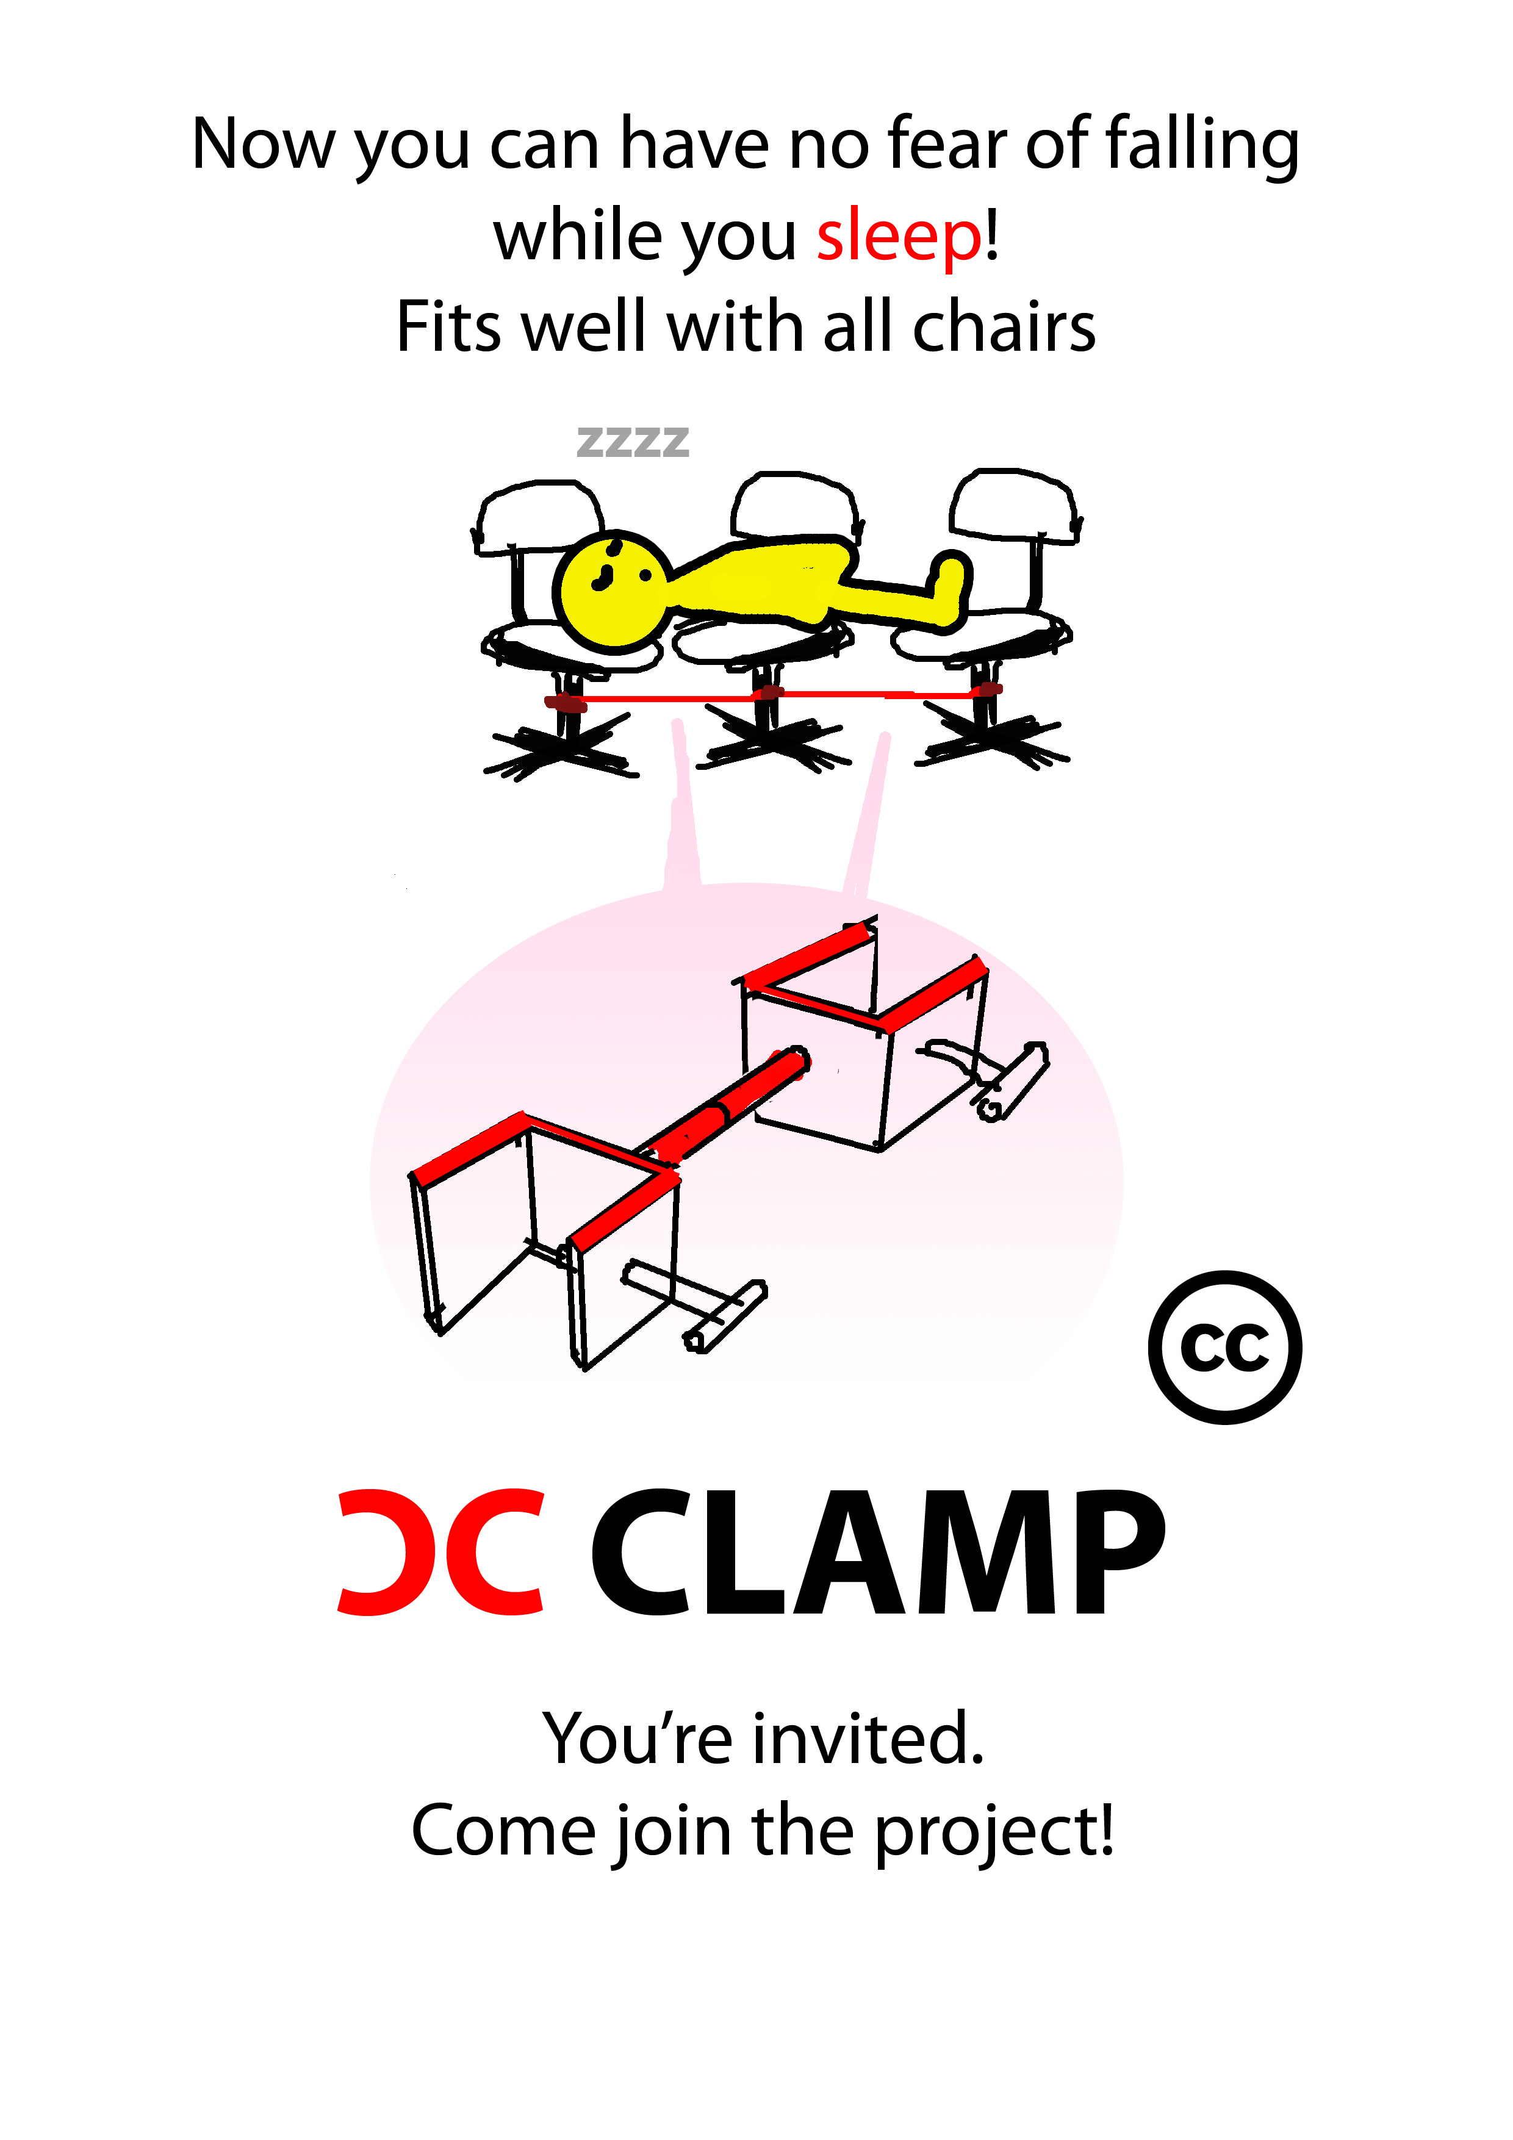
05. Open Design Activity Poster
Final posters for promoting the Open Design projects, first version and second modification.

Slide 34
03.
Example 02:
A workshop in Helsinki

Slide 35
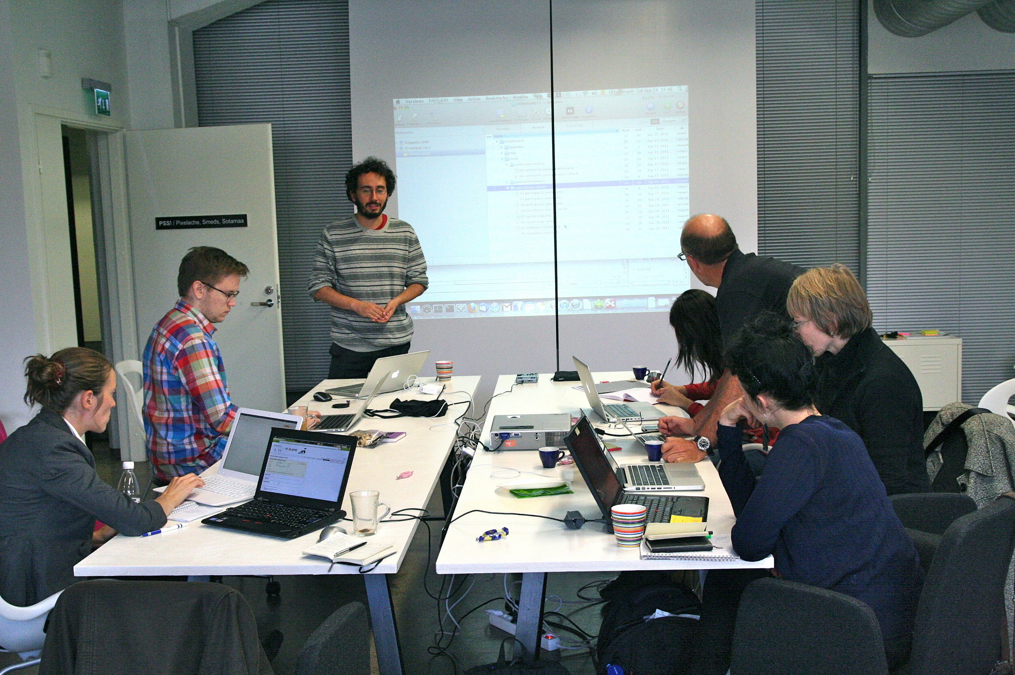
Open P2P Design Workshop, Helsinki, Pixelache
16-24 September 2011, Pixelache
Source: http://www.pixelache.ac/pixelversity/programme-2011/open-p2p-design/
http://workshop.openp2pdesign.org/

Slide 36
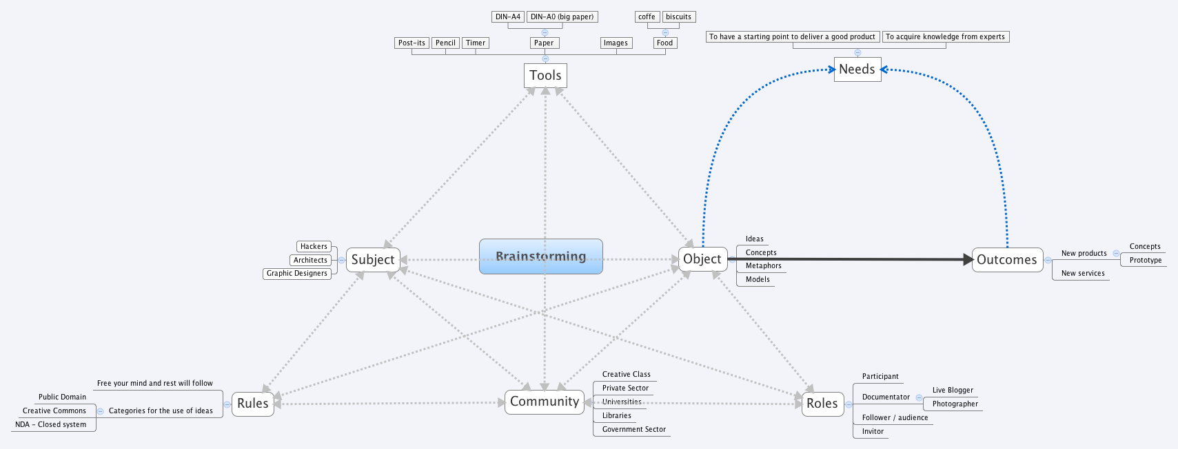
01. Community Activity Analysis
An analysis of the existing activity of the community: creative working

Slide 37
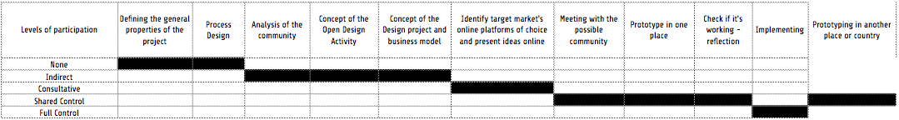
02. Process Participation Matrix
The whole process for developing the project.

Slide 38
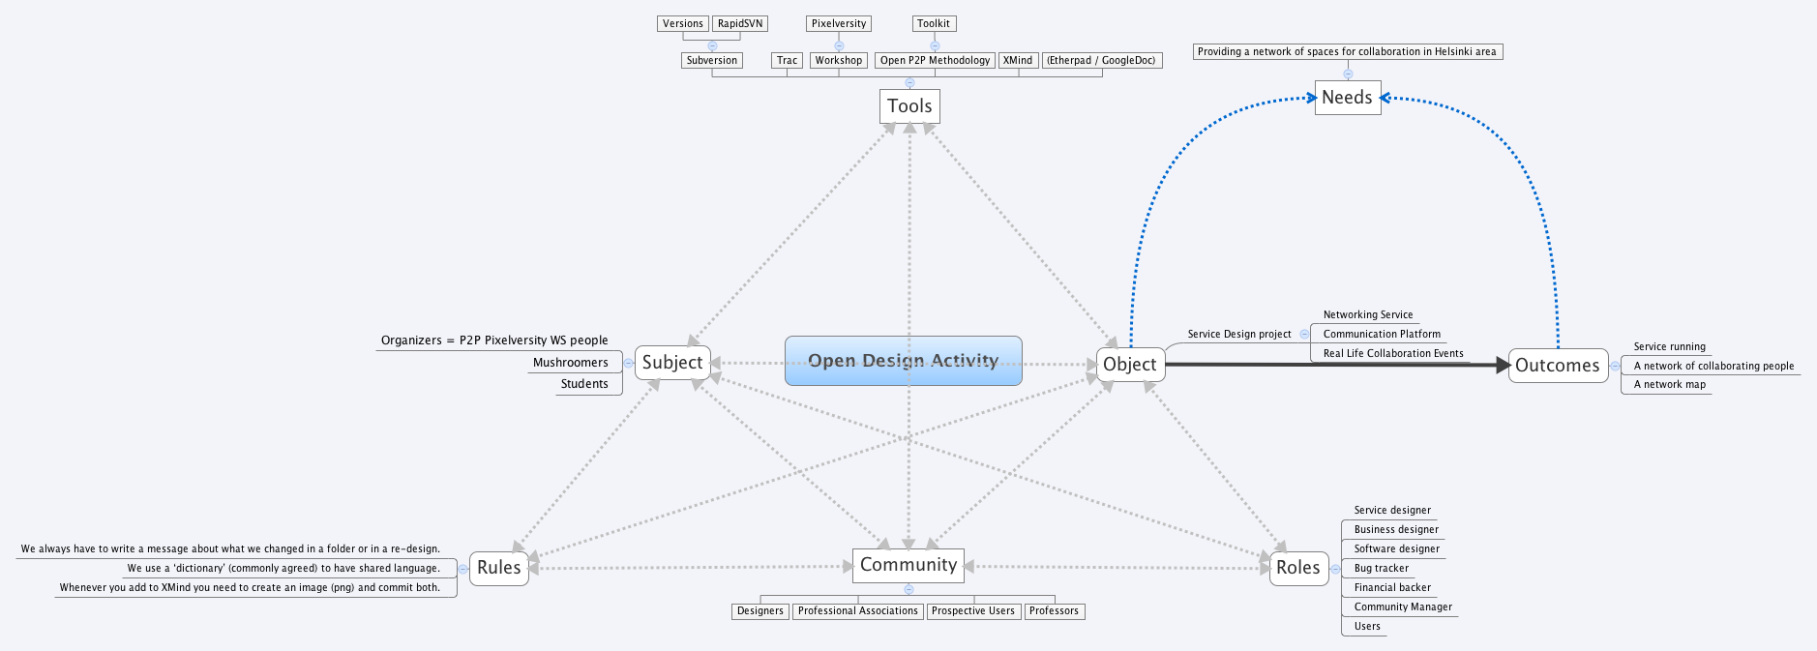
03. Open Design Activity
The activity of developing an Open Design project

Slide 39
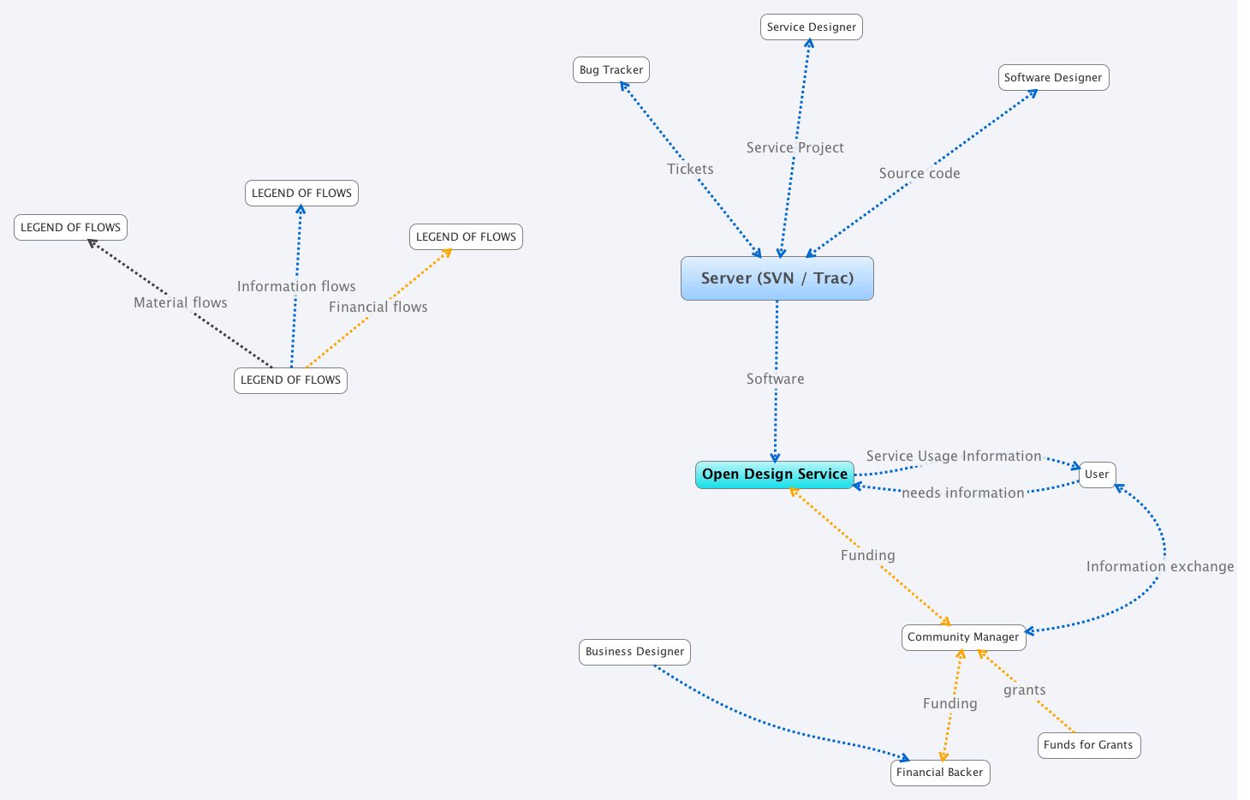
04. Open Design System Map
The flows (information, money, resources) in the development of the Open Design project.

Slide 40
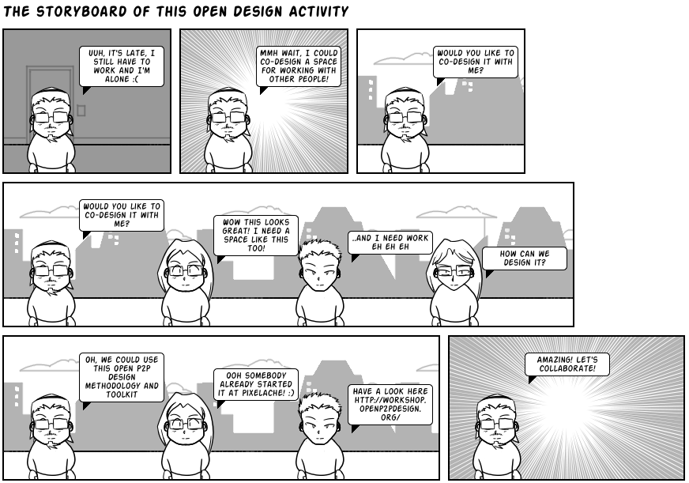
05. Open Design Storyboard
The development of the Open Design project communicated as a comic.

Slide 41
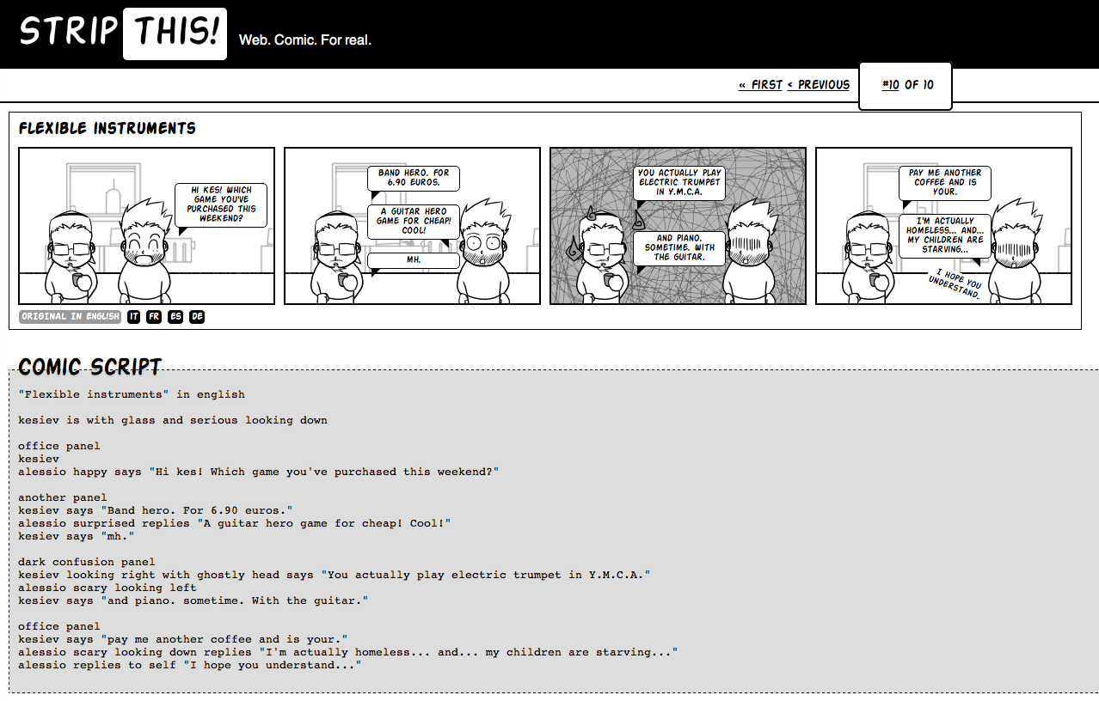
Storyboard: can be generated with software!
For generating storyboards more easily, a javascript app that turns a script into a comic.
Source: http://www.kesiev.com/stripthis/

Slide 42
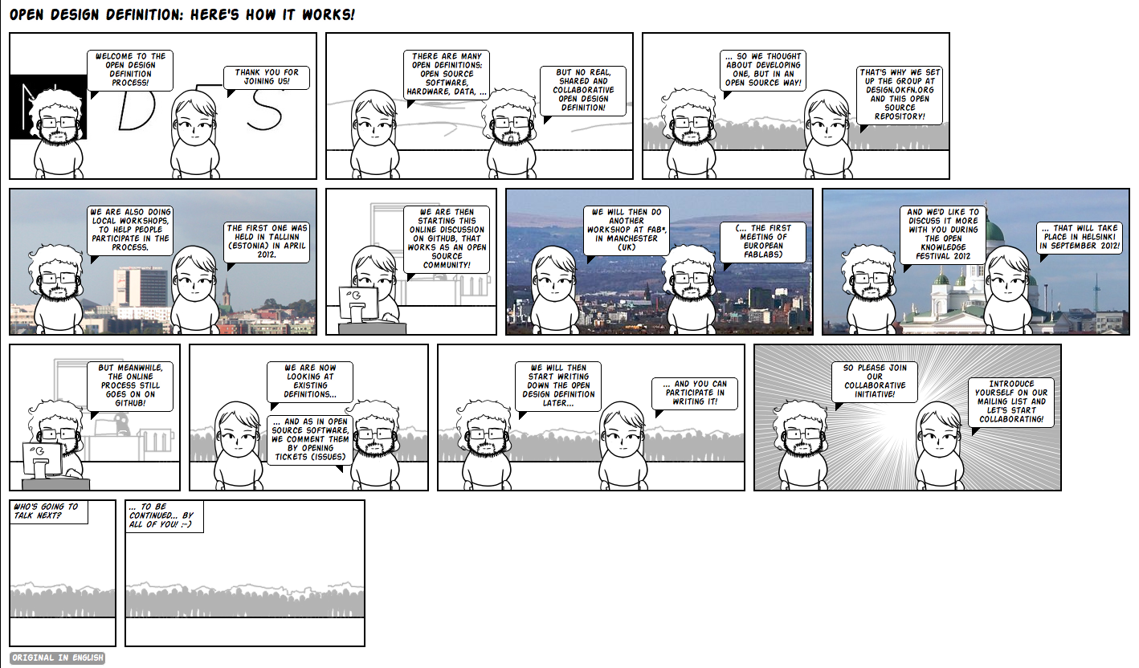
Storyboard: can be generated with software!
For generating storyboards more easily, a javascript app that turns a script into a comic.
Source: https://github.com/OpenDesign-WorkingGroup/Open-Design-Definition/tree/master/meta

Slide 43
04.
Toolkit: Open MetaDesign

Slide 44
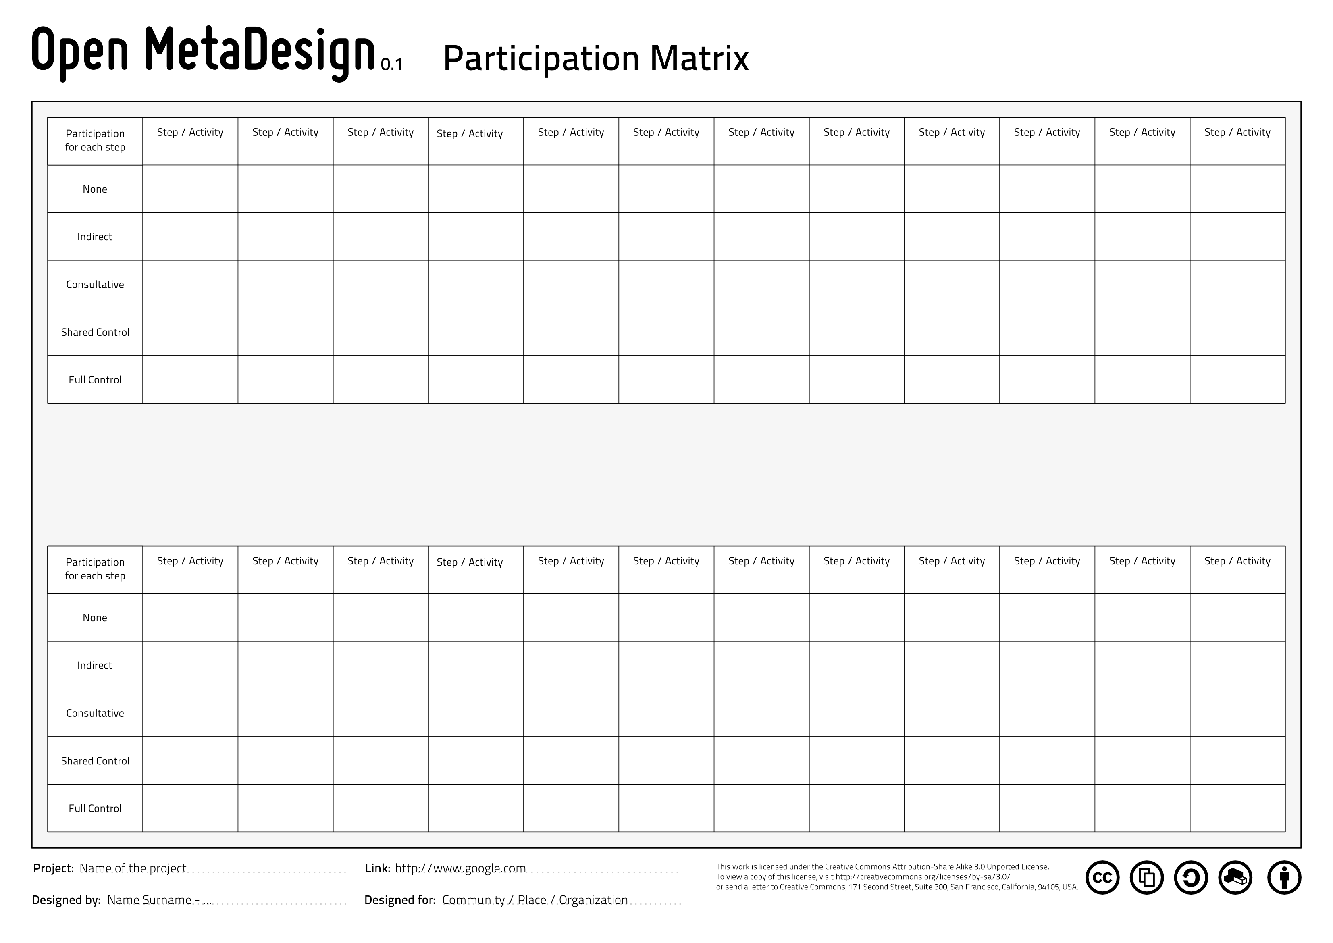
Participation Matrix
Source: https://github.com/OpenP2PDesignOrg/OpenMetaDesignToolkit/

Slide 45
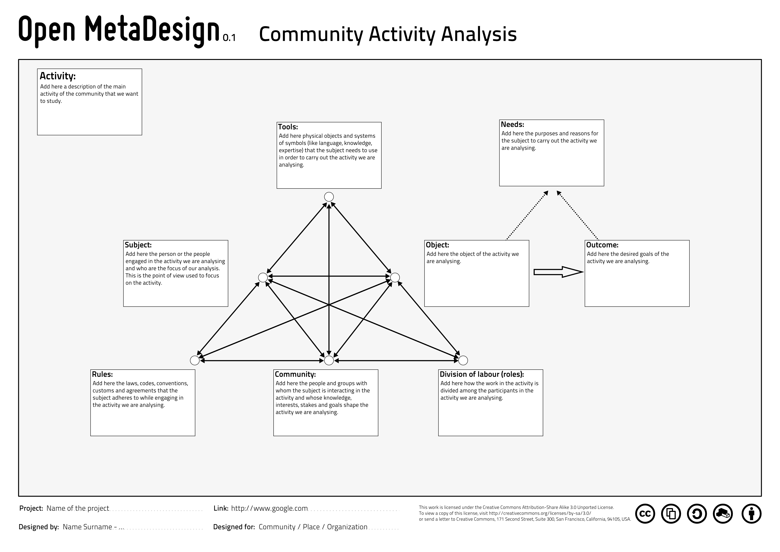
Community Activity Analysis
Source: https://github.com/OpenP2PDesignOrg/OpenMetaDesignToolkit/

Slide 46
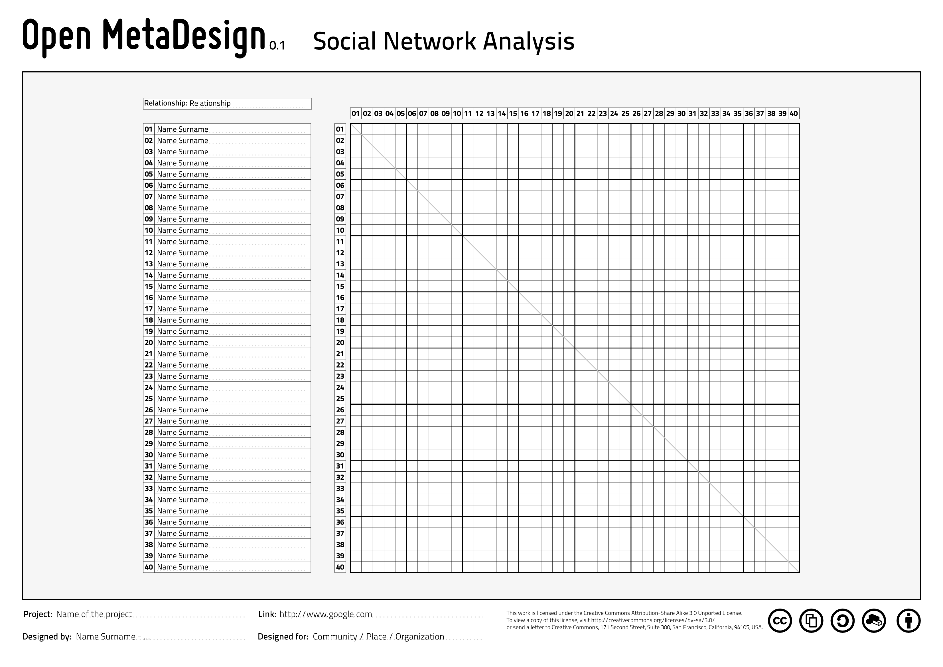
Community Social Network Analysis
Source: https://github.com/OpenP2PDesignOrg/OpenMetaDesignToolkit/

Slide 47
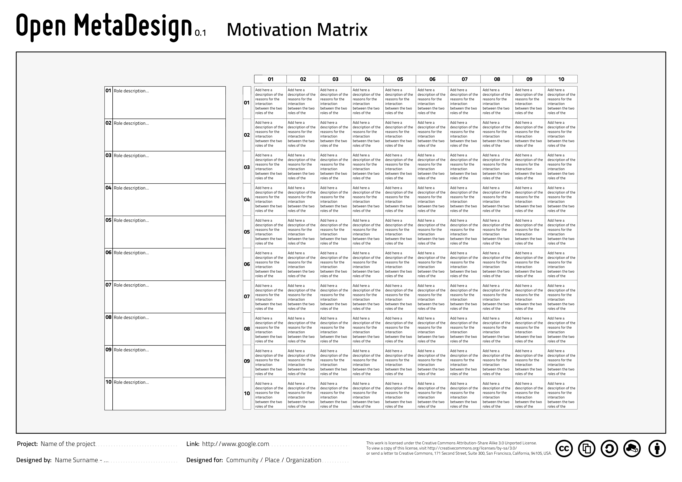
Open Activity Motivation Matrix
Source: https://github.com/OpenP2PDesignOrg/OpenMetaDesignToolkit/

Slide 48
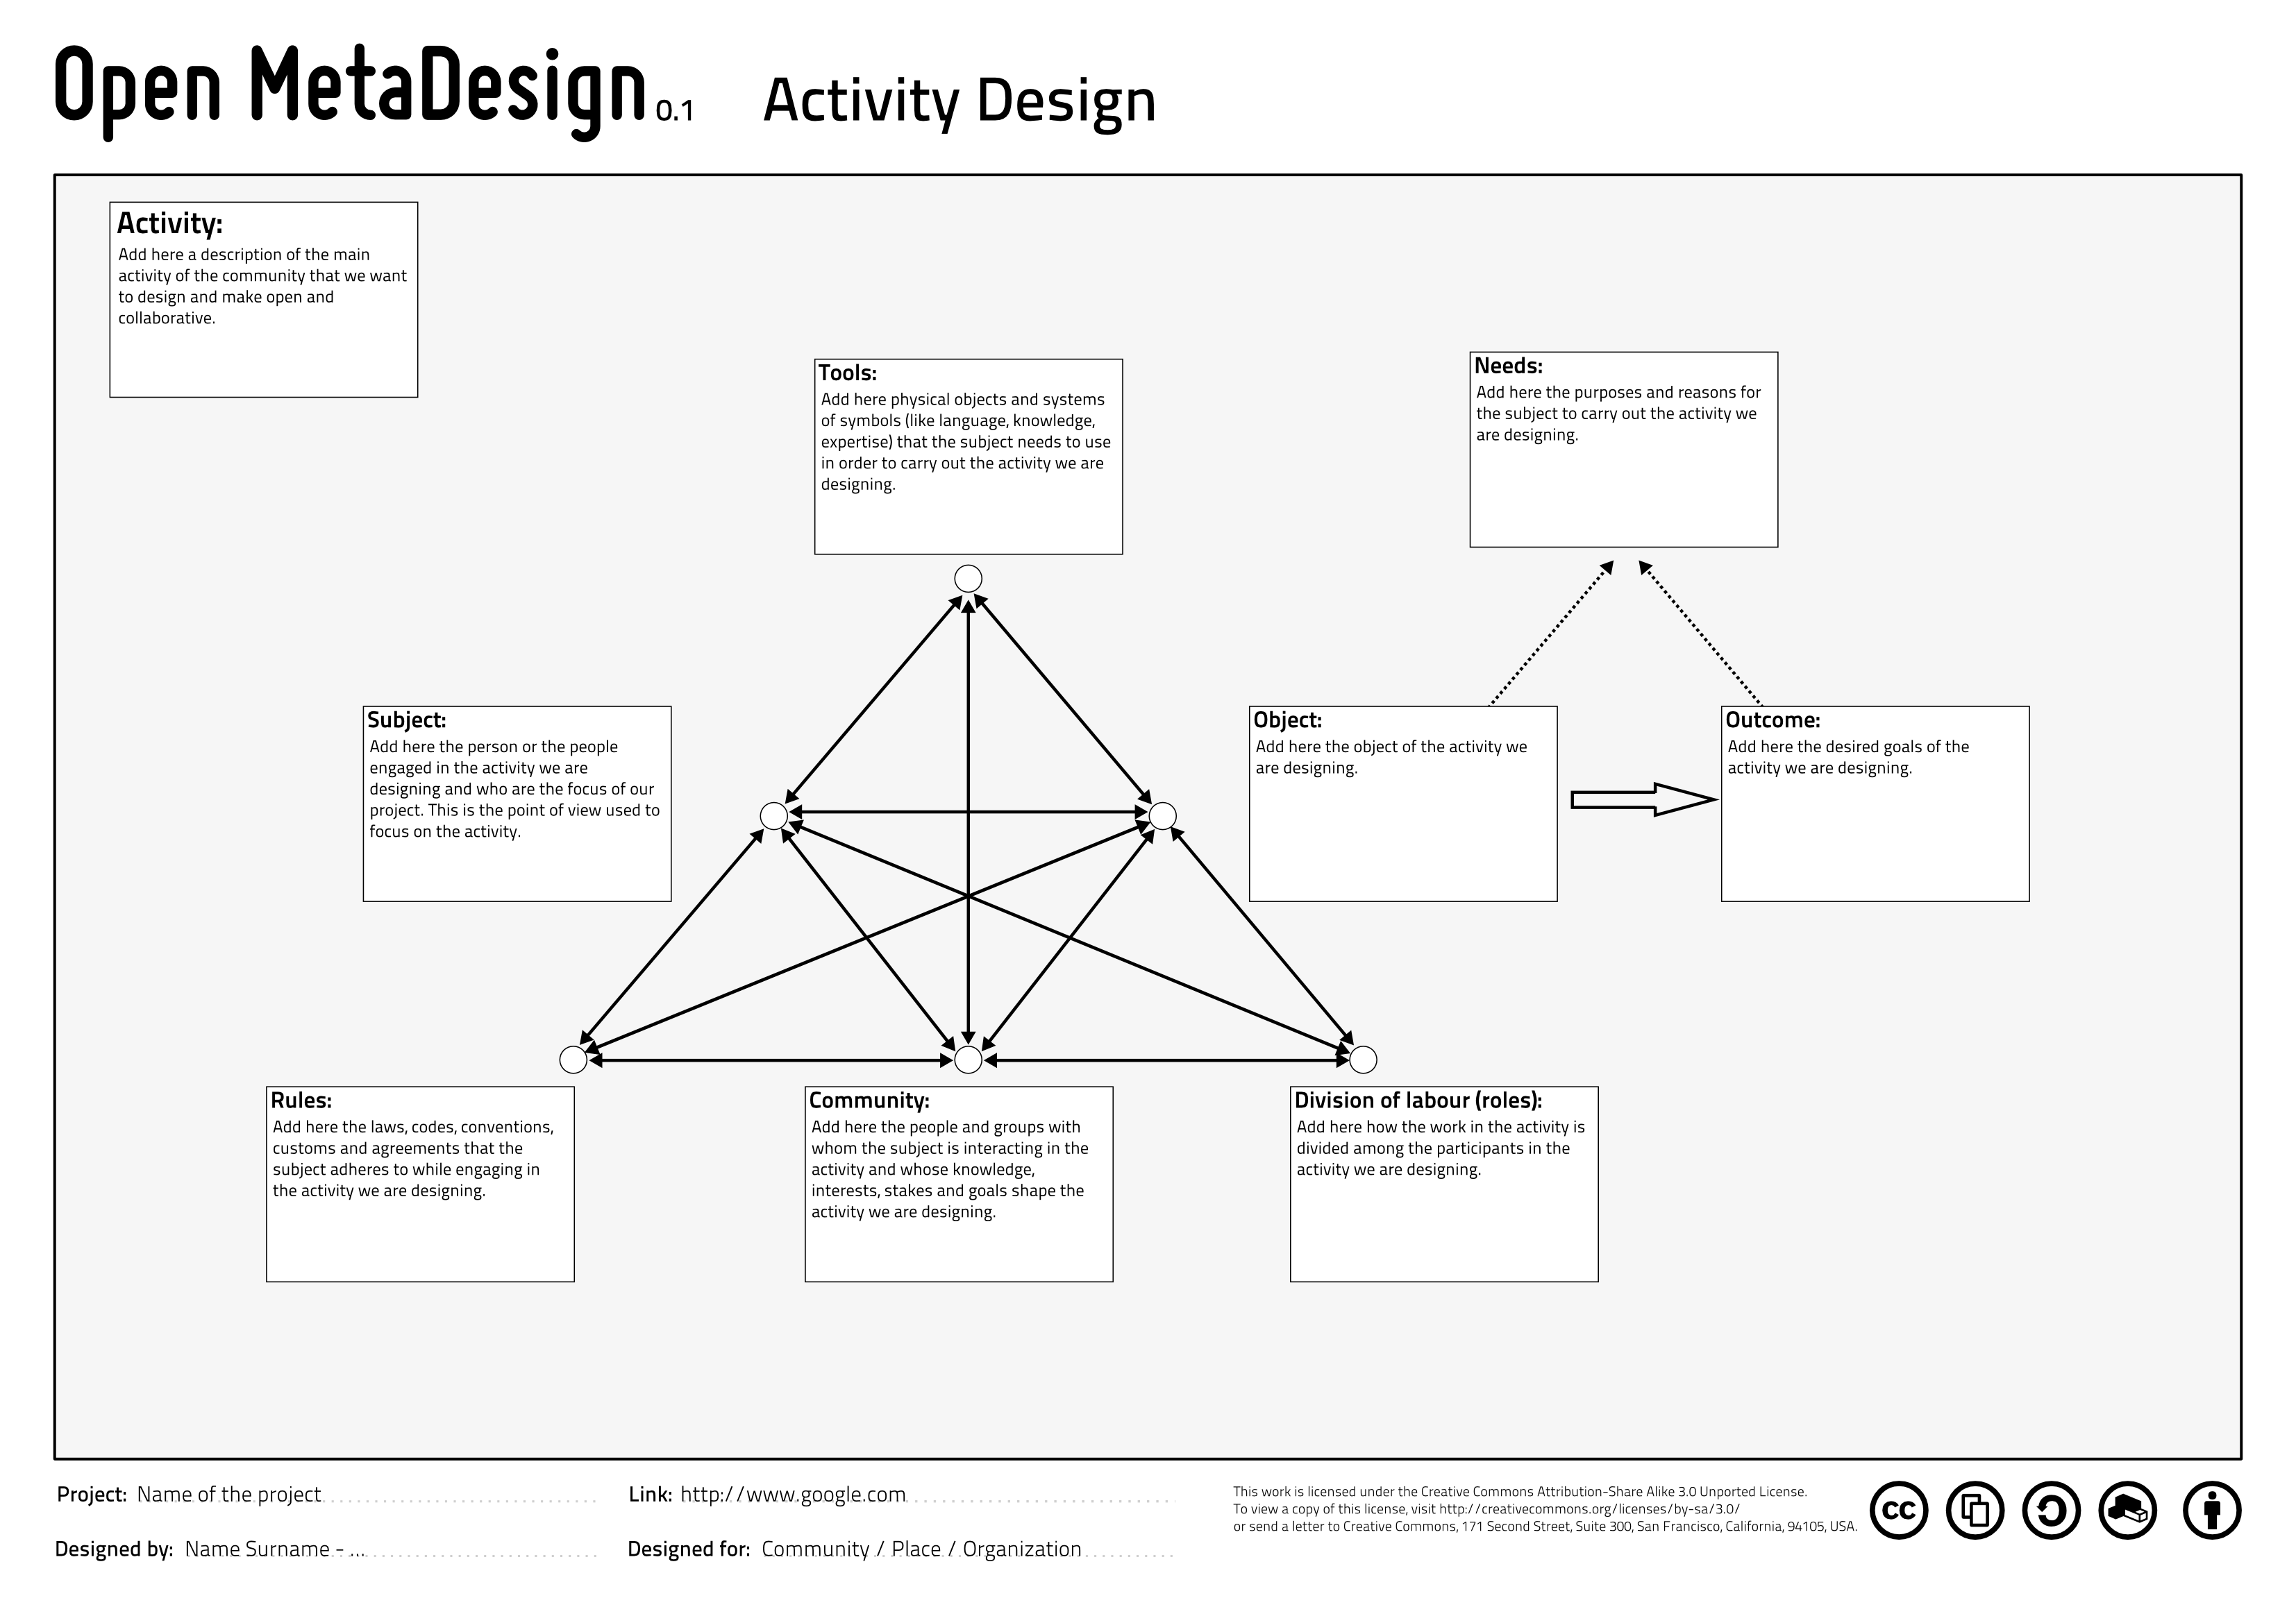
Open Design Activity
Source: https://github.com/OpenP2PDesignOrg/OpenMetaDesignToolkit/

Slide 49
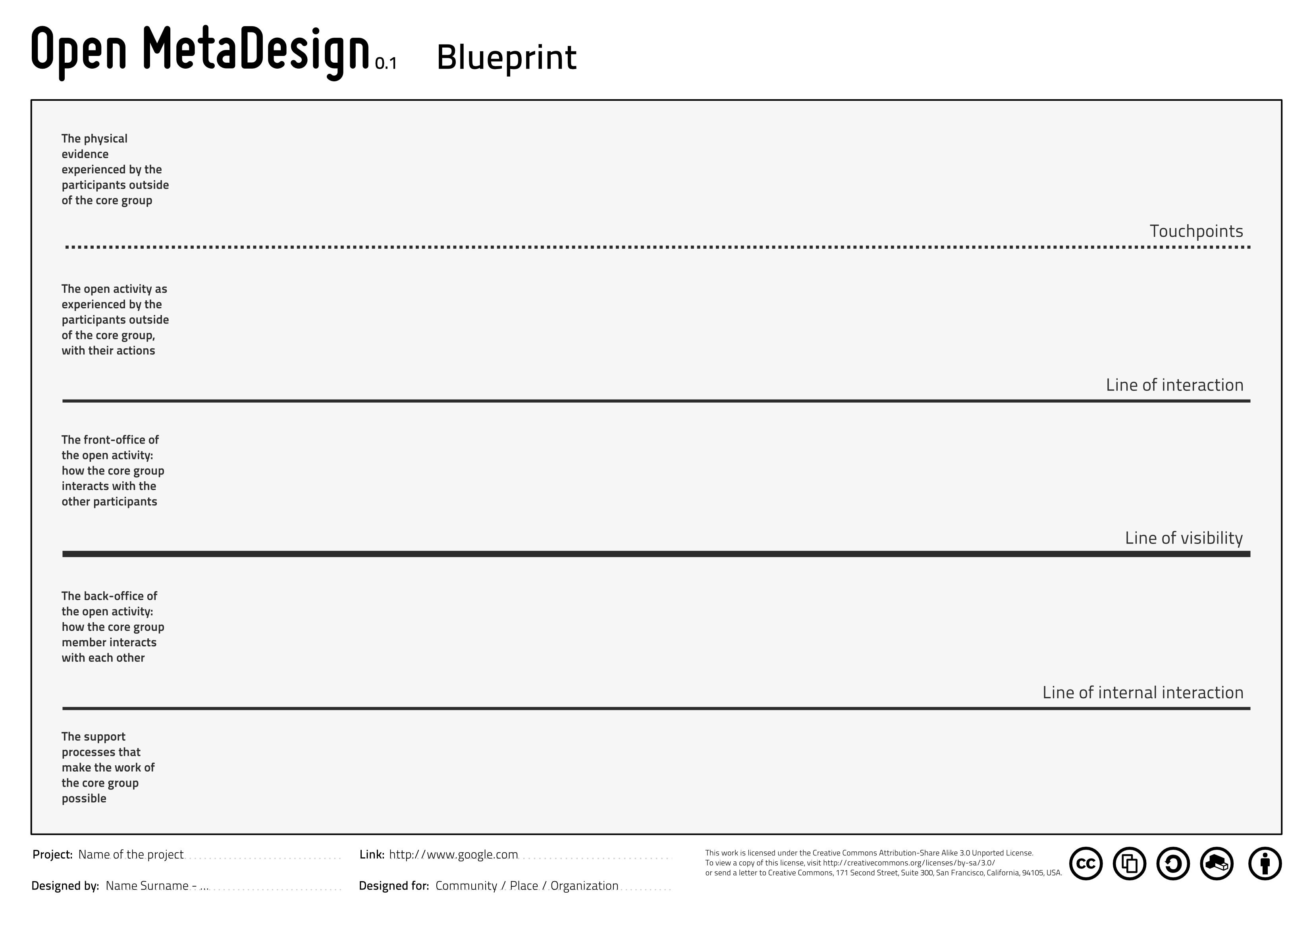
Open Activity Blueprint
Source: https://github.com/OpenP2PDesignOrg/OpenMetaDesignToolkit/

Slide 50
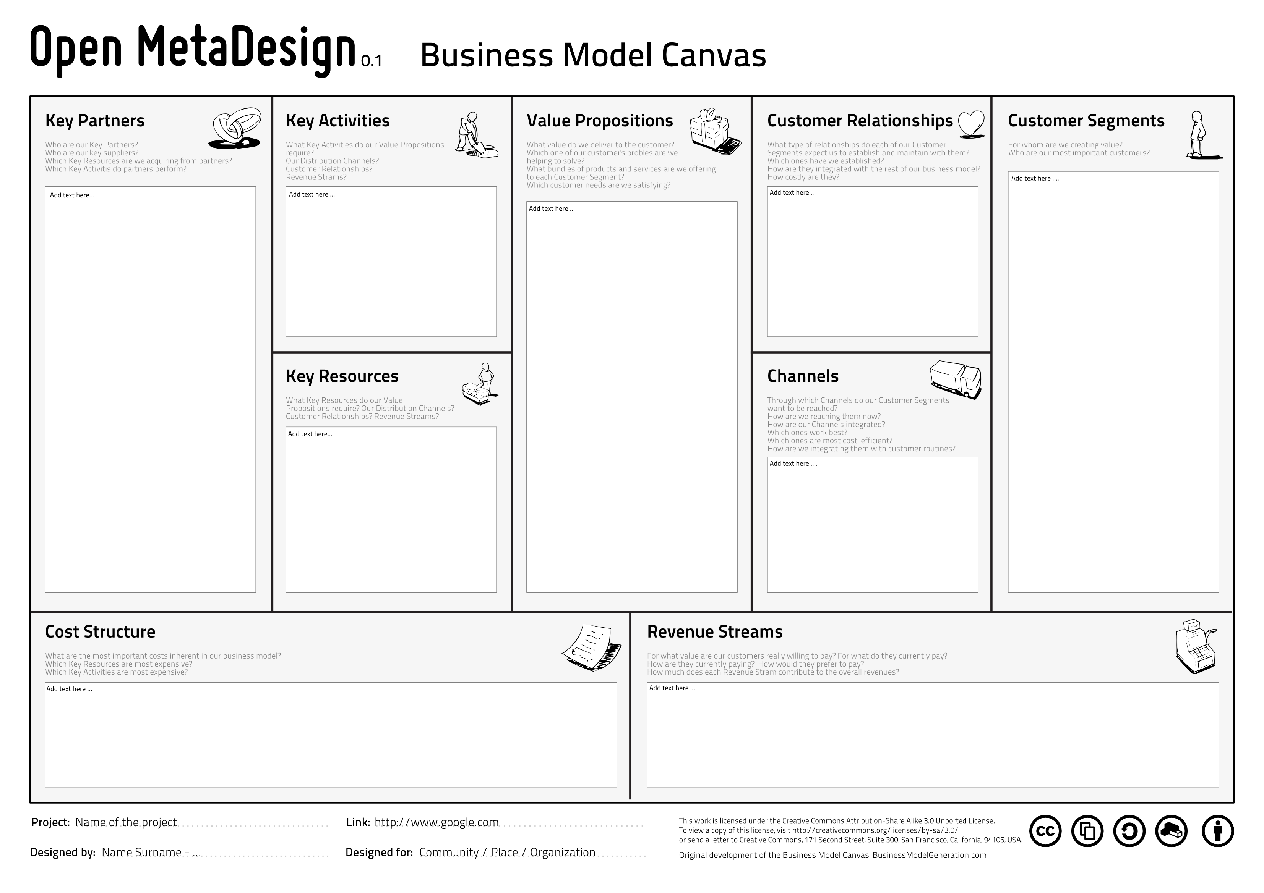
Open Activity Business Model Canvas
Source: https://github.com/OpenP2PDesignOrg/OpenMetaDesignToolkit/

Slide 51
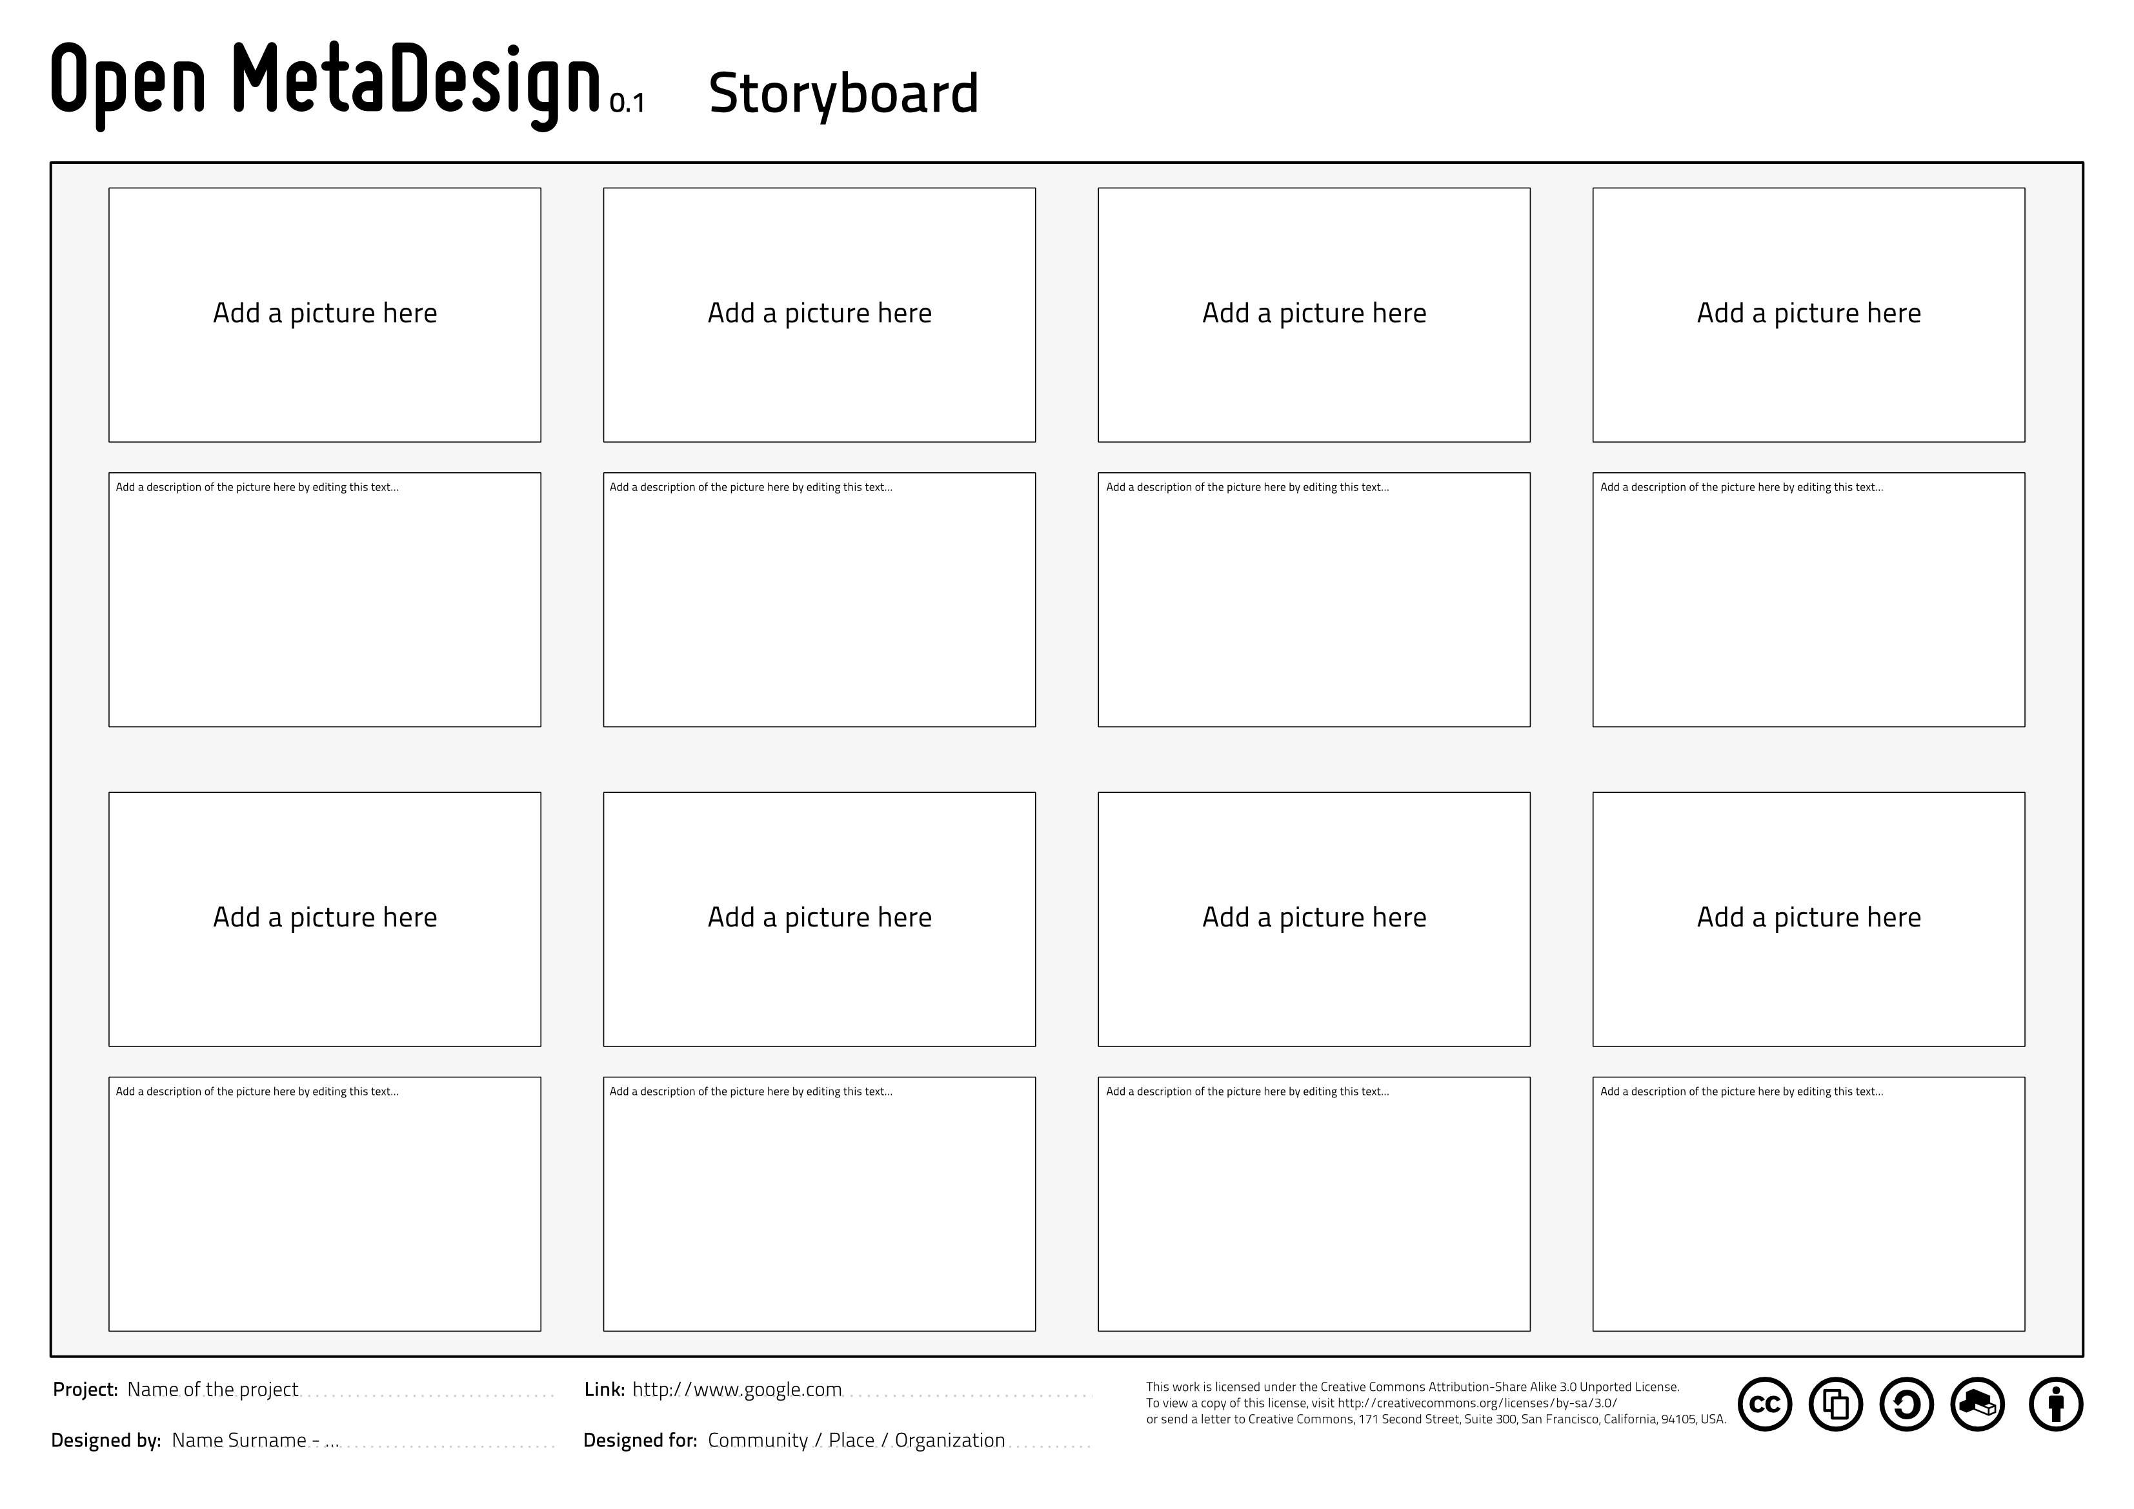
Open Activity Business Model Canvas
Source: https://github.com/OpenP2PDesignOrg/OpenMetaDesignToolkit/

Slide 52
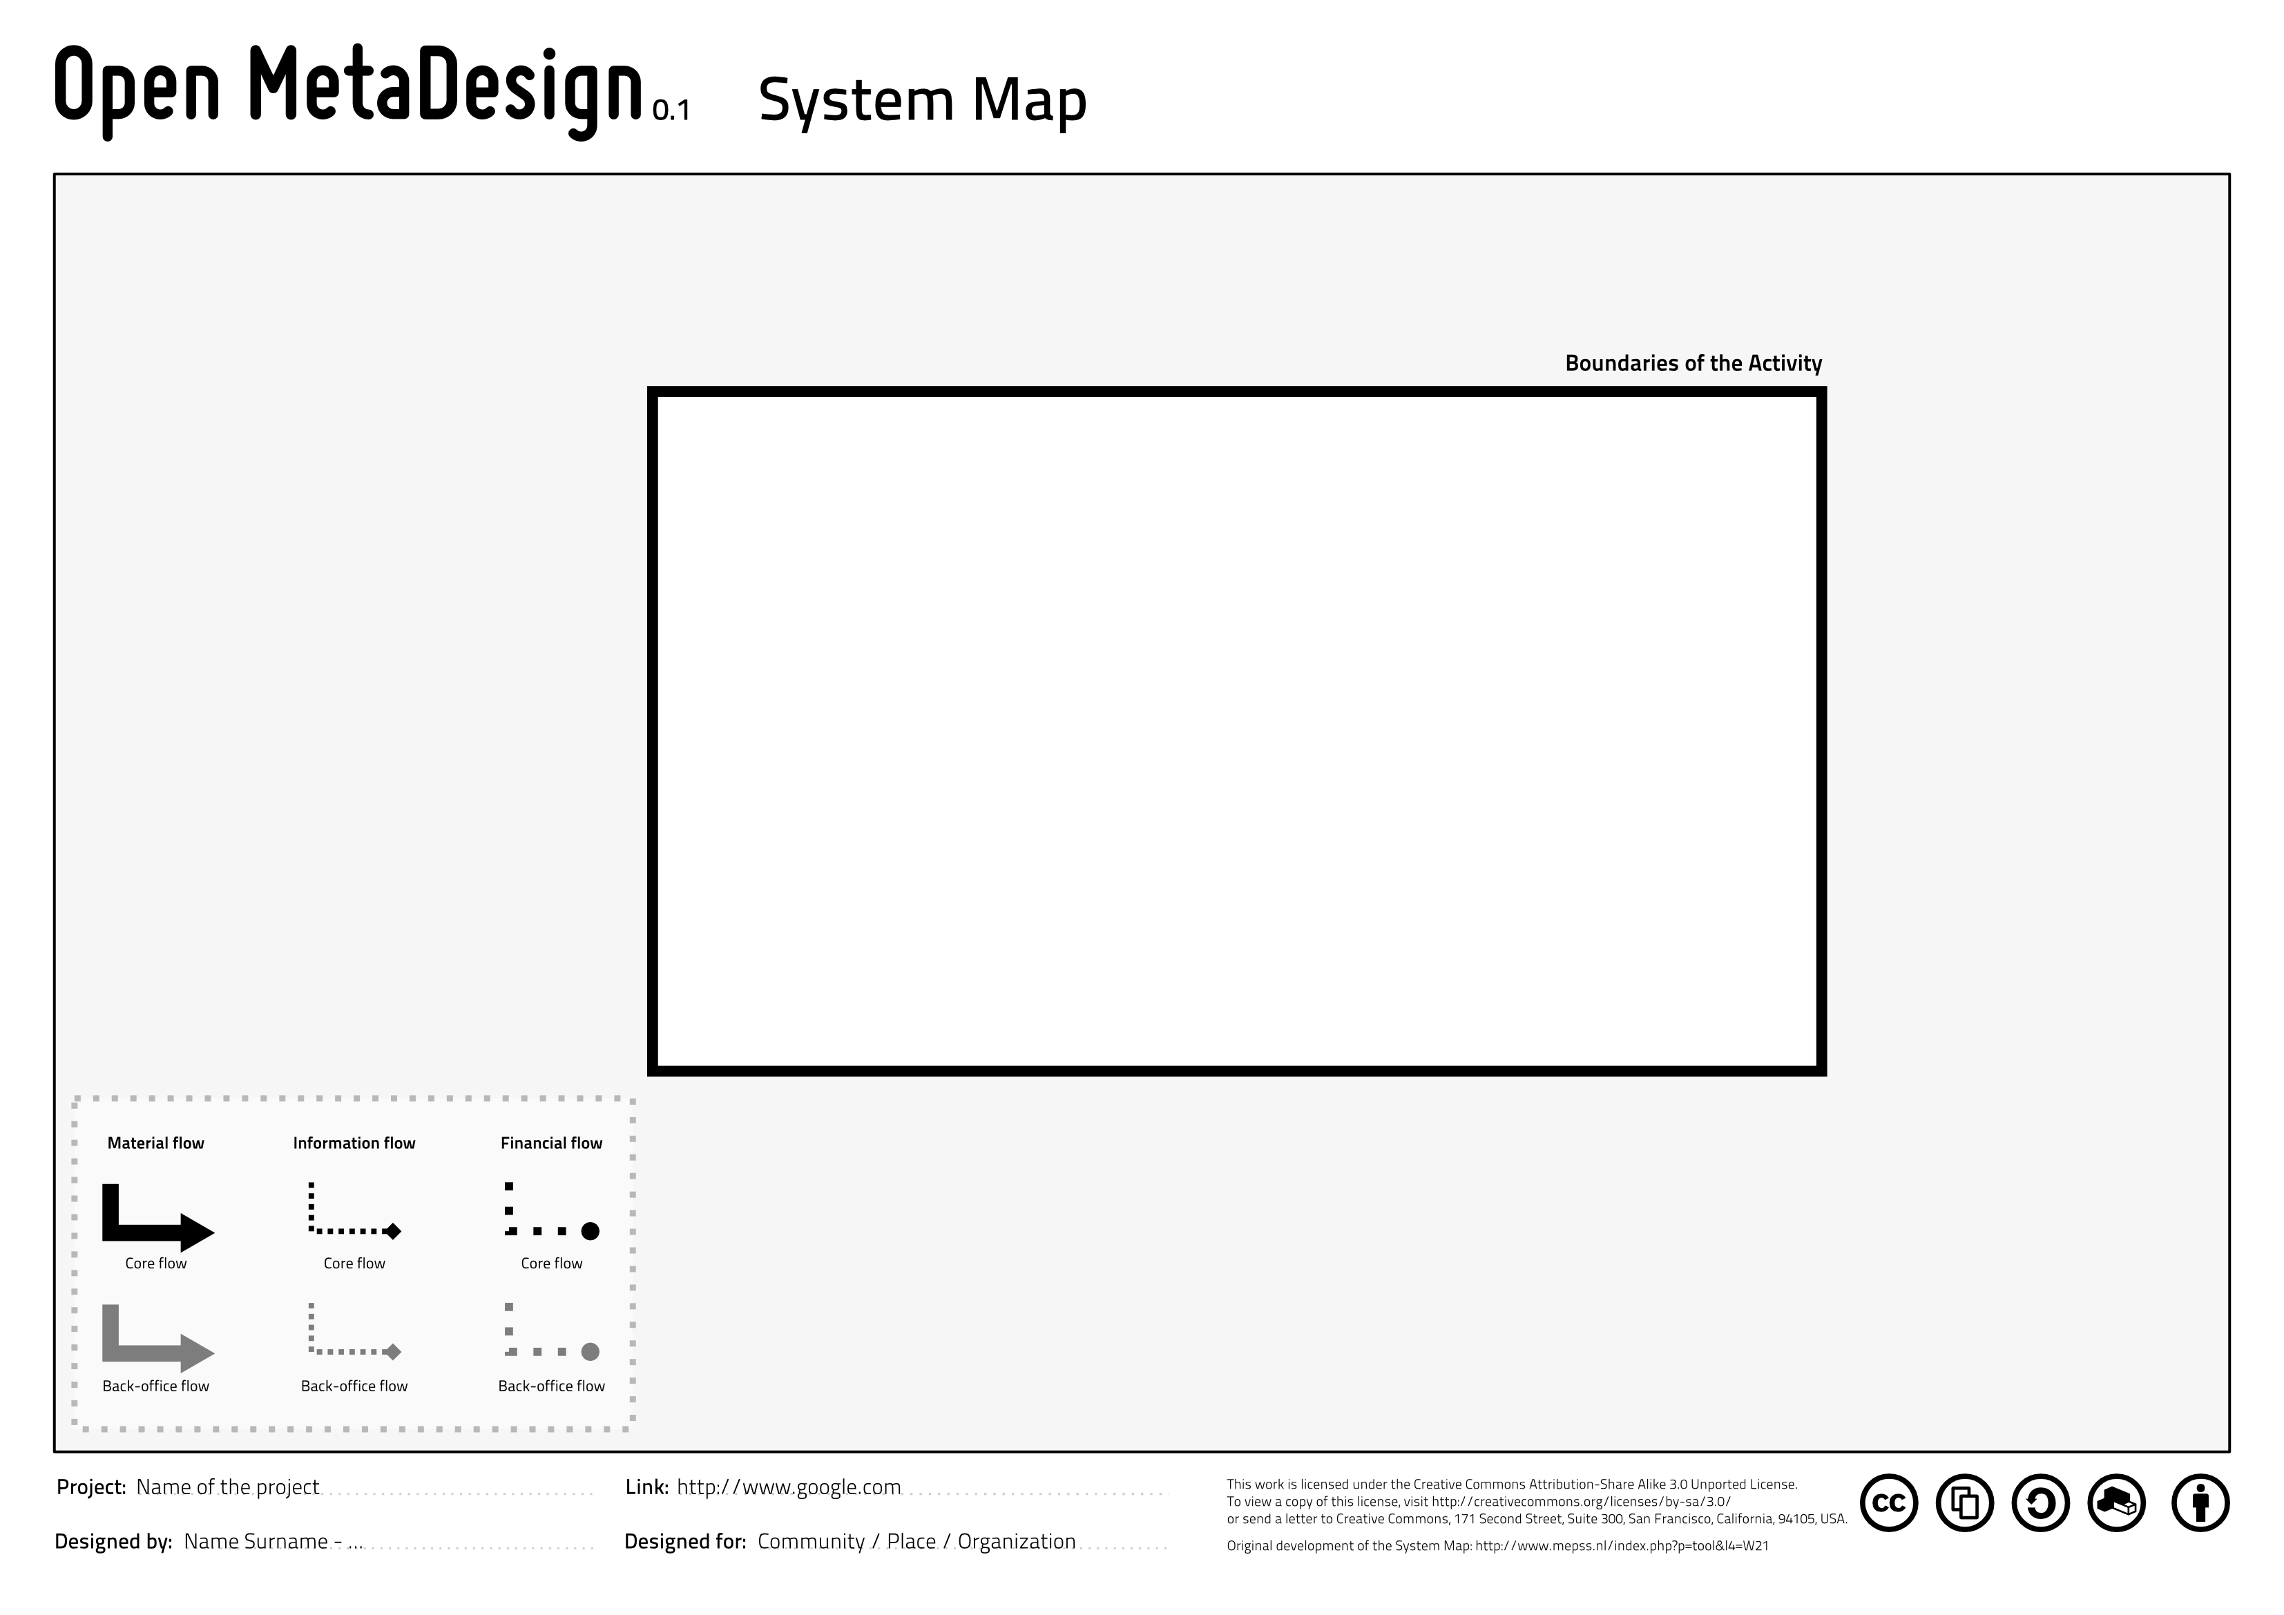
Open Activity Business Model Canvas
Source: https://github.com/OpenP2PDesignOrg/OpenMetaDesignToolkit/

Slide 53
05.
Work for today:
Each project manager should create a repository for its team with the team name in the Designing Open Innovation organization

Slide 54
05.
Work for today:
Each team: define your team name

Slide 55
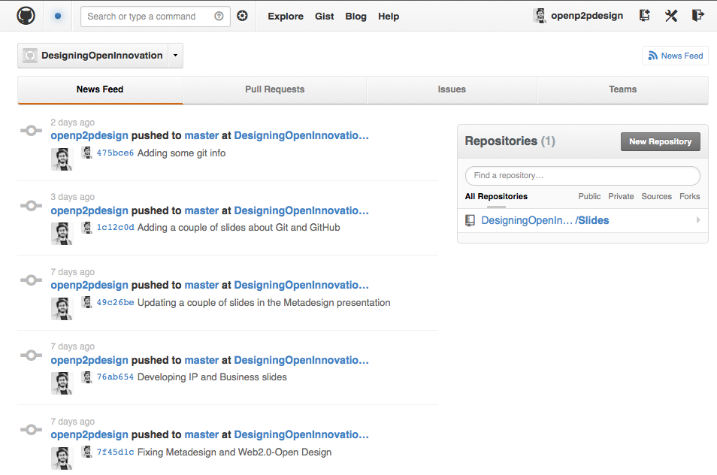
Our repo on GitHub!
This is where we will work together!
Source: https://github.com/organizations/DesigningOpenInnovation

Slide 56
06.
Work for today:
Start designing your process and analysing your community

Slide 57
Thank you!!
Massimo Menichinelli
Aalto Media Factory massimo.menichinelli@aalto.fi
@openp2pdesign http://www.slideshare.net/openp2pdesign
12.03.2013

