Slide 1

DesigningOpenInnovation.01
Open Source and Open Innovation
Massimo Menichinelli massimo.menichinelli@aalto.fi
@openp2pdesign http://www.slideshare.net/openp2pdesign
11.03.2013

Slide 2
01.
Free Software and Open Source

Slide 3
What is Open Source (Software)? A generic definition
A (software) project published with a license that facilitates its access + modifying + sharing in a collaborative way.
A (software) project developed collaboratively by a community, based not on hierarchy but on reputation.
A new model of mass collaboration, based on user-generated content and commenting.
Source: http://www.time.com/time/magazine/article/0,9171,1570810,00.html

Slide 4
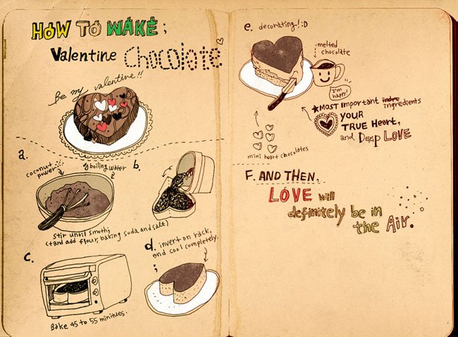
Why Open Source in Software?
Source Code (human readable) --> Binary Code (machine readable)
Source: http://www.flickr.com/photos/nyoin/3342043239/

Slide 5

Why Open Source in Software?
Source Code (human readable) --> Binary Code (machine readable)
Source: http://www.flickr.com/photos/exlibris/2997090116/

Slide 6


Why Open Source in Software?
Source Code (human readable) --> Binary Code (machine readable)
Source: http://www.flickr.com/photos/ladymixy-uk/3650120464/

Slide 7
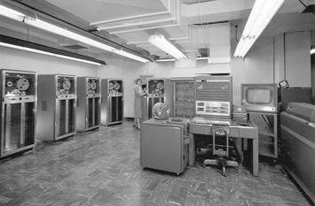
History of Open Source: the beginning
Few big computers: Software given as free, time and collaboration are the great resource people share.
Source: http://en.wikipedia.org/wiki/Mainframe_computer

Slide 8
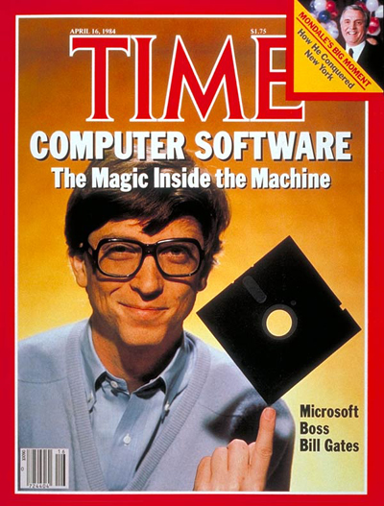
History of Open Source: closed software
'80s: Software becomes closed for making (more) business.
Source: http://www.time.com/time/covers/0,16641,19840416,00.html

Slide 9
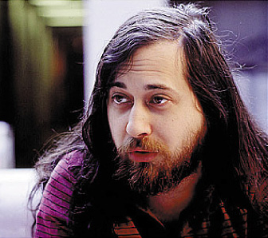

History of Open Source: Free software
'80s: An hacker tries to make it Open (or, Free) again.
Source: http://en.wikipedia.org/wiki/Richard_Stallman
http://en.wikipedia.org/wiki/GNU_Project

Slide 10
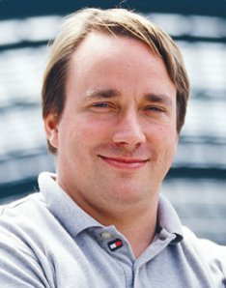

History of Open Source: Linux
'90s-...: Linux is created thanks to Internet.
Source: http://en.wikipedia.org/wiki/Linus_Torvalds http://en.wikipedia.org/wiki/Linux

Slide 11

History of Open Source: Open Source software
With the Free/Open term war Open Source becomes successful.
Source: http://en.wikipedia.org/wiki/Open_Source_Initiative

Slide 12

Open Source Softwares: PHP+MySQL+Apache
On the majority of web servers: LAMP stack
(L)inux (A)pache (M)ySQL (P)hp

Slide 13

Open Source Softwares: Mozilla
Browsing the web and reading e-mails...

Slide 14
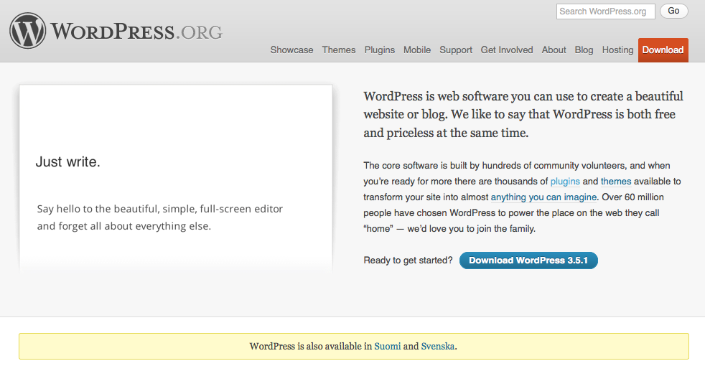
Open Source Softwares (just few examples)
Now it is even easier to run a website...
Source: http://wordpress.org/

Slide 15
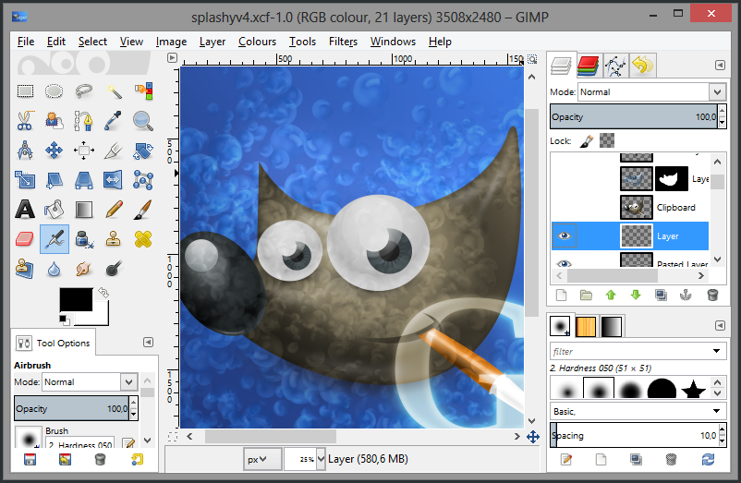
Open Source Softwares: GIMP
Now it is even easier to edit pictures...
Source: http://gimp.org http://gimp-win.sourceforge.net/

Slide 16
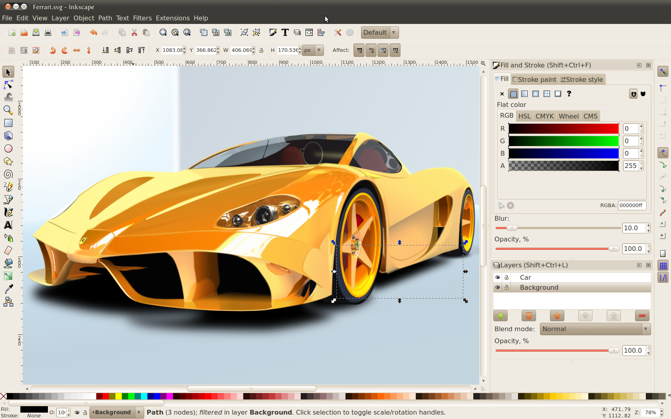
Open Source Softwares: Inkscape
Now it is even easier to edit vector drawings...
Source: http://inkscape.org/

Slide 17
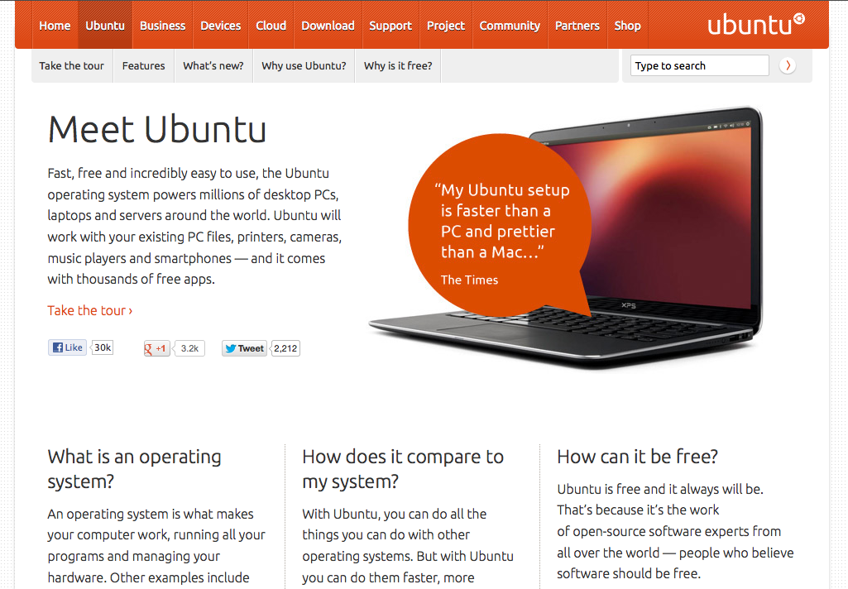
Open Source Softwares: Ubuntu
The most usable Linux distribution
Source: http://www.ubuntu.com/ubuntu

Slide 18
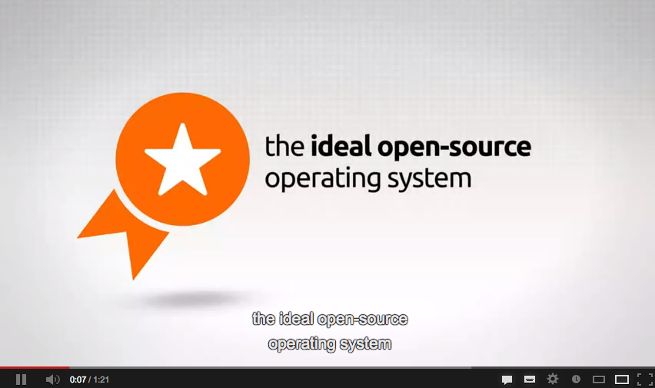
Open Source Softwares: Ubuntu
The most usable Linux distribution
Source: https://www.youtube.com/watch?v=t8rvCf7y6O4

Slide 19
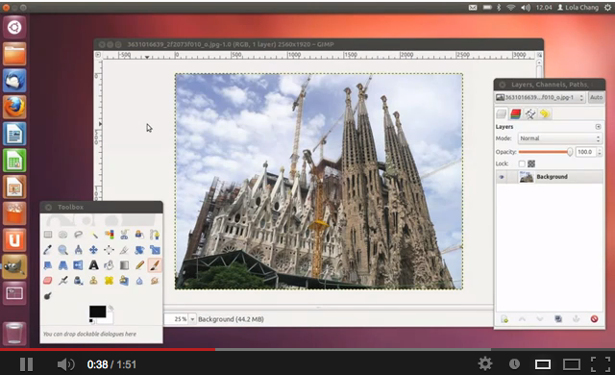
Open Source Softwares: Ubuntu
The most usable Linux distribution
Source: https://www.youtube.com/watch?v=Rk62hRBDLGc

Slide 20
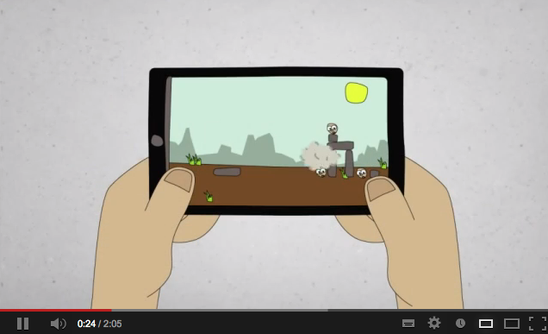
Open Source Softwares: Ubuntu on Android
The most usable Linux distribution
Source: https://www.youtube.com/watch?v=iv1Z7bf4jXY

Slide 21
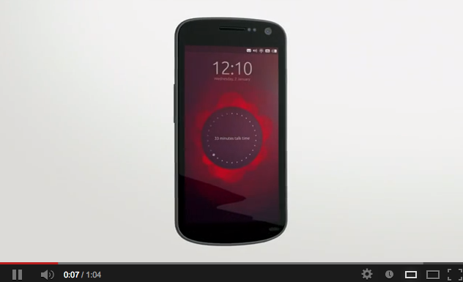
Open Source Softwares: Ubuntu Mobile
The most usable Linux distribution
Source: https://www.youtube.com/watch?v=LoXpLUr5WB4

Slide 22
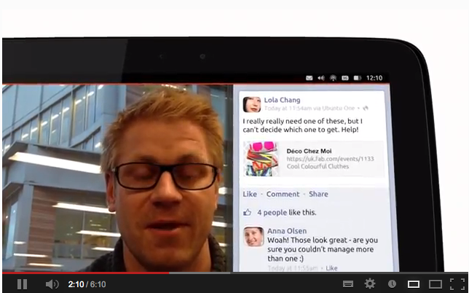
Open Source Softwares: Ubuntu Tablet
The most usable Linux distribution
Source: https://www.youtube.com/watch?v=h384z7Ph0gU

Slide 23
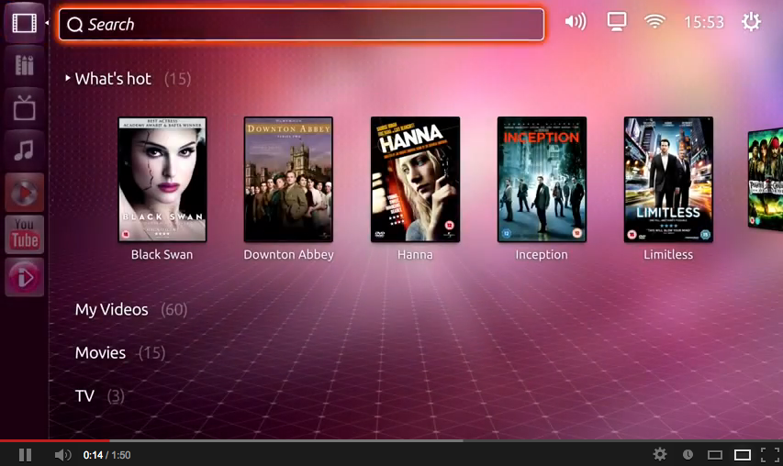
Open Source Softwares: Ubuntu TV
The most usable Linux distribution
Source: https://www.youtube.com/watch?v=jq_WaOLjdyQ

Slide 24
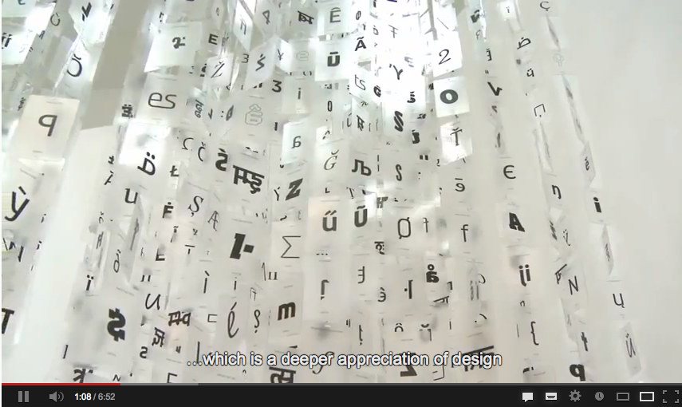
Open Source Softwares: Ubuntu Fonts
The most usable Linux distribution
Source: https://www.youtube.com/watch?v=BG-Q7hTKCws

Slide 25
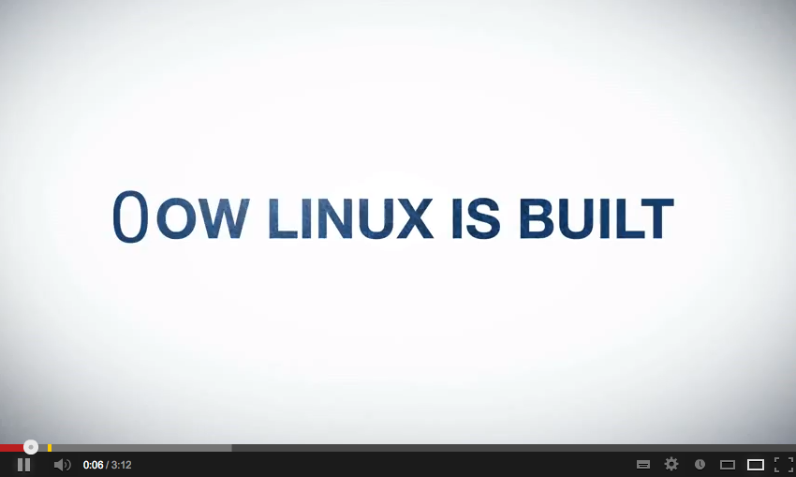
How Linux is made...
Stats and numbers about the development of Linux.
Source: https://www.youtube.com/watch?v=yVpbFMhOAwE

Slide 26
Licenses: New BSD license
Copyright (c) <year>, <copyright holder>
All rights reserved.
Redistribution and use in source and binary forms, with or without modification, are permitted provided that the following conditions are met:
* Redistributions of source code must retain the above copyright notice, this list of conditions and the following disclaimer.
* Redistributions in binary form must reproduce the above copyright notice, this list of conditions and the following disclaimer in the documentation and/or other materials provided with the distribution.
* Neither the name of the <organization> nor the names of its contributors may be used to endorse or promote products derived from this software without specific prior written permission.
THIS SOFTWARE IS PROVIDED BY THE COPYRIGHT HOLDERS AND CONTRIBUTORS "AS IS" AND ANY EXPRESS OR IMPLIED WARRANTIES, INCLUDING, BUT NOT LIMITED TO, THE IMPLIED WARRANTIES OF MERCHANTABILITY AND FITNESS FOR A PARTICULAR PURPOSE ARE DISCLAIMED. IN NO EVENT SHALL <COPYRIGHT HOLDER> BE LIABLE FOR ANY DIRECT, INDIRECT, INCIDENTAL, SPECIAL, EXEMPLARY, OR CONSEQUENTIAL DAMAGES (INCLUDING, BUT NOT LIMITED TO, PROCUREMENT OF SUBSTITUTE GOODS OR SERVICES; LOSS OF USE, DATA, OR PROFITS; OR BUSINESS INTERRUPTION) HOWEVER CAUSED AND ON ANY THEORY OF LIABILITY, WHETHER IN CONTRACT, STRICT LIABILITY, OR TORT (INCLUDING NEGLIGENCE OR OTHERWISE) ARISING IN ANY WAY OUT OF THE USE OF THISSOFTWARE, EVEN IF ADVISED OF THE POSSIBILITY OF SUCH DAMAGE.
BSD licenses are a family of permissive free software licenses, imposing minimal restrictions on the redistribution of covered software
Source: http://en.wikipedia.org/wiki/BSD_licenses

Slide 27
Licenses: MIT license
Copyright (C) <year> <copyright holders>
Permission is hereby granted, free of charge, to any person obtaining a copy of this software and associated documentation files (the "Software"), to deal in the Software without restriction, including without limitation the rights to use, copy, modify, merge, publish, distribute, sublicense, and/or sell copies of the Software, and to permit persons to whom the Software is furnished to do so, subject to the following conditions:
The above copyright notice and this permission notice shall be included in all copies or substantial portions of the Software.
THE SOFTWARE IS PROVIDED "AS IS", WITHOUT WARRANTY OF ANY KIND, EXPRESS OR IMPLIED, INCLUDING BUT NOT LIMITED TO THE WARRANTIES OF MERCHANTABILITY, FITNESS FOR A PARTICULAR PURPOSE AND NONINFRINGEMENT. IN NO EVENT SHALL THE AUTHORS OR COPYRIGHT HOLDERS BE LIABLE FOR ANY CLAIM, DAMAGES OR OTHER LIABILITY, WHETHER IN AN ACTION OF CONTRACT, TORT OR OTHERWISE, ARISING FROM, OUT OF OR IN CONNECTION WITH THE SOFTWARE OR THE USE OR OTHER DEALINGS IN THE SOFTWARE.
The MIT License is a free software license originating at the Massachusetts Institute of Technology (MIT).
Source: http://en.wikipedia.org/wiki/Mit_license

Slide 28
Licenses: GPL license (v.1, v.2, v.3)
Copyright © 2007 Free Software Foundation, Inc. <http://fsf.org/>
Everyone is permitted to copy and distribute verbatim copies of this license document, but changing it is not allowed.
Preamble
The GNU General Public License is a free, copyleft license for software and other kinds of works.
The licenses for most software and other practical works are designed to take away your freedom to share and change the works. By contrast, the GNU General Public License is intended to guarantee your freedom to share and change all versions of a program--to make sure it remains free software for all its users. We, the Free Software Foundation, use the GNU General Public License for most of our software; it applies also to any other work released this way by its authors. You can apply it to your programs, too.
When we speak of free software, we are referring to freedom, not price. Our General Public Licenses are designed to make sure that you have the freedom to distribute copies of free software (and charge for them if you wish), that you receive source code or can get it if you want it, that you can change the software or use pieces of it in new free programs, and that you know you can do these things.
To protect your rights, we need to prevent others from denying you these rights or asking you to surrender the rights. Therefore, you have certain responsibilities if you distribute copies of the software, or if you modify it: responsibilities to respect the freedom of others.
For example, if you distribute copies of such a program, whether gratis or for a fee, you must pass on to the recipients the same freedoms that you received. You must make sure that they, too, receive or can get the source code. And you must show them these terms so they know their rights.
Developers that use the GNU GPL protect your rights with two steps: (1) assert copyright on the software, and (2) offer you this License giving you legal permission to copy, distribute and/or modify it.
[...]
The GPL is a copyleft license, which means that derived works can only be distributed under the same license terms.
Source: http://en.wikipedia.org/wiki/GPL_license http://www.gnu.org/licenses/gpl.html

Slide 29
Definitions: Free Software
Freedom 0: The freedom to run the program for any purpose.
Freedom 1: The freedom to study how the program works, and change it to make it do what you wish.
Freedom 2: The freedom to redistribute copies so you can help your neighbor.
Freedom 3: The freedom to improve the program, and release your improvements (and modified versions in general) to the public, so that the whole community benefits.
The Free Software Definition, written by Richard Stallman and published by Free Software Foundation (FSF), defines free software.
Source: http://en.wikipedia.org/wiki/The_Free_Software_Definition

Slide 30
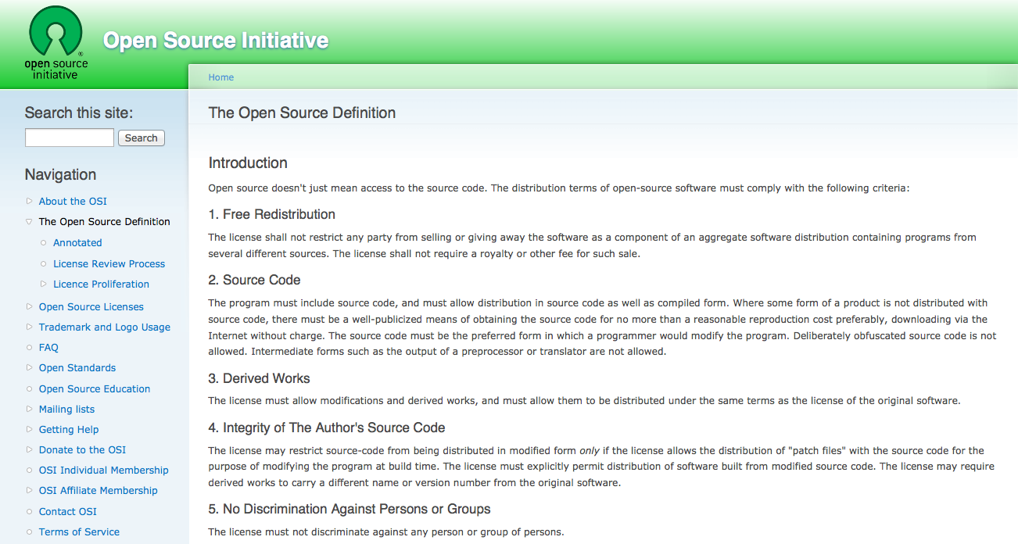
Definitions: Open Source Software
In July 1997, Bruce Perens published the Debian Free Software Guidelines, also used under the name "The Open Source Definition"
Source: http://opensource.org/osd

Slide 31
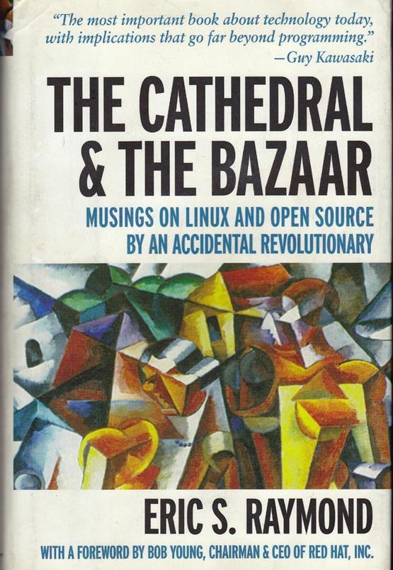
The Cathedral and the Bazaar (1997)
An essay by Eric S. Raymond on software engineering methods, based on his observations of the Linux kernel development process.
Source: http://slideshow.techworld.com/3211893/the-10-best-technology-books/
http://www.catb.org/~esr/writings/cathedral-bazaar/cathedral-bazaar/index.html#catbmain

Slide 32
02.
Open Innovation

Slide 33

Open Innovation: The New Imperative for Creating and Profiting from Technology (2003)
Useful knowledge is no longer concentrated in a few large organizations, business leaders must adopt a new, “open” model of innovation.
Source: http://www.openinnovation.net/books/

Slide 34

Open Services Innovation (2011)
A customer-centric view offers opportunities for innovation and services that are obscured by the traditional value chain model.
Source: http://www.openinnovation.net/books/

Slide 35
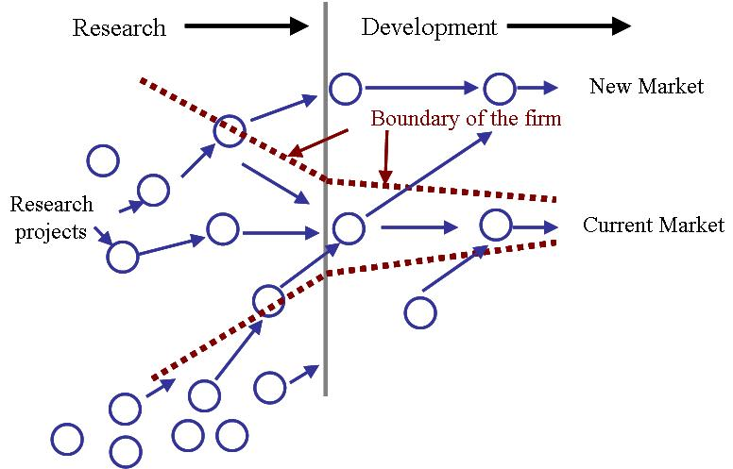
Open Innovation
Useful knowledge is no longer concentrated in a few large organizations, business leaders must adopt a new, “open” model of innovation.
Source: http://www.crowdsourcing.org/editorial/open-innovation-creating-through-community-creation/16499

Slide 36
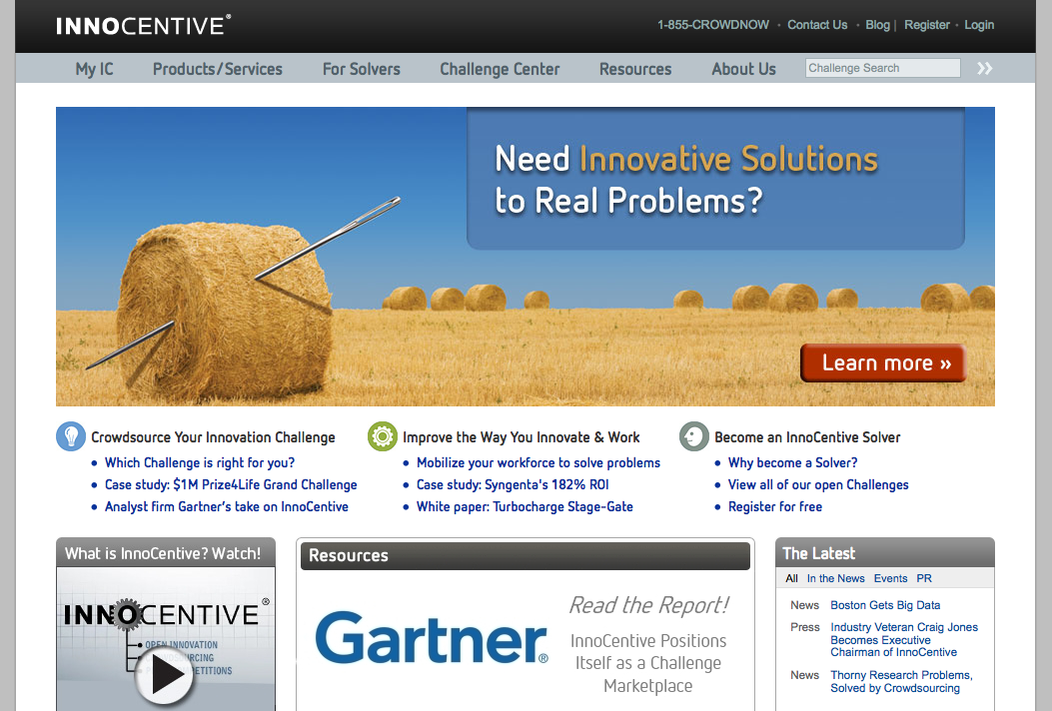
Open Innovation: Innocentive
Crowdsourcing innovation problems to the people who compete to provide ideas and solutions to important challenges.
Source: http://www.innocentive.com/

Slide 37
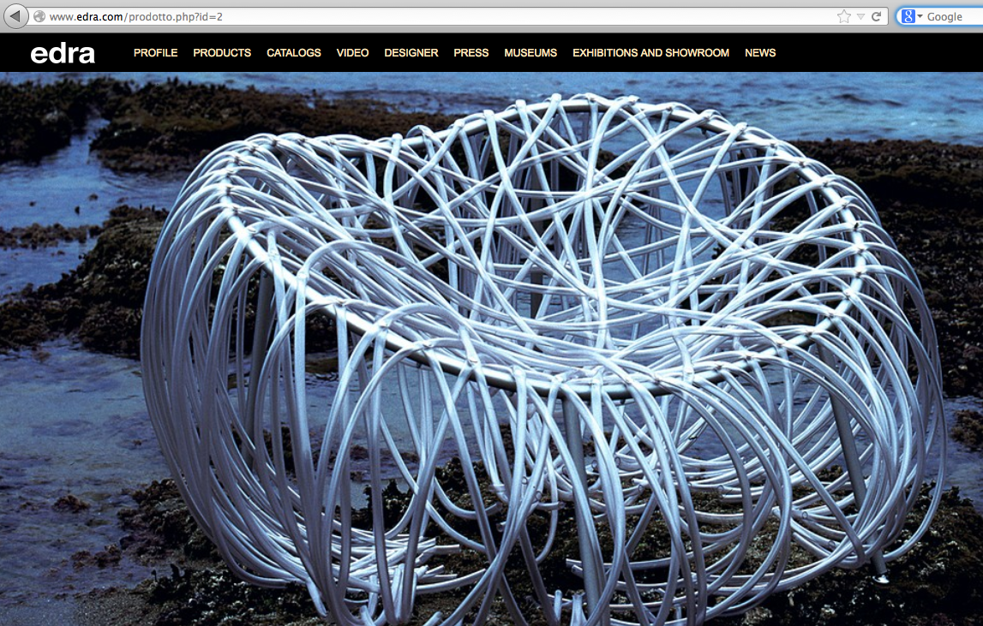
Open Innovation: Edra
Producing design products that weren't designed inside the company.
Source: http://www.edra.com/prodotto.php?id=2

Slide 38
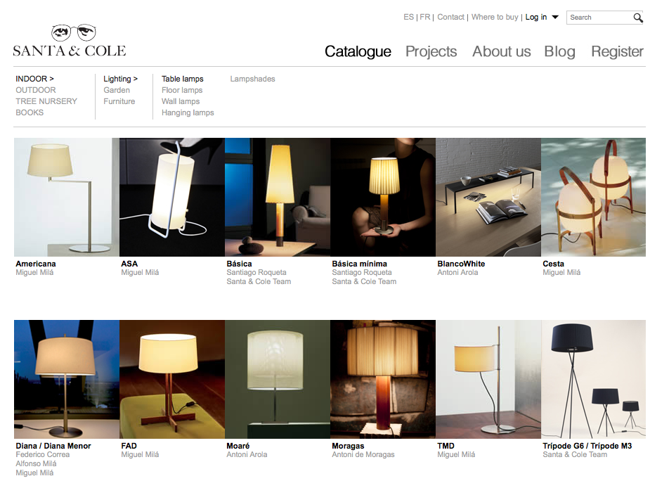
Open Innovation: Santa&Cole
Producing design products (and many more products) that weren't designed inside the company.
Source: http://www.santacole.com/en/catalogo/lamparas-de-sobremesa

Slide 39
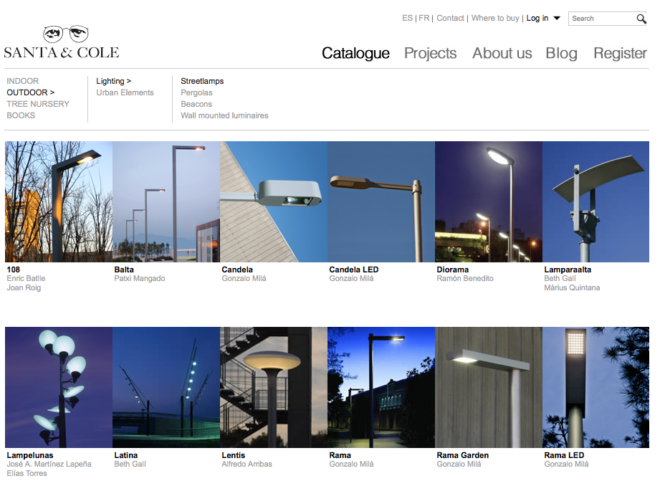
Open Innovation: Santa&Cole
Producing design products (and many more products) that weren't designed inside the company.
Source:http://www.santacole.com/en/catalogo/farolas

Slide 40
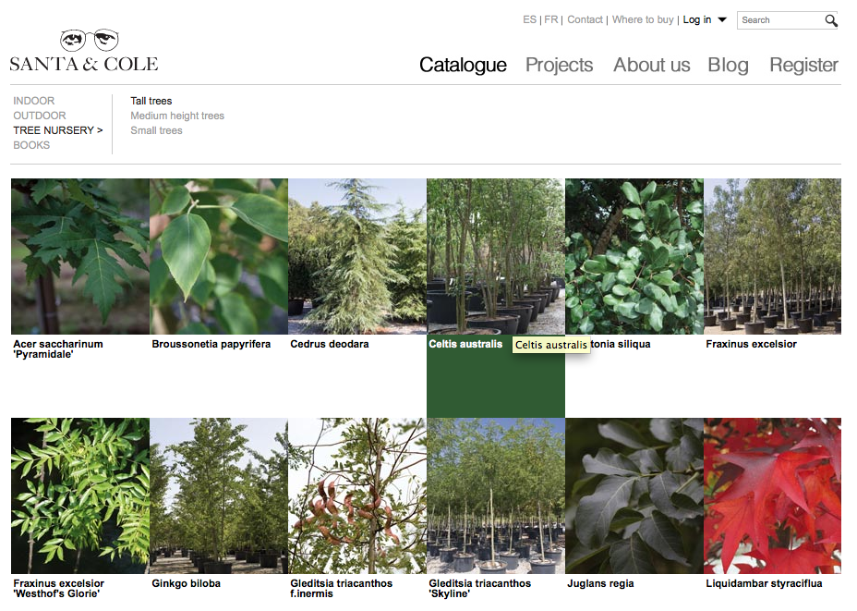
Open Innovation: Santa&Cole
Producing design products (and many more products) that weren't designed inside the company.
Source:http://www.santacole.com/en/catalogo/arboles-de-gran-desarrollo

Slide 41
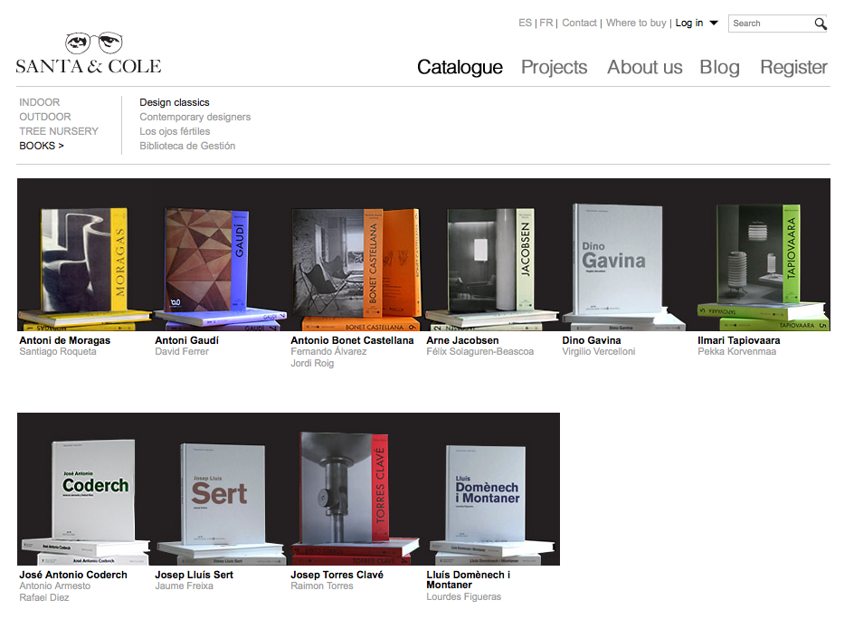
Open Innovation: Santa&Cole
Producing design products (and many more products) that weren't designed inside the company.
Source:http://www.santacole.com/en/catalogo/clasicos-del-diseno

Slide 42
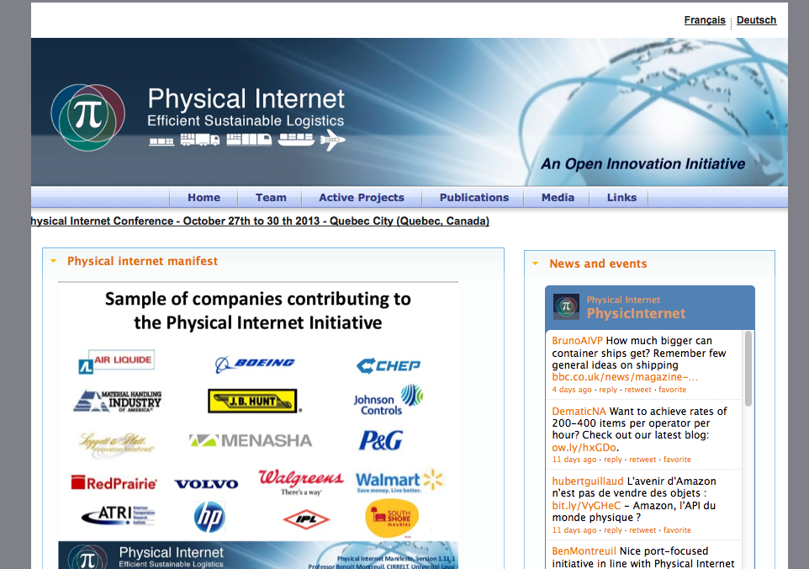
Open Innovation: the physical Internet
Rather than many standalone warehouses, "open hubs" as distribution centers. And universal protocols for how goods pass through, and a universal packet size.
Source: http://physicalinternetinitiative.org/

Slide 43

The Sources of Innovation
Innovation developed by Lead Users, a research by Eric von Hippel
Source: http://web.mit.edu/evhippel/www/sources.htm

Slide 44

Democratizing Innovation (2005)
Innovation developed by Lead Users, a research by Eric von Hippel
Source: http://web.mit.edu/evhippel/www/democ1.htm

Slide 45
Open Innovation vs. Open Source
“Open innovation is sometimes conflated with open source methodologies for software development. There are some concepts that are shared between the two, such as the idea of greater external sources of information to create value. However, open innovation explicitly incorporates the business model as the source of both value creation and value capture. This latter role of the business model enables the organization to sustain its position in the industry value chain over time. While open source shares the focus on value creation throughout an industry value chain, its proponents usually deny or downplay the importance of value capture.”
Source: Chesbrough, H., 2011. Open Services Innovation: Rethinking Your Business to Grow and Compete in a New Era 1st ed., Jossey-Bass.
Source: http://www.amazon.com/Open-Services-Innovation-Rethinking-Business/dp/0470905743

Slide 46
Thank you!!
Massimo Menichinelli massimo.menichinelli@aalto.fi
@openp2pdesign http://www.slideshare.net/openp2pdesign
11.03.2013

