Slide 1

DesigningOpenInnovation.04
Intellectual Property
Massimo Menichinelli massimo.menichinelli@aalto.fi
@openp2pdesign http://www.slideshare.net/openp2pdesign
14.03.2013

Slide 2
01.
Intellectual Property: different ways of protecting your work

Slide 3
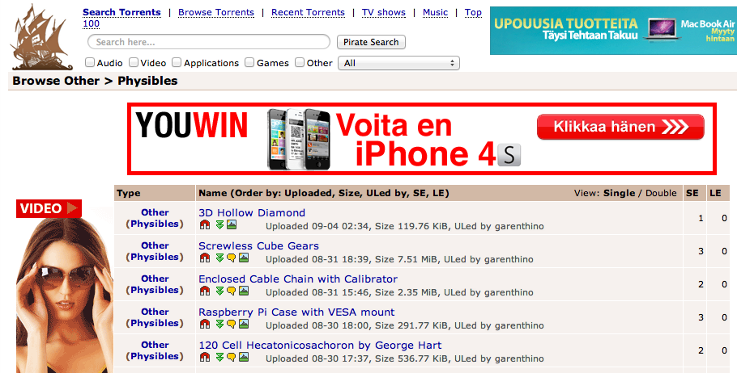
Close to the Napster case of 3D Printing
There is a rising debate about 3D printing as the next possible source of piracy... so there could be even more laws and restrictions!
Source: http://thepiratebay.se/browse/605

Slide 4
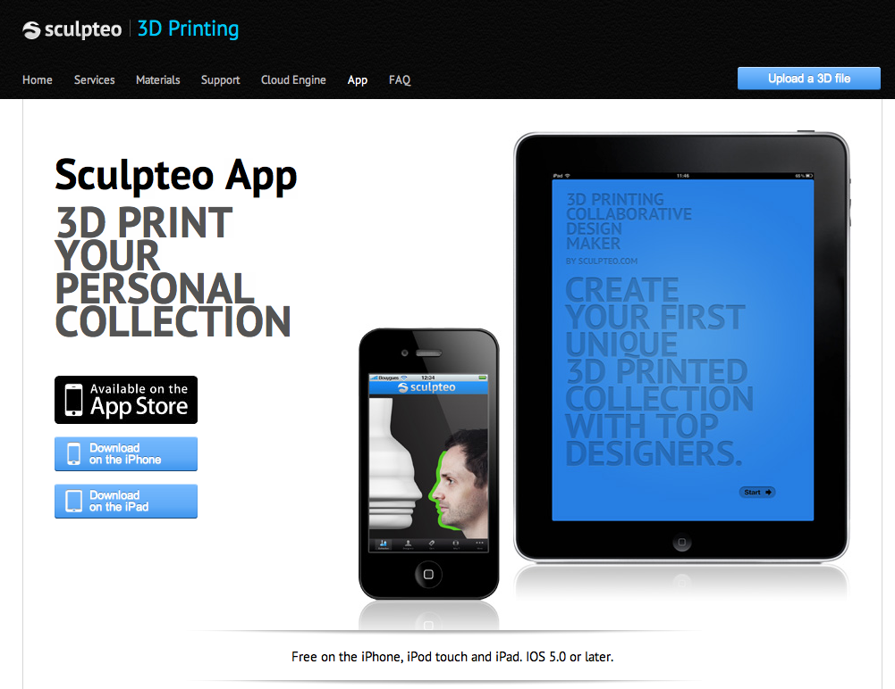
Digital Fabrication and copying...
But fabbing is only experiencing the same phenomena of design and manufacturing...
Source: http://www.sculpteo.com/en/app/

Slide 5
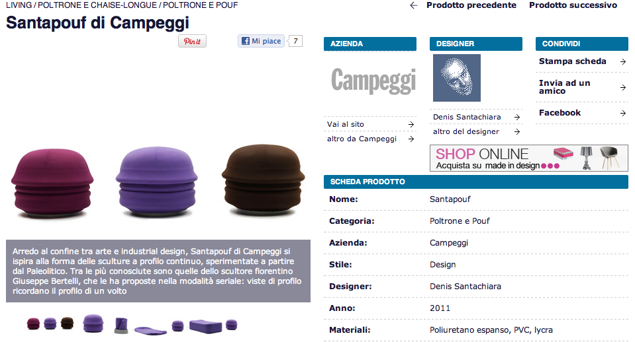
Digital Fabrication and copying...
But fabbing is only experiencing the same phenomena of design and manufacturing...
Source: http://atcasa.corriere.it/catalogo/prodotti/Campeggi/Santapouf.shtml

Slide 6
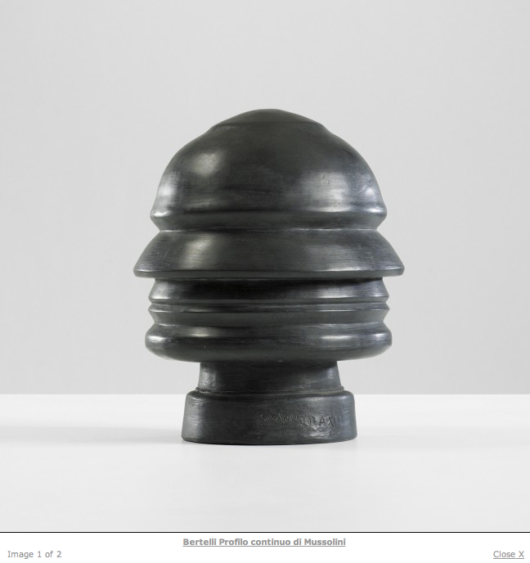
Digital Fabrication and copying...
But fabbing is only experiencing the same phenomena of design and manufacturing... So who copies who?
Source: http://www.liveauctioneers.com/item/8263457

Slide 7
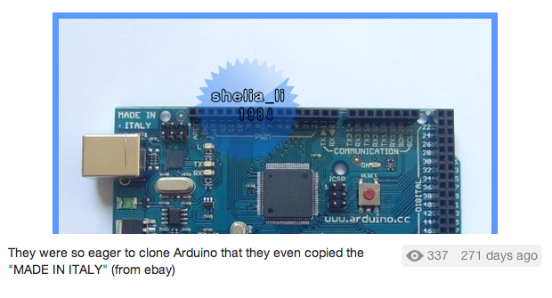
Digital Fabrication and copying... even the details
But fabbing is only experiencing the same phenomena of design and manufacturing... even details are copied!
Source: http://twitpic.com/7t9879

Slide 8
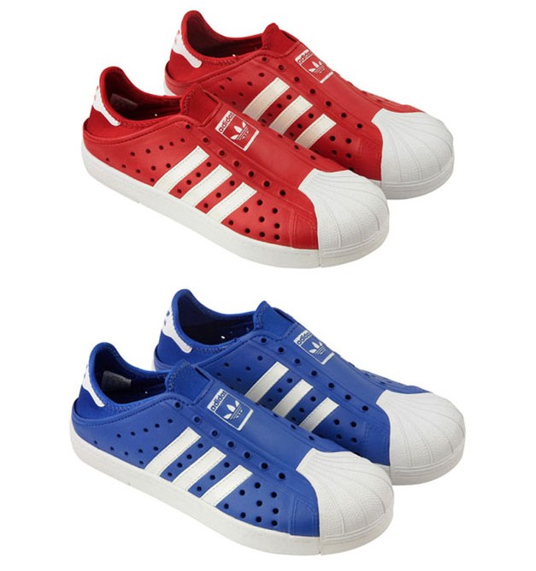
Fashion Design and copying... “piracy” ?
Copying in Fashion Design is a common practice, because only the trademark is protected.. and that's how we they set trends!
Source: http://www.refinedhype.com/hyped/entry/adidas-beachstar-sandal

Slide 9
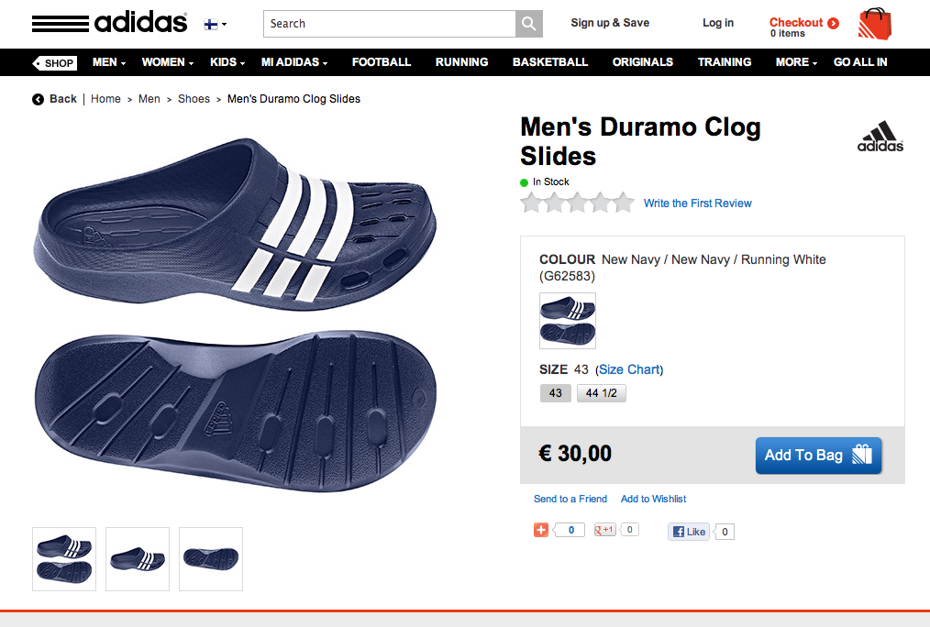
Fashion Design and copying... “piracy” ?
Copying in Fashion Design is a common practice, because only the trademark is protected.. and that's how we they set trends!
Source: http://www.adidas.fi/Men%27s-Duramo-Clog-Slides/G62583_640,fi_FI,pd.html

Slide 10
Copyright ...
Copyright essentially attaches to every original creative work that is fixed in a tangible medium. This includes most things that are written, drawn, or designed. However, the copyright only protects the actual writing, drawing, or design itself, not the idea that it expresses.
Source: http://www.publicknowledge.org/it-will-be-awesome-if-they-dont-screw-it-up
Copyright =
* the right to copy (the rights to let or stop copying)
* the author's rights (the rights to be credited)

Slide 11
Patent ...
Patent protection is not granted automatically. An inventor must apply for a patent on her invention at the Patent and Trademark Office (PTO). The invention must be new, useful, and non-obvious. In making the application, the inventor must disclose information that would allow others to practice the invention. Finally, patent protection is significantly shorter in duration than copyright protection.
Once an object has been patented, all copies, regardless of the copier’s knowledge of the patent, infringe upon that patent. Simply stated, if you are using a 3D printer to reproduce a patented object, you are infringing on the patent.
Source: http://www.publicknowledge.org/it-will-be-awesome-if-they-dont-screw-it-up

Slide 12
Copyright, Patent and originality ...
In the world of copyright law, this intuition is correct. When a child in Seattle writes an ode to his pet dog, that work is protected by copyright. If, two years later, another child in Atlanta writes an identical ode to her pet dog (unaware of the first ode), the second work is also protected by copyright. This is possible because copyright allows for independent creation, even if the same work was independently created twice (or even more than twice). While a work must be original in order to receive copyright protection, the work does not need to be unique in the world.
Source: http://www.publicknowledge.org/it-will-be-awesome-if-they-dont-screw-it-up
However, and relevantly for reproducing 3D objects, patent law does have a novelty requirement. Patent law does not allow for parallel creation. Once an invention is patented every unauthorized reproduction of that invention is an infringement, whether the reproducer is aware of the original invention or not.
Source: http://www.publicknowledge.org/it-will-be-awesome-if-they-dont-screw-it-up

Slide 13
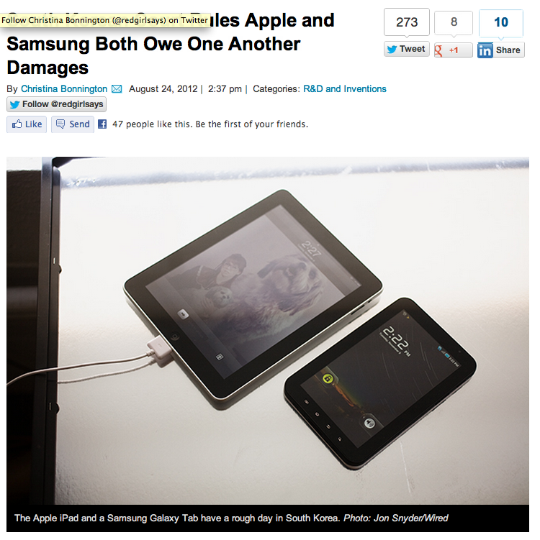
Watch out when you enter this game...
A South Korean court ruled that both Apple and Samsung infringed on one another’s intellectual property and owe each other damages.
Source: http://www.wired.com/gadgetlab/2012/08/s-korea-court-rules-damages/

Slide 14
Trademark ...
Trademark developed as a way to protect consumers, giving them confidence that a product marked with a manufacturer’s symbol was actually made and backed by that manufacturer. As a result, trademark is not designed to protect intellectual property per se. Intellectual property protection is instead a side effect of needing to protect the integrity of the mark.
Source: http://www.publicknowledge.org/it-will-be-awesome-if-they-dont-screw-it-up
Because trademark protection is specifically geared towards preventing consumer confusion in the marketplace, trademark infringement is described in terms of “use in commerce.” Unlike patent or copyright, it is not copying a trademark that creates a trademark violation. Instead, it is using that trademark in commerce (thus potentially confusing a consumer as to the origin of the product) that results in a violation.
Source: http://www.publicknowledge.org/it-will-be-awesome-if-they-dont-screw-it-up

Slide 15
Trade Dress
Trademark protection can extend beyond a logo affixed to a product to include the design of the product itself. However, in order to extend protection to product design, courts have required that trade dress acquire a distinct association with a specific manufacturer. Acquiring this type of distinctiveness takes time, and must be proven by survey results or some other proof of association in the eyes of the general public. As a result most product designs, even unique designs intended “to render the product more useful or more appealing,” will not be protected as trade dress.
Source: http://www.publicknowledge.org/it-will-be-awesome-if-they-dont-screw-it-up

Slide 16
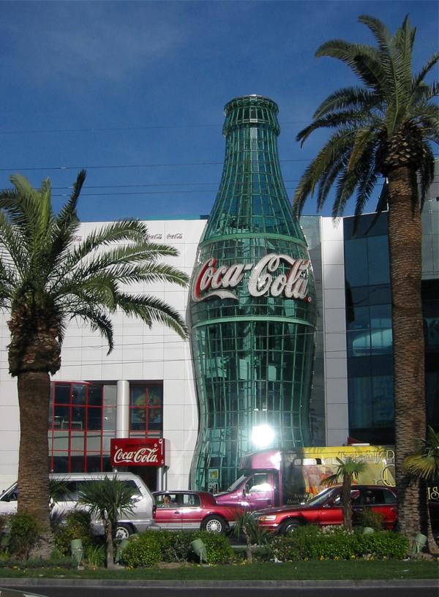
Trade Dress, an example
A very recognizable shape...
Source: http://en.wikipedia.org/wiki/Coca_cola

Slide 17
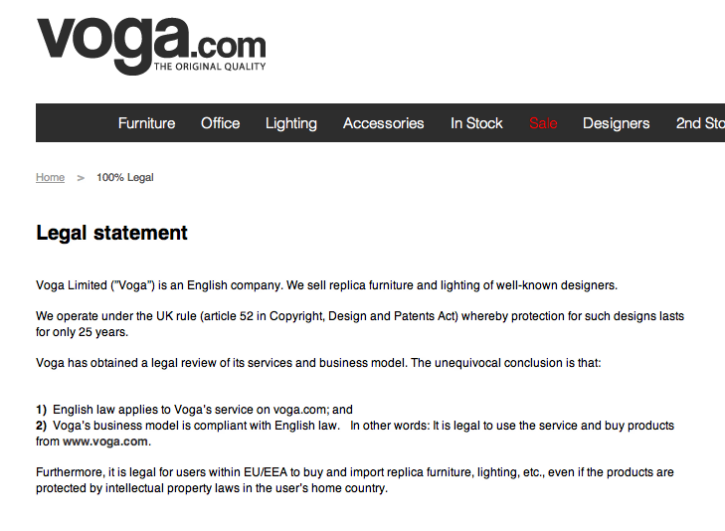
Be careful: every country has its laws...
In UK copyright only lasts 25 years after the creation ...
Source: http://www.voga.com/is-it-legal/
http://www.core77.com/blog/business/scandinavian_design_piracy_company_utilizes_uk_copyright_loophole_22318.asp

Slide 18
Licensing your project ...
The main benefit of product licensing is that you do not have all of the risk and headaches that necessarily come with running your own business. It is quite true that you could make a lot more money if you sold your own idea (if you did not screw things up at any number of places along the way).
Source: http://www.core77.com/blog/columns/product_licensing_in_an_era_of_open_innovation_22953.asp
Young designers often gasp when hearing that a good royalty rate might be 5% of wholesale cost (around 2% of retail price)—"but it is MY idea!" Seasoned designers understand that a designed product (not to mention one that is not engineered, sourced, and fully developed and tested) is but a small part of the business equation.
Source: http://www.core77.com/blog/columns/product_licensing_101_so_lets_talk_money_23366.asp

Slide 19
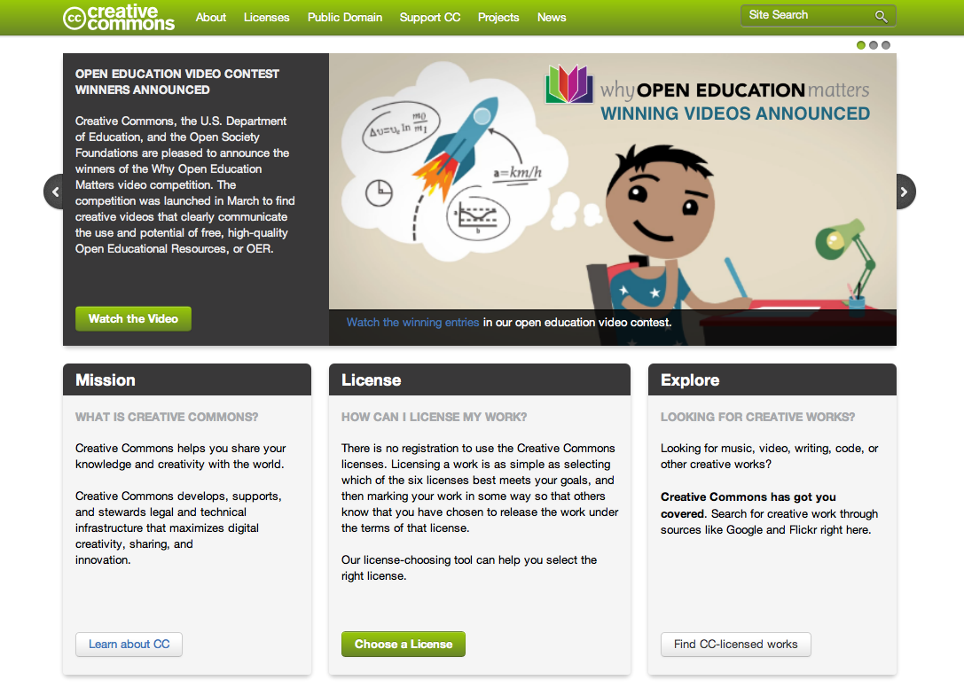
Creative Commons: licensing the sharing
How to publish your content while at the same time
enabling sharing and protecting your author rights.
Source: http://creativecommons.org/

Slide 20




License: Review conditions
Source:
http://creativecommons.org/
Attribution: Licensees may copy, distribute, display and perform the work and make derivative works based on it only if they give the author or licensor the credits in the manner specified by these.
Non commercial: Licensees may copy, distribute, display, and perform the work and make derivative works based on it only for noncommercial purposes.
No Derivate Works: Licensees may copy, distribute, display and perform only verbatim copies of the work, not derivative works based on it.
Share alike: Licensees may distribute derivative works only under a license identical to the license that governs the original work.

Slide 21
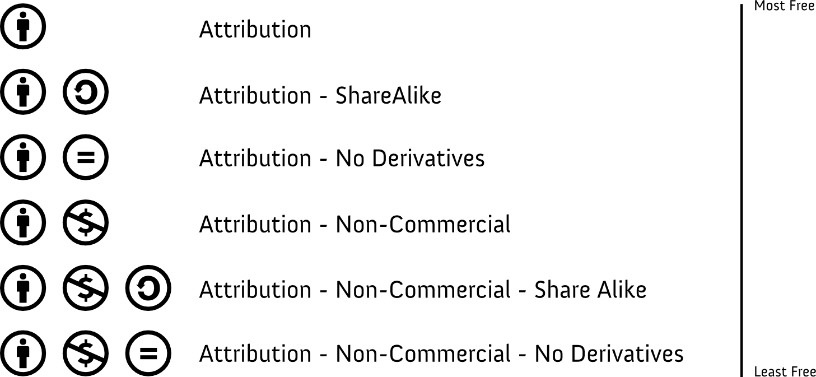
License: Select license
Source:
http://creativecommons.org/

Slide 22
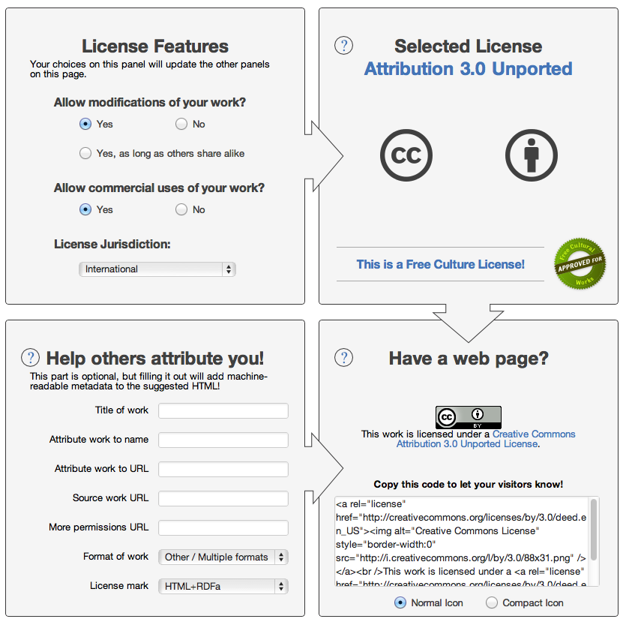
Creative Commons: licensing the sharing
How to publish your content while at the same time
enabling sharing and protecting your author rights.
Source: http://creativecommons.org/

Slide 23

Everything is a Remix #01
BugLabs has been much more successful in offering completely open products.
Source: http://vimeo.com/14912890

Slide 24
Everything is a Remix #02
BugLabs has been much more successful in offering completely open products.
Source: http://vimeo.com/19447662

Slide 25
Everything is a Remix #03
BugLabs has been much more successful in offering completely open products.
Source: http://vimeo.com/25380454

Slide 26
Everything is a Remix #04
BugLabs has been much more successful in offering completely open products.
Source: http://vimeo.com/36881035

Slide 27
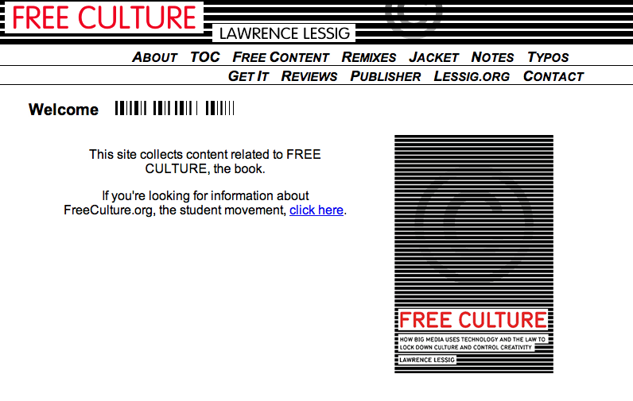
For a further reading on the topic ...
An open and free book about Free Culture and Open Knowledge.
Source: http://www.free-culture.cc/

Slide 28
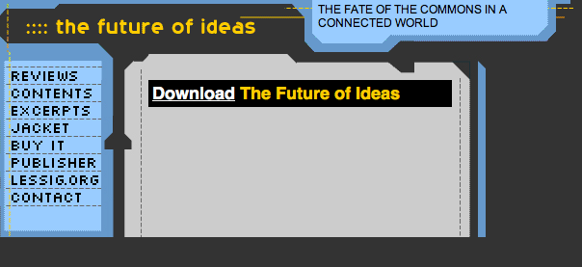
For a further reading on the topic ...
An open and free book about Free Culture and Open Knowledge.
Source: http://www.the-future-of-ideas.com/download/

Slide 29
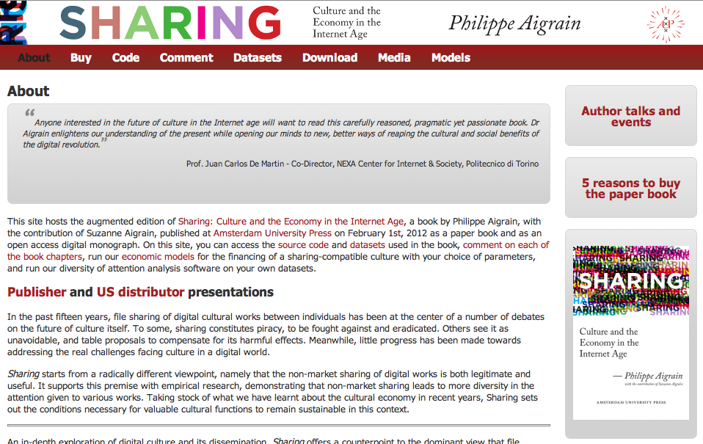
For a further reading on the topic ...
An in-depth exploration of digital culture and its dissemination, Sharing offers a counterpoint to the dominant view that file sharing is piracy.
Source: http://www.sharing-thebook.com/content/about

Slide 30
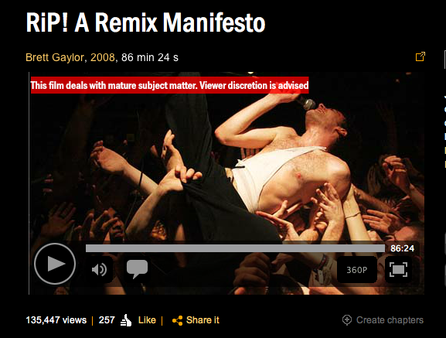
For a further watching on the topic ...
An open and free documentary about intellectual property and remix.
Source: http://ripremix.com/ http://www.nfb.ca/film/rip_a_remix_manifesto/

Slide 31
02.
Work for today: choose a Creative Commons license for your projects, and add it to the Readme.md file.

Slide 32
Thank you!!
Massimo Menichinelli
Aalto Media Factory massimo.menichinelli@aalto.fi
@openp2pdesign http://www.slideshare.net/openp2pdesign
12.09.2012

