Slide 1
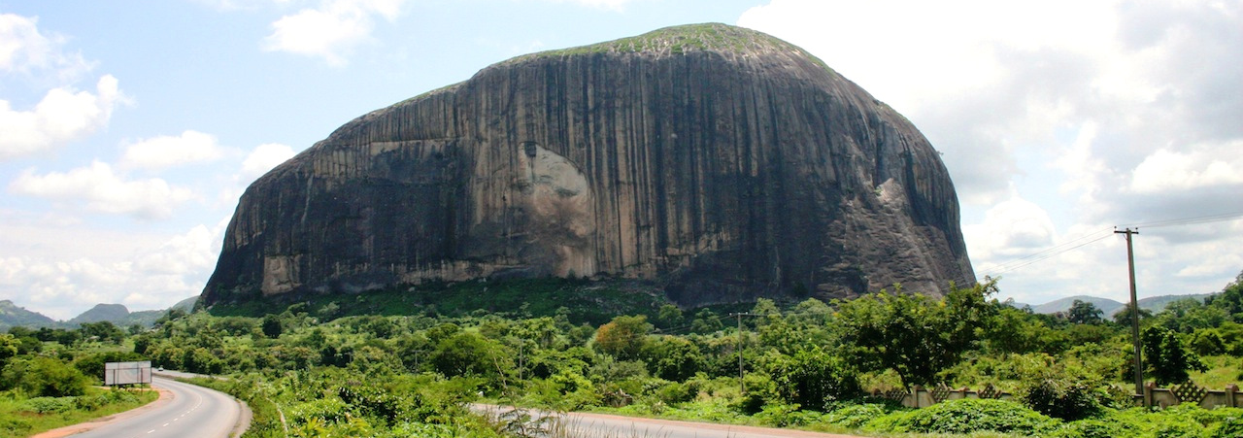
Tourism development in Nigeria: a working presentation template
Zuma Rock, Niger State
Prepared for partners and investors · Destination Nigeria · 2026

Slide 2
An alternative cover, set beside an engraved plate
Use for formal submissions, board papers and printed decks

Slide 3
Context
01
Where Nigerian tourism stands, and why it matters now.

Slide 4
Write the conclusion first, then the evidence
Executive summary
An executive summary is the slide most people read. State what you found, what it means and what you ask for, in plain sentences.
1
Lead each point with the claim; follow it with the number or source that proves it.
2
Keep to three points. A fourth usually belongs in the appendix.
3
End with the decision you need, who makes it and by when.

Slide 5
Two pillars, each with the actions that deliver it
Strategy
Experience
Invest
Name the places and journeys to promote first.
Say who the visitor is.
Say how success will be counted.
Name the projects ready for investment.
State what each needs: land, approvals, capital.
Say who the investor talks to.

Slide 6
Use the finding as the title, so the slide can be read without the chart
Finding
What the data shows
Explain the pattern in two or three sentences. Say how the data was collected and how many responses it rests on.
Illustrative data only: replace with verified figures and cite the source here.

Slide 7
A full-width chart for trends over time
Data
Illustrative data only: replace with verified figures and cite the source here.

Slide 8
Three facts about the country, each with its source
In figures
36
774
6
states
local government areas
geopolitical zones
Plus the Federal Capital Territory, Abuja.
Set out in the First Schedule of the Constitution.
The regional grouping used for national planning.
Source: Constitution of the Federal Republic of Nigeria, 1999 (as amended).

Slide 9
Five milestones, read from left to right
Timeline
Stage 1
Stage 2
Stage 3
Stage 4
Stage 5
Scoping
Research
Plan
Invest
Launch
Agree aims, partners and the places in scope.
Collect visitor, site and market evidence.
Prioritise destinations and projects.
Prepare and present investment cases.
Open, promote and measure.

Slide 10

Project name
Investment opportunity
Item | Detail
Location | [LGA, State]
Category | [Eco-lodge / visitor centre / transport]
Stage | [Concept / feasibility / shovel-ready]
Investment sought | [₦ ___ million · US$ ___]
Land and approvals | [Status]
Contact | info@destinationnigeria.org
Complete every row from verified project documents before sharing.
Agbokim Waterfalls, Cross River State

Slide 11
Say what each side commits, and what the partnership delivers
Partnership
Destination Nigeria brings
The partner brings
Together we deliver
Destination promotion
Access to the national network
Convening and coordination
Capital or in-kind support
Operating expertise
Local knowledge
A named outcome
A measure and a date
A shared review point

Slide 12
Lead with the total, then show what makes it up
Financials
Line item | 2025 | 2026 | 2027 | Change
Destination marketing | 000.0 | 000.0 | 000.0 | 0.0 %
Site development | 000.0 | 000.0 | 000.0 | 0.0 %
Training and skills | 000.0 | 000.0 | 000.0 | 0.0 %
Research and data | 000.0 | 000.0 | 000.0 | 0.0 %
Total | 000.0 | 000.0 | 000.0 | 0.0 %
Figures in ₦ million. Placeholder values: replace from audited accounts or the approved budget.

Slide 13
Four recommendations, each with an owner and a date
Recommendations
1
Recommendation one
2
Recommendation two
Owner · timing · the decision required.
Owner · timing · the decision required.
3
Recommendation three
4
Recommendation four
Owner · timing · the decision required.
Owner · timing · the decision required.

Slide 14
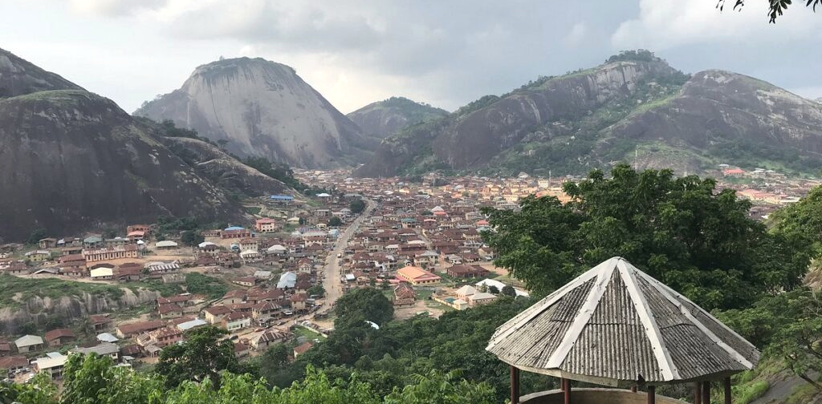
Idanre Hills, Ondo State
Photo: [credit to be confirmed]

Slide 15
“Use this layout only for a quotation that has been approved by the person who said it.”
Name
Role, organisation

Slide 16
Thank you.

