Slide 1
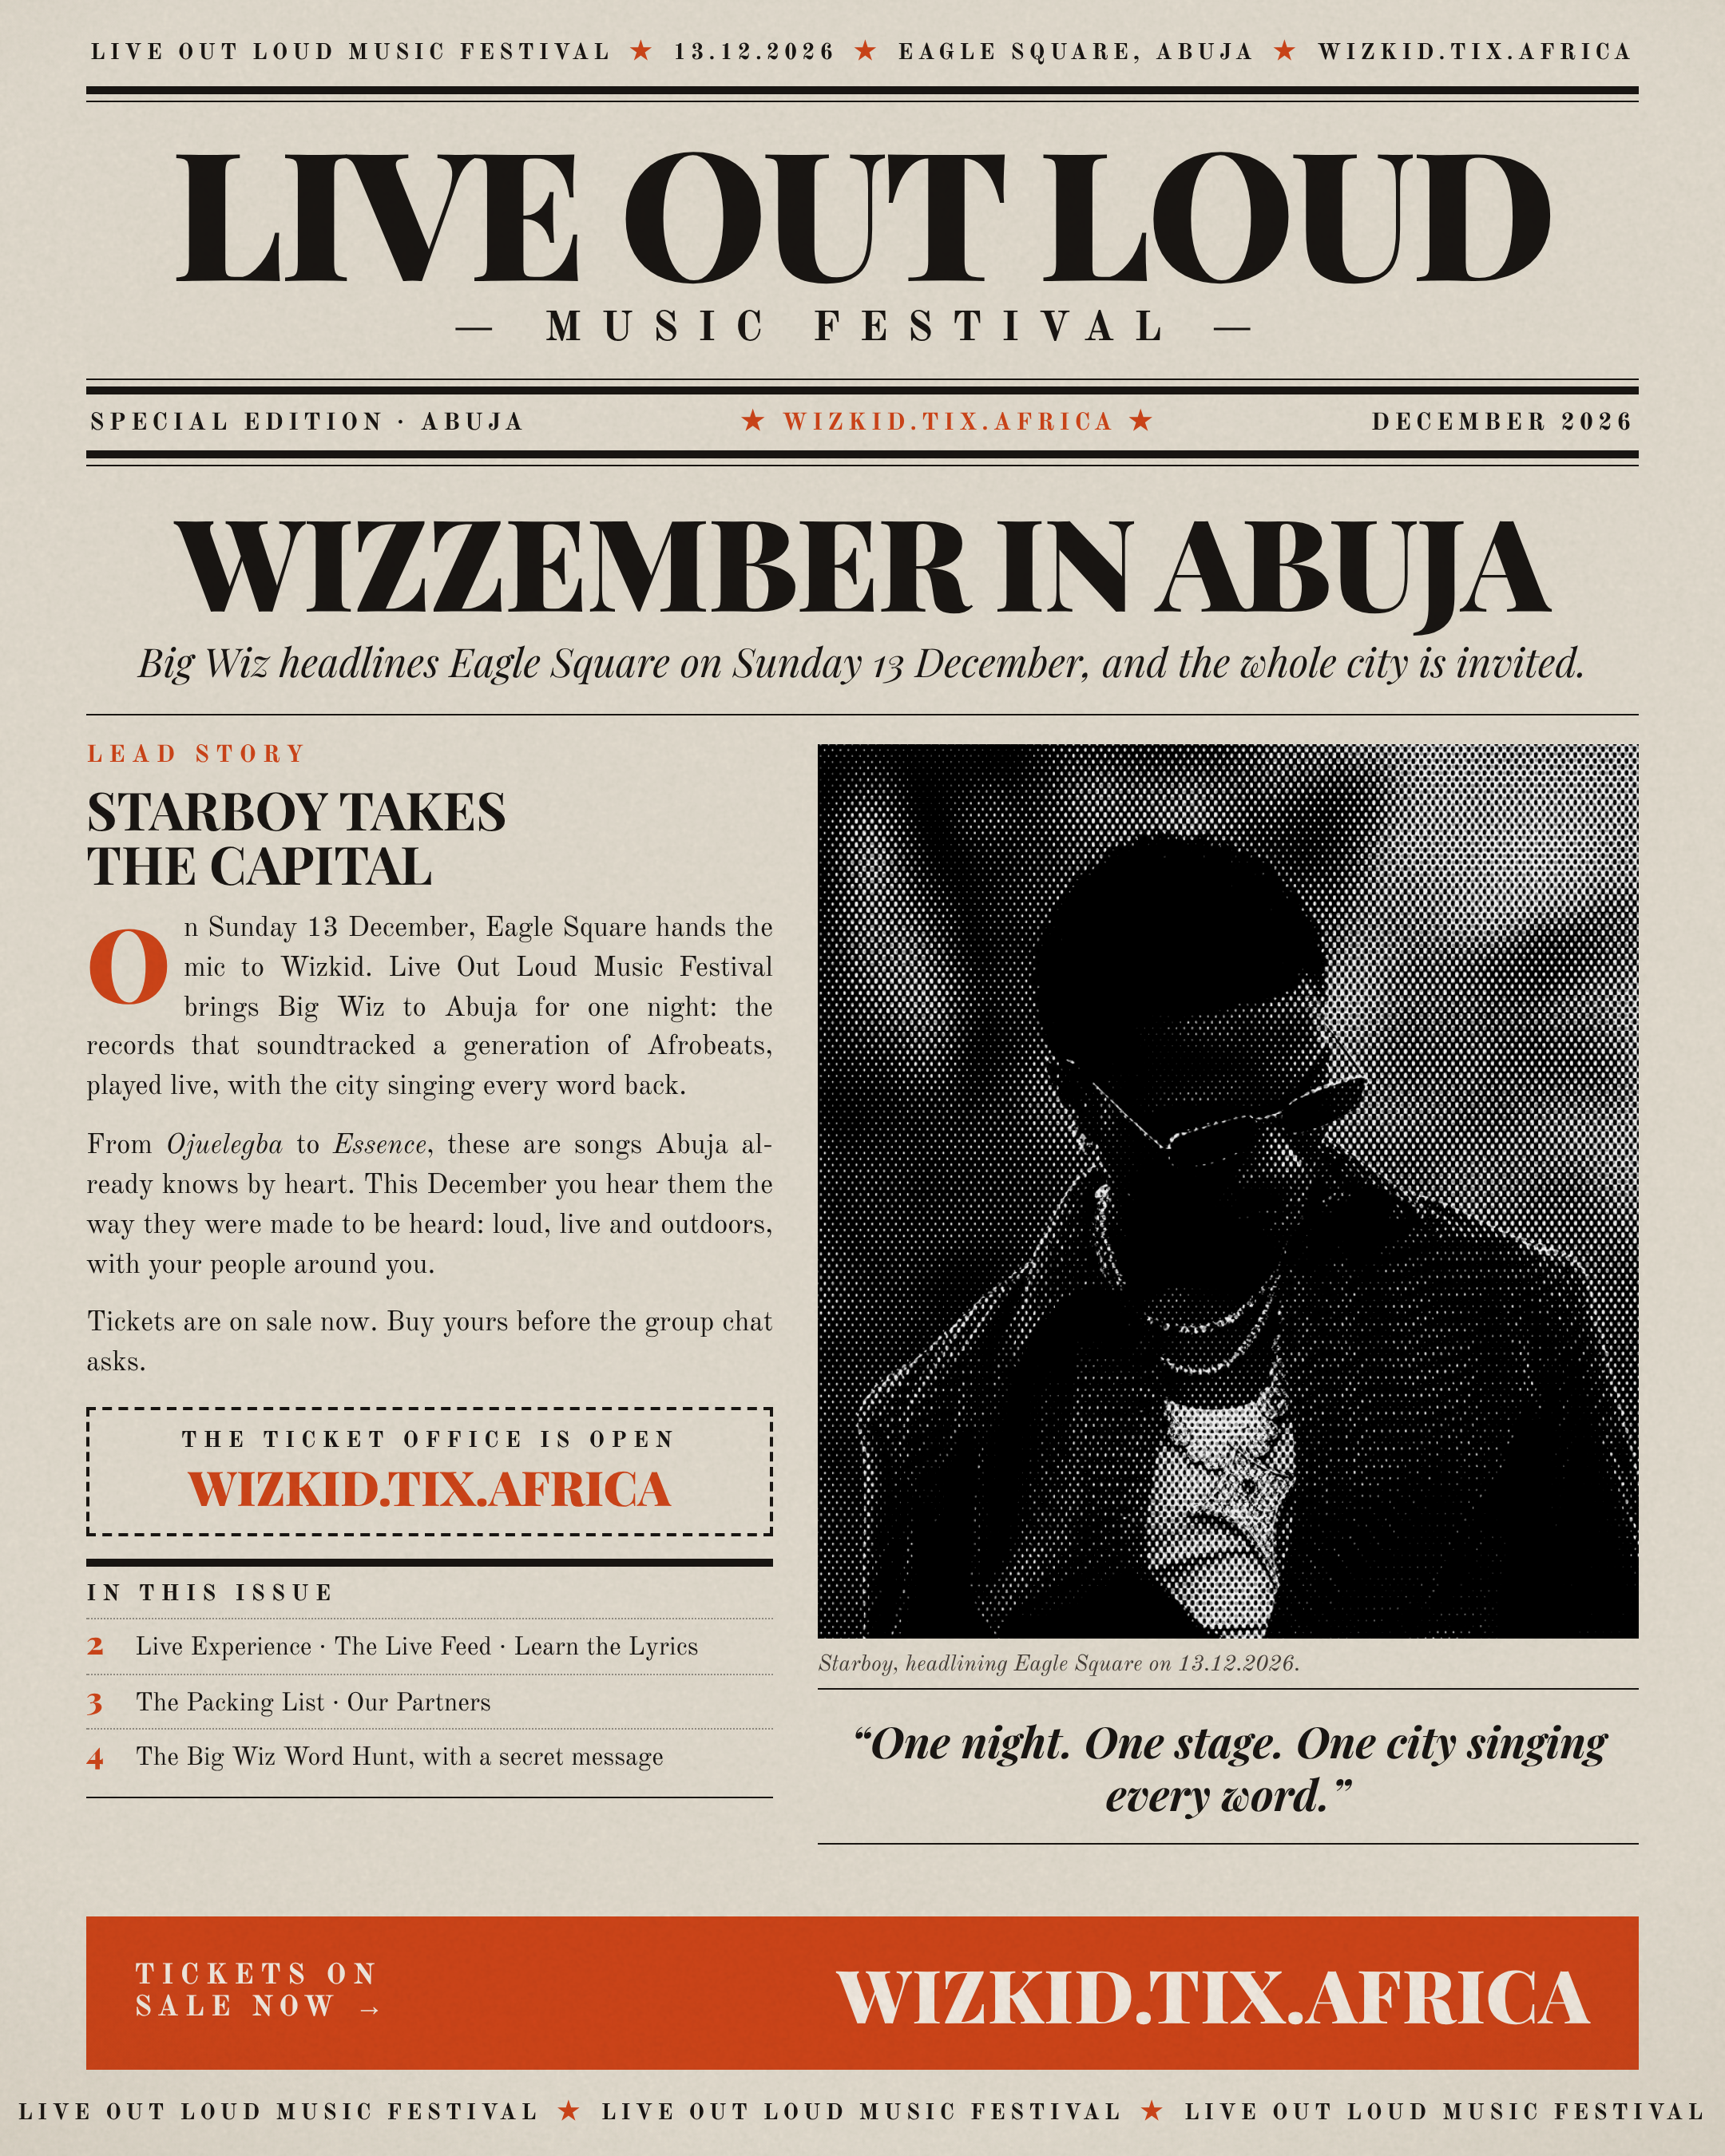
Notes:
Page 1: Cover
LIVE OUT LOUD MUSIC FESTIVAL★13.12.2026★EAGLE SQUARE, ABUJA★WIZKID.TIX.AFRICA
LIVE OUT LOUD
— MUSIC FESTIVAL —
SPECIAL EDITION · ABUJA
★ WIZKID.TIX.AFRICA ★
DECEMBER 2026
WIZZEMBER IN ABUJA
Big Wiz headlines Eagle Square on Sunday 13 December, and the whole city is invited.
LEAD STORY
STARBOY TAKES
THE CAPITAL
On Sunday 13 December, Eagle Square hands the mic to Wizkid. Live Out Loud Music Festival brings Big Wiz to Abuja for one night: the records that soundtracked a generation of Afrobeats, played live, with the city singing every word back.
From Ojuelegba to Essence, these are songs Abuja already knows by heart. This December you hear them the way they were made to be heard: loud, live and outdoors, with your people around you.
Tickets are on sale now. Buy yours before the group chat asks.
THE TICKET OFFICE IS OPEN
WIZKID.TIX.AFRICA
IN THIS ISSUE
2 Live Experience · The Live Feed · Learn the Lyrics
3 The Packing List · Our Partners
4 The Big Wiz Word Hunt, with a secret message
Starboy, headlining Eagle Square on 13.12.2026.
“One night. One stage. One city singing every word.”
TICKETS ON
SALE NOW →
WIZKID.TIX.AFRICA
LIVE OUT LOUD MUSIC FESTIVAL★LIVE OUT LOUD MUSIC FESTIVAL★LIVE OUT LOUD MUSIC FESTIVAL

Slide 2
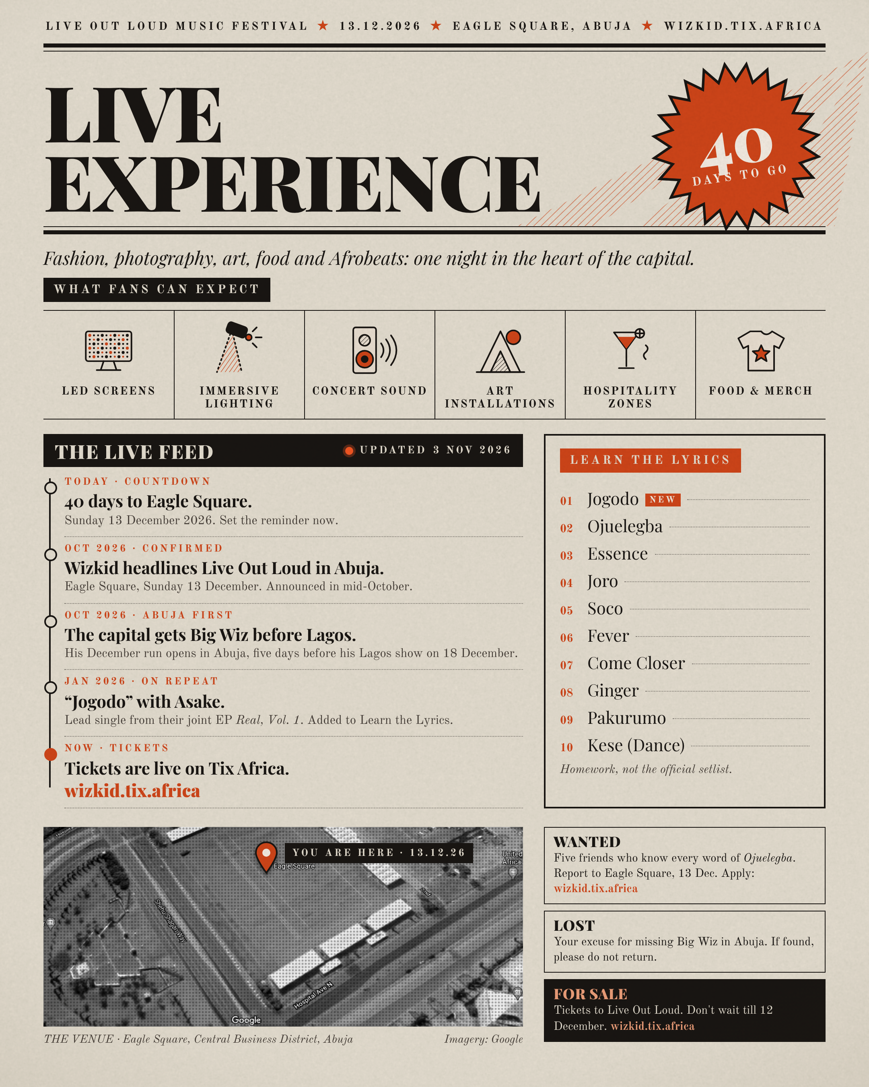
Notes:
Page 2: Live Experience
LIVE OUT LOUD MUSIC FESTIVAL★13.12.2026★EAGLE SQUARE, ABUJA★WIZKID.TIX.AFRICA
LIVE
EXPERIENCE
40
DAYS TO GO
Fashion, photography, art, food and Afrobeats: one night in the heart of the capital.
WHAT FANS CAN EXPECT
LED SCREENS
IMMERSIVE LIGHTING
CONCERT SOUND
ART INSTALLATIONS
HOSPITALITY ZONES
FOOD & MERCH
THE LIVE FEED
UPDATED
3 NOV 2026
TODAY · COUNTDOWN
40 days to Eagle Square.
Sunday 13 December 2026. Set the reminder now.
OCT 2026 · CONFIRMED
Wizkid headlines Live Out Loud in Abuja.
Eagle Square, Sunday 13 December. Announced in mid-October.
OCT 2026 · ABUJA FIRST
The capital gets Big Wiz before Lagos.
His December run opens in Abuja, five days before his Lagos show on 18 December.
JAN 2026 · ON REPEAT
“Jogodo” with Asake.
Lead single from their joint EP Real, Vol. 1. Added to Learn the Lyrics.
NOW · TICKETS
Tickets are live on Tix Africa.
wizkid.tix.africa
LEARN THE LYRICS
Jogodo
NEW
Ojuelegba
Essence
Joro
Soco
Fever
Come Closer
Ginger
Pakurumo
Kese (Dance)
Homework, not the official setlist.
YOU ARE HERE · 13.12.26
THE VENUE · Eagle Square, Central Business District, Abuja
Imagery: Google
WANTED
Five friends who know every word of Ojuelegba. Report to Eagle Square, 13 Dec. Apply: wizkid.tix.africa
LOST
Your excuse for missing Big Wiz in Abuja. If found, please do not return.
FOR SALE
Tickets to Live Out Loud. Don't wait till 12 December. wizkid.tix.africa

Slide 3

Notes:
Page 3: Festival Essentials
LIVE OUT LOUD MUSIC FESTIVAL★13.12.2026★EAGLE SQUARE, ABUJA★WIZKID.TIX.AFRICA
FESTIVAL
ESSENTIALS
PAGE 3
THE PACKING LIST
The packing list festival guides recommend the world over, adapted for a harmattan night in Abuja.
Your ticket
Get it first, on your phone and ready at the gate.
Photo ID
Valid ID, in case it's asked for at entry.
Power bank
Fully charged. Your camera roll will thank you.
Comfy shoes
You'll be on your feet from gates to encore.
Water
Stay hydrated; harmattan air is dry.
Card only
Only card is accepted for food, drinks and merch.
Earplugs
Protect your ears near the speakers.
Light jacket
Harmattan nights get cool after dark.
Pack light, and check the organiser's latest entry and bag rules before you go.
WHAT
Live Out Loud Music Festival
WHO
Wizkid
WHEN
Sunday 13 December 2026
WHERE
Eagle Square, Abuja
TICKETS
wizkid.tix.africa
OUR PARTNERS
Live Out Loud Music Festival is proudly supported by
+ YOU
WIZKID.TIX
.AFRICA

Slide 4
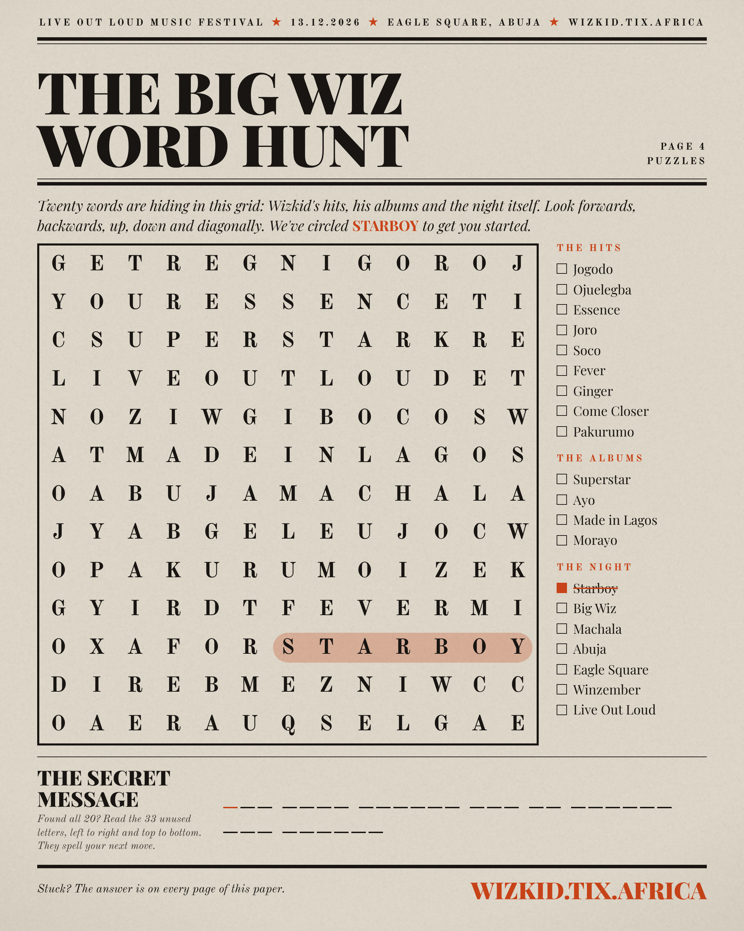
Notes:
Page 4: The Big Wiz Word Hunt
LIVE OUT LOUD MUSIC FESTIVAL★13.12.2026★EAGLE SQUARE, ABUJA★WIZKID.TIX.AFRICA
THE BIG WIZ
WORD HUNT
PAGE 4
PUZZLES
Twenty words are hiding in this grid: Wizkid's hits, his albums and the night itself. Look forwards, backwards, up, down and diagonally. We've circled STARBOY to get you started.
G
E
T
R
E
G
N
I
G
O
R
O
J
Y
O
U
R
E
S
S
E
N
C
E
T
I
C
S
U
P
E
R
S
T
A
R
K
R
E
L
I
V
E
O
U
T
L
O
U
D
E
T
N
O
Z
I
W
G
I
B
O
C
O
S
W
A
T
M
A
D
E
I
N
L
A
G
O
S
O
A
B
U
J
A
M
A
C
H
A
L
A
J
Y
A
B
G
E
L
E
U
J
O
C
W
O
P
A
K
U
R
U
M
O
I
Z
E
K
G
Y
I
R
D
T
F
E
V
E
R
M
I
O
X
A
F
O
R
S
T
A
R
B
O
Y
D
I
R
E
B
M
E
Z
N
I
W
C
C
O
A
E
R
A
U
Q
S
E
L
G
A
E
THE HITS
Jogodo
Ojuelegba
Essence
Joro
Soco
Fever
Ginger
Come Closer
Pakurumo
THE ALBUMS
Superstar
Ayo
Made in Lagos
Morayo
THE NIGHT
Starboy
Big Wiz
Machala
Abuja
Eagle Square
Winzember
Live Out Loud
THE SECRET MESSAGE
Found all 20? Read the 33 unused letters, left to right and top to bottom. They spell your next move.
Stuck? The answer is on every page of this paper.
WIZKID.TIX.AFRICA

