Slide 1
USIG PIVOT TABLE FOR EMPLOYEE TURNVER ANALYSIS
STUDENT NAME : DESIKA.S
REGISTER NO:312204233
DEPARTMENT: BCOM (Accounting and finance )
COLLEGE. ANNAI VIOLET ARTS AND SCIENCE COLLEGE

Slide 2
PROJECT TITLE
USING PIVOT TABLES FOR EMPLOYEE TURNOVER ANALYSIS

Slide 3


AGENDA
Problem Statement
Project Overview
End Users
Our Solution and Proposition
Dataset Description
Modelling Approach
Results and Discussion
Conclusion
3/21/2024 Annual Review

Slide 4

PROBLEM STATEMENT
Analyze employee turnover rates by department, role, tenure, and other factors using pivot tables. Identify trends, correlations, and high-turnover areas. Use insights to inform targeted retention strategies.

Slide 5

PROJECT OVERVIEW
This project aims to analyze employee turnover data using pivot tables to identify key trends and patterns across various factors like department, tenure, and job role. By summarizing the data, the analysis will highlight areas with high turnover and possible contributing factors. The insights gained will guide HR in developing targeted strategies to improve employee retention.
.

Slide 6

WHO ARE THE END USERS?
The end users are HR managers and leadership teams seeking to reduce employee turnover. They will use the analysis to identify trends and problem areas in staffing. This data-driven insight will inform their retention strategies and decision-making.

Slide 7

OUR SOLUTION AND ITS VALUE PROPOSITION
Our Excel-based Employee Performance Analysis tool provides customizable templates, visual dashboards, and automated reporting to streamline performance evaluations. This solution is cost-effective and user-friendly, allowing easy data tracking and insights. By leveraging real-time data, organizations can make informed decisions to enhance employee performance and engagement.

Slide 8
Dataset Description
The employee performance analysis data set includes key information such as Employee ID, Name, Department, and Job Title, along with performance metrics like KPI scores and goal achievement status. It also incorporates feedback from managers and peers, attendance records, training hours, and overall performance ratings. This comprehensive data enables effective evaluation and insights into employee performance.

Slide 9

THE "WOW" IN OUR SOLUTION
Our solutions offer deep insights through clear data visualization, making complex turnover trends easy to understand. They enable HR to take immediate, targeted action based on precise analytics. This empowers companies to improve retention with confidence and efficiency.
3/21/2024 Annual Review
9

Slide 10
MODELLING
Modeling involves gathering employee data and identifying key turnover factors like department, tenure, and salary. Pivot tables will group and summarize the data to reveal trends and correlations. These insights will guide HR in improving retention and addressing high-turnover areas.
10

Slide 11
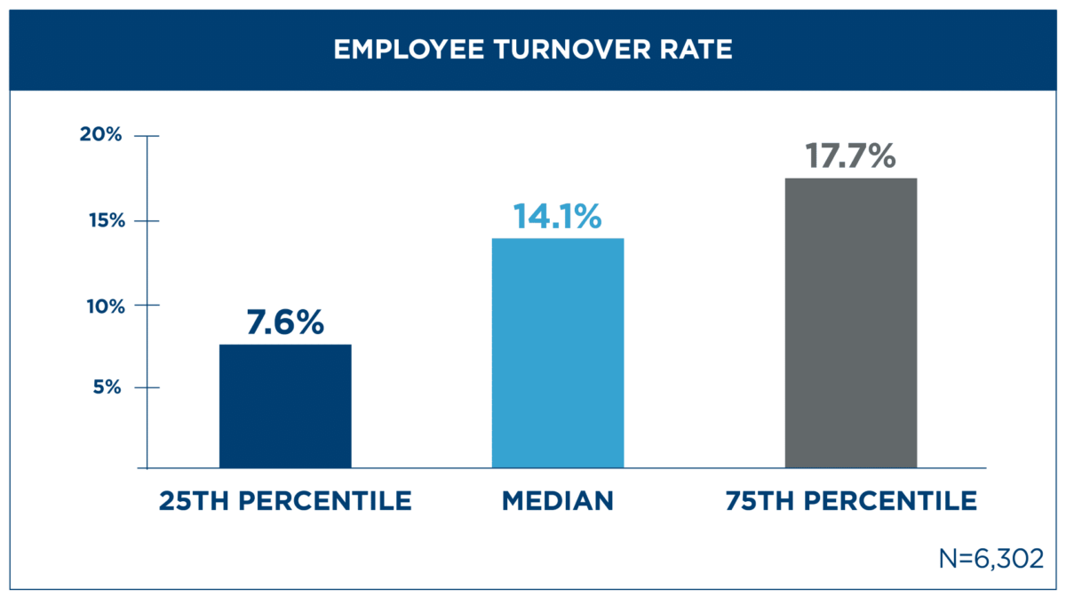
RESULTS
11

Slide 12
conclusion
The turnover analysis highlighted key factors driving employee attrition, such as tenure, department, and salary. These insights provide a clear direction for HR to implement targeted retention strategies. Addressing these areas will improve overall employee retention and stability.

