Slide 1

Multi-Classifier Deep Neural Network for Detecting Intruder Behavior in Cyber Security
ICCWAMTIP 2019
The 16th International Computer Conference on Wavelet Active Media Technology
and Information Processing, Chengdu, China.
Desire Iradukunda
School of Electronic Science Engineering, University of Electronic Science and Technology of China, iradudesire100@yahoo.fr
Xiong Wan An
School of Electronic Science Engineering, University of Electronic Science and Technology of China.
waxiong@uestc.edu.cn
Waqar Ali^{1,2}
¹ School of Computer Science and Engineering,
University of Electronic Science and Technology of China.
² Faculty of Information Technology, The University of Lahore, Pakistan
waqar@std.uestc.edu.cn

Slide 2
Structure of the Presentation
A brief overview
Introduction and key terms
Major contributions
Related work
Proposed methodology
Dataset and evaluation
Conclusion
References

Slide 3
A brief overview
The security is becoming much more important due to the massive growth in computer network technologies.
Most of the existing signature-based intrusion detection systems only rely upon the pre-configured and predetermined attack patterns that are practically not true for real life challenges
In this research work, we attempt to capture the dynamic behavior of intruders by utilizing a novel Multi-Classifier Deep Neural Network (MCDNN) framework.

Slide 4
Introduction
Networks intrusion detection has gained significant research attention in recent years.
Organizations have to use security tools such as firewalls, anti-virus anti-spam techniques for protection against network attacks.
In dynamic digital world, there are various complex challenges for effective and robust intrusion detection.
One of the key limitations of existing intrusion detection methods is that they are unable to handle the stream of fast network traffic and the detection of new threats.

Slide 5
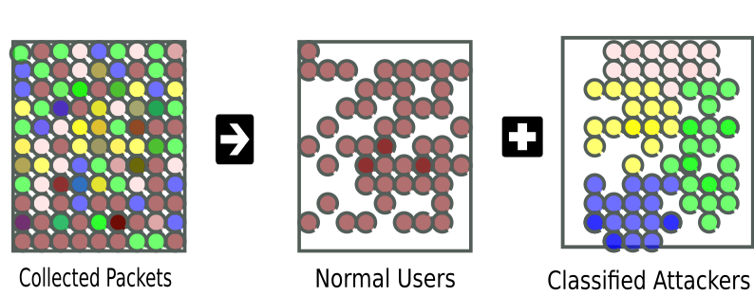
Introduction Cont…
As illustrated in Fig. 1, intruders might be curious users who want to know deeply how the system works or might be attackers from the internet who are not authorized to use the system service.

Slide 6
Major Contributions
We propose a novel two-stage feature learning method for network intrusion detection by utilizing the power of multiple classifiers with a deep neural network.
The proposed deep learning model is based on a unique architecture compared to existing models in this domain.
The proposed model has comparatively lower computational cost as compared to the existing state-of-the-art methods, we have selected limited features to reduce computational cost.
We conduct extensive experiments on the well-known publicly available challenging dataset KDD99 to evaluate the effectiveness of our proposed model and got outstanding results compared to the existing state-of-the-art methods.

Slide 7
Related Work
Since, intrusion detection have long roots in academic literature. Therefore, we discussed only a few early handcrafted and machine learning-based methods and mainly focus on recently proposed deep learning-based models.
A key milestone was the use of classical machine learning algorithms to build intruder detection systems (IDSs)
The deep learning-based intrusion detection models have achieved outstanding results in the recognition, classiﬁcation, and prediction of data types such visual, audio, text or image data formats.
These techniques excels malicious code detection performance as presented by [8-9, 12-13].

Slide 8
Related Work Cont…
Recently, most of the researchers have compared the rule-based with machine learning systems.
Any intruder code can be converted into mal-image datatype or mal-text datatype by its malicious algorithm. Deep learning-based models have proven success [13-14].
A deep learning-based intrusion detection approach proposed by Yin et al. [15] used recurrent neural networks.

Slide 9
Proposed Methodology
We proposed a multi-classifier model powered by a deep neural network for categorizing the intruders.
Since, for building a powerful Intrusion detection system, it is essential to provide features that describe information regarding the network traffic.
After feeding the first layer with these features, MCDNN applies nonlinear transformation onto its input layer and create a statistical model of what it learned.
The MCDNN is based on four layers architecture, the model is capable to automatically learn useful features from large network traffic labeled data collection and classifies intruders efficiently.

Slide 10
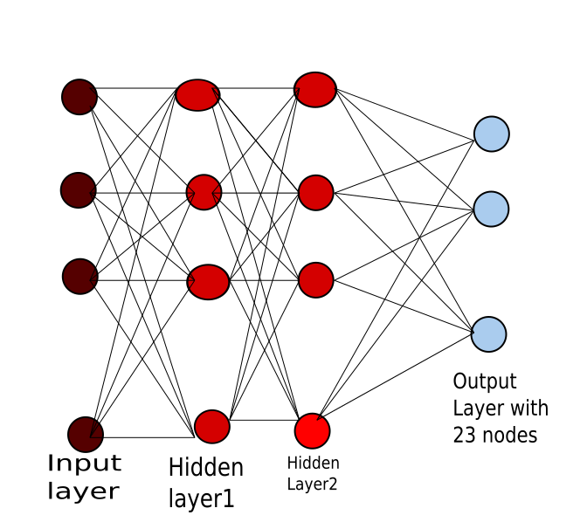
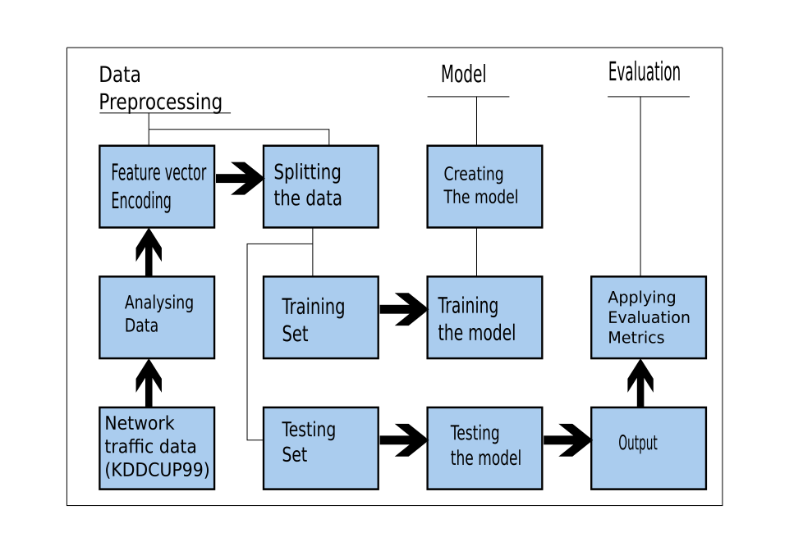
Proposed Methodology Cont…
Fig. 2 (a) illustrates the stepwise workflow, Fig. 2 (b) presents the network view of MCDNN model.
Fig. 2 (a)
Fig. 2 (b)

Slide 11
Dataset
We evaluate the effectiveness of our proposed model on a well known publicly available KDD99 dataset.
It was part of the DARPA project in 1998 where the MIT Lincoln Lab set up an environment where they used nine weeks to record data in any way from the US air force traffic.
The dataset has 494020 instances with 42 attributes and four main types of attackers:
Denial of service (Dos): An attacker seeks to make a computer or network unavailable to its intended users.
Probing-Attack: The attacker tries to gather information about the machine and attempt to bypass the firewall and gaining root access.

Slide 12
Dataset Cont…
Remote-to-Local-Attack (R2L): Attacker sends data packets to the target but has no user account of the system
User-To-Root (U2R): Attacker tries to gain local account privilege for unauthorized access.

Slide 13
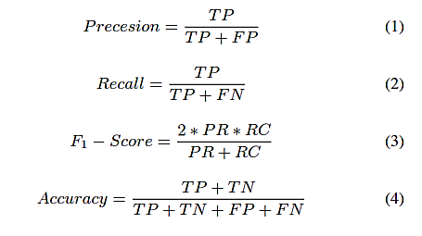
Evaluation
The effectiveness of the proposed MCDNN model is evaluated using standard evaluation measures such as: Precision, Recall, F1-Score and Accuracy.
These measures are defined as followings:

Slide 14
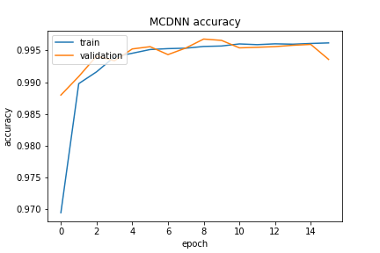
Evaluation: Accuracy

Slide 15
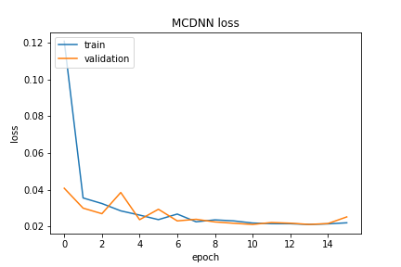
Evaluation

Slide 16
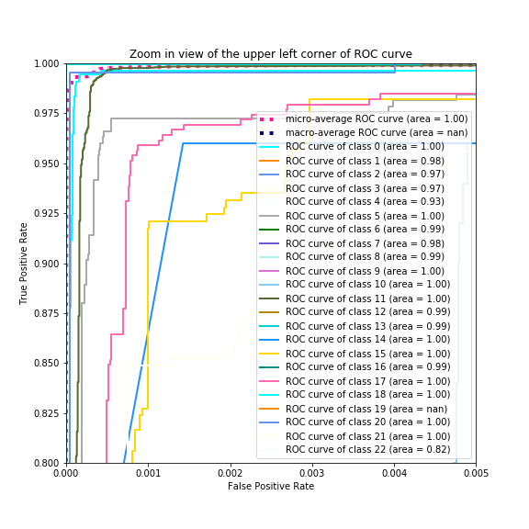
Evaluation: ROC Curve

Slide 17
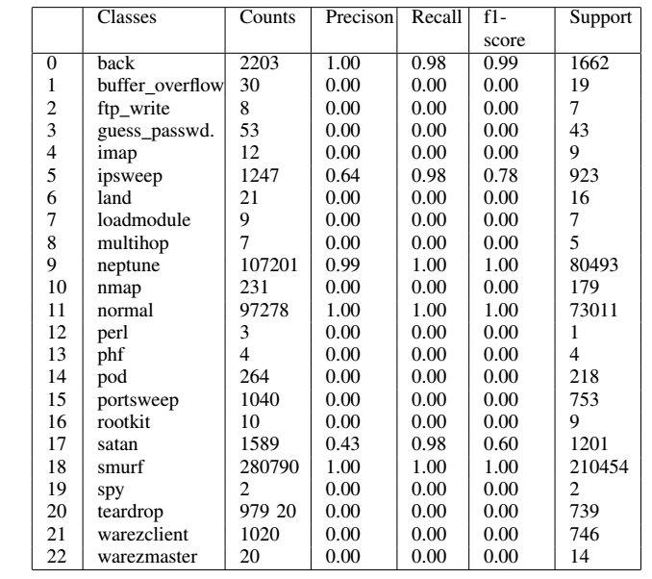
Classes

Slide 18
Welcome for your valuable Questions and Suggestions
Thank You All

