Slide 1

The Vision
Team
9 July 2018
Remind.me
Ivan
Rachev
Desislava
Aleksieva
Teodor
Dyakov

Slide 2
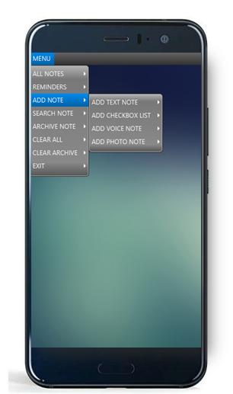

MAKE a NOTE WITH REMIND.ME to MAKE THE MOST of your day
REMIND.ME is a practical tool to organise your daily routine
Make, Prioritise, Search, Select, Show, Edit, Delete, Pin, Unpin, Archive and Restore notes for every task you’d like to follow
Get REMINDER when a deadline is approaching
Project
Purpose

Slide 3
All YOU NEED TO ORGANISE YOUR DAILY TASKS
REMIND.ME offers 4 types of notes :
TEXT notes to write what you would like to do
LIST notes with check boxes to organize tasks like grocery shopping lists or any other TO-DO list
VOICE notes when it’s faster and easier to make a voice record instead of typing
PHOTO notes enabling a notes
with an image
Project
Details

Slide 4
REMIND.ME BEST OOD PRACTICES
REMIND.ME is designed according to the best OOD practices using inheritance, abstraction and polymorphism, as well as with proper data encapsulation and exception handling.
Project implementation includes most effective usage of abstract class, classes, interfaces, enumerations, correct Data Structures, StreamingAPI , also implementing ToString() and Enumerable<T>
Program persistence is guaranteed via Serialization
Class diagram

Slide 5
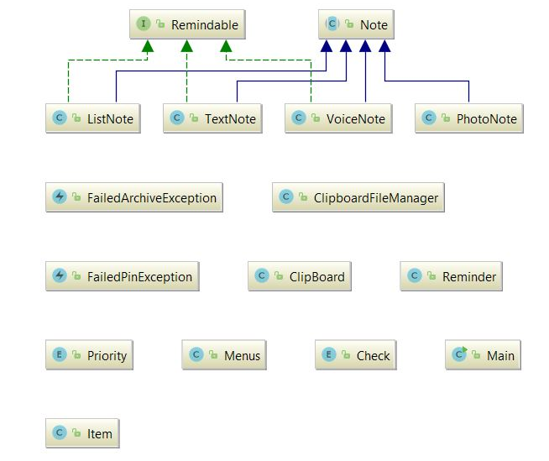
REMIND.ME : CLEAR AND EFFECTIVE STRUCTURE
INTERFACE REMINDABLE
ABSTRACT CLASS Note
Class diagram

Slide 6
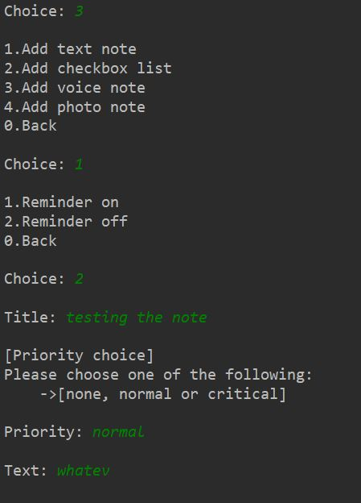
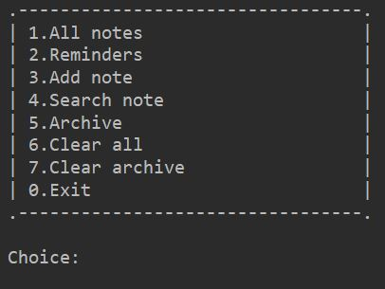
REMIND.ME HELPS TO DO ALL YOU PLANNED TO DO ON TIME
What’s in
the Menu

Slide 7
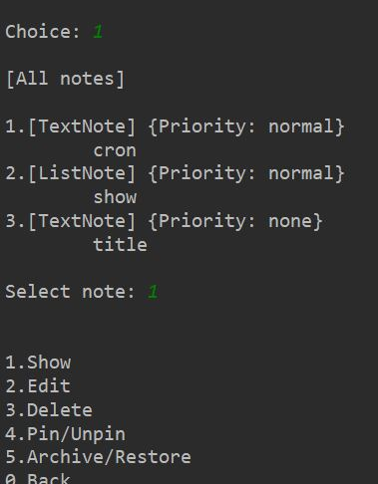
REMIND.ME HELPS TO DO ALL YOU PLANNED TO DO ON TIME
What’s in
the Menu

Slide 8
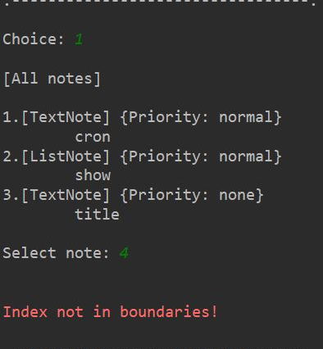
MAKE a NOTE in REMIND.ME to MAKE THE MOST of your day
What’s in
the Menu

Slide 9

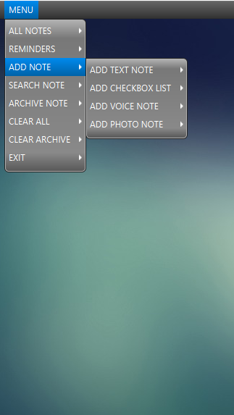
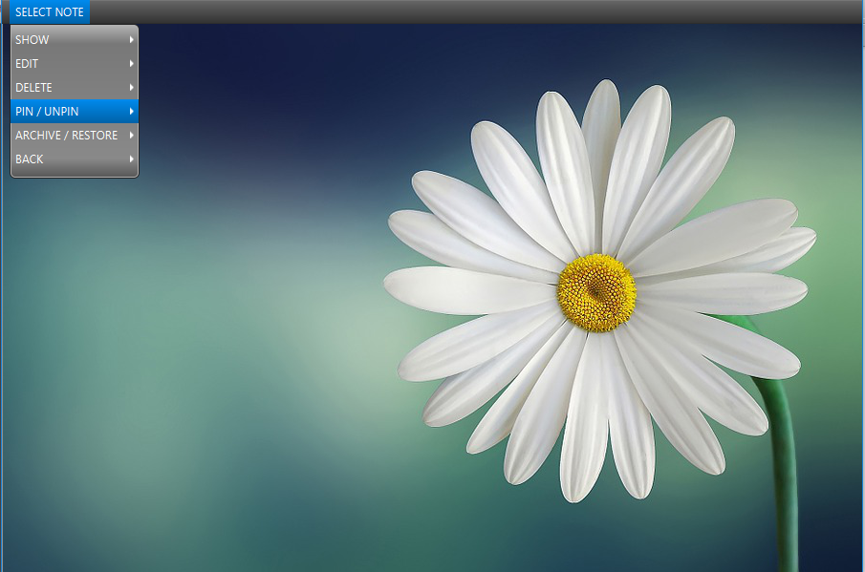
MAKE a NOTE in REMIND.ME to MAKE THE MOST of your day
Make a
Note ☺

