Slide 1


Web Fundamentals (HTML & CSS)
Team TIAMAT
Teamwork Project
Software University
http://spirtuni.cloudvps.bg

Slide 2

TIAMAT
?!
TIAsaMAT
CORRECT
TIASAMAT

Slide 3
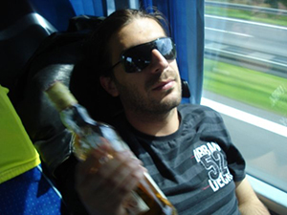
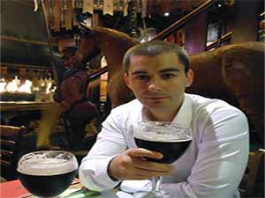
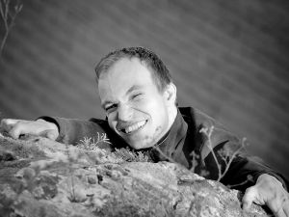
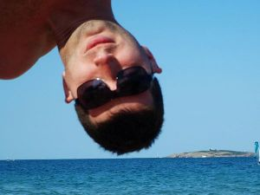
Team TIASAMAT
Georgi Inkov
Ivaylo Iliev
Kostadin Stefanov
Krasimir Garbuchev

Slide 4
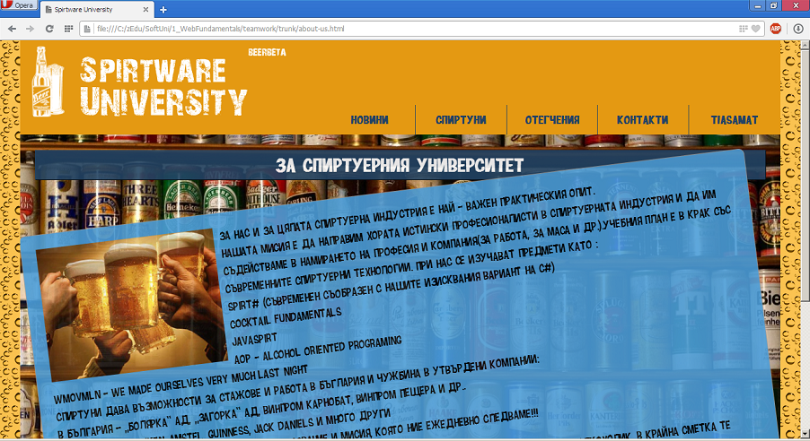

http://spirtuni.cloudvps.bg
Demo…
https://github.com/IvayloIL/Team-TIAMAT

Slide 5

Cheers!!!

