Slide 1

Introducing Exemplars for Incremental Learning in Semantic Segmentation
Anam Ur Rehman Umar Farooq
s283909@studenti.polito.it s292448@studenti.polito.it

Slide 2
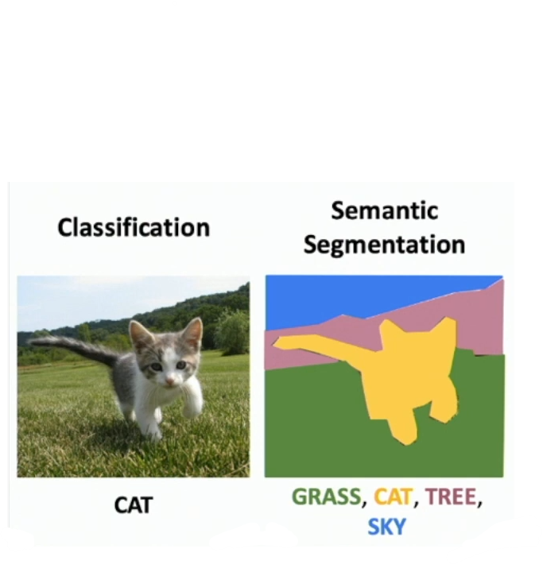
Introduction
Semantic Segmentation
Pixel Level Classification
Incremental Learning
Learning new Data continually
Catastrophic forgetting

Slide 3
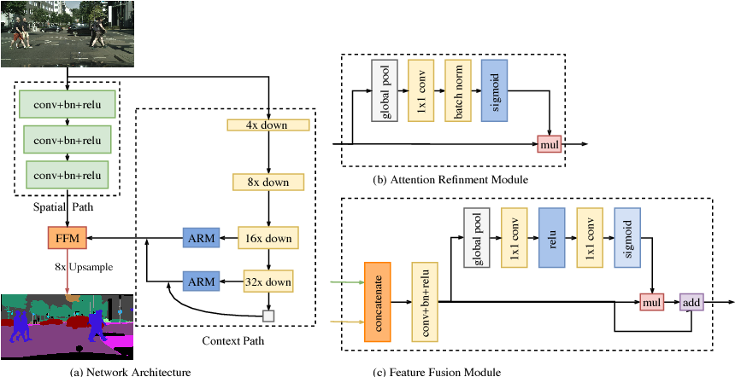
BiSeNet (Bilateral Segmentation Network)
Main Contributions
Spatial Path
Context path
ARM
FFM

Slide 4
Results of BiSeNet
Backbone | Augmentation | Val. MIoU
Resnet 50 | Random Crop = 320 | 67.4
Resnet 18 | Random Crop = 320 | 60.7
Resnet 101 | Random Crop = 320 | 70.7
Resnet 50 | Random Crop = 320 | 68.6
Resnet 50 | Random Crop = 400 | 69.5
Resnet 50Resnet 50 | Random Crop = 320 & Rotation | 69.4

Slide 5
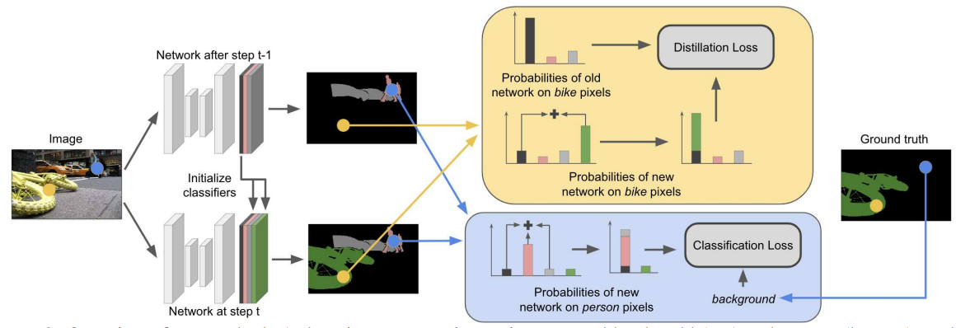
MiB (Modeling the Background for Incremental Learning in Semantic Segmentation)
Main Contributions:
Explicitly handling Semantic Shift
of background class using
Unbiased Cross Entropy loss
Unbiased Distillation loss

Slide 6
Results of MiB and other baselines
 | IL Tasks
 | 15-5 |  |  | 15-5s
Method | 1-15 | 16-20 | All | 1-15 | 16-20 | all
FT | 4.6 | 29.6 | 10.5 | 1.1 | 4.4 | 2.6
LwF | 47.8 | 32.1 | 44.1 | 4.3 | 5.6 | 4.95
ILTSS | 49.9 | 31.7 | 45.5 | 4.9 | 6.7 | 5.8
MiB | 65.5 | 39.4 | 59.3 | 29.6 | 11.8 | 25.3
Joint | 75.3 | 68.9 | 73.8 | 75.3 | 68.9 | 73.8

Slide 7
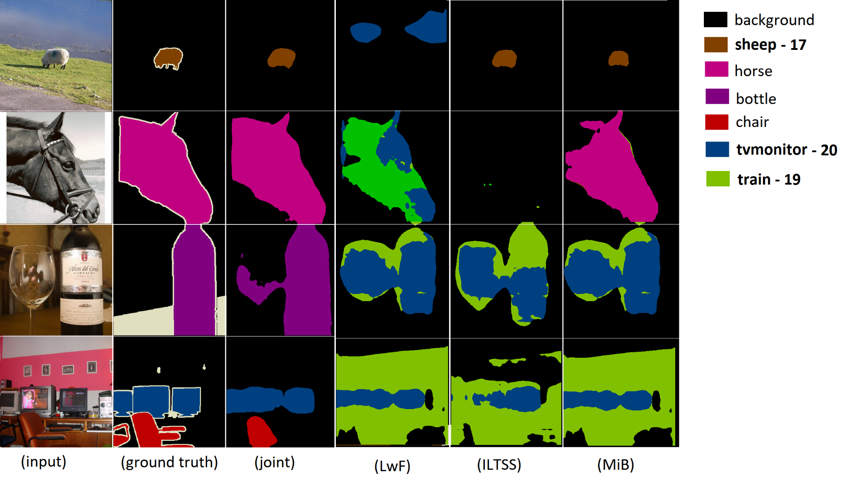
MiB: Results on 15-5s

Slide 8




SMIB: Motivation
JT: 100%
Old classes representation
MiB: 0%
What if:
We allow old classes labels in new training data?
We use exemplars of old classes for rehearsal during future IL sessions?
Sampling for exemplars?
Storage size for exemplars?

Slide 9
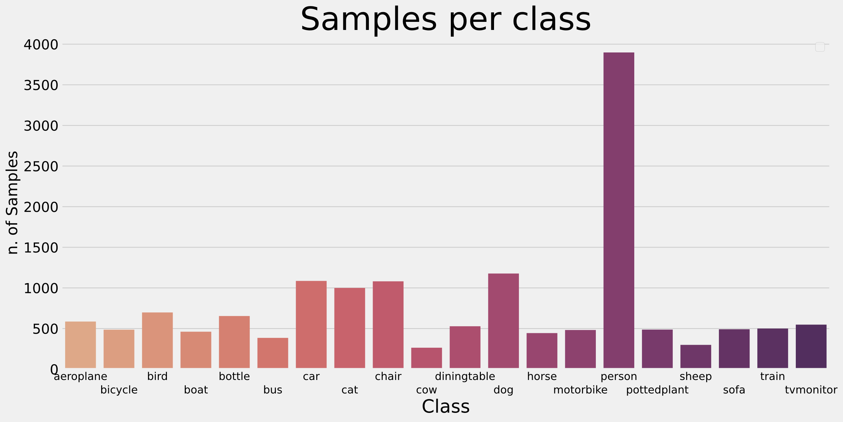
SMIB: Preliminary analysis

Slide 10
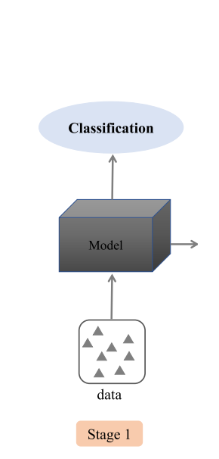
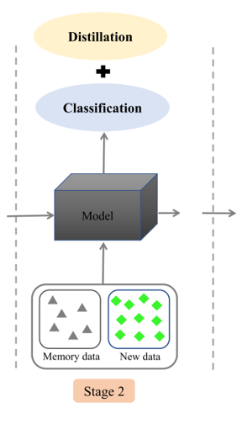
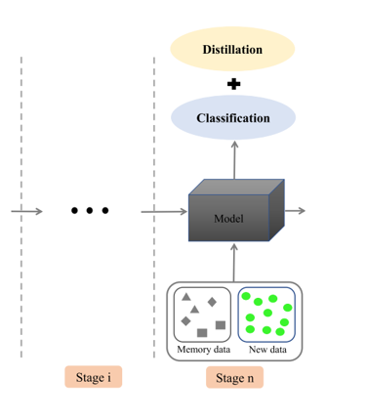
SMiB: Incremental setup

Slide 11
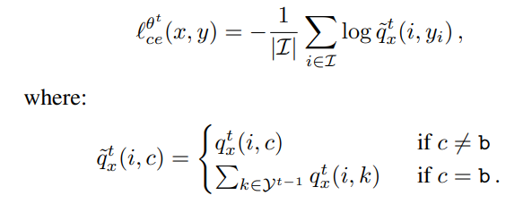
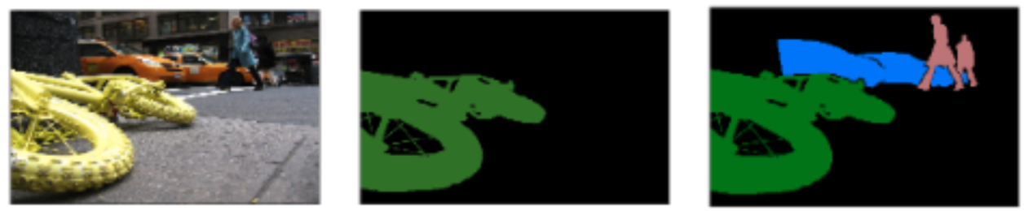
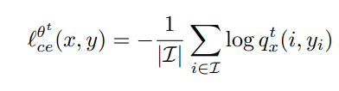
SMiB: Adjustments in loss function
MiB’s cross entropy loss
Incremental step of MiB
Standard cross entropy loss

Slide 12
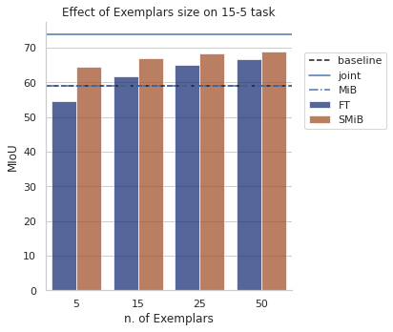
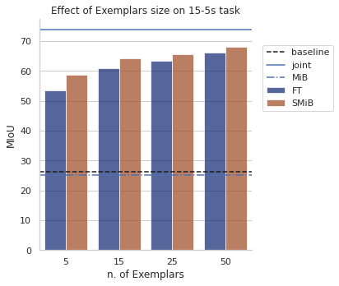
SMiB: Results

Slide 13
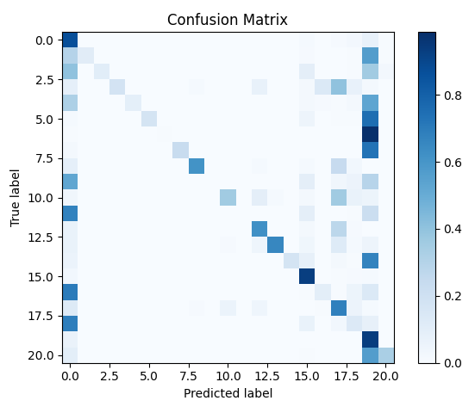
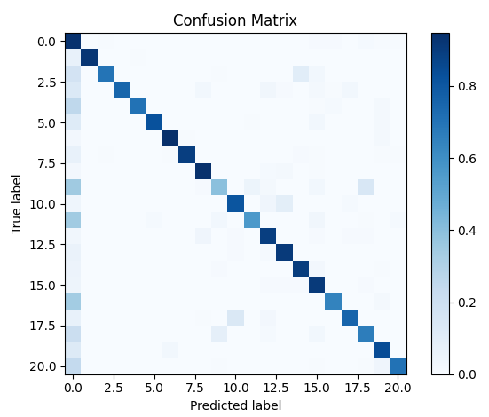
SMiB: Predictions analysis on 15-5s
a) MiB
b) SMiB

Slide 14
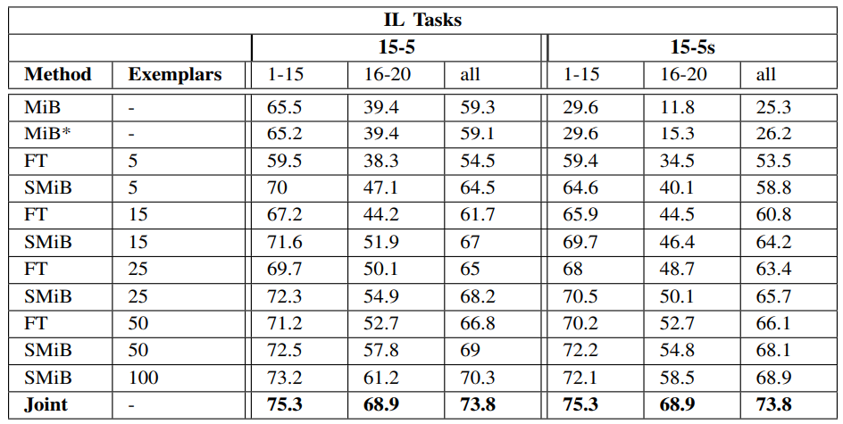
SMiB: Results

Slide 15
SMiB: Conclusions
Rehearsal based methods outperform other non-rehearsal techniques even when stored samples are very few.
Pixel-level annotations in semantic segmentation helps the model to retain the previous knowledge using very few exemplars.

