Slide 1

Exploiting Multilingualism and Multistage Fine-Tuning for Low-Resource Neural Machine Translation
Deep Natural Language Processing 2021/2022 Project Work
Presented by: Supervised by:
Mohammed EL Dor (s289298) Prof. Luca Cagliero
Anaam Ur Rahman Prof. Moreno La Quatra
Mohammad Mostafa
1/12

Slide 2


NMT Model Fine-Tuning
Neural Machine Translation (NMT) models are models trained on large corpus to learn general encodings and then fine-tuned to domain specific tasks (dataset in a unique language and sometimes in a unique style and accent)
This task is a transfer learning domain adaptation task
For low resource languages we are poor in data that will teach the model to extract general encodings
To solve it we can use the power of domain adaptation and transfer learning through multilingualism and multi-stage finetuning that was introduced in Dabre et al
Our work extends this idea
2/12

Slide 3
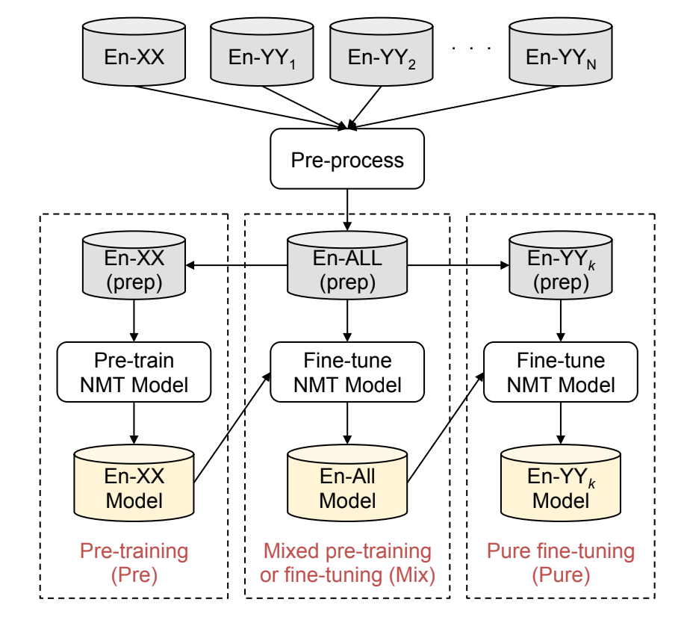
Multilingualism and Multi-Stage Fine-Turning
Multilingualism is based on training on multi-parallel corpora where the same sentence share translations in different languages
Multi-stage fine-tuning is the process in the figure
Pre-training
Mixed Pre-Training
Pure Fine-tuning
Two types of datasets used:
Helper En-XX
Target from ALTs En-YY
Training pipeline for our project consisting of three phases
https://aclanthology.org/D19-1146
https://ieeexplore.ieee.org/document/7918974
3/12

Slide 4
Pre-Training
In the pretraining process the encoder-decoder based model is trained on a large corpus from English to one of the helper languages En-XX.
In the paper of Dabre et al they used two helper languages thus they trained two models using Japanese and Chinese and so did we
We used pretrained models from Hugging Face library that have the MarianMT architecture
En-XX
Preprocess
NMT model
train
Pre-trained NMT model
https://huggingface.co/docs/transformers/model_doc/marian
http://arxiv.org/abs/1605.04800
4/12

Slide 5
Mixed Pre-Training
The pre-trained NMT model is fine-tuned (pre-training continues) on a parallel dataset of the helper language and one or more language from the ALT dataset
In the original paper the mixed-pretraining uses a dataset that was down-sampled for helper set XX, and we used the opus dataset for that and took a subset that nearly matches the size of the ALTs dataset YY
All the languages are used in a fine-tuning process for the NMT model that will later on be pure fine-tuned
En-XX
En-YY₁
. . . .
En-YY_{k}
Preprocess
Pre-trained NMT model
Train (fine-tune)
Mixed Pre-trained NMT model
5/12

Slide 6
Pure Fine-Tuning
En-YY_{j}
In the pure fine-tuning step the pretrained then fine-tuned model is again fine-tuned on a dataset En-YY_{j} from the ALTs dataset to be specific to a single target language
This step is the final step and the model will be tested afterwards
Preprocess
Mix trained NMT model
Train (Pure fine-tune)
Final pure fine-tuned NMT model
6/12

Slide 7
NMT Model Fine-Tuning
Tokenization
We used HF MarianMT models to skip pretraining stage.
Problem:
"To tokenize Chinese and Japanese sentences, we used KyotoMorph10 and JUMAN,11 respectively. For the other languages in the ALT corpus, we used the data in its raw form" Dabre et al.
Possible solutions
Use space-punctuation splits to create tokens
Example sentence of Hindi:
बुखारेस्ट को 500 से अधिक अन्य उम्मीदवार शहरों में से चुना गया था और उसे कुछ वर्षों तक इस आयोजन का इंतजार करना पड़ा।
Use open-source tokenizers for each ALT Asian language, separately
Use tokenizer that can split all (or most of) ALT Asian languages
7/12

Slide 8








NMT Model Fine-Tuning
Tokenization
Student-Teacher tokenization method:
How we trained Marian tokenizer to tokenize the new Asian Language sentence.
GitHub
Teacher
"MBART"
"Marian"
Student
List of unique tokens
8/12

Slide 9
NMT Model Fine-Tuning
Extensions
Data enrichment: We added 4 new languages in our experiments
Hindi, Filipino, Thai, Myanmar
All of them have parallel corpus of en-yy translations
We used all 9 languages from ALT dataset for Mix-Finetuning stage so that all languages can have equal chance of transfer learning in upcoming fine-tuning stages
Using all languages in mix-training phase allows the model to equally improve its translation ability in pure-finetuning stage.
9/12

Slide 10



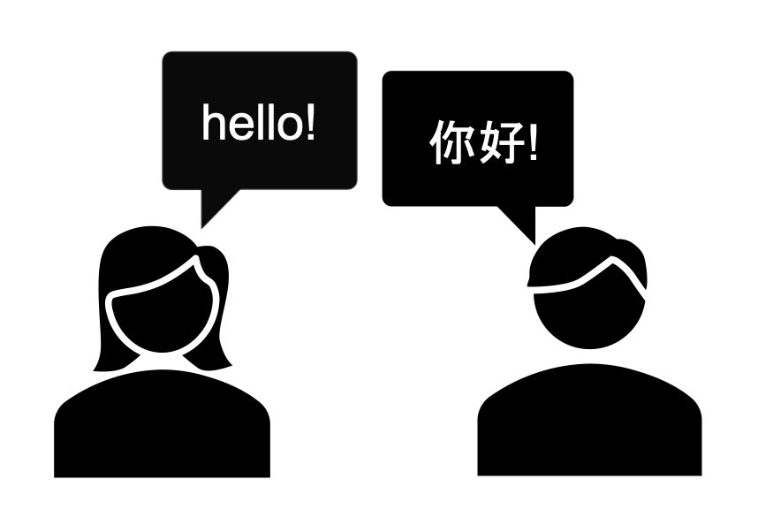
Multi-stage finetuning process for TL
Large En-XX corpus
Subset of En-XX corpus
+
Multi-parallel En-YY corpus
One En-YY pair
Mix-Finetuning
Pure-Finetuning
HUB
10/12

Slide 11
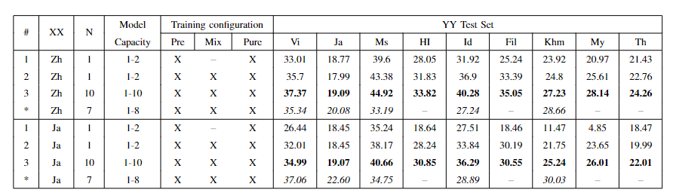
Results
What happens when we go from 1 --> 2 (multi-stage effect)
What happens when we use all languages in Mix-training stages (Multilingual effect)
Comparison with Dabre et el. Results and possible causes of better results (tokenizer, better models)
Comparison among En-zh and En-ja pretrained models
11/12

Slide 12


Conclusions and Take Home Message​
After running extensive experiments, we conclude that:
Multi stage fine tuning works significantly better than training models via fewer fine tuning stages
Multilingualism helps learning better representation of different language but similar meaning sentences. Hence, it might be beneficial to jointly train one-to-many model to achieve better performances.
The Key to multilingualism effect is the presence of parallel corpora.
12/12

