Slide 1


AUTOMATED TELLER MACHINE
BETA 3 CHANNEL

Slide 2
Objectives
The main aim of this project is to implement a
fully-functional python-based Automated Teller Machine software.
Specific objectives:
To ensure ATM security
To ascertain user-friendliness

Slide 3
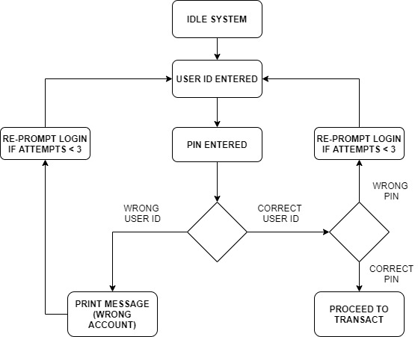
Login process

Slide 4
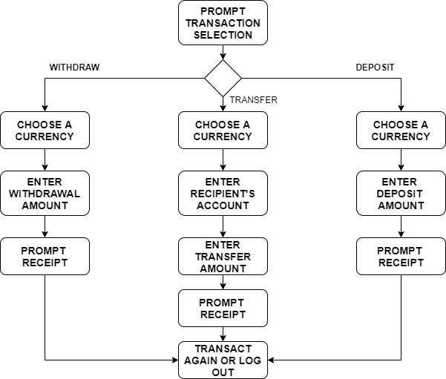
Transactions

Slide 5
Outcome and Conclusion
Implemented user IDs during logins
(Authentication).
Implemented masked pins for secure logins
(Authorization).
Logged user and general transaction history
(Accounting).

Slide 6
Brace for demonstration…

