Slide 1
Stored Procedures
(Developing and Design of databases using SQL Server)
Trainer – Danilo Borozan
Co-Trainer – Ilija Mitev

Slide 2
AGENDA
Stored Procedures
Exercises

Slide 3

STORED PROCEDURES

Slide 4
WHAT ARE STORED PROCEDURES?
A T-SQL stored procedure consists of a single batch of T-SQL code. Stored procedures have a number of important features, such as the following:
They can be called from T-SQL code by using the EXECUTE command.
You can pass data to them through input parameters, and receive data back through output parameters.
Can return result sets of queries to the client application.
They can modify data in tables.
They can create, alter, and drop tables

Slide 5
ADVANTAGES OF STORED PROCEDURES
Using T-SQL stored procedures in a SQL Server database has a number of advantages, such as the following:
To encapsulate T-SQL code.
To make a database more secure.
To help improve performance by creating execution plans that can be reused.

Slide 6
DECLARATION OF STORED PROCEDURES
Session 5 – 00 StoredProcedure.sql
CREATE PROCEDURE ProcedureName (@ParaleterList [datatype])
AS
BEGIN
DECLARE @Variable1,..N [datatype]
-- Insert statements
-- Update statements
-- Delete statements
-- Temp tables / Table variables
-- Output statements (0,1,2,..) – multiple resultsets
Select Columns
FROM Table1,...TableN
END

Slide 7
EXAMPLE OF STORED PROCEDURES
Create procedure for adding new customer
As output from the procedure return the following data:
Total number of customers starting with the same character as the new customer;
Additionally in second resultset return how many customers already exist in the new customer region.

Slide 8
WORKSHOP 01.1
Create new procedure called CreateOrder;
Procedure should create only Order header info (not Order details);
Procedure should return the total number of orders in the system for the Customer from the new order (regardless the BusinessEntity);
Procedure should return second resultset with the total amount of all orders for the customer and business entity on input;
Insert few orders in the system.

Slide 9
WORKSHOP 01.2
Create new procedure called CreateOrderDetail;
Procedure should take the single price for item from Product table (Price column);
Procedure should add details for specific order (new record for new Product/Quantity for specific order);
When the order detail is inserted, procedure should correct the TotalPrice column in the main table (dbo.order);
Output from this procedure should be resultset with order details in a form of pairs: ProductName and TotalPrice per product (Price*Quantity);
Insert few order details for some orders;
Session 5 workshop - 01 Stored Procedures.sql

Slide 10

HOMEWORK

Slide 11
Homework 02.1
Create new procedure called CreateGrade;
Procedure should create only Grade header info (not Grade Details);
Procedure should return the total number of grades in the system for the Student on input (from the CreateGrade);
Procedure should return second resultset with the MAX Grade of all grades for the Student and Teacher on input (regardless the Course).

Slide 12
Homework 02.2
Create new procedure called CreateGradeDetail;
Procedure should add details for specific Grade (new record for new AchievementTypeID, Points, MaxPoints, Date for specific Grade);
Output from this procedure should be resultset with SUM of GradePoints calculated with formula AchievementPoints/AchievementMaxPoints*ParticipationRate for specific Grade

Slide 13
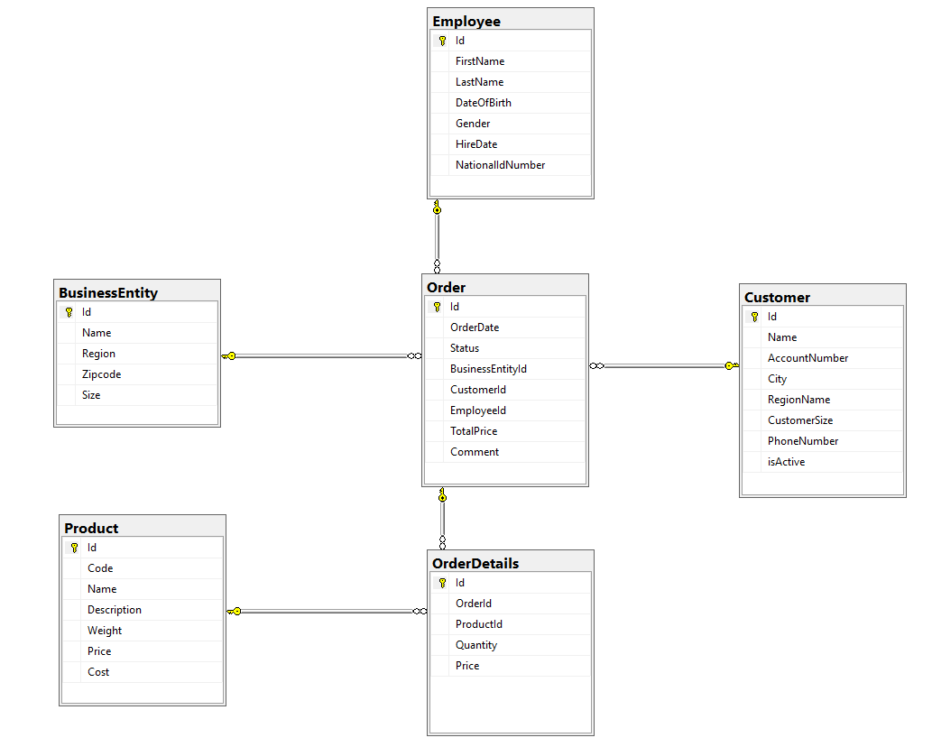
STRUCTURE IS IMPORTANT WHEN CREATING STORED PROCEDURES

Slide 14
QUESTIONS?
You can find us at
daniloborozan07@gmail.com
ilija.mitev3@gmail.com

