Slide 1


CHATBOT_v2.0 DEMO
Ivan Danny
Eva Desmond
Eric Aaron
Tina

Slide 2


Contents
Introduction
Simplify what we improve
DEMO
Guide you a dialogue path
Evaluation
Details of how we evaluate

Slide 3
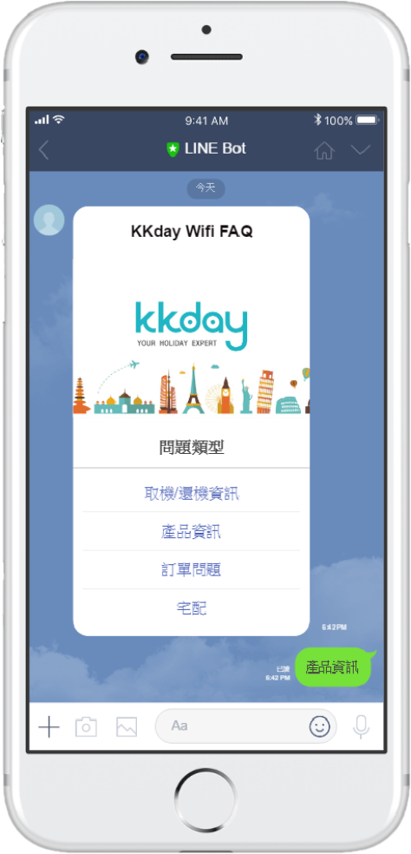
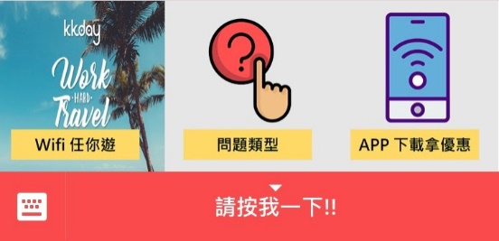

Define target
Chat bot
For product 10691(Rent wifi at Japan airports)
What we imporove?
Main menu
Button

Slide 4
Contents
Introduction
Simplify what we improve
DEMO
Guide you a dialogue path
Evaluation
Details of how we evaluate

Slide 5
Q .
Suppose there’s a person wanting to know whether he can use
wifi in Nikko?
#Layer 1
Welcome Intent
Four Categories

Slide 6
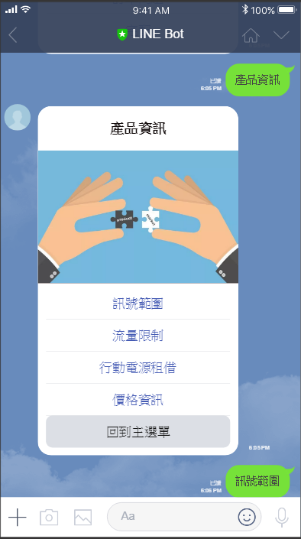
Q .
Suppose there’s a person wanting to know whether he can use
wifi in Nikko?
#Layer 2
Categorical
Intent
Back to previous layer

Slide 7
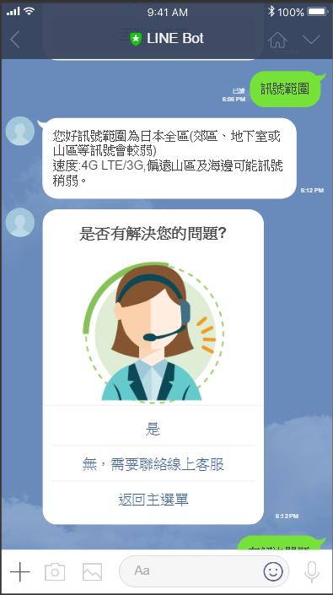
Q .
Suppose there’s a person wanting to know whether he can use
wifi in Nikko?
#Layer 3
End Session
Problems being solved
Problems not solved
Having other problems

Slide 8
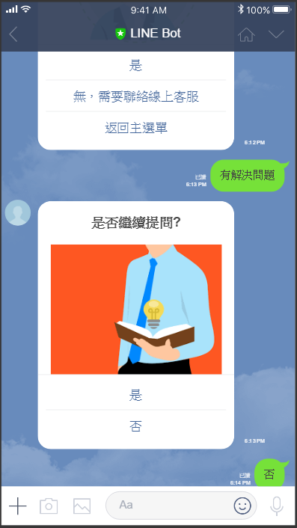
Q .
Suppose there’s a person wanting to know whether he can use
wifi in Nikko?
Measurement_1
Compute the proportion of solved questions
Underestimation

Slide 9
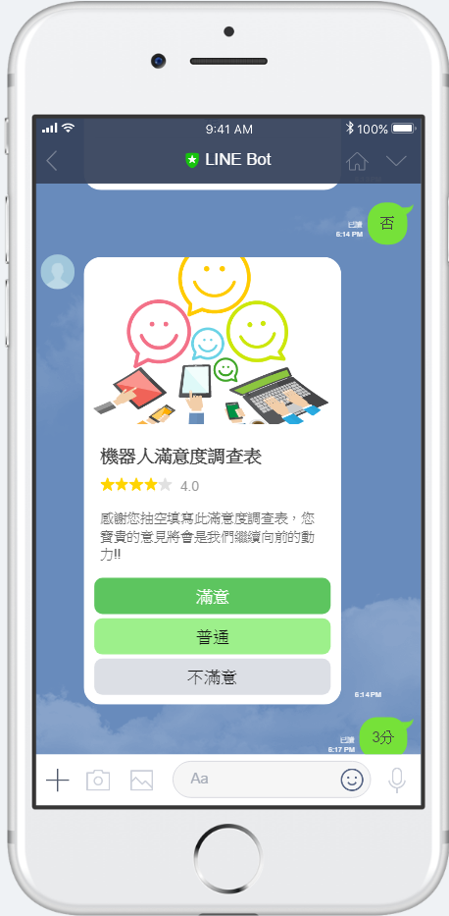
Q .
Suppose there’s a person wanting to know whether he can use
wifi in Nikko?
Measurement_2
Satisfactory Survey

Slide 10
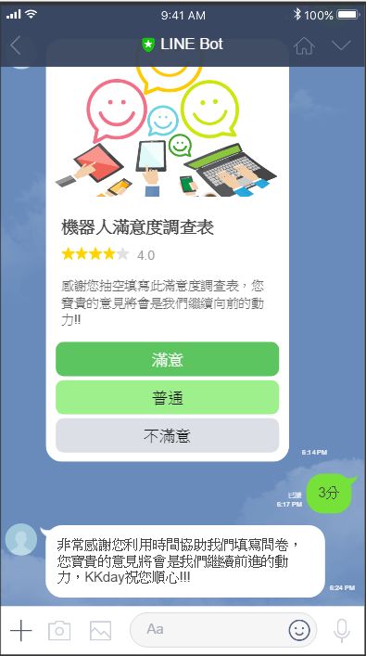
Q .
Suppose there’s a person wanting to know whether he can use
wifi in Nikko?
End

Slide 11
Contents
Introduction
Simplify what we improve
DEMO
Guide you a dialog path
Evaluation
Details of how we evaluate

Slide 12
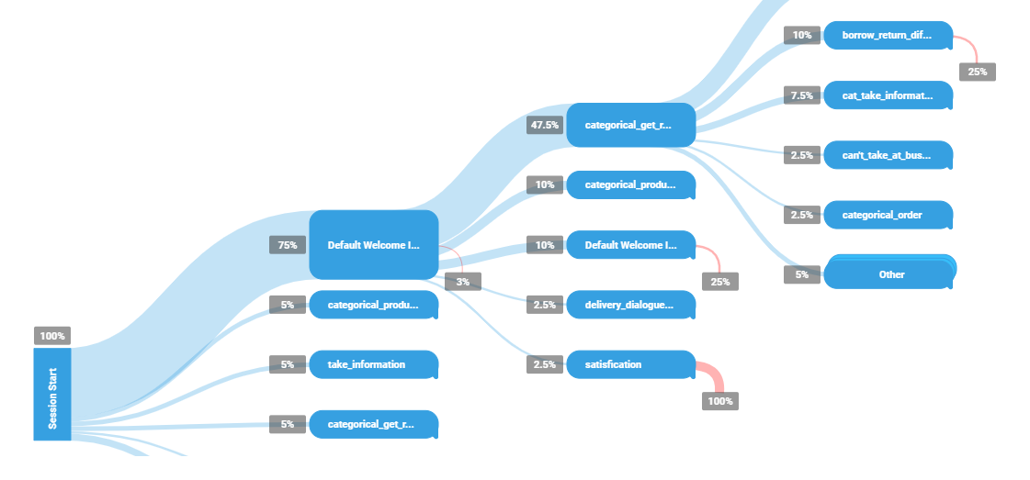
CHART How to evaluate
Tool
Analytics
Session flow
Yesterday/ 7 days/ 30 days

Slide 13
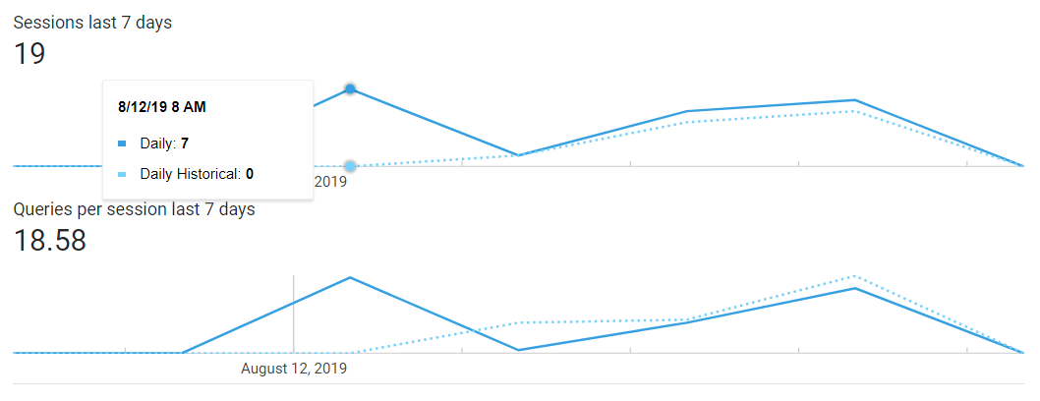
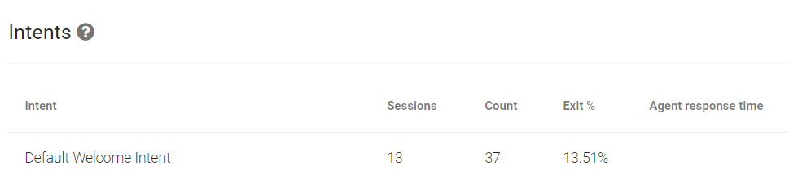
CHART How to evaluate
Performance
proportion of solved questions =
counts of solve_que intent / counts of every end session intent

Slide 14
CHART How to evaluate
Performance
Satisfaction survey
User experience

Slide 15
the END
Thanks for your listening

