Slide 1
Quarterly Customer Churn Analysis Presentation
Presented by: Olasunkanmi Titus
Date: February, 2023

Slide 2
Table of Contents
Quarterly Customer Churn Analysis
Purpose Statement
Data Story / Key Findings
Conclusions
Recommendations
Further Exploration
Appendix

Slide 3
Purpose Statement
Why should Maven Telecommunication care about Customer Churn?
What’s Customer Churn? is the percentage of customers that stopped using a company product or services during a certain time frame.
Customer acquisition cost on the other hand is the total cost of sales and marketing required to acquired a customer, facts have shown that it cost more to acquire a new customer than maintaining existing customers, the lower business keeps customer acquisition cost the more they maximize profit, gain larger market share and we can do only do this by fighting against churn as a way of looking out for the long-term sustainability of the business.

Slide 4
Objectives
The aim of this project is to identify key drivers of customers churn, determine either or not company is losing high value customers, if so, then provide actionable recommendations on how business can retain them, in order to maximize profit and gain larger market share.

Slide 5
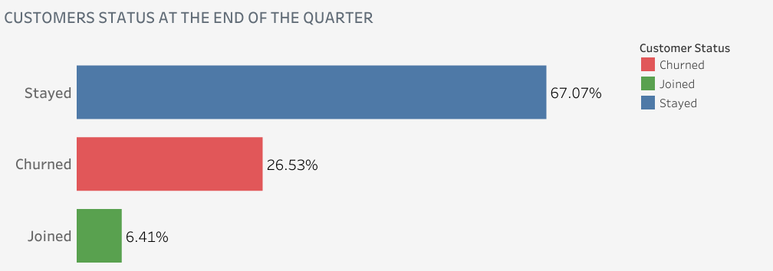
How many customers joined the company in the last quarter?
We’ve 7043 distinct customers,
454 joined, while 1869 churned,
26.5% is a disturbing churn rate.

Slide 6
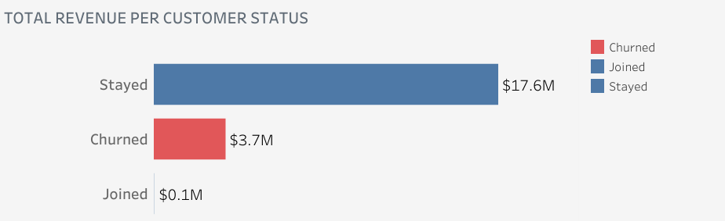
What’s the percentage of company Revenue lost to churned customers?
17.2% of company total revenue,
resulted from 26.5% churn rate
was lost to churn customers, this is
a major price to pay for customers
churn, we will explore key reasons
why customer churn in the next
slides.

Slide 7
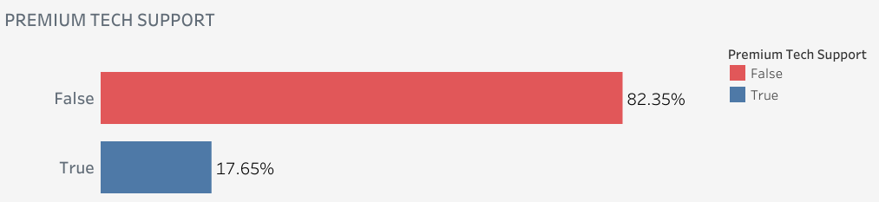
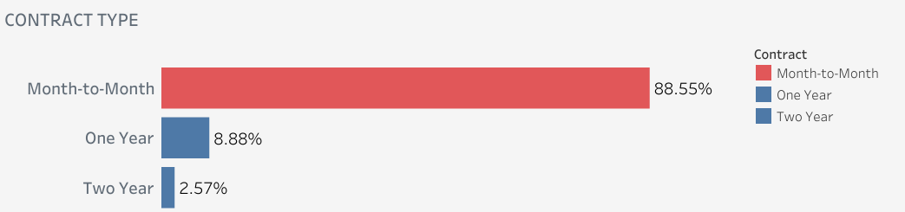
What are the key drivers of customer's churn?
Premium Tech Support help to reduce
wait time for customer support.
Month-to-Month plan account for
46% of total customer, customers on
this plan find it easy cancel subscription
as they don’t have much to lose.

Slide 8
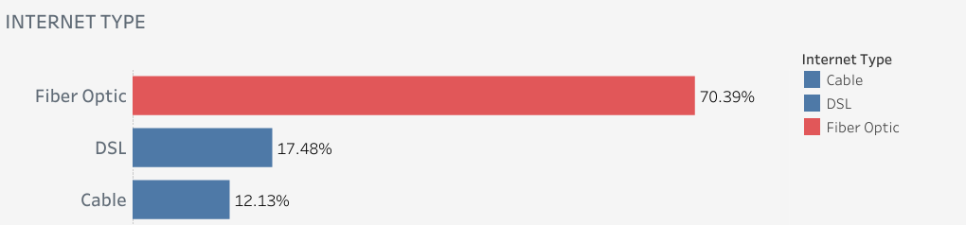
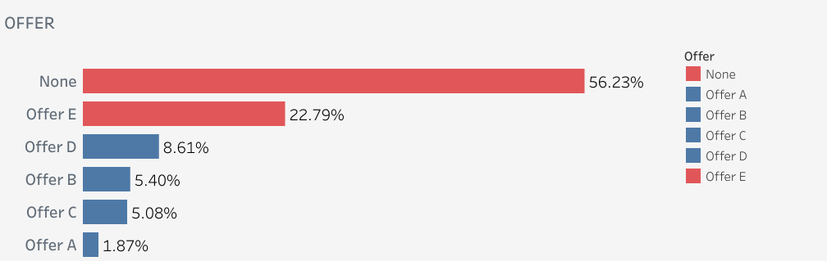
What are the key drivers of customer's churn?
94% of churn customers subscribe
for Internet Services, Fiber Optic
internet type need improvement.
% of churn customers that subscribe
for other free packages associated
with Internet Service Subscribers
are very low.
These four key drivers of churn lead us to the next slides to know why(reasons) customers churned.

Slide 9
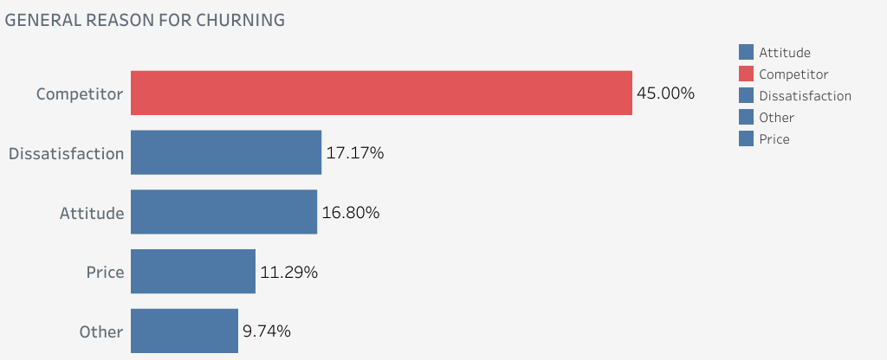
General reasons why customers churned
In the next slides depict amount of revenue lost to all general reason for churn, what customers are dissatisfied about and what competitors are doing better.

Slide 10
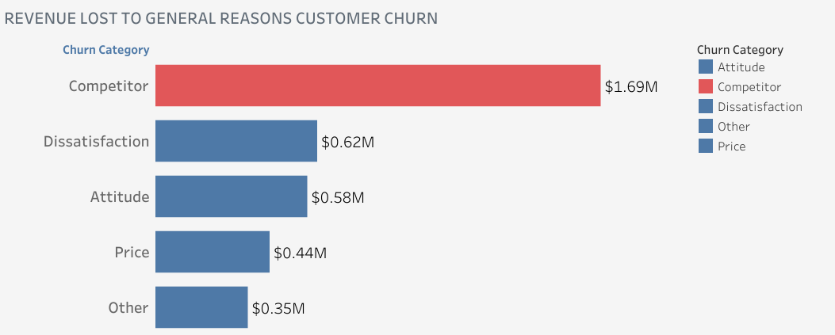
What percent of lost revenue was lost to Competitors?
$1.7million which account for 46%
of total revenue lost to churn
customer was lost to Competitors,
it makes the highest lost by reason
of churn.

Slide 11
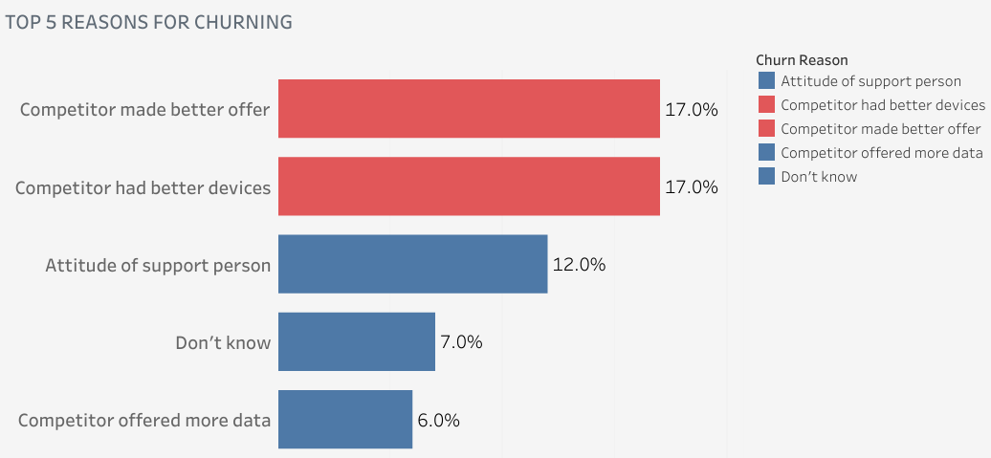
Top 5 specific reasons customers churned.
Top 3 reasons justified the key drivers
of customers churn.
In the next slide we will identify high value customers, find out risk level of business losing high value customers

Slide 12
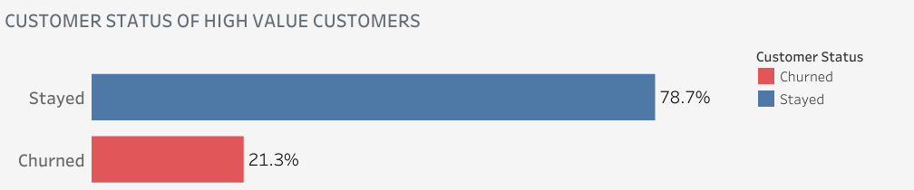
Who is a high value customer? What is the customer status of high value customers at the end of the quarter?
I identify high value customers with three metrics;
Referral: Customers that refer others to the business.
Tenure in Months: A year and more membership.
Monthly charges: In the top 50th percentile.

Slide 13
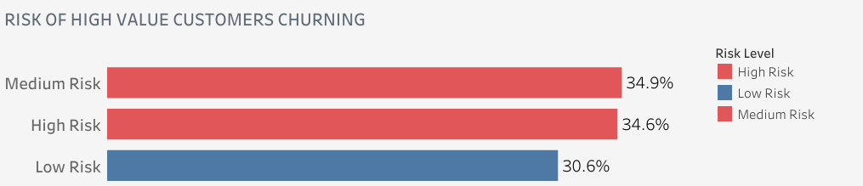
What percent of high value customers that stayed have high risk of churning?
1225 of 1557 high value customers stayed, how
many key indicators driving churn present in
high value customers record was used to categorize
the risk level of High Value customer churning.

Slide 14
Insights
1869 churned, while 454 joined at the end of the quarter, which is 4:1 ratio.
Premium Tech Support, Internet Type, Tenure in Months and Contract are the four key drivers of customers churn.
$3.7M, 17.2% of total revenue was lost to churned customers, and $1.7M, 46% of total revenue lost was specifically lost to competitors.
Most of the churn customers spend less than 6 months tenure with the company.
San Diego is the city with highest churn percentage.
Competitor made better offer, had better devices and Attitudes of support person are the top 3 reasons customers churned the company.
70% of customers lost to competitors have Fiber Optic Internet type.
Most of High Value Customers stayed and 21.3% churned at the end of the quarter, this implies 18% of churned customers are High Value Customers.
34.6% of High Value Customers that stayed have High Risk of churning, 34.9% have Medium Risk of churning the company.

Slide 15
Recommendations
Knowing 82.35% of churned customers didn’t get Premium Tech Support, company should considered it for all customers, this can improve after sales experience.
Company should create rewarding Offers for all customers, particularly for those on Month-to-Month contract plan, reward customer loyalty for long term customers.
Company should research, evaluate their internet facilities to meet industry standard, improve Fiber Optic surfing and download speed, since 90% of churned customers subscribe for Internet and 70% of customers that the company lost to competitors are on Fiber Optic Internet type.
Company should conduct survey on attitude of support person, asking specific, measurable, action-oriented questions that can help business setup workshop for support staffs to improve customer services, provide incentives for customer staff that get good customer feedback.
Deliver reminder alert particularly to Month-to-Month subscribers whose subscription are about to end and method of payment are out of date, since Month-to-Month find it easy to cancel.
Company should normalize engaging with High Value Customers to prevent them from churning, like having specific offers for them over certain interval of time, prioritize Premium Tech Support to retain them.
Company should survey customers from time to time for feedbacks, check in on customers through email marketing to measure customers satisfaction.

Slide 16
Further Exploration
Customers should be surveyed on Attitude of support person, asking specific, measurable, action-oriented and relevant questions, survey response should be analyzed to know the type and nature of workshop to put together for support staff development to improve customer support services and experience.

Slide 17
Thank you.

Slide 18
Appendix
A typical profile of a churned customer
Diversity inclusion visual specific reasons for churning across general reasons
Collection of all SQL queries for Data Cleaning process.
Collection of all SQL queries for Data, processing and analysis.

Slide 19
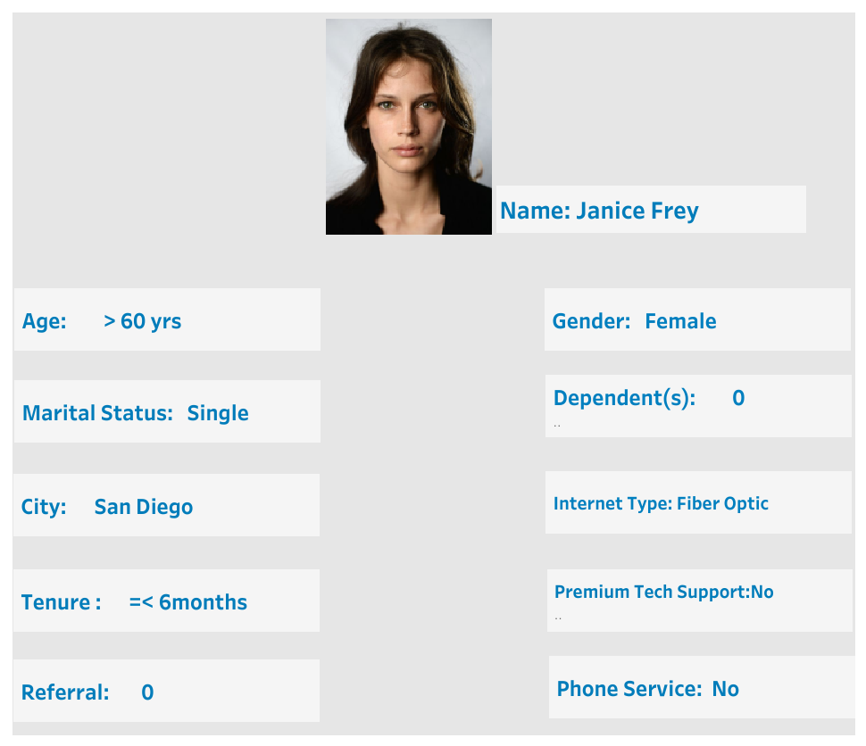
A typical profile of a churned customer

Slide 20

