Slide 1
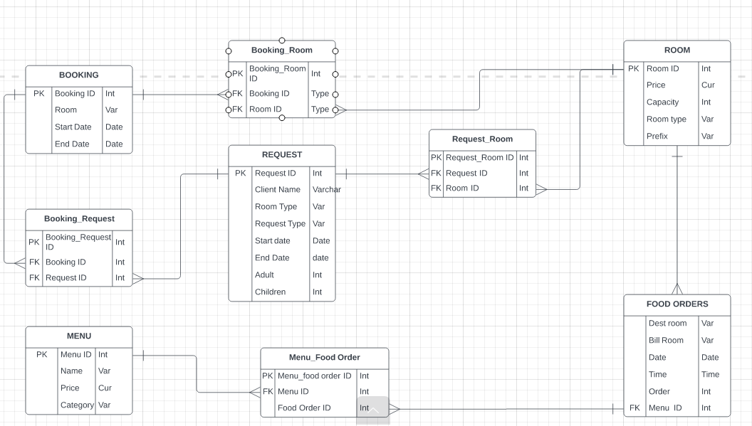
Entity Relationship Diagram
A CAPSTONE PROJECT AS PRESENTED BY DESMOND AMADI

Slide 2
ERD and Data Structure explanation
Following a series of Data transformation on Excel and subsequent SQL queries I was able to establish the business relation that exist in the Hotel business process.
This was achieved by establishing one to one relationship and many to many relationship and subsequently introduce a bridge table.
The relationships were created due to identical columns among two tables e.g.
“menu” and “food orders” tables both have a “menu_id” column and are therefore related. Same can be said for Request ,Booking and Room tables.
As result of the bridge table which established many to many relation we did merge the tables with join queries on SQL.
The tables were subsequently exported to POWER BI for analysis and creation of a dashboard.

Slide 3
Data Quality and Recommendations
The two table that was exported from SQL were named Request and Food order table; I noticed a data error showing the year as 1819 in conjunction with the time. This was fixed by eliminating the date error through data validation and Data split .
After joining “request”, “booking” and “rooms” tables (due to their relationship), the discrepancy in the “start_date” column in the “bookings” table can be observed.
Data Validation can be implemented while entering information into the Hotel System database in the future, to avoid data entry errors.
Using DAX on Power BI I was able to determine revenue generated from various aspect of the business.
Once the clean data was loaded on POWER BI it was analysed and the following insight and recommendation are given below as seen from the table below:

Slide 4
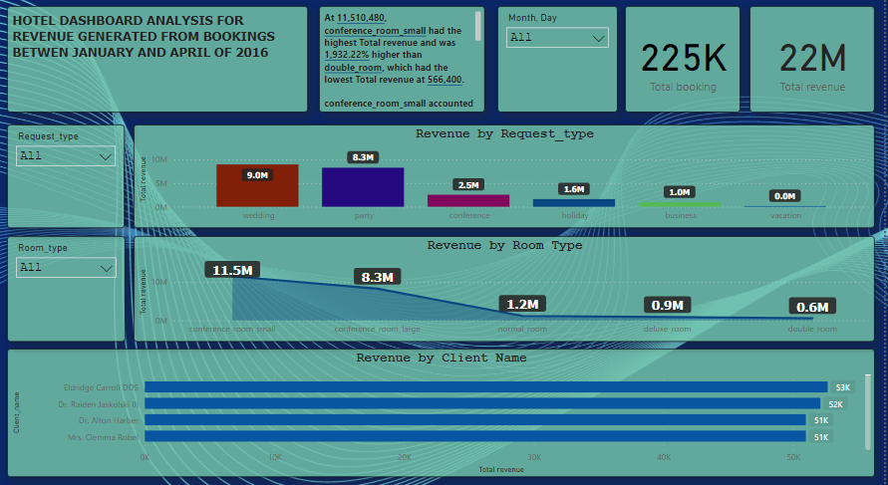
RESERVATION TABLE [Booking,Request,Room]

Slide 5
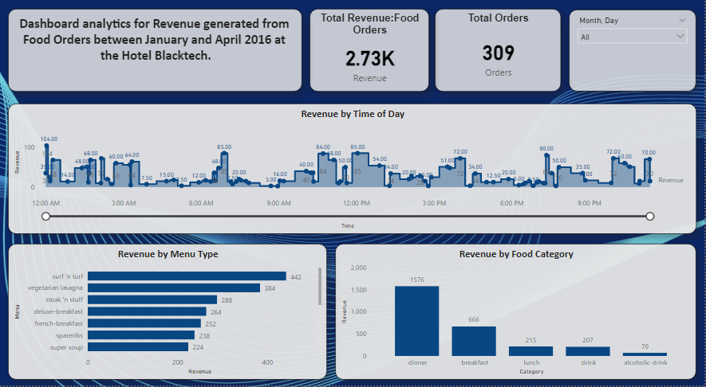
FOOD TABLE [Food Order & Menu]

Slide 6
Extracting Insights from Database
From the above table its safe to say the revenue base of the Hotel System is from Reservation 22m and food orders accounting for 2.73K
﻿Further review of revenue from reservation/food orders shows under ;
Room Type: at 11.5M conference room small had the highest total revenue and was 1,932.22% higher than double room, which had the lowest Total revenue at 5.6k. Hence accounted for 51.42% of the total revenue from reservations.
Request Type: the highest revenue was earned from Wedding at 9M, followed by Party at 8.3m and lowest revenue earned under this category is from Vacation at 3.6K.
Reservation by Client: The highest revenue was from Eldridge Carroll DDS at 52,640 followed by Dr. Raiden Jaskolski III 52,080 and Mrs. Clemma Robel 50,960.﻿Eldridge Carroll DDS accounted for 0.24% of Total revenue. Across all 4,717 Client name, Total revenue ranged from 80 to 52640.
﻿Food Category: At 1,576, dinner had the highest Revenue and was 2,151.43% higher than alcoholic-drink, which had the lowest Revenue at 70. dinner accounted for 57.64% of food order revenue. Across all 5 Category, Revenue ranged from 70 to 1,576.
Menu Type: surf 'n turf had the highest Revenue at 442, followed by vegetarian lasagna and steak 'n stuff. soft-drink had the lowest Revenue at 24. surf 'n turf accounted for 16.17% of Revenue. Across all 16 Menu, Revenue ranged from 24 to 442.

Slide 7
Recommendations based on Insights from Database
In order to boost and sustain revenue based on the insight garnered from the database ;below are some of the pertinent recommendations;
The highest revenue comes from the use of the conference rooms from weddings ,party's and business meetings. In order to drive more business to these arrears , the hotel mgmt. needs to adapt to recent trends, audience demands and offer more value added services such as making their environment more aesthetic.
Also as a means to boost revenue generation from least sources such as Vacation, holidays and double /single rooms. Management needs to create special packages that is attractive to client such as spa package, the sightseeing package, holiday packages and so on. This will go along way to drive revenue in this avenues.
It is equally important to reward our loyal clients by way of special discount and offers as a way of retaining there business because the hotel industry mostly thrive on testimonial and referrals.
Another means of increasing revenue generation from food orders or menu is to become an eco-friendly hotel, grow your own garden with fresh food that guests can see is healthy for them, offer vegan menus and various activities that are popular nowadays. All of this can help you capture your audience and offer them something unexpected and delightful.
Train and retrain your employees on being hospitable and welcoming. Follow trends on this as well since it’s very important to go above and beyond customer expectations.

