Slide 1
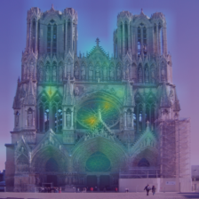
Do Self-Supervised Vision
Models Learn What
Experts See?
Attention Alignment with Human-Annotated
Architectural Features
ISY5004 — Intelligent Sensing Systems Practice Module
Mid-Project Progress Update — March 2026

Slide 2
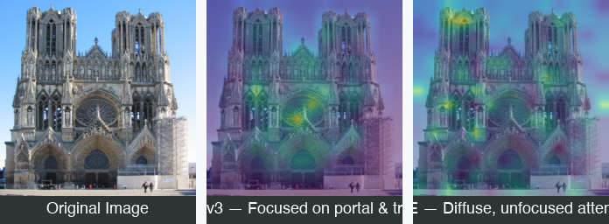
Why This Matters
SSL models achieve strong benchmarks — but what are they looking at?
The Problem
SSL models can classify “Gothic cathedral” by attending to overcast skies instead of pointed arches
The Gap
• No cross-model benchmark for expert alignment
• No study on how fine-tuning shifts attention
• No strategy comparison (LP vs LoRA vs Full)
Same image: DINOv3 focuses on architectural features (left),
MAE attention is diffuse (right)
2

Slide 3
Three Research Questions
Q1
Frozen Model Alignment
Do SSL models attend to expert-identified diagnostic features?
Complete
IoU between attention maps and 631 expert bounding boxes across 7 models × 12 layers
Q2
Fine-Tuning Effects
Does fine-tuning shift attention toward expert features? Does strategy matter?
Complete
Δ IoU (fine-tuned − frozen) with paired Wilcoxon tests, Holm correction, Cohen’s d
Q3
Per-Head Specialization
Do individual attention heads specialize for different architectural features?
Planned
Per-head IoU × feature-type matrix, rank-based head analysis
3

Slide 4
Professor’s Feedback
Four suggestions that shaped our methodology
1
Continuous Metrics
Implemented
“Apply Gaussian filtering to bounding boxes and compare with MSE, like crowd density estimation”
MSE, KL Divergence, EMD added alongside IoU
2
Fine-Tuning Impact
Implemented
“Study whether SFT preserves, enhances, or destroys attention consistency”
Preserve / Enhance / Destroy taxonomy applied to 6 models × 3 strategies
3
Cross-Layer Aggregation
Planned
“Aggregate attention from different layers (e.g. max pooling) to construct a new map”
Max pooling, depth-weighted mean, ALTI
4
Unimodal vs Multimodal Leaderboard
Partial
“Compare unimodal models (DINO) and VLM vision encoders (CLIP, SigLIP)”
Paradigm grouping applied in analysis; formal dashboard split planned
4

Slide 5
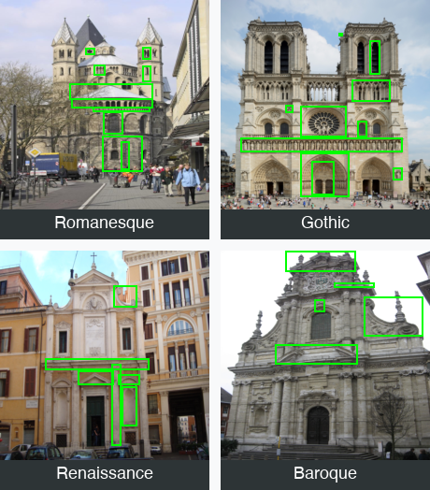
WikiChurches Dataset
Barz & Denzler, NeurIPS 2021
Total images | 9,485
Annotated eval set | 139 images, 631 bboxes
Styles | Romanesque, Gothic, Renaissance, Baroque
Feature types | 106 categories
Training (Q2) | ~4,588 labelled images
Eval holdout | 139 images (zero leakage)
Style Distribution
Romanesque
54
Gothic
49
Renaissance
22
Baroque
17
5

Slide 6
7 Models, 4 SSL Paradigms + 1 Supervised Baseline
All ViT-B architecture (12 layers, 768 dim, 12 heads, ~86M params) except ResNet-50
Model | Paradigm | Patch | Method | Key Feature
DINOv2 | Self-distillation | 14×14 | CLS, Rollout | 4 register tokens
DINOv3 | Self-distillation + Gram | 16×16 | CLS, Rollout | RoPE encoding
MAE | Masked Autoencoding | 16×16 | CLS, Rollout | Pixel reconstruction
CLIP | Contrastive (softmax) | 16×16 | CLS, Rollout | Language-image align
SigLIP | Contrastive (sigmoid) | 16×16 | Mean | No CLS token
SigLIP 2 | Contrastive (sigmoid) | 16×16 | Mean | Dense features
ResNet-50 | Supervised (ImageNet) | — | Grad-CAM | CNN baseline
6

Slide 7
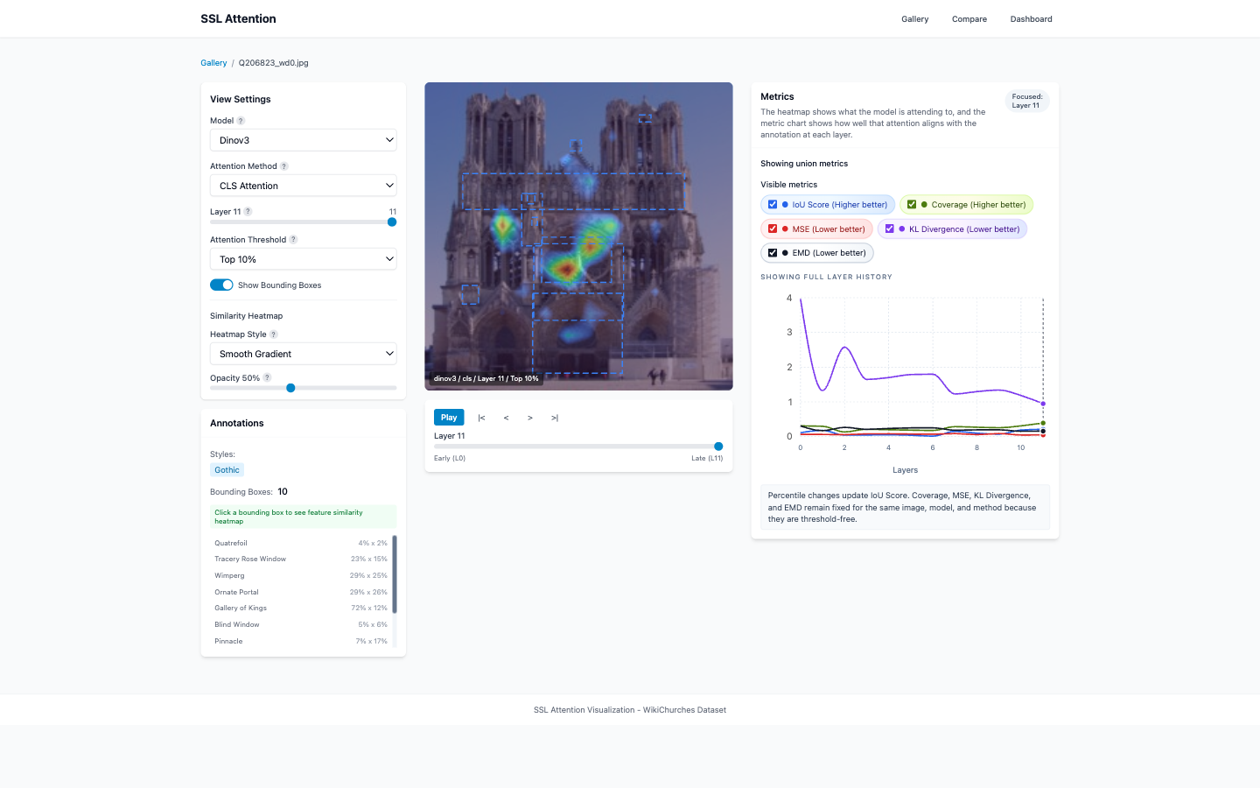
Measuring Attention-Expert Alignment
Addressing Feedback #1: continuous metrics beyond IoU
Image Detail view: attention overlay (left), expert annotations (bboxes), layer-wise metrics (right)
5 Complementary Metrics
Metric | Measures | Threshold?
IoU | Spatial overlap of top-k attention with expert regions | Yes
Coverage | Fraction of attention energy inside expert regions | No
Gaussian MSE | Distance from attention to Gaussian-blurred GT | No
KL Divergence | Distribution divergence vs ground truth | No
EMD | Optimal transport cost between distributions | No
Statistical Rigor
• Paired Wilcoxon signed-rank tests
(139 image pairs per comparison)
• Holm-Bonferroni correction
• Cohen’s d effect sizes
with 95% bootstrap CIs
7

Slide 8
Q1: Frozen Model Leaderboard
Addressing Feedback #4: unimodal vs multimodal comparison
Paradigm Ranking
Unimodal self-distillation leads
DINOv3 (0.133) achieves 1.6× the IoU of DINOv2 (0.082). Self-distillation learns part-level segmentation.
Supervised > Multimodal
ResNet-50 (0.090) outperforms all VLMs. Language alignment doesn’t help localisation.
VLMs cluster together
CLIP/SigLIP/SigLIP2 all ≈ 0.047–0.049. Contrastive objective produces similar attention patterns.
Reconstruction is worst
MAE (0.037) — pixel reconstruction ≠ object localisation.
8

Slide 9
Q2: Fine-Tuning Experiment Design
Addressing Feedback #2: does SFT preserve, enhance, or destroy consistency?
Linear Probe
LoRA
Full Fine-tune
~3K params
~300K params
~86M params
Classifier head only
Backbone frozen
Low-rank adapters on
attention layers + head
Entire backbone +
classifier head
Baseline — attention unchanged
Parameter-efficient; preserves pre-training
Maximum adaptation capacity
Training Configuration: 4-class style classification (Romanesque, Gothic, Renaissance, Baroque) • 3 epochs, batch 16 • Cosine LR + warmup • Class-weighted loss • 139 annotated images strictly excluded from training
Measurement: Δ IoU = IoU(fine-tuned) − IoU(frozen), per image, paired Wilcoxon tests with Holm correction
Taxonomy: Enhance (Δ > 0, significant) | Preserve (Δ ≈ 0, not significant) | Destroy (Δ < 0, significant)
9

Slide 10
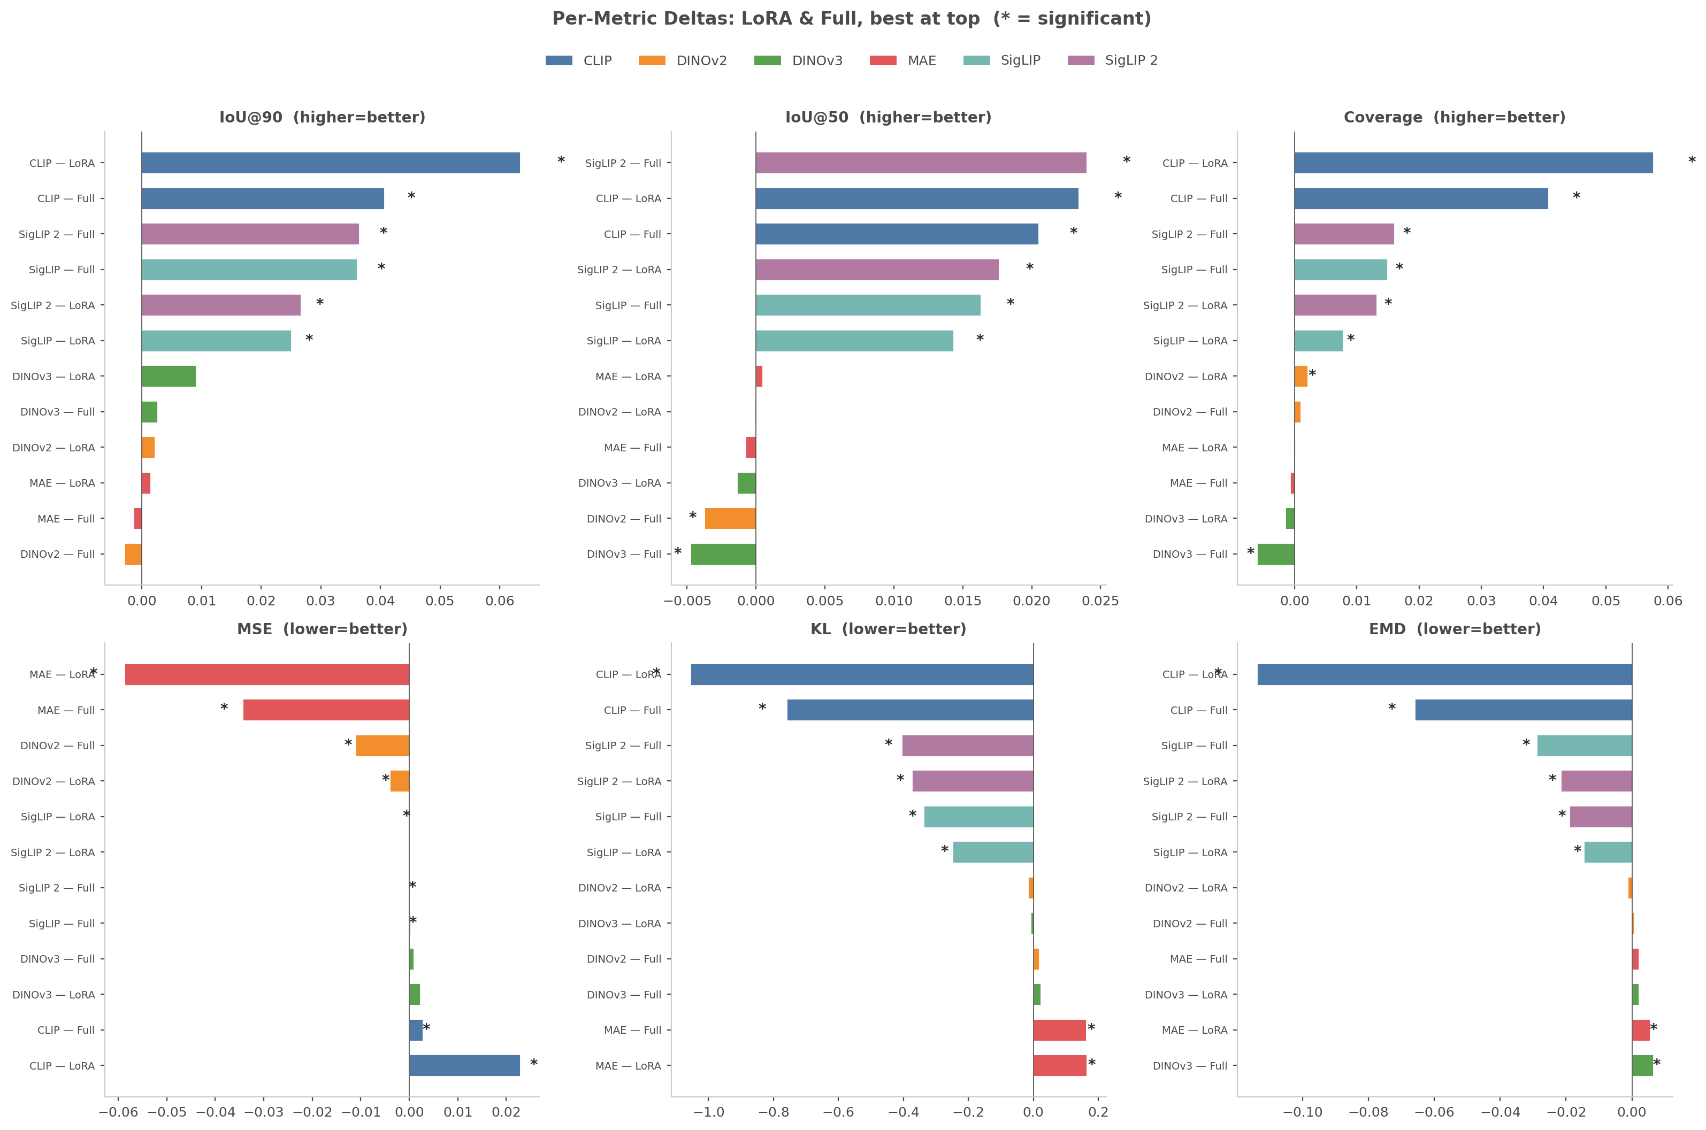
Q2: Preserve, Enhance, or Destroy?
Applying the professor’s taxonomy to fine-tuning results
Enhance
Contrastive models (CLIP, SigLIP)
CLIP LoRA: Δ +0.063 (d=1.33)
SigLIP/2 Full: Δ +0.036 (d=0.78–0.94)
All 6 comparisons statistically significant
Preserve
Self-distillation & reconstruction
DINOv3: Δ +0.003–0.009 (not significant)
MAE: Δ ≈ 0 across all strategies
Already aligned (DINO) or unreachable (MAE)
Destroy
No model conclusively destroys
DINOv2 Full: Δ −0.003 (not significant)
Directionally concerning but not catastrophic
LoRA ≥ Full across all models
285× fewer params, no forgetting risk
10

Slide 11
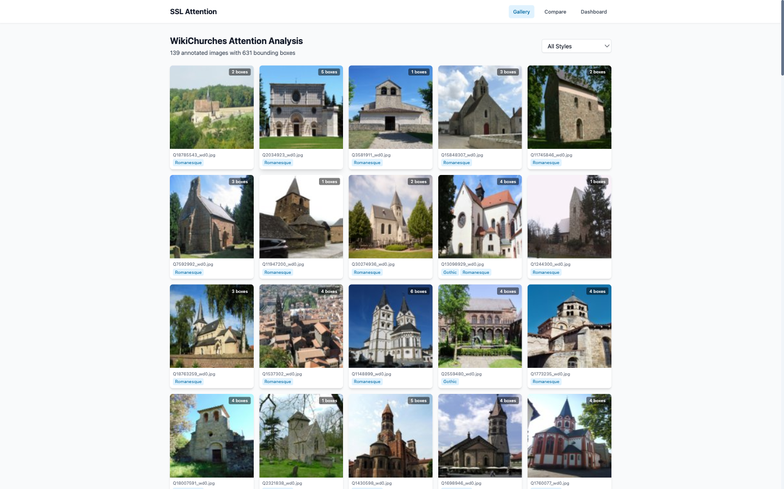
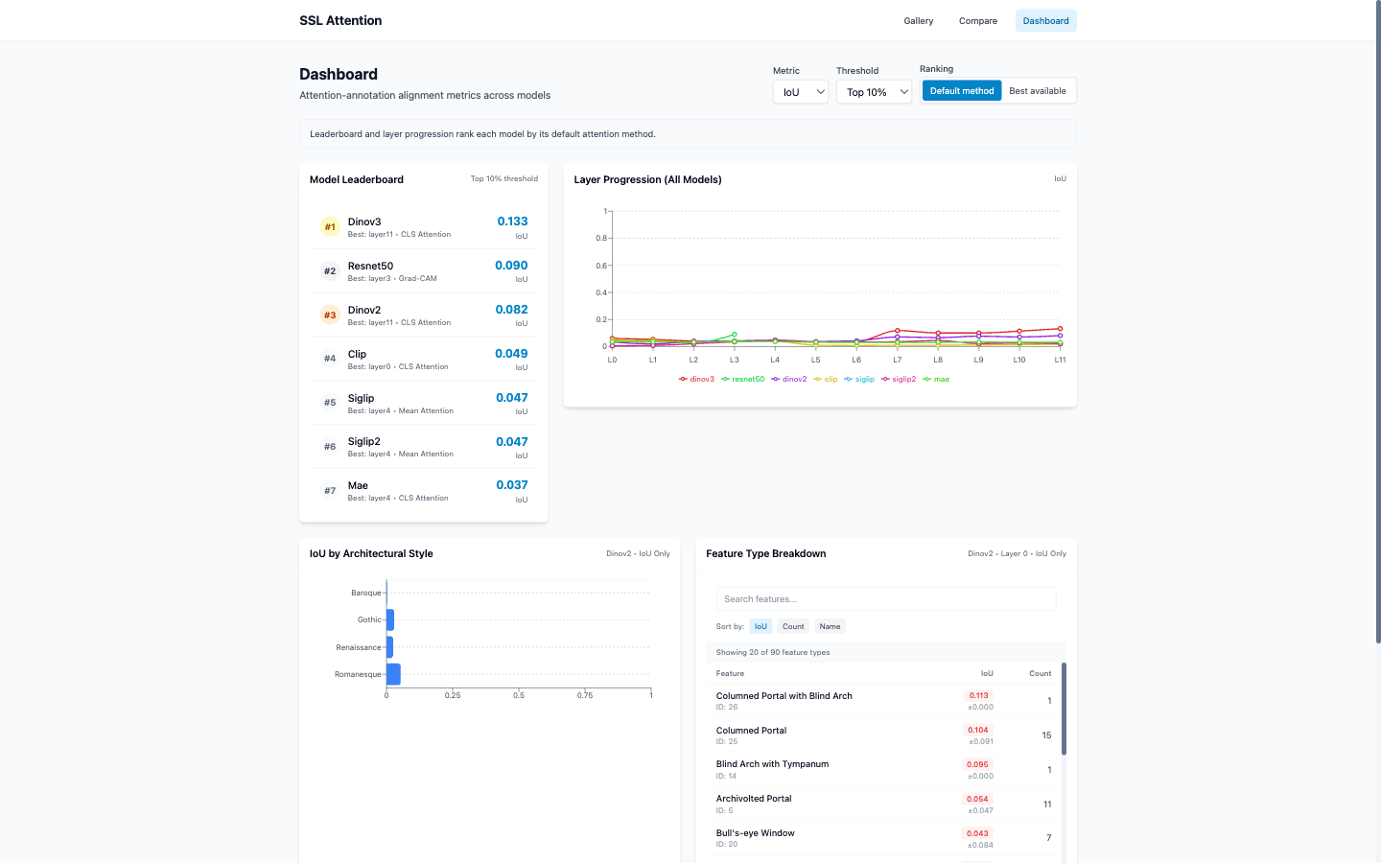

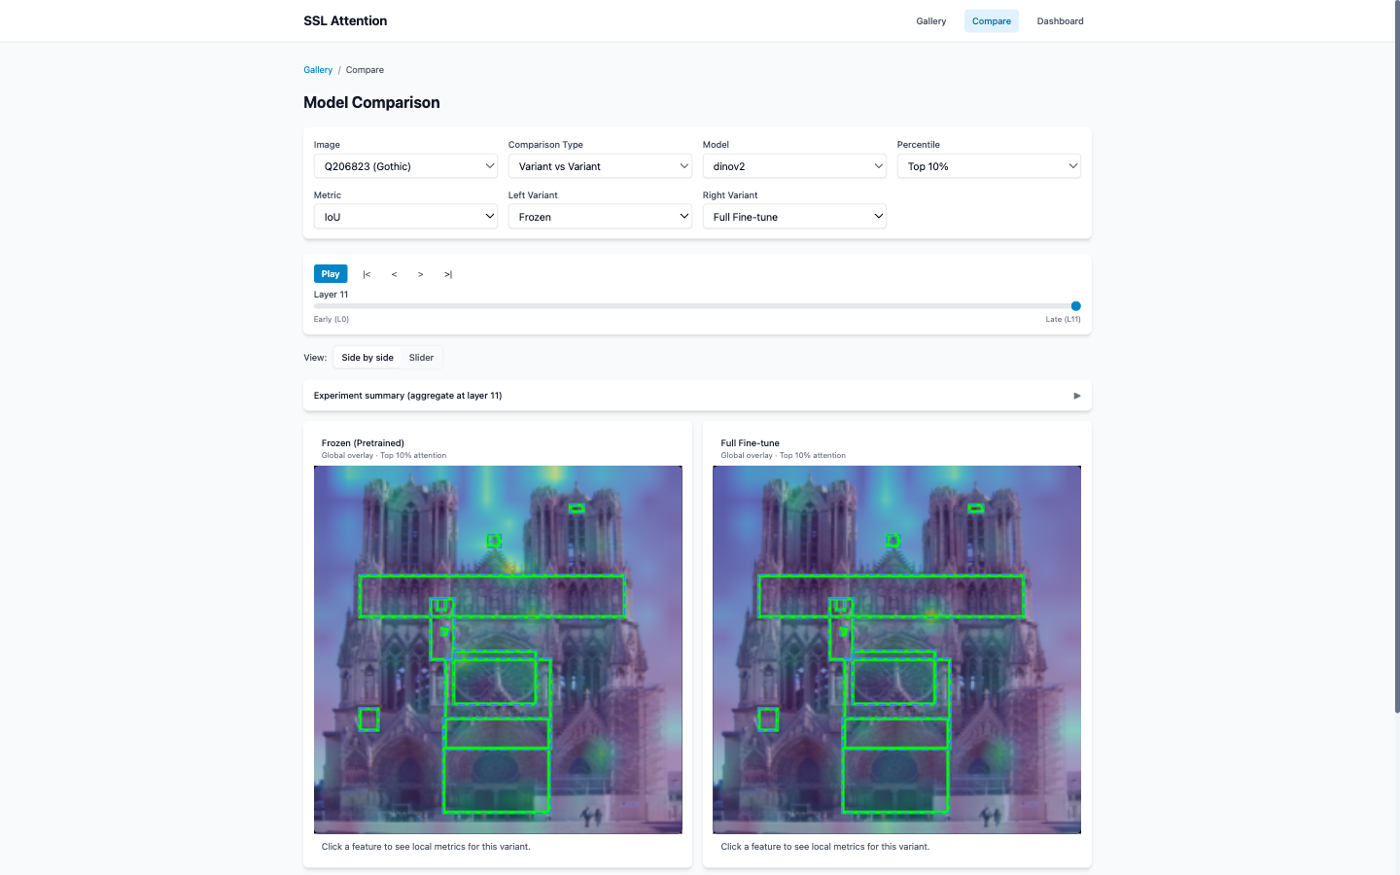
Interactive Visualization Platform
Precompute → HDF5/SQLite/PNG cache → FastAPI (25 endpoints) → React + Vite
Gallery
Dashboard
Image Detail
Compare
11

Slide 12
Engineering Highlights
Built for reproducibility and scale
WikiChurches
Dataset
Precompute
Pipeline
FastAPI
Backend
React
Frontend
→
→
→
HDF5 • SQLite • PNG
7
Vision models with unified VisionBackbone protocol
Quality Gates
• pytest test suite
• mypy type checking
• ruff linting
• IoU quantile bias fix
(torch.quantile → torch.topk)
• Deep audit epic (#9ct)
metrics, frontend, security
25
REST API endpoints across 4 routers
5
Precompute scripts (attention, features, heatmaps, metrics)
50
Tracked issues via bd (beads), 48 closed
0
GPU needed at runtime — all cache-served, <100ms responses
12

Slide 13
Remaining Work & Roadmap
Addressing remaining professor feedback
#1 Metrics
#2 SFT Impact
#3 Aggregation
#4 Leaderboard
Feedback #3: Cross-Layer Aggregation
• Max pooling across 12 layers
Pixel-wise max → comprehensive saliency map
• Depth-weighted mean pooling
Exponential decay weighting deeper (semantic) layers
• ALTI (Aggregation of Layer-wise Token Interactions)
State-of-the-art recursive aggregation (Ferrando et al., 2022)
Q3: Per-Head Specialization
• Per-head IoU × feature-type matrix
• Head ranking by alignment consistency
• Voita et al. (2019), Caron et al. (2021)
Feedback #4: Paradigm-Split Leaderboard
• Formal unimodal vs multimodal grouping in dashboard
• Sub-group averages for IoU, MSE, Coverage
• Potentially add SAM (Segment Anything) encoder
• Text-prompted evaluation for VLMs (CLIP, SigLIP)
Other Open Items
• Attention shift diff-map visualization
• Fine-tuning training loop test coverage
• Feature-specific forgetting analysis (per architectural element)
13

Slide 14
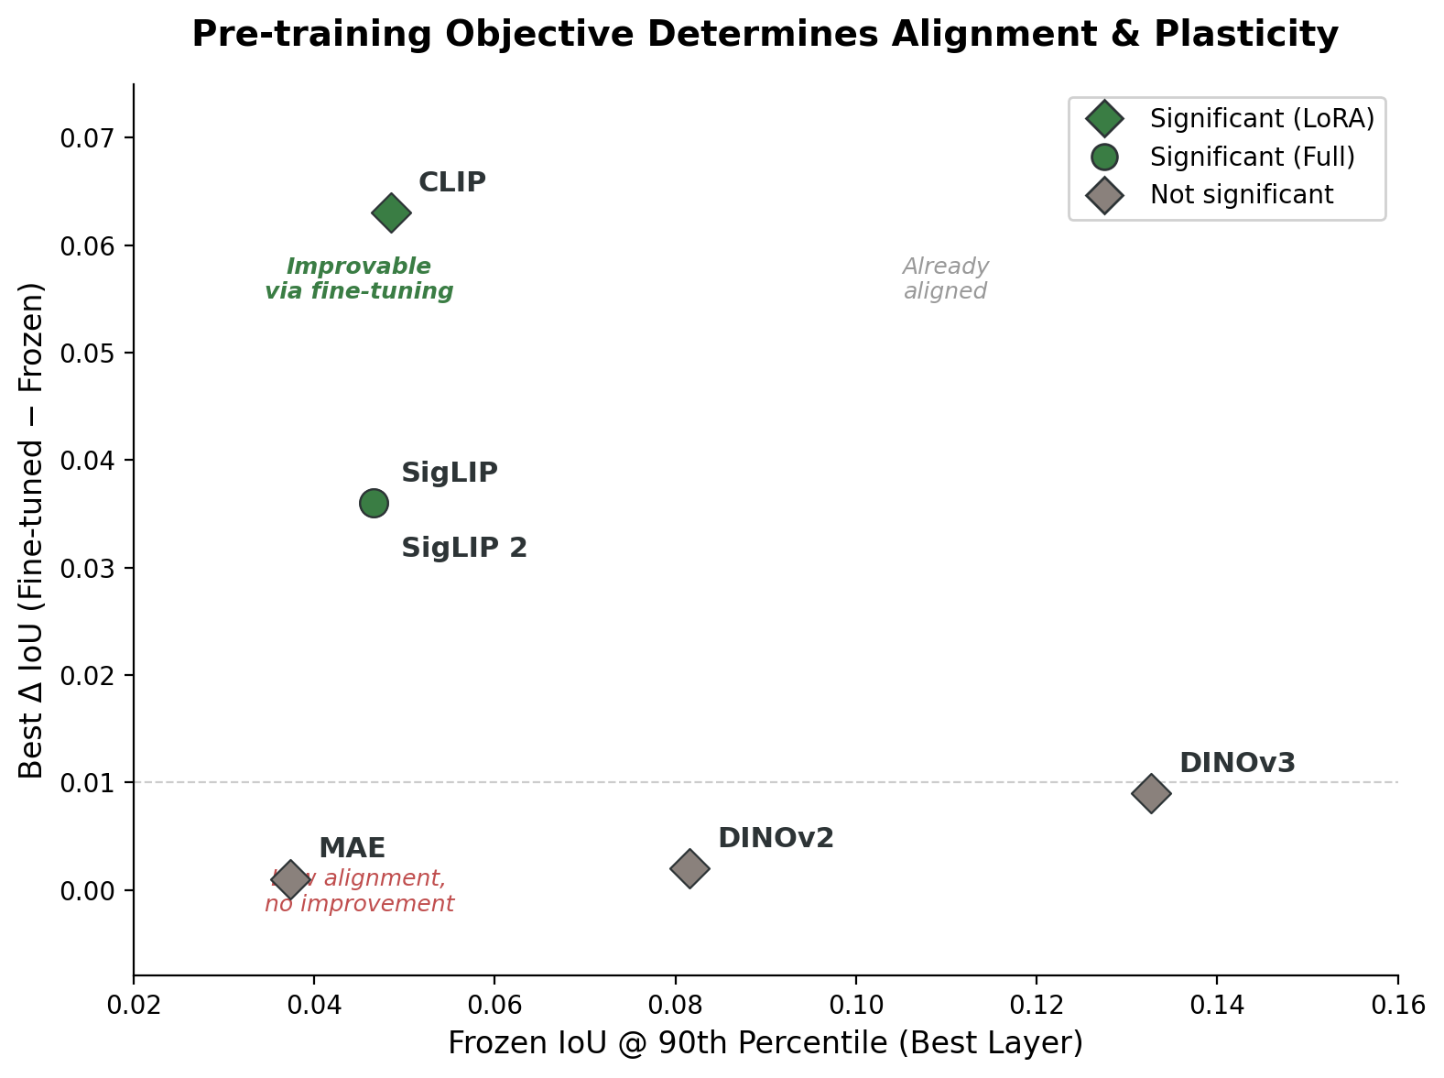
Key Takeaways
Feedback #1 — Continuous Metrics
5 complementary metrics implemented (IoU + Coverage + MSE + KL + EMD). Threshold-free metrics reveal patterns IoU alone misses.
Feedback #2 — Preserve / Enhance / Destroy
Contrastive models Enhance; self-distillation Preserves; no model Destroys. LoRA is the safest strategy with 285× fewer parameters.
Feedback #4 — Unimodal vs Multimodal
Unimodal self-distillation > supervised > multimodal. Language alignment does not improve localisation of architectural features.
Next Steps
Feedback #3 (cross-layer aggregation) + Q3 (per-head specialisation) + feedback #4 (formal dashboard split, SAM).
Frozen IoU vs Δ IoU: pre-training determines alignment & plasticity

