Slide 1

Do Self-Supervised Vision Models Learn What Experts See?
Attention Alignment with Human-Annotated Architectural Features
ISY5004 Intelligent Sensing Systems Practice Project
Team: Desmond Choy, Leong Kay Mei

Slide 2

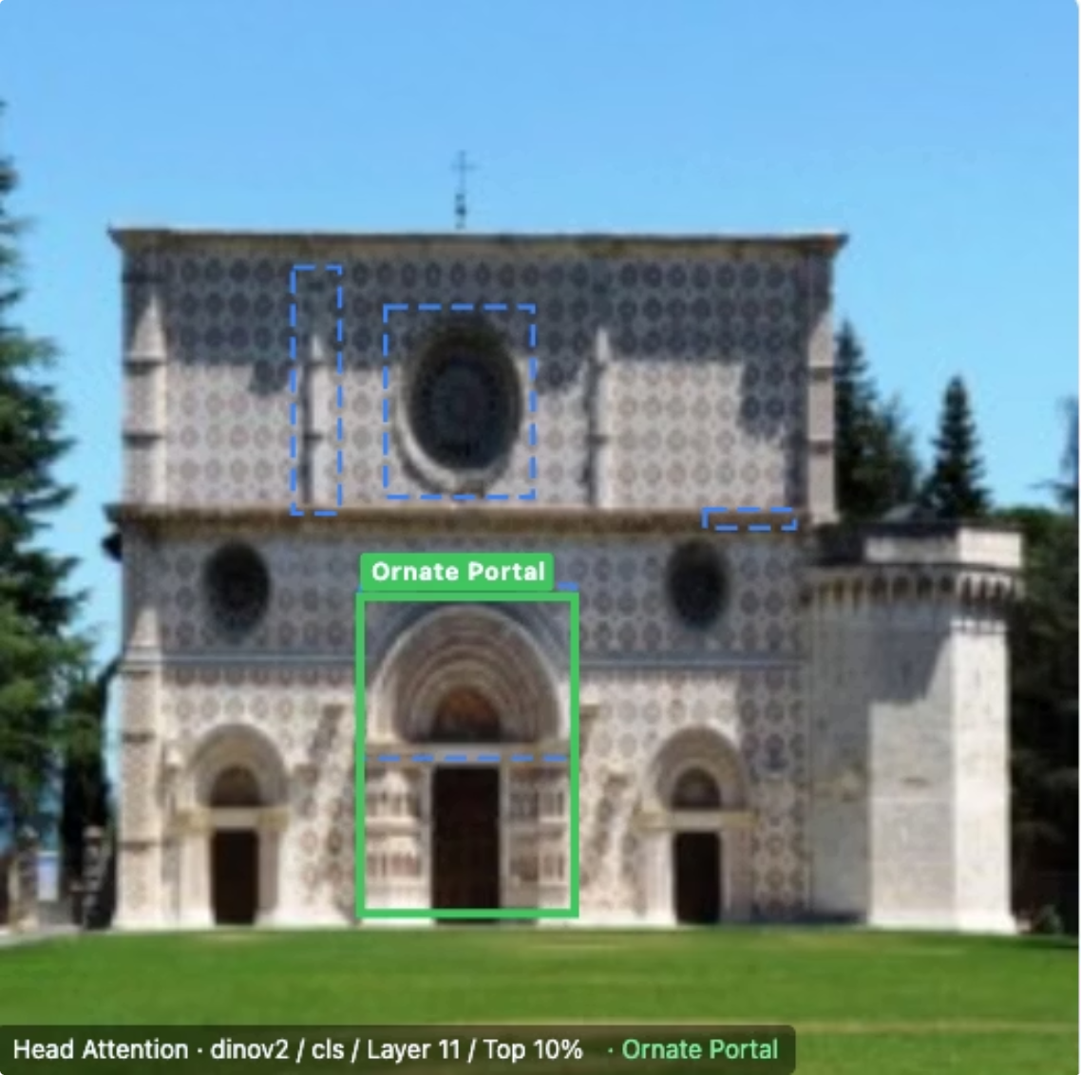
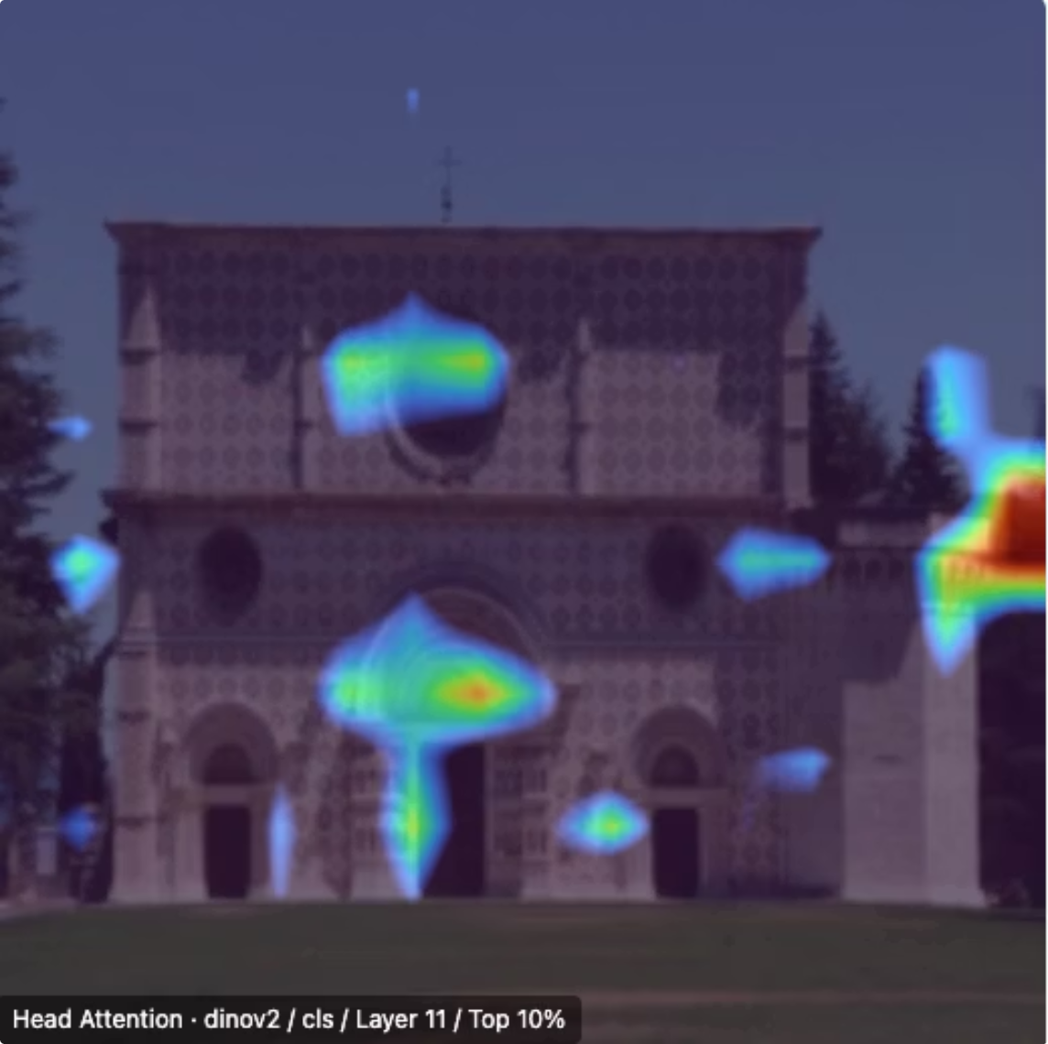
The Core Question
The Problem
What We're Comparing
A model predicts "Romanesque" correctly. But is it looking at the right thing?
Expert View
Model View
Accuracy ≠ Correct Visual Reasoning
Human-annotated bounding boxes on diagnostic architectural features
Raw attention heatmaps from self-supervised vision transformers
Notes:
Self-supervised vision models achieve strong downstream accuracy — but accuracy alone tells us nothing about where in the image the model is looking.

Slide 3
What We Studied
139
631
7
Annotated Church Images
Expert Bounding Boxes
Vision Models
Held-out evaluation set, strictly excluded from training
Across 106 architectural feature types
Across 4 SSL paradigms plus supervised baseline
5
3
Alignment Metrics
Research Questions
Across binary and continuous ground truth types
Frozen alignment, fine-tuning effects, head specialisation
Q1
Q2
Q3
Do frozen SSL models attend to the same regions experts mark as diagnostically important?
Does fine-tuning shift attention toward those regions, and does the strategy matter?
Do individual attention heads specialise for different architectural features?

Slide 4
Headline Findings
What we found — before the details:
Q1 — Frozen Alignment
Q2 — Fine-Tuning Effects
Q3 — Head Specialisation
Frozen expert-aligned attention exists, but is model-family dependent.
Fine-tuning's effect is driven by three factors: spatial prior (DINO preserves), linguistic coverage (CLIP gains only on Gothic/Romanesque), and geometric discriminability (MAE gains on Renaissance pediments).
Head specialisation is sparse and family-shaped.
DINOv3 leads across all four metrics and is the only model to clear all calibration baselines.
DINOv3 layer 10 / head 8 is stable across frozen and adapted variants.
MAE is partly reshaped under fine-tuning.
SigLIP 2 has the lowest MSE; base SigLIP has stronger overlap. Both fail EMD baseline clearance.
Models converge on the same easy images (r = +0.677), ensembling the language cluster adds no coverage on hard images.
CLIP reorganises substantially, where alignment concentrates on portals, arches, and rose windows.

Slide 5
DATASET & METHODOLOGY

Slide 6
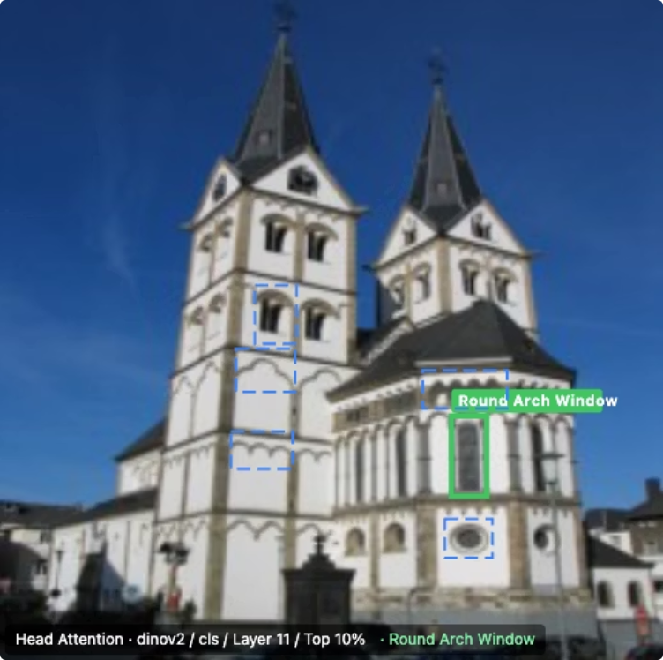
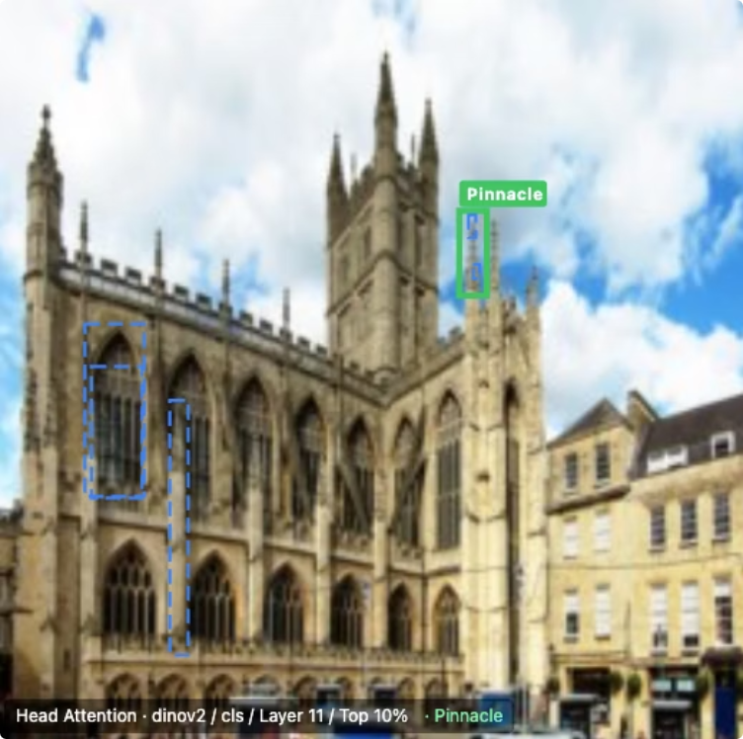
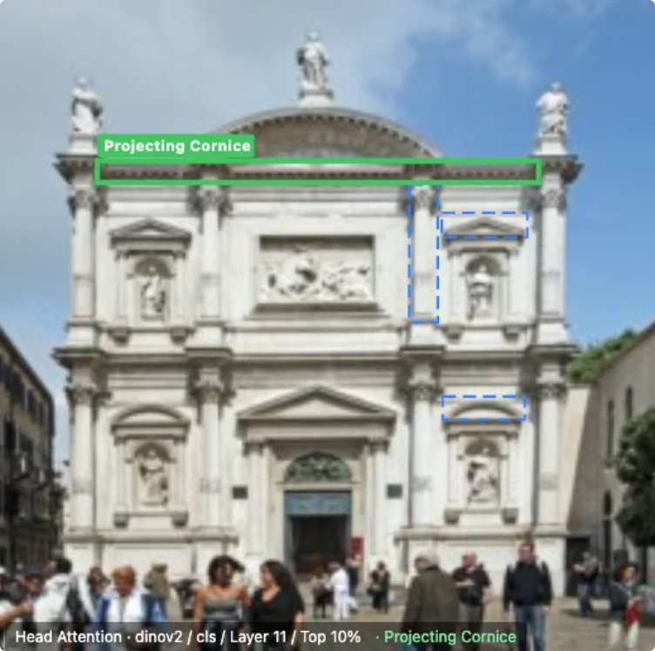
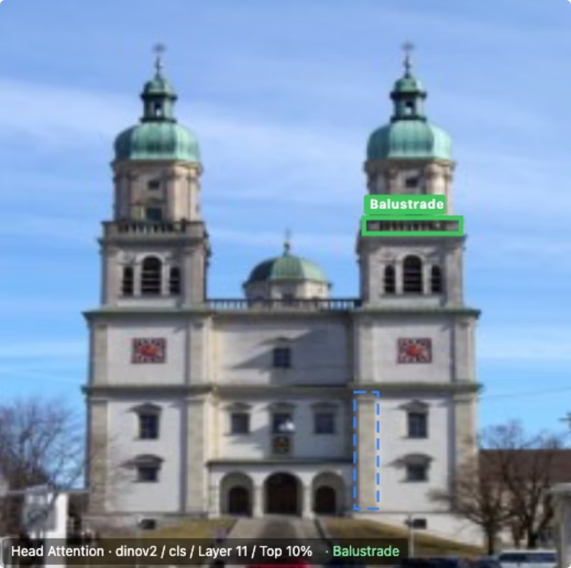
Dataset: WikiChurches
WikiChurches (Barz & Denzler, NeurIPS 2021)
Bounding boxes annotate characteristic architectural features — the diagnostic visual evidence experts use to distinguish styles.
Romanesque
Gothic
Renaissance
Baroque
Round arches, thick walls, small windows
Pointed arches, flying buttresses, large windows
Pediments, columns, symmetrical facades
Ornate decoration, dramatic use of light

Slide 7
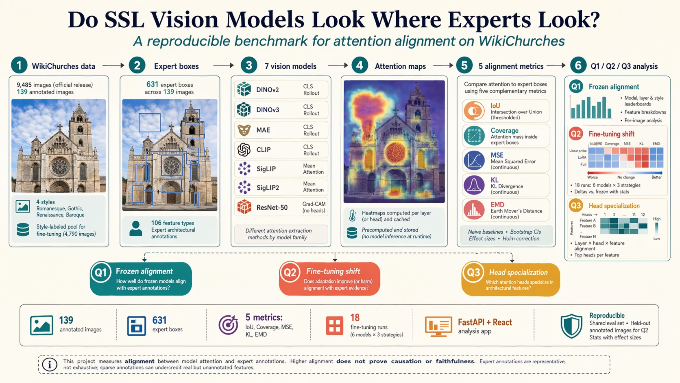

Slide 8
7 Models Across Paradigms
All ViT-B (12 layers, 768 dim, 12 heads, ~86–93M params) except ResNet-50
Model
Paradigm
Method
Key Feature
DINOv2
Self-distillation
CLS, Rollout
4 register tokens
DINOv3
Self-distillation + Gram Anchoring
CLS, Rollout
RoPE encoding
MAE
Masked Autoencoding
CLS, Rollout
Pixel reconstruction
CLIP
Contrastive (softmax)
CLS, Rollout
Language-image align
SigLIP
Contrastive (sigmoid)
Mean
No CLS token
SigLIP 2
Contrastive (sigmoid) + dense features
Mean
No CLS token
ResNet-50
Supervised (ImageNet)
Grad-CAM
CNN baseline

Slide 9

Metrics Used to Measure Alignment
5 complementary metrics across 2 ground truth types
Binary Ground Truth
Soft Gaussian Ground Truth
Hard bounding box mask
Smooth falloff from box centre
IoU
Coverage
MSE
KL Divergence
Spatial overlap of top-k% attention pixels vs. expert boxes. Higher = better.
Fraction of total attention energy inside boxes. No threshold needed. Higher = better.
Pointwise intensity error. Lower = better.
Distribution mismatch; penalises attention where experts assign none. Lower = better.
EMD
Earth Mover's Distance; spatial transport cost, distinguishes near-misses from far-misses. Lower = better.
Calibrated against 4 naive baselines: random · center Gaussian · saliency prior · Sobel edge.
Raw scores are uninterpretable without reference points.

Slide 10
RESULTS

Slide 11

Q1: Frozen Model Benchmark
DINOv3 Leads
Not a Tidy Ranking
Single-Metric Trap
The only frozen model to clear all 4 calibration baselines on all 3 continuous metrics
DINO leads; base SigLIP outranks MAE and CLIP on IoU.
SigLIP 2 has the lowest MSE; base SigLIP has stronger overlap. Both fail EMD clearance.

Slide 12

Why a Multi-Metric Benchmark?
Single metrics hide different failure modes
IoU & Coverage
MSE & KL
EMD
Spatial overlap: does the model attend to the right region at all?
Distributional fidelity: does the attention mass concentrate correctly?
Transport cost: how far does the model's attention need to travel to match the expert?
SigLIP 2 has the lowest MSE, but base SigLIP is stronger on IoU. Both fail EMD baseline clearance; one metric tells the wrong story.

Slide 13
Q1: Frozen Leaderboard
Q1: Expert-Attention Alignment — Frozen Models
Paradigm ordering: Self-distillation > Supervised > Reconstruction > Multimodal Contrastive
Rank
Model
IoU@90
Coverage
MSE
KL
EMD
1
DINOv3
0.133 (L11)
0.137
0.0270
2.325
0.260
2
ResNet-50
0.090 (L3)
0.104
0.0242
2.692
0.303
3
DINOv2
0.082 (L11)
0.100
0.0209
2.684
0.298
4
SigLIP
0.074 (L8)
0.076
0.01755
3.002
0.348
5
MAE
0.070 (L11)
0.090
0.0483
2.756
0.318
6
CLIP
0.049 (L0)
0.085
0.0211
2.912
0.326
7
SigLIP 2
0.047 (L4)
0.071
0.01745
3.071
0.354
Ranked by IoU@90 (best default-method layer per model, 139 annotated images)

Slide 14

Q1: Why Raw Scores Aren't Enough
Calibrated baseline clearance — the stronger test
Naive Baselines
Key Takeaways
Baseline
MSE
KL
EMD
DINOv3 is the only frozen model to beat all 4 naive baselines on all 3 continuous metrics.
Random
0.319
3.363
0.347
Center Gaussian
0.177
2.632
0.284
SigLIP2 narrowly wins SigLIP by MSE (0.01745 vs 0.01755), but both fail EMD (0.348 / 0.354 vs random 0.347).
Saliency Prior
0.096
2.611
0.265
Sobel Edge
0.038
3.224
0.314
→ Local smoothness ≠ correct spatial placement of attention mass.

Slide 15
Q1: Why DINOv3 Leads — The Gram Anchoring Hypothesis
Hypothesis: Gram anchoring preserves dense spatial structure
DINOv3 extends DINOv2's self-distillation recipe with a Gram anchoring loss — it explicitly penalises Frobenius drift between student and early-teacher patch-patch feature matrices during long training.
DINOv3 ADE20k mIoU
Why It Fits
Caveat
81.1 frozen — vs DINOv2's 75.9 and OpenCLIP's 63.8
A method designed to preserve clean dense patch features is a natural fit for metrics that reward spatial correspondence to expert boxes
This remains a hypothesis — the current study does not ablate data scale, model scale, and Gram anchoring separately

Slide 16
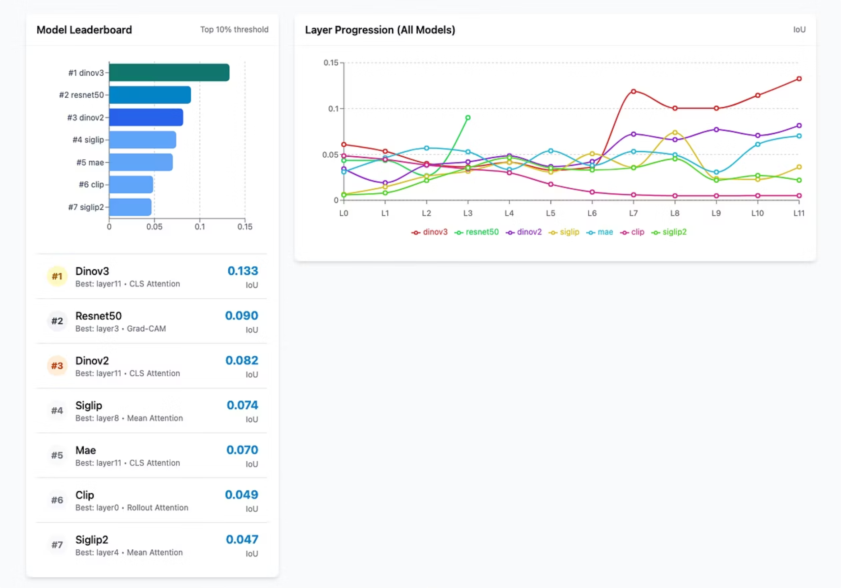
Q1: Dashboard View — DINOv3's Late-Layer Jump
DINOv3 shows a sharp alignment jump at layer 11 — IoU@90 = 0.133. No other frozen model shows this late-layer concentration. This is consistent with the Gram anchoring hypothesis: spatial coherence accumulates through depth and crystallises in the final layers.

Slide 17

Q2: Experiment Design
Does fine-tuning shift attention toward expert-marked regions?
Strategy
Backbone
Params
Role
Linear Probe
Frozen
~3K
Control — attention unchanged
LoRA
Partially adapted
~300K
Parameter-efficient adaptation
Full Fine-tuning
Updated end-to-end
86–93M
Maximum adaptation capacity
Training Setup
Measurement
4-class style classification
4,588 training images
3 epochs · Cosine LR + warmup
Class-weighted loss
Δ metric = fine-tuned − frozen
Paired Wilcoxon tests
Holm correction · Cohen's d
Linear Probe Δ ≈ 0 across all models — confirms attention movement is tied to backbone change, not a reporting artefact.

Slide 18
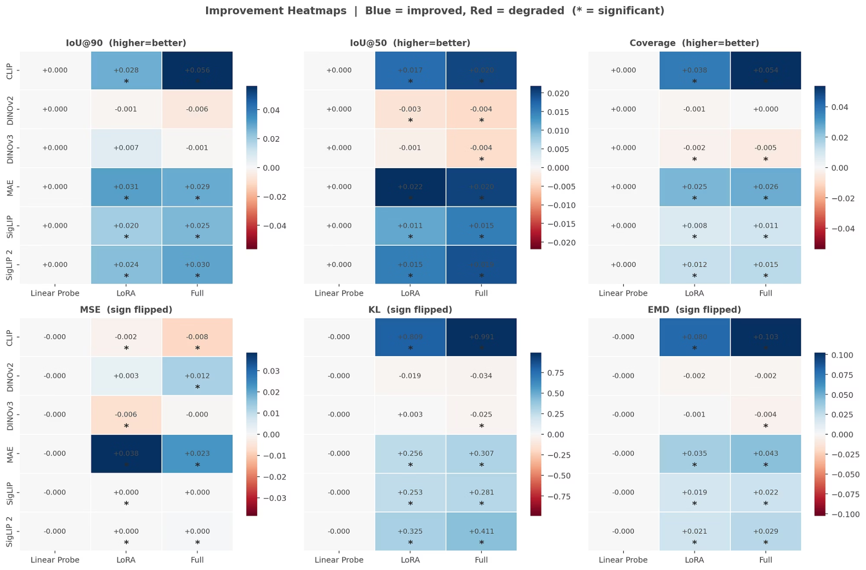
Q2: Results Overview Heatmap
Multi-metric improvement heatmap — the big picture
Three clusters in the pairwise Δ correlation matrix:
Language cluster (CLIP, SigLIP, SigLIP 2)
within-cluster r ≈ 0.43–0.58 — all improve on the same Gothic/Romanesque portals
MAE
anti-correlated with language cluster (r ≈ −0.22 to −0.31) — covers a different image subset (Renaissance geometry)
DINO pair
near-zero correlation with everything — Δ ≈ 0 everywhere, nothing to latch onto
🔵 Enhance
⚪ Preserve
🔴 Destroy
Fine-tuning improves attention alignment — statistically significant improvements marked with asterisk
Fine-tuning leaves alignment largely unchanged — DINO family near-zero
Fine-tuning degrades alignment — occasionally negative for DINO family
Notes:
Strengths:
Strong gains for MAE, CLIP, SigLIP family. Fine-tuning boosts text-image alignment and sparse representations.
Weaknesses:
DINO models shows near-zero or rare negative change. Limited fine-tuning effect for models liek SigLIP, as compared to CLIP.
Opportunities:
Combined diverse models and strategies like LoRA for optimal multimodal robustness. Maximises sparse modeling beenfits.
Threats:
Over-reliance on few fine-tuned models can cause bias, and negative gains in some metrics risk degradation. Hence multi-metric is helpful. Fine-tuning can be complex.

Slide 19
Q2: The CLIP Story
CLIP: Largest gain, but only where language already pointed
Full fine-tuning: IoU 0.018 → 0.074 (Cohen's d ≈ 1.0)
LoRA also improves substantially, but less than Full
But the gain is not uniform:
Style
CLIP Δ IoU (Full FT)
Gothic (n=49)
+0.079
Romanesque (n=54)
+0.066
Renaissance (n=22)
+0.014
Baroque (n=17)
+0.013
Why: CLIP is trained on 400M web image–text pairs with a global contrastive loss — no patch-level spatial pressure. Fine-tuning is the first spatial signal. Gains concentrate on Gothic and Romanesque because these styles' diagnostic features (Pointed Arch Portals, Round Arch Portals, Bull's-eye Windows, Tracery) are densely represented in English-language web descriptions of churches.

Slide 20
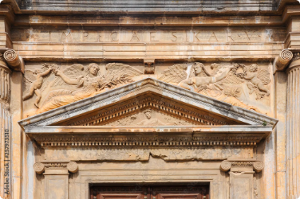
Q2: The MAE Story
MAE: Renaissance pediment geometry — gains from scratch
MAE's largest single-style gain: Renaissance Δ IoU = +0.108 (vs. +0.029 aggregate)
Feature
Frozen IoU
Fine-tuned IoU
Δ IoU
Triangular Pediment
0.036
0.116
+0.080
Cranked Cornice
0.005
0.067
+0.062
Broken Pediment
0.005
0.060
+0.055
Volute
0.009
0.052
+0.043
Segmental Pediment
0.013
0.054
+0.042
Pilaster (common)
0.023
0.011
−0.012
Belt Course (common)
0.031
0.016
−0.016
Why: MAE's 75% masking forces precise local geometry encoding. Pediments are geometrically compact and Renaissance-exclusive — the style-classification gradient routes attention to the most discriminative geometric forms, suppressing features that appear across multiple styles.

Slide 21
Q2: The SigLIP Variants
Weak layer11 frozen baselines → adaptation sharpens, but variants differ
Q2 is measured at layer11 (not each model's Q1 best layer):
Frozen IoU@90 (L11)
Full FT IoU@90 (L11)
Δ
Cohen's d
SigLIP
0.0364
0.0618
+0.0254
0.604
SigLIP 2
0.0220
0.0519
+0.0299
0.781
Base SigLIP stays higher in absolute IoU@90 post-FT (0.062 vs. 0.052).
SigLIP 2 moves further in standardised-effect terms — consistent with more late-layer adaptation headroom from a weaker starting point and SigLIP 2's denser grounding components.
Q2 is sharpening a weak layer11 signal, not improving each model's best frozen layer (Base SigLIP peaks at layer8).

Slide 22
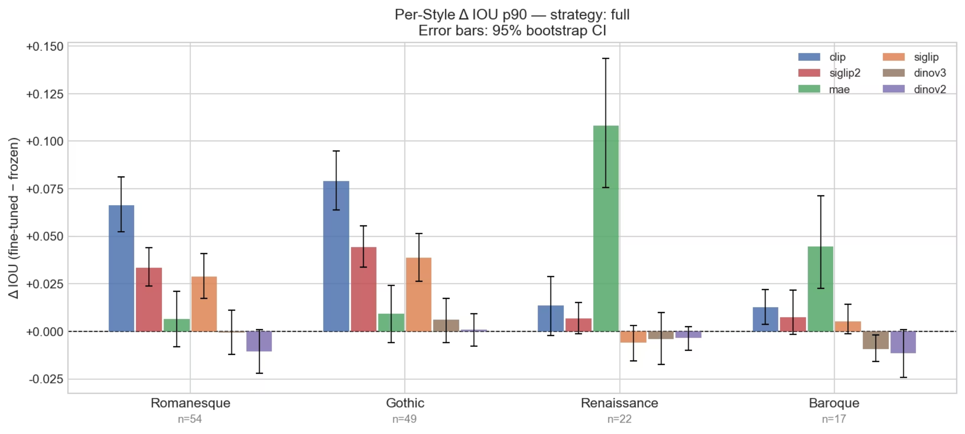
Q2: The DINO Story
DINO: Near-zero Δ is a feature, not a failure
Romanesque
Gothic
Renaissance
Baroque
DINOv2
−0.010
+0.001
−0.004
−0.012
DINOv3
−0.001
+0.006
−0.004
−0.009
DINOv3 frozen ADE20k mIoU = 81.1. Expert-aligned spatial structure is already baked in.
The style-classification gradient is absorbed by the classification head rather than propagating to reshape attention. Δ ≈ 0 is a positive generalisation result — the strong frozen prior resists reorganisation.

Slide 23
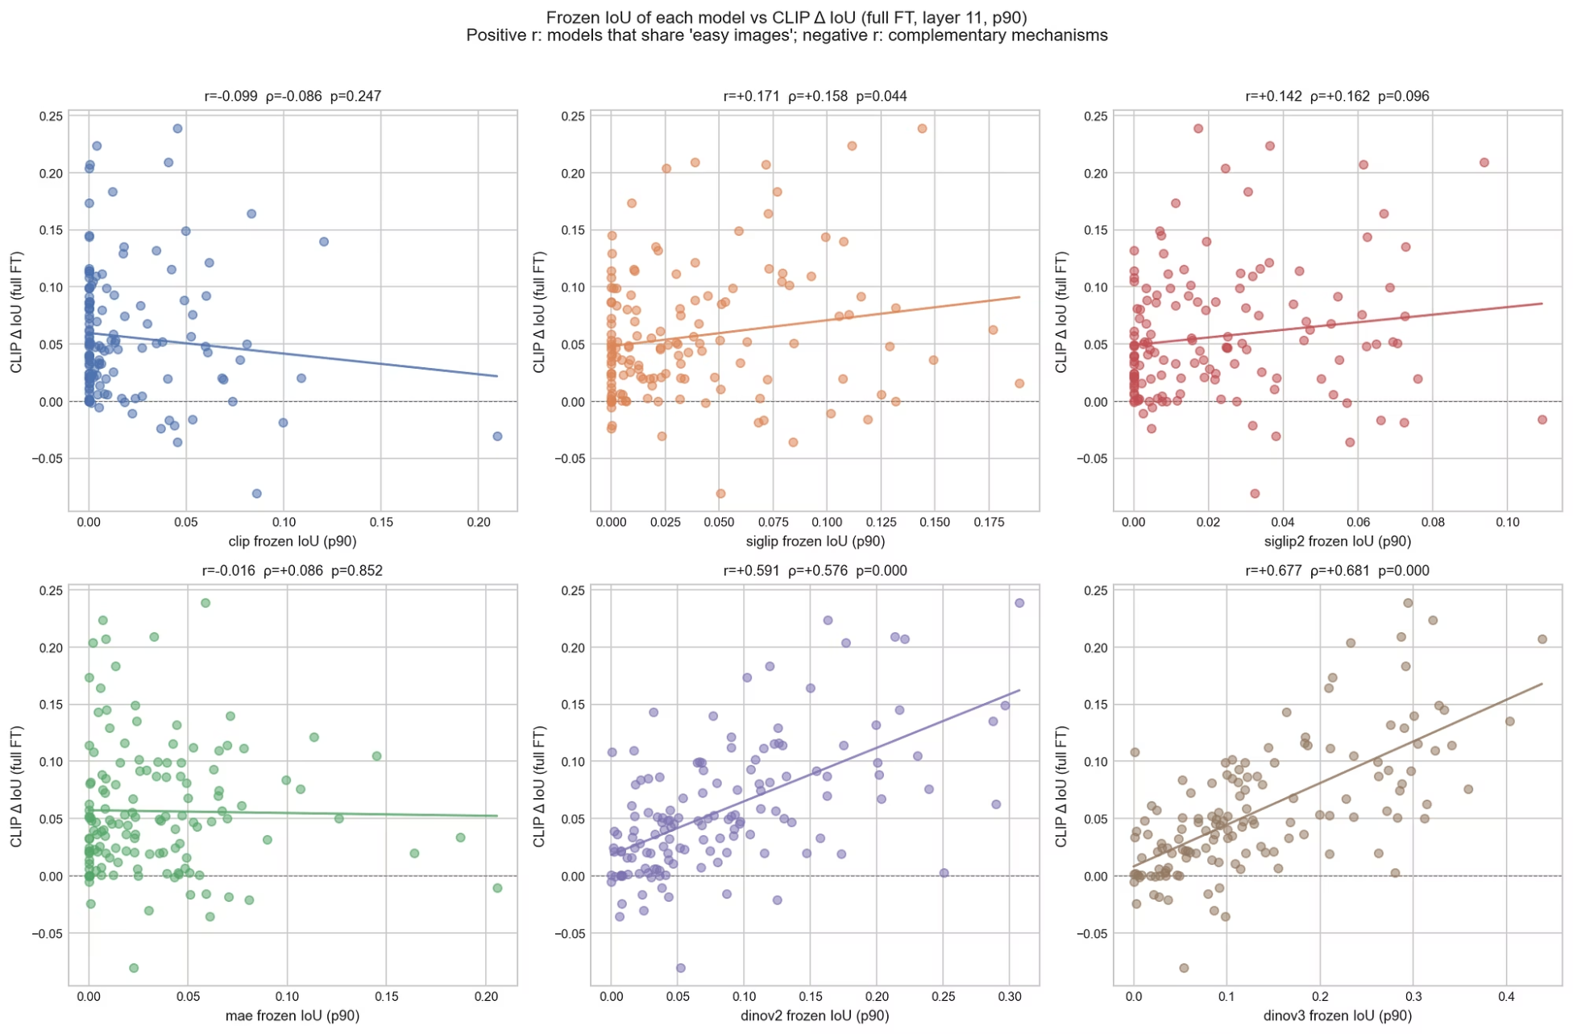

Q2: The Surprise — Models Converge on the Same Images
DINOv3 frozen IoU predicts CLIP Δ IoU at r = +0.677
Images where DINOv3 already attends correctly are the same images where CLIP's fine-tuning succeeds.
The structural barrier is the image, not the model family.
Implication: an ensemble of language-cluster models adds no coverage on hard images. MAE is the only natural complementary partner.

Slide 24
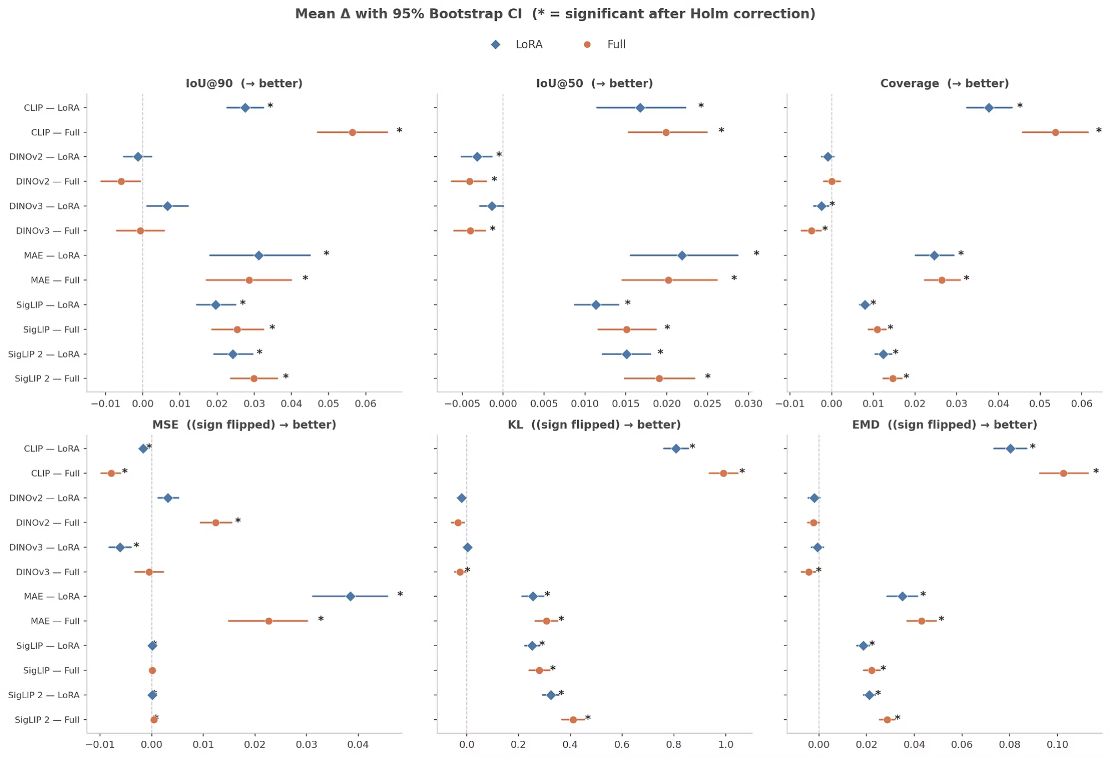

Q2: Statistical Confidence
Forest plot — are the gains real?
Mean Q2 Δ with 95% bootstrap CIs for LoRA and Full fine-tuning across all 5 metrics (sign-normalised — rightward = improvement). Asterisks = significant after Holm correction.
CLIP and MAE gains are not anecdotal — they hold under paired Wilcoxon tests across the 139 evaluation images.

Slide 25

Q3. Do individual attention heads specialise for different architectural features?
Scope: DINOv2, DINOv3, MAE, CLIP only
CLS-token models → architecture-native per-head analysis
SigLIP/SigLIP 2 excluded: mean-attention proxy, not architecture-native per-head
ResNet-50 excluded: no transformer attention heads
Method
Per-head IoU computed for all 12 heads at each layer. Heads ranked by alignment with expert boxes. Head-by-feature matrices built to test whether specific heads consistently align with specific feature types.
Variants
frozen · LoRA · full (linear probe excluded — backbone unchanged)
This is a descriptive head-specialisation analysis. We do not claim individual heads are causal feature detectors.

Slide 26
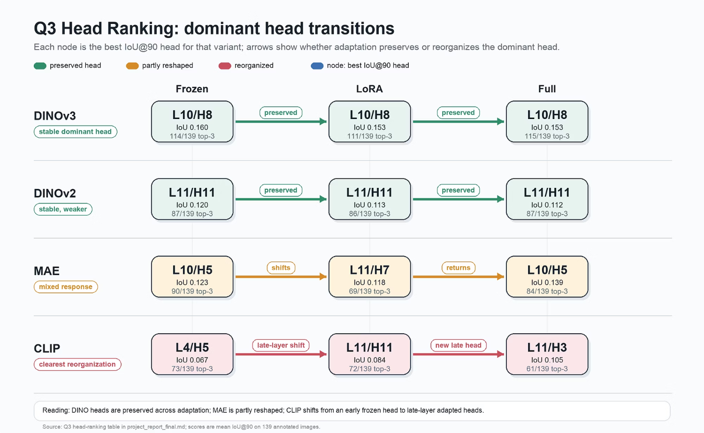
Q3. View 1: Head Ranking — Which Heads Align Best?
Per-model findings:
DINOv3 — Stable
DINOv2 — Stable
MAE — Partly reshaped
CLIP — Reorganises substantially
layer10/head8 stays top across Frozen, LoRA, and Full; appears in top-3 on 110+ of 139 images in every condition — clearest stability case.
same preserved-head pattern at lower absolute alignment.
layer10/head5 → layer11/head7 under LoRA → back to layer10/head5 under Full.
frozen best head is layer4/head5 (IoU@90 = 0.067); layer11 is weak before adaptation (max 0.034) but becomes the strongest adapted layer — best layer11 head reaches 0.084 (LoRA) and 0.105 (Full), while layer4/head5 stays near its frozen score.
Quantitative sparsity (across the full 12 × 12 layer×head grid):
Model
Top pair vs. median
Top-5 share of total mean IoU@90
DINOv3
3.45×
within 7.3–9.0% band
CLIP
3.22×
(≈ 2× the 3.5% uniform baseline)
MAE
2.92×
—
DINOv2
2.69×
—
Top-5 pairs together hold 7.3%–9.0% of total mean IoU@90 across all 144 pairs — roughly 2× what they would hold under uniform spread (3.5%). This is the quantitative content of "sparse".

Slide 27
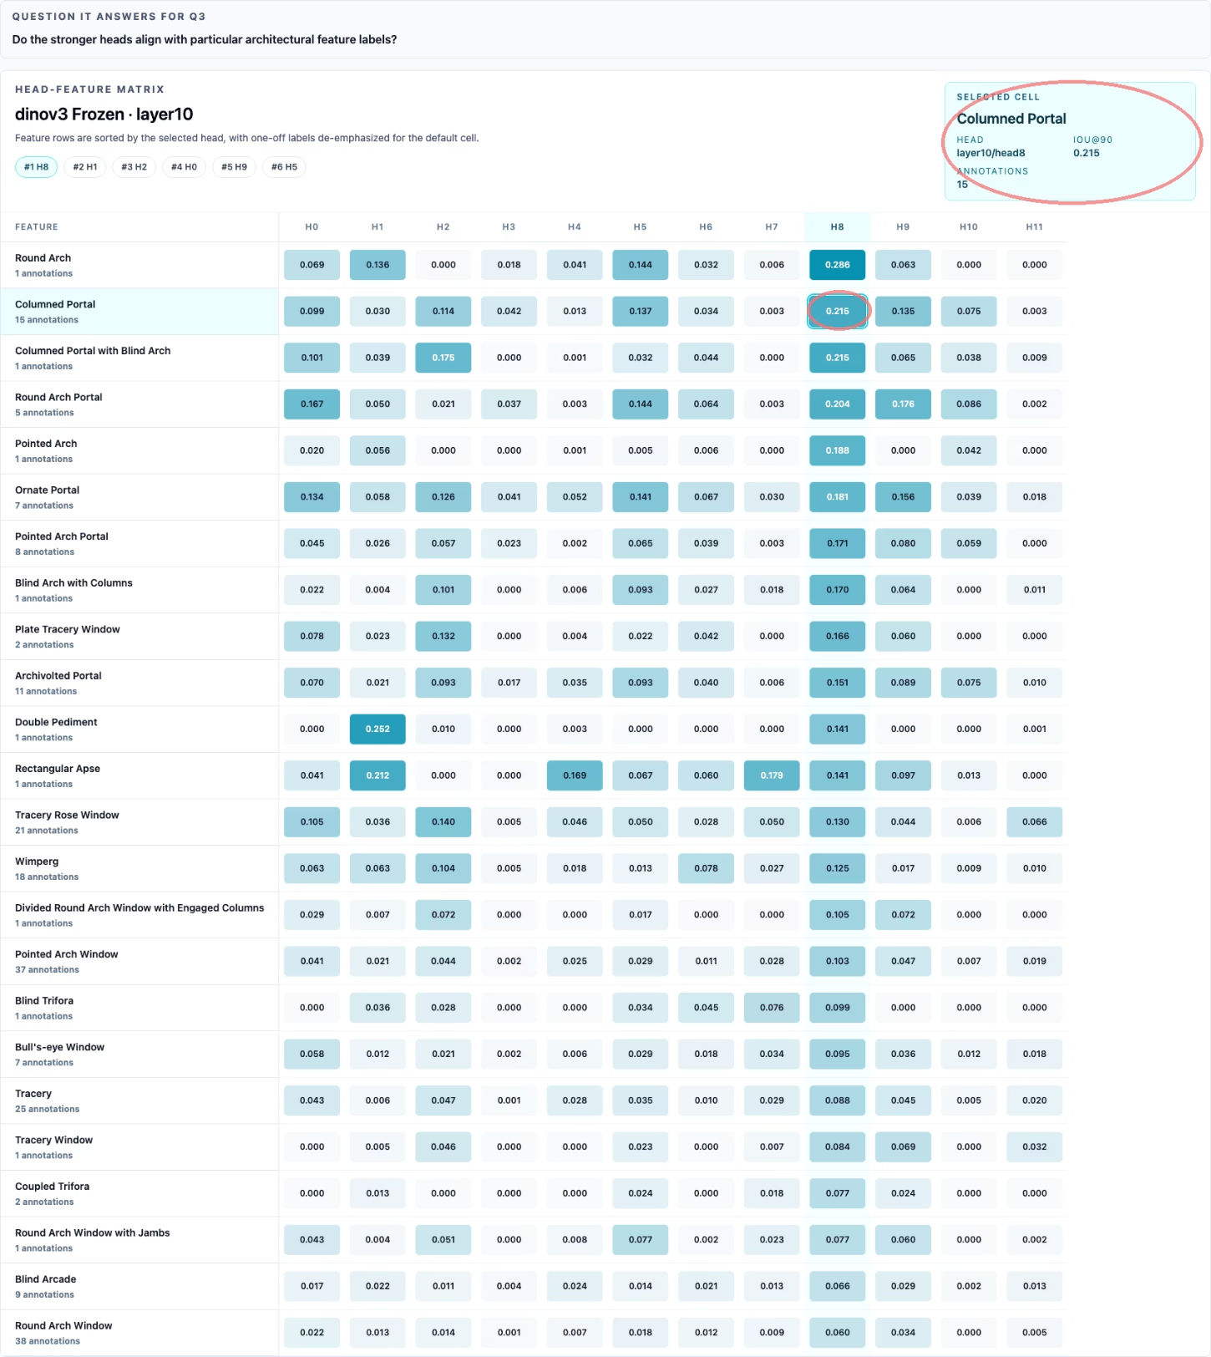
Q3 View 2a: Head-Feature Matrix (DINOv3 anchor)
Linking the ranking head to its strongest feature
The same layer10/head8 that leads the DINOv3 ranking also carries the selected matrix cell:
Columned Portal — IoU@90 = 0.215 (n = 15)
Round Arch Portal — 0.204
Ornate Portal — 0.181
This links the ranking evidence to the feature evidence: the dominant head is not only strong overall — it is strongest on portal-scale structure.

Slide 28
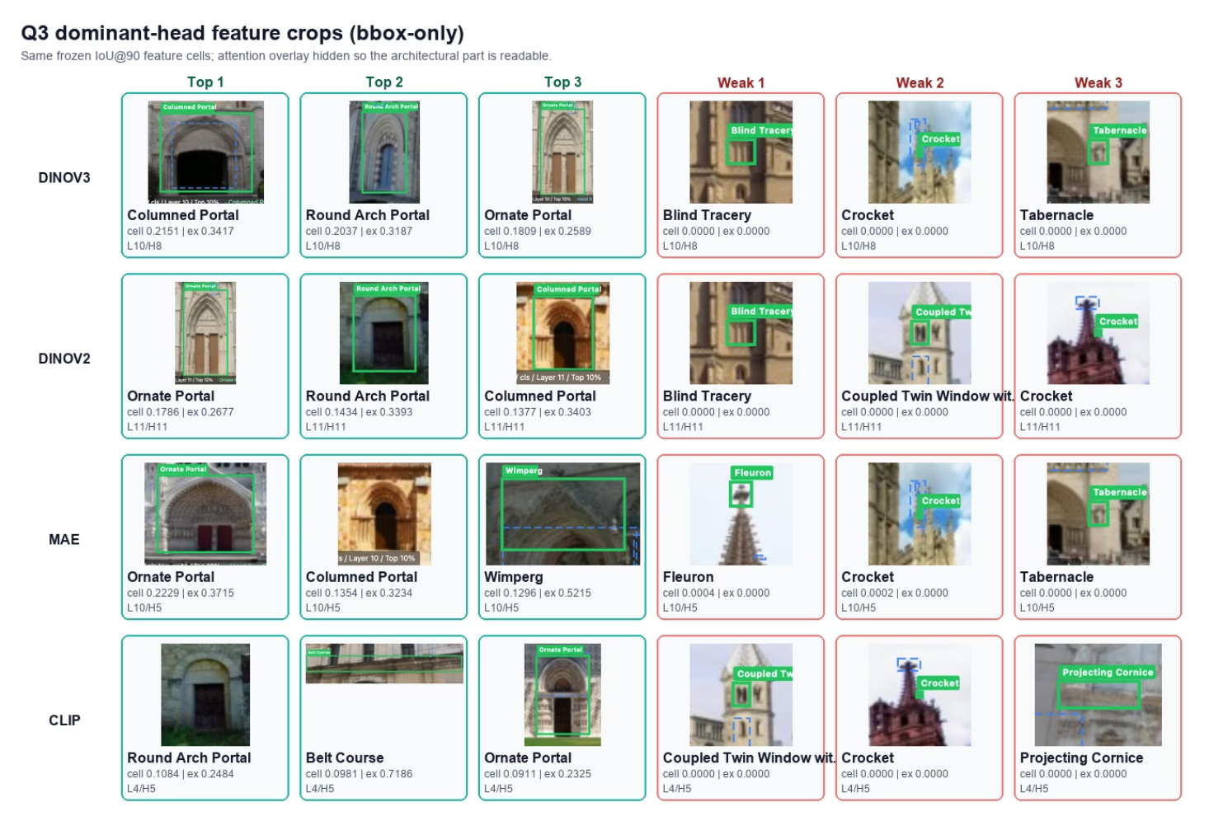
Q3 View 2b: Top vs. Bottom Features Across Models
Strongest features are structural; failures are consistent
For each scoped model's frozen IoU@90 dominant head, top-3 and bottom-3 features (≥3 annotations):
Model · Head
Strongest
Weakest
DINOv3 L10/H8
Columned Portal, Round Arch Portal, Ornate Portal
Blind Tracery, Crocket, Tabernacle (≈ 0)
DINOv2 L11/H11
Portal-class (same top end)
Same small-detail boundary
MAE L10/H5
Large facade parts + Wimperg (3rd)
—
CLIP L4/H5
Portal-class + Belt Course
—
MAE → Wimperg fits the Q2 finding that MAE responds to compact geometric forms
CLIP → Belt Course suggests feature extent and clean geometry matter, not only semantic category names
Failures aren't random — across families, weak features are small, thin, repeated, or visually entangled with surrounding masonry
Safe claim: dominant heads expose spatial patterns compatible with expert-marked structural parts — not exact ornament detectors.
**Caveat to state aloud — metric geometry**: IoU@90 keeps a fixed top-10% attention mask and scores it against a variable-size expert mask. For thin/repeated ornamentation (Crocket, Fleuron, Blind Tracery), the achievable IoU@90 is mechanically capped regardless of where attention lands. Part of the weak-feature shortfall is metric geometry, not head attribution — threshold-free Coverage would help separate the two effects.

Slide 29
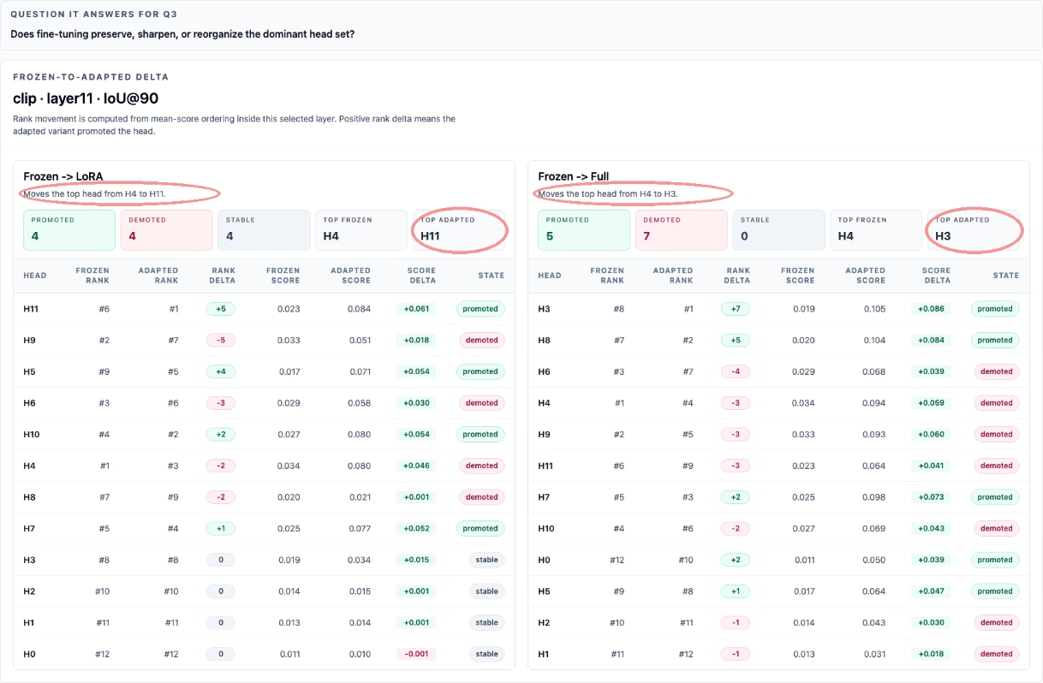
Q3. View 3: Frozen-to-Adapted Delta — How Adaptation Reshapes Heads
Sharper follow-up: when adaptation changes the dominant head, does the strongest signal stay or move?
Definition: expert-aligned signal = the selected head's normalised CLS-to-patch heatmap scored against expert boxes.
For IoU@90, the pipeline keeps the top 10% of heatmap pixels and compares against the expert-box union; the strongest head is the one with the highest mean IoU@90 across the 139 images for that (layer, variant, metric).
Family-specific answer:
DINO — Stable
MAE — Intermediate
DINOv3 layer10/head8 and DINOv2 layer11/head11 remain strongest across Frozen, LoRA, Full.
Frozen and Full both favour layer10/head5; LoRA shifts to layer11/head7 — parameter-efficient adaptation can move the dominant signal, but not a CLIP-style rewrite.
CLIP LoRA — New top head without erasing frozen pattern
CLIP Full — Stronger rewrite
Within layer11, H3 moves #8 → #1, H8 moves #7 → #2, H4 drops to #4.
Within layer11, H11 promoted #6 → #1; frozen-best H4 only falls to #3, score 0.080 vs. 0.084.
CLIP synthesis: adaptation strengthens expert alignment in layer11 (where frozen CLIP is weak, 0.034 max) and reorganises the within-layer ranking of those newly strengthened heads.
Connecting Q3 back to Q1 and Q2:
DINO already aligns well before fine-tuning, so adaptation leaves its strongest heads mostly unchanged. CLIP and MAE have more room to move — after adaptation, the best-aligned attention comes from different heads, not just the same head with a higher score. Q3 gives a head-level explanation for the Q2 result.

Slide 30
Conclusions & Takeaways
Q1 — Frozen alignment exists, but is model-family dependent
Q2 — Fine-tuning's effect is mediated by pretraining, not just strategy
Q3 — Heads show descriptive specialisation; the dominant set shifts under adaptation

Slide 31
What We Found
Three questions, three answers
Q1 — Frozen alignment exists, but is model-family dependent
Q2 — Fine-tuning's effect is mediated by pretraining, not just strategy
Q3 — Heads show descriptive specialisation; the dominant set shifts under adaptation
DINOv3 leads the benchmark and is the only frozen model to clear all calibration baselines on all continuous metrics. Frozen SSL attention is not a generic property — self-distillation with Gram anchoring produces a qualitatively different spatial prior.
CLIP's gain is linguistic: it unlocks attention on features densely described in web text.
Per-head alignment is sparse and late-layer dominant. Fine-tuning reorganises which heads carry expert-aligned structure.
MAE's gain is geometric: it redirects to compact, style-exclusive pediment forms.
DINO's near-zero Δ is a preservation result.
No single strategy wins everywhere — the right combination depends on what the task's diagnostic evidence requires.

Slide 32
Practical Implication
Model selection for domain adaptation should not be guided by accuracy alone.
Match the pretraining prior to what the task's diagnostic evidence requires:
If evidence is spatially coherent and structured → DINOv3 frozen may already be sufficient
If evidence is linguistically well-described → CLIP + Full fine-tuning unlocks the largest gain
If evidence is geometrically compact and style-exclusive → MAE covers a complementary image subset
For coverage across hard images → MAE + language-cluster ensemble (not language-cluster alone)

Slide 33
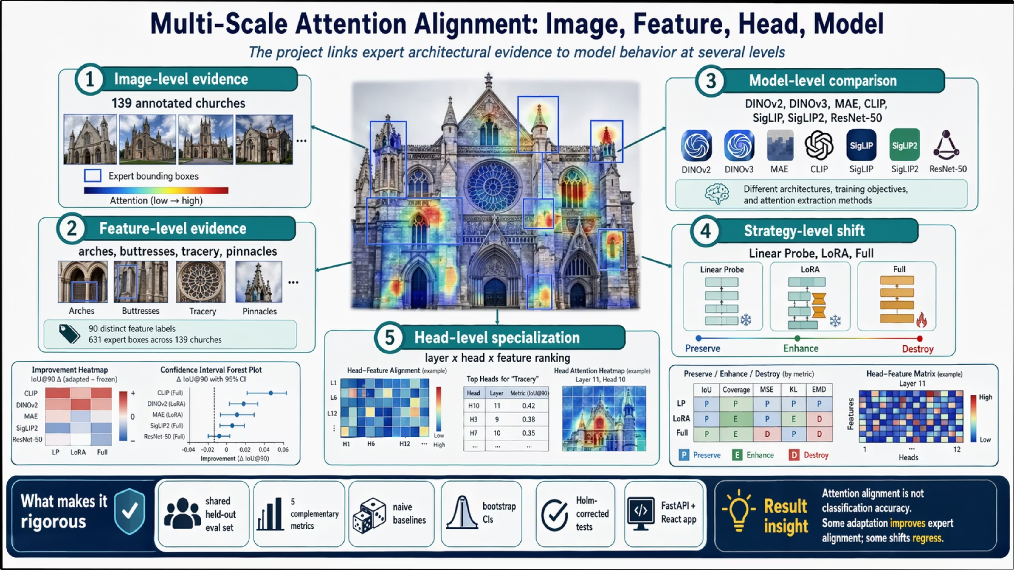

Slide 34
DEMO

Slide 35
Thank You
Do Self-Supervised Vision Models Learn What Experts See?
Sometimes. It depends on how they were trained — and what the task asks them to look at.

