Slide 1

Project Title -VOIS_Major_Project_PPT_ Seasonal Agriculture Performance Analysis
Student Name – Devdipro Bhaduri
College Name - Narula Institute of Technology
AICTE STU ID :STU68268ff7e29d31747357687

Slide 2

PROBLEM STATEMENT
Agricultural activities are influenced by seasonal variations in environmental conditions,
farming practices, resource availability and market conditions. As a result, agricultural
performance may differ from one season to another.
However, raw agricultural data does not clearly explain how agricultural performance changes
across seasons or what patterns can be observed in different seasonal conditions.
The problem is to analyze the given agricultural dataset and investigate seasonal differences
in agricultural performance by identifying meaningful patterns, trends, relationships and
variations within the available data.

Slide 3
Project Description
Executive Project Overview
This data analytics project focuses on a comprehensive, farm-level investigation of agricultural production cycles to evaluate how varying seasonal, environmental, and operational factors intersect to dictate overall crop yields and subsequent business profitability. Operating on a robust dataset of 4,000 distinct agricultural records across 28 multi-disciplinary variables, this study moves past traditional localized assumptions to extract evidence-based trends regarding resource usage, financial returns, and climate resilience.
The core motivation behind this analysis is the standard agricultural optimization dilemma: How can modern farms maximize food production volumes while ensuring commercial financial survival and sustainable natural resource management? By inspecting these data patterns, this project builds structured data pipelines to clear away noise and support strategic decision-making.
Structural Scope of the Analysis
1. Univariate Data Integrity & Cleaning
Outlier Summary Diagnostics: Built an automated, case-insensitive Interquartile Range (IQR) scanning pipeline across all numerical metrics. Identified and quantified distribution anomalies to map baseline bounds without causing breaking KeyErrors across columns.
Text Formatting Invariance: Cleaned trailing whitespaces and case-sensitivity variations across primary categorical markers (e.g., season, crop) to achieve absolute data stability in active runtime memory.
2. Bivariate Exploratory Visualizations
Seasonal Volumetric Output Analysis: Used automatic aggregation bar plots to map gross mean yields across different seasonal cycles, validating the specific seasonal windows that yield the highest raw output.
Resource Dependency Mapping: Implemented box-and-whisker plot matrices to trace water consumption profiles (Water_Used_m3) across seasons, exposing distinct structural variance and baseline consumption shifts.
Environmental Scatter Tracking: Plotted rainfall metrics (Rainfall_mm) against aggregate yields (Yield_Tonnes_Ha) to investigate linear correlation models and isolate potential plateaus in water-delivery efficiency.
3. Multivariate Optimization Matrices
The Yield-Profit-Scale Intersection: Engineered composite bubble scatter plots mapping physical output, total financial margins (Profit_INR), and geographical operating scales (Farm_Area_Hectares) concurrently across separate color-coded seasonal markers.
Synergistic Environment Profiles: Deployed comprehensive Seaborn pair-plots and correlation heatmaps to cross-examine non-isolated weather patterns (temperature, humidity, rainfall bands) and locate spatial clusters of peak performance.

Slide 4

WHO ARE THE END USERS?
The four primary end users of this agricultural analytics project include:
Farm Managers & Agri-Entrepreneurs: They leverage the volume-versus-profit insights to select high-margin crop varieties and reduce costly over-irrigation.
Agricultural Policymakers: They utilize seasonal water-usage distributions to optimize regional water-basin management and direct resource subsidies toward vulnerable smallholder operations.
Credit Providers & Insurance Actuaries: They analyze environmental synergy matrices and profit distributions to accurately evaluate farm financial stability and structure crop insurance premiums.
Agronomists & Data Scientists: They use this cleaned, outlier-vetted dataset pipeline as a foundational baseline to build predictive machine learning models for climate change forecasting.

Slide 5

Technology Used
This project was built using the following core open-source technologies:
Python 3.13: Provided the cloud-based development environment and primary programming runtime.
Pandas: Handled tabular data cleaning, dynamic string parsing, and structured data frame aggregations.
NumPy: Executed high-performance, vectorised mathematical formulas and statistical calculations.
Matplotlib & Seaborn: Generated all bivariate and multivariate data visualizations, including custom bubble charts, boxplots, and correlation heatmaps.

Slide 6
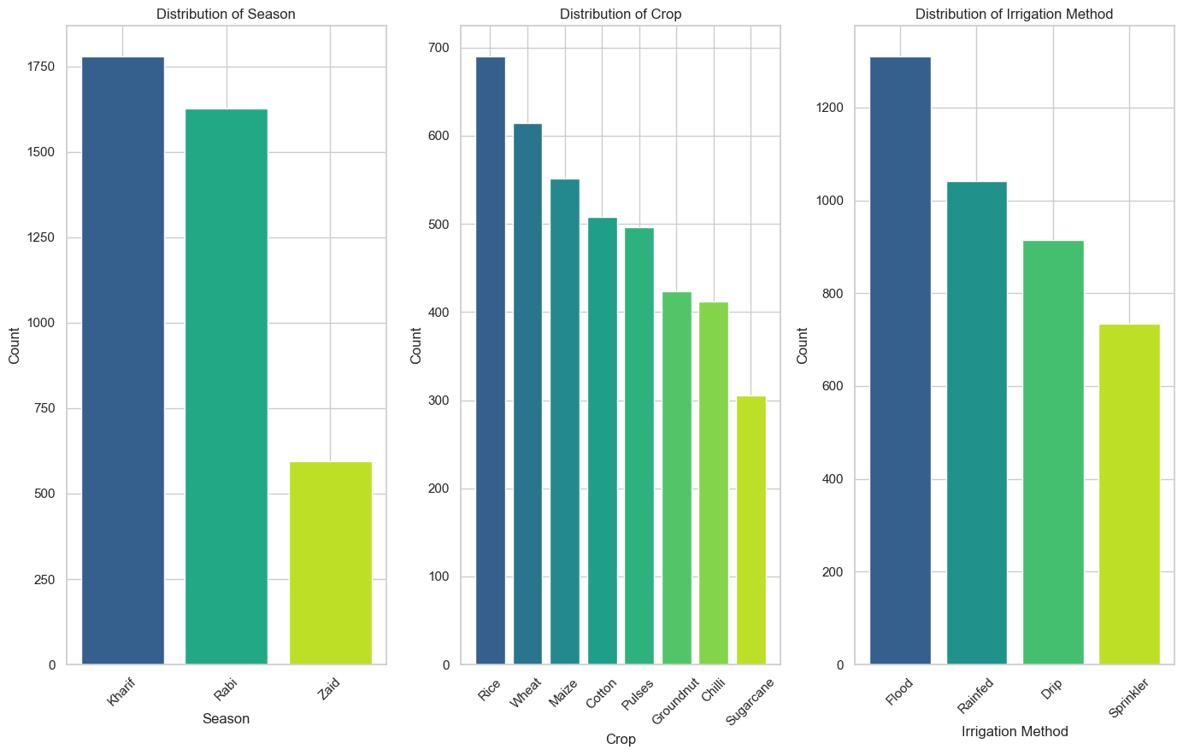
RESULTS

Slide 7
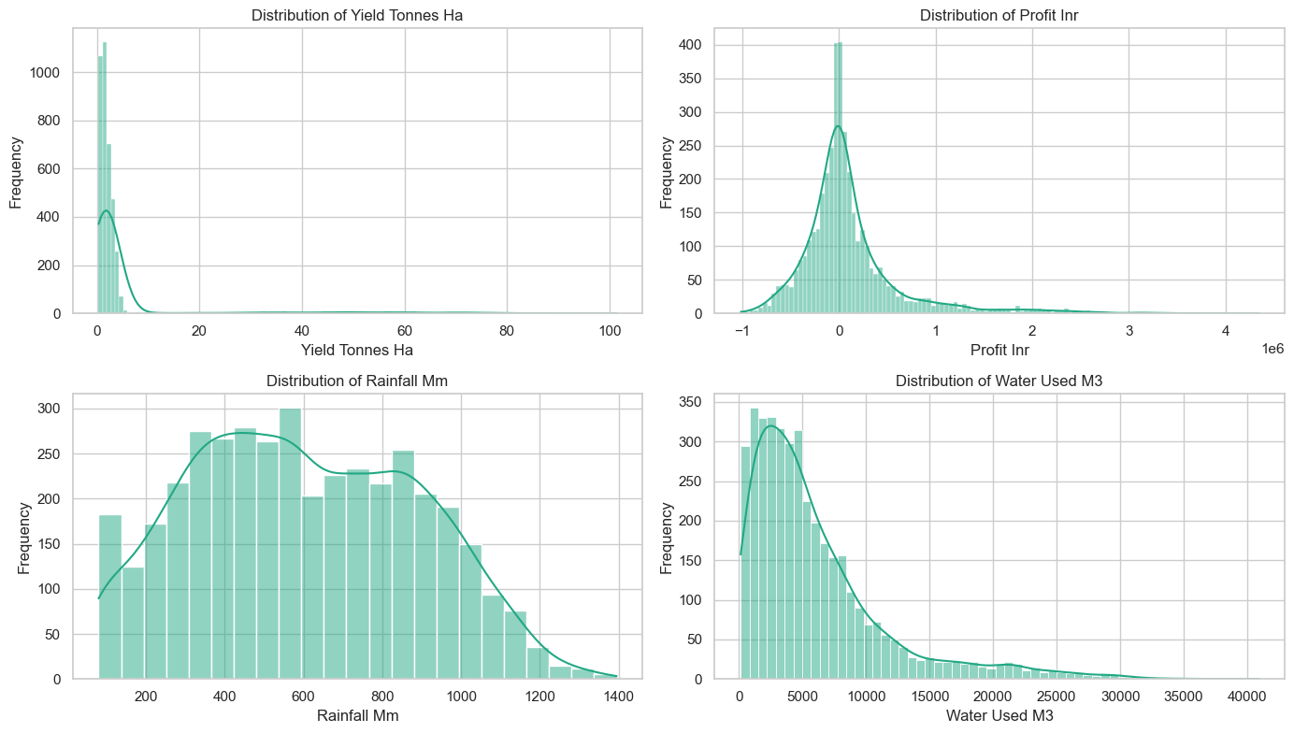
RESULTS

Slide 8
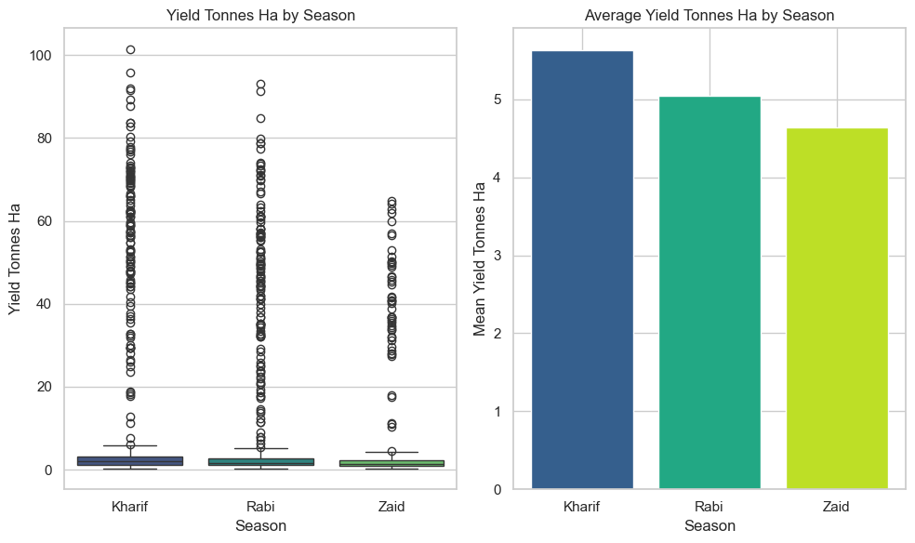
RESULTS

Slide 9
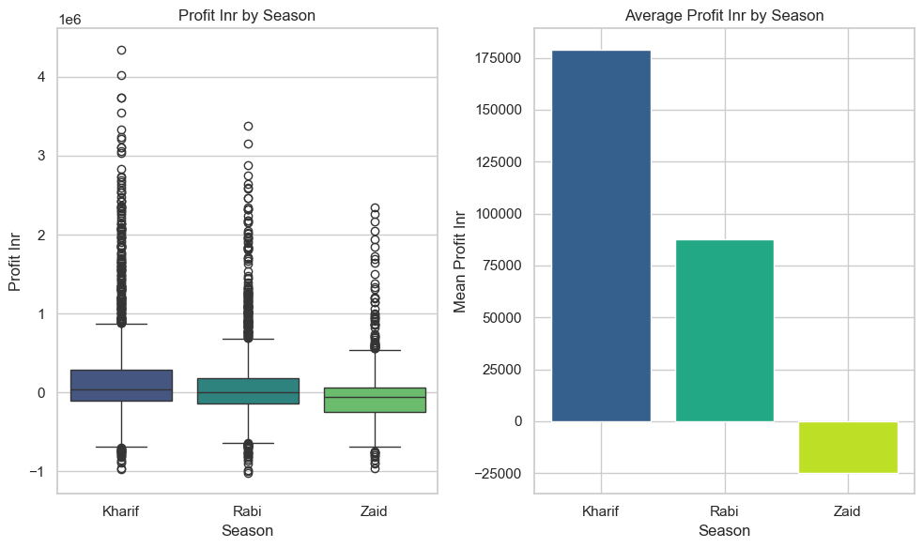
RESULTS

Slide 10
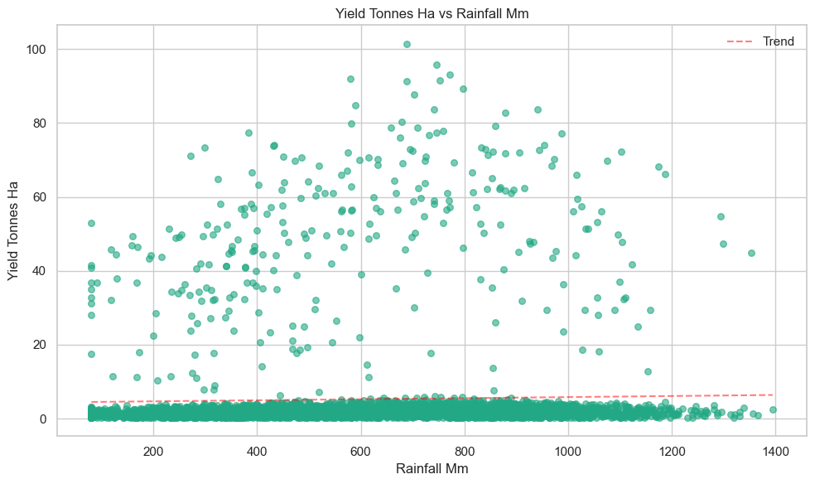
RESULTS

Slide 11
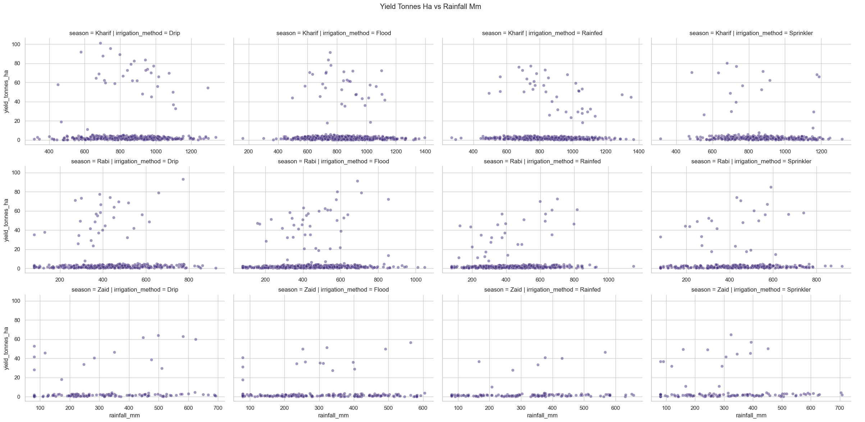
RESULTS

Slide 12
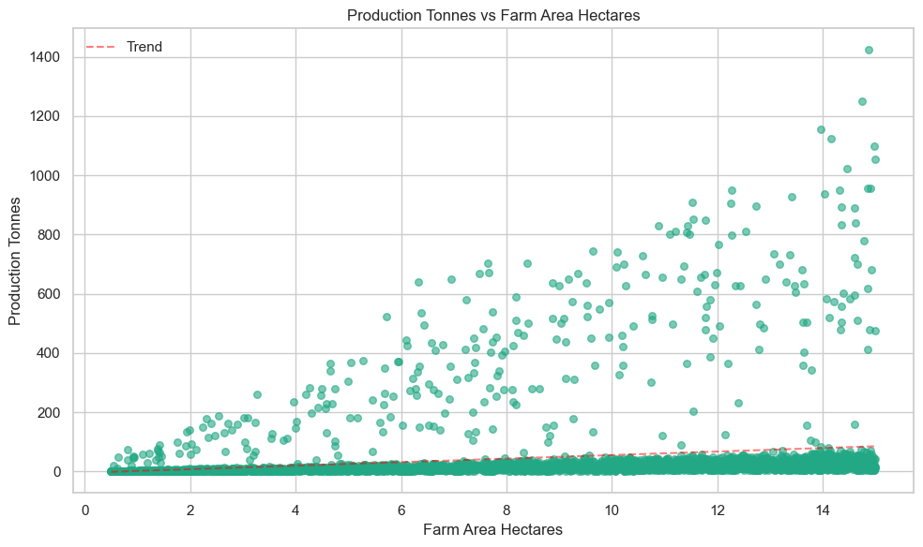
RESULTS

Slide 13
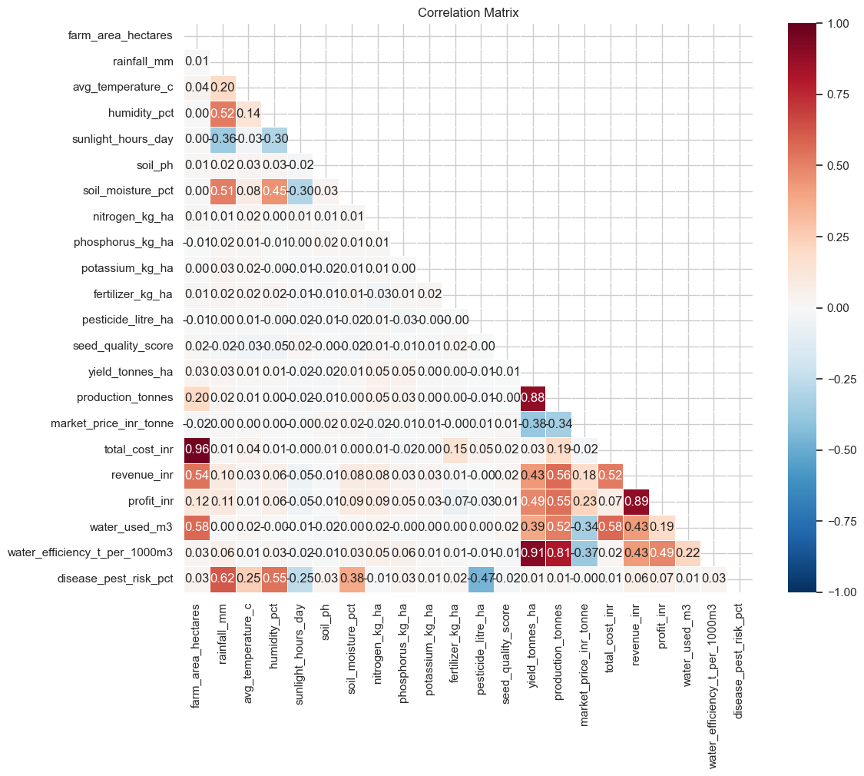
RESULTS

Slide 14
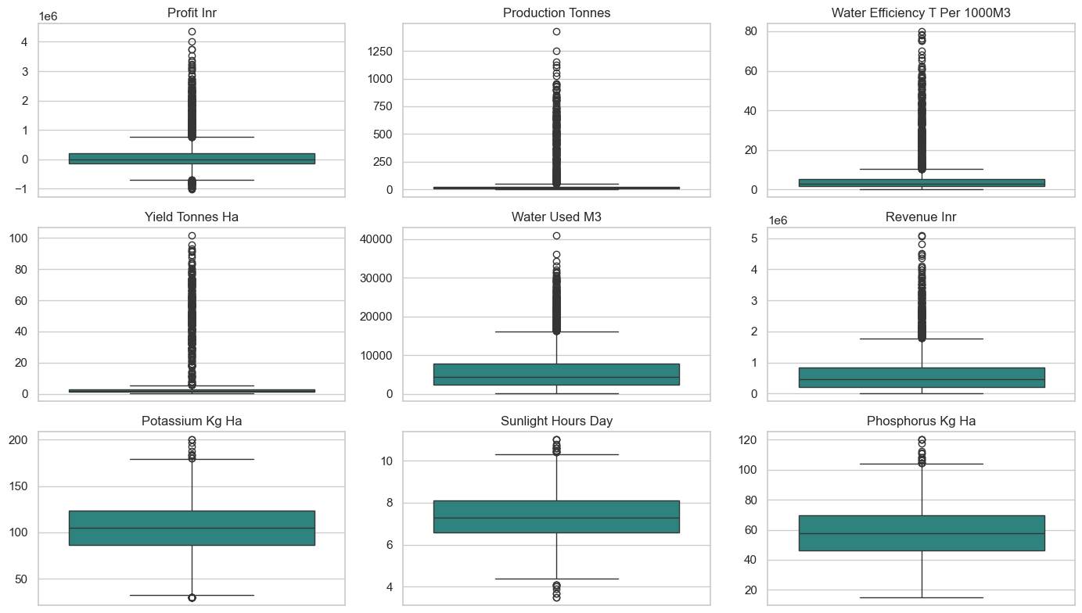
RESULTS

Slide 15
Future Scope
To build upon the findings of this analysis, future iterations of this project can expand into the following areas:
Predictive Machine Learning Integration: Transition from exploratory analysis to predictive modeling. Using the cleaned, outlier-vetted dataset, future work can train supervised regression models (such as Random Forests or XGBoost) to forecast crop yields and profit margins based on real-time weather forecasts.
Expansion of Features (Soil and Input Chemistry): Incorporate missing operational variables into the dataset—such as precise fertilizer composition ratios (NPK levels), soil nutrient degradation scores, seed variant types, and localized pest infestation metrics—to capture a more comprehensive picture of crop health.
Dynamic Market and Price Modeling: Integrate real-time commodities market APIs to factor in fluctuating wholesale market prices, regional transportation overheads, and supply-chain logistical costs. This will help refine the volume-versus-profit optimization algorithms under volatile economic conditions.
Spatial and GIS Mapping Expansion: Connect the dataset with geographic coordinates to build interactive geospatial layers. Utilizing GIS mapping will allow researchers to visualize how environmental conditions, water table depletion rates, and agricultural productivity trends cluster across different micro-climates.

Slide 16
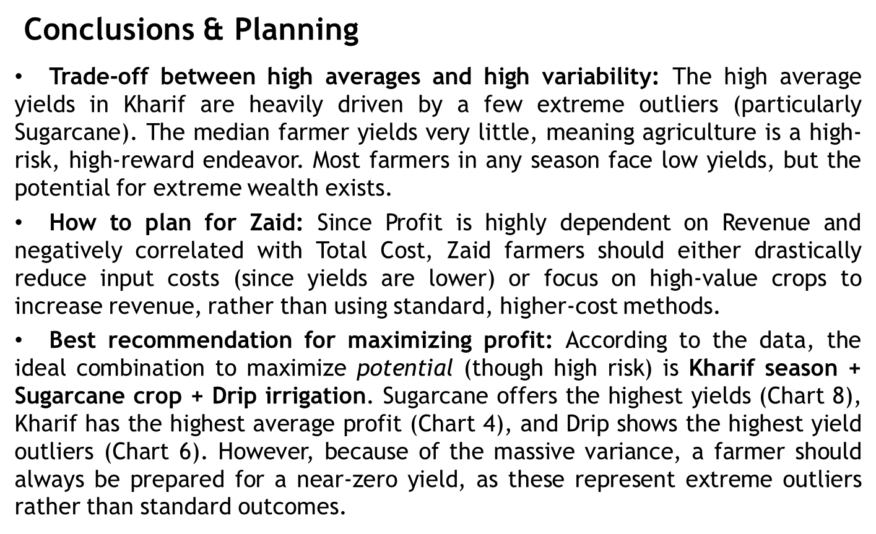

Slide 17
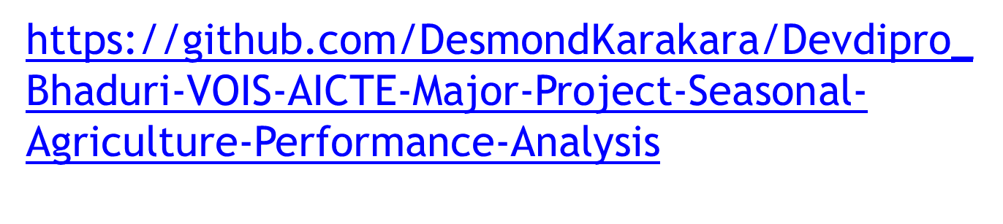
GitHub Link

Slide 18
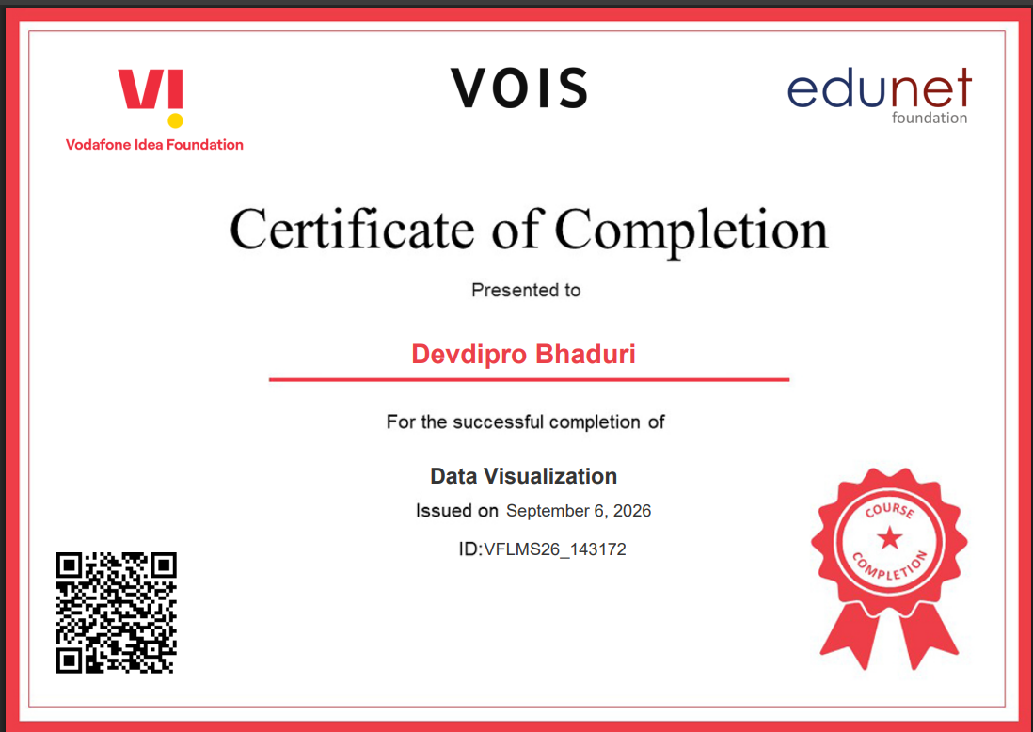
VOIS Course completion certificate -
Course name- Data Visualization

Slide 19
Thank you
.
.

