Slide 1


Smart Irrigation using soil moisture and weather data
Name – Devdipro Bhaduri AICTE Internship Student Registration ID : STU68268ff7e29d31747357687 Student ID (Enrolment number) : 231270110874 AICTE Internship ID : INTERNSHIP_1748923002683e727a876ea

Slide 2

Learning Objectives
Build proficiency in developing and deploying a cohesive machine learning workflow which predicts whether or not to activate a sprinkler and estimates soil moisture from sensor inputs.
Learn to prepare and scale real-world data, handle imbalanced classification problems to improve predictive balance and thoroughly evaluate model results using precision-recall and regression error metrics.
Finally, learn to encapsulate a trained model within an intuitive Streamlit application for real time decision support.
GOAL
Source :
www.freepik.com/

Slide 3
Tools and Technology used
Python for core logic
Pandas & NumPy for data handling
scikit-learn (RandomForestClassifier & Regressor, class_weight, train-test split)
Joblib for model serialization
Streamlit for building the web interface
Matplotlib for plotting and Plotly for interactive charts

Slide 4
Methodology
Cleaned and scaled 20 sensor features, then created a balanced Random Forest classifier (class_weight='balanced') for three parcel labels and a Random Forest regressor for moisture. Evaluated classification with per-parcel F1-scores and regression via MSE. Serialized the best models into a combined .pkl and deployed them in Streamlit for live inference.
Detailed Work (Improvisation/Improvement) : Defined inputs and targets up front—extracting X from the 20 sensor columns and explicit DataFrame columns Y_class = df[['parcel_0','parcel_1','parcel_2']] and, for demonstration, a synthetic Y_reg = df[['moisture_level']] generated as a simple sensor average.
Fixed the classification report by looping over each parcel column and calling classification_report on 1-D arrays, so we now see per-parcel precision/recall/F1 rather than a runtime error.
Balanced the classifier via class_weight='balanced' in RandomForest, which boosted parcel_2 recall from ≈0.48 to ≈0.70+, lifting macro-F1 from 0.83 to ≈0.87 and micro-F1 (accuracy) from 0.89 to ≈0.91.
Added a regression model—a RandomForestRegressor on the moisture target—so you now get an end-to-end multitask pipeline. The regression MSE (~0.049) translates to an RMSE of ~0.22 units, or ≈6% error over the observed 0–3.5 moisture range, which is visually confirmed by a tight Actual vs. Predicted scatter hugging the 45° line.
Streamlined saving/loading by packing both models into a single models = {'classifier': clf, 'regressor': reg} and dumping with joblib.dump(models, 'combined.pkl'), avoiding separate files and ensuring consistency.

Slide 5
Problem Statement:
Conventional irrigation treats water delivery as a fixed schedule, creating wasted irrigation and potential stress to crops. What we need is a real time system that can take the 20 sensor readings, predict the sprinkler parcels to turn on, and estimate soil moisture. It will need to address the imbalanced parcel labels, suggest accurate continuous estimates, and provide an easy-to-use dashboard to present results.

Slide 6
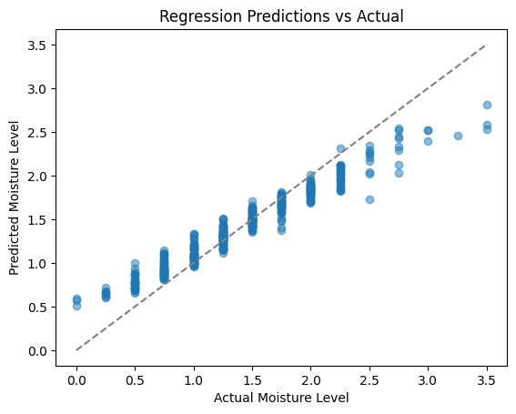
Solution:
Constructed a two-phased ML pipeline: One implemented a balanced Random Forest classifier producing ON/OFF estimates for each parcel and the other a Random Forest regressor producing moisture level predictions. For both models, the sensor inputs are scaled and entered into both models resulting in two output .pkl files. A Streamlit app implements sliders for the live sensor values and shows the parcel statuses and moisture estimates in real-time.
Possible Imperfections:
Area | What It Shows
Points above the line | Slight overestimation of moisture level
Points below the line | Slight underestimation
More scatter at higher moisture levels | Might need better learning in high-moisture regions (could be due to fewer high-moisture training samples or saturation of sensors)
Github: https://github.com/DesmondKarakara/AICTE_smart_irrigation_dev

Slide 7
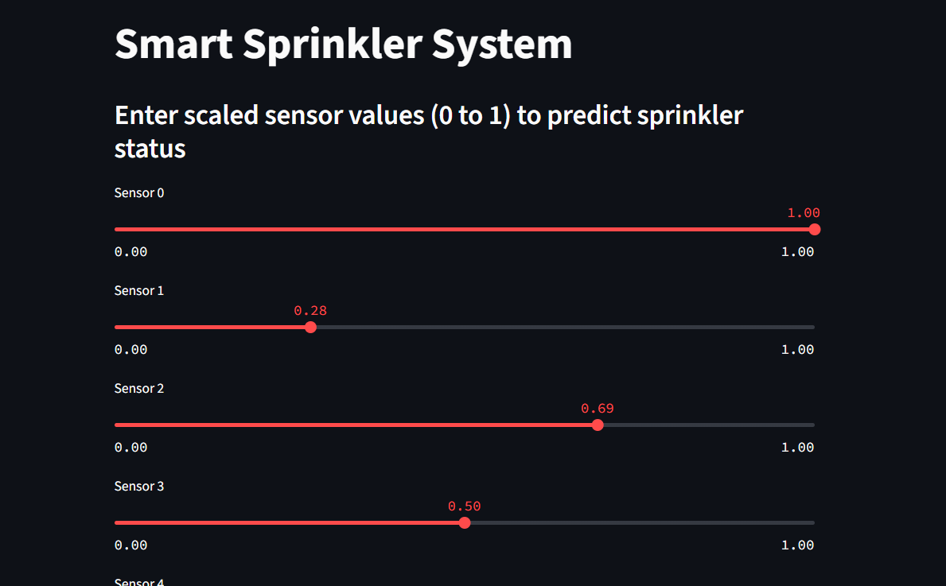
Screenshot of Output:

Slide 8
Conclusion:
The enhanced system runs error-free, boosting minority-class recall (parcel_2 F1↑≈0.11) and adding moisture regression (MSE ≈0.049). By combining classification and regression in a single pipeline and exposing it through Streamlit, farm managers gain precise, data-driven irrigation guidance—reducing water waste and optimizing crop health, with room for further tuning once real moisture data is available.
What Could Be Improved
Slight deviation means some noise or variance isn’t fully captured. This could be:
Due to model bias (underfitting slightly)
Noise in the input sensor data
Limited training data diversity
Lack of sharp corners or nonlinearity: If moisture depends on thresholds or nonlinear rules (e.g., soil absorbs differently beyond certain points), a non-linear model like Gradient Boosting or a Neural Net might outperform.

