Slide 1
LI SEM 1 2022/2023:
2nd Industrial Training Briefing (Supervision)
12 September 2022 (Monday)
10.00 am

Slide 2
Content
Actions to be taken before, during LI and after LI?
Info regarding LI Visit and Assessments
Success / Failure LI cases

Slide 3
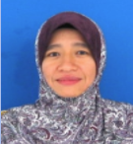
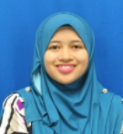
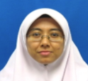
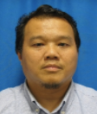
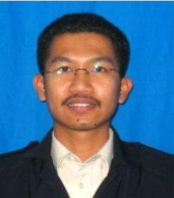
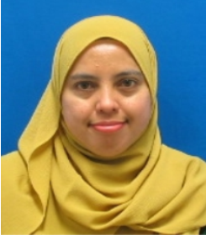

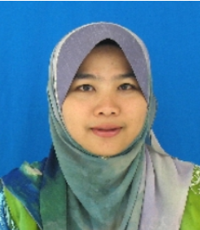
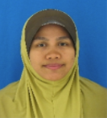
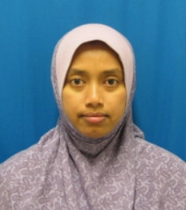
FTMK Industrial Training
Committee
&
Person-in-Charge (PIC)
Faculty Coordinator | Ts. Dr. Wahidah Md Shah
BITS | Ts. Dr. Lizawati Salahuddin
BITD & Supervision | Ts. Azlianor Abdul Aziz
BITC | Ts. Suhaimi Basrah
BITZ | En. Mohammad Radzi Motsidi
BITM | Ts. Dr. Sarni Suhaila Rahim
BITE | Muhammad Helmy Emran
BITI | Dr. Siti Azirah Asmai
DIPLOMA | Ts. Haniza Nahar & Ts. Marliza Ramly

Slide 4
What is Industrial Training (LI)?
BITU 3926
Industrial Training
6 credits
Pass/Fail
BITU 3946 Industrial Training Report
6 credits
Grading: A - E
24 weeks
(11 Oct 2022 – 24 Mac 2023)
Evaluated by Industry Supervisor and Faculty Supervisor
E-Log book & Report
Technical Area (60-80%)
Administration, Management & Training (20-40%)

Slide 5
Current Scenario
Start
Assuming that you are in the midst of applying LI placement.
Confirm LI placement?
no
yes
Confirm LI placement 2 weeks before LI start: 26/9/22
LI placement verified?
no
yes
Pass PSM2 and completed 105 credit?
Can’t go for LI. Must pass PSM2 and complete 105 credit (refer to your PA)
no
yes
LI approved?
Print all relevant doc before LI
Go for LI
no
yes
End
*** For details, please refer to
"LI Workflow (LI1-LI8) for Student"

Slide 6



Timeline
Sem 1 2022/2023
Start Internship
End Internship
Final LI Document Submission and Upload into UTeM LI System (SILI) / ULearn and Answer Surveys
1st Visit
(Online) & Pre-Evaluation
2nd Visit
(Physical/F2F)
11 Oct 2022
7 Nov – 2 Dec
2022
20 Feb – 17 Mar 2023
24 Mar 2023
24 – 30 Mar 2023

Slide 7
Timeline
Important Date | Activities
11 Oct 2022 | Report duty
7 Nov – 2 Dec 2022 | 1st LI Visit (thru phone/email /skype) – Faculty SV will contact students and do Pre-Evaluation
 | Faculty SV fill in the Pre-Evaluation report (NOT the student). Students upload e-log book by weekly into SILI.
20 Feb – 17 Mar 2023 | 2nd LI Visit (physical/f2f)
 | Presentation will be done during the 2nd visit. Faculty SV will check the draft of LI report.
24 Mar 2023 | End of LI
24 – 30 Mar 2023 | Upload Final Report (consist of ‘Akuan Tamat LI’ form and Item Verification Checklist). Upload Dokumen pengesahan penyelia (Industri), Dokumen kehadiran LI in SILI. Answer TWO (2) surveys.

Slide 8
Scope of LI
Technical Area (60-80%):
  Specifications of requirements
  Designing/Redesign
  Implementation/Construction
  Testing and Deployment
  Maintenance and Customization
  Documentation
Administration, Management & Training (20-40%):
  Attend courses and trainings, meetings, discussions, etc.
  Prepare courses, tender proposals, presentation
  Conduct courses and trainings or demos
  Data entry/clerical work, visit sites, etc.

Slide 9
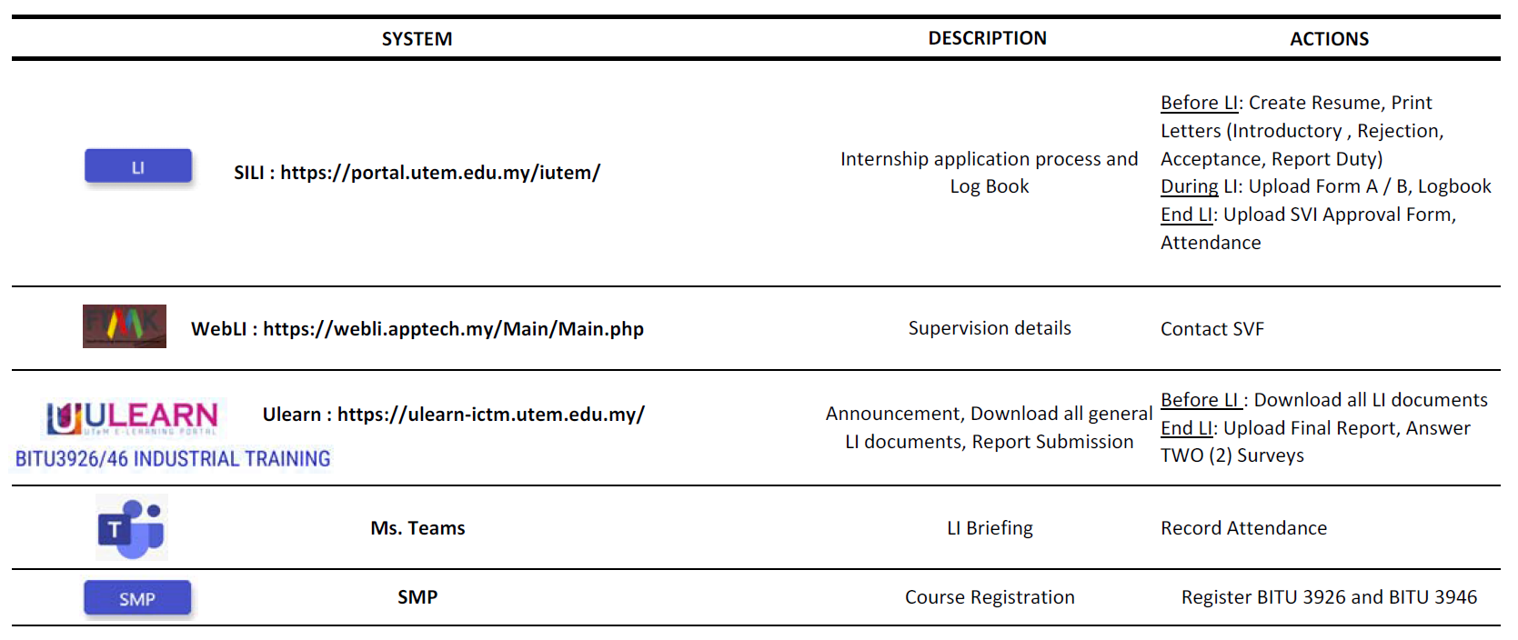
Summary of Platform/System for LI

Slide 10
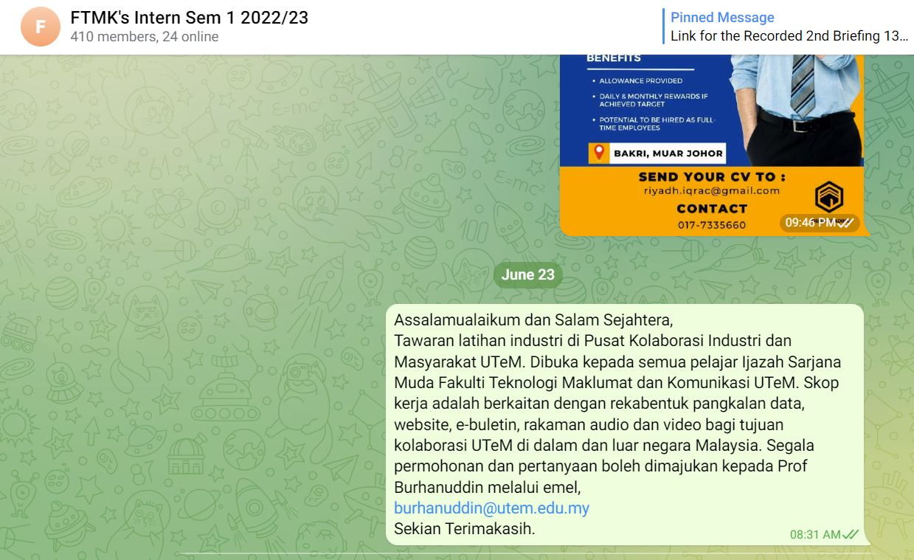
Resources
[1]:
Telegram “FTMK’s Intern Sem 1 2022/23”
Announcement, Placement offer from Companies

Slide 11
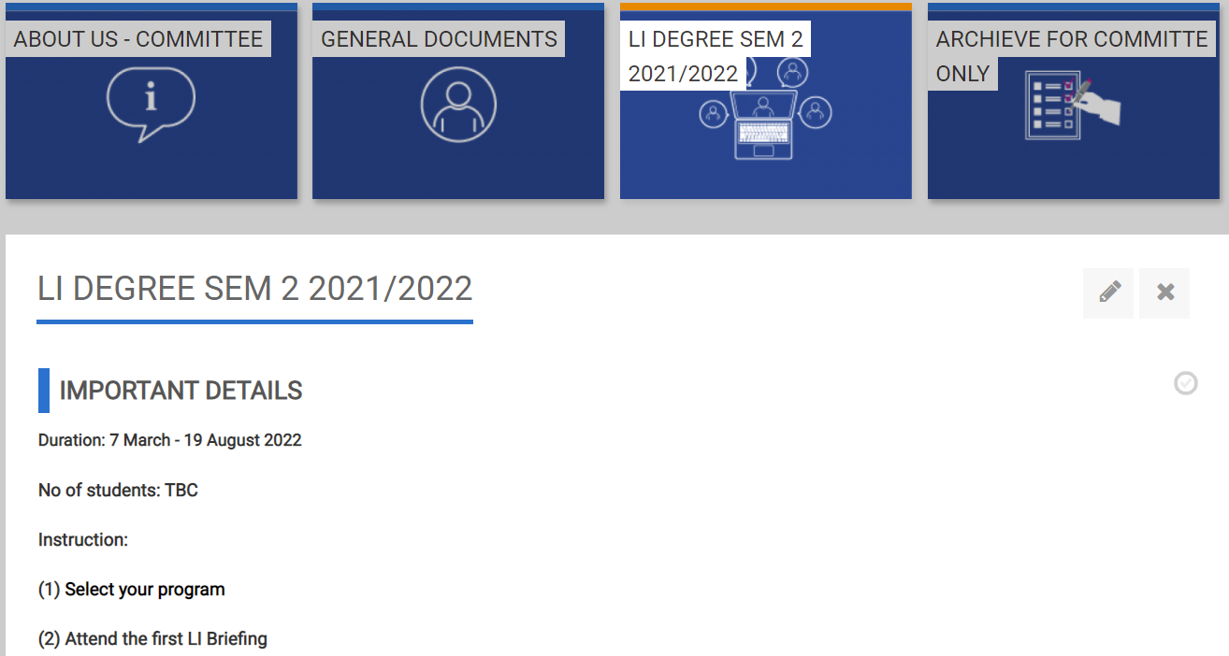
Resources
[2]:
Ulearn available later in Sem 1 2022/23
ULearn (e.g SEM 2 21/22 FTMK Industrial Training)
Announcement, all LI-related documents, briefing materials (before & during LI)
upload LI Report (end of LI)

Slide 12
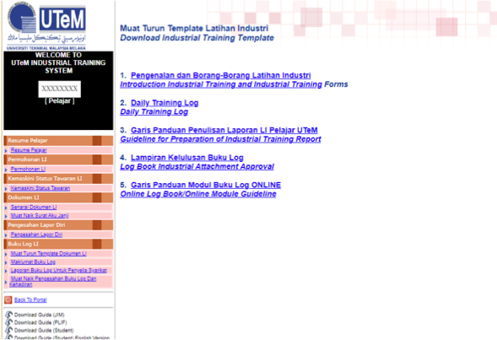
Resources [3]:
SILI
Download Admission Letter & Group Insurance Cover Letter (before LI starts)
Upload Logbook (weekly basis during LI)
Upload Confirmation of SVI and Attendance (End of LI)

Slide 13
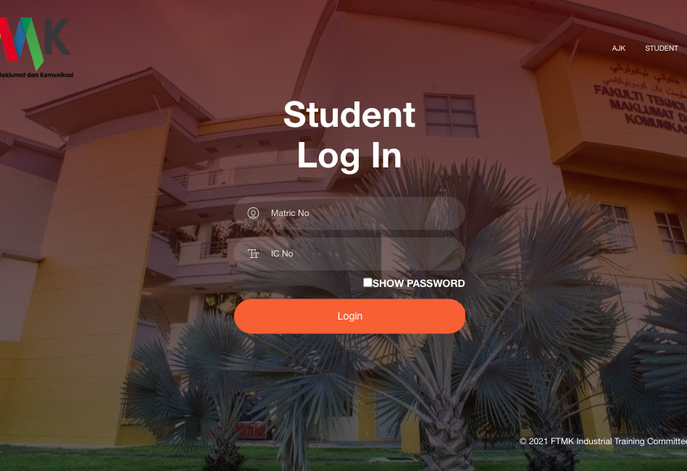
Resources
[4]:
WebLI
-Update Location of LI using latlong
-Supervision
Details

Slide 14
Before LI starts, ensure
1. Get the reply form from the company (with IT related job scope and agreed upon the working days and hours).
2. Decide ONE company for LI.
3. Reject other offers and send the rejection letters to the companies.
4. Accept the offer from the selected company for LI and send Acceptance Letter.
5. If meet minimum requirement, PIC will approve LI. Otherwise, cancel LI (contact company for cancellation).
6. Print Admission and Group Insurance Cover Letter.
7. Download All documents from the Ulearn and prepare accordingly

Slide 15
Action to be taken
First day of LI
Be
Be punctual
Well
Well-dressed
Demonstrate
Demonstrate positive attitude
Bring
Bring UTeM's matric card & related documents
Attend
Attend briefing / orientation by Company
Report
Report duty as stated in the offer letter (11 Oct 2022)

Slide 16
Action to be taken
Report Duty
  Don’t forget to bring:
  Admission letter
  Registration Confirmation (Form A)
  Change of Industrial Training Company/Organizational Address (Form B)
  Student Group Insurance Cover Letter
  Photocopy of IC / Bank Account

Slide 17
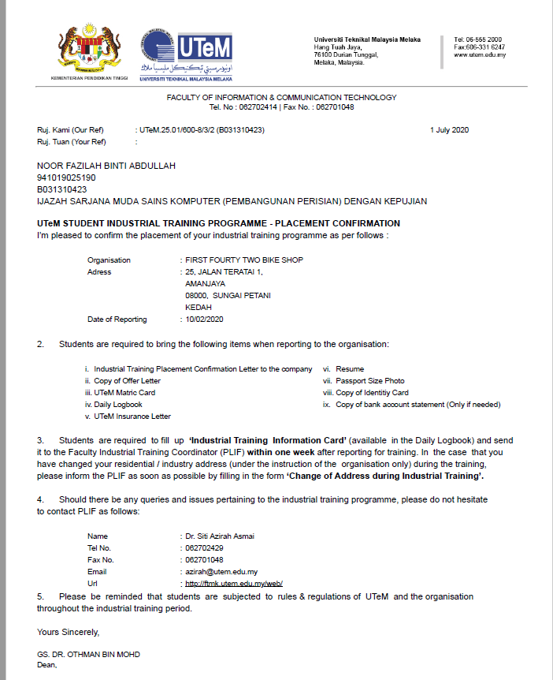
a.
Admission Letter (download from SILI)
The details of Name, IC number and Matric ID are correct
Ensure the start date is correct
The name of the current LI Coordinator
The name of the Dean

Slide 18
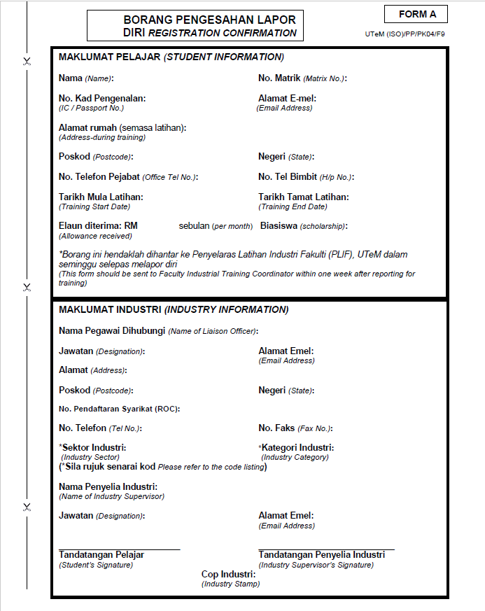
b. Registration Confirmation
(Form A) (download from ULearn)

Slide 19
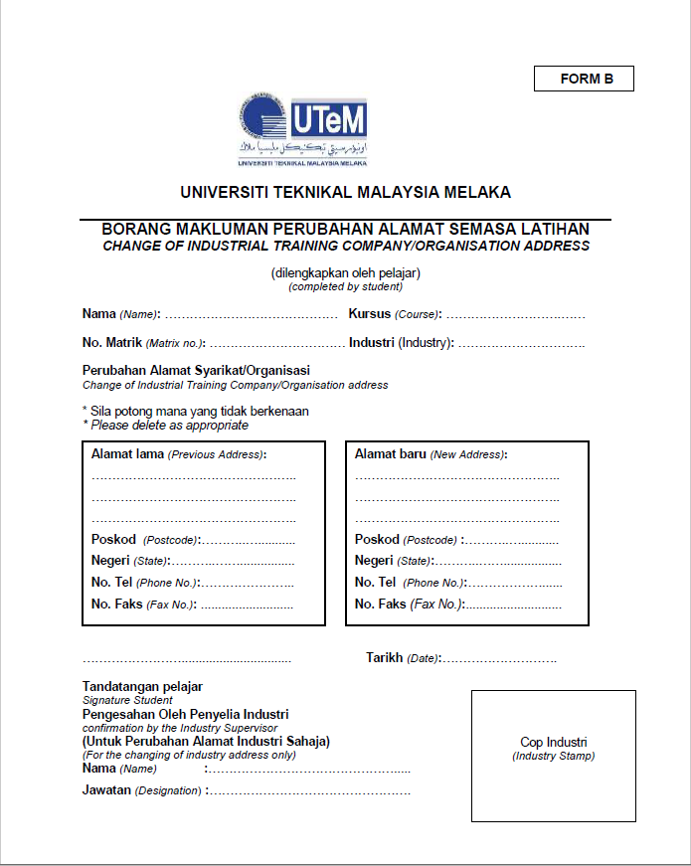
c.
Change of Industrial Training Company Address
(Form B)
(download from ULearn)

Slide 20
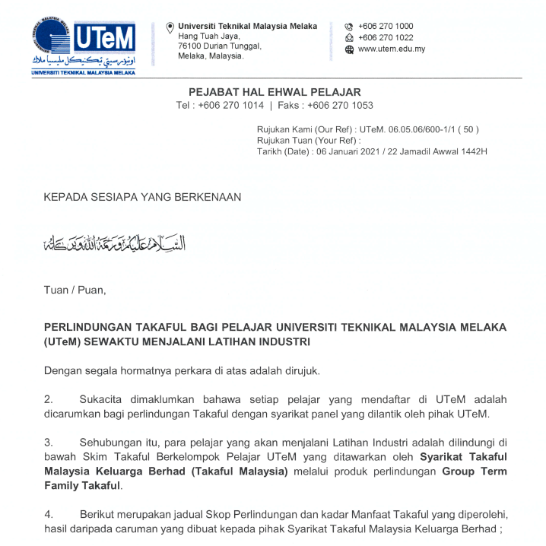
d.
Student Group Insurance Cover Letter (download from SILI)

Slide 21
Insurance Coverage
(download from SILI)
Subject: Inquiries regarding insurance coverage for LI students (overseas)
After being referred to the Group Takaful Service Operator Panel Company for UTeM students, namely Syarikat Takaful Malaysia Berhad, it was informed that students are covered under Student Group Takaful Protection worldwide & all the time (24/7) as long as the student has Active status, besides students also comply conditions of protection such as students do not violate local Laws if/ during any incident or disaster occurs.
However, it should also be noted that Student Group Takaful coverage is not hospitalization coverage such as Medical Card, but it is only coverage such as Death/ Disability Compensation only as students only contribute RM10.00 per semester.
In addition, if there are questions related to Student Insurance related to the requirements of Study Visa (Immigration Department) for International students. Therefore, detailed information related to the protection should be referred to the International Office under Mr. Deeno Aizad bin Abadi because it is managed by the International Office (International Office).
I apologize for any inconvenience caused.
Best Regards.
ABDUL MUSYRIF BIN MOHAMAD KHALIL (HEP)

Slide 22
After student report duty and starts LI …

Slide 23
One week after LI starts
Students must upload the following documents on SILI:
Form A - Registration Confirmation (compulsory)
Form B - Change of Industrial Training Company Address (if apply)
Any issues related to LI, student needs to refer their Faculty SV.
Ensure the job given is IT related.
If not, discuss with Industry SV or suggest one.

Slide 24
Important !!!
Job Scope
This must be related to Computer Science/ IT task
Ensure that student is at least involved in development of a small or medium scale project for the internal use at the organization or external project in addition to the routine tasks for the grading purpose.
It could be a small or medium scale project that has been identified by the company to be developed (e.g., developing an organizational stock management system or an equipment maintenance log system).
BUT if there is none, the student MUST propose a suitable project with consent of the Industry SV.

Slide 25
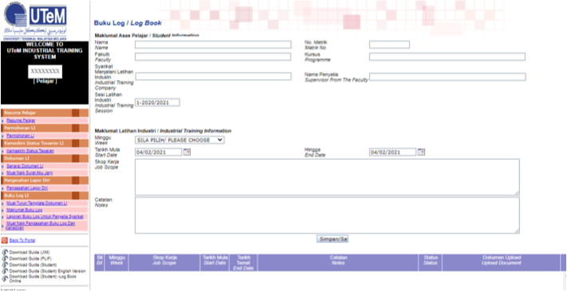
Weekly Task:
Report daily activities in e-Logbook and upload in SILI
** Just a brief information
** Report daily activity and combine into a weekly logbook. Upload here.

Slide 26
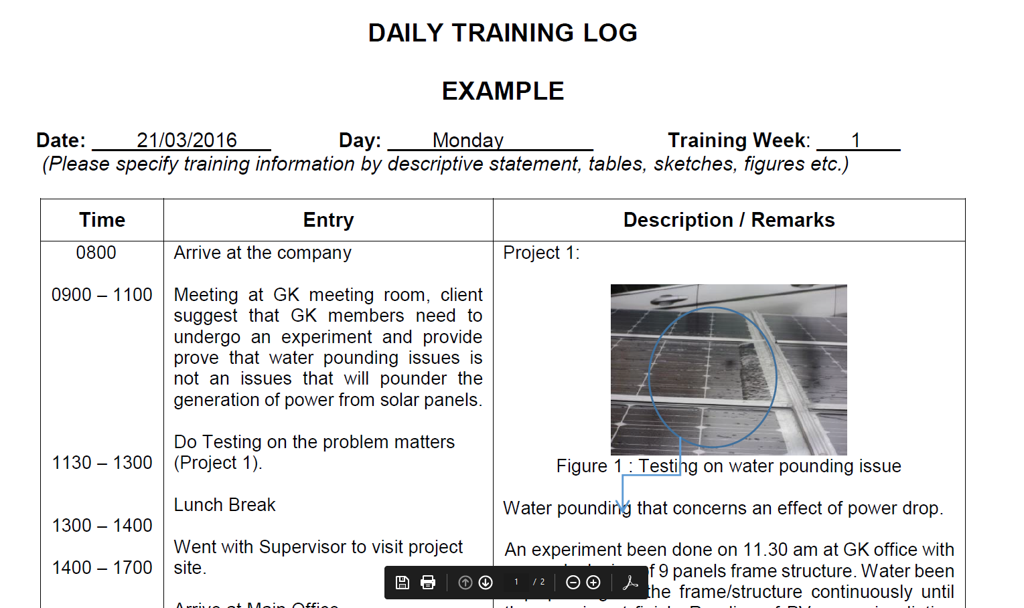
Daily e-Logbook Example
** Do not skip to upload the logbook weekly

Slide 27
What to write: e-Logbook
Log all activities while undergoing the training
Record CLEARLY all activities and tasks carried out/assigned by Industry Supervisor (SV) on a daily basis in the e-Logbook
Ensure the Industry SV inspect the e-Logbook weekly or in a period that has been agreed by the Industrial SV.
e-Logbook must be verified by the Faculty SV at least one week after completing LI.

Slide 28
What to write: e-Logbook
Objectives of tasks
Method of training provided
Describe each training task undertaken
Describe methods, materials, processes, equipment
Comments on knowledge and skills learned
Should correspond to your final report
State references (if any)
Verified by Industry SV (Logbook Industrial Attachment Approval)
Must be written in English
Record of leave taken

Slide 29
During LI
Students are subjected to UTeM’s & company’s rules & regulations.
Abide by company’s working hours.
Record daily activities in e-Logbook.
Not permitted to reveal confidential info without consent of company.
Inform Faculty SV/ LI Coordinator if there is any problem e.g., health & safety.
Inform faculty if there is any change of address.
Regularly check ULearn & FTMK Room FB page for important announcements.
Contact Faculty SV once the List of Faculty SV is announced.
Alert the PIC if your name is not in the LI Supervision List.

Slide 30
During LI : Attendance Record & Leave
WFH – students may submit your attendance records based on the method applied by the company’s.
Leave – 7 days, applied only needed (with company’s approval).
All leaves must be recorded in Record of Leave / Record of Medical Leave.
Medical Leave – required medical certificate (7 days).
Company to release students for faculty matters; get letter from University.

Slide 31
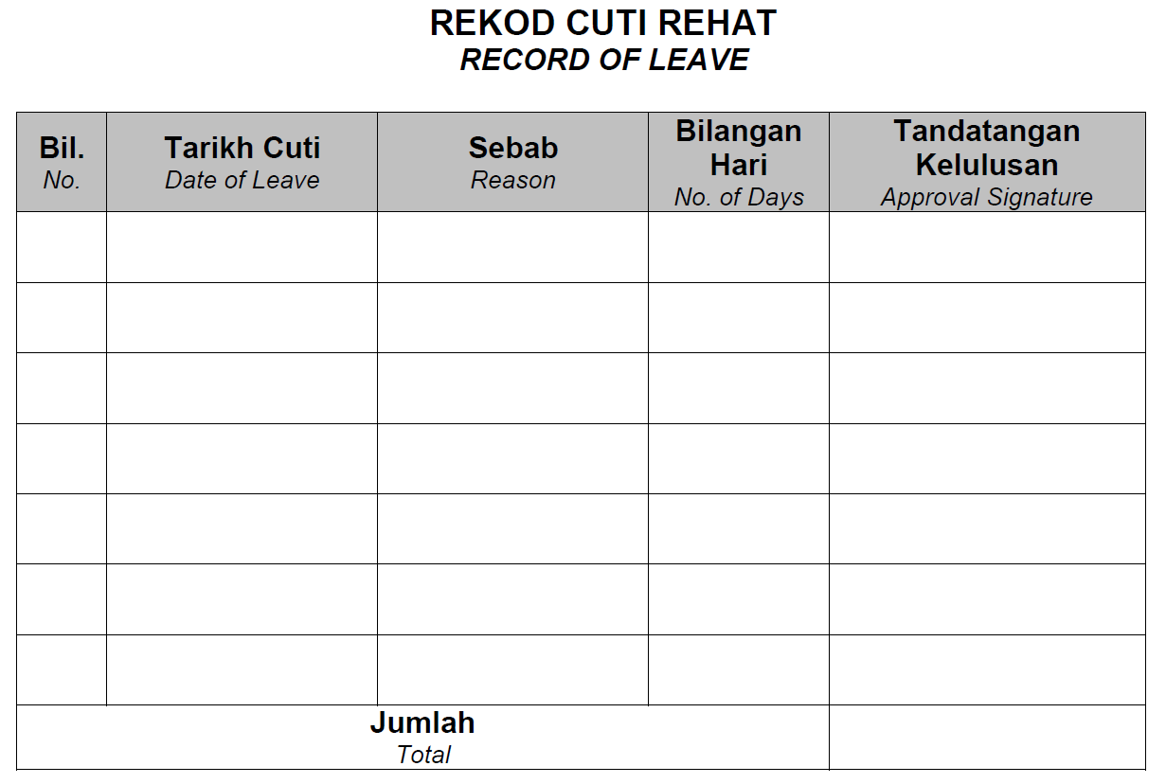
Record of Leave
(only for important event)

Slide 32
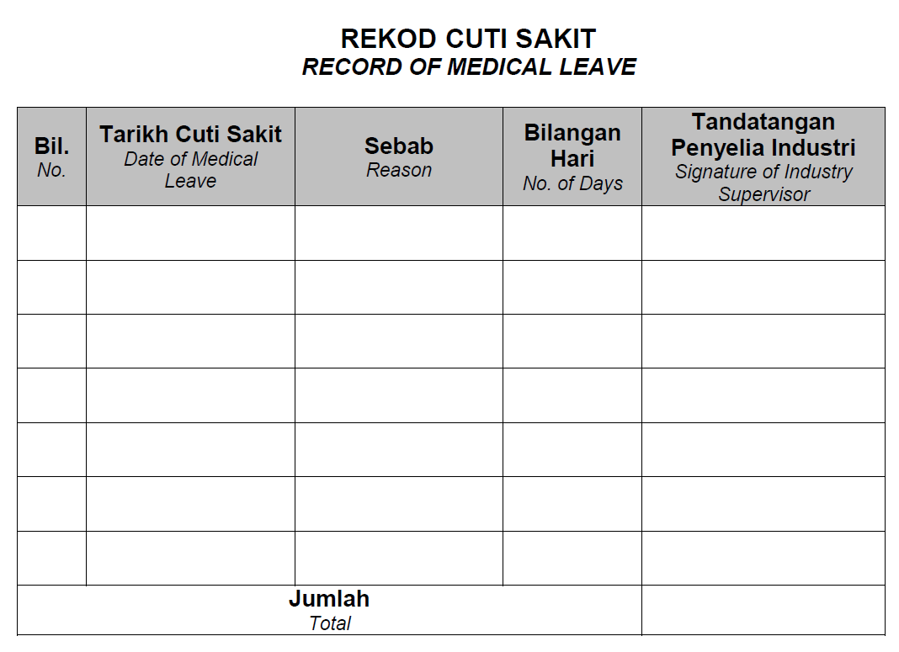
Record of Medical Leave

Slide 33
What should I do if ….?
Accidents
Inform your Industry SV and Faculty SV immediately.
Inform Industrial Training Coordinator (Ts. Dr. Wahidah – 0172907476) & your Academic Advisor (PA).
Inform Unit Kebajikan Pelajar, Bhg. Perkhidmatan Pelajar (HEPA) – also for insurance claim.
Student/beneficiary must prepare and submit:
    A Copy of Identification Card
    Police report (if necessary)
    Original medical bill (Gov’t hospital)
    Doctor report (if necessary)
    Original ward discharge note (if admitted)

Slide 34
What should I do if ….?
Police case – theft, fraud, harassment & etc.
Inform your Industry SV and Faculty SV immediately.
Lodge a police report.
Your Faculty SV or Industrial Training Coordinator will advise necessary actions.

Slide 35
Important note
Change of placement without approval from the Faculty after the industrial training started can be graded E (Clause 7.2.7).
      Source: Garis Panduan Latihan Industri, 2013

Slide 36
Supervision Details from WebLI

Slide 37
Supervision & LI Visits
List of Faculty Supervisors will be ready by Week 4 on FTMK LI System (WebLI).
Contact your Faculty SV and consult him/her on any issues/matter related to your industrial training.
1st Visit -
  4 weeks after student starts industrial training.
  Pre-evaluation.
2nd Visit -
  Within a month before industrial training ends.
  Evaluate student’s presentation and overall performance.

Slide 38
Supervision & LI Visits
(cont ..)
During 2nd visiting, student must:
Make sure the e-Logbook is updated.
Prepare a draft of industrial training report.
Prepare a presentation for the Industry and Faculty SVs.

Slide 39
Evaluation items
No. | Items | Evaluator
a. | Presentation | Industry SV Faculty SV
b. | Overall LI performance | Industry SV Faculty SV
c. | Industrial Training Report | Faculty SV
d. | e-Logbook | Faculty SV
e. | LI Briefing (1 & 2) attendance, LI report, Student Feedback form, Industrial Training Declaration form, any raised issues = 10% | Faculty SV
Failure to upload the report and e-Log book risks in getting grade E.

Slide 40
Industrial Training Report
Report must be written in ENGLISH and follow the Report Format Guideline v.2021 (download from ULearn).
Among updates from previous guideline version:
Abstract is replaced with Executive Summary.
Additional content for Chapter 1.
A new Chapter 4.
Pages required is 50 – 100. Not less than 50.
And some other minor changes.

Slide 41
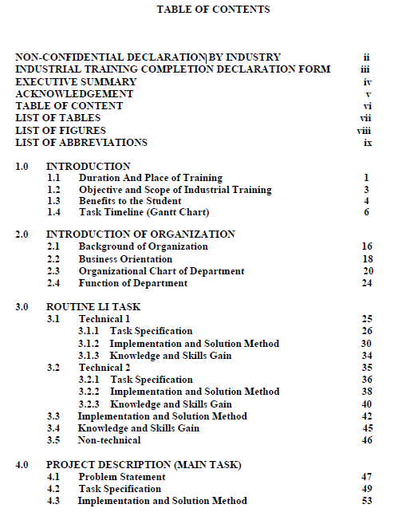
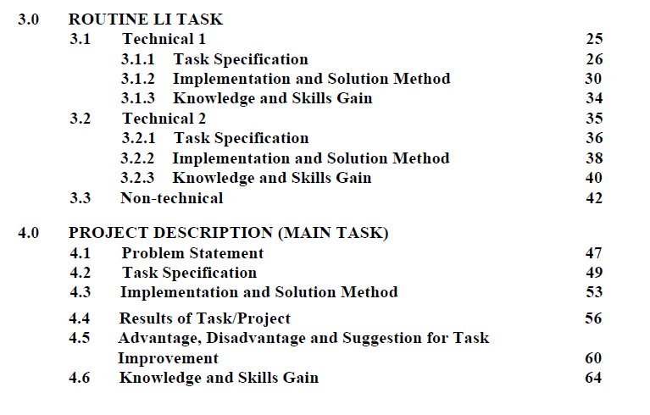
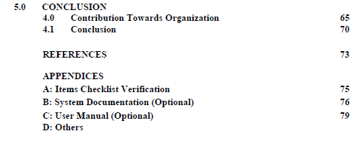
Report Format

Slide 42
After LI ends
(SILI)
  Submit these documents on SILI:
        E-Logbook until Week 24
        Logbook Industrial Attachment Approval
        Attendance Record
        Record of Leave (if any)
        Record of Medical Leave (if any)
Combined into 1 pdf file

Slide 43
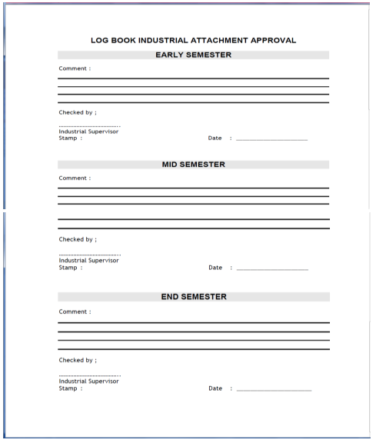
b.
Logbook
Industrial Attachment Approval
Approval by Industrial Supervisor | Datelines
Early Semester | Week-8
Mid Semester | Week-16
End Semester | Week-24

Slide 44
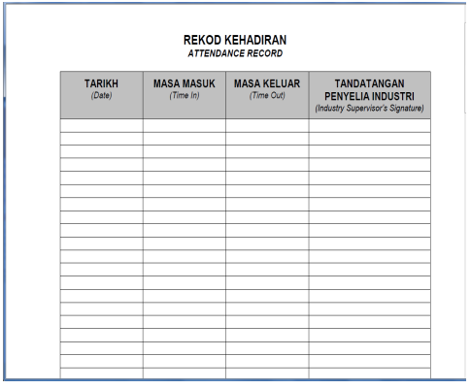
c.
Attendance Record
  Note: Can upload either the attendance generated by company or provided by UTeM.

Slide 45
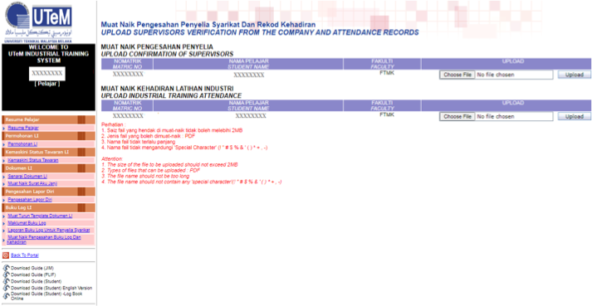
Upload Supervisors Verification from the company and Attendance Record
  Note:
  Supervisors Verification = Logbook Industrial Attachment Approval
  Please ensure Industry SV approves the Logbook Industrial Attachment Approval 3 times (Early, Mid and End Semester).

Slide 46
What do you get from ULearn?
Complementary medium/channel for
announcements from Internship Committee (JKLI) and LI report storage.
LI Briefing (1 & 2) materials.
All LI related documents.
Guideline for Preparing LI Report v2021.

Slide 47
After LI ends
ULearn
  Submit Industrial Training Report on ULearn on the next Wednesday after the LI ends.
  Ensure it has follows the v2021 Guidelines (latest).

Slide 48
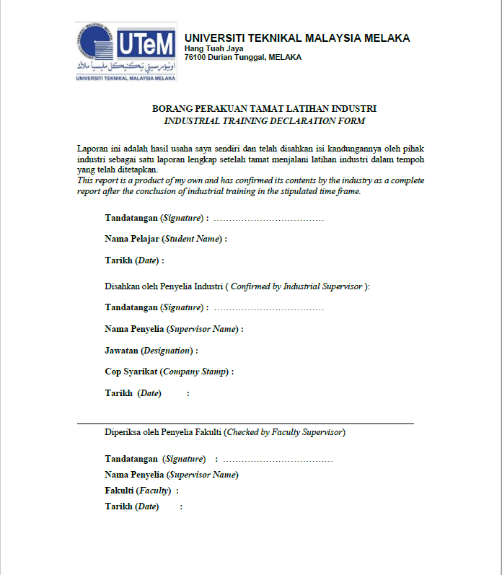
a.
Industrial Training Declaration form
*Date - must be the official LI end date

Slide 49
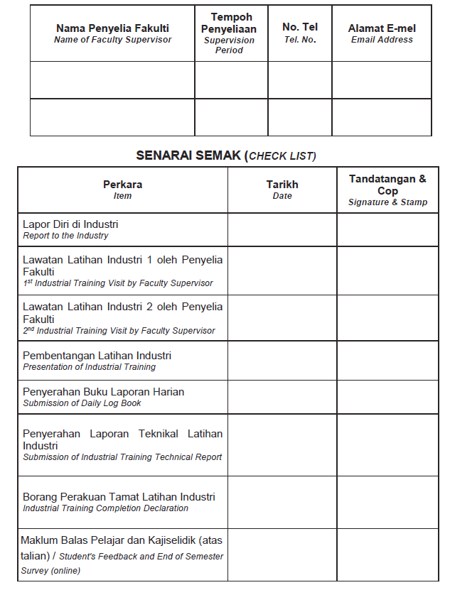
b.
Item Checklist Verification
Student fill in the Faculty SV details
Signed and stamp by the Industry SV
Signed and stamp by the Faculty SV
Student fill in the dates

Slide 50
c.
Complete Surveys
Student are required to answer TWO Survey:-
1. End-of-Sem LI Survey
2. Exit Survey
The survey link will be provided during the Second Visit and also in the ULearn.

Slide 51
Example Free PDF Software
Insert softcopy signature
Foxit Reader
Combine Multiple PDF Files
https://www.ilovepdf.com/merge_pdf

Slide 52
Industry Feedback
Bil. | Example of Industry Feedback
1 | Excellent working performance and beyond expectation
2 | Show interest and determination
3 | Good commitment & discipline
4 | Exhibit interest to learn
5 | A good team player
6 | Has leadership potential
7 | Demonstrate initiative & multi-tasking
8 | Need to improve communication skill and self-confidence
9 | Lack of confidence to share opinions
10 | Need to think critically and always ask questions to get more info and clarification on any given task

Slide 53
Avoid
Change of placement.
Scam.
Use social media to demonstrate your frustration or upload confidential documents of the organization including photos of the staff .
Getting married.
Perform umrah/hajj.
Unnecessary tasks i.e., Job task: fix traffic light.
Accident – could defer semester.
Odd working hours.

Slide 54
FAQ (1)
Q: During internship, who should I refer for any issues?
A: Contact your Faculty SV once assigned.
Q: What if the company that I want to apply is not listed in the system?
A: Contact your PIC for adding a new company into UTeM LI System (SILI).
Q: Should I submit the resume from LI system or the one I created by myself to the company?
A: It is suggested to send both of them.
Q: Where can I get the internship letter (the cover letter)?
A: You can generate the internship letter from UTeM LI System (SILI) after you apply for the company.
Q: May I accept the company that offer me a virtual internship?
A: No.

Slide 55
FAQ (2)
Q: May I have internship in a computer shop?
A: Yes, as long as you work for IT-related tasks (refer job scope) which are suitable for degree students.
Q: I have applied to many companies but still don’t get any internship placement offer (two weeks before LI).
A: Contact your PIC as soon as possible.
Q: Is the reply form sent by the company or student?
A: The company is the one who send the reply form to the student. Then student upload it into UTeM LI system (SILI) for LI committee to check and verify the form.

Slide 56
FAQ (3)
Q: May I start internship earlier than the official LI date stated by UTeM, since the company asks me to do so?
A: You are advised to follow the official LI date as stated by UTeM. But yes, it is possible to start LI early provided an offer letter from the company stated the reason why the student is requested to start early. However, please do take note that the insurance coverage for that duration is not applicable, thus anything happens, it is your own responsibility. If you still want to proceed, please do contact PIC for more details.
Q: During my internship, I am given more non-related IT tasks than IT tasks. What should I do?
A: Refer to the offer letter provided by the company. Inform your Industry SV about the job scope stated by the company in the offer letter. Contact your Faculty SV or PIC as soon as possible.

Slide 57
ANY QUESTIONS ?
THANK YOU & ALL THE BEST!

