Slide 1
DASC 5300/CSE 5300
Finding graph characteristics
Fall 2021
Enamul Karim
CSE Department
The University of Texas at Arlington

Slide 2
Graph characteristics
Number of nodes
Number of edges
Density
Number of Connected Components
Connected Components
Diameter
Minimum degree
Maximum degree
Average degree
std_dev_degree

Slide 3
Required Package
NetworkX requires Python 3.7, 3.8, or 3.9)
Installation:
Install the current release of networkx with pip:
$ pip install networkx[default]
To upgrade to a newer release use the --upgrade flag:
$ pip install --upgrade networkx[default]

Slide 4
Preprocessing the dataset
Take a subset of the route dataset based on the given airline and put them in a text file. For example:
AL4,AL4,ABE,4355,CLT,3876,Y,0,CR9 CR7 CRJ
AL4,AL4,ABE,4355,PHL,3752,Y,0,CRJ DH8
… … …
AL4,AL4,ZRH,1678,SIN,3316,,0,388
Parse the file to get the required edge information (Here we are finding all the edges for the given airline):
4355, 3876
4355, 3752
… … …
1678, 3316
Input file
Source ID
Destination ID
Input.txt

Slide 5
Making Required Changes
In network_summary.py, set the dataset and the output path inside network_sum():
datasetpath = ‘Path_to_inputDatasetDirectory’
output_path = ‘Path_to_outputFile/output.txt’
Read each line from the input file inside read_mln(directory_path) in MLN_IO.py and create the graph data structure:
layer = nx.Graph()
for i, line in enumerate(infile):
edgeInfo = line.split(",")
v1=int(edgeInfo[0])
v2=int(edgeInfo[1])
layer.add_node(v1)
layer.add_node(v2)
layer.add_edge(v1,v2)
mln.add_layer(layer)

Slide 6
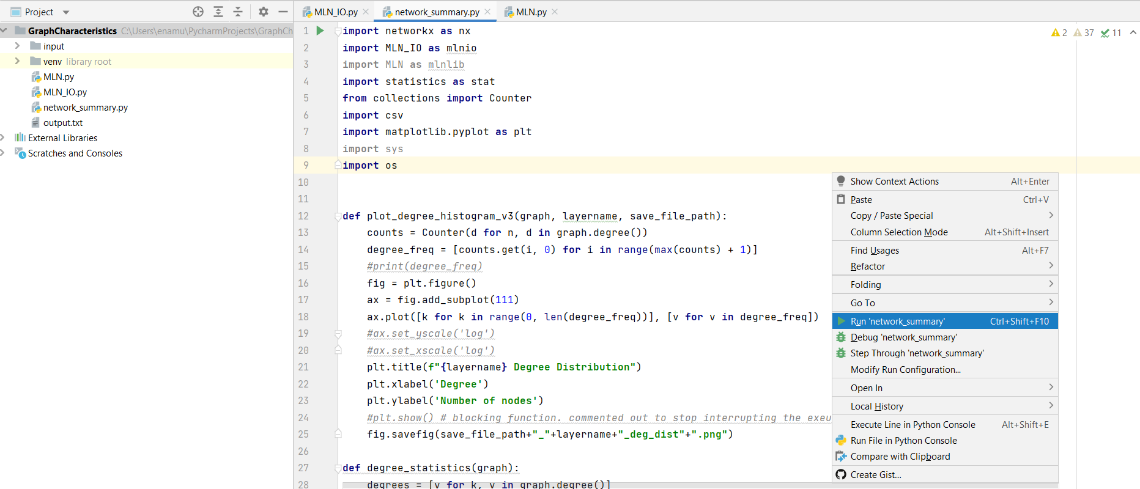
Running the program
You need to run network_summary.py file to get the desired output:

Slide 7
Output File
number_of_nodes, number_of_edges, density, number_of_connected_comp, connected_comps, diameter, min_degree, max_degree, avg_degree, std_dev_degree
352,1005, 0.0162, 1, [352], 5, 1, 180, 5.71,17.216

Slide 8
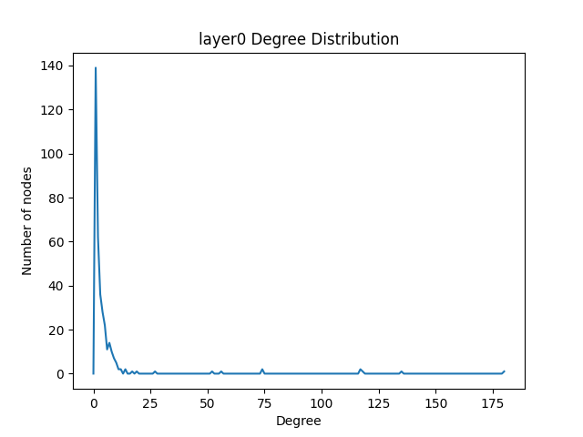
Degree Distribution

Slide 9


Thank You !!!
For more information visit:
http://itlab.uta.edu

