Slide 1
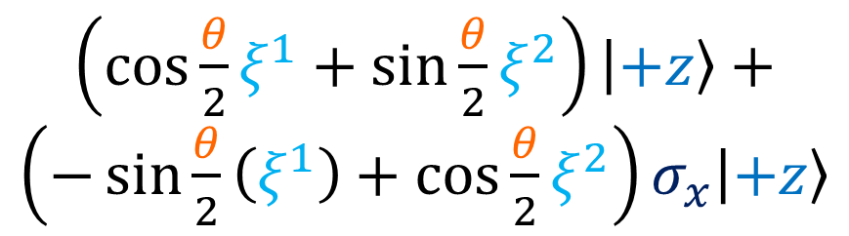


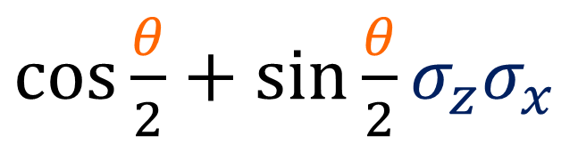





Exercise:
Hint: $σ_{z}\left|+z\right\rangle =\left|+z\right\rangle$
$ξ^{1}\left|+z\right\rangle +$
$ξ^{2}σ_{x}\left|+z\right\rangle$
$\left(\cos{\frac{θ}{2}}ξ^{1}+\sin{\frac{θ}{2}}ξ^{2}\right)\left|+z\right\rangle +\left(−\sin{\frac{θ}{2}}\left(ξ^{1}\right)+\cos{\frac{θ}{2}}ξ^{2}\right)σ_{x}\left|+z\right\rangle$
$\cos{\frac{θ}{2}}+\sin{\frac{θ}{2}}σ_{z}σ_{x}$
$$\left[\begin{matrix}\cos{\frac{θ}{2}} & \sin{\frac{θ}{2}} \\ −\sin{\frac{θ}{2}} & \cos{\frac{θ}{2}}\end{matrix}\right]$$
$$\left[\begin{matrix}ξ^{1} & 0 \\ ξ^{2} & 0\end{matrix}\right]$$
$$\left[\begin{matrix}{\tilde{ξ}}^{1} & 0 \\ {\tilde{ξ}}^{2} & 0\end{matrix}\right]$$
$$=$$

Slide 2
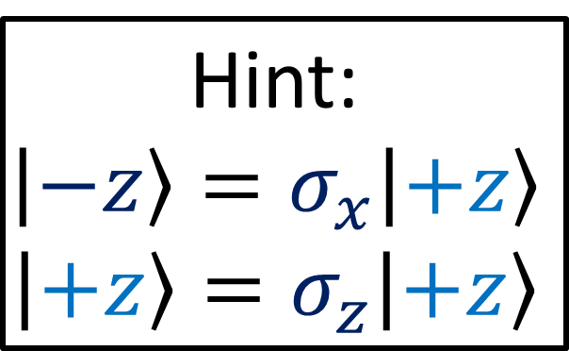
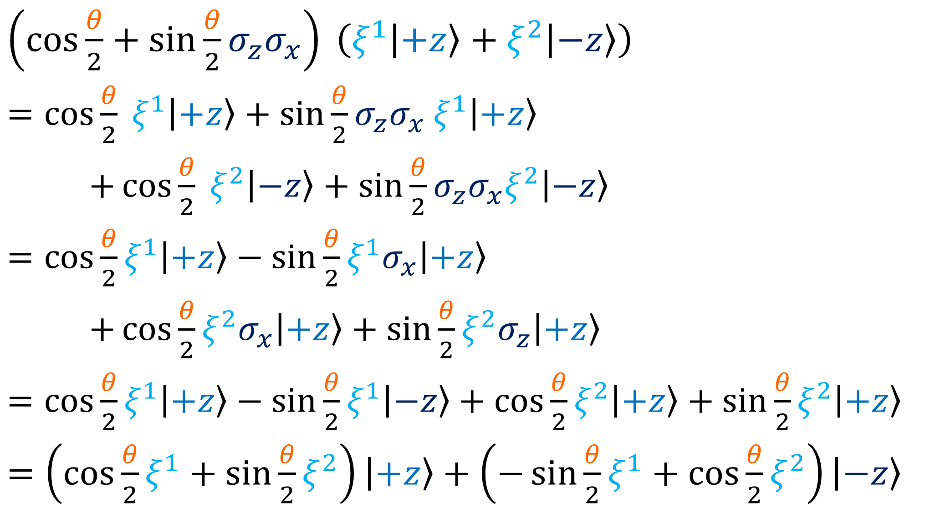
$\left(\cos{\frac{θ}{2}}+\sin{\frac{θ}{2}}σ_{z}σ_{x}\right) \left(ξ^{1}\left|+z\right\rangle +ξ^{2}\left|−z\right\rangle \right)$
$=\cos{\frac{θ}{2}} ξ^{1}\left|+z\right\rangle +\sin{\frac{θ}{2}}σ_{z}σ_{x} ξ^{1}\left|+z\right\rangle$
$+\cos{\frac{θ}{2}} ξ^{2}\left|−z\right\rangle +\sin{\frac{θ}{2}}σ_{z}σ_{x}ξ^{2}\left|−z\right\rangle$
$=\cos{\frac{θ}{2}}ξ^{1}\left|+z\right\rangle −\sin{\frac{θ}{2}}ξ^{1}σ_{x}\left|+z\right\rangle$
$+\cos{\frac{θ}{2}}ξ^{2}σ_{x}\left|+z\right\rangle +\sin{\frac{θ}{2}}ξ^{2}σ_{z}\left|+z\right\rangle$
$=\cos{\frac{θ}{2}}ξ^{1}\left|+z\right\rangle −\sin{\frac{θ}{2}}ξ^{1}\left|−z\right\rangle +\cos{\frac{θ}{2}}ξ^{2}\left|+z\right\rangle +\sin{\frac{θ}{2}}ξ^{2}\left|+z\right\rangle$
$=\left(\cos{\frac{θ}{2}}ξ^{1}+\sin{\frac{θ}{2}}ξ^{2}\right)\left|+z\right\rangle +\left(−\sin{\frac{θ}{2}}ξ^{1}+\cos{\frac{θ}{2}}ξ^{2}\right)\left|−z\right\rangle$
Hint:
$$\left|−z\right\rangle =σ_{x}\left|+z\right\rangle$$
$$\left|+z\right\rangle =σ_{z}\left|+z\right\rangle$$

