Slide 1



Spinors For Beginners
13
Projectors
Ideals
$$R P = I$$
$$ℛ𝒫=ℐ$$

Slide 2
Spinors Learning “Staircase”
Spinors in Particle Physics
Lie Groups & Algebras
Clifford Algebras
Spinors in 3D / (4D)
Examples From Physics (motivation)

Slide 3
Spinor = member of minimal left ideal in a Clifford Algebra
“Spinors are members of minimal left ideals in Clifford Algebras.”

Slide 4
Projectors
Ideals
(also called “idempotents”)
(also: rings and algebras)

Slide 5
Start with Projects for vectors
(common sense)
Use the same idea for Clifford Algebras
(more abstract)

Slide 6














$$y$$
$$y$$
$$\vec{v}$$
$$\vec{v}$$
Project onto $x$-axis
$$x$$
$$x$$
$$y$$
$$y$$
$$\vec{v}$$
$$\vec{v}$$
Project onto $y$-axis
$$x$$
$$x$$

Slide 7



$$y$$
$$y$$
$$\vec{v}$$
$$\vec{v}$$
Project onto $x$-axis
$$x$$
$$x$$
$$y$$
$$y$$
Project onto $x$-axis
(again)
Conclusion: Doing a projection once is the same thing as doing the projection twice
$$x$$
$$x$$

Slide 8




Conclusion: Doing a projection once is the same thing as doing the projection twice
Projector $P$
$$P=PP$$
Definition of projector
(idempotent)
$$P^{2}=P$$
$$P=P^{2}$$

Slide 9
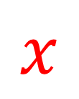
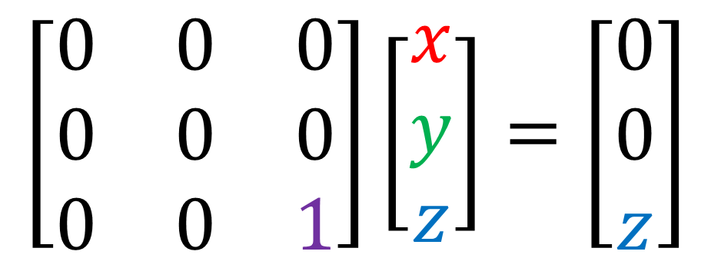


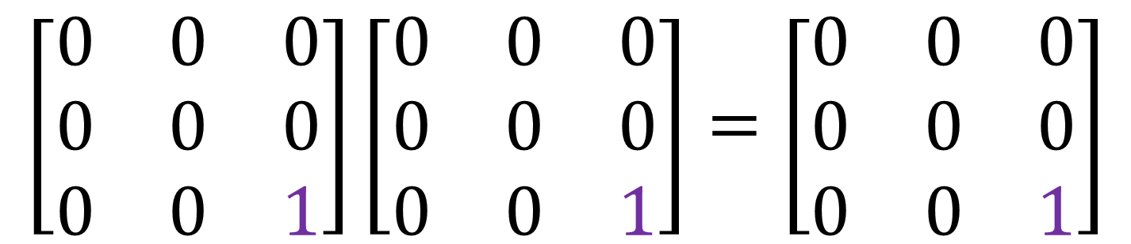


Matrix Projector example
$$\left[\begin{matrix}0 & 0 & 0 \\ 0 & 0 & 0 \\ 0 & 0 & 1\end{matrix}\right]\left[\begin{aligned}x \\ y \\ z\end{aligned}\right]=\left[\begin{aligned}0 \\ 0 \\ z\end{aligned}\right]$$
$$z$$
Project out
$z$-component
$$y$$
$$\left[\begin{matrix}0 & 0 & 0 \\ 0 & 0 & 0 \\ 0 & 0 & 1\end{matrix}\right]\left[\begin{matrix}0 & 0 & 0 \\ 0 & 0 & 0 \\ 0 & 0 & 1\end{matrix}\right]=\left[\begin{matrix}0 & 0 & 0 \\ 0 & 0 & 0 \\ 0 & 0 & 1\end{matrix}\right]$$
$$x$$

Slide 10
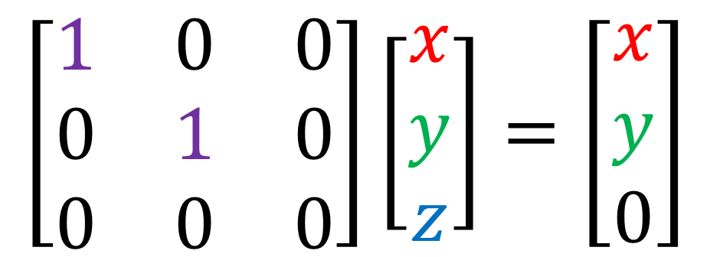
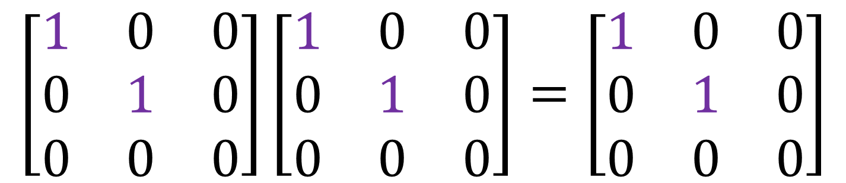
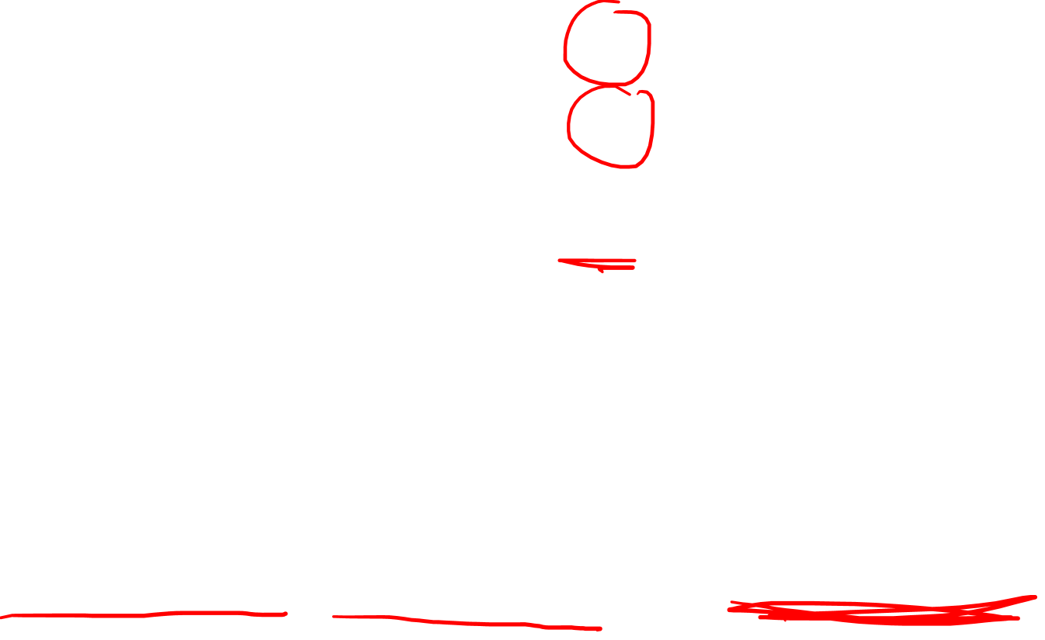
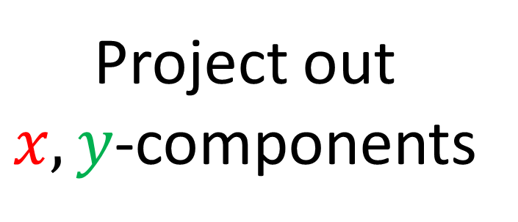
Matrix Projector example
$$\left[\begin{matrix}1 & 0 & 0 \\ 0 & 1 & 0 \\ 0 & 0 & 0\end{matrix}\right]\left[\begin{aligned}x \\ y \\ z\end{aligned}\right]=\left[\begin{aligned}x \\ y \\ 0\end{aligned}\right]$$
Project out
$x,y$-components
$$z$$
$$y$$
$$\left[\begin{matrix}1 & 0 & 0 \\ 0 & 1 & 0 \\ 0 & 0 & 0\end{matrix}\right]\left[\begin{matrix}1 & 0 & 0 \\ 0 & 1 & 0 \\ 0 & 0 & 0\end{matrix}\right]=\left[\begin{matrix}1 & 0 & 0 \\ 0 & 1 & 0 \\ 0 & 0 & 0\end{matrix}\right]$$
$$x$$

Slide 11

$$y$$
$$y$$
$$\vec{v}$$
$$\vec{v}$$
Project onto $x$-axis
$$x$$
$$x$$
$$y$$
$$y$$
Project onto $y$-axis
Conclusion: Projecting in two orthogonal directions results in “zero”.
$$x$$
$$x$$

Slide 12

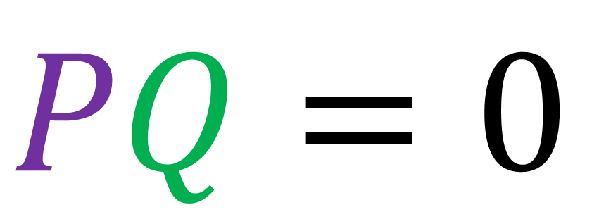
Conclusion: Projecting in two orthogonal
directions results in “zero”.
Projectors $P,Q$ are orthogonal
$$PQ=0$$
if

Slide 13


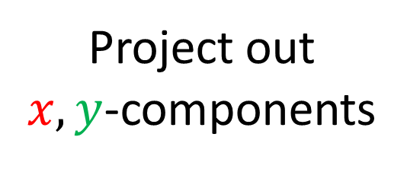
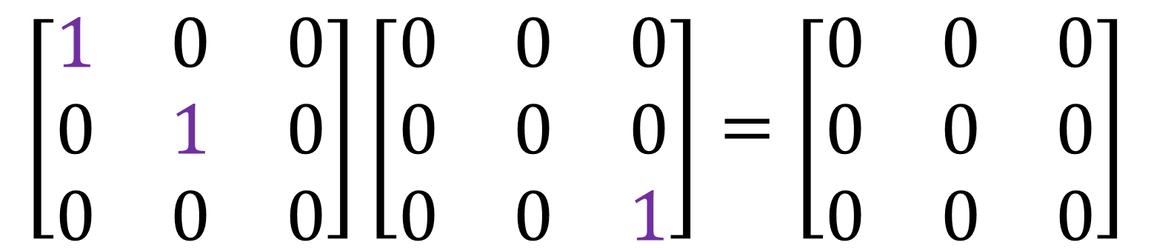
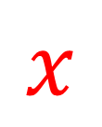
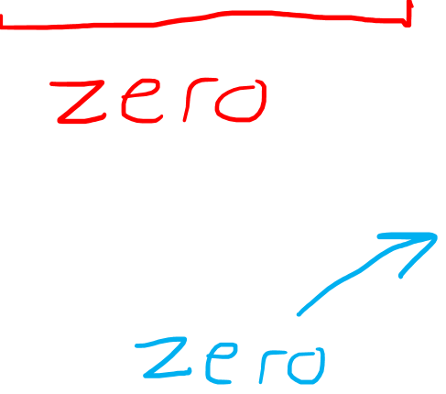
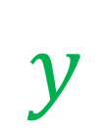
Matrix Projector example
$$\left[\begin{matrix}1 & 0 & 0 \\ 0 & 1 & 0 \\ 0 & 0 & 0\end{matrix}\right]\left[\begin{matrix}0 & 0 & 0 \\ 0 & 0 & 0 \\ 0 & 0 & 1\end{matrix}\right]=\left[\begin{matrix}0 & 0 & 0 \\ 0 & 0 & 0 \\ 0 & 0 & 0\end{matrix}\right]$$
$$z$$
Project out
$x,y$-components
Project out
$z$-component
$$y$$
$$x$$

Slide 14

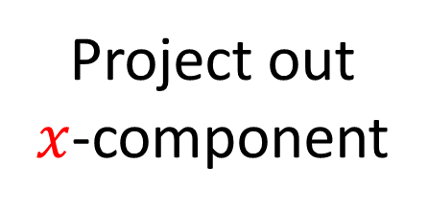
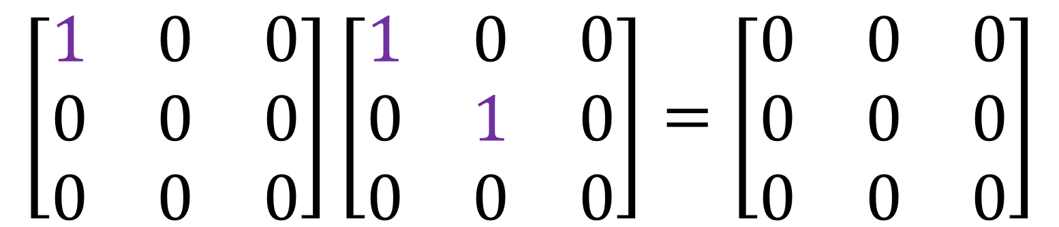
Matrix Projector example
$$\left[\begin{matrix}1 & 0 & 0 \\ 0 & 0 & 0 \\ 0 & 0 & 0\end{matrix}\right]\left[\begin{matrix}1 & 0 & 0 \\ 0 & 1 & 0 \\ 0 & 0 & 0\end{matrix}\right]=\left[\begin{matrix}0 & 0 & 0 \\ 0 & 0 & 0 \\ 0 & 0 & 0\end{matrix}\right]$$
$$z$$
Project out
$x$-component
Project out
$x,y$-components
$$y$$
$$x$$

Slide 15
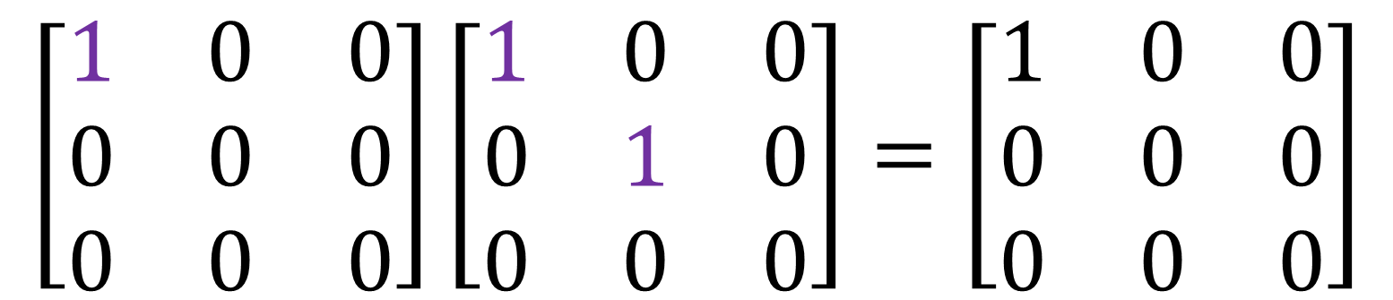
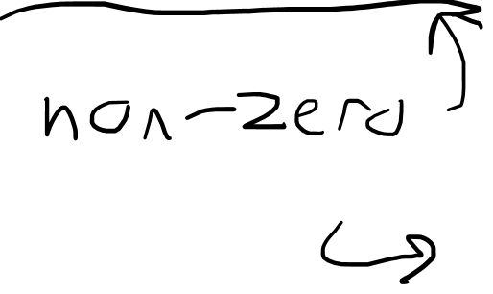
Matrix Projector example
$$\left[\begin{matrix}1 & 0 & 0 \\ 0 & 0 & 0 \\ 0 & 0 & 0\end{matrix}\right]\left[\begin{matrix}1 & 0 & 0 \\ 0 & 1 & 0 \\ 0 & 0 & 0\end{matrix}\right]=\left[\begin{matrix}1 & 0 & 0 \\ 0 & 0 & 0 \\ 0 & 0 & 0\end{matrix}\right]$$
$$z$$
Project out
$x$-component
Project out
$x,y$-components
$$y$$
$$x$$

Slide 16

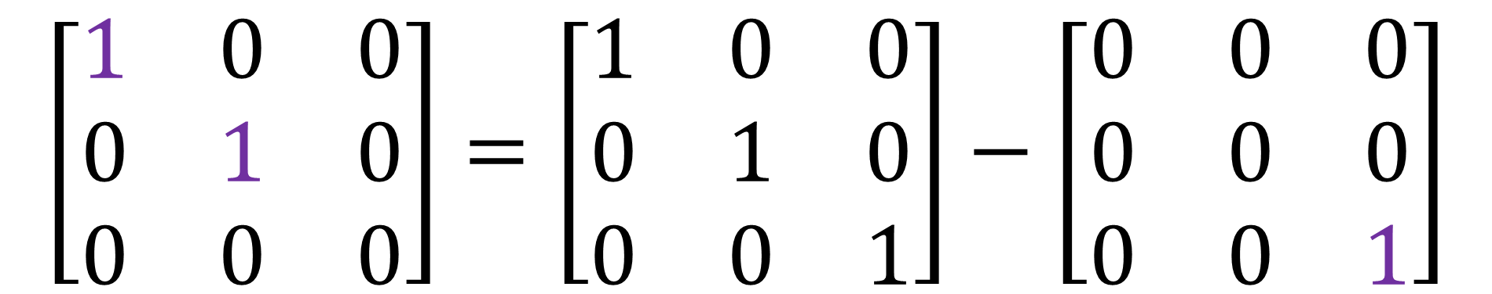


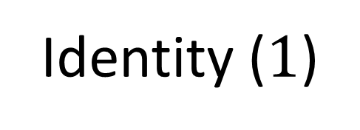
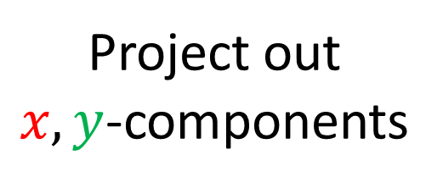
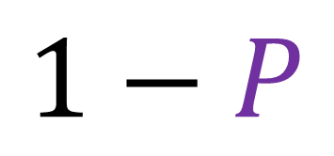
Take projector $P$
Then $\left(1−P\right)$ is also projector
$$1−P$$
$$P$$
$$\left[\begin{matrix}1 & 0 & 0 \\ 0 & 1 & 0 \\ 0 & 0 & 0\end{matrix}\right]=\left[\begin{matrix}1 & 0 & 0 \\ 0 & 1 & 0 \\ 0 & 0 & 1\end{matrix}\right]−\left[\begin{matrix}0 & 0 & 0 \\ 0 & 0 & 0 \\ 0 & 0 & 1\end{matrix}\right]$$
Project out
$x,y$-components
Project out
$z$-component
Identity ($1$)

Slide 17
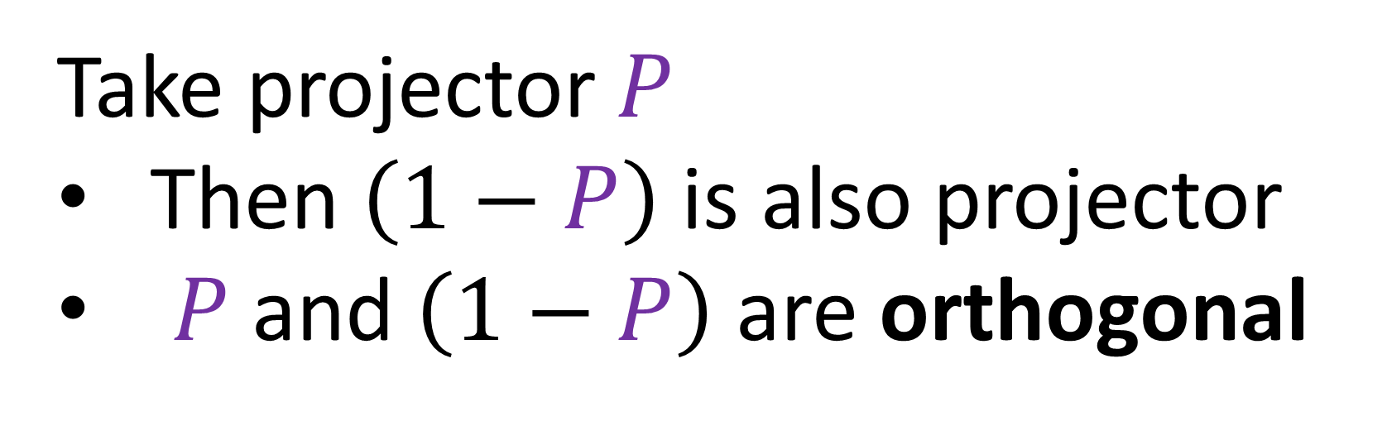
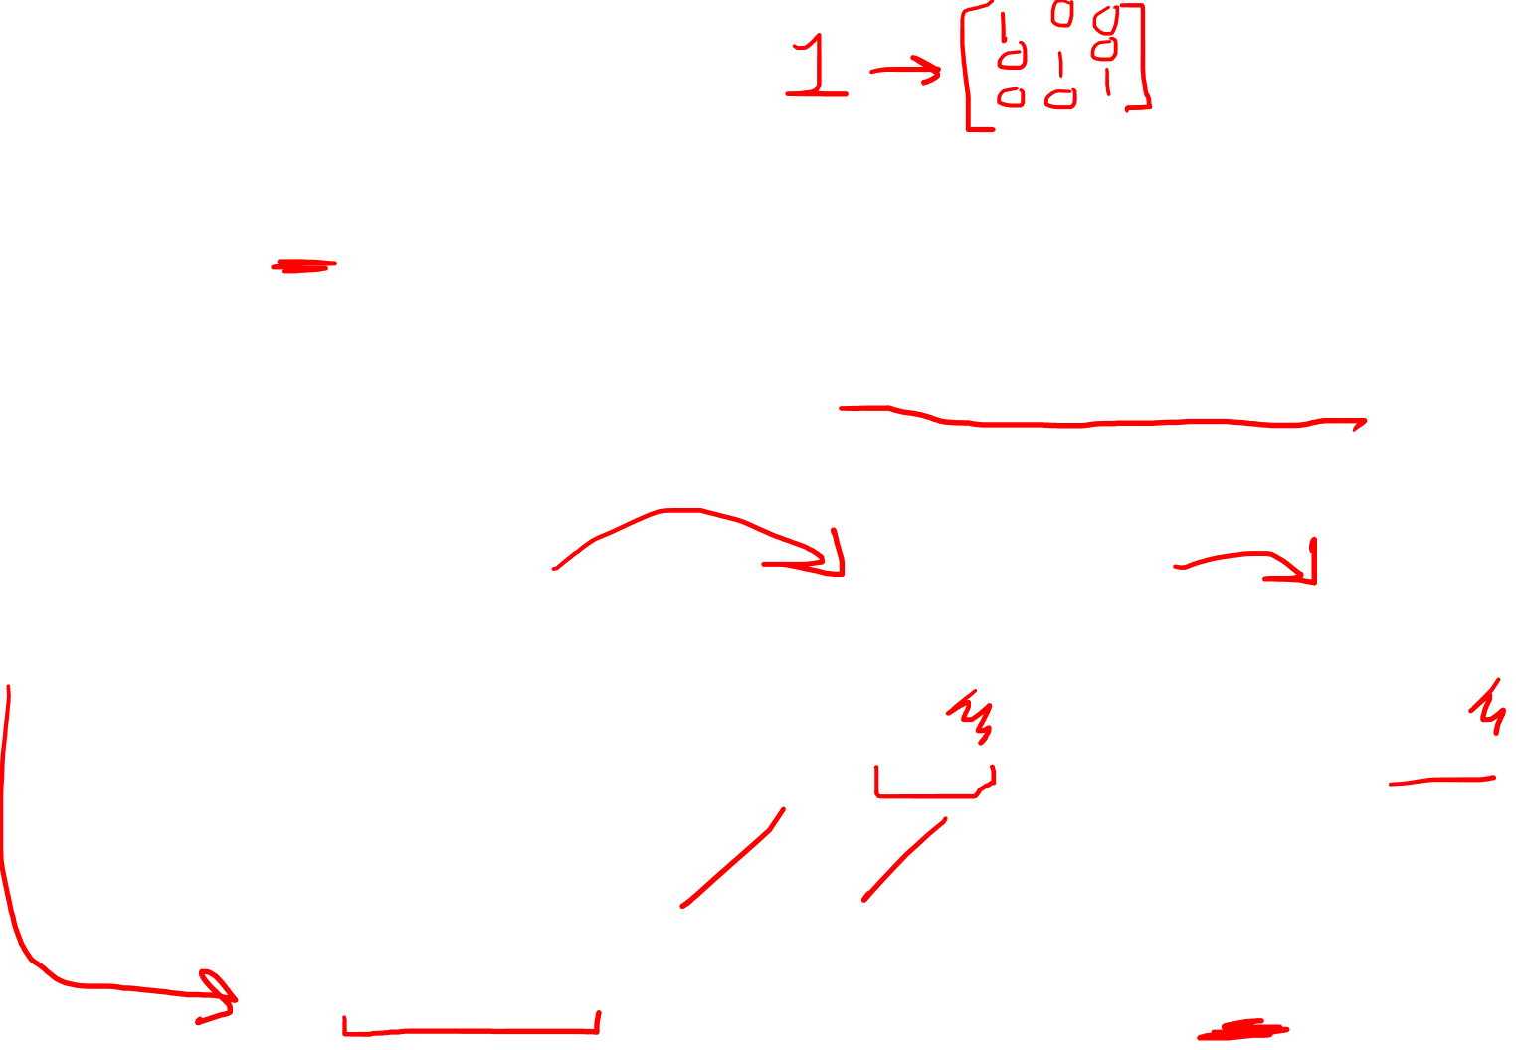
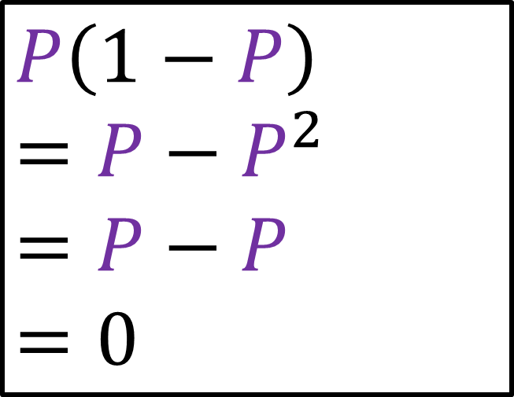
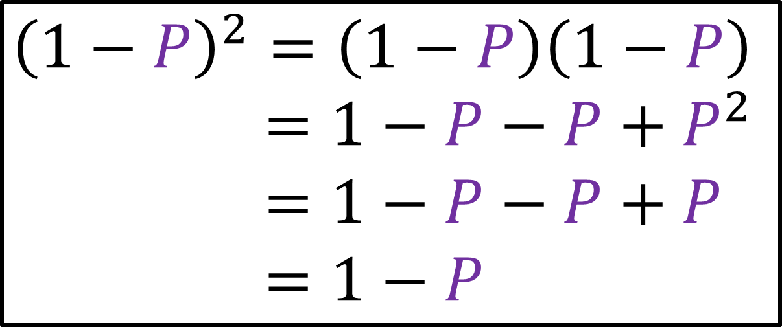
Take projector $P$
Then $\left(1−P\right)$ is also projector
$P$and $\left(1−P\right)$ are orthogonal
Projector proof:
Orthogonal proof:
$${\left(1−P\right)}^{2}=\left(1−P\right)\left(1−P\right)$$
$${\left(1−p\right)}^{2}=1−P−P+P^{2}$$
$${\left(1−p\right)}^{2}=1−P−P+P$$
$${\left(1−p\right)}^{2}=1−P$$
$$P\left(1−P\right)$$
$$=P−P^{2}$$
$$=P−P$$
$$=0$$

Slide 18

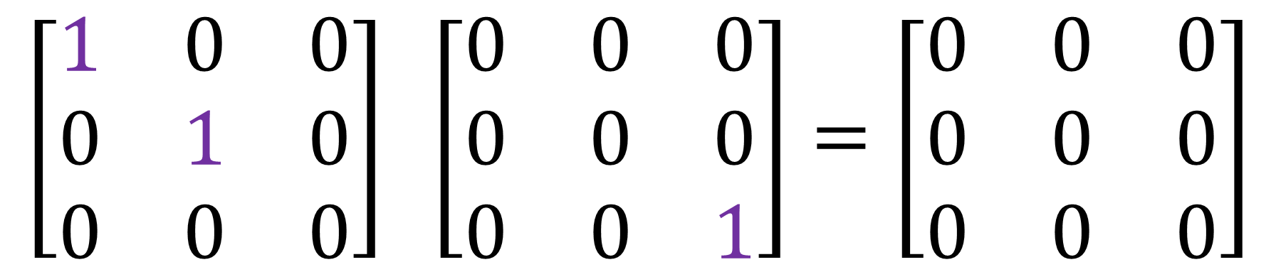


Take projector $P$
Then $\left(1−P\right)$ is also projector
$P$and $\left(1−P\right)$ are orthogonal
$$\left[\begin{matrix}1 & 0 & 0 \\ 0 & 1 & 0 \\ 0 & 0 & 0\end{matrix}\right] \left[\begin{matrix}0 & 0 & 0 \\ 0 & 0 & 0 \\ 0 & 0 & 1\end{matrix}\right]=\left[\begin{matrix}0 & 0 & 0 \\ 0 & 0 & 0 \\ 0 & 0 & 0\end{matrix}\right]$$
Project out
$x,y$-components
Project out
$z$-components

Slide 19
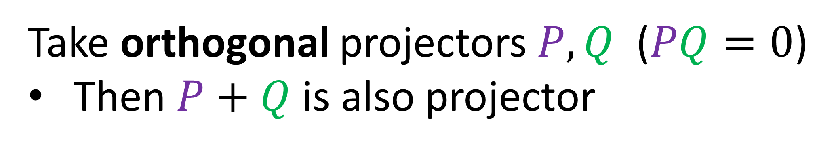
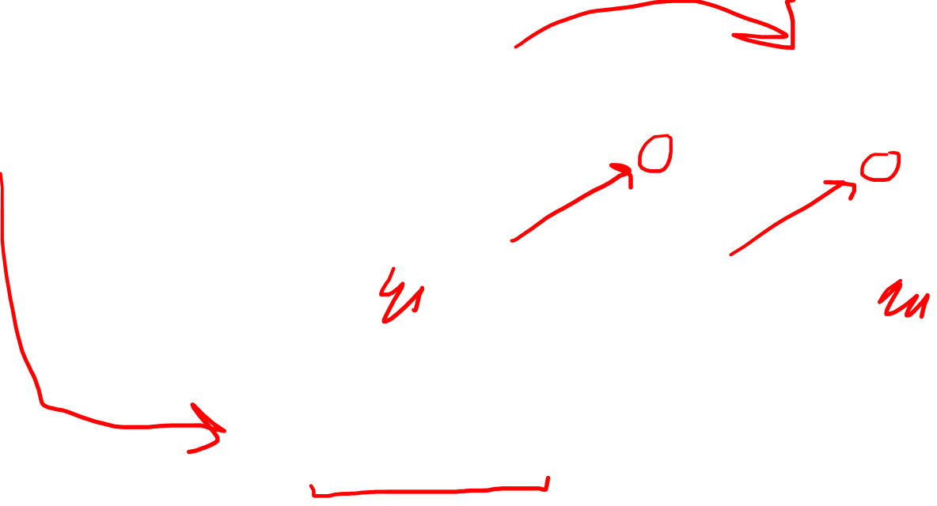
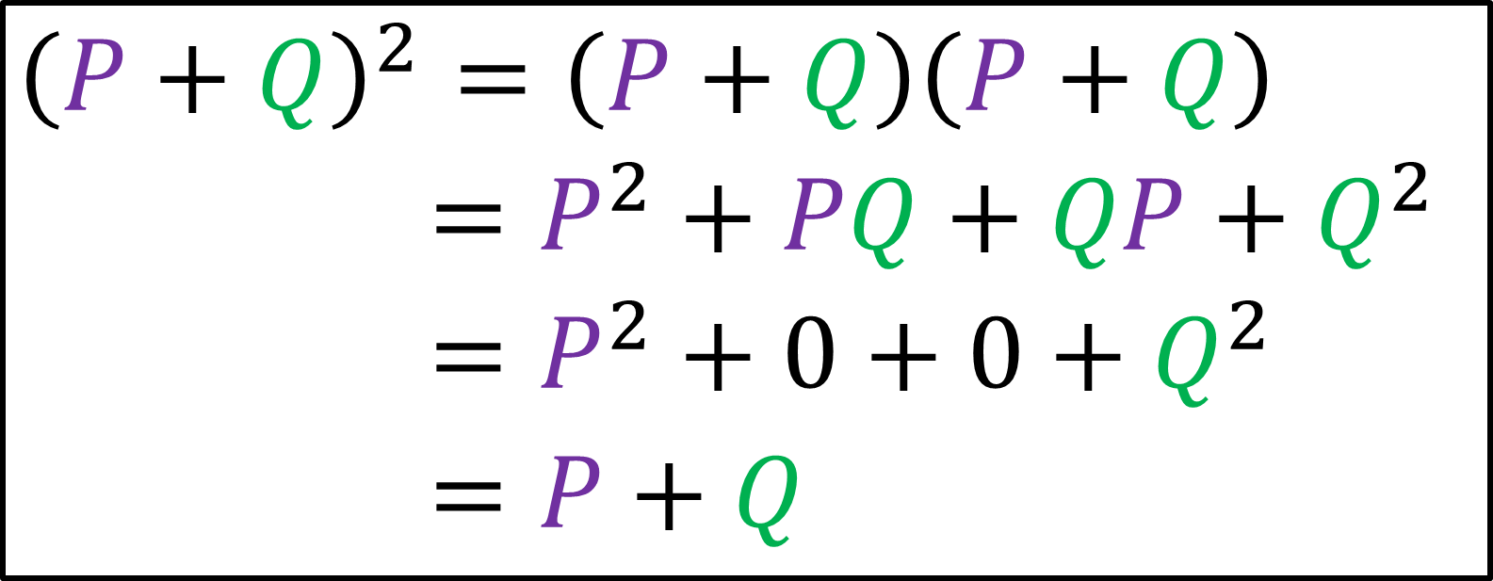
Take orthogonal projectors $P,Q$ ($PQ=0$)
Then $P+Q$ is also projector
Projector proof:
$${\left(P+Q\right)}^{2}=\left(P+Q\right)\left(P+Q\right)$$
$${\left(1−p\right)}^{2}=P^{2}+PQ+QP+Q^{2}$$
$${\left(1−p\right)}^{2}=P^{2}+0+0+Q^{2}$$
$${\left(1−p\right)}^{2}=P+Q$$

Slide 20


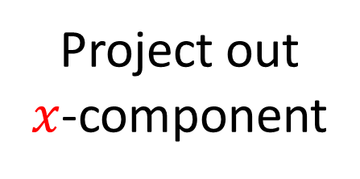
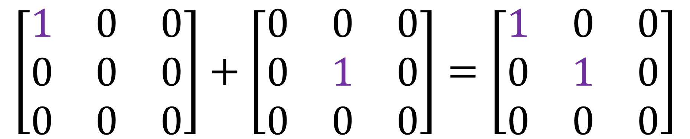
Take orthogonal projectors $P,Q$ ($PQ=0$)
Then $P+Q$ is also projector
orthogonal
$$\left[\begin{matrix}1 & 0 & 0 \\ 0 & 0 & 0 \\ 0 & 0 & 0\end{matrix}\right]+\left[\begin{matrix}0 & 0 & 0 \\ 0 & 1 & 0 \\ 0 & 0 & 0\end{matrix}\right]=\left[\begin{matrix}1 & 0 & 0 \\ 0 & 1 & 0 \\ 0 & 0 & 0\end{matrix}\right]$$
Project out
$x$-component
Project out
$y$-component
Project out
$x,y$-components

Slide 21
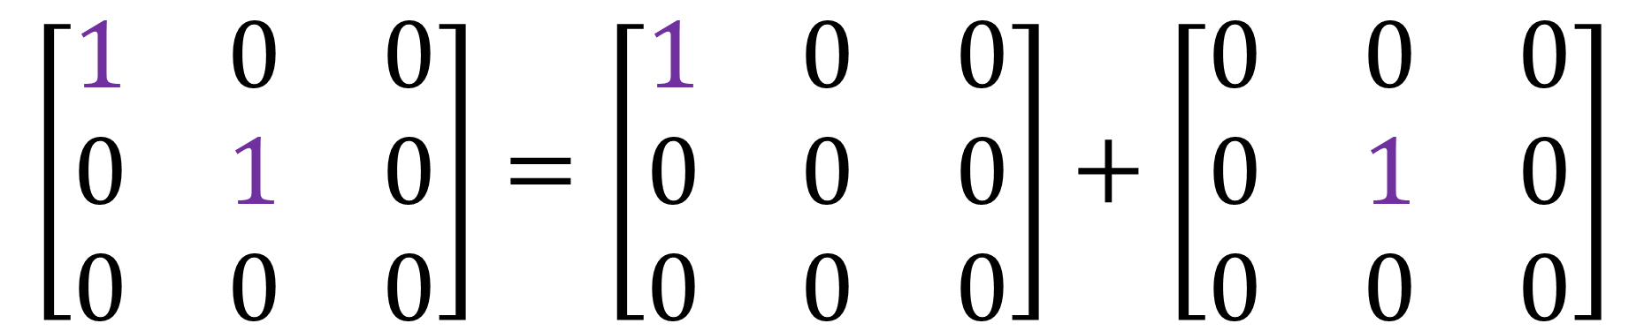
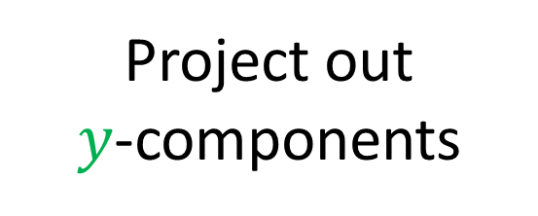
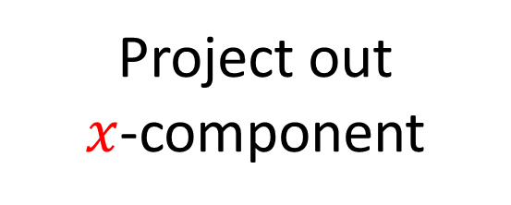

A projector is minimal if it cannot be written as the sum of other projectors.
Project out
$x,y$-components
Project out
$x$-component
Project out
$y$-components
$$\left[\begin{matrix}1 & 0 & 0 \\ 0 & 1 & 0 \\ 0 & 0 & 0\end{matrix}\right]=\left[\begin{matrix}1 & 0 & 0 \\ 0 & 0 & 0 \\ 0 & 0 & 0\end{matrix}\right]+\left[\begin{matrix}0 & 0 & 0 \\ 0 & 1 & 0 \\ 0 & 0 & 0\end{matrix}\right]$$
NOT minimal
minimal
minimal

Slide 22
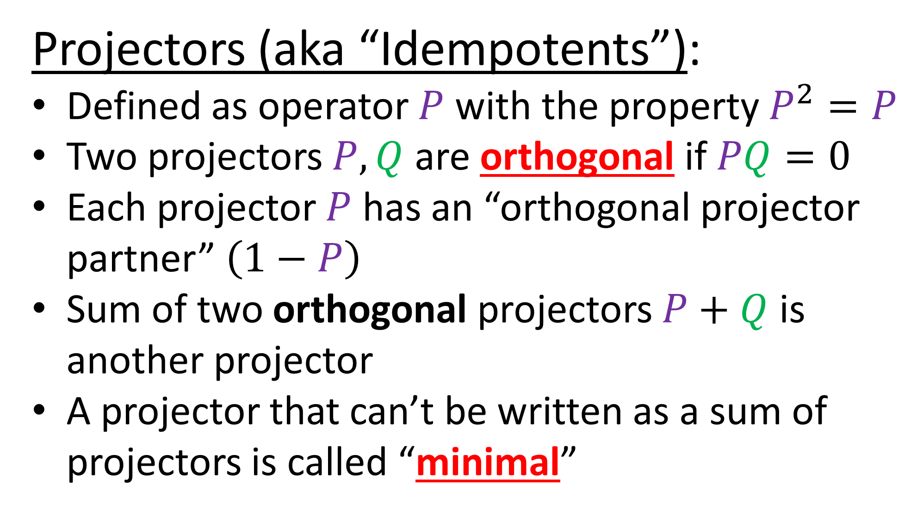

https://en.wikipedia.org/wiki/Idempotent_matrix
Projectors (aka “Idempotents”):
Defined as operator $P$ with the property $P^{2}=P$
Two projectors $P,Q$ are orthogonal if $PQ=0$
Each projector $P$ has an “orthogonal projector partner” $\left(1−P\right)$
Sum of two orthogonal projectors $P+Q$ is another projector
A projector that can’t be written as a sum of projectors is called “minimal”

Slide 23
Start with Projects for vectors
(common sense)
Use the same idea for Clifford Algebras
(more abstract)

Slide 24
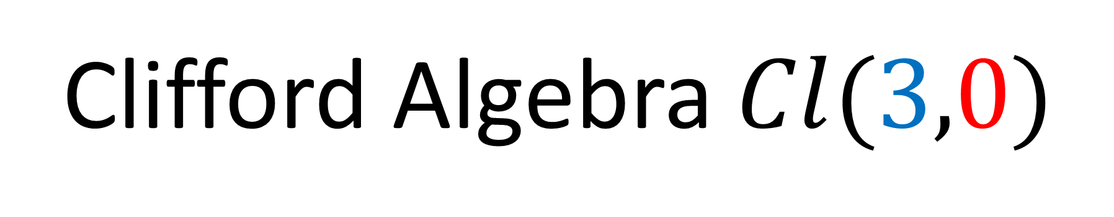
Clifford Algebra $Cl(3,0)$
3 symbols that square to $+1$
0 symbols that squares to $−1$
(unit length)
(anti-commute)
$$σ_{z}$$
$$σ_{y}σ_{z}=−σ_{z}σ_{y}$$
$$σ_{z}σ_{x}=−σ_{x}σ_{z}$$
$$σ_{x}σ_{y}=−σ_{y}σ_{x}$$
$${\left(σ_{x}\right)}^{2}=+1$$
$${\left(σ_{y}\right)}^{2}=+1$$
$${\left(σ_{z}\right)}^{2}=+1$$
$$σ_{y}$$
$$σ_{x}$$

Slide 25

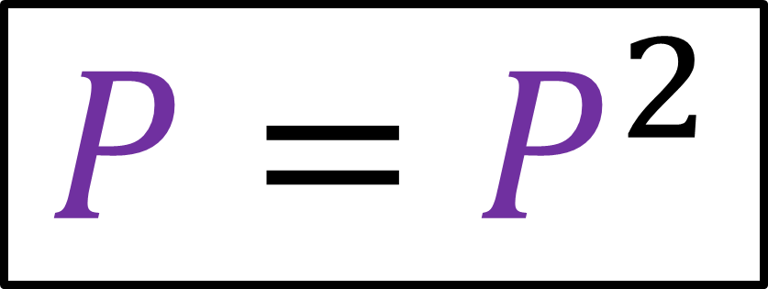
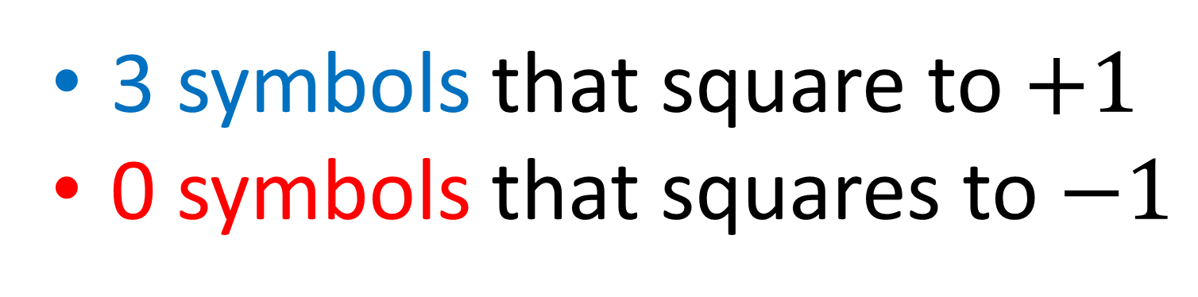
Clifford Algebra $Cl(3,0)$
3 symbols that square to $+1$
0 symbols that squares to $−1$
Projector $P∈Cl(3,0)$
$$P=P^{2}$$

Slide 26
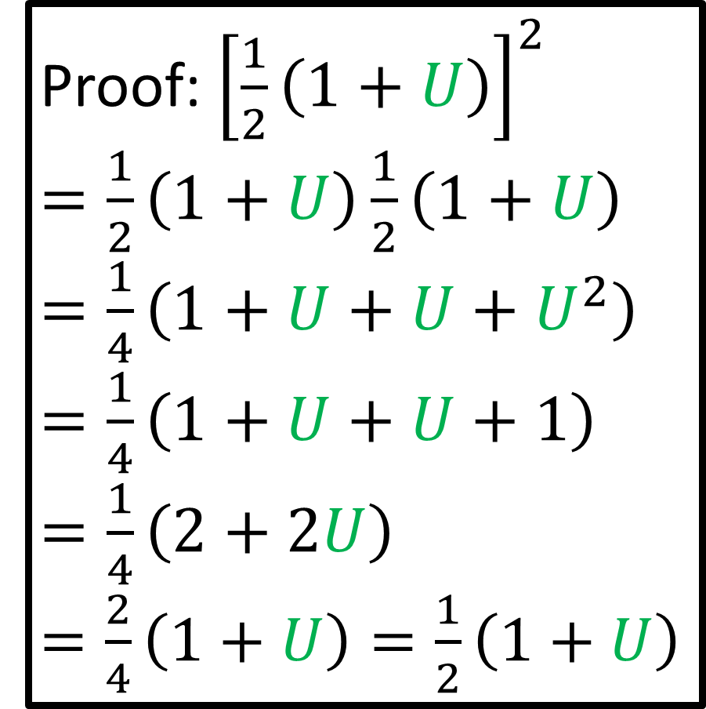
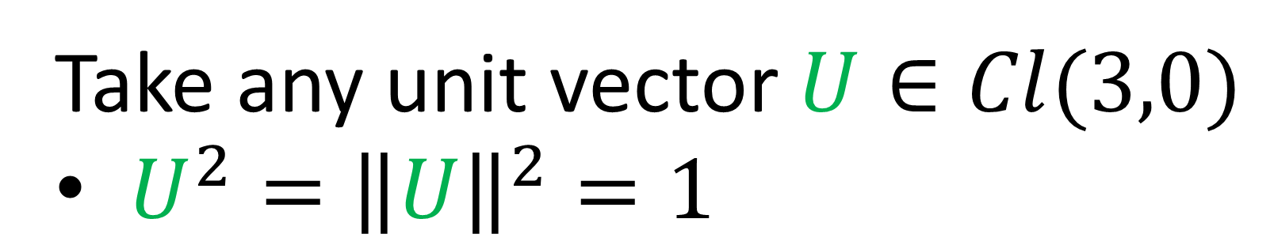
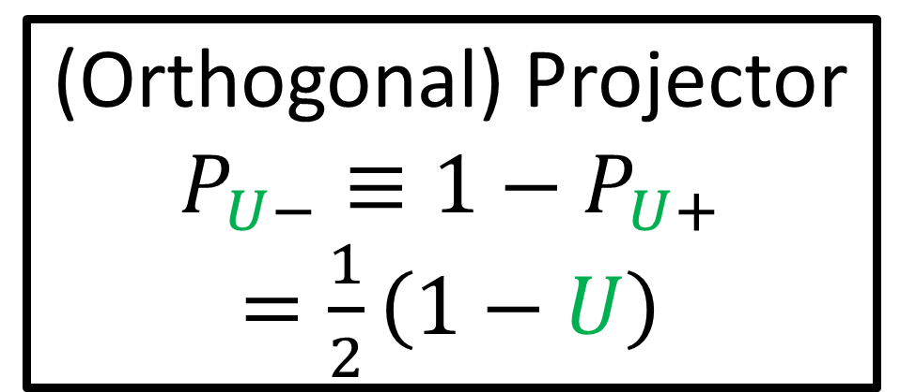
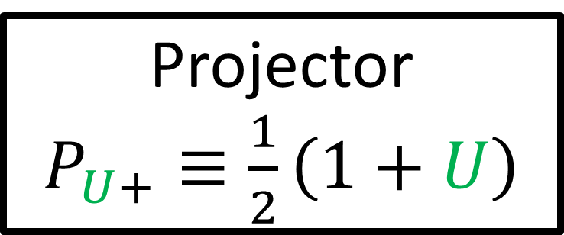
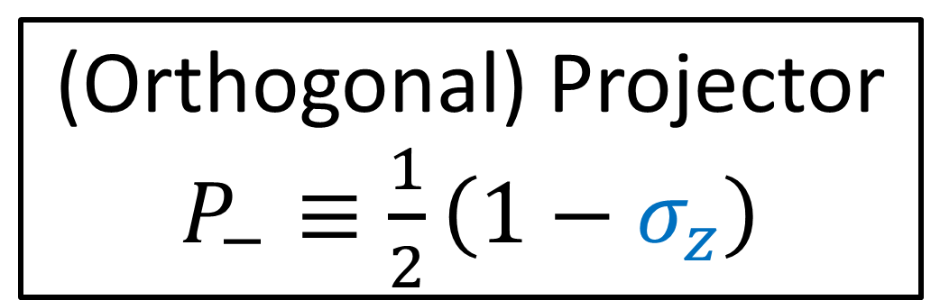
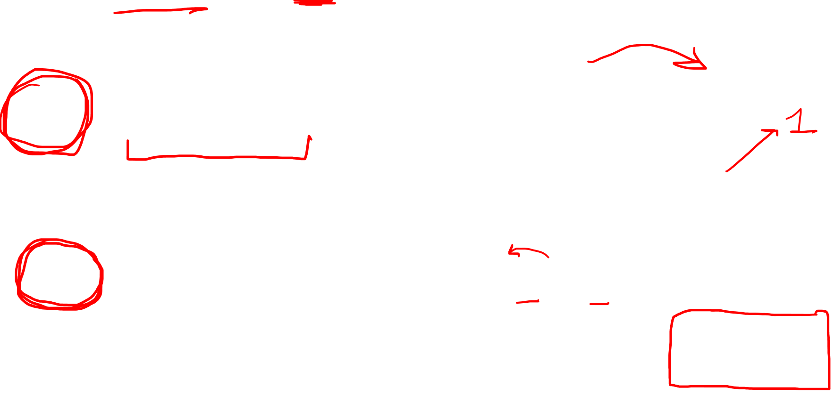
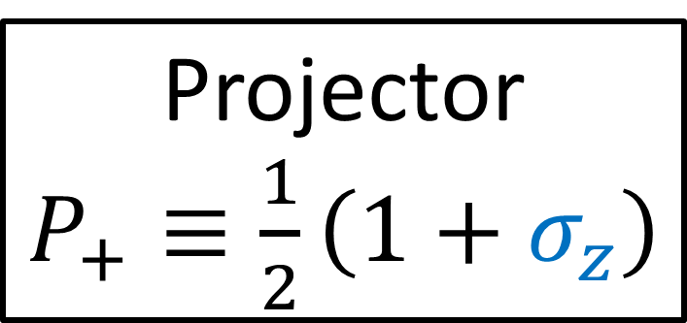
Projector
$P_{+}≡\frac{1}{2}\left(1+σ_{z}\right)$
(Orthogonal) Projector
$P_{−}≡\frac{1}{2}\left(1−σ_{z}\right)$
Take any unit vector $U∈Cl(3,0)$
$U^{2}={\left\|U\right\|}^{2}=1$
Proof: ${\left[\frac{1}{2}\left(1+U\right)\right]}^{2}$
$=\frac{1}{2}\left(1+U\right)\frac{1}{2}\left(1+U\right)$
$=\frac{1}{4}\left(1+U+U+U^{2}\right)$
$=\frac{1}{4}\left(1+U+U+1\right)$
$=\frac{1}{4}\left(2+2U\right)$
$=\frac{2}{4}\left(1+U\right)=\frac{1}{2}\left(1+U\right)$
Projector
$P_{U+}≡\frac{1}{2}\left(1+U\right)$
(Orthogonal) Projector
$$P_{U−}≡1−P_{U+}$$
$=\frac{1}{2}\left(1−U\right)$

Slide 27

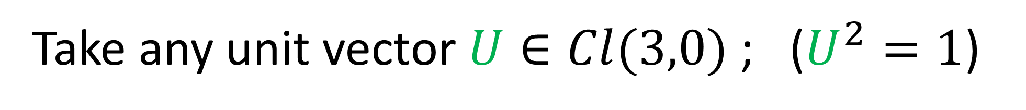
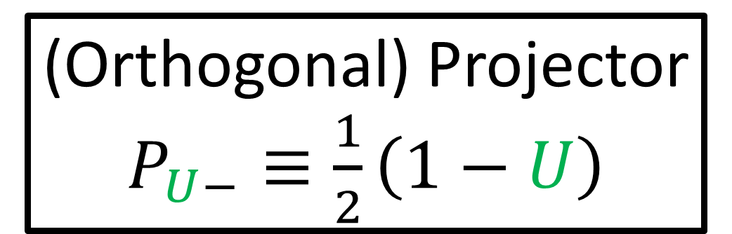
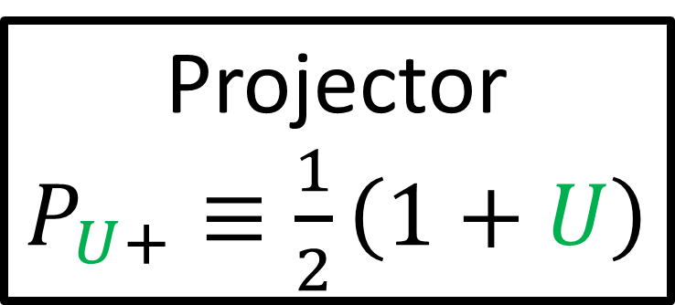
Take any unit vector $U∈Cl(3,0)$; ($U^{2}=1$)
As an example in $Cl(3,0)$, take $σ_{z}$, since ${\left(σ_{z}\right)}^{2} =+1$
Projector
$P_{U+}≡\frac{1}{2}\left(1+U\right)$
(Orthogonal) Projector
$P_{U−}≡\frac{1}{2}\left(1−U\right)$

Slide 28
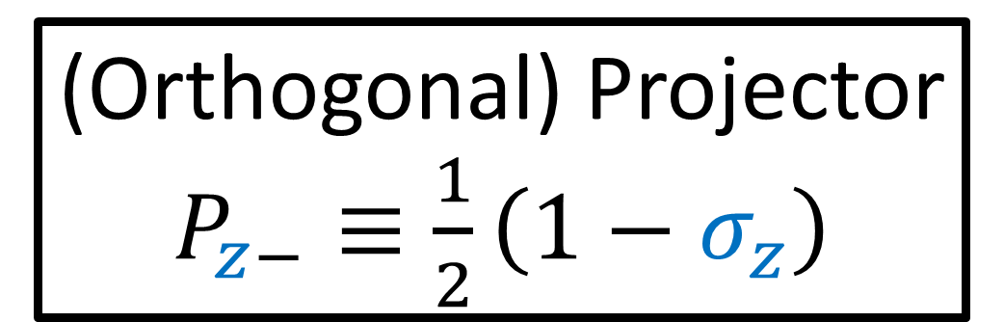
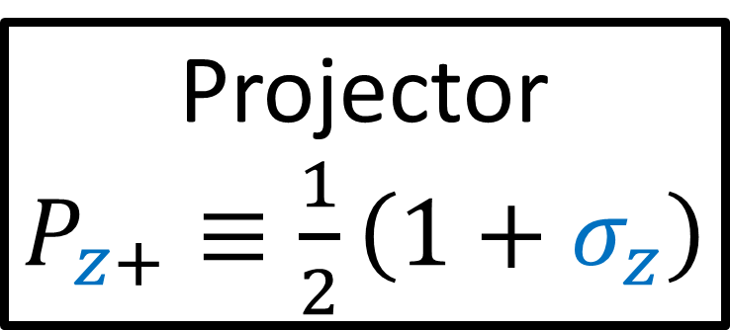


Take any unit vector $U∈Cl(3,0)$; ($U^{2}=1$)
As an example in $Cl(3,0)$, take $σ_{z}$, since ${\left(σ_{z}\right)}^{2} =+1$
Projector
$P_{z+}≡\frac{1}{2}\left(1+σ_{z}\right)$
(Orthogonal) Projector
$P_{z−}≡\frac{1}{2}\left(1−σ_{z}\right)$
$P_{z+}=\frac{1}{2}\left(\left[\begin{matrix}1 & 0 \\ 0 & 1\end{matrix}\right]+\left[\begin{matrix}1 & 0 \\ 0 & −1\end{matrix}\right]\right)=\left[\begin{matrix}1 & 0 \\ 0 & 0\end{matrix}\right]$
$P_{z−}=\frac{1}{2}\left(\left[\begin{matrix}1 & 0 \\ 0 & 1\end{matrix}\right]−\left[\begin{matrix}1 & 0 \\ 0 & −1\end{matrix}\right]\right)=\left[\begin{matrix}0 & 0 \\ 0 & 1\end{matrix}\right]$

Slide 29





Projector
$P_{z+}≡\frac{1}{2}\left(1+σ_{z}\right)$
$→\left[\begin{matrix}1 & 0 \\ 0 & 0\end{matrix}\right]$
(Orthogonal) Projector
$P_{z−}≡\frac{1}{2}\left(1−σ_{z}\right)$
$$→\left[\begin{matrix}0 & 0 \\ 0 & 1\end{matrix}\right]$$
$=\left[\begin{matrix}α & β \\ γ & δ\end{matrix}\right] P_{z+}$
$=\left[\begin{matrix}α & β \\ γ & δ\end{matrix}\right]\left[\begin{matrix}1 & 0 \\ 0 & 0\end{matrix}\right]$
$= \left[\begin{matrix}α & 0 \\ γ & 0\end{matrix}\right]$
$=\left[\begin{matrix}α & β \\ γ & δ\end{matrix}\right] P_{z−}$
$=\left[\begin{matrix}α & β \\ γ & δ\end{matrix}\right]\left[\begin{matrix}0 & 0 \\ 0 & 1\end{matrix}\right]$
$= \left[\begin{matrix}0 & β \\ 0 & δ\end{matrix}\right]$

Slide 30






Projector
$P_{z+}≡\frac{1}{2}\left(1+σ_{z}\right)$
$→\left[\begin{matrix}1 & 0 \\ 0 & 0\end{matrix}\right]$
(Orthogonal) Projector
$P_{z−}≡\frac{1}{2}\left(1−σ_{z}\right)$
$$→\left[\begin{matrix}0 & 0 \\ 0 & 1\end{matrix}\right]$$
$\left[\begin{matrix}α & β \\ γ & δ\end{matrix}\right]P_{z+}$ $=\left[\begin{matrix}α & 0 \\ γ & 0\end{matrix}\right]$
$\left[\begin{matrix}α & β \\ γ & δ\end{matrix}\right]P_{z−}$ $=\left[\begin{matrix}0 & β \\ 0 & δ\end{matrix}\right]$
$$\left[\begin{matrix}α & 0 \\ γ & 0\end{matrix}\right]+\left[\begin{matrix}0 & β \\ 0 & δ\end{matrix}\right]=\left[\begin{matrix}α & β \\ γ & δ\end{matrix}\right]$$
$$P_{z+}+P_{z−}=1$$
$$MP_{z+}+MP_{z−}=$$
$$M\left(P_{z+}+P_{z−}\right)=M(1)$$

Slide 31



Any multi-vector $M∈Cl(3,0)$
$$M=a1 + bσ_{x} + cσ_{y} + dσ_{z}$$
$+eσ_{y}σ_{z}+fσ_{z}σ_{x}+gσ_{x}σ_{y}+hσ_{x}σ_{y}σ_{z}$

Slide 32






Any multi-vector $M∈Cl(3,0)$
$$M=a+bσ_{x}+cσ_{y}+dσ_{z}+eσ_{y}σ_{z}+fσ_{z}σ_{x}+gσ_{x}σ_{y}+hσ_{x}σ_{y}σ_{z}$$
Projector
$P_{z+}≡\frac{1}{2}\left(1+σ_{z}\right)$
(Orthogonal) Projector
$P_{z−}≡\frac{1}{2}\left(1−σ_{z}\right)$
$$M_{z+}≡MP_{z+}$$
$$M_{z−}≡MP_{z−}$$
$$M_{z+}+M_{z−}=MP_{z+}+MP_{z−}$$
$=M\left(P_{z+}+P_{z−}\right)=M\left(1\right)=M$

Slide 33
Projectors
Ideals
(also called “idempotents”)
(also: rings and algebras)

Slide 34








Ring = set where $+ − ×$ are defined
don’t need $÷$ to be defined
e.g. the integers, $ℤ$
e.g. set of $n×n$ matrices
$$\left[\begin{matrix}1 & 0 \\ 2 & 1\end{matrix}\right]+\left[\begin{matrix}1 & 1 \\ 0 & 0\end{matrix}\right]=\left[\begin{matrix}2 & 1 \\ 2 & 1\end{matrix}\right]$$
$$\left[\begin{matrix}1 & 0 \\ 2 & 1\end{matrix}\right]−\left[\begin{matrix}1 & 1 \\ 0 & 0\end{matrix}\right]=\left[\begin{matrix}0 & −1 \\ 2 & 1\end{matrix}\right]$$
$$\left[\begin{matrix}1 & 0 \\ 2 & 1\end{matrix}\right]×\left[\begin{matrix}1 & 1 \\ 0 & 0\end{matrix}\right]=\left[\begin{matrix}1 & 1 \\ 2 & 2\end{matrix}\right]$$
$$2 + 3=5$$
$$10− 7=3$$
$$4 × 5=20$$
$6 ÷ 4=1.5$
$$\left[\begin{matrix}1 & 0 \\ 2 & 1\end{matrix}\right]÷\left[\begin{matrix}1 & 1 \\ 0 & 0\end{matrix}\right]=\left[\begin{matrix}1 & 0 \\ 2 & 1\end{matrix}\right]{\left[\begin{matrix}1 & 1 \\ 0 & 0\end{matrix}\right]}^{−1}$$
not integer
not invertible

Slide 35



Algebra = vector space where $+ − ×$ are defined
don’t need $÷$ to be defined
both $+$and $−$ come for free in a vector space
Grassmann Algebra
(Exterior algebra)
Clifford Algebra
(Geometric algebra)
$$\vec{u}∧\vec{v}=−\vec{v}∧\vec{u}$$
$$\vec{u}\vec{v}=\vec{u}⋅\vec{v}+\vec{u}∧\vec{v}$$
Wedge product of vectors
Clifford product of vectors

Slide 36





Ideal = a subset of a ring/algebra that’s sort of like a “black hole”…
$$P$$
$$N$$
Ideal
$$Q$$
$$M$$

Slide 37





The integers $ℤ$
$$⋯−6,−5,−4,−3,−2,−1, 0 ,+1,+2,+3,+4,+5,+6⋯$$
the multiples of 3…
Adding multiples of 3…
Multiplying by multiple of 3…
$$3+9=12$$
$$7×3=21$$
$$18+(−3)=15$$
$$\left(−5\right)×3=−15$$
… gives multiples of 3.
… gives multiples of 3.

Slide 38
















Multiples of 3: subset of integers that’s like a “black hole”…
Sum of any two set members stays in the set
Product of 1 ideal member and any other element gets sent to the ideal
$$+13$$
$$+10$$
$$+1$$
$$−4$$
$$−1$$
$$−2$$
$$−6$$
$$0$$
$$−18$$
$$−8$$
$$−12$$
$$+3$$
$$−3$$
$$+5$$
$$+9$$

Slide 39





Ideal $I$: subset of ring/algebra that’s like a “black hole”…
Sum of any two set members stays in the set
Product of 1 ideal member and any other element gets sent to the ideal
“The multiples of 3” form an ideal inside $ℤ$.
Sum of two multiples of 3 gives another multiple of 3:
$3n+3m=3(n+m)$
A multiple of 3 times any integer gives another multiple of 3:
$3n×r=3(nr)$

Slide 40





$2×2$ matrices with only the 1st column is non-zero
$⇒$ forms an ideal inside the ring of $2×2$ matrices.
$$\left[\begin{matrix}m & 0 \\ n & 0\end{matrix}\right]$$
Sum of two of these 1st-column-nonzero matrices gives another:
$$\left[\begin{matrix}m & 0 \\ n & 0\end{matrix}\right]+\left[\begin{matrix}r & 0 \\ s & 0\end{matrix}\right]=\left[\begin{matrix}m+r & 0 \\ n+s & 0\end{matrix}\right]$$
Product of a 1st-column-nonzero matrix with any matrix (from left):
$$\left[\begin{matrix}a & b \\ c & d\end{matrix}\right]\left[\begin{matrix}m & 0 \\ n & 0\end{matrix}\right]=\left[\begin{matrix}am+bn & 0 \\ cm+dn & 0\end{matrix}\right]$$

Slide 41



Multiply from LEFT
LEFT Ideal
Member
$$\left[\begin{matrix}a & b \\ c & d\end{matrix}\right]\left[\begin{matrix}m & 0 \\ n & 0\end{matrix}\right]=\left[\begin{matrix}am+bn & 0 \\ cm+dn & 0\end{matrix}\right]$$
Multiply from RIGHT
NOT Ideal Member
$$\left[\begin{matrix}m & 0 \\ n & 0\end{matrix}\right]\left[\begin{matrix}a & b \\ c & d\end{matrix}\right]=\left[\begin{matrix}am & bm \\ an & bn\end{matrix}\right]$$

Slide 42




Multiply from LEFT
NOT Ideal Member
$$\left[\begin{matrix}a & b \\ c & d\end{matrix}\right]\left[\begin{matrix}m & n \\ 0 & 0\end{matrix}\right]=\left[\begin{matrix}am & an \\ cm & cn\end{matrix}\right]$$
Multiply from RIGHT
RIGHT Ideal
Member
$$\left[\begin{matrix}m & n \\ 0 & 0\end{matrix}\right]\left[\begin{matrix}a & b \\ c & d\end{matrix}\right]=$$
$$\left[\begin{matrix}am+cn & bm+dn \\ 0 & 0\end{matrix}\right]$$

Slide 43

Multiply from LEFT
NOT Ideal Member
$$\left[\begin{matrix}a & b \\ c & d\end{matrix}\right]\left[\begin{matrix}m & n \\ 0 & 0\end{matrix}\right]=\left[\begin{matrix}am & an \\ cm & cn\end{matrix}\right]$$
Multiply from RIGHT
RIGHT Ideal
Member
$$\left[\begin{matrix}m & n \\ 0 & 0\end{matrix}\right]\left[\begin{matrix}a & b \\ c & d\end{matrix}\right]=$$
$$\left[\begin{matrix}am+cn & bm+dn \\ 0 & 0\end{matrix}\right]$$

Slide 44












Left ideals (matrices with some number of columns non-zero)
Right ideals (matrices with some number of rows non-zero)
$$\left[\begin{matrix}a & 0 \\ b & 0\end{matrix}\right]$$
$$\left[\begin{matrix}0 & a \\ 0 & b\end{matrix}\right]$$
$$\left[\begin{matrix}a & b \\ 0 & 0\end{matrix}\right]$$
$$\left[\begin{matrix}0 & 0 \\ a & b\end{matrix}\right]$$
$$\left[\begin{matrix}\begin{aligned}a \\ b \\ c\end{aligned} & \begin{aligned}0 \\ 0 \\ 0\end{aligned} & \begin{aligned}0 \\ 0 \\ 0\end{aligned}\end{matrix}\right]$$
$$\left[\begin{matrix}\begin{aligned}0 \\ 0 \\ 0\end{aligned} & \begin{aligned}a \\ b \\ c\end{aligned} & \begin{aligned}d \\ e \\ f\end{aligned}\end{matrix}\right]$$
$$\left[\begin{aligned}\begin{matrix}a & b & c\end{matrix} \\ \begin{matrix}0 & 0 & 0\end{matrix} \\ \begin{matrix}0 & 0 & 0\end{matrix}\end{aligned}\right]$$
$$\left[\begin{aligned}\begin{matrix}a & b & c\end{matrix} \\ \begin{matrix}0 & 0 & 0\end{matrix} \\ \begin{matrix}d & e & f\end{matrix}\end{aligned}\right]$$
$$\left[\begin{matrix}\begin{matrix}\begin{aligned}0 \\ 0 \\ 0 \\ 0\end{aligned} & \begin{aligned}a \\ b \\ c \\ d\end{aligned}\end{matrix} & \begin{matrix}\begin{aligned}0 \\ 0 \\ 0 \\ 0\end{aligned} & \begin{aligned}0 \\ 0 \\ 0 \\ 0\end{aligned}\end{matrix}\end{matrix}\right]$$
$$\left[\begin{matrix}\begin{matrix}\begin{aligned}0 \\ 0 \\ 0 \\ 0\end{aligned} & \begin{aligned}a \\ b \\ c \\ d\end{aligned}\end{matrix} & \begin{matrix}\begin{aligned}0 \\ 0 \\ 0 \\ 0\end{aligned} & \begin{aligned}e \\ f \\ g \\ h\end{aligned}\end{matrix}\end{matrix}\right]$$
$$\left[\begin{aligned}\begin{matrix}\begin{matrix}a & b\end{matrix} & \begin{matrix}c & d\end{matrix}\end{matrix} \\ \begin{matrix}\begin{matrix}e & f\end{matrix} & \begin{matrix}g & f\end{matrix}\end{matrix} \\ \begin{matrix}\begin{matrix}0 & 0\end{matrix} & \begin{matrix}0 & 0\end{matrix}\end{matrix} \\ \begin{matrix}\begin{matrix}0 & 0\end{matrix} & \begin{matrix}0 & 0\end{matrix}\end{matrix}\end{aligned}\right]$$
$$\left[\begin{aligned}\begin{matrix}\begin{matrix}0 & 0\end{matrix} & \begin{matrix}0 & 0\end{matrix}\end{matrix} \\ \begin{matrix}\begin{matrix}0 & 0\end{matrix} & \begin{matrix}0 & 0\end{matrix}\end{matrix} \\ \begin{matrix}\begin{matrix}a & b\end{matrix} & \begin{matrix}c & d\end{matrix}\end{matrix} \\ \begin{matrix}\begin{matrix}0 & 0\end{matrix} & \begin{matrix}0 & 0\end{matrix}\end{matrix}\end{aligned}\right]$$

Slide 45
Ideal: subset of ring/algebra that’s like a “black hole”…
Sum of any two set members stays in the set
Product of 1 ideal member and any other element gets sent to the ideal
A Useful Metaphor…

Slide 46



complicated
$$=$$
$$+$$
$$+$$
simple
simple
simple

Slide 47













$$z$$
$$\left[\begin{aligned}x \\ y \\ z\end{aligned}\right]$$
$$y$$
$$x$$
$$\left[\begin{aligned}x \\ 0 \\ 0\end{aligned}\right]$$
$$\left[\begin{aligned}0 \\ y \\ 0\end{aligned}\right]$$
$$\left[\begin{aligned}0 \\ 0 \\ z\end{aligned}\right]$$
$$=$$
$$+$$
$$+$$
$$z$$
$$y$$
$$y$$
$$x$$
$$x$$

Slide 48
Ideal
Ring / Algebra
Ideal

Slide 49






$$\left[\begin{matrix}α & 0 \\ γ & 0\end{matrix}\right]+\left[\begin{matrix}0 & β \\ 0 & δ\end{matrix}\right]=\left[\begin{matrix}α & β \\ γ & δ\end{matrix}\right]$$
$$\left[\begin{matrix}α & β \\ γ & δ\end{matrix}\right]$$
$$\left[\begin{matrix}α & 0 \\ γ & 0\end{matrix}\right]$$
$$\left[\begin{matrix}0 & β \\ 0 & δ\end{matrix}\right]$$
$$=$$
$$+$$

Slide 50





$$\left[\begin{matrix}α & 0 \\ γ & 0\end{matrix}\right]$$
Ring of $2×2$
matrices
$$\left[\begin{matrix}α & β \\ γ & δ\end{matrix}\right]$$
Ideal
(left)
Ideal
(left)
$$\left[\begin{matrix}0 & β \\ 0 & δ\end{matrix}\right]$$

Slide 51


Ring of $2×2$
matrices
$$\left[\begin{matrix}α & β \\ γ & δ\end{matrix}\right]$$
$$\left[\begin{matrix}α & β \\ 0 & 0\end{matrix}\right]$$
(right)
Ideal
$$\left[\begin{matrix}0 & 0 \\ γ & δ\end{matrix}\right]$$
(right)
Ideal

Slide 52










The “axis” metaphor doesn’t work for all ideals…
Does NOT work for multiples of 3 in $ℤ$
DOES work for if ideal is connected to a projector
$$ℤ$$
$$+13$$
$$+1$$
$$−8$$
$$−4$$
$$+10$$
$$−2$$
ideal
projector
$$+5$$
$$−6 −3 0 +3 +6$$

Slide 53
Projector
Ideal
Ring / Algebra
Projector
Ideal

Slide 54

Clifford Algebra $Cl(3,0)$
Projector
$P_{z+}→\left[\begin{matrix}1 & 0 \\ 0 & 0\end{matrix}\right]$
(Orthogonal) Projector
$$P_{z−}→\left[\begin{matrix}0 & 0 \\ 0 & 1\end{matrix}\right]$$
$$M P_{z+}$$
$$M P_{z−}$$
$\left[\begin{matrix}α & β \\ γ & δ\end{matrix}\right]\left[\begin{matrix}1 & 0 \\ 0 & 0\end{matrix}\right]=\left[\begin{matrix}α & 0 \\ γ & 0\end{matrix}\right]$
$\left[\begin{matrix}α & β \\ γ & δ\end{matrix}\right]\left[\begin{matrix}0 & 0 \\ 0 & 1\end{matrix}\right]=\left[\begin{matrix}0 & β \\ 0 & δ\end{matrix}\right]$
$$\left[\begin{matrix}α & 0 \\ γ & 0\end{matrix}\right]+\left[\begin{matrix}0 & β \\ 0 & δ\end{matrix}\right]=\left[\begin{matrix}α & β \\ γ & δ\end{matrix}\right]$$
$$P_{z+}+P_{z−}=1$$

Slide 55

Clifford Algebra $Cl(3,0)$
Projector
$P_{z+}→\left[\begin{matrix}1 & 0 \\ 0 & 0\end{matrix}\right]$
(Orthogonal) Projector
$$P_{z−}→\left[\begin{matrix}0 & 0 \\ 0 & 1\end{matrix}\right]$$
$$P_{z+} M$$
$$P_{z−} M$$
$\left[\begin{matrix}1 & 0 \\ 0 & 0\end{matrix}\right]\left[\begin{matrix}α & β \\ γ & δ\end{matrix}\right]=\left[\begin{matrix}α & β \\ 0 & 0\end{matrix}\right]$
$\left[\begin{matrix}0 & 0 \\ 0 & 1\end{matrix}\right]\left[\begin{matrix}α & β \\ γ & δ\end{matrix}\right]=\left[\begin{matrix}0 & 0 \\ γ & δ\end{matrix}\right]$
$$\left[\begin{matrix}α & β \\ 0 & 0\end{matrix}\right]+\left[\begin{matrix}0 & 0 \\ γ & δ\end{matrix}\right]=\left[\begin{matrix}α & β \\ γ & δ\end{matrix}\right]$$
$$P_{z+}+P_{z−}=1$$

Slide 56



Ideal: subset of ring/algebra that’s like a “black hole”…
Sum of any two ideal members stays in the set
Product of 1 ideal member and any other element gets sent to the ideal
Take ring/algebra $R$…
with orthogonal projectors $P_{1}$ and $P_{2}=1−P_{1}$
we have $P_{1}+P_{2}=1$ , $P_{1}P_{2}=0$
Then $I_{1}=RP_{1}$ is a left ideal.

Slide 57








Addition Property:
Ring projectors
$$P_{1},P_{2}∈R$$
$$P_{1}P_{2}=0$$
$$P_{1}+P_{2}=1$$
If $r, s∈R$ …
… then $rP_{1}, sP_{1}∈I_{1}$
$$=rP_{1}+ sP_{1}$$
$$=\left(r+s\right)P_{1}$$
Ideal Definition
$$I_{1}=RP_{1}$$
$$∈I_{1}$$
$$∈R$$

Slide 58






(Left) Multiplication Property:
Ring projectors
$$P_{1},P_{2}∈R$$
$$P_{1}P_{2}=0$$
$$P_{1}+P_{2}=1$$
If $r, s∈R$ …
… then $rP_{1}∈I_{1}$
$$=s\left(rP_{1}\right)$$
$$=\left(sr\right)P_{1}$$
Ideal Definition
$$I_{1}=RP_{1}$$
$$∈I_{1}$$
Ideal Definition
$$I_{2}=RP_{2}$$
$$∈R$$

Slide 59




If $r, s∈R$ …
Ring projectors
$$P_{1},P_{2}∈R$$
$$P_{1}P_{2}=0$$
$$P_{1}+P_{2}=1$$
… then $rP_{2}, sP_{2}∈I_{2}$
$$=rP_{2}+ sP_{2}$$
$$=\left(r+s\right)P_{2}∈I_{2}$$
Ideal Definition
$$I_{1}=RP_{1}$$
$$=s\left(rP_{2}\right)$$
$$=\left(sr\right)P_{2}∈I_{2}$$
Ideal Definition
$$I_{2}=RP_{2}$$

Slide 60







Fact: $I_{1}$and $I_{2}$ share no members except zero.
$$⇒I_{1}∩I_{2}=\left\{0\right\}$$
Ring projectors
$$P_{1},P_{2}∈R$$
$$P_{1}P_{2}=0$$
$$P_{1}+P_{2}=1$$
Ring $R$
Ideal Definition
$$I_{1}=RP_{1}$$
$$I_{2}=RP_{2}$$
Ideal $I_{1}$
$$0$$
Ideal $I_{2}$

Slide 61

















ideal
projector
Ring $R$
$$b$$
$$c$$
$$a$$
$$d$$
$P_{1}$
$P_{1}$
$P_{1}$
$P_{1}$
$$bP_{1}$$
$$cP_{1}$$
$$aP_{1}$$
$$dP_{1}$$
Ideal $I_{1}$
$$r≡aP_{1}$$
$$\left(aP_{1}\right)P_{1}=aP_{1}$$
$$\left(r\right)P_{1} = r$$

Slide 62





Assume $r∈I_{1}$ and $r∈I_{2}$
Ring projectors
$$P_{1},P_{2}∈R$$
$$P_{1}P_{2}=0$$
$$P_{1}+P_{2}=1$$
$$r=rP_{1}$$
$$r=rP_{2}$$
$$rP_{1} =rP_{2}$$
$$rP_{1}P_{1}=rP_{2}P_{1}$$
$$rP_{1} = 0$$
$$⇒r=rP_{1}=0$$
Ideal Definition
$$I_{1}=RP_{1}$$
$$I_{2}=RP_{2}$$

Slide 63

$$\left[\begin{matrix}α & 0 \\ γ & 0\end{matrix}\right]$$
Ring of $2×2$
matrices
$$\left[\begin{matrix}α & β \\ γ & δ\end{matrix}\right]$$
Ideal
Ideal
$$\left[\begin{matrix}0 & β \\ 0 & δ\end{matrix}\right]$$
$$\left[\begin{matrix}0 & 0 \\ 0 & 0\end{matrix}\right]$$
zero

Slide 64
Ring / Algebra
Ideal
Ideal
minimal ideal
(no sub-ideals inside)

Slide 65


Ring / Algebra
Ideal
Ideal
minimal ideal
(no sub-ideals inside)
$$\left[\begin{matrix}1 & 0 & 0 \\ 0 & 1 & 0 \\ 0 & 0 & 0\end{matrix}\right]$$
$$\left[\begin{matrix}1 & 0 & 0 \\ 0 & 0 & 0 \\ 0 & 0 & 0\end{matrix}\right]$$
minimal projector
(can’t be written as a sum of projectors)

Slide 66







$xy$-plane projector
Ring / Algebra
$$\left[\begin{matrix}1 & 0 & 0 \\ 0 & 1 & 0 \\ 0 & 0 & 0\end{matrix}\right]$$
Ideal
Ideal
$$z$$
$$\left[\begin{matrix}1 & 0 & 0 \\ 0 & 0 & 0 \\ 0 & 0 & 0\end{matrix}\right]$$
$$y$$
$$x$$
$x$-axis projector

Slide 67




Ring / Algebra
Ideal
Ideal
minimal ideal
(no sub-ideals inside)
$xy$-plane projector
$x$-axis projector
minimal projector
$$\left[\begin{matrix}1 & 0 & 0 \\ 0 & 1 & 0 \\ 0 & 0 & 0\end{matrix}\right]$$
$$\left[\begin{matrix}1 & 0 & 0 \\ 0 & 0 & 0 \\ 0 & 0 & 0\end{matrix}\right]$$
(can’t be written as a sum of projectors)

Slide 68


https://en.wikipedia.org/wiki/Idempotent_matrix
Conclusion:
Projector = operator $P$ with the property $P^{2}=P$
Two projectors $P,Q$ are orthogonal if $PQ=0$
Ideals = special subsets inside rings/algebras
sum of 2 ideal elements gives an ideal element
product of any element with ideal element gives an ideal element
Projectors act on ring/algebra to give ideals
Set of orthogonal projectors that sum to 1 ($\sum_{i}{P_{i}=1}$), gives ideals that act as “axes”
Minimal Projector = can’t be written as a sum of projectors
Minimal Ideal = no ideals inside (given by minimal projectors)

Slide 69



Spinor = member of minimal left ideal in a Clifford Algebra
$$\left[\begin{aligned}α \\ β\end{aligned}\right]$$
$\left[\begin{matrix}α & γ \\ β & δ\end{matrix}\right]\left[\begin{matrix}1 & 0 \\ 0 & 0\end{matrix}\right]=\left[\begin{matrix}α & 0 \\ β & 0\end{matrix}\right]$
$$M P_{z+}$$
Pauli Spinors / Jones vectors (videos 2-5)

