Slide 1

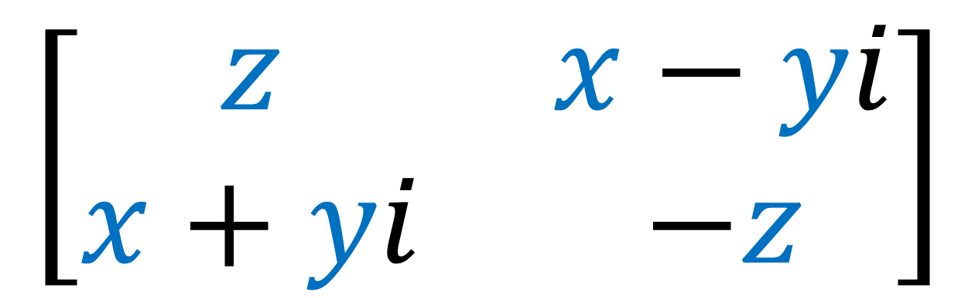
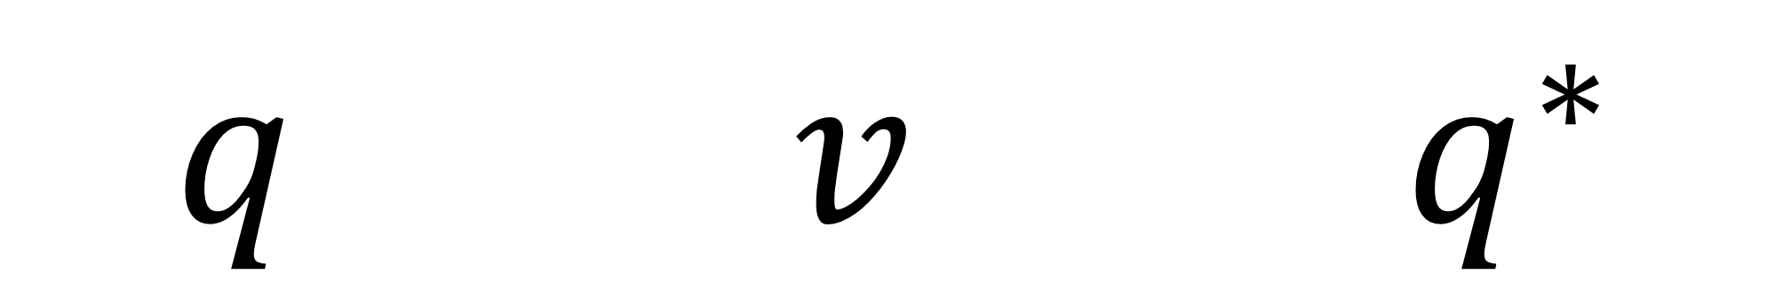


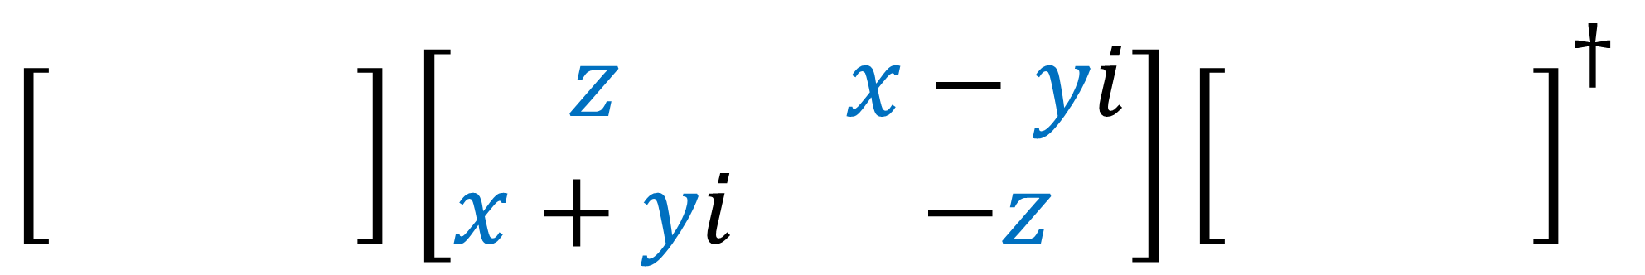
$$\left[\begin{matrix}z & x−yi \\ x+yi & −z\end{matrix}\right]$$
Spinors For Beginners
6
Pauli Vectors + Quaternions
$\left[\begin{matrix} & \\ & \end{matrix}\right]\left[\begin{matrix}z & x−yi \\ x+yi & −z\end{matrix}\right]{\left[\begin{matrix} & \\ & \end{matrix}\right]}^{†}$
$$SU\left(2\right)$$
$$SU\left(2\right)$$
$q v q^{∗}$

Slide 2


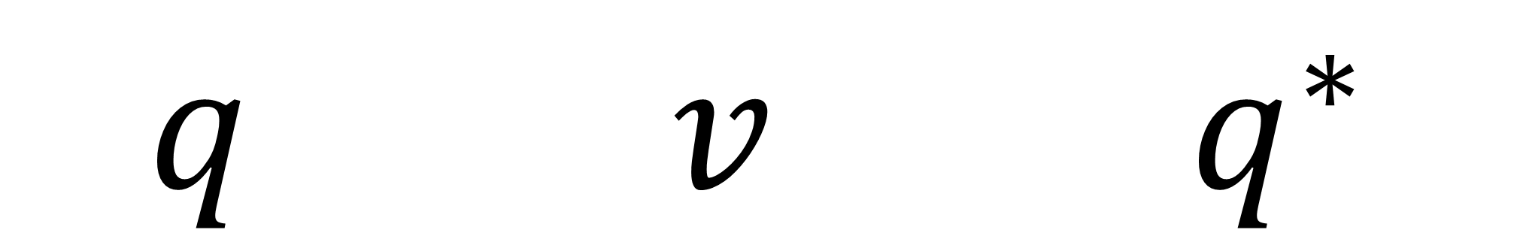


Spinors For Beginners
6
Pauli Vectors + Quaternions
$q v q^{∗}$
$$\left[\begin{matrix}z & x−yi \\ x+yi & −z\end{matrix}\right]$$
$\left[\begin{matrix} & \\ & \end{matrix}\right]\left[\begin{matrix}z & x−yi \\ x+yi & −z\end{matrix}\right]{\left[\begin{matrix} & \\ & \end{matrix}\right]}^{†}$
$$SU\left(2\right)$$
$$SU\left(2\right)$$

Slide 3

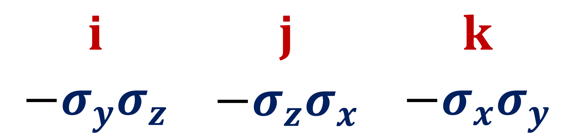

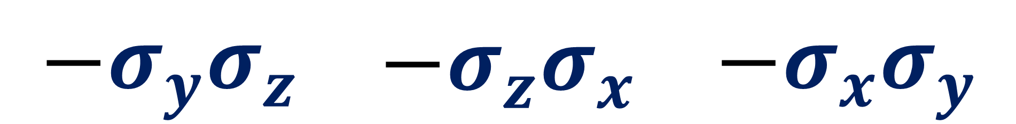
$$i$$ | $$j$$ | $$k$$
$$−σ_{y}σ_{z}$$ | $$−σ_{z}σ_{x}$$ | $$−σ_{x}σ_{y}$$
Spinors For Beginners
6.1
Equivalence of
Quaternions and $SU(2)$
$$i$$ | $$j$$ | $$k$$
$$−σ_{y}σ_{z}$$ | $$−σ_{z}σ_{x}$$ | $$−σ_{x}σ_{y}$$

Slide 4
Spinors Learning “Staircase”
Spinors in Particle Physics
Lie Groups & Algebras
Clifford Algebras
Spinors in 3D / (4D)
Examples From Physics (motivation)

Slide 5
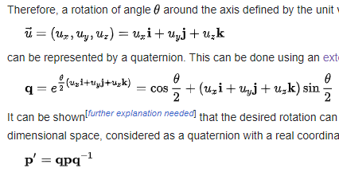
https://en.wikipedia.org/wiki/Quaternions_and_spatial_rotation

Slide 6
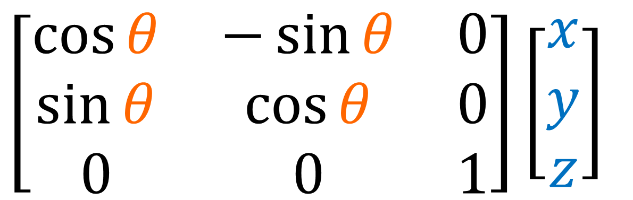
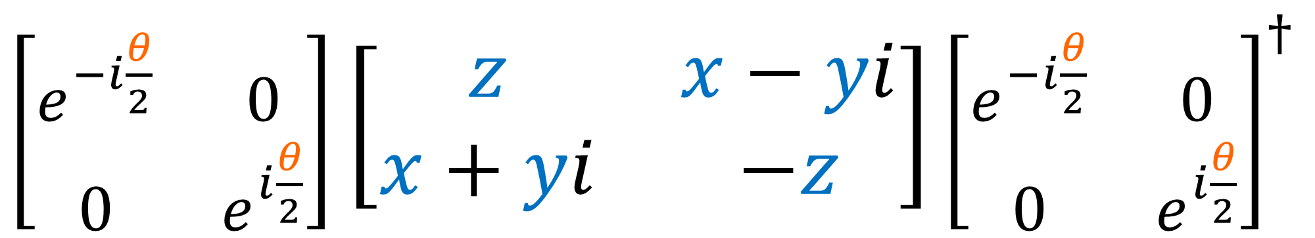
3x3 rotation matrices:
$$\left[\begin{matrix}\cos{θ} & −\sin{θ} & 0 \\ \sin{θ} & \cos{θ} & 0 \\ 0 & 0 & 1\end{matrix}\right]\left[\begin{aligned}x \\ y \\ z\end{aligned}\right]$$
Double-sided transformation:
$\left[\begin{matrix}e^{−i\frac{θ}{2}} & 0 \\ 0 & e^{i\frac{θ}{2}}\end{matrix}\right]$ $\left[\begin{matrix}z & x−yi \\ x+yi & −z\end{matrix}\right]$ ${\left[\begin{matrix}e^{−i\frac{θ}{2}} & 0 \\ 0 & e^{i\frac{θ}{2}}\end{matrix}\right]}^{†}$

Slide 7
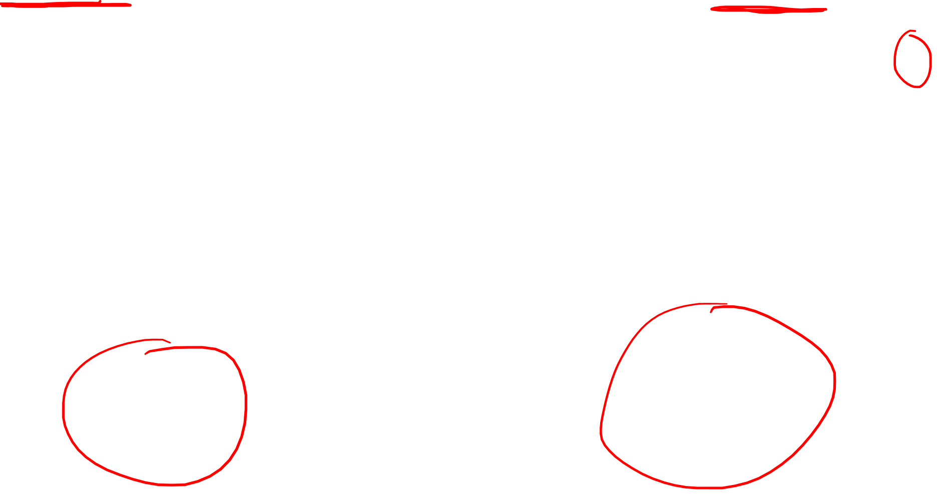

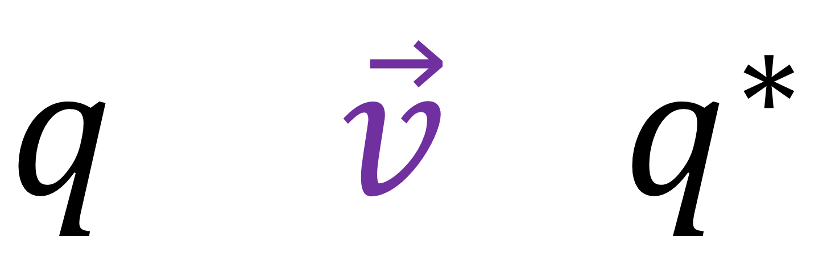
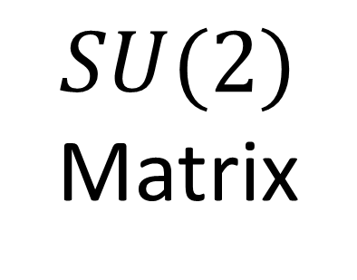
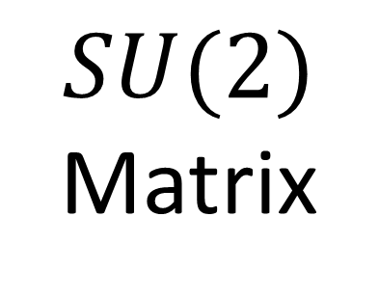
$SU(2)$ Matrix
$SU(2)$ Matrix
Pauli Vector
$\left[\begin{matrix}e^{−i\frac{θ}{2}} & 0 \\ 0 & e^{i\frac{θ}{2}}\end{matrix}\right]$ $\left[\begin{matrix}z & x−yi \\ x+yi & −z\end{matrix}\right]$ ${\left[\begin{matrix}e^{−i\frac{θ}{2}} & 0 \\ 0 & e^{i\frac{θ}{2}}\end{matrix}\right]}^{†}$
Quaternions:
$$q \vec{v} q^{∗}$$

Slide 8
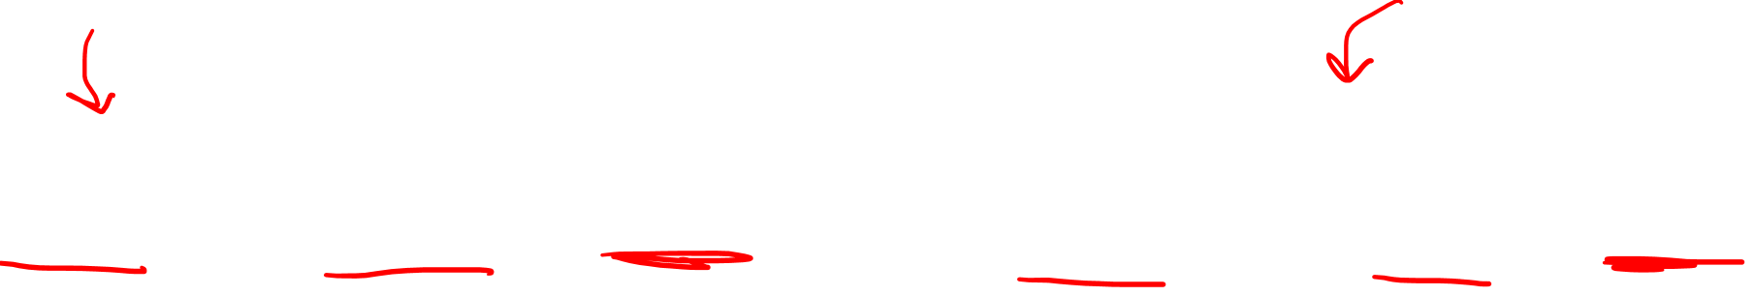
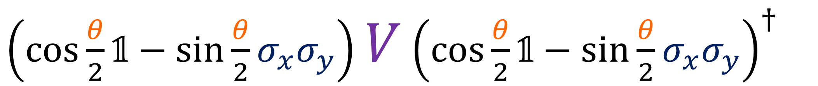
$SU(2)$ Matrix
Pauli Vector
$SU(2)$ Matrix
$\left(\cos{\frac{θ}{2}}\text{𝟙}−\sin{\frac{θ}{2}}σ_{x}σ_{y}\right)$ $V$ ${\left(\cos{\frac{θ}{2}}\text{𝟙}−\sin{\frac{θ}{2}}σ_{x}σ_{y}\right)}^{†}$
Quaternions:
$$q \vec{v} q^{∗}$$

Slide 9
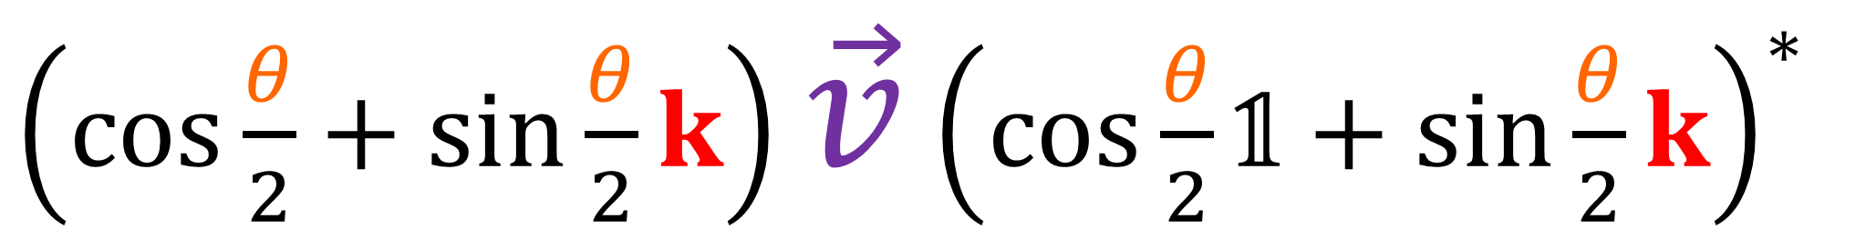
$SU(2)$ Matrix
Pauli Vector
$SU(2)$ Matrix
$\left(\cos{\frac{θ}{2}}\text{𝟙}−\sin{\frac{θ}{2}}σ_{x}σ_{y}\right)$ $V$ ${\left(\cos{\frac{θ}{2}}\text{𝟙}−\sin{\frac{θ}{2}}σ_{x}σ_{y}\right)}^{†}$
Quaternions:
$\left(\cos{\frac{θ}{2}}+\sin{\frac{θ}{2}}k\right)$ $\vec{v}$ ${\left(\cos{\frac{θ}{2}}\text{𝟙}+\sin{\frac{θ}{2}}k\right)}^{∗}$

Slide 10



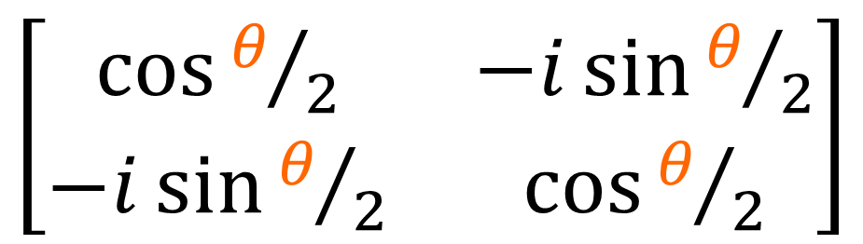
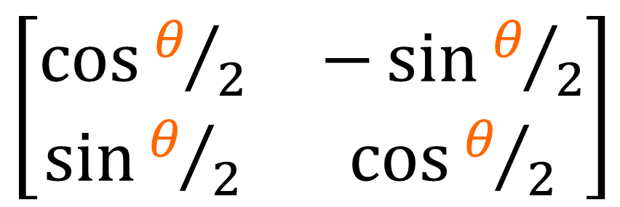
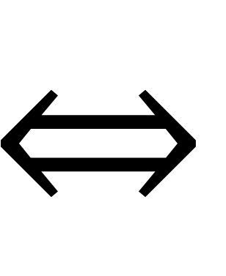
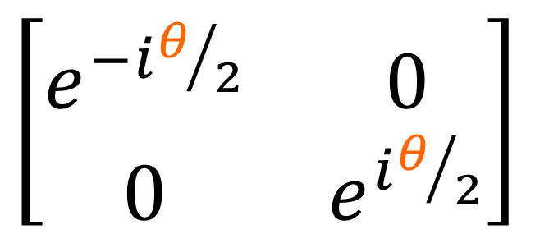

Unit Quaternions
$SU(2)$ Matrices
$$i$$
$\left[\begin{matrix}\cos{θ/2} & −i\sin{θ/2} \\ −i\sin{θ/2} & \cos{θ/2}\end{matrix}\right]$
equiv.
$$⇔$$
$$j$$
$\left[\begin{matrix}\cos{θ/2} & −\sin{θ/2} \\ \sin{θ/2} & \cos{θ/2}\end{matrix}\right]$
$$k$$
$\left[\begin{matrix}e^{−iθ/2} & 0 \\ 0 & e^{iθ/2}\end{matrix}\right]$

Slide 11
What are Quaternions?

Slide 12
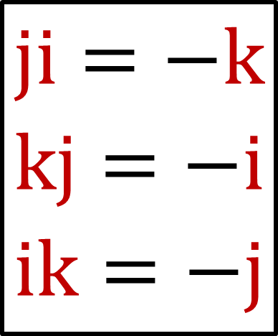
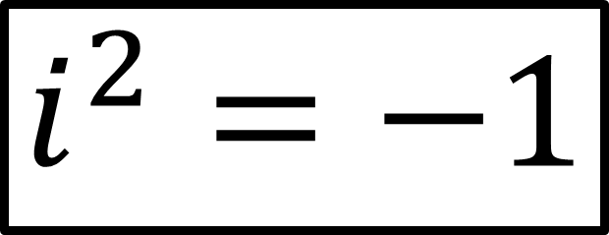
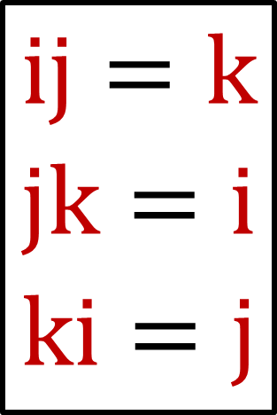

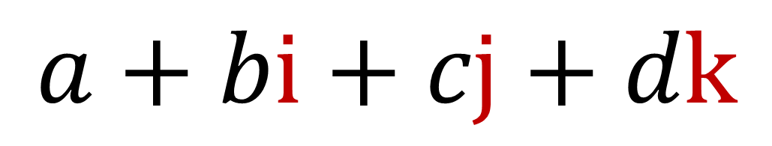

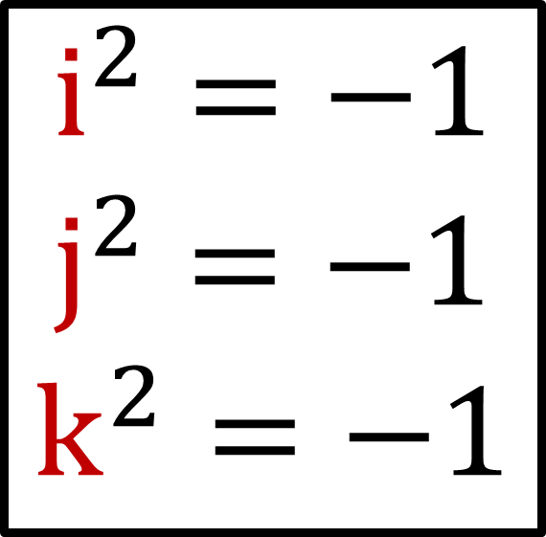

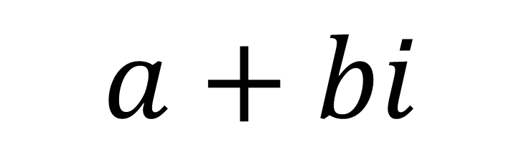

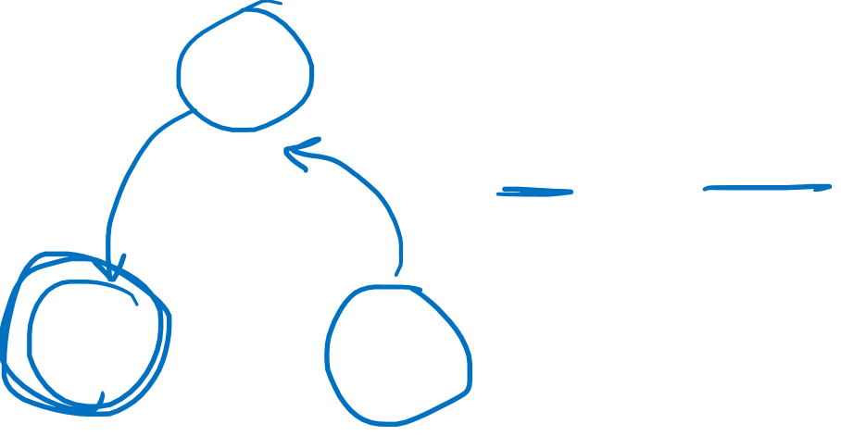
Complex Numbers:
$$i^{2}=−1$$
$$a+bi$$
Quaternions:
$$a+bi+cj+dk$$
$$i^{2}=−1$$
$$j^{2}=−1$$
$$k^{2}=−1$$
$$i$$
$$ij=k$$
$$jk=i$$
$$ki=j$$
$$ji=−k$$
$$kj=−i$$
$$ik=−j$$
$$+$$
$$k$$
$$j$$

Slide 13
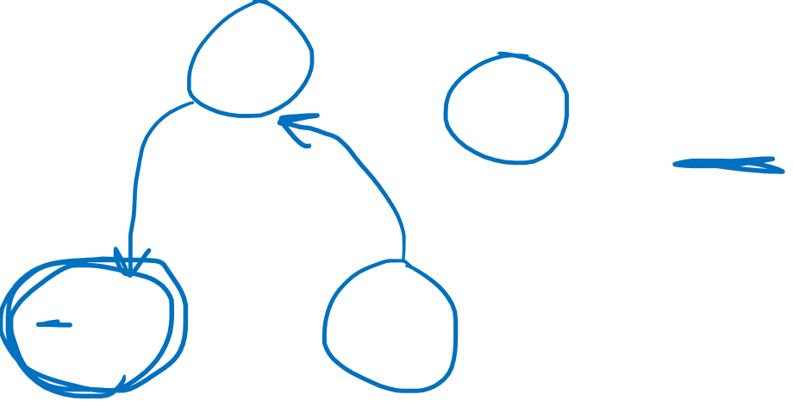
Complex Numbers:
$$i^{2}=−1$$
$$a+bi$$
Quaternions:
$$a+bi+cj+dk$$
$$i^{2}=−1$$
$$j^{2}=−1$$
$$k^{2}=−1$$
$$i$$
$$ij=k$$
$$jk=i$$
$$ki=j$$
$$ji=−k$$
$$kj=−i$$
$$ik=−j$$
$$+$$
$$k$$
$$j$$

Slide 14
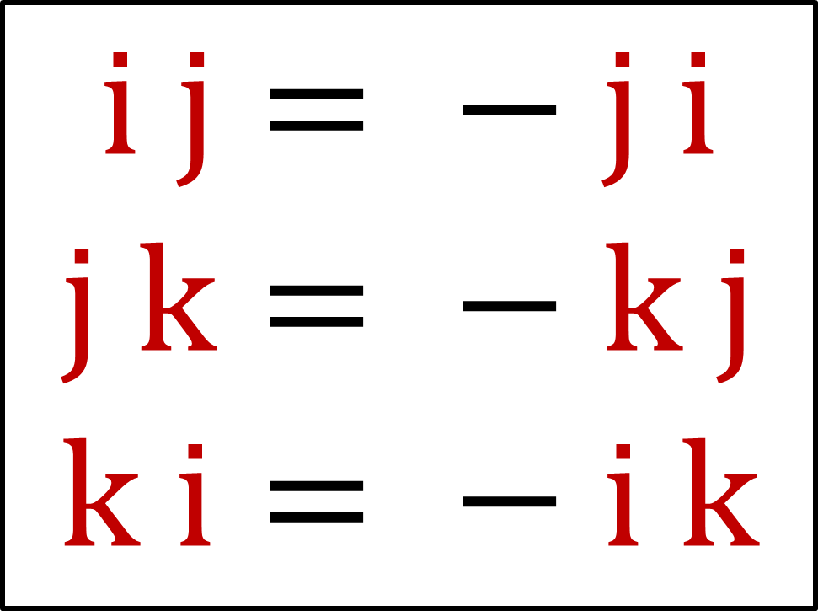




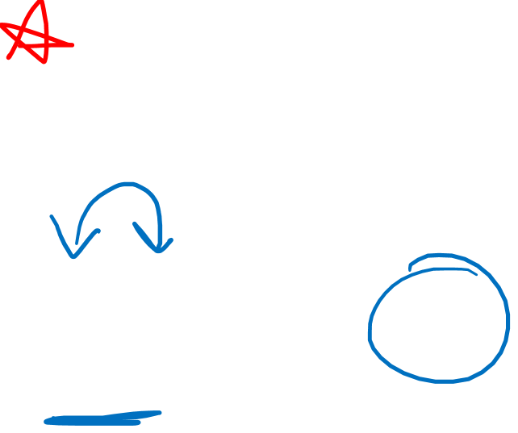
Quaternion units are anti-commutative
$$i$$
$$i j= − j i$$
$$j k= − k j$$
$$k i= − i k$$
$$+$$
$$k$$
$$j$$

Slide 15


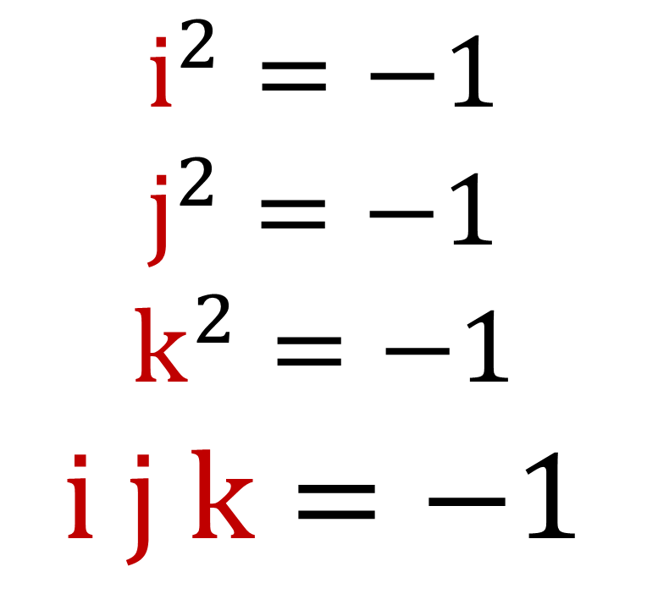
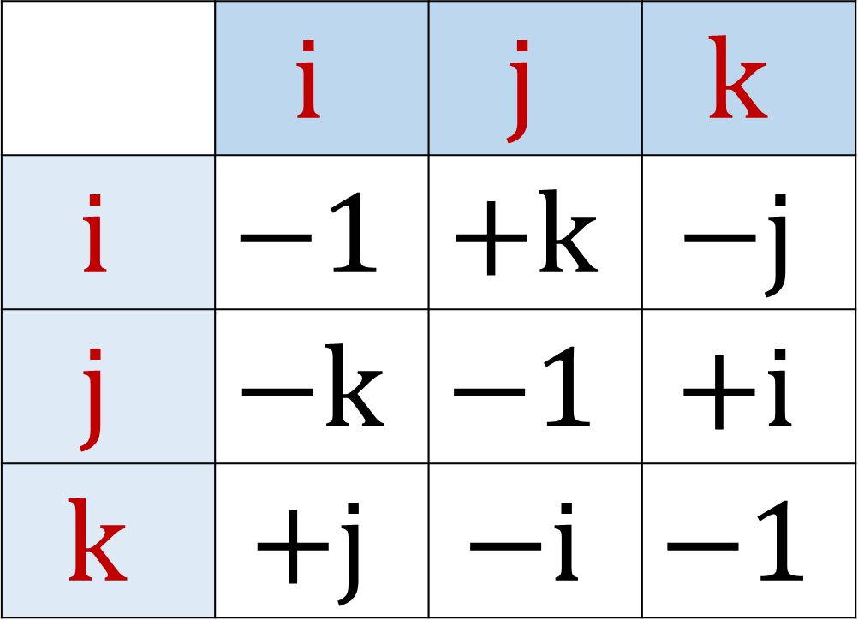
4 formulas for defining quaternions:
 | $$i$$ | $$j$$ | $$k$$
$$i$$ | $$−1$$ | $$+k$$ | $$−j$$
$$j$$ | $$−k$$ | $$−1$$ | $$+i$$
$$k$$ | $$+j$$ | $$−i$$ | $$−1$$
$$i^{2}=−1$$
$$j^{2}=−1$$
$$k^{2}=−1$$
$$i j k=−1$$

Slide 16
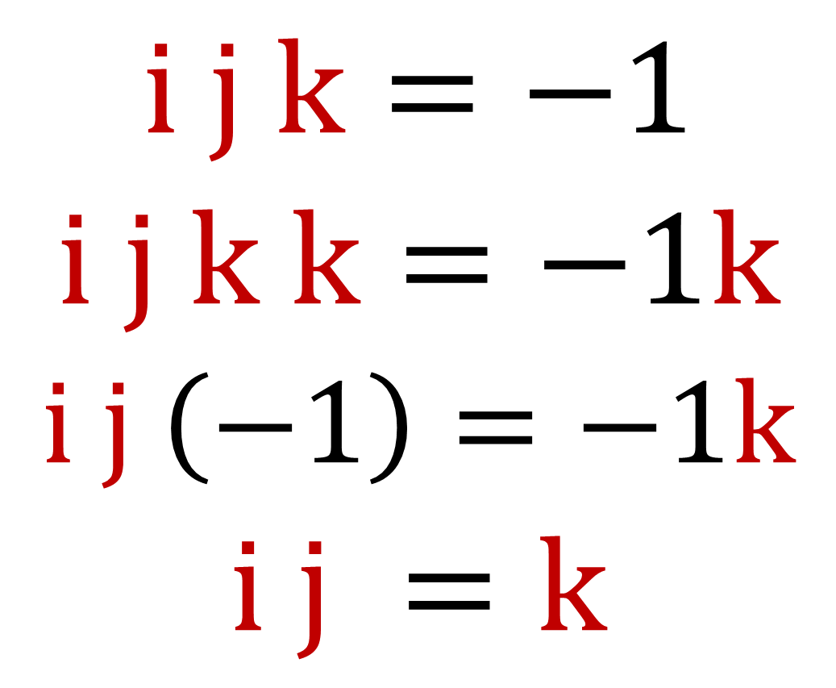

4 formulas for defining quaternions:
$$i j k=−1$$
$$i j k k=−1k$$
$$i j \left(−1\right)=−1k$$
$$i j =k$$
$$i^{2}=−1$$
$$j^{2}=−1$$
$$k^{2}=−1$$
$$i j k=−1$$

Slide 17
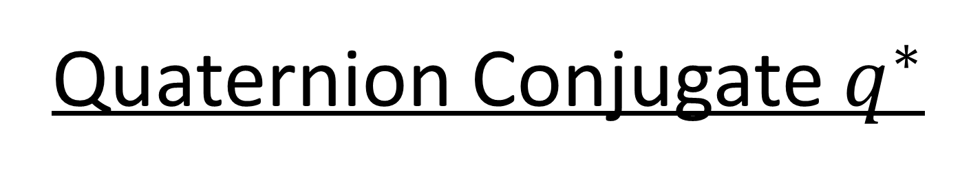
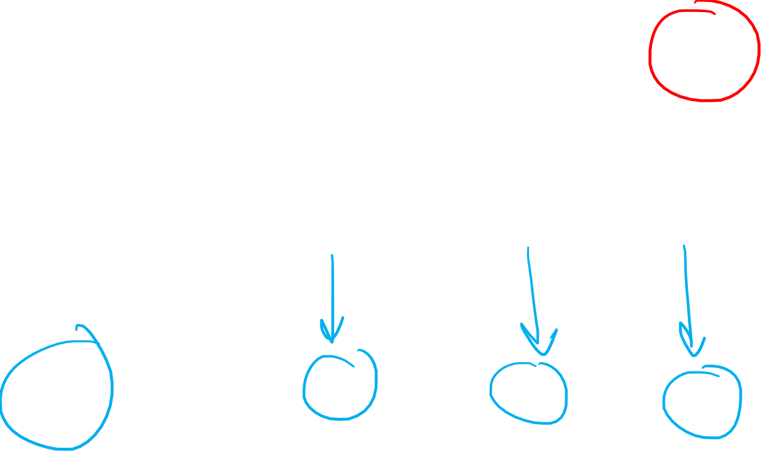

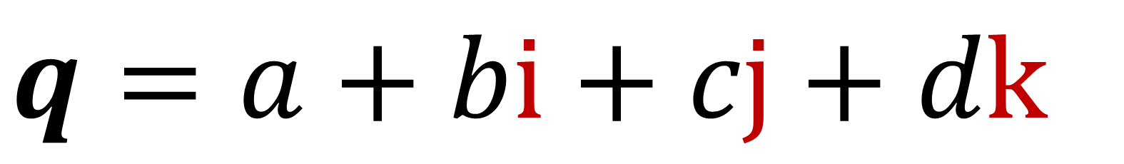
Quaternion Conjugate $q^{∗}$
$$q=a+bi+cj+dk$$
$$q^{∗}=a−bi−cj−dk$$

Slide 18
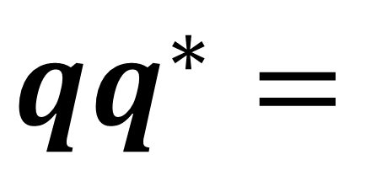
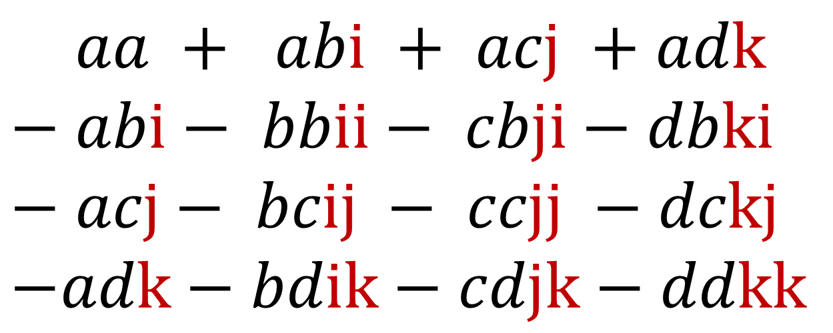
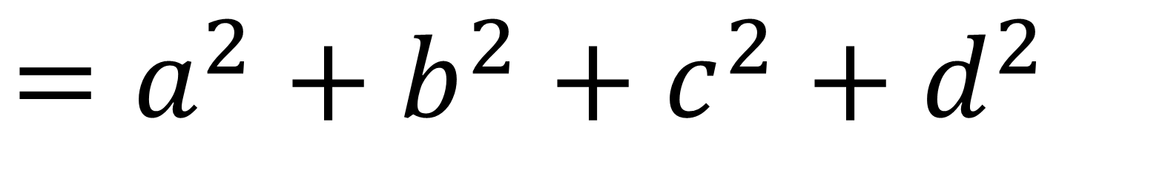
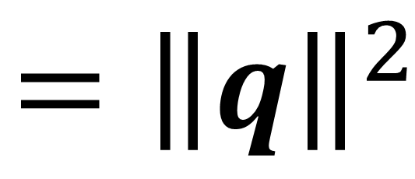
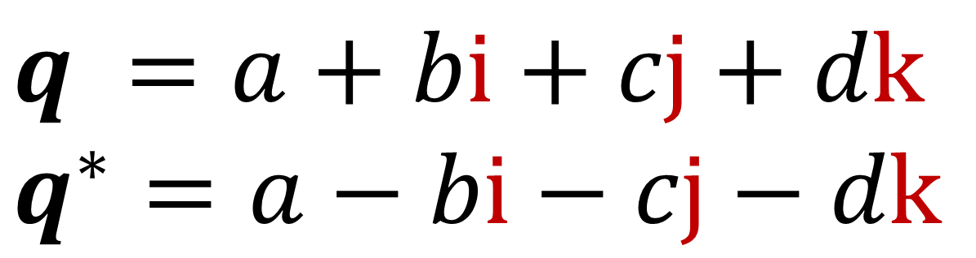
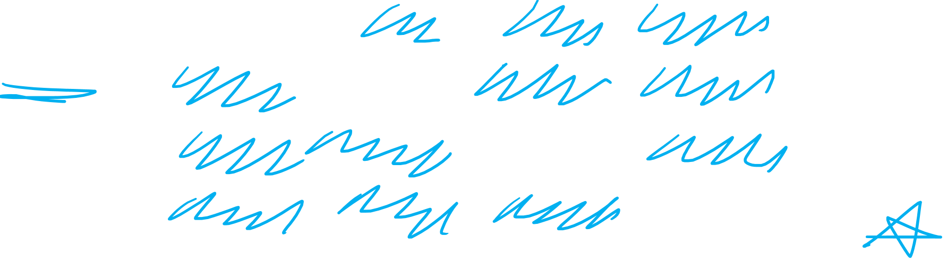
Quaternion Conjugate $q^{∗}$
$$q =a+bi+cj+dk$$
$$q^{∗}=a−bi−cj−dk$$
$$qq^{∗}=$$
$$− aa + abi + acj +adk$$
$$− abi− bbii− cbji−dbki$$
$$− acj− bcij − ccjj −dckj$$
$$−adk−bdik−cdjk−ddkk$$
$$=a^{2}+b^{2}+c^{2}+d^{2}$$
$$={\left\|q\right\|}^{2}$$

Slide 19
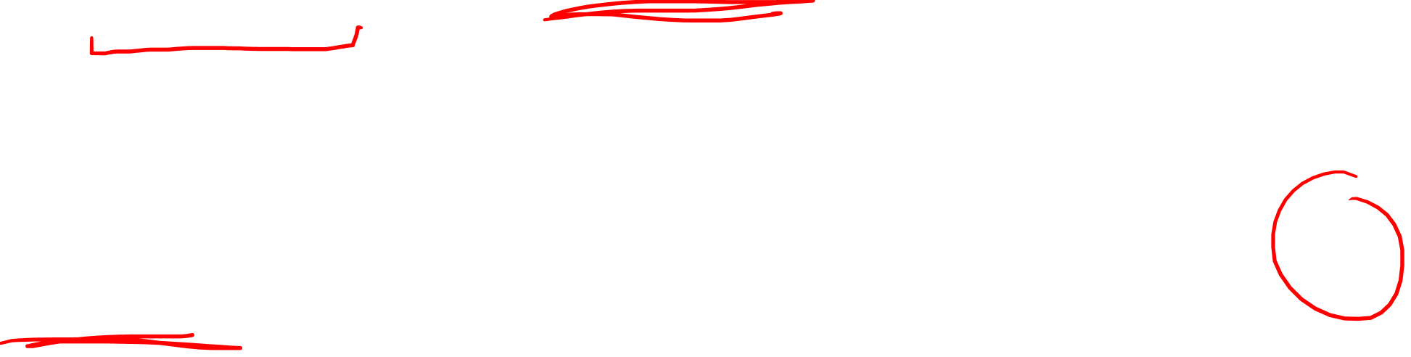
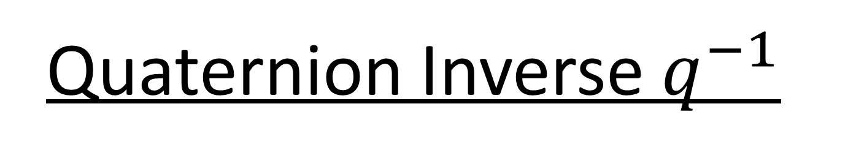



Quaternion Inverse $q^{−1}$
$$\frac{q^{∗}}{{\left\|q\right\|}^{2}}$$
$$≡q^{−1}$$
$$qq^{−1}=q\frac{q^{∗}}{{\left\|q\right\|}^{2}}=\frac{{\left\|q\right\|}^{2}}{{\left\|q\right\|}^{2}}=1$$

Slide 21



$$a+bi+cj+dk$$
$$\vec{v}=xi+yj+zk$$
$$σ_{x}=\left[\begin{matrix}0 & 1 \\ 1 & 0\end{matrix}\right]$$ | $$σ_{y}=\left[\begin{matrix}0 & −i \\ +i & 0\end{matrix}\right]$$ | $$σ_{z}=\left[\begin{matrix}1 & 0 \\ 0 & −1\end{matrix}\right]$$

Slide 22
What are Sigma Matrices?

Slide 23




Sigma Matrices:
$$σ_{x}=\left[\begin{matrix}0 & 1 \\ 1 & 0\end{matrix}\right]$$ | $$σ_{y}=\left[\begin{matrix}0 & −i \\ +i & 0\end{matrix}\right]$$ | $$σ_{z}=\left[\begin{matrix}1 & 0 \\ 0 & −1\end{matrix}\right]$$
$${σ_{x}}^{2}=+\text{𝟙}$$
$${σ_{y}}^{2}=+\text{𝟙}$$
$${σ_{z}}^{2}=+\text{𝟙}$$
$$σ_{x}σ_{y}=−σ_{y}σ_{x}$$
$$σ_{y}σ_{z}=−σ_{z}σ_{y}$$
$$σ_{z}σ_{x}=−σ_{x}σ_{z}$$

Slide 24





$$i^{2}=−1$$
$$j^{2}=−1$$
$$k^{2}=−1$$
$$ij= − ji$$
$$jk= − kj$$
$$ki= − ik$$
$${σ_{x}}^{2}=+\text{𝟙}$$
$${σ_{y}}^{2}=+\text{𝟙}$$
$${σ_{z}}^{2}=+\text{𝟙}$$
$$σ_{x}σ_{y}=−σ_{y}σ_{x}$$
$$σ_{y}σ_{z}=−σ_{z}σ_{y}$$
$$σ_{z}σ_{x}=−σ_{x}σ_{z}$$

Slide 25




$${σ_{i}}^{2}=+\text{𝟙}$$
$$i≠j$$
$${\left(σ_{i}σ_{j}\right)}^{2}=−\text{𝟙}$$

Slide 26






$${\left(σ_{x}σ_{y}\right)}^{2}=−\text{𝟙}$$
Note:
$${\left(σ_{x}σ_{y}\right)}^{2}=σ_{x}σ_{y}σ_{x}σ_{y}$$
$$=σ_{x}\left(−σ_{x}σ_{y}\right)σ_{y}$$
$$=−\left(σ_{x}σ_{x}\right)\left(σ_{y}σ_{y}\right)$$
$=−\left(\text{𝟙}\right)\left(\text{𝟙}\right)=−\text{𝟙}$
$$i^{2}=−1$$
$$j^{2}=−1$$
$$k^{2}=−1$$
$${\left(σ_{y}σ_{z}\right)}^{2}=−\text{𝟙}$$
$${\left(σ_{z}σ_{x}\right)}^{2}=−\text{𝟙}$$
$${\left(σ_{x}σ_{y}\right)}^{2}=−\text{𝟙}$$
$${\left(−σ_{y}σ_{z}\right)}^{2}=−\text{𝟙}$$
$${\left(−σ_{z}σ_{x}\right)}^{2}=−\text{𝟙}$$
$${\left(−σ_{x}σ_{y}\right)}^{2}=−\text{𝟙}$$

Slide 27





$$\left(σ_{y}σ_{z}\right)\left(σ_{z}σ_{x}\right)=−\left(σ_{z}σ_{x}\right)\left(σ_{y}σ_{z}\right)$$
$$\left(σ_{z}σ_{x}\right)\left(σ_{x}σ_{y}\right)=−\left(σ_{x}σ_{y}\right)\left(σ_{z}σ_{x}\right)$$
$$\left(σ_{x}σ_{y}\right)\left(σ_{y}σ_{z}\right)=−\left(σ_{y}σ_{z}\right)\left(σ_{x}σ_{y}\right)$$
$${\left(σ_{y}σ_{z}\right)}^{2}=−\text{𝟙}$$
$${\left(σ_{z}σ_{x}\right)}^{2}=−\text{𝟙}$$
$${\left(σ_{x}σ_{y}\right)}^{2}=−\text{𝟙}$$
$$\left(σ_{y}σ_{z}\right)\left(σ_{z}σ_{x}\right)=\left(−σ_{z}σ_{y}\right)\left(−σ_{x}σ_{z}\right)$$
$$\left(σ_{y}σ_{z}\right)= −σ_{z} σ_{y} σ_{x} σ_{z}$$
$$\left(σ_{y}σ_{z}\right)= − σ_{z} σ_{x} σ_{y} σ_{z}$$
$$=−\left(σ_{z}σ_{x}\right)\left(σ_{y}σ_{z}\right)$$

Slide 28






$$j$$
$$i$$
$$k$$
$$σ_{z}σ_{x}$$
$$σ_{x}σ_{y}$$
$$σ_{y}σ_{z}$$

Slide 29


















$$z$$
$$i$$ | $$↔$$ | $$−σ_{y}σ_{z}$$
$$y$$
$$x$$
$$z$$
$$i$$
$$z$$
$$j$$
$$j$$ | $$↔$$ | $$−σ_{z}σ_{x}$$
$$y$$
$$y$$
$$k$$
$$x$$
$$z$$
$$x$$
$$y$$
$$k$$ | $$↔$$ | $$−σ_{x}σ_{y}$$
$$x$$

Slide 30




$$i$$ | $$↔$$ | $$−σ_{y}σ_{z}$$
$$j$$ | $$↔$$ | $$−σ_{z}σ_{x}$$
$$k$$ | $$↔$$ | $$−σ_{x}σ_{y}$$
$$i$$ | $$↔$$ | $$−σ_{y}σ_{z}$$ |  | $$j$$ | $$↔$$ | $$−σ_{z}σ_{x}$$ |  | $$k$$ | $$↔$$ | $$−σ_{x}σ_{y}$$
4 formulas for defining quaternions:
$${\left(σ_{y}σ_{z}\right)}^{2}=−\text{𝟙}$$
$${\left(σ_{z}σ_{x}\right)}^{2}=−\text{𝟙}$$
$${\left(σ_{x}σ_{y}\right)}^{2}=−\text{𝟙}$$
$$i^{2}=−1$$
$$j^{2}=−1$$
$$k^{2}=−1$$
$$i j k=−1$$

Slide 31



$$i$$ | $$↔$$ | $$−σ_{y}σ_{z}$$
$$j$$ | $$↔$$ | $$−σ_{z}σ_{x}$$
$$k$$ | $$↔$$ | $$−σ_{x}σ_{y}$$
$$i$$ | $$↔$$ | $$−σ_{y}σ_{z}$$ |  | $$j$$ | $$↔$$ | $$−σ_{z}σ_{x}$$ |  | $$k$$ | $$↔$$ | $$−σ_{x}σ_{y}$$
4 formulas for defining quaternions:
$${\left(−σ_{y}σ_{z}\right)}^{2}=−\text{𝟙}$$
$${\left(−σ_{z}σ_{x}\right)}^{2}=−\text{𝟙}$$
$${\left(−σ_{x}σ_{y}\right)}^{2}=−\text{𝟙}$$
$$i^{2}=−1$$
$$j^{2}=−1$$
$$k^{2}=−1$$
$$i j k=−1$$
$$\left(−σ_{y}σ_{z}\right)\left(−σ_{z}σ_{x}\right)\left(−σ_{x}σ_{y}\right)=−\text{𝟙}$$

Slide 32





$$i$$ | $$↔$$ | $$−σ_{y}σ_{z}$$ |  | $$j$$ | $$↔$$ | $$−σ_{z}σ_{x}$$ |  | $$k$$ | $$↔$$ | $$−σ_{x}σ_{y}$$
$$i j k$$
$\left(−σ_{y}σ_{z}\right)\left(−σ_{z}σ_{x}\right)\left(−σ_{x}σ_{y}\right)$
$$=−σ_{y}σ_{z}σ_{z}σ_{x}σ_{x}σ_{y}$$
$$=−σ_{y}\left(\text{𝟙}\right)\left(\text{𝟙}\right)σ_{y}$$
$$=−σ_{y}σ_{y}=−\text{𝟙}$$
$${\left(−σ_{y}σ_{z}\right)}^{2}={\left(−σ_{z}σ_{x}\right)}^{2}={\left(−σ_{x}σ_{y}\right)}^{2}=−\text{𝟙}$$

Slide 33
$$i$$ | $$↔$$ | $$−σ_{y}σ_{z}$$
Equivalent
$$j$$ | $$↔$$ | $$−σ_{z}σ_{x}$$
(“Isomorphic”)
$$k$$ | $$↔$$ | $$−σ_{x}σ_{y}$$

Slide 34




$${\left(−σ_{y}σ_{z}\right)}^{2}={\left(−σ_{z}σ_{x}\right)}^{2}={\left(−σ_{x}σ_{y}\right)}^{2}=−\text{𝟙}$$
$$\left(−σ_{y}σ_{z}\right)\left(−σ_{z}σ_{x}\right)\left(−σ_{x}σ_{y}\right)=−\text{𝟙}$$
$$i^{2} = j^{2} = k^{2} = −1$$
$$i j k = −1$$

Slide 35


$$−σ_{y}σ_{z}$$ | $$↔$$ | $$i$$
$$−σ_{z}σ_{x}$$ | $$↔$$ | $$j$$
$$−σ_{x}σ_{y}$$ | $$↔$$ | $$k$$
Equivalent
(“Isomorphic”)
$${\left(−σ_{y}σ_{z}\right)}^{2}={\left(−σ_{z}σ_{x}\right)}^{2}={\left(−σ_{x}σ_{y}\right)}^{2}=−\text{𝟙}$$
$$\left(−σ_{y}σ_{z}\right)\left(−σ_{z}σ_{x}\right)\left(−σ_{x}σ_{y}\right)=−\text{𝟙}$$
$$i^{2}=j^{2}=k^{2}=ijk=−1$$

Slide 36
Rotating Vectors (double-sided transformations)

Slide 37



$$\vec{v} = x\vec{e_{x}} + y\vec{e_{y}} + z\vec{e_{z}}$$
$$v = x i + y j + z k$$
$$v =0+xi+yj+zk$$
Real Part

Slide 38





$$v=0+xi+yj+zk$$
Rotation: $v→qvq^{∗}$
Unit Length
$${\left\|q\right\|}^{2}=qq^{∗}=1$$
$q=$ $\cos{\frac{θ}{2}}+\sin{\frac{θ}{2}}\left(a^{x}i+a^{y}j+a^{z}k\right)$
(unit length) Axis of rotation

Slide 39




$$v=0+xi+yj+zk$$
Rotate counter-clockwise around $z$-axis.
$q=$ $\cos{\frac{θ}{2}}+\sin{\frac{θ}{2}}k$
$$qvq^{∗}=$$
$\left(\cos{\frac{θ}{2}}+\sin{\frac{θ}{2}}k\right)v\left(\cos{\frac{θ}{2}}−\sin{\frac{θ}{2}}k\right)$

Slide 40




Rotate: $v=k$ around $j$ axis:
$q v q^{∗}$
$=\left(\cos{\frac{θ}{2}}+\sin{\frac{θ}{2}}j\right)k\left(\cos{\frac{θ}{2}}−\sin{\frac{θ}{2}}j\right)$
$={\left(\cos{\frac{θ}{2}}\right)}^{2}k+\cos{\frac{θ}{2}}\sin{\frac{θ}{2}}\left(jk−kj\right)−{\left(\sin{\frac{θ}{2}}\right)}^{2}jkj$
$={\left(\cos{\frac{θ}{2}}\right)}^{2}k+\cos{\frac{θ}{2}}\sin{\frac{θ}{2}}\left(jk+jk\right)+{\left(\sin{\frac{θ}{2}}\right)}^{2}jjk$
$=\left[{\left(\cos{\frac{θ}{2}}\right)}^{2}−{\left(\sin{\frac{θ}{2}}\right)}^{2}\right]k+2\cos{\frac{θ}{2}}\sin{\frac{θ}{2}}jk$
$=\left(\cos{θ}\right)k+\left(\sin{θ}\right)i$
$$\cos{2α}={\left(\cos{α}\right)}^{2}−{\left(\sin{α}\right)}^{2}$$
$\sin{2α}=2\cos{α}\sin{α}$

Slide 41






Rotation: $v→qvq^{∗}$
Unit Length
$${\left\|q\right\|}^{2}=qq^{∗}=1$$
$$v→ q v q^{−1}$$
Non-normalized
$${\left\|q\right\|}^{2}≠1$$
$v= q v \frac{q^{∗}}{{\left\|q\right\|}^{2}}$
$v=\frac{q}{\left\|q\right\|} v \frac{q^{∗}}{\left\|q\right\|}$

Slide 42


$$\vec{v} = x\vec{e_{x}} + y\vec{e_{y}} + z\vec{e_{z}}$$
$V = xσ_{x} + yσ_{y} + zσ_{z}$
$V$ $=x\left[\begin{matrix}0 & 1 \\ 1 & 0\end{matrix}\right]+y\left[\begin{matrix}0 & −i \\ +i & 0\end{matrix}\right]+z\left[\begin{matrix}1 & 0 \\ 0 & −1\end{matrix}\right]$
$V$ $= \left[\begin{matrix}z & x−yi \\ x+yi & −z\end{matrix}\right]$
Pauli Vector

Slide 43





$$V=xσ_{x}+yσ_{y}+zσ_{z}$$
Rotation: $V→UVU^{†}$
Unitary$UU^{†}=\text{𝟙}$
$U=$ $\cos{\frac{θ}{2}}\text{𝟙}−\sin{\frac{θ}{2}}\left(a^{x}σ_{y}σ_{z}+a^{y}σ_{z}σ_{x}+a^{z}σ_{x}σ_{y}\right)$
(unit size) Plane of rotation
$\left(\cos{\frac{θ}{2}}\text{𝟙}−\sin{\frac{θ}{2}}σ_{x}σ_{y}\right)$ $V$ ${\left(\cos{\frac{θ}{2}}\text{𝟙}−\sin{\frac{θ}{2}}σ_{x}σ_{y}\right)}^{†}$

Slide 44





$$V=xσ_{x}+yσ_{y}+zσ_{z}$$
$U=$ $\cos{\frac{θ}{2}}\text{𝟙}−\sin{\frac{θ}{2}}σ_{y}σ_{z}$
Rotate in $yz$ plane.
$$UVU^{†}=$$
$\left(\cos{\frac{θ}{2}}\text{𝟙}−\sin{\frac{θ}{2}}σ_{y}σ_{z}\right)V{\left(\cos{\frac{θ}{2}}\text{𝟙}−\sin{\frac{θ}{2}}σ_{y}σ_{z}\right)}^{†}$

Slide 45





$${σ_{x}}^{†}=σ_{x}$$
$${σ_{y}}^{†}=σ_{y}$$
$${σ_{z}}^{†}=σ_{z}$$
$$={\left(σ_{y}σ_{z}\right)}^{†}={σ_{z}}^{†}{σ_{y}}^{†}$$
$$= σ_{z} σ_{y}=− σ_{y} σ_{z}$$
$$UVU^{†}=$$
$\left(\cos{\frac{θ}{2}}\text{𝟙}−\sin{\frac{θ}{2}}σ_{y}σ_{z}\right)V{\left(\cos{\frac{θ}{2}}\text{𝟙}−\sin{\frac{θ}{2}}σ_{y}σ_{z}\right)}^{†}$
$\left(\cos{\frac{θ}{2}}\text{𝟙}−\sin{\frac{θ}{2}}σ_{y}σ_{z}\right)V\left(\cos{\frac{θ}{2}}\text{𝟙}−\left(−\sin{\frac{θ}{2}}\right)σ_{y}σ_{z}\right)$
$\left(\cos{\frac{θ}{2}}\text{𝟙}−\sin{\frac{θ}{2}}σ_{y}σ_{z}\right)V\left(\cos{\frac{−θ}{2}}\text{𝟙}−\sin{\frac{−θ}{2}}σ_{y}σ_{z}\right)$
$$= U V U^{−1}$$
Unitary: $U^{†}=U^{−1}$

Slide 46




$$U V U^{†}$$
$$U→Ue^{iφ}$$
$$=\left(Ue^{iφ}\right) V {\left(Ue^{iφ}\right)}^{†}$$
$$=Ue^{iφ} V {\left(e^{iφ}\right)}^{†}U^{†}$$
$$=Ue^{iφ} V e^{−iφ}U^{†}$$
$$= U V U^{†}$$

Slide 47



If $det\left[\begin{matrix}a & b \\ c & d\end{matrix}\right]=ad−bc=e^{iθ}$
Then $det\left(e^{−i\frac{θ}{2}}\left[\begin{matrix}a & b \\ c & d\end{matrix}\right]\right)$
$$=e^{−iθ/2}ae^{−iθ/2}d−e^{−iθ/2}be^{−iθ/2}c$$
$$=e^{−iθ}\left(ad−bc\right)=e^{−iθ}e^{iθ}=+1$$

Slide 48



$$V=xσ_{x}+yσ_{y}+zσ_{z}$$
Rotation: $V→UVU^{†}$
Unitary$UU^{†}=\text{𝟙}$
$$U∈SU(2)$$
Special Unitary 2x2 Matrices
$$UU^{†}=\text{𝟙}$$
$$det U=+1$$
Special$det U=+1$

Slide 49




Rotate: $V=σ_{z}$ around $σ_{z}σ_{x}$ plane:
$U V U^{†}$
$=\left(\cos{\frac{θ}{2}}−\sin{\frac{θ}{2}}σ_{z}σ_{x}\right)σ_{z}\left(\cos{\frac{θ}{2}}+\sin{\frac{θ}{2}}σ_{z}σ_{x}\right)$
$={\left(\cos{\frac{θ}{2}}\right)}^{2}σ_{z}+\cos{\frac{θ}{2}}\sin{\frac{θ}{2}}\left(−σ_{z}σ_{x}σ_{z}+σ_{z}σ_{z}σ_{x}\right)−{\left(\sin{\frac{θ}{2}}\right)}^{2}σ_{z}σ_{x}σ_{z}σ_{z}σ_{x}$
$={\left(\cos{\frac{θ}{2}}\right)}^{2}σ_{z}+\cos{\frac{θ}{2}}\sin{\frac{θ}{2}}\left(σ_{x}σ_{z}σ_{z}+σ_{z}σ_{z}σ_{x}\right)−{\left(\sin{\frac{θ}{2}}\right)}^{2}σ_{z}σ_{x}σ_{x}$
$=\left[{\left(\cos{\frac{θ}{2}}\right)}^{2}−{\left(\sin{\frac{θ}{2}}\right)}^{2}\right]σ_{z}+2\cos{\frac{θ}{2}}\sin{\frac{θ}{2}}σ_{x}$
$$=\left(\cos{θ}\right)σ_{z}+\left(\sin{θ}\right)σ_{x}$$
$$\cos{2α}={\left(\cos{α}\right)}^{2}−{\left(\sin{α}\right)}^{2}$$
$\sin{2α}=2\cos{α}\sin{α}$

Slide 50





Rotation: $v→qvq^{∗}$
Unit Length
$${\left\|q\right\|}^{2}=qq^{∗}=1$$
Axis of rotation
$q=$ $\cos{\frac{θ}{2}}+\sin{\frac{θ}{2}}\left(a^{x}i+a^{y}j+a^{z}k\right)$
Rotation: $V→UVU^{†}$
Special Unitary
$UU^{†}=\text{𝟙}$,
$$det U=+1$$
Plane of rotation
$U=$ $\cos{\frac{θ}{2}}\text{𝟙}−\sin{\frac{θ}{2}}\left(a^{x}σ_{y}σ_{z}+a^{y}σ_{z}σ_{x}+a^{z}σ_{x}σ_{y}\right)$

Slide 51
$$−σ_{y}σ_{z}$$ | $$↔$$ | $$i$$
$$−σ_{z}σ_{x}$$ | $$↔$$ | $$j$$
$$−σ_{x}σ_{y}$$ | $$↔$$ | $$k$$
Equivalent
(“Isomorphic”)
$${\left(−σ_{y}σ_{z}\right)}^{2}={\left(−σ_{z}σ_{x}\right)}^{2}={\left(−σ_{x}σ_{y}\right)}^{2}=−\text{𝟙}$$
$$\left(−σ_{y}σ_{z}\right)\left(−σ_{z}σ_{x}\right)\left(−σ_{x}σ_{y}\right)=−\text{𝟙}$$
$$i^{2}=j^{2}=k^{2}=ijk=−1$$

Slide 53








$$Spin(3)$$
$$j$$
$$−σ_{z}σ_{x}$$
$$−σ_{y}σ_{z}$$
$$i$$
$$k$$
$$−σ_{x}σ_{y}$$
Unit Quaternions
$SU(2)$ Matrices

Slide 54
3x3 rotation matrices:
$$\left[\begin{matrix}\cos{θ} & −\sin{θ} & 0 \\ \sin{θ} & \cos{θ} & 0 \\ 0 & 0 & 1\end{matrix}\right]\left[\begin{aligned}x \\ y \\ z\end{aligned}\right]$$
Double-sided transformation:
$\left[\begin{matrix}e^{−i\frac{θ}{2}} & 0 \\ 0 & e^{i\frac{θ}{2}}\end{matrix}\right]$ $\left[\begin{matrix}z & x−yi \\ x+yi & −z\end{matrix}\right]$ ${\left[\begin{matrix}e^{−i\frac{θ}{2}} & 0 \\ 0 & e^{i\frac{θ}{2}}\end{matrix}\right]}^{†}$

Slide 55






$$R∈SO(3)$$
3x3 rotation matrices:
$$\left[\begin{matrix}\cos{θ} & −\sin{θ} & 0 \\ \sin{θ} & \cos{θ} & 0 \\ 0 & 0 & 1\end{matrix}\right]\left[\begin{aligned}x \\ y \\ z\end{aligned}\right]$$
$$qvq^{∗}$$
$$R\vec{v}$$
$$\left(−q\right)v{\left(−q\right)}^{∗}$$
$$R$$

Slide 56



$$SO(3)$$
$$\left[\begin{matrix}\cos{θ} & −\sin{θ} & 0 \\ \sin{θ} & \cos{θ} & 0 \\ 0 & 0 & 1\end{matrix}\right]\left[\begin{aligned}x \\ y \\ z\end{aligned}\right]$$
$$\left[\begin{matrix}e^{−i\frac{θ}{2}} & 0 \\ 0 & e^{i\frac{θ}{2}}\end{matrix}\right]\left[\begin{matrix}z & x−yi \\ x+yi & −z\end{matrix}\right]{\left[\begin{matrix}e^{−i\frac{θ}{2}} & 0 \\ 0 & e^{i\frac{θ}{2}}\end{matrix}\right]}^{†}$$

Slide 57




$$Spin(3)$$
$=$ double cover of $SO(3)$
$$Spin(n)$$
$=$ double cover of $SO(n)$

Slide 59





Rotate 3D vector with
Unit Quaternions
Rotate 3D vector with
$SU(2)$ Matrices
$$v→qvq^{∗}$$
$$V→UVU^{†}$$
$Spin\left(3\right)$ Group

Slide 60


$$Spin(3)$$
$=$ double cover of rotation group $SO(3)$

Slide 61







Rotate 3D vector with
$SO(3)$ Matrices
Rotate 3D vector with
Unit Quaternions
$$v→qvq^{∗}$$
$$\vec{v}→R\vec{v}$$
$$v→\left(−q\right)v{\left(−q\right)}^{∗}$$
$$R^{−1}=R^{T}$$
$$\det{R}=+1$$
$${\left\|q\right\|}^{2}=qq^{∗}=+1$$

Slide 62





Rotate 3D vector with
$SO(3)$ Matrices
Rotate 3D vector with
$SU(2)$ Matrices
$$V→UVU^{†}$$
$$\vec{v}→R\vec{v}$$
$$V→\left(−U\right)V{\left(−U\right)}^{†}$$
$$R^{−1}=R^{T}$$
$$\det{R}=+1$$
$$U^{−1}=U^{†}$$
$$\det{U}=+1$$

Slide 63





Unit Quaternions
= double-cover of $SO(3)$
($SU(2)$ matrices)
$$=\left(+q\right)v{\left(+q\right)}^{∗}=\left(−q\right)v{\left(−q\right)}^{∗}$$
$$≈R\vec{v}$$
$$=\left(+U\right)V{\left(+U\right)}^{†}=\left(−U\right)V{\left(−U\right)}^{†}$$

Slide 64






$$Spin(3)$$
$=$ unit quaternions
$$Spin(4)$$
$$Spin(5)$$
$$Spin(6)$$
$$⋮$$
$=$ 4D quaternions?
$=$ 5D quaternions?
$=$ 6D quaternions?
$$⋮$$
$⇒$ Clifford Algebras
$$Spin(n)$$
(Geometric Algebras)

Slide 65






$\left[\begin{matrix} & \\ & \end{matrix}\right]\left[\begin{matrix}z & x−yi \\ x+yi & −z\end{matrix}\right]{\left[\begin{matrix} & \\ & \end{matrix}\right]}^{†}$
$$SU\left(2\right)$$
$$SU\left(2\right)$$
half rotation
half rotation
$\left[\begin{matrix} & \\ & \end{matrix}\right]\left[\begin{aligned}ξ_{1} \\ ξ_{2}\end{aligned}\right]\left[\begin{matrix} −ξ_{2} & ξ_{1} \end{matrix}\right]{\left[\begin{matrix} & \\ & \end{matrix}\right]}^{†}$
$$SU\left(2\right)$$
$$SU\left(2\right)$$

Slide 66

$\left[\begin{matrix} & \\ & \end{matrix}\right]\left[\begin{matrix}z & x−yi \\ x+yi & −z\end{matrix}\right]{\left[\begin{matrix} & \\ & \end{matrix}\right]}^{†}$
$$SU\left(2\right)$$
$$SU\left(2\right)$$
half rotation
half rotation
$\left[\begin{matrix} & \\ & \end{matrix}\right]\left[\begin{aligned}ξ^{1} \\ ξ^{2}\end{aligned}\right]\left[\begin{matrix} −ξ^{2} & ξ^{1} \end{matrix}\right]{\left[\begin{matrix} & \\ & \end{matrix}\right]}^{†}$
$$SU\left(2\right)$$
$$SU\left(2\right)$$

Slide 67











Vectors: double-sided quaternion transformations
(or $SU(2)$ transformations)
$$v→qvq^{∗}$$
$$V→UVU^{†}$$
$$\left\|q\right\|=1$$
$$U∈SU\left(2\right)$$
Spinors: single-sided quaternion transformations
(or $SU(2)$ transformations)
$$ξ→qξ$$
$$ξ→Uξ$$
$$\left\|q\right\|=1$$
$$U∈SU\left(2\right)$$

Slide 70










$$V→\text{𝟙}V{\text{𝟙}}^{†}$$
$$V→σ_{y}σ_{x}V{\left(σ_{y}σ_{x}\right)}^{†}$$
$$0°$$
$$180°$$
$$V$$
${\left(\cos{\frac{θ}{2}}\text{𝟙}+\sin{\frac{θ}{2}}σ_{y}σ_{x}\right)}^{†}$
$\left(\cos{\frac{θ}{2}}\text{𝟙}+\sin{\frac{θ}{2}}σ_{y}σ_{x}\right)$
$$θ/2$$
$$θ/2$$
$$θ$$

Slide 71



$$\vec{v}=xi+yj+zk$$
$q=\cos{\frac{θ}{2}}+\sin{\frac{θ}{2}}\left(a_{x}i+a_{y}j+a_{z}k\right)$
$$V=xσ_{x}+yσ_{y}+zσ_{z}$$
$U=\cos{\frac{θ}{2}}\text{𝟙}−\sin{\frac{θ}{2}}\left(a_{yz}σ_{y}σ_{z}+a_{zx}σ_{z}σ_{x}++a_{xy}σ_{x}σ_{y}\right)$

Slide 72




We can “rotate” a vector using a double-sided action of a 2x2 complex half-angle matrix, which is a member of SU(2).
Each matrix does “half” the work of $θ/2$, so we get a total rotation of $θ$.
Matrices for rotating Pauli Vectors:
$\left(\cos{\frac{θ}{2}}\text{𝟙}−\sin{\frac{θ}{2}}σ_{x}σ_{y}\right)→\left[\begin{matrix}e^{−iθ/2} & 0 \\ 0 & e^{iθ/2}\end{matrix}\right]$
$\left(\cos{\frac{θ}{2}}\text{𝟙}−\sin{\frac{θ}{2}}σ_{z}σ_{x}\right)→\left[\begin{matrix}\cos{θ/2} & −\sin{θ/2} \\ \sin{θ/2} & \cos{θ/2}\end{matrix}\right]$
$\left(\cos{\frac{θ}{2}}\text{𝟙}−\sin{\frac{θ}{2}}σ_{y}σ_{z}\right)→\left[\begin{matrix}\cos{\frac{θ}{2}} & −i\sin{\frac{θ}{2}} \\ −i\sin{\frac{θ}{2}} & \cos{\frac{θ}{2}}\end{matrix}\right]$

