Slide 1
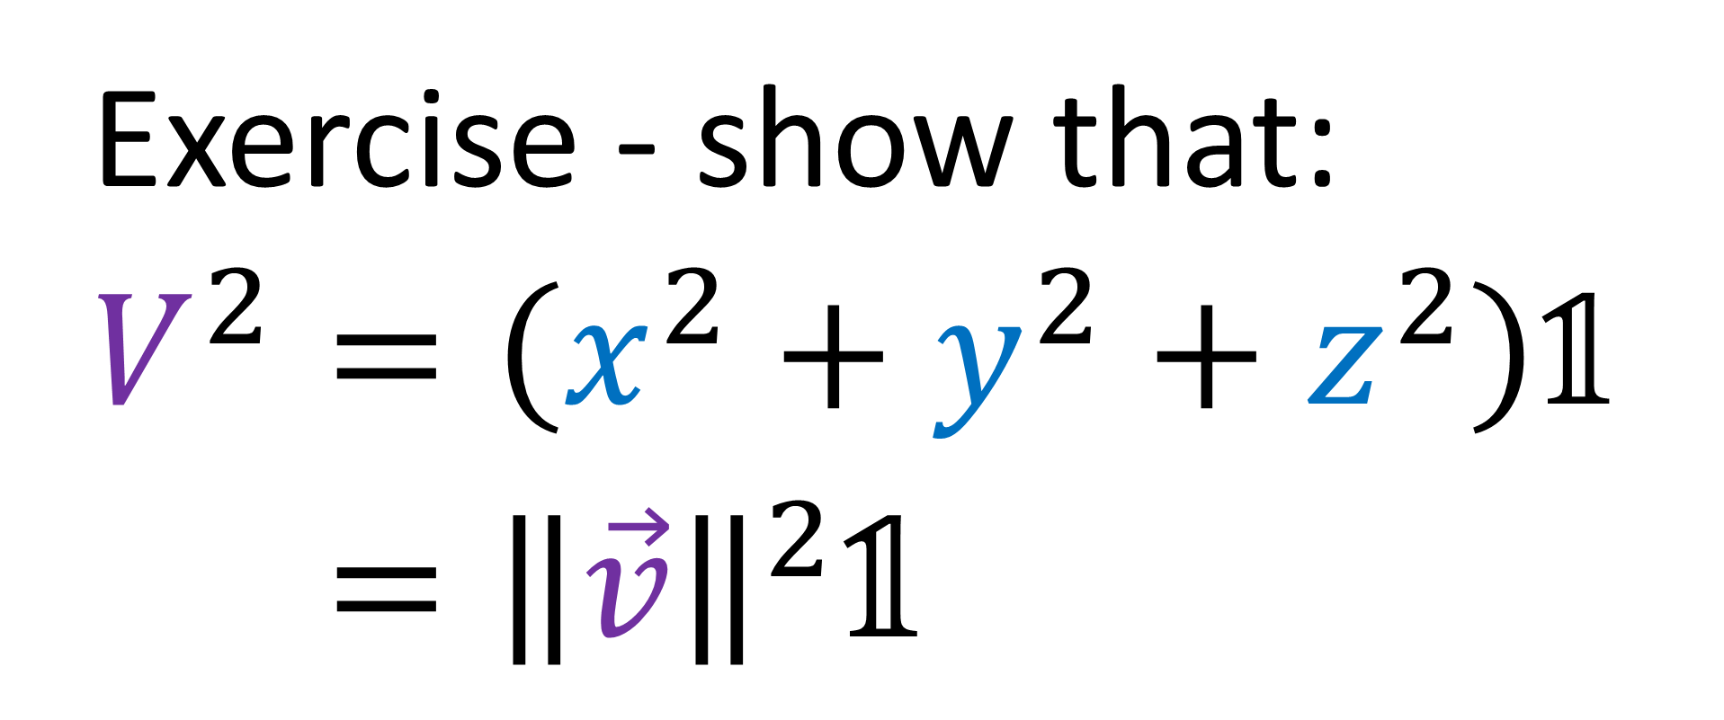

$$V= xσ_{x} + yσ_{y} + zσ_{z}$$
Exercise - show that:
$$V^{2}=\left(x^{2}+y^{2}+z^{2}\right)\text{𝟙}$$
$$V^{2}={\left\|\vec{v}\right\|}^{2}\text{𝟙}$$

Slide 2
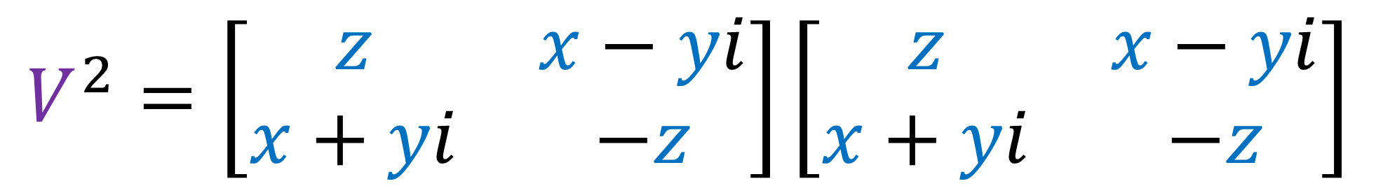
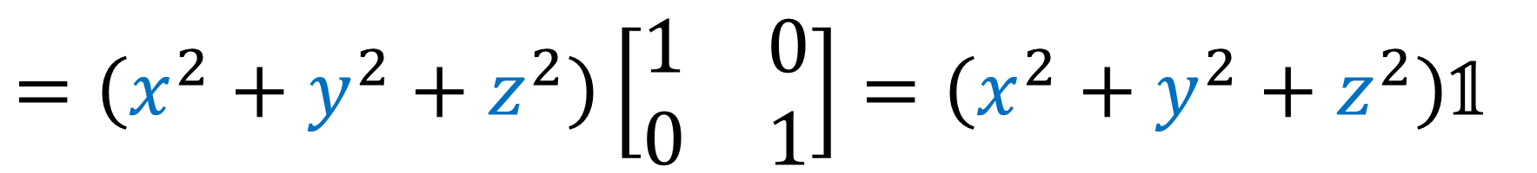
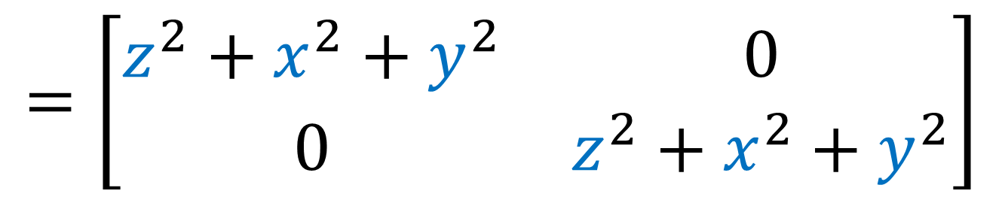
$$V^{2}=\left[\begin{matrix}z & x−yi \\ x+yi & −z\end{matrix}\right]\left[\begin{matrix}z & x−yi \\ x+yi & −z\end{matrix}\right]$$
$$=\left[\begin{matrix}\left(z\right)\left(z\right)+\left(x−yi\right)\left(x+yi\right) & \left(z\right)\left(x−yi\right)+\left(x−yi\right)\left(−z\right) \\ \left(x+yi\right)\left(z\right)+\left(−z\right)\left(x+yi\right) & \left(x+yi\right)\left(x−yi\right)+\left(−z\right)\left(−z\right)\end{matrix}\right]$$
$$=\left[\begin{matrix}z^{2}+x^{2}+y^{2} & 0 \\ 0 & z^{2}+x^{2}+y^{2}\end{matrix}\right]$$
$$=\left(x^{2}+y^{2}+z^{2}\right)\left[\begin{matrix}1 & 0 \\ 0 & 1\end{matrix}\right]=\left(x^{2}+y^{2}+z^{2}\right)\text{𝟙}$$

Slide 3

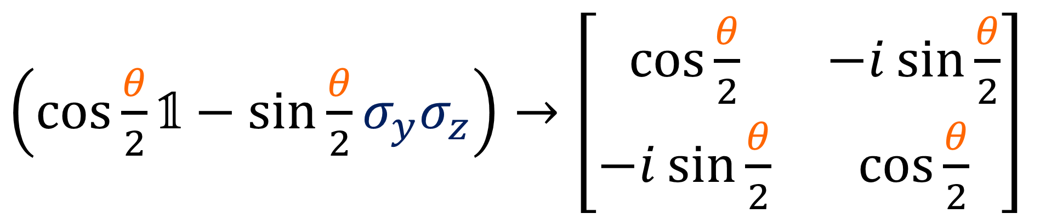
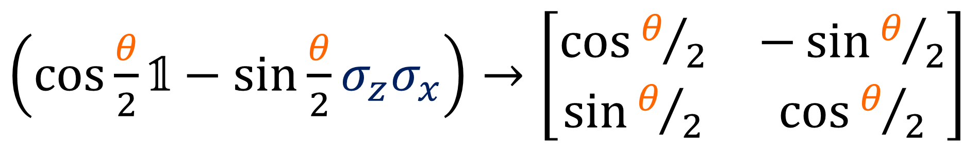
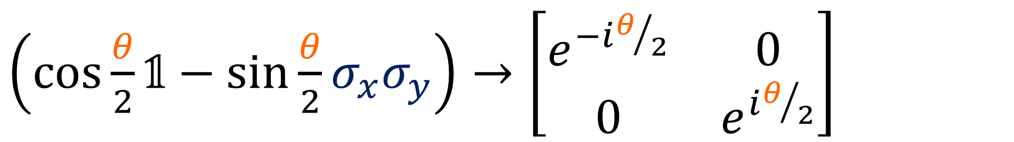
Exercise: prove that $UU^{†}=\text{𝟙}$ for below:
$\left(\cos{\frac{θ}{2}}\text{𝟙}−\sin{\frac{θ}{2}}σ_{x}σ_{y}\right)→\left[\begin{matrix}e^{−iθ/2} & 0 \\ 0 & e^{iθ/2}\end{matrix}\right]$
$\left(\cos{\frac{θ}{2}}\text{𝟙}−\sin{\frac{θ}{2}}σ_{z}σ_{x}\right)→\left[\begin{matrix}\cos{θ/2} & −\sin{θ/2} \\ \sin{θ/2} & \cos{θ/2}\end{matrix}\right]$
$\left(\cos{\frac{θ}{2}}\text{𝟙}−\sin{\frac{θ}{2}}σ_{y}σ_{z}\right)→\left[\begin{matrix}\cos{\frac{θ}{2}} & −i\sin{\frac{θ}{2}} \\ −i\sin{\frac{θ}{2}} & \cos{\frac{θ}{2}}\end{matrix}\right]$

Slide 4
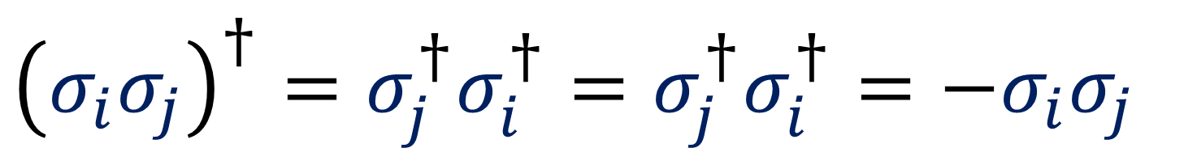
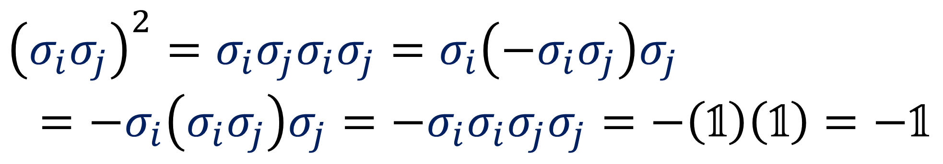


Step 1: Note that ${\left(σ_{i}σ_{j}\right)}^{2}=−\text{𝟙}$ for $i≠j$:
$${\left(σ_{i}σ_{j}\right)}^{2}=σ_{i}σ_{j}σ_{i}σ_{j}=σ_{i}\left(−σ_{i}σ_{j}\right)σ_{j}$$
$$=−σ_{i}\left(σ_{i}σ_{j}\right)σ_{j}=−σ_{i}σ_{i}σ_{j}σ_{j}=−\left(\text{𝟙}\right)\left(\text{𝟙}\right)=−\text{𝟙}$$
Step 2: Note that ${\left(σ_{i}σ_{j}\right)}^{†}=−σ_{i}σ_{j}$ for $i≠j$:
$${\left(σ_{i}σ_{j}\right)}^{†}=σ_{j}^{†}σ_{i}^{†}=σ_{j}^{†}σ_{i}^{†}=−σ_{i}σ_{j}$$

Slide 5
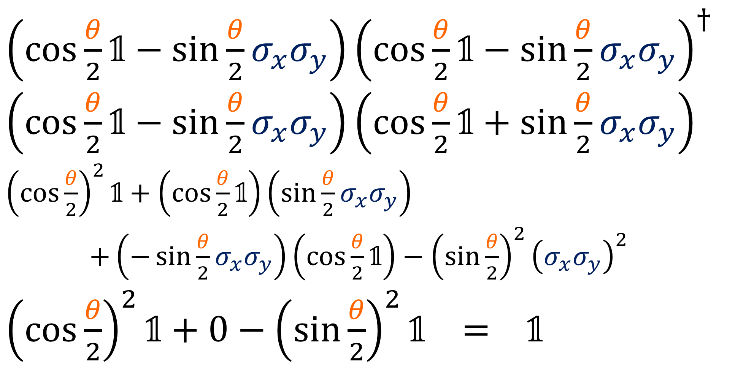
Step 3: Proof
$\left(\cos{\frac{θ}{2}}\text{𝟙}−\sin{\frac{θ}{2}}σ_{x}σ_{y}\right){\left(\cos{\frac{θ}{2}}\text{𝟙}−\sin{\frac{θ}{2}}σ_{x}σ_{y}\right)}^{†}$
$\left(\cos{\frac{θ}{2}}\text{𝟙}−\sin{\frac{θ}{2}}σ_{x}σ_{y}\right)\left(\cos{\frac{θ}{2}}\text{𝟙}+\sin{\frac{θ}{2}}σ_{x}σ_{y}\right)$
${\left(\cos{\frac{θ}{2}}\right)}^{2}\text{𝟙}+\left(\cos{\frac{θ}{2}}\text{𝟙}\right)\left(\sin{\frac{θ}{2}}σ_{x}σ_{y}\right)$
$+\left(−\sin{\frac{θ}{2}}σ_{x}σ_{y}\right)\left(\cos{\frac{θ}{2}}\text{𝟙}\right)−{\left(\sin{\frac{θ}{2}}\right)}^{2}{\left(σ_{x}σ_{y}\right)}^{2}$
${\left(\cos{\frac{θ}{2}}\right)}^{2}\text{𝟙}+0−{\left(\sin{\frac{θ}{2}}\right)}^{2}\text{𝟙} = \text{𝟙}$

