Slide 1
b) covariance & contravariance
When one thing grows, another thing shrinks
Opposite changes will balance out
Notes:
Now let’s move on to covariance and contravariance. These concepts are always seen together. It basically means that when one thing grows another thing will shrink. And that opposite changes will always balance out.

Slide 2
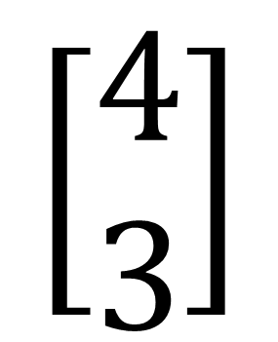
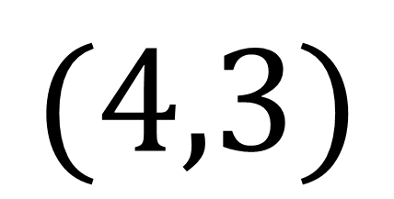
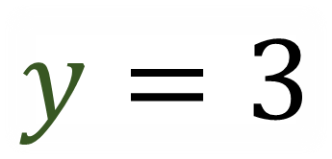
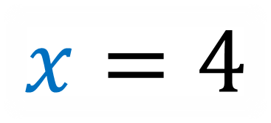
$$x=4$$
$$\left[\begin{aligned}4 \\ 3\end{aligned}\right]$$
$$(4,3)$$
$$y=3$$
Vector Components
(Coordinates/Numbers)
Notes:
A lot of physics classes put a lot of emphasis on vector components, which are the numbers that describe the vector. You might see components written as an ordered pair or written in a column.

Slide 3

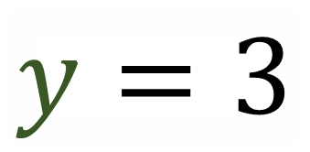
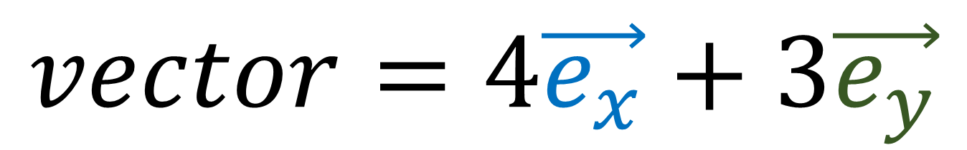
$$vector=4\vec{e_{x}}+3\vec{e_{y}}$$
$$\vec{e_{y}}$$
$$x=4$$
$$\vec{e_{x}}$$
$$y=3$$
Vector Basis (Measuring Sticks)
Vector Components
(Coordinates/Numbers)
Notes:
But it’s important to remember that vector components are only half the story. We also need to pay attention to the vector basis, which are basically the measuring sticks that give us the vector components.

Slide 4


Vector Basis (Measuring Sticks)
Vector Components
(Coordinates/Numbers)
Notes:
Basis vectors and basis components are two sides of the same coin and we can never deal with one without also dealing with the other.

Slide 5
Coordinate Transformation changes both the basis and the components!
…and they change in opposite ways!
$$\vec{e_{y}}$$
$$x=4$$
$$\vec{e_{x}}$$
$$y=3$$
Vector Basis (Measuring Sticks)
Vector Components
(Coordinates/Numbers)
Notes:
It’s very important to remember both basis vectors and vector components together, because when we change coordinates, we’ll see that both the basis vectors and the components change, and also that they change in opposite ways.

Slide 6

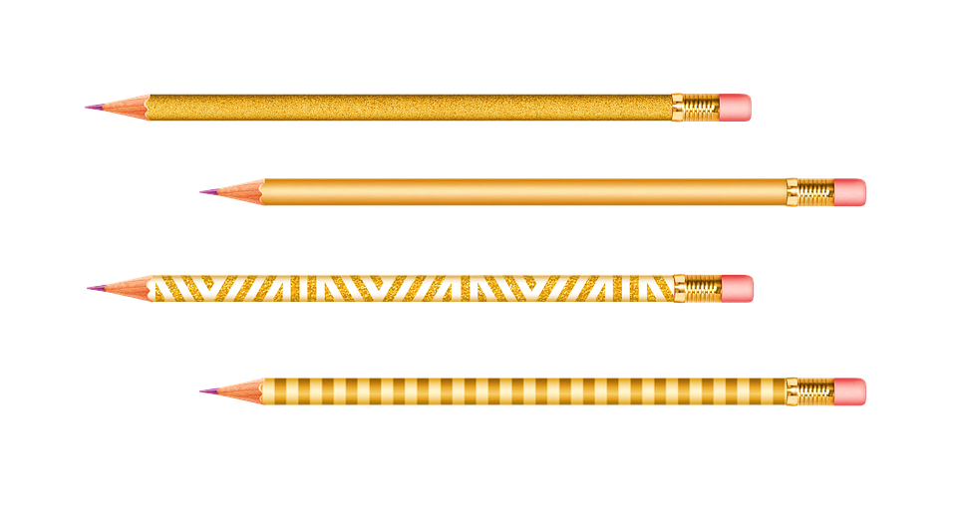
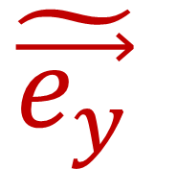
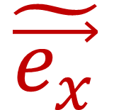
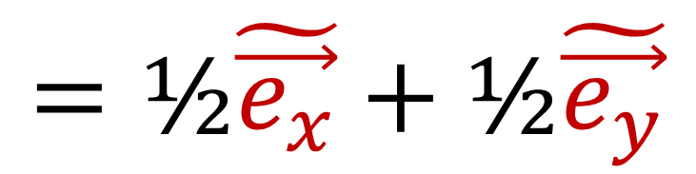
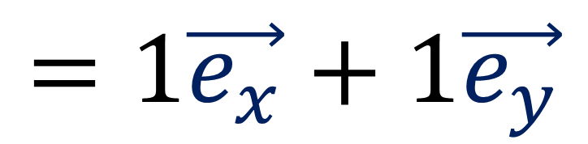
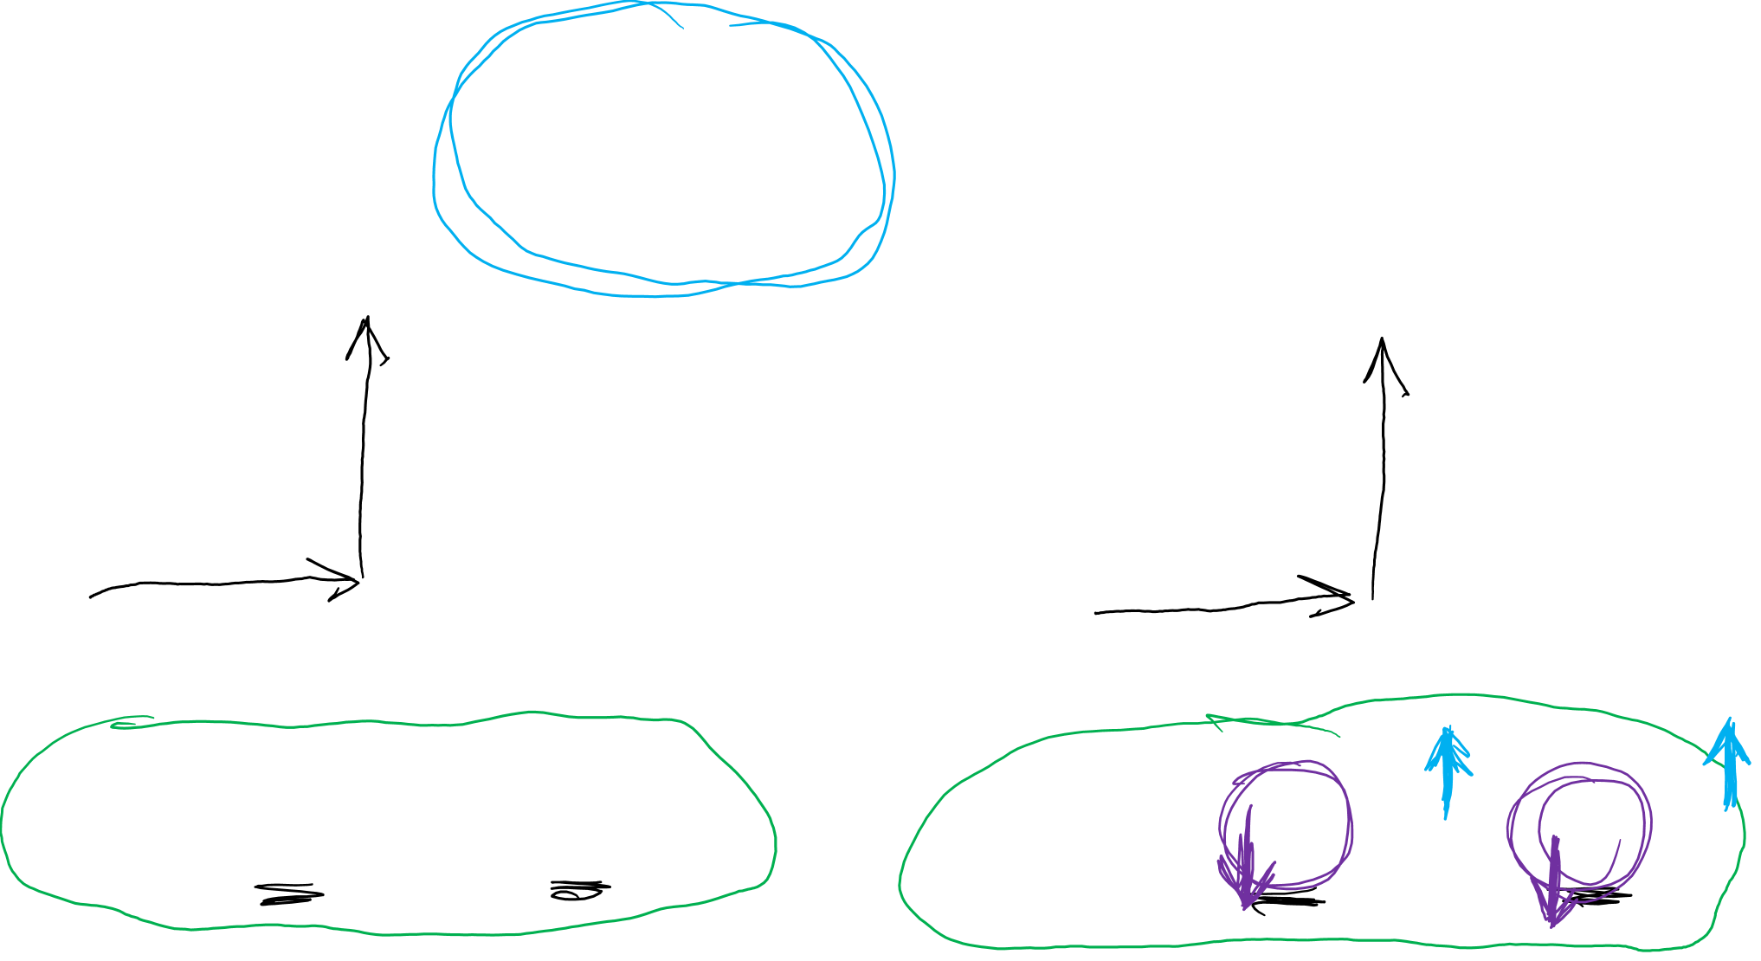
$$\tilde{\vec{e_{x}}}=2\vec{e_{x}}$$
$$\tilde{\vec{e_{y}}}=2\vec{e_{y}}$$
$$\tilde{\vec{e_{y}}}$$
$$\vec{e_{y}}$$
$$\tilde{\vec{e_{x}}}$$
$$\vec{e_{x}}$$
$$=1\vec{e_{x}}+1\vec{e_{y}}$$
$$=\text{½}\tilde{\vec{e_{x}}}+\text{½}\tilde{\vec{e_{y}}}$$
Notes:
Let’s consider this pencil sitting on the table here. If we measure it using the eX and eY basis vectors, we find that the pencil is equal to 1 eX vector and 1 eY vector. The components are 1 and 1. But now let’s look at a new basis, eX-tilde, which is twice the length of eX, and eY tilde, which is twice the length of eY. This means that to construct the pencil, we only need ½ of eX-tilde and ½ of eY-tilde. The components are now ½ and ½ . The important idea here is that when we made the basis vectors twice as big, by multiplying by 2, the pencil vector components shrunk in half, by multiplying by ½. The pencil is equal to both of these expressions, but in order to maintain the equality, the basis had to grow while the components had to shrink.

Slide 7
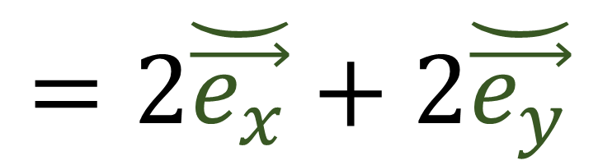
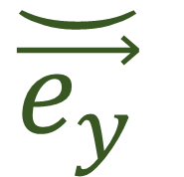
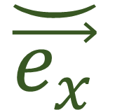
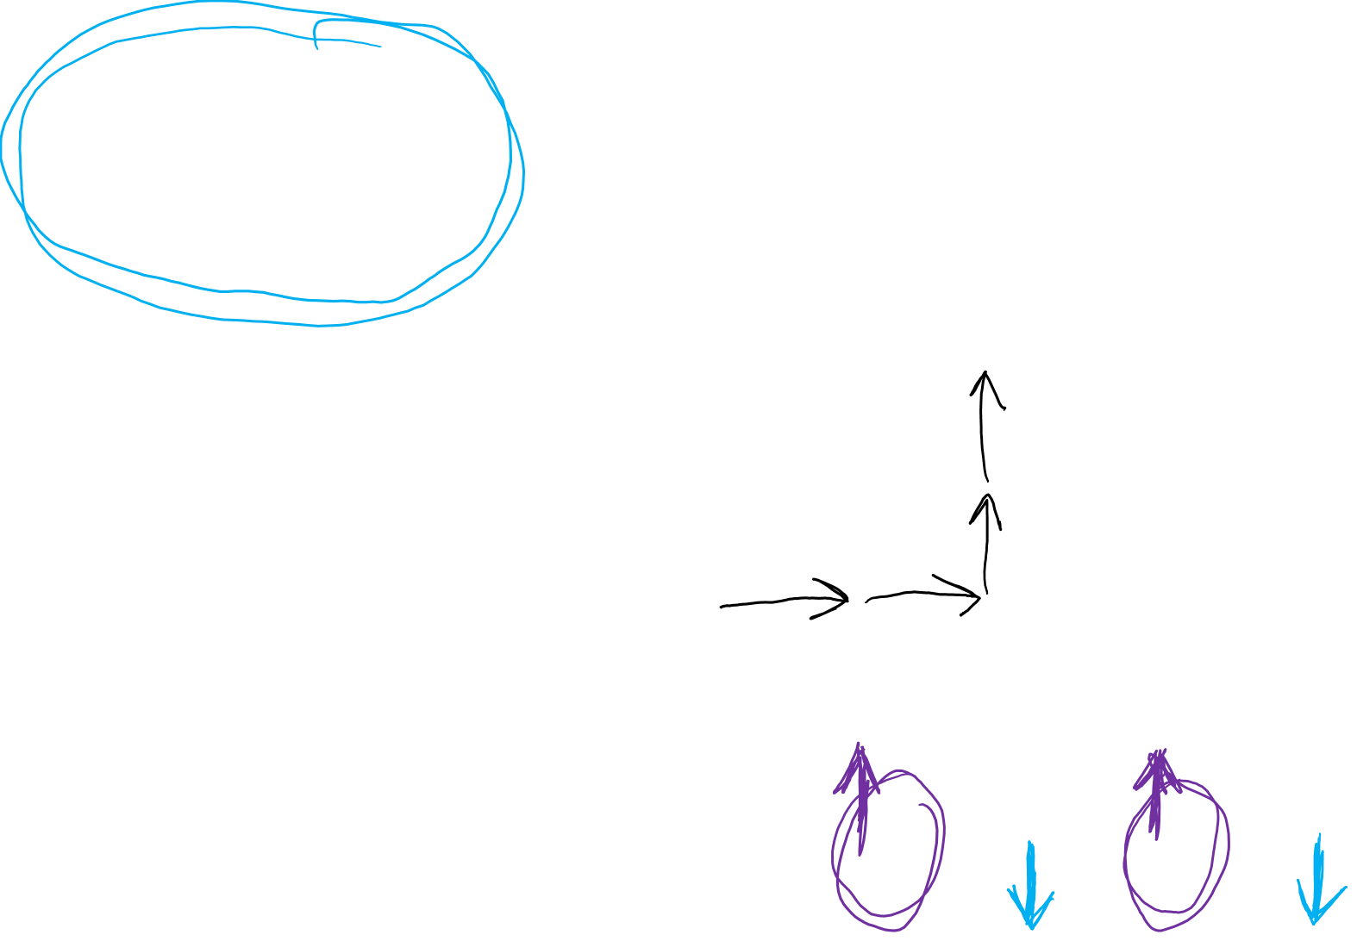
$$\breve{\vec{e_{x}}}=\text{½}\vec{e_{x}}$$
$$\breve{\vec{e_{y}}}=\text{½}\vec{e_{y}}$$
$$\vec{e_{y}}$$
$$\breve{\vec{e_{y}}}$$
$$\vec{e_{x}}$$
$$\breve{\vec{e_{x}}}$$
$$=\text{2}\breve{\vec{e_{x}}}+\text{2}\breve{\vec{e_{y}}}$$
$$=1\vec{e_{x}}+1\vec{e_{y}}$$
Notes:
Let’s look at this idea again by taking the eX and eY basis vectors and this time making them twice as small, with the new vectors being eX-smile and eY-smile. Now to construct the pencil we need 2 of eX-smile and 2 of eY-smile. This time the basis vectors shrunk in half, and the components needed to double in size in order to balance out and maintain the equality. Again, one thing grew and one thing shrunk in order to maintain balance.

Slide 8

Covariant
Contravariant
$$\vec{e_{y}}$$
$$x=4$$
$$\vec{e_{x}}$$
$$y=3$$
Vector Basis (Measuring Sticks)
Vector Components
(Coordinates/Numbers)
Notes:
So we see that basis vectors and components behave in opposite ways. When basis vectors grow, the components shrink, and when basis vectors shrink, the components grow. For this reason, we call basis vectors Covariant, and we call vector components Contravariant. Vector components do the “contrary” or “opposite” thing that basis vectors do, and this is why they are called contravariant.

Slide 9


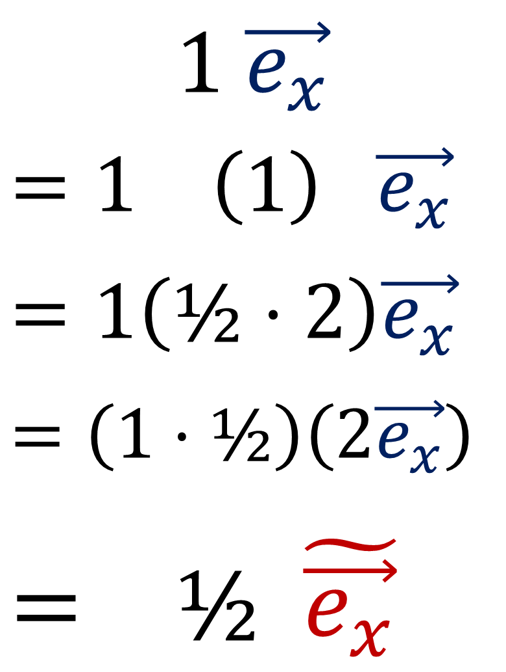
$$\tilde{\vec{e_{y}}}$$
$$\tilde{\vec{e_{x}}}=2\vec{e_{x}}$$
$$\tilde{\vec{e_{y}}}=2\vec{e_{y}}$$
$$1 \vec{e_{x}}$$
$$=1 \left(1\right) \vec{e_{x}}$$
$$=1\left(\text{½}⋅2\right)\vec{e_{x}}$$
$$=\left(1⋅\text{½}\right)\left(2\vec{e_{x}}\right)$$
$$= \text{½} \tilde{\vec{e_{x}}}$$
$$\vec{e_{y}}$$
$$\vec{e_{x}}$$
$$\tilde{\vec{e_{x}}}$$
Notes:
Let’s take a closer look at what’s going on, using the original basis eX and eY, and the basis that’s twice as long, eX-tilde and eY-tilde. Let’s start with the expression 1 eX. It’s perfectly fine to add the number 1 in the middle of this expression, since multiplying by the number 1 doesn’t change anything. Next let’s take this #1 in the middle and split it into one-half times 2. The numbers ½ and 2 are opposites and multiply to give the number 1, so we still haven’t changed anything.

Slide 10
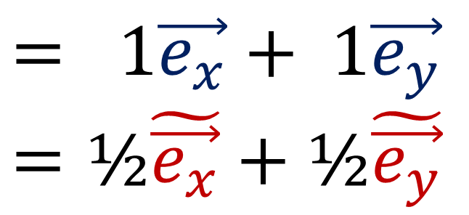
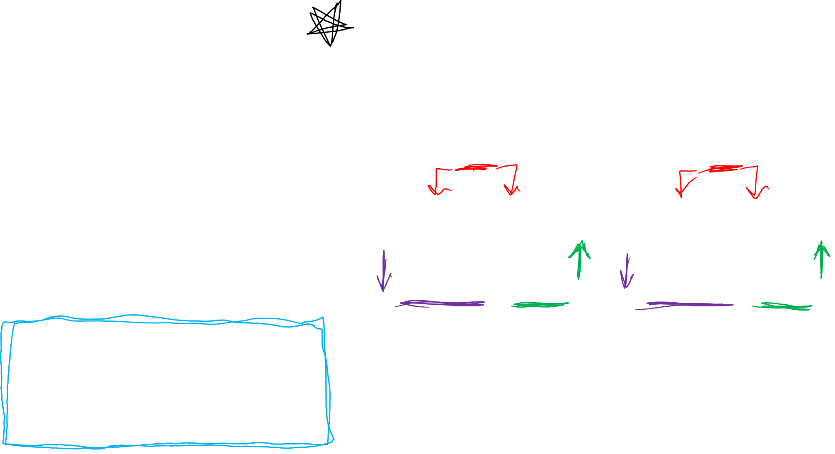
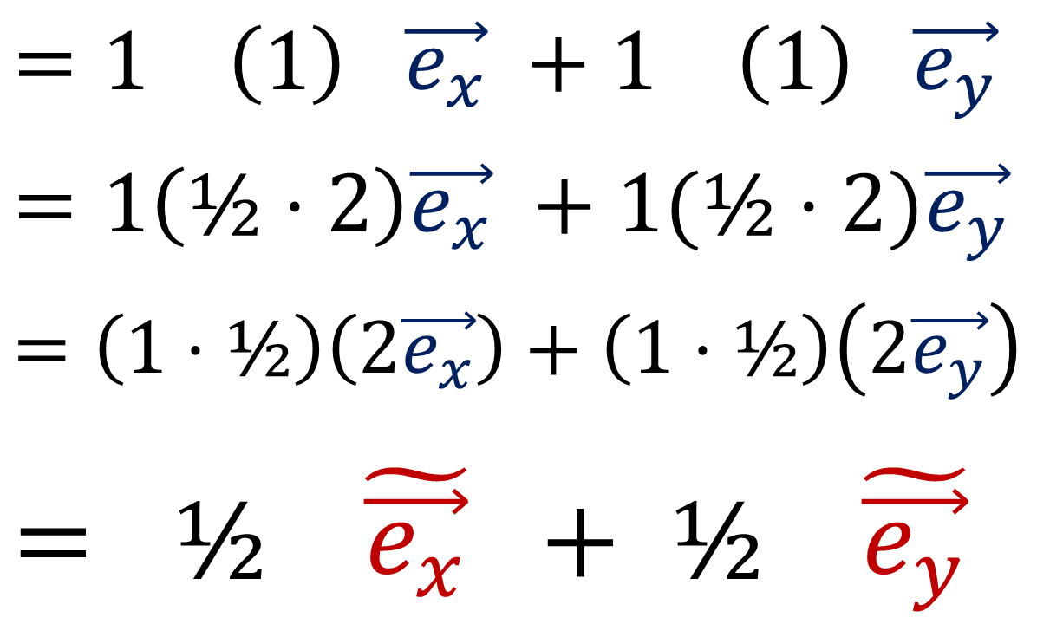
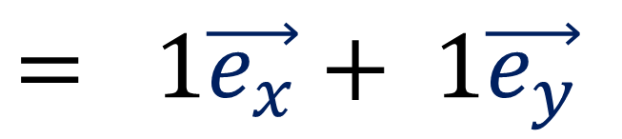
$$\tilde{\vec{e_{y}}}$$
$$\tilde{\vec{e_{x}}}=2\vec{e_{x}}$$
$$\tilde{\vec{e_{y}}}=2\vec{e_{y}}$$
$$= 1\vec{e_{x}}+ 1\vec{e_{y}}$$
$$\vec{e_{y}}$$
$$=1 \left(1\right) \vec{e_{x}} +1 \left(1\right) \vec{e_{y}}$$
$$=1\left(\text{½}⋅2\right)\vec{e_{x}} +1(\text{½}⋅2)\vec{e_{y}}$$
$$=\left(1⋅\text{½}\right)\left(2\vec{e_{x}}\right)+\left(1⋅\text{½}\right)\left(2\vec{e_{y}}\right)$$
$$= \text{½} \tilde{\vec{e_{x}}} + \text{½} \tilde{\vec{e_{y}}}$$
$$\vec{e_{x}}$$
$$\tilde{\vec{e_{x}}}$$
$$= 1\vec{e_{x}}+ 1\vec{e_{y}}$$
$$=\text{½}\tilde{\vec{e_{x}}}+\text{½}\tilde{\vec{e_{y}}}$$
Notes:
If we write out the full expression for the pencil vector, we can do this again. We can insert the number 1 in between the component and the basis vector for both X and Y. Then split the number 1 into ½ times 2. Then shrink the components to half as big, and double basis vectors grow to be twice as long. Since the tilde basis is twice as long as the original basis, we can rewrite 2eX as eX-tilde and rewrite 2eY as eY-tilde. The pencil is equal to both of these expressions because we are free to grow one thing if we shrink the other.

Slide 11
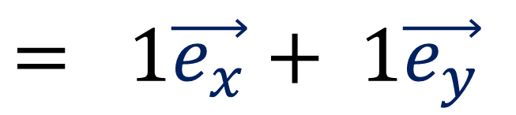
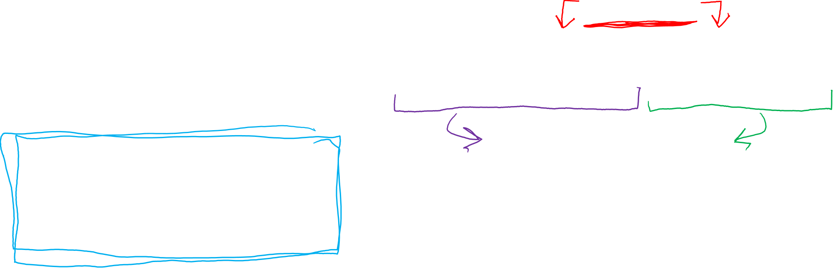
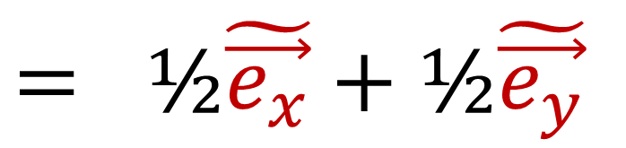
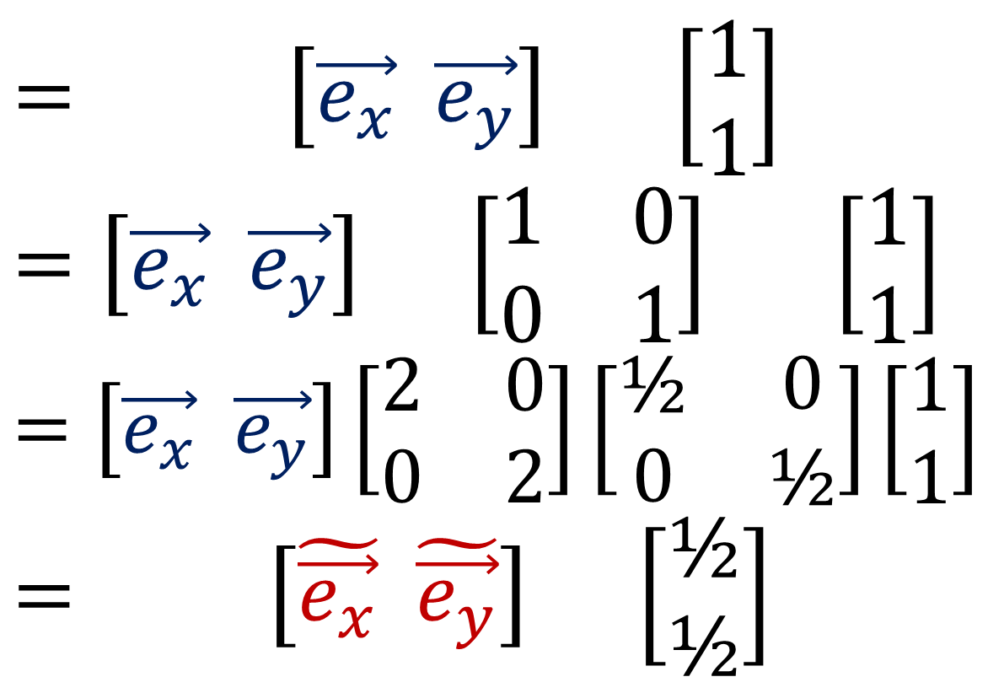
$$\tilde{\vec{e_{y}}}$$
$$\tilde{\vec{e_{x}}}=2\vec{e_{x}}$$
$$\tilde{\vec{e_{y}}}=2\vec{e_{y}}$$
$$= 1\vec{e_{x}}+ 1\vec{e_{y}}$$
$$= \left[\vec{e_{x}} \vec{e_{y}}\right] \left[\begin{aligned}1 \\ 1\end{aligned}\right]$$
$$=\left[\vec{e_{x}} \vec{e_{y}}\right] \left[\begin{matrix}1 & 0 \\ 0 & 1\end{matrix}\right] \left[\begin{aligned}1 \\ 1\end{aligned}\right]$$
$$=\left[\vec{e_{x}} \vec{e_{y}}\right]\left[\begin{matrix}2 & 0 \\ 0 & 2\end{matrix}\right]\left[\begin{matrix}\text{½} & 0 \\ 0 & \text{½}\end{matrix}\right]\left[\begin{aligned}1 \\ 1\end{aligned}\right]$$
$$= \left[\tilde{\vec{e_{x}}} \tilde{\vec{e_{y}}}\right] \left[\begin{aligned}\text{½} \\ \text{½}\end{aligned}\right]$$
$$\vec{e_{y}}$$
$$\vec{e_{x}}$$
$$\tilde{\vec{e_{x}}}$$
$$= 1\vec{e_{x}}+ 1\vec{e_{y}}$$
$$=\text{½}\tilde{\vec{e_{x}}}+\text{½}\tilde{\vec{e_{y}}}$$
$$= \text{½}\tilde{\vec{e_{x}}}+\text{½}\tilde{\vec{e_{y}}}$$
Notes:
Let’s go through this one last time, this time using array notation. We can write the pencil vector expression 1 eX + 1 eY as an array multiplication, where the row of basis vectors is multiplied by the column of vector components. We can get back the original expression using the multiplication rule I show before: first times first plus second times second. Now if you know linear algebra, you know that we can always multiply by the identity matrix with 1s along the diagonal and zeros everywhere else, without changing anything. The identity matrix is a bit like the number 1 for arrays because multiplication by the identity doesn’t change anything. Next, we can split the identity matrix into two parts, a matrix with twos along the diagonal and a matrix with ½ along the diagonal. These matrices are opposites, or inverses, and they multiply together to give the identity, so we still haven’t changed anything.

Slide 12
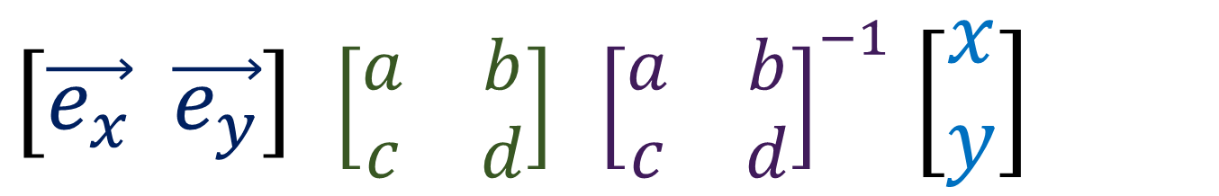
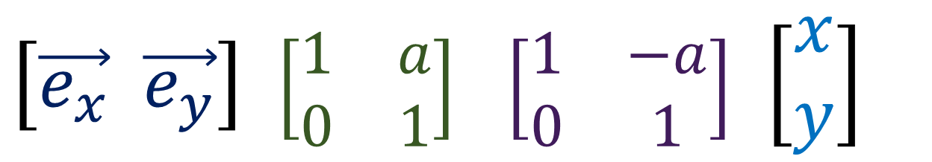
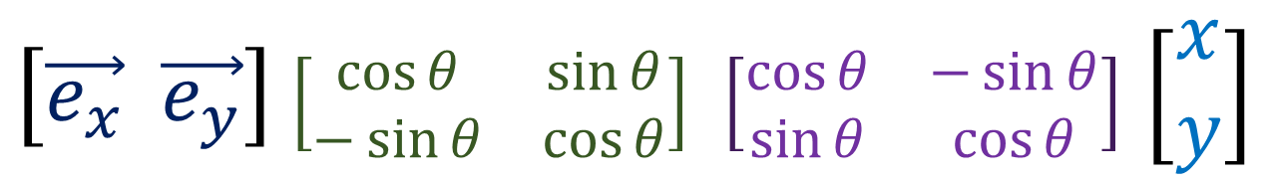
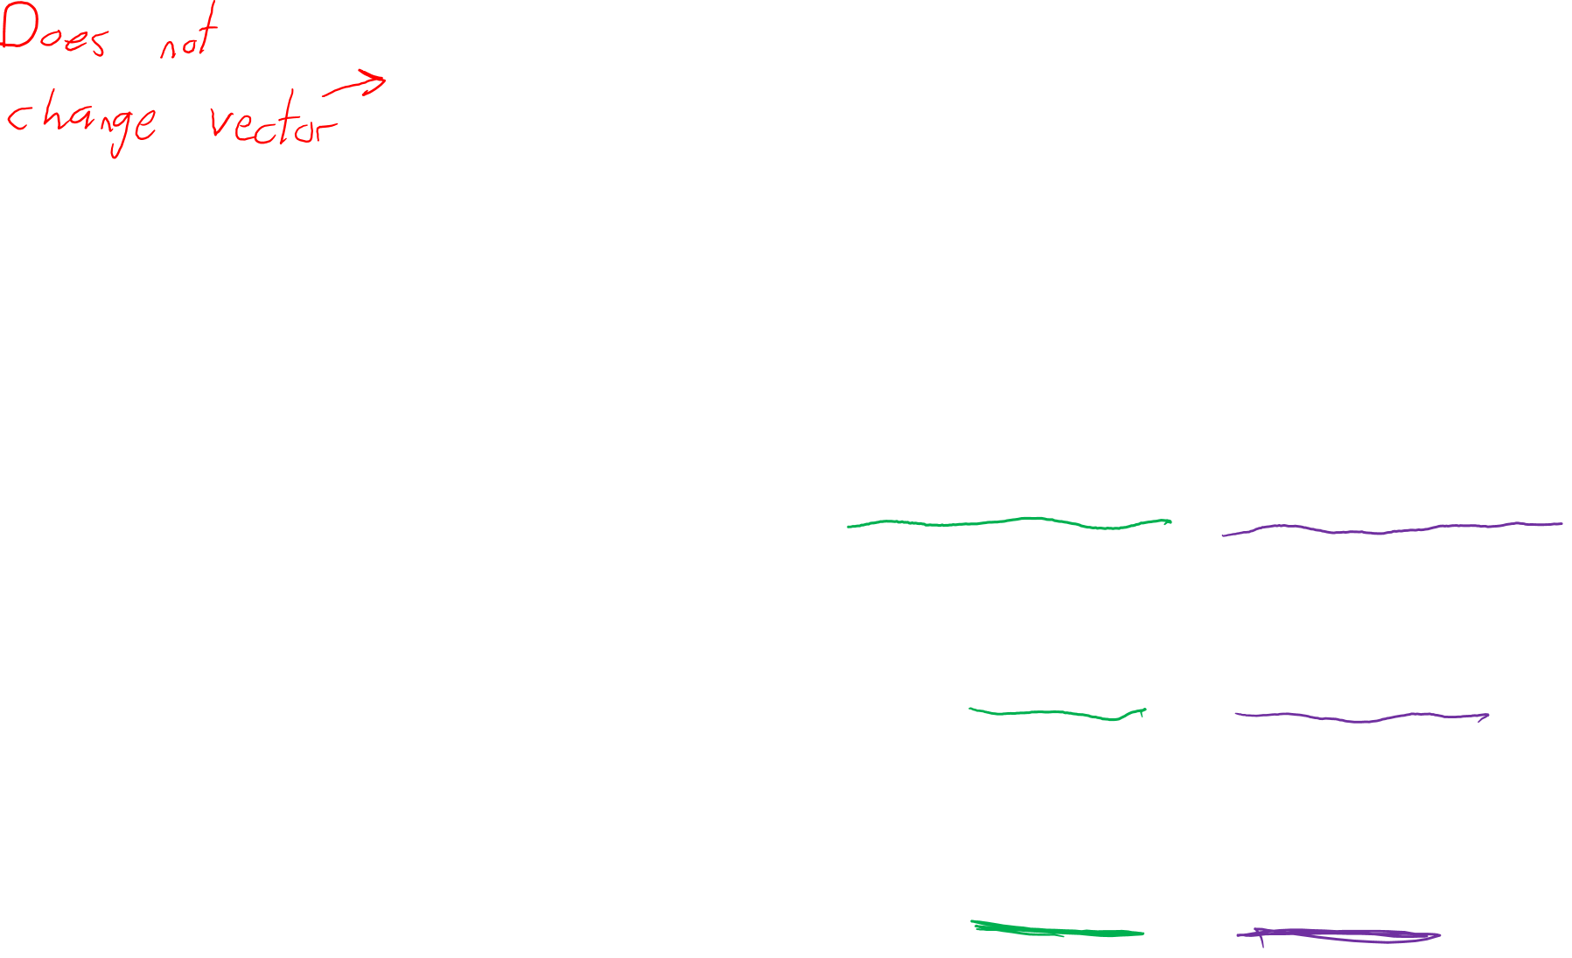
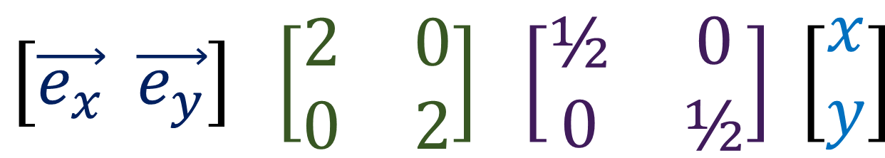
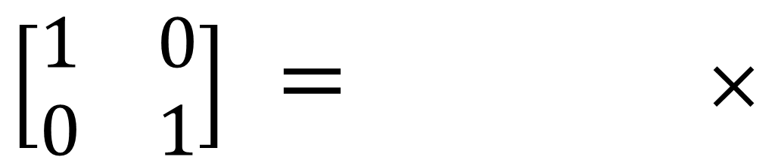
$\left[\begin{matrix}1 & 0 \\ 0 & 1\end{matrix}\right]$ $=$ $×$
Change-of- Basis Matrix
Change-of- Component Matrix
$$\left[\vec{e_{x}} \vec{e_{y}}\right] \left[\begin{matrix}2 & 0 \\ 0 & 2\end{matrix}\right] \left[\begin{matrix}\text{½} & 0 \\ 0 & \text{½}\end{matrix}\right] \left[\begin{aligned}x \\ y\end{aligned}\right]$$
Scaling Matrix
$\left[\vec{e_{x}} \vec{e_{y}}\right]$ $\left[\begin{matrix}\cos{θ} & \sin{θ} \\ −\sin{θ} & \cos{θ}\end{matrix}\right] \left[\begin{matrix}\cos{θ} & −\sin{θ} \\ \sin{θ} & \cos{θ}\end{matrix}\right]$ $\left[\begin{aligned}x \\ y\end{aligned}\right]$
Rotation Matrix
$\left[\vec{e_{x}} \vec{e_{y}}\right]$ $\left[\begin{matrix}1 & a \\ 0 & 1\end{matrix}\right] \left[\begin{matrix}1 & −a \\ 0 & 1\end{matrix}\right]$ $\left[\begin{aligned}x \\ y\end{aligned}\right]$
Shear Matrix
$\left[\vec{e_{x}} \vec{e_{y}}\right]$ $\left[\begin{matrix}a & b \\ c & d\end{matrix}\right] {\left[\begin{matrix}a & b \\ c & d\end{matrix}\right]}^{−1}$ $\left[\begin{aligned}x \\ y\end{aligned}\right]$
General Matrix
Notes:
Now, I’ve given the specific example of scaling the basis vectors and components: making them bigger or smaller. But the ideas of covariance and contravariance apply to any matrix transformations. If we rotate the basis one direction, the components will rotate by the same amount in the other direction. If we shear the basis one way, the components shear the other way. In General the change-of-basis matrix on the left, the change-of-component matrix on the right will always be the inverse, and they will multiply together to give the identity matrix.

Slide 13
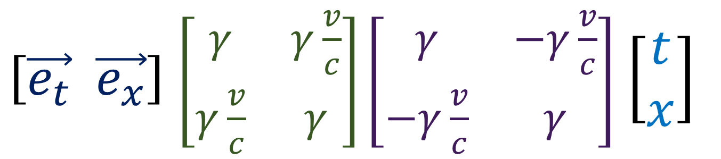
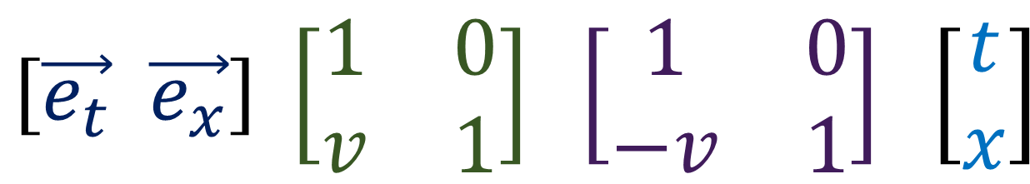

Change-of- Basis Matrix
Change-of- Component Matrix
2D Space (Scaling Matrix)
$$\left[\vec{e_{x}} \vec{e_{y}}\right] \left[\begin{matrix}2 & 0 \\ 0 & 2\end{matrix}\right] \left[\begin{matrix}\text{½} & 0 \\ 0 & \text{½}\end{matrix}\right] \left[\begin{aligned}x \\ y\end{aligned}\right]$$
Galilean Relativity (Galilean Matrix)
$$\left[\vec{e_{t}} \vec{e_{x}}\right] \left[\begin{matrix}1 & 0 \\ v & 1\end{matrix}\right] \left[\begin{matrix}\text{1} & 0 \\ −v & \text{1}\end{matrix}\right] \left[\begin{aligned}t \\ x\end{aligned}\right]$$
$\left[\vec{e_{t}} \vec{e_{x}}\right]$ $\left[\begin{matrix}γ & γ\frac{v}{c} \\ γ\frac{v}{c} & γ\end{matrix}\right]\left[\begin{matrix}γ & −γ\frac{v}{c} \\ −γ\frac{v}{c} & γ\end{matrix}\right]$ $\left[\begin{aligned}t \\ x\end{aligned}\right]$
Special Relativity (Lorentz Matrix)
Notes:
So we’ve seen in 2 dimensional space, how we can change make the basis vectors twice as long, and also make the vector components twice as small in order to transform the coordinates. This is done with a change-of-basis matrix, which transforms the basis vectors, and a change-of-component matrix, which change the vector components in the exact opposite way. Later in this video series we’ll see that Galilean relativity is really just changing time and space coordinates using a Galilean matrix, as seen here. And after that we’ll see that Special relativity is really just changing time space coordinates using a Lorentz matrix, and this can explain time dilation, length contraction, and all the other strange things Einstein predicted.

Slide 14
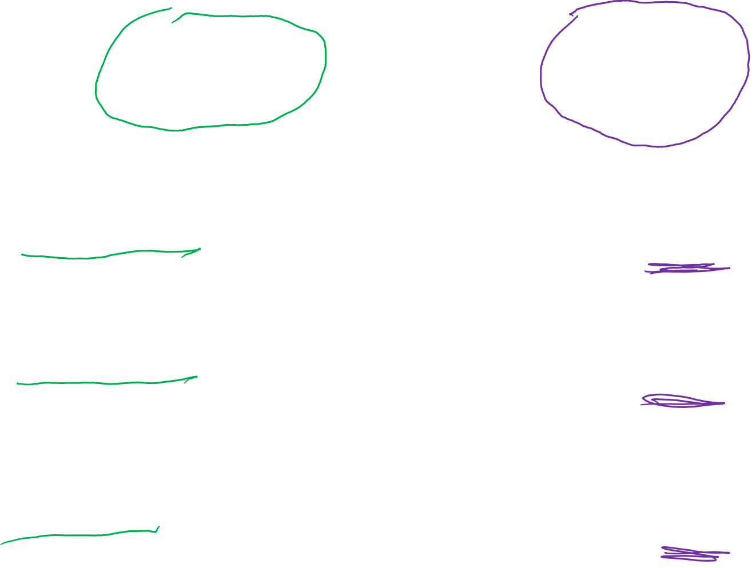
Change-of- Basis Matrix
Change-of- Component Matrix
2D Space (Scaling Matrix)
$$\left[\vec{e_{x}} \vec{e_{y}}\right] \left[\begin{matrix}2 & 0 \\ 0 & 2\end{matrix}\right] \left[\begin{matrix}\text{½} & 0 \\ 0 & \text{½}\end{matrix}\right] \left[\begin{aligned}x \\ y\end{aligned}\right]$$
Galilean Relativity (Galilean Matrix)
$$\left[\vec{e_{t}} \vec{e_{x}}\right] \left[\begin{matrix}1 & 0 \\ v & 1\end{matrix}\right] \left[\begin{matrix}\text{1} & 0 \\ −v & \text{1}\end{matrix}\right] \left[\begin{aligned}t \\ x\end{aligned}\right]$$
$\left[\vec{e_{t}} \vec{e_{x}}\right]$ $\left[\begin{matrix}γ & γ\frac{v}{c} \\ γ\frac{v}{c} & γ\end{matrix}\right]\left[\begin{matrix}γ & −γ\frac{v}{c} \\ −γ\frac{v}{c} & γ\end{matrix}\right]$ $\left[\begin{aligned}t \\ x\end{aligned}\right]$
Special Relativity (Lorentz Matrix)
Covariant
Contravariant
Notes:
When something transforms like basis vectors do, we say that it is covariant. Personally speaking, I always try to write covariant things as as rows. And when something transforms in a way opposite to basis vectors, we call it contravariant. Again, personally, I always try to write contravariant things as columns.

Slide 15
b) covariance & contravariance
When one thing grows, another thing shrinks
Opposite changes will balance out
When the basis changes one way, a vector’s components change in the opposite way
The changes “balance out”, leaving the vector unchanged
Notes:
So originally we said covariance and contravariance was all about this idea of one thing growing and another thing shrinking, and opposite changes balancing out.
To be more specific, when we change basis vectors one way, a vector’s components will change in the exact opposite way. These opposite changes will balance out, leaving the vector unchanged.

Slide 16
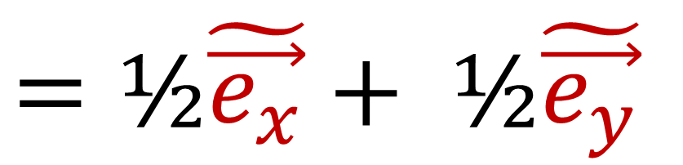
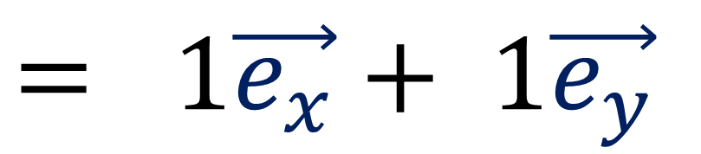

a) invariance
$$= 1\vec{e_{x}}+ 1\vec{e_{y}}$$
$$\tilde{\vec{e_{y}}}$$
$$=\text{½}\tilde{\vec{e_{x}}}+ \text{½}\tilde{\vec{e_{y}}}$$
The pencil is invariant
but the components can change.
$$\vec{e_{y}}$$
$$\vec{e_{x}}$$
$$\tilde{\vec{e_{x}}}$$
Notes:
So to sum up Relativity 102, there were two key ideas. The first idea is invariance. Invariance tells us that we can have the same physical object, which is not changing and therefore invariant, described in different ways using different coordinate systems. For example, this pencil vector as components 1,1 in the eX, eY basis, but has components ½, ½ in the eX-tilde eY-tilde basis. The pencil is invariant, but the components can change.

Slide 17

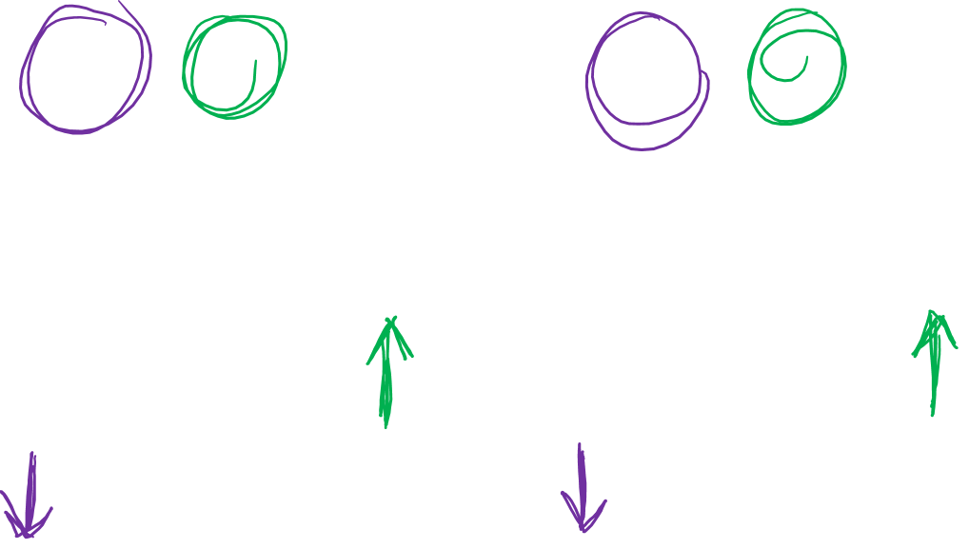
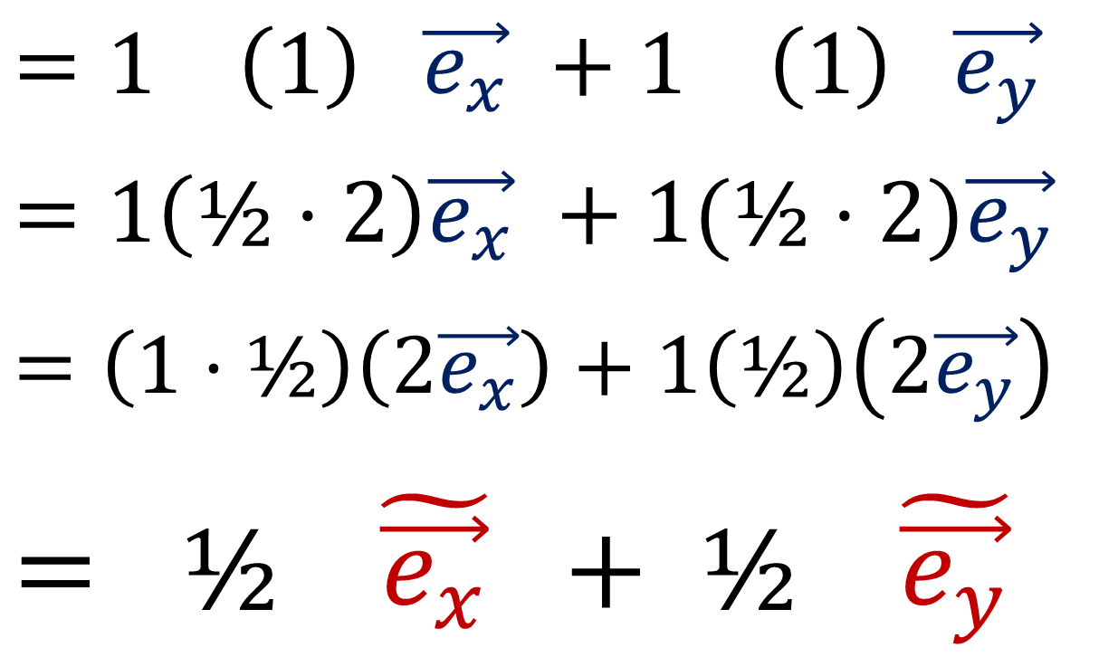
b) covariance & contravariance
$$= 1\vec{e_{x}}+ 1\vec{e_{y}}$$
$$\tilde{\vec{e_{y}}}$$
$$\tilde{\vec{e_{x}}}=2\vec{e_{x}}$$
$$\tilde{\vec{e_{y}}}=2\vec{e_{y}}$$
$$=1 \left(1\right) \vec{e_{x}} +1 \left(1\right) \vec{e_{y}}$$
$$=1\left(\text{½}⋅2\right)\vec{e_{x}} +1(\text{½}⋅2)\vec{e_{y}}$$
$$=\left(1⋅\text{½}\right)\left(2\vec{e_{x}}\right)+1\left(\text{½}\right)\left(2\vec{e_{y}}\right)$$
$$= \text{½} \tilde{\vec{e_{x}}} + \text{½} \tilde{\vec{e_{y}}}$$
$$\vec{e_{y}}$$
$$\vec{e_{x}}$$
$$\tilde{\vec{e_{x}}}$$
Notes:
The second important idea as the idea of covariance and contravariance. These ideas tell us that when the basis vectors change in one way, the vector components must change in the opposite way. For example, when writing an expression for this pencil vector, when we make the basis vectors twice as big, the components must become twice as small in order to balance out and make the equals sign still valid.

Slide 18




b) covariance & contravariance
$$\vec{e_{y}}$$
$$x=4$$
$$\vec{e_{x}}$$
$$y=3$$
$$\tilde{\vec{e_{y}}}$$
$$\tilde{\vec{e_{x}}}=2\vec{e_{x}}$$
$$\tilde{\vec{e_{y}}}=2\vec{e_{y}}$$
$$\vec{e_{y}}$$
Coordinate Transformation
changes both the basis and the components!
…and they change in opposite ways!
$$\vec{e_{x}}$$
$$\tilde{\vec{e_{x}}}$$
Notes:
Remember that basis vectors and vector components are two sides of the same coin. We can never deal with one without also dealing with the other.
A coordinate transformation will change both the basis vectors and vector components, and they will change in opposite ways in order to maintain balance.

Slide 19
It’s okay if you are still confused! We’ll go over all this again in later videos!

Slide 20
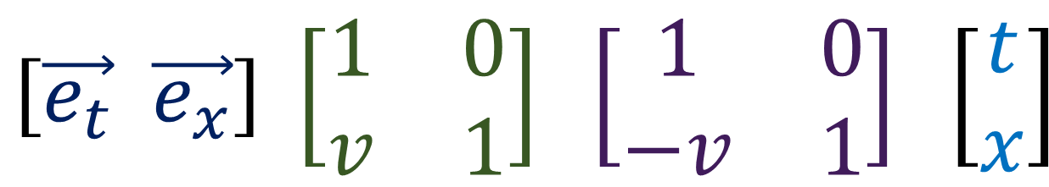
Relativity 103: Galilean Relativity
Change-of- Basis Matrix
Change-of- Component Matrix
Change inertial frames of reference using a Galilean Matrix
$$\left[\vec{e_{t}} \vec{e_{x}}\right] \left[\begin{matrix}1 & 0 \\ v & 1\end{matrix}\right] \left[\begin{matrix}\text{1} & 0 \\ −v & \text{1}\end{matrix}\right] \left[\begin{aligned}t \\ x\end{aligned}\right]$$
Covariant
Contravariant
Notes:
Next in Relativity 103, we’ll discuss Galilean Relativity, and we’ll see that all the math in Galilean Relativity can be described by changing inertial frames of reference using a Galilean matrix.

