Slide 1
Relativity 103: Galilean Relativity
Spacetime Diagrams
Spacetime Separation Vector
Galilean Transform
Metric Tensor (Euclidean)
Conclusion: Problems with Galilean Relativity
Brief review of Galilean Relativity
Problems with Galilean Relativity
Notes:
We’ve finished all the main topics in Galilean Relativity. Now I’m going to talk about some of the problems that Galilean Relativity has… and this will set the stage for why we need special relativity.

Slide 2

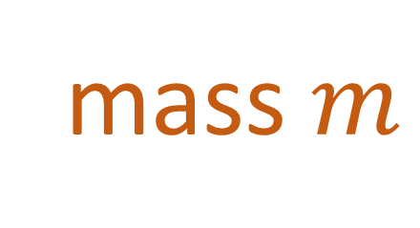
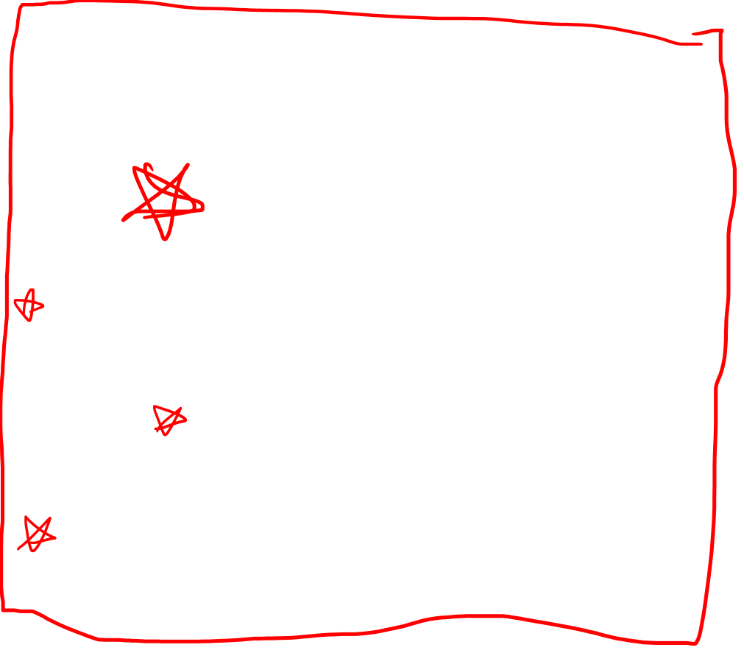

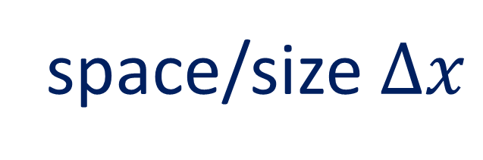
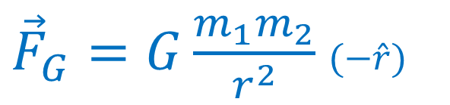
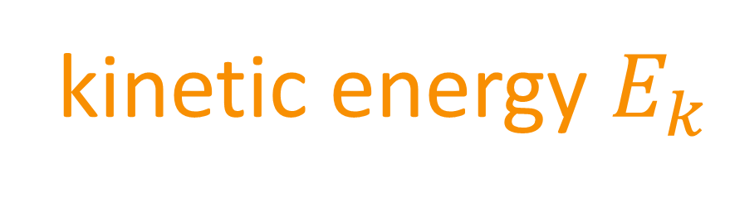

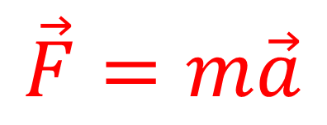

Galilean Principle of Relativity
Laws of motion are the same in all inertial reference frames
Things we disagree on:
Things we agree on:
time $Δt$
space/size $Δx$
position $x$
mass $m$
velocity $\vec{v}$
Laws of motion
momentum $\vec{p}$
$$\vec{F}=m\vec{a}$$
${\vec{F}}_{G}=G\frac{m_{1}m_{2}}{r^{2}}$ $(−\hat{r})$
kinetic energy $E_{k}$
Notes:
I said earlier that the main goal of Galilean relativity is to calculate all the different quantities that we disagree on in different inertial reference frames. The most important of these was position, but it also includes velocity, momentum, and kinetic energy.

Slide 3

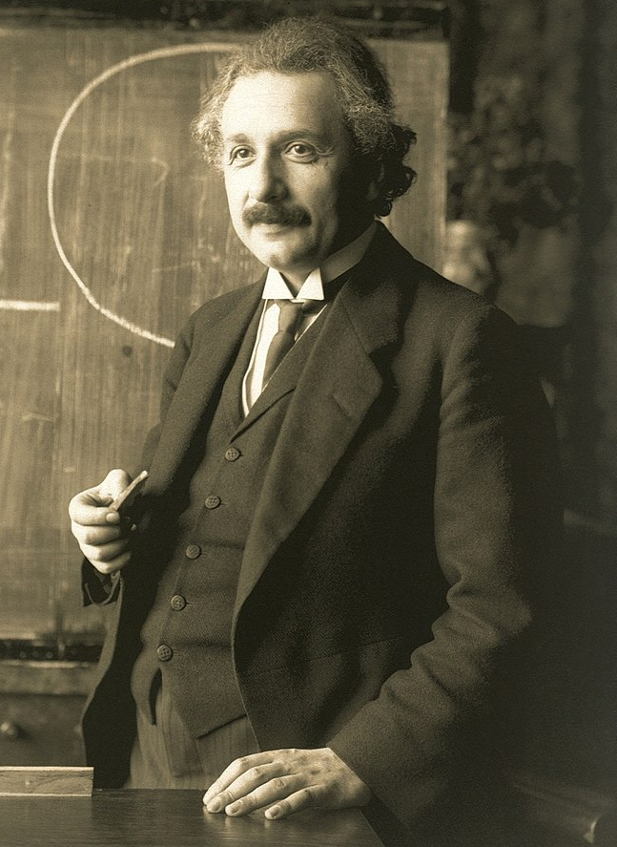
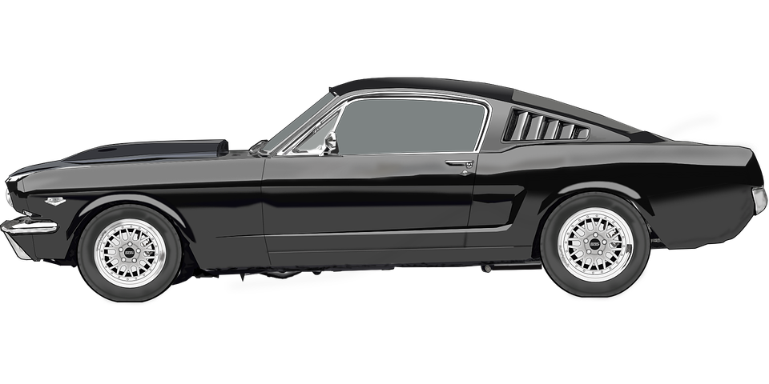



Changing coordinates (Galilean Relativity)
time $t$
position $x$
Notes:
We’ve seen that in Galilean relativity, observers in different reference frames will agree on time, but they will disagree on position.

Slide 4
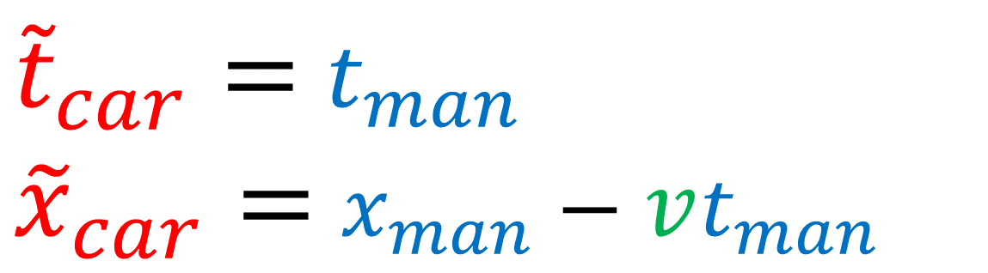

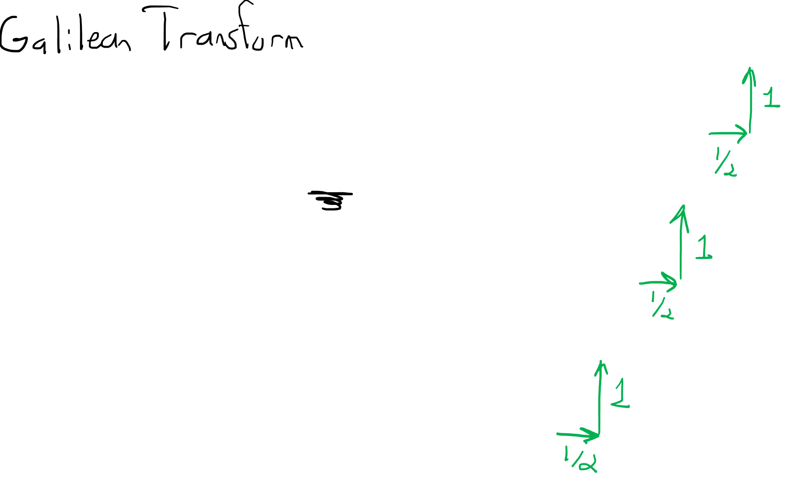
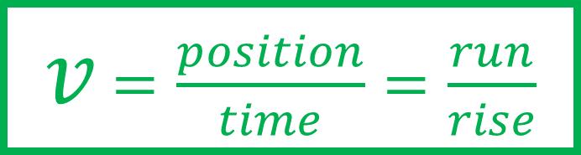
Changing coordinates (Galilean Relativity)
time $t$
${\tilde{t}}_{car}=$ $t_{man}$
${\tilde{x}}_{car}=$ $x_{man}−vt_{man}$
$v$ $=\frac{position}{time}=\frac{run}{rise}$
$$v=\text{½}$$
position $x$
Notes:
We showed we could convert between the spacetime coordinates of the man and the car using the Galilean transform equations, where V in this case is the speed of the car measured from the man’s reference frame. In this example the car’s speed is ½ because its worldline runs ½ unit of position for every upward rise of a unit in time.

Slide 5
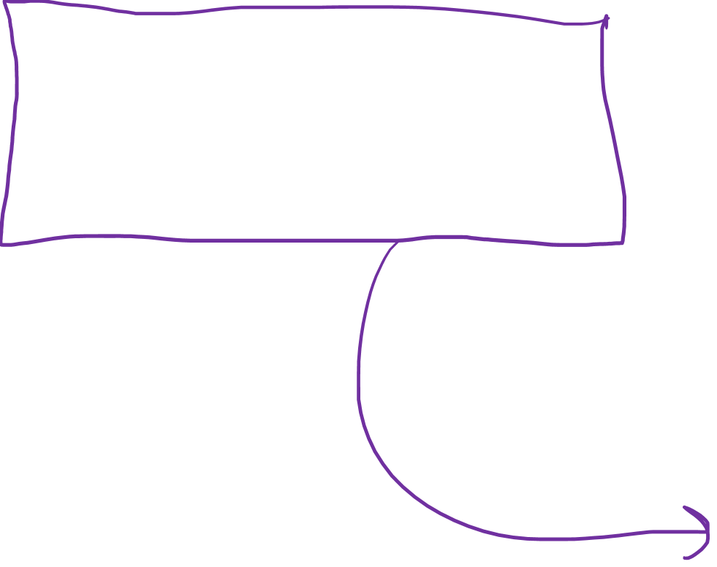
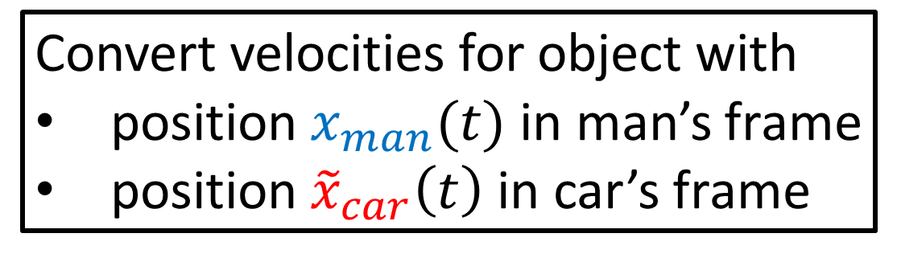
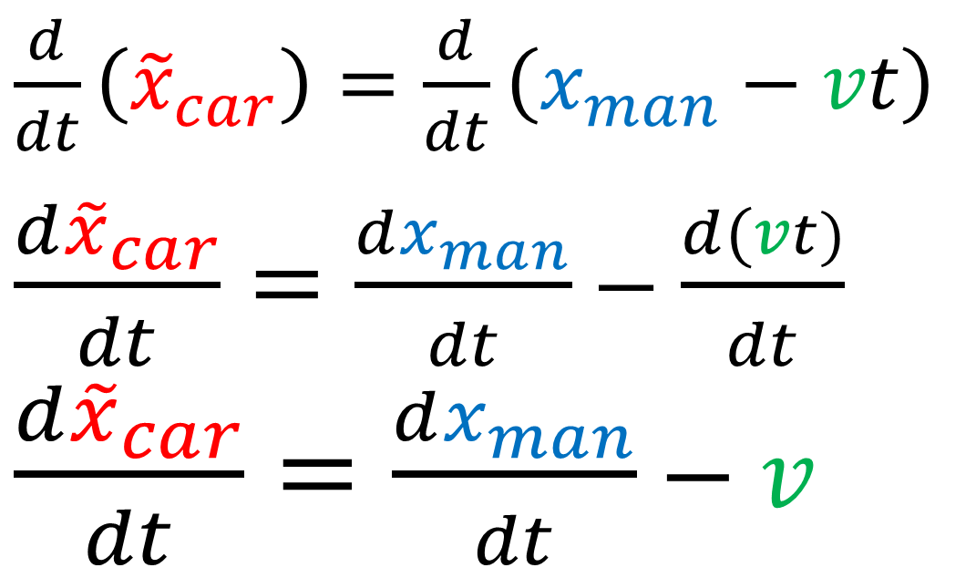
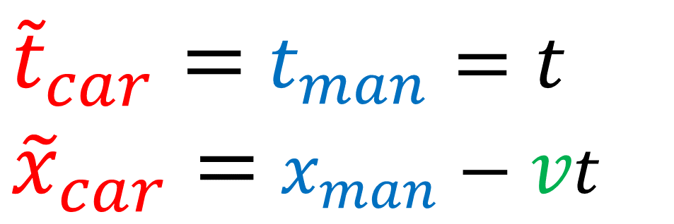
Convert velocities for object with
position $x_{man}(t)$ in man’s frame
position ${\tilde{x}}_{car}\left(t\right)$ in car’s frame
${\tilde{t}}_{car}=$ $t_{man}=t$
${\tilde{x}}_{car}=$ $x_{man}−vt$
$\frac{d}{dt}\left({\tilde{x}}_{car}\right)=\frac{d}{dt}\left(x_{man}−vt\right)$
$\frac{d{\tilde{x}}_{car}}{dt}=\frac{dx_{man}}{dt}−\frac{d(vt)}{dt}$
$\frac{d{\tilde{x}}_{car}}{dt}=\frac{dx_{man}}{dt}−v$
Notes:
And since mass is invariant, it’s not difficult to calculate the momentum and kinetic energies of an object once we know its velocity.

Slide 6


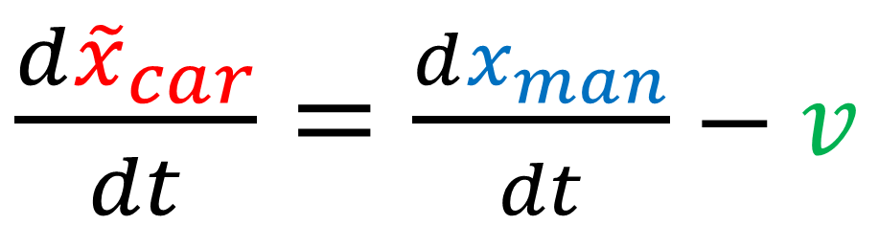

Convert time/space
Momentum
${\tilde{t}}_{car}=$ $t_{man}=t$
${\tilde{x}}_{car}=$ $x_{man}−vt$
$p_{man}=m\frac{dx_{man}}{dt}$
${\tilde{p}}_{car}=m\frac{d{\tilde{x}}_{car}}{dt}$
Convert velocity
Kinetic Energy
$\frac{d{\tilde{x}}_{car}}{dt}=\frac{dx_{man}}{dt}−v$
$E_{man}=\frac{1}{2}m{\left(\frac{dx_{man}}{dt}\right)}^{2}$
${\tilde{E}}_{car}=\frac{1}{2}m{\left(\frac{d{\tilde{x}}_{car}}{dt}\right)}^{2}$
Notes:
So we know the Galilean transform can help us convert spacetime coordinates of an object. And its derivative can help us convert the velocities of an object in different coordinates. And from there it’s easy to compute an object’s momentum and kinetic energy in different coordinate systems, because m is equal in all coordinate systems.

Slide 7
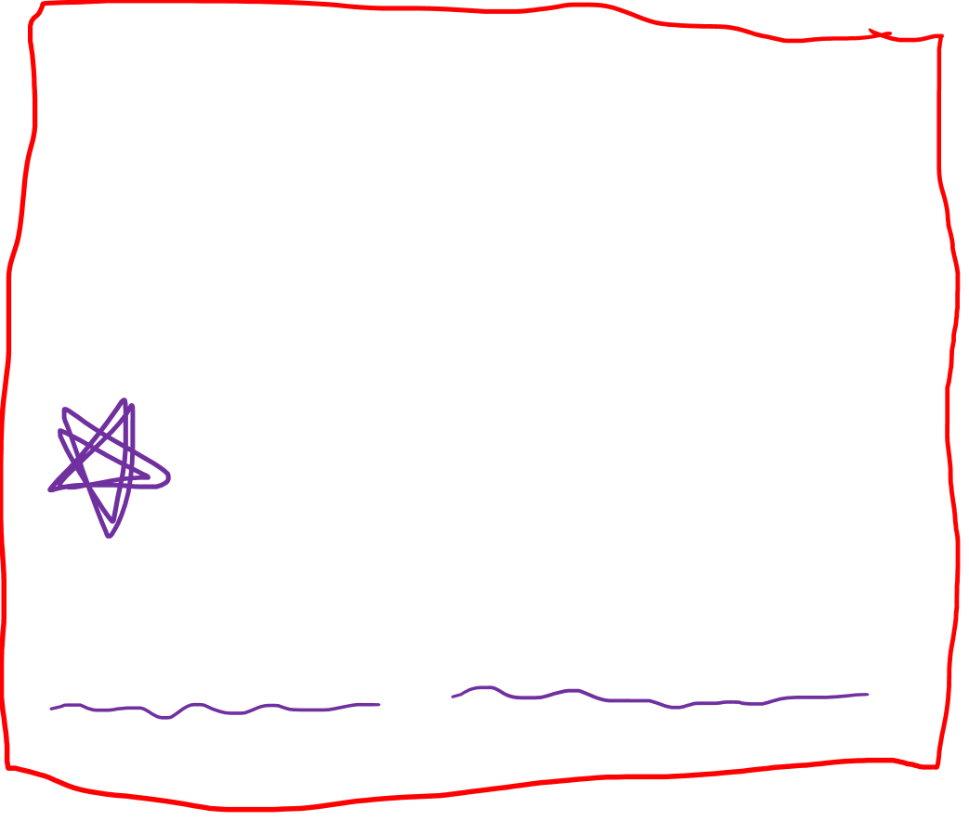
Galilean Principle of Relativity
Laws of motion are the same in all inertial reference frames
Things we disagree on:
Things we agree on:
time $Δt$
space/size $Δx$
position $x$
mass $m$
velocity $\vec{v}$
Laws of motion
momentum $\vec{p}$
$$\vec{F}=m\vec{a}$$
${\vec{F}}_{G}=G\frac{m_{1}m_{2}}{r^{2}}$ $(−\hat{r})$
kinetic energy $E_{k}$
Notes:
I said earlier that the main goal of Galilean relativity is to calculate all the different quantities that we disagree on in different inertial reference frames. The most important of these was position, but it also includes velocity, momentum, and kinetic energy.

Slide 8
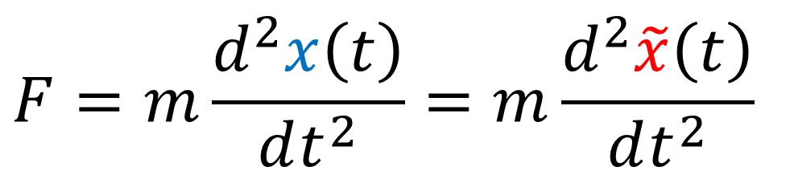
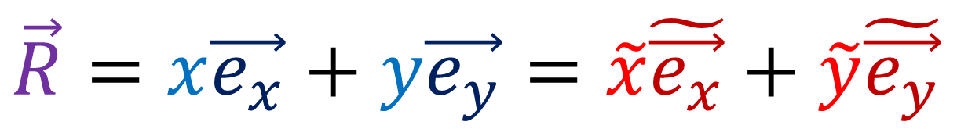
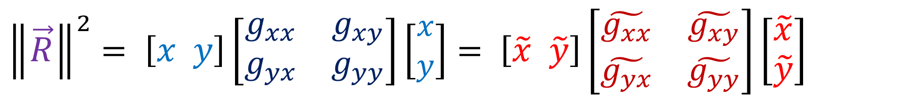
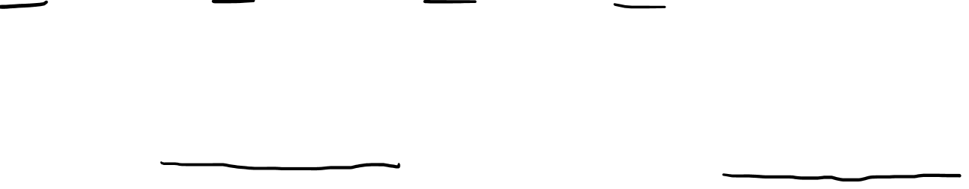
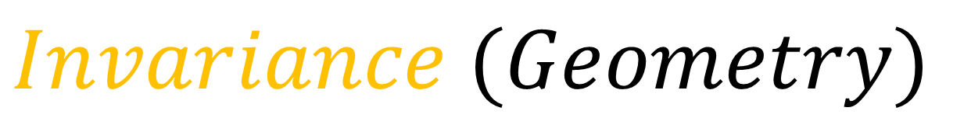
$$Invariance (Geometry)$$
$$\vec{R}=x\vec{e_{x}}+y\vec{e_{y}}=\tilde{x}\tilde{\vec{e_{x}}}+\tilde{y}\tilde{\vec{e_{y}}}$$
$${\left\|\vec{R}\right\|}^{2}= \left[x y\right]\left[\begin{matrix}g_{xx} & g_{xy} \\ g_{yx} & g_{yy}\end{matrix}\right]\left[\begin{aligned}x \\ y\end{aligned}\right]= \left[\tilde{x} \tilde{y}\right]\left[\begin{matrix}\tilde{g_{xx}} & \tilde{g_{xy}} \\ \tilde{g_{yx}} & \tilde{g_{yy}}\end{matrix}\right]\left[\begin{aligned}\tilde{x} \\ \tilde{y}\end{aligned}\right]$$
$Invariance$ $(Physics −Galilean Relativity)$
$$F=m\frac{d^{2}x\left(t\right)}{dt^{2}}=m\frac{d^{2}\tilde{x}\left(t\right)}{dt^{2}}$$
Notes:
Now I’d like to once again talk about invariance. Invariance is the idea that the same object can look different in different coordinate systems. When in comes to geometry, we’ve already seen that the same vector R can have different components in different coordinate systems. We’ve also seen the formula for the squared length of a vector R uses a different metric tensor in different coordinate systems. But now let’s consider physics in Galilean relativity. Is it possible to write newton’s second law, force equals mass times acceleration, as invariant in different reference frames?

Slide 9
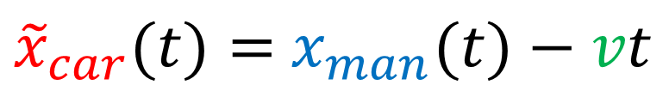
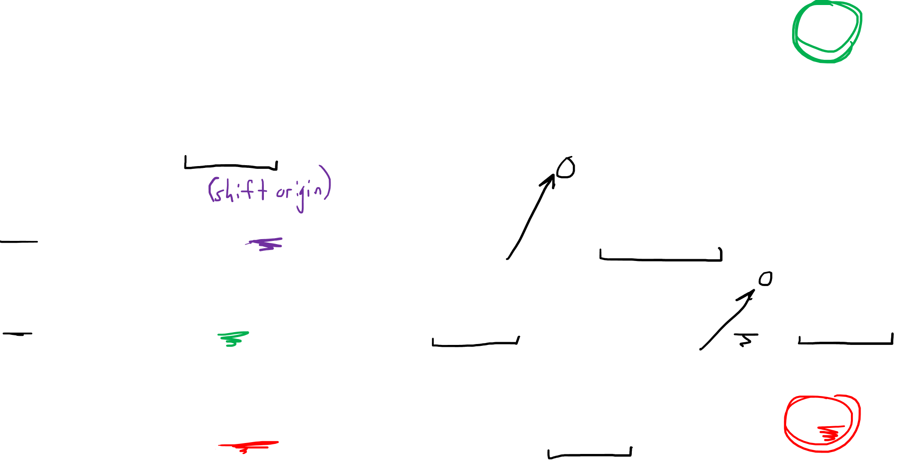
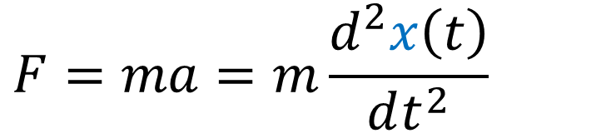
Galilean Relativity: Laws of physics are the same in all non-accelerating reference frames
Galilean Transform (space)
${\tilde{x}}_{car}(t)=$ $x_{man}(t)−vt$
$$F=ma=m\frac{d^{2}x\left(t\right)}{dt^{2}}$$
Fictitious Force
due to non-inertial
reference frame
$$F=m\frac{d^{2}}{dt^{2}}\left[x\left(t\right)+k\right]=m\frac{d^{2}x\left(t\right)}{dt^{2}}+m\frac{d^{2}k}{dt^{2}}=m\frac{d^{2}x\left(t\right)}{dt^{2}}$$
$F=m\frac{d^{2}}{dt^{2}}\left[x\left(t\right)+vt\right]=m\frac{d^{2}x\left(t\right)}{dt^{2}}+m\frac{d^{2}}{dt^{2}}\left(vt\right)=m\frac{d^{2}x\left(t\right)}{dt^{2}}+m\frac{d}{dt}\left(v\right)=m\frac{d^{2}x\left(t\right)}{dt^{2}}$
$$F=m\frac{d^{2}}{dt^{2}}\left[x\left(t\right)+\frac{1}{2}αt^{2}\right]=m\frac{d^{2}x\left(t\right)}{dt^{2}}+m\frac{d^{2}}{dt^{2}}\left(\frac{1}{2}αt^{2}\right)=m\frac{d^{2}x\left(t\right)}{dt^{2}}+mα$$
Notes:
So we know that newton’s second Law says that force equations mass times acceleration, assuming the mass is constant. In other words, force equals mass times the second derivative of position X with respect to time. Now let’s see what happens if we change coordinates by adding some constant k to the position x(t). This basically just shifts the origin of our coordinate system to another point. The second derivative of X stays the same, but the derivative of K goes to zero, since it’s a constant. So you’ll see that Newton’s 2nd law still holds if we shift the origin of our coordinate system. Next let’s try adding a linear term, velocity multiplied by time, to our coordinate system. This basically just doing a Galilean transformation to our coordinates, moving to another reference frame with a constant speed. Again, the 2nd derivative of x stays the say. The first derivative of V times T is just the constant V, and the derivative of that is zero. So we can see that when we change coordinates by adding a constant speed, Newton’s 2nd Law F=ma still holds.
Now let’s try adding a 2nd order term to the position. This is like changing coordinates to an accelerating frame, like a car that’s speeding up. We leave the 2nd derivative of X as is, but the 2nd derivative of ½ alpha t^2 doesn’t go to zero. The constant alpha survives. So in an accelerating reference frame. Newton’s 2nd law doesn’t hold. We end up with a fictitious force due to the non-inertial reference frame that makes the law stop working. This is why you feel your body being pulled downward in an elevator accererating upward, or thrown back into your seat when a car.

Slide 10
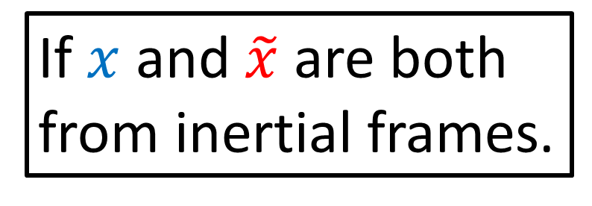
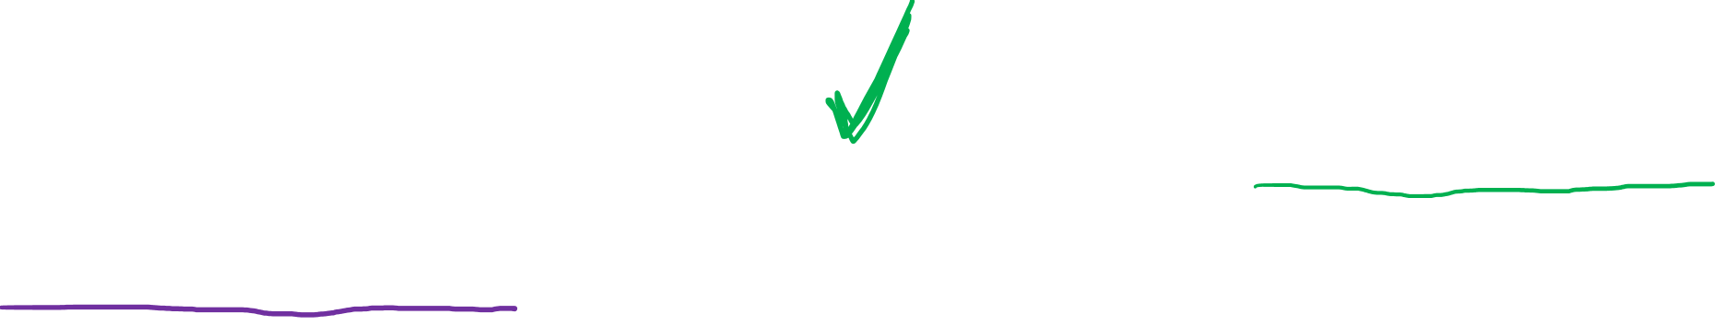
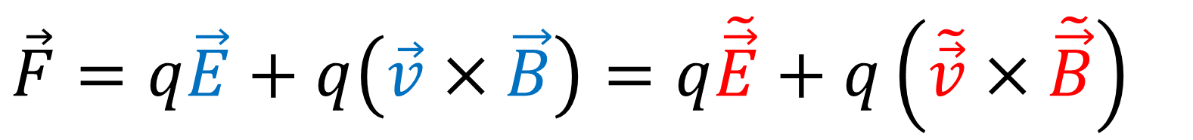
$$Invariance (Geometry)$$
$$\vec{R}=x\vec{e_{x}}+y\vec{e_{y}}=\tilde{x}\tilde{\vec{e_{x}}}+\tilde{y}\tilde{\vec{e_{y}}}$$
$${\left\|\vec{R}\right\|}^{2}= \left[x y\right]\left[\begin{matrix}g_{xx} & g_{xy} \\ g_{yx} & g_{yy}\end{matrix}\right]\left[\begin{aligned}x \\ y\end{aligned}\right]= \left[\tilde{x} \tilde{y}\right]\left[\begin{matrix}\tilde{g_{xx}} & \tilde{g_{xy}} \\ \tilde{g_{yx}} & \tilde{g_{yy}}\end{matrix}\right]\left[\begin{aligned}\tilde{x} \\ \tilde{y}\end{aligned}\right]$$
$Invariance$ $(Physics −Galilean Relativity)$
$$F=m\frac{d^{2}x\left(t\right)}{dt^{2}}=m\frac{d^{2}\tilde{x}\left(t\right)}{dt^{2}}$$
If $x$ and $\tilde{x}$ are both from inertial frames.
Is Electromagnetism Invariant under Galilean Transform?
$$\vec{F}=q\vec{E}+q\left(\vec{v}×\vec{B}\right)=q\tilde{\vec{E}}+q\left(\tilde{\vec{v}}×\tilde{\vec{B}}\right)$$
Notes:
Now I’d like to once again talk about invariance. Invariance is the idea that the same object can look different in different coordinate systems. When in comes to geometry, we’ve already seen that the same vector R can have different components in different coordinate systems. We’ve also seen the formula for the squared length of a vector R uses a different metric tensor in different coordinate systems. But now let’s consider physics in Galilean relativity. Is it possible to write newton’s second law, force equals mass times acceleration, as invariant in different reference frames?

Slide 11
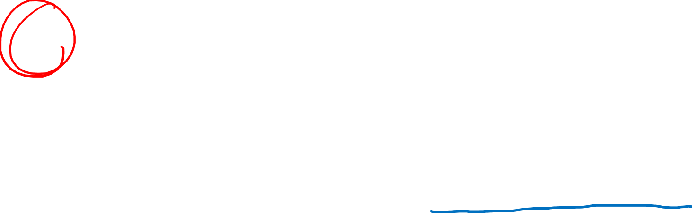
Short Answer:
Laws of Electromagnetism are not invariant under the Galilean Transform
Speed of light is invariant in all reference frames….this leads to Special Relativity, which fixes problem #1
Notes:
The short answer is that
Laws of Electromagnetism are not invariant under the Galilean Transform
But the Speed of light is invariant in all reference frames…. and taking this into account results in Special Relativity, which fixes problem #1
So first I’ll explain why the Galilean Transform fails in Electromagnetism

Slide 12
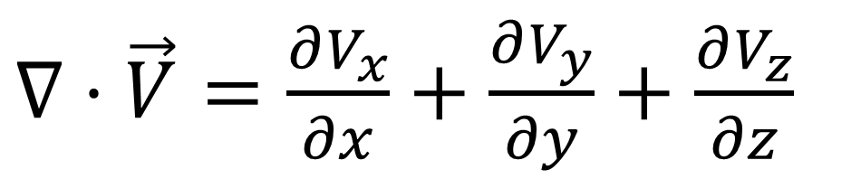
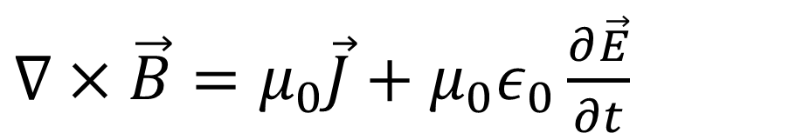
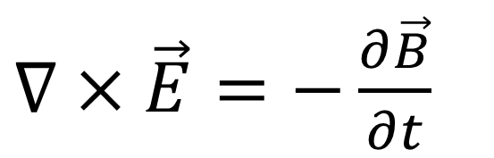
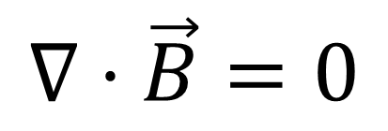
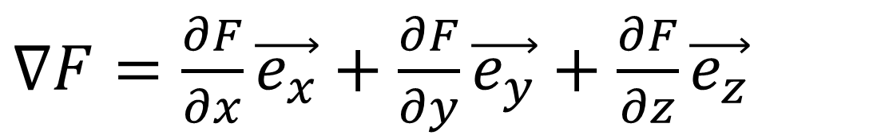
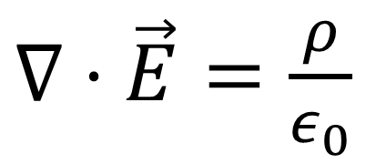
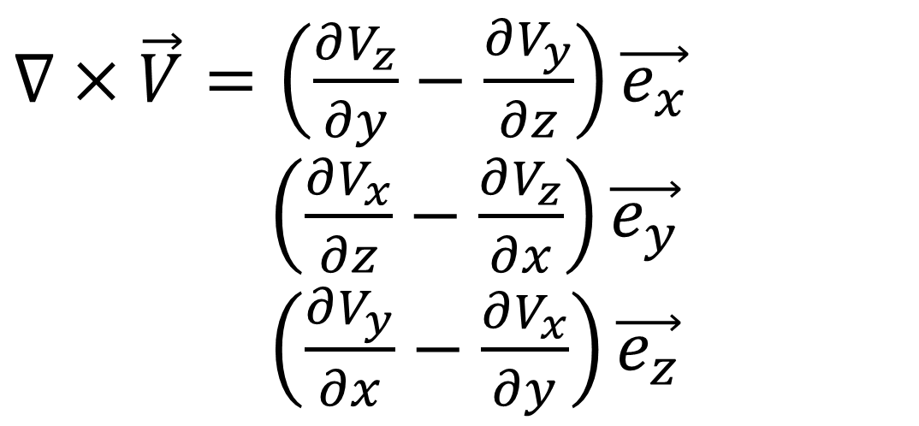
Maxwell’s Equations
Gradient
$∇F=\frac{∂F}{∂x}\vec{e_{x}}+\frac{∂F}{∂y}\vec{e_{y}}+$ $\frac{∂F}{∂z}\vec{e_{z}}$
$∇⋅\vec{E}=\frac{ρ}{ε_{0}}$
Divergence
$∇×\vec{E}=−\frac{∂\vec{B}}{∂t}$
$∇⋅\vec{V}=\frac{∂V_{x}}{∂x}+\frac{∂V_{y}}{∂y}+$ $\frac{∂V_{z}}{∂z}$
Curl
$∇×\vec{V}=\left(\frac{∂V_{z}}{∂y}−\frac{∂V_{y}}{∂z}\right)\vec{e_{x}}$
$∇×\vec{V}+\left(\frac{∂V_{x}}{∂z}−\frac{∂V_{z}}{∂x}\right)\vec{e_{y}}$
$∇×\vec{V}+\left(\frac{∂V_{y}}{∂x}−\frac{∂V_{x}}{∂y}\right)\vec{e_{z}}$
$$∇⋅\vec{B}=0$$
$∇×\vec{B}=μ_{0}\vec{J}+μ_{0}ε_{0}\frac{∂\vec{E}}{∂t}$
Notes:
The four Maxwell’s Equations describe the behaviour of electric and magnetic fields.
If you’ve studied vector calculus, you should be able to understand the behaviour of electric and magnetic fields in terms of Gradient, Divergence and Curl. However, even if you haven’t studied these concepts, I’m hoping you’ll still be able to follow my line of reasoning for why Maxwell’s equations don’t work well with the Galilean Transform.

Slide 13

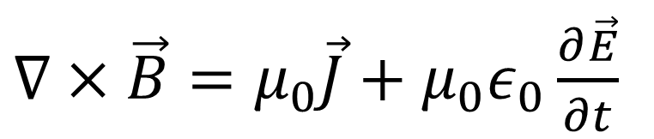
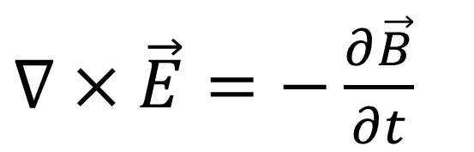
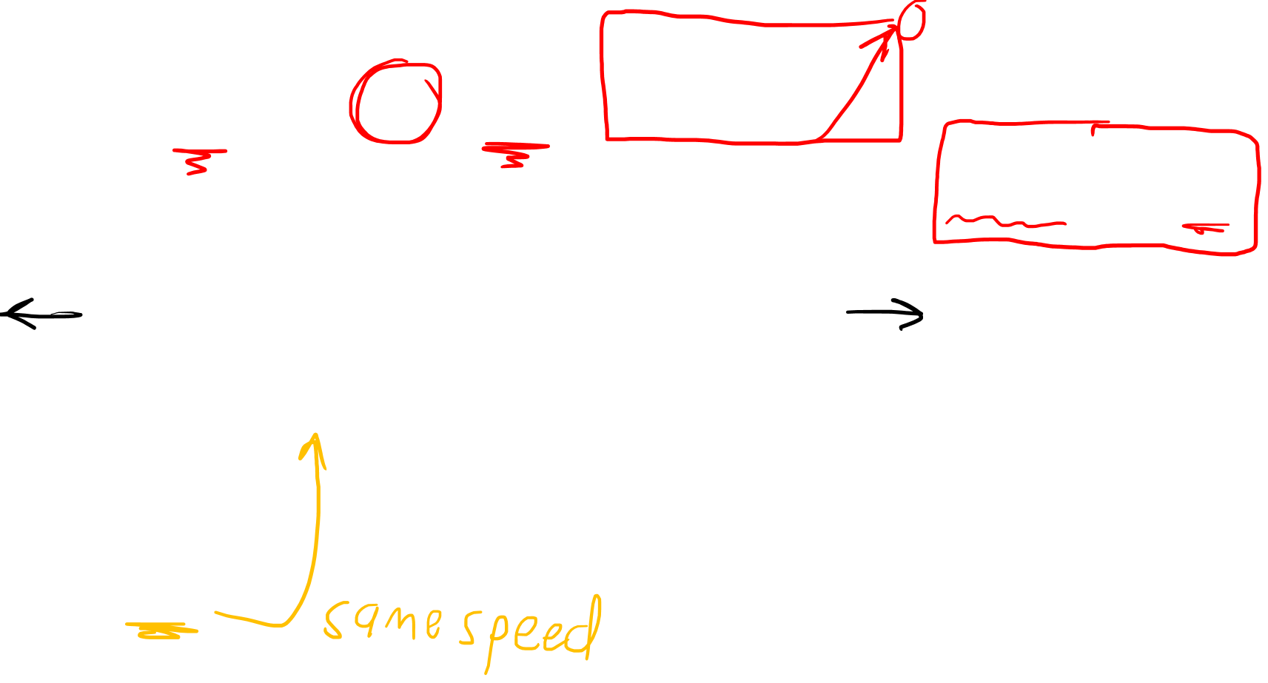
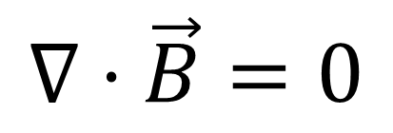

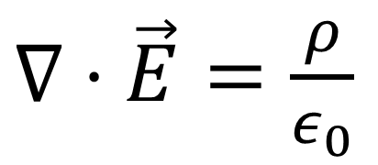
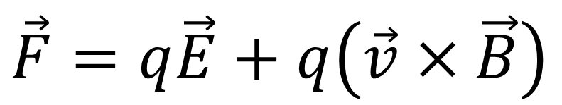

Lorentz Force
Maxwell Equations
$∇×\vec{E}=−\frac{∂\vec{B}}{∂t}$
$∇⋅\vec{E}=\frac{ρ}{ε_{0}}$
$$\vec{F}=q\vec{E}+q\left(\vec{v}×\vec{B}\right)$$
$∇×\vec{B}=μ_{0}\vec{J}+μ_{0}ε_{0}\frac{∂\vec{E}}{∂t}$
$$∇⋅\vec{B}=0$$
+
+
+
+
+
+
+
+
+
+
+
+
+
+
+
+
-
-
-
-
-
-
-
-
-
-
-
-
-
-
-
-
$$\vec{B}$$
+
$$\vec{v}$$
Frame of room
Notes:
In addition to the four Maxwell’s Equations for electric and magnetic fields, we need to remember the Lorentz force, which tells us how to calculate the force on an electric charge q due to the Electric field E and the Magnetic field B. A magnetic force only occurs if the charge is moving with velocity V. Let’s start an experiment in the reference frame of a room. We have an line of positive and negative charges arranged in a line that goes in both directions forever. Because the positive and negative charges are balanced and cancel out, and by the first Maxwell’s equation, there is no electric field. However, the negative charges are travelling to the right, and by the 4th Maxwell equation, a magnetic field will always curl around a current. So we can see this B field curling around the line of charge. Now let’s imagine a single lone proton traveling to the right.

Slide 14
Lorentz Force
Maxwell Equations
$∇×\vec{E}=−\frac{∂\vec{B}}{∂t}$
$∇⋅\vec{E}=\frac{ρ}{ε_{0}}$
$$\vec{F}=q\vec{E}+q\left(\vec{v}×\vec{B}\right)$$
$∇×\vec{B}=μ_{0}\vec{J}+μ_{0}ε_{0}\frac{∂\vec{E}}{∂t}$
$$∇⋅\vec{B}=0$$
+
+
+
+
+
+
+
+
+
+
+
+
+
+
+
+
-
-
-
-
-
-
-
-
-
-
-
-
-
-
-
-
$$\vec{B}$$
+
$$\vec{v}$$
Frame of room
Notes:
In addition to the four Maxwell’s Equations for electric and magnetic fields, we need to remember the Lorentz force, which tells us how to calculate the force on an electric charge q due to the Electric field E and the Magnetic field B. A magnetic force only occurs if the charge is moving with velocity V. Let’s start an experiment in the reference frame of a room. We have an line of positive and negative charges arranged in a line that goes in both directions forever. Because the positive and negative charges are balanced and cancel out, and by the first Maxwell’s equation, there is no electric field. However, the negative charges are travelling to the right, and by the 4th Maxwell equation, a magnetic field will always curl around a current. So we can see this B field curling around the line of charge. Now let’s imagine a single lone proton traveling to the right.

Slide 15

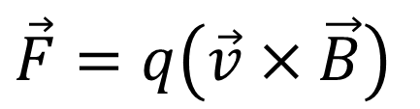
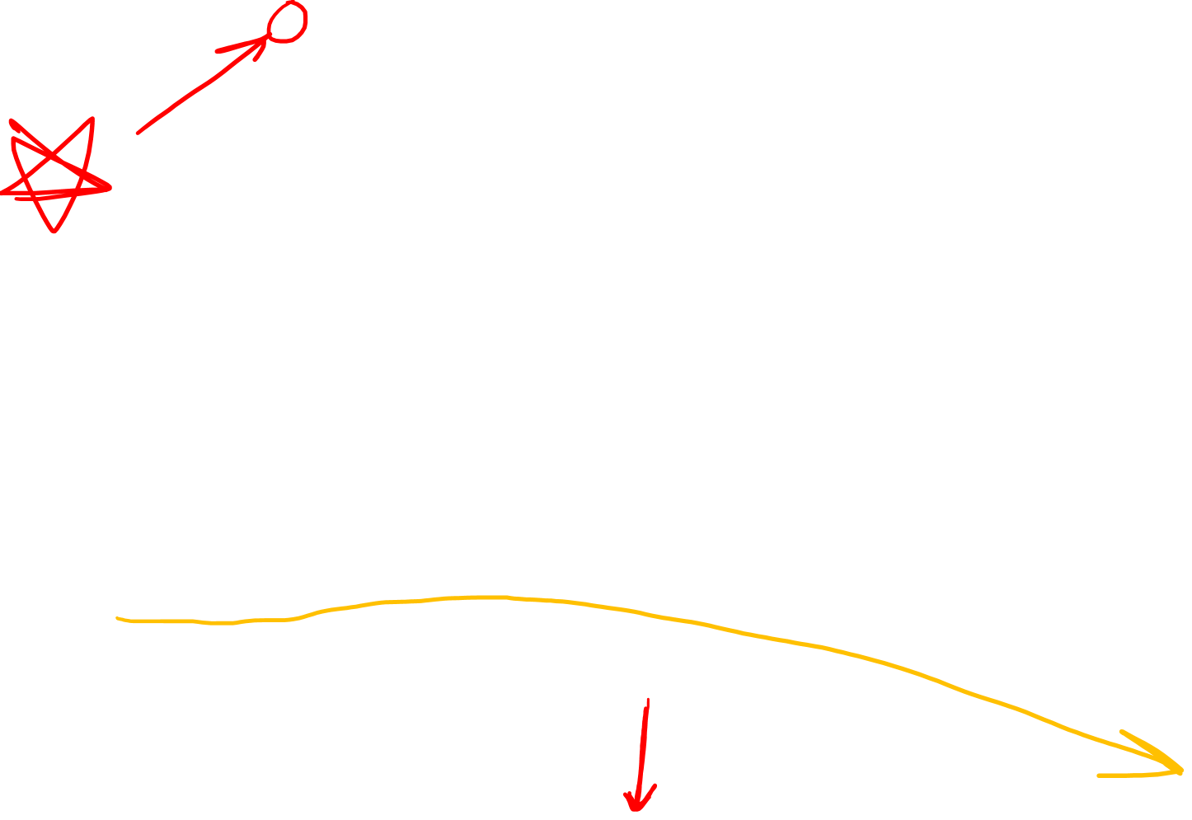
Lorentz Force
Maxwell Equations
$∇×\vec{E}=−\frac{∂\vec{B}}{∂t}$
$∇⋅\vec{E}=\frac{ρ}{ε_{0}}$
$$\vec{F}=q\vec{E}+q\left(\vec{v}×\vec{B}\right)$$
$∇×\vec{B}=μ_{0}\vec{J}+μ_{0}ε_{0}\frac{∂\vec{E}}{∂t}$
$$∇⋅\vec{B}=0$$
+
+
+
+
+
+
+
+
+
+
+
+
+
+
+
+
-
-
-
-
-
-
-
-
-
-
-
-
-
-
-
-
$$\vec{B}$$
+
$$\vec{v}$$
\
$$\vec{B}$$
$$\vec{F}=q\left(\vec{v}×\vec{B}\right)$$
Frame of room
Notes:
We’ll say the lone proton is traveling right at the same speed as the negative charges. Now let’s consider how the Lorentz force acts on this lone proton. Since the +ve and –ve charges above all cancel out, there’s no electric field, so the Lorentz force has zero Electric field portion. However there IS a magnetic field B. And at the position of the lone proton it points out of the screen towards you. Now if we do the cross product between the right-facing velocity vector, and the outward-facing magnetic field vector, we get a downward facing Force vector by the right-hand rule. So in the frame of the room, the Lorentz force pushes the lone proton downward, and it will follow a path like this.

Slide 16
Lorentz Force
Maxwell Equations
$∇×\vec{E}=−\frac{∂\vec{B}}{∂t}$
$∇⋅\vec{E}=\frac{ρ}{ε_{0}}$
$$\vec{F}=q\vec{E}+q\left(\vec{v}×\vec{B}\right)$$
$∇×\vec{B}=μ_{0}\vec{J}+μ_{0}ε_{0}\frac{∂\vec{E}}{∂t}$
$$∇⋅\vec{B}=0$$
+
+
+
+
+
+
+
+
+
+
+
+
+
+
+
+
-
-
-
-
-
-
-
-
-
-
-
-
-
-
-
-
$$\vec{B}$$
+
$$\vec{v}$$
\
$$\vec{B}$$
$$\vec{F}=q\left(\vec{v}×\vec{B}\right)$$
Frame of room
Notes:
We’ll say the lone proton is traveling right at the same speed as the negative charges. Now let’s consider how the Lorentz force acts on this lone proton. Since the +ve and –ve charges above all cancel out, there’s no electric field, so the Lorentz force has zero Electric field portion. However there IS a magnetic field B. And at the position of the lone proton it points out of the screen towards you. Now if we do the cross product between the right-facing velocity vector, and the outward-facing magnetic field vector, we get a downward facing Force vector by the right-hand rule. So in the frame of the room, the Lorentz force pushes the lone proton downward, and it will follow a path like this.

Slide 17

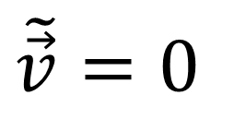
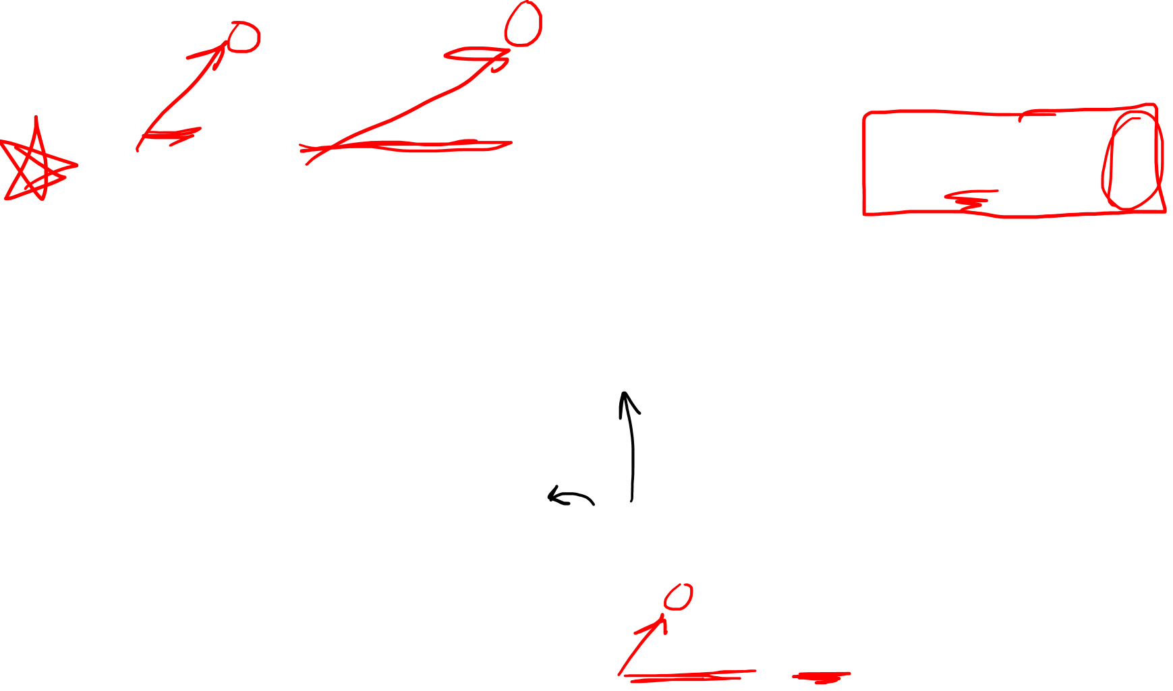


Lorentz Force
Maxwell Equations
$∇×\vec{E}=−\frac{∂\vec{B}}{∂t}$
$∇⋅\vec{E}=\frac{ρ}{ε_{0}}$
$$\vec{F}=q\vec{E}+q\left(\vec{v}×\vec{B}\right)$$
$∇×\vec{B}=μ_{0}\vec{J}+μ_{0}ε_{0}\frac{∂\vec{E}}{∂t}$
$$∇⋅\vec{B}=0$$
+
+
+
+
+
+
+
+
+
+
+
+
+
+
+
+
-
-
-
-
-
-
-
-
-
-
-
-
-
-
-
-
$$\tilde{\vec{B}}$$
+
$$\tilde{\vec{v}}=0$$
Frame of lone proton
\
$$\tilde{\vec{B}}$$
$$\tilde{\vec{F}}=q\left(\tilde{\vec{v}}×\tilde{\vec{B}}\right)=0$$
Notes:
Now let’s look at the same situation in the frame of the lone proton. It is now stationary with a velocity of zero. Since the negative charges have the same velocity as the lone proton, they are also stationary in this frame. However, the protons and the room itself are now travelling to the left. Again, according to the 4th Maxwell Equation, a current of change results in a B-field curling around it. Since this line of charge is travelling in the opposite direction and also has opposite charge, we get the same magnetic field as before.
When calculating the Lorentz force on the lone proton, there is once again no electric force because the positive and negative charges cancel out and there’s no electric field. But this time there is also no magnetic force. Even though there IS a magnetic field, the lone proton now has a velocity of zero, so this cross product also goes to zero.

Slide 18










Lorentz Force
Lorentz Force is not invariant under Galilean Transform.
$$\vec{F}=q\vec{E}+q\left(\vec{v}×\vec{B}\right)$$
Frame of room
Frame of lone proton
+
+
+
+
+
+
+
+
+
+
+
+
+
+
-
-
-
-
-
-
-
-
-
-
-
-
-
-
$$\vec{B}$$
$$\tilde{\vec{B}}$$
+
$$\tilde{\vec{v}}=0$$
+
$$\vec{v}$$
\
\
$$\vec{F}=q\left(\vec{v}×\vec{B}\right)$$
$$\tilde{\vec{B}}$$
$$\tilde{\vec{F}}=q\left(\tilde{\vec{v}}×\tilde{\vec{B}}\right)=0$$
$$\vec{B}$$
Notes:
So we found in the frame of the room, this lone proton experiences a downward Lorentz force and is pushed away. However, in the frame of the lone proton itself, the proton experiences no Lorentz force and is not pushed away. This means that the Lorentz force is NOT invariant under the Galilean Transform, which is the standard method we’ve learned for changing reference frames. The Lorentz force exists in one frame of reference, but not another. Assuming that Maxwell’s Equations are correct, this means there’s something wrong with the Galilean Transform.

Slide 19

Lorentz Force
Lorentz Transform has length contraction.
(Moving objects contract in size.)
$$\vec{F}=q\vec{E}+q\left(\vec{v}×\vec{B}\right)$$
Frame of room
Frame of lone proton
+
+
+
+
+
+
+
+
+
+
+
+
+
+
-
-
-
-
-
-
-
-
-
-
-
-
-
-
$$\vec{B}$$
$$\tilde{\vec{B}}$$
+
$$\tilde{\vec{v}}=0$$
+
$$\vec{v}$$
\
\
$$\vec{F}=q\left(\vec{v}×\vec{B}\right)$$
$$\tilde{\vec{B}}$$
$$\tilde{\vec{F}}=q\left(\tilde{\vec{v}}×\tilde{\vec{B}}\right)=0$$
$$\vec{B}$$
Notes:
Now this probably won’t make too much sense right now, but the solution to this problem is to replace the Galilean transform with something called the Lorentz Transform. The Lorentz Transform results in length contraction, which says that moving objects contract in size.

Slide 20

Lorentz Force
Lorentz Transform has length contraction.
(Moving objects contract in size.)
$$\vec{F}=q\vec{E}+q\left(\vec{v}×\vec{B}\right)$$
Frame of room
Frame of lone proton
+
+
+
+
+
+
+
+
+
+
+
+
+
+
+
+
-
-
-
-
-
-
-
-
-
-
-
-
-
-
$$\vec{B}$$
$$\tilde{\vec{B}}$$
+
$$\tilde{\vec{v}}=0$$
+
$$\vec{v}$$
\
\
$$\vec{F}=q\left(\vec{v}×\vec{B}\right)$$
$$\tilde{\vec{B}}$$
$$\vec{B}$$
Notes:
Since the positive changes are moving in the frame of the lone proton, they undergo length contraction and get closer together. And because the negative charges were already moving in the frame of the room, they were already undergoing length contraction, and in the frame of the lone proton, they will spread out since length contraction is no longer happening.

Slide 21




Lorentz Force
Lorentz Transform has length contraction.
(Moving objects contract in size.)
$$\vec{F}=q\vec{E}+q\left(\vec{v}×\vec{B}\right)$$
Frame of room
Frame of lone proton
+
+
+
+
+
+
+
+
+
+
+
+
+
+
+
+
-
-
-
-
-
-
-
-
-
-
-
-
$$\vec{B}$$
$$\tilde{\vec{B}}$$
$$\tilde{\vec{E}}$$
+
$$\tilde{\vec{v}}=0$$
+
$$\vec{v}$$
\
\
$$\tilde{\vec{B}}$$
$$\tilde{\vec{F}}=q\tilde{\vec{E}}$$
$$\vec{B}$$
$$\vec{F}=q\left(\vec{v}×\vec{B}\right)$$
$$\tilde{\vec{E}}$$
Notes:
Notice that the positive charges are now more densely packed than the negative charges. This excess of positive charge creates an electric field which points outward. The lone proton now experiences a Lorentz force that’s due to the electric field, which pushes it downward. So we can see that under the Lorentz transform, in the frame of the room, the lone proton gets pushed away because of a magnetic Lorentz force. But in the frame of the proton itself, the proton is pushed away because of an electric Lorentz force. The force Lorentz force is invariant and equal in both reference frames, it’s just that in one frame the force is due to a magnetic field, and in the other frame the force is due to an electric field.

Slide 22

Short Answer:
Laws of Electromagnetism are not invariant under the Galilean Transform
Speed of light is invariant in all reference frames….this leads to Special Relativity, which fixes problem #1
Notes:
So this length contraction effect is a result of considering the speed of light to be invariant in all reference frames. So I’ll explain why we should consider the speed of light to be invariant using Maxwell’s equations.

Slide 23
Maxwell’s Equations
Gradient
$∇F=\frac{∂F}{∂x}\vec{e_{x}}+\frac{∂F}{∂y}\vec{e_{y}}+$ $\frac{∂F}{∂z}\vec{e_{z}}$
$∇⋅\vec{E}=\frac{ρ}{ε_{0}}$
Divergence
$∇×\vec{E}=−\frac{∂\vec{B}}{∂t}$
$∇⋅\vec{V}=\frac{∂V_{x}}{∂x}+\frac{∂V_{y}}{∂y}+$ $\frac{∂V_{z}}{∂z}$
Curl
$∇×\vec{V}=\left(\frac{∂V_{z}}{∂y}−\frac{∂V_{y}}{∂z}\right)\vec{e_{x}}$
$∇×\vec{V}+\left(\frac{∂V_{x}}{∂z}−\frac{∂V_{z}}{∂x}\right)\vec{e_{y}}$
$∇×\vec{V}+\left(\frac{∂V_{y}}{∂x}−\frac{∂V_{x}}{∂y}\right)\vec{e_{z}}$
$$∇⋅\vec{B}=0$$
$∇×\vec{B}=μ_{0}\vec{J}+μ_{0}ε_{0}\frac{∂\vec{E}}{∂t}$

Slide 24


$∇⋅\vec{E}=\frac{ρ}{ε_{0}}$
Assume we’re in a vacuum… Remove the “sources”
electric charge density $ρ$
current density vector $\vec{J}$
$∇×\vec{E}=−\frac{∂\vec{B}}{∂t}$
$$∇⋅\vec{B}=0$$
$∇×\vec{B}=μ_{0}\vec{J}+μ_{0}ε_{0}\frac{∂\vec{E}}{∂t}$
Notes:
Now, let’s assume we’re in a vacuum, so let’s remove the sources of electricity and magnetism. We’ll set the electric charge density to zero, as well as the electric current density vector to zero.

Slide 25


$∇⋅\vec{E}=0$
Assume we’re in a vacuum… Remove the “sources”
electric charge density $ρ$
current density vector $\vec{J}$
$∇×\vec{E}=−\frac{∂\vec{B}}{∂t}$
$$∇⋅\vec{B}=0$$
$∇×\vec{B}=μ_{0}ε_{0}\frac{∂\vec{E}}{∂t}$

Slide 26




$∇×\vec{E}=−\frac{∂\vec{B}}{∂t}$
$∇⋅\vec{E}=0$
$∇×\vec{B}=μ_{0}ε_{0}\frac{∂\vec{E}}{∂t}$
$$∇⋅\vec{B}=0$$

Slide 27





$∇×\vec{E}=−\frac{∂\vec{B}}{∂t}$
$∇⋅\vec{E}=0$
$$∇×∇×\vec{V}=$$
$$∇\left(∇⋅\vec{V}\right)−\left(∇⋅∇\right)\vec{V}$$
$∇×\vec{B}=μ_{0}ε_{0}\frac{∂\vec{E}}{∂t}$
$$∇⋅\vec{B}=0$$
Gradient
Curl
$∇×\vec{V}=\left(\frac{∂V_{z}}{∂y}−\frac{∂V_{y}}{∂z}\right)\vec{e_{x}}$
$∇×\vec{V}+\left(\frac{∂V_{x}}{∂z}−\frac{∂V_{z}}{∂x}\right)\vec{e_{y}}$
$∇×\vec{V}+\left(\frac{∂V_{y}}{∂x}−\frac{∂V_{x}}{∂y}\right)\vec{e_{z}}$
$∇F=\frac{∂F}{∂x}\vec{e_{x}}+\frac{∂F}{∂y}\vec{e_{y}}+$ $\frac{∂F}{∂z}\vec{e_{z}}$
Divergence
$∇⋅\vec{V}=\frac{∂V_{x}}{∂x}+\frac{∂V_{y}}{∂y}+$ $\frac{∂V_{z}}{∂z}$
Notes:
So we have the 4 Maxwell’s Equations in a vacuum, and we are going to use this special vector identity here. It says the curl of the curl of some vector field V is equal to the gradient of the divergence, minus the divergence of the gradient. I’m not going to bother proving this…it can be done if you plug in all these formulas but it’s pretty painful.

Slide 28


$∇×\vec{E}=−\frac{∂\vec{B}}{∂t}$
$∇⋅\vec{E}=0$
$$∇×∇×\vec{V}=$$
$$∇\left(∇⋅\vec{V}\right)−\left(∇⋅∇\right)\vec{V}$$
$∇×\vec{B}=μ_{0}ε_{0}\frac{∂\vec{E}}{∂t}$
$$∇⋅\vec{B}=0$$
$∇×∇×\vec{E}= −\frac{∂\vec{B}}{∂t}$
$∇×∇×\vec{E}=∇×\left(−\frac{∂\vec{B}}{∂t} \right)$
$∇\left(∇⋅\vec{E}\right)−\left(∇⋅∇\right)\vec{E}=−\frac{∂}{∂t}\left(∇×\vec{B}\right)$
$−∇^{2}\vec{E}=−\frac{∂}{∂t}\left(μ_{0}ε_{0}\frac{∂\vec{E}}{∂t}\right)$
$∇^{2}\vec{E}=μ_{0}ε_{0}\frac{∂^{2}\vec{E}}{∂t^{2}}$
Notes:
Let’s start with the equation for the curl of the E-field. We’ll take the curl of both sides. On the left, we’ll replace the curl of the curl of E with the gradient of the divergence minus the divergence of the gradient, using this identity. On the right side I’ve switched the order of the time derivative and the curl. This is allowed since the curl just takes derivatives with respect to space, and the order of derivatives shouldn’t matter. Next, because we’re in a vacuum, the divergence of the e-field is zero, so we can set this this to zero. We can also re-write the divergence of the gradient using this operator, which is called the Laplacian. Also, the curl of the b-field is equal to this, so we can substitute that into the equation. After cancelling the negative signs, and bringing the physical constants out in front, we get this equations. We have the second derivative with respect to space on the left, and the second derivative with respect to time on the right. This means this is a wave equation for the electric field.

Slide 29






Electric Field Waves
magnetic permeability $μ_{0}$
electric permittivity $ε_{0}$
$∇^{2}\vec{E}=μ_{0}ε_{0}\frac{∂^{2}\vec{E}}{∂t^{2}}$
Wave in Air
air pressure $p$
air density $ρ_{0}$
Bulk Modulus $B$
$∇^{2}p=\frac{ρ_{0}}{B}\frac{∂^{2}p}{∂t^{2}}$
Wave along string
string height $h$
string mass density $ρ$
string tension $T$
$\frac{∂^{2}h}{∂x^{2}}=\frac{ρ}{T}\frac{∂^{2}h}{∂t^{2}}$

Slide 30


$∇×\vec{E}=−\frac{∂\vec{B}}{∂t}$
$∇⋅\vec{E}=0$
$$∇×∇×\vec{V}=$$
$$∇\left(∇⋅\vec{V}\right)−\left(∇⋅∇\right)\vec{V}$$
$∇×\vec{B}=μ_{0}ε_{0}\frac{∂\vec{E}}{∂t}$
$$∇⋅\vec{B}=0$$
$∇×∇×\vec{B}=μ_{0}ε_{0}\frac{∂\vec{E}}{∂t}$
$∇×∇×\vec{B}=∇×\left(μ_{0}ε_{0}\frac{∂\vec{E}}{∂t}\right)$
$∇\left(∇⋅\vec{B}\right)−\left(∇⋅∇\right)\vec{B}=μ_{0}ε_{0}\frac{∂}{∂t}\left(∇×\vec{E}\right)$
$−∇^{2}\vec{B}=μ_{0}ε_{0}\frac{∂}{∂t}\left(−\frac{∂\vec{B}}{∂t}\right)$
$∇^{2}\vec{B}=μ_{0}ε_{0}\frac{∂^{2}\vec{B}}{∂t^{2}}$
Notes:
If we start with this equation for the curl of the B-field, and walk through the same process, we get a similar wave equation for the magnetic field.

Slide 31






$∇×\vec{E}=−\frac{∂\vec{B}}{∂t}$
$∇⋅\vec{E}=0$
$$∇×∇×\vec{V}=$$
$$∇\left(∇⋅\vec{V}\right)−\left(∇⋅∇\right)\vec{V}$$
$∇×\vec{B}=μ_{0}ε_{0}\frac{∂\vec{E}}{∂t}$
$$∇⋅\vec{B}=0$$
$∇^{2}\vec{E}=μ_{0}ε_{0}\frac{∂^{2}\vec{E}}{∂t^{2}}$
$∇^{2}\vec{B}=μ_{0}ε_{0}\frac{∂^{2}\vec{B}}{∂t^{2}}$
$∇^{2}\vec{E}=\frac{1}{c^{2}}\frac{∂^{2}\vec{E}}{∂t^{2}}$
$∇^{2}\vec{B}=\frac{1}{c^{2}}\frac{∂^{2}\vec{B}}{∂t^{2}}$
$$c=\frac{1}{\sqrt{μ_{0}ε_{0}}}=\frac{1}{\sqrt{\left(8.854×{10}^{−12}\right)\left(1.257×{10}^{−6}\right)}}$$
$=2.998×{10}^{8}≈3×{10}^{8} m/s$
Notes:
So we have derived wave equations forth electric and magnetic field. And in a wave equation, the speed of the wave is located in this C coefficient here. This means that the speed of electromagnetic waves is equal to 1 over the square root of this product. Mu-naught is the magnetic permeability of the vacuum, and epsilon naught is . These are known physical constants, and when we plug them, in we get the speed of electromagnetic wave is about 3*10^8 m/s. I’ve left out the units in these physical constants to save space, but you can search them online and make sure the units work out properly.
So we’ve found when we take Maxwell’s Equations, which are laws of physics, and study them in a vacuum, we can calculate the speed of light. This seems to indicate that the speed of light is a law of physics as well. Possibly that it is true in all reference frames.

Slide 32


Michelson-Morley Experiment (1887)
Proposal: measure the speed of the earth through absolute reference frame (the “aether”)
Attempted to measure difference in speed of light beams in perpendicular directions
done by measuring interference pattern of light beams
Result: no difference in the speed of light in perpendicular directions
Strong experimental evidence that there is no “absolute” frame of reference

Slide 33

$$Invariance (Geometry)$$
$$\vec{R}=x\vec{e_{x}}+y\vec{e_{y}}=\tilde{x}\tilde{\vec{e_{x}}}+\tilde{y}\tilde{\vec{e_{y}}}$$
$Invariance$ $(Physics −Galilean Relativity)$
$$F=m\frac{d^{2}x\left(t\right)}{dt^{2}}=m\frac{d^{2}\tilde{x}\left(t\right)}{dt^{2}}$$
Notes:
Now I’d like to once again talk about invariance. Invariance is the idea that the same object can look different in different coordinate systems. When in comes to geometry, we’ve already seen that the same vector R can have different components in different coordinate systems. We’ve also seen the formula for the squared length of a vector R uses a different metric tensor in different coordinate systems. But now let’s consider physics in Galilean relativity. Is it possible to write newton’s second law, force equals mass times acceleration, as invariant in different reference frames?

Slide 34
$$Invariance (Geometry)$$
$$\vec{R}=x\vec{e_{x}}+y\vec{e_{y}}=\tilde{x}\tilde{\vec{e_{x}}}+\tilde{y}\tilde{\vec{e_{y}}}$$
$Invariance$ $(Physics −Galilean Relativity)$
$$F=m\frac{d^{2}x\left(t\right)}{dt^{2}}=m\frac{d^{2}\tilde{x}\left(t\right)}{dt^{2}}$$
If $x$ and $\tilde{x}$ are both from inertial frames.
Is Electromagnetism Invariant under Galilean Transform?
$$\vec{F}=q\vec{E}+q\left(\vec{v}×\vec{B}\right)=q\tilde{\vec{E}}+q\left(\tilde{\vec{v}}×\tilde{\vec{B}}\right)$$
Notes:
Now I’d like to once again talk about invariance. Invariance is the idea that the same object can look different in different coordinate systems. When in comes to geometry, we’ve already seen that the same vector R can have different components in different coordinate systems. We’ve also seen the formula for the squared length of a vector R uses a different metric tensor in different coordinate systems. But now let’s consider physics in Galilean relativity. Is it possible to write newton’s second law, force equals mass times acceleration, as invariant in different reference frames?

Slide 35

Special Relativity Postulates
Laws of physics are the same in all inertial reference frames
Speed of light in a vacuum $c$ is the same in all inertial reference frames

Slide 36

Galilean Principle of Relativity
Laws of motion are the same in all inertial reference frames
Different inertial frames all agree on time $t$, disagree on position $x$
Using position, $x(t)$, we can easily calculate:
velocity $v\left(t\right)=\frac{dx\left(t\right)}{dt}$
acceleration $a\left(t\right)=\frac{dv\left(t\right)}{dt}=\frac{d^{2}x\left(t\right)}{dt^{2}}$
momentum $p=mv$
Kinetic Energy $E_{k}=\frac{1}{2}mv^{2}$
Velocities $\vec{v},\vec{u}$ add together using simple addition: $\vec{v}+\vec{u}$
Laws of motion work in all Inertial Frames
$\vec{F}=m\vec{a}$
${\vec{F}}_{g}=G\frac{m_{1}m_{2}}{r^{2}}\left(−\vec{e_{r}}\right)$

Slide 37




Special Relativity
Laws of physics are the same in all inertial reference frames Speed of light in a vacuum $c$ is the same in all inertial reference frames
Different inertial frames all agree on time $t$, disagree on position $x$
Using position, $x(t)$, we can easily calculate:
velocity $v\left(t\right)=\frac{dx\left(t\right)}{dt}$
acceleration $a\left(t\right)=\frac{dv\left(t\right)}{dt}=\frac{d^{2}x\left(t\right)}{dt^{2}}$
momentum $p=mv$
Kinetic Energy $E_{k}=\frac{1}{2}mv^{2}$
Velocities $\vec{v},\vec{u}$ add together using simple addition: $\vec{v}+\vec{u}$
Laws of motion work in all Inertial Frames
$\vec{F}=m\vec{a}$
${\vec{F}}_{g}=G\frac{m_{1}m_{2}}{r^{2}}\left(−\vec{e_{r}}\right)$
Time Dilation
$$Δ\tilde{t}=γ_{v}Δt$$
$$\frac{d}{d\tilde{t}}≠\frac{d}{dt}$$
Maximum speed is $c$.
Needs some re-thinking…

Slide 38


Special Relativity
Laws of physics are the same in all inertial reference frames Speed of light in a vacuum $c$ is the same in all inertial reference frames
$\frac{1}{\sqrt{1−{\left(\frac{v}{c}\right)}^{2}}}\left[\begin{matrix}1 & −\frac{v}{c} \\ −\frac{v}{c} & 1\end{matrix}\right]$
$$\left[\begin{matrix}1 & 0 \\ −v & 1\end{matrix}\right]$$
Galilean Transform
Lorentz Transform

