Slide 1
Relativity 104:
Special Relativity In-Depth
(Check Description for Errors)
Notes:
Welcome to Relativity 104: Special Relativity In Depth.

Slide 2
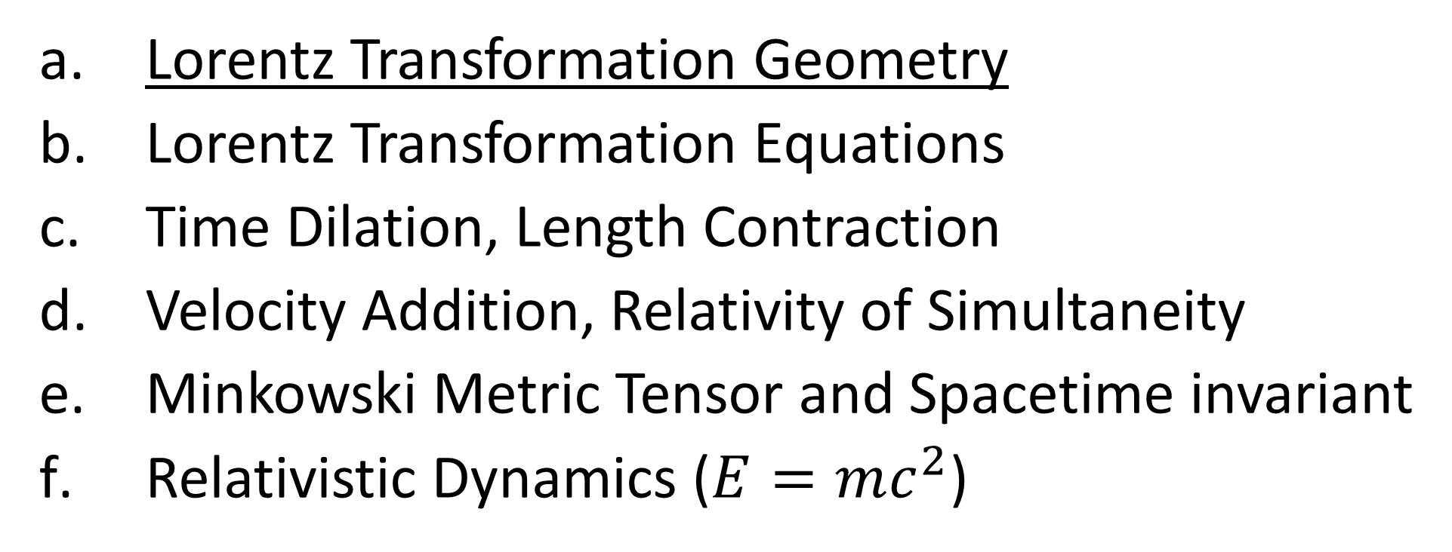
Relativity 104: Special Relativity
Lorentz Transformation Geometry
Lorentz Transformation Equations
Time Dilation, Length Contraction
Velocity Addition, Relativity of Simultaneity
Minkowski Metric Tensor and Spacetime invariant
Relativistic Dynamics ($E=mc^{2}$)
Notes:
In Relativity 104, we will talk about the Lorentz transformation, which is the method used to change reference frames according to the rules of special relativity. Then we’ll talk about how the Lorentz transformation leads to Time Dilation, Length Contraction, and new rules for Velocity Addition, and then the Relativity of Simultaniety. Next we’ll talk about the minkowski metric tensor and the spacetime invariant, which help us measure distance in spacetime. The Minkowski metric replaces the Euclidean metric that we saw in Galilean Relativity, and this brings us one step closer to understanding black holes, the expansion of the universe, and gravitational waves. Finally we’ll discuss Relativistic Dynamics which explains how things like forces, energy and momentum behave in special relativity, and also learn about E=mc^2

Slide 3
This Video:
Lorentz Transformation Geometry
(Without Equations!)
Notes:
So we have a nice way to visualize the Lorentz transform. It looks like the time and space axis scissoring together in a spacetime diagram.
But we need to get actual equations for the Lorentz transform to change coordinates to different reference frame. We’ll do this in two steps. First we’ll show that the angle between a beam of light and the time axis is equal to the angle between the beam of like and the position axis.
Next we’ll calculate the change in scale in scale on the time and position axes, which is related to time dilation and length contraction.

Slide 4
Galilean Principle of Relativity
Laws of motion are the same in all inertial reference frames
There is no “special” stationary reference frame.
Notes:
So back when we learned Galilean relativity, we said that the laws of motion are the same in all reference frames. We also said that there is no special reference frame that is stationary. All motion that we see is relative to something else.
When we plot motion on a spacetime diagram, we can see here that the scientist Einstein is standing still and the car is moving off to the right. But it’s equally correct to say the car is standing still and the scientist Einstein is moving off to the left. Both diagrams are equivalent, they are just different points of view.

Slide 5

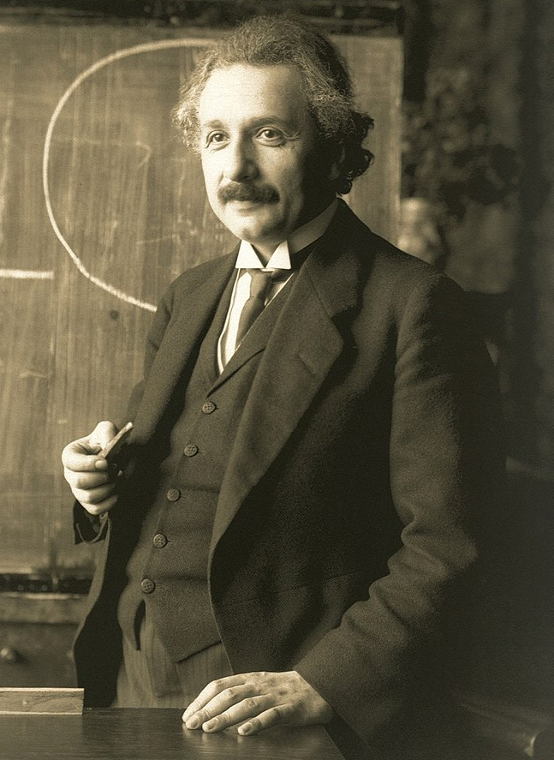
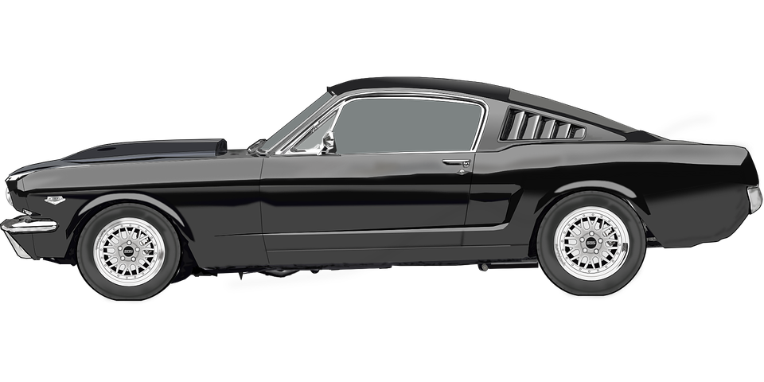


Galilean Principle of Relativity
Laws of motion are the same in all inertial reference frames
time $t$
position $x$
Frame of the scientist
Notes:
So back when we learned Galilean relativity, we said that the laws of motion are the same in all reference frames. We also said that there is no special reference frame that is stationary. All motion that we see is relative to something else.
When we plot motion on a spacetime diagram, we can see here that the scientist Einstein is standing still and the car is moving off to the right. But it’s equally correct to say the car is standing still and the scientist Einstein is moving off to the left. Both diagrams are equivalent, they are just different points of view.

Slide 6


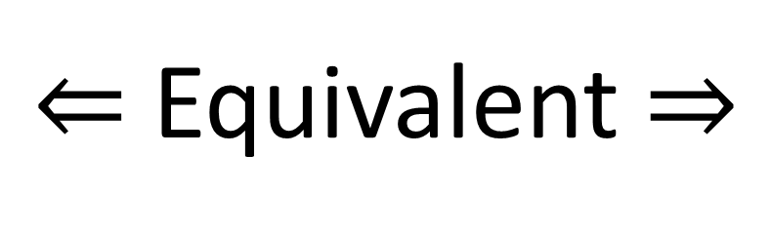
Galilean Principle of Relativity
Laws of motion are the same in all inertial reference frames
time $t$
time $t$
$⇐$ Equivalent $⇒$
position $x$
position $x$
Frame of the scientist
Frame of the car
Notes:
So back when we learned Galilean relativity, we said that the laws of motion are the same in all reference frames. We also said that there is no special reference frame that is stationary. All motion that we see is relative to something else.
When we plot motion on a spacetime diagram, we can see here that the scientist Einstein is standing still and the car is moving off to the right. But it’s equally correct to say the car is standing still and the scientist Einstein is moving off to the left. Both diagrams are equivalent, they are just different points of view.

Slide 7


time $t$
Frame of the scientist
position $x$
Notes:
Using the Galilean Transform, we can see that the speed of light is different in different reference frames. In this reference frame, Einstein is standing, The car is travelling to the right, and these suns represent a beam of light also travelling to the right, but much faster. To change to the reference frame of the car, we just rearrange the time slices so that the car’s path in spacetime is vertical. Now Einstein is moving to the left, and the beam of light is still travelling right, but at a slower speed. We can also rearrange the time slices so that the beam of light has a vertical path. This means the beam of light’s position is constant and is standing still. We can even change the frame of reference sot that it is going faster than light, so that the beam of light appears to be travelling left, because it’s not travelling fast enough to keep up with our reference frame.

Slide 8
time $t$
position $x$
Notes:
Using the Galilean Transform, we can see that the speed of light is different in different reference frames. In this reference frame, Einstein is standing, The car is travelling to the right, and these suns represent a beam of light also travelling to the right, but much faster. To change to the reference frame of the car, we just rearrange the time slices so that the car’s path in spacetime is vertical. Now Einstein is moving to the left, and the beam of light is still travelling right, but at a slower speed. We can also rearrange the time slices so that the beam of light has a vertical path. This means the beam of light’s position is constant and is standing still. We can even change the frame of reference sot that it is going faster than light, so that the beam of light appears to be travelling left, because it’s not travelling fast enough to keep up with our reference frame.

Slide 9
time $t$
Frame of the car
position $x$

Slide 10
time $t$
position $x$

Slide 11
time $t$
position $x$

Slide 12
time $t$
Frame of the light
position $x$

Slide 13
time $t$
position $x$

Slide 14
time $t$
Using the Galilean Transform, we can see that the speed of light is different in different reference frames.
position $x$

Slide 15
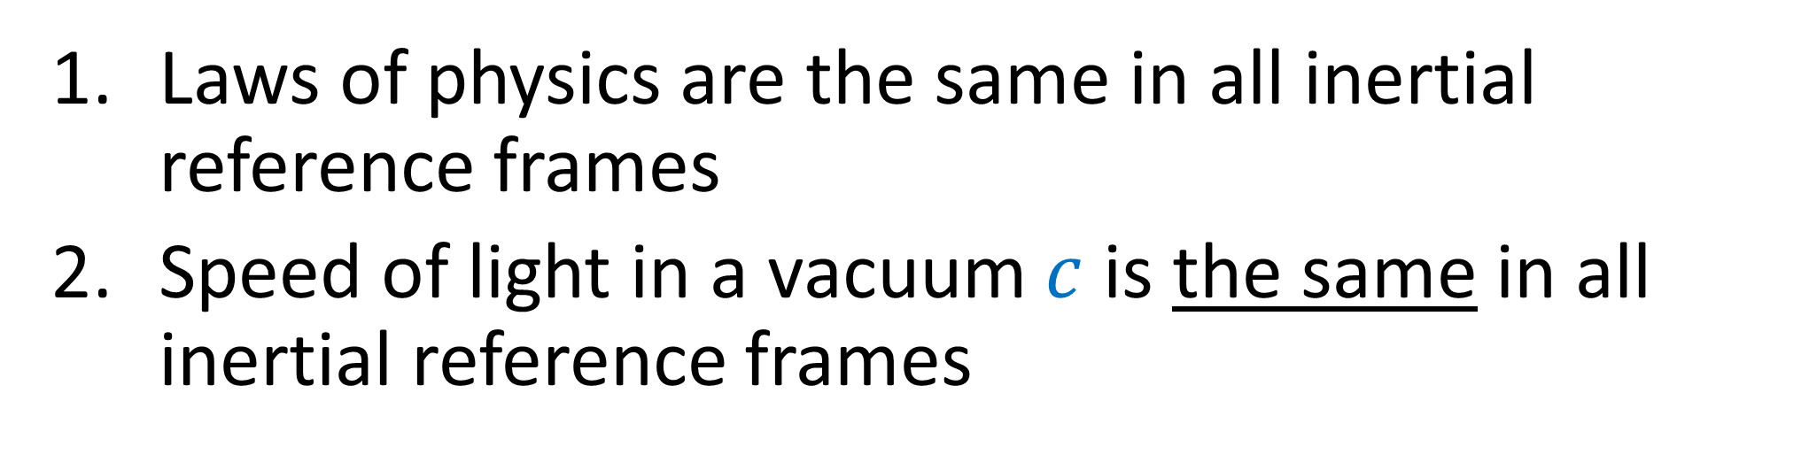
Special Relativity Postulates
Laws of physics are the same in all inertial reference frames
Speed of light in a vacuum $c$ is the same in all inertial reference frames
Lorentz Transformation can do this!
Notes:
So we’ve seen that with the Galilean Transform, the speed of light is different in different reference frames.
But this goes against Einstein’s second postulate of special relativity, that the speed of light in a vacuum is constant in all reference frames. To fix this, we need a new transform that leaves the speed of light unchanged when we go to a different reference frame.
This new transform is called the Lorentz transform. It was Lorentz who first discovered this transform, not Einstein. But Einstein was the first person to derive the transform from the above two postulates.

Slide 16

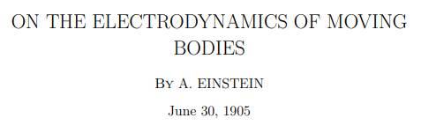
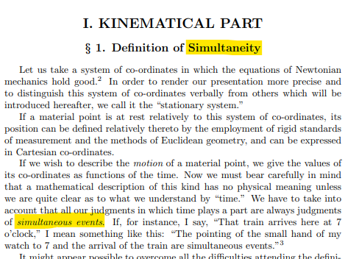
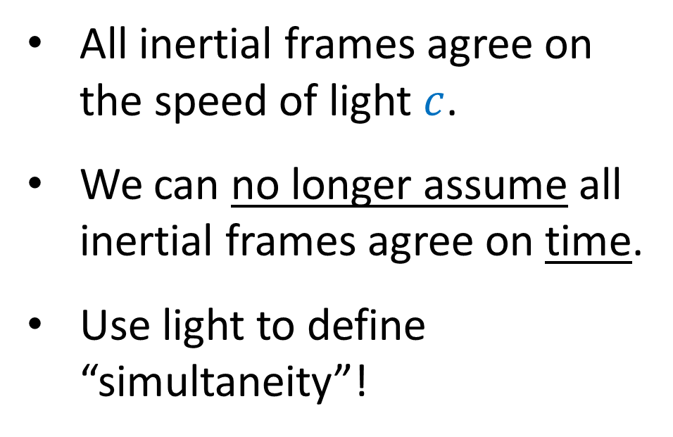
Simultaneity = “events happening at the same time”
All inertial frames agree on the speed of light $c$.
We can no longer assume all inertial frames agree on time.
Use light to define “simultaneity”!
Notes:
Einstein derived this new Lorentz transform in his 1905 paper, which introduced special relativity. The first thing he did in this paper was to define the concept of Simultaneity. Simultaneity is just a fancy way of saying “when two events happen at the same time”. Einstein argued that when we assume the speed of light is constant for all inertial frames, observers can no longer take for granted a universal definition of time for all reference frames as they do in Galilean relativity.
So Einstein decided that he need to use light to define what it would mean for two events to happen at the same time, since light is something agreed upon by all inertial observers.

Slide 17






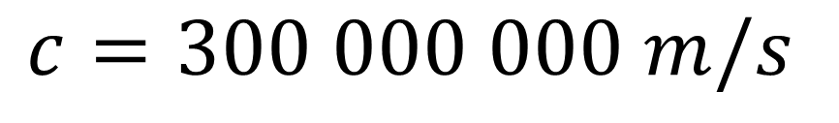


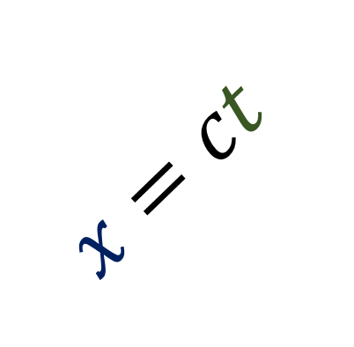


time $t$
time $t$
5s
5s
4s
4s
$$x=ct$$
$$1$$
3s
3s
$$1$$
2s
2s
Slope = 1 (45 degrees)
$$1$$
1s
1s
$$x=ct$$
$$1$$
position $x$
position $x$
1m
2m
3m
4m
5m
1 ls
2 ls
3 ls
4 ls
5 ls
300 000 000m
= 1 light-second (ls)
$$c=300 000 000 m/s$$
Notes:
Before we start the derivation, I want to point out a problem with spacetime diagrams. If we use everyday units on a spacetime diagram, like seconds for time and meters for position, a beam of light travels so fast at a speed of c = 300 million m/s, that it looks like a horizontal line, which makes it hard to see what’s happening.
For this reason it is very common in special relativity to choose units of time and space that make a beam of light travel 1 unit of distance in one unit of time. For example if time is in seconds, then one unit of position is the distance light travels in one second, which is 300 million meters, or 1 light-second.
You can see that the equation of a beam of light, x = c * t, now travels 1 unit of distance or one unit of time, which means it always travels in a diagonal line 45 degrees from the horizontal.
Another change you may see in special relativity is changing the time variable T to c times T. In terms of the mathematics… this reinforces the idea that the slope of a light beam should be exactly 1, since the line equation x = ct has slope 1 if c times t is considered as a single variable. Now, since c is the speed of light, and t stands for time, the quantity c times t would have units of distances, such as meters or lightseconds. Measuring time using meters might seem like a strange choice, but we’ll see later in this video that it’s a useful choice to make.
1 meter of time is the amount of time it takes for a light beam to travel 1 meter. And 1 lightsecond of time is the amount of time it takes for light to travel 1 lightsecond.
So to sum, in this video you will always see beams of light angled at 45 degrees with a slope of 1, and you will sometimes see me write the time axis with the variable ct.

Slide 18
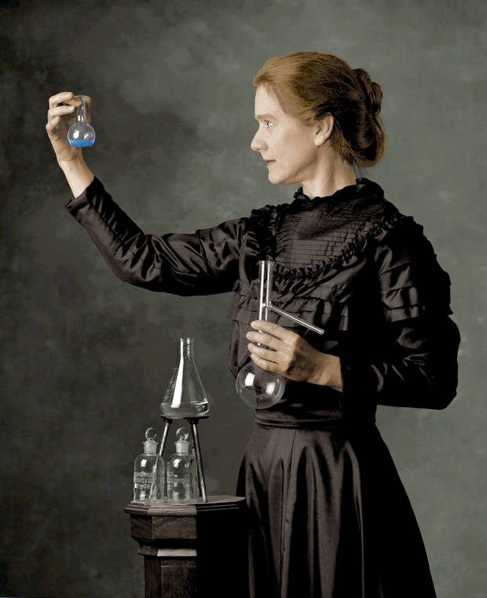
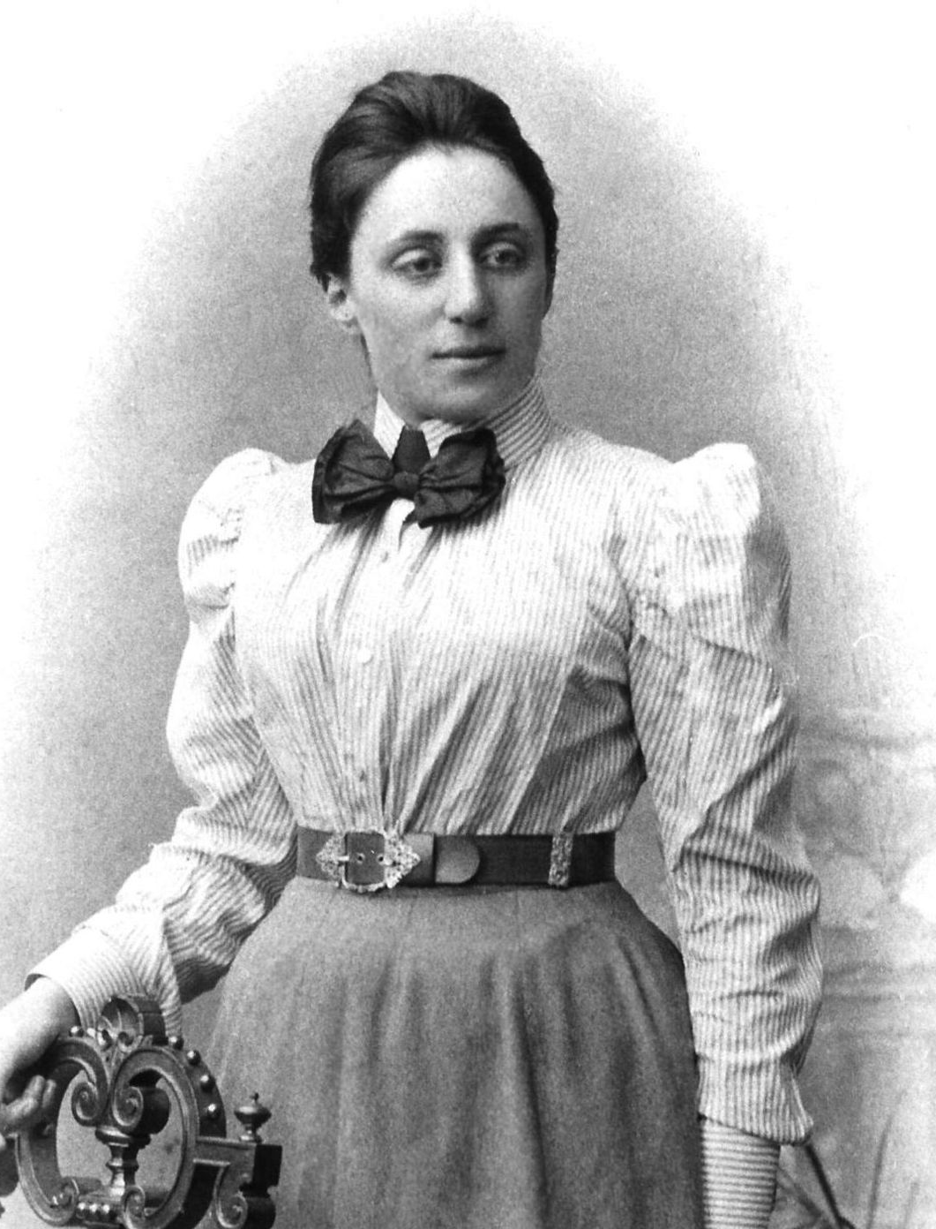
time $t$
position $x$
train
Notes:
Now let’s derive the Lorentz transform by looking at an example.
Let’s say that Einstein is standing still on the ground. And physicists Mary Curie and Emmy Noether are standing on either end of a moving train car. From Einstein’s frame of reference, he is standing still, and Mary and Emmy are moving towards the right.

Slide 19
time $t$
Frame of
Einstein
position $x$
train
Notes:
Now let’s derive the Lorentz transform by looking at an example.
Let’s say that Einstein is standing still on the ground. And physicists Mary Curie and Emmy Noether are standing on either end of a moving train car. From Einstein’s frame of reference, he is standing still, and Mary and Emmy are moving towards the right.

Slide 20
time $t$
Frame of
Train
position $x$
train
Notes:
In the frame of the train, Mary and Emmy are standing still, and Einstein is moving off to the left

Slide 21
Simultaneity = “events happening at the same time”

Slide 22



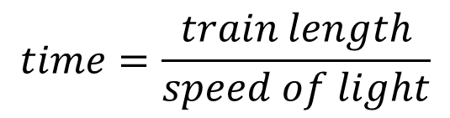
Frame of
Train
time $t$
$$time=\frac{train length}{speed of light}$$
$$t_{2}=\frac{d}{c}$$
(halfway time)
simultaneity
$$t_{1}=\frac{d}{c}$$
$$d$$
position $x$
train
Notes:
Let’s say Mary and Emmy would like to find a way to synchronize their clocks so they can decide when events happen at the same time. The two of them agree that Mary will shoot a beam of light towards Emmy. When Emmy receives it, she will shoot another beam of light back towards Mary. By symmetry, the time it takes for the light to go from Mary to Emmy, and the time it takes for the light to go from Emmy back to Mary should both be equal to the same thing: the distance between them D divided by the speed of light C. Now that they have agreed on a way to measure time on each of their clocks, they can agree that this event where Emmy receives the light beam and sends a new one out, is simultaneous with this event point which is halfway between the time she sent her light signal, and the time she receives Emmy’s light signal. Mary and Emmy have successfully synchronized their clocks and can agree on when events in space time happen at the same time.

Slide 23
Frame of
Train
time $t$
train
$$time=\frac{train length}{speed of light}$$
simultaneity
In frame of Train… Marie/Emmy’s lines of simultaneity are HORIZONTAL.
simultaneity
simultaneity
simultaneity
simultaneity
position $x$
Notes:
Let’s say Mary and Emmy would like to find a way to synchronize their clocks so they can decide when events happen at the same time. The two of them agree that Mary will shoot a beam of light towards Emmy. When Emmy receives it, she will shoot another beam of light back towards Mary. By symmetry, the time it takes for the light to go from Mary to Emmy, and the time it takes for the light to go from Emmy back to Mary should both be equal to the same thing: the distance between them D divided by the speed of light C. Now that they have agreed on a way to measure time on each of their clocks, they can agree that this event where Emmy receives the light beam and sends a new one out, is simultaneous with this event point which is halfway between the time she sent her light signal, and the time she receives Emmy’s light signal. Mary and Emmy have successfully synchronized their clocks and can agree on when events in space time happen at the same time.

Slide 24
Frame of
Einstein
time $t$
position $x$
train
Notes:
Now let’s look at this experiment from Einstein’s point of view. Einstein sees Mary and Emmy travelling right on their train car. Now remember that the speed of light is constant in all reference frames. That means light beams still travel at a 45 degree angle.

Slide 25


Frame of
Einstein
time $t$
$$t_{2}$$
(halfway time)
simultaneity
$$t_{1}$$
position $x$
train
Notes:
Now, in Einstein’s reference frame, since the train is travelling to the right, when Mary sends her light beam to the right, it takes a little more time to reach Emmy, since Emmy is basically running away from it. And since the second light beam is travelling left, it takes less time to reach Mary, since Mary is basically running toward it.
Previously, in the reference frame of the train, Mary and Emmy’s lines of simultaneity were horizontal lines, but in Einstein’s frame this is no longer true. Remember, Mary and Emmy take this event where the light beam is reflected to be simultaneous with an event halfway between when Mary sends the first light beam and receives the second light beam. If these two events are simultaneous for Mary and Emmy, then their line of simultaneity will be a diagonal line instead.

Slide 26
Frame of
Einstein
time $t$
train
simultaneity
simultaneity
simultaneity
In frame of Einstein
Marie/Emmy’s lines of simultaneity are DIAGONAL.
simultaneity
simultaneity
position $x$
Notes:
Now, in Einstein’s reference frame, since the train is travelling to the right, when Mary sends her light beam to the right, it takes a little more time to reach Emmy, since Emmy is basically running away from it. And since the second light beam is travelling left, it takes less time to reach Mary, since Mary is basically running toward it.
Previously, in the reference frame of the train, Mary and Emmy’s lines of simultaneity were horizontal lines, but in Einstein’s frame this is no longer true. Remember, Mary and Emmy take this event where the light beam is reflected to be simultaneous with an event halfway between when Mary sends the first light beam and receives the second light beam. If these two events are simultaneous for Mary and Emmy, then their line of simultaneity will be a diagonal line instead.

Slide 27
Creating a Coordinate System for Marie…
Notes:
And for a moving object, the coordinate lines form a grid of parallelograms, because the position coordinate is measured from the diagonal worldline… and so the position lines are also diagonal.

Slide 28
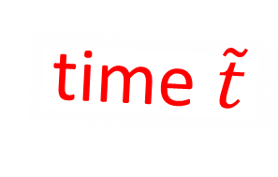
Creating a Coordinate System for Marie…
ls = lightyear
= 300 000 000m
-4ls
-3ls
-2ls
-1ls
1ly
2ls
3ls
4ls
time $\tilde{t}$
(time axis has constant position)
Notes:
And for a moving object, the coordinate lines form a grid of parallelograms, because the position coordinate is measured from the diagonal worldline… and so the position lines are also diagonal.

Slide 29
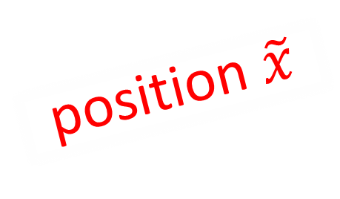
Creating a Coordinate System for Marie…
6sec
5sec
4sec
3sec
simultaneity
2sec
simultaneity
1sec
simultaneity
time $\tilde{t}$
0sec
position $\tilde{x}$
Notes:
And for a moving object, the coordinate lines form a grid of parallelograms, because the position coordinate is measured from the diagonal worldline… and so the position lines are also diagonal.

Slide 30
Galilean
Transform
Notes:
So with the Galilean transform, to change reference frames, we tilt the time axis so that it lines up with a moving object’s worldine. But we keep the position axis the same.

Slide 31
Galilean
Transform
Time axis “slants” (to align with worldline)
Position axis stays horizontal

Slide 32
Lorentz
Transform

Slide 33
Lorentz
Transform
Time axis “slants” (to align with worldline)
Position axis “slants” (to align with simultaneity)
simultaneity
Notes:
But now in special relativity, we are proposing a new way to change reference frames: The Lorentz transform. In the Lorentz transform both the time and position axes are slanted. So the Lorentz transform involves changing the coordinate system so that the time axis and the position axis sort of bend toward each other, kind of like the blades in a pair of scissors.

Slide 34
Lorentz
Transform
Notes:
The Lorentz Transform is a bit like a pair of scissors, with the blades being the time axis and the position axis. When the blades are spread apart, this is like when the time and space axes are at right angles. But after a Lorentz transform, the axes close together like the blades on a pair of scissors.

Slide 35

Lorentz
Transform
Notes:
The Lorentz Transform is a bit like a pair of scissors, with the blades being the time axis and the position axis. When the blades are spread apart, this is like when the time and space axes are at right angles. But after a Lorentz transform, the axes close together like the blades on a pair of scissors.

Slide 36
Lorentz
Transform
Notes:
But now in special relativity, we are proposing a new way to change reference frames: The Lorentz transform. In the Lorentz transform both the time and position axes are slanted. This ensure that

Slide 37
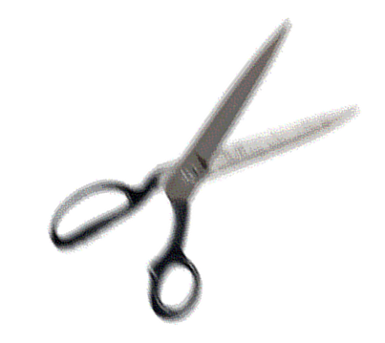
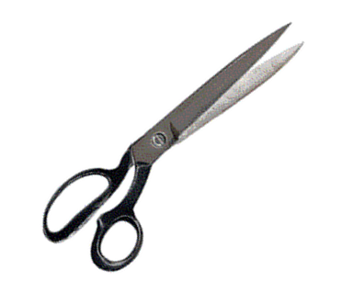
Lorentz
Transform
Notes:
But now in special relativity, we are proposing a new way to change reference frames: The Lorentz transform. In the Lorentz transform both the time and position axes are slanted. This ensure that

Slide 38
Lorentz Transformations
Leave Speed of Light Constant!
Notes:
So we have a nice way to visualize the Lorentz transform. It looks like the time and space axis scissoring together in a spacetime diagram.
But we need to get actual equations for the Lorentz transform to change coordinates to different reference frame. We’ll do this in two steps. First we’ll show that the angle between a beam of light and the time axis is equal to the angle between the beam of like and the position axis.
Next we’ll calculate the change in scale in scale on the time and position axes, which is related to time dilation and length contraction.

Slide 39
same length
Theorem: midpoint of longest side is equal distance from all corners.
simultaneity
midpoint
midpoint
light beam
rectangle
right-angle triangle
same length
train back
train front
Notes:
So first I want to show a simple geometrical fact. Imagine we have a rectangle, if we draw this purple line between opposite corners and then this other line between the other two opposite corners, the point where the two lines cross should be the midpoint of both lines. It should make sense, then that these four line segments that I’ve marked with blue tick marks should all have the same length.
Now if I cover up half this rectangle, we get a right angle-triangle. So it’s a theorem that if you take the midpoint on the longest side of a right angle triangle, that point is an equal distance from all corners on the triangle.
The reason I bring this up is because if we look at the worldlines of the moving train in our spacetime diagram, and look at the beam of light that travels back and forth, we have a right angle triangle because beams of light always travel at 45 degree angles. And if we take the midpoint of this worldline, we said it was simultaneous with the point where the beam of light is reflected.
And by the same logic we used before, this midpoint is an equal distance from all 3 corners of the triangle.

Slide 40
simultaneity
train back
train front
Notes:
Now if we consider another line of simultaneity that’s connected to the origin we can see that we get a parallelogram shape here. But it’s not just any parallelogram, it’s a parallelogram where all the sides have the same length.
And this is a special parallelogram with 4 equal side lengths is called a rhombus.
And with a rhombus, this diagonal beam of light that connects opposite corners will form an equal angle with the time axis and with the position axis.

Slide 41


A special parallelogram called a rhombus.
all sides have equal length.
same angle
Lorentz transform: space/time axes form equal angles with a beam of light.
$$θ$$
$$θ$$
same length
train back
train front
Notes:
Now if we consider another line of simultaneity that’s connected to the origin we can see that we get a parallelogram shape here. But it’s not just any parallelogram, it’s a parallelogram where all the sides have the same length.
And this is a special parallelogram with 4 equal side lengths is called a rhombus.
And with a rhombus, this diagonal beam of light that connects opposite corners will form an equal angle with the time axis and with the position axis.

Slide 42
Galilean
Transform
Notes:
With the Galilean transform, the parallelograms we get in the coordinate system are not rhombuses… one pair of sides is longer than the other pair… the result is that a beam of light travelling on a 45 degree angle does not cut through the corners of the parallelograms… This means the speed of light can change depending on the tilting angle we use for the Galilean transform.
But with the Lorentz transform, the coordinate system grid is made of rhombuses, and so the beam of light will always. This means the speed of light always travels 1 unit of distance in 1 unit of time. This fact is independent of the tilting angle for the axes. So the speed of light is the same in all inertial reference frames.

Slide 43
Galilean
Transform
shorter
longer
Speed of light is not constant

Slide 44
Lorentz
Transform

Slide 45
Lorentz
Transform
same
same
Speed of light is constant

Slide 46


Lorentz Transformation Summary:
Galilean Transformation:
speed of light not constant
tilt time axis to align with worldline
leave position axis the same
Lorentz Transformation:
speed of light is constant
tilt time axis to align with worldline
tilt time position axis to align with simultaneity
Angles are equal:
$$θ$$
$$θ$$
Notes:
In Relativity 104, we will talk about the Lorentz transformation, which is the method used to change reference frames according to the rules of special relativity. Then we’ll talk about how the Lorentz transformation leads to Time Dilation, Length Contraction, and new rules for Velocity Addition, and then the Relativity of Simultaniety. Next we’ll talk about the minkowski metric tensor and the spacetime invariant, which help us measure distance in spacetime. The Minkowski metric replaces the Euclidean metric that we saw in Galilean Relativity, and this brings us one step closer to understanding black holes, the expansion of the universe, and gravitational waves. Finally we’ll discuss Relativistic Dynamics which explains how things like forces, energy and momentum behave in special relativity, and also learn about E=mc^2

Slide 47

time $t$
time $\tilde{t}$
simultaneity
simultaneity
Notes:
But we reasoned that if light bounces back and forth on a train car, the point in spacetime where it is reflected should be simultaneous between the halfway point when the signal is sent and received. When we apply this reasoning to a moving reference frame, we find that the line of simultaneity is tilted, meaning both the time and position axes are tilted.
This leads to the Lorentz transform where both the time and position axes tilt so that the coordinate lines form rhombuses, meaning the speed of light in constant in all reference frames since it travels one unit of distance in one unit of time.

Slide 48
Next Video:
Lorentz Transformation Equations!
Notes:
So we have a nice way to visualize the Lorentz transform. It looks like the time and space axis scissoring together in a spacetime diagram.
But we need to get actual equations for the Lorentz transform to change coordinates to different reference frame. We’ll do this in two steps. First we’ll show that the angle between a beam of light and the time axis is equal to the angle between the beam of like and the position axis.
Next we’ll calculate the change in scale in scale on the time and position axes, which is related to time dilation and length contraction.

