Slide 1

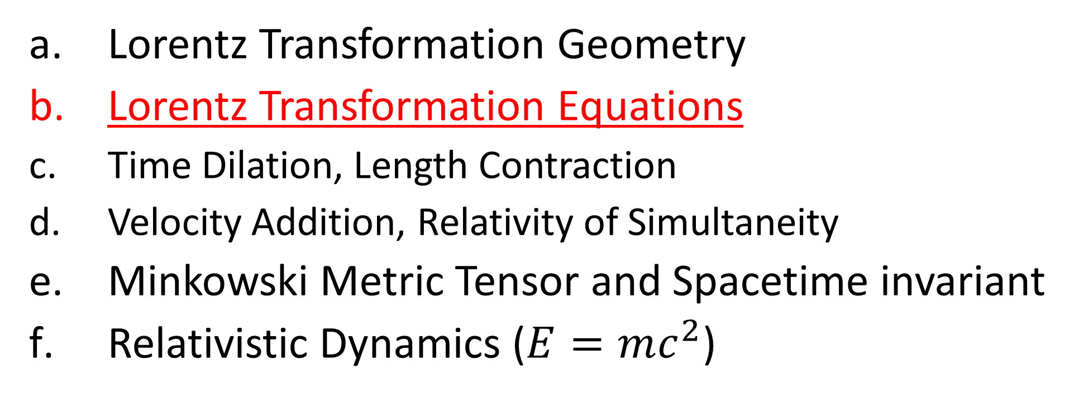
Relativity 104: Special Relativity
Lorentz Transformation Geometry
Lorentz Transformation Equations
Time Dilation, Length Contraction
Velocity Addition, Relativity of Simultaneity
Minkowski Metric Tensor and Spacetime invariant
Relativistic Dynamics ($E=mc^{2}$)
Notes:
In the last video we talked about the geometry of the Lorentz transformation. In this video we’ll derivative the actual equations for the Lorentz transformations

Slide 2

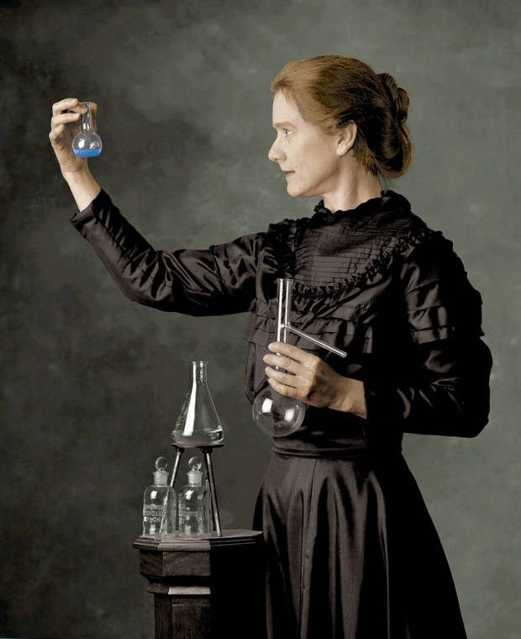
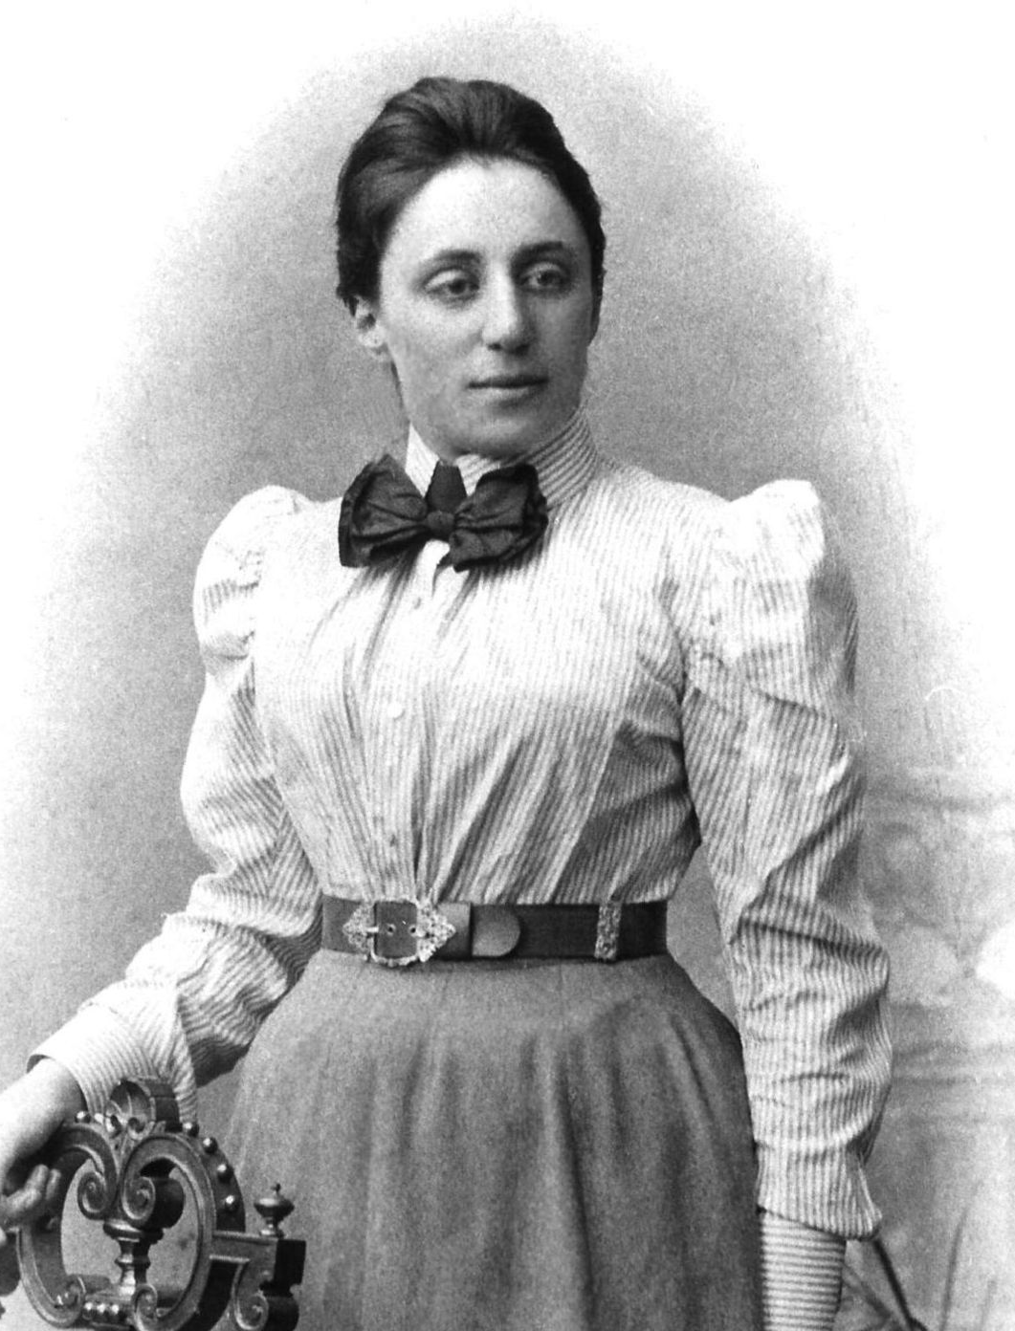



time $t$
time $\tilde{t}$
simultaneity
simultaneity
Notes:
Recall from the last video we used a beam of light to define when two events in spacetime are simultaneous.
We sent a beam of light to the right, which was then reflected back to its source. And we reasoned that the event halfway between sending and receiving the light signal should happen at the same time as when the beam of light is reflected. Therefore the lines of simultaneity in this frame are horizontal.
When we applied this logic to the same experiment on a moving train, we found that lines of simultaneity were diagonal.

Slide 3
Lorentz
Transform

Slide 4
Lorentz
Transform
Time axis “slants” (to align with worldline)
Position axis “slants” (to align with simultaneity)
simultaneity
Notes:
But now in special relativity, we are proposing a new way to change reference frames: The Lorentz transform. In the Lorentz transform both the time and position axes are slanted. So the Lorentz transform involves changing the coordinate system so that the time axis and the position axis sort of bend toward each other, kind of like the blades in a pair of scissors.

Slide 5
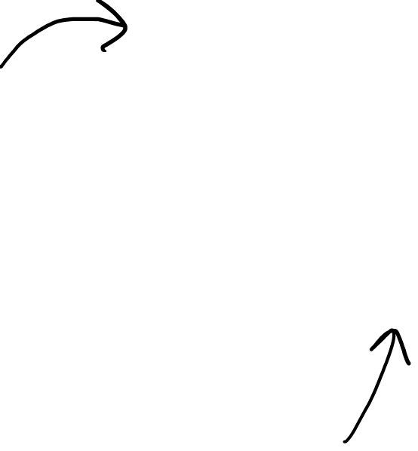
Need the actual Lorentz Transform Equations!
Notes:
We already know that visually, the Lorentz transformation looks like the time an space axes scissoring together, but now we need to get the actual Loretnz Transformation equations.

Slide 6



Calculate slopes of axes:
$$β$$
$$θ$$
$$θ$$
2. Calculate scale change on axes:
Notes:
So to get the equations for this transformation we need to figure out 2 things. First is the slopes of the new time axis and new space axis according to the old coordinate system. And second, we need to decide how the spacing changes between units of time and space. This is related to the effects of time dilation and length contraction.

Slide 7
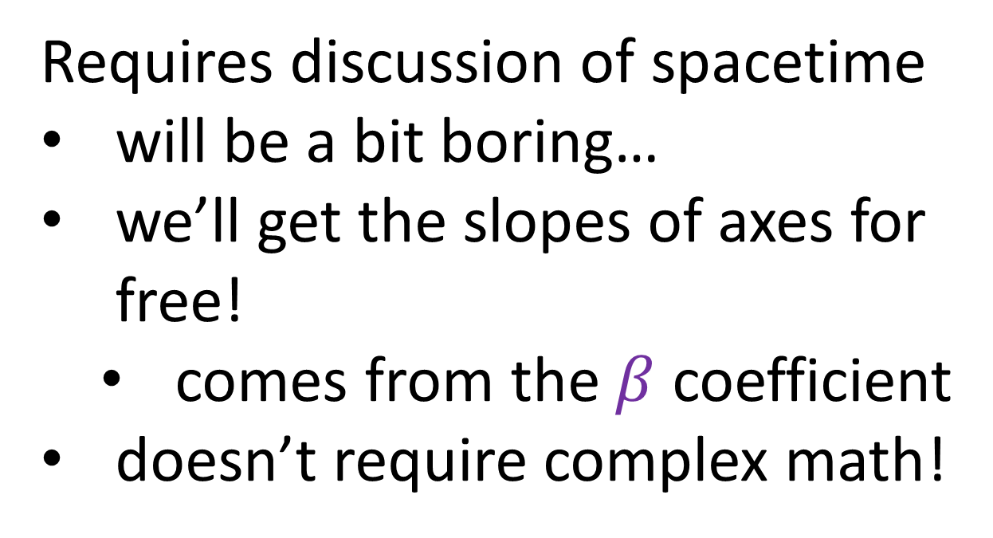
Calculate slopes of axes:
Requires discussion of spacetime
will be a bit boring…
we’ll get the slopes of axes for free!
comes from the $β$ coefficient
doesn’t require complex math!
$$θ$$
$$θ$$
Notes:
So to get the equations for this transformation we need to figure out 2 things. First is the slopes of the new time axis and new space axis according to the old coordinate system. And second, we need to decide how the spacing changes between units of time and space. This is related to the effects of time dilation and length contraction.

Slide 8


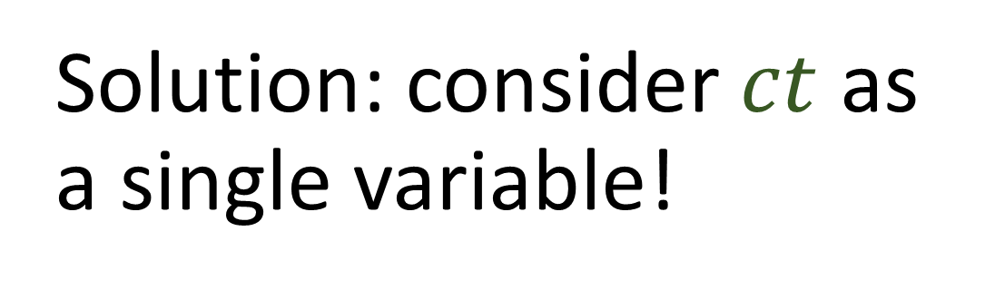


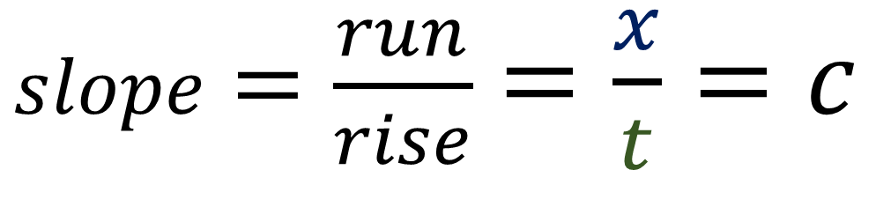




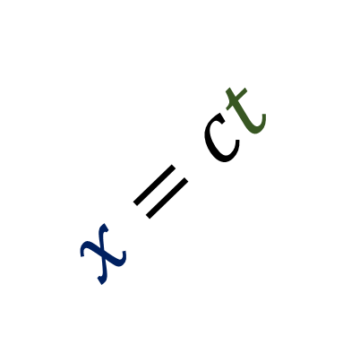


time $t$
5s
This equations does not have slope 1:
$$x=ct$$
4s
$$x=ct$$
$$1$$
3s
$slope$ $=\frac{run}{rise}$ $=\frac{x}{t}=c$
$$1$$
2s
Slope = 1 (45 degrees)
$$1$$
Solution: consider $ct$ as a single variable!
1s
$$1$$
position $x$
1 ls
2 ls
3 ls
4 ls
5 ls
$ct$-axis
$x$-axis
300 000 000m
= 1 light-second (ls)
Notes:
Remember in the last video we said we specifically chose units for time and space so that a beam of light with the equation x = c * t would have a slope of 1, and travel upward at a 45 degree angle.
There is something a bit strange with this approach, though. The linear equation x = c * t does NOT have a slope of 1. In special relativity, because time is on the vertical axis, I’m going to calculate the slope of the line using run over rise. This is the opposite of the normal formula, which is rise/run. If we calculate the slope using the run over rise, or position over time, the slope is actually c.
There is a way to make this line have a slope of 1, and that’s to consider c * t as a single variable, so that we have a ct-axis for time and an x-axis for position.
=====
Another change you may see in special relativity is changing the time variable T to c times T. In terms of the mathematics… this reinforces the idea that the slope of a light beam should be exactly 1, since the line equation x = ct has slope 1 if c times t is considered as a single variable. Now, since c is the speed of light, and t stands for time, the quantity c times t would have units of distances, such as meters or lightseconds. Measuring time using meters might seem like a strange choice, but we’ll see later in this video that it’s a useful choice to make.
1 meter of time is the amount of time it takes for a light beam to travel 1 meter. And 1 lightsecond of time is the amount of time it takes for light to travel 1 lightsecond.
So to sum, in this video you will always see beams of light angled at 45 degrees with a slope of 1, and you will sometimes see me write the time axis with the variable ct.

Slide 9

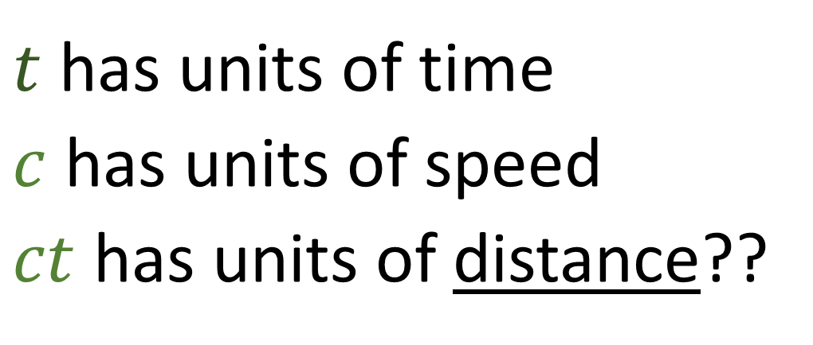

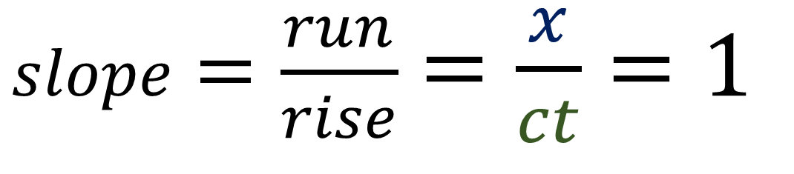
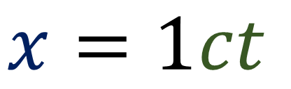
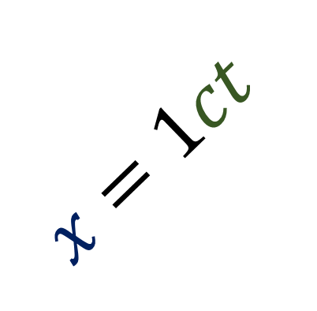
time $ct$
5 ls
This equations does have slope 1:
$$x=1ct$$
4 ls
$$x=1ct$$
$$1$$
$slope$ $=\frac{run}{rise}$ $=\frac{x}{ct}=1$
3 ls
$$1$$
2 ls
Slope = 1 (45 degrees)
$$1$$
1 ls
$$1$$
$t$ has units of time
$c$ has units of speed
$ct$ has units of distance??
position $x$
1 ls
2 ls
3 ls
4 ls
5 ls
Notes:
Using this interpretation, the equation x = 1 * ct does have a slope of 1. The run / rise equals x / ct, which is 1.
Now you might find this idea of using the ct axis confusing. After all, the variable t has units of time, and c (the speed of light) has units of speed. So that means that the ct axis would have units of distance.
How can we be measuring time using units distance?

Slide 10
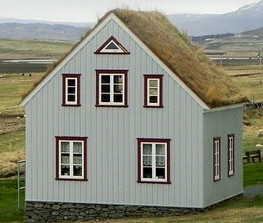


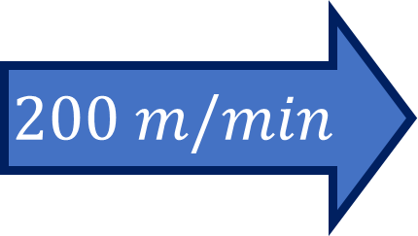
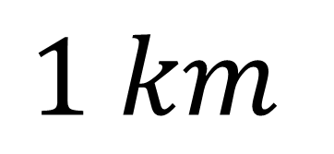
We can measure time using meters!
bro when u getting here???
$$200 m/min⁡$$
$$1 km$$
$≈5$minutes
Notes:
Well, actually, measuring time using distance units like meters is something you are probably used to doing in everyday life.
If you’re biking to a friend’s house, and they call to ask how long you’ll be until you arrive, you might tell them you’re 1km away.
Knowing that you’re 1 km away, and assuming an average biking speed of XXXX, your friend could probably figure out
So telling your friend you are 1km away is the same thing as telling them how much time it will take for you to arrive at their house.
1m of time is just the amount of time it takes you to travel 1m on your bike, or about XXXX seconds
1km of time is just the amount of time it takes you to travel 1km on your bike… or about XXXX seconds

Slide 11

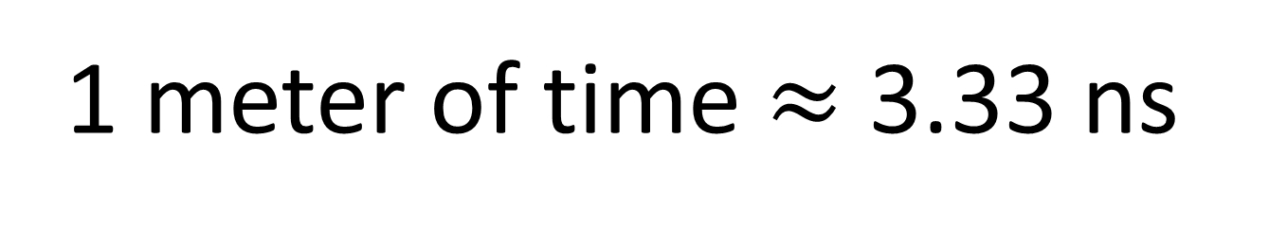
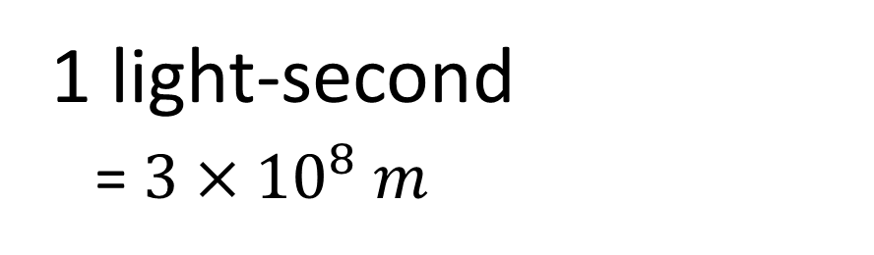
We can measure time using meters!
1 m of time = amount of time it takes light to travel 1m
1 meter of time $≈$ 3.33 ns
1 meter
1 ls of time = amount of time it takes light to travel 1 ls
1 ls of time $≈$ 1 second
1 light-second
= $3×{10}^{8} m$
Notes:
We can do the same thing with a beam of light to help us measure time using distance units, like meters.
1 meter of time is equal to the amount of time it takes a light beam to travel 1 meter. This means that 1 meter of time is about 3.33 nanoseconds, since light travels so fast.
1 light-second of time is the amount of time it takes light to travel 1 light-second. Remember, 1 light-second of time is 300 million meters. So 1 light-second of time is equal to 1 second.
So hopefully it’s not too confusing that we are measuring time using units of distance. It’s a similar idea

Slide 12

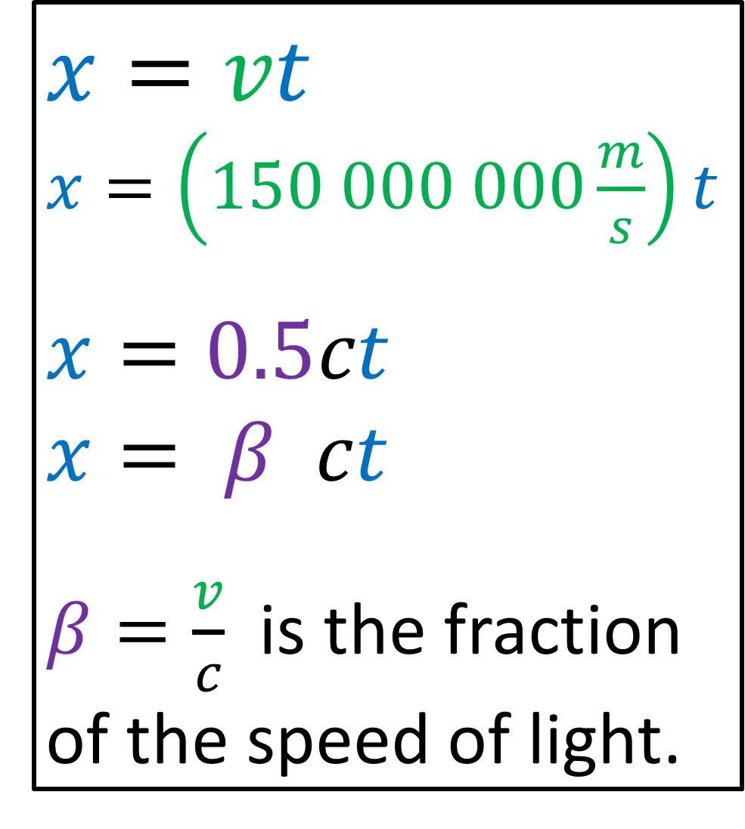


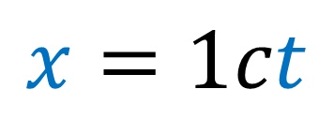
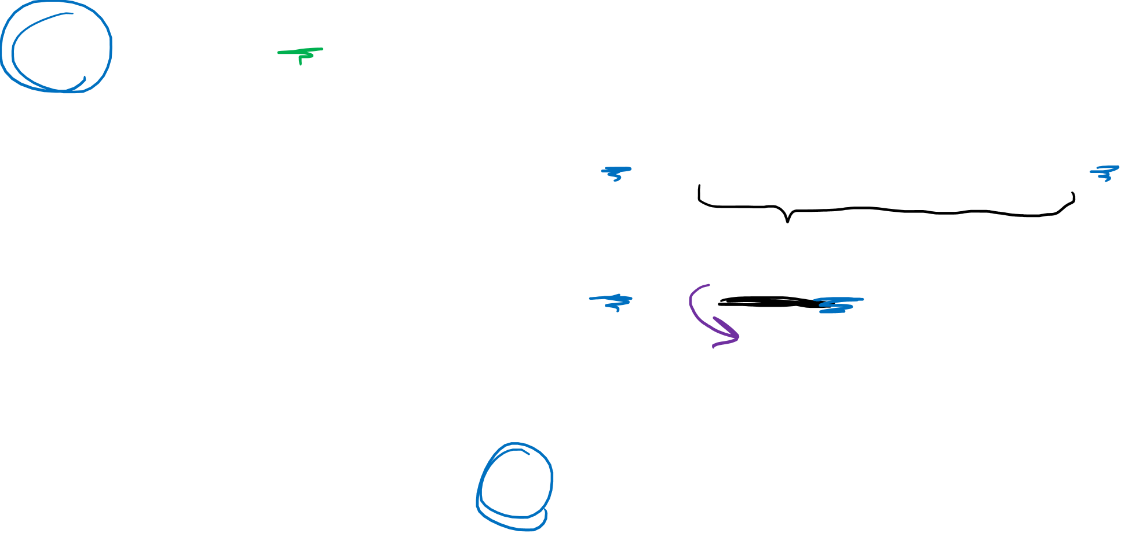
$$x=vt$$
$$x=1ct$$
$$x=vt$$
$x=\left(150 000 000\frac{m}{s}\right)t$
$$x=0.5ct$$
$$x= β ct$$
$β=\frac{v}{c}$ is the fraction of the speed of light.
$$ct$$
$$x$$
Notes:
Before we talk about this, I want to bring up one other convention we use in spacetime diagrams in relativity. Remember how we said that a beam of light on a spacetime diagram should always travel at a 45-degree angle, one unit of distance per one unit of time.
This means the slope of this light beam should be 1. However, the equation x = ct implies the slope of the line is C.

Slide 13
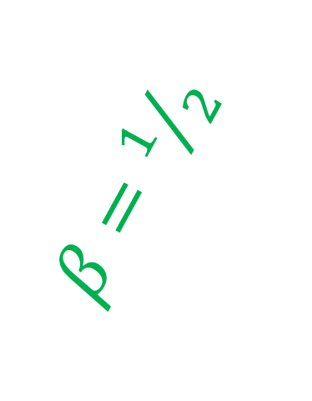

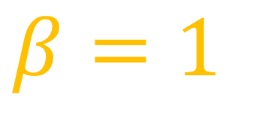



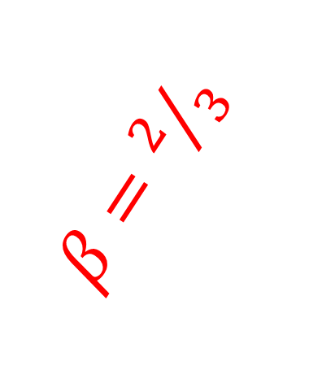

$ct$
$$β=1$$
$β=2/3$
$β=1/2$
$β=1/6$
$$x=βct$$
$β=\frac{v}{c}$ is the fraction of the speed of light.
$x$
Notes:
Obviously, light has a BETA coefficient of 1, since light is described by the equation x = 1 * ct.
Here we can also see a worldline with BETA = ½, which is half the speed of light.
This worldline has BETA = 2/3, two-thirds the speed of light. And this worldline has BETA = 1/6, one sixth the speed of light.

Slide 14
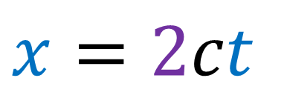
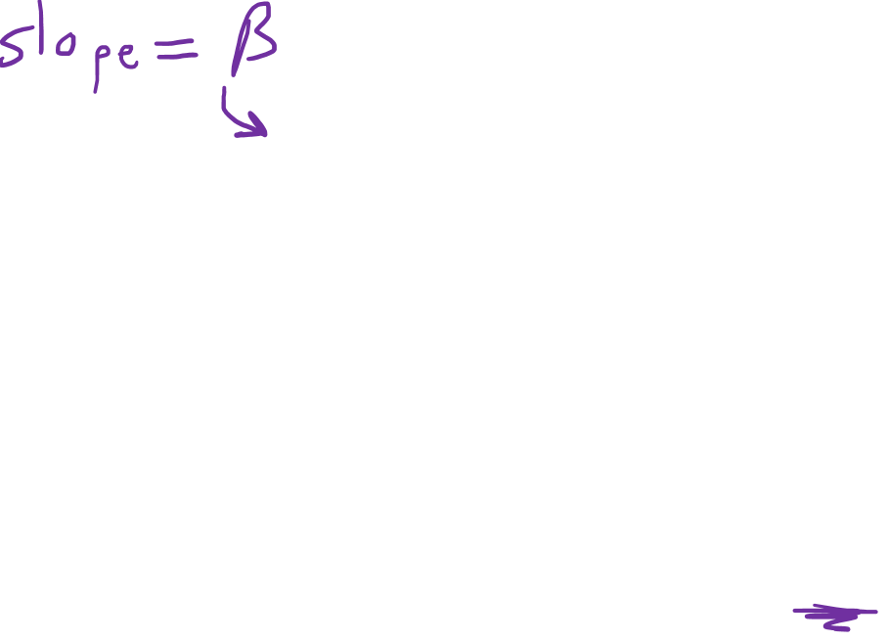
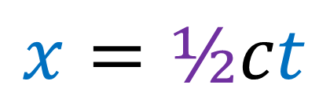




$$x=\text{½}ct$$
Reciprocal Slopes (e.g. ½ and 2)
$$ct$$
$x=2ct$
$$θ$$
$$θ$$
simultaneity
$$x$$
Notes:
So you can see here we are writing the equation of this worldine using Beta to describe the speed. Since this worldline travels ½ unit of distance in 1 units of time, it is travelling at half the speed of light. So beta would be ½.
And if we were to look at the axis of simultaneity for the reference frame of this worldine, it would be another line that looks like this, where these two angles are equal. Since the angles are equal, this line would have a slope that’s equal to the reciprocal of beta. So if the slope up here indicates ½ unit of distance per 1 unit time, the beta coefficient is ½. And the reciprocal of ½ is 2. So this line of simultaneity travels 2 units of distance per 1 unit time.
We could also move the beta to the other side of the equation and write this line of simultaneity using the equation beta x = ct.

Slide 15
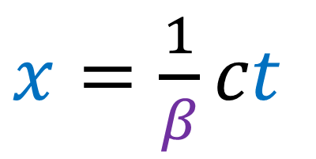
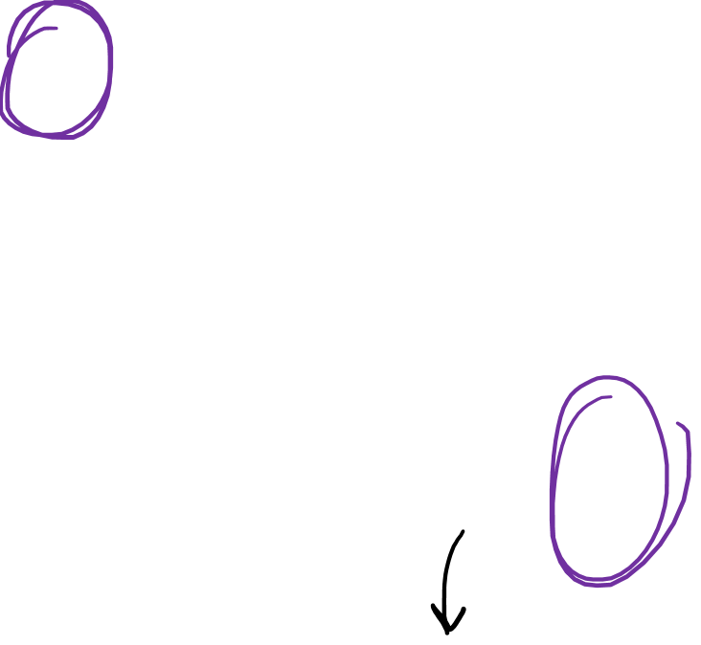

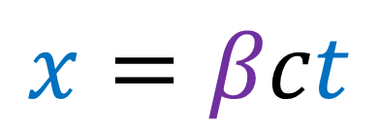
$$x=βct$$
Reciprocal Slopes (e.g. ½ and 2)
$$ct$$
$x=\frac{1}{β}ct$
$$θ$$
$$βx=ct$$
$$θ$$
simultaneity
$$x$$
Notes:
So you can see here we are writing the equation of this worldine using Beta to describe the speed. Since this worldline travels ½ unit of distance in 1 units of time, it is travelling at half the speed of light. So beta would be ½.
And if we were to look at the axis of simultaneity for the reference frame of this worldine, it would be another line that looks like this, where these two angles are equal. Since the angles are equal, this line would have a slope that’s equal to the reciprocal of beta. So if the slope up here indicates ½ unit of distance per 1 unit time, the beta coefficient is ½. And the reciprocal of ½ is 2. So this line of simultaneity travels 2 units of distance per 1 unit time.
We could also move the beta to the other side of the equation and write this line of simultaneity using the equation beta x = ct.

Slide 16
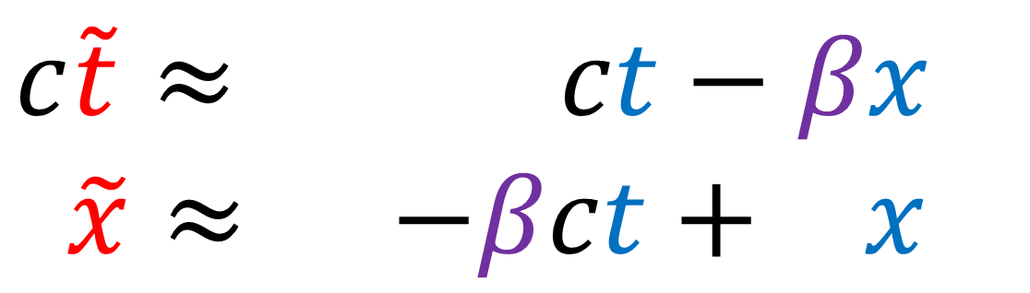










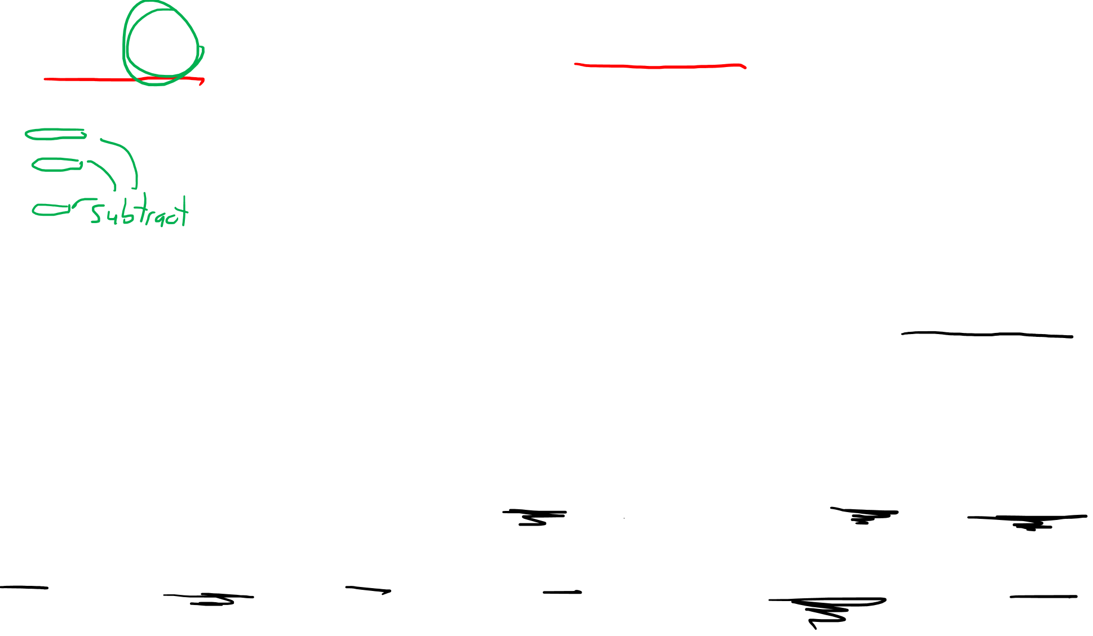
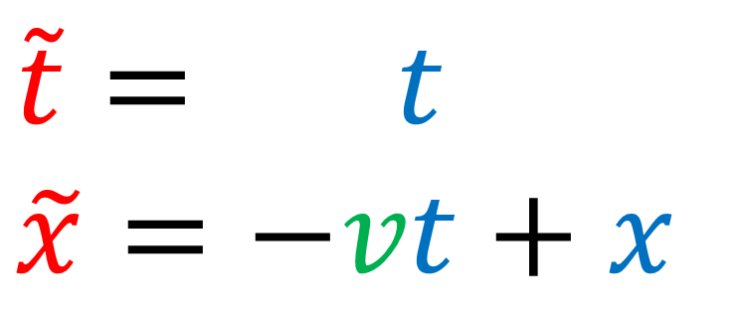

Galilean
$$x=βct$$
Lorentz
$$x=vt$$
$$t$$
$$ct$$
$$c\tilde{t}$$
$$\tilde{t}$$
$$βx=ct$$
$$\tilde{x}$$
$$\tilde{x}$$
$$x$$
$$x$$
$$\tilde{t}= t$$
$$\tilde{x}=−vt+x$$
$$c\tilde{t}≈γ\left( ct−βx\right)$$
$$\tilde{x}≈γ\left(−βct+ x\right)$$

Slide 17
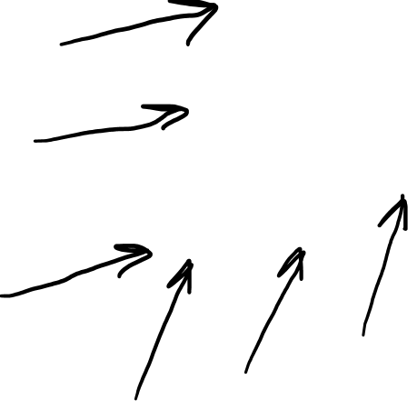
$$x=βct$$
Angles are correct!
But spacing might not be!
$$ct$$
$$c\tilde{t}$$
after
before
$$βx=ct$$
$$\tilde{x}$$
$$x$$
$$c\tilde{t}≈γ\left( ct−βx\right)$$
$$\tilde{x}≈γ\left(−βct+ x\right)$$

Slide 18
$$x=βct$$
Angles are correct!
But spacing might not be!
$$ct$$
$$c\tilde{t}$$
after
before
$$βx=ct$$
$$\tilde{x}$$
$$x$$
$$c\tilde{t}≈γ\left( ct−βx\right)$$
$$\tilde{x}≈γ\left(−βct+ x\right)$$

Slide 19

$$x=βct$$
$$ct$$
$$c\tilde{t}$$
Scales of time and space:
4m
3m
2m
1m
$$βx=ct$$
1m
2m
3m
4m
5m
$$\tilde{x}$$
$$x$$
(due to assuming the speed of light $c$ is constant.)
$$c\tilde{t}≈γ\left( ct−βx\right)$$
$$\tilde{x}≈γ\left(−βct+ x\right)$$

Slide 20
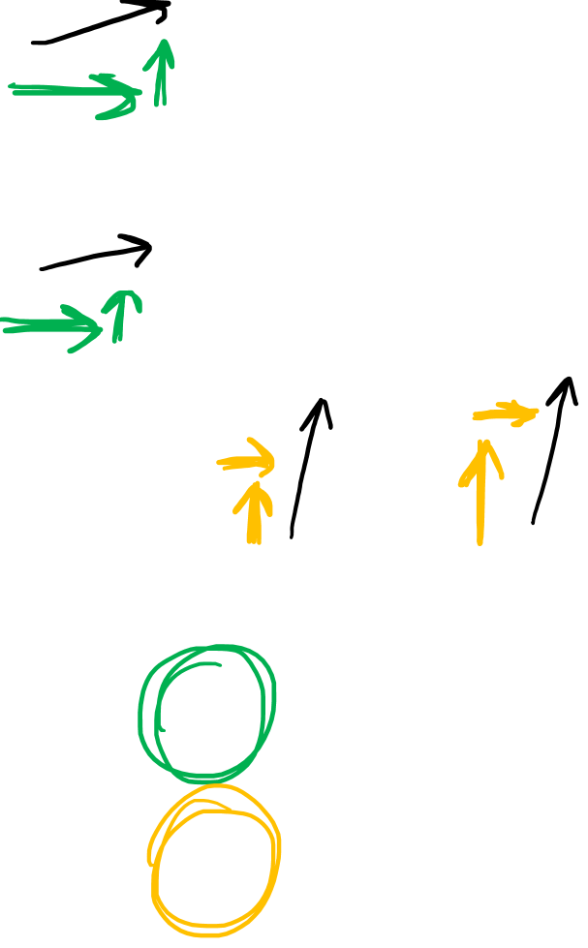
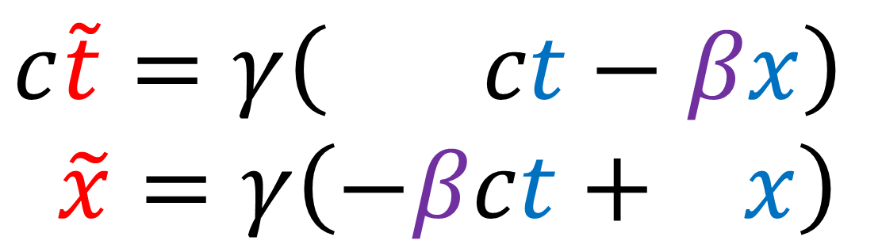

$$x=βct$$
$$ct$$
$$c\tilde{t}$$
Scales of time and space:
4m
3m
2m
1m
$$βx=ct$$
1m
2m
3m
4m
5m
$$\tilde{x}$$
$$x$$
(due to assuming the speed of light $c$ is constant.)
$$c\tilde{t}=γ\left( ct−βx\right)$$
$$\tilde{x}=γ\left(−βct+ x\right)$$

Slide 21


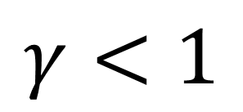




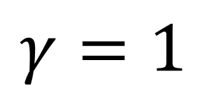





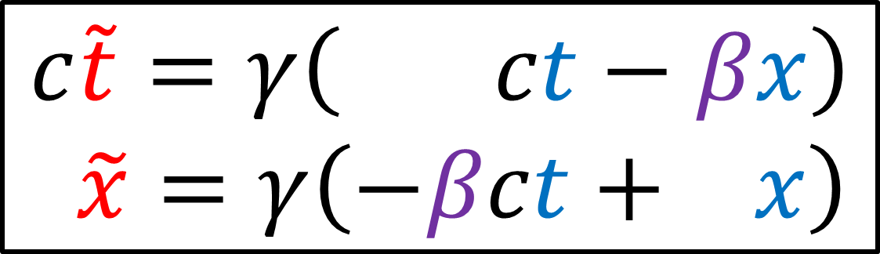
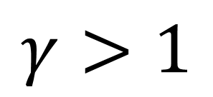

$$c\tilde{t}$$
$$c\tilde{t}$$
$$c\tilde{t}$$
$$ct$$
$$ct$$
$$ct$$
$$\tilde{x}$$
$$\tilde{x}$$
$$\tilde{x}$$
$$x$$
$$x$$
$$x$$
$$γ<1$$
$$γ=1$$
$$γ>1$$
$$c\tilde{t}=γ\left( ct−βx\right)$$
$$\tilde{x}=γ\left(−βct+ x\right)$$
Notes:
In other words, we don’t know for sure if the scales of time and space are the same in different reference frames. This is something we sacrifice what we force all inertial frames to agree on the speed of light.
The solution to this problem is to multiply our transformation equations by a scaling factor gamma, to allow different reference frames to measure time and space at different scales.
If gamma = 1, then the spacing between the gridlines is equal before and after the transformation. If gamma is < 1, then the gridline spacing is smaller after the transformation. If gamma is > 1, then the gridline spacing is larger after the transformation.
We don’t know what gamma is, but we know that time and space will be scaled by the same amount.

Slide 22
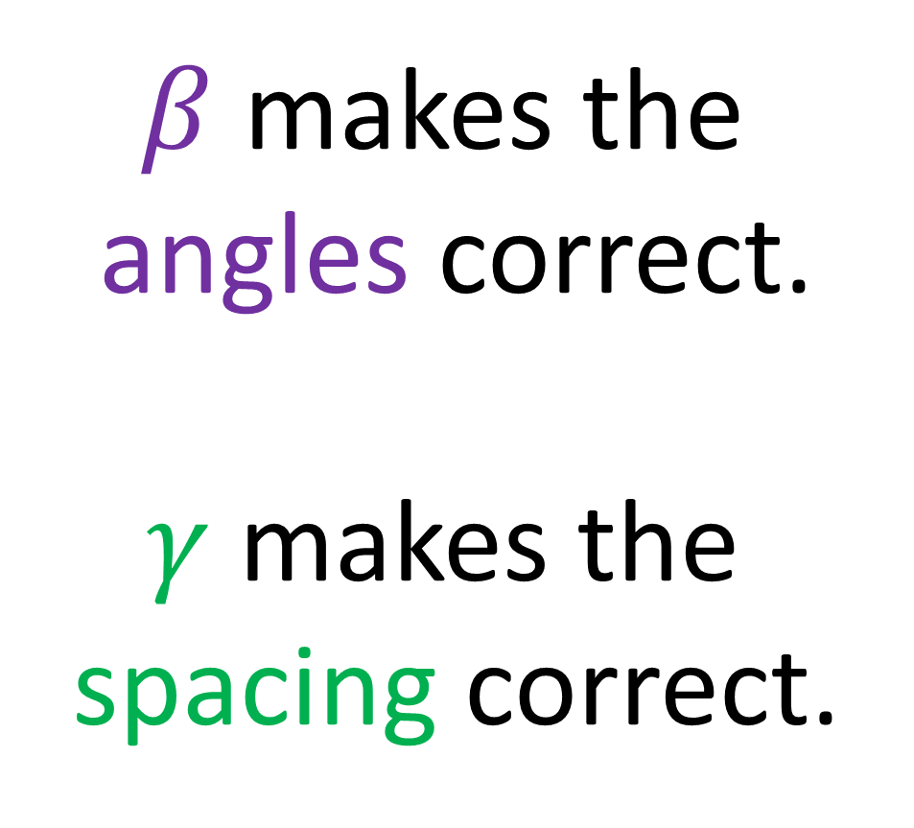
$$x=βct$$
$β$ makes the angles correct.
$γ$ makes the spacing correct.
$$ct$$
$$c\tilde{t}$$
light beam must have slope of 1
$$βx=ct$$
$$\tilde{x}$$
$$x$$
$$c\tilde{t}=γ\left( ct−βx\right)$$
$$\tilde{x}=γ\left(−βct+ x\right)$$

Slide 23
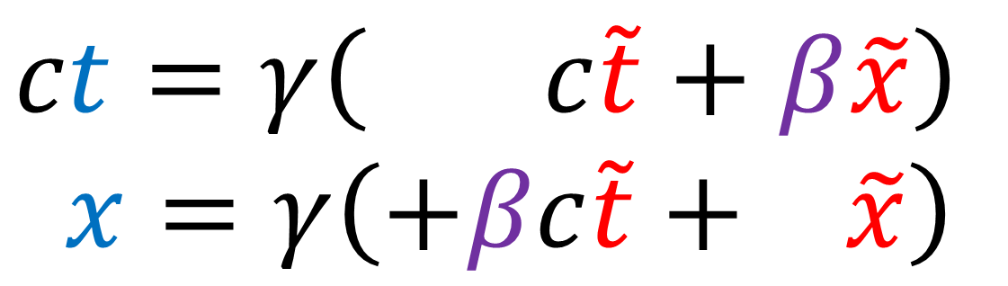
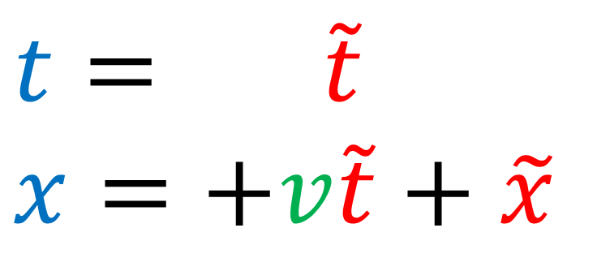
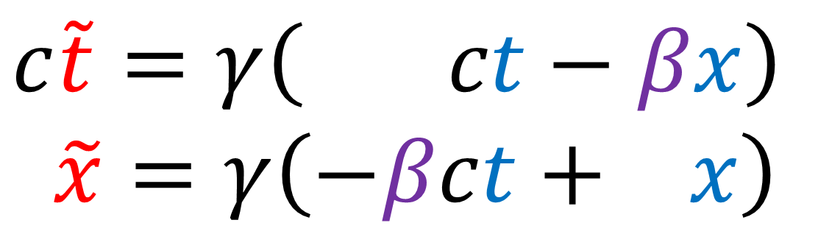
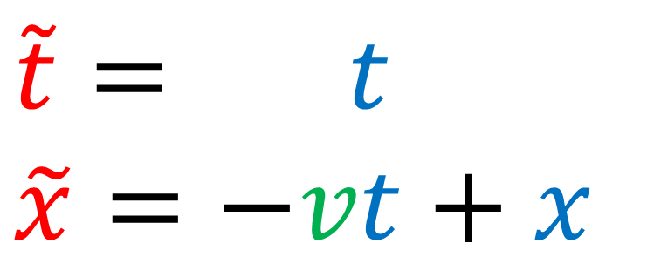
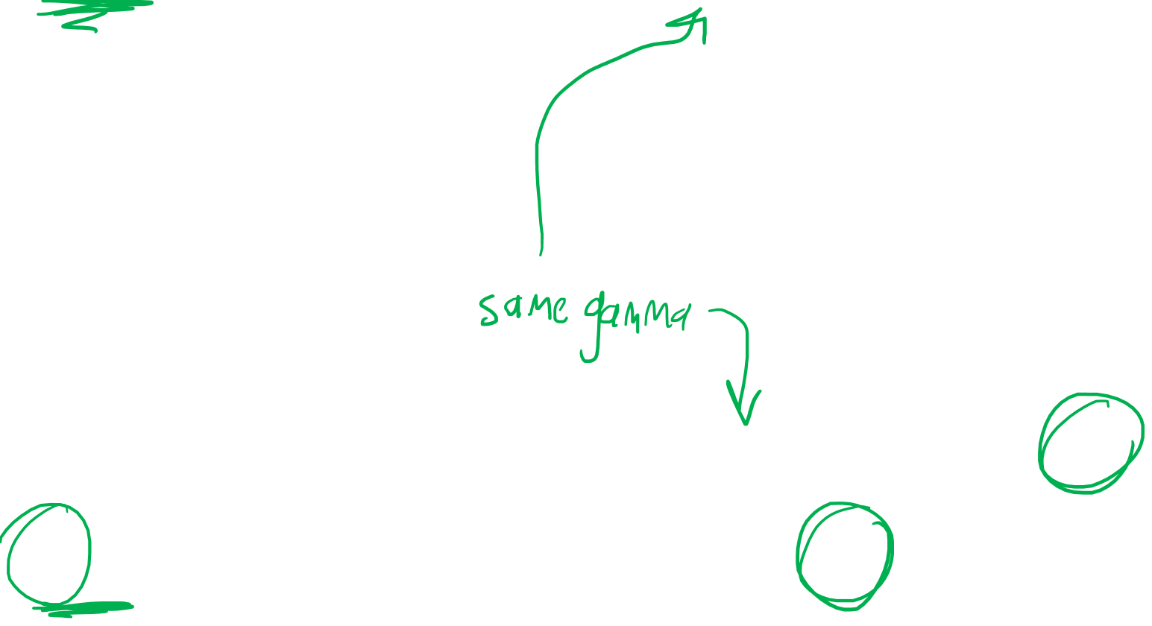
$$\tilde{t}= t$$
$$\tilde{x}=−vt+x$$
$$c\tilde{t}=γ\left( ct−βx\right)$$
$$\tilde{x}=γ\left(−βct+ x\right)$$
Reverse
Reverse
$$t= \tilde{t}$$
$$x=+v\tilde{t}+\tilde{x}$$
$$ct=γ\left( c\tilde{t}+β\tilde{x}\right)$$
$$x=γ\left(+βc\tilde{t}+ \tilde{x}\right)$$
Notes:
Now to solve for gamma we need the reverse Lorentz transformation. Recall with the Galilean transform that changes T and X to T-tilde and X-tilde… we have this –v coefficient here which represents the velocity change.
To reverse the transform to change from T-tilde and X-tilde to X and T… all we need to do is change the sign of V from negative to Positive.
With the Lorentz transform we can use similar logic. To reverse the transform and change from cT-tilde and X-tilde to cT and X, all we need to do is change these beta coefficients which represent velocity from negative to positive.
The scaling factor Gamma should be the same in both directions… we can’t pick one direction as special. The only thing that can change is the direction of the velocity.

Slide 24

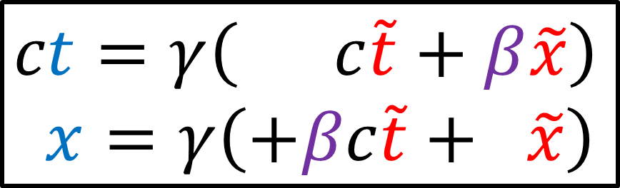
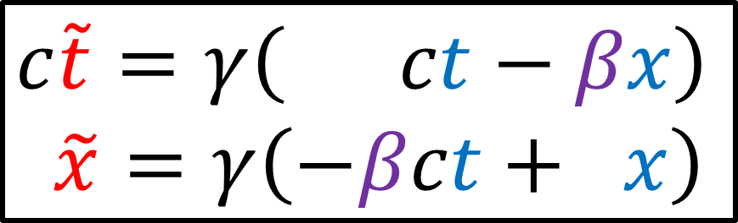
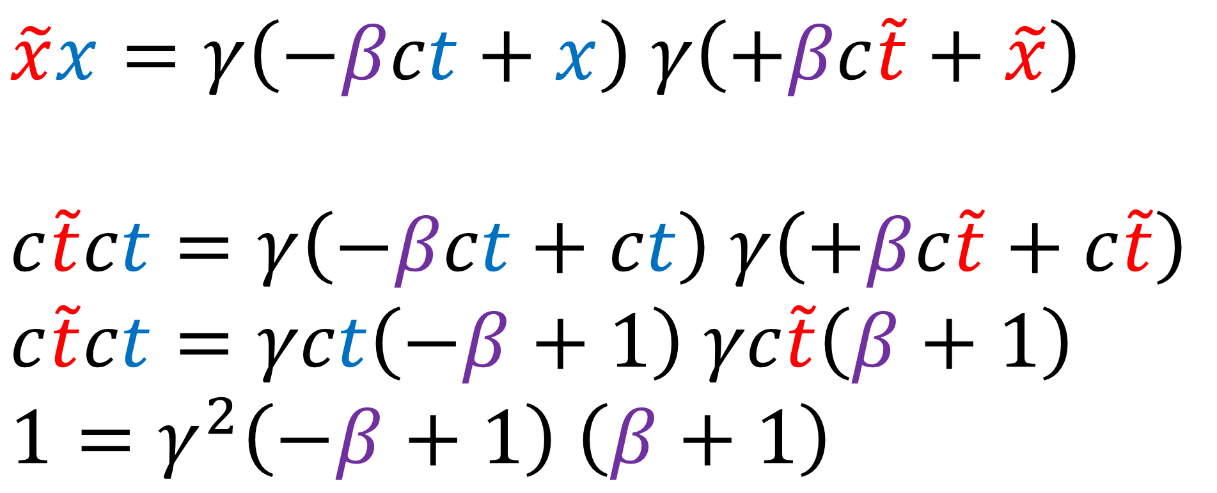
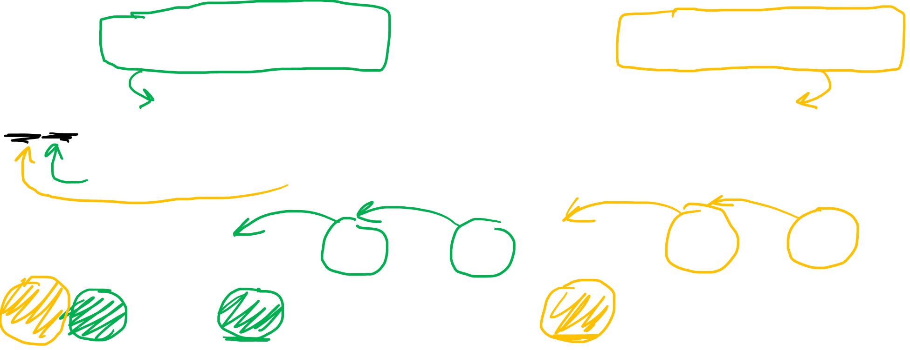
Forward
Reverse
$$c\tilde{t}=γ\left( ct−βx\right)$$
$$\tilde{x}=γ\left(−βct+ x\right)$$
$$ct=γ\left( c\tilde{t}+β\tilde{x}\right)$$
$$x=γ\left(+βc\tilde{t}+ \tilde{x}\right)$$
$$\tilde{x}x=γ\left(−βct+x\right) γ\left(+βc\tilde{t}+\tilde{x}\right)$$
$$c\tilde{t}ct=γ\left(−βct+ct\right) γ\left(+βc\tilde{t}+c\tilde{t}\right)$$
$$c\tilde{t}ct=γct\left(−β+1\right) γc\tilde{t}\left(β+1\right)$$
$$1=γ^{2}\left(−β+1\right) \left(β+1\right)$$
$$x=ct \tilde{x}=c\tilde{t}$$
Notes:
Now that we have the forward and reverse Lorentz transform equations, we can solve for Gamma.
We multiply X-tilde by X. Which gives us this formula times this formula. Assuming the speed of light is constant in all reference frames, we know that a beam of light should have the equation x = ct in one reference frame and the same beam of light will have equation x-tilde = c t-tilde in the other reference frame.
If we sub in X = cT and X-tilde = c T-tilde, we get this. We can factor out cT from this term and factor out cT-tilde from this term.
We can then cancel cT from both sides and cancel cT-tilde from both sides to get this.

Slide 25



Forward
Reverse
$$c\tilde{t}=γ\left( ct−βx\right)$$
$$\tilde{x}=γ\left(−βct+ x\right)$$
$$ct=γ\left( c\tilde{t}+β\tilde{x}\right)$$
$$x=γ\left(+βc\tilde{t}+ \tilde{x}\right)$$
$$1=γ^{2}\left(−β+1\right) \left(β+1\right)$$
$$1=γ^{2}\left(−β^{2}+β−β+1\right)$$
$$1=γ^{2}\left(1−β^{2}\right)$$
$γ=\frac{1}{\sqrt{1−β^{2}}}=\frac{1}{\sqrt{1−({v^{2}}/{c^{2}})}}$
$β=\frac{v}{c}$
Notes:
If we multiply these terms out, we get 4 terms. The +beta and –beta cancel out and we get 1-beta squared.
If we divide both sides by this term an takes the square room, we get Gamma = 1 divided by the square root of (1-beta square). We can also replace beta with v/c and write the formula like this.

Slide 26



Lorentz Transform
$$c\tilde{t}=γ\left( ct−βx\right)$$
$$\tilde{x}=γ\left(−βct+ x\right)$$
$γ=\frac{1}{\sqrt{1−β^{2}}}$
$β=\frac{v}{c}$
Notes:
So we have successfully derived the Lorentz transform Where Beta is just the fraction of the speed of light, V/C And the scaling factor Gamma equals 1 / square root of (1- beta squared)

Slide 27




Galilean Transform
Lorentz Transform
$β=\frac{v}{c}$
$γ=\frac{1}{\sqrt{1−β^{2}}}$
$$\tilde{t}= t$$
$$\tilde{x}=−vt+x$$
$$c\tilde{t}=γ\left( ct−βx\right)$$
$$\tilde{x}=γ\left(−βct+ x\right)$$
Notes:
So we have successfully derived the Lorentz transform Where Beta is just the fraction of the speed of light, V/C And the scaling factor Gamma equals 1 / square root of (1- beta squared)

Slide 28


Galilean Transform
Lorentz Transform
$β=\frac{v}{c}$
$γ=\frac{1}{\sqrt{1−β^{2}}}$
$$\left[\begin{matrix}\tilde{t} \\ \tilde{x}\end{matrix}\right]=\left[\begin{matrix}1 & 0 \\ −v & 1\end{matrix}\right]\left[\begin{matrix}t \\ x\end{matrix}\right]$$
$$\left[\begin{matrix}c\tilde{t} \\ \tilde{x}\end{matrix}\right]=γ\left[\begin{matrix}1 & −β \\ −β & 1\end{matrix}\right]\left[\begin{matrix}ct \\ x\end{matrix}\right]$$
Galilean Matrix
Lorentz Matrix
Notes:
And if we write things in Matrix notation, this is the familiar Galilean matrix, and this is the new Lorentz matrix.

Slide 29

Change in Area
=
determinant of transformation matrix
$$\det\left(\left[\begin{matrix}γ & −γβ \\ −γβ & γ\end{matrix}\right]\right)$$

Slide 30
determinant of transformation matrix
=
Change in Area
$$\det\left(\left[\begin{matrix}γ & −γβ \\ −γβ & γ\end{matrix}\right]\right)$$

Slide 31




Lorentz Matrix
$$γ\left[\begin{matrix}1 & −β \\ −β & 1\end{matrix}\right]$$
$$\det\left(\left[\begin{matrix}a & b \\ c & d\end{matrix}\right]\right)=ad−bc$$
$$\det\left(\left[\begin{matrix}γ & −γβ \\ −γβ & γ\end{matrix}\right]\right)$$
$=γγ−\left(−γβ\right)\left(−γβ\right)$
$=γ^{2}−γ^{2}β^{2}$
$=γ^{2}\left(1−β^{2}\right)$
Notes:
We can find the change in area of a gridbox by taking the determinant of the Lorentz matrix. Remember, the determinant of a matrix ABCD is equal to AD – BC, and that’s the change in area that results from transformation the space with this matrix
So then the determinant of the Lorentz matrix is gamma * gamma – negative gamma*beta times negative gamma*beta.
This equals Gamma^2 – Gamma^2 * Beta^2,
Or equivalently, Gamma^2 * ( 1 – beta^2)

Slide 32




$γ=\frac{1}{\sqrt{1−β^{2}}}$
$\det\left(\left[\begin{matrix}γ & −γβ \\ −γβ & γ\end{matrix}\right]\right)$ $=γ^{2}\left(1−β^{2}\right)$
$={\left(\frac{1}{\sqrt{1−β^{2}}}\right)}^{2}\left(1−β^{2}\right)$
$=\frac{1}{1−β^{2}}\left(1−β^{2}\right)$
$\det\left(\left[\begin{matrix}γ & −γβ \\ −γβ & γ\end{matrix}\right]\right)$ $=1$
No change in area!
Notes:
But remember, Gamma is just equal to 1/ sqrt ( 1 – beta^2).
So if we plug this in for Gamma and square it, we find that the numerator and denominator cancel out, and we get the determinant is equal to 1, which proves that there is no change in area between this square and this parallelogram when we apply the Lorentz transformation.

Slide 33

Area = 1
Spacing is chosen so that area stays the same.
(will be important for the Minkowski metric)
Area = 1
Notes:
Now, remember that I said the area of a coordinate gridbox should be the same before and after a Lorentz transformation.

Slide 34







1. Get slopes of new time/space axes
2. Choose scaling $γ$ so that grid box area stays the same.
$$β$$
$\frac{1}{β}$
$$θ$$
$β=\frac{v}{c}$
$$θ$$
3. Get the Lorentz Transformation
$$c\tilde{t}=γ\left( ct−βx\right)$$
$$\tilde{x}=γ\left(−βct+ x\right)$$
$γ=\frac{1}{\sqrt{1−β^{2}}}$

Slide 35
Next Video: Time Dilation + Length Contraction

