Slide 1

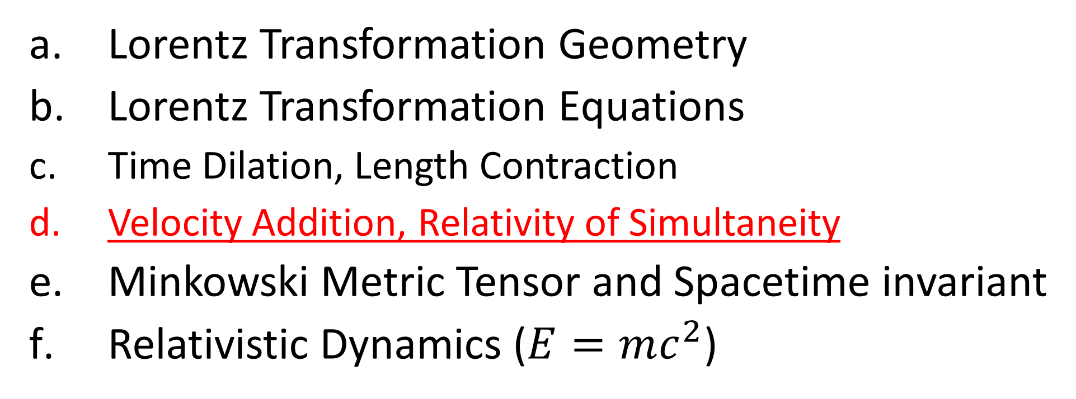
Relativity 104: Special Relativity
Lorentz Transformation Geometry
Lorentz Transformation Equations
Time Dilation, Length Contraction
Velocity Addition, Relativity of Simultaneity
Minkowski Metric Tensor and Spacetime invariant
Relativistic Dynamics ($E=mc^{2}$)
Notes:
In this video we’ll see how the Lorentz transformations can be used to understand velocity addition and the relativity of simultaneity in special relativity.
We’ll also see how the relativity of simultaneity can be used to explain the famous “ladder in a barn” paradox.

Slide 2
Velocity Addition Rules

Slide 3

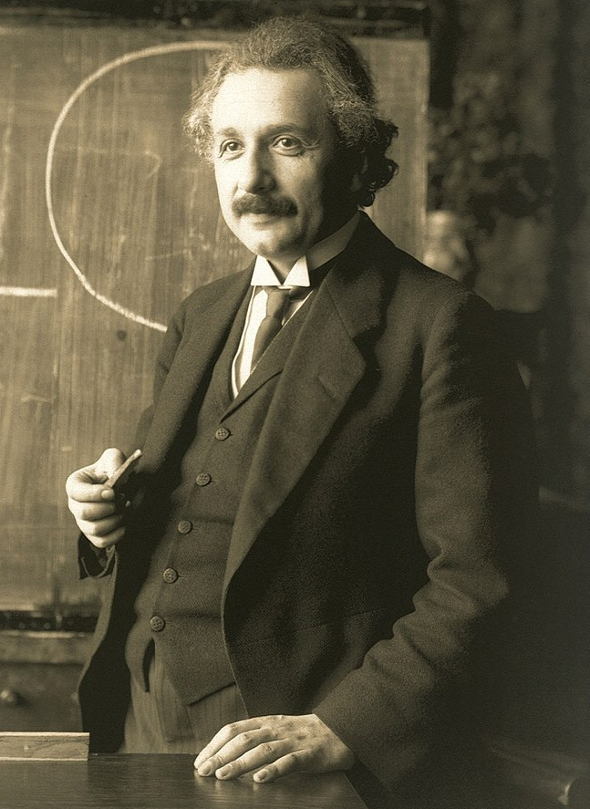


time $t$
position $x$
Notes:
Let’s start with how velocity addition works in special relativity…
Let’s say that Albert Einstein is standing still on the ground. A train is going by to the right at 90% the speed of light. Hendrik Lorentz is onboard the train and fires and fires a gun to the right. The bullet travels out from the gun at 90% the speed of light relative to the train.
It is interesting to ask how fast the bullet is travelling in Einstein’s frame.
Figuring this out would involve changing reference frames twice. First from Einstein to the train, and then again from the train to the bullet.
In Galilean Relativity, we’ll find the speed of the bullet agrees with common sense, but in special relativity the answer is more surprising. (explain better an give a spacetime diagram picture!!)

Slide 4
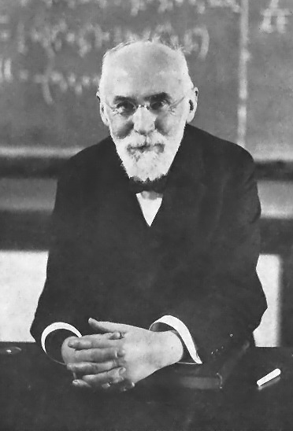
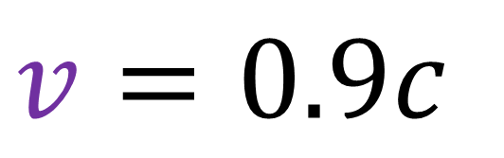
time $t$
$$v=0.9c$$
position $x$
train
Notes:
Let’s start with how velocity addition works in special relativity…
Let’s say that Albert Einstein is standing still on the ground. A train is going by to the right at 90% the speed of light. Hendrik Lorentz is onboard the train and fires and fires a gun to the right. The bullet travels out from the gun at 90% the speed of light relative to the train.
It is interesting to ask how fast the bullet is travelling in Einstein’s frame.
Figuring this out would involve changing reference frames twice. First from Einstein to the train, and then again from the train to the bullet.
In Galilean Relativity, we’ll find the speed of the bullet agrees with common sense, but in special relativity the answer is more surprising. (explain better an give a spacetime diagram picture!!)

Slide 5


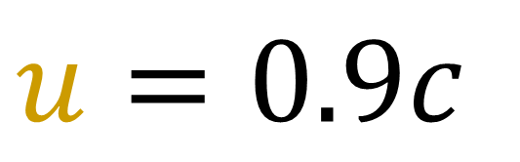



time $t$
$$u=0.9c$$
position $x$
train
Notes:
Let’s start with how velocity addition works in special relativity…
Let’s say that Albert Einstein is standing still on the ground. A train is going by to the right at 90% the speed of light. Hendrik Lorentz is onboard the train and fires and fires a gun to the right. The bullet travels out from the gun at 90% the speed of light relative to the train.
It is interesting to ask how fast the bullet is travelling in Einstein’s frame.
Figuring this out would involve changing reference frames twice. First from Einstein to the train, and then again from the train to the bullet.
In Galilean Relativity, we’ll find the speed of the bullet agrees with common sense, but in special relativity the answer is more surprising. (explain better an give a spacetime diagram picture!!)

Slide 6
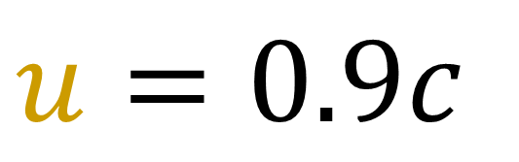
time $t$
$$u=0.9c$$
position $x$
train
Notes:
Let’s start with how velocity addition works in special relativity…
Let’s say that Albert Einstein is standing still on the ground. A train is going by to the right at 90% the speed of light. Hendrik Lorentz is onboard the train and fires and fires a gun to the right. The bullet travels out from the gun at 90% the speed of light relative to the train.
It is interesting to ask how fast the bullet is travelling in Einstein’s frame.
Figuring this out would involve changing reference frames twice. First from Einstein to the train, and then again from the train to the bullet.
In Galilean Relativity, we’ll find the speed of the bullet agrees with common sense, but in special relativity the answer is more surprising. (explain better an give a spacetime diagram picture!!)

Slide 7





time $t$
train $→$ bullet
$$u=0.9c$$
Einstein $→$ train
$$v=0.9c$$
What is the speed of the bullet in Einstein’s frame?
position $x$
train
Notes:
Let’s start with how velocity addition works in special relativity…
Let’s say that Albert Einstein is standing still on the ground. A train is going by to the right at 90% the speed of light. Hendrik Lorentz is onboard the train and fires and fires a gun to the right. The bullet travels out from the gun at 90% the speed of light relative to the train.
It is interesting to ask how fast the bullet is travelling in Einstein’s frame.
Figuring this out would involve changing reference frames twice. First from Einstein to the train, and then again from the train to the bullet.
In Galilean Relativity, we’ll find the speed of the bullet agrees with common sense, but in special relativity the answer is more surprising. (explain better an give a spacetime diagram picture!!)

Slide 8
What is the speed of the bullet in Einstein’s frame?
Galilean Relativity: result agrees with common sense
Special Relativity: result is more surprising!
Let’s start with Galilean Relativity.

Slide 9
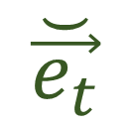

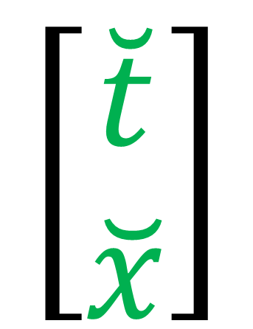


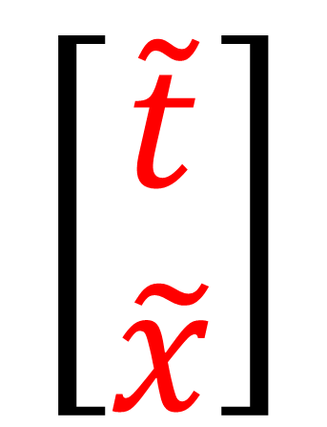
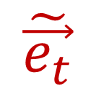

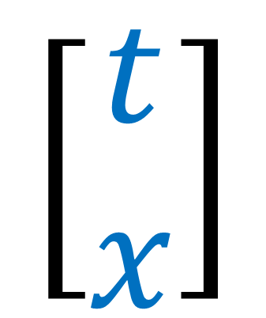
$$\vec{e_{t}}$$
$$\tilde{\vec{e_{t}}}$$
$$\breve{\vec{e_{t}}}$$
$$\vec{e_{x}}$$
$$\tilde{\vec{e_{x}}}$$
$$\breve{\vec{e_{x}}}$$
train
$$\left[\begin{aligned}\tilde{t} \\ \tilde{x}\end{aligned}\right]$$
$$\left[\begin{aligned}\breve{t} \\ \breve{x}\end{aligned}\right]$$
$$\left[\begin{aligned}t \\ x\end{aligned}\right]$$
Notes:
Let’s start by looking at this problem in Galilean relativity.
Let’s say that Einstein uses the spacetime coordinates t and x The Train uses coordinates t-tilde, and x-tilde And the bullet uses coordinates t-smile and x-smile.

Slide 10

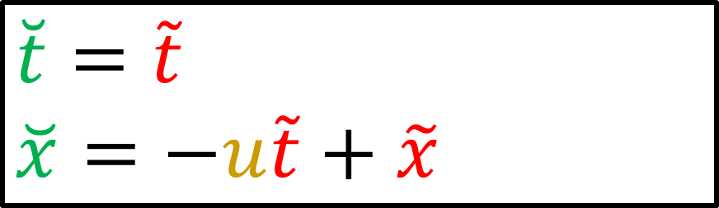
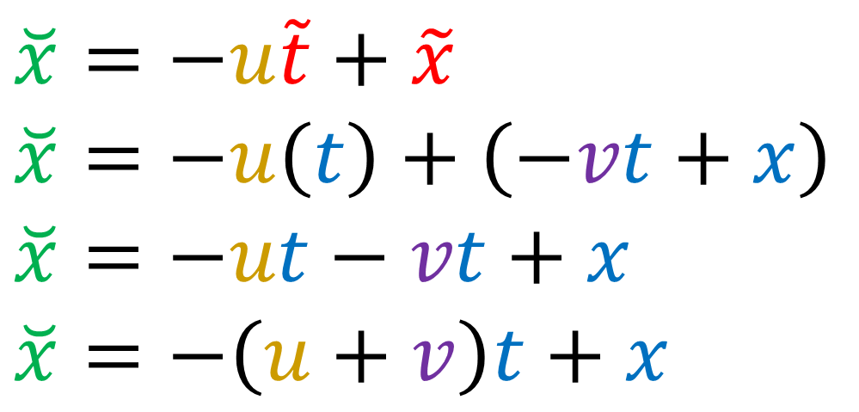
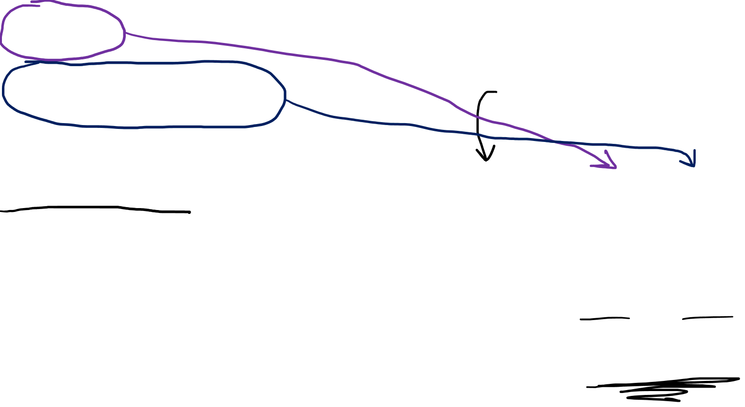

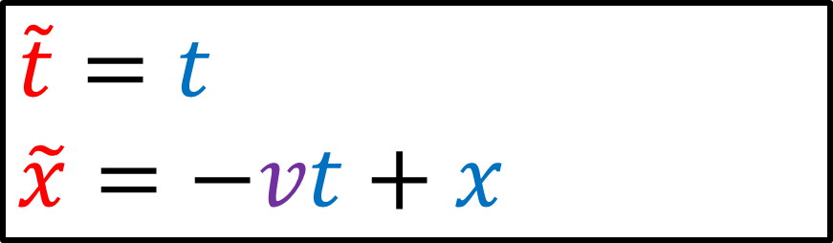
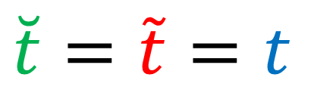
Einstein $→$ Train
Train $→$ Bullet
$$\tilde{t}=t$$
$$\tilde{x}=−vt+x$$
$$\breve{t}=\tilde{t}$$
$$\breve{x}=−u\tilde{t}+\tilde{x}$$
$$\breve{t}=\tilde{t}=t$$
$$\breve{x}=−u\tilde{t}+\tilde{x}$$
$$\breve{x}=−u\left(t\right)+\left(−vt+x\right)$$
$$\breve{x}=−ut−vt+x$$
$$\breve{x}=−\left(u+v\right)t+x$$
Notes:
The Galilean Transformation from Einstein to the train changes t and x into t-tilde and x=tilde, using the velocity V, which is the velocity of the train according to Einstein And the Galilean Transformation from the train to the bullet changes t-tilde and x-tilde into t-smile and x-smile using velocity U, which is the velocity of the bullet according to the train.
To see how velocities add in Galilean Relativity, let’s combine these two Galilean Transformations together to get a new transformation from Einstein’s coordinates to the bullet’s coordinates.
Time in Galilean Relativity is universal, so t-smile = t-tilde = t. But for position, let’s start with the equation for x-smile, then substitute in the equations for t-tilde and x-tilde.
If we factor out t from these terms, we see that we get a new Galilean transformation that changes x to x-smile, using velocity U +V.

Slide 11
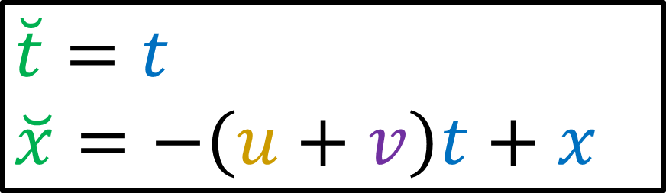






Einstein $→$ Train
Train $→$ Bullet
$$\tilde{t}=t$$
$$\tilde{x}=−vt+x$$
$$\breve{t}=\tilde{t}$$
$$\breve{x}=−u\tilde{t}+\tilde{x}$$
Velocity Addition Rule for Galilean Relativity:
Einstein $→$ Bullet
$$u$$
$$v$$
$$\breve{t}=t$$
$$\breve{x}=−\left(u+v\right)t+x$$
$$u+v$$
Notes:
This shows us that to add velocities U and V in Galilean Relativity, we literally just add them together using the + (plus) operation. This agrees with our common sense experience that the speed of the bullet should be added together with the speed of the train.
This seems like the obvious answer but we’ll find that it’s not true in Special Relativity.

Slide 12
Einstein $→$ Train
Train $→$ Bullet
$$\tilde{t}=t$$
$$\tilde{x}=−vt+x$$
$$\breve{t}=\tilde{t}$$
$$\breve{x}=−u\tilde{t}+\tilde{x}$$
Notes:
This shows us that to add velocities U and V in Galilean Relativity, we literally just add them together using the + (plus) operation. This agrees with our common sense experience that the speed of the bullet should be added together with the speed of the train.
This seems like the obvious answer but we’ll find that it’s not true in Special Relativity.

Slide 13

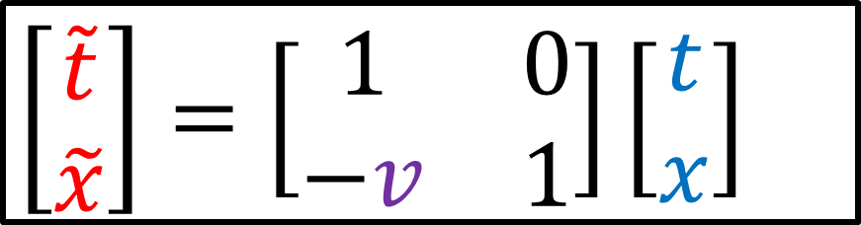

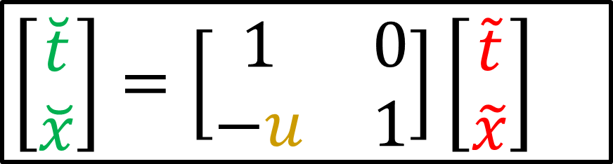
Einstein $→$ Train
Train $→$ Bullet
$$\left[\begin{aligned}\tilde{t} \\ \tilde{x}\end{aligned}\right]=\left[\begin{matrix}1 & 0 \\ −v & 1\end{matrix}\right]\left[\begin{aligned}t \\ x\end{aligned}\right]$$
$$\left[\begin{aligned}\breve{t} \\ \breve{x}\end{aligned}\right]=\left[\begin{matrix}1 & 0 \\ −u & 1\end{matrix}\right]\left[\begin{aligned}\tilde{t} \\ \tilde{x}\end{aligned}\right]$$
Notes:
Another way to show this is that if we write the two Galilean transformations in matrix form, and then substitute this equation in for the column with t-tilde and x-tilde, We can just multiply the Galilean matrix with speed U and the Galilean matrix with speed V to get a new Galilean matrix with speed U+V, which gives us the combine Galilean transformation

Slide 14
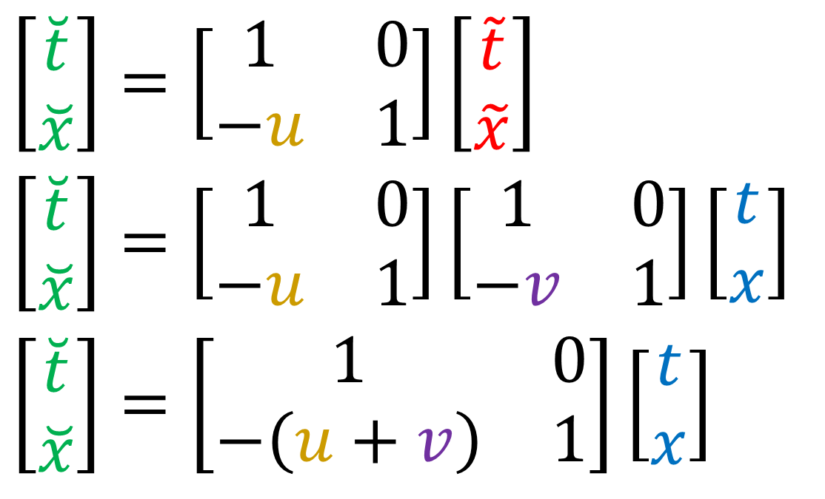
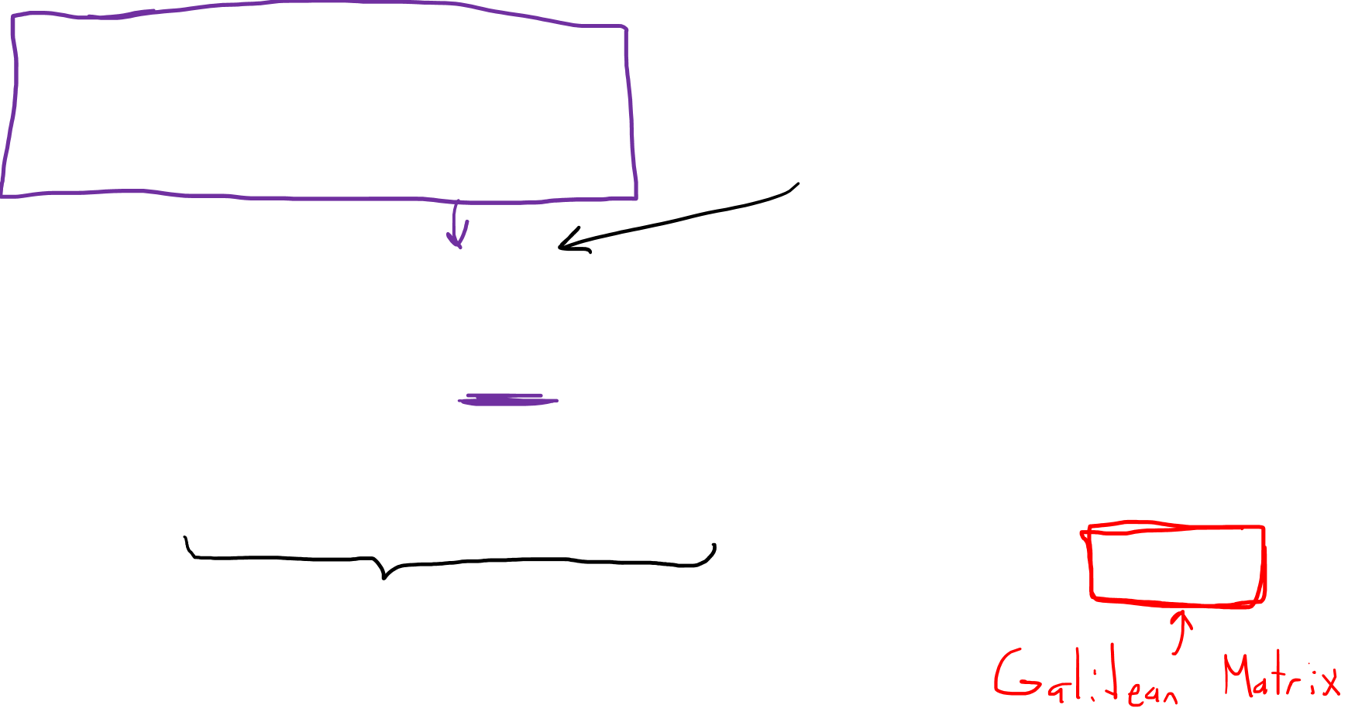

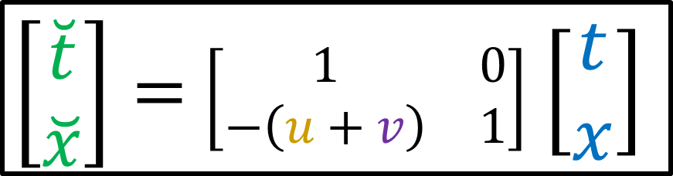
Einstein $→$ Train
Train $→$ Bullet
$$\left[\begin{aligned}\tilde{t} \\ \tilde{x}\end{aligned}\right]=\left[\begin{matrix}1 & 0 \\ −v & 1\end{matrix}\right]\left[\begin{aligned}t \\ x\end{aligned}\right]$$
$$\left[\begin{aligned}\breve{t} \\ \breve{x}\end{aligned}\right]=\left[\begin{matrix}1 & 0 \\ −u & 1\end{matrix}\right]\left[\begin{aligned}\tilde{t} \\ \tilde{x}\end{aligned}\right]$$
$$\left[\begin{aligned}\breve{t} \\ \breve{x}\end{aligned}\right]=\left[\begin{matrix}1 & 0 \\ −u & 1\end{matrix}\right]\left[\begin{aligned}\tilde{t} \\ \tilde{x}\end{aligned}\right]$$
$$\left[\begin{aligned}\breve{t} \\ \breve{x}\end{aligned}\right]=\left[\begin{matrix}1 & 0 \\ −u & 1\end{matrix}\right]\left[\begin{matrix}1 & 0 \\ −v & 1\end{matrix}\right]\left[\begin{aligned}t \\ x\end{aligned}\right]$$
$$\left[\begin{aligned}\breve{t} \\ \breve{x}\end{aligned}\right]=\left[\begin{matrix}1 & 0 \\ −\left(u+v\right) & 1\end{matrix}\right]\left[\begin{aligned}t \\ x\end{aligned}\right]$$
Einstein $→$ Bullet
$\left[\begin{aligned}\breve{t} \\ \breve{x}\end{aligned}\right]=$ $\left[\begin{matrix}1 & 0 \\ −\left(u+v\right) & 1\end{matrix}\right]$ $\left[\begin{aligned}t \\ x\end{aligned}\right]$
Notes:
Another way to show this is that if we write the two Galilean transformations in matrix form, and then substitute this equation in for the column with t-tilde and x-tilde, We can just multiply the Galilean matrix with speed U and the Galilean matrix with speed V to get a new Galilean matrix with speed U+V, which gives us the combine Galilean transformation

Slide 15
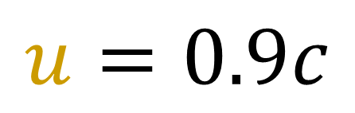


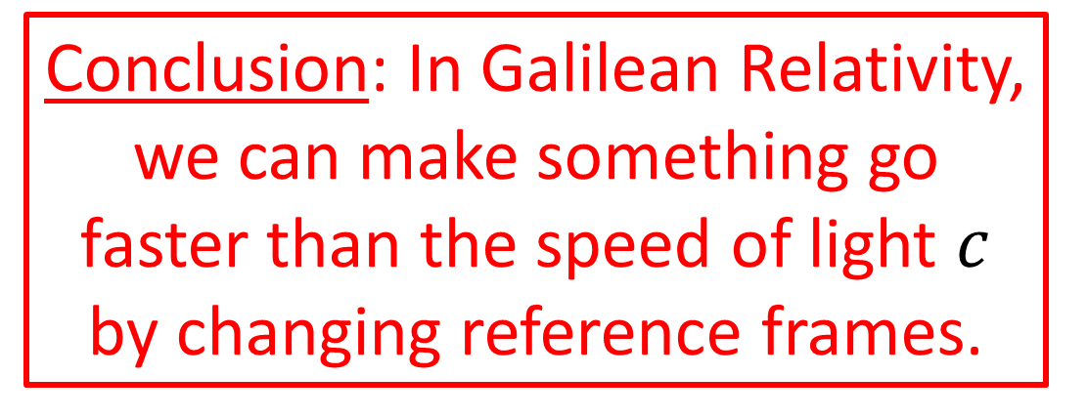




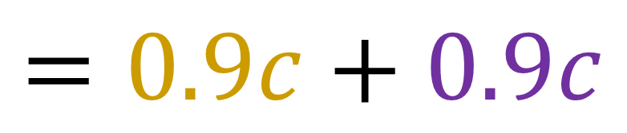

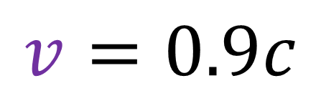
Velocity Addition Rule for Galilean Relativity:
$c=$ speed of light
$$u$$
$$v$$
$$u=0.9c$$
$$v=0.9c$$
$$u+v$$
$$u+v$$
Conclusion: In Galilean Relativity, we can make something go faster than the speed of light $c$ by changing reference frames.
$$=0.9c+0.9c$$
$$= 1.8c$$
Notes:
With this rule for velocity addition, if we take c to be the speed of light, then 0.9c added with 0.9c gives 1.8c, 1.8 times the speed of light. This means that in Galilean Relativity, we can make something appear to go faster than light just by changing reference frames. So when Einstein sees Lorentz aboard the train going 90% the speed of light, and Lorentz fires a bullet going 90% the speed of light relative to the train, Einstein sees the bullet going 180% the speed of light according to Galilean relativity.

Slide 16

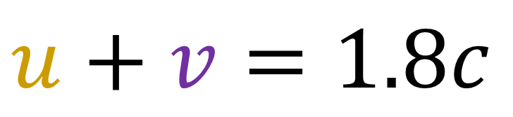
time $t$
train $→$ bullet
$$u=0.9c$$
Einstein $→$ train
$$v=0.9c$$
Einstein $→$ bullet
$$u+v=1.8c$$
position $x$
train
Notes:
Let’s start with how velocity addition works in special relativity…
Let’s say that Albert Einstein is standing still on the ground. A train is going by to the right at 90% the speed of light. Hendrik Lorentz is onboard the train and fires and fires a gun to the right. The bullet travels out from the gun at 90% the speed of light relative to the train.
It is interesting to ask how fast the bullet is travelling in Einstein’s frame.
Figuring this out would involve changing reference frames twice. First from Einstein to the train, and then again from the train to the bullet.
In Galilean Relativity, we’ll find the speed of the bullet agrees with common sense, but in special relativity the answer is more surprising. (explain better an give a spacetime diagram picture!!)

Slide 17


time $t$
train $→$ bullet
$$u=0.9c$$
Einstein $→$ train
$$v=0.9c$$
What is the speed of the bullet in Einstein’s frame?
position $x$
train
Notes:
Let’s start with how velocity addition works in special relativity…
Let’s say that Albert Einstein is standing still on the ground. A train is going by to the right at 90% the speed of light. Hendrik Lorentz is onboard the train and fires and fires a gun to the right. The bullet travels out from the gun at 90% the speed of light relative to the train.
It is interesting to ask how fast the bullet is travelling in Einstein’s frame.
Figuring this out would involve changing reference frames twice. First from Einstein to the train, and then again from the train to the bullet.
In Galilean Relativity, we’ll find the speed of the bullet agrees with common sense, but in special relativity the answer is more surprising. (explain better an give a spacetime diagram picture!!)

Slide 18
time $t$
train $→$ bullet
$$u=0.9c$$
Einstein $→$ train
$$v=0.9c$$
What is the speed of the bullet in Einstein’s frame?
position $x$
train
Notes:
Let’s start with how velocity addition works in special relativity…
Let’s say that Albert Einstein is standing still on the ground. A train is going by to the right at 90% the speed of light. Hendrik Lorentz is onboard the train and fires and fires a gun to the right. The bullet travels out from the gun at 90% the speed of light relative to the train.
It is interesting to ask how fast the bullet is travelling in Einstein’s frame.
Figuring this out would involve changing reference frames twice. First from Einstein to the train, and then again from the train to the bullet.
In Galilean Relativity, we’ll find the speed of the bullet agrees with common sense, but in special relativity the answer is more surprising. (explain better an give a spacetime diagram picture!!)

Slide 19

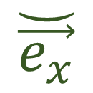
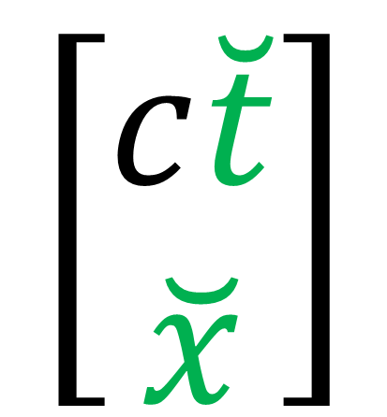
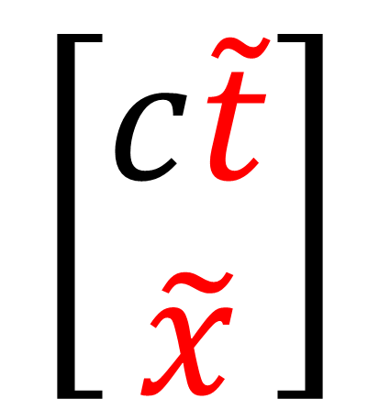

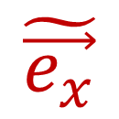
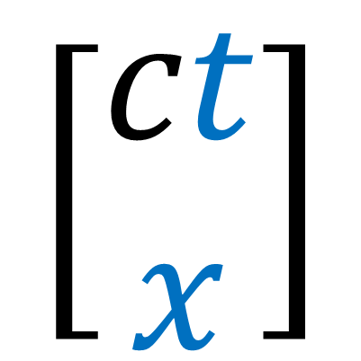
$$\vec{e_{t}}$$
$$\tilde{\vec{e_{t}}}$$
$$\breve{\vec{e_{t}}}$$
$$\vec{e_{x}}$$
$$\tilde{\vec{e_{x}}}$$
$$\breve{\vec{e_{x}}}$$
train
$$\left[\begin{aligned}c\tilde{t} \\ \tilde{x}\end{aligned}\right]$$
$$\left[\begin{aligned}c\breve{t} \\ \breve{x}\end{aligned}\right]$$
$$\left[\begin{aligned}ct \\ x\end{aligned}\right]$$
Notes:
Let’s start by looking at this problem in Galilean relativity.
Let’s say that Einstein uses the spacetime coordinates t and x The Train uses coordinates t-tilde, and x-tilde And the bullet uses coordinates t-smile and x-smile.

Slide 20
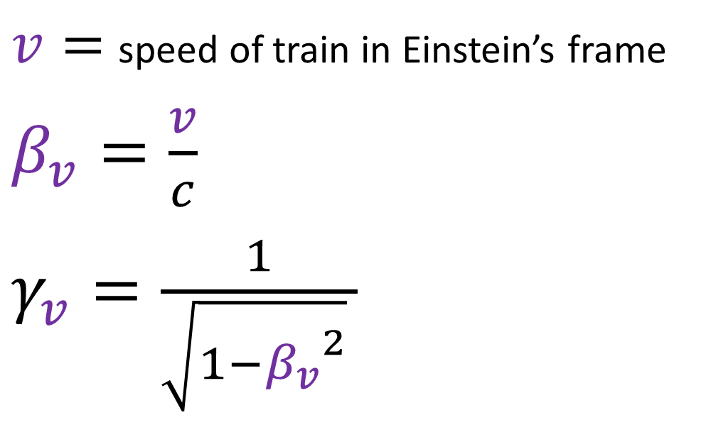

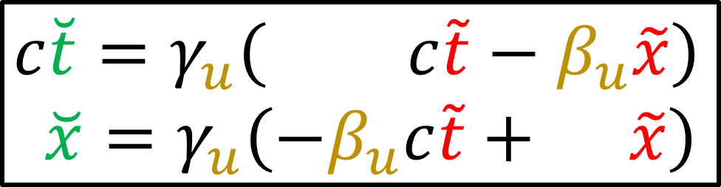

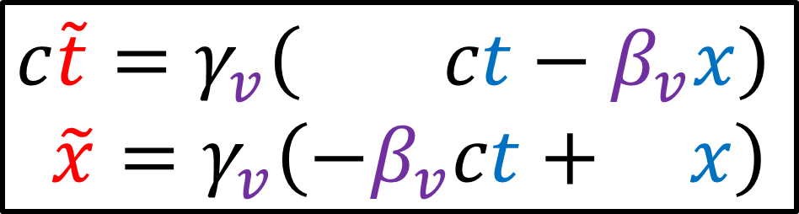
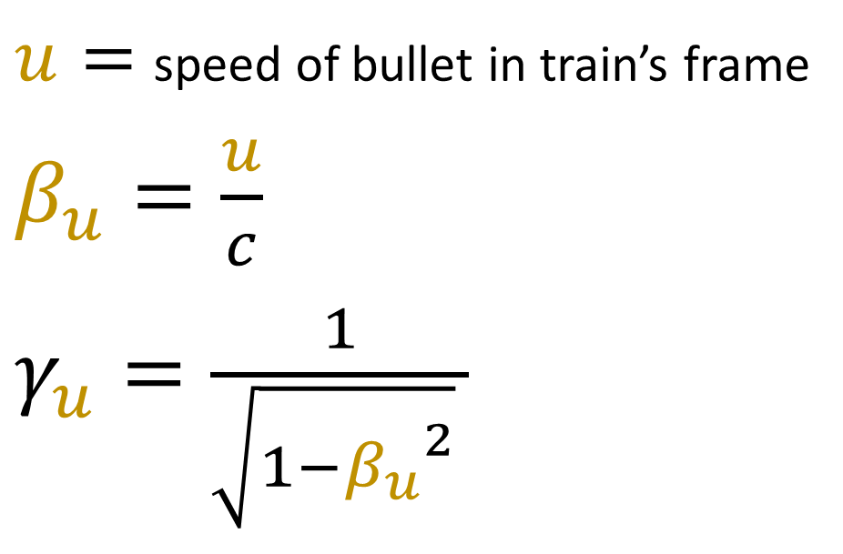
Einstein $→$ Train
Train $→$ Bullet
$$c\tilde{t}=γ_{v}\left( ct−β_{v}x\right)$$
$$\tilde{x}=γ_{v}\left(−β_{v}ct+ x\right)$$
$$c\breve{t}=γ_{u}\left( c\tilde{t}−β_{u}\tilde{x}\right)$$
$$\breve{x}=γ_{u}\left(−β_{u}c\tilde{t}+ \tilde{x}\right)$$
$v=$ speed of train in Einstein’s frame
$β_{v}=\frac{v}{c}$
$γ_{v}=\frac{1}{\sqrt{1−{β_{v}}^{2}} }$
$u=$ speed of bullet in train’s frame
$β_{u}=\frac{u}{c}$
$γ_{u}=\frac{1}{\sqrt{1−{β_{u}}^{2}} }$
Notes:
Now let’s see how velocity addition works in special relativity.
Let’s say that Einstein uses the spacetime coordinates ct and x The Train uses coordinates ct-tilde, and x-tilde And the bullet uses coordinates ct-smile and x-smile. We’ll start with two Lorentz transformations. The first Lorentz transformation changes ct and x into ct-tilde and x-tilde, using the velocity V. The velocity V will have the corresponding Beta_v and Gamma_v coefficients given here. Remember that Beta is just a fraction of the speed of light, so it’s between 0 and 1.
The other Lorentz trnasformationn will changes ct-tilde and x-tilde into ct-smile and x-smile, using the velocity u, with coefficents beta_u and gamma_u.
We can combine the Lorentz transformations the same way as before, starting with the cT-smile equation, and subbing in these equations for ct-tilde and x-tilde.
We can factor out Gamma V to the front, and also combine the terms containing cT and also X. We can do the same thing for the x-smile equation.

Slide 21
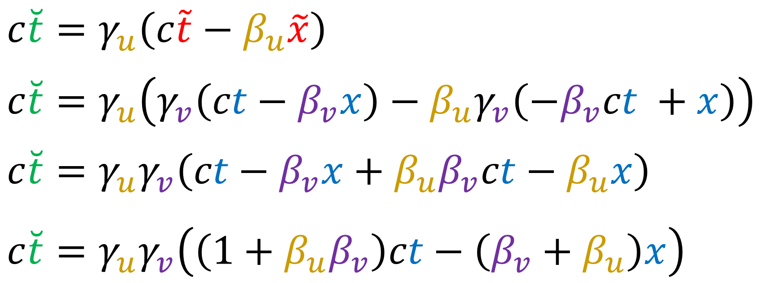
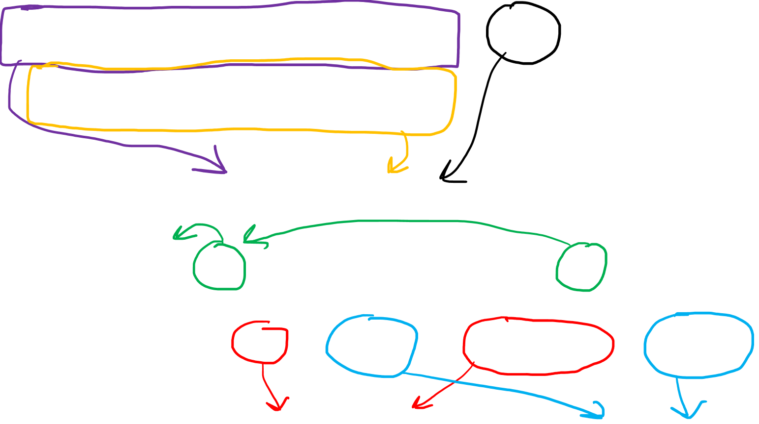
Einstein $→$ Train
Train $→$ Bullet
$$c\tilde{t}=γ_{v}\left( ct−β_{v}x\right)$$
$$\tilde{x}=γ_{v}\left(−β_{v}ct+ x\right)$$
$$c\breve{t}=γ_{u}\left( c\tilde{t}−β_{u}\tilde{x}\right)$$
$$\breve{x}=γ_{u}\left(−β_{u}c\tilde{t}+ \tilde{x}\right)$$
$$c\breve{t}=γ_{u}\left(c\tilde{t}−β_{u}\tilde{x}\right)$$
$$c\breve{t}=γ_{u}\left(γ_{v}\left(ct−β_{v}x\right)−β_{u}γ_{v}\left(−β_{v}ct +x\right)\right)$$
$$c\breve{t}=γ_{u}γ_{v}\left(ct−β_{v}x+β_{u}β_{v}ct−β_{u}x\right)$$
$$c\breve{t}=γ_{u}γ_{v}\left(\left(1+β_{u}β_{v}\right)ct−\left(β_{v}+β_{u}\right)x\right)$$
Notes:
Now let’s see how velocity addition works in special relativity.
Let’s say that Einstein uses the spacetime coordinates ct and x The Train uses coordinates ct-tilde, and x-tilde And the bullet uses coordinates ct-smile and x-smile. We’ll start with two Lorentz transformations. The first Lorentz transformation changes ct and x into ct-tilde and x-tilde, using the velocity V. The velocity V will have the corresponding Beta_v and Gamma_v coefficients given here. Remember that Beta is just a fraction of the speed of light, so it’s between 0 and 1.
The other Lorentz trnasformationn will changes ct-tilde and x-tilde into ct-smile and x-smile, using the velocity u, with coefficents beta_u and gamma_u.
We can combine the Lorentz transformations the same way as before, starting with the cT-smile equation, and subbing in these equations for ct-tilde and x-tilde.
We can factor out Gamma V to the front, and also combine the terms containing cT and also X. We can do the same thing for the x-smile equation.

Slide 22
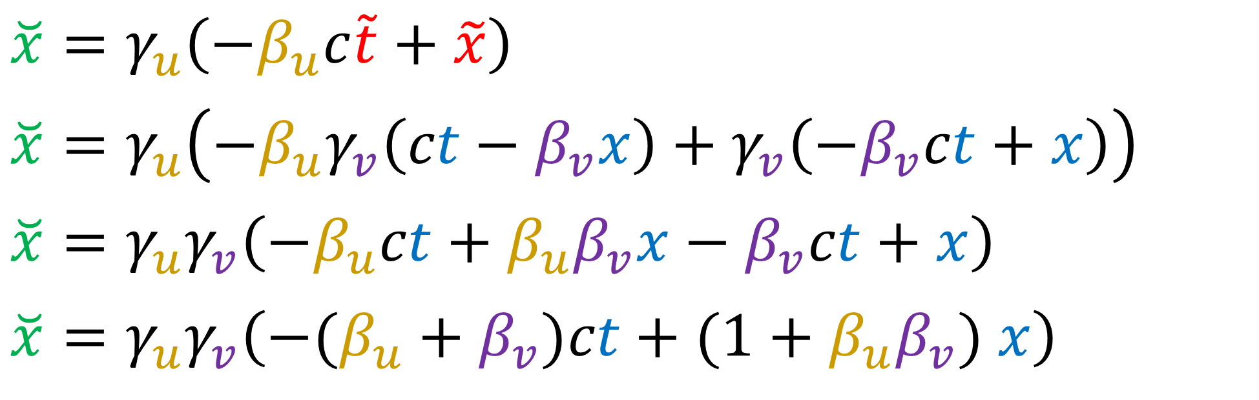
Einstein $→$ Train
Train $→$ Bullet
$$c\tilde{t}=γ_{v}\left( ct−β_{v}x\right)$$
$$\tilde{x}=γ_{v}\left(−β_{v}ct+ x\right)$$
$$c\breve{t}=γ_{u}\left( c\tilde{t}−β_{u}\tilde{x}\right)$$
$$\breve{x}=γ_{u}\left(−β_{u}c\tilde{t}+ \tilde{x}\right)$$
$$\breve{x}=γ_{u}\left(−β_{u}c\tilde{t}+\tilde{x}\right)$$
$$\breve{x}=γ_{u}\left(−β_{u}γ_{v}\left(ct−β_{v}x\right)+γ_{v}\left(−β_{v}ct+x\right)\right)$$
$$\breve{x}=γ_{u}γ_{v}\left(−β_{u}ct+β_{u}β_{v}x−β_{v}ct+x\right)$$
$$\breve{x}=γ_{u}γ_{v}\left(−(β_{u}+β_{v})ct+(1+β_{u}β_{v}) x\right)$$

Slide 23
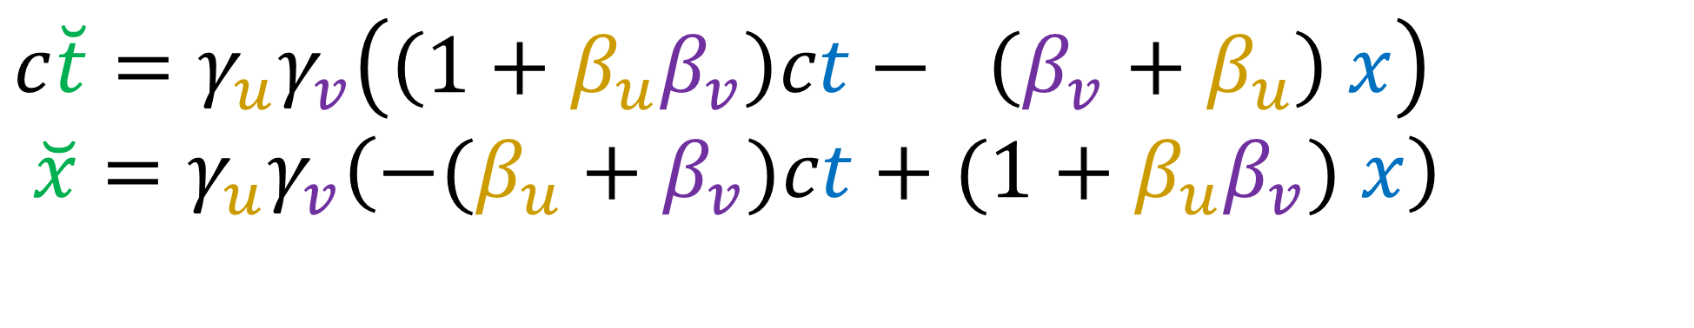
Einstein $→$ Train
Train $→$ Bullet
$$c\tilde{t}=γ_{v}\left( ct−β_{v}x\right)$$
$$\tilde{x}=γ_{v}\left(−β_{v}ct+ x\right)$$
$$c\breve{t}=γ_{u}\left( c\tilde{t}−β_{u}\tilde{x}\right)$$
$$\breve{x}=γ_{u}\left(−β_{u}c\tilde{t}+ \tilde{x}\right)$$
$$c\breve{t}=γ_{u}γ_{v}\left(\left(1+β_{u}β_{v}\right)ct− \left(β_{v}+β_{u}\right) x\right)$$
$\breve{x}=γ_{u}γ_{v}\left(−(β_{u}+β_{v})ct+(1+β_{u}β_{v}) x\right)$
Notes:
So the equations for converting ct and x to ct-smile and x-smile are here.

Slide 24

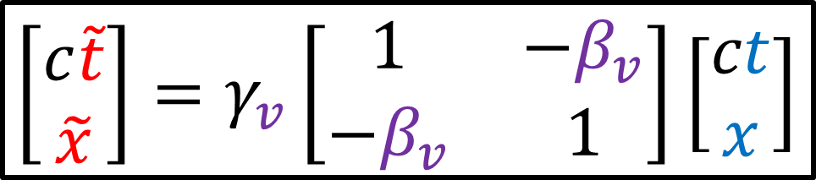

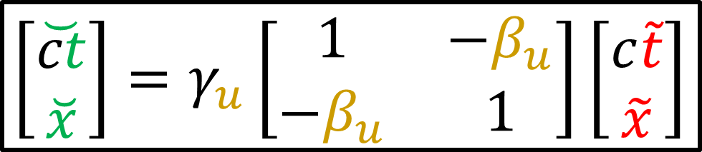

Einstein $→$ Train
Train $→$ Bullet
$$\left[\begin{aligned}c\tilde{t} \\ \tilde{x}\end{aligned}\right]=γ_{v}\left[\begin{matrix}1 & −β_{v} \\ −β_{v} & 1\end{matrix}\right]\left[\begin{aligned}ct \\ x\end{aligned}\right]$$
$$\left[\begin{aligned}\breve{ct} \\ \breve{x}\end{aligned}\right]=γ_{u}\left[\begin{matrix}1 & −β_{u} \\ −β_{u} & 1\end{matrix}\right]\left[\begin{aligned}c\tilde{t} \\ \tilde{x}\end{aligned}\right]$$
Notes:
Another way to get the same result is to write the Lorentz transformations in matrix form, and then take this matrix equation and substitute in the equation for the column with ct-tilde and x-tilde.
We end up with a new matrix equation where we multiply these two Lorentz matrices.

Slide 25


Einstein $→$ Train
Train $→$ Bullet
$$\left[\begin{aligned}c\tilde{t} \\ \tilde{x}\end{aligned}\right]=γ_{v}\left[\begin{matrix}1 & −β_{v} \\ −β_{v} & 1\end{matrix}\right]\left[\begin{aligned}ct \\ x\end{aligned}\right]$$
$$\left[\begin{aligned}\breve{ct} \\ \breve{x}\end{aligned}\right]=γ_{u}\left[\begin{matrix}1 & −β_{u} \\ −β_{u} & 1\end{matrix}\right]\left[\begin{aligned}c\tilde{t} \\ \tilde{x}\end{aligned}\right]$$
$$\left[\begin{aligned}\breve{ct} \\ \breve{x}\end{aligned}\right]=γ_{u}\left[\begin{matrix}1 & −β_{u} \\ −β_{u} & 1\end{matrix}\right]\left[\begin{aligned}c\tilde{t} \\ \tilde{x}\end{aligned}\right]$$
$$\left[\begin{aligned}\breve{ct} \\ \breve{x}\end{aligned}\right]=γ_{u}\left[\begin{matrix}1 & −β_{u} \\ −β_{u} & 1\end{matrix}\right]γ_{v}\left[\begin{matrix}1 & −β_{v} \\ −β_{v} & 1\end{matrix}\right]\left[\begin{aligned}ct \\ x\end{aligned}\right]$$
Notes:
Another way to get the same result is to write the Lorentz transformations in matrix form, and then take this matrix equation and substitute in the equation for the column with ct-tilde and x-tilde.
We end up with a new matrix equation where we multiply these two Lorentz matrices.

Slide 26



$$γ_{u}\left[\begin{matrix}1 & −β_{u} \\ −β_{u} & 1\end{matrix}\right]$$
$$γ_{v}\left[\begin{matrix}1 & −β_{v} \\ −β_{v} & 1\end{matrix}\right]$$
$$=γ_{u}γ_{v}\left[\begin{matrix}1+β_{u}β_{v} & −\left(β_{u}+β_{v}\right) \\ −\left(β_{u}+β_{v}\right) & 1+β_{u}β_{v}\end{matrix}\right]$$
Notes:
When we multiply the Lorentz matrices, the Gamma coefficients go out in front, then to get the matrix entries we just multiply the a row by a column. Here get 1 + -beta_u * - beta_v. And if we do this for all the matrix entries we get this.

Slide 27



Einstein $→$ Train
Train $→$ Bullet
$$c\tilde{t}=γ_{v}\left( ct−β_{v}x\right)$$
$$\tilde{x}=γ_{v}\left(−β_{v}ct+ x\right)$$
$$c\breve{t}=γ_{u}\left( c\tilde{t}−β_{u}\tilde{x}\right)$$
$$\breve{x}=γ_{u}\left(−β_{u}c\tilde{t}+ \tilde{x}\right)$$
$$c\breve{t}=γ_{u}γ_{v}\left(\left(1+β_{u}β_{v}\right)ct− \left(β_{v}+β_{u}\right) x\right)$$
$\breve{x}=γ_{u}γ_{v}\left(−(β_{u}+β_{v})ct+(1+β_{u}β_{v}) x\right)$
$$\left[\begin{aligned}\breve{ct} \\ \breve{x}\end{aligned}\right]=γ_{u}γ_{v} \left[\begin{matrix}1+β_{u}β_{v} & −\left(β_{u}+β_{v}\right) \\ −\left(β_{u}+β_{v}\right) & 1+β_{u}β_{v}\end{matrix}\right]\left[\begin{aligned}ct \\ x\end{aligned}\right]$$
Notes:
so we can write out the combined Lorentz transformations in either the standard form, or in matrix form.
It turns out we can simplify the coefficients in this equations, or in other words, simplify this matrix here.
Simplifying this matrix is very easy with something called Hyperbolic Geometry!
But we won’t learn about hyperbolic geometry until the next video on the Minkowski metric.
For now, we’ll simplify the matrix using brute-force algebra.

Slide 28
Einstein $→$ Train
Train $→$ Bullet
Simplifying this is easier with Hyperbolic Geometry!
… but we won’t learn that until the next video.
Do it brute-force for now.
$$c\tilde{t}=γ_{v}\left( ct−β_{v}x\right)$$
$$\tilde{x}=γ_{v}\left(−β_{v}ct+ x\right)$$
$$c\breve{t}=γ_{u}\left( c\tilde{t}−β_{u}\tilde{x}\right)$$
$$\breve{x}=γ_{u}\left(−β_{u}c\tilde{t}+ \tilde{x}\right)$$
$$c\breve{t}=γ_{u}γ_{v}\left(\left(1+β_{u}β_{v}\right)ct− \left(β_{v}+β_{u}\right) x\right)$$
$\breve{x}=γ_{u}γ_{v}\left(−(β_{u}+β_{v})ct+(1+β_{u}β_{v}) x\right)$
$$\left[\begin{aligned}\breve{ct} \\ \breve{x}\end{aligned}\right]=γ_{u}γ_{v} \left[\begin{matrix}1+β_{u}β_{v} & −\left(β_{u}+β_{v}\right) \\ −\left(β_{u}+β_{v}\right) & 1+β_{u}β_{v}\end{matrix}\right]\left[\begin{aligned}ct \\ x\end{aligned}\right]$$

Slide 29




$$γ_{u}γ_{v} \left[\begin{matrix}1+β_{u}β_{v} & −\left(β_{u}+β_{v}\right) \\ −\left(β_{u}+β_{v}\right) & 1+β_{u}β_{v}\end{matrix}\right]$$
Factor out $\left(1+β_{u}β_{v}\right)$
$γ_{u}γ_{v}\left(1+β_{u}β_{v}\right)\left[\begin{matrix}1 & −\frac{\left(β_{u}+β_{v}\right)}{\left(1+β_{u}β_{v}\right)} \\ −\frac{\left(β_{u}+β_{v}\right)}{\left(1+β_{u}β_{v}\right)} & 1\end{matrix}\right]$
Notes:
To start we’ll factor out the term (1 + beta_U * beta_V) from each entry in the matrix. This means the main-diagonal entries become 1, because that’s just dividing a term by itself. And the off-diagonal entries because negative (beta_U + beta_V) all divided by (1 + beta_U * beta_V)
For now we’re just going to leave the matrix as it is and focus on the term out in front, gamma_u gamma_v times 1 + beta_u beta_v

Slide 30





$$γ_{u}γ_{v}\left(1+β_{u}β_{v}\right)$$
$$=\frac{1}{\sqrt{1−β_{u}^{2}}}\frac{1}{\sqrt{1−β_{v}^{2}}}\left(1+β_{u}β_{v}\right)$$
$$=\frac{1}{\sqrt{1−β_{u}^{2}}}\frac{1}{\sqrt{1−β_{v}^{2}}}\sqrt{{\left(1+β_{u}β_{v}\right)}^{2}}$$
$$=\sqrt{\frac{{\left(1+β_{u}β_{v}\right)}^{2}}{\left(1−β_{u}^{2}\right)\left(1−β_{v}^{2}\right)}}$$
Notes:
We can write out each gamma coefficient as 1 over the square root of 1-beta^2 for their respective beta coefficients.
We can also take the term 1 + beta_u beta_v and square it if we put it under a square root sign…. the square and square root balance out so the equation hasn’t changed.
Now, since all 3 of these terms contain square roots, we can put them all under the same square root using the rules of algebra.

Slide 31





$$\sqrt{\frac{{\left(1+β_{u}β_{v}\right)}^{2}}{\left(1−β_{u}^{2}\right)\left(1−β_{v}^{2}\right)}}$$
$$=\sqrt{\frac{{\left(1+β_{u}β_{v}\right)}^{2}}{1+β_{u}^{2}β_{v}^{2}−β_{u}^{2}−β_{v}^{2}}}$$
$$=\sqrt{\frac{{\left(1+β_{u}β_{v}\right)}^{2}}{1+β_{u}^{2}β_{v}^{2}+2β_{u}β_{v}−2β_{u}β_{v}−β_{u}^{2}−β_{v}^{2}}}$$
$$=\sqrt{\frac{{\left(1+β_{u}β_{v}\right)}^{2}}{{\left(1+β_{u}β_{v}\right)}^{2}−{\left(β_{u}+β_{v}\right)}^{2}}}$$
Notes:
Now I’m going to expand the denominator… 1-beta_u squared * 1 – beta)v squared gives us 1 + beta_u^2 beta_v^2 – beta_u^2 – beta_v^2
Next, also in the denominator, I’m going to add and subtract the same term, and that won’t change the equation since they balance out.
I’m going to add 2 beta_u beta_v and then subtract 2 beta_u beta_v
Now if you’ve observant, the first 3 terms in the denominator can be factored into 1 + beta_u beta_v all squared. And the last 3 terms can be factored into (beta_u + beta_v) all squared, with a negative sign in front.

Slide 32





$$\sqrt{\frac{{\left(1+β_{u}β_{v}\right)}^{2}}{{\left(1+β_{u}β_{v}\right)}^{2}−{\left(β_{u}+β_{v}\right)}^{2}}}$$
$\frac{\frac{1}{{\left(1+β_{u}β_{v}\right)}^{2}} }{\frac{1}{{\left(1+β_{u}β_{v}\right)}^{2}}}$
$$=\sqrt{\frac{1}{1−\frac{{\left(β_{u}+β_{v}\right)}^{2}}{{\left(1+β_{u}β_{v}\right)}^{2}}}}$$
$$=\frac{1}{\sqrt{1−{\left(\frac{β_{u}+β_{v}}{1+β_{u}β_{v}}\right)}^{2}}}$$

Slide 33


$γ_{u}γ_{v}\left(1+β_{u}β_{v}\right)\left[\begin{matrix}1 & −\frac{\left(β_{u}+β_{v}\right)}{\left(1+β_{u}β_{v}\right)} \\ −\frac{\left(β_{u}+β_{v}\right)}{\left(1+β_{u}β_{v}\right)} & 1\end{matrix}\right]$
$$=\frac{1}{\sqrt{1−{\left(\frac{β_{u}+β_{v}}{1+β_{u}β_{v}}\right)}^{2}}}\left[\begin{matrix}1 & −\left(\frac{β_{u}+β_{v}}{1+β_{u}β_{v}}\right) \\ −\left(\frac{β_{u}+β_{v}}{1+β_{u}β_{v}}\right) & 1\end{matrix}\right]$$
Notes:
So if we bring the matrix back, we’ve discovered that we can write this coefficient, as this big square rooted term here.

Slide 34





Velocity Addition Rule for Special Relativity:
Lorentz Transformation
$$β_{u}$$
$$β_{v}$$
$$\frac{1}{\sqrt{1−β^{2}}}\left[\begin{matrix}1 & −β \\ −β & 1\end{matrix}\right]$$
$\frac{β_{u}+β_{v}}{1+β_{u}β_{v}}$
$$=\frac{1}{\sqrt{1−{\left(\frac{β_{u}+β_{v}}{1+β_{u}β_{v}}\right)}^{2}}}\left[\begin{matrix}1 & −\left(\frac{β_{u}+β_{v}}{1+β_{u}β_{v}}\right) \\ −\left(\frac{β_{u}+β_{v}}{1+β_{u}β_{v}}\right) & 1\end{matrix}\right]$$
Notes:
Now if you’re observant, you’ll notice that this big matrix formula here has the same format as a Lorentz matrix, except the beta coefficient is replaced by this big expression here… beta_u + beta_v, all over 1 + beta_u * beta_v. This means we now know how to combined the beta velocities in special relativity. When we do two Lorentz transformations in a row, they combine to give a new Lorentz transformation with beta coefficient of beta_u + beta_v, all over 1 + beta_u * beta_v.

Slide 35





Einstein $→$ Train
Train $→$ Bullet
$$c\tilde{t}=γ_{v}\left( ct−β_{v}x\right)$$
$$\tilde{x}=γ_{v}\left(−β_{v}ct+ x\right)$$
$$c\breve{t}=γ_{u}\left( c\tilde{t}−β_{u}\tilde{x}\right)$$
$$\breve{x}=γ_{u}\left(−β_{u}c\tilde{t}+ \tilde{x}\right)$$
Matrix equation:
$\left[\begin{aligned}\breve{ct} \\ \breve{x}\end{aligned}\right]=\frac{1}{\sqrt{1−β^{2}}}\left[\begin{matrix}1 & −β \\ −β & 1\end{matrix}\right]\left[\begin{aligned}ct \\ x\end{aligned}\right]$
$β=\frac{β_{u}+β_{v}}{1+β_{u}β_{v}}$
$c\breve{t}=\frac{1}{\sqrt{1−β^{2}}}\left( ct−βx\right)$
$\breve{x}=\frac{1}{\sqrt{1−β^{2}}}\left(−βct+ x\right)$
Standard equations:
Notes:
So here we can see the combined Lorentz transformation that changes ct and x into ct-smile and x-smile
is given by this new Lorentz transformation, with this new beta coefficient.

Slide 36






train $→$ bullet
Einstein $→$ train
$$β_{u}=0.9$$
$$β_{v}=0.9$$
$β=\frac{β_{u}+β_{v}}{1+β_{u}β_{v}}$
$=\frac{0.9+0.9}{1+\left(0.9\right)\left(0.9\right)}$
$=\frac{1.8}{1+0.81}$
$$=0.9945$$
(99.45% of the speed of light.)
Notes:
Let’s see what this new beta coefficient is when beta_u is 90% the speed of light, and beta_v is also 90% the speed of light. According to the formula, the new beta is 0.9 + 0.9 all over 1 + 0.9*0.9. This gives 1.8 divided by 1.81, which is about 99.45 % of the speed of light.
So even though in Galilean relativity, adding velocities of 0.9 and 0.9 together ends up going faster than light, in special relativity with this new velocity addition rule, the two velocities don’t add to go faster than the speed of light.
(show spacetime diagram example).

Slide 37






Galilean Relativity:
Special Relativity:
$$β_{u}=0.9$$
$$β_{v}=0.9$$
$$u=0.9c$$
$$v=0.9c$$
$$u+v=1.8c$$
$$\frac{β_{u}+β_{v}}{1+β_{u}β_{v}}=0.9945$$

Slide 38








$$0<β_{u}<1$$
$0<\frac{β_{u}+β_{v}}{1+β_{u}β_{v}}<1$
$$0<β_{v}<1$$
$$1+β_{v}=1+β_{v}$$
$$β_{u}−1<β_{v}\left(β_{u}−1\right)$$
$$1+β_{v}+β_{u}−1<1+β_{v}+β_{v}\left(β_{u}−1\right)$$
$$β_{v}+β_{u}<1+β_{v}+β_{v}β_{u}−β_{v}$$
$$β_{v}+β_{u}<1+β_{v}β_{u}$$
Notes:
And it turns out that if the two beta coefficients are between 0 and 1, which they always will be,
then the combined velocity is also going to be between zero and 1. And here’s the proof.
We can all agree that 1+beta_v = 1 + beta_V
What is less obvious is that beta_u -1 is less than beta_u -1 multiplied by the fraction beta_v.
Keep in mind that since beta_u is between zero and 1, the left-hand-side, beta_u -1 is a negative number.
And on the right-hand side, we’re shrinking the size of this same negative number by the fraction beta_v. So it is also a negative number, bit it’s scaled to be closer to zero. This means that the left side is more negative, and therefore less than the right side.
Now if we take this inequality, and add 1+beta_v to both sides, the inequality shouldn’t change. We’re just increases both sides by the same number.
Now the left-hand side, the +1 and -1 cancel out. And no the right side, after we distribute beta_v into here, we notice that the +beta_v and – beta_v cancel.
So we’re left with beta_v + beta_u is less than 1 + beta_v * beta_u

Slide 39


$$0<β_{u}<1$$
$0<\frac{β_{u}+β_{v}}{1+β_{u}β_{v}}<1$
$$0<β_{v}<1$$
$$β_{v}+β_{u}<\left(1+β_{v}β_{u}\right)$$
Positive, so we can divide on both sides without changing inequality.
$$\frac{β_{u}+β_{v}}{1+β_{u}β_{v}}<1$$
Conclusion: No matter how many times we Lorentz transform to a new frame, nothing goes faster than light.
Notes:
Since 1 + beta_v * beta_u is positive, we can divide both sides of the inequality by it without changing the inequality. If it was a negative number, we’d have to change the direction of the inequality, but because it’s positive, we can leave it as it is.
And so we end up with the conclusion that beta_u + beta_v all over 1 + beta_u * beta_v is always going to be less than 1. This means that no matter how many times we do a Lorentz transformation, we can never make anything go faster than the speed of light, because the resulting beta coefficient is always less than 1 according to this velocity addition rule.

Slide 40






Einstein $→$ Train
Train $→$ Bullet
$$c\tilde{t}=γ_{v}\left( ct−β_{v}x\right)$$
$$\tilde{x}=γ_{v}\left(−β_{v}ct+ x\right)$$
$$c\breve{t}=γ_{u}\left( c\tilde{t}−β_{u}\tilde{x}\right)$$
$$\breve{x}=γ_{u}\left(−β_{u}c\tilde{t}+ \tilde{x}\right)$$
Velocity Addition Rule for Special Relativity:
Einstein $→$ Bullet
$$c\breve{t}=γ\left( ct−βx\right)$$
$$\breve{x}=γ\left(−βct+ x\right)$$
$$β_{u}$$
$$β_{v}$$
$β=\frac{β_{u}+β_{v}}{1+β_{u}β_{v}}<1$
$$\frac{1}{\sqrt{1−β^{2}}}$$
Notes:
So we’ve confirmed that combining two Lorentz transformations gives us another Lorentz transformation where the beta coefficient is always less than 1.

Slide 41





time $t$
train $→$ bullet
$$β_{u}=0.9$$
Einstein $→$ train
$$β_{v}=0.9$$
Einstein $→$ bullet
$β$ $=0.9945$
$β=\frac{β_{u}+β_{v}}{1+β_{u}β_{v}}$
position $x$
train
Notes:
Let’s start with how velocity addition works in special relativity…
Let’s say that Albert Einstein is standing still on the ground. A train is going by to the right at 90% the speed of light. Hendrik Lorentz is onboard the train and fires and fires a gun to the right. The bullet travels out from the gun at 90% the speed of light relative to the train.
It is interesting to ask how fast the bullet is travelling in Einstein’s frame.
Figuring this out would involve changing reference frames twice. First from Einstein to the train, and then again from the train to the bullet.
In Galilean Relativity, we’ll find the speed of the bullet agrees with common sense, but in special relativity the answer is more surprising. (explain better an give a spacetime diagram picture!!)

Slide 42






bullet #1 $→$ bullet #2
Einstein $→$ bullet #1
$β_{w}$ $=0.9$
$β_{1}$ $=0.9945$
Einstein $→$ bullet #2
$β_{2}$ $=\frac{β_{1}+β_{w}}{1+β_{1}β_{w}}=0.9997$
Notes:
Let’s start with how velocity addition works in special relativity…
Let’s say that Albert Einstein is standing still on the ground. A train is going by to the right at 90% the speed of light. Hendrik Lorentz is onboard the train and fires and fires a gun to the right. The bullet travels out from the gun at 90% the speed of light relative to the train.
It is interesting to ask how fast the bullet is travelling in Einstein’s frame.
Figuring this out would involve changing reference frames twice. First from Einstein to the train, and then again from the train to the bullet.
In Galilean Relativity, we’ll find the speed of the bullet agrees with common sense, but in special relativity the answer is more surprising. (explain better an give a spacetime diagram picture!!)

Slide 43










$β_{v}$ $=0.9$
$$0<β_{u}<1$$
train
$$0<β_{v}<1$$
1
$β_{1}$ $=0.9945$
2
$β_{2}$ $=0.9997$
$β=\frac{β_{u}+β_{v}}{1+β_{u}β_{v}}<1$
3
$β_{3}$ $=0.99998$
In Special Relativity,
no massive object can ever reach the speed of light in a vacuum $c$.
4
$β_{4}$ $=0.9999992$
5
$β_{5}$ $=0.99999996$

Slide 44
Relativity of Simultaneity
Notes:
Next let’s talk about the relativity of Simultaneity

Slide 45




time $t$
time $\tilde{t}$
position $\tilde{x}$
simultaneity
simultaneity
position $x$
Notes:
You already know from previous videos that if we bounce a beam of light between both ends of a train car, we can establish a line of simultaneity in spacetime by taking the event point halfway between sending and receiving the light signal to happen at the same time as the event point when the beam of light is reflected.
And if we repeat this experiment for a moving train car, the lines of simultaneity for the passengers on that train car will be diagonal.

Slide 46













Frame A
Frame B
$$ct=5$$
$$ct=5$$
$$ct=4$$
$$ct=4$$
$$ct=3$$
$$ct=3$$
$$ct=2$$
$$ct=2$$
$$ct=1$$
$$ct=1$$
$$ct=0$$
$$ct=0$$
Notes:
So in some reference frames, we see time passing by in a spacetime diagram as a horizontal line moving upward. But in other reference frames, we see time as a diagonal line moving upward.
So what this means is that two events that appear to happen at the same time in one reference frame will NOT happen at the same time in another reference frame.

Slide 47







Frame A
Frame B
$$ct=5$$
$$ct=5$$
$$ct=4$$
$$ct=4$$
$$ct=3$$
$$ct=3$$
$$ct=2$$
$$ct=2$$
$$ct=1$$
$$ct=1$$
$$ct=0$$
$$ct=0$$
Notes:
So in some reference frames, we see time passing by in a spacetime diagram as a horizontal line moving upward. But in other reference frames, we see time as a diagonal line moving upward.
So what this means is that two events that appear to happen at the same time in one reference frame will NOT happen at the same time in another reference frame.

Slide 48




Frame A
Frame B
$$ct=5$$
$$ct=5$$
$$ct=4$$
$$ct=4$$
$$ct=3$$
$$ct=3$$
$$ct=2$$
$$ct=2$$
$$ct=1$$
$$ct=1$$
$$ct=0$$
$$ct=0$$
Notes:
So in some reference frames, we see time passing by in a spacetime diagram as a horizontal line moving upward. But in other reference frames, we see time as a diagonal line moving upward.
So what this means is that two events that appear to happen at the same time in one reference frame will NOT happen at the same time in another reference frame.

Slide 49
same time
Notes:
So in one reference frame the sun and star event happen at the same time. But in another frame, the star event happens first, and in another frame, the sun event happens first.

Slide 50
after
before

Slide 52
after
before

Slide 53
Simultaneity is Relative (in Special Relativity)

Slide 54


Notes:
Now, after learning about the relativity of simultaneity, you may have some concerns.
For example, let’s say at one event in spacetime we fire a bullet from a gun, and then a bit later the bullet hits a vase, which shatters into pieces.
In this reference frame, the bullet is fired first, and then the vase is shattered after.
But since the order of events is relative, you might wonder if you could find another reference frame where the order is reversed… where the vase shatters first, and then the bullet is fired…
If you could figure out how to do this, it would be very concerning because you will have broken the causal relationship between events… you would have made the effect—the vase shattering—happen BEFORE the cause—the bullet being fired.
However, even in special relativity, we cannot make effects happen before their causes.

Slide 55






$$ct=5$$
$$ct=4$$
$$ct=3$$
$$ct=2$$
$$ct=1$$
$$ct=0$$
Notes:
Now, after learning about the relativity of simultaneity, you may have some concerns.
For example, let’s say at one event in spacetime we fire a bullet from a gun, and then a bit later the bullet hits a vase, which shatters into pieces.
In this reference frame, the bullet is fired first, and then the vase is shattered after.
But since the order of events is relative, you might wonder if you could find another reference frame where the order is reversed… where the vase shatters first, and then the bullet is fired…
If you could figure out how to do this, it would be very concerning because you will have broken the causal relationship between events… you would have made the effect—the vase shattering—happen BEFORE the cause—the bullet being fired.
However, even in special relativity, we cannot make effects happen before their causes.

Slide 56
Notes:
Now, after learning about the relativity of simultaneity, you may have some concerns.
For example, let’s say at one event in spacetime we fire a bullet from a gun, and then a bit later the bullet hits a vase, which shatters into pieces.
In this reference frame, the bullet is fired first, and then the vase is shattered after.
But since the order of events is relative, you might wonder if you could find another reference frame where the order is reversed… where the vase shatters first, and then the bullet is fired…
If you could figure out how to do this, it would be very concerning because you will have broken the causal relationship between events… you would have made the effect—the vase shattering—happen BEFORE the cause—the bullet being fired.
However, even in special relativity, we cannot make effects happen before their causes.

Slide 57
Notes:
Now, after learning about the relativity of simultaneity, you may have some concerns.
For example, let’s say at one event in spacetime we fire a bullet from a gun, and then a bit later the bullet hits a vase, which shatters into pieces.
In this reference frame, the bullet is fired first, and then the vase is shattered after.
But since the order of events is relative, you might wonder if you could find another reference frame where the order is reversed… where the vase shatters first, and then the bullet is fired…
If you could figure out how to do this, it would be very concerning because you will have broken the causal relationship between events… you would have made the effect—the vase shattering—happen BEFORE the cause—the bullet being fired.
However, even in special relativity, we cannot make effects happen before their causes.

Slide 58






$$ct=5$$
$$ct=4$$
$$ct=3$$
$$ct=2$$
$$ct=1$$
$$ct=0$$
Notes:
Now, after learning about the relativity of simultaneity, you may have some concerns.
For example, let’s say at one event in spacetime we fire a bullet from a gun, and then a bit later the bullet hits a vase, which shatters into pieces.
In this reference frame, the bullet is fired first, and then the vase is shattered after.
But since the order of events is relative, you might wonder if you could find another reference frame where the order is reversed… where the vase shatters first, and then the bullet is fired…
If you could figure out how to do this, it would be very concerning because you will have broken the causal relationship between events… you would have made the effect—the vase shattering—happen BEFORE the cause—the bullet being fired.
However, even in special relativity, we cannot make effects happen before their causes.

Slide 59






$$ct=5$$
$$ct=4$$
$$ct=3$$
$$ct=2$$
$$ct=1$$
$$ct=0$$
Notes:
Now, after learning about the relativity of simultaneity, you may have some concerns.
For example, let’s say at one event in spacetime we fire a bullet from a gun, and then a bit later the bullet hits a vase, which shatters into pieces.
In this reference frame, the bullet is fired first, and then the vase is shattered after.
But since the order of events is relative, you might wonder if you could find another reference frame where the order is reversed… where the vase shatters first, and then the bullet is fired…
If you could figure out how to do this, it would be very concerning because you will have broken the causal relationship between events… you would have made the effect—the vase shattering—happen BEFORE the cause—the bullet being fired.
However, even in special relativity, we cannot make effects happen before their causes.

Slide 60
$$ct=5$$
$$ct=4$$
$$ct=3$$
$$ct=2$$
$$ct=1$$
$$ct=0$$
It is impossible to make effects happen before their causes.
Notes:
Now, after learning about the relativity of simultaneity, you may have some concerns.
For example, let’s say at one event in spacetime we fire a bullet from a gun, and then a bit later the bullet hits a vase, which shatters into pieces.
In this reference frame, the bullet is fired first, and then the vase is shattered after.
But since the order of events is relative, you might wonder if you could find another reference frame where the order is reversed… where the vase shatters first, and then the bullet is fired…
If you could figure out how to do this, it would be very concerning because you will have broken the causal relationship between events… you would have made the effect—the vase shattering—happen BEFORE the cause—the bullet being fired.
However, even in special relativity, we cannot make effects happen before their causes.

Slide 61



Recall: Lorentz Transformations can’t make things go faster than light.
$$0<β_{u}<1$$
$0<\frac{β_{u}+β_{v}}{1+β_{u}β_{v}}<1$
$$0<β_{v}<1$$

Slide 62
Time axis represents path of an object in an inertial frame.
time
time
time
Notes:
Let’s start with how velocity addition works in special relativity…
Let’s say that Albert Einstein is standing still on the ground. A train is going by to the right at 90% the speed of light. Hendrik Lorentz is onboard the train and fires and fires a gun to the right. The bullet travels out from the gun at 90% the speed of light relative to the train.
It is interesting to ask how fast the bullet is travelling in Einstein’s frame.
Figuring this out would involve changing reference frames twice. First from Einstein to the train, and then again from the train to the bullet.
In Galilean Relativity, we’ll find the speed of the bullet agrees with common sense, but in special relativity the answer is more surprising. (explain better an give a spacetime diagram picture!!)

Slide 63
time
time axis will always live in this region
position
Notes:
Earlier in this video, we learned that, no matter how fast you go, and no matter how many Lorentz transformations you do to switch reference frames… you can never make something go faster than the speed of light.
The time axis is always going to exist within this highlighted region of the spacetime diagram. This region is called the “light cone” because it contains all the events between a beam of light sent to the left, and a beam of light sent to the right.
Likewise, the position axis is always going to exist outsight this highlighted region—outside the light cone.
It is impossible to make the time and position axes cross 45 degree line with a slope of 1 that represents a beam of light. So it is impossible for the time and position axes to cross over each other, and it is impossible for the position axis to cross over into the light cone, which would be required to connect the event of the gunshot and the event of the vase shattered to make them happen at the same time.
Basically, if two events are connected by a line that’s slower than the speed of light… it means that these events COULD have a causal relationship. One event might cause the other, for example a gunshot causing a vase to break, or a beam of light causing a sensor to activate.
Events that can have a causal relationship can never have their order in time switched… it is mathematically impossible to do with a Lorentz transformation.
On the other hand, if two events are connected by a line that’s faster than the speed of light… it means that it is impossible for the two events to have a causal relationship. Nothing that we sent out from the first event, not even a light beam, can reach the second event, because the events are too far apart in space.
It is only events like this that have no causal relationship with each other that are capable of having their order switched in different reference frames using a Lorentz transformation.

Slide 64
time
time axis will always live in this region
position
Notes:
Earlier in this video, we learned that, no matter how fast you go, and no matter how many Lorentz transformations you do to switch reference frames… you can never make something go faster than the speed of light.
The time axis is always going to exist within this highlighted region of the spacetime diagram. This region is called the “light cone” because it contains all the events between a beam of light sent to the left, and a beam of light sent to the right.
Likewise, the position axis is always going to exist outsight this highlighted region—outside the light cone.
It is impossible to make the time and position axes cross 45 degree line with a slope of 1 that represents a beam of light. So it is impossible for the time and position axes to cross over each other, and it is impossible for the position axis to cross over into the light cone, which would be required to connect the event of the gunshot and the event of the vase shattered to make them happen at the same time.
Basically, if two events are connected by a line that’s slower than the speed of light… it means that these events COULD have a causal relationship. One event might cause the other, for example a gunshot causing a vase to break, or a beam of light causing a sensor to activate.
Events that can have a causal relationship can never have their order in time switched… it is mathematically impossible to do with a Lorentz transformation.
On the other hand, if two events are connected by a line that’s faster than the speed of light… it means that it is impossible for the two events to have a causal relationship. Nothing that we sent out from the first event, not even a light beam, can reach the second event, because the events are too far apart in space.
It is only events like this that have no causal relationship with each other that are capable of having their order switched in different reference frames using a Lorentz transformation.

Slide 65
time
time axis will always live in this region
position

Slide 66
time
time axis will always live in this region
position

Slide 67

time
light cone
time axis will always live in this region
position
light cone

Slide 68
time
light cone
position
light cone

Slide 69
time
light cone
position
light cone

Slide 70
position
impossible with the Lorentz transformation
light cone
time
(position & time axes cannot cross)
light cone

Slide 71
position
reference frame going faster than light according to Einstein
(impossible!)
light cone
time
light cone

Slide 72
position
time
impossible for these to happen at the same time

Slide 73
position
time

Slide 74
position
time

Slide 75
position
time

Slide 76
position
time

Slide 77
position
time

Slide 78






position
time
$$ct=2$$
$$ct=1$$
$$ct=0$$
$$ct=−1$$
$$ct=−2$$
$$ct=−3$$

Slide 79
time
Two events connected by line slower than light.
position
(possible causal relationship)
Notes:
Basically, if two events are connected by a line that’s slower than the speed of light… it means that these events COULD have a causal relationship. One event might cause the other, for example a gunshot causing a vase to break, or a beam of light causing a sensor to activate.
Events that can have a causal relationship can never have their order in time switched… it is mathematically impossible to do with a Lorentz transformation.
On the other hand, if two events are connected by a line that’s faster than the speed of light… it means that it is impossible for the two events to have a causal relationship. Nothing that we sent out from the first event, not even a light beam, can reach the second event, because the events are too far apart in space.
It is only events like this that have no causal relationship with each other that are capable of having their order switched in different reference frames using a Lorentz transformation.

Slide 80





time
Two events connected by line slower than light.
$$ct=4$$
$$ct=3$$
$$ct=2$$
position
$$ct=1$$
(possible causal relationship)
$$ct=0$$

Slide 81
time
Two events connected by line slower than light.
position
(possible causal relationship)

Slide 82




time
Two events connected by line slower than light.
$$ct=3$$
$$ct=2$$
position
$$ct=1$$
(possible causal relationship)
$$ct=0$$
(cannot switch order of events)

Slide 83
time
Two events connected by line faster than light.
position
(no causal relationship)
Notes:
Basically, if two events are connected by a line that’s slower than the speed of light… it means that these events COULD have a causal relationship. One event might cause the other, for example a gunshot causing a vase to break, or a beam of light causing a sensor to activate.
Events that can have a causal relationship can never have their order in time switched… it is mathematically impossible to do with a Lorentz transformation.
On the other hand, if two events are connected by a line that’s faster than the speed of light… it means that it is impossible for the two events to have a causal relationship. Nothing that we sent out from the first event, not even a light beam, can reach the second event, because the events are too far apart in space.
It is only events like this that have no causal relationship with each other that are capable of having their order switched in different reference frames using a Lorentz transformation.

Slide 84





time
Two events connected by line faster than light.
$$ct=2$$
$$ct=1$$
position
$$ct=0$$
$$ct=−1$$
(no causal relationship)
$$ct=−2$$
Notes:
Basically, if two events are connected by a line that’s slower than the speed of light… it means that these events COULD have a causal relationship. One event might cause the other, for example a gunshot causing a vase to break, or a beam of light causing a sensor to activate.
Events that can have a causal relationship can never have their order in time switched… it is mathematically impossible to do with a Lorentz transformation.
On the other hand, if two events are connected by a line that’s faster than the speed of light… it means that it is impossible for the two events to have a causal relationship. Nothing that we sent out from the first event, not even a light beam, can reach the second event, because the events are too far apart in space.
It is only events like this that have no causal relationship with each other that are capable of having their order switched in different reference frames using a Lorentz transformation.

Slide 85
time
Two events connected by line faster than light.
position
(no causal relationship)
Notes:
Basically, if two events are connected by a line that’s slower than the speed of light… it means that these events COULD have a causal relationship. One event might cause the other, for example a gunshot causing a vase to break, or a beam of light causing a sensor to activate.
Events that can have a causal relationship can never have their order in time switched… it is mathematically impossible to do with a Lorentz transformation.
On the other hand, if two events are connected by a line that’s faster than the speed of light… it means that it is impossible for the two events to have a causal relationship. Nothing that we sent out from the first event, not even a light beam, can reach the second event, because the events are too far apart in space.
It is only events like this that have no causal relationship with each other that are capable of having their order switched in different reference frames using a Lorentz transformation.

Slide 86





time
Two events connected by line faster than light.
$$ct=2$$
$$ct=1$$
position
$$ct=0$$
$$ct=−1$$
(no causal relationship)
(order can be switched)
$$ct=−2$$
Notes:
Basically, if two events are connected by a line that’s slower than the speed of light… it means that these events COULD have a causal relationship. One event might cause the other, for example a gunshot causing a vase to break, or a beam of light causing a sensor to activate.
Events that can have a causal relationship can never have their order in time switched… it is mathematically impossible to do with a Lorentz transformation.
On the other hand, if two events are connected by a line that’s faster than the speed of light… it means that it is impossible for the two events to have a causal relationship. Nothing that we sent out from the first event, not even a light beam, can reach the second event, because the events are too far apart in space.
It is only events like this that have no causal relationship with each other that are capable of having their order switched in different reference frames using a Lorentz transformation.

Slide 87
Two events connected by line faster than light.
(no causal relationship)
(order can be switched)
after
before
after
before
Notes:
Basically, if two events are connected by a line that’s slower than the speed of light… it means that these events COULD have a causal relationship. One event might cause the other, for example a gunshot causing a vase to break, or a beam of light causing a sensor to activate.
Events that can have a causal relationship can never have their order in time switched… it is mathematically impossible to do with a Lorentz transformation.
On the other hand, if two events are connected by a line that’s faster than the speed of light… it means that it is impossible for the two events to have a causal relationship. Nothing that we sent out from the first event, not even a light beam, can reach the second event, because the events are too far apart in space.
It is only events like this that have no causal relationship with each other that are capable of having their order switched in different reference frames using a Lorentz transformation.

Slide 88
Two events connected by line slower than light.
(possible causal relationship)
(order cannot be switched)
after
after
before
before
Notes:
Basically, if two events are connected by a line that’s slower than the speed of light… it means that these events COULD have a causal relationship. One event might cause the other, for example a gunshot causing a vase to break, or a beam of light causing a sensor to activate.
Events that can have a causal relationship can never have their order in time switched… it is mathematically impossible to do with a Lorentz transformation.
On the other hand, if two events are connected by a line that’s faster than the speed of light… it means that it is impossible for the two events to have a causal relationship. Nothing that we sent out from the first event, not even a light beam, can reach the second event, because the events are too far apart in space.
It is only events like this that have no causal relationship with each other that are capable of having their order switched in different reference frames using a Lorentz transformation.

Slide 89

Einstein $→$ Train
Train $→$ Bullet
$$c\tilde{t}=γ_{v}\left( ct−β_{v}x\right)$$
$$\tilde{x}=γ_{v}\left(−β_{v}ct+ x\right)$$
$$c\breve{t}=γ_{u}\left( c\tilde{t}−β_{u}\tilde{x}\right)$$
$$\breve{x}=γ_{u}\left(−β_{u}c\tilde{t}+ \tilde{x}\right)$$
Velocity Addition Rule for Special Relativity:
Einstein $→$ Bullet
$$c\breve{t}=γ\left( ct−βx\right)$$
$$\breve{x}=γ\left(−βct+ x\right)$$
$$β_{u}$$
$$β_{v}$$
$β=\frac{β_{u}+β_{v}}{1+β_{u}β_{v}}<1$
$$\frac{1}{\sqrt{1−β^{2}}}$$
Notes:
So to summarize this video, we learned that combining two Lorentz transformations gives us another Lorentz transformation, with this law here for adding the velocities of the reference frames. We showed that no matter which velocities we use, it is impossible to make an object travel faster than light using the Lorentz transformations.
We also talked about the relativity of simultaneity, and how the order of events can change in different reference frames in special relativity.
However, it impossible to break causality. If two events are connected by a line that’s slower than light, it means they could have a causal relationship, and therefore Lorentz transformations cannot change the order of events.
However when events are connected by a line that’s faster than light, it means it is impossible for the events to have a causal relationship, and so we can use a Lorentz transformation to change reference frames and switch the order that they occur in.

Slide 90
Slower-Than-Light separation
possible causal relationship
can’t switch order
Faster-Than-Light separation
no causal relationship
can switch order
time
time
position
position

