Slide 1
Relativity 105: Acceleration In Special Relativity
Hyperbolic Motion (acceleration), Rindler Horizon
Rindler Coordinates and Bell’s Spaceship Paradox
Basis Vectors/Jacobian in Curvilinear Coordinates
The Proper Time Along Curves and Twin Paradox
Covariant Derivative
Geodesic Curves (inertial frames/zero forces)

Slide 2
“Paradoxes” in Special Relativity
Bell’s spaceship paradox
twin paradox
ladder paradox
more…
These “paradoxes” can be resolved… Special Relativity works just fine!

Slide 3


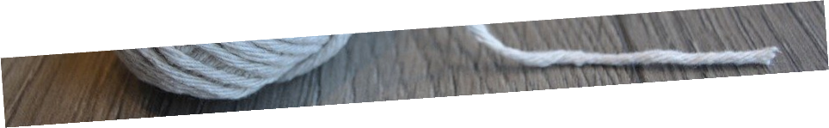
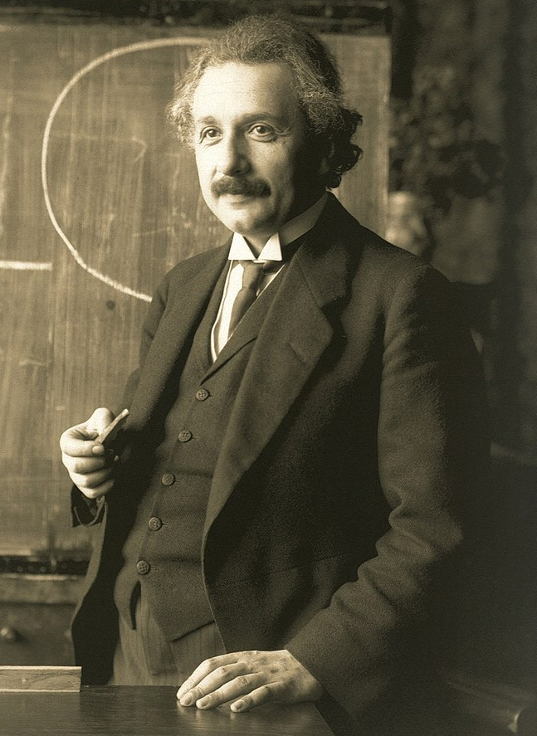

$$D$$
Notes:
Bell’s Spaceship paradox is one of many so-called paradoxes in Special Relativity, like the Twin Paradox and the Ladder Paradox.
At first these paradoxes seem like contradictions that indicate flaws in Special Relativity, but more careful thinking reveals that there is no paradox at all and Special Relativity works just fine.
Bell’s Spaceship paradox works like this: Let’s say there are two spaceships some distance D apart. There is a string that ties the two spaceships together. The string is exactly long enough to cover the distance between the spaceships. If the spaceships move even slightly further apart, the string will break.
Einstein is standing stationary halfway between the two the two ships, and sends a light signal to each one, which tells each ship to begin accelerating to the right in the same manner, so that they are always travelling at the same velocity according to Einstein, and the distance D between the ships never changes, according to Einstein.
The question is: does the string between the ships break?
Some people might argue that the string will not break, because the distance between the ships does not change according to Einstein.
Others will argue that the string does break, because once the string starts moving, it will undergo Length Contraction, and that it will become too short to cover the distance D between the ships and snap.

Slide 4
$$D$$
same speed
Notes:
Bell’s Spaceship paradox is one of many so-called paradoxes in Special Relativity, like the Twin Paradox and the Ladder Paradox.
At first these paradoxes seem like contradictions that indicate flaws in Special Relativity, but more careful thinking reveals that there is no paradox at all and Special Relativity works just fine.
Bell’s Spaceship paradox works like this: Let’s say there are two spaceships some distance D apart. There is a string that ties the two spaceships together. The string is exactly long enough to cover the distance between the spaceships. If the spaceships move even slightly further apart, the string will break.
Einstein is standing stationary halfway between the two the two ships, and sends a light signal to each one, which tells each ship to begin accelerating to the right in the same manner, so that they are always travelling at the same velocity according to Einstein, and the distance D between the ships never changes, according to Einstein.
The question is: does the string between the ships break?
Some people might argue that the string will not break, because the distance between the ships does not change according to Einstein.
Others will argue that the string does break, because once the string starts moving, it will undergo Length Contraction, and that it will become too short to cover the distance D between the ships and snap.

Slide 5





$$D$$
Does the string break??
$$D$$
Option 1:
string doesn’t break (same distance $D$!)
$$D$$
Option 2:
string breaks (length contraction!)

Slide 6
Bell’s Spaceship Paradox:
$$D$$
Does the string break or not??
$$D$$

Slide 7


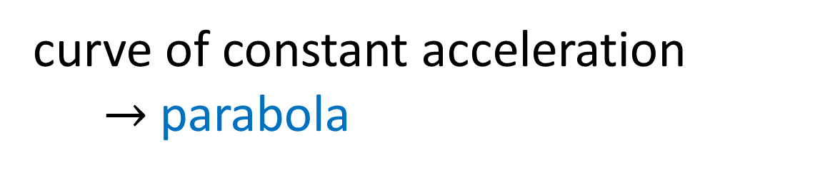


Acceleration in Newtonian Physics
$$ct$$
curve of constant acceleration
$→$ parabola
$$x$$

Slide 8


Accelerating spaceships in Newtonian Physics
$$ct$$
$$x$$

Slide 9
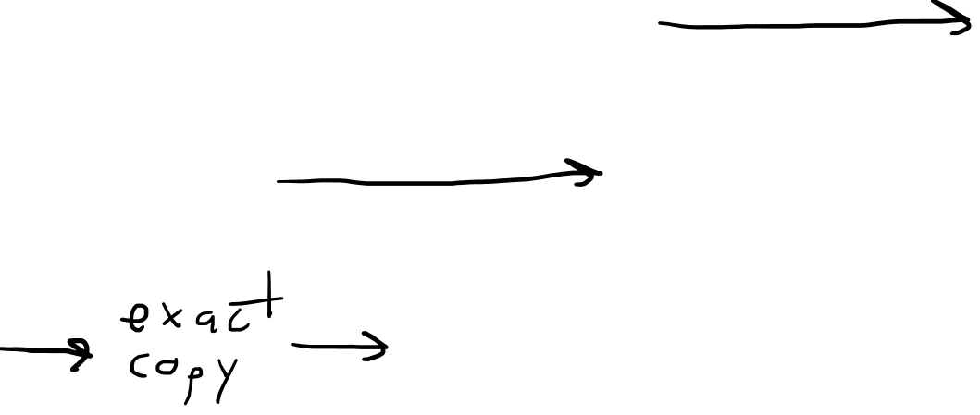

Accelerating spaceships in Newtonian Physics
$$ct$$
same acceleration
$$D$$
$$x$$

Slide 10
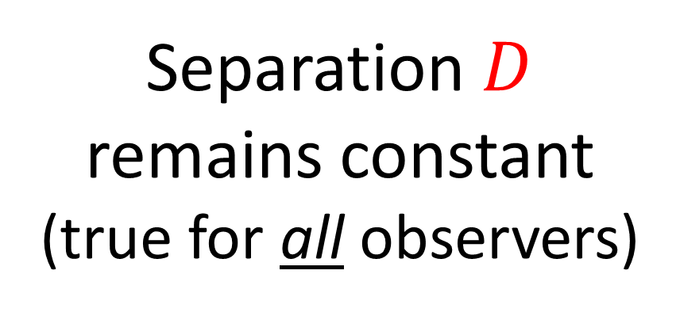
Accelerating spaceships in Newtonian Physics
$$ct$$
Separation $D$ remains constant
(true for all observers)
$$D$$
$$x$$

Slide 11

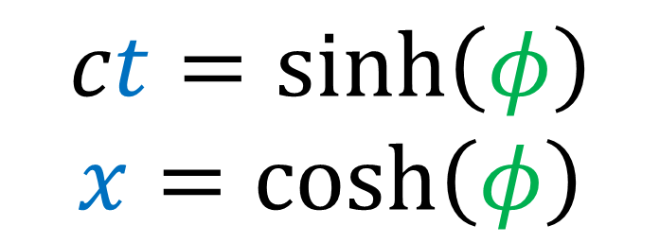
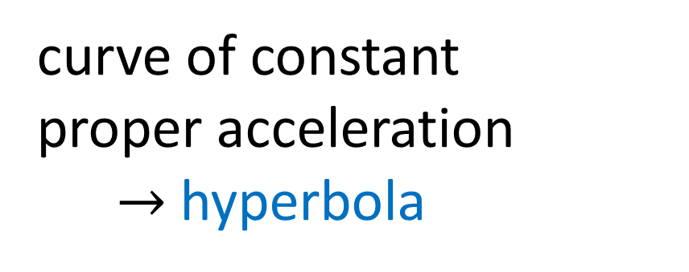
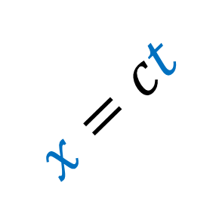


Acceleration in Special Relativity
$$ct$$
D
(light beam)
$$x=ct$$
never reaches the speed of light!!
curve of constant proper acceleration
$→$ hyperbola
$$x$$
$$ct=\sinh\left(φ\right)$$
$$x=\cosh\left(φ\right)$$

Slide 12
Accelerating spaceships in Special Relativity
$$ct$$
$$x$$

Slide 13
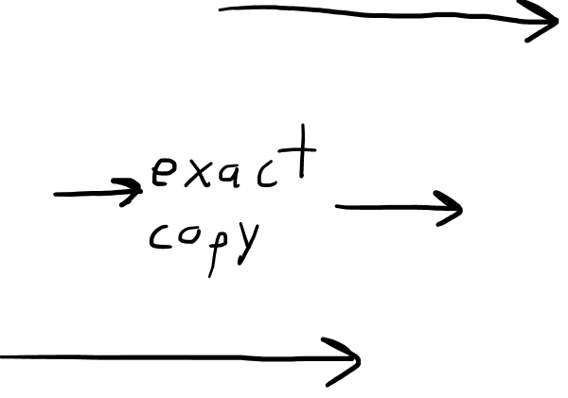
Accelerating spaceships in Special Relativity
$$ct$$
D
D
same proper acceleration
$$D$$
$$x$$

Slide 14

Accelerating spaceships in Special Relativity
$$ct$$
D
D
same proper acceleration
Separation $D$ remains constant for stationary observer...
But in special relativity… distances are relative!!
$$D$$
$$x$$

Slide 15
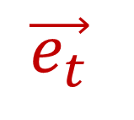
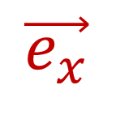
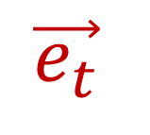
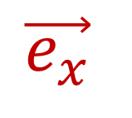

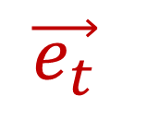
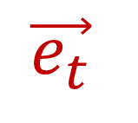

Relativity 105a: curved worldlines have “instantaneous inertial frames” at every point.
D
$$\vec{e_{t}}$$
$$\vec{e_{x}}$$
$$\vec{e_{t}}$$
$$\vec{e_{x}}$$
$$\vec{e_{t}}$$
$$\vec{e_{x}}$$
$$\vec{e_{t}}$$
$$\vec{e_{x}}$$

Slide 16
Relativity 105a: curved worldlines have “instantaneous inertial frames” at every point.
D
$$\vec{e_{t}}$$
$$\vec{e_{t}}$$
$$\vec{e_{t}}$$
$$\vec{e_{t}}$$

Slide 17
Relativity 105a: curved worldlines have “instantaneous inertial frames” at every point.
D
$$\vec{e_{x}}$$
$$\vec{e_{x}}$$
$$\vec{e_{x}}$$
$$\vec{e_{x}}$$

Slide 18


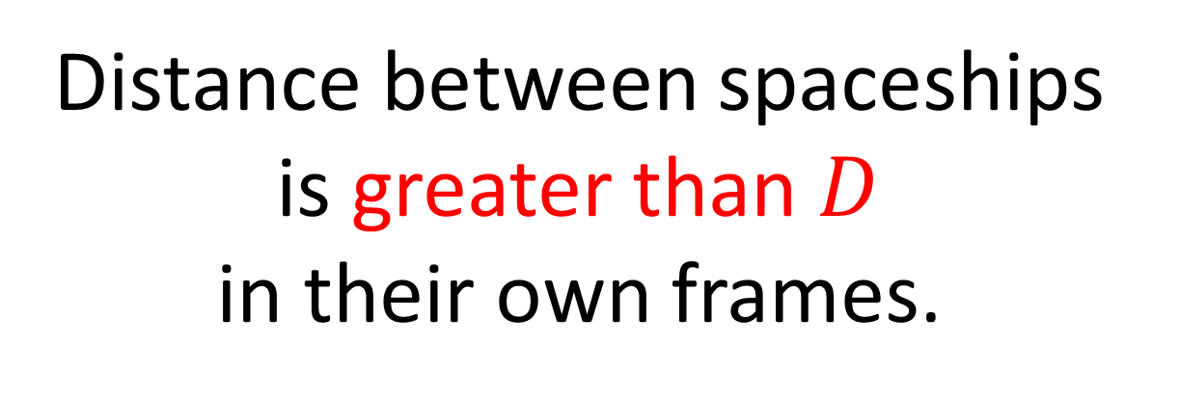
Accelerating spaceships in Special Relativity
$$ct$$
D
D
$$D$$
Distance between spaceships is greater than $D$ in their own frames.
$$D$$
$$D$$
$$x$$

Slide 19
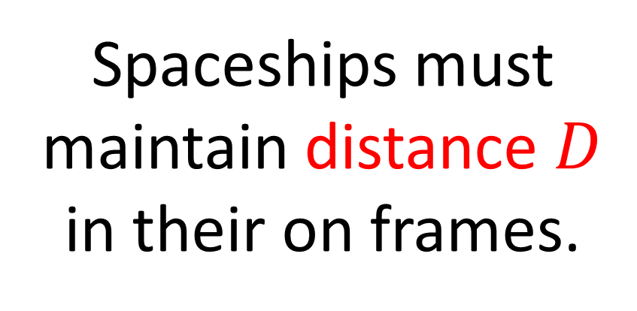
Accelerating spaceships in Special Relativity
$$ct$$
Spaceships must maintain distance $D$ in their on frames.
D
D
$$D$$
$$D$$
More curved
Less Curved
$$D$$
$$x$$

Slide 20
Accelerating spaceships in Special Relativity
$$ct$$
Spaceships must maintain distance $D$ in their on frames.
D
higher acceleration
$$D$$
$$D$$
lower acceleration
$$D$$
$$x$$

Slide 21
Accelerating spaceships in Special Relativity
$$ct$$
Spaceships must maintain distance $D$ in their on frames.
D
Stationary observer sees back ship catching up to front ship.
$$D$$
$$x$$

Slide 22
Accelerating spaceships in Special Relativity
$$ct$$
Spaceships must maintain distance $D$ in their on frames.
D
$$D$$
Stationary observer sees back ship catching up to front ship.
$$D$$
$$D$$
$$x$$

Slide 23








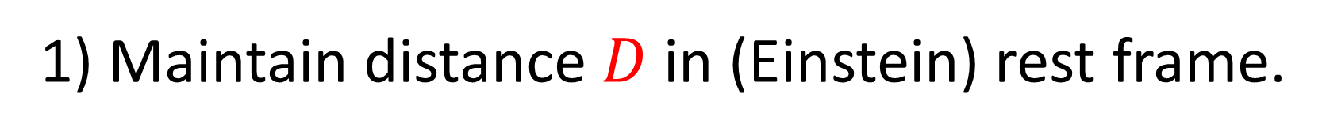
1) Maintain distance $D$ in (Einstein) rest frame.
Stationary Einstein sees constant distance $D$.
Accelerating spaceships see increasing distance $>D$.
$$ct$$
$$ct$$
D
D
D
$$D$$
$$D$$
$$x$$
$$x$$

Slide 24
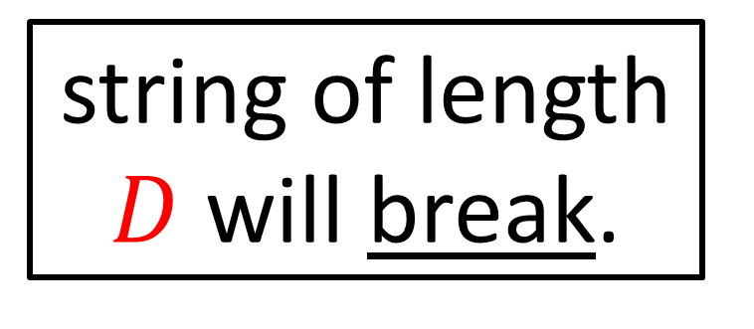
1) Maintain distance $D$ in (Einstein) rest frame.
Stationary Einstein sees constant distance $D$.
Accelerating spaceships see increasing distance $>D$.
$$ct$$
$$ct$$
D
D
D
string of length $D$ will break.
$$D$$
$$D$$
$$x$$
$$x$$

Slide 25





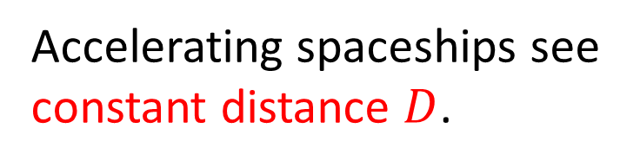


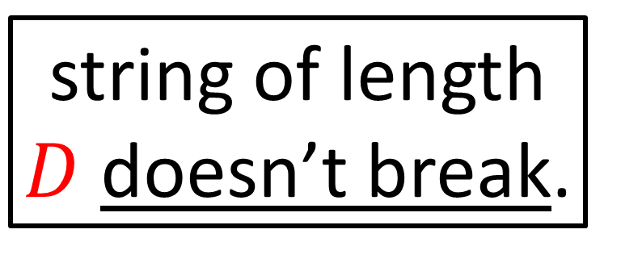
2) Maintain distance $D$ in accelerating (spaceship) frame.
Stationary Einstein sees shrinking distance $<D$.
Accelerating spaceships see constant distance $D$.
$$ct$$
$$ct$$
D
D
string of length $D$ doesn’t break.
$$D$$
$$D$$
$$x$$
$$x$$

Slide 26





string of length $D$ will break.
string of length $D$ doesn’t break.
$$ct$$
$$ct$$
D
D
$$D$$
$$D$$
$$x$$
$$x$$

Slide 27







$$ct$$
$$ct$$
$$c\tilde{t}$$
D
$$\tilde{x}$$
$$x$$
$$x$$
D
Accelerating spaceships
Rindler coordinates

Slide 28
Rindler Coordinates:
how space and time are measured for an observer with constant proper acceleration
spacetime coordinates of a non-inertial frame
$$ct$$
$$c\tilde{t}$$
$$\tilde{x}$$
$$x$$
Rindler coordinates

Slide 29
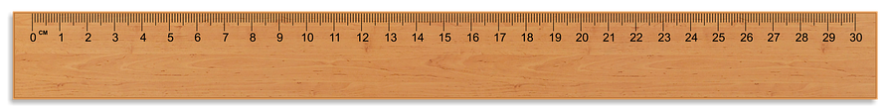
Observer on accelerating spaceship needs to know
how to measure distances in front of and behind them.

Slide 30
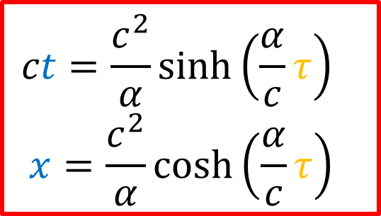



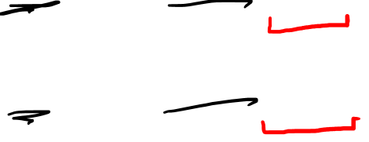
Take a “train” of accelerating rockets…
maintaining distance $D$ from each other in their own frames.
$$ct=\frac{c^{2}}{α}\sinh\left(\frac{α}{c}τ\right)$$
$$x=\frac{c^{2}}{α}\cosh\left(\frac{α}{c}τ\right)$$
$$D$$
$$D$$
$$D$$
$$D$$
$$D$$

Slide 31





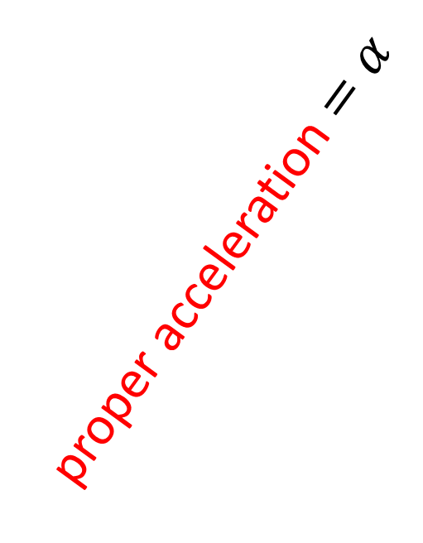
Take a “train” of accelerating rockets… maintaining distance $D$ from each other in their own frames.
$$ct=\frac{c^{2}}{α}\sinh\left(\frac{α}{c^{2}}cτ\right)$$
$$x=\frac{c^{2}}{α}\cosh\left(\frac{α}{c^{2}}cτ\right)$$
proper acceleration $=α$
Rindler Horizon
$=\frac{c^{2}}{α}$
$$D$$
$$D$$
$$D$$
$$D$$
$$D$$

Slide 32
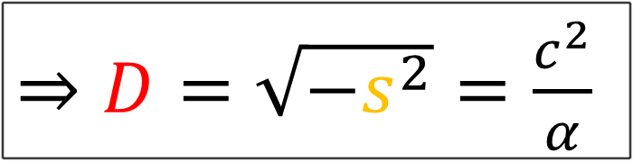

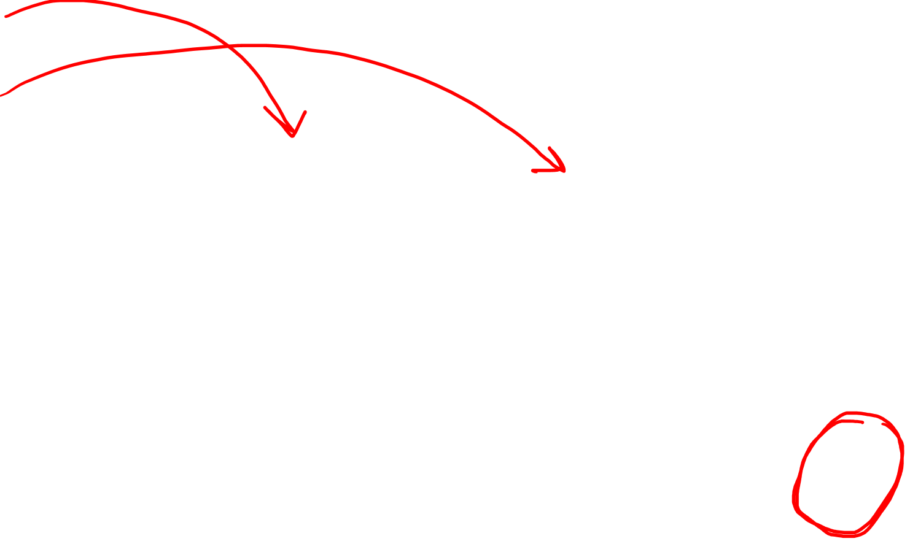
$$ct=\frac{c^{2}}{α}\sinh\left(\frac{α}{c^{2}}cτ\right)$$
$$x=\frac{c^{2}}{α}\cosh\left(\frac{α}{c^{2}}cτ\right)$$
$$s^{2}= {\left(ct\right)}^{2} − x^{2}$$
$s^{2}=$ ${\left(\frac{c^{2}}{α}\sinh\left(\frac{α}{c^{2}}cτ\right)\right)}^{2}−{\left(\frac{c^{2}}{α}\cosh\left(\frac{α}{c^{2}}cτ\right)\right)}^{2}$
$s^{2}=$ ${\left(\frac{c^{2}}{α}\right)}^{2}$ $\left({\left(\sinh\left(\frac{α}{c^{2}}cτ\right)\right)}^{2}−{\left(\cosh\left(\frac{α}{c^{2}}cτ\right)\right)}^{2}\right)$
$s^{2}=$ ${\left(\frac{c^{2}}{α}\right)}^{2}\left(−1\right)$
Rindler Horizon
$=\frac{c^{2}}{α}$
$$D$$
$⇒D=\sqrt{−s^{2}}=\frac{c^{2}}{α}$

Slide 33

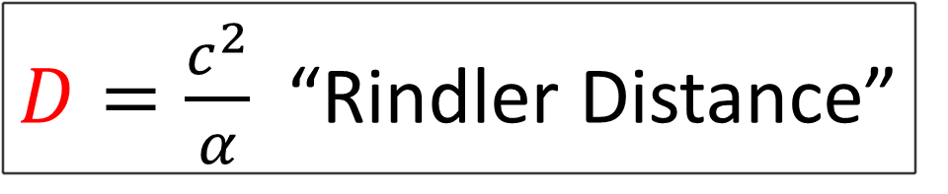
$$ct=\frac{c^{2}}{α}\sinh\left(\frac{α}{c^{2}}cτ\right)$$
$$x=\frac{c^{2}}{α}\cosh\left(\frac{α}{c^{2}}cτ\right)$$
$ct=D\sinh\left(\frac{1}{D}cτ\right)$
$x=D\cosh\left(\frac{1}{D}cτ\right)$
$D=\frac{c^{2}}{α}$ “Rindler Distance”
Rindler Horizon
$=\frac{c^{2}}{α}$
$$D$$

Slide 34
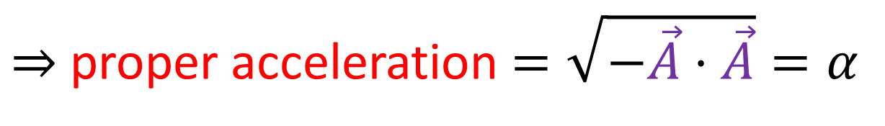

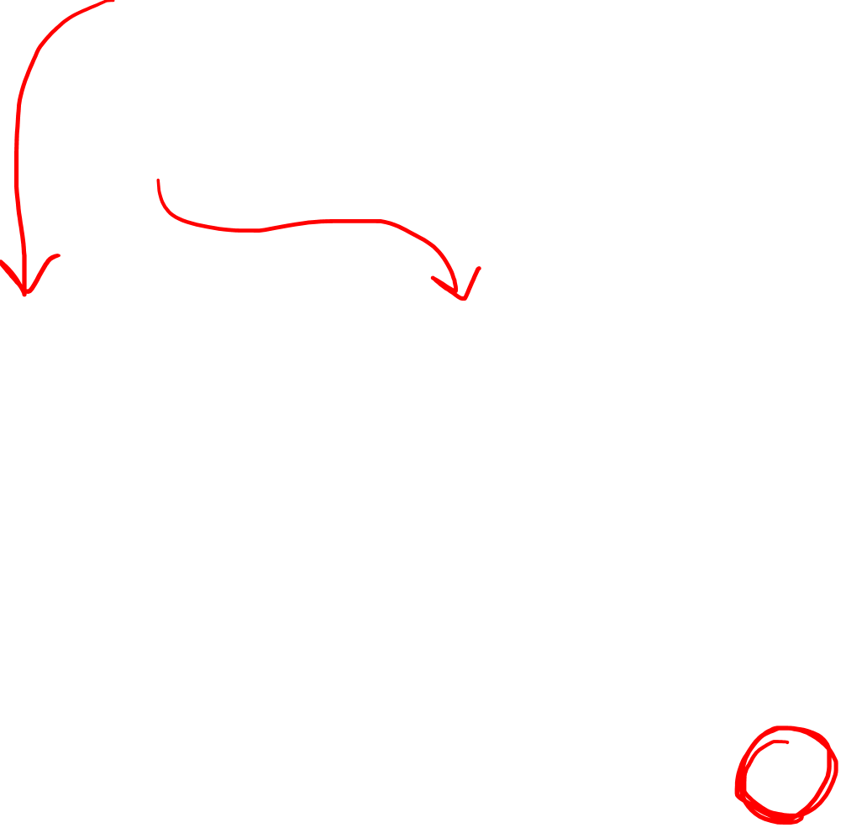
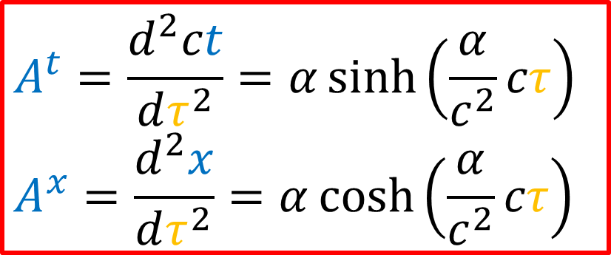
$$A^{t}=\frac{d^{2}ct}{dτ^{2}}=α\sinh\left(\frac{α}{c^{2}}cτ\right)$$
$$A^{x}=\frac{d^{2}x}{dτ^{2}}=α\cosh\left(\frac{α}{c^{2}}cτ\right)$$
$$ct=\frac{c^{2}}{α}\sinh\left(\frac{α}{c^{2}}cτ\right)$$
$$x=\frac{c^{2}}{α}\cosh\left(\frac{α}{c^{2}}cτ\right)$$
$$\vec{A}⋅\vec{A}$$
$$s^{2}= {\left(A^{t}\right)}^{2} − {\left(A^{x}\right)}^{2}$$
$s^{2}=$ ${\left(α\sinh\left(\frac{α}{c^{2}}cτ\right)\right)}^{2}−{\left(α\cosh\left(\frac{α}{c^{2}}cτ\right)\right)}^{2}$
$s^{2}=$ $α^{2}$ $\left({\left(\sinh\left(\frac{α}{c^{2}}cτ\right)\right)}^{2}−{\left(\cosh\left(\frac{α}{c^{2}}cτ\right)\right)}^{2}\right)$
$s^{2}=$ $α^{2}\left(−1\right)=−α^{2}$
Rindler Horizon
$=\frac{c^{2}}{α}$
$$D$$
$⇒$ proper acceleration $=\sqrt{−\vec{A}⋅\vec{A}}=α$

Slide 35
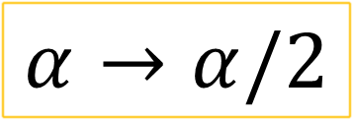
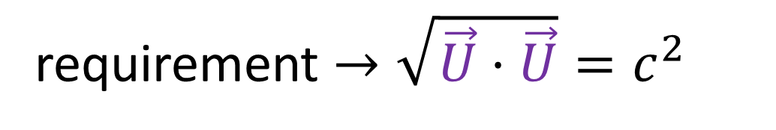
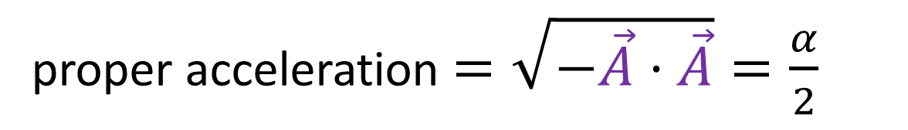

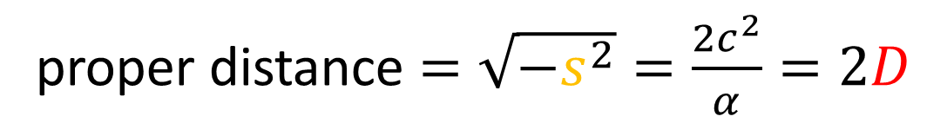
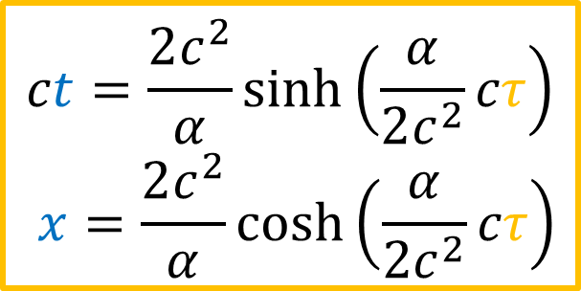
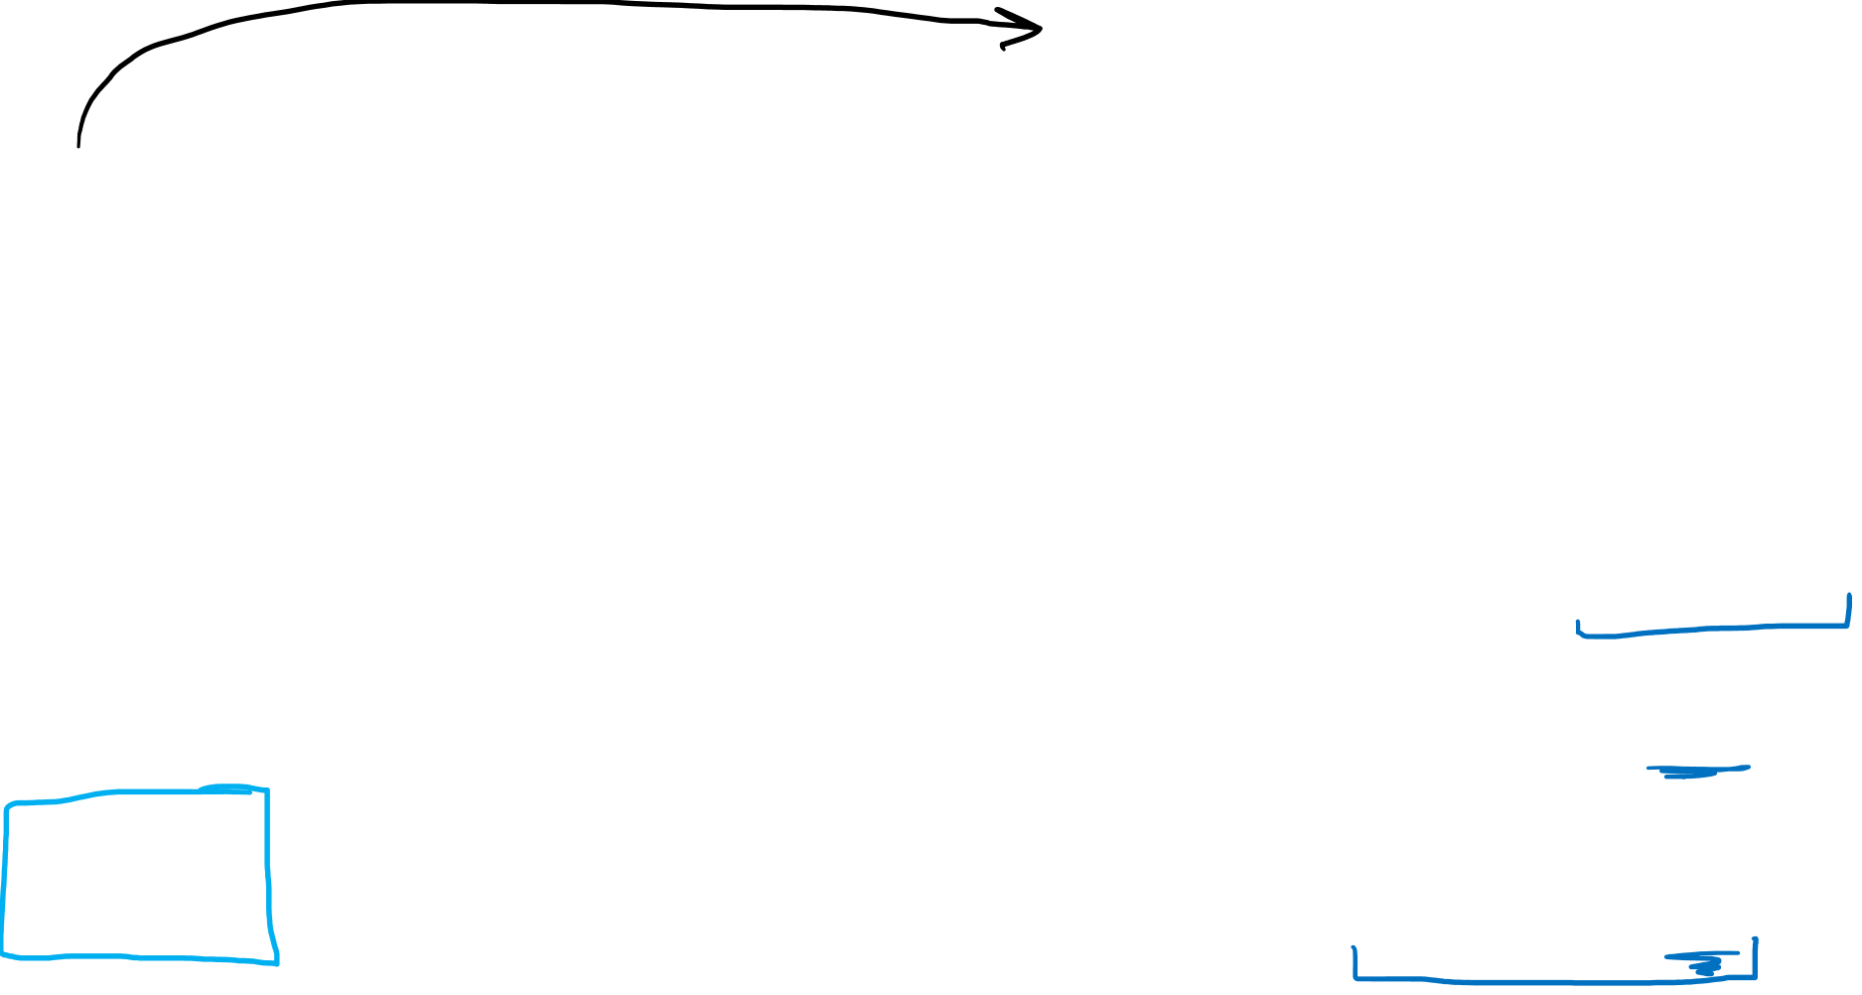
$$α→α/2$$
$$ct=\frac{2c^{2}}{α}\sinh\left(\frac{α}{2c^{2}}cτ\right)$$
$$x=\frac{2c^{2}}{α}\cosh\left(\frac{α}{2c^{2}}cτ\right)$$
$$ct=\frac{c^{2}}{α}\sinh\left(\frac{α}{c^{2}}cτ\right)$$
$$x=\frac{c^{2}}{α}\cosh\left(\frac{α}{c^{2}}cτ\right)$$
proper acceleration $=α$
proper distance $=\sqrt{−s^{2}}=\frac{2c^{2}}{α}=2D$
Rindler Horizon
requirement $→\sqrt{\vec{U}⋅\vec{U}}=c^{2}$
$=\frac{c^{2}}{α}$
$=\frac{c^{2}}{α}$
proper acceleration $=\sqrt{−\vec{A}⋅\vec{A}}=\frac{α}{2}$
$$D$$
$$D$$

Slide 36
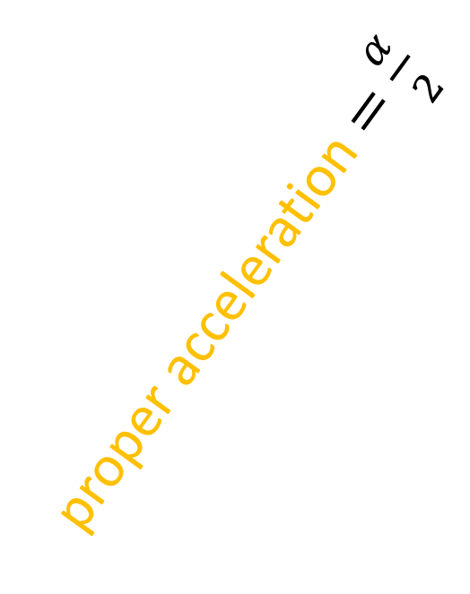

$$ct=\frac{c^{2}}{α}\sinh\left(\frac{α}{c^{2}}cτ\right)$$
$$x=\frac{c^{2}}{α}\cosh\left(\frac{α}{c^{2}}cτ\right)$$
proper acceleration $=\frac{α}{2}$
proper acceleration $=α$
Rindler Horizon
$=\frac{c^{2}}{α}$
$=\frac{c^{2}}{α}$
$$D$$
$$D$$

Slide 37


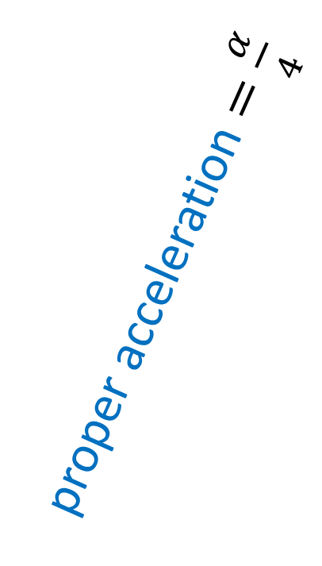


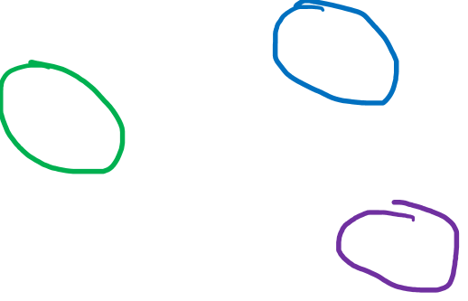
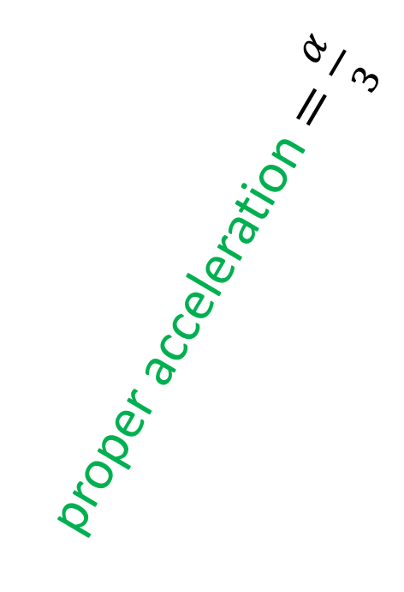


The particle at the back has to accelerate “harder” to keep up!
$$ct=\frac{c^{2}}{α}\sinh\left(\frac{α}{c^{2}}cτ\right)$$
$$x=\frac{c^{2}}{α}\cosh\left(\frac{α}{c^{2}}cτ\right)$$
proper acceleration $=\frac{α}{4}$
proper acceleration $=\frac{α}{3}$
proper acceleration $=\frac{α}{2}$
proper acceleration $=α$
proper acceleration $=\frac{α}{5}$
Rindler Horizon
$=\frac{c^{2}}{α}$
$=\frac{c^{2}}{α}$
$$D$$
$=\frac{c^{2}}{α}$
$=\frac{c^{2}}{α}$
$=\frac{c^{2}}{α}$
$$D$$
$$D$$
$$D$$
$$D$$

Slide 38
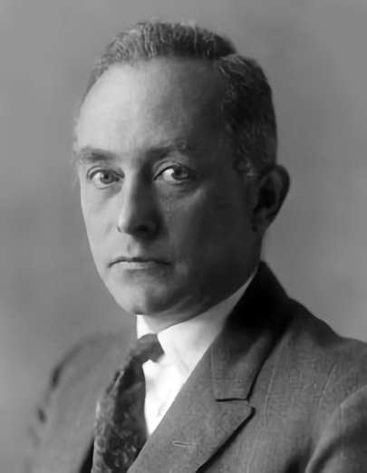












Collection of particles that:
accelerate together
have constant proper distance between them
$$ct$$
$$D$$
$$D$$
Rindler Horizon
$$D$$
$$D$$
$$D$$
Born Rigid Motion
$$x$$
$$D$$
$$D$$
$$D$$
$$D$$
$$D$$
Max Born (1882-1970)

Slide 39
Turn worldlines into coordinate system.
$$ct$$
$$x$$

Slide 40
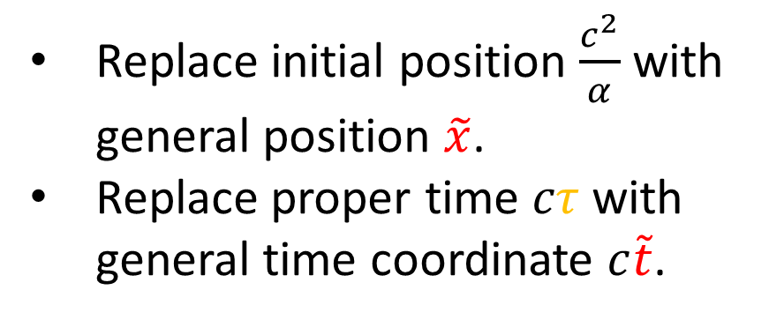
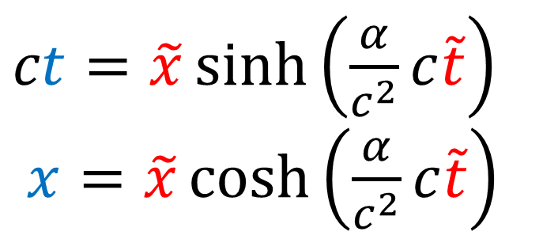






Turn worldlines into coordinate system.
$$ct$$
$ct=\frac{c^{2}}{α}\sinh\left(\frac{α}{c^{2}}cτ\right)$
$x=\frac{c^{2}}{α}\cosh\left(\frac{α}{c^{2}}cτ\right)$
Rindler horizon
Replace initial position $\frac{c^{2}}{α}$ with general position $\tilde{x}$.
Replace proper time $cτ$ with general time coordinate $c\tilde{t}$.
$$c\tilde{t}$$
$$x$$
$$\tilde{x}$$
$ct=\tilde{x}\sinh\left(\frac{α}{c^{2}}c\tilde{t}\right)$
$x=\tilde{x}\cosh\left(\frac{α}{c^{2}}c\tilde{t}\right)$
$\tilde{x}=$ proper distance from origin
$\left(c\tilde{t},\tilde{x}\right)$ are coordinates for observer travelling with proper acceleration $α$
(Rindler horizon at origin)

Slide 41


$$ct$$
$$c\tilde{t}$$
Rindler Coordinates only covers a portion of the spacetime diagram.
Rindler horizon
$$\tilde{x}$$
$$x$$
(accelerated observers can’t see beyond their Rindler horizon)

Slide 42









Rindler Coordinates
Lorentz Transformation
$ct=\tilde{x}\sinh\left(\frac{α}{c^{2}}c\tilde{t}\right)$
$x=\tilde{x}\cosh\left(\frac{α}{c^{2}}c\tilde{t}\right)$
$$ct=γ\left( c\tilde{t}+β\tilde{x}\right)$$
$x=γ\left(βc\tilde{t}+ \tilde{x}\right)$
$$c\tilde{t}$$
$$ct$$
$$ct$$
$$c\tilde{t}$$
$$\tilde{x}$$
$$\tilde{x}$$
$$x$$
$$x$$
Curvilinear Coordinates
Straight Coordinates

Slide 43

Rindler Coordinates
Lorentz Transformation
$ct=\tilde{x}\sinh\left(\frac{α}{c^{2}}c\tilde{t}\right)$
$x=\tilde{x}\cosh\left(\frac{α}{c^{2}}c\tilde{t}\right)$
$$ct=γ\left( c\tilde{t}+β\tilde{x}\right)$$
$x=γ\left(βc\tilde{t}+ \tilde{x}\right)$
No matrix
formula!
$$\left[\begin{aligned}ct \\ x\end{aligned}\right]=γ\left[\begin{matrix}1 & β \\ β & 1\end{matrix}\right]\left[\begin{aligned}c\tilde{t} \\ \tilde{x}\end{aligned}\right]$$

Slide 44





Rindler Coordinates
$$ct$$
$ct=\tilde{x}\sinh\left(\frac{α}{c^{2}}c\tilde{t}\right)$
$x=\tilde{x}\cosh\left(\frac{α}{c^{2}}c\tilde{t}\right)$
$$c\tilde{t}$$
Rindler horizon
$$\tilde{x}$$
curves of constant $\tilde{x}$
$$x$$
Curves of constant position according to an acclerated observer
curves of constant $c\tilde{t}$
Lines of constant time
$\tilde{t}$ is NOT the proper time $τ$ measured by particle ($τ=\frac{α}{c^{2}}\tilde{x}\tilde{t}$)

Slide 45
Rindler Coordinates
$$ct$$
$ct=\tilde{x}\sinh\left(\frac{α}{c^{2}}c\tilde{t}\right)$
$x=\tilde{x}\cosh\left(\frac{α}{c^{2}}c\tilde{t}\right)$
$$c\tilde{t}$$
Rindler horizon
$$\tilde{x}$$
curves of constant $\tilde{x}$
$$x$$
Curves of constant position according to an acclerated observer
curves of constant $c\tilde{t}$
Lines of constant time
$\tilde{t}$ is NOT the proper time $τ$ measured by particle ($τ=\frac{α}{c^{2}}\tilde{x}\tilde{t}$)

Slide 46




Rindler Coordinates
$$ct$$
$ct=\tilde{x}\sinh\left(\frac{α}{c^{2}}c\tilde{t}\right)$
$x=\tilde{x}\cosh\left(\frac{α}{c^{2}}c\tilde{t}\right)$
$$c\tilde{t}$$
$$\tilde{x}$$
Rindler coordinates have parameter $α$.
$c^{2}=$ proper acceleration of hyperbola on worldline $\tilde{x}=1$
$$x$$
There are several versions of Rindler coordinates, each with a different $α$ parameter.
Particles have proper acceleration $\frac{c^{2}}{\tilde{x}}$.

Slide 47



Spacetime interval in Inertial Frames
Lorentz Transformation
$\left(ct,x\right)$
$$c\breve{t}=γ\left( ct−βx\right)$$
$\breve{x}=γ\left(−βct + x\right)$
$\left(c\breve{t},\breve{x}\right)$
$$s^{2}={\left(ct\right)}^{2}−{\left(x\right)}^{2}={\left(c\breve{t}\right)}^{2}−{\left(\breve{x}\right)}^{2}$$

Slide 48



Spacetime interval in Rindler Coordinates
$ct=\tilde{x}\sinh\left(\frac{α}{c^{2}}c\tilde{t}\right)$ $x=\tilde{x}\cosh\left(\frac{α}{c^{2}}c\tilde{t}\right)$
$$s^{2}={\left(ct\right)}^{2}−{\left(x\right)}^{2}$$
$$s^{2}={\left(\tilde{x}\sinh\left(\frac{α}{c^{2}}c\tilde{t}\right)\right)}^{2}−{\left(\tilde{x}\cosh\left(\frac{α}{c^{2}}c\tilde{t}\right)\right)}^{2}$$
$$s^{2}={\tilde{x}}^{2}\left[{\left(\sinh\left(\frac{α}{c^{2}}c\tilde{t}\right)\right)}^{2}−{\left(\cosh\left(\frac{α}{c^{2}}c\tilde{t}\right)\right)}^{2}\right]$$
$$s^{2}={\tilde{x}}^{2}[−1]$$
$$s^{2}=−{\tilde{x}}^{2}$$

Slide 49








Rindler Coordinates
$$ct$$
Spacetime interval $s^{2}$ doesn’t change with time $c\tilde{t}$.
$$c\tilde{t}$$
Rindler horizon
(negative $⇒$ spacelike)
$$\tilde{x}$$
$$s^{2}=−{\tilde{x}}^{2}$$
$$x$$
$$L_{0}=\sqrt{−s^{2}}=\tilde{x}$$
This confirms $\tilde{x}$is the proper distance from the origin.
Each hyperbola has constant $\tilde{x}$, and constant proper distance from origin.
Rindler coordinates are only valid for $x>0$ and $−x<ct<x$.

Slide 50





$$?????$$
$\left(ct,x\right)$
$\left(c\tilde{t},\tilde{x}\right)$
$ct=\tilde{x}\sinh\left(\frac{α}{c^{2}}c\tilde{t}\right)$
$x=\tilde{x}\cosh\left(\frac{α}{c^{2}}c\tilde{t}\right)$

Slide 51



$$ct=\tilde{x}\sinh\left(\frac{α}{c^{2}}c\tilde{t}\right) \\ x=\tilde{x}\cosh\left(\frac{α}{c^{2}}c\tilde{t}\right)$$
$$s^{2}= {\left(ct\right)}^{2}−x^{2}=−{\tilde{x}}^{2}$$
$$s^{2}= −{\left(ct\right)}^{2}+x^{2}= {\tilde{x}}^{2}$$
$$s^{2}=\sqrt{−{\left(ct\right)}^{2}+x^{2}}= \tilde{x}$$
$$s^{2}=\sqrt{ x^{2}− {\left(ct\right)}^{2}}= \tilde{x}$$

Slide 52




$$ct=\tilde{x}\sinh\left(\frac{α}{c^{2}}c\tilde{t}\right) \\ x=\tilde{x}\cosh\left(\frac{α}{c^{2}}c\tilde{t}\right)$$
$$\tilde{x}=\sqrt{x^{2}−{\left(ct\right)}^{2}}$$
$$\frac{ct}{x}=\frac{\tilde{x}\sinh\left(\frac{α}{c^{2}}c\tilde{t}\right)}{\tilde{x}\cosh\left(\frac{α}{c^{2}}c\tilde{t}\right)}=\tanh\left(\frac{α}{c^{2}}c\tilde{t}\right)$$
$$\operatorname{arctanh}\left(\frac{ct}{x}\right)=\frac{α}{c^{2}}c\tilde{t}$$
$$\frac{c^{2}}{α }\operatorname{arctanh}\left(\frac{ct}{x}\right)= c\tilde{t}$$

Slide 53

$$ct=\tilde{x}\sinh\left(\frac{α}{c^{2}}c\tilde{t}\right) \\ x=\tilde{x}\cosh\left(\frac{α}{c^{2}}c\tilde{t}\right)$$
$c\tilde{t}=\frac{c^{2}}{α }\operatorname{arctanh}\left(\frac{ct}{x}\right)$
$$\tilde{x}=\sqrt{x^{2}−{\left(ct\right)}^{2}}$$

Slide 54
$$ct=\tilde{x}\sinh\left(\frac{α}{c^{2}}c\tilde{t}\right) \\ x=\tilde{x}\cosh\left(\frac{α}{c^{2}}c\tilde{t}\right)$$
$c\tilde{t}=\frac{c^{2}}{α }\operatorname{arctanh}\left(\frac{ct}{x}\right)$
$$\tilde{x}=\sqrt{x^{2}−{\left(ct\right)}^{2}}$$

Slide 55

$c\tilde{t}=\frac{c^{2}}{α}\operatorname{arctanh}\left(\frac{ct}{x}\right)$
$\tilde{x}=\sqrt{{\left(x\right)}^{2}−{\left(ct\right)}^{2}}$
$\left(ct,x\right)$
$\left(c\tilde{t},\tilde{x}\right)$
$ct=\tilde{x}\sinh\left(\frac{α}{c^{2}}c\tilde{t}\right)$
$x=\tilde{x}\cosh\left(\frac{α}{c^{2}}c\tilde{t}\right)$

Slide 56
1) Spaceships with same constant proper acceleration.
Stationary Einstein sees constant distance $D$.
Accelerating spaceships see increasing distance $>D$.
$$ct$$
$$ct$$
D
D
D
$$D$$
$$D$$
$$x$$
$$x$$

Slide 57
2) Maintain distance $D$ in accelerating (spaceship) frame.
Stationary Einstein sees shrinking distance $<D$.
Accelerating spaceships see constant distance $D$.
$$ct$$
$$ct$$
D
D
higher acceleration
lower acceleration
$$D$$
$$D$$
$$x$$
$$x$$

Slide 58
2) Maintain distance $D$ in accelerating (spaceship) frame.
$$ct$$
D
common Rindler Horizon
$$D$$
$$x$$

Slide 59


Rindler Coordinates
$$ct$$
$$c\tilde{t}$$
$ct=\tilde{x}\sinh\left(\frac{α}{c^{2}}c\tilde{t}\right)$
$x=\tilde{x}\cosh\left(\frac{α}{c^{2}}c\tilde{t}\right)$
$$\tilde{x}$$
$$x$$
Curves of constant $\tilde{x}$:
proper acceleration $\frac{c^{2}}{\tilde{x}}$
proper time $τ=\frac{α}{c^{2}}\tilde{x}\tilde{t}$
$s^{2}=−{\tilde{x}}^{2}$

Slide 60
$c\tilde{t}=\frac{c^{2}}{α}\operatorname{arctanh}\left(\frac{ct}{x}\right)$
$\tilde{x}=\sqrt{{\left(x\right)}^{2}−{\left(ct\right)}^{2}}$
$\left(ct,x\right)$
$\left(c\tilde{t},\tilde{x}\right)$
$ct=\tilde{x}\sinh\left(\frac{α}{c^{2}}c\tilde{t}\right)$
$x=\tilde{x}\cosh\left(\frac{α}{c^{2}}c\tilde{t}\right)$

Slide 61



In Rindler coordinates, it is possible that
the speed of light can be less than $c$ or greater than $c$. *
($c$ is the speed of light in an inertial frame)
* please note that…
This comes down to the definition of “speed” as $\frac{d\tilde{x}}{d\tilde{t}}$
not invariant (not based on 4-vectors)
$\frac{d\tilde{x}}{d\tilde{t}}>c$ is the result of using a strange coordinate system
Any light beam travelling beside you always has speed $c$
Need to be careful when interpreting $c\tilde{t},\tilde{x}$ coordinates

Slide 62


Find the speed of light $\frac{d\tilde{x}}{d\tilde{t}}$ at various positions on the horizontal axis.
Initial
$x$-position
Equation of light beam: $x=ct+x_{0}$
Rindler Horizon
$=\frac{c^{2}}{α}$
$=\frac{c^{2}}{α}$
$$D$$
$=\frac{c^{2}}{α}$
$=\frac{c^{2}}{α}$
$=\frac{c^{2}}{α}$
$$D$$
$$D$$
$$D$$
$$D$$

Slide 63





Equation of
light beam:
$$x=ct+x_{0}$$
$${\tilde{x}}^{2}= x^{2} − {\left(ct\right)}^{2}$$
$${\tilde{x}}^{2}={\left(ct+x_{0}\right)}^{2}−{\left(ct\right)}^{2}$$
$${\tilde{x}}^{2}={\left(ct\right)}^{2}+2x_{0}ct+{x_{0}}^{2}−{\left(ct\right)}^{2}$$
$${\tilde{x}}^{2}−2x_{0}ct−{x_{0}}^{2}=0$$
${\tilde{x}}^{2}−2x_{0}\tilde{x}\sinh\left(\frac{c\tilde{t}}{D}\right)−{x_{0}}^{2}=0$
Initial
$x$-position
$ct=\tilde{x}\sinh\left(\frac{c\tilde{t}}{D}\right)$
$x=\tilde{x}\cosh\left(\frac{c\tilde{t}}{D}\right)$

Slide 64



${\tilde{x}}^{2}−\tilde{x}2x_{0}\sinh\left(\frac{c\tilde{t}}{D}\right)−{x_{0}}^{2}=0$
$$\tilde{x}=\frac{1}{2𝔞}\left[−𝔟±\sqrt{𝔟^{2}−4𝔞𝔠 }\right]$$
$\tilde{x}=\frac{1}{2(1)}\left[−\left(−2x_{0}\sinh\left(\frac{c\tilde{t}}{D}\right)\right)±\sqrt{{\left(−2x_{0}\sinh\left(\frac{c\tilde{t}}{D}\right)\right)}^{2}−4(1)(−{x_{0}}^{2}) }\right]$
$\tilde{x}=$ $x_{0}\sinh\left(\frac{c\tilde{t}}{D}\right)±\sqrt{{{x_{0}}^{2}\left(\sinh\left(\frac{c\tilde{t}}{D}\right)\right)}^{2}+{x_{0}}^{2}}$
$\tilde{x}=x_{0}\left[\sinh\left(\frac{c\tilde{t}}{D}\right)±\sqrt{{\left(\sinh\left(\frac{c\tilde{t}}{D}\right)\right)}^{2}+1}\right]$

Slide 65




$${\left(\cosh{φ}\right)}^{2}−{\left(\sinh{φ}\right)}^{2}=1$$
$${\left(\cosh{φ}\right)}^{2}=1+{\left(\sinh{φ}\right)}^{2}$$
$\tilde{x}=x_{0}\left[\sinh\left(\frac{c\tilde{t}}{D}\right)±\sqrt{{\left(\sinh\left(\frac{c\tilde{t}}{D}\right)\right)}^{2}+1}\right]$
$\tilde{x}=x_{0}\left[\sinh\left(\frac{c\tilde{t}}{D}\right)±\sqrt{{\left(\cosh\left(\frac{c\tilde{t}}{D}\right)\right)}^{2}}\right]$
$\tilde{x}=x_{0}\left[\sinh\left(\frac{c\tilde{t}}{D}\right)±\cosh\left(\frac{c\tilde{t}}{D}\right)\right]$
$\tilde{x}=x_{0}\left[\sinh\left(\frac{c\tilde{t}}{D}\right)+\cosh\left(\frac{c\tilde{t}}{D}\right)\right]$
Enforce
$$\tilde{x}≥0$$

Slide 66





$\cosh{φ}=\frac{1}{2}\left(e^{φ}+e^{−φ}\right)$
$\sinh{φ} =\frac{1}{2}\left(e^{φ}−e^{−φ}\right)$
$$\cosh{φ}+\sinh{φ}=e^{φ}$$
$\tilde{x}=x_{0}\left[\sinh\left(\frac{c\tilde{t}}{D}\right)+\cosh\left(\frac{c\tilde{t}}{D}\right)\right]$
$\tilde{x}\left(\tilde{t}\right)=x_{0} e^{\frac{c\tilde{t}}{D}}$
$\frac{d\tilde{x}}{d\tilde{t}}=\frac{c}{D}x_{0} e^{\frac{c\tilde{t}}{D}}$

Slide 67












$$x_{0}=0$$
$\frac{d\tilde{x}}{d\tilde{t}} =0$
Rindler Horizon
$=\frac{c^{2}}{α}$
$=\frac{c^{2}}{α}$
$$D$$
$=\frac{c^{2}}{α}$
$=\frac{c^{2}}{α}$
$=\frac{c^{2}}{α}$
$$D$$
$$D$$
$$D$$
$$D$$
$x_{0}=\frac{1}{2}D$
$\frac{d\tilde{x}}{d\tilde{t}} =\frac{1}{2}c$
$$x_{0}=D$$
$\frac{d\tilde{x}}{d\tilde{t}} =c$
$$x_{0}=2D$$
$\frac{d\tilde{x}}{d\tilde{t}} =2c$
$$x_{0}=3D$$
$\frac{d\tilde{x}}{d\tilde{t}} =3c$
$$x_{0}=4D$$
$\frac{d\tilde{x}}{d\tilde{t}} =4c$
$\frac{d\tilde{x}}{d\tilde{t}}=\frac{c}{D}x_{0}$
$\frac{d\tilde{x}}{d\tilde{t}}=\frac{c}{D}x_{0} e^{\frac{c\tilde{t}}{D}}$
$$c\tilde{t}=0$$
Horizontal axis

Slide 68









$$x_{0}=0$$
$\frac{d\tilde{x}}{d\tilde{t}} =0$
Rindler Horizon
$=\frac{c^{2}}{α}$
$=\frac{c^{2}}{α}$
$$D$$
$=\frac{c^{2}}{α}$
$=\frac{c^{2}}{α}$
$=\frac{c^{2}}{α}$
$$D$$
$$D$$
$$D$$
$$D$$
$x_{0}=\frac{1}{2}D$
$\frac{d\tilde{x}}{d\tilde{t}} =\frac{1}{2}c$
$$x_{0}=D$$
$\frac{d\tilde{x}}{d\tilde{t}} =c$
$$x_{0}=2D$$
$\frac{d\tilde{x}}{d\tilde{t}} =2c$
$$x_{0}=3D$$
$\frac{d\tilde{x}}{d\tilde{t}} =3c$
$$x_{0}=4D$$
$\frac{d\tilde{x}}{d\tilde{t}} =4c$
Speed of light $\frac{d\tilde{x}}{d\tilde{t}}$ depends on
position in Rindler Coordinates??

Slide 69













$$ct$$
On $x$-axis
$$c\tilde{t}$$
$\frac{d\tilde{x}}{d\tilde{t}}=\frac{x_{0}}{D}c$
$\frac{d\tilde{x}}{d\tilde{t}}>c$
$$\tilde{x}$$
$\frac{d\tilde{x}}{d\tilde{t}}=c$
$\frac{d\tilde{x}}{d\tilde{t}}<c$
$$x$$
$$x_{0}<D$$
$$x_{0}=D$$
$$x_{0}>D$$

Slide 70


















$τ_{5}=5$
Line of Simultaneity
$\tilde{t}=1$ second
$τ_{4}=4$
$τ_{3}=3$
Rindler Horizon
$τ_{2}=2$
$τ_{1}=1$
$=\frac{c^{2}}{α}$
$=\frac{c^{2}}{α}$
$$D$$
$=\frac{c^{2}}{α}$
$=\frac{c^{2}}{α}$
$=\frac{c^{2}}{α}$
$$D$$
$$D$$
$$D$$
$$D$$
Remember that $τ≠\tilde{t}$ !!
On a hyperbola of constant $\tilde{x}$: $τ=\frac{α}{c^{2}}\tilde{x}\tilde{t}=\frac{\tilde{x}}{D}\tilde{t}$

Slide 71
$τ_{5}=5$
Line of Simultaneity
$\tilde{t}=1$ second
$τ_{4}=4$
$τ_{3}=3$
Rindler Horizon
$τ_{2}=2$
$τ_{1}=1$
$=\frac{c^{2}}{α}$
$=\frac{c^{2}}{α}$
$$D$$
$=\frac{c^{2}}{α}$
$=\frac{c^{2}}{α}$
$=\frac{c^{2}}{α}$
$$D$$
$$D$$
$$D$$
$$D$$
Remember that $τ≠\tilde{t}$ !!
On a hyperbola of constant $\tilde{x}$: $τ=\frac{α}{c^{2}}\tilde{x}\tilde{t}=\frac{\tilde{x}}{D}\tilde{t}$

Slide 72









$τ_{4}=4$
$$4τ_{1}=4\tilde{t}=τ_{4}$$
Rindler Horizon
$\tilde{t}=1$
$τ_{1}=1$
$=\frac{c^{2}}{α}$
$=\frac{c^{2}}{α}$
$$D$$
$=\frac{c^{2}}{α}$
$=\frac{c^{2}}{α}$
$=\frac{c^{2}}{α}$
$$D$$
$$D$$
$$D$$
$$D$$
$$\frac{d\tilde{x}}{d\tilde{t}}=\frac{d\tilde{x}}{dτ_{1}}=c$$
$\frac{d\tilde{x}}{d\tilde{t}}=\frac{d\tilde{x}}{d\left(\text{¼}τ_{4}\right)}=4c$
$\frac{d\tilde{x}}{dτ_{4}}=c$
$$4\tilde{t}=4τ_{1}=τ_{4}$$
$\frac{d\tilde{x}}{dτ_{4}}=c$
$\frac{d\tilde{x}}{d\tilde{t}}\frac{d\tilde{t}}{dτ_{4}}=c$
$\frac{d\tilde{x}}{d\tilde{t}}=\frac{dτ_{4}}{d\tilde{t}}c$
$$\tilde{t}=τ_{1}=\text{¼}τ_{4}$$
$τ=\frac{\tilde{x}}{D} \tilde{t}$
$\frac{d\tilde{t}}{dτ}=\frac{D}{\tilde{x}}$

Slide 73








$$ct$$
$$c\tilde{t}$$
$$\tilde{x}=L_{0}$$
$$x$$
$\frac{d\tilde{x}}{d\tilde{t}}<c$
$\frac{d\tilde{x}}{d\tilde{t}}=c$
$$\tilde{t}>τ$$
$\frac{d\tilde{x}}{d\tilde{t}}>c$
$$\tilde{t}=τ$$
$$\tilde{t}<τ$$
$\frac{dL_{0}}{dτ}=c$ always (locally)

Slide 74



















Inertial Frame
Non-Inertial Frame
$$ct$$
$\tilde{x}=L_{0}$
(true for
Rindler)
$$c\tilde{t}$$
$τ_{1}=1$
$τ_{2}=1$
$τ_{3}=1$
$τ_{3}=3$
$τ_{2}=2$
$τ_{1}=1$
$τ_{1}=0$
$τ_{2}=0$
$τ_{3}=0$
$$x$$
$$\tilde{x}$$
$τ_{1}=0$
$τ_{2}=0$
$τ_{3}=0$
$t=τ$ (proper time)
$x=L_{0}$ (proper length)
$\tilde{t}≠τ$ (proper time)
$\tilde{x}≠L_{0}$ (proper length)

Slide 75

Non-Inertial Frames:
It’s possible that $\tilde{t}≠τ$ and $\tilde{x}≠L_{0}$
Measuring local speeds $\frac{dL_{0}}{dτ}$ requires more than $\frac{d\tilde{x}}{d\tilde{t}}$
We need:
The Jacobian Matrix (Relativity 105c)
The Rindler Metric for proper time along curves (Relativity 105d)

Slide 76

In Rindler coordinates, it is possible that
the speed of light can be less than $c$ or greater than $c$. *
($c$ is the speed of light in an inertial frame)
* please note that…
This comes down to the definition of “speed” as $\frac{d\tilde{x}}{d\tilde{t}}$
not invariant (not based on 4-vectors)
$\frac{d\tilde{x}}{d\tilde{t}}≠c$ is the result of using a strange coordinate system
Any light beam travelling beside you always has speed $c$
Need to be careful when interpreting $c\tilde{t},\tilde{x}$ coordinates

