Slide 1
Relativity 105: Acceleration In Special Relativity
Hyperbolic Motion (acceleration), Rindler Horizon
Rindler Coordinates and Bell’s Spaceship Paradox
Basis Vectors/Jacobian in Curvilinear Coordinates
The Proper Time Along Curves and Twin Paradox
Covariant Derivative
Geodesic Curves (inertial frames/zero forces)
Notes:
In this video we’re going to talk about relativistic dynamics, which is how things like forces, energy, and momentum work in special relativity. We’ll also derive the famous equations E = mc^2.

Slide 2
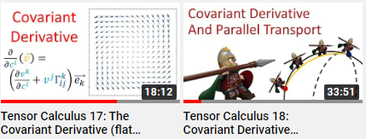
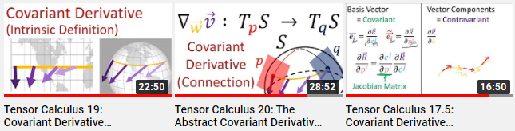
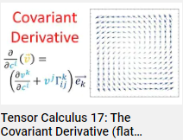
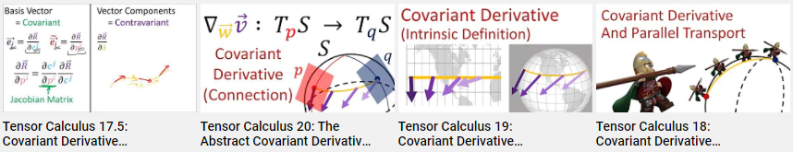
Tensor Calculus Videos on the Covariant Derivative:
(see links in description)
This video:
Covariant Derivative in flat spacetime only!
Curved spacetimes will come later

Slide 3
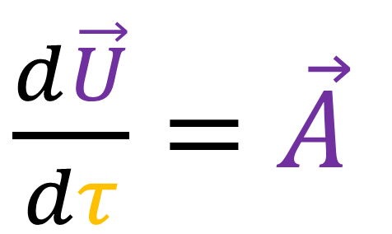
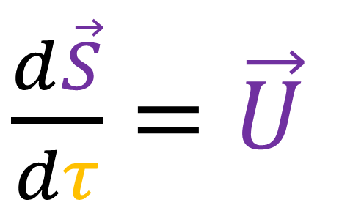
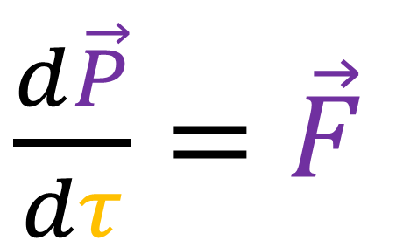
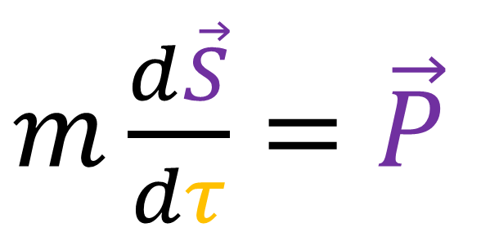
Relativity 104f: 4-vectors
$\frac{d\vec{S}}{dτ}=\vec{U}$
$m\frac{d\vec{S}}{dτ}=\vec{P}$
$\frac{d\vec{U}}{dτ}=\vec{A}$
$\frac{d\vec{P}}{dτ}=\vec{F}$

Slide 4
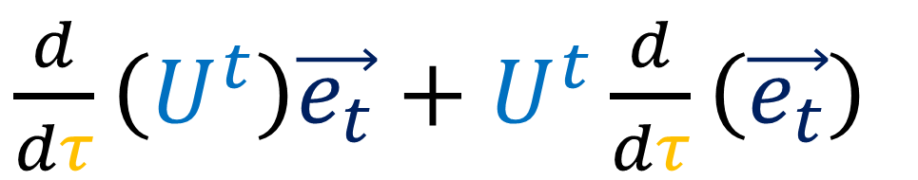
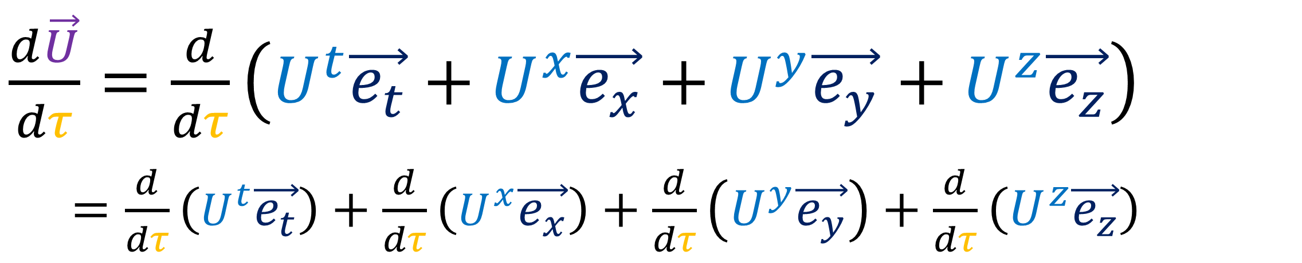
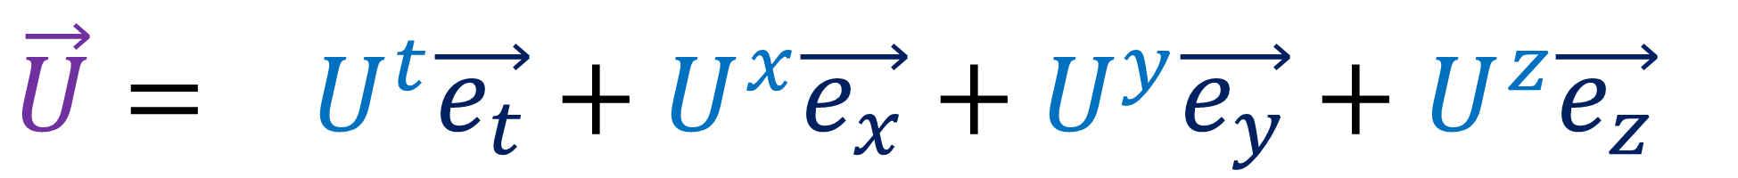
$$\vec{U}= U^{t}\vec{e_{t}}+U^{x}\vec{e_{x}}+U^{y}\vec{e_{y}}+U^{z}\vec{e_{z}}$$
$\frac{d\vec{U}}{dτ}=\frac{d}{dτ}\left(U^{t}\vec{e_{t}}+U^{x}\vec{e_{x}}+U^{y}\vec{e_{y}}+U^{z}\vec{e_{z}}\right)$
$\frac{d\vec{S}}{dτ}=\frac{d}{dτ}\left(U^{t}\vec{e_{t}}\right)+\frac{d}{dτ}\left(U^{x}\vec{e_{x}}\right)+\frac{d}{dτ}\left(U^{y}\vec{e_{y}}\right)+\frac{d}{dτ}\left(U^{z}\vec{e_{z}}\right)$
Product Rule
(Working in inertial frame!)
(Basis vectors are constant!)
$\frac{d}{dτ}\left(U^{t}\right)\vec{e_{t}}+U^{t}\frac{d}{dτ}\left(\vec{e_{t}}\right)$

Slide 5



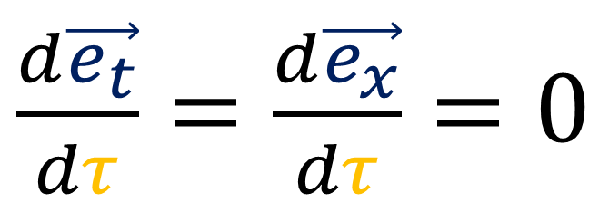


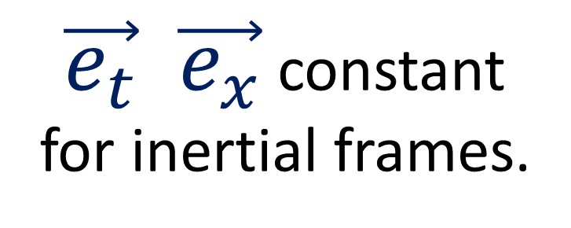





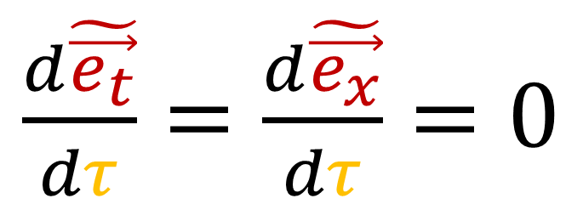



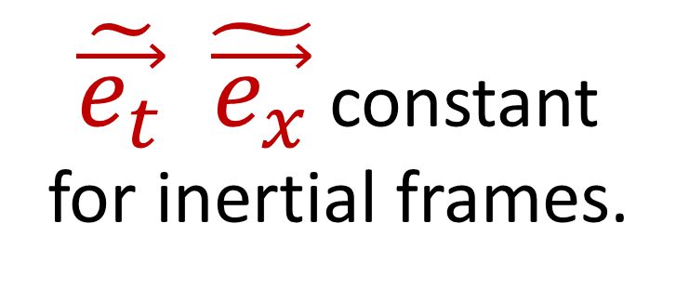
$$\vec{e_{t}}$$
$$\vec{e_{t}}$$
$$\tilde{\vec{e_{t}}}$$
$$\tilde{\vec{e_{t}}}$$
$$\vec{e_{x}}$$
$$\vec{e_{x}}$$
$$\tilde{\vec{e_{x}}}$$
$$\tilde{\vec{e_{x}}}$$
$$\vec{e_{t}}$$
$$\vec{e_{t}}$$
$$\tilde{\vec{e_{t}}}$$
$$\tilde{\vec{e_{t}}}$$
$$\vec{e_{x}}$$
$$\vec{e_{x}}$$
$$\tilde{\vec{e_{x}}}$$
$$\tilde{\vec{e_{x}}}$$
$\tilde{\vec{e_{t}}} \tilde{\vec{e_{x}}}$ constant for inertial frames.
$\vec{e_{t}} \vec{e_{x}}$ constant for inertial frames.
$\frac{d\vec{e_{t}}}{dτ}=\frac{d\vec{e_{x}}}{dτ}=0$
$\frac{d\tilde{\vec{e_{t}}}}{dτ}=\frac{d\tilde{\vec{e_{x}}}}{dτ}=0$

Slide 6

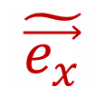

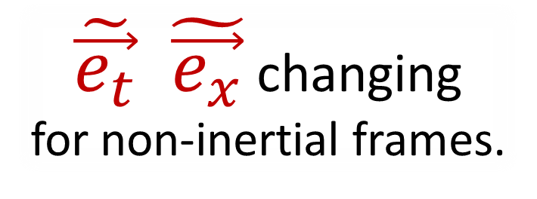
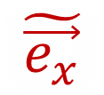





$$\vec{e_{t}}$$
$$\vec{e_{t}}$$
Rindler Coordinates
$$\vec{e_{x}}$$
$$\vec{e_{x}}$$
$\tilde{\vec{e_{t}}} \tilde{\vec{e_{x}}}$ changing for non-inertial frames.
$\tilde{\vec{e_{t}}}$
$$\vec{e_{t}}$$
$$\vec{e_{t}}$$
$\tilde{\vec{e_{x}}}$
$\tilde{\vec{e_{t}}}$
$\tilde{\vec{e_{t}}}$
$$\vec{e_{x}}$$
$$\vec{e_{x}}$$
$\vec{e_{t}} \vec{e_{x}}$ constant for inertial frames.
$\tilde{\vec{e_{t}}}$
$\tilde{\vec{e_{x}}}$
$\tilde{\vec{e_{x}}}$
$\tilde{\vec{e_{x}}}$
$\frac{d\vec{e_{t}}}{dτ}=\frac{d\vec{e_{x}}}{dτ}=0$
$\frac{d\tilde{\vec{e_{t}}}}{dτ}≠\frac{d\tilde{\vec{e_{x}}}}{dτ}≠0$

Slide 7
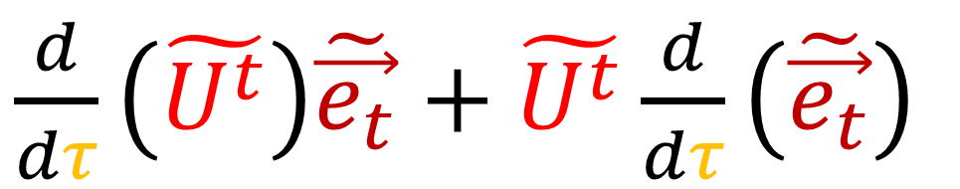
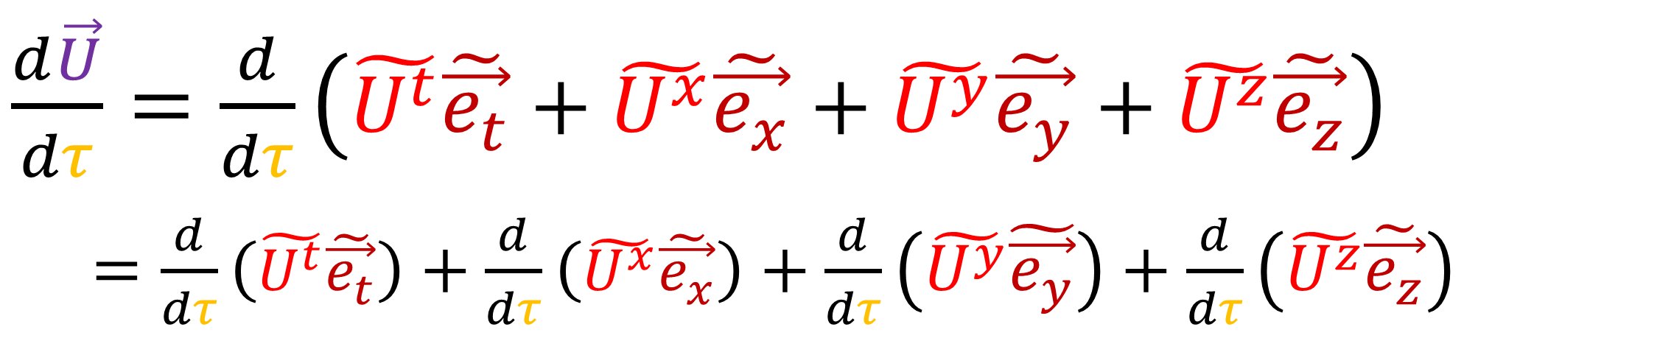
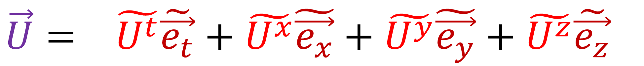
$$\vec{U}= \tilde{U^{t}}\tilde{\vec{e_{t}}}+\tilde{U^{x}}\tilde{\vec{e_{x}}}+\tilde{U^{y}}\tilde{\vec{e_{y}}}+\tilde{U^{z}}\tilde{\vec{e_{z}}}$$
$\frac{d\vec{U}}{dτ}=\frac{d}{dτ}\left(\tilde{U^{t}}\tilde{\vec{e_{t}}}+\tilde{U^{x}}\tilde{\vec{e_{x}}}+\tilde{U^{y}}\tilde{\vec{e_{y}}}+\tilde{U^{z}}\tilde{\vec{e_{z}}}\right)$
$\frac{d\vec{S}}{dτ}=\frac{d}{dτ}\left(\tilde{U^{t}}\tilde{\vec{e_{t}}}\right)+\frac{d}{dτ}\left(\tilde{U^{x}}\tilde{\vec{e_{x}}}\right)+\frac{d}{dτ}\left(\tilde{U^{y}}\tilde{\vec{e_{y}}}\right)+\frac{d}{dτ}\left(\tilde{U^{z}}\tilde{\vec{e_{z}}}\right)$
Product Rule
(Basis vectors might change
for non-inertial frames!)
$\frac{d}{dτ}\left(\tilde{U^{t}}\right)\tilde{\vec{e_{t}}}+\tilde{U^{t}}\frac{d}{dτ}\left(\tilde{\vec{e_{t}}}\right)$

Slide 8
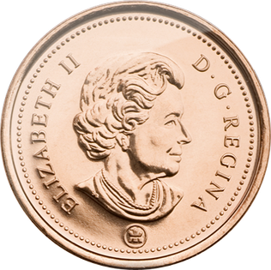




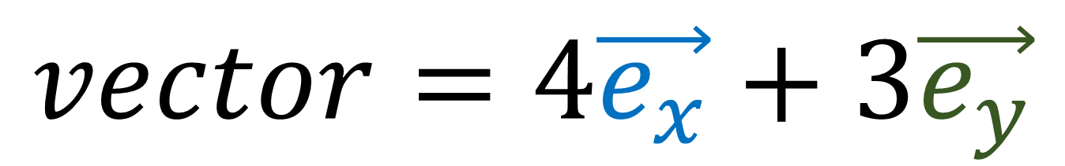
$$vector=4\vec{e_{x}}+3\vec{e_{y}}$$
$$\vec{e_{y}}$$
$$x=4$$
$$\vec{e_{x}}$$
$$y=3$$
Vector Basis (Measuring Sticks)
Vector Components
(Coordinates/Numbers)
Notes:
So I’ve said this several times throughout this series but I’m going to say it again: Basis vectors and vector components are two sides of the same coin.
Any time we’re dealing with vectors, we need to think about both the basis vectors and the components. It doesn’t make sense to talk about one without talking about the other.

Slide 9

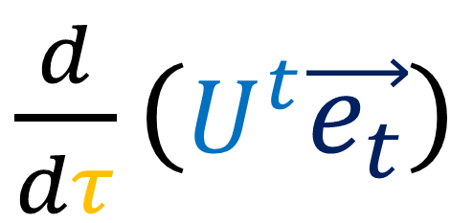
In flat spacetime…
covariant derivative = take the derivatives of basis vectors into account.
$\frac{d}{dτ}\left(U^{t}\vec{e_{t}}\right)$
Product Rule
$\frac{d}{dτ}\left(U^{t}\right)\vec{e_{t}}+U^{t}\frac{d}{dτ}\left(\vec{e_{t}}\right)$
(Covariant Derivative in curved spacetime is more complicated…)

Slide 10


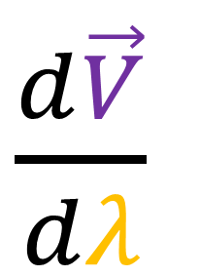
Covariant Derivative
Derivative of 4-position w.r.t. proper time
Derivative of 4-velocity w.r.t. proper time
Derivative of general 4-vector w.r.t. parameter
$\frac{d\vec{S}}{dτ}=\vec{U}$
$\frac{d\vec{U}}{dτ}=\vec{A}$
$\frac{d\vec{V}}{dλ}$

Slide 11








Relativity 105b:
$$ct$$
$$ct$$
$c\tilde{t}=\frac{c^{2}}{α}\operatorname{arctanh}\left(\frac{ct}{x}\right)$
$\tilde{x}=\sqrt{{\left(x\right)}^{2}−{\left(ct\right)}^{2}}$
$$c\tilde{t}$$
$$\tilde{x}$$
$$x$$
$$x$$
$ct=\tilde{x}\sinh\left(\frac{α}{c^{2}}c\tilde{t}\right)$
$x=\tilde{x}\cosh\left(\frac{α}{c^{2}}c\tilde{t}\right)$
Rindler Coordinates
Inertial Coordinates

Slide 12
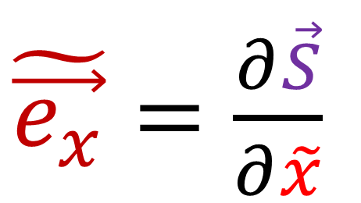
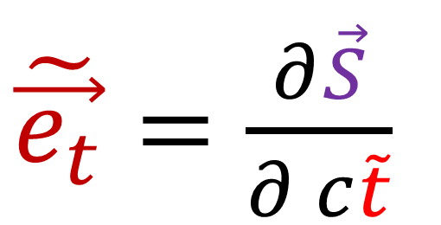
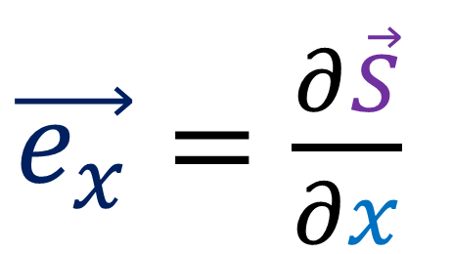
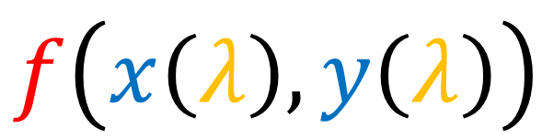
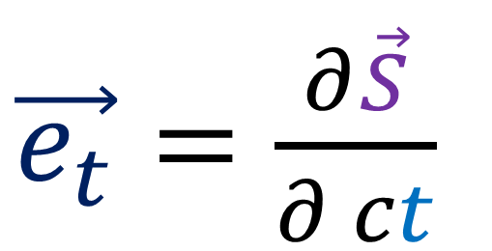
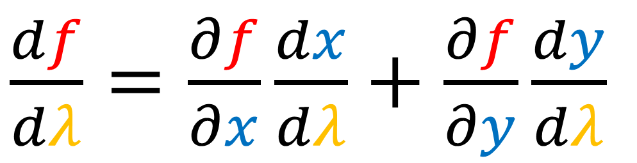
1. Multivariable Chain Rule
$\frac{df}{dλ}=\frac{∂f}{∂x}\frac{dx}{dλ}+\frac{∂f}{∂y}\frac{dy}{dλ}$
$f\left(x\left(λ\right),y\left(λ\right)\right)$
2. Basis Vectors as Tangent Vectors
$\vec{e_{t}}=\frac{∂\vec{S}}{∂ ct}$
$\tilde{\vec{e_{t}}}=\frac{∂\vec{S}}{∂ c\tilde{t}}$
$\vec{e_{x}}=\frac{∂\vec{S}}{∂x}$
$\tilde{\vec{e_{x}}}=\frac{∂\vec{S}}{∂\tilde{x}}$
Notes:
To understand the Jacobian matrix, we need to understand 2 ideas:
#1 we need multi-variable chain rule, and #2, we need to think of basis vectors as tangent vectors. If you understand these two ideas, you already know everything you need to know about the Jacobian matrix. Everything afterward is just filling in the details and giving examples.

Slide 13
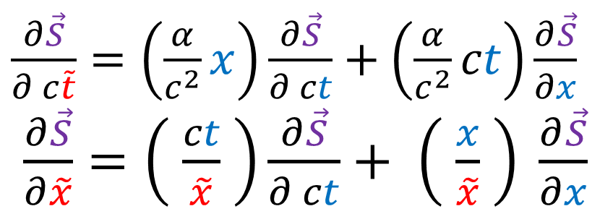
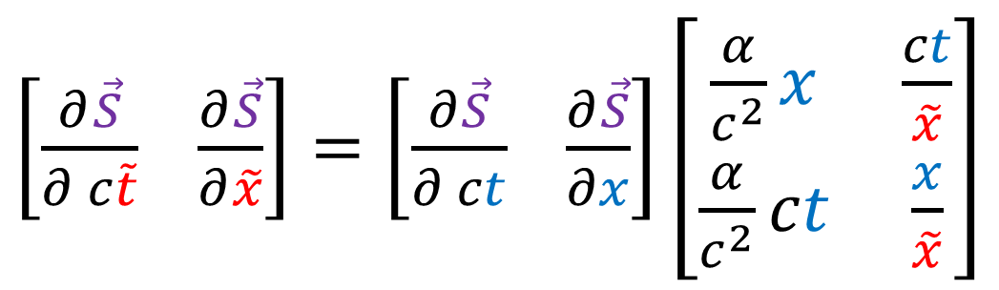
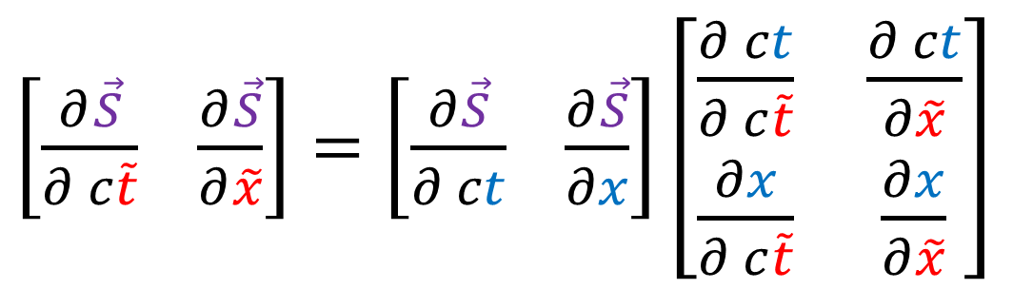
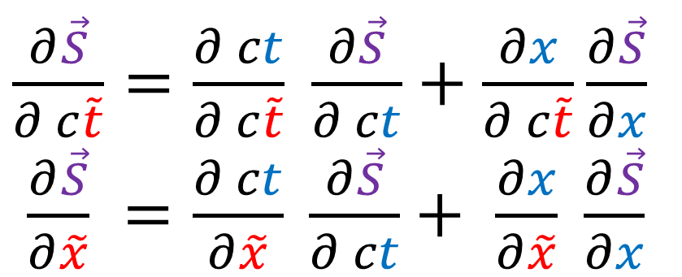
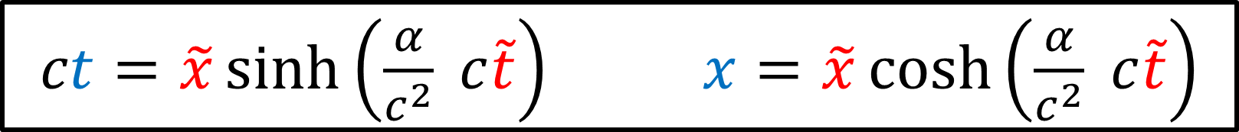
$ct=\tilde{x}\sinh\left(\frac{α}{c^{2}} c\tilde{t}\right)$ $x=\tilde{x}\cosh\left(\frac{α}{c^{2}} c\tilde{t}\right)$
$\frac{∂\vec{S}}{∂ c\tilde{t}}=\frac{∂ ct}{∂ c\tilde{t}} \frac{∂\vec{S}}{∂ ct}+\frac{∂x}{∂ c\tilde{t}}\frac{∂\vec{S}}{∂x}$
$\frac{∂\vec{S}}{∂\tilde{x}} =\frac{∂ ct}{∂\tilde{x}} \frac{∂\vec{S}}{∂ ct}+ \frac{∂x}{∂\tilde{x}} \frac{∂\vec{S}}{∂x}$
$\left[\frac{∂\vec{S}}{∂ c\tilde{t}} \frac{∂\vec{S}}{∂\tilde{x}}\right]=\left[\frac{∂\vec{S}}{∂ ct} \frac{∂\vec{S}}{∂x}\right]\left[\begin{matrix}\frac{∂ ct}{∂ c\tilde{t}} & \frac{∂ ct}{∂\tilde{x}} \\ \frac{∂x}{∂ c\tilde{t}} & \frac{∂x}{∂\tilde{x}}\end{matrix}\right]$
Jacobian Matrix
$\frac{∂\vec{S}}{∂ c\tilde{t}}=\left(\frac{α}{c^{2}}x\right)\frac{∂\vec{S}}{∂ ct}+\left(\frac{α}{c^{2}}ct\right)\frac{∂\vec{S}}{∂x}$
$\frac{∂\vec{S}}{∂\tilde{x}}=\left( \frac{ct}{\tilde{x}} \right)\frac{∂\vec{S}}{∂ ct}+ \left( \frac{x}{\tilde{x}} \right) \frac{∂\vec{S}}{∂x}$
$\left[\frac{∂\vec{S}}{∂ c\tilde{t}} \frac{∂\vec{S}}{∂\tilde{x}}\right]=\left[\frac{∂\vec{S}}{∂ ct} \frac{∂\vec{S}}{∂x}\right]\left[\begin{matrix}\frac{α}{c^{2}}x & \frac{ct}{\tilde{x}} \\ \frac{α}{c^{2}}ct & \frac{x}{\tilde{x}}\end{matrix}\right]$
Notes:
So we’ve found all the coefficients in these multi-variable chain rule formulas for converting between the standard spacetime basis and the Rindler basis vector. Writing these formulas in array notation, this also means we’ve found the coefficients of the Jacobian Matrix.

Slide 14
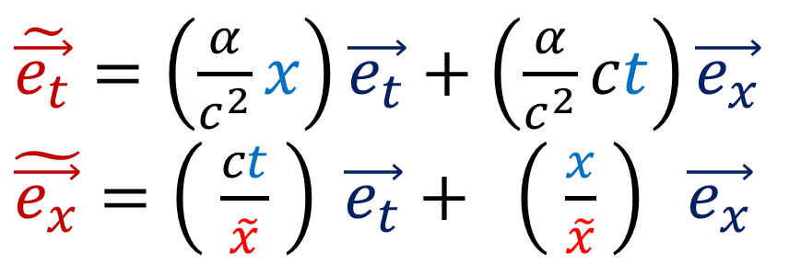
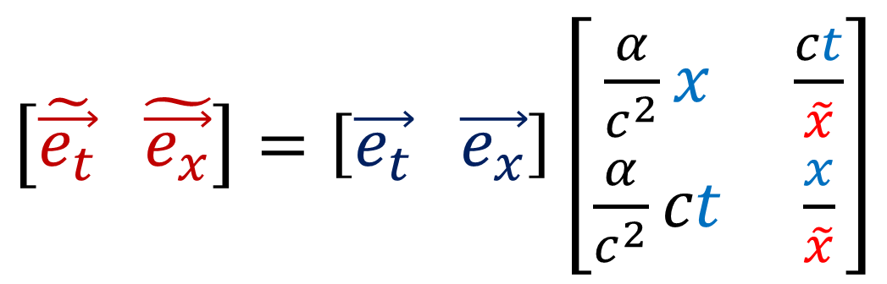
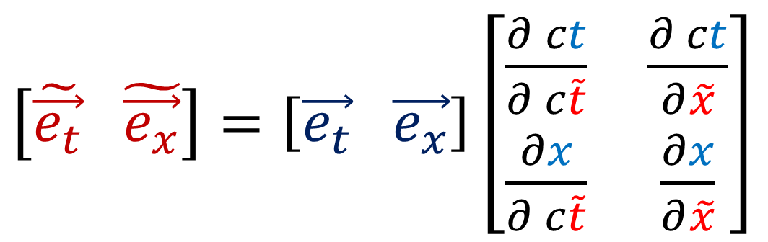

$ct=\tilde{x}\sinh\left(\frac{α}{c^{2}} c\tilde{t}\right)$ $x=\tilde{x}\cosh\left(\frac{α}{c^{2}} c\tilde{t}\right)$
$\tilde{\vec{e_{t}}}=\frac{∂ ct}{∂ c\tilde{t}}\vec{e_{t}}+\frac{∂x}{∂ c\tilde{t}}\vec{e_{x}}$
$\tilde{\vec{e_{x}}}=\frac{∂ ct}{∂\tilde{x}}\vec{e_{t}}+ \frac{∂x}{∂\tilde{x}}\vec{e_{x}}$
$\left[\tilde{\vec{e_{t}}} \tilde{\vec{e_{x}}}\right]=\left[\vec{e_{t}} \vec{e_{x}}\right]\left[\begin{matrix}\frac{∂ ct}{∂ c\tilde{t}} & \frac{∂ ct}{∂\tilde{x}} \\ \frac{∂x}{∂ c\tilde{t}} & \frac{∂x}{∂\tilde{x}}\end{matrix}\right]$
Jacobian Matrix
$\tilde{\vec{e_{t}}}=\left(\frac{α}{c^{2}}x\right)\vec{e_{t}}+\left(\frac{α}{c^{2}}ct\right)\vec{e_{x}}$
$\tilde{\vec{e_{x}}}=\left( \frac{ct}{\tilde{x}} \right) \vec{e_{t}}+ \left( \frac{x}{\tilde{x}} \right) \vec{e_{x}}$
$\left[\tilde{\vec{e_{t}}} \tilde{\vec{e_{x}}}\right]=\left[\vec{e_{t}} \vec{e_{x}}\right]\left[\begin{matrix}\frac{α}{c^{2}}x & \frac{ct}{\tilde{x}} \\ \frac{α}{c^{2}}ct & \frac{x}{\tilde{x}}\end{matrix}\right]$

Slide 15





$c\tilde{t}=\frac{c^{2}}{α}\operatorname{arctanh}\left(\frac{ct}{x}\right)$ $\tilde{x}=\sqrt{{\left(x\right)}^{2}−{\left(ct\right)}^{2}}$
$\frac{∂\vec{S}}{∂ ct}=\frac{∂ c\tilde{t}}{∂ ct} \frac{∂\vec{S}}{∂ c\tilde{t}}+\frac{∂\tilde{x}}{∂ ct}\frac{∂\vec{S}}{∂\tilde{x}}$
$\frac{∂\vec{S}}{∂x} =\frac{∂ c\tilde{t}}{∂x} \frac{∂\vec{S}}{∂ c\tilde{t}}+ \frac{∂\tilde{x}}{∂x} \frac{∂\vec{S}}{∂\tilde{x}}$
$\left[\frac{∂\vec{S}}{∂ ct} \frac{∂\vec{S}}{∂x}\right]=\left[\frac{∂\vec{S}}{∂ c\tilde{t}} \frac{∂\vec{S}}{∂\tilde{x}}\right]\left[\begin{matrix}\frac{∂ c\tilde{t}}{∂ ct} & \frac{∂ c\tilde{t}}{∂x} \\ \frac{∂\tilde{x}}{∂ ct} & \frac{∂\tilde{x}}{∂x}\end{matrix}\right]$
(Inverse)
Jacobian Matrix
$\frac{∂\vec{S}}{∂ ct}= \left(\frac{c^{2}}{α}\frac{x}{{\tilde{x}}^{2}}\right) \frac{∂\vec{S}}{∂ c\tilde{t}}+\left(−\frac{ct}{\tilde{x}}\right)\frac{∂\vec{S}}{∂\tilde{x}}$
$\frac{∂\vec{S}}{∂x} =\left(−\frac{c^{2}}{α}\frac{ct}{{\tilde{x}}^{2}}\right)\frac{∂\vec{S}}{∂ c\tilde{t}}+ \left(\frac{x}{\tilde{x}}\right) \frac{∂\vec{S}}{∂\tilde{x}}$
$\left[\frac{∂\vec{S}}{∂ ct} \frac{∂\vec{S}}{∂x}\right]=\left[\frac{∂\vec{S}}{∂ c\tilde{t}} \frac{∂\vec{S}}{∂\tilde{x}}\right]\left[\begin{matrix}\frac{c^{2}}{α}\frac{x}{{\tilde{x}}^{2}} & −\frac{c^{2}}{α}\frac{ct}{{\tilde{x}}^{2}} \\ −\frac{ct}{\tilde{x}} & \frac{x}{\tilde{x}}\end{matrix}\right]$
Notes:
Using these coefficients, we can get the inverse Jacobian matrix.

Slide 16




$c\tilde{t}=\frac{c^{2}}{α}\operatorname{arctanh}\left(\frac{ct}{x}\right)$ $\tilde{x}=\sqrt{{\left(x\right)}^{2}−{\left(ct\right)}^{2}}$
$\vec{e_{t}}=\frac{∂ c\tilde{t}}{∂ ct}\tilde{\vec{e_{t}}}+\frac{∂\tilde{x}}{∂ ct}\tilde{\vec{e_{x}}}$
$\vec{e_{x}}=\frac{∂ c\tilde{t}}{∂x}\tilde{\vec{e_{t}}}+ \frac{∂\tilde{x}}{∂x}\tilde{\vec{e_{x}}}$
$\left[\vec{e_{t}} \vec{e_{x}}\right]=\left[\tilde{\vec{e_{t}}} \tilde{\vec{e_{x}}}\right]\left[\begin{matrix}\frac{∂ c\tilde{t}}{∂ ct} & \frac{∂ c\tilde{t}}{∂x} \\ \frac{∂\tilde{x}}{∂ ct} & \frac{∂\tilde{x}}{∂x}\end{matrix}\right]$
(Inverse)
Jacobian Matrix
$\vec{e_{t}}= \left(\frac{c^{2}}{α}\frac{x}{{\tilde{x}}^{2}}\right)\tilde{\vec{e_{t}}}+\left(−\frac{ct}{\tilde{x}}\right)\tilde{\vec{e_{x}}}$
$\vec{e_{x}}=\left(−\frac{c^{2}}{α}\frac{ct}{{\tilde{x}}^{2}}\right)\tilde{\vec{e_{t}}}+ \left(\frac{x}{\tilde{x}}\right) \tilde{\vec{e_{x}}}$
$\left[\vec{e_{t}} \vec{e_{x}}\right]=\left[\tilde{\vec{e_{t}}} \tilde{\vec{e_{x}}}\right]\left[\begin{matrix}\frac{c^{2}}{α}\frac{x}{{\tilde{x}}^{2}} & −\frac{c^{2}}{α}\frac{ct}{{\tilde{x}}^{2}} \\ −\frac{ct}{\tilde{x}} & \frac{x}{\tilde{x}}\end{matrix}\right]$

Slide 17




4-position in Rindler coordinates
$\vec{e_{t}}= \frac{c^{2}}{α}\frac{x}{{\tilde{x}}^{2}}\tilde{\vec{e_{t}}}−\frac{ct}{\tilde{x}}\tilde{\vec{e_{x}}}$
$\vec{e_{x}}=−\frac{c^{2}}{α}\frac{ct}{{\tilde{x}}^{2}}\tilde{\vec{e_{t}}}+\frac{x}{\tilde{x}}\tilde{\vec{e_{x}}}$
$\vec{S}=ct\vec{e_{t}}+x\vec{e_{x}}$
$\vec{S}=ct\left(\frac{c^{2}}{α}\frac{x}{{\tilde{x}}^{2}}\tilde{\vec{e_{t}}}−\frac{ct}{\tilde{x}}\tilde{\vec{e_{x}}}\right)+x\left(−\frac{c^{2}}{α}\frac{ct}{{\tilde{x}}^{2}}\tilde{\vec{e_{t}}}+\frac{x}{\tilde{x}}\tilde{\vec{e_{x}}}\right)$
$\vec{S}=\left(\frac{{−\left(ct\right)}^{2}+x^{2}}{\tilde{x}}\right)\tilde{\vec{e_{x}}}$
$\vec{S}=\tilde{x}\tilde{\vec{e_{x}}}$
$c\tilde{t}=\frac{c^{2}}{α}\operatorname{arctanh}\left(\frac{ct}{x}\right)$
$${\tilde{x}}^{2}=−{\left(ct\right)}^{2}+x^{2}$$

Slide 18


4-position in Rindler coordinates
$\vec{e_{t}}= \frac{c^{2}}{α}\frac{x}{{\tilde{x}}^{2}}\tilde{\vec{e_{t}}}−\frac{ct}{\tilde{x}}\tilde{\vec{e_{x}}}$
$\vec{e_{x}}=−\frac{c^{2}}{α}\frac{ct}{{\tilde{x}}^{2}}\tilde{\vec{e_{t}}}+\frac{x}{\tilde{x}}\tilde{\vec{e_{x}}}$
$\vec{S}=ct\vec{e_{t}}+x\vec{e_{x}}$
$\vec{S}=\tilde{x}\tilde{\vec{e_{x}}}$

Slide 19













$$\vec{S}=ct\vec{e_{t}}+x\vec{e_{x}}$$
$$\vec{S}=\tilde{x}\tilde{\vec{e_{x}}}$$
$\tilde{\vec{e_{t}}}$
$$ct$$
$$\vec{e_{t}}$$
$\tilde{\vec{e_{x}}}$
$$\vec{e_{x}}$$
$$c\tilde{t}$$
$$\vec{S}$$
$$\vec{S}$$
$$\tilde{x}$$
$$x$$
Standard (Inertial) Coordinates
Rindler Coordinates

Slide 20



4-position in Rindler coordinates
$\vec{e_{t}}= \frac{c^{2}}{α}\frac{x}{{\tilde{x}}^{2}}\tilde{\vec{e_{t}}}−\frac{ct}{\tilde{x}}\tilde{\vec{e_{x}}}$
$\vec{e_{x}}=−\frac{c^{2}}{α}\frac{ct}{{\tilde{x}}^{2}}\tilde{\vec{e_{t}}}+\frac{x}{\tilde{x}}\tilde{\vec{e_{x}}}$
$\vec{e_{y}}= \tilde{\vec{e_{y}}}$
$\vec{e_{z}}= \tilde{\vec{e_{z}}}$
$c\tilde{t}=\frac{c^{2}}{α}\operatorname{arctanh}\left(\frac{ct}{x}\right)$
$\tilde{x}=\sqrt{{\left(x\right)}^{2}−{\left(ct\right)}^{2}}$
$\tilde{y}=y$
$\tilde{z}=z$
$\vec{S}=ct\vec{e_{t}}+x\vec{e_{x}}+y\vec{e_{y}}+z\vec{e_{z}}$
$\vec{S}= \tilde{x}\tilde{\vec{e_{x}}}+\tilde{y}\tilde{\vec{e_{y}}}+\tilde{z}\tilde{\vec{e_{z}}}$

Slide 21





Covariant Derivative
$$\vec{S}=ct\vec{e_{t}}+x\vec{e_{x}}$$
$$= \tilde{x}\tilde{\vec{e_{x}}}$$
$\frac{d\vec{S}}{dτ}=\frac{d}{dτ}\left(ct\vec{e_{t}}+x\vec{e_{x}}\right)$
$\frac{d\vec{S}}{dτ}=\frac{d ct}{dτ}\vec{e_{t}}+\frac{dx}{dτ}\vec{e_{x}}$
$=\frac{d}{dτ}\left(\tilde{x}\tilde{\vec{e_{x}}}\right)$
$=\frac{d\tilde{x}}{dτ}\tilde{\vec{e_{x}}}+\tilde{x}\frac{d\tilde{\vec{e_{x}}}}{dτ}$
$\frac{d\tilde{\vec{e_{x}}}}{dτ}=\frac{dc\tilde{t}}{dτ}\frac{∂\tilde{\vec{e_{x}}}}{∂ c\tilde{t}}+\frac{d\tilde{x}}{dτ}\frac{∂\tilde{\vec{e_{x}}}}{∂\tilde{x}}$
The hard part.

Slide 22



$ct=\tilde{x}\sinh\left(\frac{α}{c^{2}} c\tilde{t}\right)$ $x=\tilde{x}\cosh\left(\frac{α}{c^{2}} c\tilde{t}\right)$
$\frac{∂\vec{S}}{∂ c\tilde{t}}= \frac{∂ ct}{∂ c\tilde{t}} \frac{∂\vec{S}}{∂ ct}+ \frac{∂x}{∂ c\tilde{t}} \frac{∂\vec{S}}{∂x}$
$\tilde{\vec{e_{t}}}=\frac{α}{c^{2}}\tilde{x}\cosh\left(\frac{α}{c^{2}}c\tilde{t}\right)\vec{e_{t}}+\frac{α}{c^{2}}\tilde{x}\sinh\left(\frac{α}{c^{2}}c\tilde{t}\right)\vec{e_{x}}$
$\frac{∂\vec{S}}{∂\tilde{x}}= \frac{∂ ct}{∂\tilde{x}} \frac{∂\vec{S}}{∂ ct}+ \frac{∂x}{∂\tilde{x}} \frac{∂\vec{S}}{∂x}$
$\tilde{\vec{e_{x}}} = \sinh\left(\frac{α}{c^{2}} c\tilde{t}\right) \vec{e_{t}}+ \cosh\left(\frac{α}{c^{2}} c\tilde{t}\right) \vec{e_{x}}$

Slide 23




$\tilde{\vec{e_{t}}}=\frac{α}{c^{2}}\tilde{x}\cosh\left(\frac{α}{c^{2}}c\tilde{t}\right)\vec{e_{t}}+\frac{α}{c^{2}}\tilde{x}\sinh\left(\frac{α}{c^{2}}c\tilde{t}\right)\vec{e_{x}}$
$\tilde{\vec{e_{x}}}= \sinh\left(\frac{α}{c^{2}}c\tilde{t}\right)\vec{e_{t}}+ \cosh\left(\frac{α}{c^{2}}c\tilde{t}\right)\vec{e_{x}}$
$\frac{∂\tilde{\vec{e_{x}}}}{∂\tilde{x}}=\frac{∂}{∂\tilde{x}}\left(\sinh\left(\frac{α}{c^{2}}c\tilde{t}\right)\vec{e_{t}}+\cosh\left(\frac{α}{c^{2}}c\tilde{t}\right)\vec{e_{x}}\right)=\vec{0}$
$\frac{∂\tilde{\vec{e_{x}}}}{∂ c\tilde{t}}=\frac{∂}{∂ c\tilde{t}}\left(\sinh\left(\frac{α}{c^{2}}c\tilde{t}\right)\vec{e_{t}}+\cosh\left(\frac{α}{c^{2}}c\tilde{t}\right)\vec{e_{x}}\right)$
$\frac{∂\tilde{\vec{e_{x}}}}{∂ c\tilde{t}}=\frac{α}{c^{2}}\cosh\left(\frac{α}{c^{2}}c\tilde{t}\right)\vec{e_{t}}+\frac{α}{c^{2}}\sinh\left(\frac{α}{c^{2}}c\tilde{t}\right)\vec{e_{x}}$
$\frac{∂\tilde{\vec{e_{x}}}}{∂ c\tilde{t}}=\frac{1}{\tilde{x}}\tilde{\vec{e_{t}}}$
$\frac{d\tilde{\vec{e_{x}}}}{dτ}=\frac{dc\tilde{t}}{dτ}\frac{∂\tilde{\vec{e_{x}}}}{∂ c\tilde{t}}+\frac{d\tilde{x}}{dτ}\frac{∂\tilde{\vec{e_{x}}}}{∂\tilde{x}}=\frac{dc\tilde{t}}{dτ}\frac{1}{\tilde{x}}\tilde{\vec{e_{t}}}$

Slide 24



Covariant Derivative
$\frac{d\tilde{\vec{e_{x}}}}{dτ}=\frac{dc\tilde{t}}{dτ}\frac{1}{\tilde{x}}\tilde{\vec{e_{t}}}$
$$\vec{S}=\tilde{x}\tilde{\vec{e_{x}}}$$
$\frac{d\vec{S}}{dτ}=\frac{d}{dτ}\left(\tilde{x}\tilde{\vec{e_{x}}}\right)=\frac{d\tilde{x}}{dτ}\tilde{\vec{e_{x}}}+\tilde{x}\frac{d\tilde{\vec{e_{x}}}}{dτ}$
$\frac{d\vec{S}}{dτ}=\frac{d}{dτ}\left(\tilde{x}\tilde{\vec{e_{x}}}\right)=\frac{d\tilde{x}}{dτ}\tilde{\vec{e_{x}}}+\tilde{x}\left(\frac{dc\tilde{t}}{dτ}\frac{1}{\tilde{x}}\tilde{\vec{e_{t}}}\right)$
$\frac{d\vec{S}}{dτ}=\frac{d}{dτ}\left(\tilde{x}\tilde{\vec{e_{x}}}\right)=\frac{d\tilde{x}}{dτ}\tilde{\vec{e_{x}}}+\frac{dc\tilde{t}}{dτ}\tilde{\vec{e_{t}}}$
Agrees with multi-variable chain rule.

Slide 25






Covariant Derivative
$$\vec{S}= ct \vec{e_{t}}+ x \vec{e_{x}}$$
$$= \tilde{x} \tilde{\vec{e_{x}}}$$
$\frac{d\vec{S}}{dτ}=\frac{d ct}{dτ}\vec{e_{t}}+\frac{dx}{dτ}\vec{e_{x}}$
$=\frac{d c\tilde{t}}{dτ}\tilde{\vec{e_{t}}}+\frac{d\tilde{x}}{dτ}\tilde{\vec{e_{x}}}$
Comes from $\frac{d}{dτ}$ of basis vector.
Comes from $\frac{d}{dτ}$ of component

Slide 26
Covariant Derivative
Derivative of 4-position w.r.t. proper time
Derivative of 4-velocity w.r.t. proper time
Derivative of general 4-vector w.r.t. parameter
$\frac{d\vec{S}}{dτ}=\vec{U}$
$\frac{d\vec{U}}{dτ}=\vec{A}$
$\frac{d\vec{V}}{dλ}$

Slide 27

4-velocity Vector
$$\vec{U}= U^{t} \vec{e_{t}} +U^{x}\vec{e_{x}}= \tilde{U^{t}} \tilde{\vec{e_{t}}} +\tilde{U^{x}}\tilde{\vec{e_{x}}}$$
$\frac{d\vec{S}}{dτ}=\frac{d ct}{dτ}\frac{∂\vec{S}}{∂ ct}+\frac{dx}{dτ}\frac{∂\vec{S}}{∂x}=\frac{d c\tilde{t}}{dτ}\frac{∂\vec{S}}{∂ c\tilde{t}}+\frac{d\tilde{x}}{dτ}\frac{∂\vec{S}}{∂\tilde{x}}$

Slide 28






Covariant Derivative
$$\vec{U}= U^{t}\vec{e_{t}} +U^{x}\vec{e_{x}}$$
$$=\tilde{U^{t}}\tilde{\vec{e_{t}}}+\tilde{U^{x}}\tilde{\vec{e_{x}}}$$
$\frac{d\vec{U}}{dτ}=\frac{d}{dτ}\left(U^{t}\vec{e_{t}}+U^{x}\vec{e_{x}}\right)$
$\frac{d\vec{U}}{dτ}=\frac{dU^{t}}{dτ}\vec{e_{t}}+\frac{dU^{x}}{dτ}\vec{e_{x}}$
$\frac{d^{2}\vec{S}}{dτ^{2}}=\frac{d^{2}(ct)}{dτ^{2}}\vec{e_{t}}+\frac{d^{2}x}{dτ^{2}}\vec{e_{x}}$
$=\frac{d}{dτ}\left(\tilde{U^{t}}\tilde{\vec{e_{t}}}+\tilde{U^{x}}\tilde{\vec{e_{x}}}\right)$
$=\frac{d\tilde{U^{t}}}{dτ}\tilde{\vec{e_{t}}}+\tilde{U^{t}}\frac{d\tilde{\vec{e_{t}}}}{dτ}$
$+\frac{d\tilde{U^{x}}}{dτ}\tilde{\vec{e_{x}}}+\tilde{U^{x}}\frac{d\tilde{\vec{e_{x}}}}{dτ}$
$\frac{d\tilde{\vec{e_{t}}}}{dτ}=\frac{dc\tilde{t}}{dτ}\frac{∂\tilde{\vec{e_{t}}}}{∂ c\tilde{t}}+\frac{d\tilde{x}}{dτ}\frac{∂\tilde{\vec{e_{t}}}}{∂\tilde{x}}$
$\frac{d\tilde{\vec{e_{x}}}}{dτ}=\frac{dc\tilde{t}}{dτ}\frac{1}{\tilde{x}}\tilde{\vec{e_{t}}}$

Slide 29



$\tilde{\vec{e_{t}}}= \frac{\tilde{x}}{D} \cosh\left(\frac{c\tilde{t}}{D}\right)\vec{e_{t}}+ \frac{\tilde{x}}{D} \sinh\left(\frac{c\tilde{t}}{D}\right)\vec{e_{x}}$
$\tilde{\vec{e_{x}}}= \sinh\left(\frac{c\tilde{t}}{D}\right)\vec{e_{t}}+ \cosh\left(\frac{c\tilde{t}}{D}\right)\vec{e_{x}}$
$\tilde{\vec{e_{t}}}=\frac{α}{c^{2}}\tilde{x}\cosh\left(\frac{α}{c^{2}}c\tilde{t}\right)\vec{e_{t}}+\frac{α}{c^{2}}\tilde{x}\sinh\left(\frac{α}{c^{2}}c\tilde{t}\right)\vec{e_{x}}$
$\tilde{\vec{e_{x}}}= \sinh\left(\frac{α}{c^{2}}c\tilde{t}\right)\vec{e_{t}}+ \cosh\left(\frac{α}{c^{2}}c\tilde{t}\right)\vec{e_{x}}$
$\frac{∂\tilde{\vec{e_{t}}}}{∂\tilde{x}} =\frac{α}{c^{2}}\cosh\left(\frac{α}{c^{2}}c\tilde{t}\right)\vec{e_{t}}+\frac{α}{c^{2}}\sinh\left(\frac{α}{c^{2}}c\tilde{t}\right)\vec{e_{x}}=\frac{1}{\tilde{x}}\tilde{\vec{e_{t}}}$
$\frac{∂\tilde{\vec{e_{t}}}}{∂ c\tilde{t}}=\frac{∂}{∂ c\tilde{t}}\left(\frac{α}{c^{2}}\tilde{x}\cosh\left(\frac{α}{c^{2}}c\tilde{t}\right)\vec{e_{t}}+\frac{α}{c^{2}}\tilde{x}\sinh\left(\frac{α}{c^{2}}c\tilde{t}\right)\vec{e_{x}} \right)$
$\frac{∂\tilde{\vec{e_{t}}}}{∂ c\tilde{t}}=\frac{α}{c^{2}}\frac{α}{c^{2}}\tilde{x}\sinh\left(\frac{α}{c^{2}}c\tilde{t}\right)\vec{e_{t}}+\frac{α}{c^{2}}\frac{α}{c^{2}}\tilde{x}\cosh\left(\frac{α}{c^{2}}c\tilde{t}\right)\vec{e_{x}}$
$\frac{∂\tilde{\vec{e_{t}}}}{∂ c\tilde{t}}={\left(\frac{α}{c^{2}}\right)}^{2}\tilde{x} \tilde{\vec{e_{x}}}=\frac{\tilde{x}}{D^{2}} \tilde{\vec{e_{x}}}$

Slide 30




$\frac{d\tilde{\vec{e_{t}}}}{dτ}=\frac{d c\tilde{t}}{dτ}\frac{∂\tilde{\vec{e_{t}}}}{∂ c\tilde{t}}+\frac{d\tilde{x}}{dτ}\frac{∂\tilde{\vec{e_{t}}}}{∂\tilde{x}}$
$\frac{∂\tilde{\vec{e_{t}}}}{∂ c\tilde{t}}={\left(\frac{α}{c^{2}}\right)}^{2}\tilde{x} \tilde{\vec{e_{x}}}$
$\frac{∂\tilde{\vec{e_{t}}}}{∂\tilde{x}}=\frac{1}{\tilde{x}}\tilde{\vec{e_{t}}}$
$\frac{d\tilde{\vec{e_{t}}}}{dτ}=\frac{d c\tilde{t}}{dτ}{\left(\frac{α}{c^{2}}\right)}^{2}\tilde{x} \tilde{\vec{e_{x}}}+\frac{d\tilde{x}}{dτ}\frac{1}{\tilde{x}}\tilde{\vec{e_{t}}}$

Slide 31






$\frac{d\vec{U}}{dτ}=\frac{d\tilde{U^{t}}}{dτ}\tilde{\vec{e_{t}}}+\tilde{U^{t}}\frac{d\tilde{\vec{e_{t}}}}{dτ}+\frac{d\tilde{U^{x}}}{dτ}\tilde{\vec{e_{x}}}+\tilde{U^{x}}\frac{d\tilde{\vec{e_{x}}}}{dτ}$
$\frac{d\tilde{\vec{e_{t}}}}{dτ}=\frac{d c\tilde{t}}{dτ}{\left(\frac{α}{c^{2}}\right)}^{2}\tilde{x} \tilde{\vec{e_{x}}}+\frac{d\tilde{x}}{dτ}\frac{1}{\tilde{x}}\tilde{\vec{e_{t}}}$
$\frac{d\tilde{\vec{e_{x}}}}{dτ}=\frac{dc\tilde{t}}{dτ}\frac{1}{\tilde{x}}\tilde{\vec{e_{t}}}$
$\frac{d\vec{U}}{dτ}=\frac{d\tilde{U^{t}}}{dτ}\tilde{\vec{e_{t}}}+\tilde{U^{t}}\left(\frac{d c\tilde{t}}{dτ}{\left(\frac{α}{c^{2}}\right)}^{2}\tilde{x} \tilde{\vec{e_{x}}}+\frac{d\tilde{x}}{dτ}\frac{1}{\tilde{x}}\tilde{\vec{e_{t}}}\right)$ $+\frac{d\tilde{U^{x}}}{dτ}\tilde{\vec{e_{x}}}+\tilde{U^{x}}\left(\frac{dc\tilde{t}}{dτ}\frac{1}{\tilde{x}}\tilde{\vec{e_{t}}}\right)$
$\tilde{U^{t}}=\frac{dc\tilde{t}}{dτ}, \tilde{U^{x}}=\frac{d\tilde{x}}{dτ}$
$\frac{d\vec{U}}{dτ}=\left(\frac{d^{2}c\tilde{t}}{dτ^{2}}+2\frac{d c\tilde{t}}{dτ}\frac{d\tilde{x}}{dτ}\frac{1}{\tilde{x}}\right)\tilde{\vec{e_{t}}}+\left(\frac{d^{2}\tilde{x}}{dτ^{2}}+{\left(\frac{d c\tilde{t}}{dτ}\right)}^{2}{\left(\frac{α}{c^{2}}\right)}^{2}\tilde{x}\right)\tilde{\vec{e_{x}}}$

Slide 32



$c\tilde{t}=cτ, \tilde{x}=\frac{c^{2}}{α}=D$
$\frac{d\vec{U}}{dτ}=\left(\frac{d^{2}c\tilde{t}}{dτ^{2}}+2\frac{d c\tilde{t}}{dτ}\frac{d\tilde{x}}{dτ}\frac{1}{\tilde{x}}\right)\tilde{\vec{e_{t}}}+\left(\frac{d^{2}\tilde{x}}{dτ^{2}}+{\left(\frac{d c\tilde{t}}{dτ}\right)}^{2}{\left(\frac{α}{c^{2}}\right)}^{2}\tilde{x}\right)\tilde{\vec{e_{x}}}$
$\frac{d\vec{U}}{dτ}=\left(0+0\right)\tilde{\vec{e_{t}}}+\left(0+c^{2}{\left(\frac{α}{c^{2}}\right)}^{2}\frac{c^{2}}{α}\right)\tilde{\vec{e_{x}}}$
$\vec{A}=α\tilde{\vec{e_{x}}}$

Slide 33
Covariant Derivative
Derivative of 4-position w.r.t. proper time
Derivative of 4-velocity w.r.t. proper time
Derivative of general 4-vector w.r.t. parameter
$\frac{d\vec{S}}{dτ}=\vec{U}$
$\frac{d\vec{U}}{dτ}=\vec{A}$
$\frac{d\vec{V}}{dλ}$

Slide 34





$\frac{d\vec{V}}{dλ}=\frac{d}{dλ}\left(\tilde{V^{t}}\tilde{\vec{e_{t}}}+\tilde{V^{x}}\tilde{\vec{e_{x}}}\right)$
$\frac{d\vec{V}}{dλ}=\frac{d\tilde{V^{t}}}{dλ}\tilde{\vec{e_{t}}}+\tilde{V^{t}}\frac{d\tilde{\vec{e_{t}}}}{dλ}+\frac{d\tilde{V^{x}}}{dλ}\tilde{\vec{e_{x}}}+\tilde{V^{x}}\frac{d\tilde{\vec{e_{x}}}}{dλ}$
$\frac{d\tilde{\vec{e_{t}}}}{dλ}=\frac{d c\tilde{t}}{dλ}\frac{∂\tilde{\vec{e_{t}}}}{∂ c\tilde{t}}+\frac{d\tilde{x}}{dλ}\frac{∂\tilde{\vec{e_{t}}}}{∂\tilde{x}}$
$\frac{d\tilde{\vec{e_{x}}}}{dλ}=\frac{d c\tilde{t}}{dλ}\frac{∂\tilde{\vec{e_{t}}}}{∂ c\tilde{t}}+\frac{d\tilde{x}}{dλ}\frac{∂\tilde{\vec{e_{t}}}}{∂\tilde{x}}$
$\frac{∂\tilde{\vec{e_{t}}}}{∂ c\tilde{t}}=\tilde{Γ_{tt}^{t}}\tilde{\vec{e_{t}}}+\tilde{Γ_{tt}^{x}}\tilde{\vec{e_{x}}}$
$\frac{∂\tilde{\vec{e_{t}}}}{∂\tilde{x}}=\tilde{Γ_{tx}^{t}}\tilde{\vec{e_{t}}}+\tilde{Γ_{tx}^{x}}\tilde{\vec{e_{x}}}$
$\frac{∂\tilde{\vec{e_{x}}}}{∂ c\tilde{t}}=\tilde{Γ_{xt}^{t}}\tilde{\vec{e_{t}}}+\tilde{Γ_{xt}^{x}}\tilde{\vec{e_{x}}}$
$\frac{∂\tilde{\vec{e_{x}}}}{∂\tilde{x}}=\tilde{Γ_{xx}^{t}}\tilde{\vec{e_{t}}}+\tilde{Γ_{xx}^{x}}\tilde{\vec{e_{x}}}$

Slide 35




Standard Inertial Coords. to Rindler Coords.
$\frac{∂\tilde{\vec{e_{t}}}}{∂ c\tilde{t}}=\tilde{Γ_{tt}^{t}}\tilde{\vec{e_{t}}}+\tilde{Γ_{tt}^{x}}\tilde{\vec{e_{x}}}$
$\frac{∂\tilde{\vec{e_{t}}}}{∂\tilde{x}}=\tilde{Γ_{tx}^{t}}\tilde{\vec{e_{t}}}+\tilde{Γ_{tx}^{x}}\tilde{\vec{e_{x}}}$
$\frac{∂\tilde{\vec{e_{t}}}}{∂ c\tilde{t}}=0\tilde{\vec{e_{t}}}+{\left(\frac{α}{c^{2}}\right)}^{2}\tilde{x}\tilde{\vec{e_{x}}}$
$\frac{∂\tilde{\vec{e_{t}}}}{∂\tilde{x}}=\frac{1}{\tilde{x}}\tilde{\vec{e_{t}}}+0\tilde{\vec{e_{x}}}$
$\frac{∂\tilde{\vec{e_{x}}}}{∂ c\tilde{t}}=\tilde{Γ_{xt}^{t}}\tilde{\vec{e_{t}}}+\tilde{Γ_{xt}^{x}}\tilde{\vec{e_{x}}}$
$\frac{∂\tilde{\vec{e_{x}}}}{∂\tilde{x}}=\tilde{Γ_{xx}^{t}}\tilde{\vec{e_{t}}}+\tilde{Γ_{xx}^{x}}\tilde{\vec{e_{x}}}$
$\frac{∂\tilde{\vec{e_{x}}}}{∂ c\tilde{t}}=\frac{1}{\tilde{x}}\tilde{\vec{e_{t}}}+0\tilde{\vec{e_{x}}}$
$\frac{∂\tilde{\vec{e_{x}}}}{∂\tilde{x}}=0\tilde{\vec{e_{t}}}+0\tilde{\vec{e_{x}}}$

