Slide 1

Linearized Gravity
$$g_{μν}=η_{μν}+h_{μν}$$
Gravitational Waves happen here

Slide 2
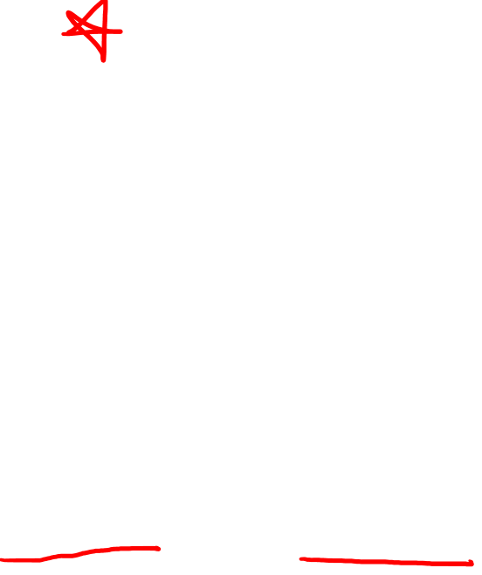
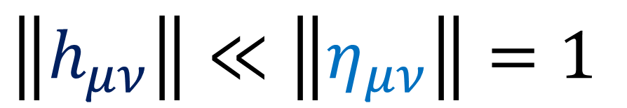

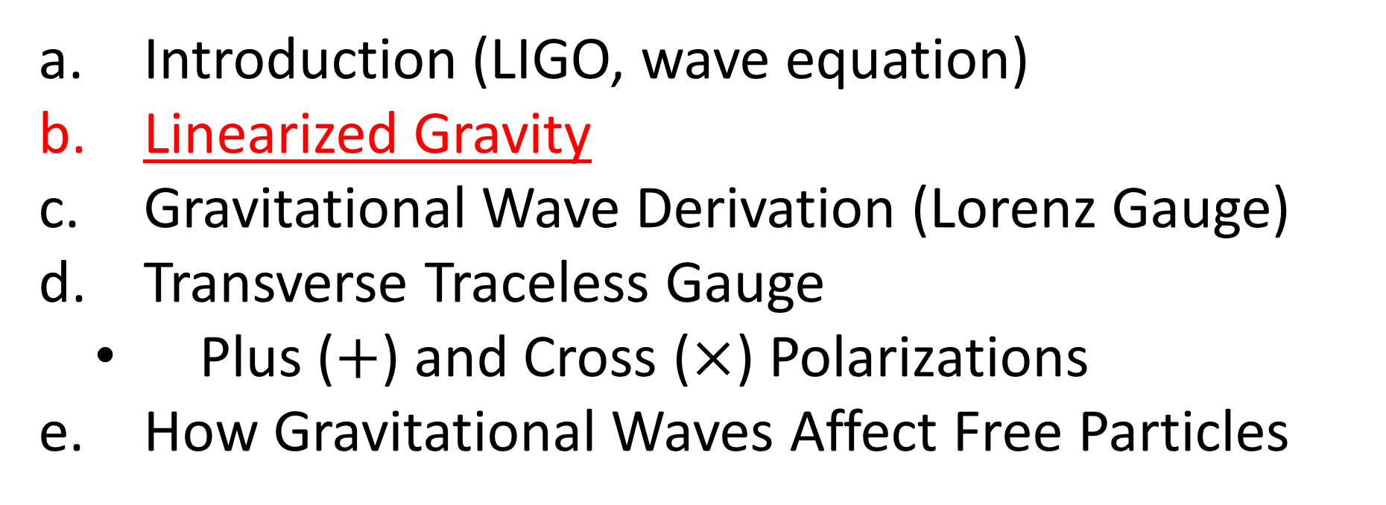
Relativity 109: Gravitational Waves
Introduction (LIGO, wave equation)
Linearized Gravity
Gravitational Wave Derivation (Lorenz Gauge)
Transverse Traceless Gauge
Plus ($+$) and Cross ($×$) Polarizations
How Gravitational Waves Affect Free Particles
$$g_{μν}≈η_{μν}+h_{μν}$$
$$\left\|h_{μν}\right\|≪\left\|η_{μν}\right\|=1$$
Sources:
Good PDF: http://star-www.st-and.ac.uk/~hz4/gr/hendry_GRwaves.pdf
Sean Caroll: https://preposterousuniverse.com/wp-content/uploads/grnotes-six.pdf
Wikipedia: https://en.wikipedia.org/wiki/Linearized_gravity
YouTube: https://www.youtube.com/watch?v=kIBdtbCszB0
Other PDF: https://www.tat.physik.uni-tuebingen.de/~kokkotas/Teaching/NS.BH.GW_files/GW_Physics.pdf

Slide 3

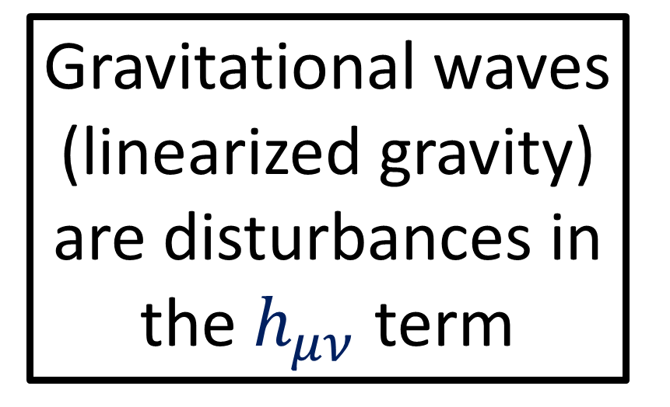
$$g_{μν}=η_{μν}+h_{μν}$$
Gravitational waves (linearized gravity) are disturbances in the $h_{μν}$ term
Flat spacetime

Slide 4
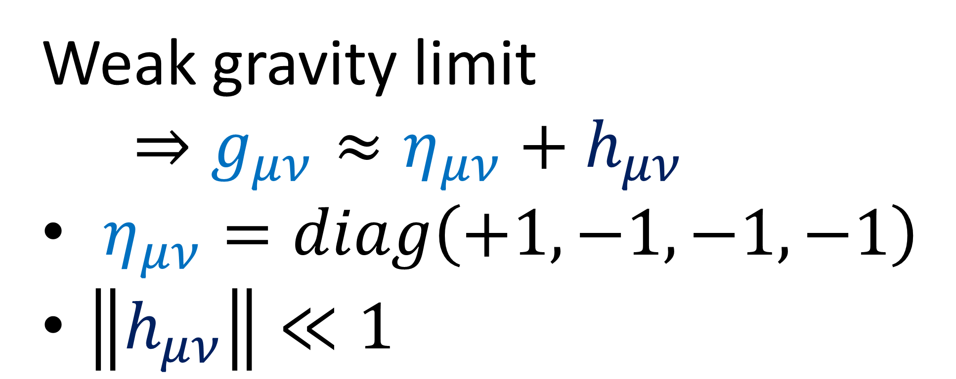
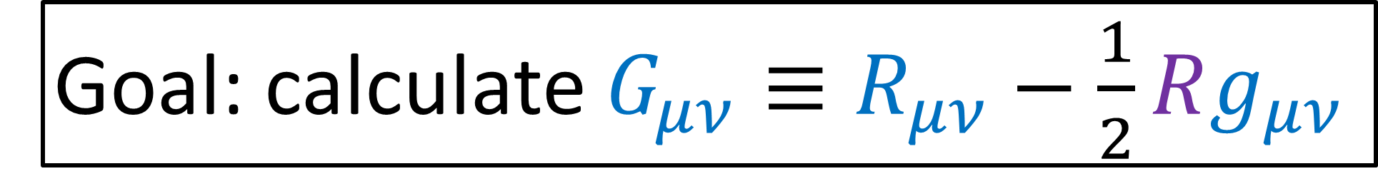
Weak gravity limit
$⇒g_{μν}≈η_{μν}+h_{μν}$
$η_{μν}=diag\left(+1,−1,−1,−1\right)$
$\left\|h_{μν}\right\|≪1$
Goal: calculate $G_{μν}≡R_{μν}−\frac{1}{2}Rg_{μν}$

Slide 5

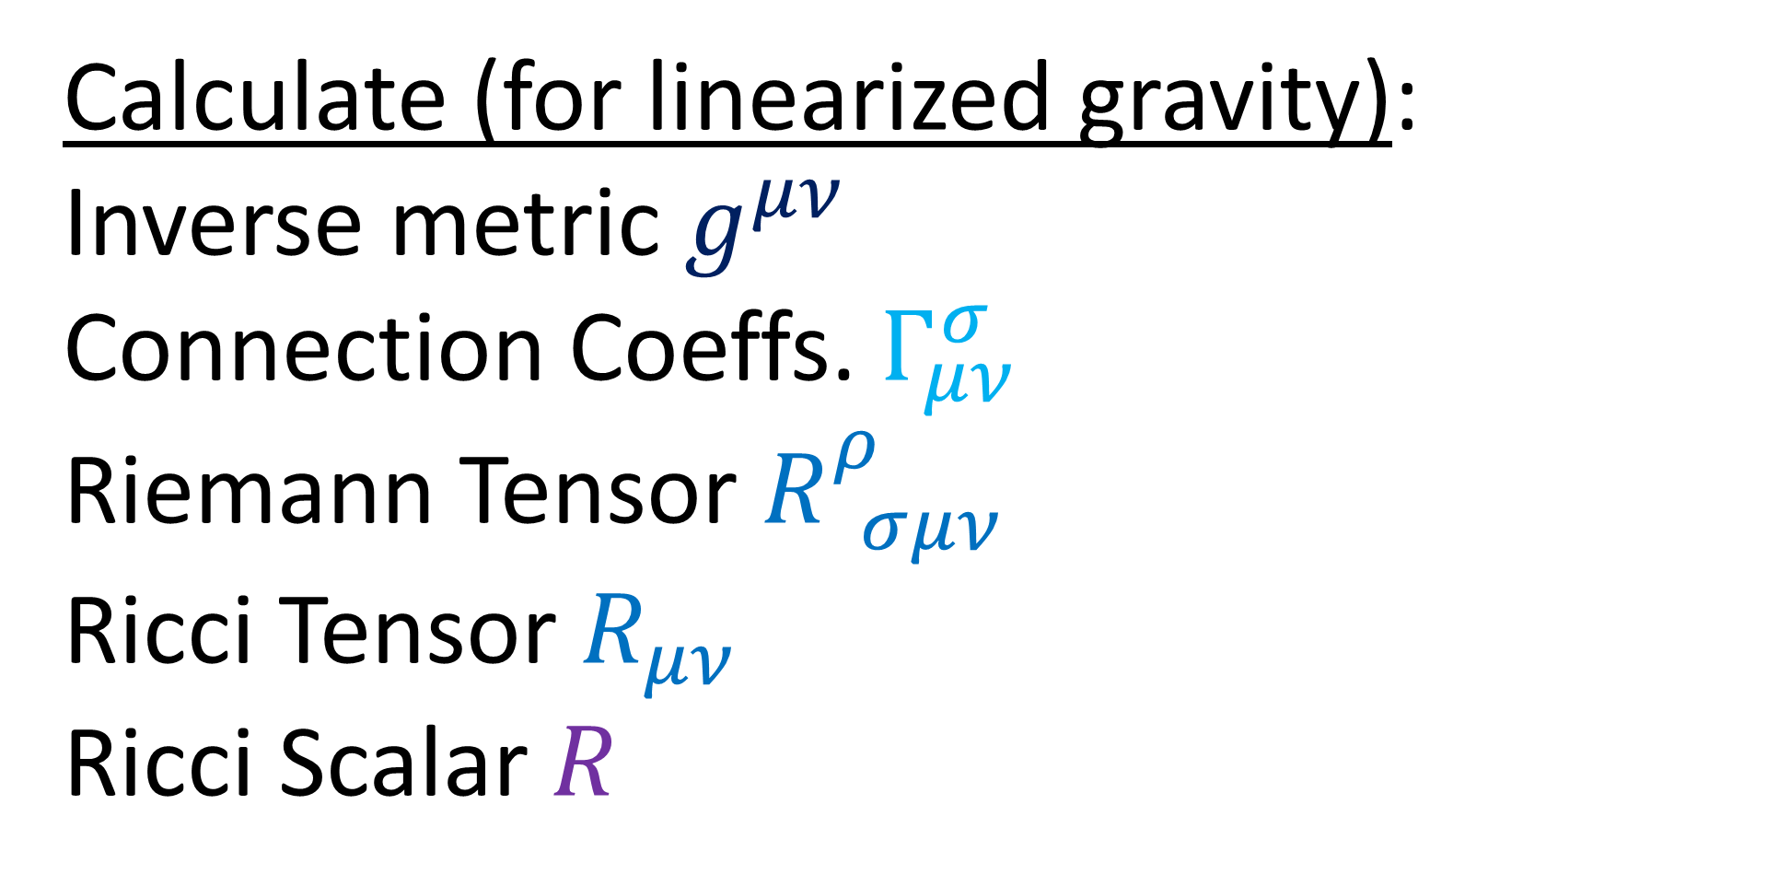
Goal: calculate $G_{μν}≡R_{μν}−\frac{1}{2}Rg_{μν}$
Calculate (for linearized gravity):
Inverse metric $g^{μν}$
Connection Coeffs. $Γ_{μν}^{σ}$
Riemann Tensor $R_{ σμν}^{ρ}$
Ricci Tensor $R_{μν}$
Ricci Scalar $R$

Slide 6
What is “Linearized Gravity”?
(aka “Weak Gravity”)

Slide 7
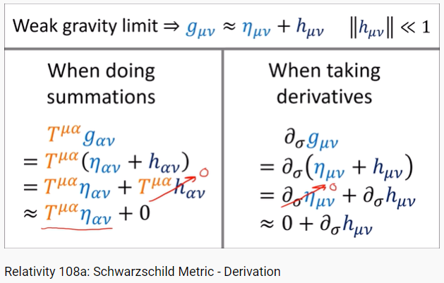
a bit sloppy

Slide 8

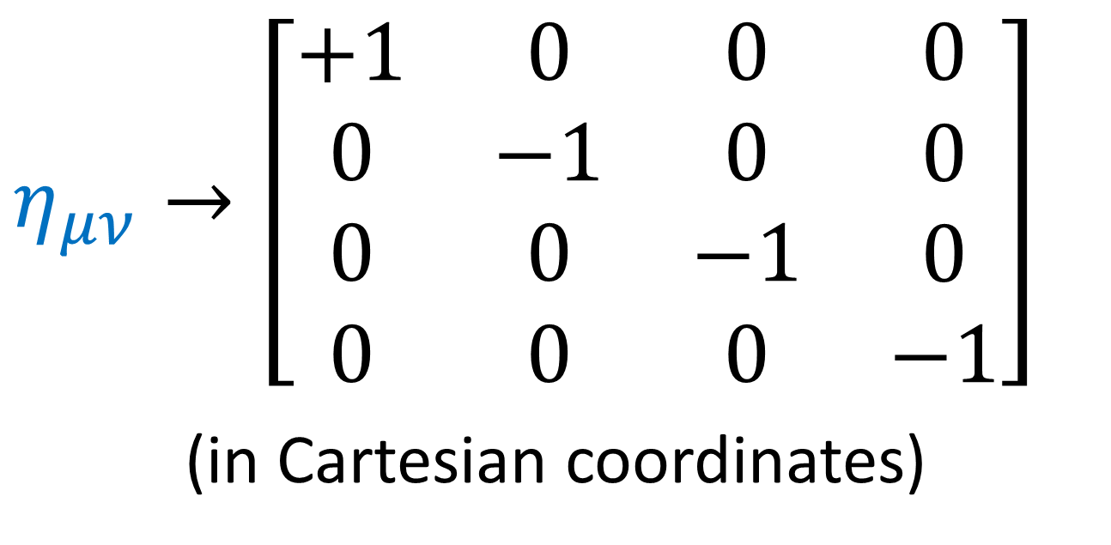
Linearized Gravity
$$g_{μν}=η_{μν}+h_{μν}$$
$$η_{μν}→\left[\begin{matrix}\begin{matrix}\begin{aligned}+1 \\ 0 \\ 0 \\ 0\end{aligned} & \begin{aligned}0 \\ −1 \\ 0 \\ 0\end{aligned}\end{matrix} & \begin{matrix}\begin{aligned}0 \\ 0 \\ −1 \\ 0\end{aligned} & \begin{aligned}0 \\ 0 \\ 0 \\ −1\end{aligned}\end{matrix}\end{matrix}\right]$$
(in Cartesian coordinates)

Slide 9
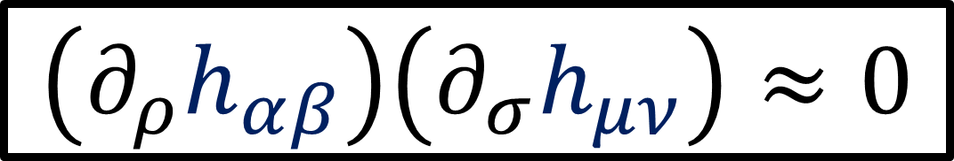
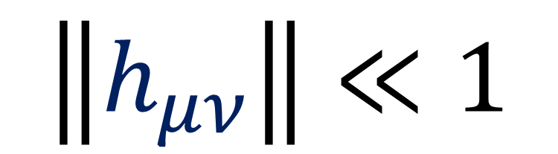

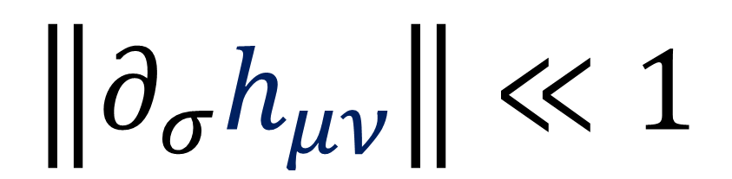

Linearized Gravity
$$\left\|h_{μν}\right\|≪1$$
$$g_{μν}=η_{μν}+h_{μν}$$
$$h_{αβ}h_{μν}≈0$$
Another assumption: (often left out of books)
$$\left\|∂_{σ}h_{μν}\right\|≪1$$
$$\left(∂_{ρ}h_{αβ}\right)\left(∂_{σ}h_{μν}\right)≈0$$
$$h_{αβ}\left(∂_{σ}h_{μν}\right)≈0$$

Slide 10
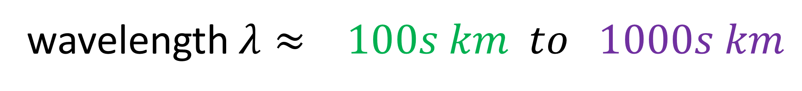

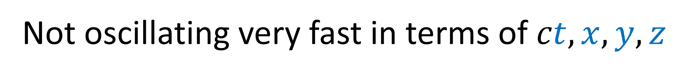

Gravitational waves detected by LIGO:
wavelength $λ≈ 100s km to 1000s km$
period $T= \frac{λ}{c}≈ \sim 0.001sec to \sim 0.01 sec$
Not oscillating very fast in terms of $ct,x,y,z$
$⇒$ reasonable to assume $∂_{σ}h_{μν}$ is small

Slide 11
Goal: calculate $G_{μν}≡R_{μν}−\frac{1}{2}Rg_{μν}$
Calculate (for linearized gravity):
Inverse metric $g^{μν}$
Connection Coeffs. $Γ_{μν}^{σ}$
Riemann Tensor $R_{ σμν}^{ρ}$
Ricci Tensor $R_{μν}$
Ricci Scalar $R$

Slide 12

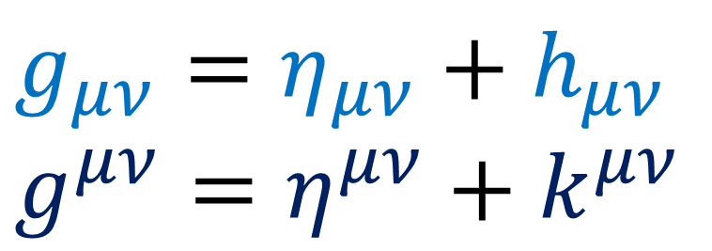
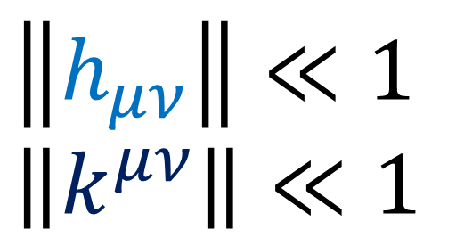
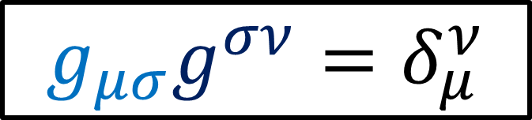
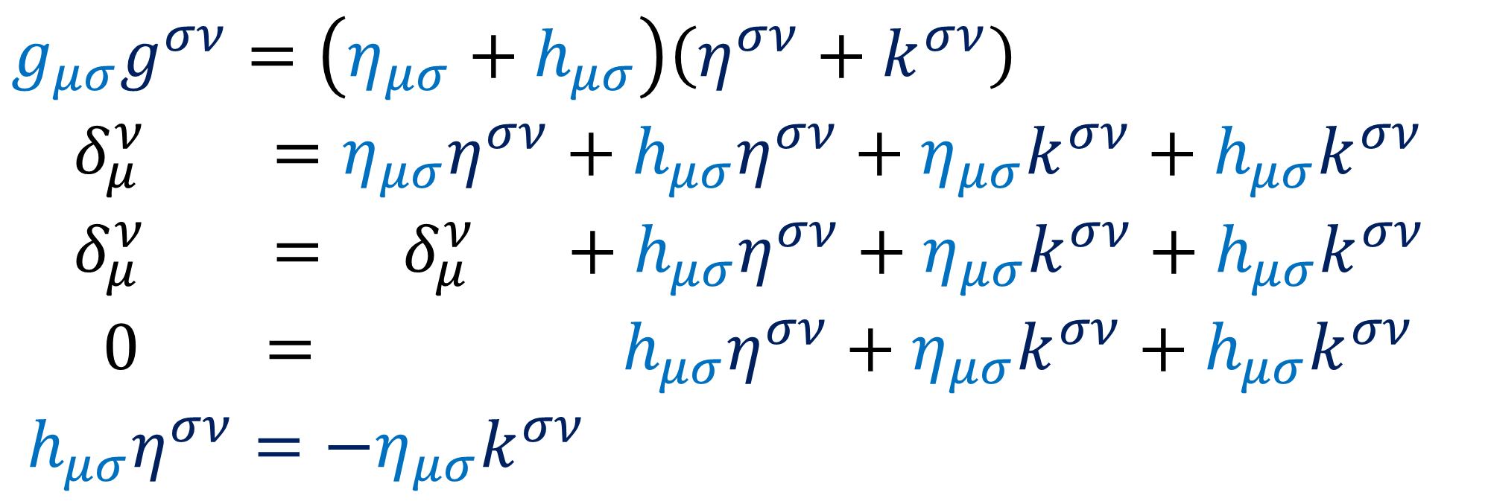

Introduction to General Relativity – Lewis Ryder
$g_{μν}=η_{μν}+h_{μν}$
$g^{μν}=η^{μν}+k^{μν}$
$$\left\|h_{μν}\right\|≪1$$
$\left\|k^{μν}\right\|≪1$
$$g_{μσ}g^{σν}=δ_{μ}^{ν}$$
$g_{μσ}g^{σν}=\left(η_{μσ}+h_{μσ}\right)\left(η^{σν}+k^{σν}\right)$
$δ_{μ}^{ν} =η_{μσ}η^{σν}+h_{μσ}η^{σν}+η_{μσ}k^{σν}+h_{μσ}k^{σν}$
$δ_{μ}^{ν} = δ_{μ}^{ν} +h_{μσ}η^{σν}+η_{μσ}k^{σν}+h_{μσ}k^{σν}$
$0 = h_{μσ}η^{σν}+η_{μσ}k^{σν}+h_{μσ}k^{σν}$
$h_{μσ}η^{σν}=−η_{μσ}k^{σν}$

Slide 13
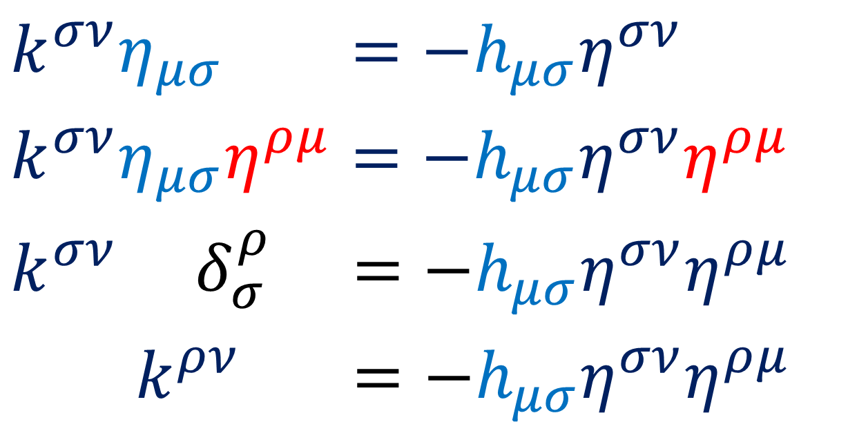
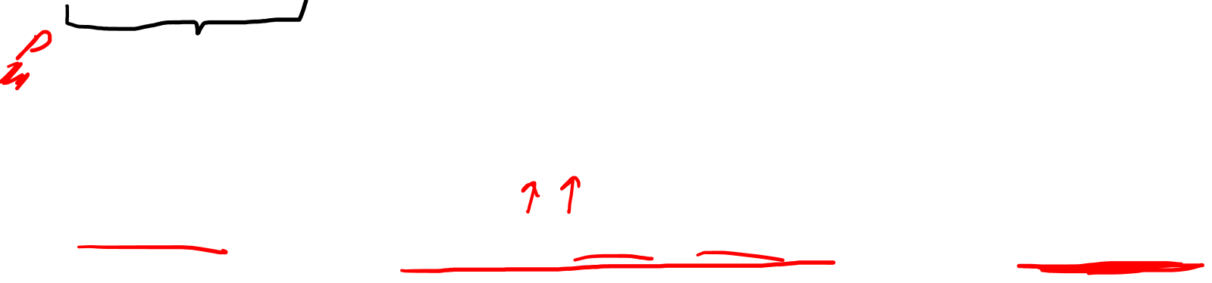
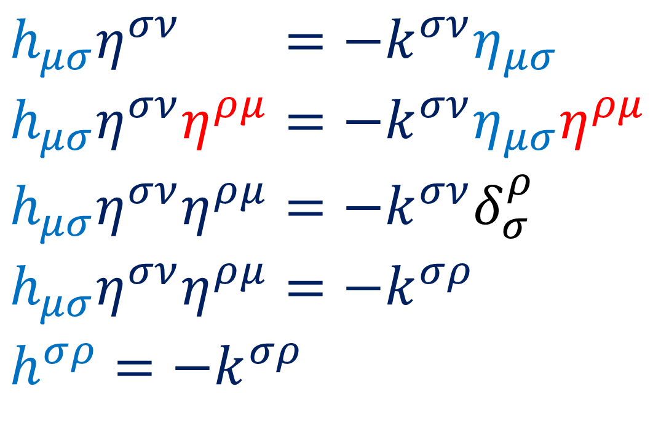
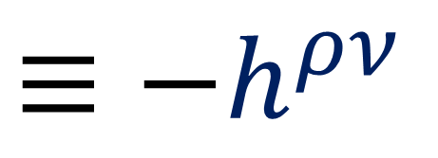
Introduction to General Relativity – Lewis Ryder
$g_{μν}=η_{μν}+h_{μν}$
$g^{μν}=η^{μν}+k^{μν}$
$\left\|h_{μν}\right\|≪1$ $\left\|k^{μν}\right\|≪1$
$$g_{μσ}g^{σν}=δ_{μ}^{ν}$$
$h_{μσ}η^{σν}η^{ρμ}=−k^{σν}η_{μσ}η^{ρμ}$
$h_{μσ}η^{σν}η^{ρμ}=−k^{σν}η_{μσ}η^{ρμ}$
$h_{μσ}η^{σν}η^{ρμ}=−k^{σν}δ_{σ}^{ρ}$
$h_{μσ}η^{σν}η^{ρμ}=−k^{σρ}$
$h^{σρ}=−k^{σρ}$
$k^{σν}η_{μσ}η^{ρμ}=−h_{μσ}η^{σν}η^{ρμ}$
$k^{σν}η_{μσ}η^{ρμ}=−h_{μσ}η^{σν}η^{ρμ}$
$k^{σν} δ_{σ}^{ρ} =−h_{μσ}η^{σν}η^{ρμ}$
$k^{ρν} =−h_{μσ}η^{σν}η^{ρμ}$
$≡−h^{ρν}$

Slide 14
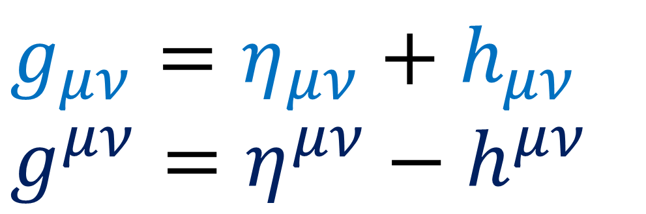
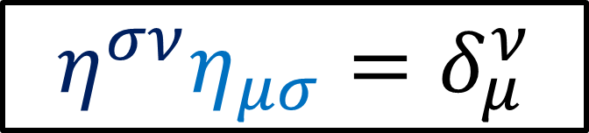


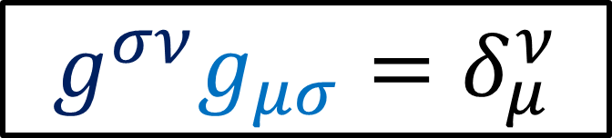
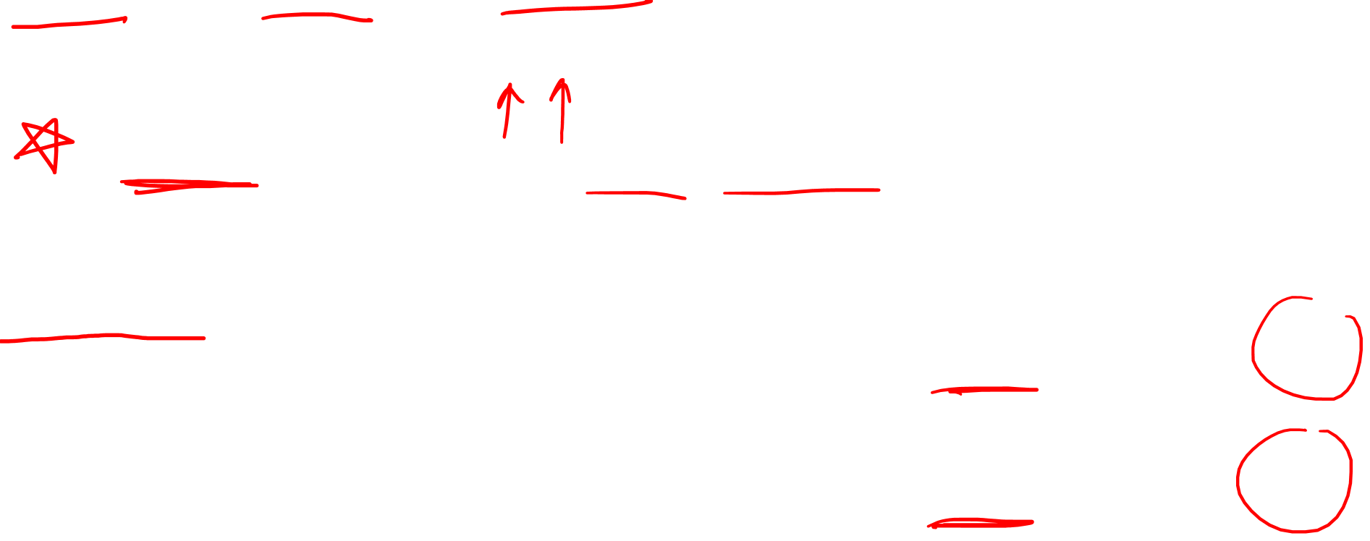
Introduction to General Relativity – Lewis Ryder
$g_{μν}=η_{μν}+h_{μν}$
$g^{μν}=η^{μν}−h^{μν}$
$$\left\|h_{μν}\right\|≪1$$
$\left\|h^{μν}\right\|≪1$
$h^{μν}=h_{ρσ}η^{ρμ}η^{σν}$
raised indices
(not inverse!)
$$g^{σν}g_{μσ}=δ_{μ}^{ν}$$
inverses
$$η^{σν}η_{μσ}=δ_{μ}^{ν}$$

Slide 15
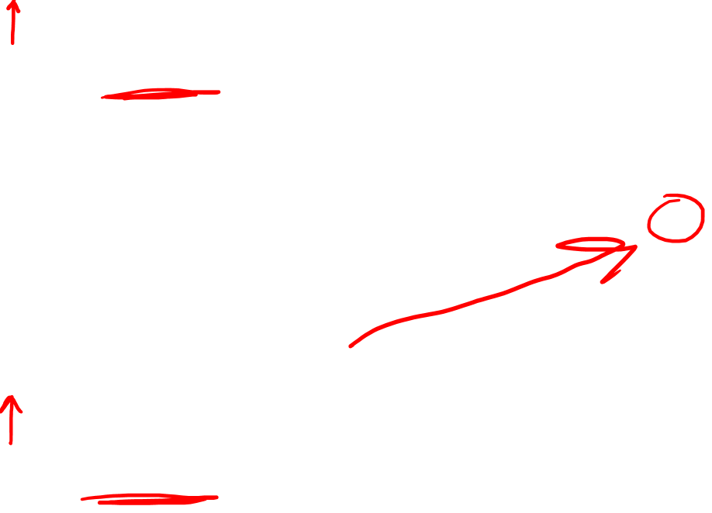
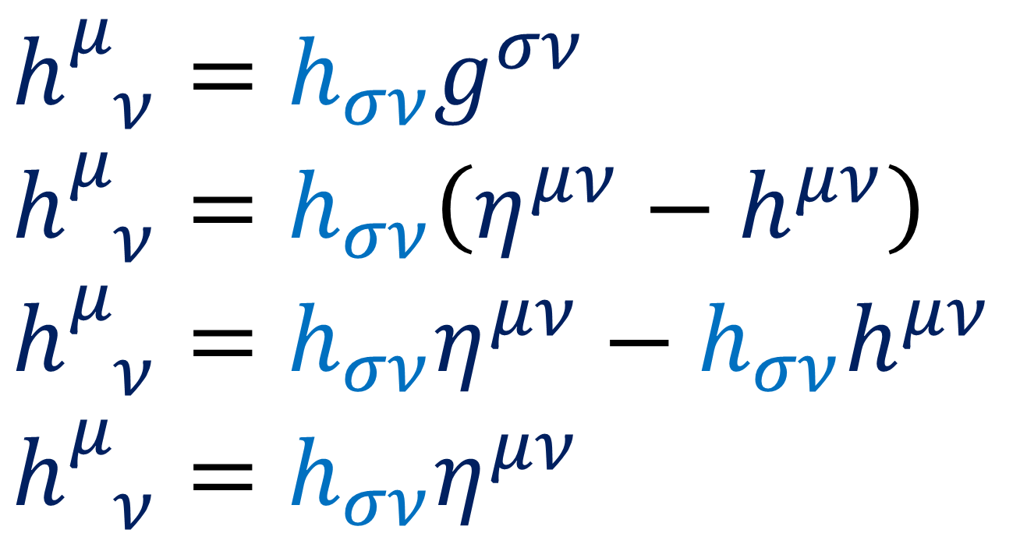
Introduction to General Relativity – Lewis Ryder
$g_{μν}=η_{μν}+h_{μν}$
$g^{μν}=η^{μν}−h^{μν}$
$$\left\|h_{μν}\right\|≪1$$
$\left\|h^{μν}\right\|≪1$
$h_{ ν}^{μ}=h_{σν}g^{σν}$
$h_{ ν}^{μ}=h_{σν}\left(η^{μν}−h^{μν}\right)$
$$h_{ ν}^{μ}=h_{σν}η^{μν}−h_{σν}h^{μν}$$
$$h_{ ν}^{μ}=h_{σν}η^{μν}$$

Slide 16
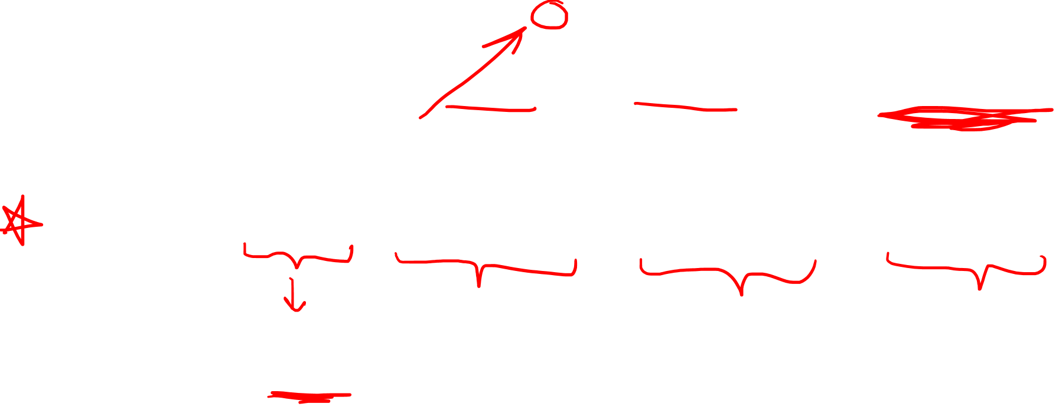
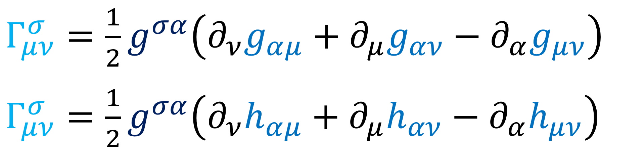

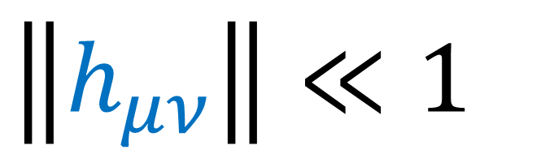

$g_{μν}=η_{μν}+h_{μν}$
$\left\|h_{μν}\right\|≪1$
$∂_{ρ}g_{μν}=∂_{ρ}\left(η_{μν}+h_{μν}\right)=∂_{ρ}h_{μν}$
$Γ_{μν}^{σ}=\frac{1}{2}g^{σα}\left(∂_{ν}g_{αμ}+∂_{μ}g_{αν}−∂_{α}g_{μν}\right)$
$Γ_{μν}^{σ}=\frac{1}{2}g^{σα}\left(∂_{ν}h_{αμ}+∂_{μ}h_{αν}−∂_{α}h_{μν}\right)$

Slide 17
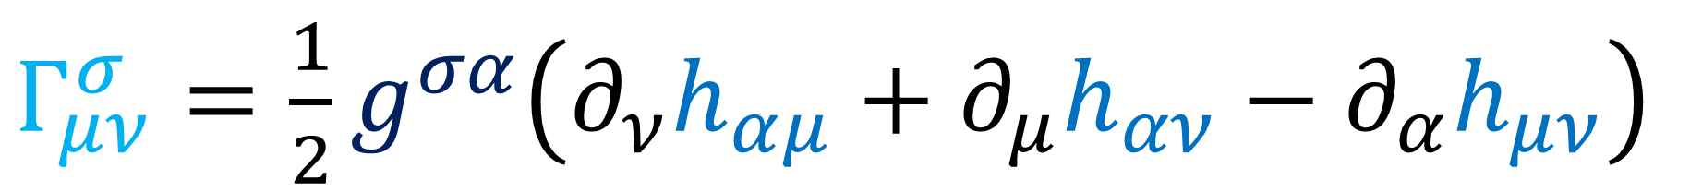
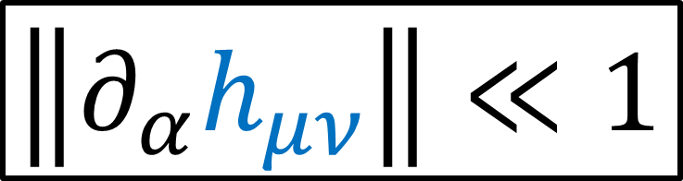
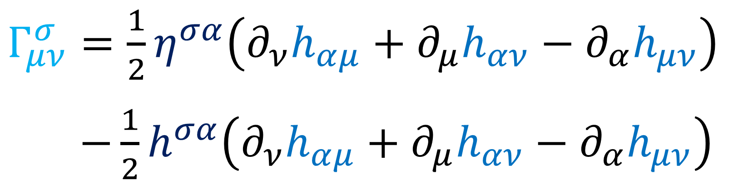

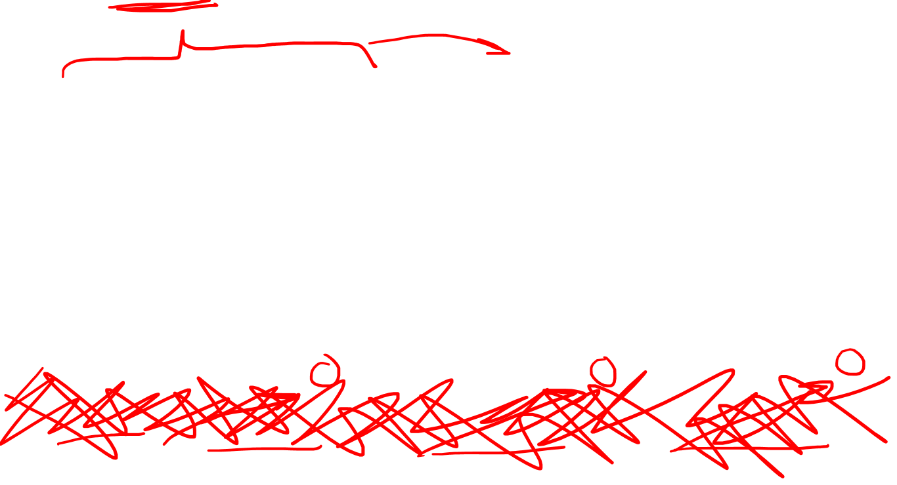
$Γ_{μν}^{σ}=\frac{1}{2}g^{σα}\left(∂_{ν}h_{αμ}+∂_{μ}h_{αν}−∂_{α}h_{μν}\right)$
$Γ_{μν}^{σ}=\frac{1}{2}\left(η^{σα}−h^{σα}\right)\left(∂_{ν}h_{αμ}+∂_{μ}h_{αν}−∂_{α}h_{μν}\right)$
$Γ_{μν}^{σ}=\frac{1}{2}η^{σα}\left(∂_{ν}h_{αμ}+∂_{μ}h_{αν}−∂_{α}h_{μν}\right)$
$−\frac{1}{2}h^{σα}\left(∂_{ν}h_{αμ}+∂_{μ}h_{αν}−∂_{α}h_{μν}\right)$
Linearized Gravity:
$\left\|∂_{α}h_{μν}\right\|≪1$
$\left\|h^{σα}\right\|≪1$

Slide 18
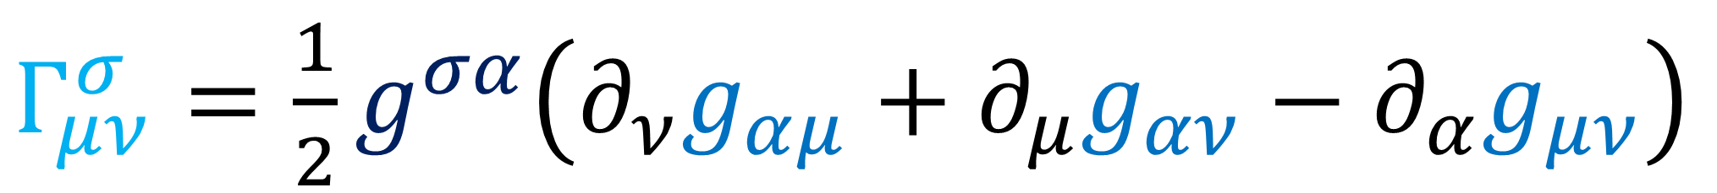
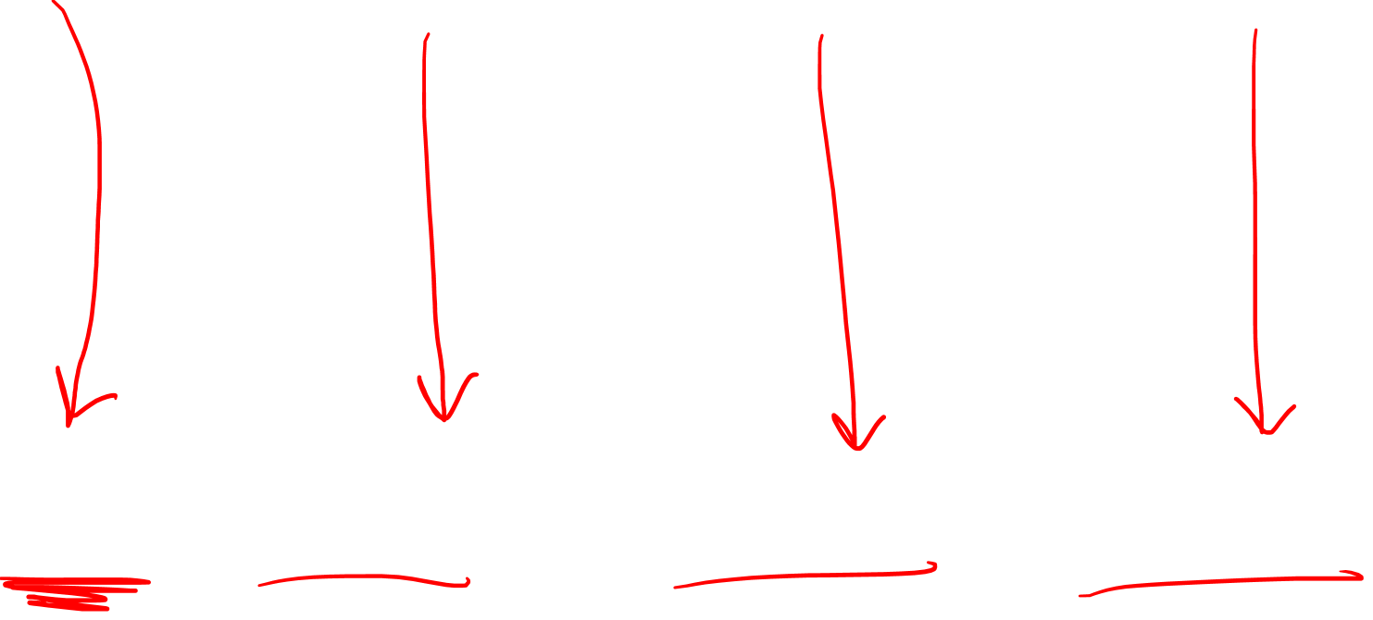
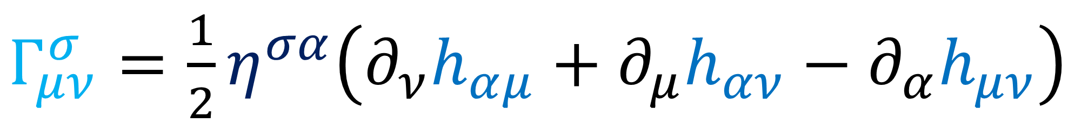
$Γ_{μν}^{σ}=\frac{1}{2}g^{σα}\left(∂_{ν}g_{αμ}+∂_{μ}g_{αν}−∂_{α}g_{μν}\right)$
Linearized Gravity:
$Γ_{μν}^{σ}=\frac{1}{2}η^{σα}\left(∂_{ν}h_{αμ}+∂_{μ}h_{αν}−∂_{α}h_{μν}\right)$

Slide 19
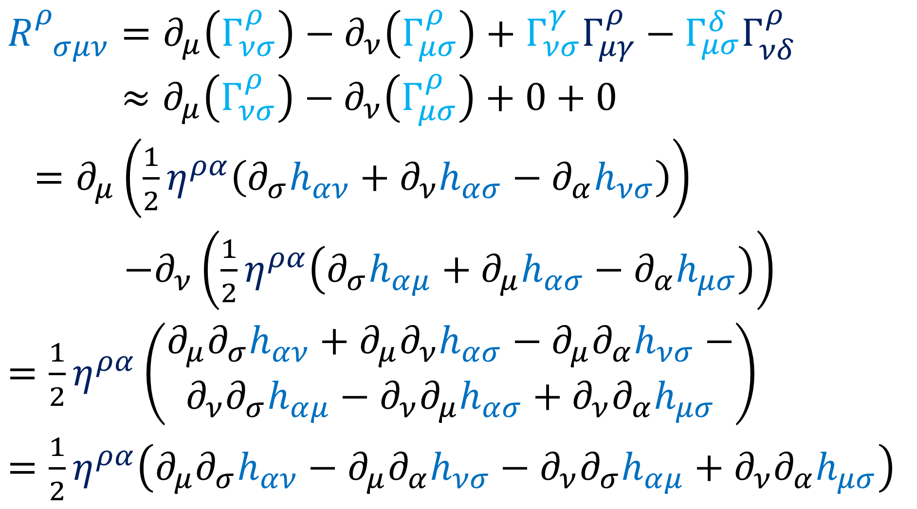

$$R_{ σμν}^{ρ}=∂_{μ}\left(Γ_{νσ}^{ρ}\right)−∂_{ν}\left(Γ_{μσ}^{ρ}\right)+Γ_{νσ}^{γ}Γ_{μγ}^{ρ}−Γ_{μσ}^{δ}Γ_{νδ}^{ρ}$$
$$R_{ σμν}^{ρ}≈∂_{μ}\left(Γ_{νσ}^{ρ}\right)−∂_{ν}\left(Γ_{μσ}^{ρ}\right)+0+0$$
$=∂_{μ}\left(\frac{1}{2}η^{ρα}\left(∂_{σ}h_{αν}+∂_{ν}h_{ασ}−∂_{α}h_{νσ}\right)\right)$
$−∂_{ν}\left(\frac{1}{2}η^{ρα}\left(∂_{σ}h_{αμ}+∂_{μ}h_{ασ}−∂_{α}h_{μσ}\right)\right)$
$=\frac{1}{2}η^{ρα}\left(\begin{aligned}∂_{μ}∂_{σ}h_{αν}+∂_{μ}∂_{ν}h_{ασ}−∂_{μ}∂_{α}h_{νσ}− \\ ∂_{ν}∂_{σ}h_{αμ}−∂_{ν}∂_{μ}h_{ασ}+∂_{ν}∂_{α}h_{μσ}\end{aligned}\right)$
$=\frac{1}{2}η^{ρα}\left(∂_{μ}∂_{σ}h_{αν}−∂_{μ}∂_{α}h_{νσ}−∂_{ν}∂_{σ}h_{αμ}+∂_{ν}∂_{α}h_{μσ}\right)$
Is this Lorentz-Invariant?

Slide 20
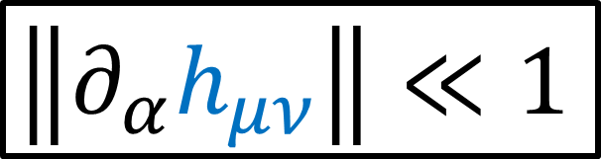
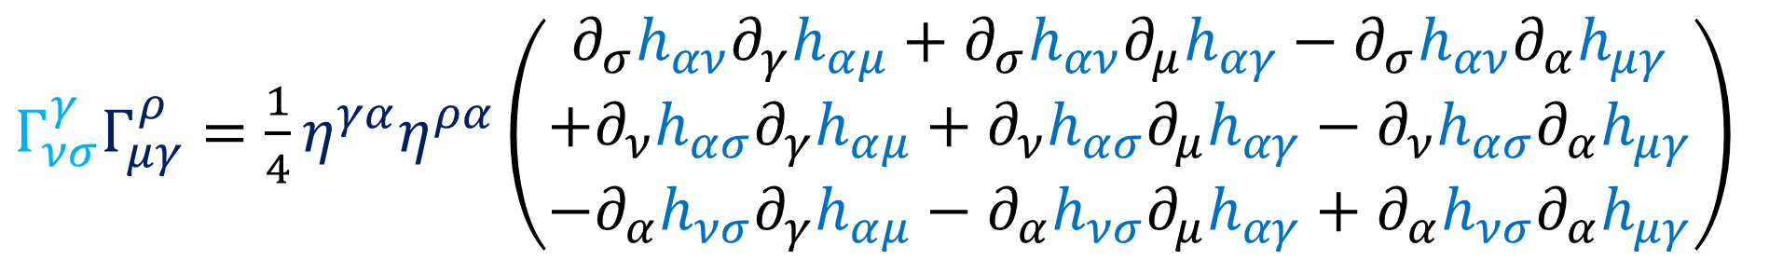
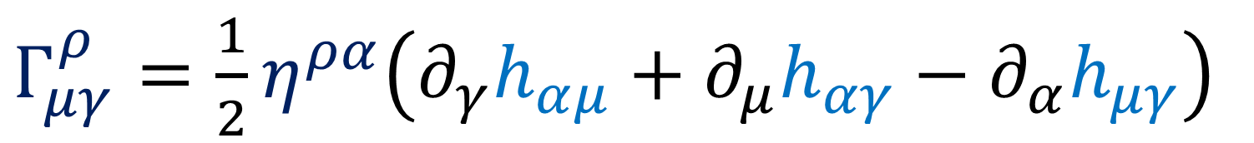
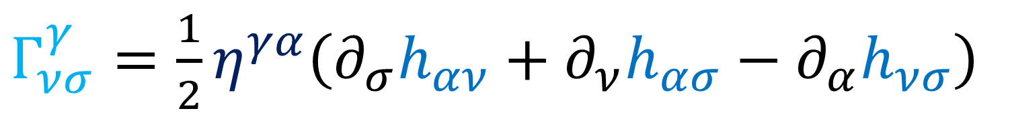
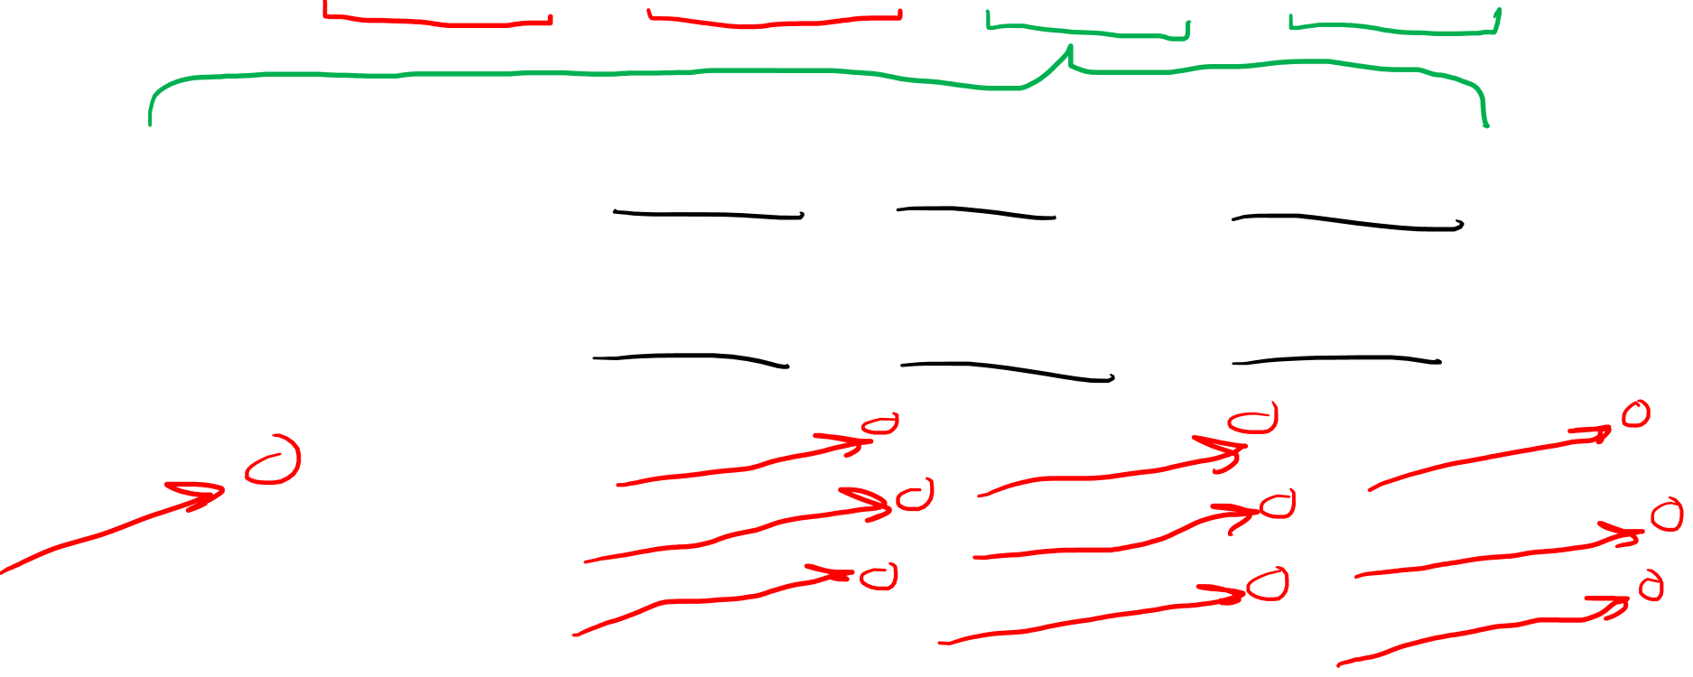
$$R_{ σμν}^{ρ}=∂_{μ}\left(Γ_{νσ}^{ρ}\right)−∂_{ν}\left(Γ_{μσ}^{ρ}\right)+Γ_{νσ}^{γ}Γ_{μγ}^{ρ}−Γ_{μσ}^{δ}Γ_{νδ}^{ρ}$$
$Γ_{νσ}^{γ}=\frac{1}{2}η^{γα}\left(∂_{σ}h_{αν}+∂_{ν}h_{ασ}−∂_{α}h_{νσ}\right)$
$Γ_{μγ}^{ρ}=\frac{1}{2}η^{ρα}\left(∂_{γ}h_{αμ}+∂_{μ}h_{αγ}−∂_{α}h_{μγ}\right)$
$Γ_{νσ}^{γ}Γ_{μγ}^{ρ}=\frac{1}{4}η^{γα}η^{ρα}\left(\begin{aligned}∂_{σ}h_{αν}∂_{γ}h_{αμ}+∂_{σ}h_{αν}∂_{μ}h_{αγ}−∂_{σ}h_{αν}∂_{α}h_{μγ} \\ \begin{aligned}+∂_{ν}h_{ασ}∂_{γ}h_{αμ}+∂_{ν}h_{ασ}∂_{μ}h_{αγ}−∂_{ν}h_{ασ}∂_{α}h_{μγ} \\ −∂_{α}h_{νσ}∂_{γ}h_{αμ}−∂_{α}h_{νσ}∂_{μ}h_{αγ}+∂_{α}h_{νσ}∂_{α}h_{μγ}\end{aligned}\end{aligned}\right)$
Linearized Gravity:
$\left\|∂_{α}h_{μν}\right\|≪1$
Is this Lorentz-Invariant?

Slide 21

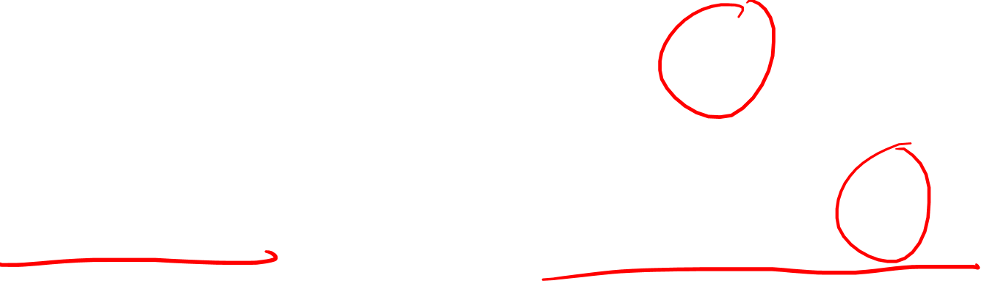
Ricci Tensor
$$R_{σν}=R_{ σμν}^{μ}$$

Slide 22
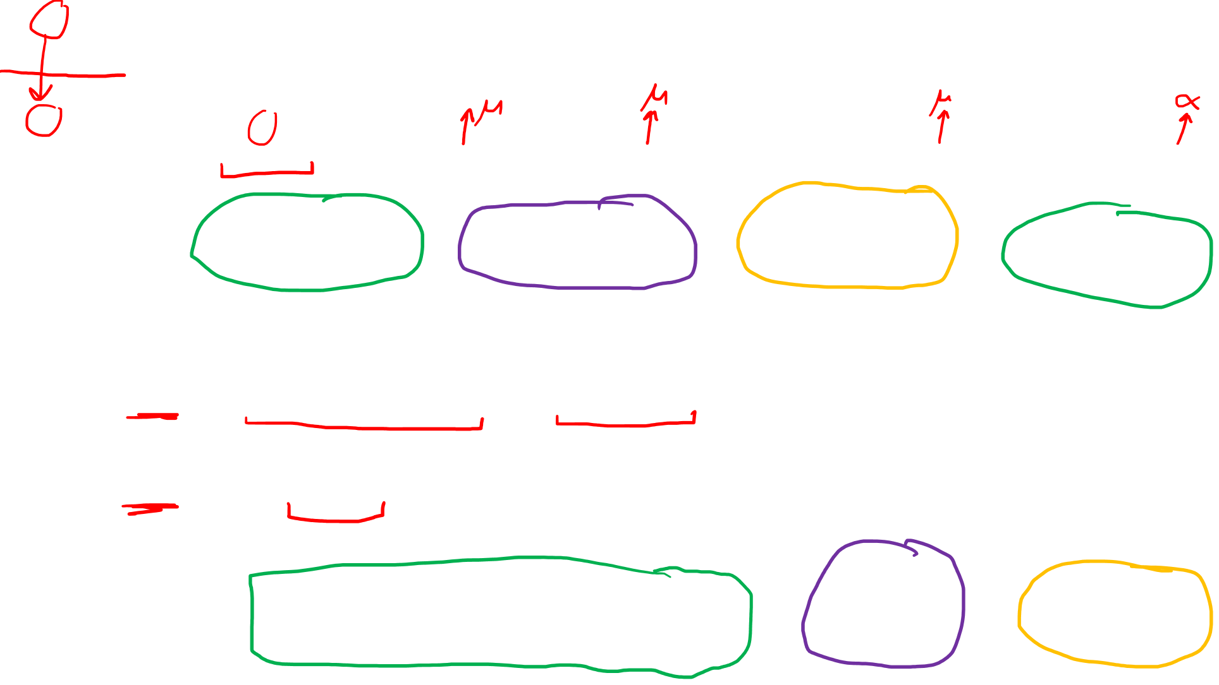
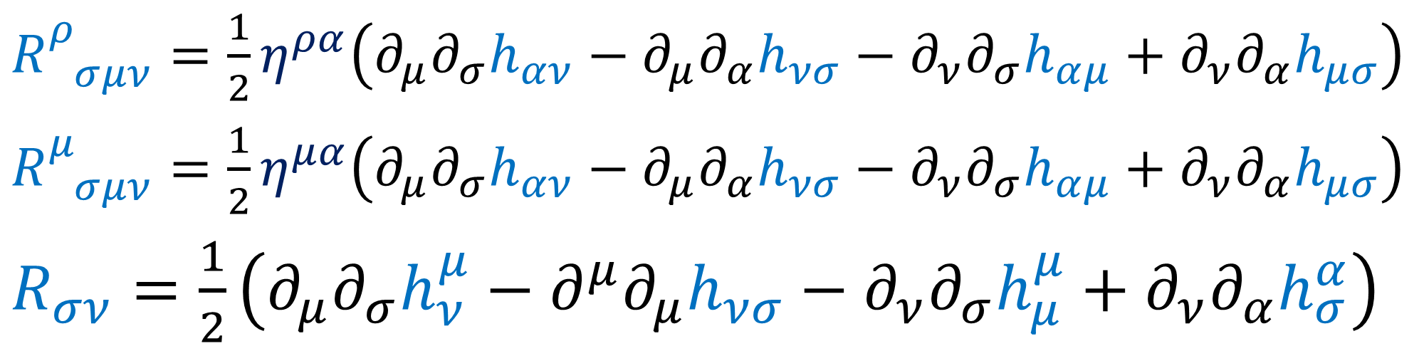
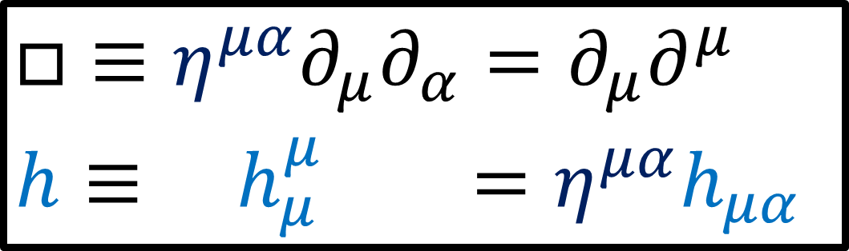
$R_{ σμν}^{ρ}=\frac{1}{2}η^{ρα}\left(∂_{μ}∂_{σ}h_{αν}−∂_{μ}∂_{α}h_{νσ}−∂_{ν}∂_{σ}h_{αμ}+∂_{ν}∂_{α}h_{μσ}\right)$
$R_{ σμν}^{μ}=\frac{1}{2}η^{μα}\left(∂_{μ}∂_{σ}h_{αν}−∂_{μ}∂_{α}h_{νσ}−∂_{ν}∂_{σ}h_{αμ}+∂_{ν}∂_{α}h_{μσ}\right)$
$R_{σν}=\frac{1}{2}\left(∂_{μ}∂_{σ}h_{ν}^{μ}−∂^{μ}∂_{μ}h_{νσ}−∂_{ν}∂_{σ}h_{μ}^{μ}+∂_{ν}∂_{α}h_{σ}^{α}\right)$
$□≡η^{μα}∂_{μ}∂_{α}=∂_{μ}∂^{μ}$
$h≡ h_{μ}^{μ} =η^{μα}h_{μα}$
$R_{σν}=\frac{1}{2}\left(∂_{μ}∂_{σ}h_{ν}^{μ}+∂_{ν}∂_{α}h_{σ}^{α}−□h_{νσ}−∂_{ν}∂_{σ}h\right)$
This matches with: https://en.wikipedia.org/wiki/Linearized_gravity

Slide 23


$R_{σν}=\frac{1}{2}\left(∂_{μ}∂_{σ}h_{ν}^{μ}+∂_{ν}∂_{α}h_{σ}^{α}−□h_{νσ}−∂_{ν}∂_{σ}h\right)$
$$R=R_{ ν}^{ν}=η^{σν}R_{σν}$$
$=η^{σν}\frac{1}{2}\left(∂_{μ}∂_{σ}h_{ν}^{μ}+∂_{ν}∂_{α}h_{σ}^{α}−□h_{νσ}−∂_{ν}∂_{σ}h\right)$
$=\frac{1}{2}\left(∂_{μ}∂_{σ}h^{μσ}+∂_{ν}∂_{α}h^{αν}−□h_{σ}^{σ}−∂^{σ}∂_{σ}h\right)$
$=\frac{1}{2}\left(∂_{μ}∂_{σ}h^{μσ}+∂_{μ}∂_{σ}h^{μσ}−□h−□h\right)$
$$=∂_{μ}∂_{σ}h^{μσ}−□h$$

Slide 24




$G_{μν}≡R_{μν}−\frac{1}{2}g_{μν}R$
$=\frac{1}{2}\left(∂_{α}∂_{μ}h_{ν}^{α}+∂_{ν}∂_{α}h_{μ}^{α}−□h_{μν}−∂_{μ}∂_{ν}h\right)$
$−\frac{1}{2}g_{μν}\left(∂_{α}∂_{β}h^{αβ}−□h\right)$
$−\frac{1}{2}\left(η_{μν}+h_{μν}\right)\left(∂_{α}∂_{β}h^{αβ}−□h\right)$
$=−\frac{1}{2}η_{μν}\left(∂_{α}∂_{β}h^{αβ}−□h\right)$
$−\frac{1}{2}h_{μν}\left(∂_{α}∂_{β}h^{αβ}−□h\right)$
Linearized Gravity:
$\left\|h^{αβ}\right\|≪1$
$\left\|∂_{α}h_{μν}\right\|≪1$

Slide 25



$G_{μν}≡R_{μν}−\frac{1}{2}g_{μν}R$
$=\frac{1}{2}\left(∂_{α}∂_{μ}h_{ν}^{α}+∂_{ν}∂_{α}h_{μ}^{α}−□h_{μν}−∂_{μ}∂_{ν}h\right)$
$−\frac{1}{2}η_{μν}\left(∂_{α}∂_{β}h^{αβ}−□h\right)$
$=\frac{1}{2}\left(∂_{α}∂_{μ}h_{ν}^{α}+∂_{ν}∂_{α}h_{μ}^{α}−□h_{μν}−∂_{μ}∂_{ν}h−η_{μν}∂_{α}∂_{β}h^{αβ}+η_{μν}□h\right)$
$=\frac{1}{2}\left(∂^{α}∂_{μ}h_{αν}+∂^{α}∂_{ν}h_{μα}−□h_{μν}−∂_{μ}∂_{ν}h−η_{μν}∂^{α}∂^{β}h_{αβ}+η_{μν}□h\right)$
$\overline{h_{μν}}≡h_{μν}−\frac{1}{2}η_{μν}h$
$⇒h_{μν}=\overline{h_{μν}}+\frac{1}{2}η_{μν}h$

Slide 26



$∂_{μ} h^{μν}$
$$=∂_{μ}η^{μα}h_{α}^{ ν}$$
$$= ∂^{α} h_{α}^{ ν}$$
Exchange summation indices
$∂_{μ} h^{μν}$
$$= ∂^{α}h_{α}^{ ν}$$

Slide 27





$⇒G_{μν}=\frac{1}{2}\left(∂^{α}∂_{μ}\overline{h_{αν}}+∂^{α}∂_{ν}\overline{h_{μα}}−∂^{α}∂_{α}\overline{h_{μν}}−η_{μν}∂^{α}∂^{β}\overline{h_{αβ}}\right)$
$⇒h_{μν}={\overline{h}}_{μν}+\frac{1}{2}η_{μν}h$
$G_{μν}≡R_{μν}−\frac{1}{2}g_{μν}R$
$=\frac{1}{2}\left(∂^{α}∂_{μ}h_{αν}+∂^{α}∂_{ν}h_{μα}−□h_{μν}−∂_{μ}∂_{ν}h−η_{μν}∂^{α}∂^{β}h_{αβ}+η_{μν}□h\right)$
$\frac{1}{2}\left[\begin{aligned}∂^{α}∂_{μ}\left({\overline{h}}_{αν}+\frac{1}{2}η_{αν}h\right) \\ +∂^{α}∂_{ν}\left({\overline{h}}_{μα}+\frac{1}{2}η_{μα}h\right) \\ −∂^{α}∂_{α}\left({\overline{h}}_{μν}+\frac{1}{2}η_{μν}h\right) \\ −η_{μν}∂^{α}∂^{β}\left({\overline{h}}_{αβ}+\frac{1}{2}η_{αβ}h\right) \\ −∂_{μ}∂_{ν}h+η_{μν}∂^{α}∂_{α}h\end{aligned}\right]$
$⇒∂^{α}∂_{μ}\frac{1}{2}η_{αν}h=∂_{ν}∂_{μ}\frac{1}{2}h$
$⇒∂^{α}∂_{ν}\frac{1}{2}η_{μα}h=∂_{μ}∂_{ν}\frac{1}{2}h$
$⇒−∂^{α}∂_{α}\frac{1}{2}η_{μν}h$
$⇒−η_{μν}∂^{α}∂^{β}\frac{1}{2}η_{αβ}h$ $=−∂^{α}∂_{α}\frac{1}{2}η_{μν}h$

Slide 28

$G_{μν}≡R_{μν}−\frac{1}{2}g_{μν}R$
$=\frac{1}{2}\left(∂_{α}∂_{μ}h_{ν}^{α}+∂_{ν}∂_{α}h_{μ}^{α}−□h_{μν}−∂_{μ}∂_{ν}h\right)$
$−\frac{1}{2}η_{μν}\left(∂_{α}∂_{β}h^{αβ}−□h\right)$
$=\frac{1}{2}\left(∂_{α}∂_{μ}h_{ν}^{α}+∂_{ν}∂_{α}h_{μ}^{α}−□h_{μν}−∂_{μ}∂_{ν}h−η_{μν}∂_{α}∂_{β}h^{αβ}+η_{μν}□h\right)$
$=\frac{1}{2}\left(∂^{α}∂_{μ}h_{αν}+∂^{α}∂_{ν}h_{μα}−□h_{μν}−∂_{μ}∂_{ν}h−η_{μν}∂^{α}∂^{β}h_{αβ}+η_{μν}□h\right)$
${\overline{h}}_{μν}≡h_{μν}−\frac{1}{2}η_{μν}h$
$⇒h_{μν}={\overline{h}}_{μν}+\frac{1}{2}η_{μν}h$

Slide 29
$⇒G_{μν}=\frac{1}{2}\left(∂^{α}∂_{μ}\overline{h_{αν}}+∂^{α}∂_{ν}\overline{h_{μα}}−∂^{α}∂_{α}\overline{h_{μν}}−η_{μν}∂^{α}∂^{β}\overline{h_{αβ}}\right)$
$⇒h_{μν}={\overline{h}}_{μν}+\frac{1}{2}η_{μν}h$
$G_{μν}≡R_{μν}−\frac{1}{2}g_{μν}R$
$=\frac{1}{2}\left(∂^{α}∂_{μ}h_{αν}+∂^{α}∂_{ν}h_{μα}−□h_{μν}−∂_{μ}∂_{ν}h−η_{μν}∂^{α}∂^{β}h_{αβ}+η_{μν}□h\right)$
$\frac{1}{2}\left[\begin{aligned}∂^{α}∂_{μ}\left({\overline{h}}_{αν}+\frac{1}{2}η_{αν}h\right) \\ +∂^{α}∂_{ν}\left({\overline{h}}_{μα}+\frac{1}{2}η_{μα}h\right) \\ −∂^{α}∂_{α}\left({\overline{h}}_{μν}+\frac{1}{2}η_{μν}h\right) \\ −η_{μν}∂^{α}∂^{β}\left({\overline{h}}_{αβ}+\frac{1}{2}η_{αβ}h\right) \\ −∂_{μ}∂_{ν}h+η_{μν}∂^{α}∂_{α}h\end{aligned}\right]$
$⇒∂^{α}∂_{μ}\frac{1}{2}η_{αν}h=∂_{ν}∂_{μ}\frac{1}{2}h$
$⇒∂^{α}∂_{ν}\frac{1}{2}η_{μα}h=∂_{μ}∂_{ν}\frac{1}{2}h$
$⇒−∂^{α}∂_{α}\frac{1}{2}η_{μν}h$
$⇒−η_{μν}∂^{α}∂^{β}\frac{1}{2}η_{αβ}h$ $=−∂^{α}∂_{α}\frac{1}{2}η_{μν}h$

Slide 30

$⇒h_{μν}={\overline{h}}_{μν}+\frac{1}{2}η_{μν}h$
$G_{μν}≡R_{μν}−\frac{1}{2}g_{μν}R$
$=\frac{1}{2}\left(∂^{α}∂_{μ}h_{αν}+∂^{α}∂_{ν}h_{μα}−□h_{μν}−∂_{μ}∂_{ν}h−η_{μν}∂^{α}∂^{β}h_{αβ}+η_{μν}□h\right)$
$$⇒G_{μν}=$$
$\frac{1}{2}\left(∂^{α}∂_{μ}{\overline{h}}_{αν}+∂^{α}∂_{ν}{\overline{h}}_{μα}−∂^{α}∂_{α}{\overline{h}}_{μν}−η_{μν}∂^{α}∂^{β}{\overline{h}}_{αβ}\right)$

Slide 31




$g_{μν}=η_{μν}+h_{μν}$
$g^{μν}=η^{μν}−h^{μν}$
$Γ_{μν}^{σ}=\frac{1}{2}η^{σα}\left(∂_{ν}h_{αμ}+∂_{μ}h_{αν}−∂_{α}h_{μν}\right)$
$R_{ σμν}^{ρ}=\frac{1}{2}η^{ρα}\left(∂_{μ}∂_{σ}h_{αν}−∂_{μ}∂_{α}h_{νσ}−∂_{ν}∂_{σ}h_{αμ}+∂_{ν}∂_{α}h_{μσ}\right)$
$R_{σν}=\frac{1}{2}\left(∂_{μ}∂_{σ}h_{ν}^{μ}+∂_{ν}∂_{α}h_{σ}^{α}−□h_{νσ}−∂_{ν}∂_{σ}h\right)$
$$R=∂_{μ}∂_{σ}h^{μσ}−□h$$
$G_{μν}=\frac{1}{2}\left(∂^{α}∂_{μ}{\overline{h}}_{αν}+∂^{α}∂_{ν}{\overline{h}}_{μα}−∂^{α}∂_{α}{\overline{h}}_{μν}−η_{μν}∂^{α}∂^{β}{\overline{h}}_{αβ}\right)$
$h^{μν}=h_{ρσ}η^{ρμ}η^{σν}$
$h_{μν}≡{\overline{h}}_{μν}+\frac{1}{2}η_{μν}h$

Slide 32



$G_{μν}≡R_{μν}−\frac{1}{2}g_{μν}R=\frac{8πG}{c^{4}}T_{μν}$
Linearized Gravity
$g_{μν}=η_{μν}+h_{μν}$ $\left\|h_{μν}\right\|≪1$
${\overline{h}}_{μν}≡h_{μν}−\frac{1}{2}η_{μν}h$
$\frac{1}{2}\left(∂^{α}∂_{μ}{\overline{h}}_{αν}+∂^{α}∂_{ν}{\overline{h}}_{μα}−∂^{α}∂_{α}{\overline{h}}_{μν}−η_{μν}∂^{α}∂^{β}{\overline{h}}_{αβ}\right)=\frac{8πG}{c^{4}}T_{μν}$

Slide 33

Next Video: “Lorenz Gauge” Coordinate System
Existence of gravitational waves becomes obvious:
$$∂_{β}{\overline{h}}^{αβ}=0 ⇒ □{\overline{h}}_{μν}=0$$

