Slide 1
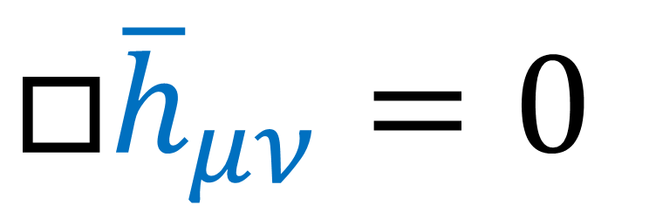
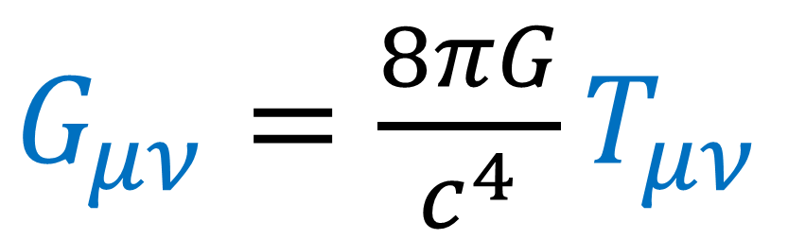
The Lorenz Gauge
$G_{μν}=\frac{8πG}{c^{4}}T_{μν}$
$$□{\overline{h}}_{μν}=0$$
Gravitational Waves
Einstein Field Equations

Slide 2
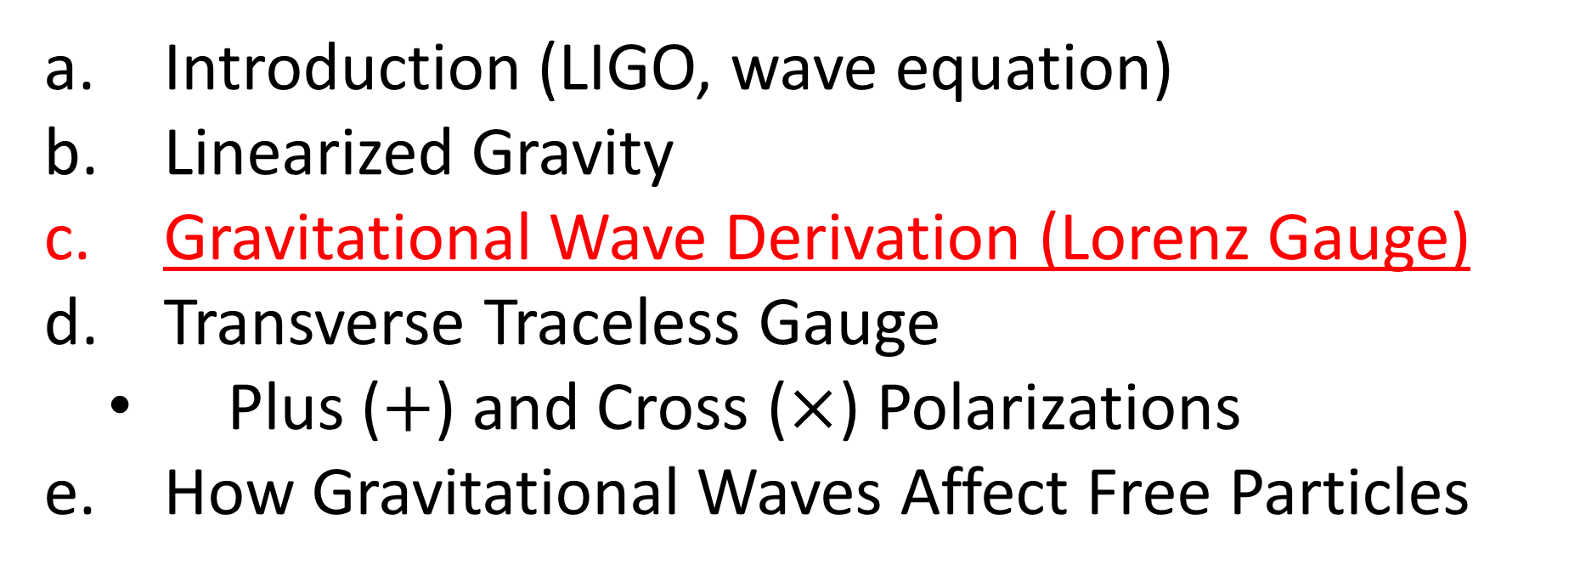

Relativity 109: Gravitational Waves
Introduction (LIGO, wave equation)
Linearized Gravity
Gravitational Wave Derivation (Lorenz Gauge)
Transverse Traceless Gauge
Plus ($+$) and Cross ($×$) Polarizations
How Gravitational Waves Affect Free Particles
Sources:
Good PDF: http://star-www.st-and.ac.uk/~hz4/gr/hendry_GRwaves.pdf
Sean Caroll: https://preposterousuniverse.com/wp-content/uploads/grnotes-six.pdf
Wikipedia: https://en.wikipedia.org/wiki/Linearized_gravity
YouTube: https://www.youtube.com/watch?v=kIBdtbCszB0
Other PDF: https://www.tat.physik.uni-tuebingen.de/~kokkotas/Teaching/NS.BH.GW_files/GW_Physics.pdf
THANK-YOU!!! https://pages.pomona.edu/~tmoore/LesHouches/les-houches-4.pdf
https://pages.pomona.edu/~tmoore/LesHouches/les-houches-5.pdf

Slide 3
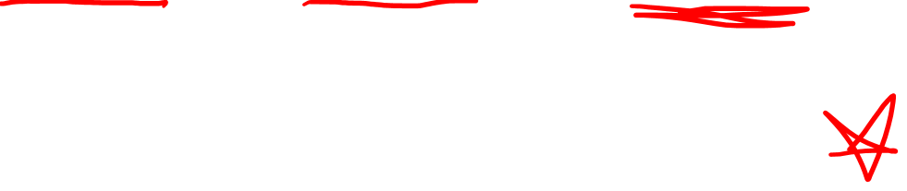
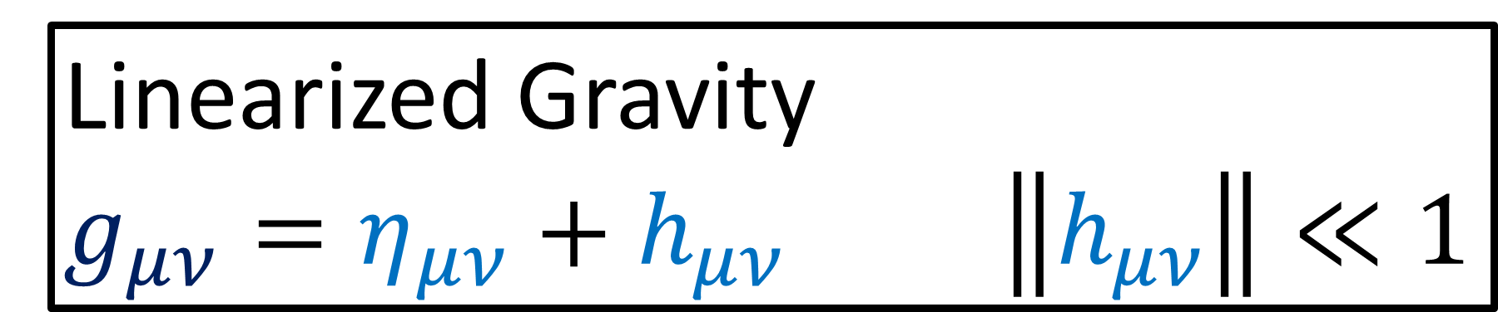
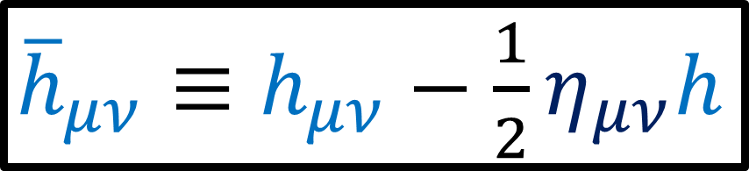

$G_{μν}≡R_{μν}−\frac{1}{2}g_{μν}R=\frac{8πG}{c^{4}}T_{μν}$
Linearized Gravity
$g_{μν}=η_{μν}+h_{μν}$ $\left\|h_{μν}\right\|≪1$
${\overline{h}}_{μν}≡h_{μν}−\frac{1}{2}η_{μν}h$
$\frac{1}{2}\left(∂^{α}∂_{μ}{\overline{h}}_{αν}+∂^{α}∂_{ν}{\overline{h}}_{μα}−∂^{α}∂_{α}{\overline{h}}_{μν}−η_{μν}∂^{α}∂^{β}{\overline{h}}_{αβ}\right)=\frac{8πG}{c^{4}}T_{μν}$

Slide 4
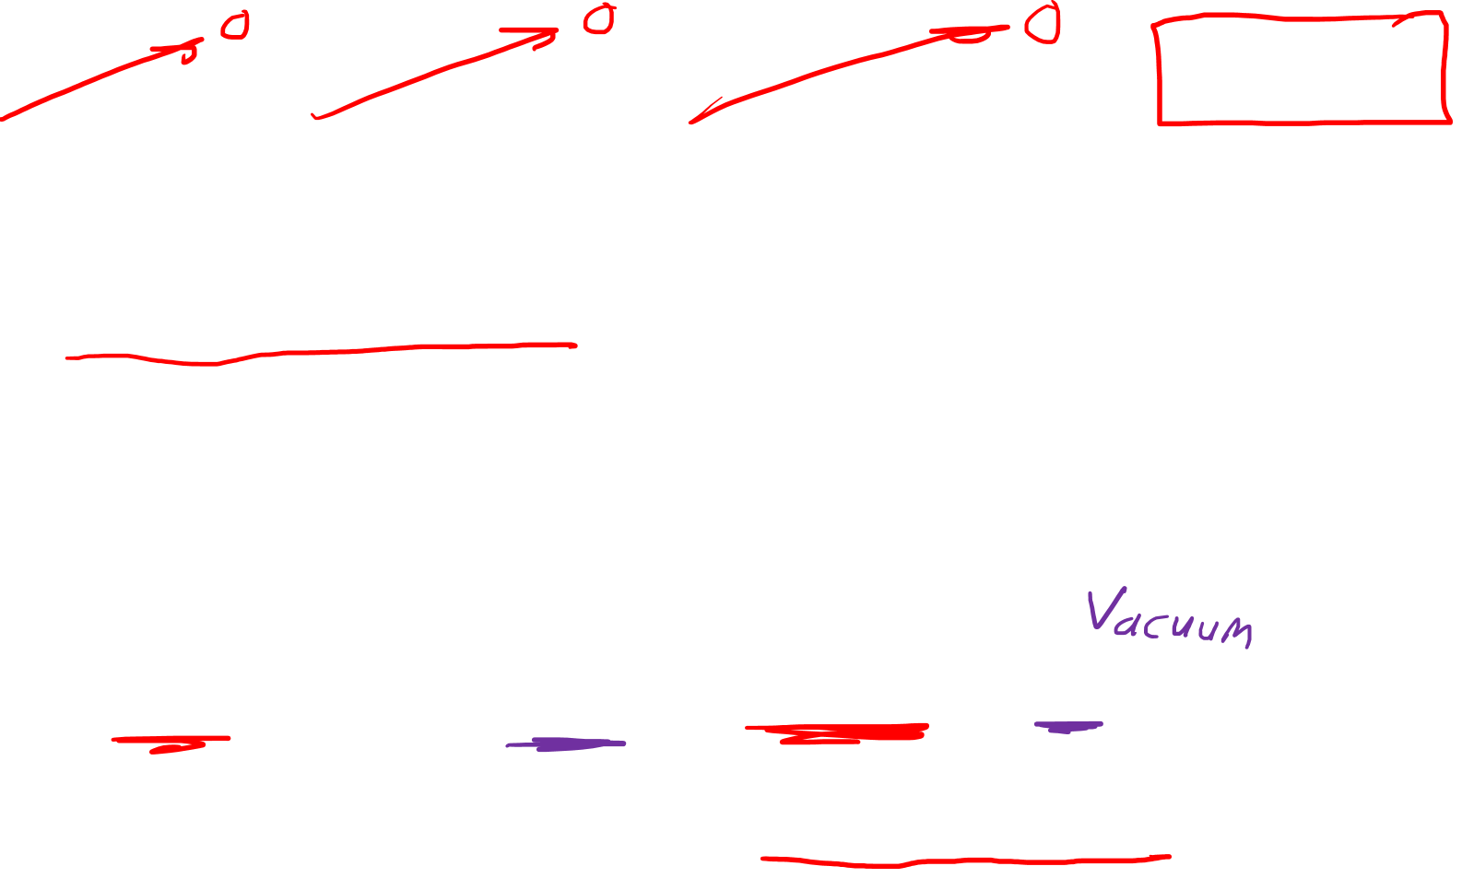
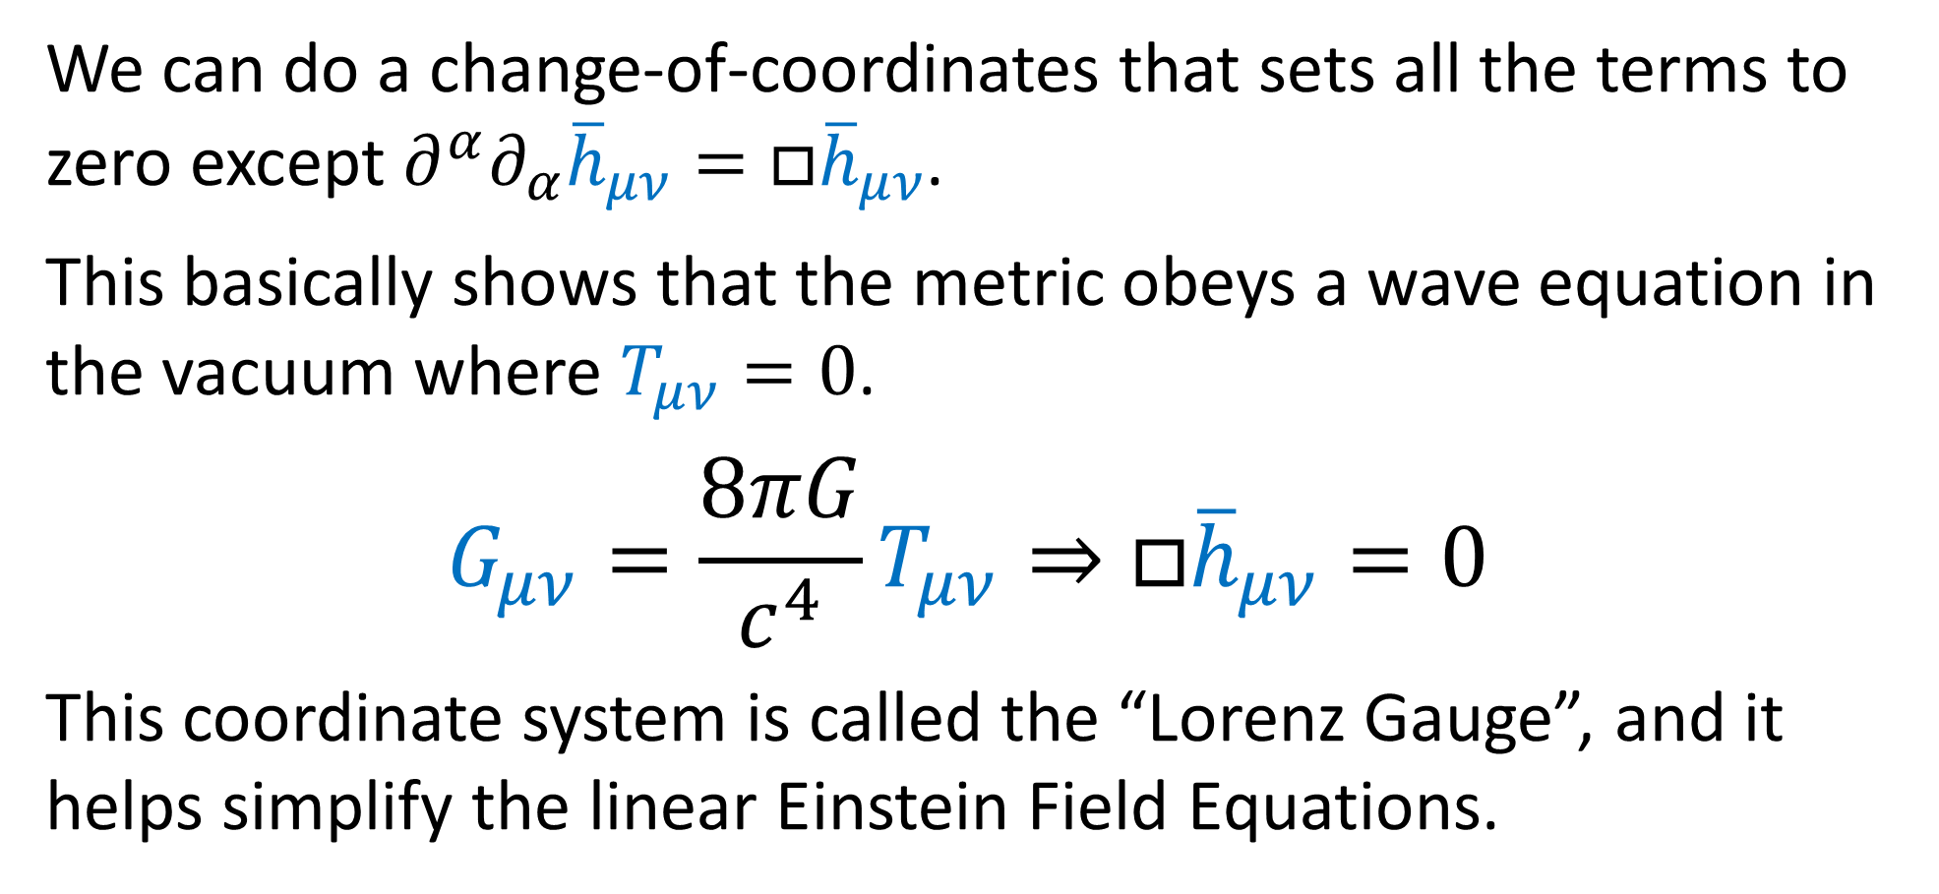
$G_{μν}=\frac{1}{2}\left(∂^{α}∂_{μ}{\overline{h}}_{αν}+∂^{α}∂_{ν}{\overline{h}}_{μα}−η_{μν}∂^{α}∂^{β}{\overline{h}}_{αβ}−∂^{α}∂_{α}{\overline{h}}_{μν}\right)$
We can do a change-of-coordinates that sets all the terms to zero except $∂^{α}∂_{α}{\overline{h}}_{μν}=□{\overline{h}}_{μν}$.
This basically shows that the metric obeys a wave equation in the vacuum where $T_{μν}=0$.
$$G_{μν}=\frac{8πG}{c^{4}}T_{μν}⇒□{\overline{h}}_{μν}=0$$
This coordinate system is called the “Lorenz Gauge”, and it helps simplify the linear Einstein Field Equations.

Slide 5
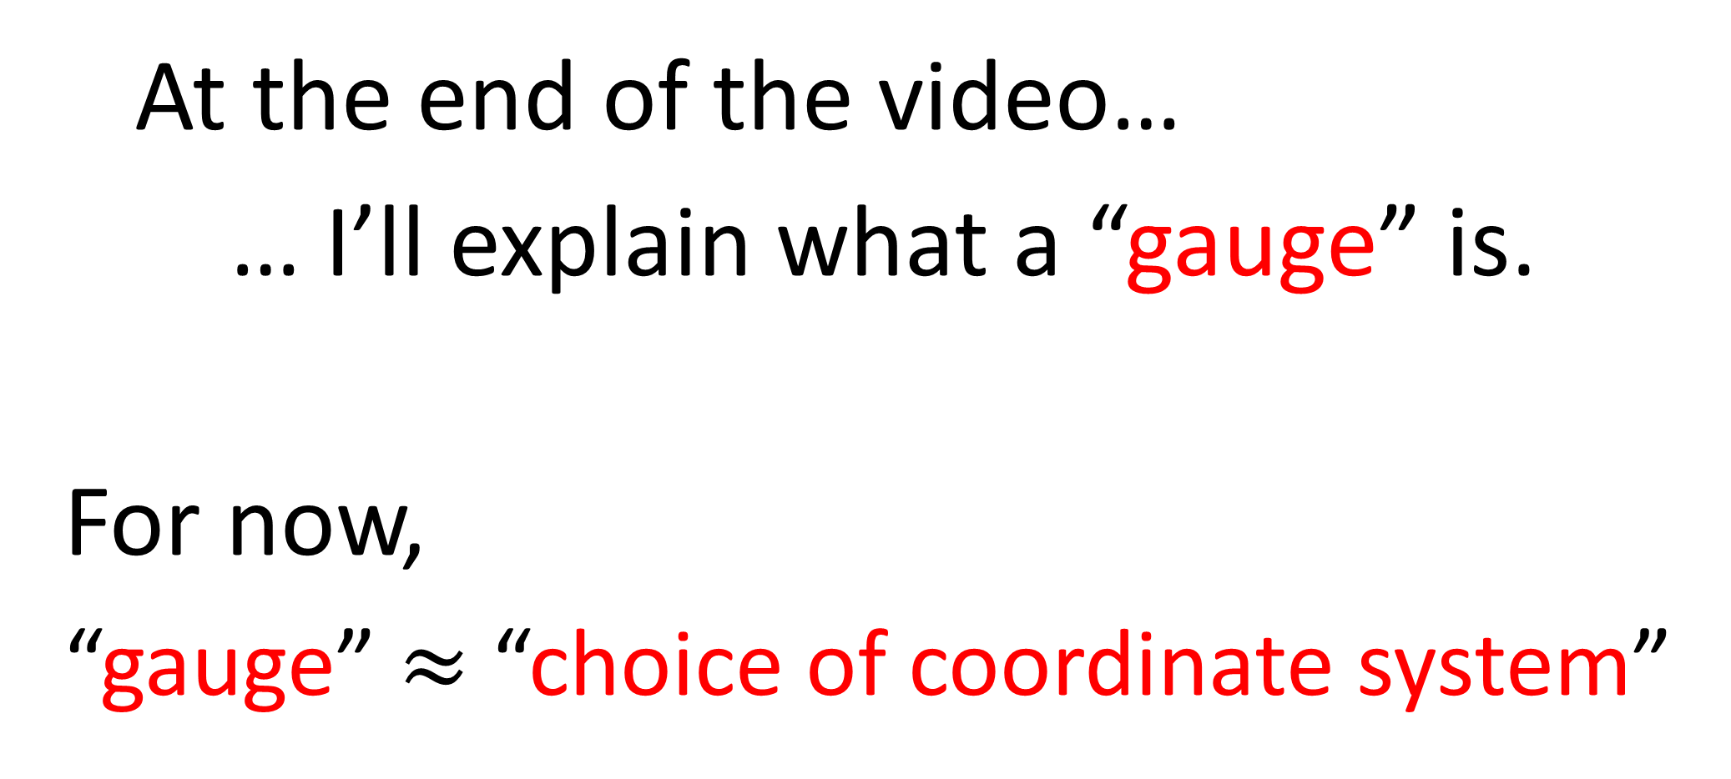
At the end of the video…
… I’ll explain what a “gauge” is.
For now,
“gauge” $≈$ “choice of coordinate system”

Slide 6
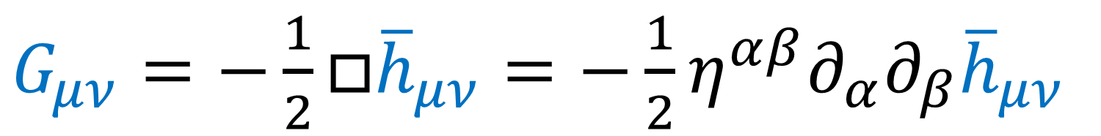
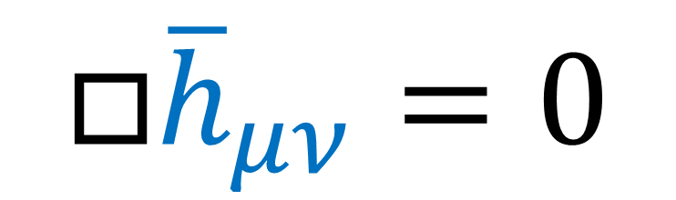
This Video:
1. Prove Lorenz Gauge coordinate system exists
$G_{μν}=−\frac{1}{2}□{\overline{h}}_{μν}=−\frac{1}{2}η^{αβ}∂_{α}∂_{β}{\overline{h}}_{μν}$
2. Provide a recipe for changing to the Lorenz Gauge
This will show the Einstein Field Equations predict gravitational waves can exist in a vacuum.
$$□{\overline{h}}_{μν}=0$$

Slide 7
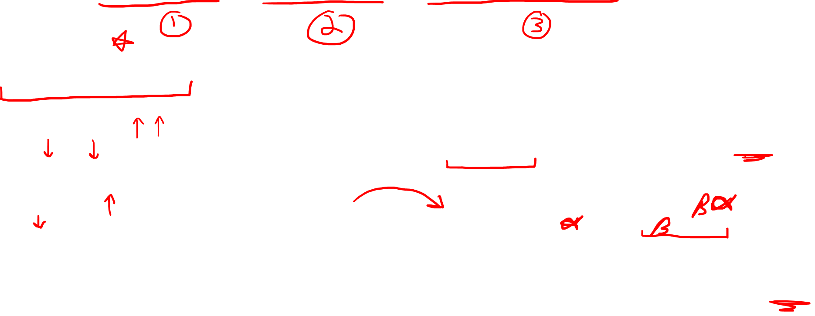
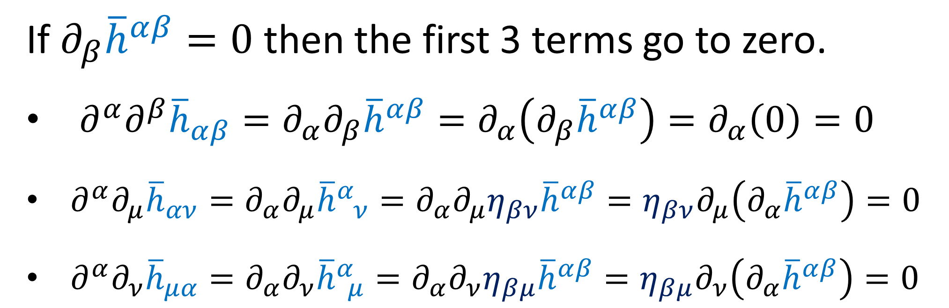
$G_{μν}=\frac{1}{2}\left(∂^{α}∂_{μ}{\overline{h}}_{αν}+∂^{α}∂_{ν}{\overline{h}}_{μα}−η_{μν}∂^{α}∂^{β}{\overline{h}}_{αβ}−∂^{α}∂_{α}{\overline{h}}_{μν}\right)$
If $∂_{β}{\overline{h}}^{αβ}=0$ then the first 3 terms go to zero.
$∂^{α}∂^{β}{\overline{h}}_{αβ}=∂_{α}∂_{β}{\overline{h}}^{αβ}=∂_{α}\left(∂_{β}{\overline{h}}^{αβ}\right)=∂_{α}\left(0\right)=0$
$∂^{α}∂_{μ}{\overline{h}}_{αν}=∂_{α}∂_{μ}{\overline{h}}_{ ν}^{α}=∂_{α}∂_{μ}η_{βν}{\overline{h}}^{αβ}=η_{βν}∂_{μ}\left(∂_{α}{\overline{h}}^{αβ}\right)=0$
$∂^{α}∂_{ν}{\overline{h}}_{μα}=∂_{α}∂_{ν}{\overline{h}}_{ μ}^{α}=∂_{α}∂_{ν}η_{βμ}{\overline{h}}^{αβ}=η_{βμ}∂_{ν}\left(∂_{α}{\overline{h}}^{αβ}\right)=0$

Slide 8
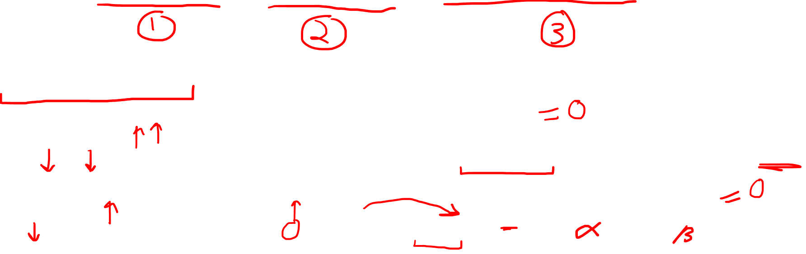
$G_{μν}=\frac{1}{2}\left(∂^{α}∂_{μ}{\overline{h}}_{αν}+∂^{α}∂_{ν}{\overline{h}}_{μα}−η_{μν}∂^{α}∂^{β}{\overline{h}}_{αβ}−∂^{α}∂_{α}{\overline{h}}_{μν}\right)$
If $∂_{β}{\overline{h}}^{αβ}=0$ then the first 3 terms go to zero.
$∂^{α}∂^{β}{\overline{h}}_{αβ}=∂_{α}∂_{β}{\overline{h}}^{αβ}=∂_{α}\left(∂_{β}{\overline{h}}^{αβ}\right)=∂_{α}\left(0\right)=0$
$∂^{α}∂_{μ}{\overline{h}}_{αν}=∂_{α}∂_{μ}{\overline{h}}_{ ν}^{α}=∂_{α}∂_{μ}η_{βν}{\overline{h}}^{αβ}=η_{βν}∂_{μ}\left(∂_{α}{\overline{h}}^{αβ}\right)=0$
$∂^{α}∂_{ν}{\overline{h}}_{μα}=∂_{α}∂_{ν}{\overline{h}}_{ μ}^{α}=∂_{α}∂_{ν}η_{βμ}{\overline{h}}^{αβ}=η_{βμ}∂_{ν}\left(∂_{α}{\overline{h}}^{αβ}\right)=0$

Slide 9
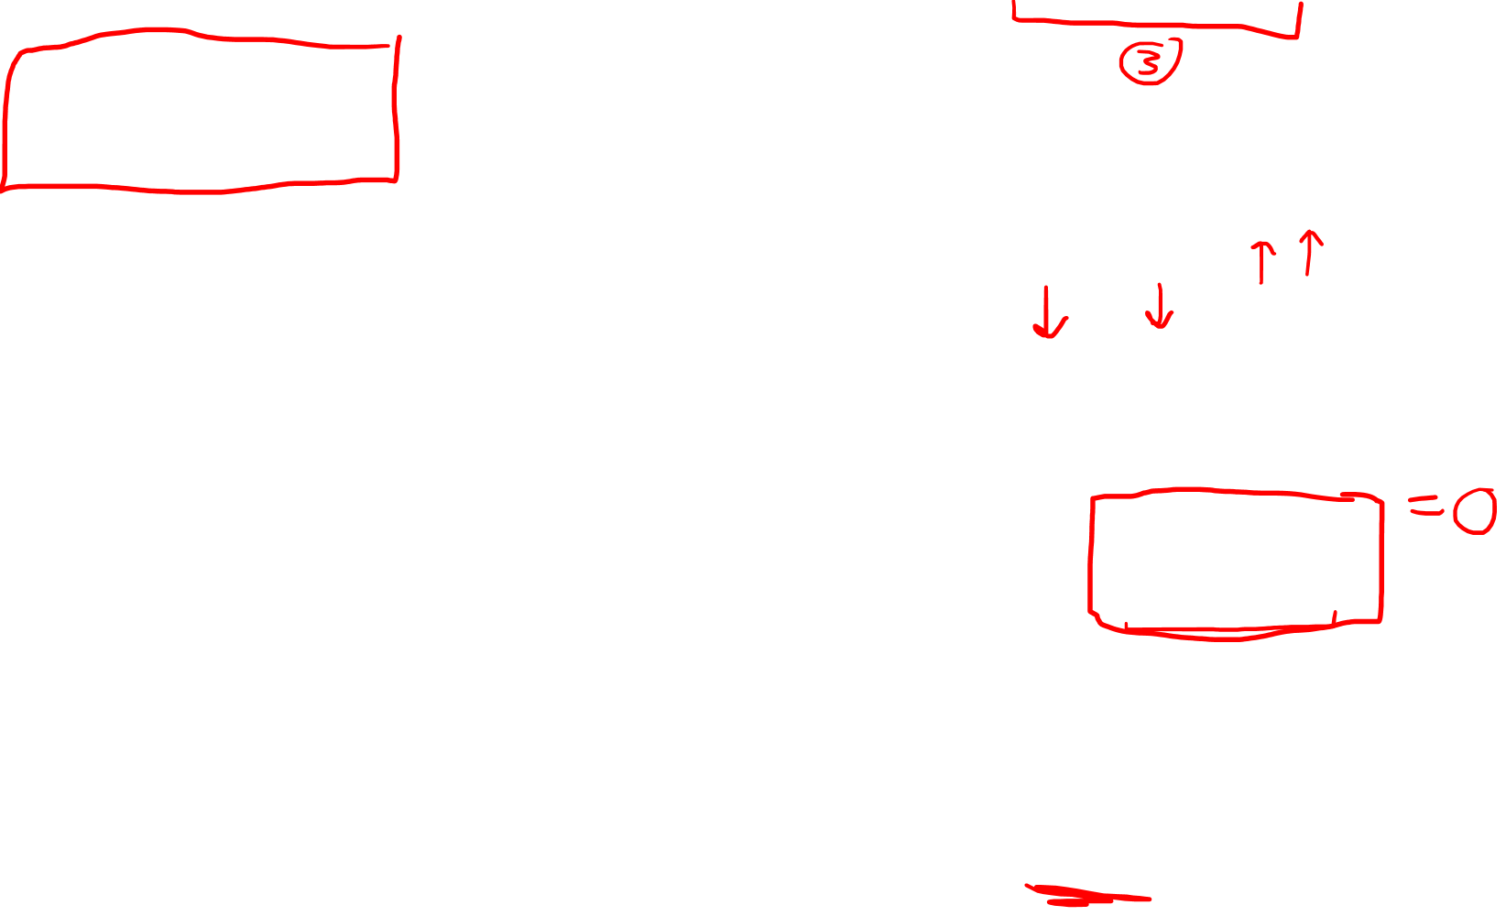
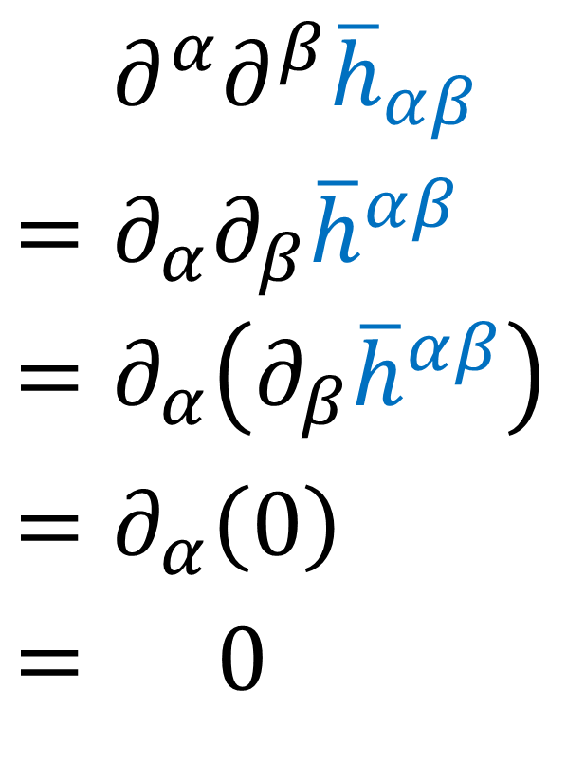
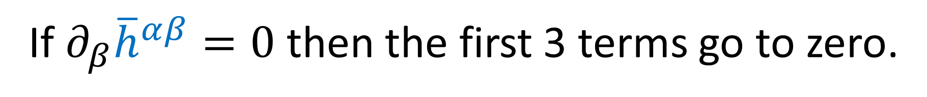
$G_{μν}=\frac{1}{2}\left(∂^{α}∂_{μ}{\overline{h}}_{αν}+∂^{α}∂_{ν}{\overline{h}}_{μα}−η_{μν}∂^{α}∂^{β}{\overline{h}}_{αβ}−∂^{α}∂_{α}{\overline{h}}_{μν}\right)$
If $∂_{β}{\overline{h}}^{αβ}=0$ then the first 3 terms go to zero.
$$=∂^{α}∂^{β}{\overline{h}}_{αβ}$$
$$=∂_{α}∂_{β}{\overline{h}}^{αβ}$$
$$=∂_{α}\left(∂_{β}{\overline{h}}^{αβ}\right)$$
$$=∂_{α}\left(0\right)$$
$$= 0$$

Slide 10
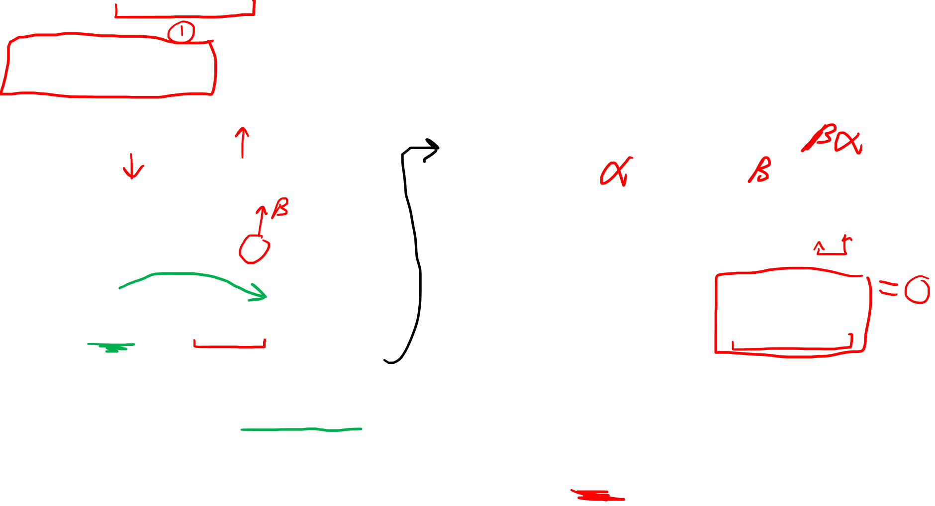
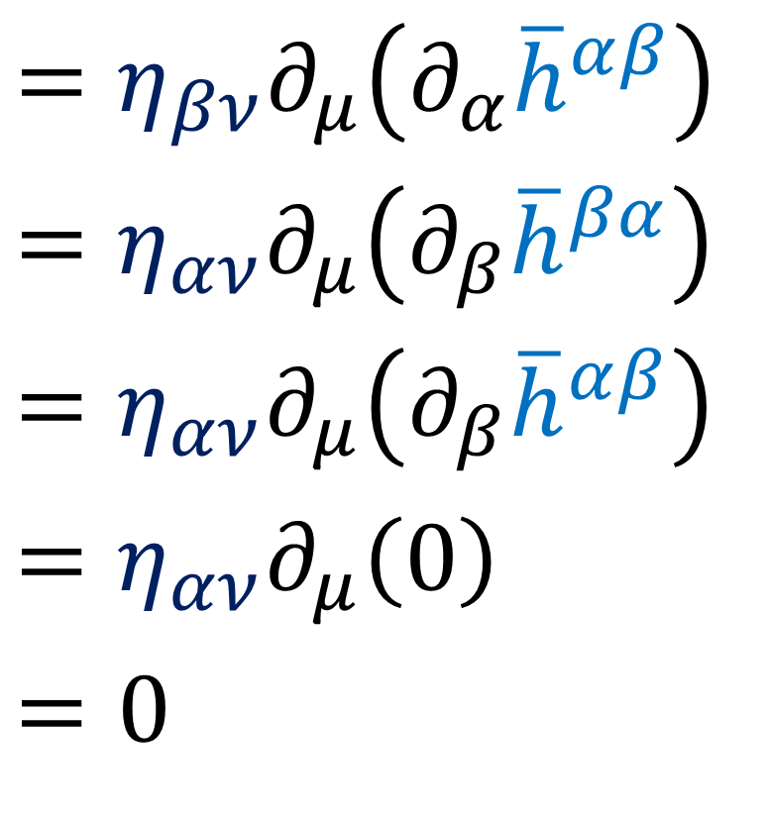
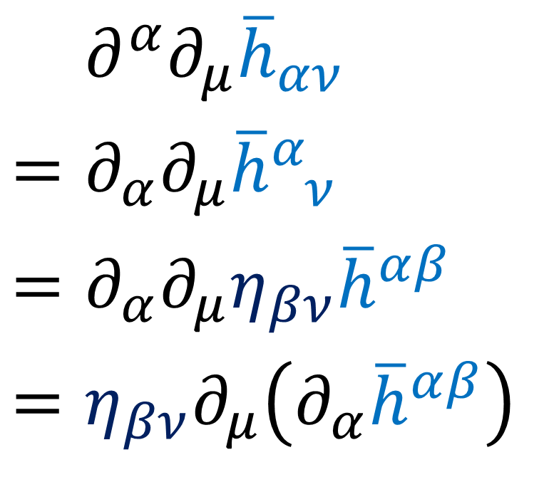
$G_{μν}=\frac{1}{2}\left(∂^{α}∂_{μ}{\overline{h}}_{αν}+∂^{α}∂_{ν}{\overline{h}}_{μα}−η_{μν}∂^{α}∂^{β}{\overline{h}}_{αβ}−∂^{α}∂_{α}{\overline{h}}_{μν}\right)$
If $∂_{β}{\overline{h}}^{αβ}=0$ then the first 3 terms go to zero.
$$=∂^{α}∂_{μ}{\overline{h}}_{αν}$$
$$=∂_{α}∂_{μ}{\overline{h}}_{ ν}^{α}$$
$$=∂_{α}∂_{μ}η_{βν}{\overline{h}}^{αβ}$$
$$=η_{βν}∂_{μ}\left(∂_{α}{\overline{h}}^{αβ}\right)$$
$$=η_{βν}∂_{μ}\left(∂_{α}{\overline{h}}^{αβ}\right)$$
$$=η_{αν}∂_{μ}\left(∂_{β}{\overline{h}}^{βα}\right)$$
$$=η_{αν}∂_{μ}\left(∂_{β}{\overline{h}}^{αβ}\right)$$
$$=η_{αν}∂_{μ}\left(0\right)$$
$$=0$$

Slide 11
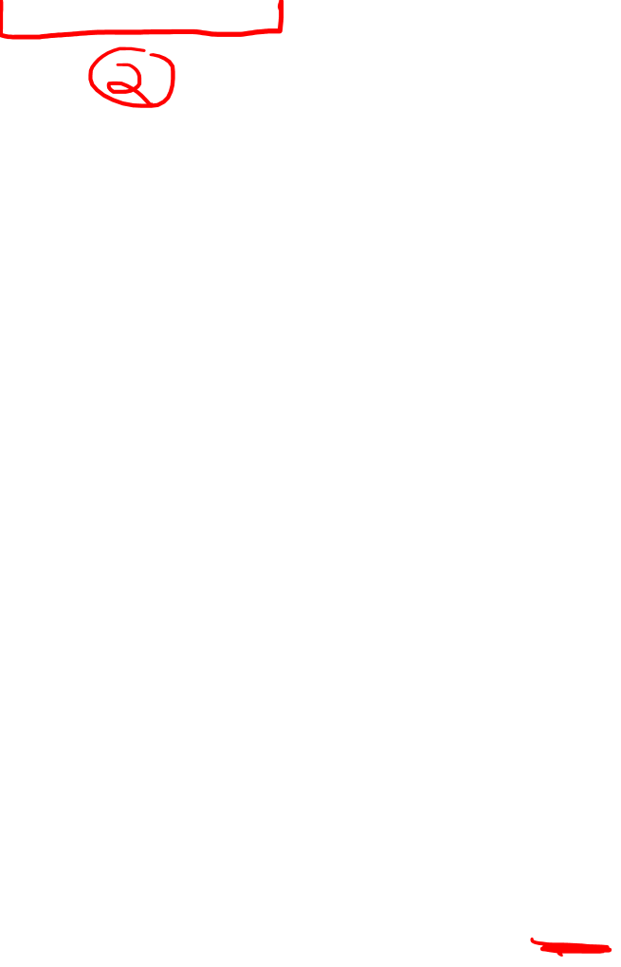
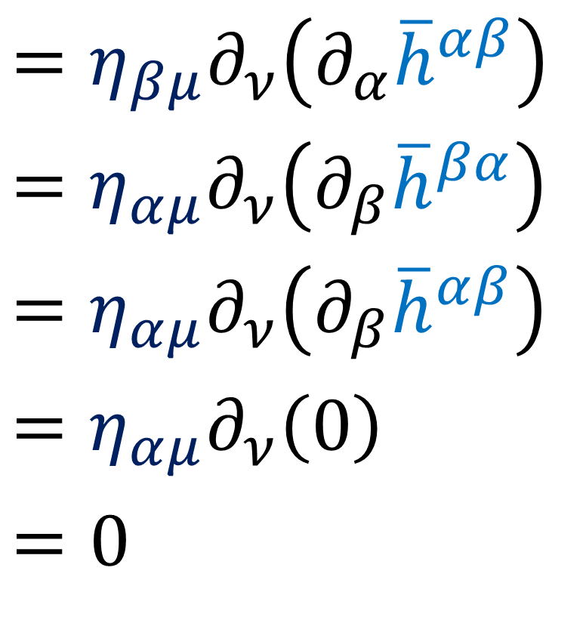
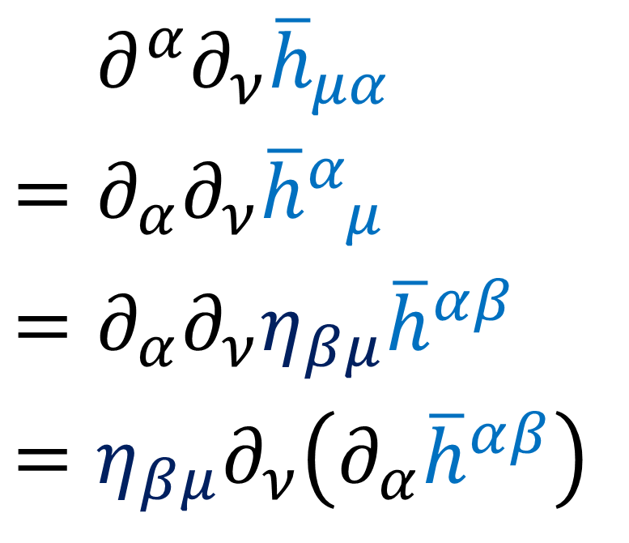
$G_{μν}=\frac{1}{2}\left(∂^{α}∂_{μ}{\overline{h}}_{αν}+∂^{α}∂_{ν}{\overline{h}}_{μα}−η_{μν}∂^{α}∂^{β}{\overline{h}}_{αβ}−∂^{α}∂_{α}{\overline{h}}_{μν}\right)$
If $∂_{β}{\overline{h}}^{αβ}=0$ then the first 3 terms go to zero.
$$=∂^{α}∂_{ν}{\overline{h}}_{μα}$$
$$=∂_{α}∂_{ν}{\overline{h}}_{ μ}^{α}$$
$$=∂_{α}∂_{ν}η_{βμ}{\overline{h}}^{αβ}$$
$$=η_{βμ}∂_{ν}\left(∂_{α}{\overline{h}}^{αβ}\right)$$
$$=η_{βμ}∂_{ν}\left(∂_{α}{\overline{h}}^{αβ}\right)$$
$$=η_{αμ}∂_{ν}\left(∂_{β}{\overline{h}}^{βα}\right)$$
$$=η_{αμ}∂_{ν}\left(∂_{β}{\overline{h}}^{αβ}\right)$$
$$=η_{αμ}∂_{ν}\left(0\right)$$
$$=0$$

Slide 12
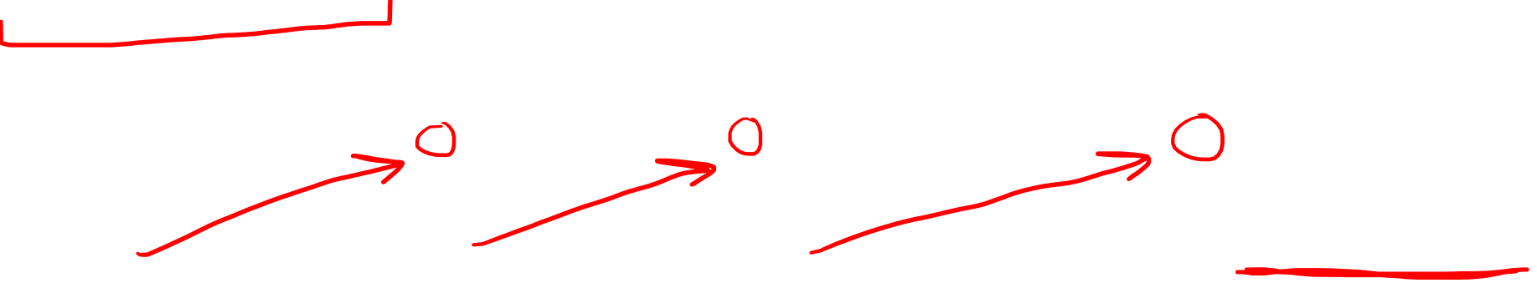
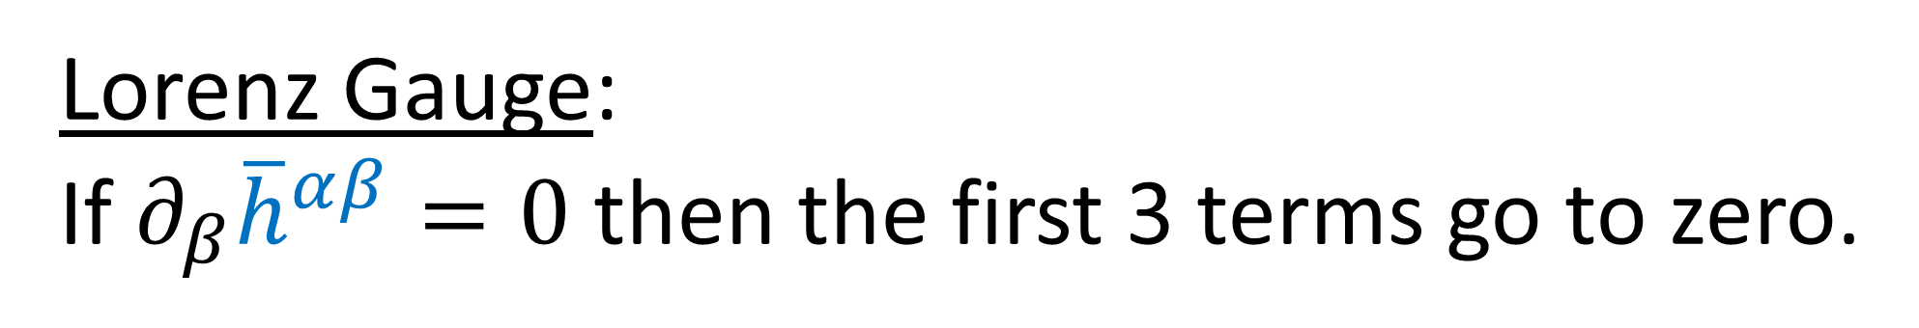
Lorenz Gauge: If $∂_{β}{\overline{h}}^{αβ}=0$ then the first 3 terms go to zero.
$G_{μν}=\frac{1}{2}\left(∂^{α}∂_{μ}{\overline{h}}_{αν}+∂^{α}∂_{ν}{\overline{h}}_{μα}−η_{μν}∂^{α}∂^{β}{\overline{h}}_{αβ}−∂^{α}∂_{α}{\overline{h}}_{μν}\right)$

Slide 13

$G_{μν}=\frac{1}{2}\left(∂^{α}∂_{μ}{\overline{h}}_{αν}+∂^{α}∂_{ν}{\overline{h}}_{μα}−η_{μν}∂^{α}∂^{β}{\overline{h}}_{αβ}−∂^{α}∂_{α}{\overline{h}}_{μν}\right)$
If $∂_{β}{\overline{h}}^{αβ}=0$ then the first 3 terms go to zero.
$∂^{α}∂^{β}{\overline{h}}_{αβ}=∂_{α}∂_{β}{\overline{h}}^{αβ}=∂_{α}\left(∂_{β}{\overline{h}}^{αβ}\right)=∂_{α}\left(0\right)=0$
$∂^{α}∂_{μ}{\overline{h}}_{αν}=∂_{α}∂_{μ}{\overline{h}}_{ ν}^{α}=∂_{α}∂_{μ}η_{βν}{\overline{h}}^{αβ}=η_{βν}∂_{μ}\left(∂_{α}{\overline{h}}^{αβ}\right)=0$
$∂^{α}∂_{ν}{\overline{h}}_{μα}=∂_{α}∂_{ν}{\overline{h}}_{ μ}^{α}=∂_{α}∂_{ν}η_{βμ}{\overline{h}}^{αβ}=η_{βμ}∂_{ν}\left(∂_{α}{\overline{h}}^{αβ}\right)=0$

Slide 14
$G_{μν}=\frac{1}{2}\left(∂^{α}∂_{μ}{\overline{h}}_{αν}+∂^{α}∂_{ν}{\overline{h}}_{μα}−η_{μν}∂^{α}∂^{β}{\overline{h}}_{αβ}−∂^{α}∂_{α}{\overline{h}}_{μν}\right)$
If $∂_{β}{\overline{h}}^{αβ}=0$ then the first 3 terms go to zero.
$∂^{α}∂^{β}{\overline{h}}_{αβ}=∂_{α}∂_{β}{\overline{h}}^{αβ}=∂_{α}\left(∂_{β}{\overline{h}}^{αβ}\right)=∂_{α}\left(0\right)=0$
$∂^{α}∂_{μ}{\overline{h}}_{αν}=∂_{α}∂_{μ}{\overline{h}}_{ ν}^{α}=∂_{α}∂_{μ}η_{βν}{\overline{h}}^{αβ}=η_{βν}∂_{μ}\left(∂_{α}{\overline{h}}^{αβ}\right)=0$
$∂^{α}∂_{ν}{\overline{h}}_{μα}=∂_{α}∂_{ν}{\overline{h}}_{ μ}^{α}=∂_{α}∂_{ν}η_{βμ}{\overline{h}}^{αβ}=η_{βμ}∂_{ν}\left(∂_{α}{\overline{h}}^{αβ}\right)=0$

Slide 15
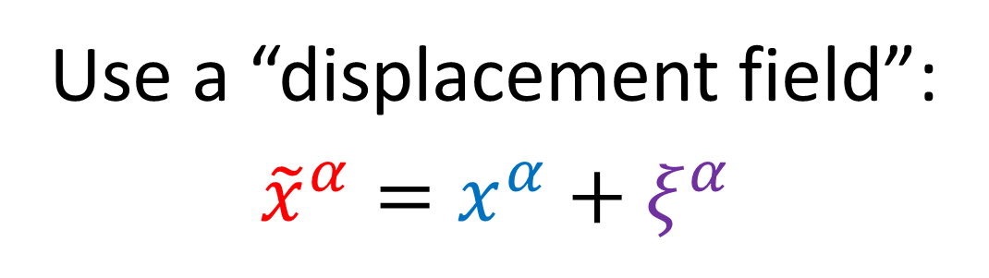


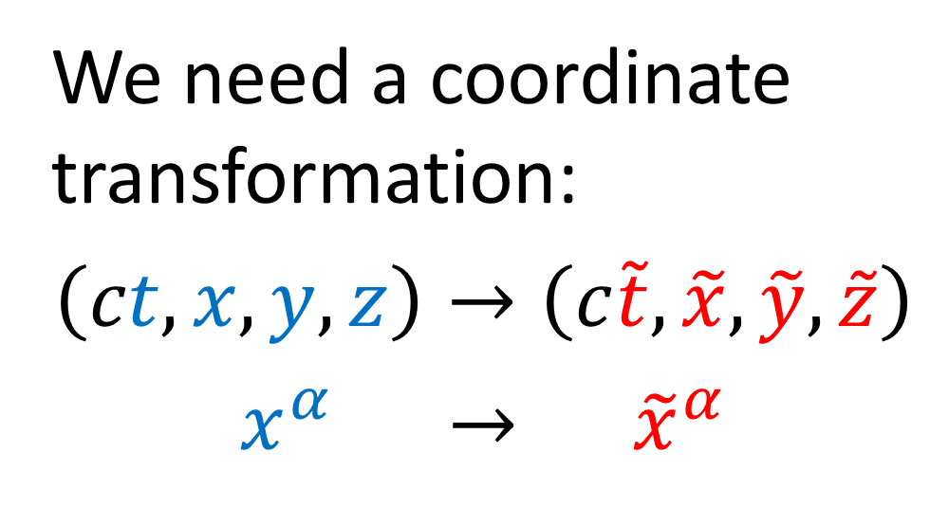
How do we find a coordinate system with $∂_{β}{\overline{h}}^{αβ}=0$ ?
We need a coordinate transformation:
$$\left(ct,x,y,z\right)→\left(c\tilde{t},\tilde{x},\tilde{y},\tilde{z}\right)$$
$$x^{α} → {\tilde{x}}^{α}$$
$$ct$$
Use a “displacement field”:
$${\tilde{x}}^{α}=x^{α}+ξ^{α}$$
$$x$$
Depends on spacetime point

Slide 16
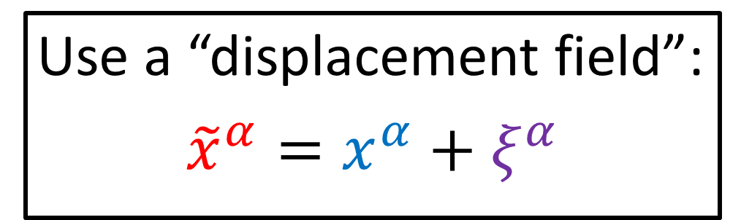


Use a “displacement field”:
$${\tilde{x}}^{α}=x^{α}+ξ^{α}$$
Assume small displacement $$\left\|ξ^{α}\right\|≪1$$

Slide 17

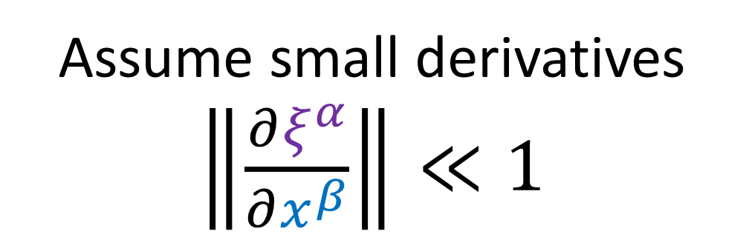
Use a “displacement field”:
$${\tilde{x}}^{α}=x^{α}+ξ^{α}$$
Assume small derivatives $\left\|\frac{∂ξ^{α}}{∂x^{β}}\right\|≪1$

Slide 18
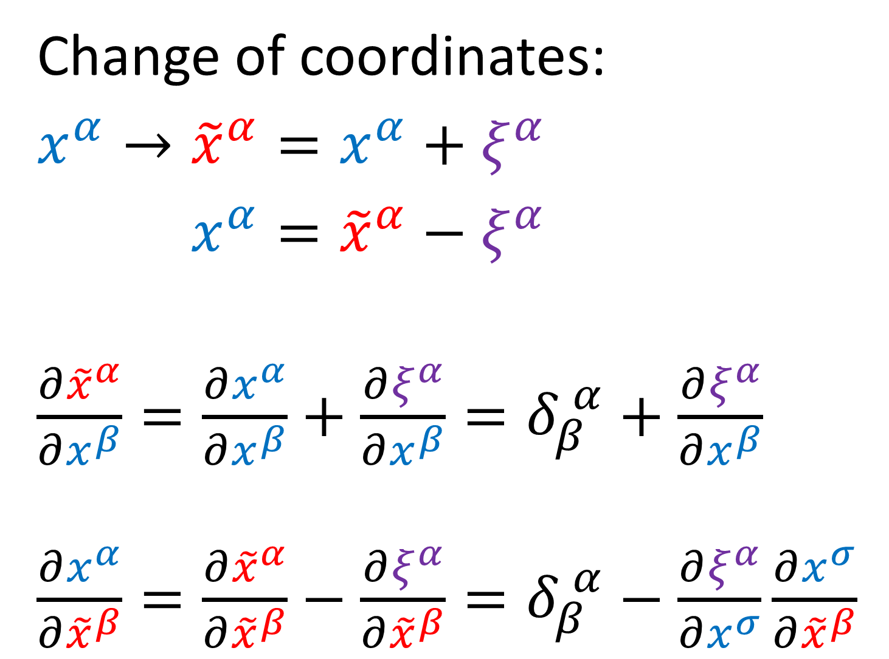
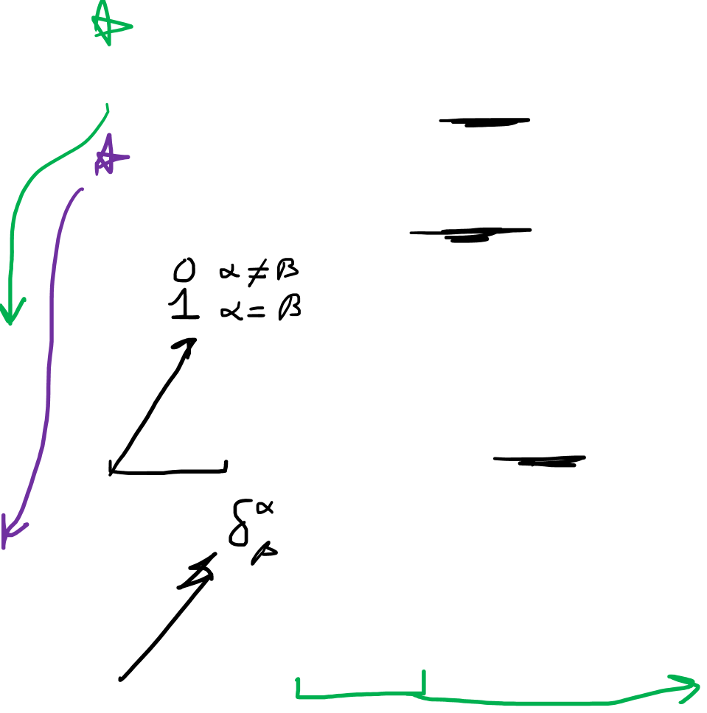
Change of coordinates:
$$x^{α}→{\tilde{x}}^{α}=x^{α}+ξ^{α}$$
$$x^{α}→x^{α}={\tilde{x}}^{α}−ξ^{α}$$
$\frac{∂{\tilde{x}}^{α}}{∂x^{β}}=\frac{∂x^{α}}{∂x^{β}}+\frac{∂ξ^{α}}{∂x^{β}}=δ_{β}^{ α}+\frac{∂ξ^{α}}{∂x^{β}}$
$\frac{∂x^{α}}{∂{\tilde{x}}^{β}}=\frac{∂{\tilde{x}}^{α}}{∂{\tilde{x}}^{β}}−\frac{∂ξ^{α}}{∂{\tilde{x}}^{β}}=δ_{β}^{ α}−\frac{∂ξ^{α}}{∂x^{σ}}\frac{∂x^{σ}}{∂{\tilde{x}}^{β}}$

Slide 19
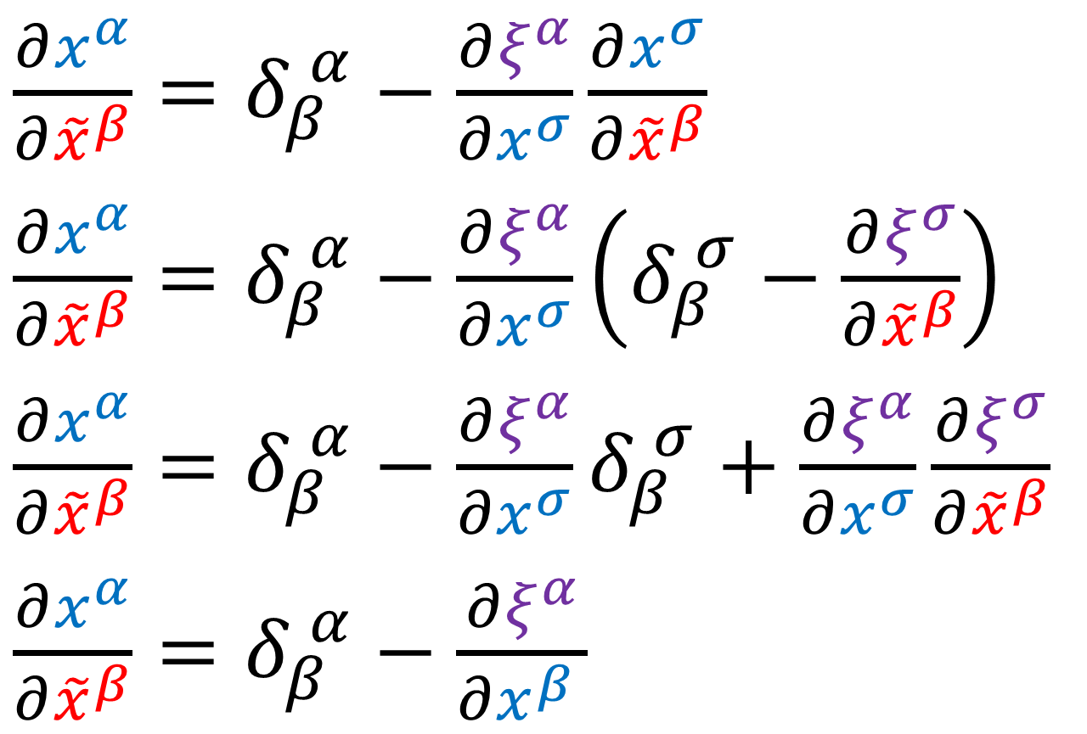
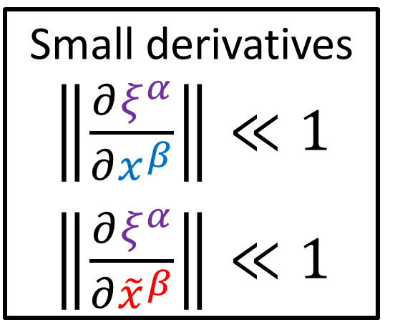
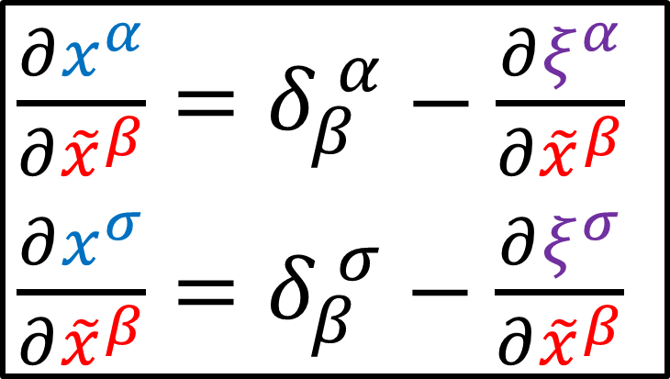
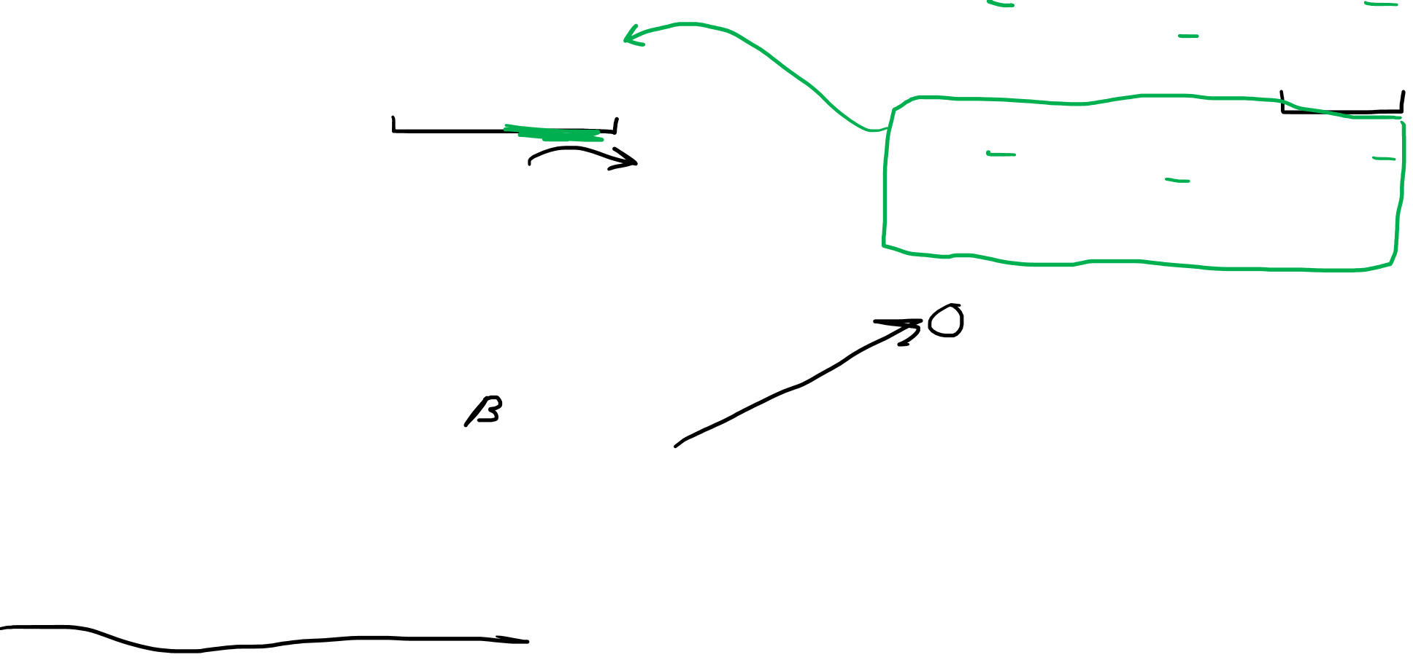
$\frac{∂x^{α}}{∂{\tilde{x}}^{β}}=δ_{β}^{ α}−\frac{∂ξ^{α}}{∂{\tilde{x}}^{β}}$
$\frac{∂x^{σ}}{∂{\tilde{x}}^{β}}=δ_{β}^{ σ}−\frac{∂ξ^{σ}}{∂{\tilde{x}}^{β}}$
$\frac{∂x^{α}}{∂{\tilde{x}}^{β}}=δ_{β}^{ α}−\frac{∂ξ^{α}}{∂x^{σ}}\frac{∂x^{σ}}{∂{\tilde{x}}^{β}}$
$\frac{∂x^{α}}{∂{\tilde{x}}^{β}}=δ_{β}^{ α}−\frac{∂ξ^{α}}{∂x^{σ}}\left(δ_{β}^{ σ}−\frac{∂ξ^{σ}}{∂{\tilde{x}}^{β}}\right)$
$\frac{∂x^{α}}{∂{\tilde{x}}^{β}}=δ_{β}^{ α}−\frac{∂ξ^{α}}{∂x^{σ}}δ_{β}^{ σ}+\frac{∂ξ^{α}}{∂x^{σ}}\frac{∂ξ^{σ}}{∂{\tilde{x}}^{β}}$
$\frac{∂x^{α}}{∂{\tilde{x}}^{β}}=δ_{β}^{ α}−\frac{∂ξ^{α}}{∂x^{β }}$
Small derivatives $\left\|\frac{∂ξ^{α}}{∂x^{β}}\right\|≪1$
$\left\|\frac{∂ξ^{α}}{∂{\tilde{x}}^{β}}\right\|≪1$
THANK-YOU!!! https://pages.pomona.edu/~tmoore/LesHouches/les-houches-4.pdf
https://pages.pomona.edu/~tmoore/LesHouches/les-houches-5.pdf

Slide 20
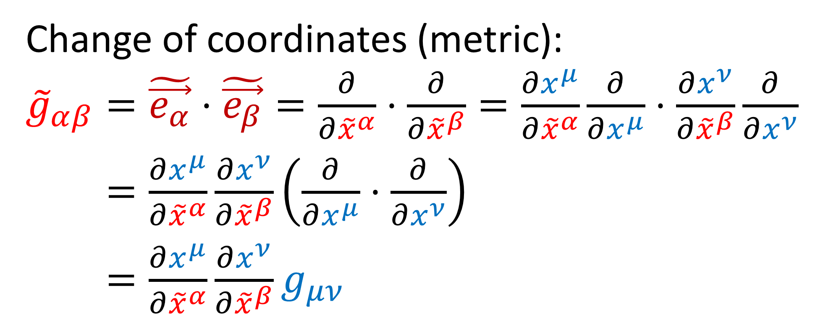
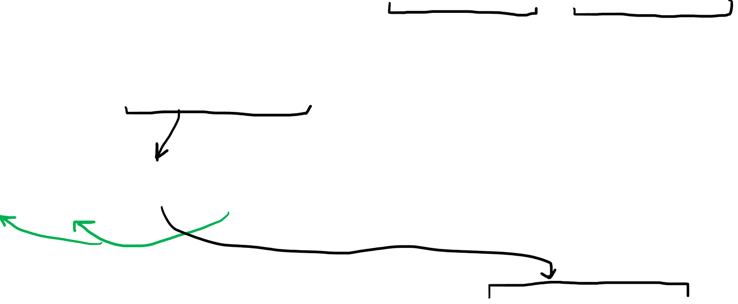
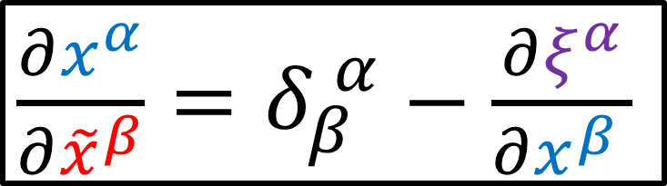
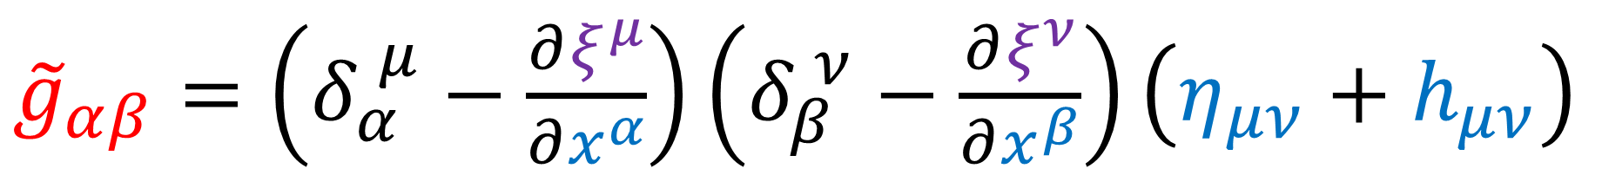
Change of coordinates (metric):
${\tilde{g}}_{αβ}=\tilde{\vec{e_{α}}}⋅\tilde{\vec{e_{β}}}=\frac{∂}{∂{\tilde{x}}^{α}}⋅\frac{∂}{∂{\tilde{x}}^{β}}=\frac{∂x^{μ}}{∂{\tilde{x}}^{α}}\frac{∂}{∂x^{μ}}⋅\frac{∂x^{ν}}{∂{\tilde{x}}^{β}}\frac{∂}{∂x^{ν}}$
${\tilde{g}}_{αβ}=\frac{∂x^{μ}}{∂{\tilde{x}}^{α}}\frac{∂x^{ν}}{∂{\tilde{x}}^{β}}\left(\frac{∂}{∂x^{μ}}⋅\frac{∂}{∂x^{ν}}\right)$
${\tilde{g}}_{αβ}=\frac{∂x^{μ}}{∂{\tilde{x}}^{α}}\frac{∂x^{ν}}{∂{\tilde{x}}^{β}}g_{μν}$
$\frac{∂x^{α}}{∂{\tilde{x}}^{β}}=δ_{β}^{ α}−\frac{∂ξ^{α}}{∂x^{β }}$
${\tilde{g}}_{αβ}=\left(δ_{α}^{ μ}−\frac{∂ξ^{μ}}{∂x^{α}}\right)\left(δ_{β}^{ ν}−\frac{∂ξ^{ν}}{∂x^{β}}\right)\left(η_{μν}+h_{μν}\right)$

Slide 21
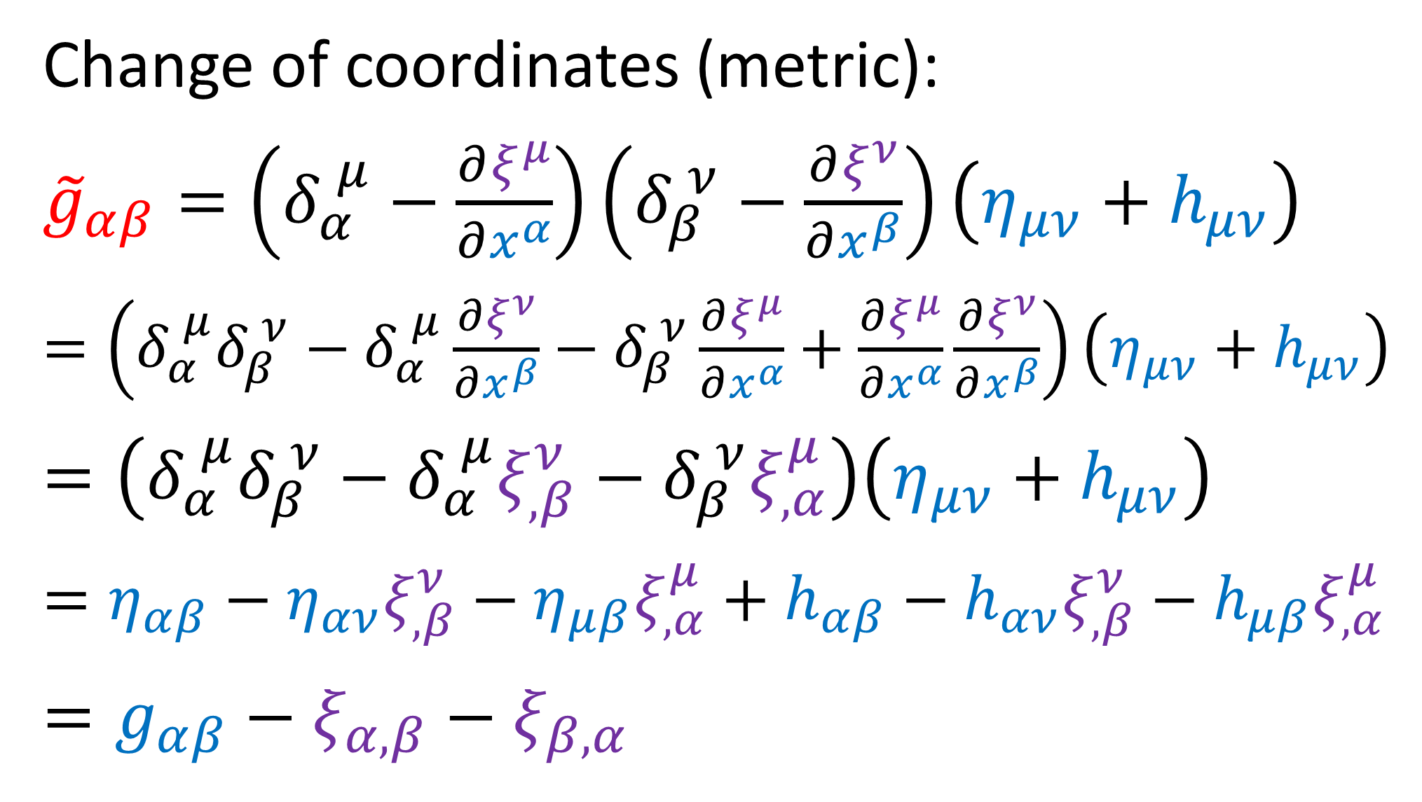



Change of coordinates (metric):
${\tilde{g}}_{αβ}=\left(δ_{α}^{ μ}−\frac{∂ξ^{μ}}{∂x^{α}}\right)\left(δ_{β}^{ ν}−\frac{∂ξ^{ν}}{∂x^{β}}\right)\left(η_{μν}+h_{μν}\right)$
$=\left(δ_{α}^{ μ}δ_{β}^{ ν}−δ_{α}^{ μ}\frac{∂ξ^{ν}}{∂x^{β}}−δ_{β}^{ ν}\frac{∂ξ^{μ}}{∂x^{α}}+\frac{∂ξ^{μ}}{∂x^{α}}\frac{∂ξ^{ν}}{∂x^{β}}\right)\left(η_{μν}+h_{μν}\right)$
$=\left(δ_{α}^{ μ}δ_{β}^{ ν}−δ_{α}^{ μ}ξ_{,β}^{ν}−δ_{β}^{ ν}ξ_{,α}^{μ}\right)\left(η_{μν}+h_{μν}\right)$
$$=η_{αβ}−η_{αν}ξ_{,β}^{ν}−η_{μβ}ξ_{,α}^{μ}+h_{αβ}−h_{αν}ξ_{,β}^{ν}−h_{μβ}ξ_{,α}^{μ}$$
$$=g_{αβ}−ξ_{α,β}−ξ_{β,α }$$
$\left\|\frac{∂ξ^{ν}}{∂x^{β}}\right\|≪1$
$\left\|h_{μν}\right\|≪1$

Slide 22
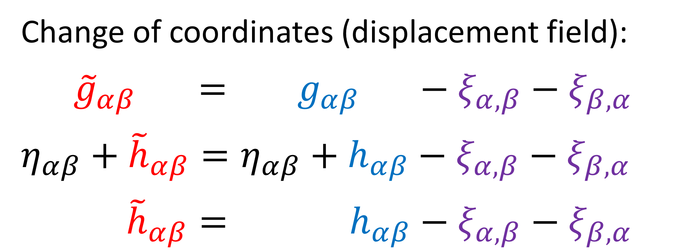
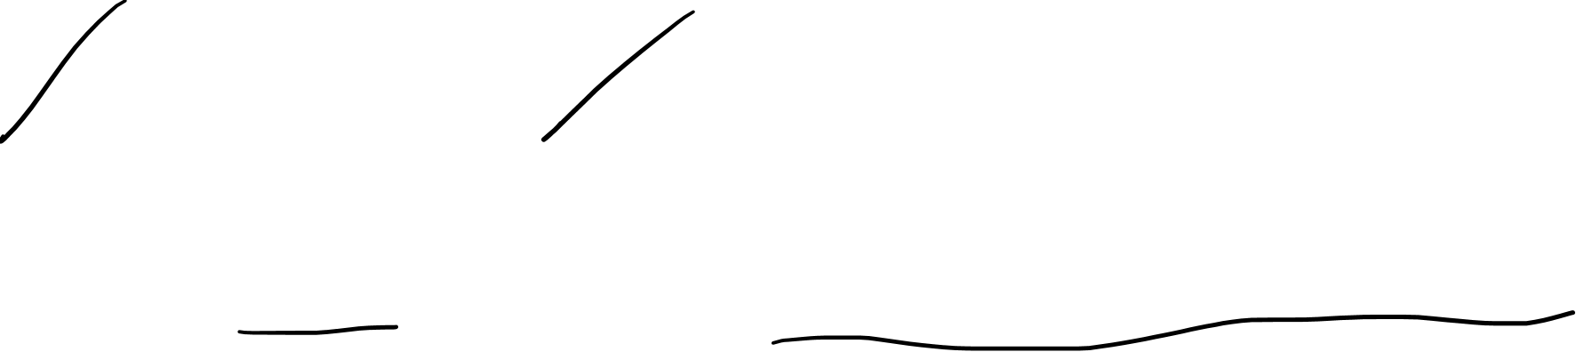
Change of coordinates (displacement field):
${\tilde{g}}_{αβ} = g_{αβ} −ξ_{α,β}−ξ_{β,α }$
$$η_{αβ}+{\tilde{h}}_{αβ}=η_{αβ}+h_{αβ}−ξ_{α,β}−ξ_{β,α }$$
${\tilde{h}}_{αβ}= h_{αβ}−ξ_{α,β}−ξ_{β,α }$

Slide 23
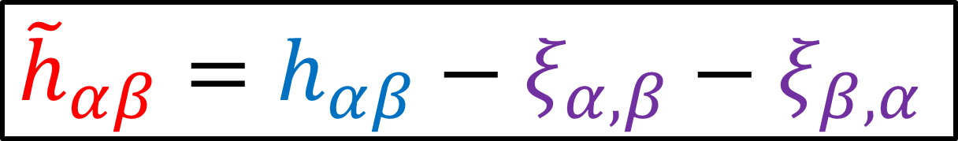
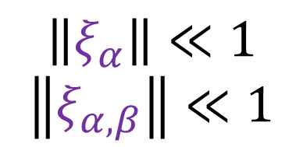
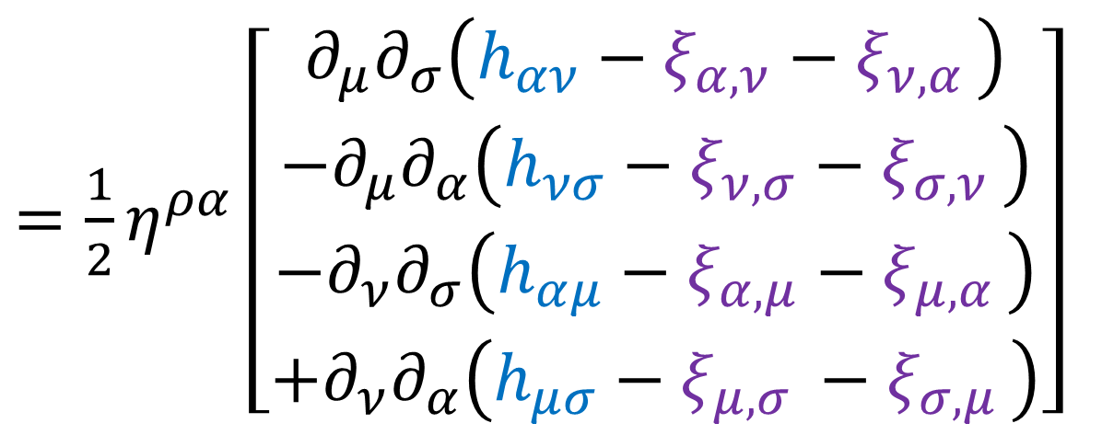
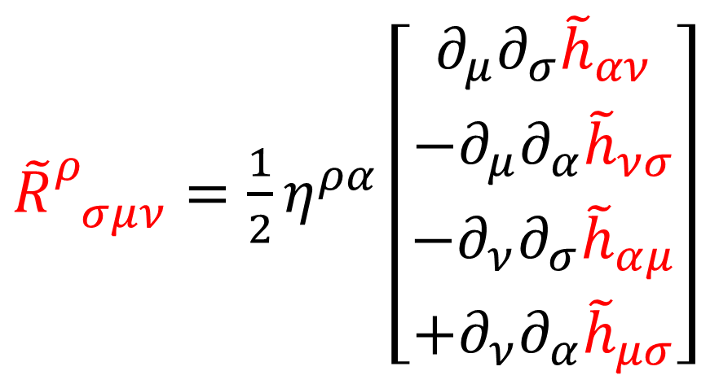
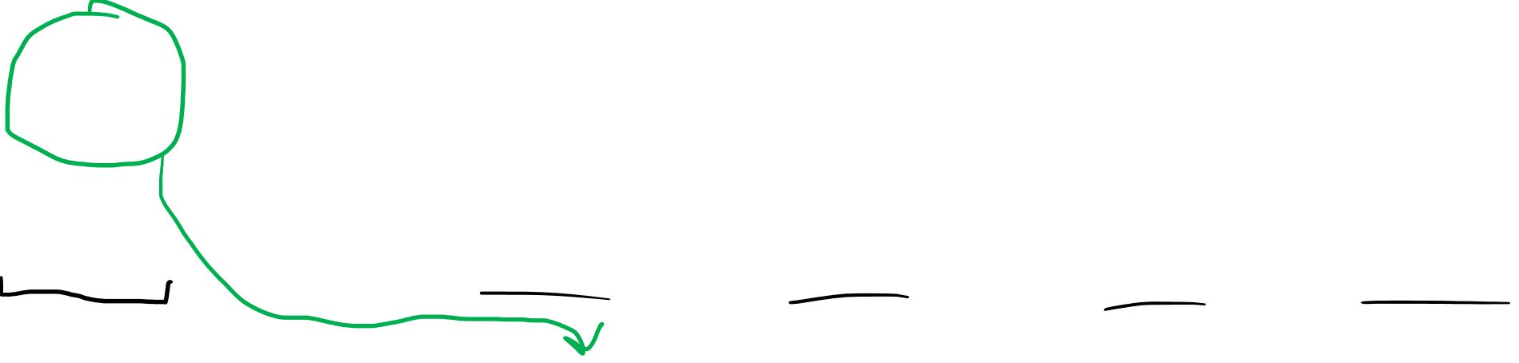
$${\tilde{h}}_{αβ}=h_{αβ}−ξ_{α,β}−ξ_{β,α }$$
$$\left\|ξ_{α}\right\|≪1$$
$$\left\|ξ_{α,β}\right\|≪1$$
${\tilde{R}}_{ σμν}^{ρ}=\frac{1}{2}η^{ρα}\left(∂_{μ}∂_{σ}{\tilde{h}}_{αν}−∂_{μ}∂_{α}{\tilde{h}}_{νσ}−∂_{ν}∂_{σ}{\tilde{h}}_{αμ}+∂_{ν}∂_{α}{\tilde{h}}_{μσ}\right)$
${\tilde{R}}_{ σμν}^{ρ}=\frac{1}{2}η^{ρα}\left[\begin{aligned}∂_{μ}∂_{σ}{\tilde{h}}_{αν} \\ −∂_{μ}∂_{α}{\tilde{h}}_{νσ} \\ −∂_{ν}∂_{σ}{\tilde{h}}_{αμ} \\ +∂_{ν}∂_{α}{\tilde{h}}_{μσ}\end{aligned}\right]$
$=\frac{1}{2}η^{ρα}\left[\begin{aligned}∂_{μ}∂_{σ}\left(h_{αν}−ξ_{α,ν}−ξ_{ν,α }\right) \\ −∂_{μ}∂_{α}\left(h_{νσ}−ξ_{ν,σ}−ξ_{σ,ν }\right) \\ −∂_{ν}∂_{σ}\left(h_{αμ}−ξ_{α,μ}−ξ_{μ,α }\right) \\ +∂_{ν}∂_{α}\left(h_{μσ}−ξ_{μ,σ }−ξ_{σ,μ }\right)\end{aligned}\right]$

Slide 24
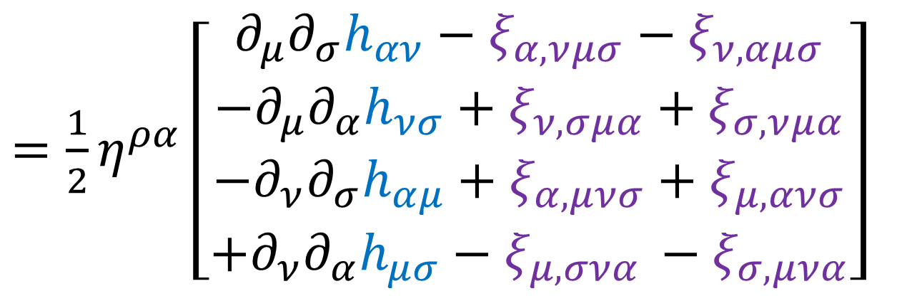


$${\tilde{h}}_{αβ}=h_{αβ}−ξ_{α,β}−ξ_{β,α }$$
$$\left\|ξ_{α}\right\|≪1$$
$$\left\|ξ_{α,β}\right\|≪1$$
${\tilde{R}}_{ σμν}^{ρ}=\frac{1}{2}η^{ρα}\left(∂_{μ}∂_{σ}{\tilde{h}}_{αν}−∂_{μ}∂_{α}{\tilde{h}}_{νσ}−∂_{ν}∂_{σ}{\tilde{h}}_{αμ}+∂_{ν}∂_{α}{\tilde{h}}_{μσ}\right)$
$=\frac{1}{2}η^{ρα}\left[\begin{aligned}∂_{μ}∂_{σ}h_{αν}−ξ_{α,νμσ}−ξ_{ν,αμσ} \\ −∂_{μ}∂_{α}h_{νσ}+ξ_{ν,σμα}+ξ_{σ,νμα} \\ −∂_{ν}∂_{σ}h_{αμ}+ξ_{α,μνσ}+ξ_{μ,ανσ} \\ +∂_{ν}∂_{α}h_{μσ}−ξ_{μ,σνα }−ξ_{σ,μνα}\end{aligned}\right]$
$=\frac{1}{2}η^{ρα}\left[\begin{aligned}∂_{μ}∂_{σ}\left(h_{αν}−ξ_{α,ν}−ξ_{ν,α }\right) \\ −∂_{μ}∂_{α}\left(h_{νσ}−ξ_{ν,σ}−ξ_{σ,ν }\right) \\ −∂_{ν}∂_{σ}\left(h_{αμ}−ξ_{α,μ}−ξ_{μ,α }\right) \\ +∂_{ν}∂_{α}\left(h_{μσ}−ξ_{μ,σ }−ξ_{σ,μ }\right)\end{aligned}\right]$
$=\frac{1}{2}η^{ρα}\left(∂_{μ}∂_{σ}h_{αν}−∂_{μ}∂_{α}h_{νσ}−∂_{ν}∂_{σ}h_{αμ}+∂_{ν}∂_{α}h_{μσ}\right)=R_{ σμν}^{ρ}$

Slide 25



$${\tilde{h}}_{αβ}=h_{αβ}−ξ_{α,β}−ξ_{β,α }$$
$$\left\|ξ_{α}\right\|≪1$$
$$\left\|ξ_{α,β}\right\|≪1$$
${\tilde{R}}_{ σμν}^{ρ}=\frac{1}{2}η^{ρα}\left(∂_{μ}∂_{σ}{\tilde{h}}_{αν}−∂_{μ}∂_{α}{\tilde{h}}_{νσ}−∂_{ν}∂_{σ}{\tilde{h}}_{αμ}+∂_{ν}∂_{α}{\tilde{h}}_{μσ}\right)$
$=\frac{1}{2}η^{ρα}\left[\begin{aligned}∂_{μ}∂_{σ}h_{αν}−ξ_{α,νμσ}−ξ_{ν,αμσ} \\ −∂_{μ}∂_{α}h_{νσ}+ξ_{ν,σμα}+ξ_{σ,νμα} \\ −∂_{ν}∂_{σ}h_{αμ}+ξ_{α,μνσ}+ξ_{μ,ανσ} \\ +∂_{ν}∂_{α}h_{μσ}−ξ_{μ,σνα }−ξ_{σ,μνα}\end{aligned}\right]$
$=\frac{1}{2}η^{ρα}\left[\begin{aligned}∂_{μ}∂_{σ}\left(h_{αν}−ξ_{α,ν}−ξ_{ν,α }\right) \\ −∂_{μ}∂_{α}\left(h_{νσ}−ξ_{ν,σ}−ξ_{σ,ν }\right) \\ −∂_{ν}∂_{σ}\left(h_{αμ}−ξ_{α,μ}−ξ_{μ,α }\right) \\ +∂_{ν}∂_{α}\left(h_{μσ}−ξ_{μ,σ }−ξ_{σ,μ }\right)\end{aligned}\right]$
$\frac{∂x^{ν}}{∂{\tilde{x}}^{μ}}=δ_{μ}^{ ν}−\frac{∂ξ^{ν}}{∂x^{μ }}$
$=\frac{1}{2}η^{ρα}\left(∂_{μ}∂_{σ}h_{αν}−∂_{μ}∂_{α}h_{νσ}−∂_{ν}∂_{σ}h_{αμ}+∂_{ν}∂_{α}h_{μσ}\right)=R_{ σμν}^{ρ}$
$\frac{∂ξ^{α }}{∂{\tilde{x}}^{μ}}=\frac{∂ξ^{α }}{∂x^{ν}}\frac{∂x^{ν}}{∂{\tilde{x}}^{μ}}$ $=\frac{∂ξ^{α }}{∂x^{ν}}\left(δ_{μ}^{ ν}−\frac{∂ξ^{ν}}{∂x^{μ }}\right)=\frac{∂ξ^{α }}{∂x^{ν}}δ_{μ}^{ ν}−\frac{∂ξ^{α }}{∂x^{ν}}\frac{∂ξ^{ν}}{∂x^{μ }}=\frac{∂ξ^{α }}{∂x^{μ}}$

Slide 26


$${\tilde{h}}_{αβ}=h_{αβ}−ξ_{α,β}−ξ_{β,α }$$
$$\left\|ξ_{α}\right\|≪1$$
$$\left\|ξ_{α,β}\right\|≪1$$
$${\tilde{R}}_{ σμν}^{ρ}=R_{ σμν}^{ρ}$$
Riemann Tensor components don’t change under a change of coordinates from a small displacement field $ξ^{α}$.

Slide 27





Goal: change coordinates to Lorenz Gauge
$$x^{α} → {\tilde{x}}^{α}$$
Lorenz Condition
$${\overline{h}}_{μν} → {\overline{\tilde{h}}}_{μν}$$
$$⇒∂_{β}{\overline{\tilde{h}}}^{αβ}=0$$
${\overline{h}}_{μν}≡h_{μν}−\frac{1}{2}η_{μν}h$
${\overline{\tilde{h}}}_{μν}≡{\tilde{h}}_{μν}−\frac{1}{2}η_{μν}\tilde{h}$

Slide 28




$${\overline{\tilde{h}}}_{μν}$$
$←$ Hard to read
New notation:
$$\overline{h_{μν}}$$
$$\overline{{\tilde{h}}_{μν}}$$

Slide 29


$${\tilde{h}}_{μν}≡h_{μν}−ξ_{μ,ν}−ξ_{ν,μ}$$
$\overline{{\tilde{h}}_{μν}}≡{\tilde{h}}_{μν}−\frac{1}{2}η_{μν}\tilde{h}={\tilde{h}}_{μν}−\frac{1}{2}η_{μν}η^{αβ}{\tilde{h}}_{αβ}$
$\overline{{\tilde{h}}_{μν}}=\left(h_{μν}−ξ_{μ,ν}−ξ_{ν,μ}\right)−\frac{1}{2}η_{μν}\left[η^{αβ}\left(h_{αβ}−ξ_{α,β}−ξ_{β,α}\right)\right]$
$\overline{{\tilde{h}}_{μν}}=h_{μν}−\frac{1}{2}η_{μν}h−ξ_{μ,ν}−ξ_{ν,μ}+\frac{1}{2}η_{μν}η^{αβ}ξ_{α,β}+\frac{1}{2}η_{μν}η^{αβ}ξ_{β,α}$
$\overline{{\tilde{h}}_{μν}}=h_{μν}−\frac{1}{2}η_{μν}h−ξ_{μ,ν}−ξ_{ν,μ}+\frac{1}{2}η_{μν}ξ_{ ,β}^{β}+\frac{1}{2}η_{μν}ξ_{ ,β}^{β}$
$$\overline{{\tilde{h}}_{μν}}=\overline{h_{μν}}−ξ_{μ,ν}−ξ_{ν,μ}+η_{μν}ξ_{ ,σ}^{σ}$$
$$η^{μα}η^{νβ}\overline{{\tilde{h}}_{μν}}=η^{μα}η^{νβ}\left(\overline{h_{μν}}−ξ_{μ,ν}−ξ_{ν,μ}+η_{μν}ξ_{ ,σ}^{σ}\right)$$
$$\overline{{\tilde{h}}^{αβ}}=\overline{h^{αβ}}−η^{μα}η^{νβ}ξ_{μ,ν}−η^{μα}η^{νβ}ξ_{ν,μ}+η^{αβ}ξ_{ ,σ}^{σ}$$

Slide 30


$$\overline{{\tilde{h}}^{αβ}}=\overline{h^{αβ}}−η^{μα}η^{νβ}ξ_{μ,ν}−η^{μα}η^{νβ}ξ_{ν,μ}+η^{αβ}ξ_{ ,σ}^{σ}$$
$$\overline{{\tilde{h}}^{αβ}}=\overline{h^{αβ}}−η^{νβ}ξ_{ ,ν}^{α}−η^{μα}ξ_{ ,μ}^{β}+η^{αβ}ξ_{ ,σ}^{σ}$$
$$\overline{{\tilde{h}}_{ ,β}^{αβ}}=\overline{h_{ ,β}^{αβ}}−η^{νβ}ξ_{ ,νβ}^{α}−η^{μα}ξ_{ ,μβ}^{β}+η^{αβ}ξ_{ ,σβ}^{σ}$$
$$\overline{{\tilde{h}}_{ ,β}^{αβ}}=\overline{h_{ ,β}^{αβ}}−η^{νβ}∂_{ν}∂_{β }ξ^{α}$$
$$∂_{β }\overline{{\tilde{h}}^{αβ}}=∂_{β }\overline{h^{αβ}}−□ξ^{α}$$
Choose $ξ^{α}$ such that $∂_{β }\overline{h^{αβ}}=□ξ^{α}$
$⇒∂_{β }\overline{{\tilde{h}}^{αβ}}=0$ is part of the Lorenz Gauge.

Slide 31



$$∂_{β }\overline{{\tilde{h}}^{αβ}}=∂_{β }\overline{h^{αβ}}−□ξ^{α}$$
Choose $ξ^{α}$ such that $∂_{β }\overline{h^{αβ}}=□ξ^{α}$
$⇒∂_{β }\overline{{\tilde{h}}^{αβ}}=0$ is part of the Lorenz Gauge.
The choice of $ξ^{α}$ is not unique.
Any $χ^{α}$ with $□χ^{α}=0$ will also solve
$∂_{β }\overline{h^{αβ}}=□\left(ξ^{α}+χ^{α}\right)=□ξ^{α}+□χ^{α}=□ξ^{α}$
The “Lorenz Gauge” is really a class of coordinate systems, not just one coordinate system.

Slide 32






If $∂_{β}\overline{{\tilde{h}}^{αβ}}=0$ (Lorenz Gauge)
then the first 3 terms go to zero.
${\tilde{G}}_{μν}=\frac{1}{2}\left(∂^{α}∂_{μ}\overline{{\tilde{h}}_{αν}}+∂^{α}∂_{ν}\overline{{\tilde{h}}_{μα}}−η_{μν}∂^{α}∂^{β}\overline{{\tilde{h}}_{αβ}}−∂^{α}∂_{α}\overline{{\tilde{h}}_{μν}}\right)$
Linearized Gravity + Lorenz Gauge
${\tilde{G}}_{μν}=\frac{8πG}{c^{4}}{\tilde{T}}_{μν}$
${\tilde{G}}_{μν}=−\frac{1}{2}□\overline{{\tilde{h}}_{μν}}$
Vacuum
$${\tilde{T}}_{μν}=0$$
$$□\overline{{\tilde{h}}_{μν}}=0$$
Wave Equation

Slide 33





Wave Equation
${\tilde{g}}_{μν}=η_{μν}+{\tilde{h}}_{μν}$
$\overline{{\tilde{h}}_{μν}}={\tilde{h}}_{μν}−\frac{1}{2}η_{μν}\tilde{h}$
$$□\overline{{\tilde{h}}_{μν}}=0$$
$\frac{∂^{2}\overline{{\tilde{h}}_{μν}}}{∂c{\tilde{t}}^{2}}−\frac{∂^{2}\overline{{\tilde{h}}_{μν}}}{∂{\tilde{x}}^{2}}−\frac{∂^{2}\overline{{\tilde{h}}_{μν}}}{∂{\tilde{y}}^{2}}−\frac{∂^{2}\overline{{\tilde{h}}_{μν}}}{∂{\tilde{z}}^{2}}=0$
$\frac{1}{c^{2}}\frac{∂^{2}\overline{{\tilde{h}}_{μν}}}{∂{\tilde{t}}^{2}}=∇^{2}\overline{{\tilde{h}}_{μν}}$
Wave speed = speed of light $c$

Slide 34

Reminder:
Gravitational Waves exist in all coordinates
Coordinate systems are a human invention
Choice of coordinates has absolutely no impact on real physics
Lorenz Gauge coordinates give $□\overline{{\tilde{h}}_{μν}}=0$,
which makes existence of gravitational waves very obvious

Slide 35


Next video:
Transverse-Traceless Gauge
$+$ Polarization
$×$ Polarization
(Animation credits to Wikipedia User MOBle)

Slide 36
To finish this video, I’m going to talk about:
The Lorenz Gauge in Electricity & Magnetism
How it relates to the Lorenz Gauge in General Relativity
If I make a video on Relativistic E&M, I’ll link it in the description.
For now I’ll just do a quick review…

Slide 37

Gauge $≈$ choice we have the freedom to make
This choice doesn’t change our
physical system.

Slide 38
















Electrostatics (no moving charges)
Electric Force Field
Electric Potential
$$φ$$
$${\vec{F}}_{E}=q\vec{E}=q\left(−∇φ\right)$$
$$+$$
$$+$$
$+$
$+$
$$+$$
$$+$$
$$−$$
$$−$$
$$−$$
$$+$$
$$+$$

Slide 39


Different Potentials result in the same Electric Field (the same physics)
$$\vec{E}=−∇φ$$
$$\vec{E}=−∇\left(φ+k\right)$$
$$\vec{E}=−∇φ−∇k$$
$$\vec{E}=−∇φ−0$$

Slide 40




Different Potentials result in the same Electric Field (the same physics)
$$\vec{E}=−∇φ$$
$$φ→φ+k$$
$$\vec{E}=−∇\left(φ+k\right)$$
$$\vec{E}=−∇φ−∇k$$
$$\vec{E}=−∇φ$$

Slide 41


Magnetic Force
$${\vec{F}}_{B}=q\left(v×\vec{B}\right)$$
$$\vec{B}=∇×\vec{a}$$
Magnetic Field
Magnetic Vector Potential

Slide 42




Different Potentials result in the same Magnetic Field (the same physics)
$$\vec{B}=∇×\vec{a}$$
$$\vec{a}→\vec{a}+∇f$$
$$\vec{B}=∇×\left(\vec{a}+∇f\right)$$
$$\vec{B}=∇×\vec{a}+∇×\left(∇f\right)$$
$$\vec{B}=∇×\vec{a}$$

Slide 43







(electrodynamics)
Electric Field:
(scalar $φ$, vector $\vec{a}$)
Magnetic Field: (vector $\vec{a}$)
$\vec{E}=−∇φ−\frac{∂\vec{a}}{∂t}$
$$\vec{B}=∇×\vec{a}$$
$E_{x}=−∂_{x}φ−∂_{t}a^{x}$
$E_{y}=−∂_{y}φ−∂_{t}a^{y}$
$E_{z}=−∂_{z}φ−∂_{t}a^{z}$
$$B_{x}=∂_{y}a^{z}−∂_{z}a^{y}$$
$$B_{y}=∂_{z}a^{x}−∂_{x}a^{z}$$
$$B_{z}=∂_{x}a^{y}−∂_{y}a^{x}$$

Slide 44



Electric Potential $$φ$$
(scalar)
4-Potential $$\vec{𝒜}$$
(4-vector)
Magnetic Potential $$\vec{a}$$
(3D vector)

Slide 45




4-Potential Vector
$\vec{𝒜}→\left[\begin{aligned}𝒜^{t} \\ 𝒜^{x} \\ 𝒜^{y} \\ 𝒜^{z}\end{aligned}\right]=\left[\begin{aligned}\frac{φ}{c} \\ a^{x} \\ a^{y} \\ a^{z}\end{aligned}\right]$
$η_{μν}→\left[\begin{matrix}\begin{matrix}\begin{aligned}+1 \\ 0 \\ 0 \\ 0\end{aligned} & \begin{aligned}0 \\ −1 \\ 0 \\ 0\end{aligned}\end{matrix} & \begin{matrix}\begin{aligned}0 \\ 0 \\ −1 \\ 0\end{aligned} & \begin{aligned}0 \\ 0 \\ 0 \\ −1\end{aligned}\end{matrix}\end{matrix}\right]$
4-Potential Covector
$$𝒜_{μ}=η_{μν}𝒜^{ν}$$
$→\left[\begin{matrix}\begin{matrix}𝒜^{t} & −𝒜^{x}\end{matrix} & −\begin{matrix}𝒜^{y} & −𝒜^{z}\end{matrix}\end{matrix}\right]$
$=\left[\begin{matrix}\begin{matrix}\frac{φ}{c} & −a^{x}\end{matrix} & \begin{matrix}−a^{y} & −a^{z}\end{matrix}\end{matrix}\right]$
$$𝒜_{μ}=η_{μν}𝒜^{ν}→$$
$=\left[\begin{matrix}\begin{matrix}−𝒜_{t} & 𝒜_{x}\end{matrix} & \begin{matrix}𝒜_{y} & 𝒜_{z}\end{matrix}\end{matrix}\right]$
$=\left[\begin{matrix}\begin{matrix}−\frac{φ}{c} & a_{x}\end{matrix} & \begin{matrix}a_{y} & a_{z}\end{matrix}\end{matrix}\right]$

Slide 46







Electric Field:
($𝒜_{t}=\frac{φ}{c}$, $𝒜_{i}=−a^{i}$)
Magnetic Field: (vector $𝒜_{i}=−a^{i}$)
$\frac{\vec{E}}{c}=−∇\frac{φ}{c}−\frac{∂\vec{a}}{∂ct}$
$$\vec{B}=∇×\vec{a}$$
$\frac{E_{x}}{c}=−∂_{x}𝒜_{t}+∂_{ct}𝒜_{x}$
$\frac{E_{y}}{c}=−∂_{y}𝒜_{t}+∂_{ct}𝒜_{y}$
$\frac{E_{z}}{c}=−∂_{z}𝒜_{t}+∂_{ct}𝒜_{z}$
$$B_{x}=−∂_{y}𝒜_{z}+∂_{z}𝒜_{y}$$
$$B_{y}=−∂_{z}𝒜_{x}+∂_{x}𝒜_{z}$$
$$B_{z}=−∂_{x}𝒜_{y}+∂_{y}𝒜_{x}$$

Slide 47







$$−B_{x}=∂_{y}𝒜_{z}−∂_{z}𝒜_{y}$$
$$−B_{y}=∂_{z}𝒜_{x}−∂_{x}𝒜_{z}$$
$$−B_{z}=∂_{x}𝒜_{y}−∂_{y}𝒜_{x}$$
$$=F_{yz}$$
$$=F_{zx}$$
$$=F_{xy}$$
Faraday Tensor
$$F_{μν}$$
$$=∂_{μ}𝒜_{ν}−∂_{ν}𝒜_{μ}$$
$\frac{E_{x}}{c}=∂_{ct}𝒜_{x}−∂_{x}𝒜_{t}$
$\frac{E_{y}}{c}=∂_{ct}𝒜_{y}−∂_{y}𝒜_{t}$
$\frac{E_{z}}{c}=∂_{ct}𝒜_{z}−∂_{z}𝒜_{t}$
$$=F_{tx}$$
$$=F_{ty}$$
$$=F_{tz}$$
$F_{μν}→\left[\begin{matrix}\begin{matrix}\begin{aligned}0 \\ −E_{x}/c \\ −E_{y}/c \\ −E_{Z}/c\end{aligned} & \begin{aligned}E_{x}/c \\ 0 \\ B_{z} \\ −B_{y}\end{aligned}\end{matrix} & \begin{matrix}\begin{aligned}E_{y}/c \\ −B_{z} \\ 0 \\ B_{x}\end{aligned} & \begin{aligned}E_{z}/c \\ B_{y} \\ −B_{x} \\ 0\end{aligned}\end{matrix}\end{matrix}\right]$

Slide 48




Different Potentials result in the same Faraday Tensor (the same physics)
$$F_{μν}=∂_{μ}𝒜_{ν}−∂_{ν}𝒜_{μ}$$
$$𝒜_{μ}→𝒜_{μ}+∂_{μ}f$$
$$F_{μν}=∂_{μ}\left(𝒜_{ν}+∂_{ν}f\right)−∂_{ν}\left(𝒜_{μ}+∂_{μ}f\right)$$
$$F_{μν}=∂_{μ}𝒜_{ν}+∂_{μ}∂_{ν}f−∂_{ν}𝒜_{μ}−∂_{ν}∂_{μ}f$$
$$F_{μν}=∂_{μ}𝒜_{ν}−∂_{ν}𝒜_{μ}$$

Slide 49







There are multiple possible 4-potentials $𝒜_{μ}$ that give the same Faraday Tensor $F_{μν}$.
$$𝒜_{μ}+∂_{μ}f$$
$$F_{μν}$$
$$𝒜_{μ}+∂_{μ}g$$
$$𝒜_{μ}+∂_{μ}h$$
Freedom to pick $𝒜_{μ}$ is called “Gauge Freedom”.
Choosing a specific $𝒜_{μ}$ is called “Choosing a Gauge”.
Changing from one $𝒜_{μ}$ to another in a way that doesn’t change $F_{μν}$ is called a “Gauge Transformation”.

Slide 50









Electro-magnetism
(Linearized) General Relativity
Choice of coordinates $x^{α}$ (with metric perturbation $h_{μν}$)
Choice of 4-Potential $𝒜_{μ}$
Multiple $𝒜_{μ}$, Same $F_{μν}$
Multiple $h_{μν}$, Same $R_{ σμν}^{ρ}$
Gauge Transformation
$$x^{α}→x^{α}+ξ^{α}$$
$$h_{μν}→h_{μν}−ξ_{μ,ν}−ξ_{ν,μ}$$
Gauge Transformation $𝒜_{μ}→𝒜_{μ}+∂_{μ}f$
Lorenz Gauge $∂_{μ}𝒜^{μ}=0$
Lorenz Gauge $∂_{μ}\overline{h^{μν}}=0$

