Slide 1
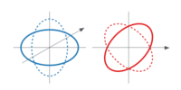

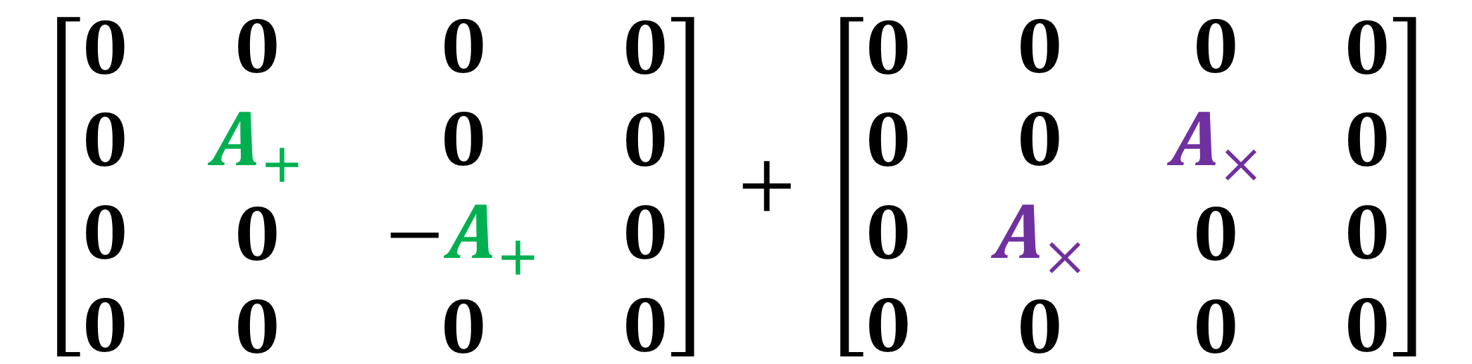

Transverse-Traceless Gauge
$$\left[\begin{matrix}\begin{matrix}\begin{aligned}0 \\ 0 \\ 0 \\ 0\end{aligned} & \begin{aligned}0 \\ A_{+} \\ 0 \\ 0\end{aligned}\end{matrix} & \begin{matrix}\begin{aligned}0 \\ 0 \\ −A_{+} \\ 0\end{aligned} & \begin{aligned}0 \\ 0 \\ 0 \\ 0\end{aligned}\end{matrix}\end{matrix}\right] + \left[\begin{matrix}\begin{matrix}\begin{aligned}0 \\ 0 \\ 0 \\ 0\end{aligned} & \begin{aligned}0 \\ 0 \\ A_{×} \\ 0\end{aligned}\end{matrix} & \begin{matrix}\begin{aligned}0 \\ A_{×} \\ 0 \\ 0\end{aligned} & \begin{aligned}0 \\ 0 \\ 0 \\ 0\end{aligned}\end{matrix}\end{matrix}\right]$$
Plus $+$ Polarization
Cross $×$ Polarization
(Polarizations of gravitational waves)

Slide 2
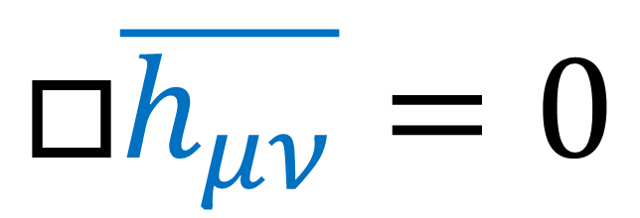

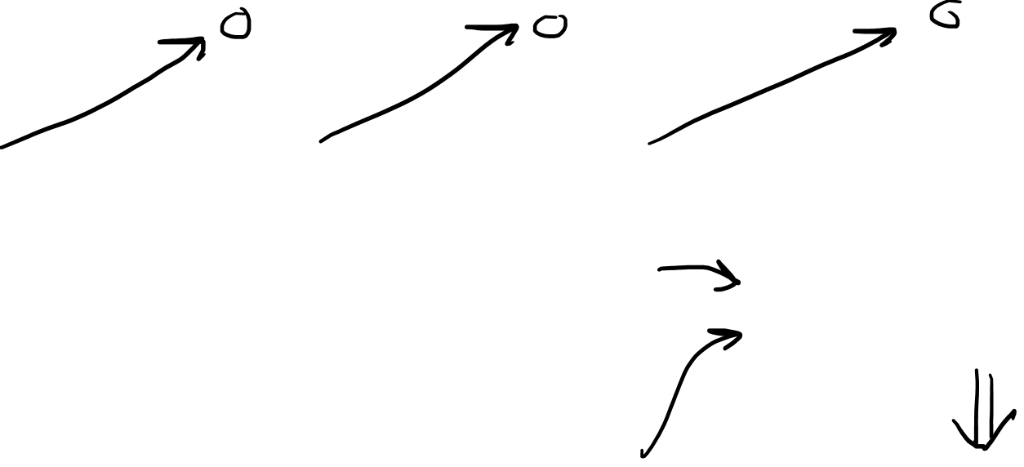
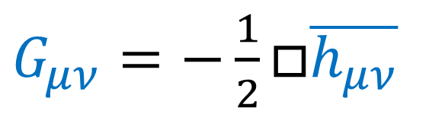
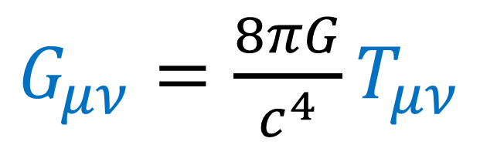
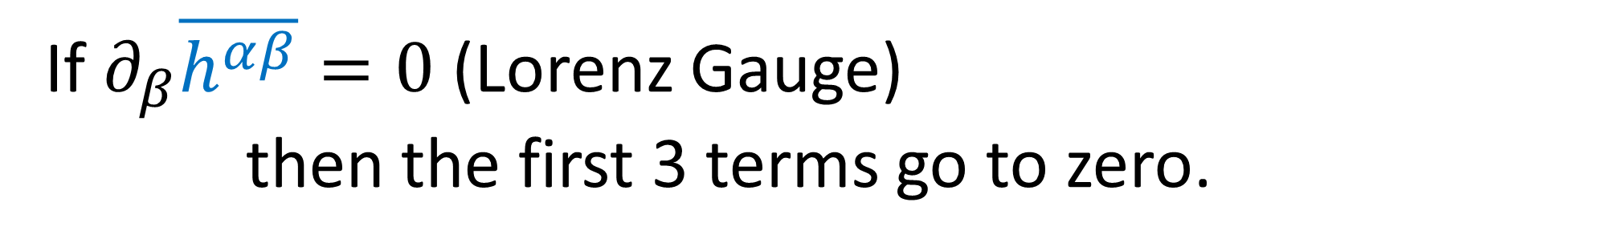
If $∂_{β}\overline{h^{αβ}}=0$ (Lorenz Gauge)
then the first 3 terms go to zero.
$G_{μν}=\frac{1}{2}\left(∂^{α}∂_{μ}\overline{h_{αν}}+∂^{α}∂_{ν}\overline{h_{μα}}−η_{μν}∂^{α}∂^{β}\overline{h_{αβ}}−∂^{α}∂_{α}\overline{h_{μν}}\right)$
Linearized Gravity + Lorenz Gauge
$G_{μν}=\frac{8πG}{c^{4}}T_{μν}$
$G_{μν}=−\frac{1}{2}□\overline{h_{μν}}$
Vacuum
$$T_{μν}=0$$
$$□\overline{h_{μν}}=0$$
Wave Equation

Slide 3
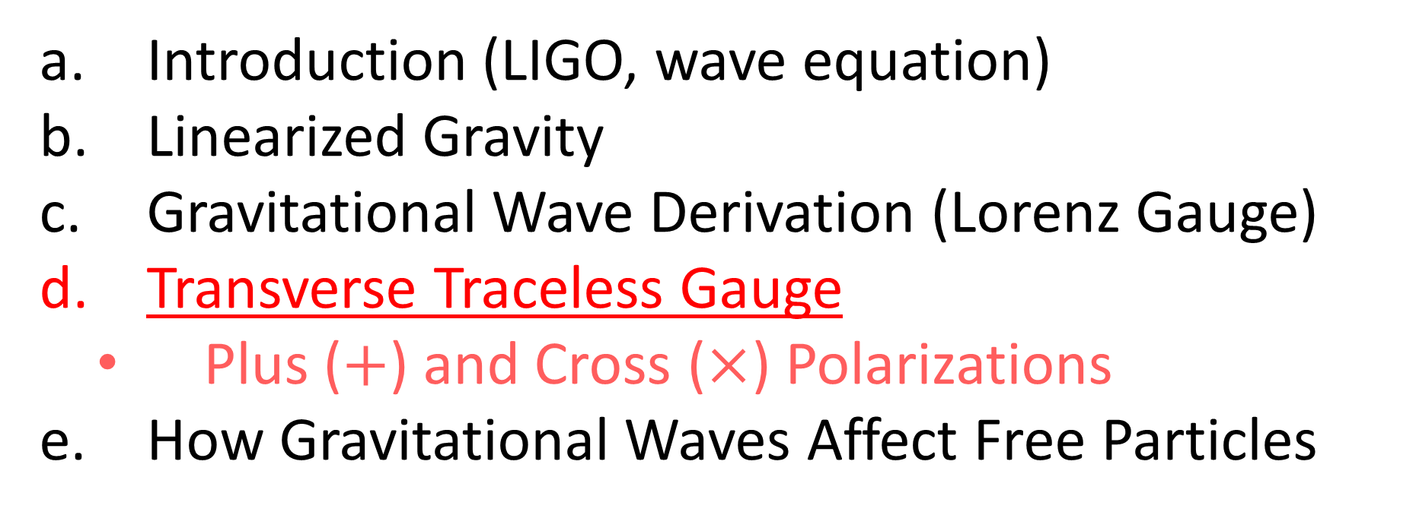

Relativity 109: Gravitational Waves
Introduction (LIGO, wave equation)
Linearized Gravity
Gravitational Wave Derivation (Lorenz Gauge)
Transverse Traceless Gauge
Plus ($+$) and Cross ($×$) Polarizations
How Gravitational Waves Affect Free Particles
Sources:
Good PDF: http://star-www.st-and.ac.uk/~hz4/gr/hendry_GRwaves.pdf
Sean Caroll: https://preposterousuniverse.com/wp-content/uploads/grnotes-six.pdf
Wikipedia: https://en.wikipedia.org/wiki/Linearized_gravity
YouTube: https://www.youtube.com/watch?v=kIBdtbCszB0
Other PDF: https://www.tat.physik.uni-tuebingen.de/~kokkotas/Teaching/NS.BH.GW_files/GW_Physics.pdf

Slide 4
Polarization = geometric orientation of waves

Slide 5


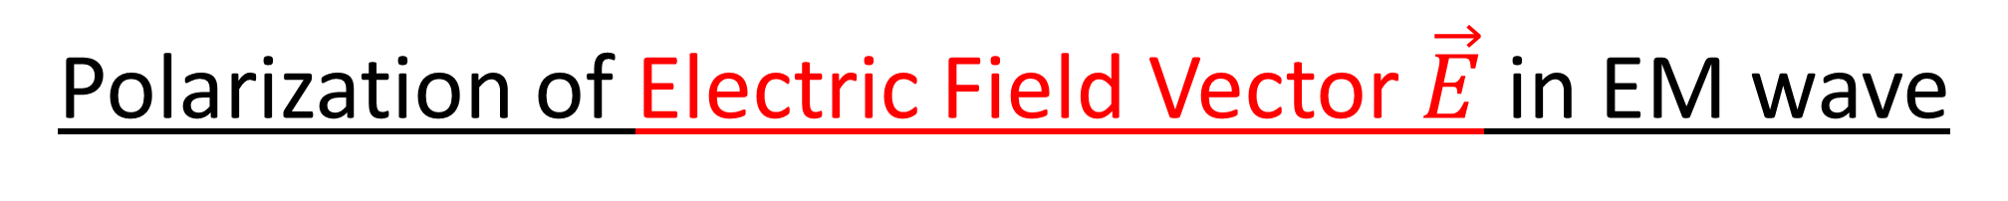








Polarization of Electric Field Vector $\vec{E}$ in EM wave
$$y$$
$$y$$
$$y$$
$$y$$
$$x$$
$$x$$
$$x$$
$$x$$
Vertical Polarization
Horizontal Polarization
$$z$$
$$z$$

Slide 6
Polarization of Electric Field Vector $\vec{E}$ in EM wave
$$y$$
$$y$$
$$y$$
$$y$$
$$x$$
$$x$$
$$x$$
$$x$$
Diagonal Polarization
Circular Polarization
$$z$$
$$z$$

Slide 7



Polarization of Electric Field Vector $\vec{E}$ in EM wave
$$y$$
$$y$$
$$y$$
$$y$$
$$x$$
$$x$$
$$x$$
$$x$$
Vertical Polarization
Horizontal Polarization
$$z$$
$$z$$

Slide 8
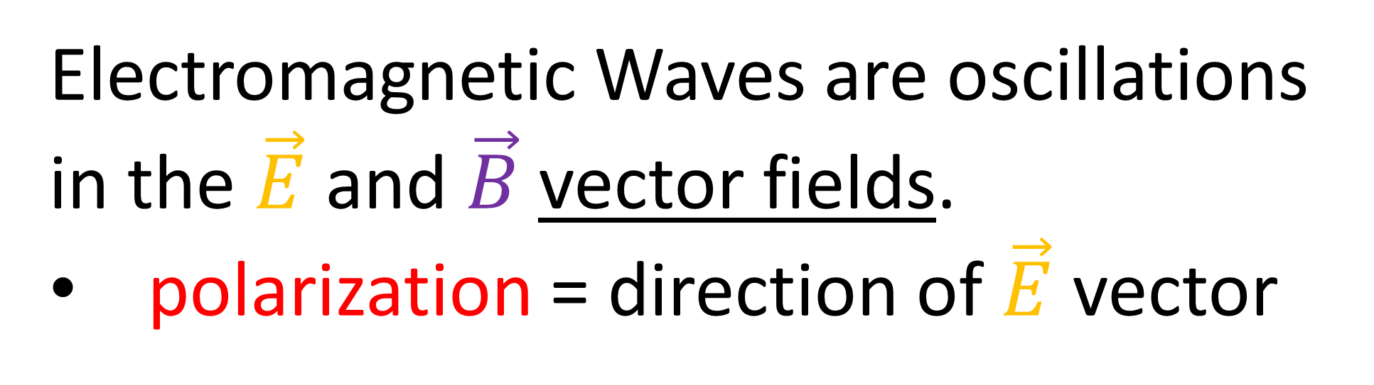
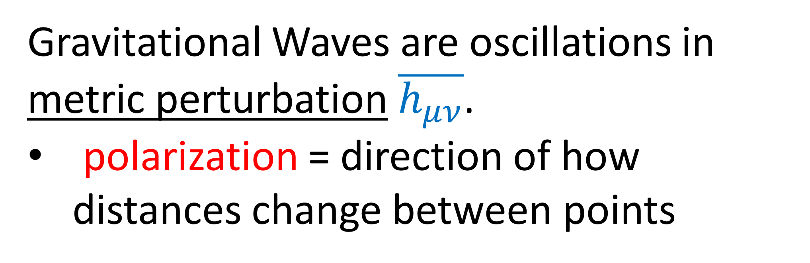
Electromagnetic Waves are oscillations in the $\vec{E}$ and $\vec{B}$ vector fields.
polarization = direction of $\vec{E}$ vector
Gravitational Waves are oscillations in metric perturbation $\overline{h_{μν}}$.
polarization = direction of how distances change between points

Slide 9




Gravitational Wave Polarizations
$$y$$
$$x$$
$+$ Polarization
$×$ Polarization
(Animation credits to Wikipedia User MOBle / Mike Boyle)

Slide 10
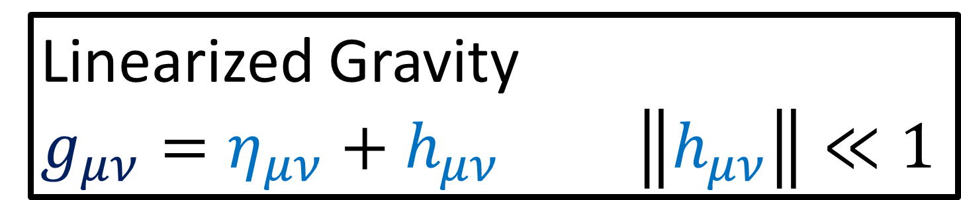
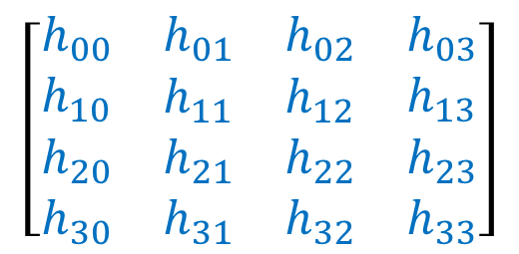
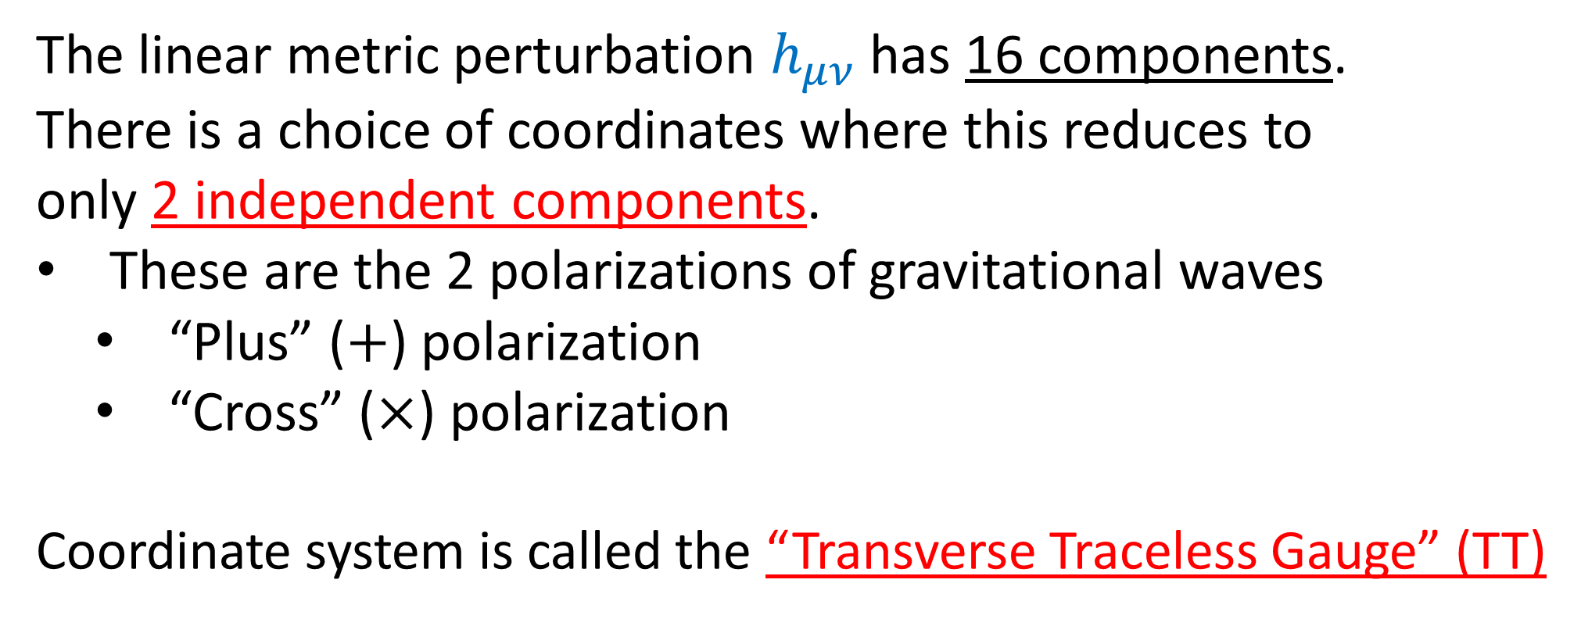
Linearized Gravity
$g_{μν}=η_{μν}+h_{μν}$ $\left\|h_{μν}\right\|≪1$
$$\left[\begin{matrix}\begin{matrix}\begin{aligned}h_{00} \\ h_{10} \\ h_{20} \\ h_{30}\end{aligned} & \begin{aligned}h_{01} \\ h_{11} \\ h_{21} \\ h_{31}\end{aligned}\end{matrix} & \begin{matrix}\begin{aligned}h_{02} \\ h_{12} \\ h_{22} \\ h_{32}\end{aligned} & \begin{aligned}h_{03} \\ h_{13} \\ h_{23} \\ h_{33}\end{aligned}\end{matrix}\end{matrix}\right]$$
The linear metric perturbation $h_{μν}$ has 16 components.
There is a choice of coordinates where this reduces to only 2 independent components.
These are the 2 polarizations of gravitational waves
“Plus” ($+$) polarization
“Cross” ($×$) polarization
Coordinate system is called the “Transverse Traceless Gauge” (TT)

Slide 11
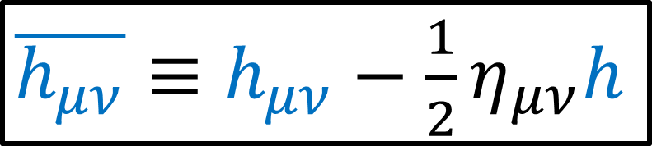
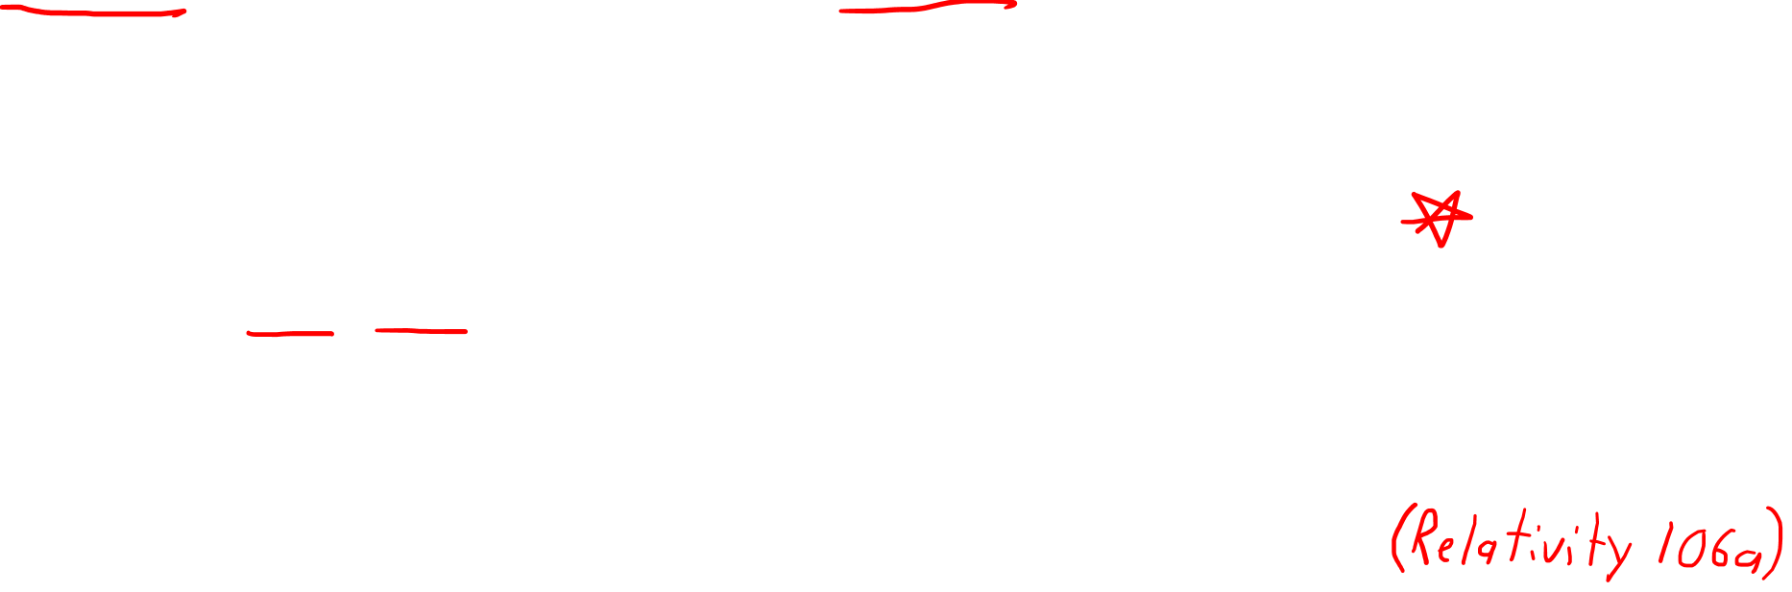
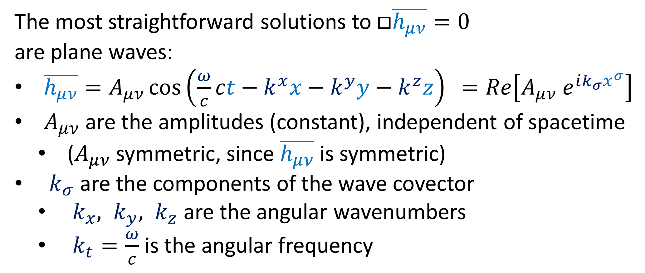
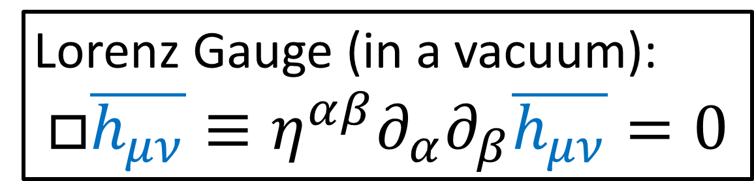
Lorenz Gauge (in a vacuum):
$$□\overline{h_{μν}}≡η^{αβ}∂_{α}∂_{β}\overline{h_{μν}}=0$$
$\overline{h_{μν}}≡h_{μν}−\frac{1}{2}η_{μν}h$
The most straightforward solutions to $□\overline{h_{μν}}=0$
are plane waves:
$\overline{h_{μν}}=A_{μν}\cos\left(\frac{ω}{c}ct−k^{x}x−k^{y}y−k^{z}z\right) =Re\left[A_{μν} e^{ik_{σ}x^{σ}}\right]$
$A_{μν}$ are the amplitudes (constant), independent of spacetime
($A_{μν}$ symmetric, since $\overline{h_{μν}}$is symmetric)
$k_{σ}$ are the components of the wave covector
$k_{x}, k_{y}, k_{z}$ are the angular wavenumbers
$k_{t}=\frac{ω}{c}$ is the angular frequency

Slide 12
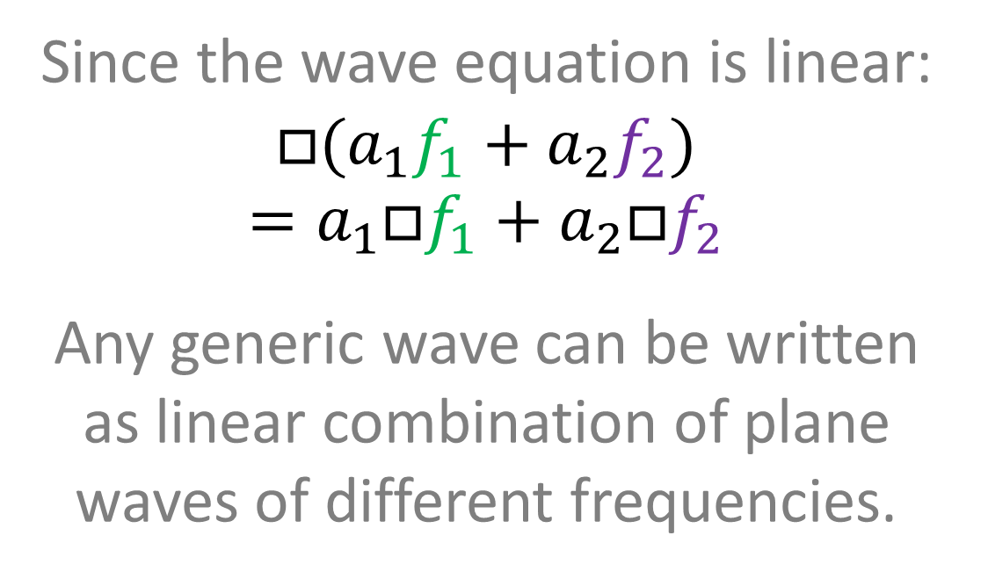
Lorenz Gauge (in a vacuum):
$$□\overline{h_{μν}}≡η^{αβ}∂_{α}∂_{β}\overline{h_{μν}}=0$$
$\overline{h_{μν}}≡h_{μν}−\frac{1}{2}η_{μν}h$
The most straightforward solutions to $□\overline{h_{μν}}=0$ are plane waves
Since the wave equation is linear:
$$□(a_{1}f_{1}+a_{2}f_{2})$$
$$=a_{1}□f_{1}+a_{2}□f_{2}$$
Any generic wave can be written as linear combination of plane waves of different frequencies.
constant spacing

Slide 13
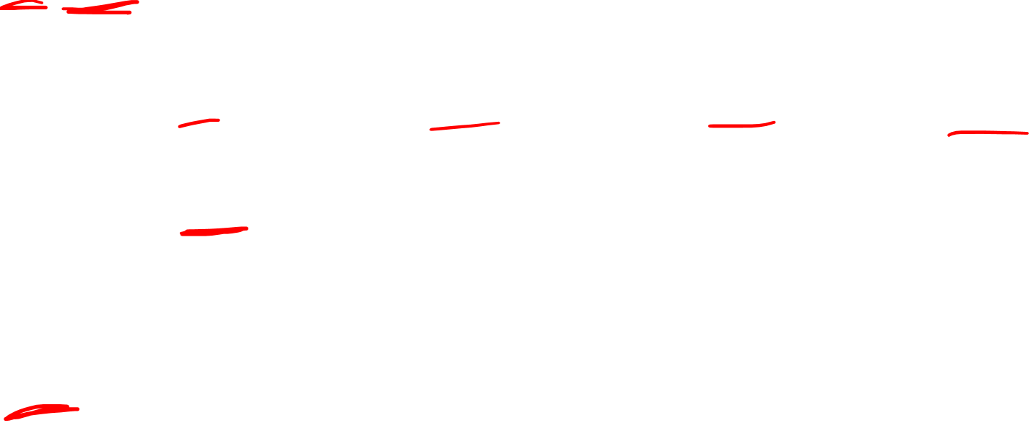
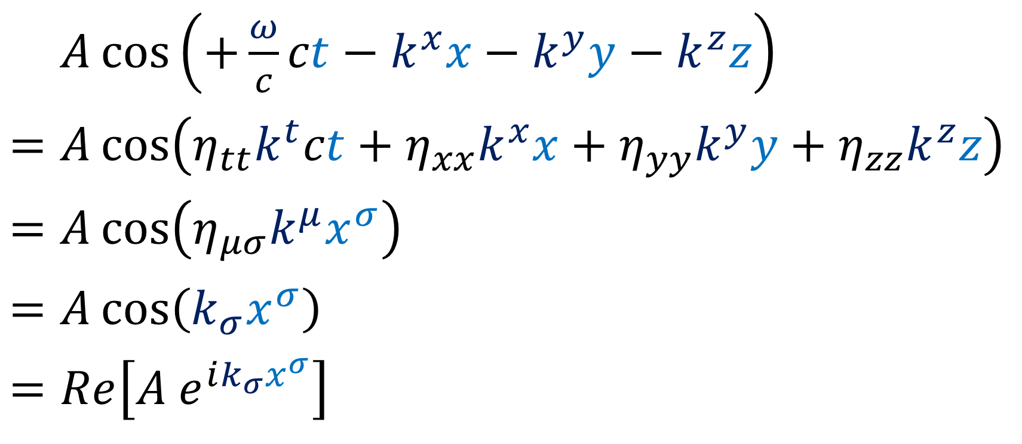
Lorenz Gauge (in a vacuum):
$$□\overline{h_{μν}}≡η^{αβ}∂_{α}∂_{β}\overline{h_{μν}}=0$$
$\overline{h_{μν}}≡h_{μν}−\frac{1}{2}η_{μν}h$
The most straightforward solutions to $□\overline{h_{μν}}=0$ are plane waves
$=A\cos\left(+\frac{ω}{c}ct−k^{x}x−k^{y}y−k^{z}z\right)$
$$=A\cos\left(η_{tt}k^{t}ct+η_{xx}k^{x}x+η_{yy}k^{y}y+η_{zz}k^{z}z\right)$$
$$=A\cos\left(η_{μσ}k^{μ}x^{σ}\right)$$
$$=A\cos\left(k_{σ}x^{σ}\right)$$
$$=Re\left[A e^{ik_{σ}x^{σ}}\right]$$

Slide 14
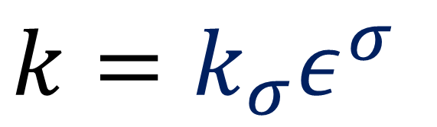
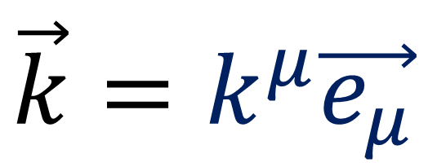
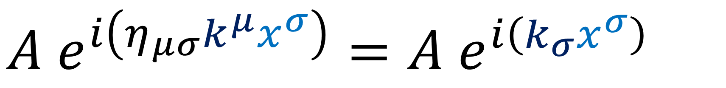
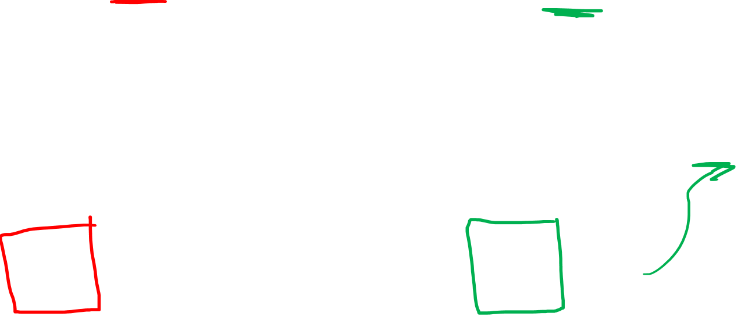
Lorenz Gauge (in a vacuum):
$$□\overline{h_{μν}}≡η^{αβ}∂_{α}∂_{β}\overline{h_{μν}}=0$$
$\overline{h_{μν}}≡h_{μν}−\frac{1}{2}η_{μν}h$
The most straightforward solutions to $□\overline{h_{μν}}=0$ are plane waves
$A e^{i\left(η_{μσ}k^{μ}x^{σ}\right)}=A e^{i\left(k_{σ}x^{σ}\right)}$
Wave Vector components
Wave Covector components
(Relativity 106a)
$\vec{k}=k^{μ}\vec{e_{μ}}$
$k=k_{σ}ε^{σ}$

Slide 15
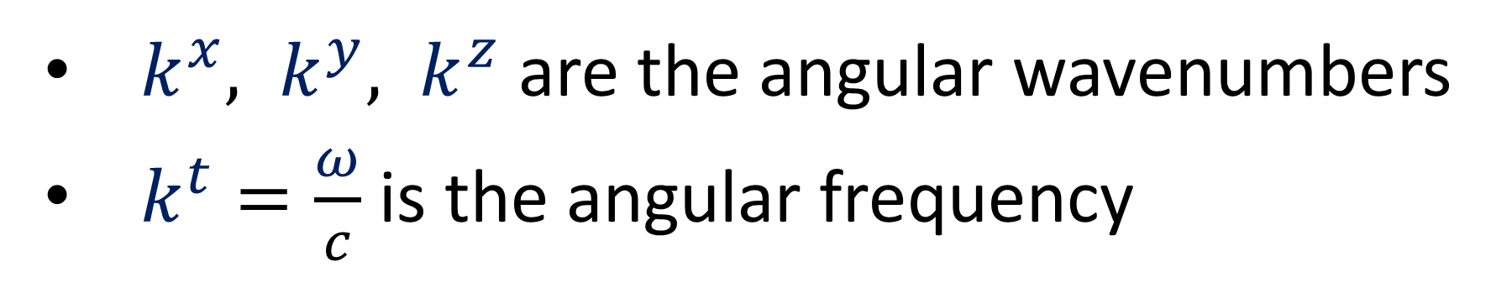
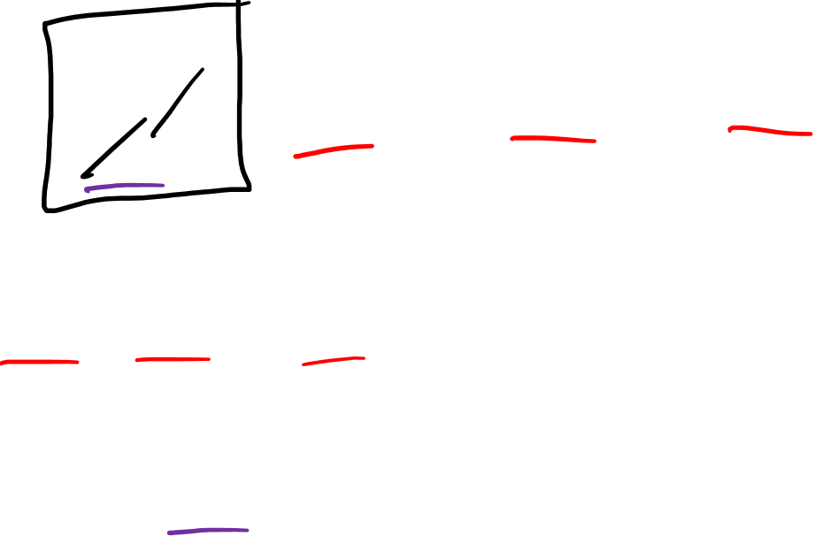
Lorenz Gauge (in a vacuum):
$$□\overline{h_{μν}}≡η^{αβ}∂_{α}∂_{β}\overline{h_{μν}}=0$$
$\overline{h_{μν}}≡h_{μν}−\frac{1}{2}η_{μν}h$
The most straightforward solutions to $□\overline{h_{μν}}=0$ are plane waves
$$A\cos\left(+\frac{ω}{c}ct−k^{x}x−k^{y}y−k^{z}z\right)=Re\left[A e^{i\left(η_{μσ}k^{μ}x^{σ}\right)}\right]$$
$k^{x}, k^{y}, k^{z}$ are the angular wavenumbers
$k^{t}=\frac{ω}{c}$ is the angular frequency

Slide 16
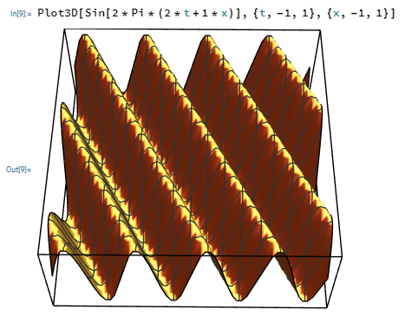


time $ct$
space $x$

Slide 17
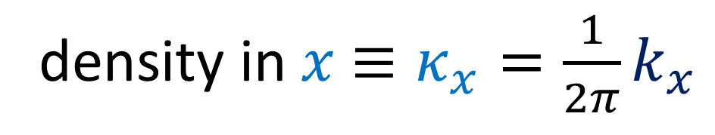
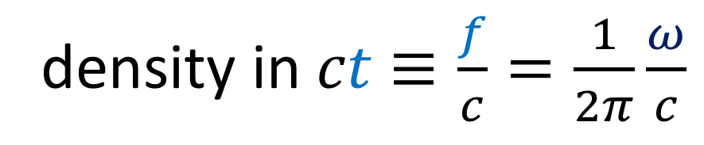
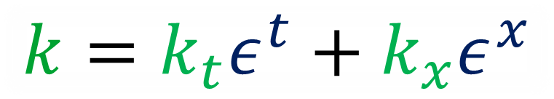
time $ct$
wave covector
density in $x$ $≡κ_{x}=\frac{1}{2π}k_{x}$
linear wavenumber
angular wavenumber
density in $ct$ $≡\frac{f}{c}=\frac{1}{2π}\frac{ω}{c}$
$$k=k_{t}ε^{t}+k_{x}ε^{x}$$
space $x$

Slide 18
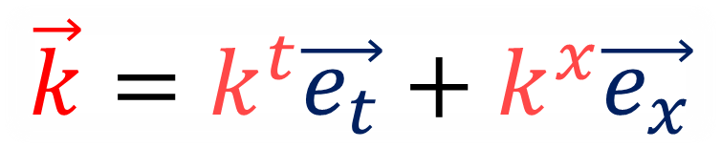
time $ct$
wave covector
wave vector
space $x$
$$\vec{k}=k^{t}\vec{e_{t}}+k^{x}\vec{e_{x}}$$
$$k=k_{t}ε^{t}+k_{x}ε^{x}$$

Slide 19
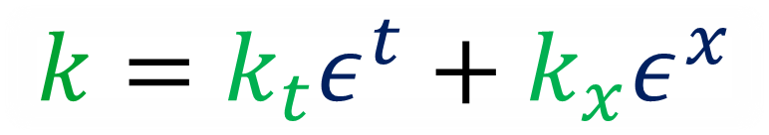
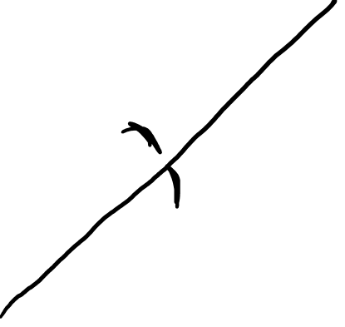
time $ct$
wave covector
wave vector
space $x$
$$\vec{k}=k^{t}\vec{e_{t}}+k^{x}\vec{e_{x}}$$
$$k=k_{t}ε^{t}+k_{x}ε^{x}$$

Slide 20
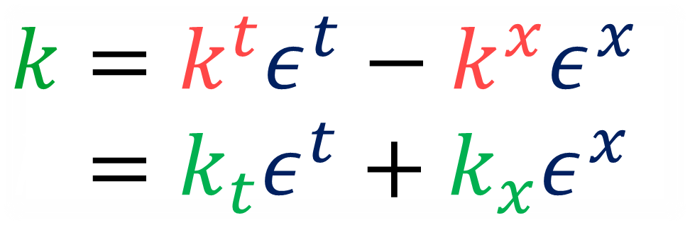
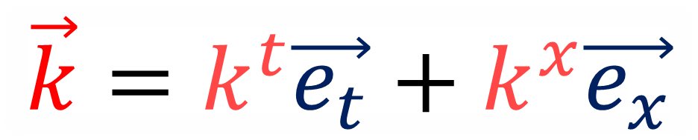
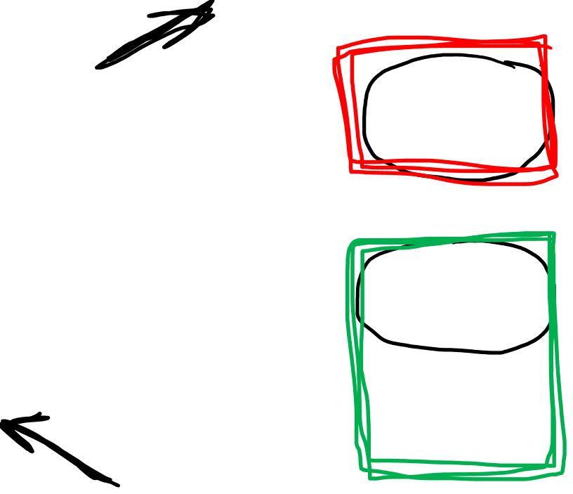
time $ct$
wave covector
$$\vec{k}=k^{t}\vec{e_{t}}+k^{x}\vec{e_{x}}$$
$$k=k^{t}ε^{t}−k^{x}ε^{x}$$
$$k=k_{t}ε^{t}+k_{x}ε^{x}$$
space $x$

Slide 21
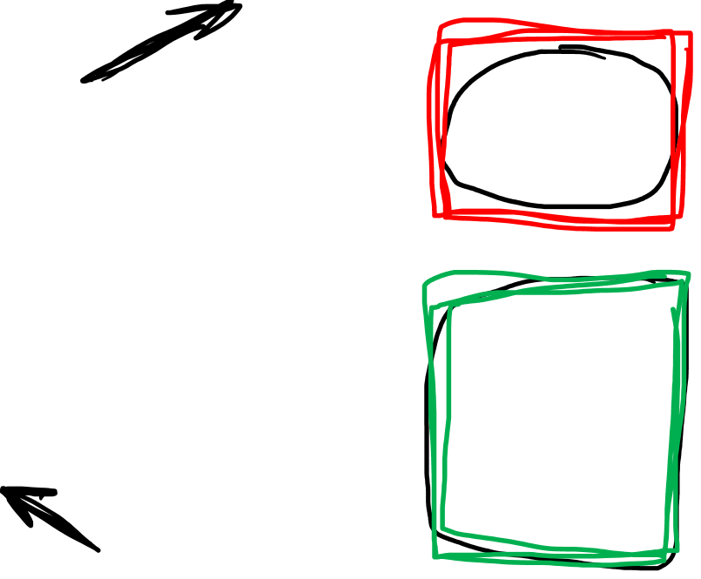
time $ct$
wave covector
$$\vec{k}=k^{t}\vec{e_{t}}+k^{x}\vec{e_{x}}$$
$$k=k^{t}ε^{t}−k^{x}ε^{x}$$
$$k=k_{t}ε^{t}+k_{x}ε^{x}$$
space $x$

Slide 22
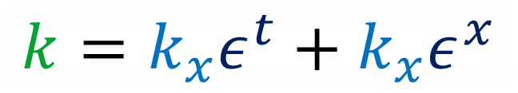
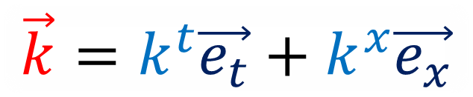
time $ct$
wave covector
$$\vec{k}=k^{t}\vec{e_{t}}+k^{x}\vec{e_{x}}$$
space $x$
$$k=k_{x}ε^{t}+k_{x}ε^{x}$$

Slide 23
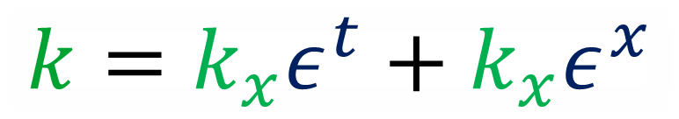


time $ct$
space $x$
wave covector
wave vector
$$\vec{k}=k^{t}\vec{e_{t}}+k^{x}\vec{e_{x}}$$
$$k=k_{x}ε^{t}+k_{x}ε^{x}$$

Slide 24
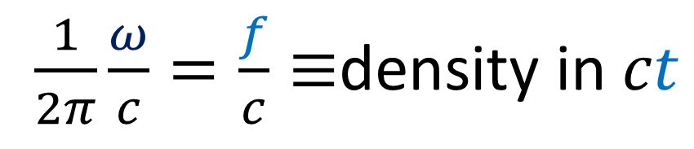
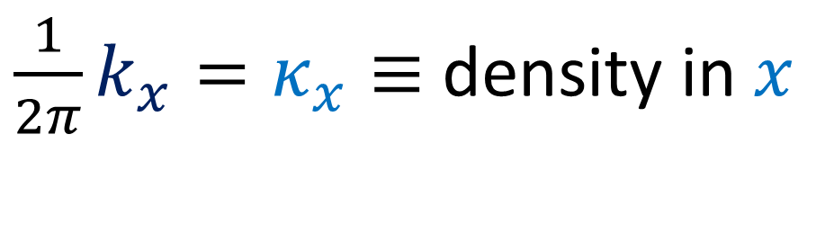
time $ct$
space $x$
wave covector
$\frac{1}{2π}\frac{ω}{c}=\frac{f}{c}≡$density in $ct$
angular frequency
linear frequency
$\frac{1}{2π}k_{x}=κ_{x}≡$density in $x$
$$k=k_{x}ε^{t}+k_{x}ε^{x}$$

Slide 25


time $ct$
space $x$
wave covector
wave vector
$$k_{t}=+k^{t}$$
$$k_{x}=−k^{x}$$
$$\vec{k}=k^{t}\vec{e_{t}}+k^{x}\vec{e_{x}}$$
$$k=k_{t}ε^{t}+k_{x}ε^{x}$$

Slide 26
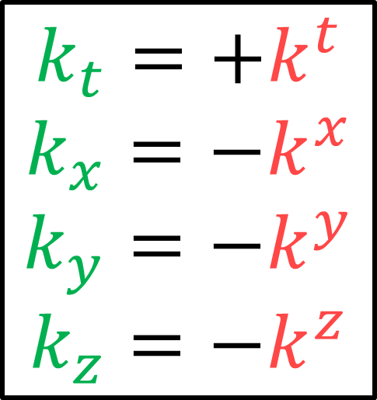
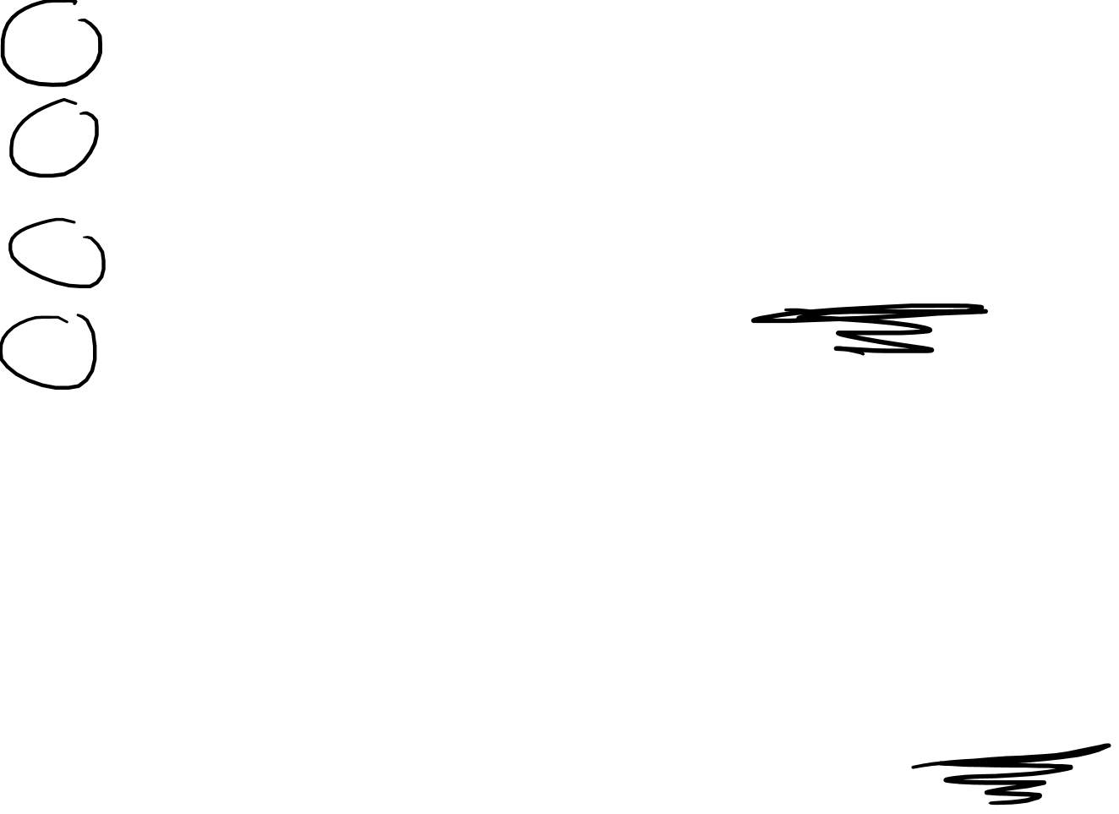
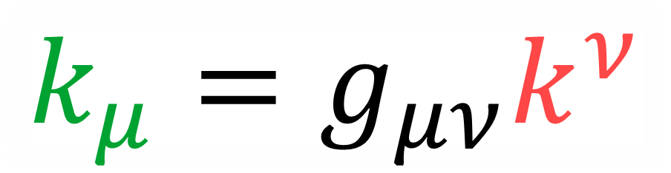
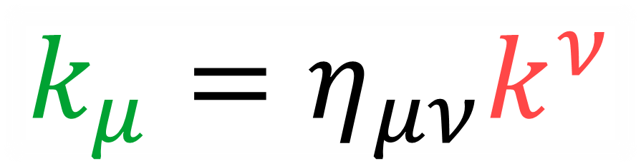
(flat spacetime/ cartesian coordinates)
$$k_{t}=+k^{t}$$
$$k_{x}=−k^{x}$$
$$k_{y}=−k^{y}$$
$$k_{z}=−k^{z}$$
$$k_{μ}=η_{μν}k^{ν}$$
$$k_{μ}=g_{μν}k^{ν}$$
More generically:

Slide 27
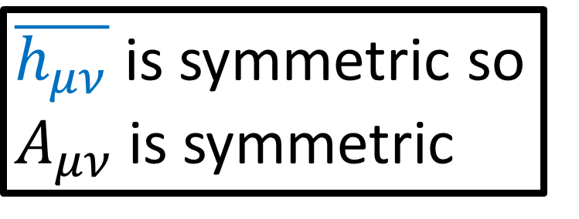



Lorenz Gauge (in a vacuum):
$$□\overline{h_{μν}}≡η^{αβ}∂_{α}∂_{β}\overline{h_{μν}}=0$$
$\overline{h_{μν}}≡h_{μν}−\frac{1}{2}η_{μν}h$
The most straightforward solutions to $□\overline{h_{μν}}=0$ are plane waves
$\overline{h_{μν}}=A_{μν}\cos\left(+\frac{ω}{c}ct−k^{x}x−k^{y}y−k^{z}z\right)$
$\overline{h_{μν}}=Re\left[A_{μν}e^{i\left(k_{σ}x^{σ}\right)}\right]$
$\overline{h_{μν}}$ is symmetric so $A_{μν}$is symmetric
$$A_{μν}=A_{νμ}$$

Slide 28




time $ct$
density in $ct$ $≡\frac{f}{c}=\frac{1}{2π}\frac{ω}{c}$
linear frequency
angular frequency
density in $x$ $≡κ_{x}=\frac{1}{2π}k_{x}$
(See “Relativity 106a” for review)
wave covector
space $x$

Slide 29



$$\overline{h_{μν}}=A_{μν} e^{ik_{σ}x^{σ}}$$
$$=∂_{α}\left(\overline{h_{μν}}\right)$$
$$=∂_{α}\left(A_{μν} e^{ik_{σ}x^{σ}}\right)$$
$$=A_{μν}∂_{α}\left(e^{ik_{σ}x^{σ}}\right)$$
$$=A_{μν}\left(e^{ik_{σ}x^{σ}}\right)∂_{α}\left(ik_{σ}x^{σ}\right)$$
$$=A_{μν}\left(e^{ik_{σ}x^{σ}}\right)ik_{σ}∂_{α}\left(x^{σ}\right)$$
$=A_{μν}\left(e^{ik_{σ}x^{σ}}\right)ik_{σ}\left(\frac{∂x^{σ}}{∂x^{α}}\right)$
$$=A_{μν}\left(e^{ik_{σ}x^{σ}}\right)ik_{σ}δ_{α}^{σ}$$
$$=A_{μν}\left(e^{ik_{σ}x^{σ}}\right)ik_{α}$$
$$=\overline{h_{μν}}ik_{α}$$
What happens when we take the derivative of a plane wave?

Slide 30



$$\overline{h_{μν}}=A_{μν} e^{ik_{σ}x^{σ}}$$
$\frac{ω}{k_{xyz}}=wave speed$
Wave Covector must be “null” ${\left\|k\right\|}^{2}=η^{αβ}∂_{α}∂_{β }=k_{α}k^{α}=0$
since the wave travels at the speed of light $c$
${\left\|k\right\|}^{2} ={\left(\frac{ω}{c}\right)}^{2}−{\left(k_{x}\right)}^{2}−{\left(k_{y}\right)}^{2}−{\left(k_{z}\right)}^{2}={\left(\frac{ω}{c}\right)}^{2}−{\left(k_{xyz}\right)}^{2}=0$
$0=□\overline{h_{μν}}=η^{αβ}∂_{α}∂_{β }\overline{h_{μν}}=η^{αβ}ik_{α}ik_{β }\overline{h_{μν}}=−k_{α}k^{α}\overline{h_{μν}}$ $⇒k_{α}k^{α}=0$
The Lorenz condition $0=∂_{β}\overline{h^{αβ}}=ik_{β}A^{αβ}e^{ik_{σ}x^{σ}}$also gives:
$A^{αβ}k_{β}=A_{αβ}k^{β}=0$
The columns of the wave amplitude “matrix” $A^{αβ}$ must be orthogonal to the wave covector row $k_{β}$

Slide 31




$$\overline{h_{μν}}=A_{μν} e^{ik_{σ}x^{σ}}$$
$←$ travels at the speed of light $c$
Wave Covector must be “null” ${\left\|k\right\|}^{2}=g^{αβ}k_{α}k_{β }=k_{α}k^{α}=0$
Proof:
$$0=□\overline{h_{μν}}$$
$$0=g^{αβ}∂_{α}∂_{β }\overline{h_{μν}}$$
$$0=g^{αβ}ik_{α}ik_{β }\overline{h_{μν}}$$
$$0=−k_{α}k^{α}\overline{h_{μν}}$$
$$⇒k_{α}k^{α}={\left\|k\right\|}^{2}=0$$

Slide 32



$$\overline{h_{μν}}=A_{μν} e^{ik_{σ}x^{σ}}$$
$A_{μν}$ has 16 components
Symmetry $A_{μν}=A_{νμ}$ reduces this from 16 to 10 independent components
Lorenz Gauge $∂_{β}\overline{h^{αβ}}=0$ gives $A^{αβ}k_{β}=0$gives 4 equations,
reducing from 10 to 6 independent components
The Lorenz Gauge $∂_{β}\overline{h^{αβ}}=0$ is not unique because for $x^{α}={\breve{x}}^{α}→{\breve{x}}^{α}+ξ^{α}$ with $∂_{\breve{β}}\overline{{\breve{h}}^{αβ}}=□ξ^{α}$, we can always change $ξ^{α}→ξ^{α}+χ^{α}$ with $□χ^{α}=0$ and stay within LG
A special LG called the “Transverse Traceless Gauge” (TT) reduces from 6 to 2 independent components

Slide 33


$$∂_{β }\overline{h^{αβ}}=∂_{β }\overline{{\breve{h}}^{αβ}}−□ξ^{α}$$
Choose $ξ^{α}$ such that $∂_{β }\overline{{\breve{h}}^{αβ}}=□ξ^{α}$
$⇒∂_{β }\overline{h^{αβ}}=0$ is part of the Lorenz Gauge.
The choice of $ξ^{α}$ is not unique.
Any $χ^{α}$ with $□χ^{α}=0$ will also solve
$∂_{β }\overline{{\breve{h}}^{αβ}}=□\left(ξ^{α}+χ^{α}\right)=□ξ^{α}+□χ^{α}=□ξ^{α}$
The “Lorenz Gauge” is really a class of coordinate systems, not just one coordinate system.

Slide 34

$$\overline{h_{μν}}=A_{μν} e^{ik_{σ}x^{σ}}$$
$A_{μν}$ has 16 components
Symmetry $A_{μν}=A_{νμ}$ reduces this to 10 independent components
Lorenz Gauge $∂_{β}\overline{h^{αβ}}=0$ reduces this to 6 independent components
$k_{β}A^{αβ} =0$ gives 4 constraint equations

Slide 35




$$\overline{h_{μν}}=A_{μν} e^{ik_{σ}x^{σ}}$$
$A_{μν}$ has 16 components
Symmetry $A_{μν}=A_{νμ}$ reduces this to 10 independent components
Lorenz Gauge $∂_{β}\overline{h^{αβ}}=0$ reduces this to 6 independent components
$k_{β}A^{αβ} =0$ gives 4 constraint equations
Displacement Field
$${\tilde{x}}^{α}=x^{α}+χ^{α}$$
$$□χ^{α}=0$$
Transformation Rule
$$∂_{β }\overline{{\tilde{h}}^{αβ}}=∂_{β }\overline{h^{αβ}}−□χ^{α}$$
$$∂_{β }\overline{h^{αβ}}=0→∂_{β }\overline{{\tilde{h}}^{αβ}}=0$$
(still in Lorenz Gauge)
Lorenz Gauge coords $x^{α}$
$∂_{β}\overline{h^{αβ}}=0$

Slide 36

$$\overline{h_{μν}}=A_{μν} e^{ik_{σ}x^{σ}}$$
$A_{μν}$ has 16 components
Symmetry $A_{μν}=A_{νμ}$ reduces this to 10 independent components
Lorenz Gauge $∂_{β}\overline{h^{αβ}}=0$ reduces this to 6 independent components
$k_{β}A^{αβ} =0$ gives 4 constraint equations
Picking a specific Lorenz Gauge reduces this to 2 independent components
Our specific choice is called the Transverse-Traceless (TT) Gauge
In TT Gauge, “plus” and “cross” polarizations become very obvious

Slide 37








$$\left[\begin{aligned}χ^{t} \\ χ^{x} \\ χ^{y} \\ χ^{z}\end{aligned}\right]$$
$□χ^{α}=0$
4 degrees of freedom
4 d.o.f. on $χ^{α}$
$$x^{α}→x^{α}+χ^{α}$$
4 d.o.f. on $\overline{h_{αβ}}$
$$\overline{h_{αβ}}→\overline{h_{αβ}}−χ_{α,β }−χ_{α,β }−η_{αβ}χ_{ ,σ}^{σ}$$
4 d.o.f. on $A_{αβ}$
$$\overline{h_{αβ}}=A_{αβ} e^{ik_{σ}x^{σ}}$$

Slide 38


$$\left[\begin{aligned}χ^{t} \\ χ^{x} \\ χ^{y} \\ χ^{z}\end{aligned}\right]$$
$□χ^{α}=0$
4 degrees of freedom
We can define 4 more constraints on $A_{μν}$:
3 of them will be “transverse” constraints
1 of them will be the “traceless” constraint

Slide 39






$$\vec{U}$$
3 transverse constraints:
Take an observer with 4-velocity $\vec{U}=U^{μ}\vec{e_{μ}}$ who is experiencing gravitational waves
plane
wavefronts
Want gravitational wave amplitudes $A_{μν}$ to be at right angles (“orthogonal”/”transverse”) to the observer.
$$\left[\begin{matrix}\begin{matrix}\begin{aligned}A_{tt} \\ A_{xt} \\ A_{yt} \\ A_{zt}\end{aligned} & \begin{aligned}A_{tx} \\ A_{xx} \\ A_{yx} \\ A_{zx}\end{aligned}\end{matrix} & \begin{matrix}\begin{aligned}A_{ty} \\ A_{xy} \\ A_{yy} \\ A_{zy}\end{aligned} & \begin{aligned}A_{tz} \\ A_{xz} \\ A_{yz} \\ A_{zz}\end{aligned}\end{matrix}\end{matrix}\right]\left[\begin{aligned}U^{t} \\ U^{x} \\ U^{y} \\ U^{z}\end{aligned}\right]=\left[\begin{aligned}0 \\ 0 \\ 0 \\ 0\end{aligned}\right]$$
$$A_{μν}U^{μ}=0$$

Slide 40


$$\vec{U}$$
3 transverse constraints:
Take an observer with 4-velocity $\vec{U}=U^{μ}\vec{e_{μ}}$ who is experiencing gravitational waves
plane
wavefronts
Want gravitational wave amplitudes $A_{μν}$ to be at right angles (“orthogonal”/”transverse”) to the observer.
$$\left[\begin{matrix}\begin{matrix}\begin{aligned}A_{tt} \\ A_{xt} \\ A_{yt} \\ A_{zt}\end{aligned} & \begin{aligned}A_{tx} \\ A_{xx} \\ A_{yx} \\ A_{zx}\end{aligned}\end{matrix} & \begin{matrix}\begin{aligned}A_{ty} \\ A_{xy} \\ A_{yy} \\ A_{zy}\end{aligned} & \begin{aligned}A_{tz} \\ A_{xz} \\ A_{yz} \\ A_{zz}\end{aligned}\end{matrix}\end{matrix}\right]\left[\begin{aligned}U^{t} \\ U^{x} \\ U^{y} \\ U^{z}\end{aligned}\right]=\left[\begin{aligned}0 \\ 0 \\ 0 \\ 0\end{aligned}\right]$$
$$A_{μν}U^{μ}=0$$

Slide 41



$$k^{μ}A_{μν}=0$$
$$A_{μν}U^{μ}=0$$
4 constraints
4 constraints
7 total constraints
1 shared constraint

Slide 42

$$k^{μ}A_{μν}=0$$
$$A_{μν}U^{μ}=0$$
4 constraints
4 constraints
7 total constraints
1 shared constraint

Slide 43







$$\left[\begin{matrix}\begin{matrix}\begin{aligned}A_{tt} \\ A_{xt} \\ A_{yt} \\ A_{zt}\end{aligned} & \begin{aligned}A_{tx} \\ A_{xx} \\ A_{yx} \\ A_{zx}\end{aligned}\end{matrix} & \begin{matrix}\begin{aligned}A_{ty} \\ A_{xy} \\ A_{yy} \\ A_{zy}\end{aligned} & \begin{aligned}A_{tz} \\ A_{xz} \\ A_{yz} \\ A_{zz}\end{aligned}\end{matrix}\end{matrix}\right]\left[\begin{aligned}U^{t} \\ U^{x} \\ U^{y} \\ U^{z}\end{aligned}\right]=\left[\begin{aligned}0 \\ 0 \\ 0 \\ 0\end{aligned}\right]$$
$$A_{μν}U^{ν}=0$$
$$\left[\begin{matrix}\begin{matrix}\begin{aligned}A_{tt} \\ A_{xt} \\ A_{yt} \\ A_{zt}\end{aligned} & \begin{aligned}A_{tx} \\ A_{xx} \\ A_{yx} \\ A_{zx}\end{aligned}\end{matrix} & \begin{matrix}\begin{aligned}A_{ty} \\ A_{xy} \\ A_{yy} \\ A_{zy}\end{aligned} & \begin{aligned}A_{tz} \\ A_{xz} \\ A_{yz} \\ A_{zz}\end{aligned}\end{matrix}\end{matrix}\right]\left[\begin{aligned}U^{t} \\ 0 \\ 0 \\ 0\end{aligned}\right]=\left[\begin{aligned}0 \\ 0 \\ 0 \\ 0\end{aligned}\right]$$
$$\left[\begin{matrix}\begin{matrix}\begin{aligned}0 \\ 0 \\ 0 \\ 0\end{aligned} & \begin{aligned}0 \\ A_{xx} \\ A_{yx} \\ A_{zx}\end{aligned}\end{matrix} & \begin{matrix}\begin{aligned}0 \\ A_{xy} \\ A_{yy} \\ A_{zy}\end{aligned} & \begin{aligned}0 \\ A_{xz} \\ A_{yz} \\ A_{zz}\end{aligned}\end{matrix}\end{matrix}\right]$$
$\left[\begin{aligned}A_{tt}U^{t}+0+0+0 \\ A_{xt}U^{t}+0+0+0 \\ A_{yt}U^{t}+0+0+0 \\ A_{zt}U^{t}+0+0+0\end{aligned}\right]=\left[\begin{aligned}0 \\ 0 \\ 0 \\ 0\end{aligned}\right]$
$A_{μt}=0=A_{tμ}$

Slide 44






$$A_{μν}U^{ν}=0$$
$A_{μt}=0=A_{tν}$
$$\left[\begin{matrix}\begin{matrix}\begin{aligned}0 \\ 0 \\ 0 \\ 0\end{aligned} & \begin{aligned}0 \\ A_{xx} \\ A_{yx} \\ A_{zx}\end{aligned}\end{matrix} & \begin{matrix}\begin{aligned}0 \\ A_{xy} \\ A_{yy} \\ A_{zy}\end{aligned} & \begin{aligned}0 \\ A_{xz} \\ A_{yz} \\ A_{zz}\end{aligned}\end{matrix}\end{matrix}\right]\left[\begin{aligned}k^{t} \\ k^{x} \\ k^{y} \\ k^{z}\end{aligned}\right]=\left[\begin{aligned}0 \\ 0 \\ 0 \\ 0\end{aligned}\right]$$
$$\left[\begin{matrix}\begin{matrix}\begin{aligned}0 \\ 0 \\ 0 \\ 0\end{aligned} & \begin{aligned}0 \\ A_{xx} \\ A_{yx} \\ A_{zx}\end{aligned}\end{matrix} & \begin{matrix}\begin{aligned}0 \\ A_{xy} \\ A_{yy} \\ A_{zy}\end{aligned} & \begin{aligned}0 \\ A_{xz} \\ A_{yz} \\ A_{zz}\end{aligned}\end{matrix}\end{matrix}\right]$$
$$k^{μ}A_{μν}=0$$
$k^{t}A_{tν}=0$ already satisfied since $A_{tν}=0$.
So $k^{μ}A_{μν}=0$ only gives us 3 extra constraints.

Slide 45


$$k^{μ}A_{μν}=0$$
4 constraints
then
$$A_{μν}U^{ν}=0$$
3 constraints

Slide 46

Lorenz Gauge additional constraints on $A_{μν}$:
$A_{μν}U^{μ}=0$ gives 3 “transverse” constraints
We can also get 1 “traceless” constraint

Slide 47


1 traceless constraint:
Taking $A_{μν}$ to be traceless gives us our last constraint
$$0= A_{μ}^{ μ} =A_{t}^{ t}+A_{x}^{ x}+A_{y}^{ y}+A_{z}^{ z}$$
$$0=A_{μν}η^{μν}=A_{tt}−A_{xx}−A_{yy}−A_{zz}$$

Slide 48









Transverse-Traceless Gauge defines 4 constraints on $A_{μν}$:
3 are “transverse” constraints
1 is the “traceless” constraint
$$\overline{h_{μν}}=A_{μν} e^{ik_{σ}x^{σ}}$$
$$A_{μν}U^{μ}=0$$
$$⇒$$
$$\overline{h_{μν}}U^{μ}=0$$
$$A_{μ}^{ μ}=0$$
$$⇒$$
$$\overline{h_{μ}^{ μ}}=0$$

Slide 49


Transverse-Traceless (TT) Gauge
Specific Lorenz Gauge $∂_{μ}\overline{h^{μν}}=0$ where:
$$\overline{h_{μν}}U^{μ}=0=\overline{h_{μ}^{ μ}}$$
4-velocity of person observing gravitational wave

Slide 50








$\overline{h_{μν}}≡h_{μν}−\frac{1}{2}η_{μν}h$
$$g_{μν}=η_{μν}+h_{μν}$$
$\overline{h_{μν}}η^{μν}=h_{μν}η^{μν}−\frac{1}{2}η_{μν}η^{μν}h$
$\overline{h_{μ}^{ μ}}=h_{μ}^{ μ}−\frac{1}{2}δ_{μ}^{ μ}h$
$\overline{h} = h − \frac{1}{2}4h$
$\overline{h} = h −2 h$
$\overline{h} =−h$
$$\overline{h_{μν}}=A_{μν} e^{ik_{σ}x^{σ}}$$
$$h_{μν}=A_{μν} e^{ik_{σ}x^{σ}}$$
$$=0$$
Transverse-Traceless Gauge
$$\overline{h_{μν}}≡h_{μν}$$
Transverse-Traceless Gauge
$$\overline{h_{μ}^{ μ}}=\overline{h}=0$$

Slide 51




$$\overline{h_{μν}}=A_{μν} e^{ik_{σ}x^{σ}}$$
$A_{μν}$ has 16 components
Symmetry $A_{μν}=A_{νμ}$ reduces this to 10 independent components
$$\left[\begin{matrix}\begin{matrix}\begin{aligned}A_{tt} \\ A_{xt} \\ A_{yt} \\ A_{zt}\end{aligned} & \begin{aligned}A_{tx} \\ A_{xx} \\ A_{yx} \\ A_{zx}\end{aligned}\end{matrix} & \begin{matrix}\begin{aligned}A_{ty} \\ A_{xy} \\ A_{yy} \\ A_{zy}\end{aligned} & \begin{aligned}A_{tz} \\ A_{xz} \\ A_{yz} \\ A_{zz}\end{aligned}\end{matrix}\end{matrix}\right]$$
$$A_{μν}=A_{νμ}$$

Slide 52





$$\overline{h_{μν}}=A_{μν} e^{ik_{σ}x^{σ}}$$
$A_{μν}$ has 16 components
Symmetry $A_{μν}=A_{νμ}$ reduces this to 10 independent components
Lorenz Gauge $∂_{β}\overline{h^{αβ}}=0$ reduces this to 6 independent components
$∂_{β}\overline{h^{αβ}}=0$
$$ik_{β}\overline{h^{αβ}}=0$$
$ik_{β}A^{αβ} e^{ik_{σ}x^{σ}}=0$
$$\left[\begin{matrix}\begin{matrix}k_{t} & k_{x}\end{matrix} & \begin{matrix}k_{y} & k_{z}\end{matrix}\end{matrix}\right]\left[\begin{matrix}\begin{matrix}\begin{aligned}A^{tt} \\ A^{xt} \\ A^{yt} \\ A^{zt}\end{aligned} & \begin{aligned}A^{tx} \\ A^{xx} \\ A^{yx} \\ A^{zx}\end{aligned}\end{matrix} & \begin{matrix}\begin{aligned}A^{ty} \\ A^{xy} \\ A^{yy} \\ A^{zy}\end{aligned} & \begin{aligned}A^{tz} \\ A^{xz} \\ A^{yz} \\ A^{zz}\end{aligned}\end{matrix}\end{matrix}\right]$$
$$=\left[\begin{matrix}\begin{matrix}0 & 0\end{matrix} & \begin{matrix}0 & 0\end{matrix}\end{matrix}\right]$$
$k_{β}A^{αβ} =0$

Slide 53


$$\overline{h_{μν}}=A_{μν} e^{ik_{σ}x^{σ}}$$
$A_{μν}$ has 16 components
Symmetry $A_{μν}=A_{νμ}$ reduces this to 10 independent components
Lorenz Gauge $∂_{β}\overline{h^{αβ}}=0$ reduces this to 6 independent components
$k_{β} A^{αβ} =0$
$k^{ν}g_{νβ}A^{αβ} =0$
$k^{ν} A_{ ν}^{α} =0$
$k^{ν} A_{ ν}^{α}g_{αμ}=0g_{αμ}$
$k^{ν} A_{μν} =0$
$∂_{β}\overline{h^{αβ}}=0$
$$ik_{β}\overline{h^{αβ}}=0$$
$ik_{β}A^{αβ} e^{ik_{σ}x^{σ}}=0$
$k_{β}A^{αβ} =0$

Slide 54



$$\overline{h_{μν}}=A_{μν} e^{ik_{σ}x^{σ}}$$
$A_{μν}$ has 16 components
Symmetry $A_{μν}=A_{νμ}$ reduces this to 10 independent components
Lorenz Gauge $∂_{β}\overline{h^{αβ}}=0$ reduces this to 6 independent components
$⇒$ $A_{αβ}k^{β}=0$
$∂_{β}\overline{h^{αβ}}=0$
$$ik_{β}\overline{h^{αβ}}=0$$
$ik_{β}A^{αβ} e^{ik_{σ}x^{σ}}=0$
$$\left[\begin{matrix}\begin{matrix}\begin{aligned}A_{tt} \\ A_{xt} \\ A_{yt} \\ A_{zt}\end{aligned} & \begin{aligned}A_{tx} \\ A_{xx} \\ A_{yx} \\ A_{zx}\end{aligned}\end{matrix} & \begin{matrix}\begin{aligned}A_{ty} \\ A_{xy} \\ A_{yy} \\ A_{zy}\end{aligned} & \begin{aligned}A_{tz} \\ A_{xz} \\ A_{yz} \\ A_{zz}\end{aligned}\end{matrix}\end{matrix}\right]\left[\begin{aligned}k^{t} \\ k^{x} \\ k^{y} \\ k^{z}\end{aligned}\right]=\left[\begin{aligned}0 \\ 0 \\ 0 \\ 0\end{aligned}\right]$$
$k_{β}A^{αβ} =0$

Slide 55

$$\overline{h_{μν}}=A_{μν} e^{ik_{σ}x^{σ}}$$
A special LG called the “Transverse Traceless Gauge” (TT) reduces from 6 to 2 independent components
Take an arbitrary 4-velocity vector $\vec{U}=U^{μ }\vec{e_{μ}}$ at all points in flat spacetime, and use $A_{μν}U^{μ }=0$
A 4th constraint is for $A_{μν}$ to be “traceless”: $A_{ μ}^{μ}=η^{μν}A_{μν}=0$

Slide 56






Components of $A_{μν}$
Symmetry: $A_{μν}=A_{νμ}$
LG: $A^{αβ}k_{β}=0$
TT: $A_{μν}U^{μ }=A_{ μ}^{μ}=0$
16 components
6 constraints
4 constraints
4 constraints
2 independent components
$$−$$
$$−$$
$$−$$
Take $\vec{U}=c\vec{e_{t}}$
so $U^{μ}→\left(c,0,0,0\right)$
Take $k_{β}→\left(\frac{ω}{c},0,0,\frac{ω}{c}\right)$

Slide 57





Components of $A_{μν}$:
Symmetry: $A_{μν}=A_{νμ}$
LG: $A_{μν}k^{μ}=0$
TT: $A_{μν}U^{μ }=A_{ μ}^{μ}=0$
Take $\vec{U}=c\vec{e_{t}}$
so $U^{μ}→\left(c,0,0,0\right)$
Take $k_{μ}→\left(\frac{ω}{c},0,0,\frac{ω}{c}\right)$
$A_{μν}U^{μ }=0$ gives
$$A_{tν}U^{t}=A_{tν}c=0$$
$⇒A_{tν}=A_{νt}=0$
$$\left[\begin{matrix}\begin{matrix}\begin{aligned}A_{tt} \\ A_{xt} \\ A_{yt} \\ A_{zt}\end{aligned} & \begin{aligned}A_{tx} \\ A_{xx} \\ A_{yx} \\ A_{zx}\end{aligned}\end{matrix} & \begin{matrix}\begin{aligned}A_{ty} \\ A_{xy} \\ A_{yy} \\ A_{zy}\end{aligned} & \begin{aligned}A_{tz} \\ A_{xz} \\ A_{yz} \\ A_{zz}\end{aligned}\end{matrix}\end{matrix}\right]$$

Slide 58

Components of $A_{μν}$:
Symmetry: $A_{μν}=A_{νμ}$
LG: $A_{μν}k^{μ}=0$
TT: $A_{μν}U^{μ }=A_{ μ}^{μ}=0$
Take $\vec{U}=c\vec{e_{t}}$
so $U^{μ}→\left(c,0,0,0\right)$
Take $k_{μ}→\left(\frac{ω}{c},0,0,\frac{ω}{c}\right)$
$A_{μν}U^{μ }=0$ gives
$$A_{tν}U^{t}=A_{tν}c=0$$
$⇒A_{tν}=A_{νt}=0$
$$\left[\begin{matrix}\begin{matrix}\begin{aligned}0 \\ 0 \\ 0 \\ 0\end{aligned} & \begin{aligned}0 \\ A_{xx} \\ A_{yx} \\ A_{zx}\end{aligned}\end{matrix} & \begin{matrix}\begin{aligned}0 \\ A_{xy} \\ A_{yy} \\ A_{zy}\end{aligned} & \begin{aligned}0 \\ A_{xz} \\ A_{yz} \\ A_{zz}\end{aligned}\end{matrix}\end{matrix}\right]$$

Slide 59


Components of $A_{μν}$:
Symmetry: $A_{μν}=A_{νμ}$
LG: $A_{μν}k^{μ}=0$
TT: $A_{μν}U^{μ }=A_{ μ}^{μ}=0$
Take $\vec{U}=c\vec{e_{t}}$
so $U^{μ}→\left(c,0,0,0\right)$
Take $k_{μ}→\left(\frac{ω}{c},0,0,\frac{ω}{c}\right)$
$A_{μν}k^{μ}=0$ gives
$A_{tν}k^{t}+A_{zν}k^{z}=0$
$0\left(+\frac{ω}{c}\right)+A_{zν}\left(−\frac{ω}{c}\right)=0$
$⇒A_{zν}=A_{νz}=0$
$$\left[\begin{matrix}\begin{matrix}\begin{aligned}0 \\ 0 \\ 0 \\ 0\end{aligned} & \begin{aligned}0 \\ A_{xx} \\ A_{yx} \\ A_{zx}\end{aligned}\end{matrix} & \begin{matrix}\begin{aligned}0 \\ A_{xy} \\ A_{yy} \\ A_{zy}\end{aligned} & \begin{aligned}0 \\ A_{xz} \\ A_{yz} \\ A_{zz}\end{aligned}\end{matrix}\end{matrix}\right]$$

Slide 60

Components of $A_{μν}$:
Symmetry: $A_{μν}=A_{νμ}$
LG: $A_{μν}k^{μ}=0$
TT: $A_{μν}U^{μ }=A_{ μ}^{μ}=0$
Take $\vec{U}=c\vec{e_{t}}$
so $U^{μ}→\left(c,0,0,0\right)$
Take $k_{μ}→\left(\frac{ω}{c},0,0,\frac{ω}{c}\right)$
$A_{μν}k^{μ}=0$ gives
$A_{tν}k^{t}+A_{zν}k^{z}=0$
$0\left(+\frac{ω}{c}\right)+A_{zν}\left(−\frac{ω}{c}\right)=0$
$⇒A_{zν}=A_{νz}=0$
$$\left[\begin{matrix}\begin{matrix}\begin{aligned}0 \\ 0 \\ 0 \\ 0\end{aligned} & \begin{aligned}0 \\ A_{xx} \\ A_{yx} \\ 0\end{aligned}\end{matrix} & \begin{matrix}\begin{aligned}0 \\ A_{xy} \\ A_{yy} \\ 0\end{aligned} & \begin{aligned}0 \\ 0 \\ 0 \\ 0\end{aligned}\end{matrix}\end{matrix}\right]$$

Slide 61



Components of $A_{μν}$:
Symmetry: $A_{μν}=A_{νμ}$
LG: $A_{μν}k^{μ}=0$
TT: $A_{μν}U^{μ }=A_{ μ}^{μ}=0$
Take $\vec{U}=c\vec{e_{t}}$
so $U^{μ}→\left(c,0,0,0\right)$
Take $k_{μ}→\left(\frac{ω}{c},0,0,\frac{ω}{c}\right)$
$A_{ μ}^{μ}=η^{μν}A_{μν}=0$
$η^{xx}A_{xx}+η^{yy}A_{yy}=0$
$−A_{xx} − A_{yy}=0$
gives $⇒A_{xx}=−A_{yy}$
$$\left[\begin{matrix}\begin{matrix}\begin{aligned}0 \\ 0 \\ 0 \\ 0\end{aligned} & \begin{aligned}0 \\ A_{xx} \\ A_{yx} \\ 0\end{aligned}\end{matrix} & \begin{matrix}\begin{aligned}0 \\ A_{xy} \\ A_{yy} \\ 0\end{aligned} & \begin{aligned}0 \\ 0 \\ 0 \\ 0\end{aligned}\end{matrix}\end{matrix}\right]$$
and $A_{xy}=A_{yx}$ by symmetry

Slide 62



Components of $A_{μν}$:
Symmetry: $A_{μν}=A_{νμ}$
LG: $A_{μν}k^{μ}=0$
TT: $A_{μν}U^{μ }=A_{ μ}^{μ}=0$
Take $\vec{U}=c\vec{e_{t}}$
so $U^{μ}→\left(c,0,0,0\right)$
Take $k_{μ}→\left(\frac{ω}{c},0,0,\frac{ω}{c}\right)$
$$\left[\begin{matrix}\begin{matrix}\begin{aligned}0 \\ 0 \\ 0 \\ 0\end{aligned} & \begin{aligned}0 \\ A_{xx} \\ A_{yx} \\ 0\end{aligned}\end{matrix} & \begin{matrix}\begin{aligned}0 \\ A_{xy} \\ −A_{xx} \\ 0\end{aligned} & \begin{aligned}0 \\ 0 \\ 0 \\ 0\end{aligned}\end{matrix}\end{matrix}\right]$$
and $A_{xy}=A_{yx}$ by symmetry

Slide 63

Components of $A_{μν}$:
Symmetry: $A_{μν}=A_{νμ}$
LG: $A_{μν}k^{μ}=0$
TT: $A_{μν}U^{μ }=A_{ μ}^{μ}=0$
Take $\vec{U}=c\vec{e_{t}}$
so $U^{μ}→\left(c,0,0,0\right)$
Take $k_{μ}→\left(\frac{ω}{c},0,0,\frac{ω}{c}\right)$
$$\left[\begin{matrix}\begin{matrix}\begin{aligned}0 \\ 0 \\ 0 \\ 0\end{aligned} & \begin{aligned}0 \\ A_{xx} \\ A_{xy} \\ 0\end{aligned}\end{matrix} & \begin{matrix}\begin{aligned}0 \\ A_{xy} \\ −A_{xx} \\ 0\end{aligned} & \begin{aligned}0 \\ 0 \\ 0 \\ 0\end{aligned}\end{matrix}\end{matrix}\right]$$
and $A_{xy}=A_{yx}$ by symmetry

Slide 64




Two independent components:
$$\left[\begin{matrix}\begin{matrix}\begin{aligned}0 \\ 0 \\ 0 \\ 0\end{aligned} & \begin{aligned}0 \\ A_{xx} \\ A_{xy} \\ 0\end{aligned}\end{matrix} & \begin{matrix}\begin{aligned}0 \\ A_{xy} \\ −A_{xx} \\ 0\end{aligned} & \begin{aligned}0 \\ 0 \\ 0 \\ 0\end{aligned}\end{matrix}\end{matrix}\right]$$
$$⇒\left[\begin{matrix}\begin{matrix}\begin{aligned}0 \\ 0 \\ 0 \\ 0\end{aligned} & \begin{aligned}0 \\ A_{+} \\ A_{×} \\ 0\end{aligned}\end{matrix} & \begin{matrix}\begin{aligned}0 \\ A_{×} \\ −A_{+} \\ 0\end{aligned} & \begin{aligned}0 \\ 0 \\ 0 \\ 0\end{aligned}\end{matrix}\end{matrix}\right]$$
$$\left[\begin{matrix}\begin{matrix}\begin{aligned}0 \\ 0 \\ 0 \\ 0\end{aligned} & \begin{aligned}0 \\ A_{+} \\ 0 \\ 0\end{aligned}\end{matrix} & \begin{matrix}\begin{aligned}0 \\ 0 \\ −A_{+} \\ 0\end{aligned} & \begin{aligned}0 \\ 0 \\ 0 \\ 0\end{aligned}\end{matrix}\end{matrix}\right] + \left[\begin{matrix}\begin{matrix}\begin{aligned}0 \\ 0 \\ 0 \\ 0\end{aligned} & \begin{aligned}0 \\ 0 \\ A_{×} \\ 0\end{aligned}\end{matrix} & \begin{matrix}\begin{aligned}0 \\ A_{×} \\ 0 \\ 0\end{aligned} & \begin{aligned}0 \\ 0 \\ 0 \\ 0\end{aligned}\end{matrix}\end{matrix}\right]$$
“Plus” Polarization
“Cross” Polarization

Slide 65



Components of $A_{μν}$
Symmetry: $A_{μν}=A_{νμ}$
LG: $A_{μν}k^{μ}=0$
TT: $A_{μν}U^{μ }=A_{ μ}^{μ}=0$
16 components
6 constraints
4 constraints
4 constraints
2 independent components
$$−$$
$$−$$
$$−$$
Take $\vec{U}=c\vec{e_{t}}$
so $U^{μ}→\left(c,0,0,0\right)$
Take $k^{μ}→\left(\frac{ω}{c},0,0,\frac{ω}{c}\right)$

Slide 66


Components of $A_{μν}$:
Symmetry: $A_{μν}=A_{νμ}$
LG: $A_{μν}k^{μ}=0$
TT: $A_{μν}U^{μ }=A_{ μ}^{μ}=0$
Take $\vec{U}=c\vec{e_{t}}$
so $U^{μ}→\left(c,0,0,0\right)$
Take $k^{μ}→\left(\frac{ω}{c},0,0,\frac{ω}{c}\right)$
$A_{μν}U^{μ }=0$ gives
$$A_{tν}U^{t}=A_{tν}c=0$$
$⇒A_{tν}=A_{νt}=0$
$$\left[\begin{matrix}\begin{matrix}\begin{aligned}A_{tt} \\ A_{xt} \\ A_{yt} \\ A_{zt}\end{aligned} & \begin{aligned}A_{tx} \\ A_{xx} \\ A_{yx} \\ A_{zx}\end{aligned}\end{matrix} & \begin{matrix}\begin{aligned}A_{ty} \\ A_{xy} \\ A_{yy} \\ A_{zy}\end{aligned} & \begin{aligned}A_{tz} \\ A_{xz} \\ A_{yz} \\ A_{zz}\end{aligned}\end{matrix}\end{matrix}\right]$$

Slide 67
Components of $A_{μν}$:
Symmetry: $A_{μν}=A_{νμ}$
LG: $A_{μν}k^{μ}=0$
TT: $A_{μν}U^{μ }=A_{ μ}^{μ}=0$
Take $\vec{U}=c\vec{e_{t}}$
so $U^{μ}→\left(c,0,0,0\right)$
Take $k^{μ}→\left(\frac{ω}{c},0,0,\frac{ω}{c}\right)$
$A_{μν}U^{μ }=0$ gives
$$A_{tν}U^{t}=A_{tν}c=0$$
$⇒A_{tν}=A_{νt}=0$
$$\left[\begin{matrix}\begin{matrix}\begin{aligned}0 \\ 0 \\ 0 \\ 0\end{aligned} & \begin{aligned}0 \\ A_{xx} \\ A_{yx} \\ A_{zx}\end{aligned}\end{matrix} & \begin{matrix}\begin{aligned}0 \\ A_{xy} \\ A_{yy} \\ A_{zy}\end{aligned} & \begin{aligned}0 \\ A_{xz} \\ A_{yz} \\ A_{zz}\end{aligned}\end{matrix}\end{matrix}\right]$$

Slide 68


Components of $A_{μν}$:
Symmetry: $A_{μν}=A_{νμ}$
LG: $A_{μν}k^{μ}=0$
TT: $A_{μν}U^{μ }=A_{ μ}^{μ}=0$
Take $\vec{U}=c\vec{e_{t}}$
so $U^{μ}→\left(c,0,0,0\right)$
Take $k^{μ}→\left(\frac{ω}{c},0,0,\frac{ω}{c}\right)$
$A_{μν}k^{μ}=0$ gives
$A_{tν}k^{t}+A_{zν}k^{z}=0$
$0 \left(\frac{ω}{c}\right)+A_{zν}\left(\frac{ω}{c}\right)=0$
$⇒A_{zν}=A_{νz}=0$
$$\left[\begin{matrix}\begin{matrix}\begin{aligned}0 \\ 0 \\ 0 \\ 0\end{aligned} & \begin{aligned}0 \\ A_{xx} \\ A_{yx} \\ A_{zx}\end{aligned}\end{matrix} & \begin{matrix}\begin{aligned}0 \\ A_{xy} \\ A_{yy} \\ A_{zy}\end{aligned} & \begin{aligned}0 \\ A_{xz} \\ A_{yz} \\ A_{zz}\end{aligned}\end{matrix}\end{matrix}\right]$$

Slide 69
Components of $A_{μν}$:
Symmetry: $A_{μν}=A_{νμ}$
LG: $A_{μν}k^{μ}=0$
TT: $A_{μν}U^{μ }=A_{ μ}^{μ}=0$
Take $\vec{U}=c\vec{e_{t}}$
so $U^{μ}→\left(c,0,0,0\right)$
Take $k^{μ}→\left(\frac{ω}{c},0,0,\frac{ω}{c}\right)$
$A_{μν}k^{μ}=0$ gives
$A_{tν}k^{t}+A_{zν}k^{z}=0$
$0 \left(\frac{ω}{c}\right)+A_{zν}\left(\frac{ω}{c}\right)=0$
$⇒A_{zν}=A_{νz}=0$
$$\left[\begin{matrix}\begin{matrix}\begin{aligned}0 \\ 0 \\ 0 \\ 0\end{aligned} & \begin{aligned}0 \\ A_{xx} \\ A_{yx} \\ 0\end{aligned}\end{matrix} & \begin{matrix}\begin{aligned}0 \\ A_{xy} \\ A_{yy} \\ 0\end{aligned} & \begin{aligned}0 \\ 0 \\ 0 \\ 0\end{aligned}\end{matrix}\end{matrix}\right]$$

Slide 70
Components of $A_{μν}$:
Symmetry: $A_{μν}=A_{νμ}$
LG: $A_{μν}k^{μ}=0$
TT: $A_{μν}U^{μ }=A_{ μ}^{μ}=0$
Take $\vec{U}=c\vec{e_{t}}$
so $U^{μ}→\left(c,0,0,0\right)$
Take $k^{μ}→\left(\frac{ω}{c},0,0,\frac{ω}{c}\right)$
$A_{ μ}^{μ}=η^{μν}A_{μν}=0$
$η^{xx}A_{xx}+η^{yy}A_{yy}=0$
$−A_{xx} − A_{yy}=0$
gives $⇒A_{xx}=−A_{yy}$
$$\left[\begin{matrix}\begin{matrix}\begin{aligned}0 \\ 0 \\ 0 \\ 0\end{aligned} & \begin{aligned}0 \\ A_{xx} \\ A_{yx} \\ 0\end{aligned}\end{matrix} & \begin{matrix}\begin{aligned}0 \\ A_{xy} \\ A_{yy} \\ 0\end{aligned} & \begin{aligned}0 \\ 0 \\ 0 \\ 0\end{aligned}\end{matrix}\end{matrix}\right]$$

Slide 71
Components of $A_{μν}$:
Symmetry: $A_{μν}=A_{νμ}$
LG: $A_{μν}k^{μ}=0$
TT: $A_{μν}U^{μ }=A_{ μ}^{μ}=0$
Take $\vec{U}=c\vec{e_{t}}$
so $U^{μ}→\left(c,0,0,0\right)$
Take $k^{μ}→\left(\frac{ω}{c},0,0,\frac{ω}{c}\right)$
$$\left[\begin{matrix}\begin{matrix}\begin{aligned}0 \\ 0 \\ 0 \\ 0\end{aligned} & \begin{aligned}0 \\ A_{xx} \\ A_{yx} \\ 0\end{aligned}\end{matrix} & \begin{matrix}\begin{aligned}0 \\ A_{xy} \\ −A_{xx} \\ 0\end{aligned} & \begin{aligned}0 \\ 0 \\ 0 \\ 0\end{aligned}\end{matrix}\end{matrix}\right]$$
and $A_{xy}=A_{yx}$ by symmetry

Slide 72
Components of $A_{μν}$:
Symmetry: $A_{μν}=A_{νμ}$
LG: $A_{μν}k^{μ}=0$
TT: $A_{μν}U^{μ }=A_{ μ}^{μ}=0$
Take $\vec{U}=c\vec{e_{t}}$
so $U^{μ}→\left(c,0,0,0\right)$
Take $k^{μ}→\left(\frac{ω}{c},0,0,\frac{ω}{c}\right)$
$$\left[\begin{matrix}\begin{matrix}\begin{aligned}0 \\ 0 \\ 0 \\ 0\end{aligned} & \begin{aligned}0 \\ A_{xx} \\ A_{xy} \\ 0\end{aligned}\end{matrix} & \begin{matrix}\begin{aligned}0 \\ A_{xy} \\ −A_{xx} \\ 0\end{aligned} & \begin{aligned}0 \\ 0 \\ 0 \\ 0\end{aligned}\end{matrix}\end{matrix}\right]$$
and $A_{xy}=A_{yx}$ by symmetry

Slide 73
Gravitational Wave Polarizations
$+$ Polarization
$×$ Polarization
(Animation credits to Wikipedia User MOBle / Mike Boyle)

Slide 74



Components of $A_{μν}$
Symmetry: $A_{μν}=A_{νμ}$
LG: $A^{αβ}k_{β}=0$
TT: $A_{μν}U^{μ }=A_{ μ}^{μ}=0$
16 components
6 constraints
4 constraints
4 constraints
2 independent components
$$−$$
$$−$$
$$−$$
Transverse Traceless Gauge
Lorenz Gauge Coordinate Systems
($+$ and $×$ polarizations)
$$\overline{h_{μν}}=A_{μν} e^{ik_{σ}x^{σ}}$$

