Slide 1
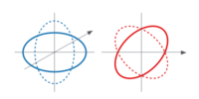


How gravitational waves affect free particles
$\text{Plus}$ Polarization
$\text{Cross}$ Polarization

Slide 2
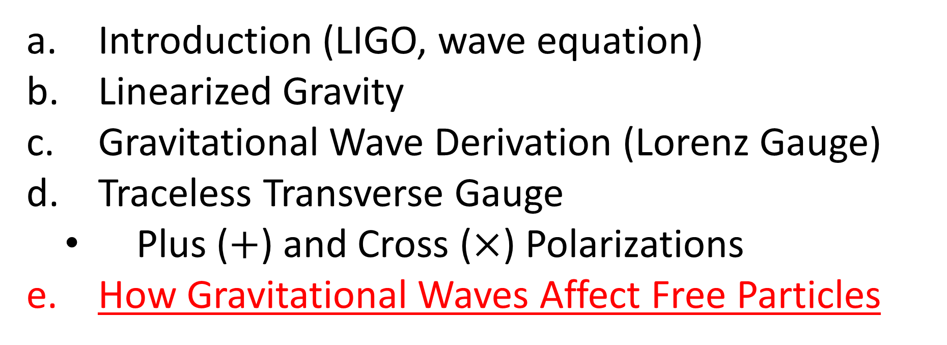

Relativity 109: Gravitational Waves
Introduction (LIGO, wave equation)
Linearized Gravity
Gravitational Wave Derivation (Lorenz Gauge)
Traceless Transverse Gauge
Plus ($+$) and Cross ($×$) Polarizations
How Gravitational Waves Affect Free Particles
Sources:
Good PDF: http://star-www.st-and.ac.uk/~hz4/gr/hendry_GRwaves.pdf
Sean Caroll: https://preposterousuniverse.com/wp-content/uploads/grnotes-six.pdf
Wikipedia: https://en.wikipedia.org/wiki/Linearized_gravity
YouTube: https://www.youtube.com/watch?v=kIBdtbCszB0
Other PDF: https://www.tat.physik.uni-tuebingen.de/~kokkotas/Teaching/NS.BH.GW_files/GW_Physics.pdf
THANK-YOU!!! https://pages.pomona.edu/~tmoore/LesHouches/les-houches-4.pdf
https://pages.pomona.edu/~tmoore/LesHouches/les-houches-5.pdf

Slide 3

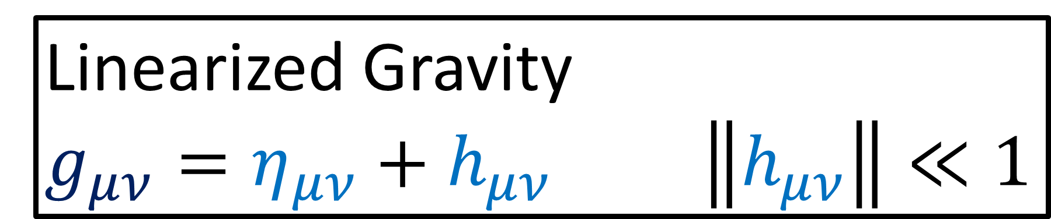
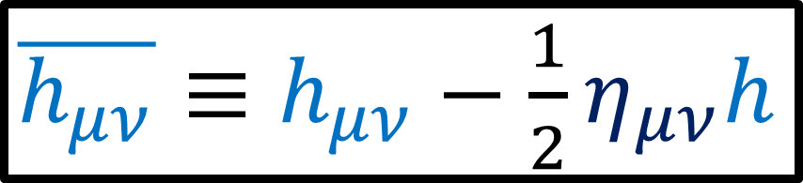

$G_{μν}≡R_{μν}−\frac{1}{2}g_{μν}R=\frac{8πG}{c^{4}}T_{μν}$
Linearized Gravity
$g_{μν}=η_{μν}+h_{μν}$ $\left\|h_{μν}\right\|≪1$
$\overline{h_{μν}}≡h_{μν}−\frac{1}{2}η_{μν}h$
$\frac{1}{2}\left(∂^{α}∂_{μ}\overline{h_{αν}}+∂^{α}∂_{ν}\overline{h_{μα}}−η_{μν}∂^{α}∂^{β}\overline{h_{αβ}}−∂^{α}∂_{α}\overline{h_{μν}}\right)=\frac{8πG}{c^{4}}T_{μν}$

Slide 4
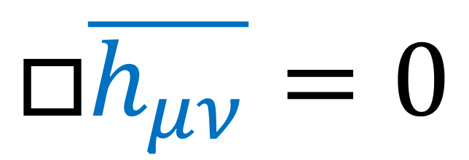

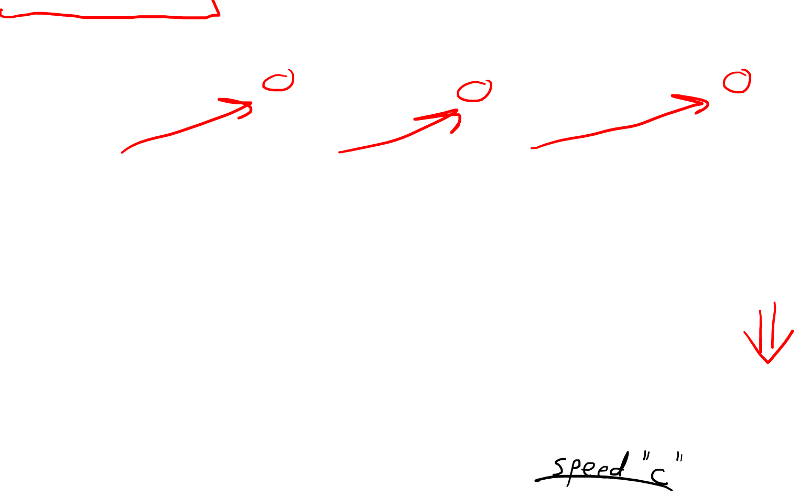
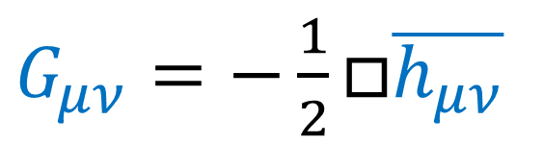
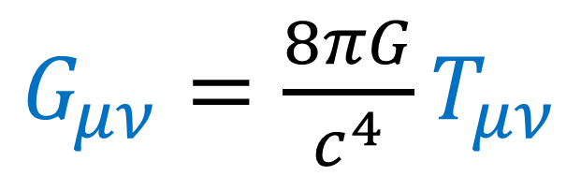
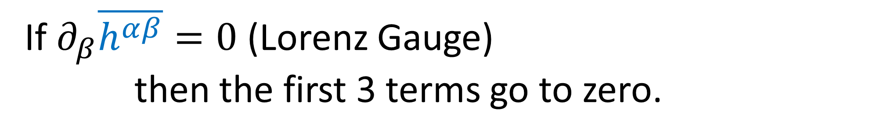
If $∂_{β}\overline{h^{αβ}}=0$ (Lorenz Gauge)
then the first 3 terms go to zero.
$G_{μν}=\frac{1}{2}\left(∂^{α}∂_{μ}\overline{h_{αν}}+∂^{α}∂_{ν}\overline{h_{μα}}−η_{μν}∂^{α}∂^{β}\overline{h_{αβ}}−∂^{α}∂_{α}\overline{h_{μν}}\right)$
Linearized Gravity + Lorenz Gauge
$G_{μν}=\frac{8πG}{c^{4}}T_{μν}$
$G_{μν}=−\frac{1}{2}□\overline{h_{μν}}$
Vacuum
$$T_{μν}=0$$
$$□\overline{h_{μν}}=0$$
Wave Equation

Slide 5
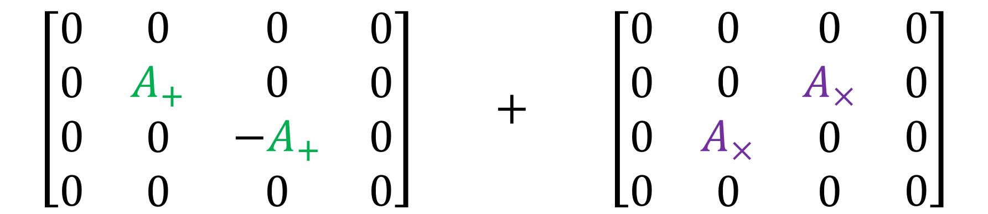
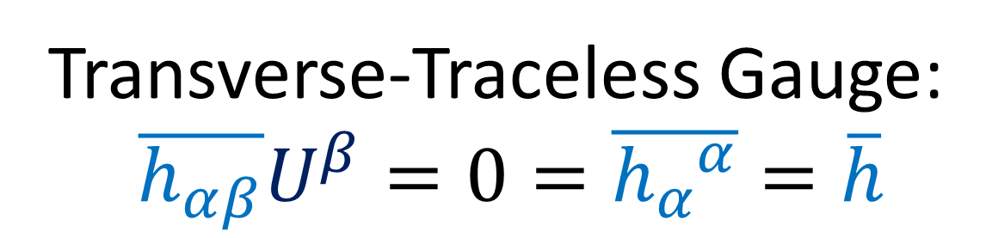
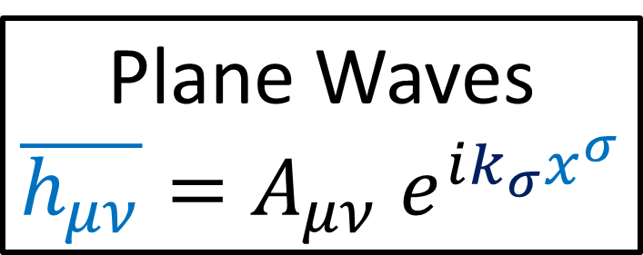
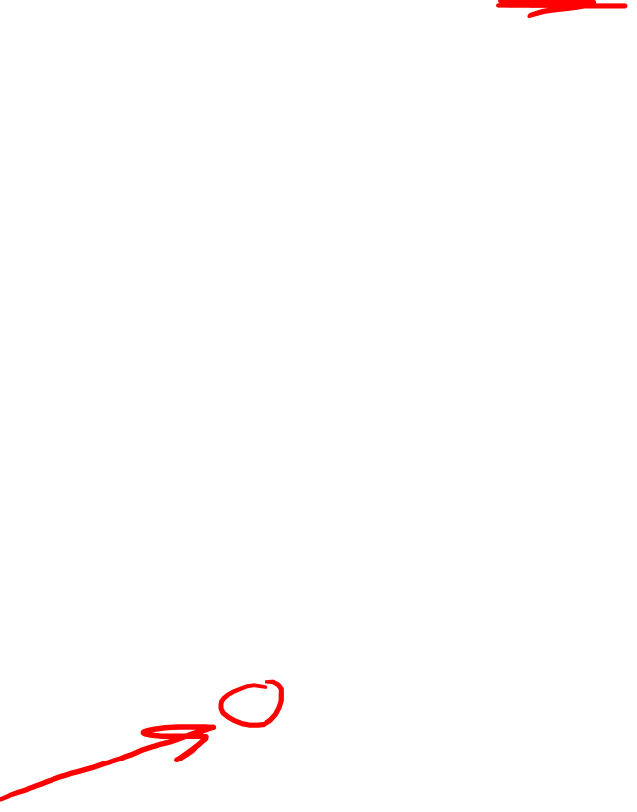
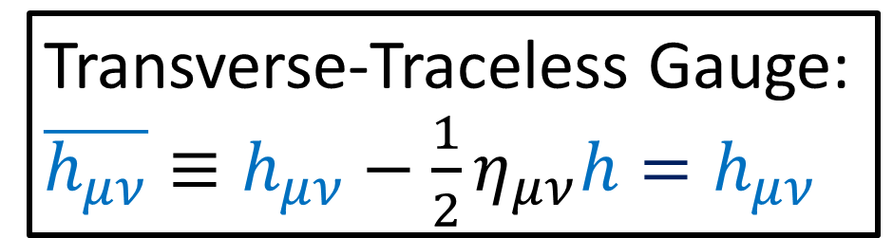
Transverse-Traceless Gauge:
$\overline{h_{αβ}}U^{β}=0=\overline{h_{α}^{ α}}=\overline{h}$
Plane Waves
$$\overline{h_{μν}}=A_{μν} e^{ik_{σ}x^{σ}}$$
$$\left[\begin{matrix}\begin{matrix}\begin{aligned}0 \\ 0 \\ 0 \\ 0\end{aligned} & \begin{aligned}0 \\ A_{+} \\ 0 \\ 0\end{aligned}\end{matrix} & \begin{matrix}\begin{aligned}0 \\ 0 \\ −A_{+} \\ 0\end{aligned} & \begin{aligned}0 \\ 0 \\ 0 \\ 0\end{aligned}\end{matrix}\end{matrix}\right] + \left[\begin{matrix}\begin{matrix}\begin{aligned}0 \\ 0 \\ 0 \\ 0\end{aligned} & \begin{aligned}0 \\ 0 \\ A_{×} \\ 0\end{aligned}\end{matrix} & \begin{matrix}\begin{aligned}0 \\ A_{×} \\ 0 \\ 0\end{aligned} & \begin{aligned}0 \\ 0 \\ 0 \\ 0\end{aligned}\end{matrix}\end{matrix}\right]$$
“Plus” Polarization
“Cross” Polarization
Transverse-Traceless Gauge:
$\overline{h_{μν}}≡h_{μν}−\frac{1}{2}η_{μν}h=h_{μν}$

Slide 6




Gravitational Wave Polarizations
$$y$$
$$x$$
$+$ Polarization
$×$ Polarization
(Animation credits to Wikipedia User MOBle / Mike Boyle)

Slide 7
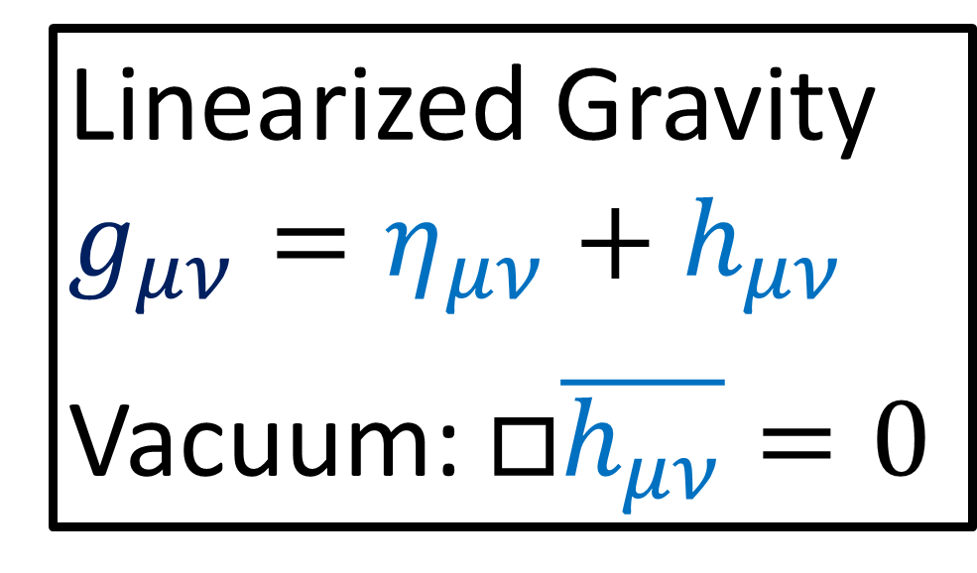
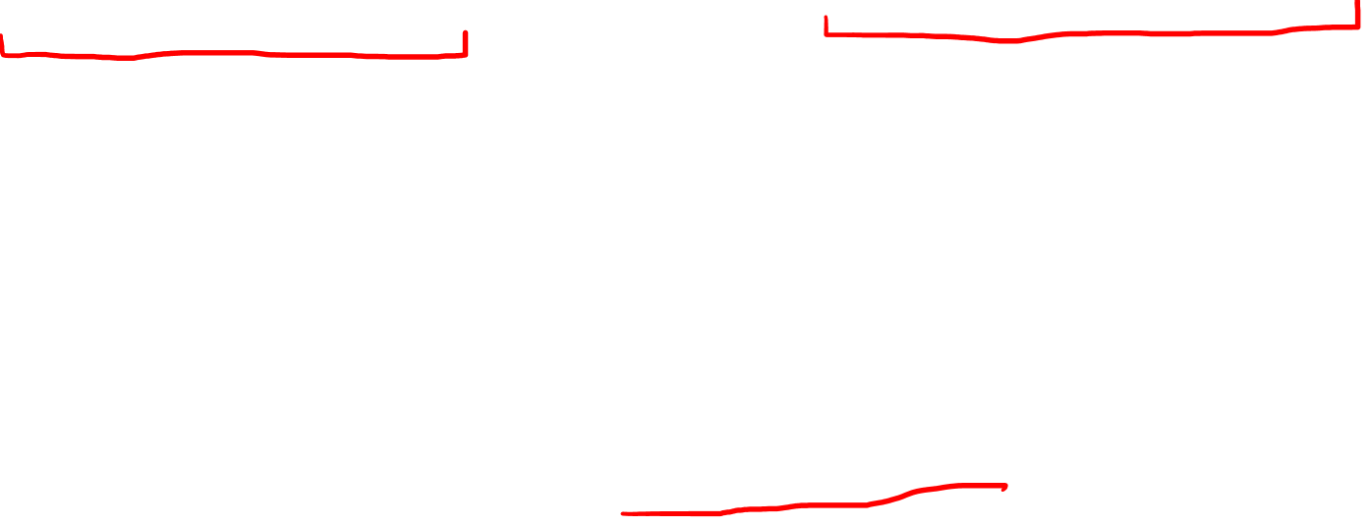

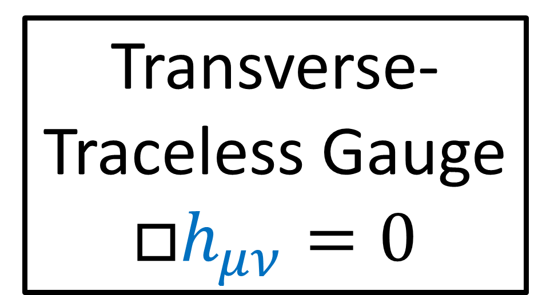
Linearized Gravity
$$g_{μν}=η_{μν}+h_{μν}$$
Vacuum: $□\overline{h_{μν}}=0$
Transverse-Traceless Gauge
$$□h_{μν}=0$$
In relativity, coordinate systems are arbitrary and don’t impact physics.
What if this wave equation $□h_{μν}=0$ is just the result of “wavey” coordinate lines?

Slide 8





time $ct$
time $ct$
space $x$
space $x$
Real Gravitational Waves:
Space “stretching” and “compressing”
Just “wavey” coordinate curves?

Slide 9
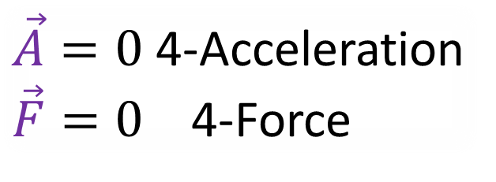
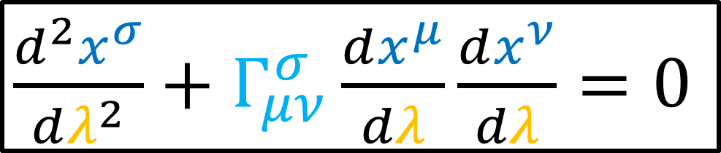
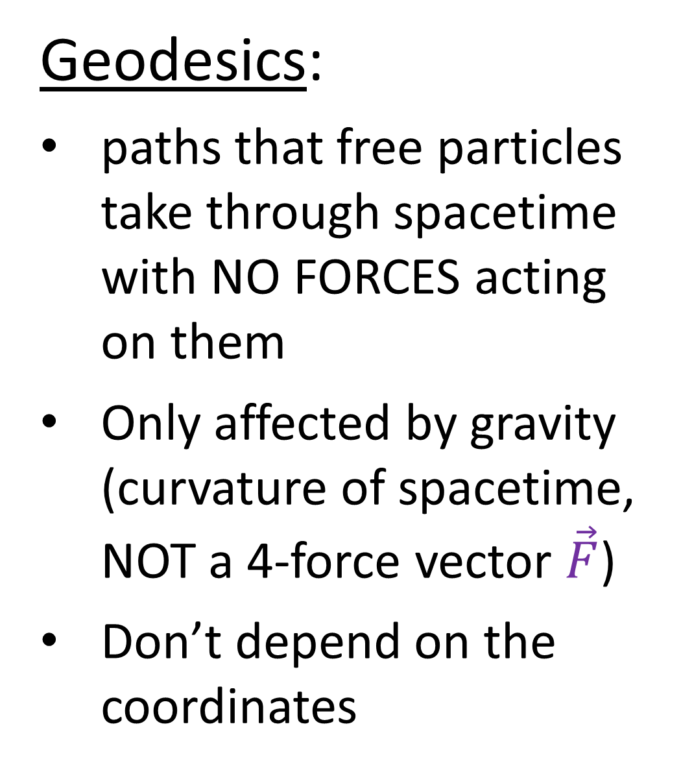
Geodesics:
paths that free particles take through spacetime with NO FORCES acting on them
Only affected by gravity (curvature of spacetime, NOT a 4-force vector $\vec{F}$)
Don’t depend on the coordinates
$\frac{d^{2}x^{σ}}{dλ^{2}}+Γ_{μν}^{σ}\frac{dx^{μ}}{dλ}\frac{dx^{ν}}{dλ}=0$
$\vec{A}=0$ 4-Acceleration
$\vec{F}=0$ 4-Force

Slide 10
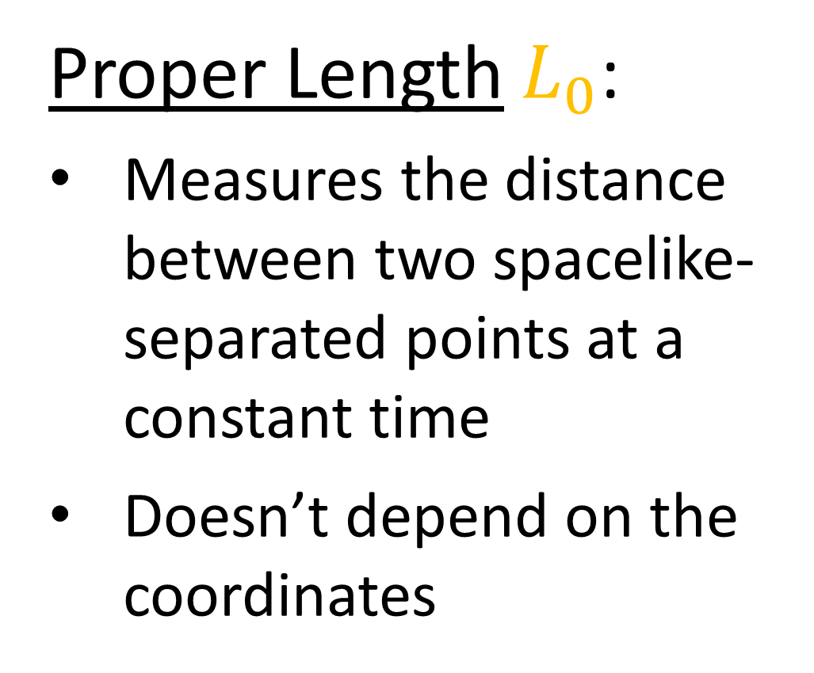
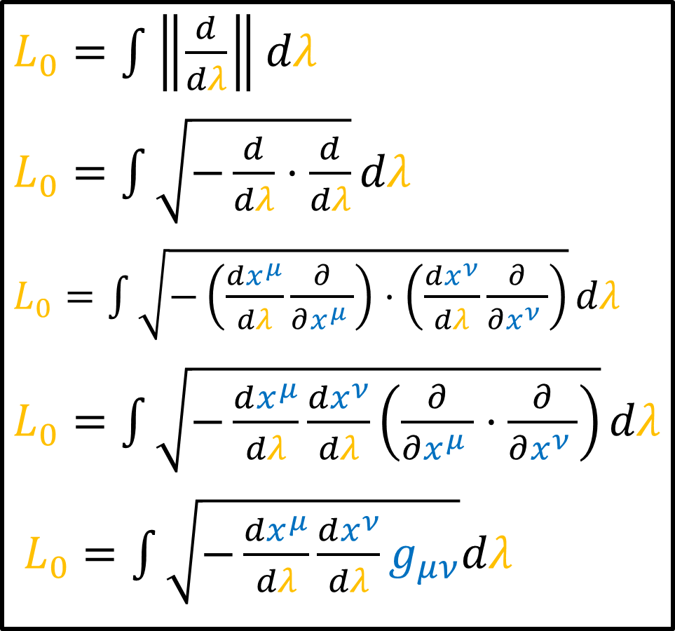
Proper Length $L_{0}$:
Measures the distance between two spacelike-separated points at a constant time
Doesn’t depend on the coordinates
$L_{0}=\int{\left\|\frac{d}{dλ}\right\|dλ}$
$L_{0}=\int{\sqrt{−\frac{d}{dλ}⋅\frac{d}{dλ}}dλ}$
$L_{0}=\int{\sqrt{−\left(\frac{dx^{μ}}{dλ}\frac{∂}{∂x^{μ} }\right)⋅\left(\frac{dx^{ν}}{dλ}\frac{∂}{∂x^{ν} }\right)}dλ}$
$L_{0}=\int{\sqrt{−\frac{dx^{μ}}{dλ}\frac{dx^{ν}}{dλ}\left(\frac{∂}{∂x^{μ} }⋅\frac{∂}{∂x^{ν} }\right)}dλ}$
$L_{0}=\int{\sqrt{−\frac{dx^{μ}}{dλ}\frac{dx^{ν}}{dλ}g_{μν}}dλ}$

Slide 11
Geodesics
Proper Distance
(paths of free particles)
(coordinate-independent)
(lengths in space) (coordinate-independent)
Measure how gravitational waves stretch/compress space in a coordinate-independent way.

Slide 12
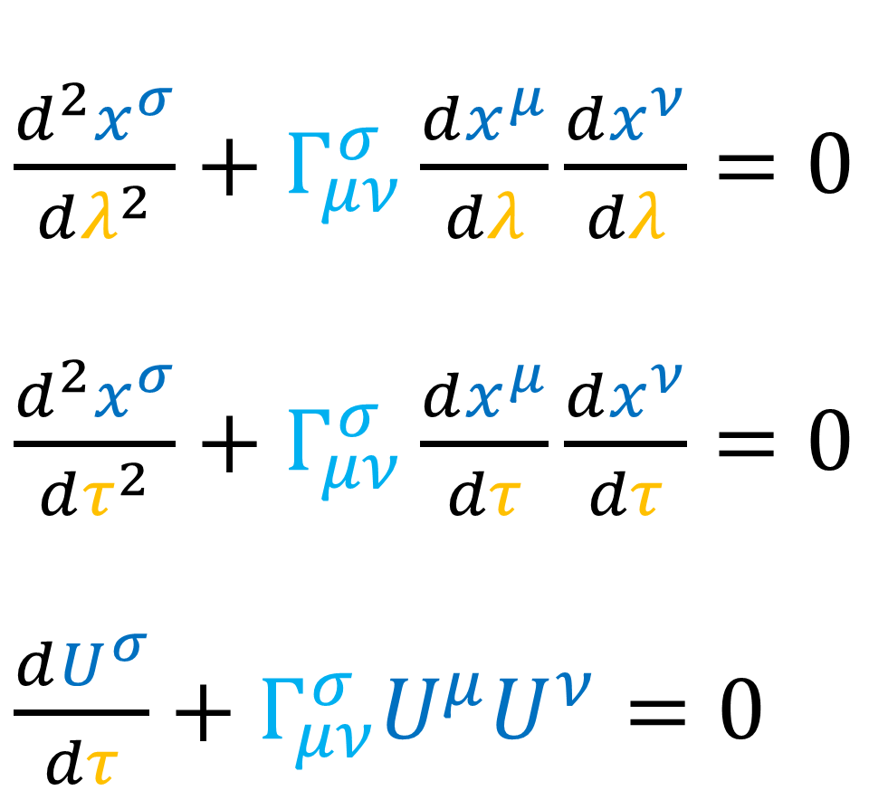
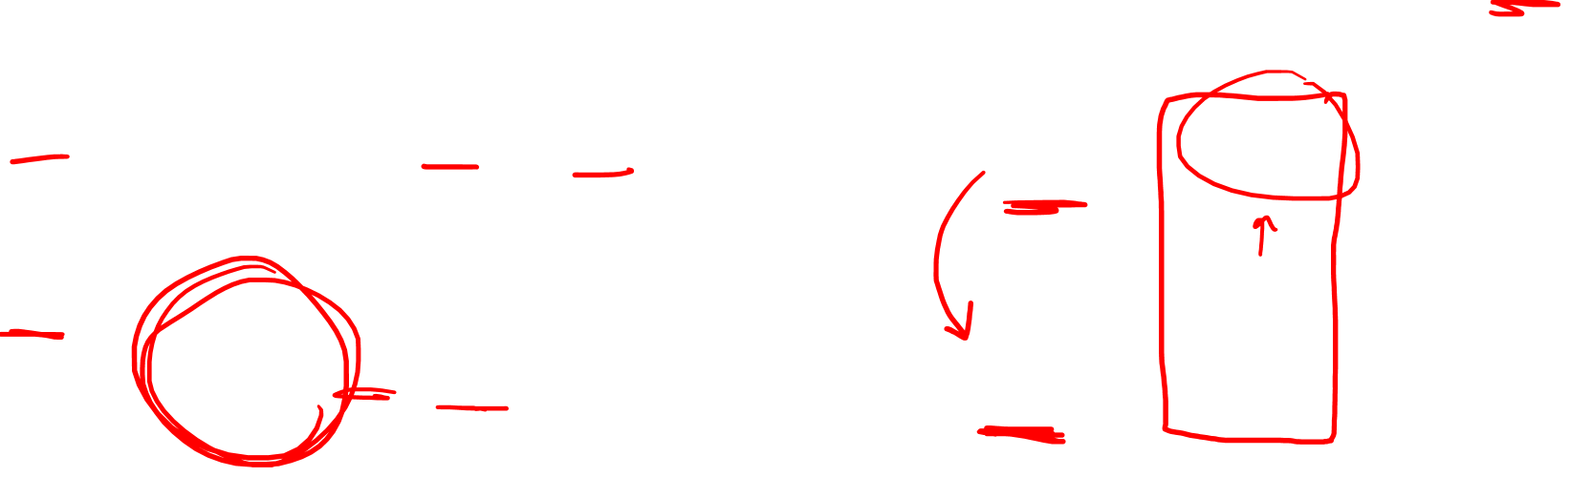
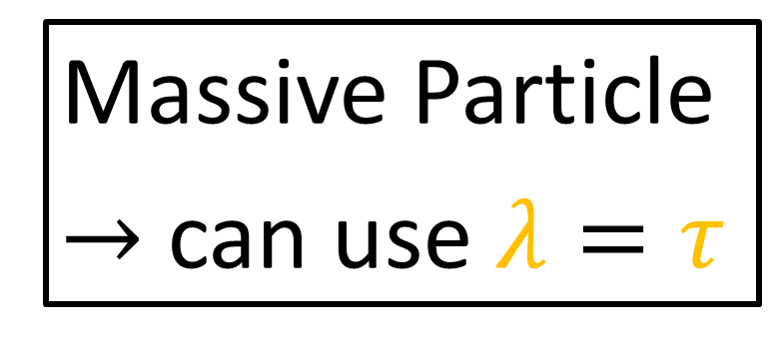
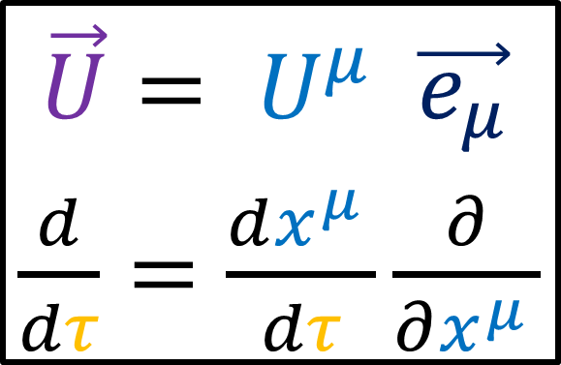
Geodesic Equation
$\frac{d^{2}x^{σ}}{dλ^{2}}+Γ_{μν}^{σ}\frac{dx^{μ}}{dλ}\frac{dx^{ν}}{dλ}=0$
$\frac{d^{2}x^{σ}}{dτ^{2}}+Γ_{μν}^{σ}\frac{dx^{μ}}{dτ}\frac{dx^{ν}}{dτ}=0$
$\frac{dU^{σ}}{dτ}+Γ_{μν}^{σ}U^{μ}U^{ν}=0$
Massive Particle
$→$ can use $λ=τ$
$\vec{U}= U^{μ} \vec{e_{μ}}$
$\frac{d}{dτ}=\frac{dx^{μ }}{dτ}\frac{∂}{∂x^{μ }}$

Slide 13
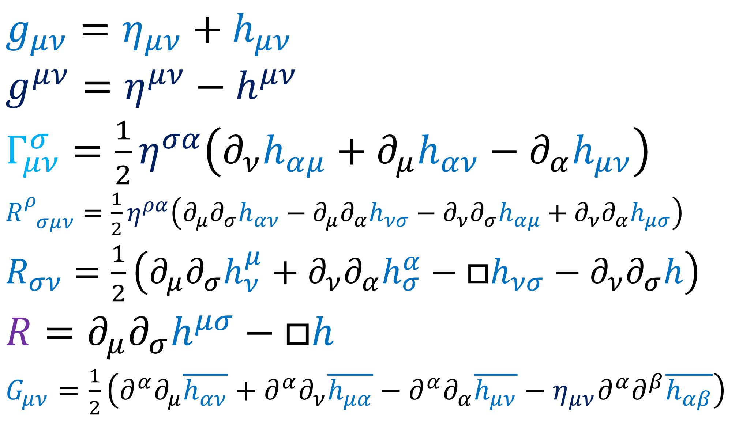



$g_{μν}=η_{μν}+h_{μν}$
$g^{μν}=η^{μν}−h^{μν}$
$Γ_{μν}^{σ}=\frac{1}{2}η^{σα}\left(∂_{ν}h_{αμ}+∂_{μ}h_{αν}−∂_{α}h_{μν}\right)$
$R_{ σμν}^{ρ}=\frac{1}{2}η^{ρα}\left(∂_{μ}∂_{σ}h_{αν}−∂_{μ}∂_{α}h_{νσ}−∂_{ν}∂_{σ}h_{αμ}+∂_{ν}∂_{α}h_{μσ}\right)$
$R_{σν}=\frac{1}{2}\left(∂_{μ}∂_{σ}h_{ν}^{μ}+∂_{ν}∂_{α}h_{σ}^{α}−□h_{νσ}−∂_{ν}∂_{σ}h\right)$
$$R=∂_{μ}∂_{σ}h^{μσ}−□h$$
$G_{μν}=\frac{1}{2}\left(∂^{α}∂_{μ}\overline{h_{αν}}+∂^{α}∂_{ν}\overline{h_{μα}}−∂^{α}∂_{α}\overline{h_{μν}}−η_{μν}∂^{α}∂^{β}\overline{h_{αβ}}\right)$
(From Relativity 109b)
$h^{μν}=h_{ρσ}η^{ρμ}η^{σν}$
$h_{μν}≡\overline{h_{μν}}+\frac{1}{2}η_{μν}h$

Slide 14

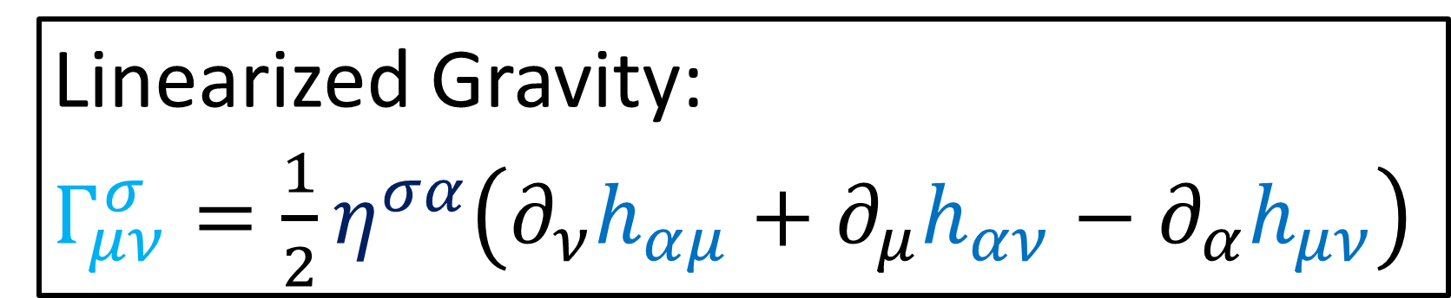
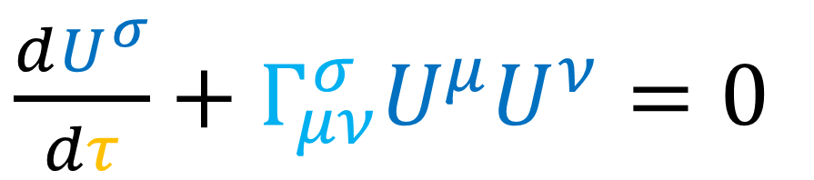
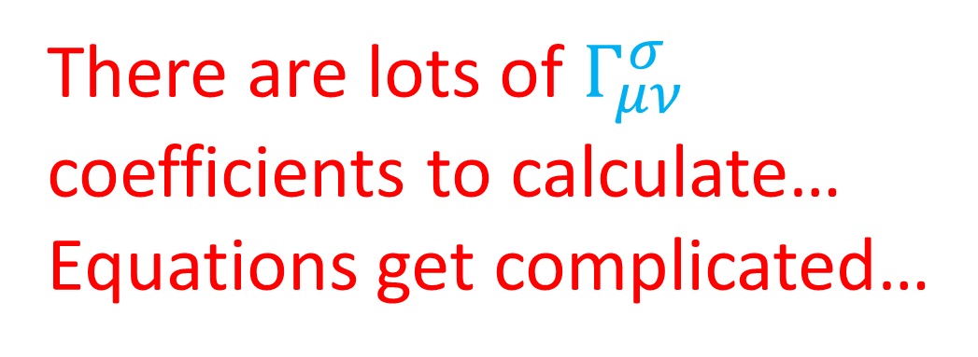
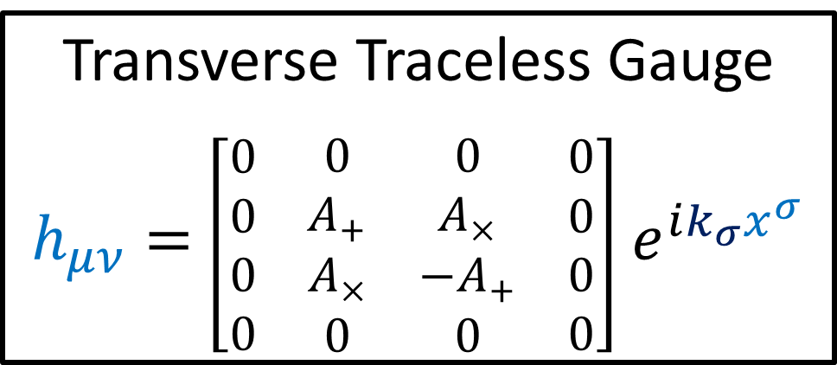
Linearized Gravity:
$Γ_{μν}^{σ}=\frac{1}{2}η^{σα}\left(∂_{ν}h_{αμ}+∂_{μ}h_{αν}−∂_{α}h_{μν}\right)$
$\frac{dU^{σ}}{dτ}+Γ_{μν}^{σ}U^{μ}U^{ν}=0$
Transverse Traceless Gauge
$h_{μν}=$ $\left[\begin{matrix}\begin{matrix}\begin{aligned}0 \\ 0 \\ 0 \\ 0\end{aligned} & \begin{aligned}0 \\ A_{+} \\ A_{×} \\ 0\end{aligned}\end{matrix} & \begin{matrix}\begin{aligned}0 \\ A_{×} \\ −A_{+} \\ 0\end{aligned} & \begin{aligned}0 \\ 0 \\ 0 \\ 0\end{aligned}\end{matrix}\end{matrix}\right]$ $e^{ik_{σ}x^{σ}}$
There are lots of $Γ_{μν}^{σ}$ coefficients to calculate…
Equations get complicated…
BUT there’s one set of solutions that’s easy to verify…

Slide 15
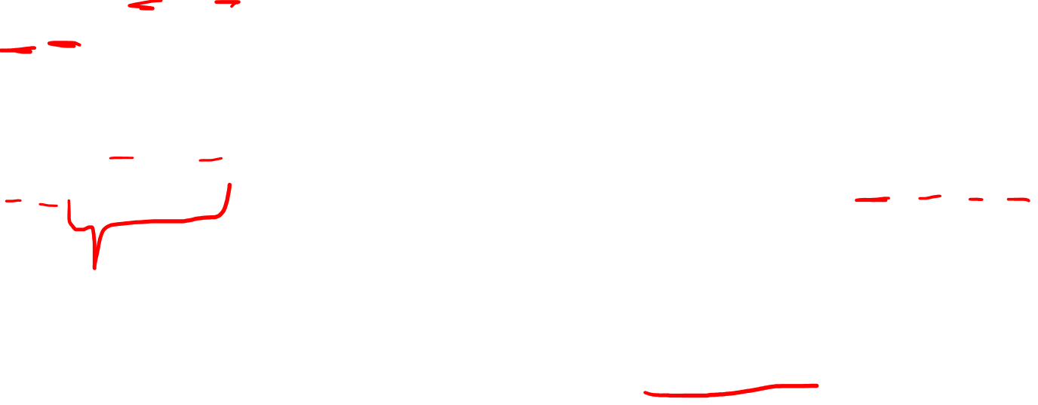
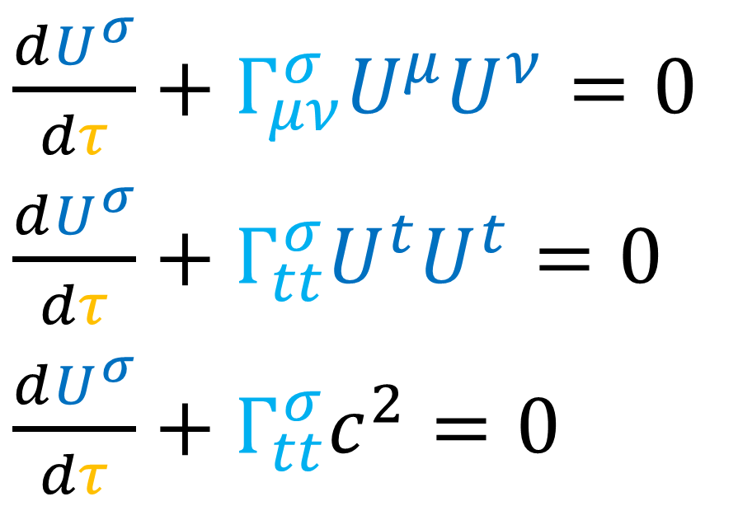
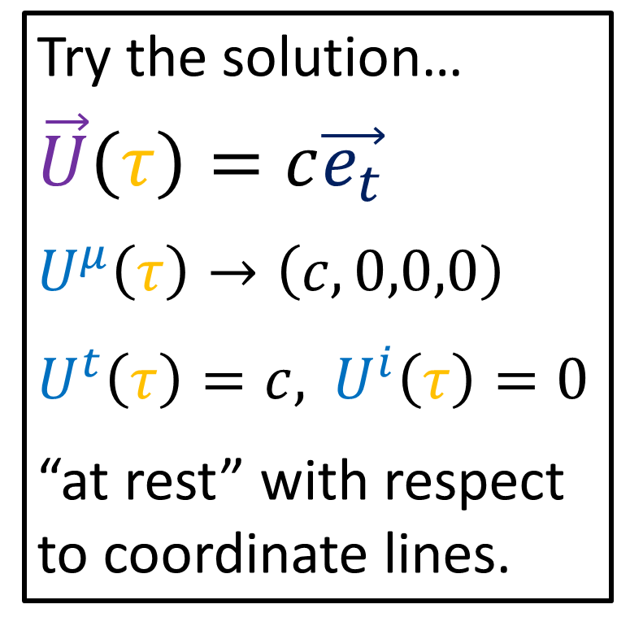
Linearized Gravity:
$Γ_{μν}^{σ}=\frac{1}{2}η^{σα}\left(∂_{ν}h_{αμ}+∂_{μ}h_{αν}−∂_{α}h_{μν}\right)$
$\frac{dU^{σ}}{dτ}+Γ_{μν}^{σ}U^{μ}U^{ν}=0$
$\frac{dU^{σ}}{dτ}+Γ_{tt}^{σ}U^{t}U^{t}=0$
$\frac{dU^{σ}}{dτ}+Γ_{tt}^{σ}c^{2}=0$
Try the solution…
$$\vec{U}\left(τ\right)=c\vec{e_{t}}$$
$$U^{μ}\left(τ\right)→\left(c,0,0,0\right)$$
$U^{t}\left(τ\right)=c,$ $U^{i}\left(τ\right)=0$
“at rest” with respect to coordinate lines.

Slide 16
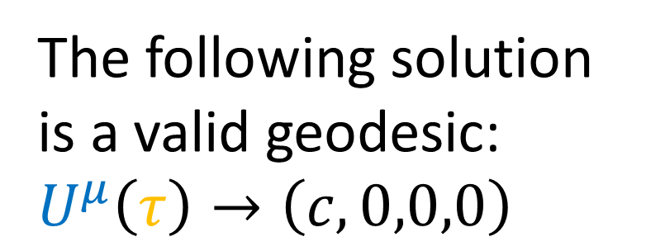
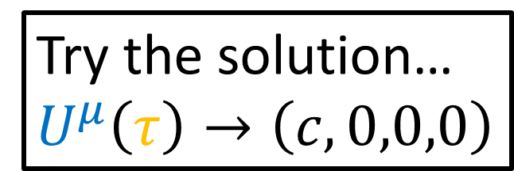
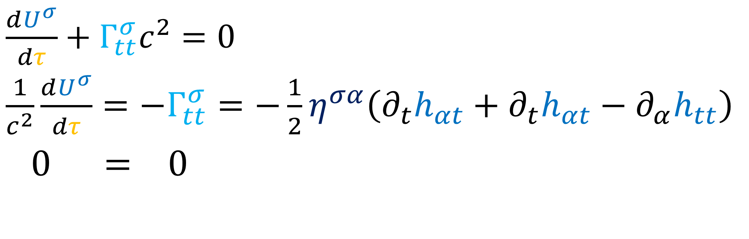

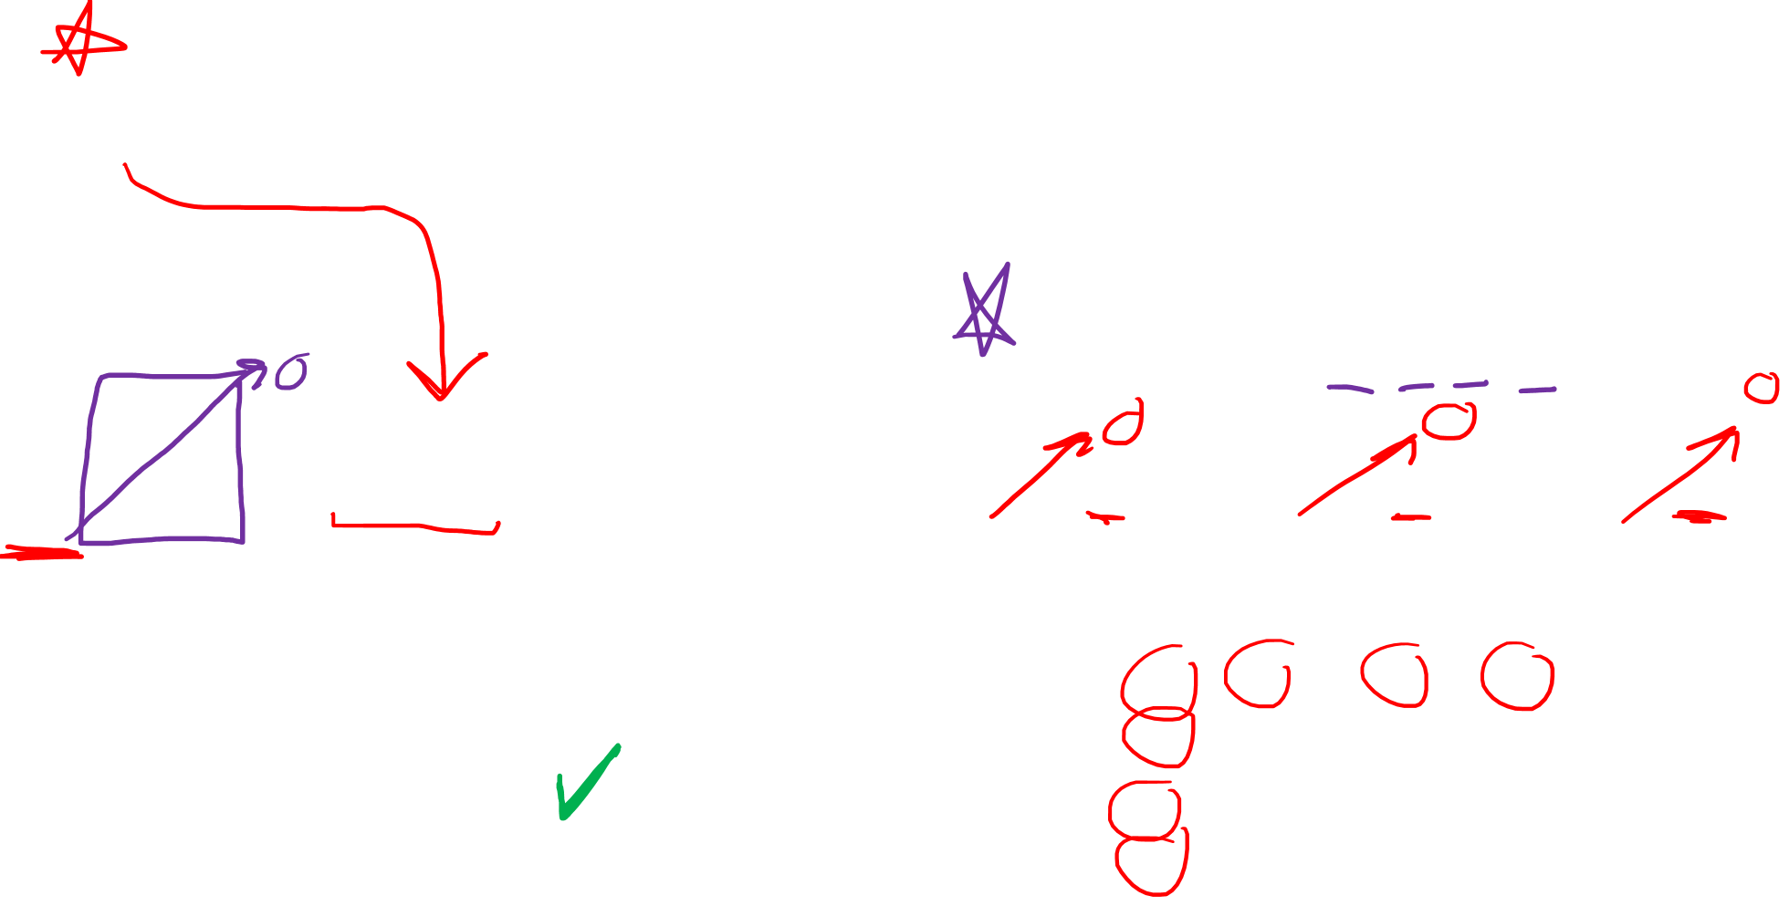
Linearized Gravity:
$Γ_{μν}^{σ}=\frac{1}{2}η^{σα}\left(∂_{ν}h_{αμ}+∂_{μ}h_{αν}−∂_{α}h_{μν}\right)$
$\frac{dU^{σ}}{dτ}+Γ_{tt}^{σ}c^{2}=0$
$\frac{1}{c^{2}}\frac{dU^{σ}}{dτ}=−Γ_{tt}^{σ}=−\frac{1}{2}η^{σα}\left(∂_{t}h_{αt}+∂_{t}h_{αt}−∂_{α}h_{tt}\right)$
$0 = 0$
Try the solution…
$$U^{μ}\left(τ\right)→\left(c,0,0,0\right)$$
Transverse Traceless Gauge
$h_{μν}=$ $\left[\begin{matrix}\begin{matrix}\begin{aligned}0 \\ 0 \\ 0 \\ 0\end{aligned} & \begin{aligned}0 \\ A_{+} \\ A_{×} \\ 0\end{aligned}\end{matrix} & \begin{matrix}\begin{aligned}0 \\ A_{×} \\ −A_{+} \\ 0\end{aligned} & \begin{aligned}0 \\ 0 \\ 0 \\ 0\end{aligned}\end{matrix}\end{matrix}\right]$ $e^{ik_{σ}x^{σ}}$
The following solution is a valid geodesic:
$$U^{μ}\left(τ\right)→\left(c,0,0,0\right)$$

Slide 17
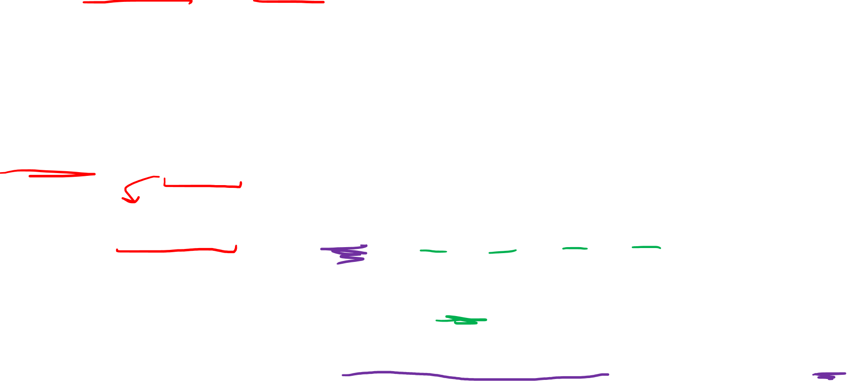
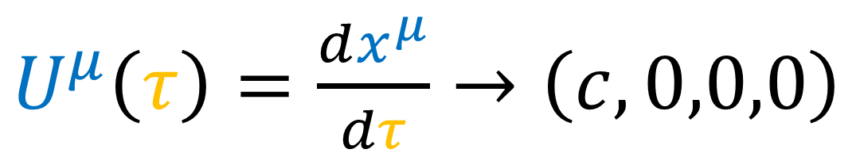
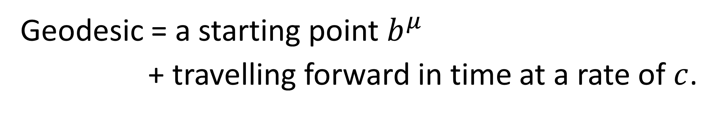
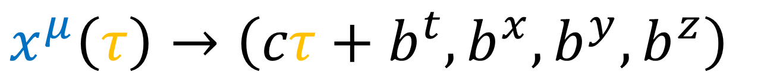
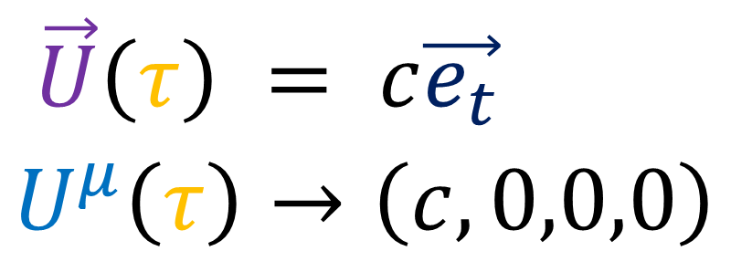
The following is a geodesic in the TT Gauge:
$\vec{U}\left(τ\right) = c\vec{e_{t}}$
$$U^{μ}\left(τ\right)→\left(c,0,0,0\right)$$
$U^{μ}\left(τ\right)=\frac{dx^{μ}}{dτ}→\left(c,0,0,0\right)$
$x^{μ}\left(τ\right)→\left(cτ+b^{t},b^{x},b^{y},b^{z}\right)$
Geodesic = a starting point $b^{μ}$
+ travelling forward in time at a rate of $c$.

Slide 18
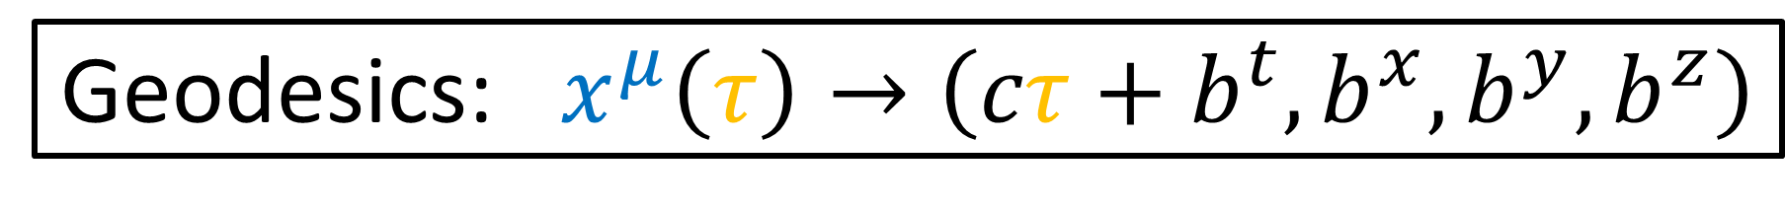
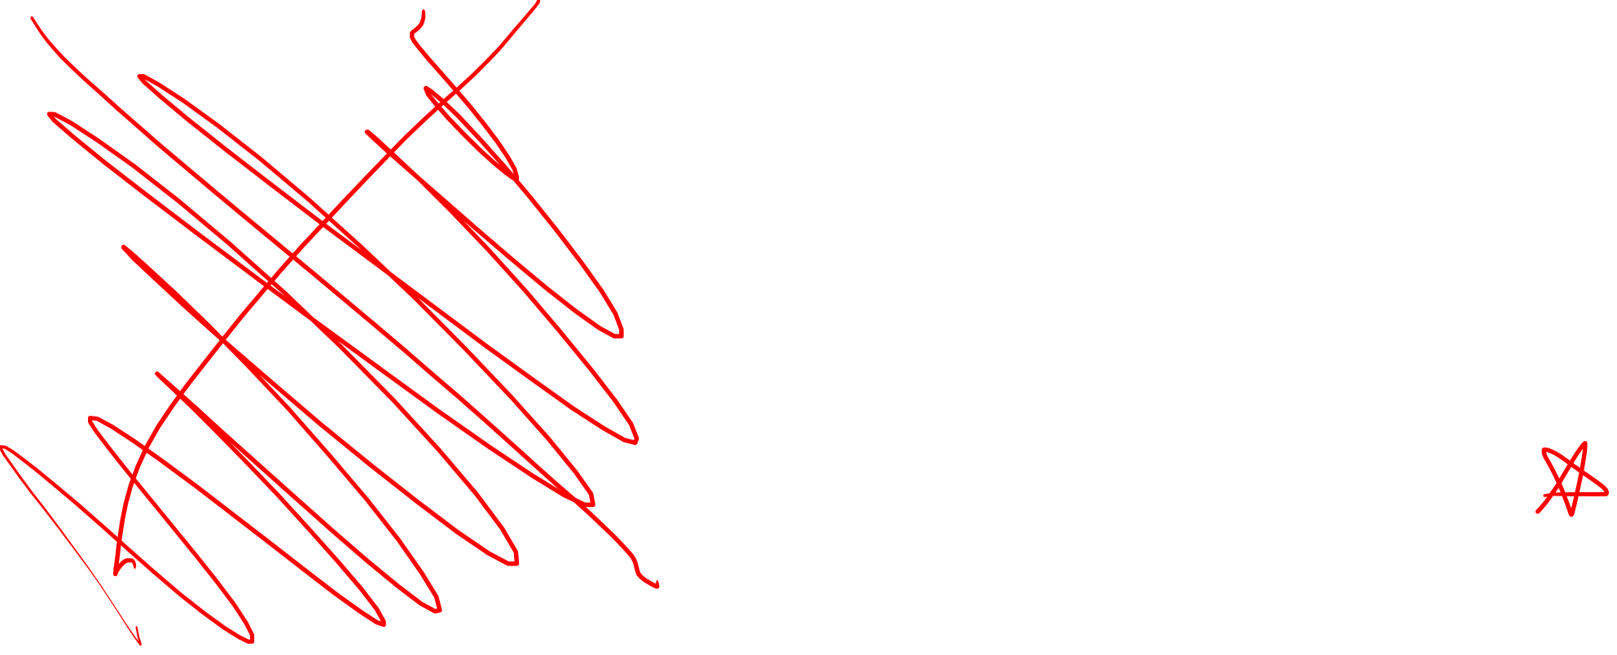

Geodesics: $x^{μ}\left(τ\right)→\left(cτ+b^{t},b^{x},b^{y},b^{z}\right)$
time $ct$
time $ct$
$$L_{0}$$
space $x$
space $x$

Slide 19

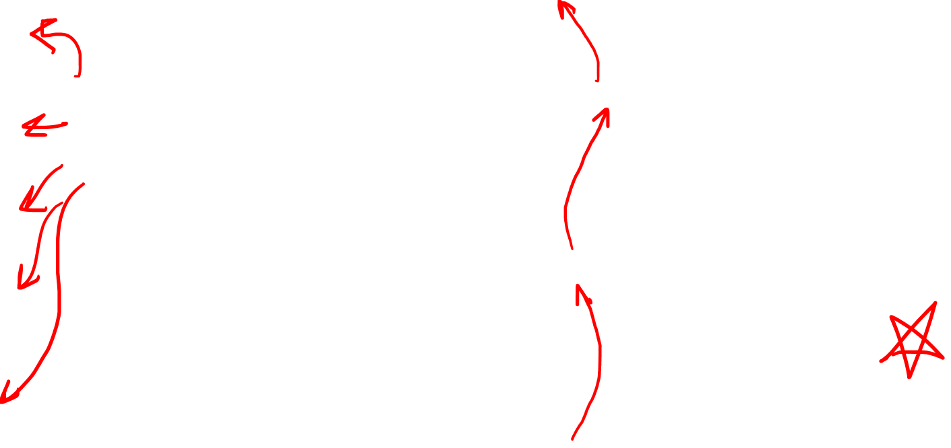


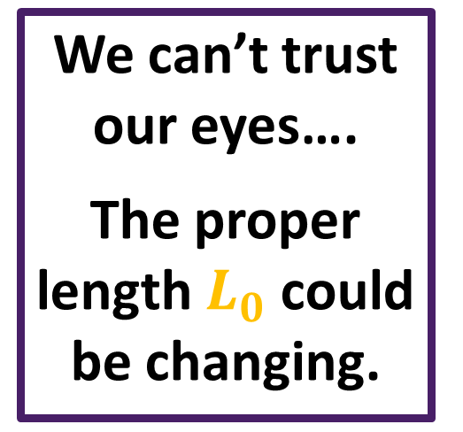

Geodesics: $x^{μ}\left(τ\right)→\left(cτ+b^{t},b^{x},b^{y},b^{z}\right)$
time $ct$
We can’t trust our eyes….
The proper length $L_{0}$ could be changing.
time $ct$
$$L_{0}$$
space $x$
space $x$

Slide 20



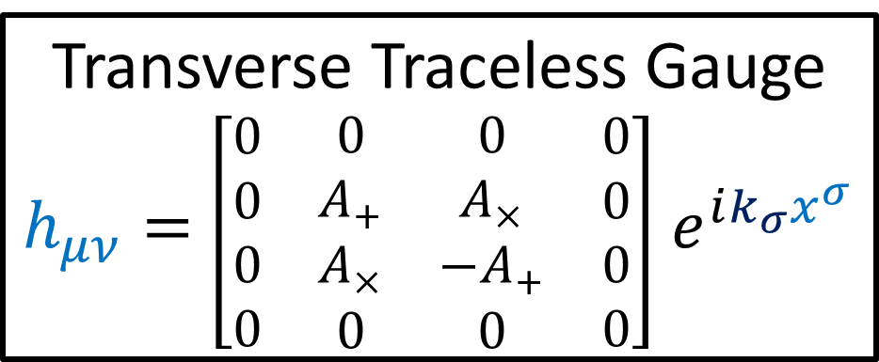




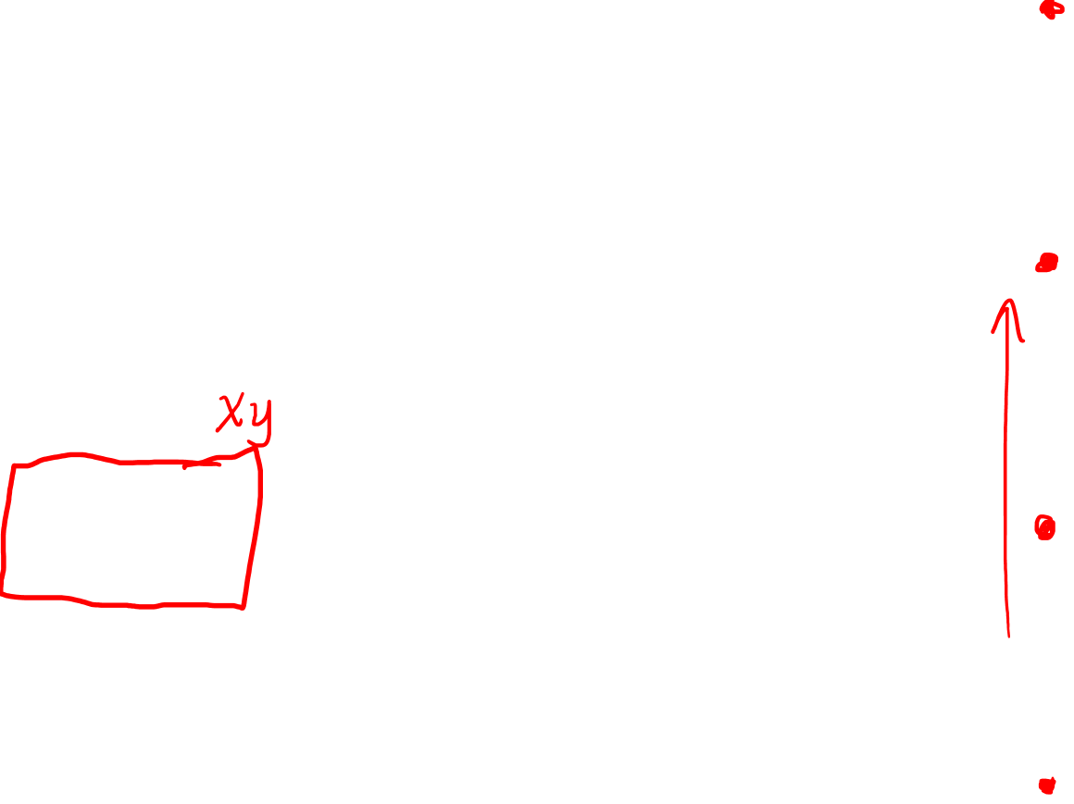






Wave travelling only in the $z$-direction
$$\vec{v}$$
$$ct$$
$$y$$
$$L_{0}$$
Wave vector
$k^{μ}→\left(\frac{ω}{c},0,0,\frac{ω}{c}\right)$
$$x$$
$$\vec{v}$$
Transverse Traceless Gauge
$h_{μν}=$ $\left[\begin{matrix}\begin{matrix}\begin{aligned}0 \\ 0 \\ 0 \\ 0\end{aligned} & \begin{aligned}0 \\ A_{+} \\ A_{×} \\ 0\end{aligned}\end{matrix} & \begin{matrix}\begin{aligned}0 \\ A_{×} \\ −A_{+} \\ 0\end{aligned} & \begin{aligned}0 \\ 0 \\ 0 \\ 0\end{aligned}\end{matrix}\end{matrix}\right]$ $e^{ik_{σ}x^{σ}}$
$$L_{0}$$
$$\vec{v}$$
$$L_{0}$$
$$\vec{v}$$
$$L_{0}$$

Slide 21






$L_{0}=∫\left\|\frac{d}{dλ}\right\|dλ$
$=∫\sqrt{−\frac{d}{dλ}⋅\frac{d}{dλ}}dλ$
$=∫\sqrt{−\left(\frac{dx}{dλ}\frac{∂}{∂x}+\frac{dy}{dλ}\frac{∂}{∂y}\right)⋅\left(\frac{dx}{dλ}\frac{∂}{∂x}+\frac{dy}{dλ}\frac{∂}{∂y}\right)}dλ$
$=∫\sqrt{−{\left(\frac{dx}{dλ}\right)}^{2}g_{xx}+\left(\frac{dx}{dλ}\right)\left(\frac{dy}{dλ}\right)g_{xy}+{\left(\frac{dy}{dλ}\right)}^{2}g_{yy}}dλ$
$=\int_{0}^{1}{\sqrt{−{\left(v^{x}\right)}^{2}g_{xx}+\left(v^{x}\right)\left(v^{y}\right)g_{xy}+{\left(v^{y}\right)}^{2}g_{yy}}dλ}$
$=\int_{0}^{1}{\sqrt{−\vec{v}⋅\vec{v}}dλ}=\sqrt{−\vec{v}⋅\vec{v}}\int_{0}^{1}{dλ}=\sqrt{−\vec{v}⋅\vec{v}}=\left\|\vec{v}\right\|$
$$x\left(λ\right)=v^{x}λ$$
$$y\left(λ\right)=v^{y}λ$$
$$\vec{v}$$
$$λ=0$$
$$λ=1$$

Slide 22



$\vec{v}⋅\vec{v}=\left(v^{μ} \vec{e_{μ}}\right)⋅\left(v^{ν} \vec{e_{ν}}\right)$
$\vec{v}⋅\vec{v}=v^{μ}v^{ν}\left(\vec{e_{μ}}⋅\vec{e_{ν}}\right)$
$\vec{v}⋅\vec{v}=v^{μ}v^{ν}g_{μν}$
$=v^{x}v^{x}g_{xx}+v^{x}v^{y}g_{xy}+v^{y}v^{x}g_{yx}+v^{y}v^{y}g_{yy}$
$={\left(v^{x}\right)}^{2}g_{xx}+2v^{x}v^{y}g_{xy}+{\left(v^{y}\right)}^{2}g_{yy}$

Slide 23







Transverse Traceless Gauge
$h_{μν}=$ $\left[\begin{matrix}\begin{matrix}\begin{aligned}0 \\ 0 \\ 0 \\ 0\end{aligned} & \begin{aligned}0 \\ A_{+} \\ A_{×} \\ 0\end{aligned}\end{matrix} & \begin{matrix}\begin{aligned}0 \\ A_{×} \\ −A_{+} \\ 0\end{aligned} & \begin{aligned}0 \\ 0 \\ 0 \\ 0\end{aligned}\end{matrix}\end{matrix}\right]$ $e^{ik_{σ}x^{σ}}$
Proper Length
$L_{0}=∫\left\|\frac{d}{dλ}\right\|dλ$
$=∫\sqrt{−\frac{d}{dλ}⋅\frac{d}{dλ}}dλ$
space $y$
displacement vector $\frac{d}{dλ}=\vec{v}$
$$L_{0}$$
space $x$

Slide 24




$\frac{d}{dλ}⋅\frac{d}{dλ}=\left(\frac{dx^{μ}}{dλ}\frac{∂}{∂x^{μ}}\right)⋅\left(\frac{dx^{ν}}{dλ}\frac{∂}{∂x^{ν}}\right)$
$\vec{v}⋅\vec{v}=\left(v^{μ} \vec{e_{μ}}\right)⋅\left(v^{ν} \vec{e_{ν}}\right)$
$\vec{v}⋅\vec{v}=v^{μ}v^{ν}\left(\vec{e_{μ}}⋅\vec{e_{ν}}\right)$
$\vec{v}⋅\vec{v}=v^{μ}v^{ν}g_{μν}$
spacelike vector
$\frac{d}{dλ}=\frac{dx^{μ}}{dλ}\frac{∂}{∂x^{μ}}$
$\vec{v} = v^{μ} \vec{e_{μ}}$
$=v^{x}v^{x}g_{xx}+v^{x}v^{y}g_{xy}+v^{y}v^{x}g_{yx}+v^{y}v^{y}g_{yy}$
$={\left(v^{x}\right)}^{2}g_{xx}+2v^{x}v^{y}g_{xy}+{\left(v^{y}\right)}^{2}g_{yy}$

Slide 25




$\vec{v}⋅\vec{v}={\left(v^{x}\right)}^{2}g_{xx}+2v^{x}v^{y}g_{xy}+{\left(v^{y}\right)}^{2}g_{yy}$
$$={\left(v^{x}\right)}^{2}\left(η_{xx}+h_{xx}\right)$$
$+2v^{x}v^{y}\left(η_{xy}+h_{xy}\right)$
$$+{\left(v^{y}\right)}^{2}\left(η_{yy}+h_{yy}\right)$$
$$={\left(v^{x}\right)}^{2}\left(−1+A_{+}e^{ik_{σ}x^{σ}}\right)$$
$+2v^{x}v^{y}\left(0+A_{×}e^{ik_{σ}x^{σ}}\right)$
$$+{\left(v^{y}\right)}^{2}\left(−1−A_{+}e^{ik_{σ}x^{σ}}\right)$$
Transverse Traceless Gauge
$h_{μν}=$ $\left[\begin{matrix}\begin{matrix}\begin{aligned}0 \\ 0 \\ 0 \\ 0\end{aligned} & \begin{aligned}0 \\ A_{+} \\ A_{×} \\ 0\end{aligned}\end{matrix} & \begin{matrix}\begin{aligned}0 \\ A_{×} \\ −A_{+} \\ 0\end{aligned} & \begin{aligned}0 \\ 0 \\ 0 \\ 0\end{aligned}\end{matrix}\end{matrix}\right]$ $e^{ik_{σ}x^{σ}}$
$η_{μν}=$ $\left[\begin{matrix}\begin{matrix}\begin{aligned}+1 \\ 0 \\ 0 \\ 0\end{aligned} & \begin{aligned}0 \\ −1 \\ 0 \\ 0\end{aligned}\end{matrix} & \begin{matrix}\begin{aligned}0 \\ 0 \\ −1 \\ 0\end{aligned} & \begin{aligned}0 \\ 0 \\ 0 \\ −1\end{aligned}\end{matrix}\end{matrix}\right]$

Slide 26




$$\vec{v}⋅\vec{v} ={\left(v^{x}\right)}^{2}\left(−1+A_{+}e^{ik_{σ}x^{σ}}\right)$$
$+2v^{x}v^{y}\left(0+A_{×}e^{ik_{σ}x^{σ}}\right)$
$+ {\left(v^{y}\right)}^{2}\left(−1−A_{+}e^{ik_{σ}x^{σ}}\right)$
$$=−\left[{\left(v^{x}\right)}^{2}+{\left(v^{y}\right)}^{2}\right]$$
$$+\left[A_{+}{\left(v^{x}\right)}^{2}+A_{×}2v^{x}v^{y}−A_{+}{\left(v^{y}\right)}^{2}\right]e^{ik_{σ}x^{σ}}$$
$$=−\left[{\left(v^{x}\right)}^{2}+{\left(v^{y}\right)}^{2}\right]$$
$$+\left[A_{+}\left({\left(v^{x}\right)}^{2}−{\left(v^{y}\right)}^{2}\right)+A_{×}2v^{x}v^{y}\right]e^{ik_{σ}x^{σ}}$$

Slide 27


Standard flat Minkowski metric
(negative because it’s spacelike)
$$\vec{v}⋅\vec{v}=−\left[{\left(v^{x}\right)}^{2}+{\left(v^{y}\right)}^{2}\right]$$
$$+\left[A_{+}\left({\left(v^{x}\right)}^{2}−{\left(v^{y}\right)}^{2}\right)+A_{×}2v^{x}v^{y}\right]e^{ik_{σ}x^{σ}}$$
Changes to metric due to gravitational waves
The distance between neighbouring geodesics IS changing due to vibrations in $h_{μν}$, even though the geodesics have constant space coordinates in the transverse-traceless gauge.

Slide 28

$$\vec{v}⋅\vec{v}=−\left[{\left(v^{x}\right)}^{2}+{\left(v^{y}\right)}^{2}\right]$$
$$+\left[A_{+}\left({\left(v^{x}\right)}^{2}−{\left(v^{y}\right)}^{2}\right)+A_{×}2v^{x}v^{y}\right]e^{ik_{σ}x^{σ}}$$
See how this affects the geometry of spacetime
$$≡Δ$$

Slide 29








$$y$$
$$Δ=\left[A_{+}\left({\left(v^{x}\right)}^{2}−{\left(v^{y}\right)}^{2}\right)+A_{×}2v^{x}v^{y}\right]e^{ik_{σ}x^{σ}}$$
$$Δ=A_{+}{\left(v^{x}\right)}^{2}e^{ik_{σ}x^{σ}}$$
$$x$$
$$\vec{v}$$
$$y$$
$$Δ=\left[A_{+}\left({\left(v^{x}\right)}^{2}−{\left(v^{y}\right)}^{2}\right)+A_{×}2v^{x}v^{y}\right]e^{ik_{σ}x^{σ}}$$
$$Δ=−A_{+}{\left(v^{y}\right)}^{2}e^{ik_{σ}x^{σ}}$$
$$Δ=e^{iπ}A_{+}{\left(v^{y}\right)}^{2}e^{ik_{σ}x^{σ}}$$
$$Δ=A_{+}{\left(v^{y}\right)}^{2}e^{i\left(k_{σ}x^{σ}+π\right)}$$
$$\vec{v}$$
$$x$$

Slide 30









$$y$$
$$Δ=\left[A_{+}\left({\left(v^{x}\right)}^{2}−{\left(v^{y}\right)}^{2}\right)+A_{×}2v^{x}v^{y}\right]e^{ik_{σ}x^{σ}}$$
$$Δ=+A_{×}2‖v^{x}v^{y}‖e^{ik_{σ}x^{σ}}$$
$$\vec{v}$$
$$x$$
$v^{x},v^{y}$ same sign
$$y$$
$$Δ=\left[A_{+}\left({\left(v^{x}\right)}^{2}−{\left(v^{y}\right)}^{2}\right)+A_{×}2v^{x}v^{y}\right]e^{ik_{σ}x^{σ}}$$
$$Δ=−A_{×}2‖v^{x}v^{y}‖e^{ik_{σ}x^{σ}}$$
$$Δ=e^{iπ}A_{×}2‖v^{x}v^{y}‖e^{ik_{σ}x^{σ}}$$
$$Δ=A_{×}2‖v^{x}v^{y}‖e^{i\left(k_{σ}x^{σ}+π\right)}$$
$$\vec{v}$$
$$x$$
$v^{x},v^{y}$ opposite sign

Slide 31









$$y$$
$$y$$
$A_{+}$ only
$$\vec{v}$$
$$x$$
$$x$$
$$\vec{v}$$
No $A_{×}$
$$y$$
$$y$$
No $A_{+}$
$$\vec{v}$$
$$\vec{v}$$
$$x$$
$$x$$
$A_{×}$ only

Slide 32









$$y$$
$$y$$
$A_{+}$ only
$$\vec{v}$$
$$x$$
$$x$$
$$\vec{v}$$
No $A_{×}$
$$y$$
$$y$$
No $A_{+}$
$$\vec{v}$$
$$\vec{v}$$
$$x$$
$$x$$
$A_{×}$ only

Slide 33
Gravitational Wave Polarizations
$$y$$
$$x$$
$+$ Polarization
$×$ Polarization
(Animation credits to Wikipedia User MOBle / Mike Boyle)

Slide 34


$+$ Polarization
$×$ Polarization
(diagonal points unaffected)
(horizontal / vertical points unaffected)

Slide 35
$+$ Polarization
$×$ Polarization
(diagonal points unaffected)
(horizontal / vertical points unaffected)

Slide 36




$$y$$
Proper Length during gravitational waves
$$\vec{v}$$
$$x$$
$L_{0}=\sqrt{−\vec{v}⋅\vec{v}}$
$=\sqrt{\begin{aligned}+\left[{\left(v^{x}\right)}^{2}+{\left(v^{y}\right)}^{2}\right] \\ −A_{+}\left({\left(v^{x}\right)}^{2}−{\left(v^{y}\right)}^{2}\right)e^{ik_{σ}x^{σ}} \\ −A_{×}2v^{x}v^{y}e^{ik_{σ}x^{σ}}\end{aligned}}$

Slide 37

LIGO Detector (Laser Interferometer Gravitational-Wave Observatory)
$$4 km$$
$$4 km$$
LIGO Hanford (WA)
LIGO Livingston (IL)
Local noise will only affect one… true G-waves will affect both.
VIRGO (Italy)

Slide 38
mirror
mirror

Slide 39
mirror
mirror

Slide 40
mirror
mirror

Slide 41

Difference in path lengths $⇒$ interference of photons
mirror
mirror

Slide 42



Gravitational Waves
$$g_{μν}= η_{μν} + h_{μν}$$
$$\left[\begin{matrix}\begin{matrix}\begin{aligned}+1 \\ 0 \\ 0 \\ 0\end{aligned} & \begin{aligned}0 \\ −1 \\ 0 \\ 0\end{aligned}\end{matrix} & \begin{matrix}\begin{aligned}0 \\ 0 \\ −1 \\ 0\end{aligned} & \begin{aligned}0 \\ 0 \\ 0 \\ −1\end{aligned}\end{matrix}\end{matrix}\right]$$
$\left[\begin{matrix}\begin{matrix}\begin{aligned}0 \\ 0 \\ 0 \\ 0\end{aligned} & \begin{aligned}0 \\ A_{+} \\ A_{×} \\ 0\end{aligned}\end{matrix} & \begin{matrix}\begin{aligned}0 \\ A_{×} \\ −A_{+} \\ 0\end{aligned} & \begin{aligned}0 \\ 0 \\ 0 \\ 0\end{aligned}\end{matrix}\end{matrix}\right]$ $e^{i\left(\frac{ω}{c}ct−k^{z}z\right)}$
Transverse Traceless Gauge

Slide 43


Proper Length during gravitational wave
$$\vec{v}$$
time $ct$
$L_{0}=\sqrt{−\vec{v}⋅\vec{v}}$
$=\sqrt{\begin{aligned}−\left[{\left(v^{x}\right)}^{2}+{\left(v^{y}\right)}^{2}\right] \\ −A_{+}\left({\left(v^{x}\right)}^{2}−{\left(v^{y}\right)}^{2}\right)e^{ik_{σ}x^{σ}} \\ −A_{×}2v^{x}v^{y}e^{ik_{σ}x^{σ}}\end{aligned}}$
space $x$

Slide 44
$+$ Polarization
$×$ Polarization
(diagonal points unaffected)
(horizontal / vertical points unaffected)

Slide 45
$+$ Polarization
$×$ Polarization
(diagonal points unaffected)
(horizontal / vertical points unaffected)

Slide 46




$R_{ σμν}^{ρ}=\frac{1}{2}η^{ρα}\left(∂_{μ}∂_{σ}h_{αν}−∂_{μ}∂_{α}h_{νσ}−∂_{ν}∂_{σ}h_{αμ}+∂_{ν}∂_{α}h_{μσ}\right)$
$R_{ txt}^{ρ}=\frac{1}{2}η^{ρα}\left(∂_{x}∂_{t}h_{αt}−∂_{x}∂_{α}h_{tt}−∂_{t}∂_{t}h_{αx}+∂_{t}∂_{t}h_{xt}\right)$
$R_{ txt}^{ρ}=−\frac{1}{2}η^{ρα}\left(∂_{t}∂_{t}h_{αx}\right)$ $=−\frac{1}{2}\left(η^{ρx}∂_{t}∂_{t}h_{xx}+η^{ρy}∂_{t}∂_{t}h_{yx}\right)$
$R_{ txt}^{x}=−\frac{1}{2}\left(η^{xx}∂_{t}∂_{t}h_{xx}+η^{xy}∂_{t}∂_{t}h_{yx}\right)$
$R_{ txt}^{x}=−\frac{1}{2}\left(\left(−1\right)∂_{t}∂_{t}h_{xx}+0\right)=\frac{1}{2}∂_{t}∂_{t}h_{xx}=\frac{1}{2}{\left(\frac{ω}{c}\right)}^{2}h_{xx}$
$R_{ txt}^{y}=−\frac{1}{2}\left(η^{yx}∂_{t}∂_{t}h_{xx}+η^{yy}∂_{t}∂_{t}h_{yx}\right)$
$R_{ txt}^{y}=−\frac{1}{2}\left(0+\left(−1\right)∂_{t}∂_{t}h_{yx}\right)$ $=\frac{1}{2}∂_{t}∂_{t}h_{yx}=\frac{1}{2}{\left(\frac{ω}{c}\right)}^{2}h_{yx}$

Slide 47
(See description for links to full calculation)
$R_{ txt}^{x}=−\frac{1}{2}\left(η^{xx}∂_{t}∂_{t}h_{xx}+η^{xy}∂_{t}∂_{t}h_{yx}\right)$
$R_{ txt}^{x}=−\frac{1}{2}\left(\left(−1\right)∂_{t}∂_{t}h_{xx}+0\right)=\frac{1}{2}∂_{t}∂_{t}h_{xx}=\frac{1}{2}{\left(\frac{ω}{c}\right)}^{2}h_{xx}$
$R_{ txt}^{y}=−\frac{1}{2}\left(η^{yx}∂_{t}∂_{t}h_{xx}+η^{yy}∂_{t}∂_{t}h_{yx}\right)$
$R_{ txt}^{y}=−\frac{1}{2}\left(0+\left(−1\right)∂_{t}∂_{t}h_{yx}\right)$ $=\frac{1}{2}∂_{t}∂_{t}h_{yx}=\frac{1}{2}{\left(\frac{ω}{c}\right)}^{2}h_{yx}$

Slide 48

Check links in description
See Section 5.2 of:
https://pages.pomona.edu/~tmoore/LesHouches/les-houches-5.pdf
See Section 8.2 of:
http://star-www.st-and.ac.uk/~hz4/gr/hendry_GRwaves.pdf

