Slide 1
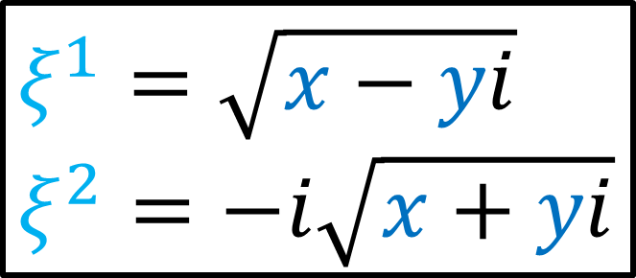
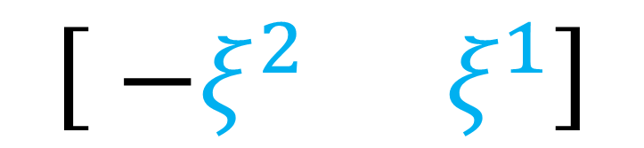
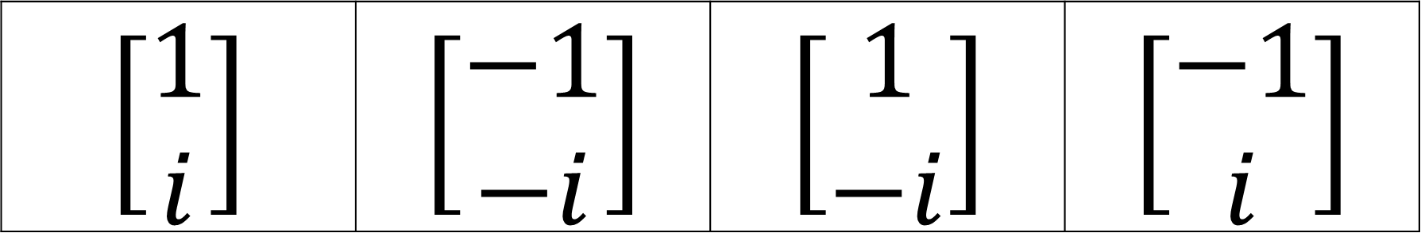
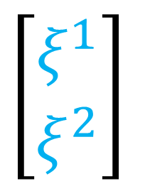
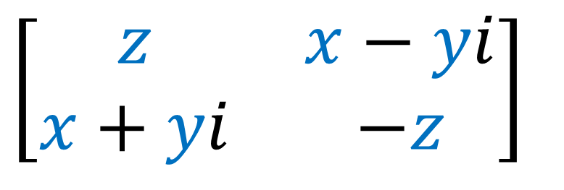
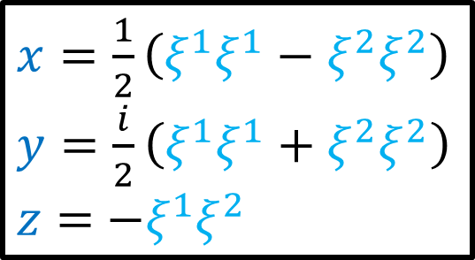
Exercise: Calculate the Pauli vectors for these Pauli spinors (and check that they make sense)
$$\left[\begin{aligned}1 \\ i\end{aligned}\right]$$ | $$\left[\begin{aligned}−1 \\ −i\end{aligned}\right]$$ | $$\left[\begin{aligned}1 \\ −i\end{aligned}\right]$$ | $$\left[\begin{aligned}−1 \\ i\end{aligned}\right]$$
$$ξ^{1}=\sqrt{x−yi}$$
$$ξ^{2}=−i\sqrt{x+yi}$$
$$\left[\begin{matrix} −ξ^{2} & ξ^{1}\end{matrix}\right]$$
$\left[\begin{aligned}ξ^{1} \\ ξ^{2}\end{aligned}\right]$
$$\left[\begin{matrix}z & x−yi \\ x+yi & −z\end{matrix}\right]$$
$x=\frac{1}{2}\left(ξ^{1}ξ^{1}−ξ^{2}ξ^{2}\right)$
$y=\frac{i}{2}\left(ξ^{1}ξ^{1}+ξ^{2}ξ^{2}\right)$
$z=$ $−ξ^{1}ξ^{2}$

Slide 2
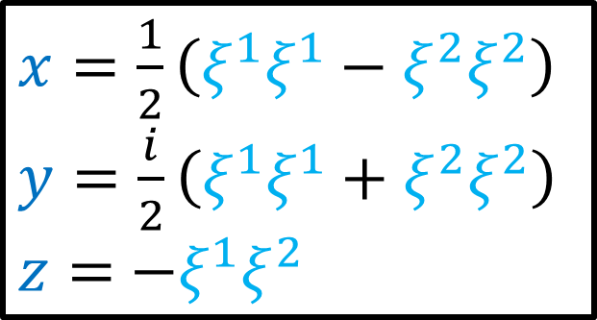
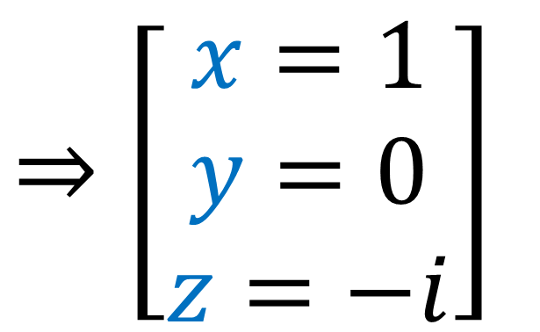
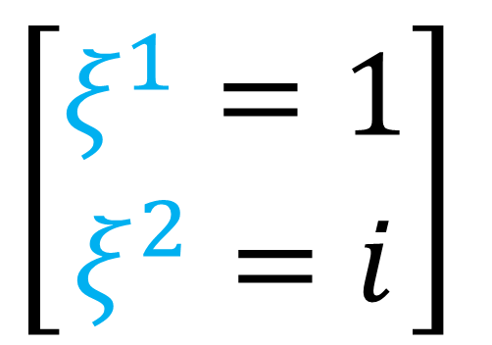
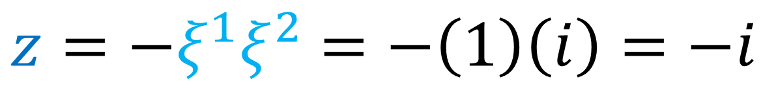
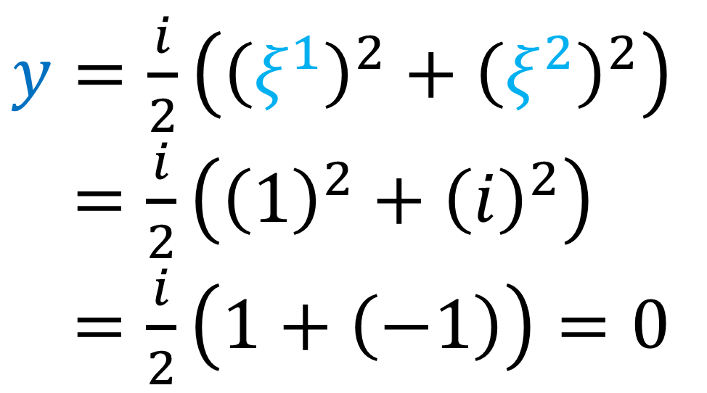
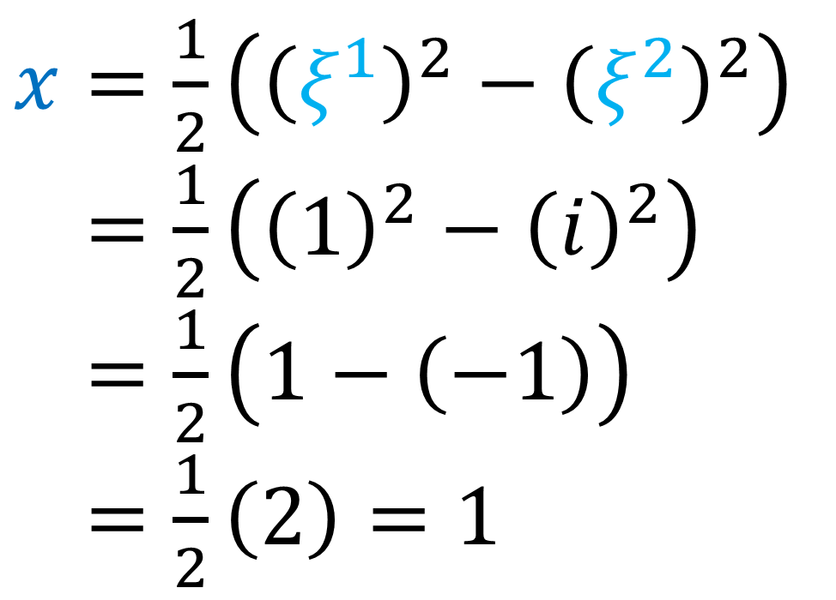
$$\left[\begin{aligned}ξ^{1}=1 \\ ξ^{2}=i\end{aligned}\right]$$
$$⇒\left[\begin{aligned}x=1 \\ y=0 \\ z=−i\end{aligned}\right]$$
$x=\frac{1}{2}\left(ξ^{1}ξ^{1}−ξ^{2}ξ^{2}\right)$
$y=\frac{i}{2}\left(ξ^{1}ξ^{1}+ξ^{2}ξ^{2}\right)$
$z=$ $−ξ^{1}ξ^{2}$
$x=\frac{1}{2}\left({\left(ξ^{1}\right)}^{2}−{\left(ξ^{2}\right)}^{2}\right)$
$x=\frac{1}{2}\left({\left(1\right)}^{2}−{\left(i\right)}^{2}\right)$
$x=\frac{1}{2}\left(1−\left(−1\right)\right)$
$x=\frac{1}{2}\left(2\right)=1$
$y=\frac{i}{2}\left({\left(ξ^{1}\right)}^{2}+{\left(ξ^{2}\right)}^{2}\right)$
$x=\frac{i}{2}\left({\left(1\right)}^{2}+{\left(i\right)}^{2}\right)$
$x=\frac{i}{2}\left(1+\left(−1\right)\right)=0$
$z=−ξ^{1}ξ^{2}$ $=−\left(1\right)\left(i\right)=−i$

Slide 3
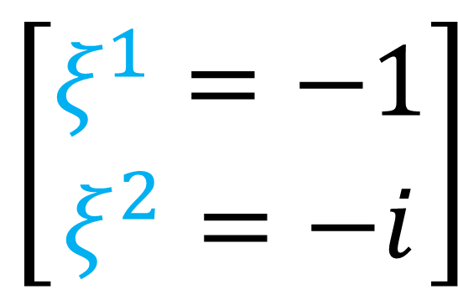
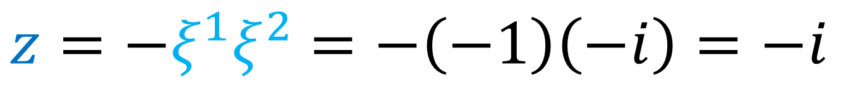
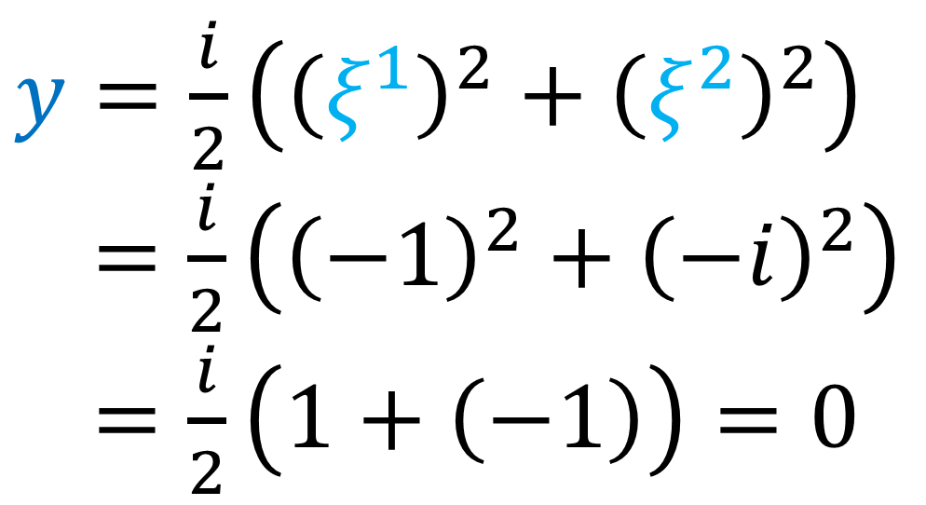
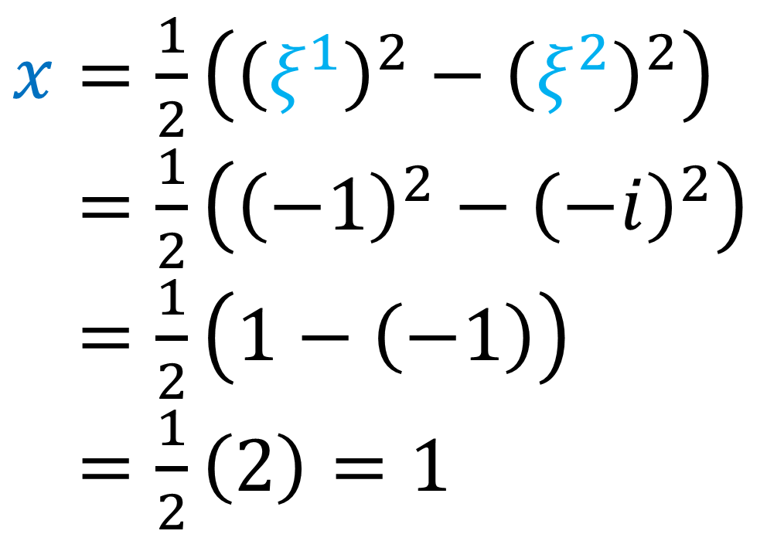
$$\left[\begin{aligned}ξ^{1}=−1 \\ ξ^{2}=−i\end{aligned}\right]$$
$$⇒\left[\begin{aligned}x=1 \\ y=0 \\ z=−i\end{aligned}\right]$$
$x=\frac{1}{2}\left(ξ^{1}ξ^{1}−ξ^{2}ξ^{2}\right)$
$y=\frac{i}{2}\left(ξ^{1}ξ^{1}+ξ^{2}ξ^{2}\right)$
$z=$ $−ξ^{1}ξ^{2}$
$x=\frac{1}{2}\left({\left(ξ^{1}\right)}^{2}−{\left(ξ^{2}\right)}^{2}\right)$
$x=\frac{1}{2}\left({\left(−1\right)}^{2}−{\left(−i\right)}^{2}\right)$
$x=\frac{1}{2}\left(1−\left(−1\right)\right)$
$x=\frac{1}{2}\left(2\right)=1$
$y=\frac{i}{2}\left({\left(ξ^{1}\right)}^{2}+{\left(ξ^{2}\right)}^{2}\right)$
$x=\frac{i}{2}\left({\left(−1\right)}^{2}+{\left(−i\right)}^{2}\right)$
$x=\frac{i}{2}\left(1+\left(−1\right)\right)=0$
$z=−ξ^{1}ξ^{2}$ $=−\left(−1\right)\left(−i\right)=−i$

Slide 4
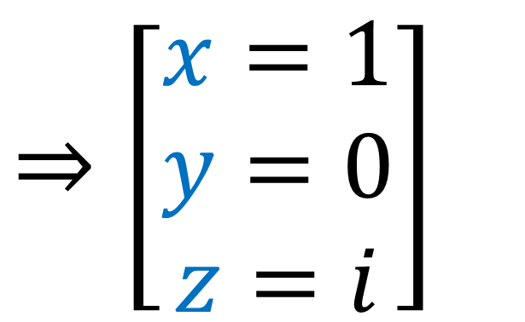
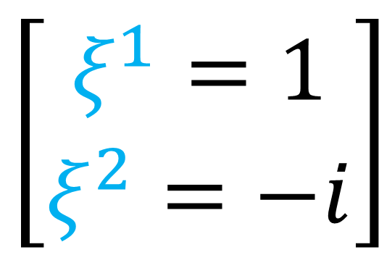

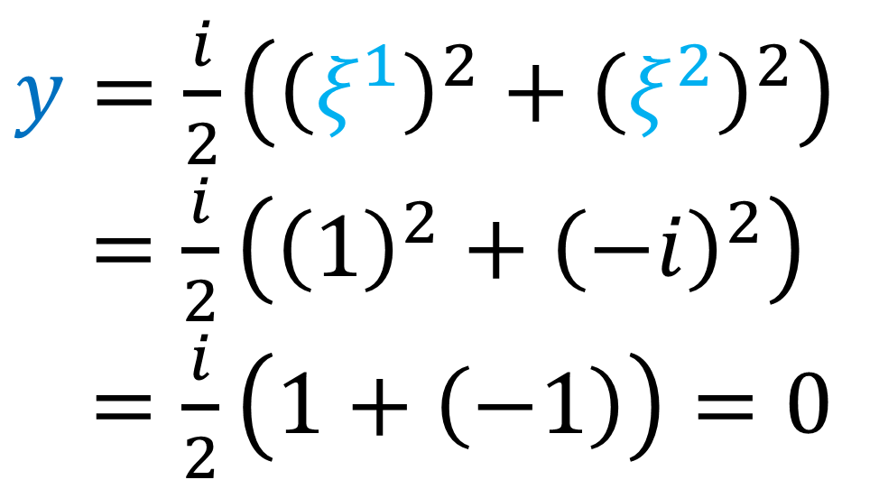
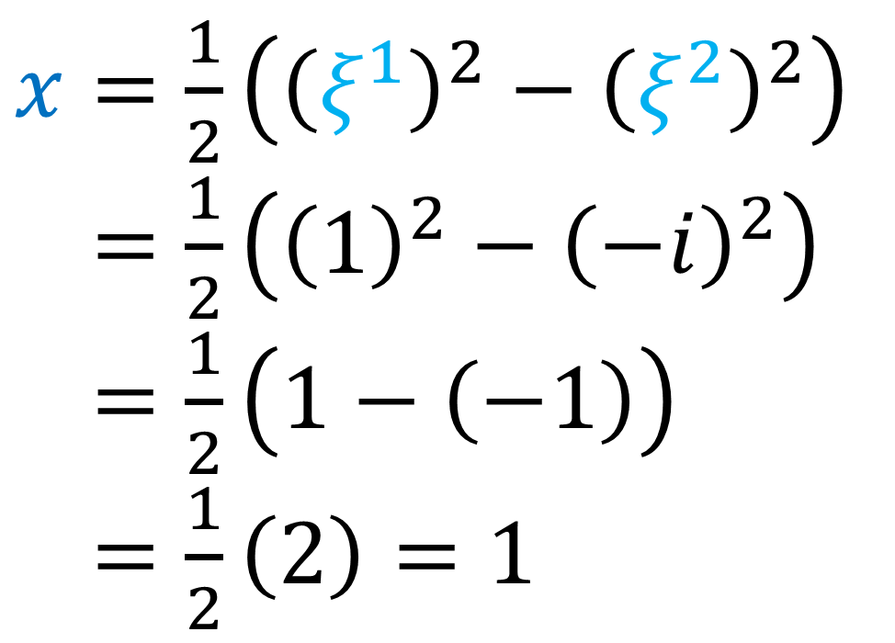
$$\left[\begin{aligned}ξ^{1}=1 \\ ξ^{2}=−i\end{aligned}\right]$$
$$⇒\left[\begin{aligned}x=1 \\ y=0 \\ z=i\end{aligned}\right]$$
$x=\frac{1}{2}\left(ξ^{1}ξ^{1}−ξ^{2}ξ^{2}\right)$
$y=\frac{i}{2}\left(ξ^{1}ξ^{1}+ξ^{2}ξ^{2}\right)$
$z=$ $−ξ^{1}ξ^{2}$
$x=\frac{1}{2}\left({\left(ξ^{1}\right)}^{2}−{\left(ξ^{2}\right)}^{2}\right)$
$x=\frac{1}{2}\left({\left(1\right)}^{2}−{\left(−i\right)}^{2}\right)$
$x=\frac{1}{2}\left(1−\left(−1\right)\right)$
$x=\frac{1}{2}\left(2\right)=1$
$y=\frac{i}{2}\left({\left(ξ^{1}\right)}^{2}+{\left(ξ^{2}\right)}^{2}\right)$
$x=\frac{i}{2}\left({\left(1\right)}^{2}+{\left(−i\right)}^{2}\right)$
$x=\frac{i}{2}\left(1+\left(−1\right)\right)=0$
$z=−ξ^{1}ξ^{2}$ $=−\left(1\right)\left(−i\right)=i$

Slide 5
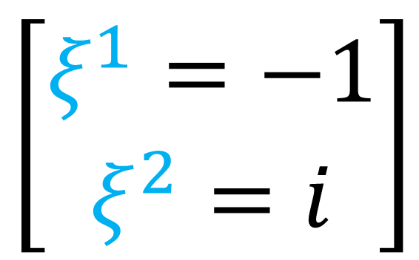
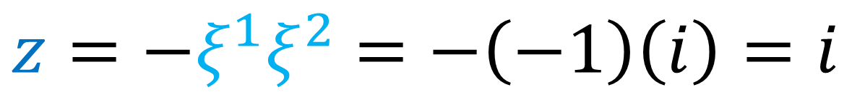
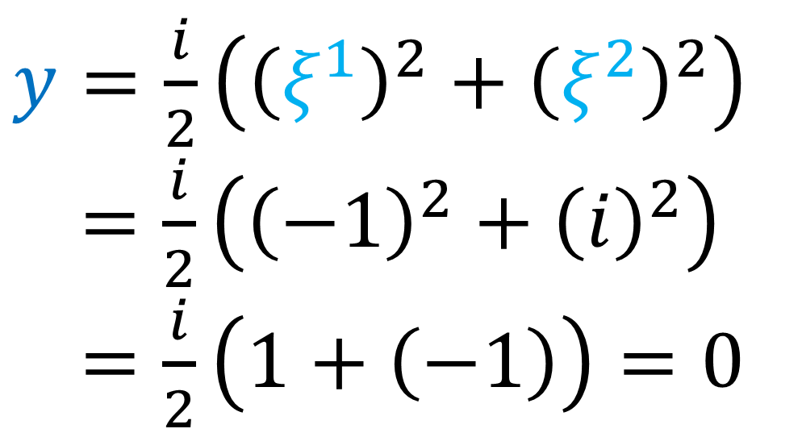
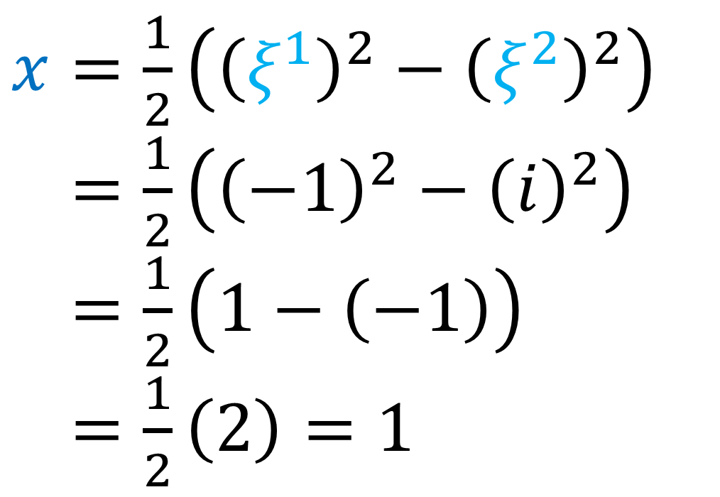
$$\left[\begin{aligned}ξ^{1}=−1 \\ ξ^{2}=i\end{aligned}\right]$$
$$⇒\left[\begin{aligned}x=1 \\ y=0 \\ z=i\end{aligned}\right]$$
$x=\frac{1}{2}\left(ξ^{1}ξ^{1}−ξ^{2}ξ^{2}\right)$
$y=\frac{i}{2}\left(ξ^{1}ξ^{1}+ξ^{2}ξ^{2}\right)$
$z=$ $−ξ^{1}ξ^{2}$
$x=\frac{1}{2}\left({\left(ξ^{1}\right)}^{2}−{\left(ξ^{2}\right)}^{2}\right)$
$x=\frac{1}{2}\left({\left(−1\right)}^{2}−{\left(i\right)}^{2}\right)$
$x=\frac{1}{2}\left(1−\left(−1\right)\right)$
$x=\frac{1}{2}\left(2\right)=1$
$y=\frac{i}{2}\left({\left(ξ^{1}\right)}^{2}+{\left(ξ^{2}\right)}^{2}\right)$
$x=\frac{i}{2}\left({\left(−1\right)}^{2}+{\left(i\right)}^{2}\right)$
$x=\frac{i}{2}\left(1+\left(−1\right)\right)=0$
$z=−ξ^{1}ξ^{2}$ $=−\left(−1\right)\left(i\right)=i$

Slide 6
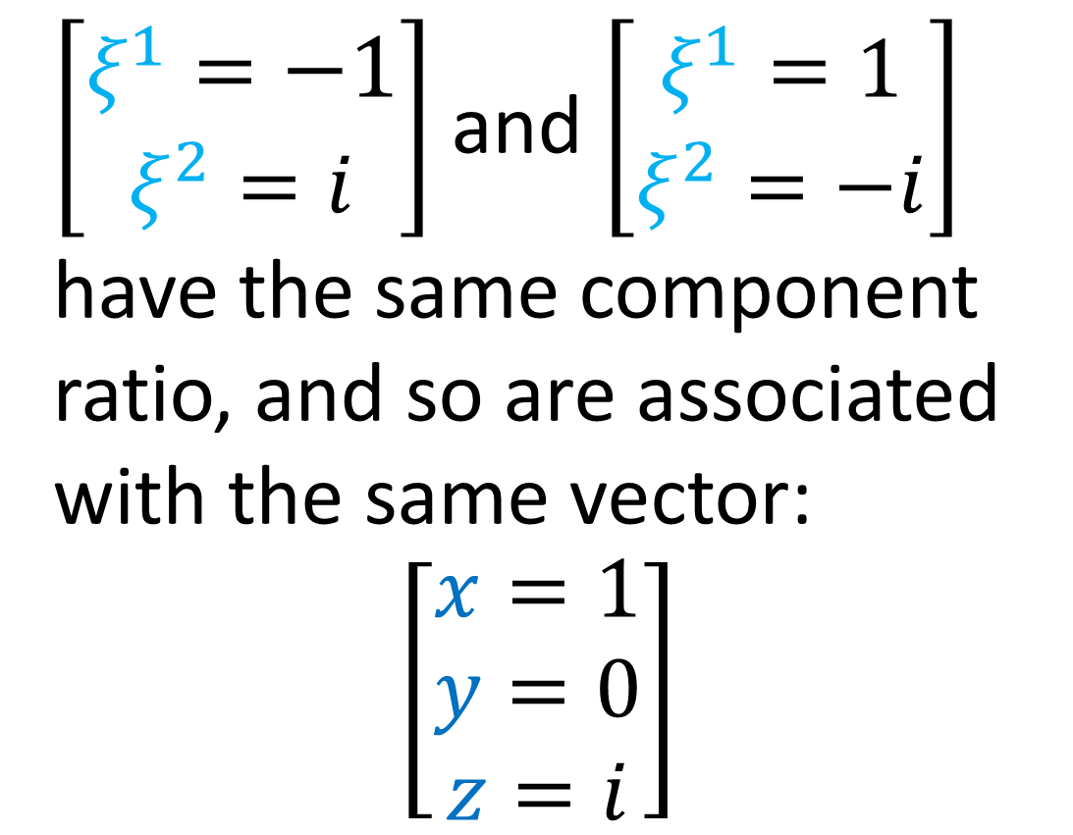
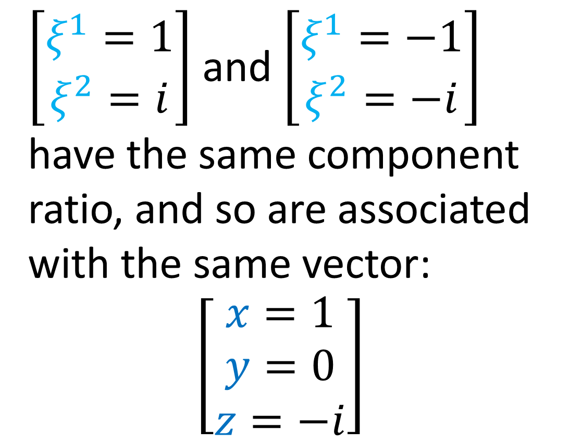
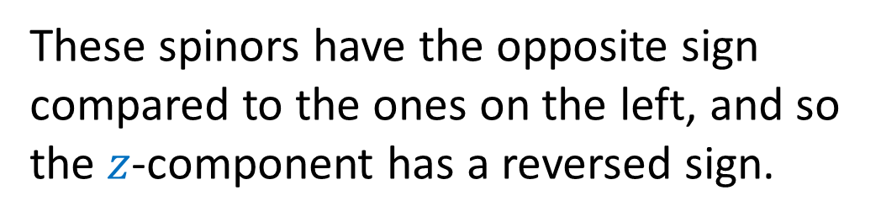
$\left[\begin{aligned}ξ^{1}=1 \\ ξ^{2}=i\end{aligned}\right]$ and $\left[\begin{aligned}ξ^{1}=−1 \\ ξ^{2}=−i\end{aligned}\right]$ have the same component ratio, and so are associated with the same vector:
$\left[\begin{aligned}x=1 \\ y=0 \\ z=−i\end{aligned}\right]$
$\left[\begin{aligned}ξ^{1}=−1 \\ ξ^{2}=i\end{aligned}\right]$ and $\left[\begin{aligned}ξ^{1}=1 \\ ξ^{2}=−i\end{aligned}\right]$ have the same component ratio, and so are associated with the same vector:
$\left[\begin{aligned}x=1 \\ y=0 \\ z=i\end{aligned}\right]$
These spinors have the opposite sign compared to the ones on the left, and so the $z$-component has a reversed sign.

