Slide 1
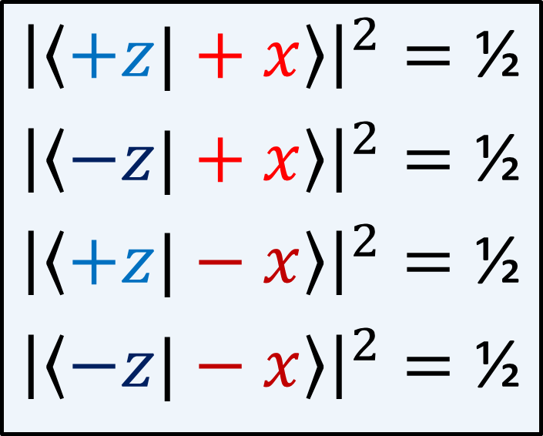

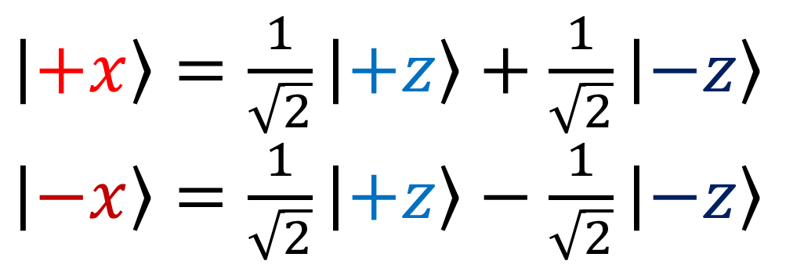
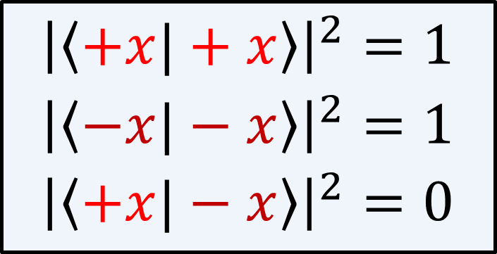
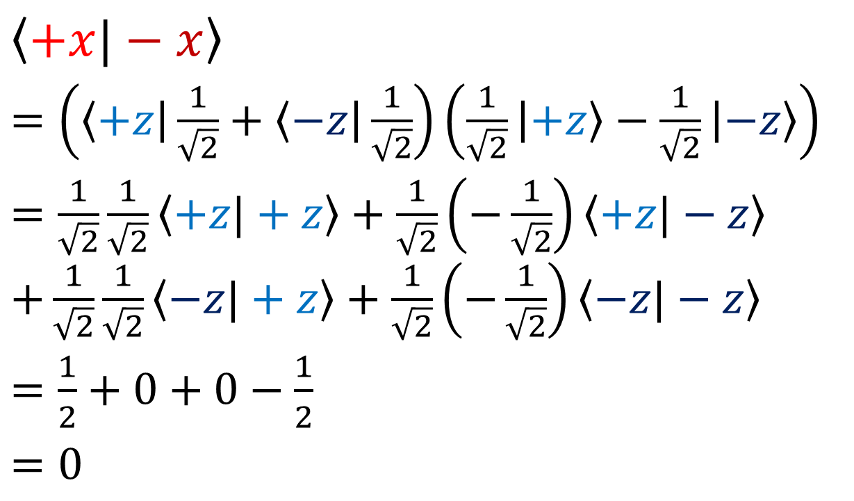
Born Rule Results:
$\left|+x\right\rangle =\frac{1}{\sqrt{2}}\left|+z\right\rangle +\frac{1}{\sqrt{2}}\left|−z\right\rangle$
$\left|−x\right\rangle =\frac{1}{\sqrt{2}}\left|+z\right\rangle −\frac{1}{\sqrt{2}}\left|−z\right\rangle$
$${\left|\left\langle +z|+x\right\rangle \right|}^{2}=\text{½}$$
$${\left|\left\langle −z|+x\right\rangle \right|}^{2}=\text{½}$$
$${\left|\left\langle +z|−x\right\rangle \right|}^{2}=\text{½}$$
$${\left|\left\langle −z|−x\right\rangle \right|}^{2}=\text{½}$$
$\left\langle +x|−x\right\rangle$
$=\left(\left\langle +z\right|\frac{1}{\sqrt{2}}+\left\langle −z\right|\frac{1}{\sqrt{2}}\right)\left(\frac{1}{\sqrt{2}}\left|+z\right\rangle −\frac{1}{\sqrt{2}}\left|−z\right\rangle \right)$
$=\frac{1}{\sqrt{2}}\frac{1}{\sqrt{2}}\left\langle +z|+z\right\rangle +\frac{1}{\sqrt{2}}\left(−\frac{1}{\sqrt{2}}\right)\left\langle +z|−z\right\rangle$ $+\frac{1}{\sqrt{2}}\frac{1}{\sqrt{2}}\left\langle −z|+z\right\rangle +\frac{1}{\sqrt{2}}\left(−\frac{1}{\sqrt{2}}\right)\left\langle −z|−z\right\rangle$
$=\frac{1}{2}+0+0−\frac{1}{2}$
$=0$
$${\left|\left\langle +x|+x\right\rangle \right|}^{2}=\text{1}$$
$${\left|\left\langle −x|−x\right\rangle \right|}^{2}=1$$
$${\left|\left\langle +x|−x\right\rangle \right|}^{2}=0$$
Left as exercise:
$${\left|\left\langle +x|+x\right\rangle \right|}^{2}=\text{1}$$
$${\left|\left\langle −x|−x\right\rangle \right|}^{2}=1$$

Slide 2
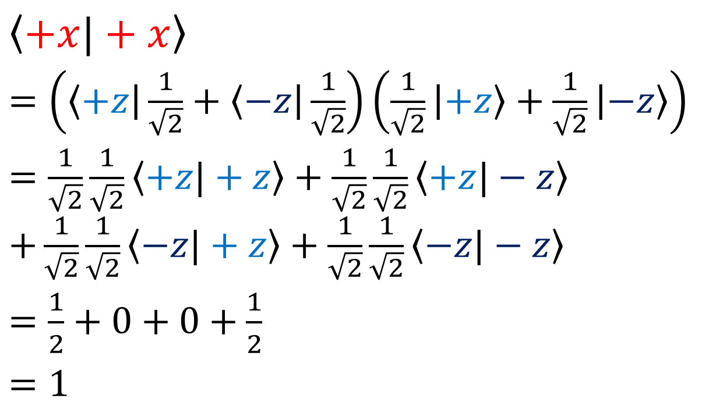


$\left|+x\right\rangle =\frac{1}{\sqrt{2}}\left|+z\right\rangle +\frac{1}{\sqrt{2}}\left|−z\right\rangle$
$\left|−x\right\rangle =\frac{1}{\sqrt{2}}\left|+z\right\rangle −\frac{1}{\sqrt{2}}\left|−z\right\rangle$
Left as exercise:
$${\left|\left\langle +x|+x\right\rangle \right|}^{2}=\text{1}$$
$${\left|\left\langle −x|−x\right\rangle \right|}^{2}=1$$
$\left\langle +x|+x\right\rangle$
$=\left(\left\langle +z\right|\frac{1}{\sqrt{2}}+\left\langle −z\right|\frac{1}{\sqrt{2}}\right)\left(\frac{1}{\sqrt{2}}\left|+z\right\rangle +\frac{1}{\sqrt{2}}\left|−z\right\rangle \right)$
$=\frac{1}{\sqrt{2}}\frac{1}{\sqrt{2}}\left\langle +z|+z\right\rangle +\frac{1}{\sqrt{2}}\frac{1}{\sqrt{2}}\left\langle +z|−z\right\rangle$ $+\frac{1}{\sqrt{2}}\frac{1}{\sqrt{2}}\left\langle −z|+z\right\rangle +\frac{1}{\sqrt{2}}\frac{1}{\sqrt{2}}\left\langle −z|−z\right\rangle$
$=\frac{1}{2}+0+0+\frac{1}{2}$
$=1$

Slide 3
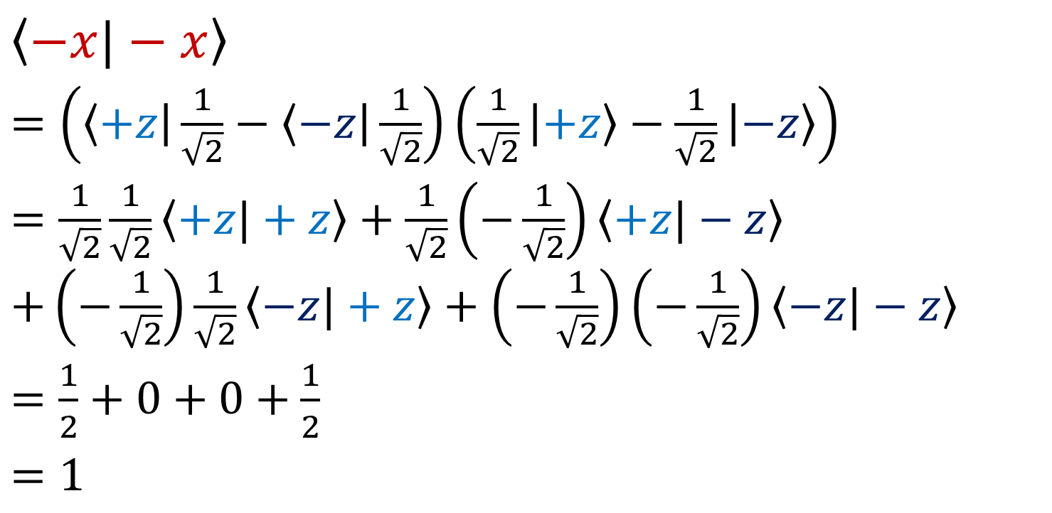
$\left|+x\right\rangle =\frac{1}{\sqrt{2}}\left|+z\right\rangle +\frac{1}{\sqrt{2}}\left|−z\right\rangle$
$\left|−x\right\rangle =\frac{1}{\sqrt{2}}\left|+z\right\rangle −\frac{1}{\sqrt{2}}\left|−z\right\rangle$
Left as exercise:
$${\left|\left\langle +x|+x\right\rangle \right|}^{2}=\text{1}$$
$${\left|\left\langle −x|−x\right\rangle \right|}^{2}=1$$
$\left\langle −x|−x\right\rangle$
$=\left(\left\langle +z\right|\frac{1}{\sqrt{2}}−\left\langle −z\right|\frac{1}{\sqrt{2}}\right)\left(\frac{1}{\sqrt{2}}\left|+z\right\rangle −\frac{1}{\sqrt{2}}\left|−z\right\rangle \right)$
$=\frac{1}{\sqrt{2}}\frac{1}{\sqrt{2}}\left\langle +z|+z\right\rangle +\frac{1}{\sqrt{2}}\left(−\frac{1}{\sqrt{2}}\right)\left\langle +z|−z\right\rangle$ $+\left(−\frac{1}{\sqrt{2}}\right)\frac{1}{\sqrt{2}}\left\langle −z|+z\right\rangle +\left(−\frac{1}{\sqrt{2}}\right)\left(−\frac{1}{\sqrt{2}}\right)\left\langle −z|−z\right\rangle$
$=\frac{1}{2}+0+0+\frac{1}{2}$
$=1$

Slide 4
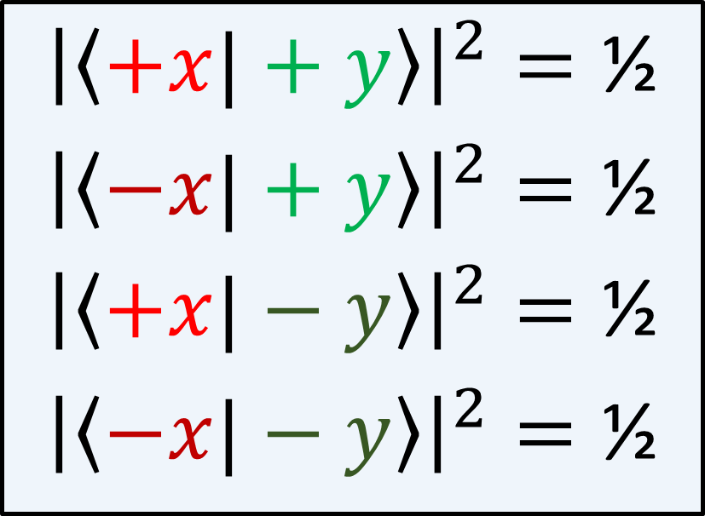
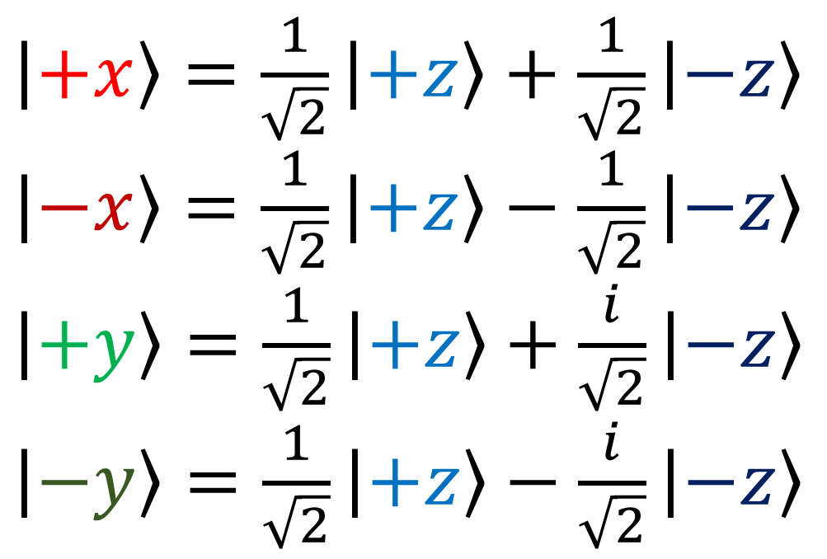
Exercise: Show that…
$\left|+x\right\rangle =\frac{1}{\sqrt{2}}\left|+z\right\rangle +\frac{1}{\sqrt{2}}\left|−z\right\rangle$
$\left|−x\right\rangle =\frac{1}{\sqrt{2}}\left|+z\right\rangle −\frac{1}{\sqrt{2}}\left|−z\right\rangle$
$\left|+y\right\rangle =\frac{1}{\sqrt{2}}\left|+z\right\rangle +\frac{i}{\sqrt{2}}\left|−z\right\rangle$
$\left|−y\right\rangle =\frac{1}{\sqrt{2}}\left|+z\right\rangle −\frac{i}{\sqrt{2}}\left|−z\right\rangle$
$${\left|\left\langle +x|+y\right\rangle \right|}^{2}=\text{½}$$
$${\left|\left\langle −x|+y\right\rangle \right|}^{2}=\text{½}$$
$${\left|\left\langle +x|−y\right\rangle \right|}^{2}=\text{½}$$
$${\left|\left\langle −x|−y\right\rangle \right|}^{2}=\text{½}$$
What does this mean in terms of the results of the corresponding Stern Gerlach experiments?

Slide 5
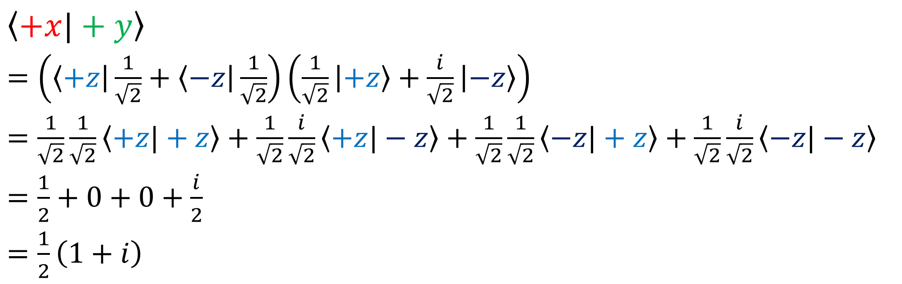
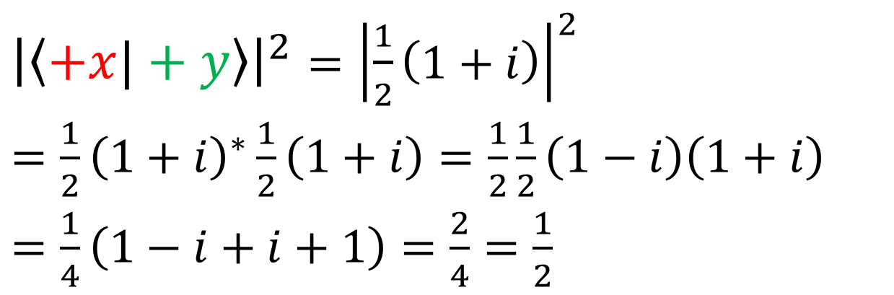
$\left\langle +x|+y\right\rangle$
$=\left(\left\langle +z\right|\frac{1}{\sqrt{2}}+\left\langle −z\right|\frac{1}{\sqrt{2}}\right)\left(\frac{1}{\sqrt{2}}\left|+z\right\rangle +\frac{i}{\sqrt{2}}\left|−z\right\rangle \right)$
$=\frac{1}{\sqrt{2}}\frac{1}{\sqrt{2}}\left\langle +z|+z\right\rangle +\frac{1}{\sqrt{2}}\frac{i}{\sqrt{2}}\left\langle +z|−z\right\rangle +\frac{1}{\sqrt{2}}\frac{1}{\sqrt{2}}\left\langle −z|+z\right\rangle +\frac{1}{\sqrt{2}}\frac{i}{\sqrt{2}}\left\langle −z|−z\right\rangle$
$=\frac{1}{2}+0+0+\frac{i}{2}$
$=\frac{1}{2}\left(1+i\right)$
${\left|\left\langle +x|+y\right\rangle \right|}^{2}={\left|\frac{1}{2}\left(1+i\right)\right|}^{2}$
$=\frac{1}{2}{\left(1+i\right)}^{∗}\frac{1}{2}\left(1+i\right)=\frac{1}{2}\frac{1}{2}\left(1−i\right)\left(1+i\right)$
$=\frac{1}{4}\left(1−i+i+1\right)=\frac{2}{4}=\frac{1}{2}$

Slide 6
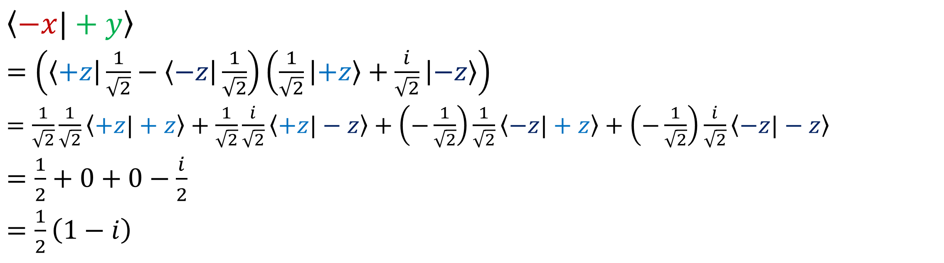
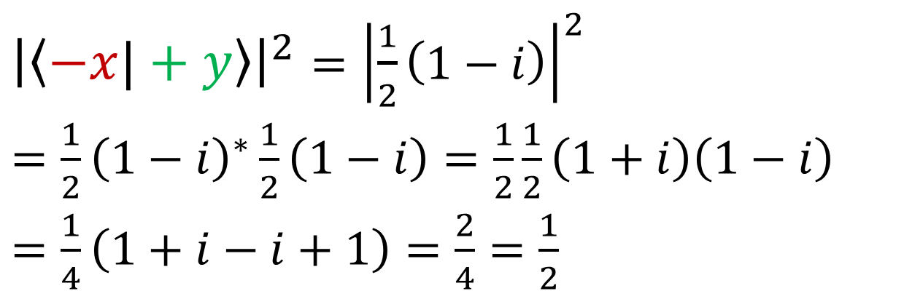
$\left\langle −x|+y\right\rangle$
$=\left(\left\langle +z\right|\frac{1}{\sqrt{2}}−\left\langle −z\right|\frac{1}{\sqrt{2}}\right)\left(\frac{1}{\sqrt{2}}\left|+z\right\rangle +\frac{i}{\sqrt{2}}\left|−z\right\rangle \right)$
$=\frac{1}{\sqrt{2}}\frac{1}{\sqrt{2}}\left\langle +z|+z\right\rangle +\frac{1}{\sqrt{2}}\frac{i}{\sqrt{2}}\left\langle +z|−z\right\rangle +\left(−\frac{1}{\sqrt{2}}\right)\frac{1}{\sqrt{2}}\left\langle −z|+z\right\rangle +\left(−\frac{1}{\sqrt{2}}\right)\frac{i}{\sqrt{2}}\left\langle −z|−z\right\rangle$
$=\frac{1}{2}+0+0−\frac{i}{2}$
$=\frac{1}{2}\left(1−i\right)$
${\left|\left\langle −x|+y\right\rangle \right|}^{2}={\left|\frac{1}{2}\left(1−i\right)\right|}^{2}$
$=\frac{1}{2}{\left(1−i\right)}^{∗}\frac{1}{2}\left(1−i\right)=\frac{1}{2}\frac{1}{2}\left(1+i\right)\left(1−i\right)$
$=\frac{1}{4}\left(1+i−i+1\right)=\frac{2}{4}=\frac{1}{2}$

Slide 7
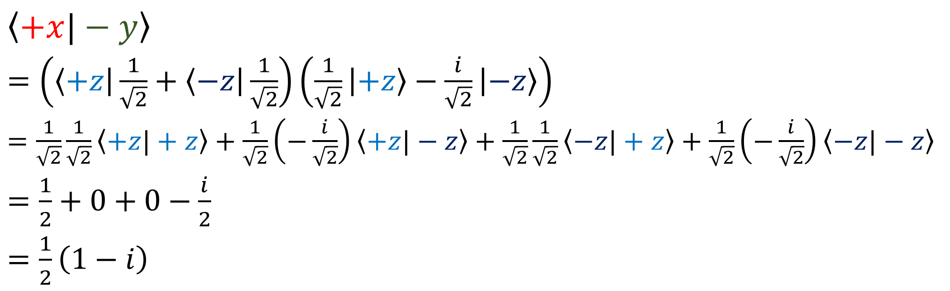
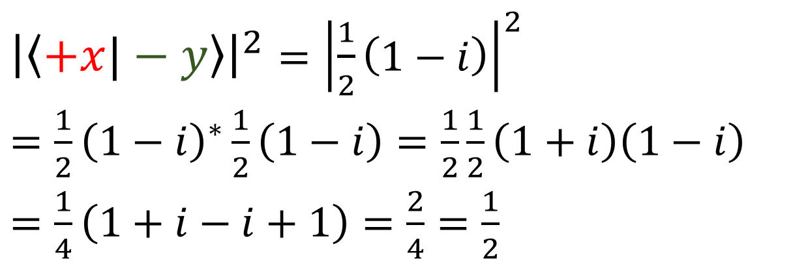
$\left\langle +x|−y\right\rangle$
$=\left(\left\langle +z\right|\frac{1}{\sqrt{2}}+\left\langle −z\right|\frac{1}{\sqrt{2}}\right)\left(\frac{1}{\sqrt{2}}\left|+z\right\rangle −\frac{i}{\sqrt{2}}\left|−z\right\rangle \right)$
$=\frac{1}{\sqrt{2}}\frac{1}{\sqrt{2}}\left\langle +z|+z\right\rangle +\frac{1}{\sqrt{2}}\left(−\frac{i}{\sqrt{2}}\right)\left\langle +z|−z\right\rangle +\frac{1}{\sqrt{2}}\frac{1}{\sqrt{2}}\left\langle −z|+z\right\rangle +\frac{1}{\sqrt{2}}\left(−\frac{i}{\sqrt{2}}\right)\left\langle −z|−z\right\rangle$
$=\frac{1}{2}+0+0−\frac{i}{2}$
$=\frac{1}{2}\left(1−i\right)$
${\left|\left\langle +x|−y\right\rangle \right|}^{2}={\left|\frac{1}{2}\left(1−i\right)\right|}^{2}$
$=\frac{1}{2}{\left(1−i\right)}^{∗}\frac{1}{2}\left(1−i\right)=\frac{1}{2}\frac{1}{2}\left(1+i\right)\left(1−i\right)$
$=\frac{1}{4}\left(1+i−i+1\right)=\frac{2}{4}=\frac{1}{2}$

Slide 8
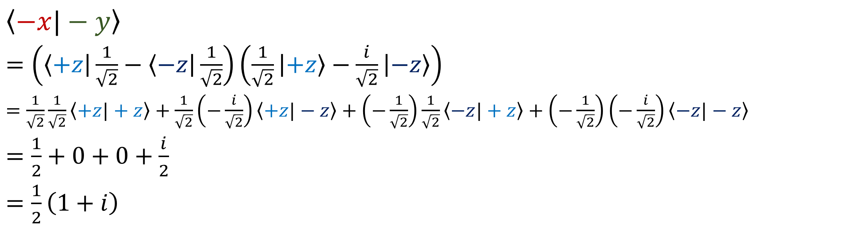
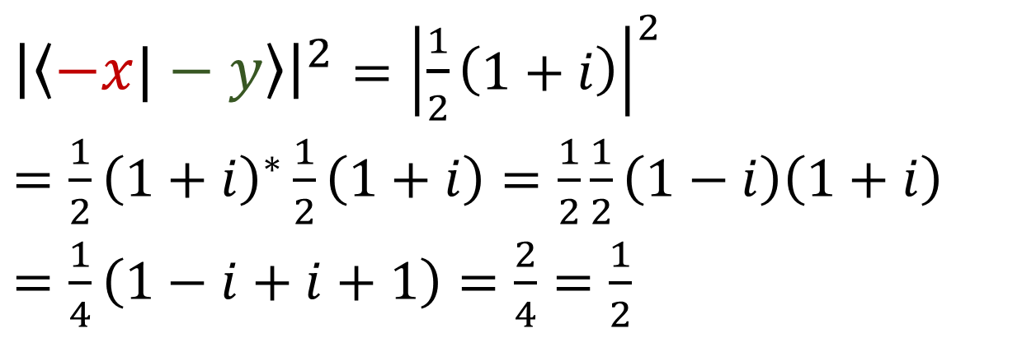
$\left\langle −x|−y\right\rangle$
$=\left(\left\langle +z\right|\frac{1}{\sqrt{2}}−\left\langle −z\right|\frac{1}{\sqrt{2}}\right)\left(\frac{1}{\sqrt{2}}\left|+z\right\rangle −\frac{i}{\sqrt{2}}\left|−z\right\rangle \right)$
$=\frac{1}{\sqrt{2}}\frac{1}{\sqrt{2}}\left\langle +z|+z\right\rangle +\frac{1}{\sqrt{2}}\left(−\frac{i}{\sqrt{2}}\right)\left\langle +z|−z\right\rangle +\left(−\frac{1}{\sqrt{2}}\right)\frac{1}{\sqrt{2}}\left\langle −z|+z\right\rangle +\left(−\frac{1}{\sqrt{2}}\right)\left(−\frac{i}{\sqrt{2}}\right)\left\langle −z|−z\right\rangle$
$=\frac{1}{2}+0+0+\frac{i}{2}$
$=\frac{1}{2}\left(1+i\right)$
${\left|\left\langle −x|−y\right\rangle \right|}^{2}={\left|\frac{1}{2}\left(1+i\right)\right|}^{2}$
$=\frac{1}{2}{\left(1+i\right)}^{∗}\frac{1}{2}\left(1+i\right)=\frac{1}{2}\frac{1}{2}\left(1−i\right)\left(1+i\right)$
$=\frac{1}{4}\left(1−i+i+1\right)=\frac{2}{4}=\frac{1}{2}$

Slide 9
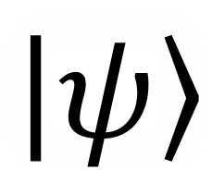

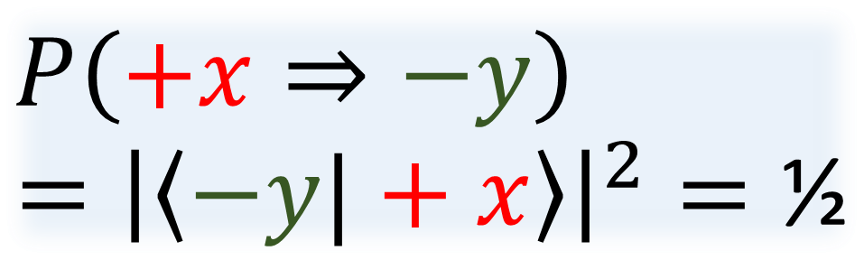

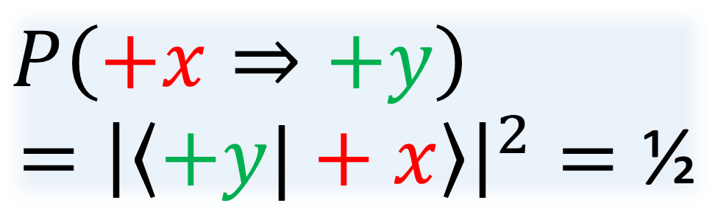

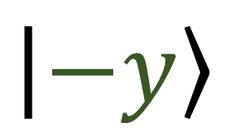
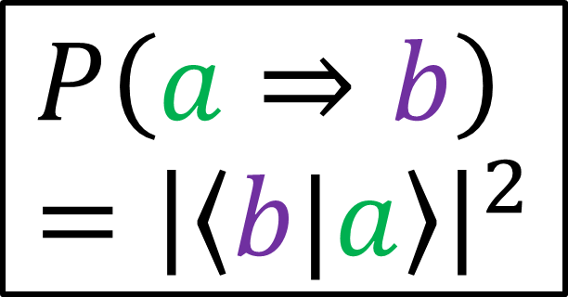
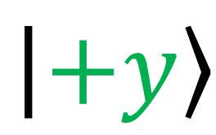
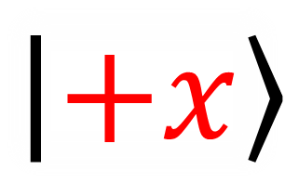

$$P\left(a⇒b\right)={\left|\left\langle b|a\right\rangle \right|}^{2}$$
$$P\left(+x⇒+y\right)$$
$$={\left|\left\langle +y|+x\right\rangle \right|}^{2}=\text{½}$$
$$\left|+y\right\rangle$$
$$\left|+x\right\rangle$$
S.G.
$$+y$$
$Y$
$$\left|ψ\right\rangle$$
S.G.
$$\left|−y\right\rangle$$
$X$
$$+x$$
$$P\left(+x⇒−y\right)$$
$$={\left|\left\langle −y|+x\right\rangle \right|}^{2}=\text{½}$$

Slide 10

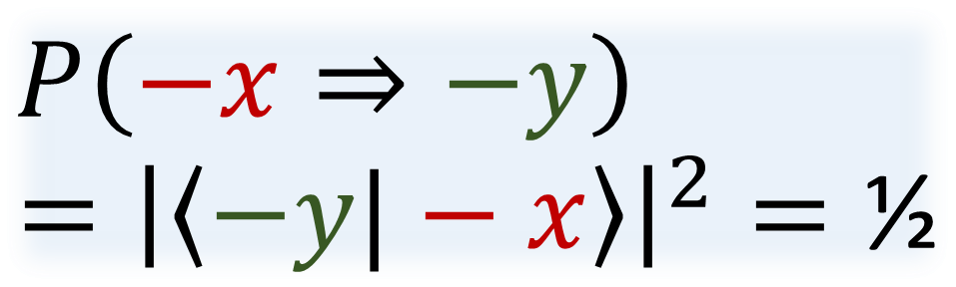


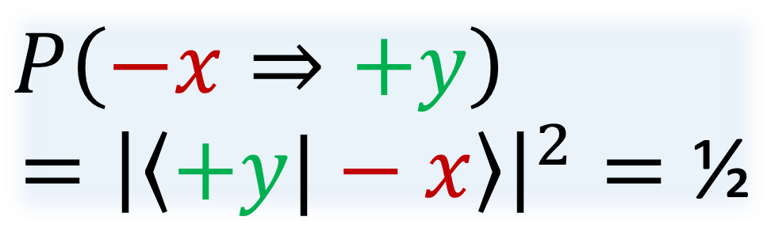

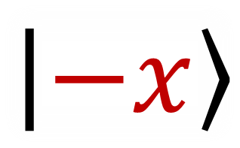

$$P\left(−x⇒+y\right)$$
$$={\left|\left\langle +y|−x\right\rangle \right|}^{2}=\text{½}$$
$$\left|ψ\right\rangle$$
S.G.
$$\left|+y\right\rangle$$
$X$
$$+x$$
S.G.
$$+y$$
$Y$
$$\left|−x\right\rangle$$
$$\left|−y\right\rangle$$
$$P\left(a⇒b\right)={\left|\left\langle b|a\right\rangle \right|}^{2}$$
$$P\left(−x⇒−y\right)$$
$$={\left|\left\langle −y|−x\right\rangle \right|}^{2}=\text{½}$$

