Slide 1
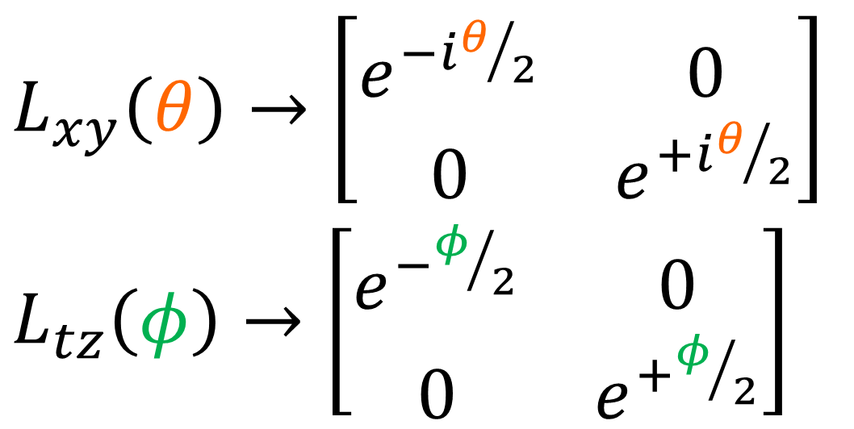
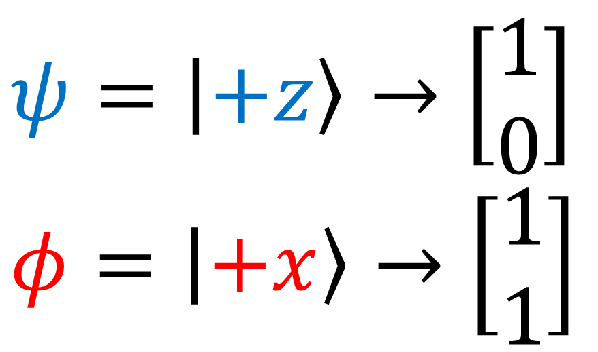

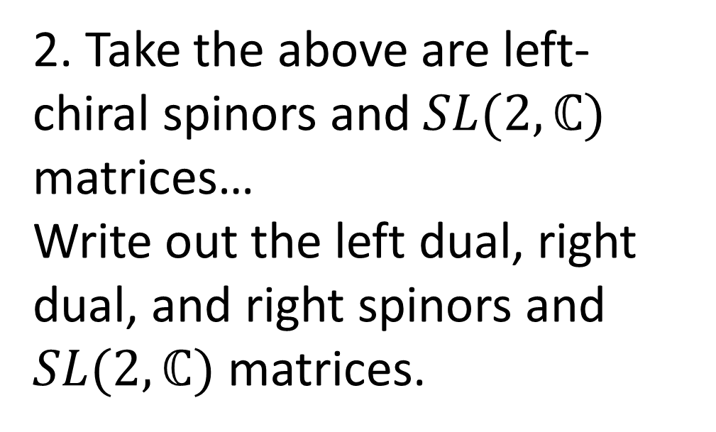
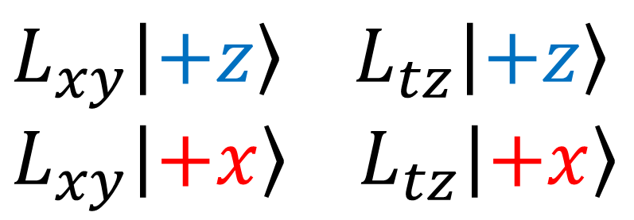
Exercises:
$L_{xy}\left(θ\right)→\left[\begin{matrix}e^{−iθ/2} & 0 \\ 0 & e^{+iθ/2}\end{matrix}\right]$
$L_{tz}\left(φ\right)→\left[\begin{matrix}e^{−φ/2} & 0 \\ 0 & e^{+φ/2}\end{matrix}\right]$
$$ψ=\left|+z\right\rangle →\left[\begin{aligned}1 \\ 0\end{aligned}\right]$$
$$φ=\left|+x\right\rangle →\left[\begin{aligned}1 \\ 1\end{aligned}\right]$$
1.Calculate the following:
2. Take the above are left-chiral spinors and $SL(2,ℂ)$ matrices…
Write out the left dual, right dual, and right spinors and $SL(2,ℂ)$ matrices.
$$L_{xy}\left|+z\right\rangle L_{tz}\left|+z\right\rangle$$
$$L_{xy}\left|+x\right\rangle L_{tz}\left|+x\right\rangle$$
(Bonus: Draw on Bloch Sphere from Video #5 for various $θ$ and $φ$ angles.)

Slide 2
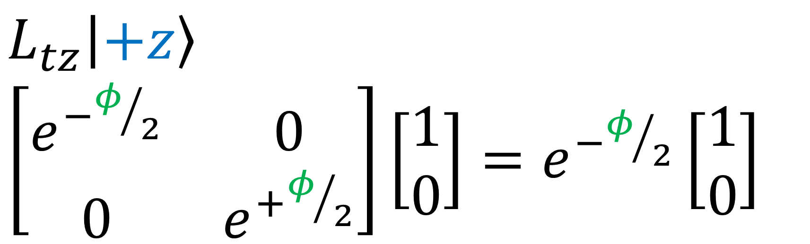
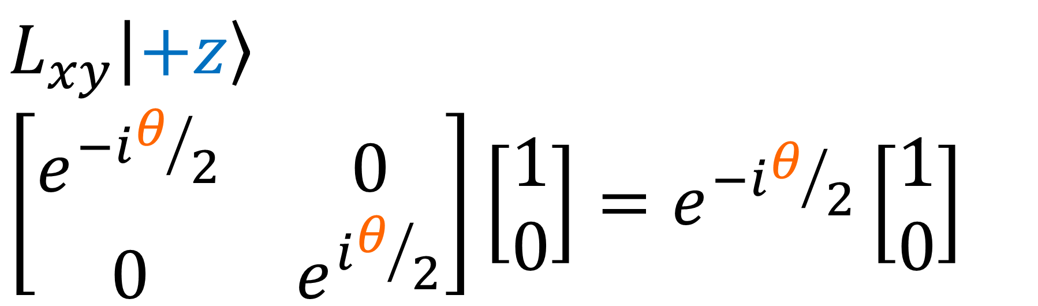
$$L_{xy}\left|+z\right\rangle$$
$$\left[\begin{matrix}e^{−iθ/2} & 0 \\ 0 & e^{iθ/2}\end{matrix}\right]\left[\begin{aligned}1 \\ 0\end{aligned}\right]=e^{−iθ/2}\left[\begin{aligned}1 \\ 0\end{aligned}\right]$$
$$L_{tz}\left|+z\right\rangle$$
$\left[\begin{matrix}e^{−φ/2} & 0 \\ 0 & e^{+φ/2}\end{matrix}\right]\left[\begin{aligned}1 \\ 0\end{aligned}\right]=e^{−φ/2}\left[\begin{aligned}1 \\ 0\end{aligned}\right]$

Slide 3
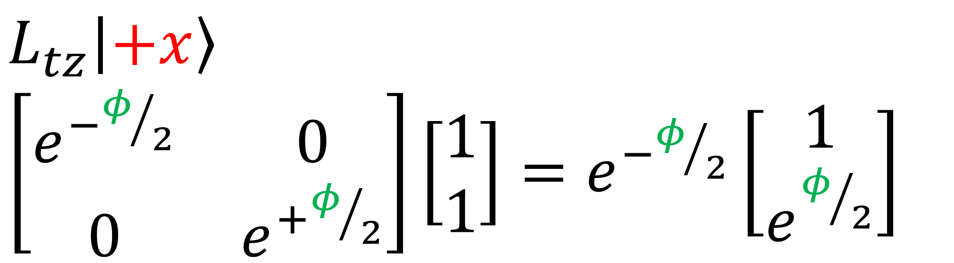
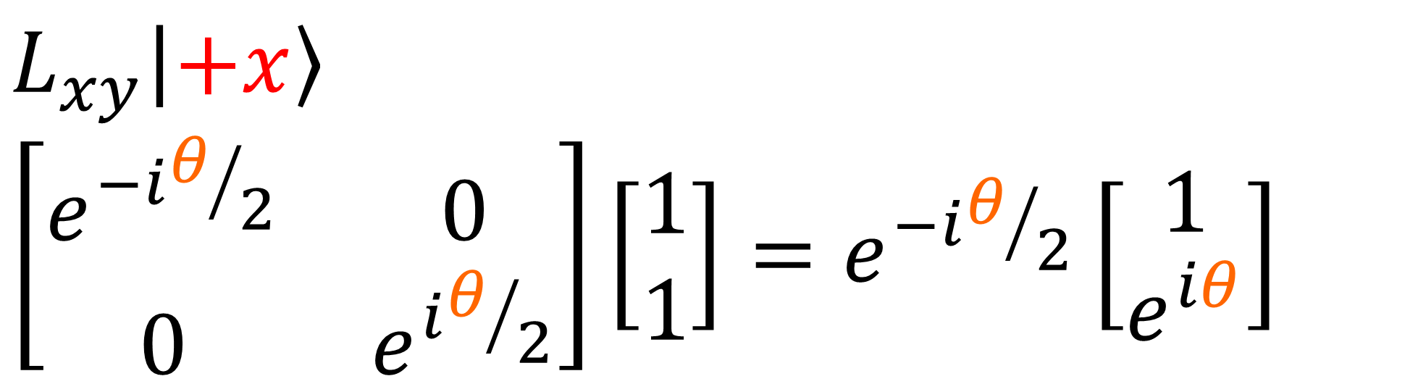
$$L_{xy}\left|+x\right\rangle$$
$$\left[\begin{matrix}e^{−iθ/2} & 0 \\ 0 & e^{iθ/2}\end{matrix}\right]\left[\begin{aligned}1 \\ 1\end{aligned}\right]=e^{−iθ/2}\left[\begin{aligned}1 \\ e^{iθ}\end{aligned}\right]$$
$$L_{tz}\left|+x\right\rangle$$
$\left[\begin{matrix}e^{−φ/2} & 0 \\ 0 & e^{+φ/2}\end{matrix}\right]\left[\begin{aligned}1 \\ 1\end{aligned}\right]=e^{−φ/2}\left[\begin{aligned}1 \\ e^{φ/2}\end{aligned}\right]$

Slide 4
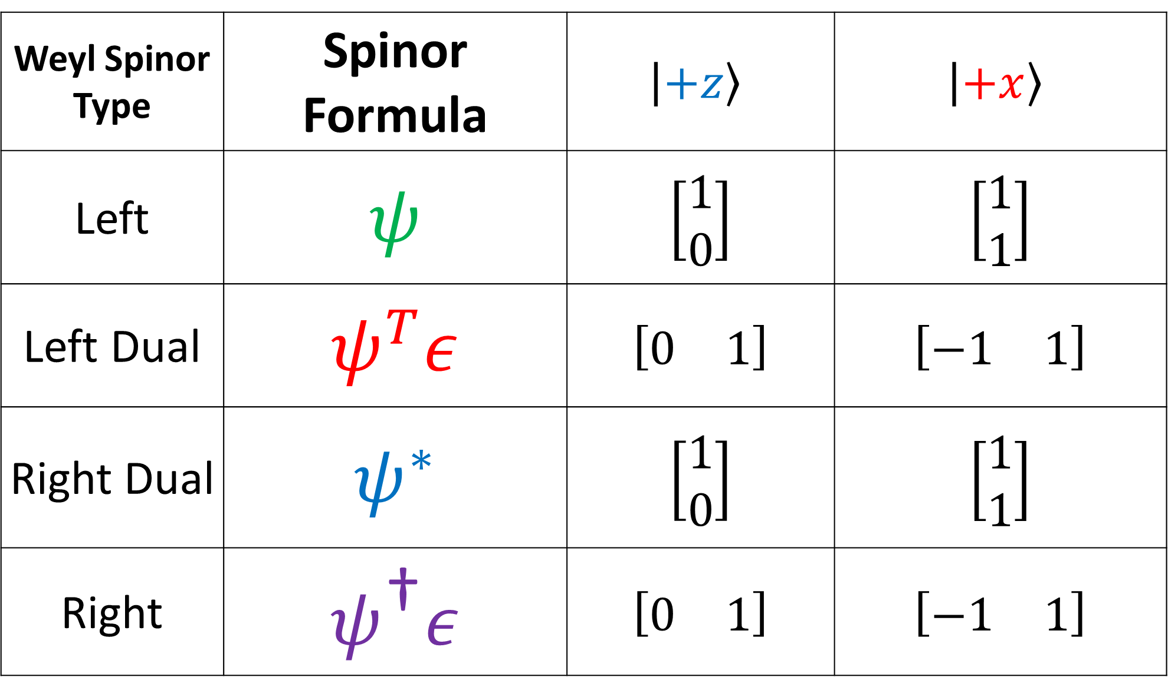
Weyl Spinor Type | Spinor Formula | $$\left|+z\right\rangle$$ | $$\left|+x\right\rangle$$
Left | $$ψ$$ | $$\left[\begin{aligned}1 \\ 0\end{aligned}\right]$$ | $$\left[\begin{aligned}1 \\ 1\end{aligned}\right]$$
Left Dual | $$ψ^{T}ε$$ | $$\left[\begin{matrix}0 & 1\end{matrix}\right]$$ | $$\left[\begin{matrix}−1 & 1\end{matrix}\right]$$
Right Dual | $$ψ^{∗}$$ | $$\left[\begin{aligned}1 \\ 0\end{aligned}\right]$$ | $$\left[\begin{aligned}1 \\ 1\end{aligned}\right]$$
Right | $$ψ^{\text{†}}ε$$ | $$\left[\begin{matrix}0 & 1\end{matrix}\right]$$ | $$\left[\begin{matrix}−1 & 1\end{matrix}\right]$$

Slide 5
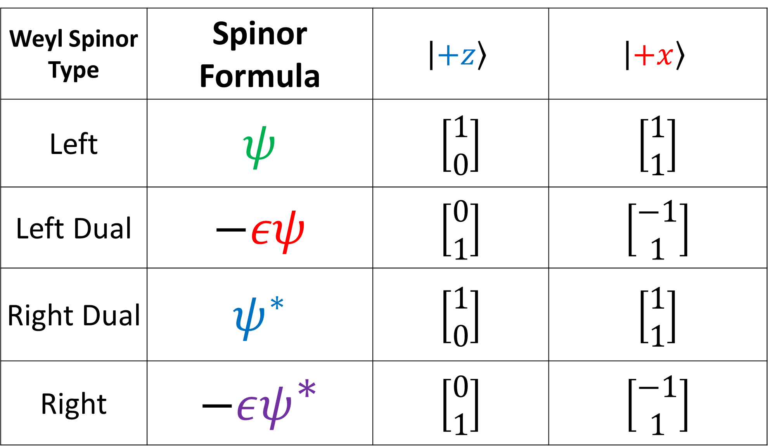
Weyl Spinor Type | Spinor Formula | $$\left|+z\right\rangle$$ | $$\left|+x\right\rangle$$
Left | $$ψ$$ | $$\left[\begin{aligned}1 \\ 0\end{aligned}\right]$$ | $$\left[\begin{aligned}1 \\ 1\end{aligned}\right]$$
Left Dual | $$−εψ$$ | $$\left[\begin{aligned}0 \\ 1\end{aligned}\right]$$ | $$\left[\begin{aligned}−1 \\ 1\end{aligned}\right]$$
Right Dual | $$ψ^{∗}$$ | $$\left[\begin{aligned}1 \\ 0\end{aligned}\right]$$ | $$\left[\begin{aligned}1 \\ 1\end{aligned}\right]$$
Right | $$−εψ^{\text{∗}}$$ | $$\left[\begin{aligned}0 \\ 1\end{aligned}\right]$$ | $$\left[\begin{aligned}−1 \\ 1\end{aligned}\right]$$

Slide 6
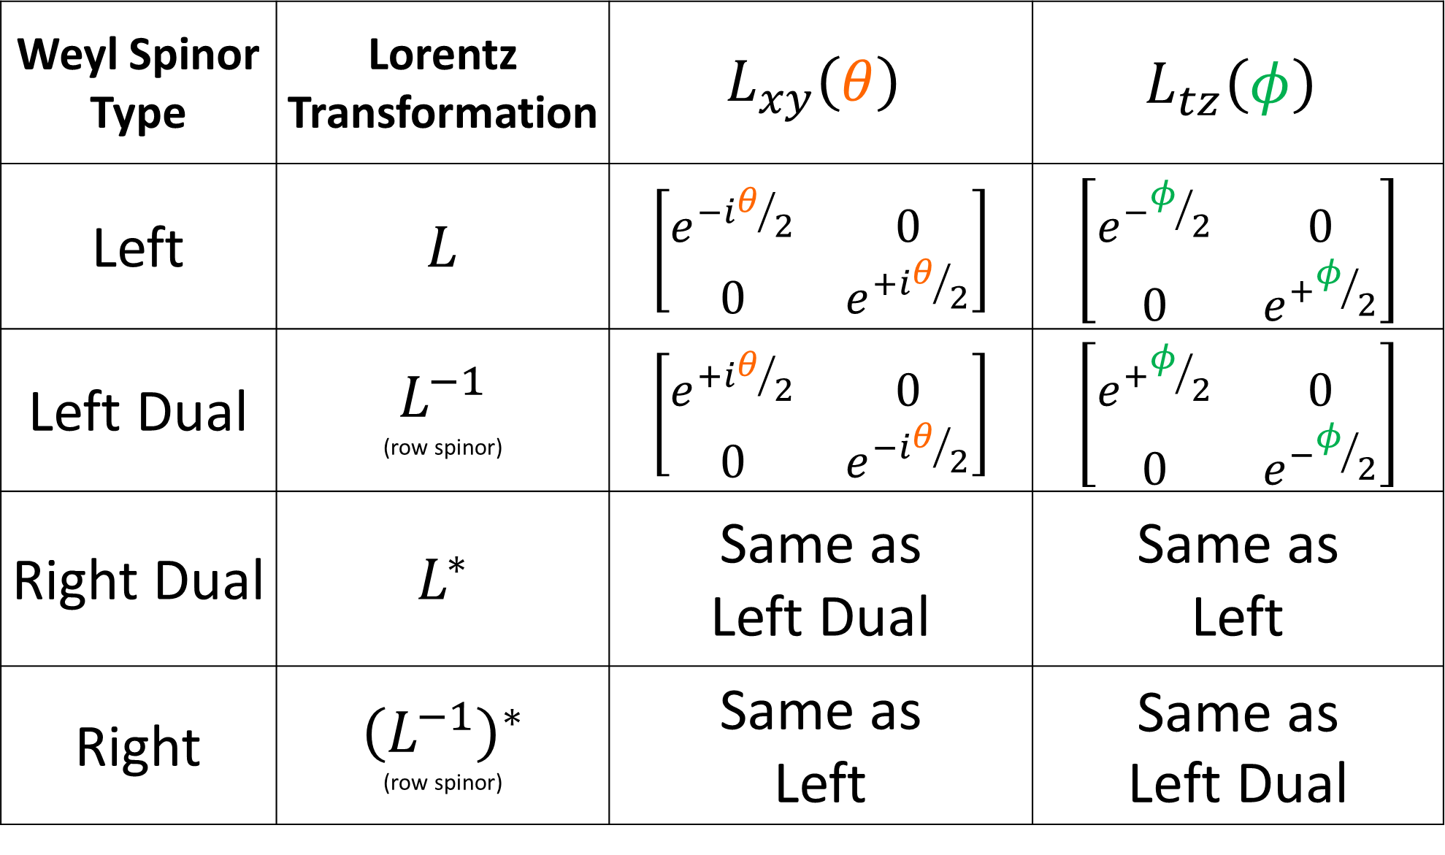
Weyl Spinor Type | Lorentz Transformation | $$L_{xy}\left(θ\right)$$ | $$L_{tz}\left(φ\right)$$
Left | $$L$$ | $$\left[\begin{matrix}e^{−iθ/2} & 0 \\ 0 & e^{+iθ/2}\end{matrix}\right]$$ | $$\left[\begin{matrix}e^{−φ/2} & 0 \\ 0 & e^{+φ/2}\end{matrix}\right]$$
Left Dual | $L^{−1}$ (row spinor) | $$\left[\begin{matrix}e^{+iθ/2} & 0 \\ 0 & e^{−iθ/2}\end{matrix}\right]$$ | $$\left[\begin{matrix}e^{+φ/2} & 0 \\ 0 & e^{−φ/2}\end{matrix}\right]$$
Right Dual | $$L^{∗}$$ | Same as Left Dual | Same as Left
Right | ${\left(L^{−1}\right)}^{∗}$ (row spinor) | Same as Left | $$\text{Same} \text{as} \\ \text{Left} \text{Dual}$$

Slide 7
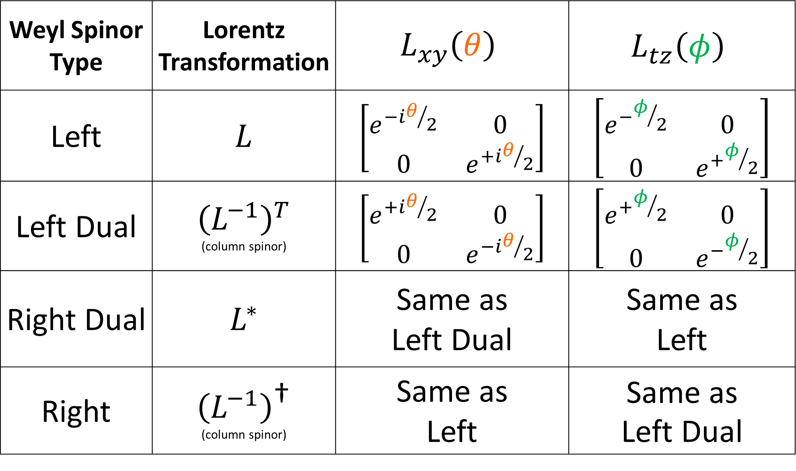
Weyl Spinor Type | Lorentz Transformation | $$L_{xy}\left(θ\right)$$ | $$L_{tz}\left(φ\right)$$
Left | $$L$$ | $$\left[\begin{matrix}e^{−iθ/2} & 0 \\ 0 & e^{+iθ/2}\end{matrix}\right]$$ | $$\left[\begin{matrix}e^{−φ/2} & 0 \\ 0 & e^{+φ/2}\end{matrix}\right]$$
Left Dual | $${\left(L^{−1}\right)}^{T}$$ (column spinor) | $$\left[\begin{matrix}e^{+iθ/2} & 0 \\ 0 & e^{−iθ/2}\end{matrix}\right]$$ | $$\left[\begin{matrix}e^{+φ/2} & 0 \\ 0 & e^{−φ/2}\end{matrix}\right]$$
Right Dual | $$L^{∗}$$ | Same as Left Dual | Same as Left
Right | $${\left(L^{−1}\right)}^{\text{†}}$$ (column spinor) | Same as Left | $$\text{Same} \text{as} \\ \text{Left} \text{Dual}$$

