Slide 1
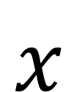
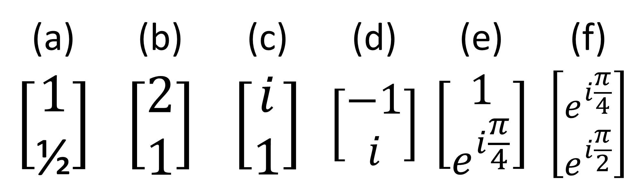

$$y$$
Exercise: Draw the wave overtime in the XY plane for these Jones Vectors:
(answers in description)
$$x$$
(a) | (b) | (c) | (d) | (e) | (f)
$$\left[\begin{aligned}1 \\ \text{½}\end{aligned}\right]$$ | $$\left[\begin{aligned}2 \\ 1\end{aligned}\right]$$ | $$\left[\begin{aligned}i \\ 1\end{aligned}\right]$$ | $$\left[\begin{aligned}−1 \\ i\end{aligned}\right]$$ | $$\left[\begin{aligned}1 \\ e^{i\frac{π}{4}}\end{aligned}\right]$$ | $$\left[\begin{aligned}e^{i\frac{π}{4}} \\ e^{i\frac{π}{2}}\end{aligned}\right]$$

Slide 2
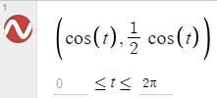

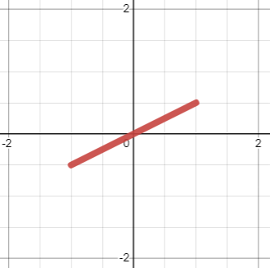
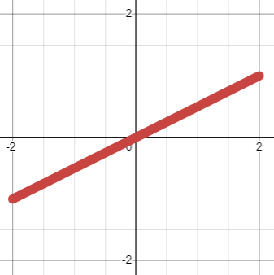
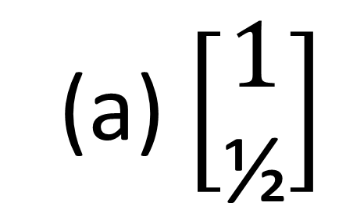
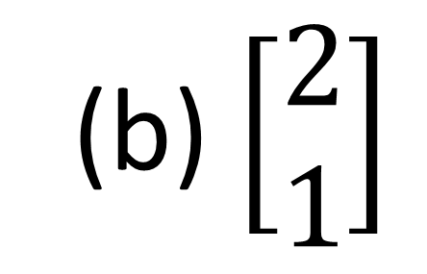
(a) $\left[\begin{aligned}1 \\ \text{½}\end{aligned}\right]$
(b) $\left[\begin{aligned}2 \\ 1\end{aligned}\right]$

Slide 3
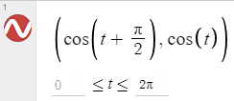
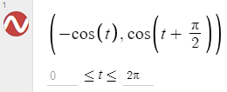
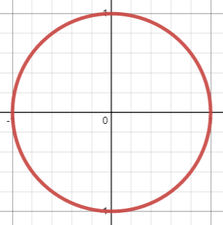
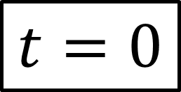
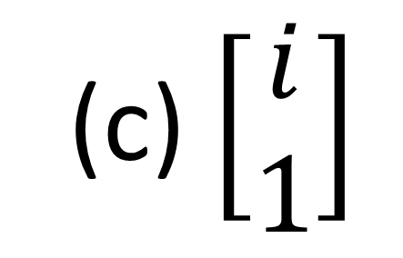
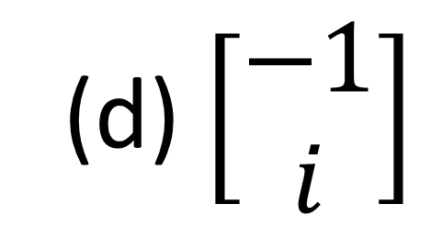
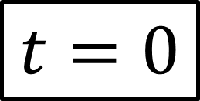
(c) $\left[\begin{aligned}i \\ 1\end{aligned}\right]$
(d) $\left[\begin{aligned}−1 \\ i\end{aligned}\right]$
$$t=0$$
$$t=0$$

Slide 4
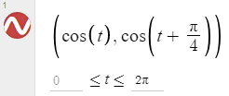
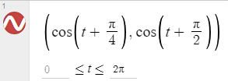
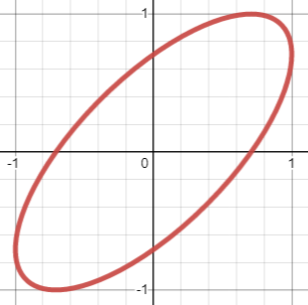

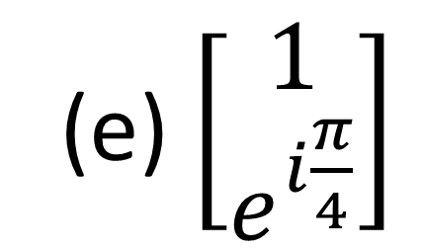
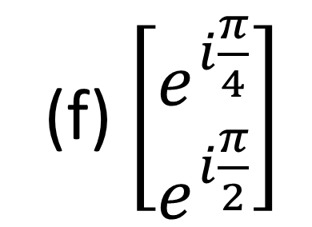

(e) $\left[\begin{aligned}1 \\ e^{i\frac{π}{4}}\end{aligned}\right]$
(f) $\left[\begin{aligned}e^{i\frac{π}{4}} \\ e^{i\frac{π}{2}}\end{aligned}\right]$
$$t=0$$
$$t=0$$

