Slide 1
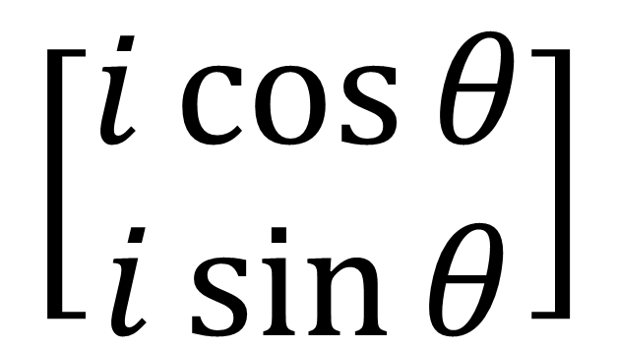

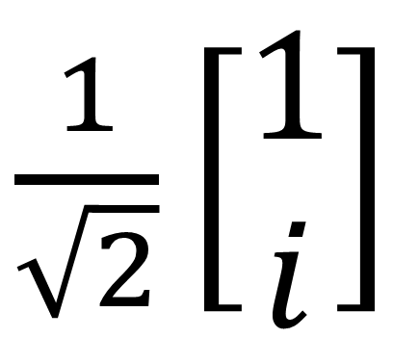
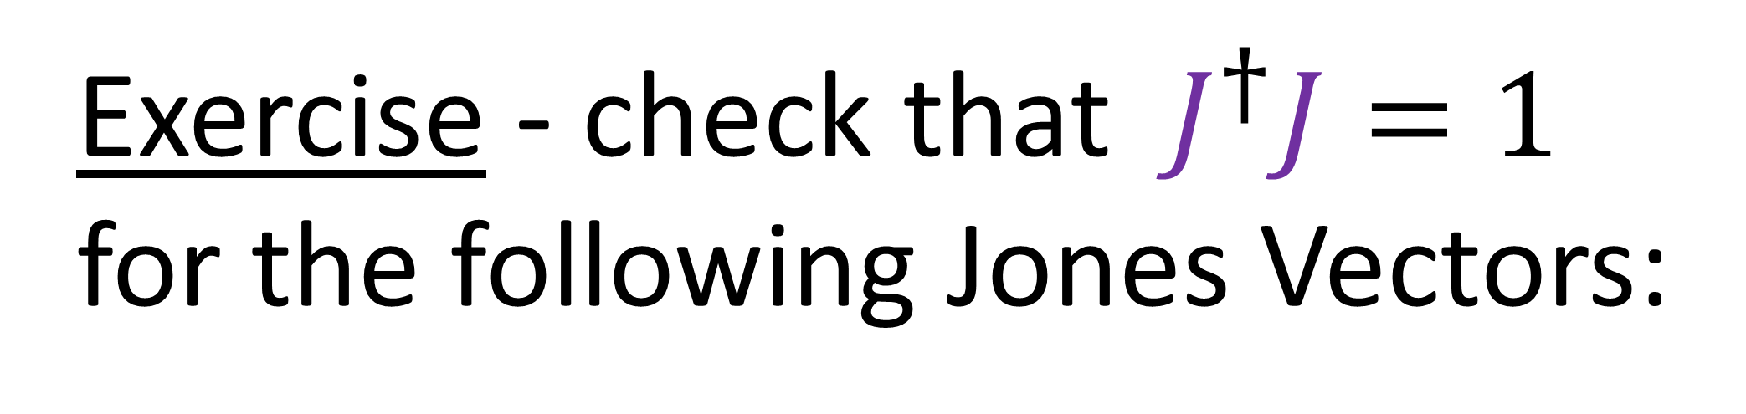
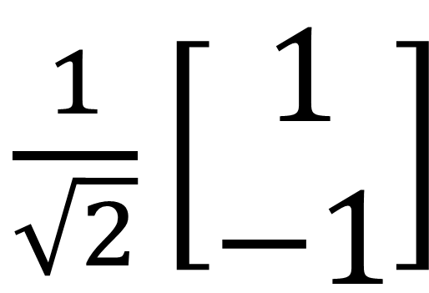
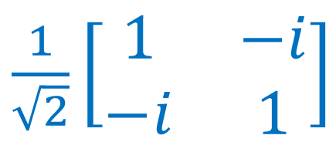
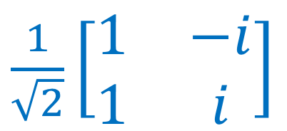
Exercise - check that $J^{†}J=1$ for the following Jones Vectors:
$$\left[\begin{matrix}1 & 0 \\ 0 & i\end{matrix}\right]$$
$\frac{1}{\sqrt{2}}\left[\begin{aligned}1 \\ −1\end{aligned}\right]$
$\frac{1}{\sqrt{2}}\left[\begin{aligned}1 \\ i\end{aligned}\right]$
$$\left[\begin{aligned}i\cos{θ} \\ i\sin{θ}\end{aligned}\right]$$
$\frac{1}{\sqrt{2}}\left[\begin{matrix}1 & −i \\ 1 & i\end{matrix}\right]$
$\frac{1}{\sqrt{2}}\left[\begin{matrix}1 & −i \\ −i & 1\end{matrix}\right]$

Slide 2
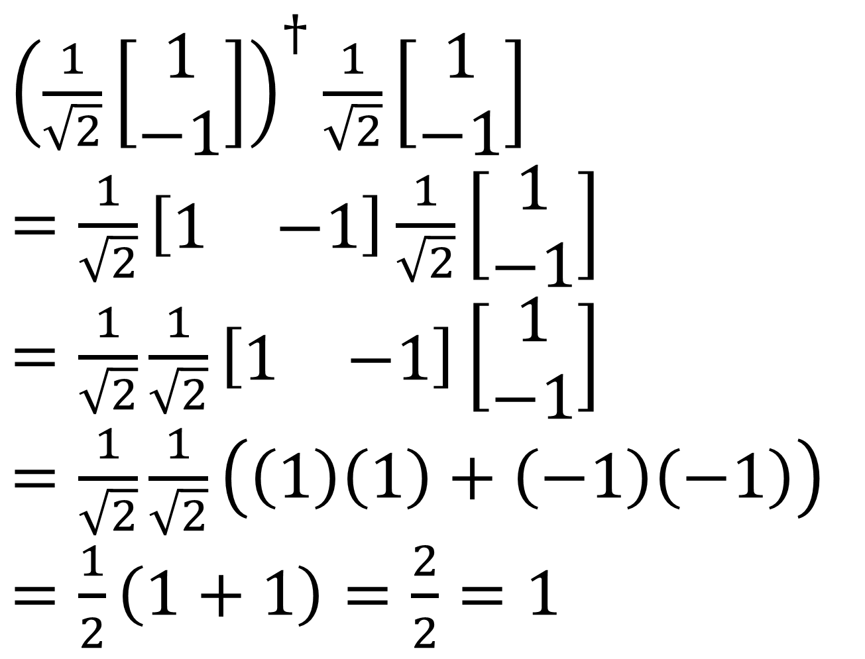
${\left(\frac{1}{\sqrt{2}}\left[\begin{aligned}1 \\ −1\end{aligned}\right]\right)}^{†}\frac{1}{\sqrt{2}}\left[\begin{aligned}1 \\ −1\end{aligned}\right]$
$=\frac{1}{\sqrt{2}}\left[\begin{matrix}1 & −1\end{matrix}\right]\frac{1}{\sqrt{2}}\left[\begin{aligned}1 \\ −1\end{aligned}\right]$
$=\frac{1}{\sqrt{2}}\frac{1}{\sqrt{2}}\left[\begin{matrix}1 & −1\end{matrix}\right]\left[\begin{aligned}1 \\ −1\end{aligned}\right]$
$=\frac{1}{\sqrt{2}}\frac{1}{\sqrt{2}}\left(\left(1\right)\left(1\right)+\left(−1\right)\left(−1\right)\right)$
$=\frac{1}{2}\left(1+1\right)=\frac{2}{2}=1$

Slide 3
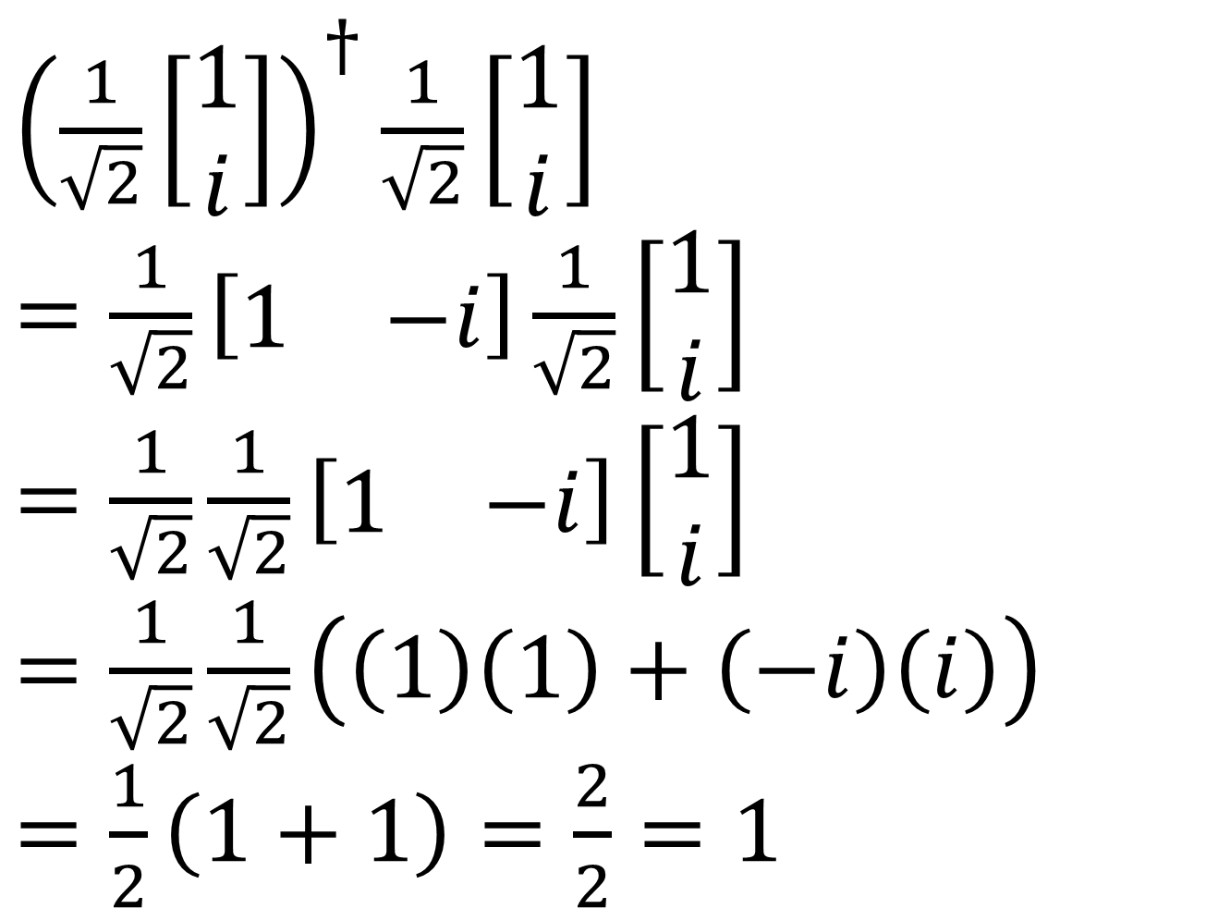
${\left(\frac{1}{\sqrt{2}}\left[\begin{aligned}1 \\ i\end{aligned}\right]\right)}^{†}\frac{1}{\sqrt{2}}\left[\begin{aligned}1 \\ i\end{aligned}\right]$
$=\frac{1}{\sqrt{2}}\left[\begin{matrix}1 & −i\end{matrix}\right]\frac{1}{\sqrt{2}}\left[\begin{aligned}1 \\ i\end{aligned}\right]$
$=\frac{1}{\sqrt{2}}\frac{1}{\sqrt{2}}\left[\begin{matrix}1 & −i\end{matrix}\right]\left[\begin{aligned}1 \\ i\end{aligned}\right]$
$=\frac{1}{\sqrt{2}}\frac{1}{\sqrt{2}}\left(\left(1\right)\left(1\right)+\left(−i\right)\left(i\right)\right)$
$=\frac{1}{2}\left(1+1\right)=\frac{2}{2}=1$

Slide 4
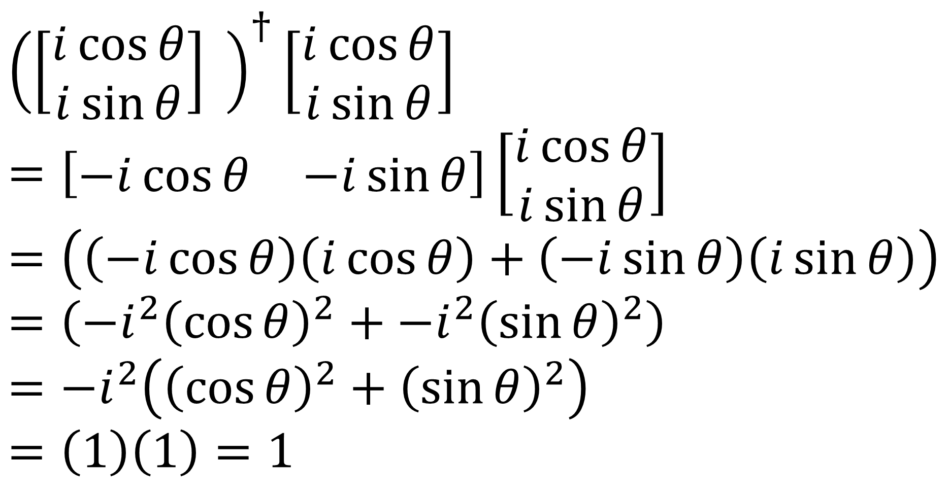
${\left(\left[\begin{aligned}i\cos{θ} \\ i\sin{θ}\end{aligned}\right] \right)}^{†}\left[\begin{aligned}i\cos{θ} \\ i\sin{θ}\end{aligned}\right]$
$=\left[\begin{matrix}−i\cos{θ} & −i\sin{θ}\end{matrix}\right]\left[\begin{aligned}i\cos{θ} \\ i\sin{θ}\end{aligned}\right]$
$=\left(\left(−i\cos{θ}\right)\left(i\cos{θ}\right)+\left(−i\sin{θ}\right)\left(i\sin{θ}\right)\right)$
$=\left(−i^{2}{\left(\cos{θ}\right)}^{2}+−i^{2}{\left(\sin{θ}\right)}^{2}\right)$
$=−i^{2}\left({\left(\cos{θ}\right)}^{2}+{\left(\sin{θ}\right)}^{2}\right)$
$=\left(1\right)\left(1\right)=1$

Slide 5
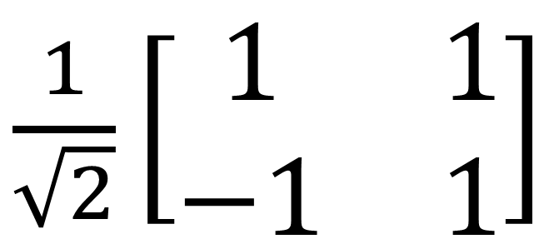
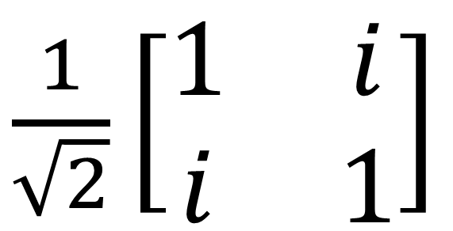
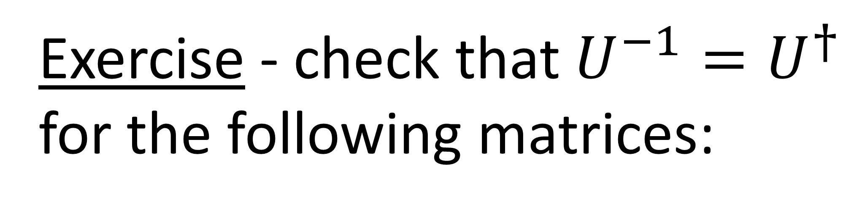
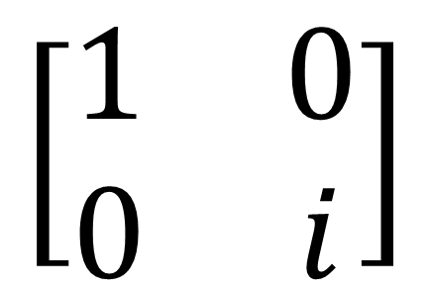
Exercise - check that $U^{−1}=U^{†}$ for the following matrices:
$$\left[\begin{matrix}1 & 0 \\ 0 & i\end{matrix}\right]$$
$\frac{1}{\sqrt{2}}\left[\begin{matrix}1 & i \\ i & 1\end{matrix}\right]$
$\frac{1}{\sqrt{2}}\left[\begin{matrix}1 & 1 \\ −1 & 1\end{matrix}\right]$

Slide 6
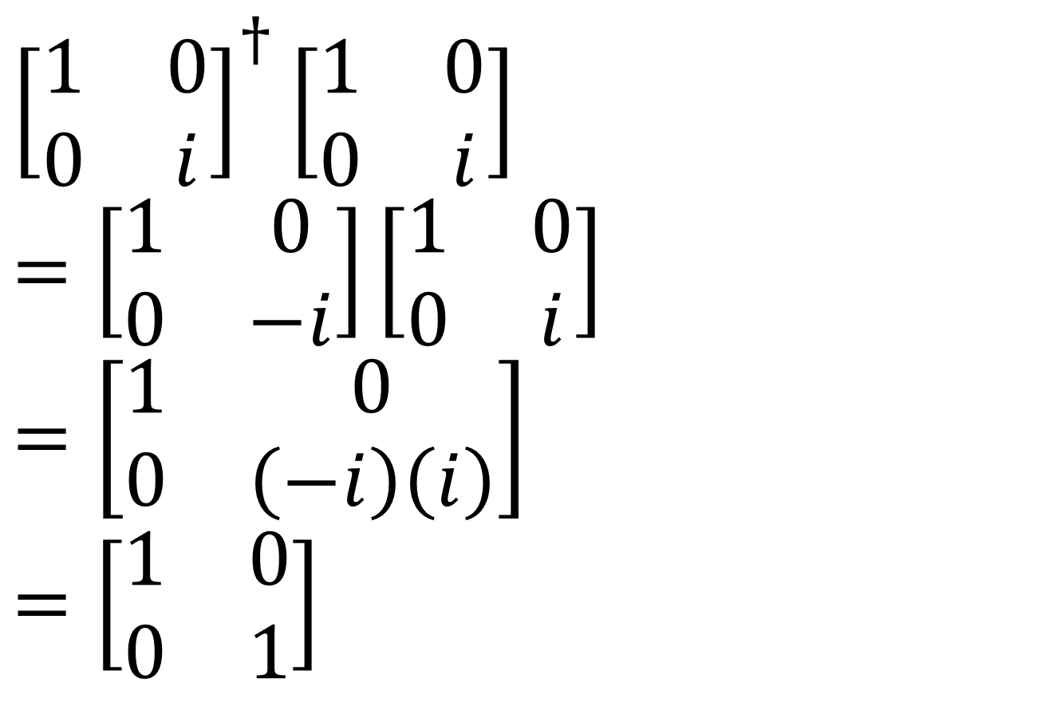
${\left[\begin{matrix}1 & 0 \\ 0 & i\end{matrix}\right]}^{†}\left[\begin{matrix}1 & 0 \\ 0 & i\end{matrix}\right]$
$=\left[\begin{matrix}1 & 0 \\ 0 & −i\end{matrix}\right]\left[\begin{matrix}1 & 0 \\ 0 & i\end{matrix}\right]$
$=\left[\begin{matrix}1 & 0 \\ 0 & \left(−i\right)\left(i\right)\end{matrix}\right]$
$=\left[\begin{matrix}1 & 0 \\ 0 & 1\end{matrix}\right]$

Slide 7
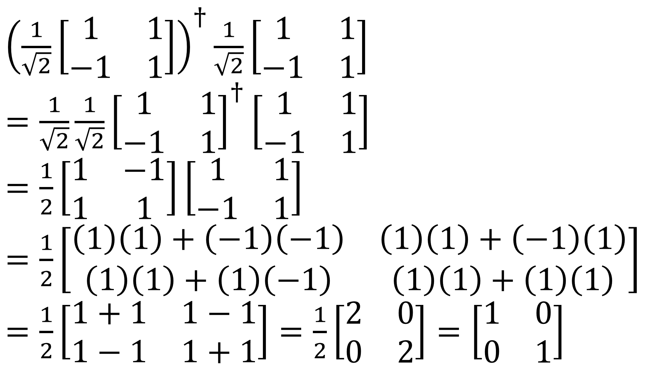
${\left(\frac{1}{\sqrt{2}}\left[\begin{matrix}1 & 1 \\ −1 & 1\end{matrix}\right]\right)}^{†}\frac{1}{\sqrt{2}}\left[\begin{matrix}1 & 1 \\ −1 & 1\end{matrix}\right]$
$=\frac{1}{\sqrt{2}}\frac{1}{\sqrt{2}}{\left[\begin{matrix}1 & 1 \\ −1 & 1\end{matrix}\right]}^{†}\left[\begin{matrix}1 & 1 \\ −1 & 1\end{matrix}\right]$
$=\frac{1}{2}\left[\begin{matrix}1 & −1 \\ 1 & 1\end{matrix}\right]\left[\begin{matrix}1 & 1 \\ −1 & 1\end{matrix}\right]$
$=\frac{1}{2}\left[\begin{matrix}\left(1\right)\left(1\right)+\left(−1\right)\left(−1\right) & \left(1\right)\left(1\right)+\left(−1\right)\left(1\right) \\ \left(1\right)\left(1\right)+\left(1\right)\left(−1\right) & \left(1\right)\left(1\right)+\left(1\right)\left(1\right)\end{matrix}\right]$
$=\frac{1}{2}\left[\begin{matrix}1+1 & 1−1 \\ 1−1 & 1+1\end{matrix}\right]=\frac{1}{2}\left[\begin{matrix}2 & 0 \\ 0 & 2\end{matrix}\right]=\left[\begin{matrix}1 & 0 \\ 0 & 1\end{matrix}\right]$

Slide 8
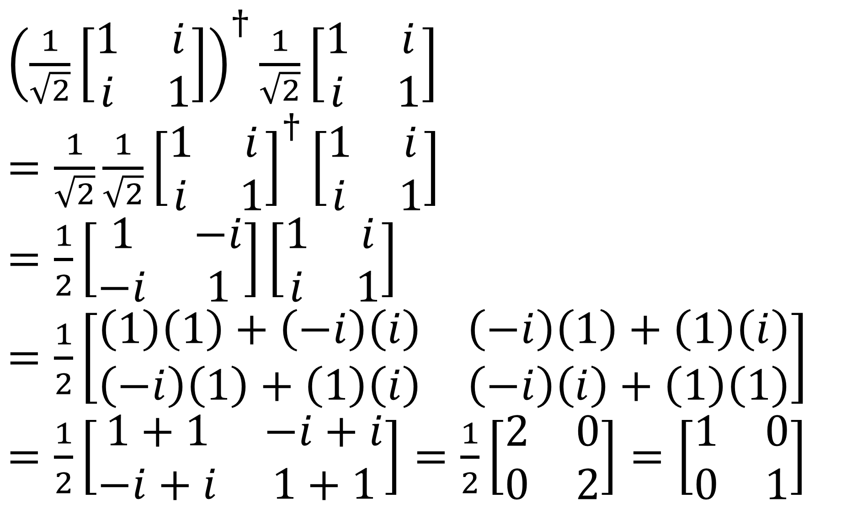
${\left(\frac{1}{\sqrt{2}}\left[\begin{matrix}1 & i \\ i & 1\end{matrix}\right]\right)}^{†}\frac{1}{\sqrt{2}}\left[\begin{matrix}1 & i \\ i & 1\end{matrix}\right]$
$=\frac{1}{\sqrt{2}}\frac{1}{\sqrt{2}}{\left[\begin{matrix}1 & i \\ i & 1\end{matrix}\right]}^{†}\left[\begin{matrix}1 & i \\ i & 1\end{matrix}\right]$
$=\frac{1}{2}\left[\begin{matrix}1 & −i \\ −i & 1\end{matrix}\right]\left[\begin{matrix}1 & i \\ i & 1\end{matrix}\right]$
$=\frac{1}{2}\left[\begin{matrix}\left(1\right)\left(1\right)+\left(−i\right)\left(i\right) & \left(−i\right)\left(1\right)+\left(1\right)\left(i\right) \\ \left(−i\right)\left(1\right)+\left(1\right)\left(i\right) & \left(−i\right)\left(i\right)+\left(1\right)\left(1\right)\end{matrix}\right]$
$=\frac{1}{2}\left[\begin{matrix}1+1 & −i+i \\ −i+i & 1+1\end{matrix}\right]=\frac{1}{2}\left[\begin{matrix}2 & 0 \\ 0 & 2\end{matrix}\right]=\left[\begin{matrix}1 & 0 \\ 0 & 1\end{matrix}\right]$

Slide 9



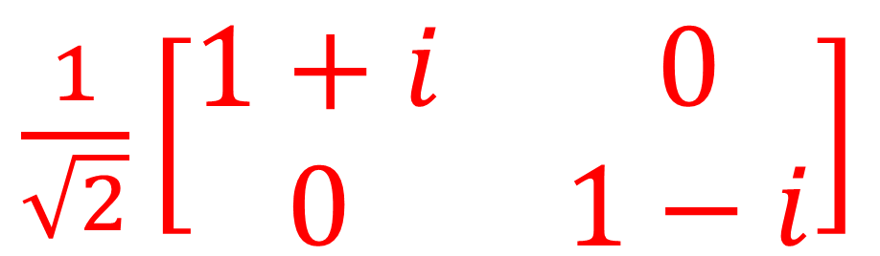

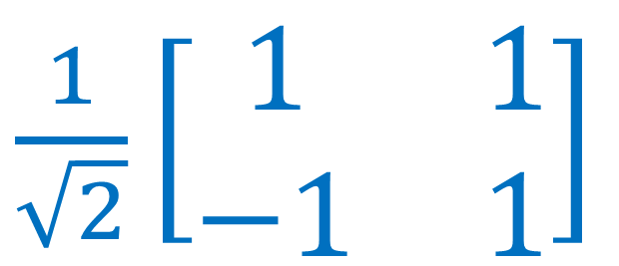



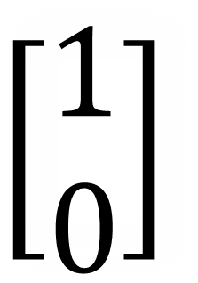


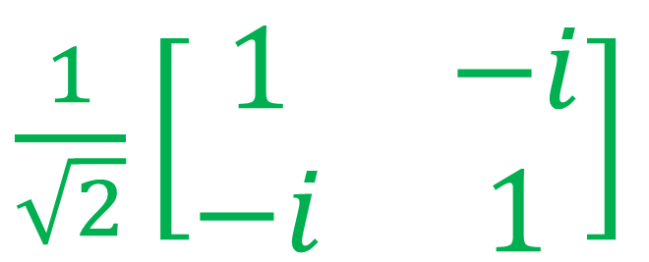
$$\left[\begin{aligned}1 \\ 0\end{aligned}\right]$$
Exercise
$\frac{1}{\sqrt{2}}\left[\begin{matrix}1 & −i \\ −i & 1\end{matrix}\right]$
$$H$$
$$D$$
$$D$$
$\frac{1}{\sqrt{2}}\left[\begin{matrix}1+i & 0 \\ 0 & 1−i\end{matrix}\right]$
$$R$$
$$R$$
$$L$$
$$L$$
$$A$$
$\frac{1}{\sqrt{2}}\left[\begin{matrix}1 & 1 \\ −1 & 1\end{matrix}\right]$
$$V$$

Slide 10
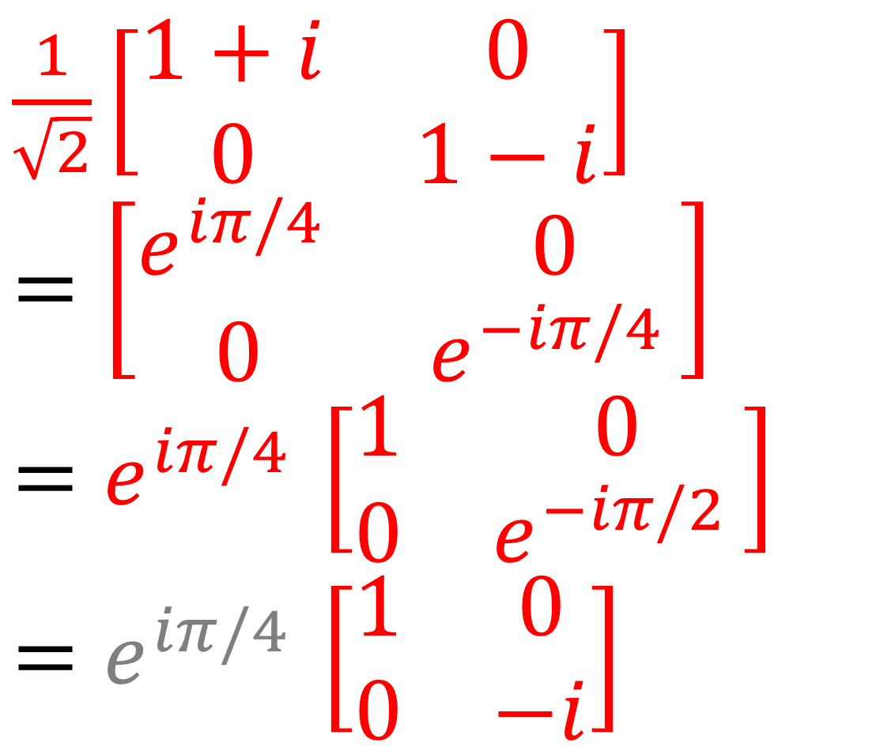
$\frac{1}{\sqrt{2}}\left[\begin{matrix}1+i & 0 \\ 0 & 1−i\end{matrix}\right]$
$$=\left[\begin{matrix}e^{iπ/4 } & 0 \\ 0 & e^{−iπ/4 }\end{matrix}\right]$$
$$=e^{iπ/4 }\left[\begin{matrix}1 & 0 \\ 0 & e^{−iπ/2 }\end{matrix}\right]$$
$$=e^{iπ/4 }\left[\begin{matrix}1 & 0 \\ 0 & −i\end{matrix}\right]$$

Slide 11
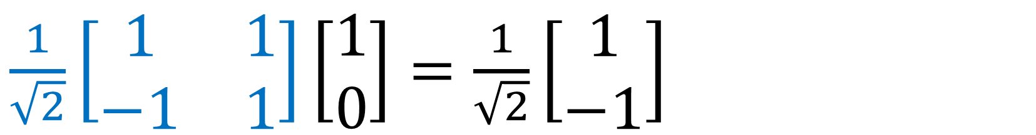
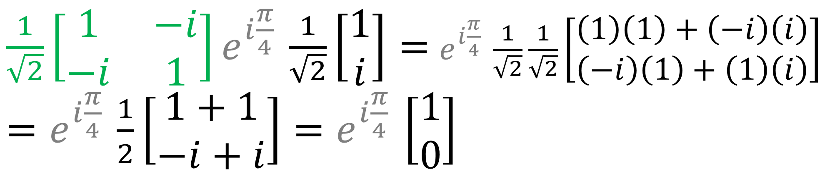
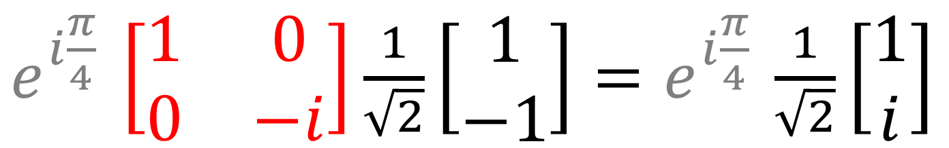
$\frac{1}{\sqrt{2}}\left[\begin{matrix}1 & 1 \\ −1 & 1\end{matrix}\right]\left[\begin{aligned}1 \\ 0\end{aligned}\right]=\frac{1}{\sqrt{2}}\left[\begin{aligned}1 \\ −1\end{aligned}\right]$
$e^{i\frac{π}{4} }\left[\begin{matrix}1 & 0 \\ 0 & −i\end{matrix}\right]\frac{1}{\sqrt{2}}\left[\begin{aligned}1 \\ −1\end{aligned}\right]=e^{i\frac{π}{4} }\frac{1}{\sqrt{2}}\left[\begin{aligned}1 \\ i\end{aligned}\right]$
$\frac{1}{\sqrt{2}}\left[\begin{matrix}1 & −i \\ −i & 1\end{matrix}\right]e^{i\frac{π}{4} }\frac{1}{\sqrt{2}}\left[\begin{aligned}1 \\ i\end{aligned}\right]=$ $e^{i\frac{π}{4} }\frac{1}{\sqrt{2}}\frac{1}{\sqrt{2}}\left[\begin{aligned}\left(1\right)\left(1\right)+\left(−i\right)\left(i\right) \\ \left(−i\right)\left(1\right)+\left(1\right)\left(i\right)\end{aligned}\right]$
$=e^{i\frac{π}{4} }\frac{1}{2}\left[\begin{aligned}1+1 \\ −i+i\end{aligned}\right]=e^{i\frac{π}{4} }\left[\begin{aligned}1 \\ 0\end{aligned}\right]$

